Slide 1




Search for Shape Coexistence Signatures in ¹⁰⁰Ru using Thermal Neutron Capture
Sangeet-Pal Pannu
June 22nd, 2026
CAP 2026 Ottawa

Slide 2
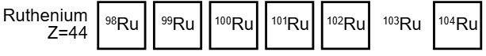
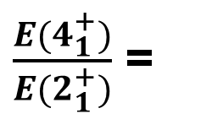
Historical Context of Ru Isotopes
Image: ANU Chart of Nuclides.
Spherical Vibrators
$\frac{E(4_{1}^{+})}{E(2_{1}^{+})}$ =
2.14
2.27
2.32
2nd phonon structure was nearly degenerate.
[8] Van Voorthuysen
et al. (1981).
[4] L. Genilloud et al.
(2000)
[7] H. Duckwitz et al.
(2013)
Multitude of Structural interpretations:
Near Spherical Vibrators
Transitional nucleus between spherical to γ-soft rotor
Shape coexistent chain.
Image: ANU Chart of Nuclides.
Canada, ON
University of Guelph
Sangeet-Pal Pannu
Slide 1

Slide 3
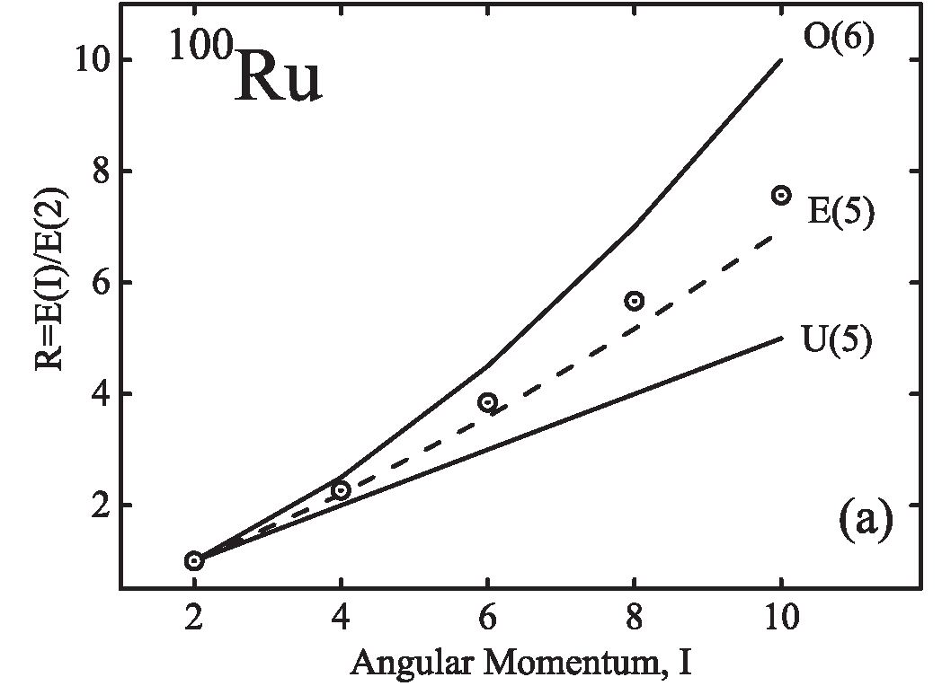
Historical Context of Ru Isotopes
Image: ANU Chart of Nuclides.
γ-soft rotor O(6)
Spherical Vibrators
U(5)
Multitude of Structural interpretations:
Near Spherical Vibrators
Transitional nucleus between spherical to γ-soft rotor
Shape coexistent chain.
T. Konstantinopoulos et al., PRC 95, 014309 (2017).
Canada, ON
University of Guelph
Sangeet-Pal Pannu
Slide 2

Slide 4
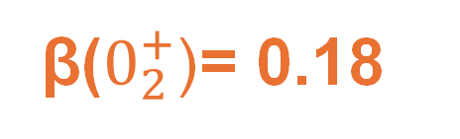
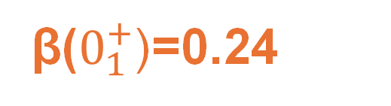
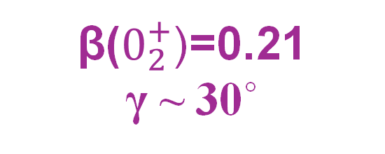
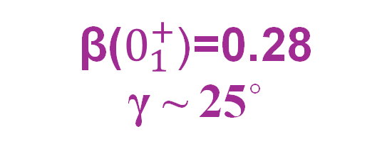
Historical Context of Ru Isotopes
Image: ANU Chart of Nuclides.
Signatures of Shape coexistence FOUND
Shape coexistence signatures AMBIGOUS!
Unique deformations of low-lying 0+ States.
β($0_{1}^{+}$)=0.24
β($0_{1}^{+}$)=0.28
γ ~ 25˚
β($0_{2}^{+}$)= 0.18
Multitude of Structural interpretations:
Near Spherical Vibrators
Transitional nucleus between spherical to γ-soft rotor
Shape coexistent chain?
β($0_{2}^{+}$)=0.21
γ ~ 30˚
Garrett, P. E, et al. (2022). Physical Review. C, 106(6).
Srebrny, J., et al. Nuclear Physics. A, 766, 25–51
Canada, ON
University of Guelph
Sangeet-Pal Pannu
Slide 3

Slide 5
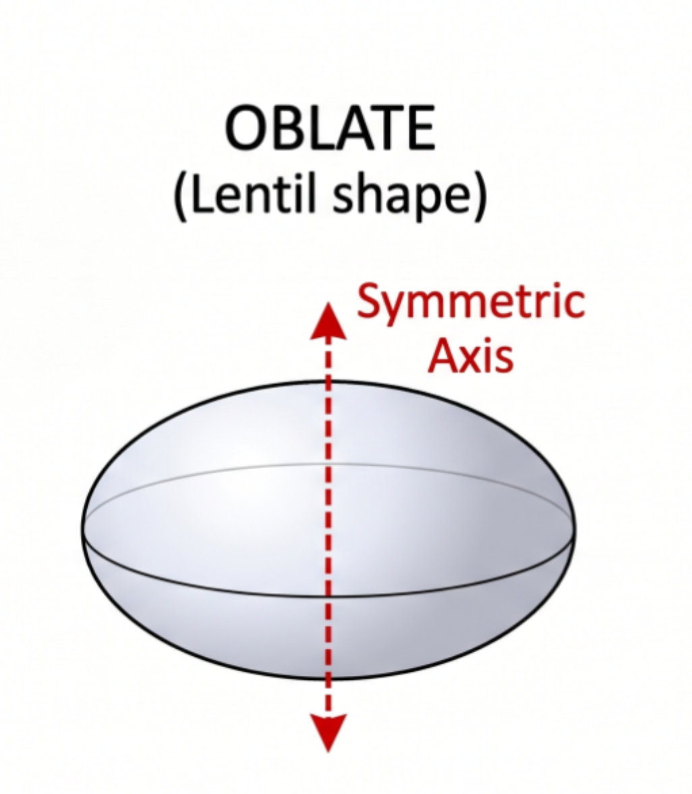
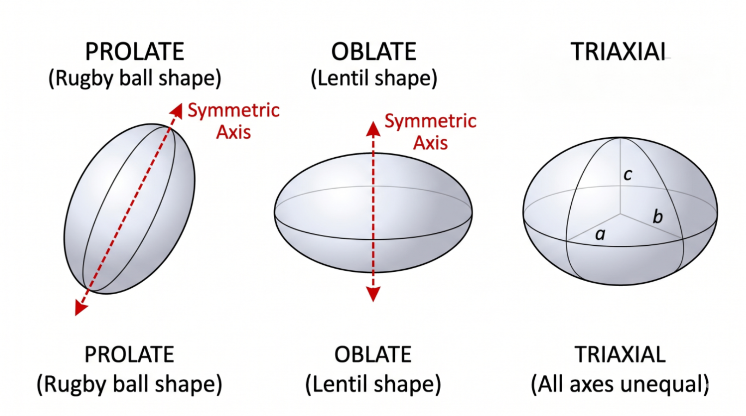
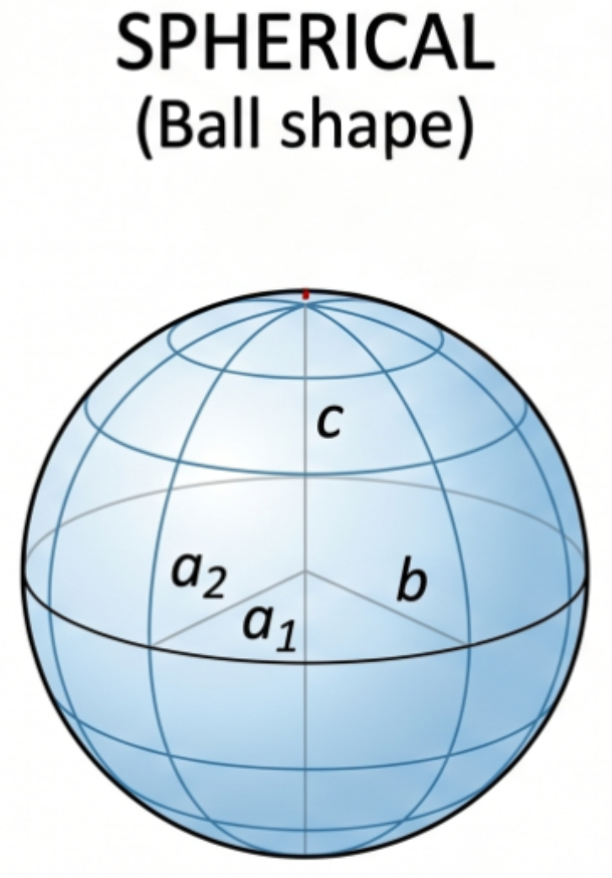
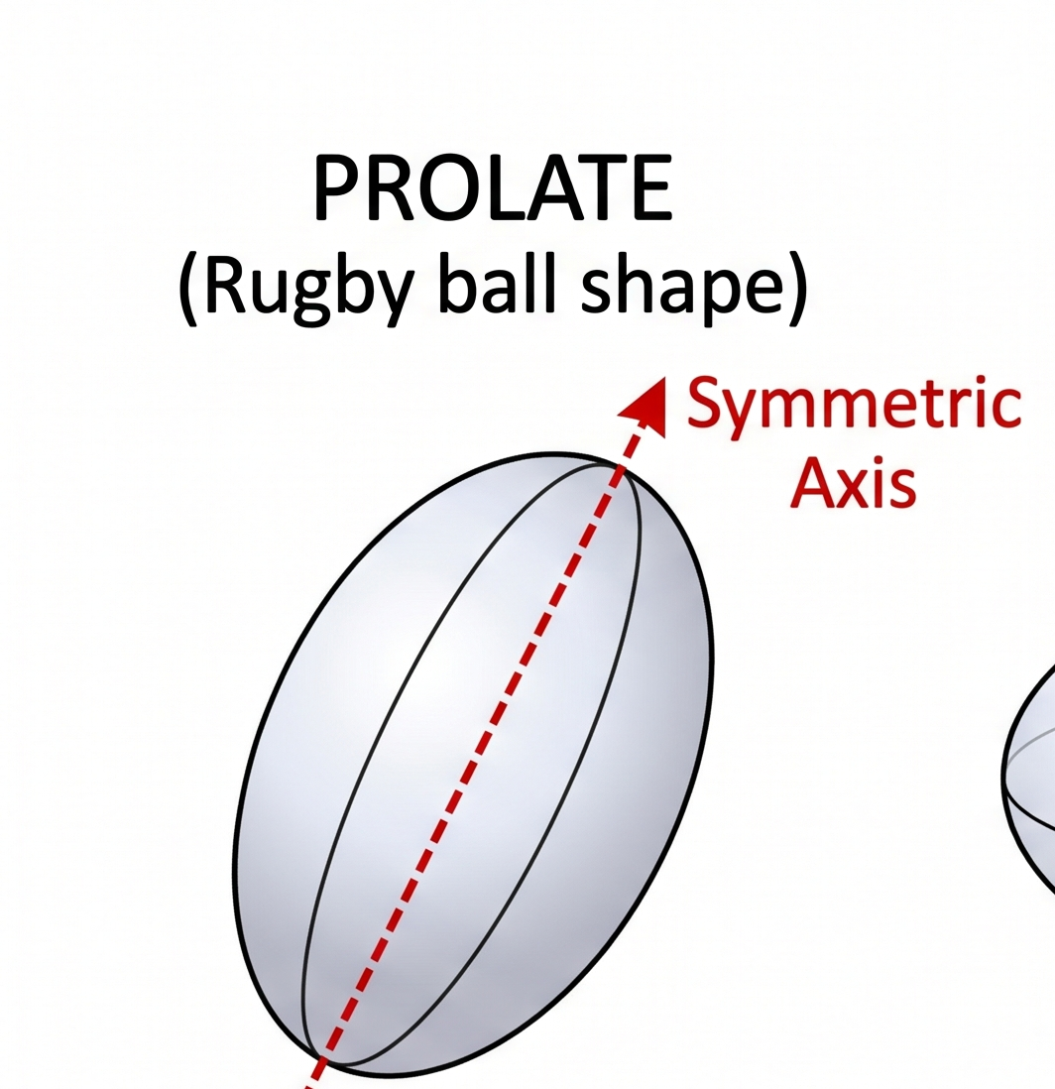
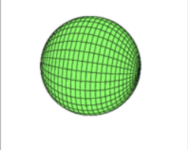


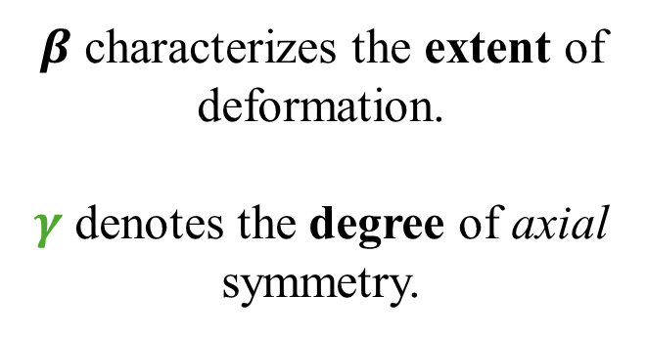



Shapes and Configuration Co-existence
Shapes can be quantified by deformations parameters.
“Normal” structures of nuclei conform to a single intrinsic shape.
The COLLECTIVE excitation characteristics “revolve” around this single shape.
$(β,γ)$
Excitation Energy
4+
$${60}^{°}$$
$${30}^{°}$$
2+
γ
$β$ characterizes the extent of deformation.
$γ$ denotes the degree of axial symmetry.
0+
0
$$0^{°}$$
$$(0.23,60°)$$
0.1
0.2
0.3
0.4
0.5
β
Canada, ON
University of Guelph
Sangeet-Pal Pannu
Slide 4

Slide 6








Shapes and Configuration Co-existence
Shapes can be quantified by deformations parameters.
Configuration Coexistence
$$B\left(E2\right)∝β$$
$(β,γ)$
Excitation Energy
4+
Signatures of Shape Coexistence:
Unique energy spacing of levels in bands
Different B(E2;2→0) in the bands.
4+
$${60}^{°}$$
2+
$$B\left(E2\right)\sim 20 W.u$$
$${30}^{°}$$
2+
γ
$$B\left(E2\right)\sim 50 W.u$$
0+
Shape Coexistence: A critical benchmark for theoretical models.
Chains of Coexistence: The ultimate stress test for tracking structural evolution.
0+
0
$$0^{°}$$
$$(0.23,60°)$$
$$(0.5,0°)$$
0.1
0.2
0.3
0.4
0.5
β
Canada, ON
University of Guelph
Sangeet-Pal Pannu
Slide 5

Slide 7
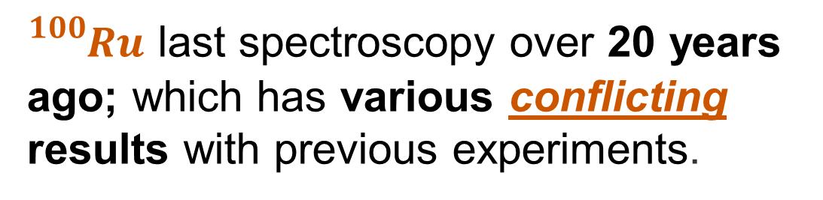
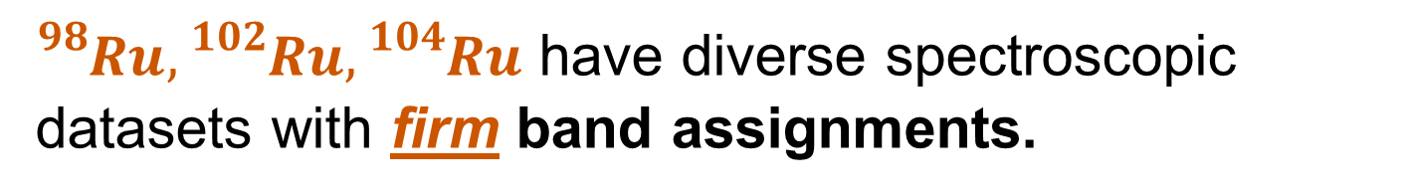
Spectroscopy of Ru isotopes
Image: ANU Chart of Nuclides.
${}_{}^{98}{Ru,{}_{}^{102}{Ru},{}_{}^{104}{Ru} }$have diverse spectroscopic datasets with firm band assignments.
Beta-decay of 98Rh to 98Ru (2020)
Coulomb excitation of 102Ru (2022)
${}_{}^{100}{Ru }$last spectroscopy over 20 years ago; which has various conflicting results with previous experiments.
Coulomb excitation of 104Ru (2005)
Canada, ON
University of Guelph
Sangeet-Pal Pannu
Slide 6

Slide 8
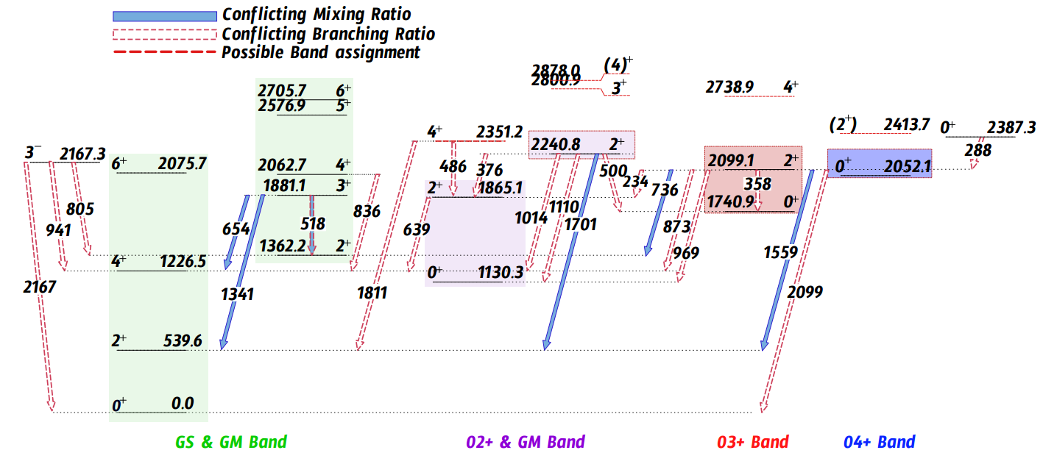
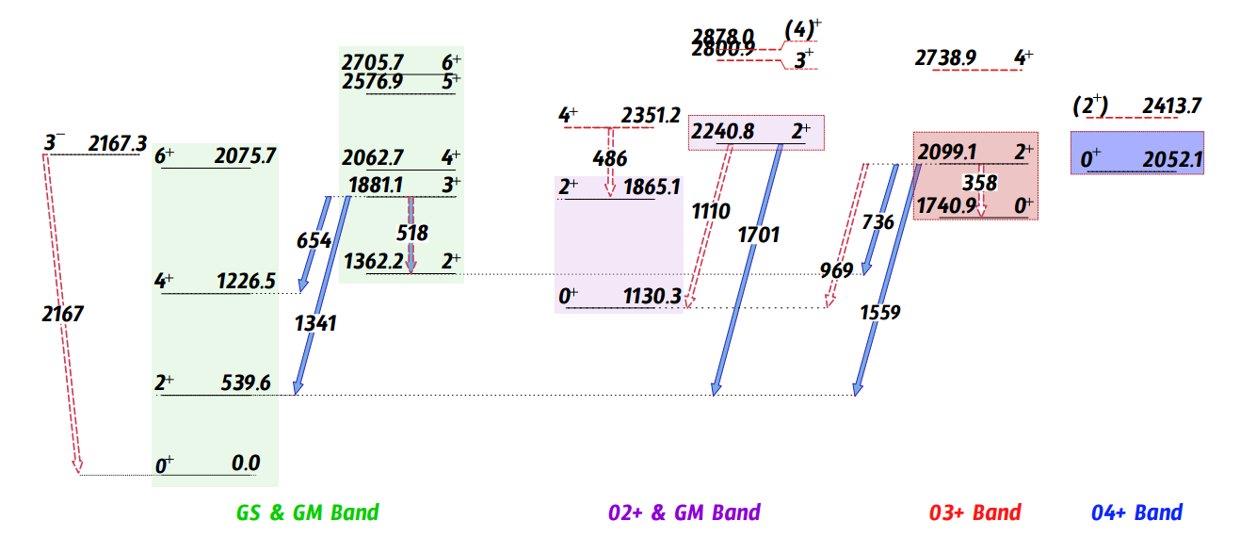
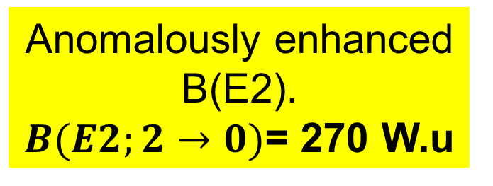
Missing/uncertain spectroscopy data limiting idea of shape coexistence.
Spectroscopy of 100 Ru
Anomalously enhanced B(E2).
$B(E2;2→0)$= 270 W.u
Canada, ON
University of Guelph
Sangeet-Pal Pannu
Slide 7

Slide 9
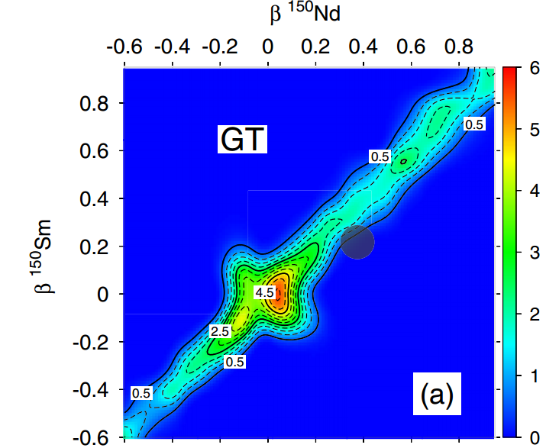
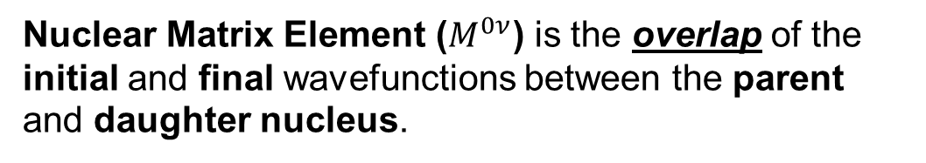
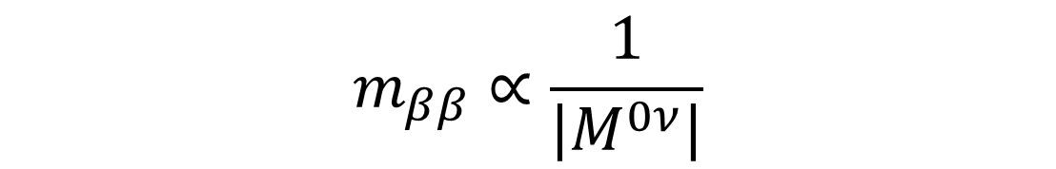
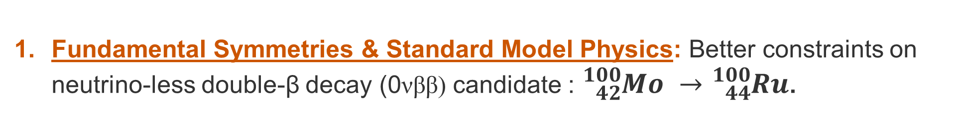
Implications for clarifying Ru structure.
Fundamental Symmetries & Standard Model Physics: Better constraints on neutrino-less double-β decay (0νββ) candidate : ${}_{42}^{100}{Mo }→{}_{44}^{100}{Ru}$.
$$m_{ββ}∝\frac{1}{\left|M^{0ν}\right|}$$
Strength of GT transition operators.
Nuclear Matrix Element ($M^{0ν}$) is the overlap of the initial and final wavefunctions between the parent and daughter nucleus.
→ Deformation position of Parent (150Nd) and Daughter (150Sm) nuclei. → NME is small.
$${}_{60}^{150}{Nd }→{}_{62}^{150}{Sm}$$
→ Decay between states with different initial and final deformations is hindered!
T. R. Rodríguez & G. Martínez-Pinedo, Phys. Rev. Lett. 105, 252503 (2010).
Canada, ON
University of Guelph
Sangeet-Pal Pannu
Slide 8

Slide 10
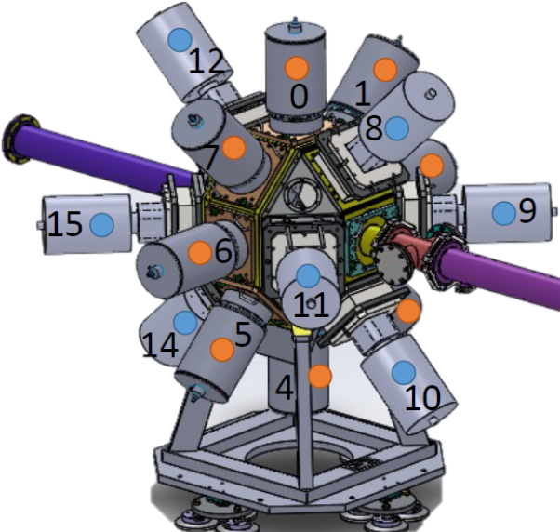
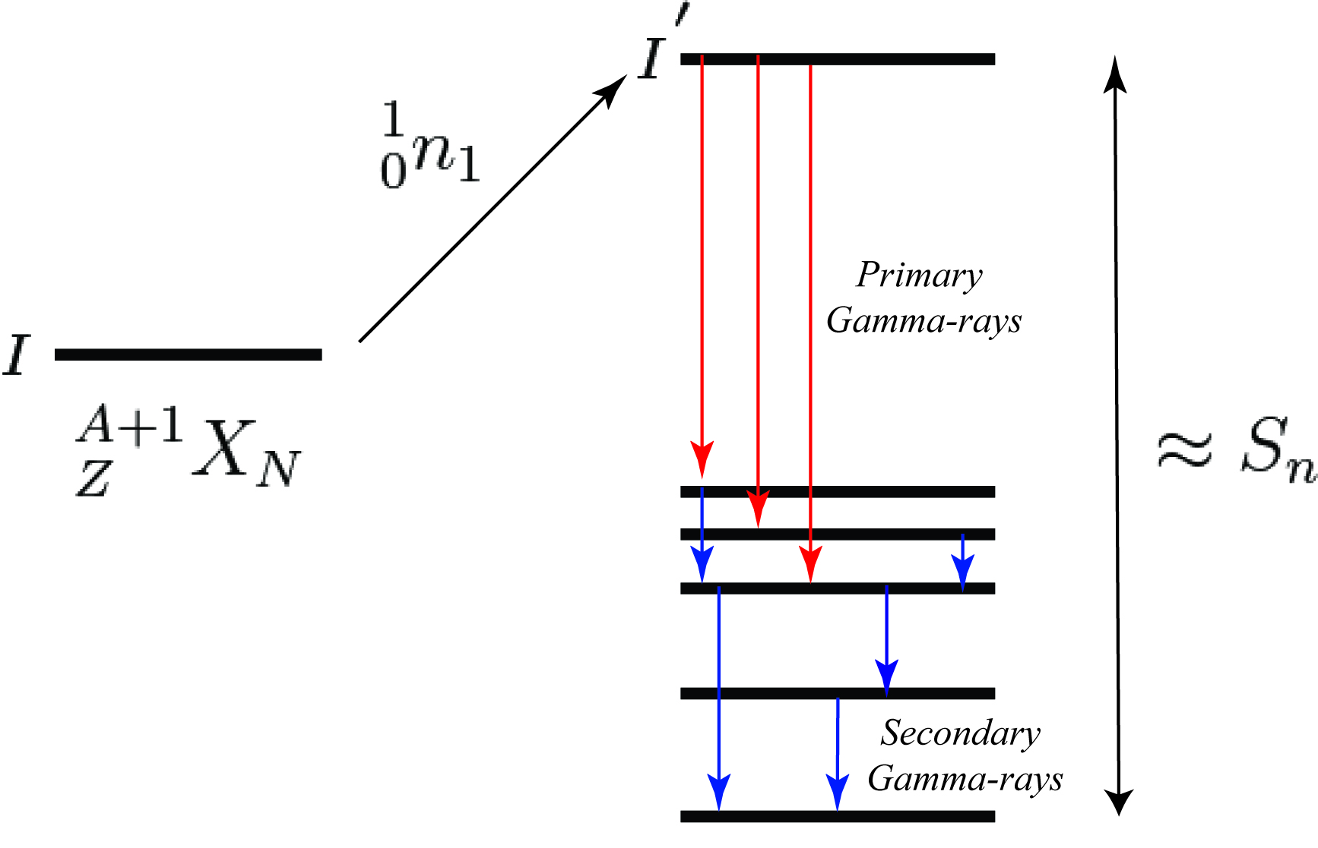






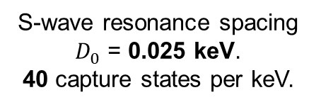
${}_{44}^{100}{Ru} via {}_{44}^{99}{Ru(n,γ)}$
Neutron Capture:
Location:
ILL- (Institut Laue-Langevin)
S-wave resonance spacing
$D_{0}$ = 0.025 keV.
40 capture states per keV.
Grenoble, France
$$2^{+} or 3^{+}$$
E1, M1, E2 Hierarchy
For primary decay.
$${\frac{5}{2}}^{+}$$
(6-9 MeV)
= 9.6 MeV
$${}_{44}^{99}{Ru}$$
FIPPS (HPGe)
Fission Product Prompt Spectrometer
(100-2000 KeV)
$${}_{44}^{100}{Ru}$$
IFIN-HH (HPGe)
High flux of thermal neutrons were produced by the onsite research reactor via induced fission of 235 U.
Total Array Efficiency: 4.8% at 1MeV.
FWHM: 2.5 keV at 1MeV.
Canada, ON
University of Guelph
Sangeet-Pal Pannu
Slide 9

Slide 11
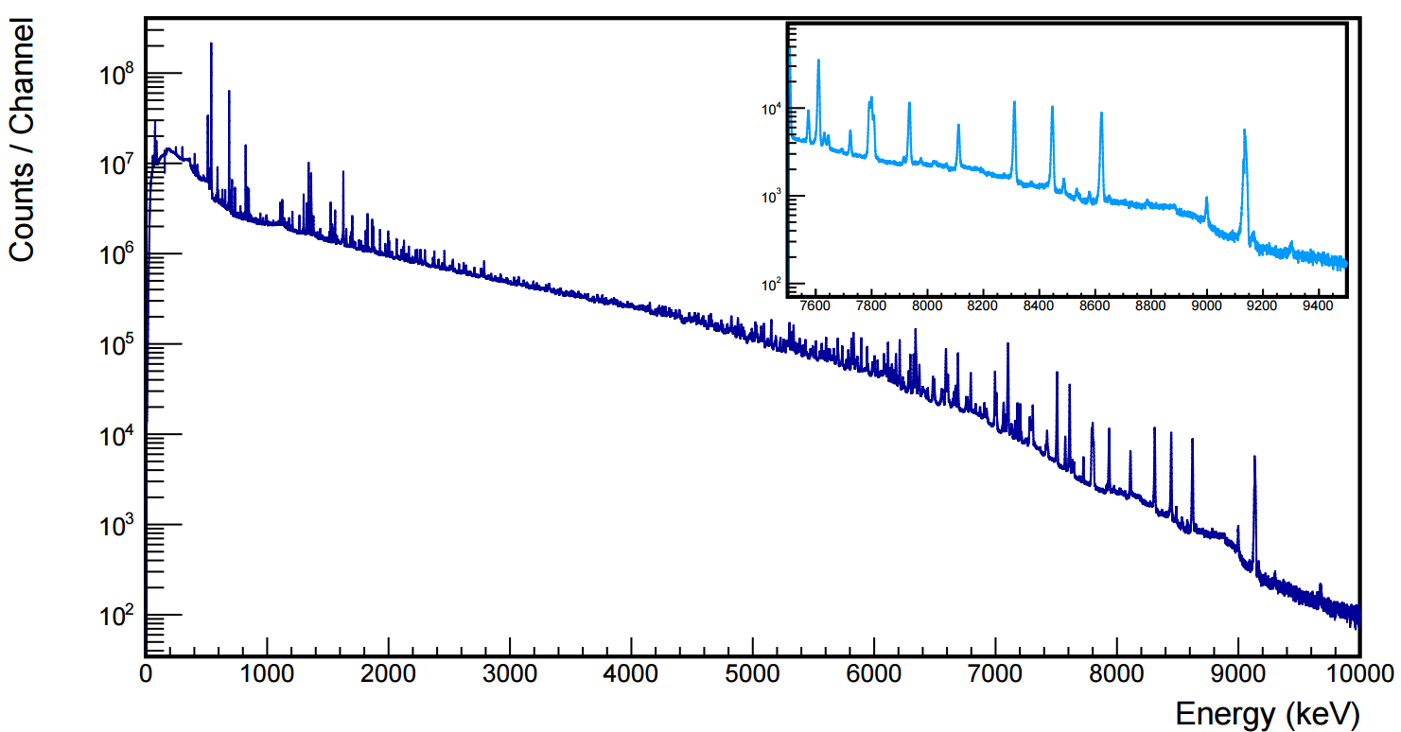








Neutron Capture: Experimental Spectrum
$$7506 keV →3_{1}^{−}$$
DE $2_{1}^{+}$
$$8310 keV →2_{2}^{+}$$
SE $2_{1}^{+}$
$$8447 keV →4_{1}^{+}$$
$$9133 keV →2_{1}^{+}$$
$$9673 keV →0_{1}^{+}$$
$$7791 keV →3_{1}^{+}$$
γ-Singles
X
X
X
X
X
X
X
X
X
X
35 hours of data collection
X
X
X
X
X
Spectroscopy with sensitivity for decay branches <1% possible through gating on primary transitions.
X
X- Primary Gammas
Canada, ON
University of Guelph
Sangeet-Pal Pannu
Slide 10

Slide 12
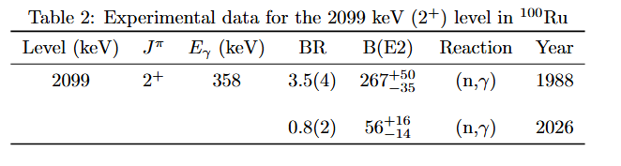
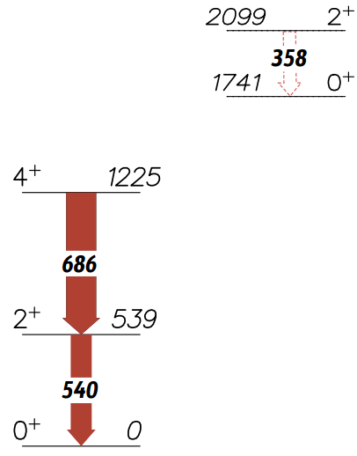



Results: Excited Band; Large B(E2)
$$0_{3}^{+}$$
$$2_{4}^{+}$$
$0_{3}^{+}$ Band
Large B(E2) value casts doubt on the branch, and hence band assignment.
Ground State Band
Canada, ON
University of Guelph
Sangeet-Pal Pannu
Slide 11

Slide 13
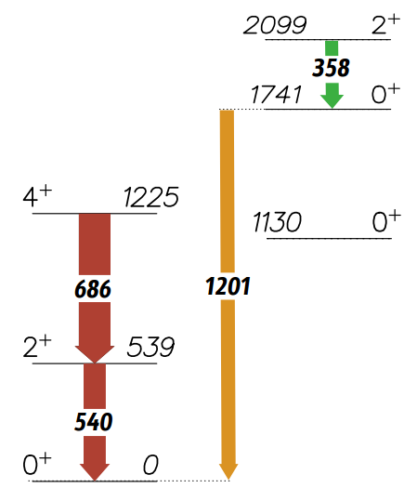
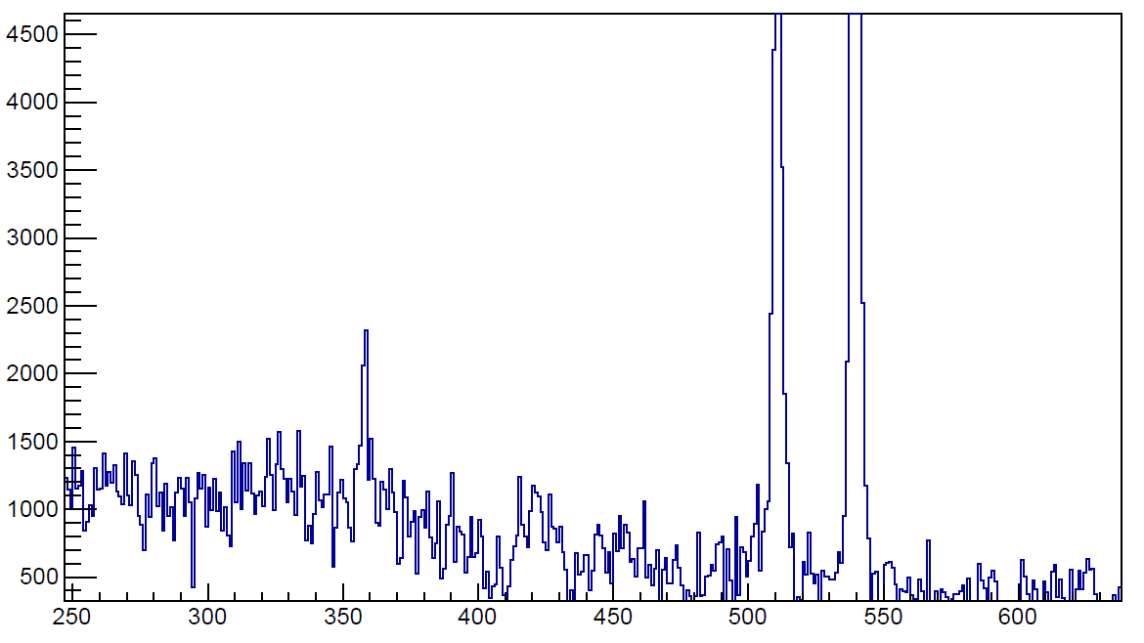
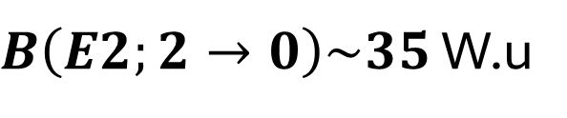
Results: Excited Band; Large B(E2)
$$0_{3}^{+}$$
$$2_{4}^{+}$$
Our Results →
$0_{3}^{+}$ Band
Gate on 1201 keV
511*
540
Gated γ
358
Counts (1 keV/bin)
Signature of Shape
Coexistence!!!
Ground State Band
$B\left(E2;2→0\right)\sim 35$ W.u
Energy (keV)
Canada, ON
University of Guelph
Sangeet-Pal Pannu
Slide 12

Slide 14
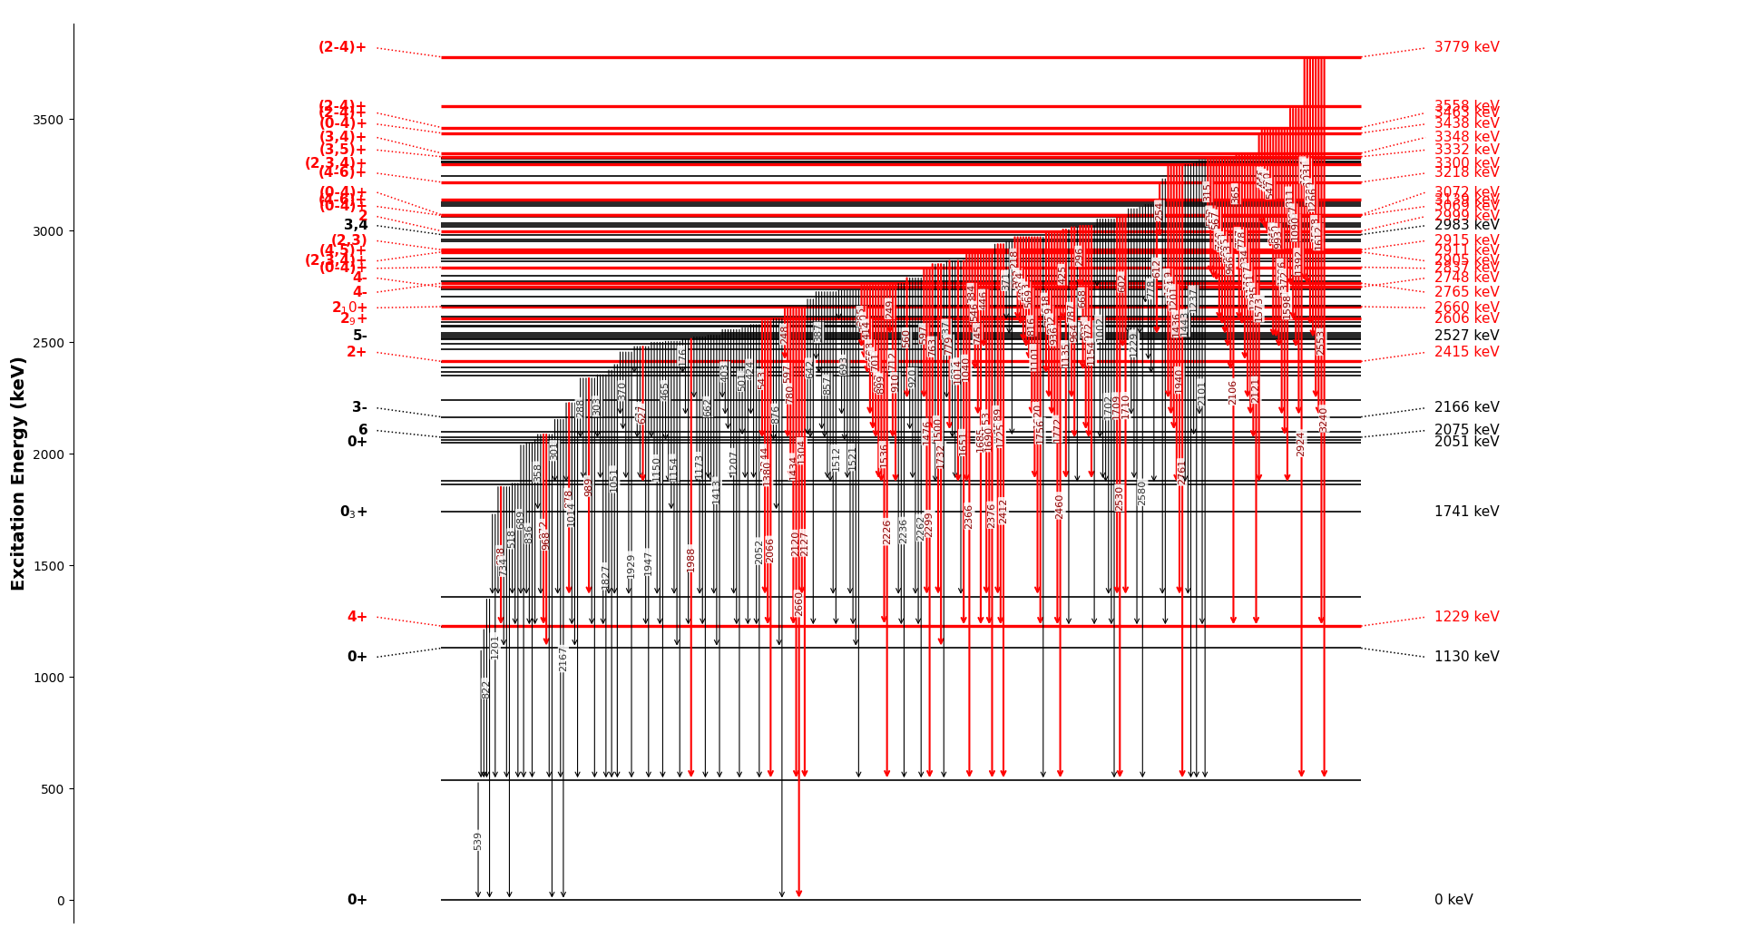
Results: Overview of Spectroscopy
Transitions:
  Total Identified: 305 transitions found.
  New Discoveries: 105 newly discovered.
Mixing Ratios:
  Total Extracted: 30 unique mixing ratios.
  Literature updates: 7 re-measured values.
Band Structures:
  02+ Band + γ Band structures.
  03+ Band + 04+ Band determined!
Canada, ON
University of Guelph
Sangeet-Pal Pannu
Slide 13

Slide 15
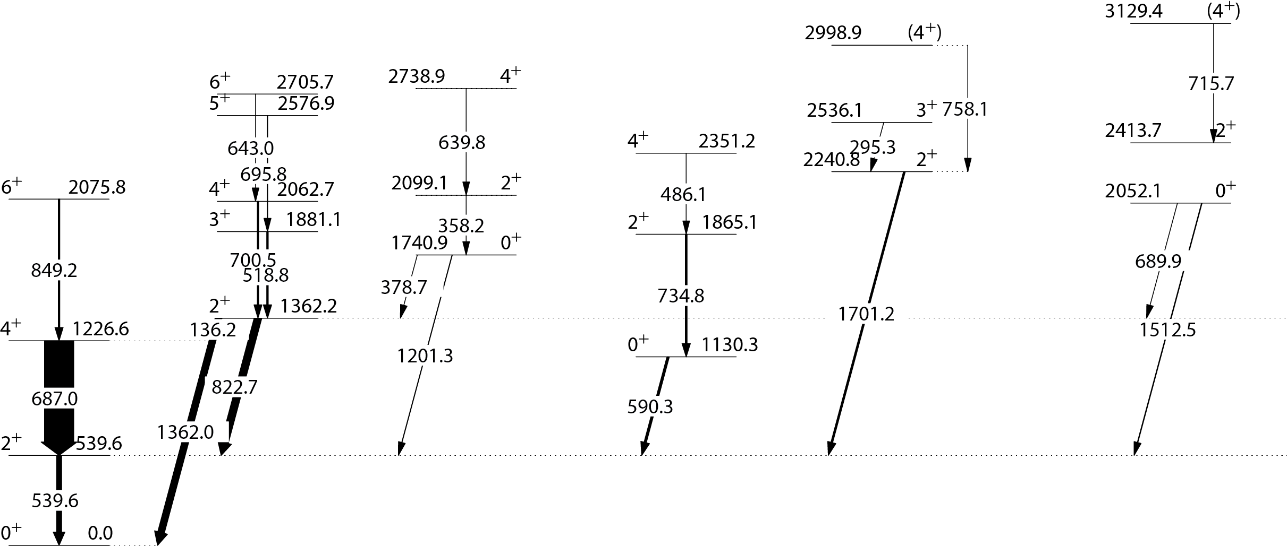

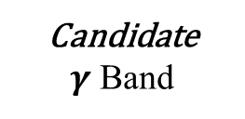





Results: Built Structure within 100Ru
New γ Transitions !!
New Band Structures!!
B(E2) Values
63
63(27)
< 558
56(6)
375.47
38(8)
1110.6
< 744
0.70(8)
30(5)
50.8(4)
1.6 (16) x$10^{−5}$
30(10)
< 3.5
35(1)
1.9(10)
35.7(4)
$γ$ Band
$0_{3}^{+}$ Band
$0_{2}^{+}$ Band
Candidate
$γ$ Band
$0_{4}^{+}$ Band
$0_{gs}^{+}$ Band
Canada, ON
University of Guelph
Sangeet-Pal Pannu
Slide 14

Slide 16
Summary/Next Steps
100Ru has signatures of shape coexistence, the assertion cannot be made based Soley on level structure analysis.
→ We require a methodology of to extract the shape parameters!
Solution: Coulomb excitation studies which can extract β and γ parameters in a model-independent method!
Next Steps are under progress:
Our group and collaborators from HIL in Warsaw, Poland are doing exactly that!
100Ru Coulomb excitation was successfully completed!
  Our updated results from this analysis will allow the precise evaluations of the gamma and beta parameters!
Canada, ON
University of Guelph
Sangeet-Pal Pannu
Slide 24

Slide 17
Thank you
S. Pannu¹, P.E. Garrett¹, V. Bildstein¹, M. Rocchini² , J. Froats¹, K. Stoychev¹, D. Kalaydjieva¹ , M. Beuschlein⁴, G. Colombi¹, K. Ide⁴, C. Michelagnoli³, J.R. Muria⁶, K. Ortner⁵, C. Petrache⁷, N. Pietralla⁴ , T. R. Rodríguez⁸, K.H Yung³
Department of Physics, University of Guelph, Guelph, Canada.
INFN - Istituto Nazionale di Fisica Nucleare, Florence, Italy.
ILL - Institut Laue-Langevin, Gernoble, France.
Technical University Darmstadt, Germany.
Department of Chemistry, SFU – Simon Frasier University, Burnaby, Canada.
TRIUMF, Vancouver, Canada.
IJCLab - Laboratoire de Physique des 2 infinis Irène Joliot-Curie, Paris, France.
Departamento de Física Teórica, Universidad Autónoma de Madrid, Spain
Canada, ON
University of Guelph
Sangeet Singh Pannu
END

Slide 18
Reference
[1] T. Konstantinopoulos et al., Phys. Rev. C 95, 014309 (2017).
[2] T. R. Rodríguez and G. Martínez-Pinedo, "Energy Density Functional Study of Nuclear Matrix Elements for Neutrinoless $\beta\beta$ Decay," Phys. Rev. Lett. 105, 252503 (2010).
[3] T. R. Rodríguez, Departamento de Física Teórica, Universidad Autónoma de Madrid, Spain (theoretical calculations / private communication).
[4] P. E. Garrett, "Shape coexistence in the Sr – Ru isotopes," Presentation at the International Symposium on Capture Gamma-Ray Spectroscopy and Related Topics (CGS).
[5] National Nuclear Data Center (NNDC), Brookhaven National Laboratory. Data available at: https://www.nndc.bnl.gov/
[6] Australian National University, Interactive Chart of Nuclides. Available at: https://people.physics.anu.edu.au/~ecs103/chart/
[7] Bonatsos et al., "Triaxiality in Mo and Ru," Phys. Rev. C 133, 054306 (2026).
[8] Maass et al., "Fingerprints of Triaxiality in Charge Radii of Neutron-Rich Ruthenium," Phys. Rev. C 135, 202501 (2025).
[9] D. T. Doherty et al., "Triaxiality near the $^{110}\text{Ru}$ ground state from Coulomb excitation," Phys. Lett. B 766, 334 (2017).
Canada, ON
University of Guelph
Sangeet-Pal Pannu
END

Slide 19
BACKUP SLIDES
Canada, ON
University of Guelph
Sangeet-Pal Pannu
END

Slide 20


Backup: Phenomenon of Shape Coexistence.
Unperturbed Energy of Particle-Hole Excitation
Expected 0+ Energy State
0+
Pairing interaction Energy.
Particle-Hole Excitation
Energy correlations
reduce expected
energy state.
Excitation Energy (MeV)
Monopole Shift Energy.
4+
2+
0+
INTRUDER 0+ Energy State
Quadrupole π- ν interaction energy
0+
Normal Energy levels
2 Protons are excited out of the closed core.
Heyde and Wood, RMP 83, 1467 (2011)
Canada, ON
University of Guelph
Sangeet-Pal Pannu

Slide 21
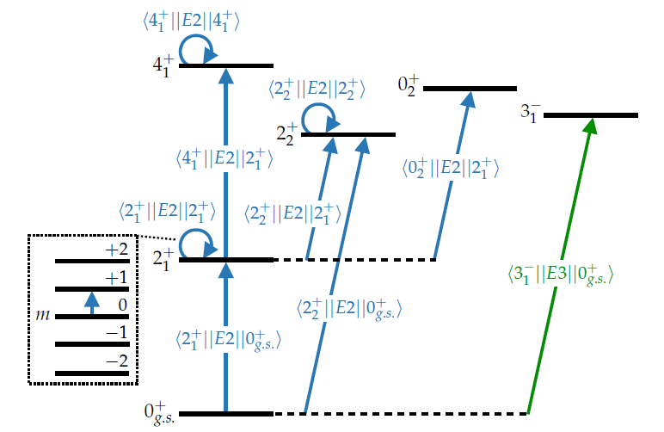
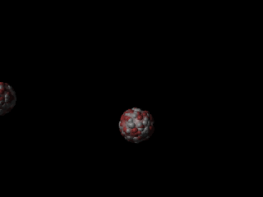
Backup: Coulomb Excitation, Probe for Shapes
Direct Reaction: Only Electromagnetic interactions
Best method for extracting shape invariant parameters.
  Model independent results!
Excitation via EM Interactions.
De-excitation via gamma emissions.
*Animation from H. J. Wollersheim, GSI
Beam particle
Target Nucleus
Canada, ON
University of Guelph
Sangeet-Pal Pannu

Slide 22
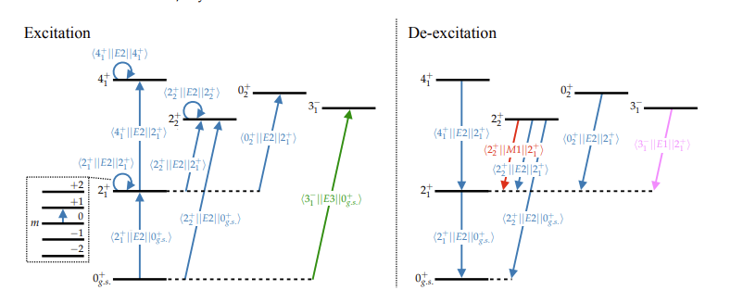
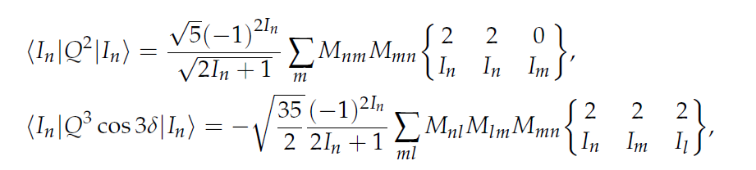

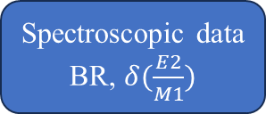



Backup: Coulomb Excitation, Probe for Shapes
Measured γ-ray yields
From Coulomb excitation data
Fixed Parameters
Level Scheme
Experimental setup
Spectroscopic data
BR, $δ(\frac{E2}{M1})$
Initial Matrix Elements
GOSIA CODE
$$\sim \left\langle β^{2}\right\rangle$$
Set of matrix elements and errors
$$\sim \left\langle β^{3}cos3γ\right\rangle$$
$$\left\langle I_{a} | |E2| | I_{b}\right\rangle$$
Canada, ON
University of Guelph
Sangeet-Pal Pannu

Slide 23
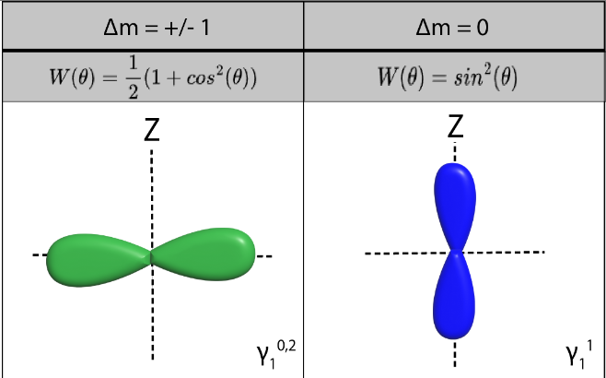
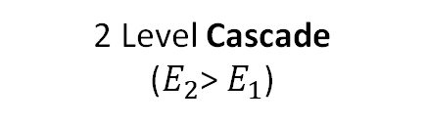













Backup: Coulomb Excitation, Probe for Shapes
Angular Correlations
Multipole character has an angular emission probability.
Behind the scenes
Degenerate
Magnetic Sub-states
$\left(L=1\right) (∆m=0) ∝\sin^{2}{θ}$
$$\left(L=1\right) (∆m= ±1) ∝\frac{1}{2}\left(1+\cos^{2}{θ}\right)$$
$${J^{π}=1}^{+}$$
$$E_{2}$$
$$m_{1}=+1$$
$$m_{1}=0$$
$$m_{1}=−1$$
$$(L_{2}^{′}/L_{2})$$
$$γ_{2}$$
$$∆m=0$$
$$∆m=+1$$
$$∆m=−1$$
$$0^{+}$$
$$E_{1}$$
2 Level Cascade
($E_{2}$> $E_{1}$)
$$m_{0}=0$$
Canada, ON
University of Guelph
Sangeet-Pal Pannu

Slide 24
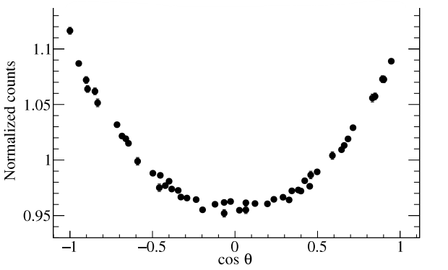











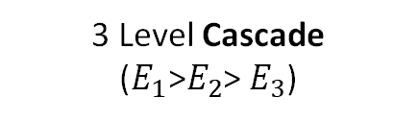








Backup: Coulomb Excitation, Probe for Shapes
Angular Correlations
Multipole character has an angular emission probability.
Behind the scenes
$\left(L=1\right) (∆m=0) ∝\sin^{2}{θ}$
$J^{π}$= $0^{+}$
$$\left(L=1\right) (∆m= ±1) ∝\frac{1}{2}\left(1+\cos^{2}{θ}\right)$$
$$E_{1}$$
$$m_{0}=0$$
$$(L_{1}^{′}/L_{1})$$
$$γ_{1}$$
$$∆m=+1$$
$$∆m=0$$
$$∆m=−1$$
$W_{exp}\left(θ\right)∝\frac{1}{2}\left(1+\cos^{2}{θ}\right)$+ $\frac{1}{2}\left(1+\cos^{2}{θ}\right)$+ $\sin^{2}{θ∝1}$
$$1^{+}$$
$$E_{2}$$
$$m_{1}=+1$$
$$m_{1}=0$$
$$m_{1}=−1$$
$$(L_{2}^{′}/L_{2})$$
$$γ_{2}$$
$$∆m=0$$
$$∆m=+1$$
$$∆m=−1$$
$$0^{+}$$
$$E_{3}$$
3 Level Cascade
($E_{1}\text{>}E_{2}$> $E_{3}$)
$$m_{0}=0$$
Canada, ON
University of Guelph
Sangeet-Pal Pannu

Slide 25
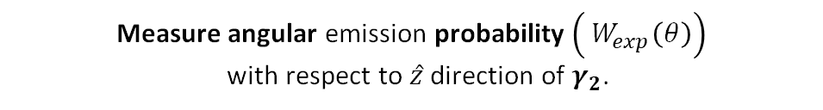
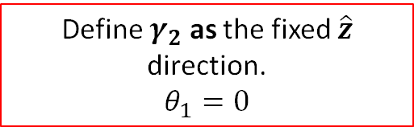




Backup: Coulomb Excitation, Probe for Shapes
Angular Correlations
Measure angular emission probability $\left({ W}_{exp}\left(θ\right)\right)$
with respect to $\hat{z}$ direction of $γ_{2}$.
Behind the scenes
Det 1
Define $γ_{2}$ as the fixed $\hat{z}$ direction.
$$θ_{1}=0$$
$J^{π}$= $0^{+}$
$$E_{1}$$
$$m_{0}=0$$
$$γ_{1}$$
$$(L_{1}^{′}/L_{1})$$
$$γ_{1}$$
$$θ_{2}$$
$$∆m=+1$$
$$∆m=0$$
$$∆m=−1$$
Det 2
$$\hat{z}$$
$$1^{+}$$
$$γ_{2}$$
$$E_{2}$$
$$m_{1}=+1$$
$$m_{1}=0$$
$$γ_{2}$$
$$W_{exp}\left(θ\right)$$
$$(L_{2}^{′}/L_{2})$$
$$∆m=0$$
$$∆m=+1$$
$$∆m=−1$$
$$0^{+}$$
$$E_{3}$$
3 Level Cascade
($E_{1}\text{>}E_{2}$> $E_{3}$)
$$m_{0}=0$$
$\left(L=1\right) (∆m=0) ∝\sin^{2}{θ}$
$$\left(L=1\right) (∆m= ±1) ∝\frac{1}{2}\left(1+\cos^{2}{θ}\right)$$
Note: Det 1 and 2 are equivalent HPGe detectors.
Canada, ON
University of Guelph
Sangeet-Pal Pannu

Slide 26





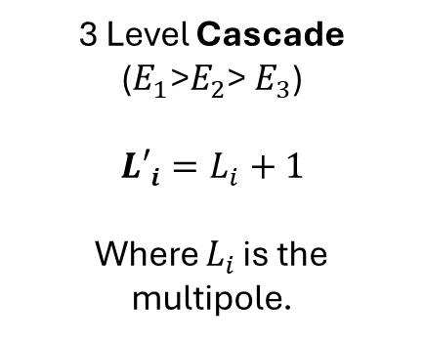









Backup: Angular Correlations Methodology
Angular Correlations
$$W_{theo}\left(θ_{i}\right)=1+a_{2}P_{2}\left(cosθ_{i}\right)+a_{4}P_{4}\left(cosθ_{i}\right)$$
$$J_{1}^{π}$$
$$E_{1}$$
$$γ_{1}$$
Mixing Ratio dependence
$$δ_{1}(L_{1}^{′}/L_{1})$$
Constant terms tabulated in [5]
$$J_{2}^{π}$$
$$E_{2}$$
$δ_{2}(L_{2}^{′}/L_{2})$ = 0
$$γ_{2}$$
$$J_{3}^{π}$$
$$E_{3}$$
$$=$$
3 Level Cascade
($E_{1}\text{>}E_{2}$> $E_{3}$)
$${L′}_{i}=L_{i}+1$$
Where $L_{i }$is the multipole.
$δ_{2}=0,$ as $γ_{2}$ is usually a pure Multipole (${L′}_{i}=L_{i}$) transition and has no mixing.
Canada, ON
University of Guelph
Sangeet-Pal Pannu

Slide 27
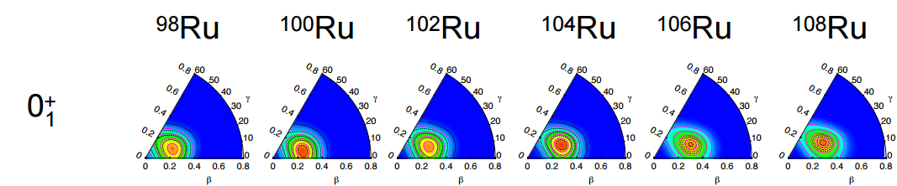
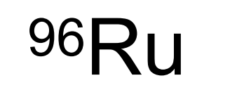
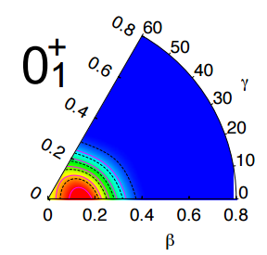


Backup: Inversion @ 96-98 Ru
Occupancies of orbitals with respect to spherical HF states extracted
Generally, p-h content increases as N, reflecting higher deformation in both gs and 0₂⁺ state
Change in proton p-h content for 0₁⁺ and 0₂⁺ states from ⁹⁶Ru to ⁹⁸Ru – crossing of configurations in calculations
Large increase in neutron p-h content occurring from ⁹⁶Ru to ¹⁰⁰Ru
PG et al., PLB 809, 135762 (2020)
Canada, ON
University of Guelph
Sangeet-Pal Pannu

Slide 28



Backup: Beamline information
Absorb the neutrons backscattered from the apertures.
Both have a high neutron capture cross section
The beam tubes are made of thin-walled aluminum metal, which is virtually transparent to neutrons.
Avoids the γ ray background from boron being carried through beamline
The neutron beams are guided in nickel-coated glass.
High reflectivity, which contain the neutrons in the guides.
Canada, ON
University of Guelph
Sangeet-Pal Pannu

Slide 29


Backup: Overestimation of Collectivity in 102Ru
Predictions overestimate the degree of deformation of all states
Garrett, P. E, et al. (2022). Physical Review. C, 106(6).
$${}_{44}^{102}{Ru}$$
Experimental results from Coulomb excitation.
Beyond Mean Field Calculations
Canada, ON
University of Guelph
Sangeet-Pal Pannu

Slide 30
Missing/uncertain spectroscopy data limiting idea of shape coexistence.
Spectroscopy of 100 Ru
Canada, ON
University of Guelph
Sangeet-Pal Pannu
Slide 7

Slide 31
Missing/uncertain spectroscopy data limiting idea of shape coexistence.
Spectroscopy of 100 Ru
Canada, ON
University of Guelph
Sangeet-Pal Pannu
Slide 8

Slide 32
Missing/uncertain spectroscopy data limiting idea of shape coexistence.
Spectroscopy of 100 Ru
Highly discrepant mixing ratios!
E2 or M1 possible assignments.
Canada, ON
University of Guelph
Sangeet-Pal Pannu
Slide 9

Slide 33
Missing/uncertain spectroscopy data limiting idea of shape coexistence.
Spectroscopy of 100 Ru
Arbitrarily assigned band members.
Canada, ON
University of Guelph
Sangeet-Pal Pannu
Slide 12

Slide 34
















Results: Mixing Ratio Evaluation Method:
Angular Correlations
One can retrieve mixing ratios from angular correlations technique.
Study of the emission probability of a certain γ as a function of the θ with respect to a previously emitted γ-ray.
$$W(θ_{i})∝δ$$
$$J_{1}^{π}$$
$$E_{1}$$
$$δ_{1}(L_{1}^{′}/L_{1})$$
$$γ_{1}$$
Det 1
$$J_{2}^{π}$$
$$E_{2}$$
$$γ_{1}$$
$$θ_{i}$$
Det 2
$$\hat{z}$$
$$γ_{2}$$
$δ_{2}(L_{2}^{′}/L_{2})$
$$γ_{2}$$
$$J_{3}^{π}$$
$$E_{3}$$
3 Level Cascade
($E_{1}\text{>}E_{2}$> $E_{3}$)
$$W_{theo}\left(θ_{i}\right)=1+a_{2}P_{2}\left(cosθ_{i}\right)+a_{4}P_{4}\left(cosθ_{i}\right)$$
Angular Coefficients has dependence on the $δ_{1}$ and $δ_{2}$
Canada, ON
University of Guelph
Sangeet-Pal Pannu
Slide 16

Slide 35




Results: 3+ State @ 1881 keV Mixing Ratios.
Mixing Ratios from 1881 State
Structural Fingerprint: Mixing ratios reveal the extent of collective quadrupole deformation, anchoring our theoretical models to measurable observables.
Pure E2 Polarity → Collective State
Mixing Ratio $δ(\frac{E2}{M1})$
$$B\left(E2\right)∝\frac{δ^{2}}{δ^{2}+1}∝β$$
Pure M1 Polarity → Single Particle State
The Probe for Deformation: Mixing ratios $δ(\frac{E2}{M1})$act as a highly sensitive gauge, quantifying the balance between collective nuclear shape and single-particle states.
Discrepant Mixing Ratios ➔ Conflicting Multipolarities ➔ Altered Structural Interpretation
Canada, ON
University of Guelph
Sangeet-Pal Pannu
Slide 17

Slide 36




Results: 3+ State Mixing Ratios: 1341 keV
Mixing Ratio $δ(\frac{E2}{M1})$
Discrepancy resolved: 1341 keV transition firmly assigned as pure E2 polarity.
Canada, ON
University of Guelph
Sangeet-Pal Pannu
Slide 18

Slide 37

Results: 3+ State @ 1881 keV Mixing Ratios.
Mixing Ratios from 1881 State
Pure E2 Polarity → Collective State
Mixing Ratio $δ(\frac{E2}{M1})$
Canada, ON
University of Guelph
Sangeet-Pal Pannu
Slide 19

Slide 38
Backup: BMF Wavefunction Plots
Model Complexity: Facilitates deeper insights into structural evolution and configuration mixing.
$${60}^{°}$$
Wavefunction distributions in (β,γ) plots.
Allows access to state deformation properties.
$${30}^{°}$$
γ
0
$$0^{°}$$
β
Canada, ON
University of Guelph
Sangeet-Pal Pannu

Slide 39




Backup: Configuration interactions Calculations
${}_{44}^{102}{Ru} \left(n,γ\right)$results:
Mixing amplitudes
$$D_{1}=\left\langle 0_{1}^{+}\right|D\left|0_{1}^{+}\right\rangle =αD_{1u}+βD_{2u}$$
$$D_{2}=\left\langle 0_{2}^{+}\right|D\left|0_{2}^{+}\right\rangle =−βD_{1u}+αD_{2u}$$
$0_{1}^{+}$→ Past crossing point collectivity increases.
$0_{2}^{+}$→ Past crossing point collectivity decreases.
Exchange of properties between the 0+ configurations, as simulated in two-level mixing.
$0_{3}^{+}$ experimental results were scarce and unable to explore its effect on lower 0+ configurations
Canada, ON
University of Guelph
Sangeet-Pal Pannu

Slide 40












Backup: Configuration interactions Calculations
${}_{44}^{98}{Ru}$results:
$0_{2}^{+}$
$0_{2}^{+}$
Slope of lines has inverse relation to moment of Inertia.
$0_{1}^{+}$
$0_{1}^{+}$
${}_{44}^{98}{Ru}$: $0_{1}^{+}$ Moment of inertia is Small.
$0_{2}^{+}$ Moment of inertia is Large
$$E_{rot}=\frac{ℏ}{2Τ}I(I+1)$$
${}_{44}^{100}{Ru}$: $0_{1}^{+}$ Moment of inertia is Large.
$0_{2}^{+}$ Moment of inertia is Small
$0_{2}^{+}$
${}_{44}^{102}{Ru}$: $0_{1}^{+}$ Moment of inertia is Large.
$0_{2}^{+}$ Moment of inertia is Small
Moment of Inertia
$0_{1}^{+}$
Canada, ON
University of Guelph
Sangeet-Pal Pannu

Slide 41



Region of Shape coexistence
Prolate
Spherical
$$0_{2}^{+}$$
$$0_{1}^{+}$$
Shape Coexistence
The presence of low-lying nuclear states within a narrow energy gap, which exhibit distinct and well-defined intrinsic shapes [10].
Image: ANU Chart of Nuclides.
Canada, ON
University of Guelph
Sangeet-Pal Pannu
Slide 4

Slide 42

Region of Shape coexistence:
Image: ANU Chart of Nuclides.
Canada, ON
University of Guelph
Sangeet-Pal Pannu
Slide 5

Slide 43

Region of Shape coexistence: No Inversion?
Outside region with unique inversion?
Image: ANU Chart of Nuclides.
Canada, ON
University of Guelph
Sangeet-Pal Pannu
Slide 6

Slide 44





Results: Excited Band; Tentative Member
$$0_{2}^{+}$$
$$4_{3}^{+}$$
Spacing seems un-natural.
$0_{2}^{+}$Band
Ground State Band
Canada, ON
University of Guelph
Sangeet-Pal Pannu
Slide 20

Slide 45


Results: Excited Band; Tentative Member
$$0_{2}^{+}$$
$$4_{3}^{+}$$
402
Gate on 1865 keV
511*
540
486
424
Gated γ
$0_{2}^{+}$Band
Ground State Band
Our Results →
Canada, ON
University of Guelph
Sangeet-Pal Pannu
Slide 21

