Slide 1
Ultracold Neutron Transport and Simulation Studies for the TUCAN EDM Experiment
June 23, 2026
Ryunosuke Chiba
Notes:
Hello everyone. Thank you very much for attending this presentation. I am master student at Simon fraser university and reserching in TUCAN group at Triumf. In this presentation I will be taking about Ultracold Neutron Transport and Simulation Studies for the TUCAN EDM Experiment.

Slide 2
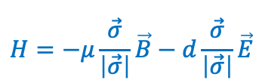
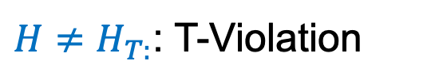
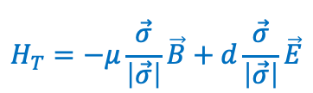
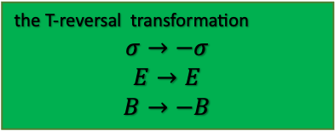
Background – Search For the Neutron Electric Dipole Moment
Sakharov’s three conditions:
1. Baryon number violation
2. CP (Charge-Parity) violation
3. Departure from thermal equilibrium
CP violation is crucial to explain the matter–antimatter asymmetry in the Universe.
But CP violation from experiments is not sufficient to explain today’s imbalance of matter and antimatter -> We need more CP violation.
Neutron
Hamiltonian under the T-reversal transformation
Neutron Hamiltonian
the T-reversal transformation
$$σ→−σ$$
$$E→E$$
$$B→−B$$
$$H=−μ\frac{\vec{σ}}{\left|\vec{σ}\right|}\vec{B}−d\frac{\vec{σ}}{\left|\vec{σ}\right|}\vec{E}$$
$$H_{T}=−μ\frac{\vec{σ}}{\left|\vec{σ}\right|}\vec{B}+d\frac{\vec{σ}}{\left|\vec{σ}\right|}\vec{E}$$
＋
d
ー
+
-
This term becomes positive
$H≠H_{T:}$: T-Violation
CPT Theorem
CP-Violation
Notes:
So I will start with background and briefly explain why it is important to search for the neutron electric dipole moment, nEDM. In 1967, Andrei Sakharov proposed that in order to explain matter-anti matter asymmetry, we have to have three conditions, which are Baryon number violation, CP violation and Departure from thermal equilibrium. One key concept here is CP violation (click). CP violation has been observed in various experiments, however the CP violation from the experiments is not sufficient to explain imbalance of matter and antimatter that we observe today. So we need more CP violation. In fact, neutron electric dipole moment has a possibility of explaining the CP violation. (click)nEDM is a separation between charges in a neutron, and the neutron Hamiltonian explains how neutron EDM indicates CP violation, so firstly, the left equation is the neutron Hamiltonian including magnetic and electric dipole interactions, and under the Time reversal transformation, the signs of spin and magnetic field flip but the sign of electric field doesn’t, so after the transformation, the Hamiltonian becomes not equal to the original Hamiltonian since the second term becomes positive, which originally was negative. So we now have H not equal to H_T, so we have T-violation, and from CPT theorem, we have to have overall symmetric, so we have CP violation.

Slide 3

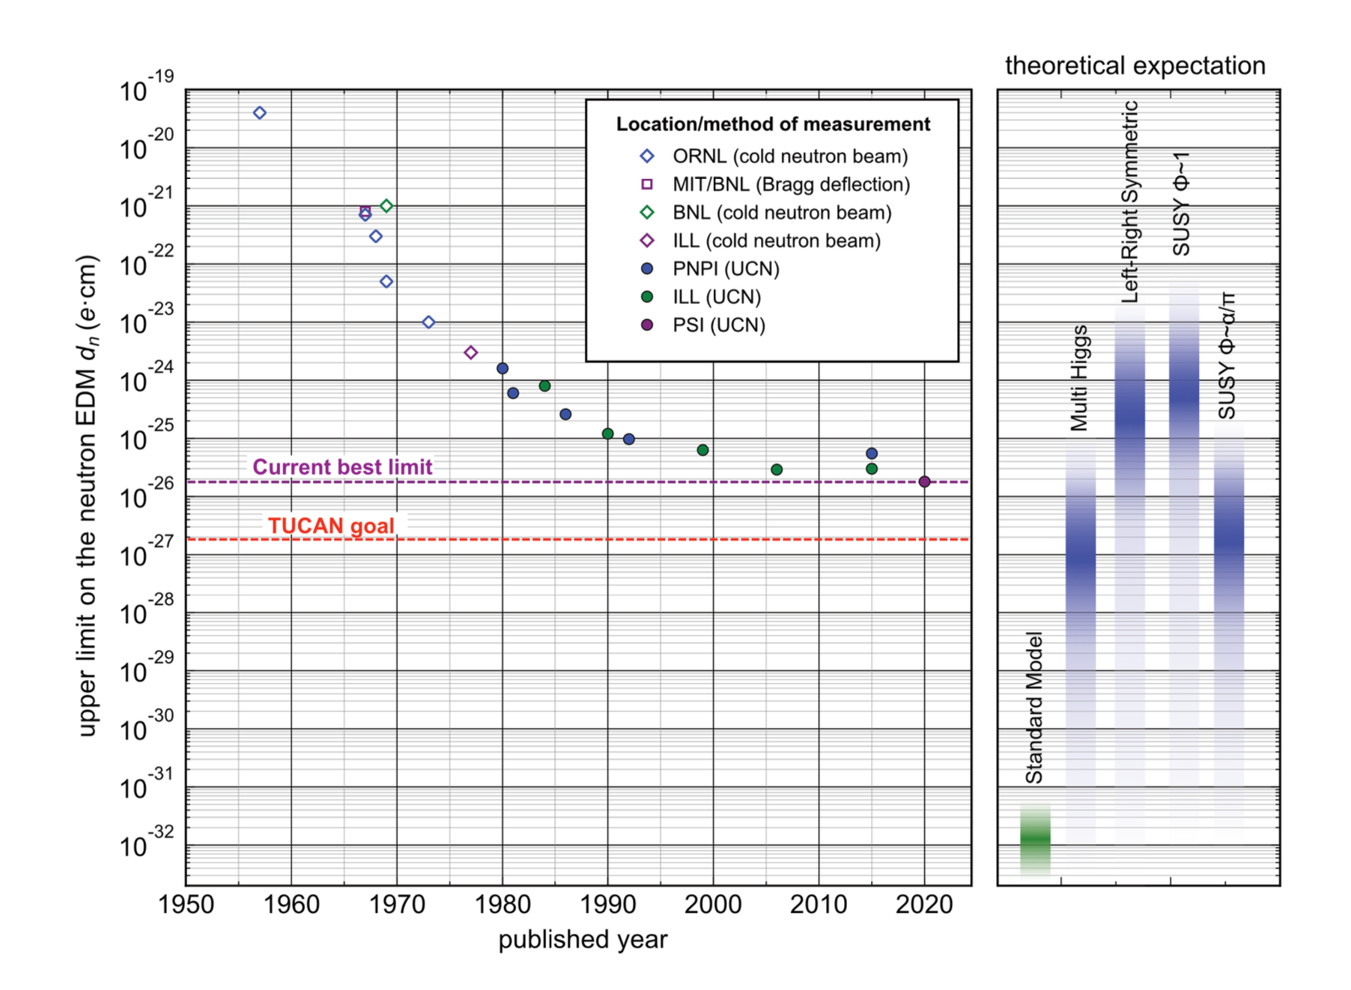
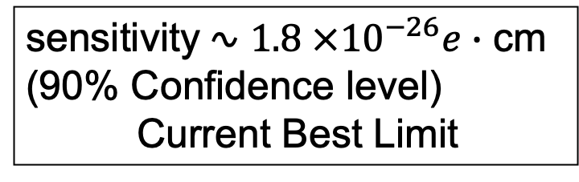
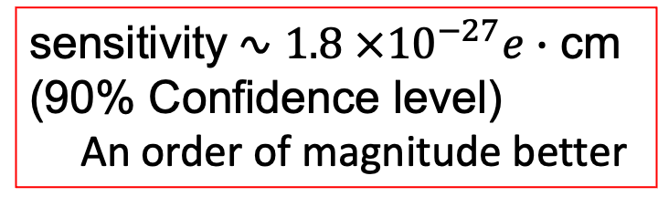
History of nEDM measurement
The experimental sensitivity of nEDM measurements has been steadily improved over the years.
PSI experiment:
The TUCAN (TRIUMF UltraCold Advanced Neutron) collaboration goal:
History
sensitivity ∿ ${1.8 ×10}^{−26}e∙$ cm
(90% Confidence level)
Current Best Limit
sensitivity ∿ ${1.8 ×10}^{−27}e∙$ cm
(90% Confidence level)
An order of magnitude better
Standard Model prediction
Notes:
Now, the sensitivity of nEDM has been stewadily improved over the years, and the current best measurement is with the sensitivity of ${1.8 ×10}^{−26}e∙$ cm by PSI, and our group, TUCAN collaboration group aims to achieve the sensitivity of ${1.8 ×10}^{−27}e∙$ cm, which is an order of magnitude better than the current best.

Slide 4
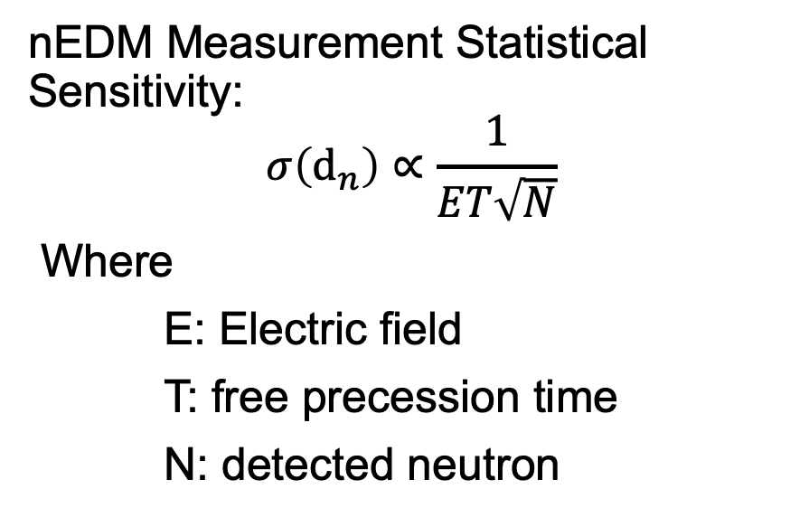
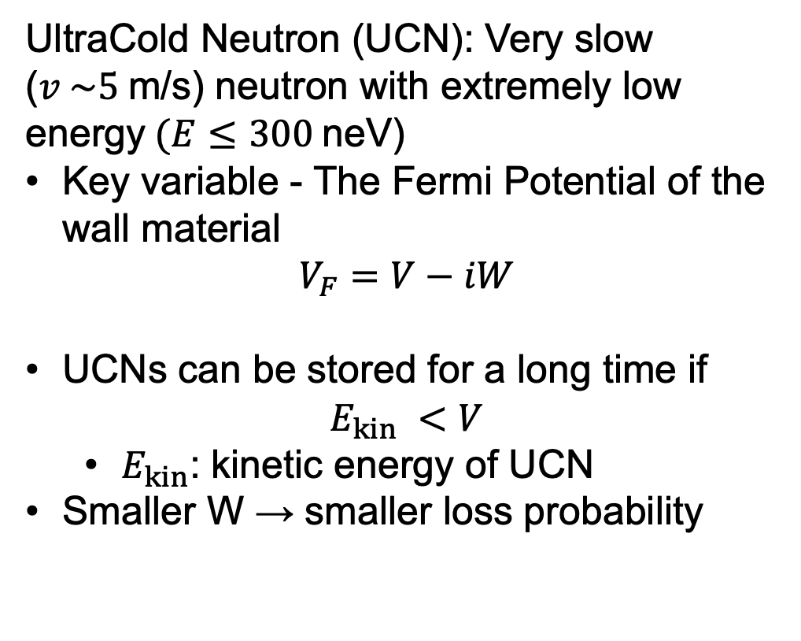
UCN and Statistical Sensitivity
TUCAN (TRIUMF UltraCold Advanced Neutron)
nEDM Measurement Statistical Sensitivity:
$$σ\left(d_{n}\right)∝\frac{1}{ET\sqrt{N}}$$
Where
E: Electric field
T: free precession time
N: detected neutron
UltraCold Neutron (UCN): Very slow ($v \sim 5$m/s) neutron with extremely low energy$(E≤300$neV)
Key variable - The Fermi Potential of the wall material
$$V_{F}=V−iW$$
UCNs can be stored for a long time if
$$E_{kin} <V$$
  $E_{kin}$: kinetic energy of UCN
Smaller W → smaller loss probability
Notes:
Now, before moving onto the TUCAN experiment, I would like to explain why we use UCN and the statistical sensitivity equation. So ultracold neutron, UCN, is a very slow neutron with extremely low energy, which is less than 300 neV. And another key comcept that I would like ot introduce is the Fermi potential of the wall material, and this can be descriped as V –iW, where V is called real fermi potential and W is called imaginary fermi potential. Now, in order to conduct the nEDM experiment, we have to keep neutrons in a volume, and if the kinetic energy of UCN is less than the real fermi potential, then UCNs can be store for a long time, so this is why we want UCN and in addition, the imaginary fermi potential corresponds to the loss probability of UCN, so if we have smaller W, then we have smaller loss probability. And (click) statistical sensitivity is inversely proportional to the free precession time, which directly related to the experiment time, so if we have large real and small W, then we can store more UCN for a long time, and this leads to the improvement of statistical sensitivity.

Slide 5
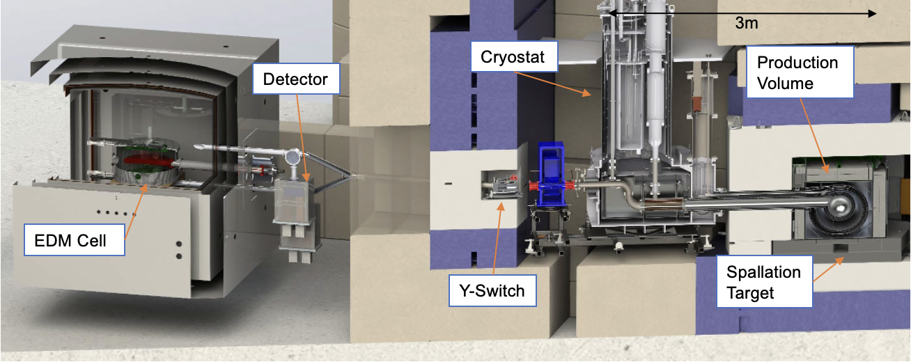
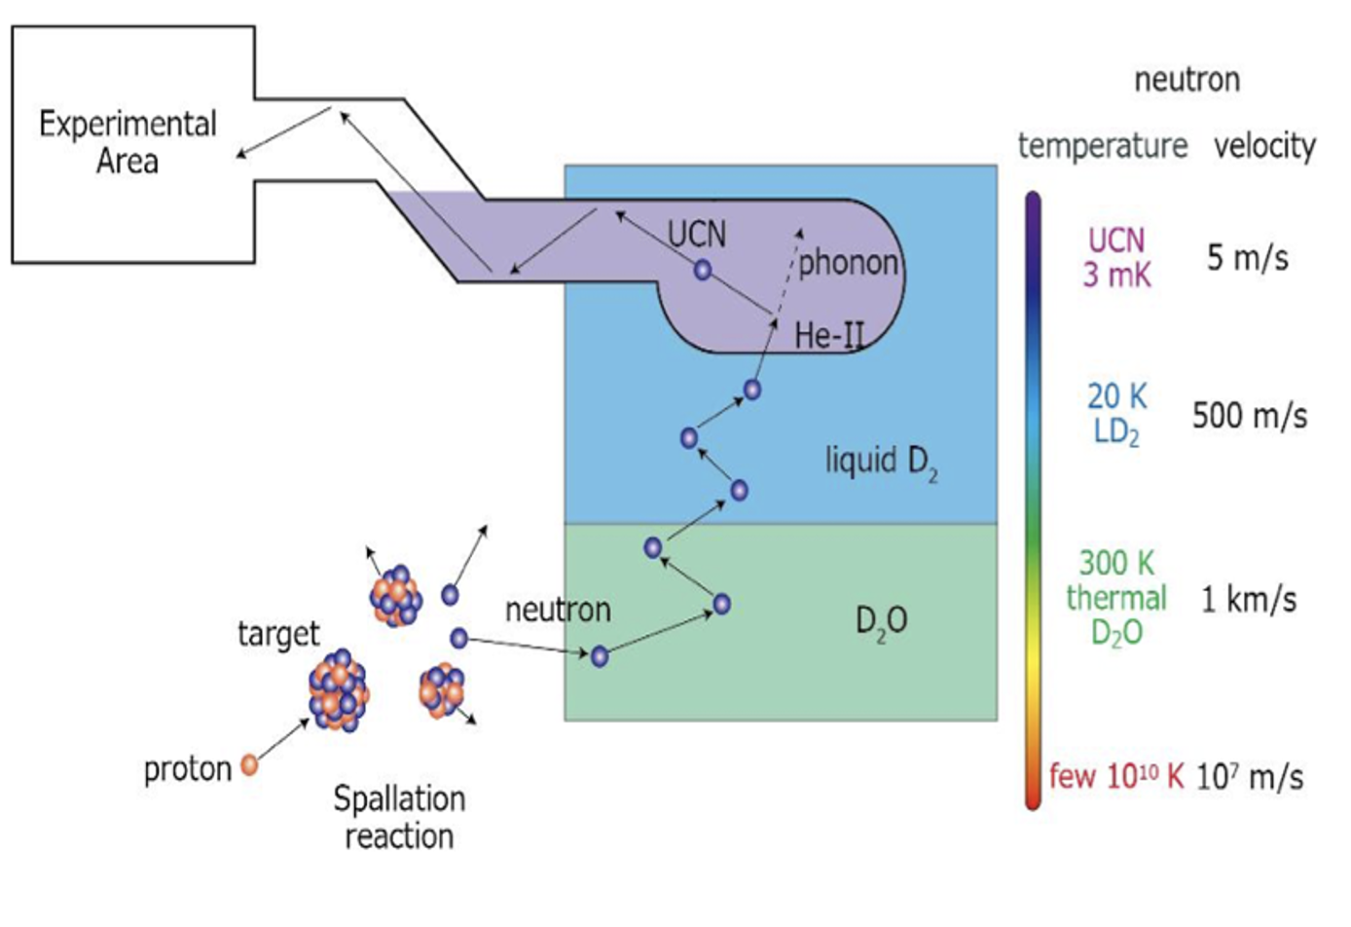
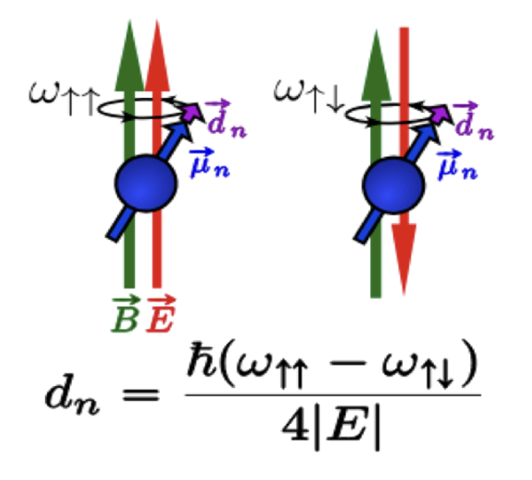
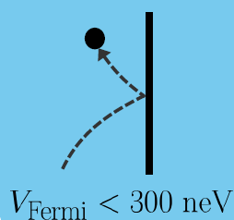
TUCAN Experimental Setup
Parallel
Anti-parallel
UCN reflecting on the wall surface
UCN Production
Neutrons inside the nEDM cell
Notes:
Now, this is the TUCAN experiment set up, and firstly proton from particle accelerator collides with a spallation target, in our case, it is tungsten target, and the target produces many high energy neutrons. Then, these high energy neutrons becomes cold neutrons in the D2O and Liquid deuterium region through elastic scattering, and then cold neutrons becomes ultracold neutrons in the superfluid region through phonon scattering. Once the UCNs are produced, the neutrons deliver to the nEDM cell through the UCN guide, and using Ramsey method of the separated oscillatory field, we measure the nEDM.

Slide 6
EDM Storage Trial in 2026
“Development and testing of the TUCAN superfluid He-II
based ultra cold neutron source at TRIUMF”
Wolfgang Klassen June 24, 2026, 10:45 a.m. Room 241, LMX building
Notes:
And in 2026, using this source, we achieved the highest UCN density in one cell nEDM experiment. And there will be a talk by my colleague on Thursday at 10:45 Am about the TUCAN UCN source, so if you are interested, I would recommend attending the talk.

Slide 7
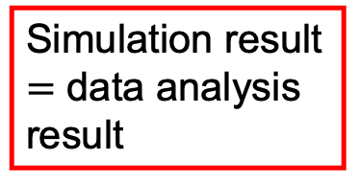
Characterize the TUCAN EDM experiment.
My focus areas:
  Data Analysis – extraction of UCN storage lifetime in nEDM prototype cell
  Simulation (PENTrack) – Characterize the cell performance
Validate my simulation results against my data analysis results to determine the cell performance and extract the imaginary Fermi potential (loss rate, W_F) of the cell material
Simulation Result
Simulation result $=$ data analysis result
Obtain W of the cell material
Compare
Data analysis Result
Notes:
Now, to achieve the better sensitivity, it is important to understand the nEDM cell performance, and my focus areas consists of data analysis and Simulation. Through the data analysis, I extract UCN storage lifetime in the nEDM prototype cell to determine the properties of the cell, and through the Simulation, I characterize the cell performance. And data analysis and simulations are closely connected, as I valudate my simulation results against my data analysis results to determine the cell performance and extract the imaginary Fermi potential (loss rate, W_F) of the cell material.

Slide 8
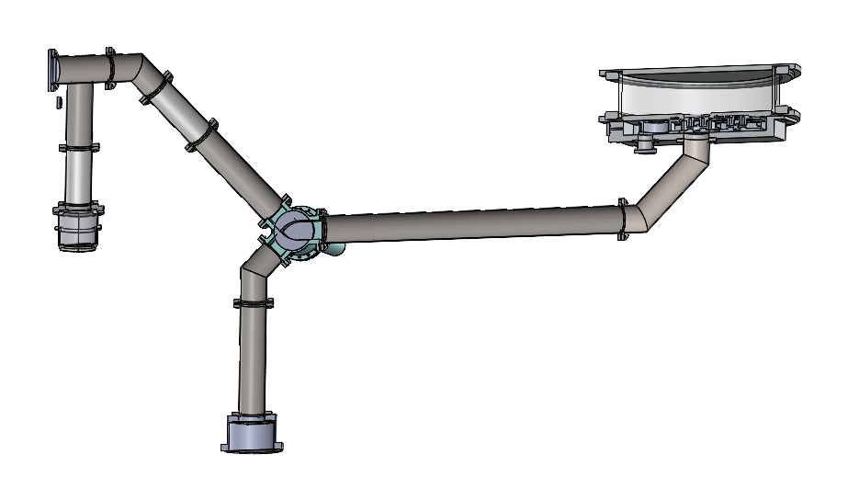
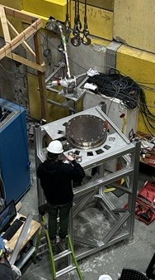
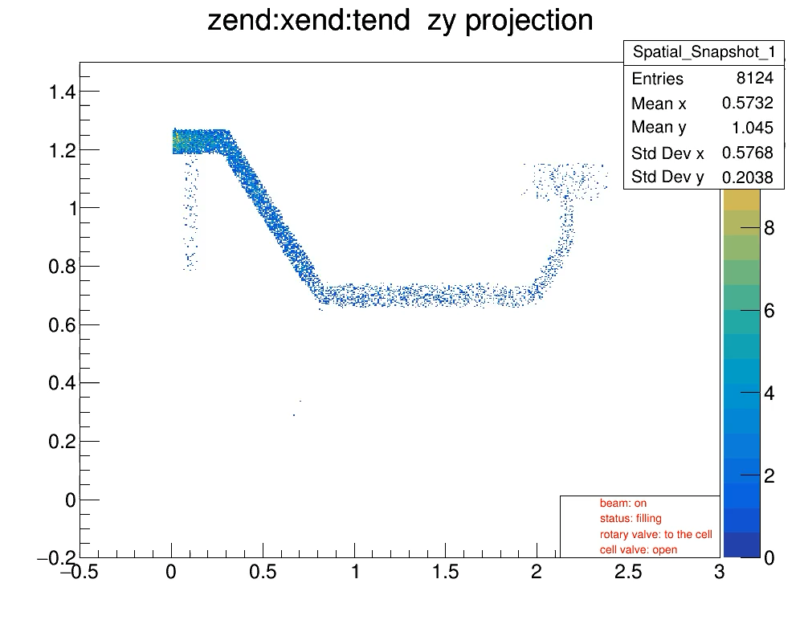
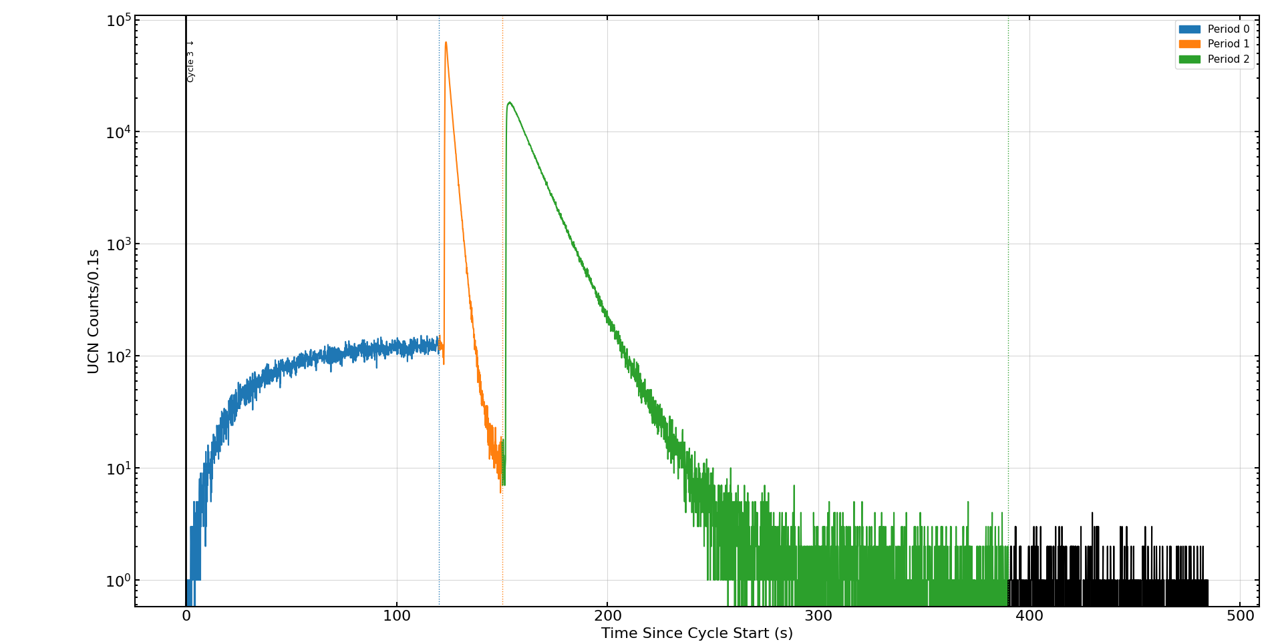
2nd Port: Prototype Cell Experiment
7
Purpose: understand the properties of the cell, which replicates the actual nEDM cell design
2nd Port
Cell to Det
Prototype EDM cell
Source to Cell
Closed
Open
CAD model
Detector
Signal
Set up on site
Detector
Filling Period
Storage Period
Counting Period
Notes:
And to understand the properties of the cell, we developed prototype cell, which replicates the actual nEDM cell design, and conducted the storage lifetime experiment. Using the top figure, I will explain the valve timing, and the animation below shows the behaviour of UCN during the experiment, and this animation is generated from my simulation. And so firstly, (click )during the filling period, the rotary valve direction is toward cell and cell valve is open to store the UCNs, then during storage period, the rotary valve rotates to the detector direction and the cell valve is closed to determine the storage lifetime. Then during the counting period, the cell valve opens to count UCNs

Slide 9
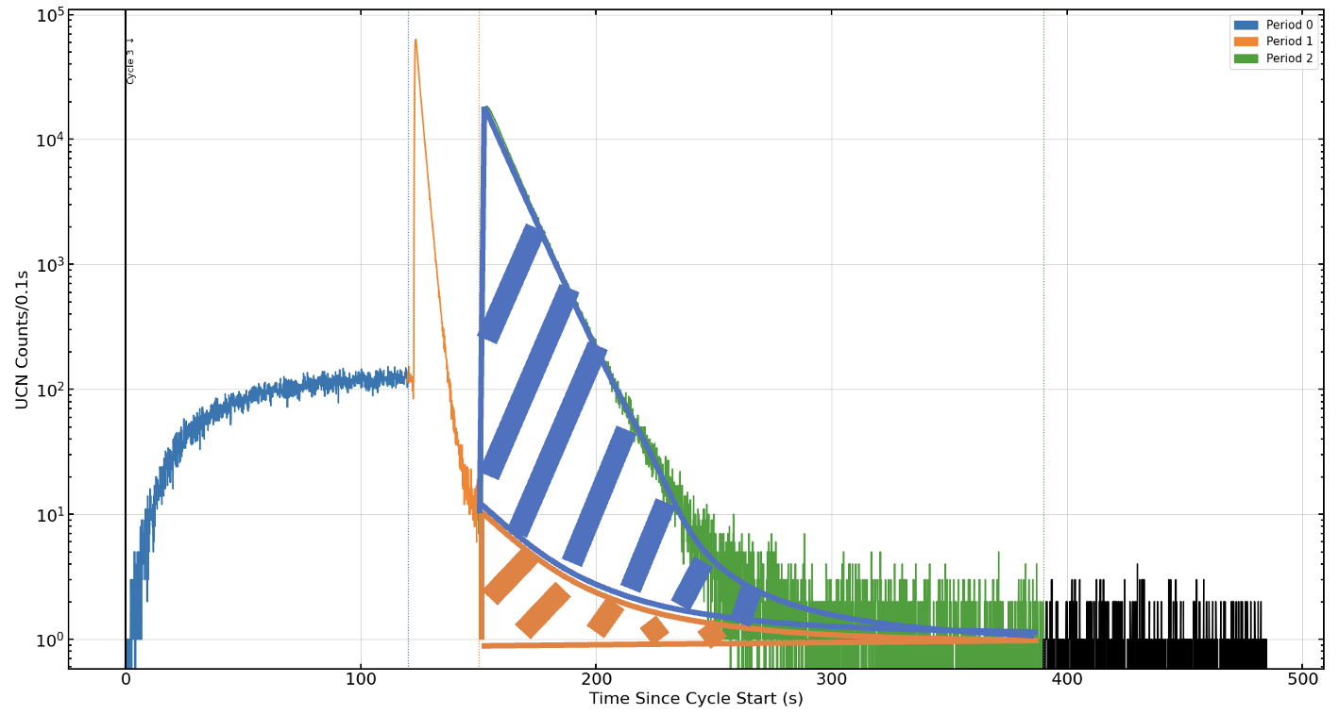
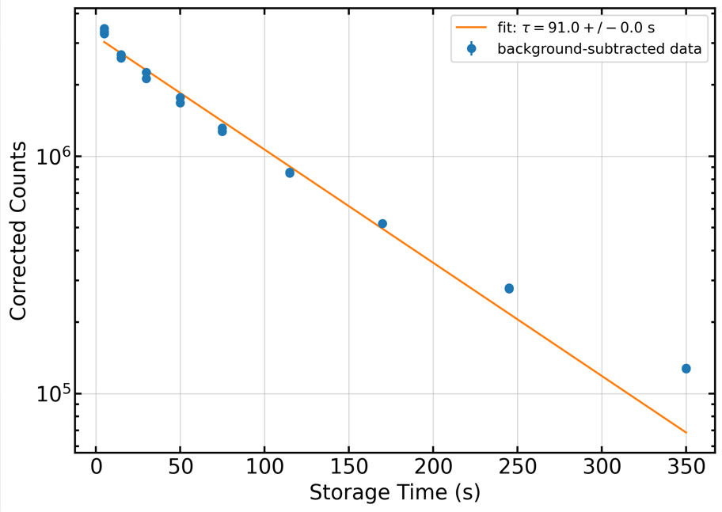
Prototype Cell Storage Lifetime Analysis
Extract counts in the counting period, and subtract the background.
Signal
Count vs. storage time
We want this
UCN Counts/0.1s
Preliminary Result
Time (s)
Subtract this guide UCNs
Challenges
Period timing misalignment
Background subtraction method consideration
Notes:
Ok so the goal of the data analysis is to extract the UCN count in the counting period. But there are back ground count in the counting period, and in this experiment, we had UCNs in the guide between the cell and detector, and since we are trying to determine the cell storage lifetime, we don’t want to count guide UCN, so we basically want only the blue region. And based on the analysis, I generated the graph on the right, this is just preliminary result, because there are still chanllenges such as period timing misalignment and background subtraction method consideration

Slide 10
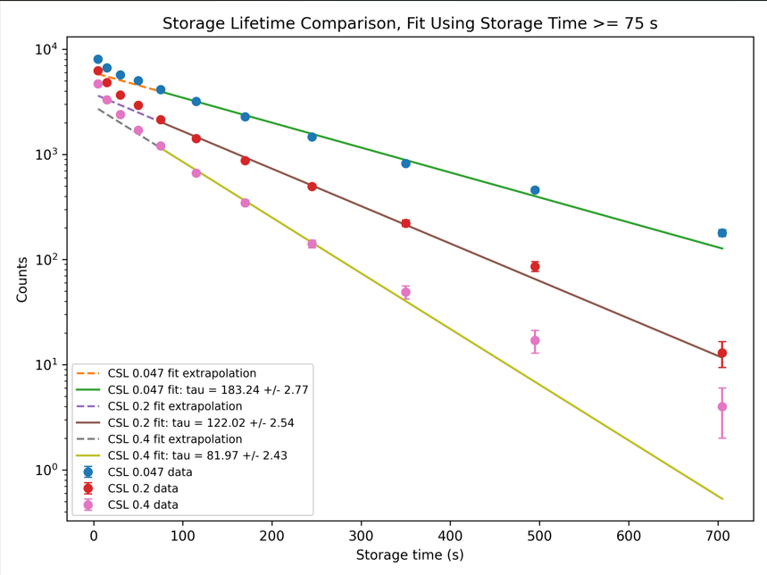
Simulation Analysis
10
Comparing this to the experimental results allows us to extract W for the cell material
Cell W_F: 0.047neV
-tau = 183.24 +/- 2.77 s
Cell W_F: 0.047neV
-tau = 183.24 +/- 2.77 s
Cell W_F: 0.2neV
-tau = 122.02 +/- 2.54 s
Counts
Compare
EXAMPLE
Cell W_F: 0.2neV
-tau = 122.02 +/- 2.54 s
Preliminary Result
Cell W_F: 0.4neV
-tau = 81.97 +/- 2.43 s
Cell W_F: 0.4neV
-tau = 81.97 +/- 2.43 s
Time (s)
Simulation Results
Experimental Results
Larger W
Higher wall loss probability
Shorter Storage Lifetime
Notes:
And the left plot is an example of the simulation result, and again if we have larger imaginary fermi potential, this means we have higher wall loss probability, and this leads to the shorter storage lifetime. And as we can see, we have a higher storage lifetime as imaginally fermi potential gets smaller. And we would like to compare the experimental results, which is on the right, to extract imaginary Fermi potentialof the cell material

Slide 11
Conclusion
Greater Cell performance leads to better sensitivity.
Data analysis and simulation are utilized to determine the cell performance
Comparing the results, find the imaginary Fermi potential of the cell
Identify whether the current cell design is sufficient for our sensitivity goal.
Notes:
Finally, in conclusion, since sensitivity is inversely proportional to the experiment time, the greater cell performance leads to better sensitivity, and we use data analysis and simulation to evaluate the cell performance by comparing the results. and we try to find the imaginally fermi potential of the cell material, then we determine whether the current cell design is sufficient for our goal, which is the sensitiviy of 10^-27.

Slide 12
Thank you!

Slide 14
BACKUP SLIDES

Slide 15
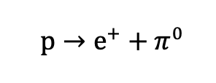
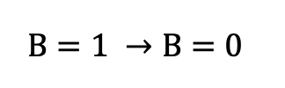

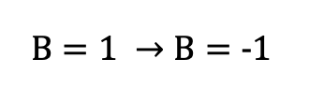
Baryon number violation
Proton decay
Neutron oscilation

Slide 16
CP violation
CP violation through the experiments is based on the CKM matrix, but the amount of CP violation from the CKM matrix is not enough to explain the matter-antimatter asymmetry
We need other source of CP violation

Slide 17
Deperture form thermal equilibrium
Expansion of universe
In thermal equilibrium,
  reaction ↔︎ reverse reaction
As the universe expands and cools, some particle reactions become too slow and no longer to be able to maintain the thermal equilibrium

Slide 18
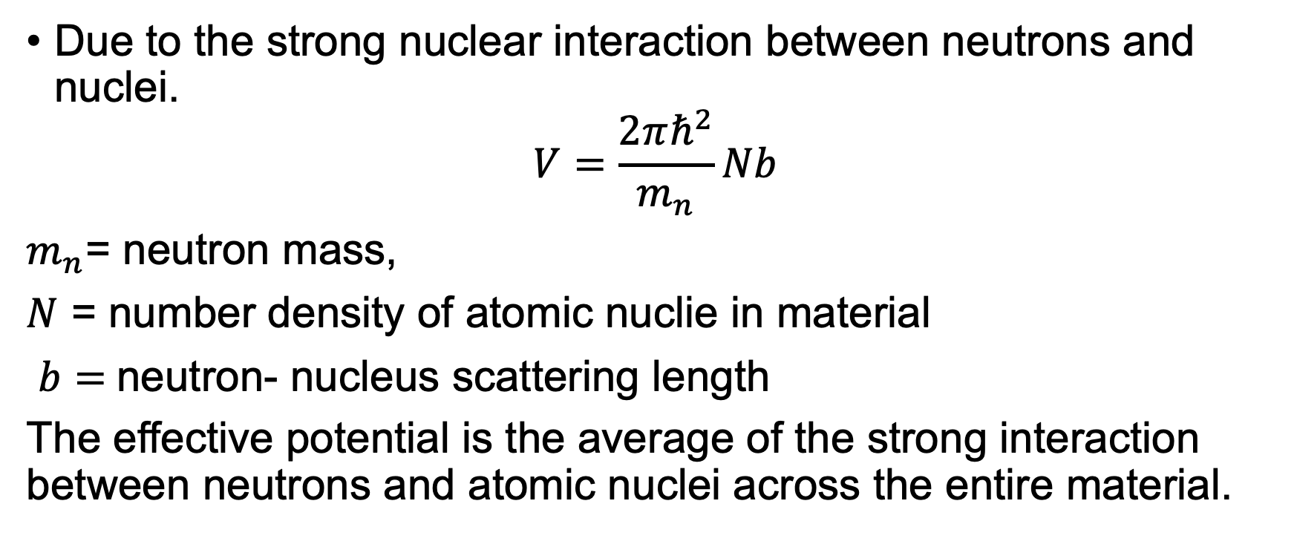
Real fermi potential
Due to the strong nuclear interaction between neutrons and nuclei.
$$V=\frac{2πℏ^{2}}{m_{n}}Nb$$
$m_{n}$= neutron mass,
$N$ = number density of atomic nuclie in material
$b=$neutron- nucleus scattering length
The effective potential is the average of the strong interaction between neutrons and atomic nuclei across the entire material.

Slide 19

Imaginary fermi potential
$$ψ(t)∝e^{\frac{−iVt}{ℏ}}e^{\frac{−Wt}{ℏ}}$$
$e^{\frac{−Wt}{ℏ}}$ is the amplitude decay
Fermi potential
$$V=\frac{2πℏ^{2}}{m_{n}}N(b^{′}−ib^{′′})$$
$$W=\frac{2πℏ^{2}}{m_{n}}Nb^{′′}$$
Where
$$b^{′′}\sim \frac{kσ_{loss}}{4π}$$
$$large σ_{loss}→large b^{′′}→largeW$$

Slide 20
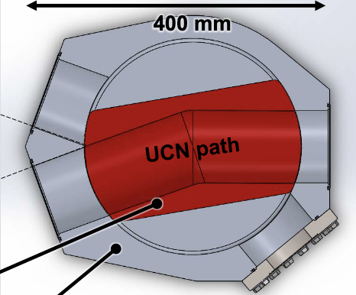
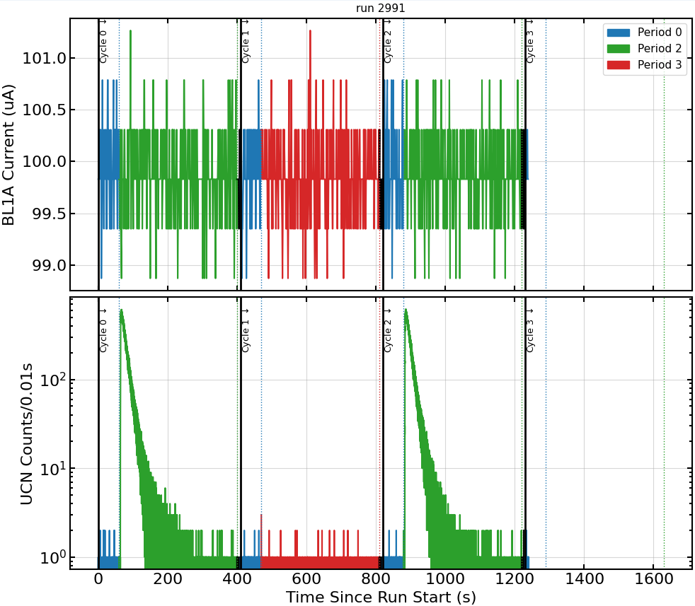
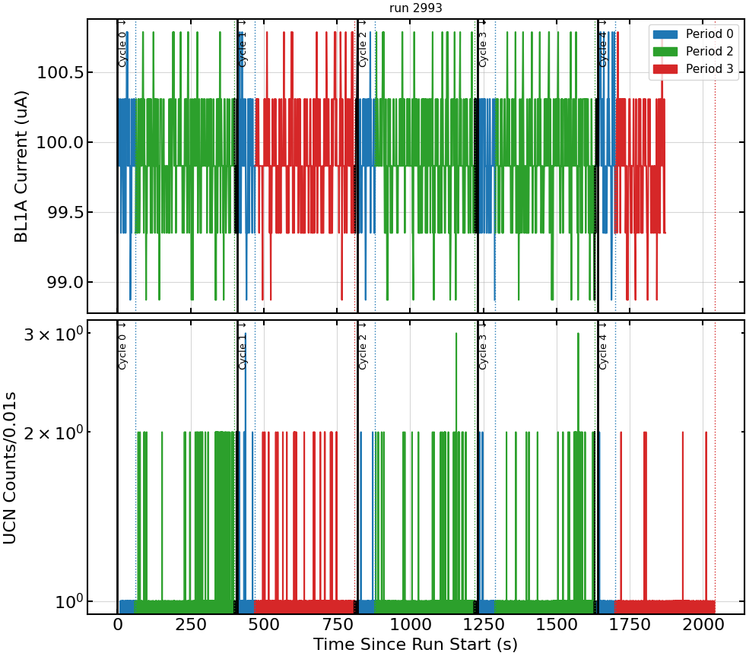
Current work: Y-Switch Leakage
Y Switch Leakage Analysis
Objective: Determine the leaking rate of the Y switch
Method: Compare the UCN count of two different directions of the Y Switch while keeping the detector location.
Detector
Detector
n
n
n
n
n
n
n
n
Normal count
Leakage count

Slide 21
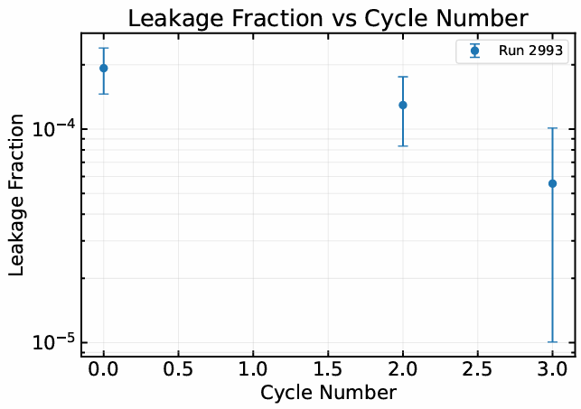
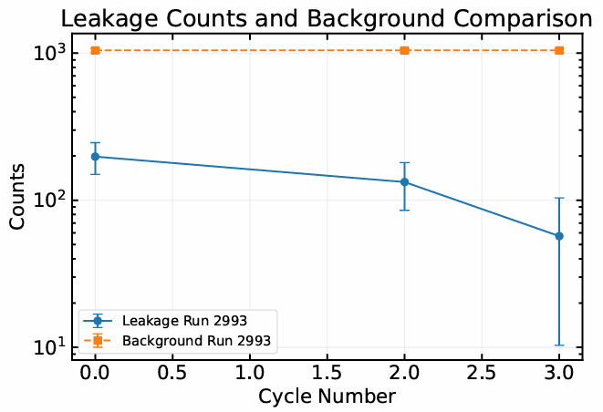
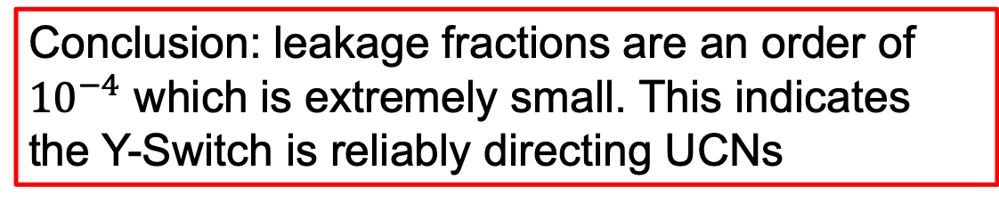

Current work: Y-Switch Leakage
NOTE:
Normalized by current
Used nearest background cycle for background subtraction
Error propagation for uncertainty
$$Leakage Fraction=\frac{N_leak}{N_normal}$$
Leakage Count = count - background
Conclusion: leakage fractions are an order of ${10}^{−4}$ which is extremely small. This indicates the Y-Switch is reliably directing UCNs

Slide 22

Time-Reversal Transformation
Under the T-reversal transformation
t → -t
So
v → -v & p → -p
Therefore;
L = r x p -L
And the spin is also an angular momentum, so
𝜎 → -𝜎
And under the T-reversal transformation, current becomes
$J=ρv$ $−J$
And from the right had rule, B field becomes
B → -B
For Electric field,
$$E∝\frac{q}{r^{2}}$$
Therefore,
E → E
p → -p
v → -v

Slide 23
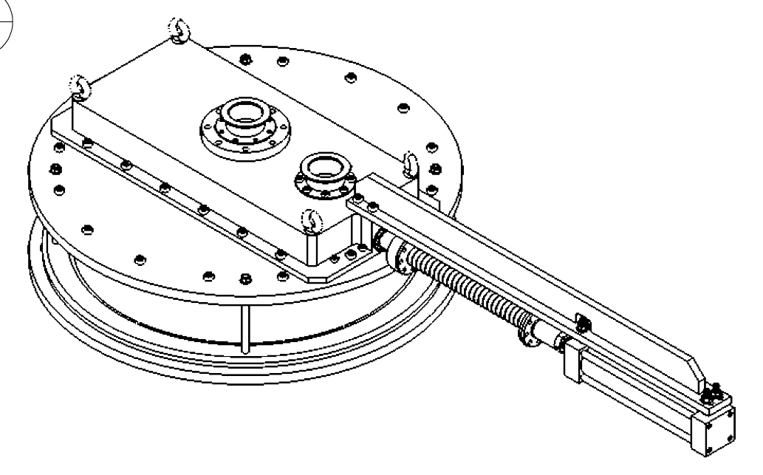
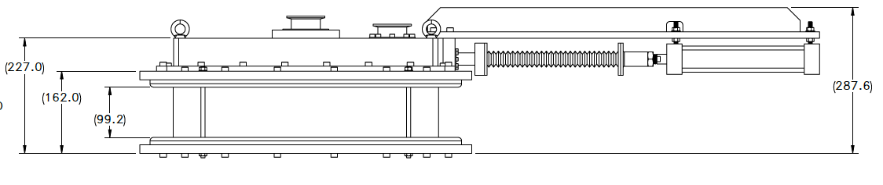
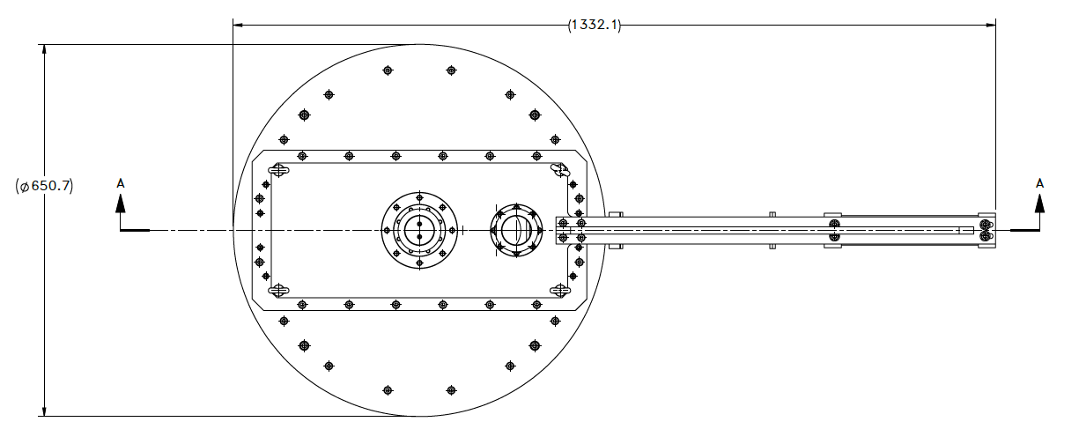
Prototype cell Geometry
1 micro T
12kV/cm

Slide 24
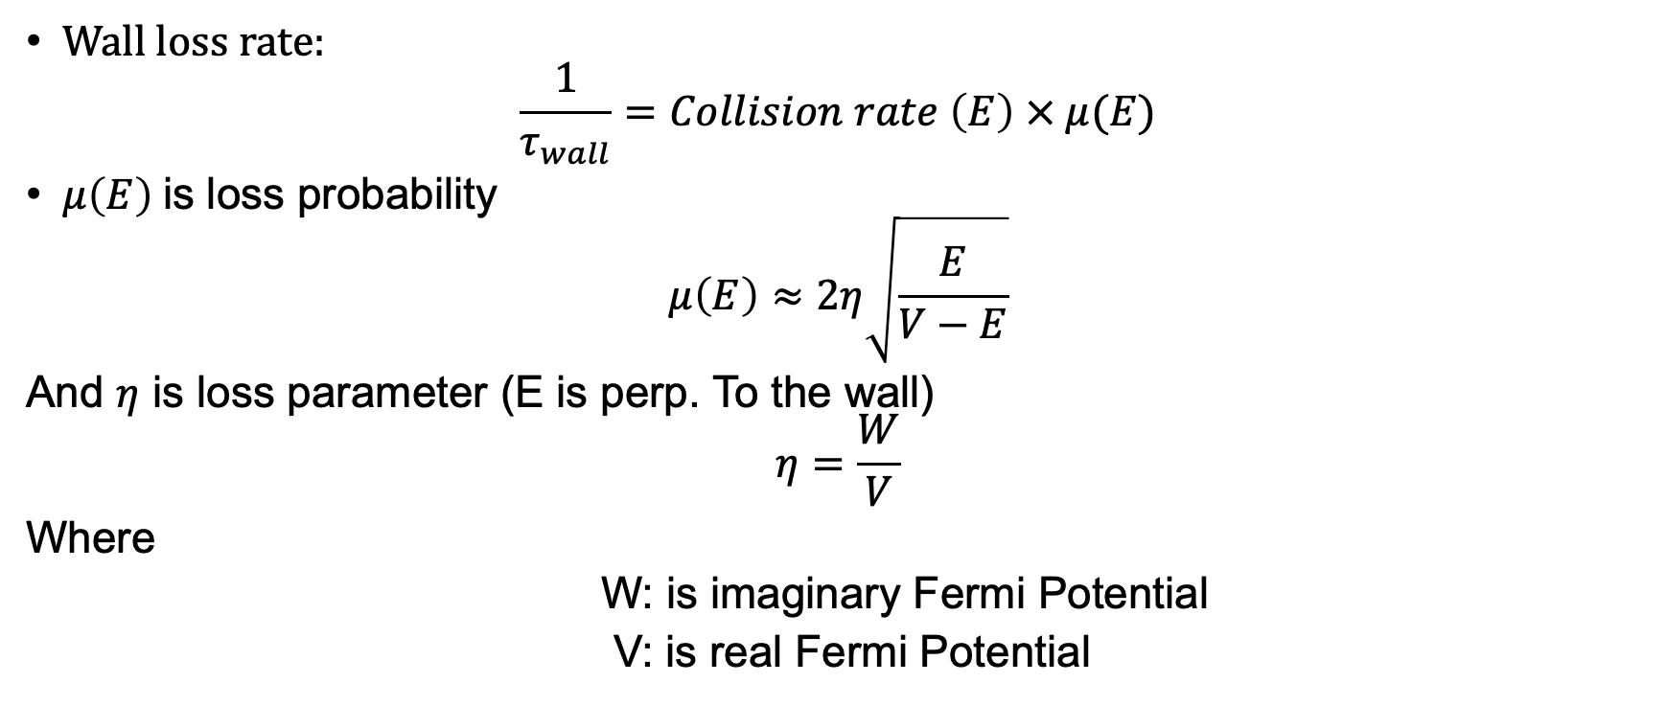
wall loss rate
Wall loss rate:
$$\frac{1}{τ_{wall}}=Collision rate \left(E\right) × μ(E)$$
$μ\left(E\right)$is loss probability
$$μ\left(E\right)≈2η\sqrt{\frac{E}{V−E}}$$
And $η$ is loss parameter (E is perp. To the wall)
$$η=\frac{W}{V}$$
Where
W: is imaginary Fermi Potential
V: is real Fermi Potential

Slide 25
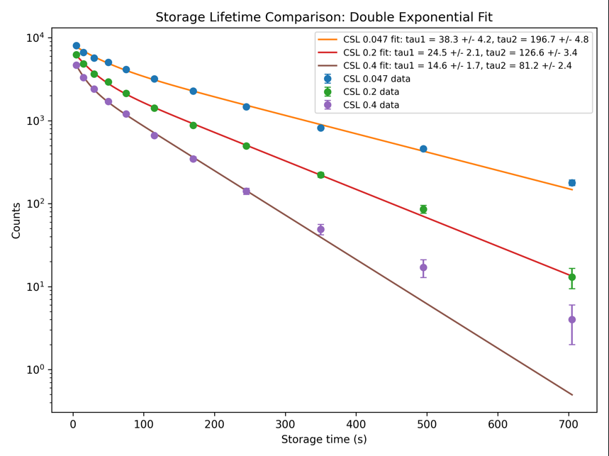
Double exponential fit

Slide 26
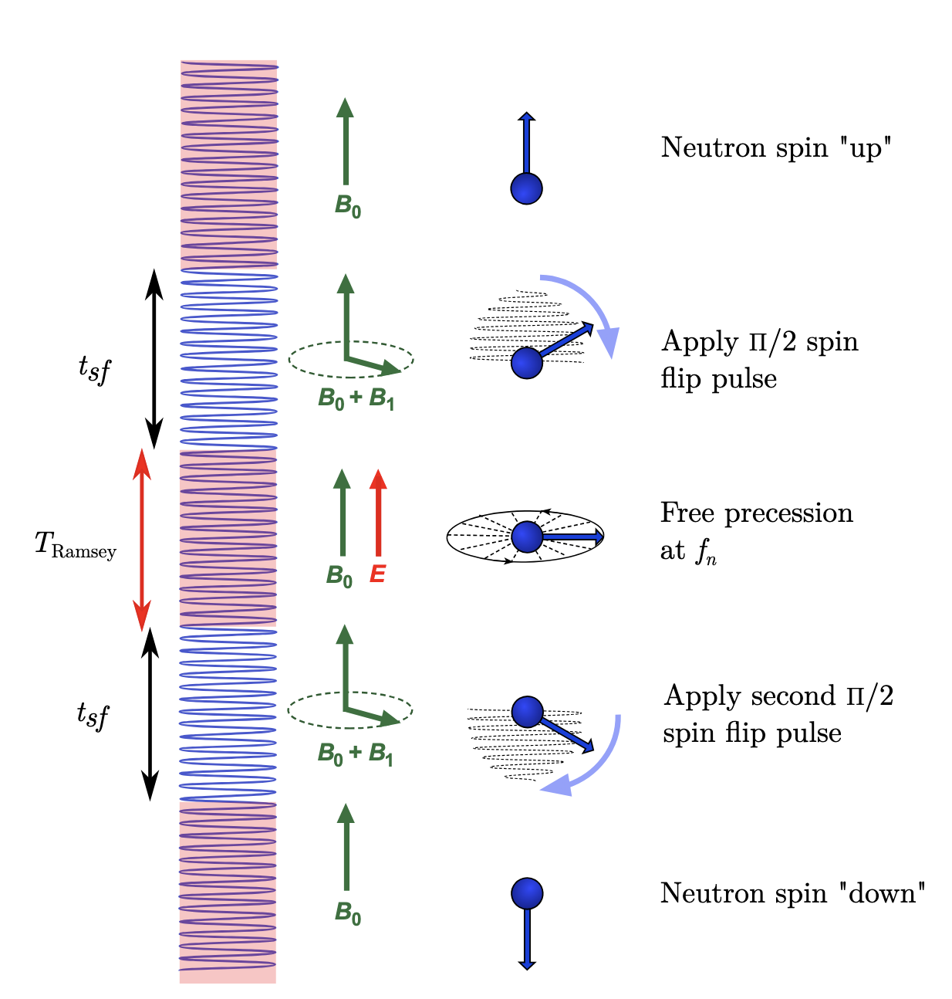
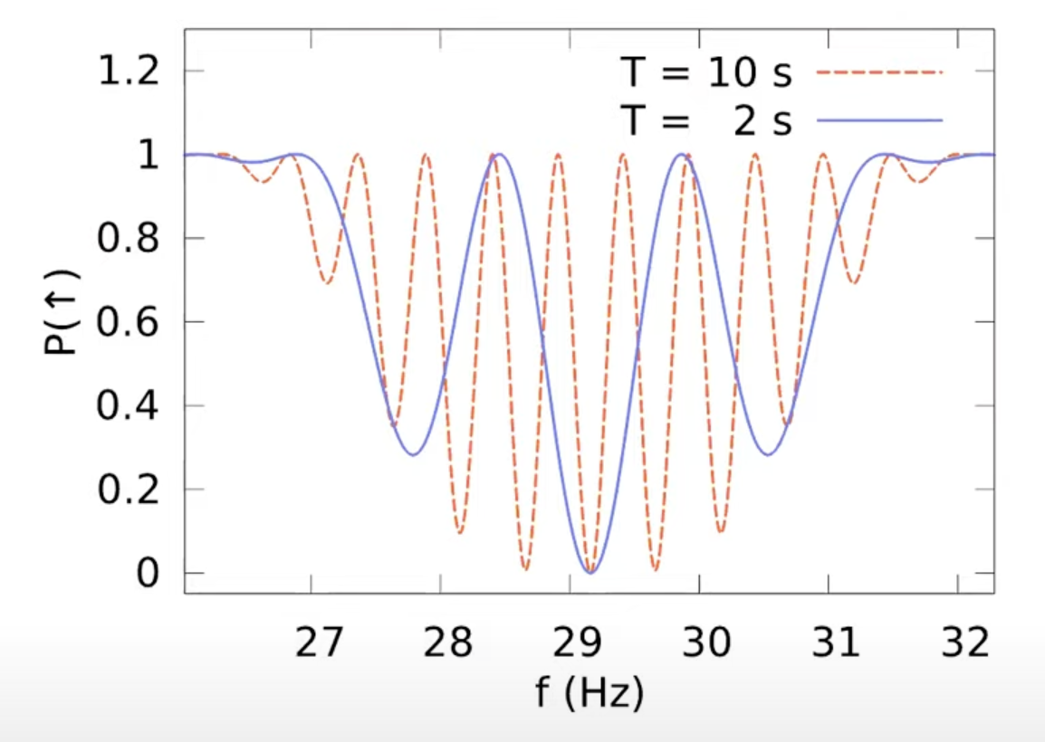
Ramsey’s method of separated oscillatory fields
Down
the frequency of B_1 field = the larmor frequency

Slide 27
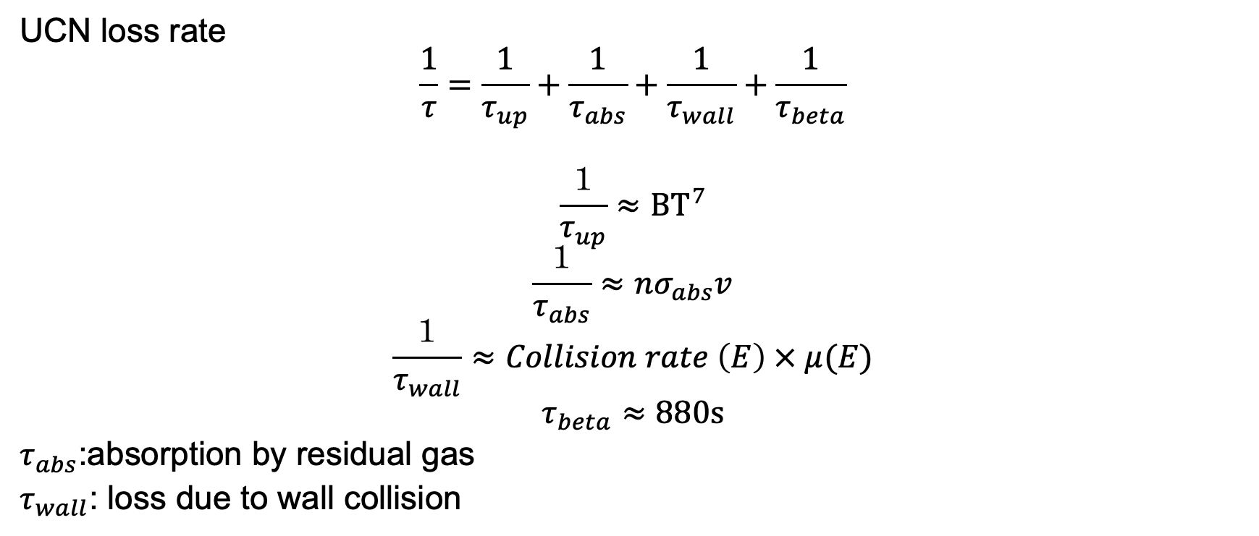
The loss rate
UCN loss rate
$$\frac{1}{τ}=\frac{1}{τ_{up}}+\frac{1}{τ_{abs}}+\frac{1}{τ_{wall}}+\frac{1}{τ_{beta}}$$
$$\frac{１}{τ_{up}}≈BT^{7}$$
$$\frac{１}{τ_{abs}}≈nσ_{abs}v$$
$$\frac{１}{τ_{wall}}≈Collision rate \left(E\right) × μ(E)$$
$$τ_{beta}≈880s$$
$τ_{abs}$:absorption by residual gas
$τ_{wall}$: loss due to wall collision

Slide 28
PENTrack Simulation
Objective: Simulate the storage lifetime ​experiment, and determine the storage lifetime of the prototype cell insulator
A simulation tool called PENTrack
Simulate the actual experiment we conducted
  Irradiation time: 120s
  Storage time: 5s - 705s
  Counting: 240s
Notes:
Now, the goal of the simulation study is to simulate the actual storage lifetime experiment we conducted, and determine the storage lifetime of the prototype cell. We use simulation tool called PENTrack, and in this simulation, I had 120s of irradiation time, 5s – 705s of storage time and 240s of counting time

