Slide 1
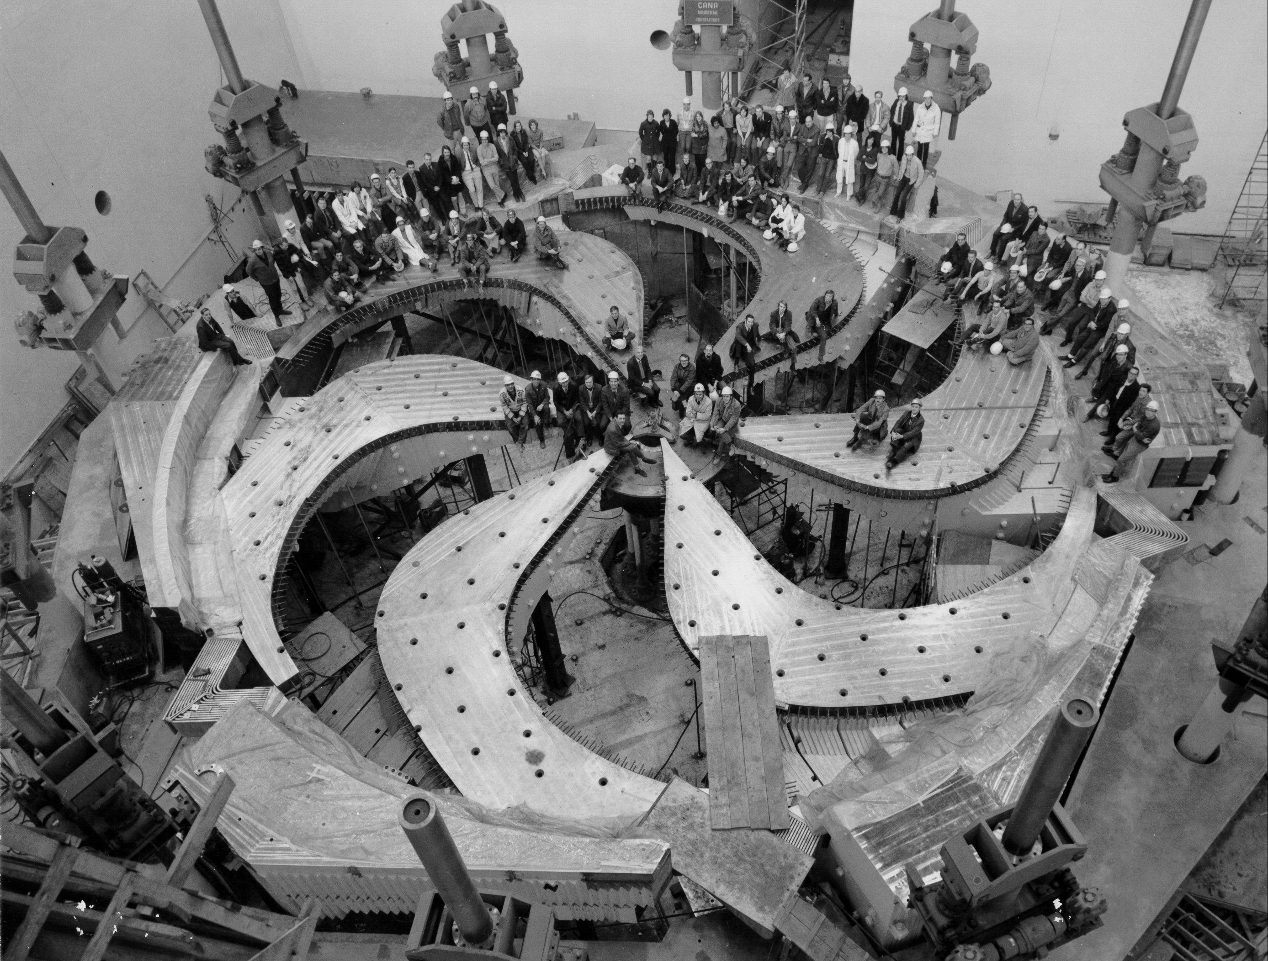
Tripling TRIUMF’s RIB capabilities with the ARIEL facility
Luca Egoriti
Target Physicists
ARIEL Target Stations Project Co-Lead

Slide 2
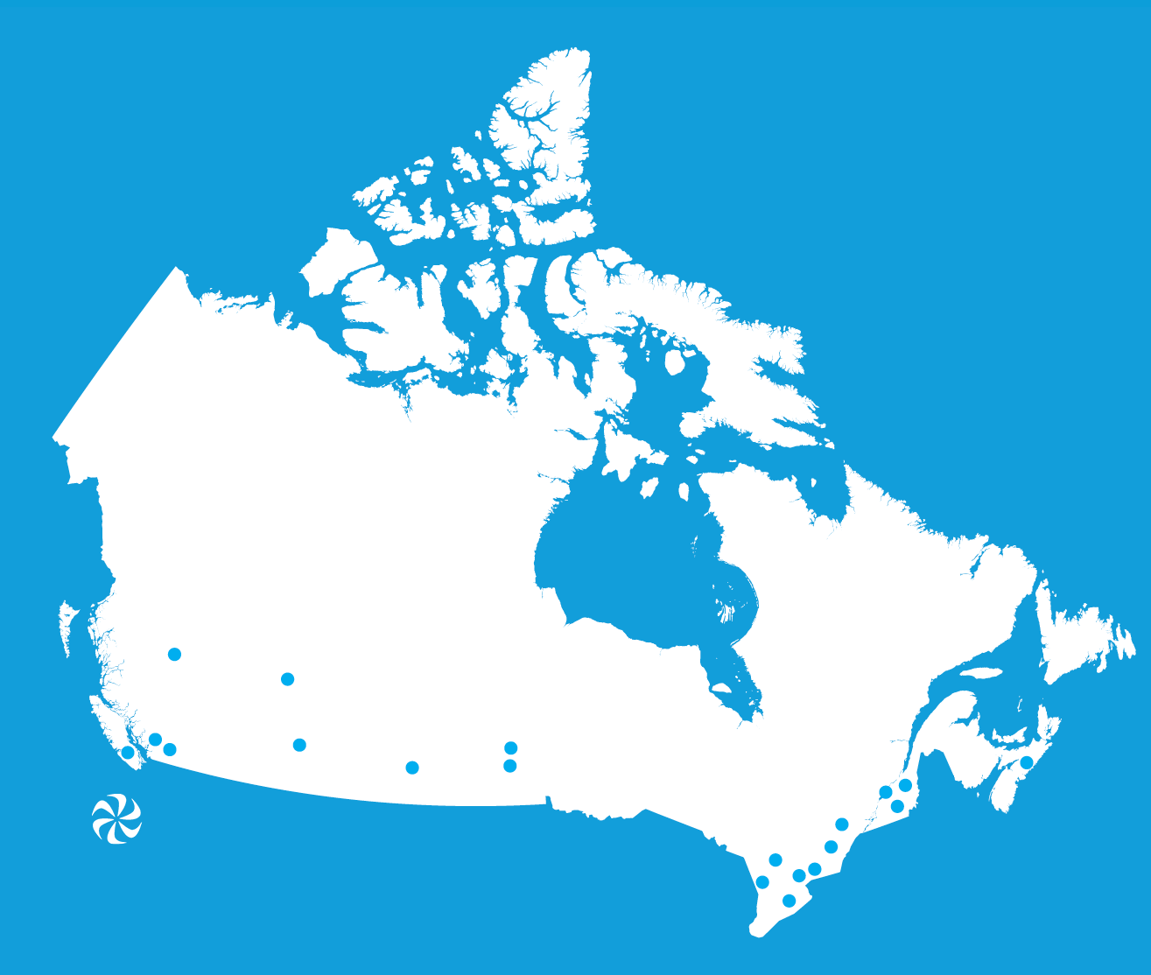
TRIUMF: Canada’s particle accelerator center
TRIUMF is a not-for-profit corporation owned by a consortium of 21 member universities
Member Universities
University of Alberta
University of British Columbia
Carleton University
University of Calgary
University of Guelph
University of Manitoba
McGill University
McMaster University
Université de Montréal
University of Northern
British Columbia
Queen's University
University of Regina
Saint Mary’s University
Université de Sherbrooke
Simon Fraser University
University of Toronto
University of Victoria
University of Waterloo
Western University
University of Winnipeg
York University
2

Slide 3
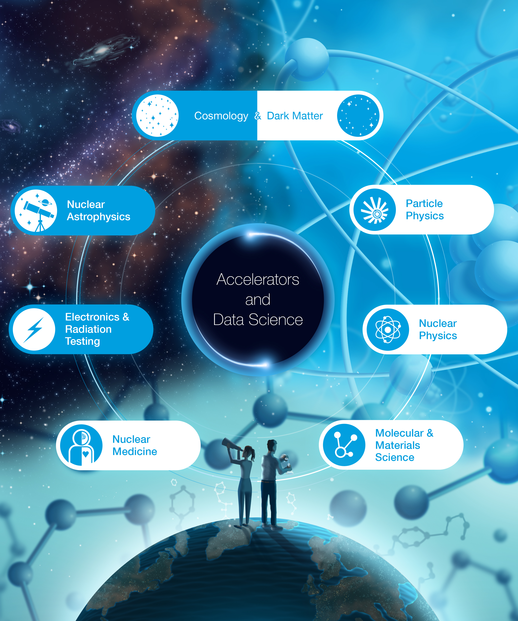
TRIUMF’s Role in Canada
Notes:
TRIUMF operates at the interface between academia, government, and industry – the three pillars of Canada’s research and innovation ecosystem.
Our multidisciplinary community uses its world-class accelerator infrastructure to drive leading-edge research that delivers impact in science, medicine, and industry

Slide 4
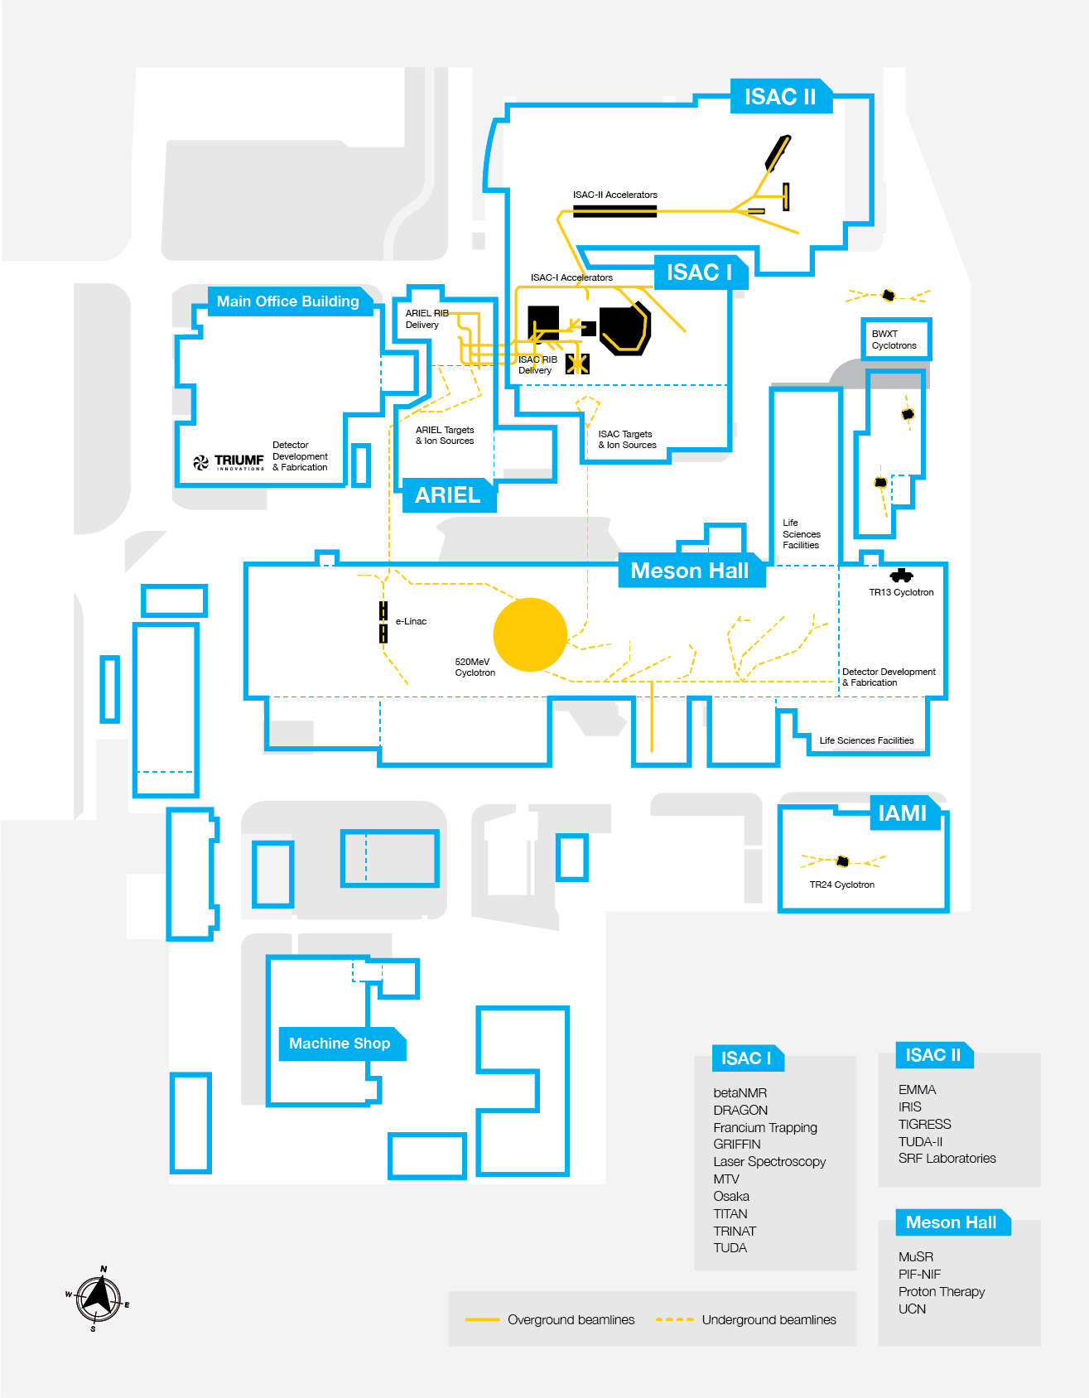


Slide 5
One-year long shutdown to focus on installing the ARIEL facility
LS 26
User facilities
Cyclotron & beamlines (since ~1975)
TRIUMF accelerators
ISAC ISOL targets (since 2000s)
RIB lines
ARIEL ISOL targets (from 2027)
E-linac and beamline (since ~2013)
Radioactive Ion Beams
~10 user facilities
Nuclear & atomic physics
Material science
Spectroscopy γ, β, n (GRIFFIN and DESCANT, LE)
Precision mass measurements (TITAN, LE)
β-NMR (LE)
Atomic laser trap (TRINAT, LE)
Recoil separator (DRAGON, ME)
Recoil detector (TUDA, ME)
Radiochemistry (ASPIRE, ME)
Gamma-ray spectrometer (TIGRESS, HE)
Recoil separator (EMMA, HE)
Recoil detector (IRIS, HE)
ISAC I and II halls
Medical isotopes
ARIEL
(ISOL)
TR: 13
APTW
AETE
TR: 30-1
TR: 30-2
ISAC
(ISOL)
TR: 24
120 MeV – 10 nA
Electronics irradiations
Proton FLASH
Ocular melanoma treatments (-2019)
ITW
ITE
PIF
Neutron Irradiations
BL2A
NIF
⁸²Sr medical production
STF
BL2C
Muons for
material science
²²⁵Ac et al. production
T1
T2
IPF
30 MeV – 10 mA
e- LINAC
500 MeV – 400 μA
P+ Cyclotron
BL1A

Slide 6
User facilities
Cyclotron & beamlines (since ~1975)
ARIEL ultimate objectives
ISAC ISOL targets (since 2000s)
RIB lines
ARIEL ISOL targets (from 2027)
E-linac and beamline (since ~2013)
Radioactive Ion Beams
~10 user facilities
Nuclear & atomic physics
Material science
ISAC I and II halls
ARIEL
(ISOL)
APTW
AETE
ISAC
(ISOL)
Two new radioisotope production stations
50 kW protons and 100 kW electrons
Multi-user operation
up to three simultaneous beams (9000 RIB hours)
More efficient post acceleration
EBIS, RFQ, Nier-spectrometer and 1/20,000 mass separator.
Medical Isotopes
production in proton target station beam dump and transfer to medical isotope research
ITW
ITE
BL2A
30 MeV – 10 mA
e- LINAC
500 MeV – 400 μA
P+ Cyclotron

Slide 7
User facilities
Cyclotron & beamlines (since ~1975)
ARIEL program
ISAC ISOL targets (since 2000s)
RIB lines
ARIEL ISOL targets (from 2027)
E-linac and beamline (since ~2013)
Radioactive Ion Beams
~10 user facilities
Nuclear & atomic physics
Material science
ISAC I and II halls
ARIEL
(ISOL)
APTW
AETE
ISAC
(ISOL)
ARIEL-I (2012 - 2014):
e-linac, beam tunnel, target building
ARIEL-II (2017 - 2028)
target stations, shielding, hot cells, RIB distribution
CANREB (2014 - 2019)
charge state breeding and purification
Therapeutic Isotopes (2020 - 2028)
Parasitic ²²⁵Ac production
200 $M by federal and 6 provincial governments;
ITW
ITE
BL2A
30 MeV – 10 mA
e- LINAC
500 MeV – 400 μA
P+ Cyclotron

Slide 8
User facilities
Cyclotron & beamlines (since ~1975)
ARIEL program
ISAC ISOL targets (since 2000s)
RIB lines
ARIEL ISOL targets (from 2027)
E-linac and beamline (since ~2013)
Radioactive Ion Beams
~10 user facilities
Nuclear & atomic physics
Material science
ISAC I and II halls
ARIEL
(ISOL)
APTW
AETE
ISAC
(ISOL)
ITW
ITE
BL2A
Electron linac
30 MeV – 10 mA
e- LINAC
500 MeV – 400 μA
P+ Cyclotron

Slide 9
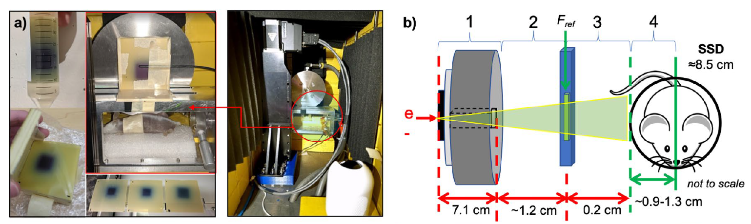
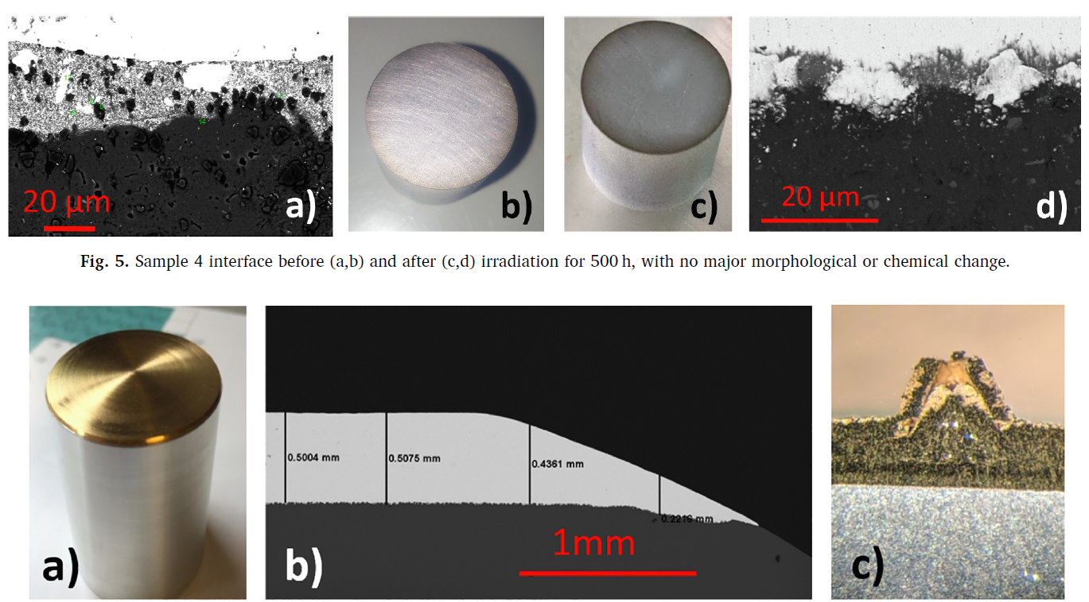
ARIEL e-linac
←NORTH
30 MeV
FLASH
CTS
To “Driver tunnel”
300 keV
10 MeV
DarkLight
E = 30 MeV (upgradable to 50 MeV); Current up to 10 mA; Power up to 100 kW
Early science enabled: AETE material developments, FLASH studies on mice, DarkLight
Status: Commissioned up to 10 kW (beam dump rating)
[1] Egoriti, L. et al., Material development towards a solid 100 kW electron-gamma converter for TRIUMF-ARIEL https://doi.org/10.1016/j.nimb.2019.05.031
[2] Esplen, N., et al., Dosimetric characterization of a novel UHDR megavoltage X-ray source for FLASH radiobiological experiments. Sci Rep 14, 822 (2024). https://doi.org/10.1038/s41598-023-50412-w
[3] Ford, N. et al., Respiratory-gated micro-computed tomography imaging to measure radiation-induced lung injuries in mice following ultra-high dose-rate and conventional dose-rate radiation therapy, J. Med. Imag. 12(1) 014002 (30 January 2025) 10.1117/1.JMI.12.1.014002

Slide 10
User facilities
Cyclotron & beamlines (since ~1975)
TRIUMF accelerators for RIB
ISAC ISOL targets (since 2000s)
RIB lines
ARIEL ISOL targets (from 2027)
E-linac and beamline (since ~2013)
Radioactive Ion Beams
~10 user facilities
Nuclear & atomic physics
Material science
ISAC I and II halls
ARIEL
(ISOL)
APTW
AETE
ISAC
(ISOL)
ITW
ITE
BL2A
Driver beamline tunnel
30 MeV – 10 mA
e- LINAC
500 MeV – 400 μA
P+ Cyclotron

Slide 11
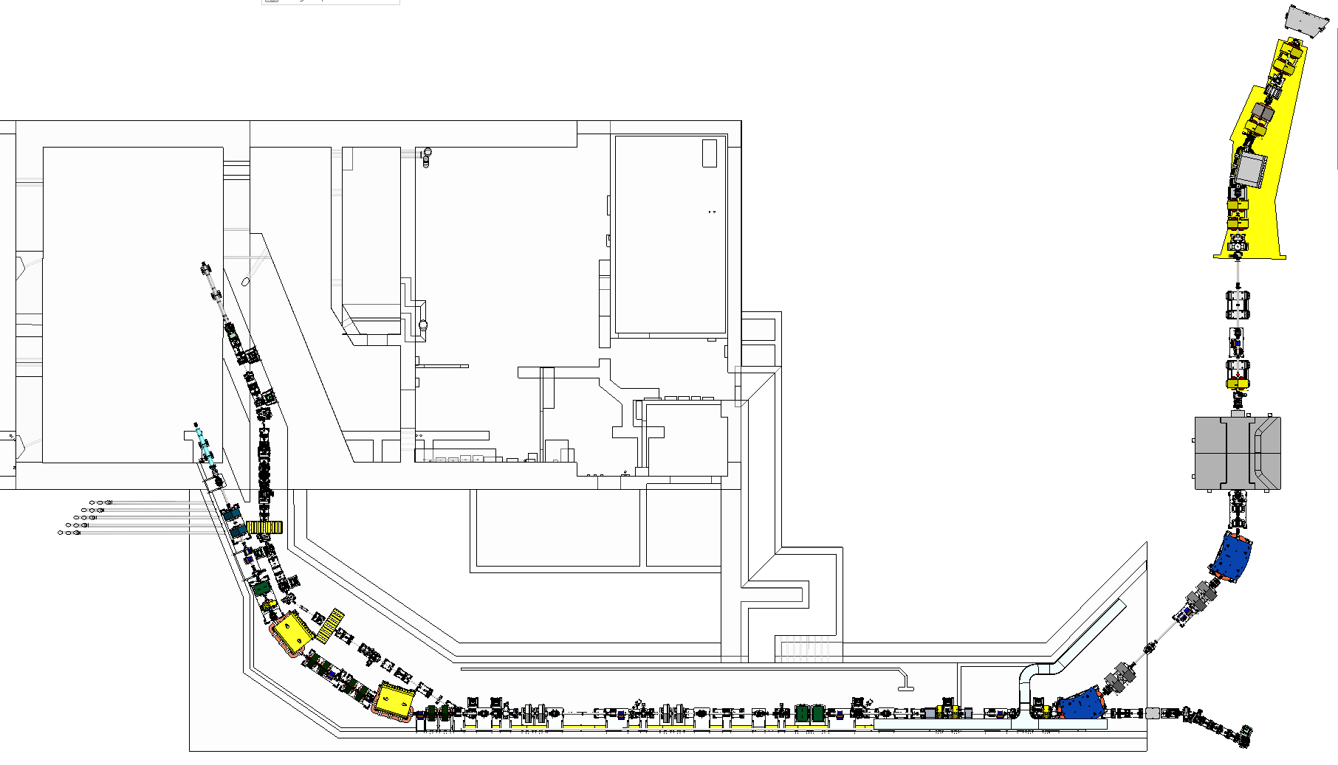
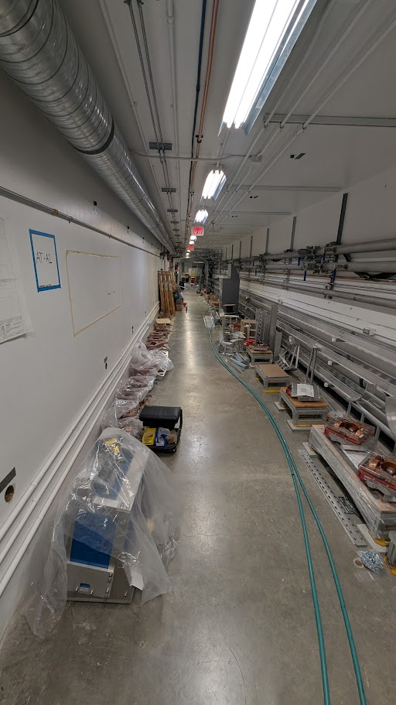
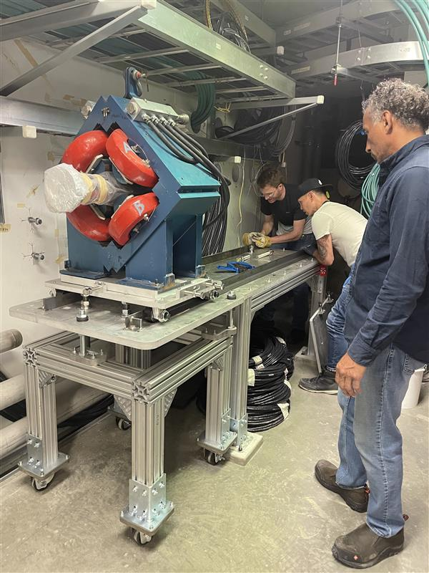
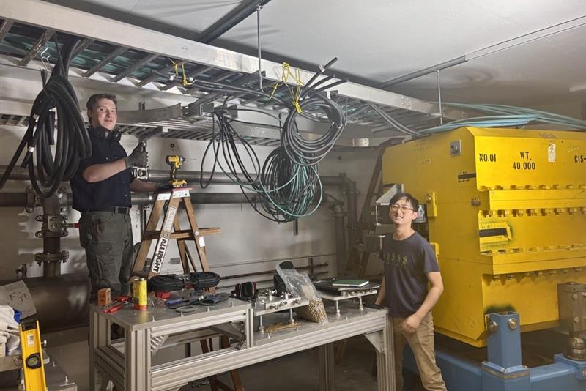
Driver beam line tunnel
One proton & one electron beam line, for transport, spaced by ~1 meter
Status: beam line & services (cables, piping) installation in progress
←NORTH
BL4N Vault region
AETE
BL4N Pharoah’s tomb region
APTW
BL4N Proton Cave region
BL4N & EHBT
Straight Tunnel section
BL4N & EHBT
North Tunnel bend section
EHBT dogleg region

Slide 12
User facilities
Cyclotron & beamlines (since ~1975)
TRIUMF accelerators for RIB
ISAC ISOL targets (since 2000s)
RIB lines
ARIEL ISOL targets (from 2027)
E-linac and beamline (since ~2013)
Radioactive Ion Beams
~10 user facilities
Nuclear & atomic physics
Material science
ISAC I and II halls
ARIEL
(ISOL)
APTW
AETE
ISAC
(ISOL)
ITW
ITE
BL2A
Target stations
30 MeV – 10 mA
e- LINAC
500 MeV – 400 μA
P+ Cyclotron

Slide 13
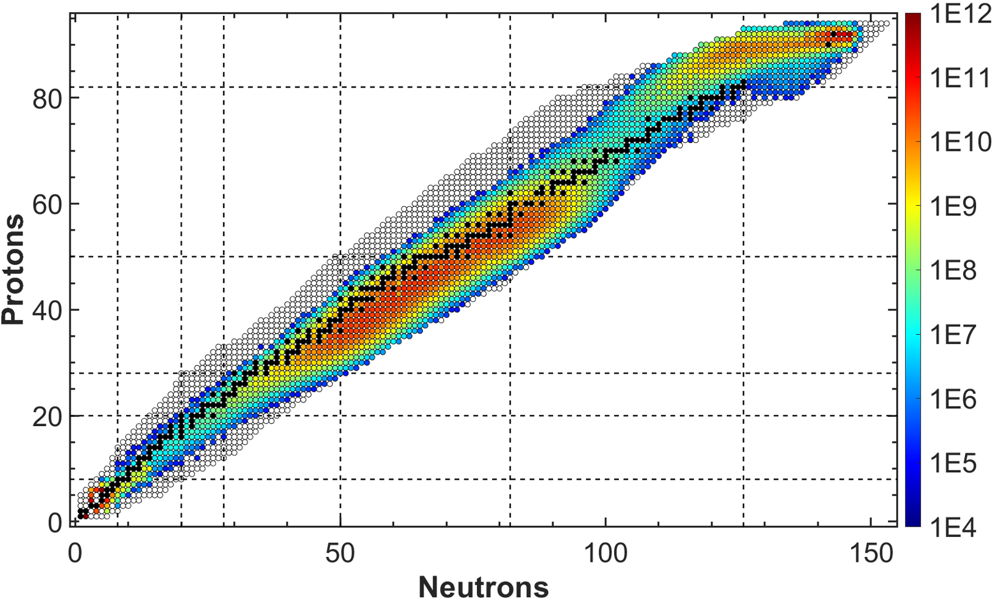
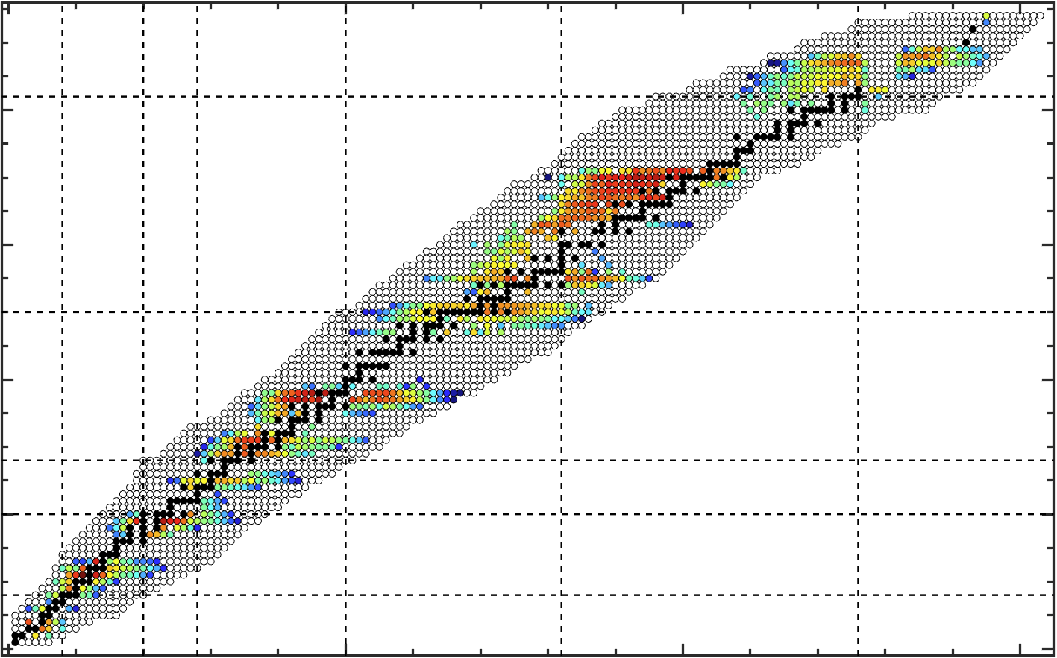
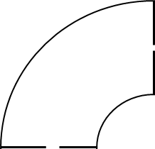


Evaporation
t>10⁻¹⁸
ISOL targets for RIB production
10 - 50 m
[pps]
Mass separator
*
Post-accelerator
Intra-nuclear cascade
t~10⁻²² s
n
p
500 MeV protons
μ,π,k
Nuclei: U, Ta
…
*
Low energy experiments
High energy experiments
Radioactive
Ion
Beam
Nuclei: U, Th, Ta, Si, C, O, Zr, Nb, Ni, Al, Ca
Fission
t>10⁻²⁰
18 m
Extraction electrode
Neutrals
Isobars only
HV 60 kV
2 kV
Ions
Post-accelerated
Ionizer
$$IRIB=I∙Ntarg∙σi∙ε$$
Target
T=2000 °C
$ε=εR∙εI∙$ $εMS∙$ $εT$
500 MeV – 100 μA
P+ Cyclotron
20 cm

Slide 14
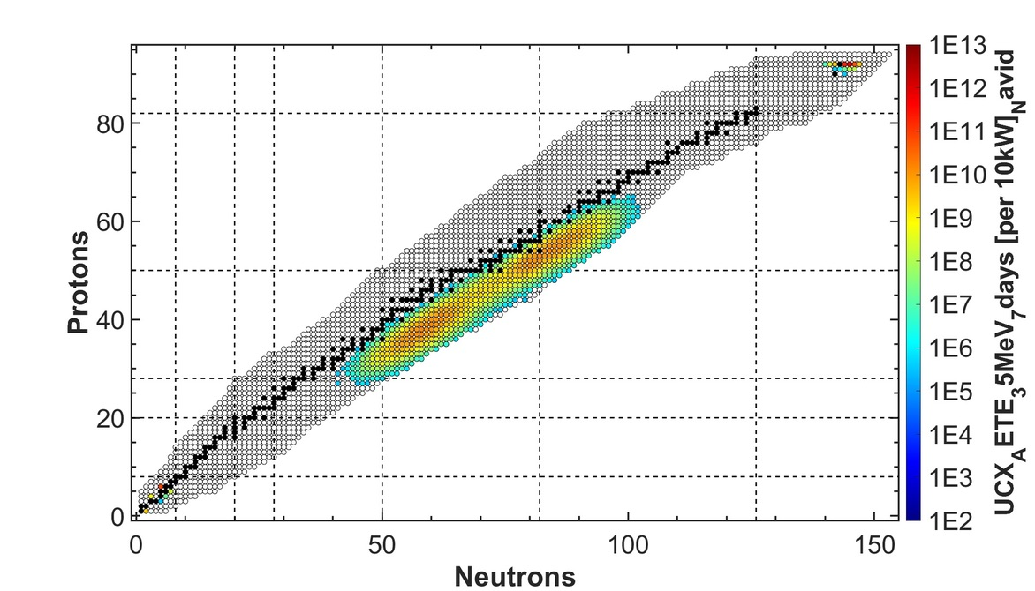
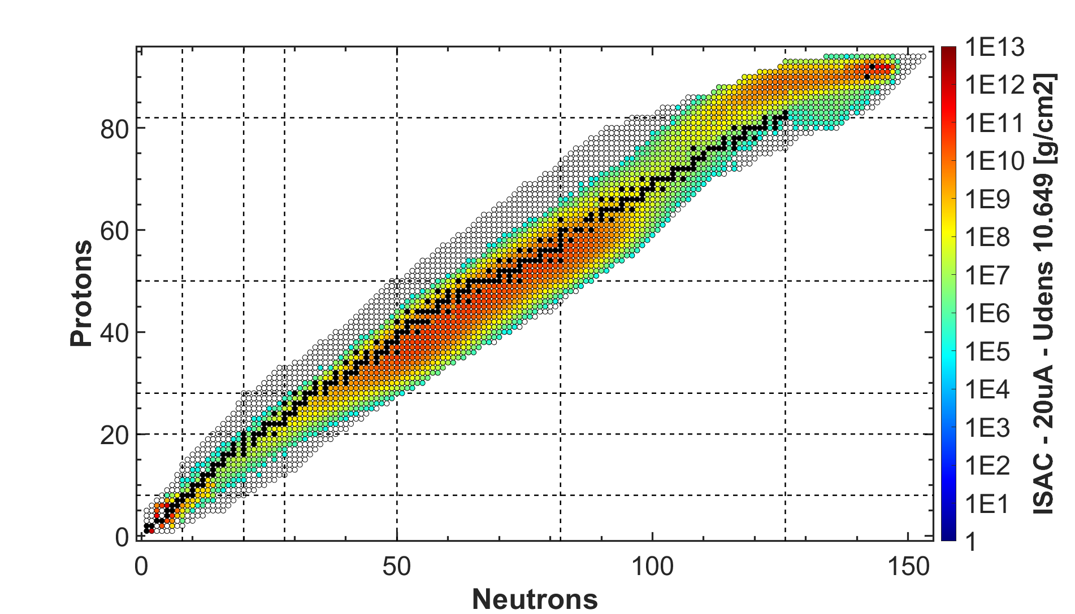
ARIEL’s objective: Three parallel RIBs
ISAC I and ISAC-II halls
[1/s]
[1/s]
x 2
γ
e-
Ion Source
30 MeV – 10 mA
e- LINAC
ARIEL - AETE
Converter
Target
ARIEL - APTW
ISAC
500 MeV – 100 μA
P+ Cyclotron

Slide 15

User facilities
Cyclotron & beamlines (since ~1975)
RIBs from electrons: How?
ISAC ISOL targets (since 2000s)
RIB lines
ARIEL ISOL targets (from 2027)
E-linac and beamline (since ~2013)
[1/s]
Radioactive Ion Beams
~10 user facilities
Nuclear & atomic physics
Material science
Medical isotopes
ISAC I and II halls
ISOL
(ARIEL)
TR: 13
APTW
TR: 30-1
AETE
TR: 30-2
Current ISAC Future APTW
ISOL
(ISAC)
CP: 42
120 MeV – 10 nA
Electronics irradiations
Proton FLASH
Ocular melanoma treatments (-2019)
ITW
ITE
PIF
TR: 24
[1/s]
Neutron Irradiations
BL2A
NIF
γ
BL2C
e-
Ion Source
²²⁵Ac et al. production
IPF
30 MeV – 10 mA
e- LINAC
Future AETE
500 MeV – 400 μA
P+ Cyclotron
BL1A
Converter
Target

Slide 16
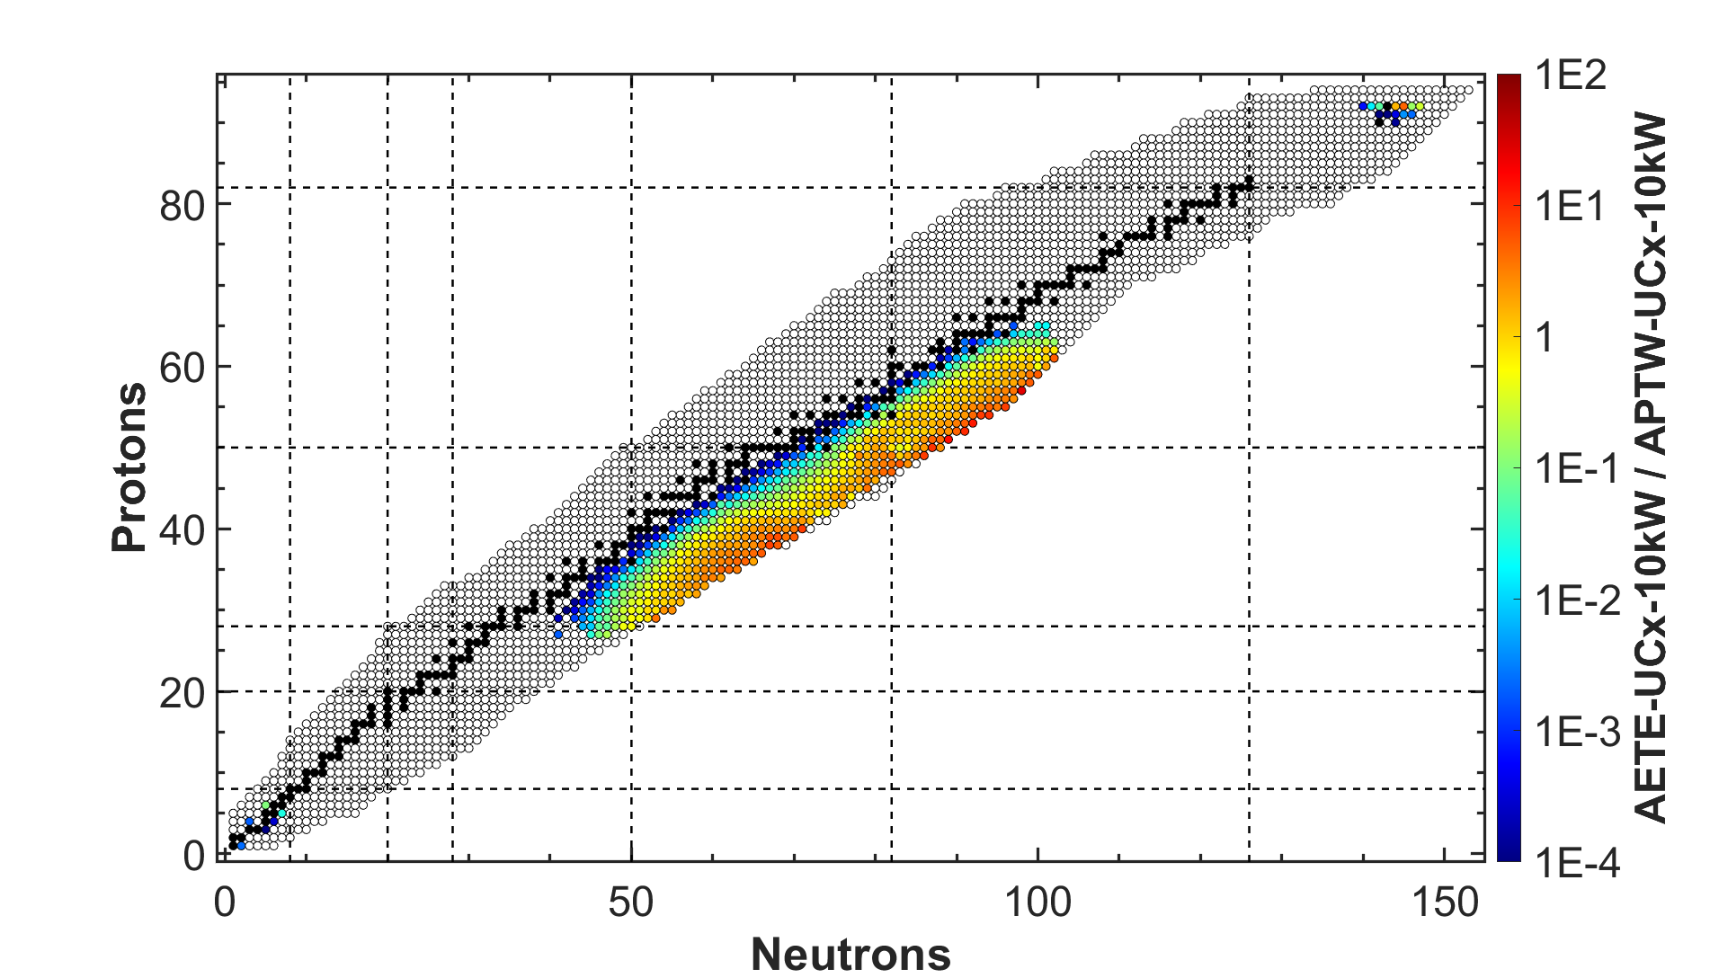
User facilities
Cyclotron & beamlines (since ~1975)
RIBs from electrons: How?
ISAC ISOL targets (since 2000s)
RIB lines
ARIEL ISOL targets (from 2027)
E-linac and beamline (since ~2013)
[1/s]
Radioactive Ion Beams
~10 user facilities
Nuclear & atomic physics
Material science
Medical isotopes
ISAC I and II halls
ISOL
(ARIEL)
TR: 13
APTW
TR: 30-1
AETE
TR: 30-2
Current ISAC Future APTW
ISOL
(ISAC)
CP: 42
120 MeV – 10 nA
Electronics irradiations
Proton FLASH
Ocular melanoma treatments (-2019)
ITW
ITE
PIF
TR: 24
[1/s]
Neutron Irradiations
BL2A
NIF
γ
e-
BL2C
Muons for
material science
²²⁵Ac et al. production
T1
T2
Ion Source
IPF
30 MeV – 10 mA
e- LINAC
Future AETE
500 MeV – 400 μA
P+ Cyclotron
Converter
Target

Slide 17
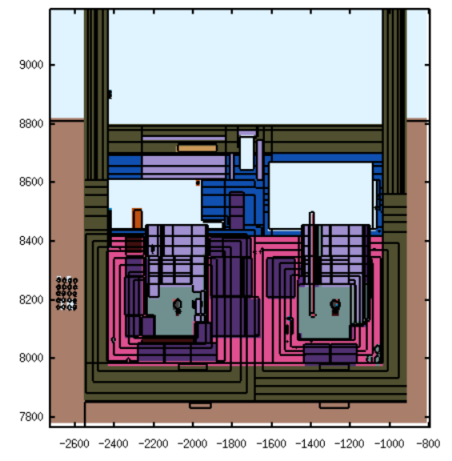
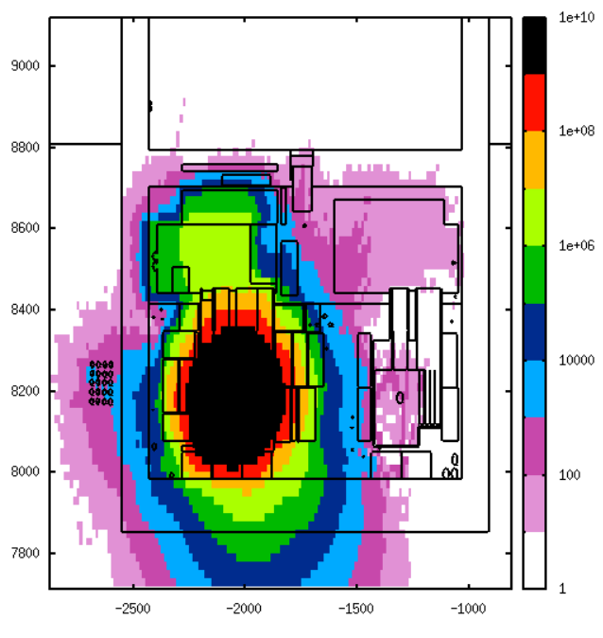

Compact, modular shielding approach – similar to ISAC
P⁺ beam on APTW at 100 µA
[µSv/h]
~2m tall
Steel + Concrete
~2.5m tall
Steel “plugs”
APTW target
AETE target

Slide 18

ISAC target lifetime and sequence
Three weeks irradiation
One week cooldown
Hands-on service disconnection
Move module to Hot Cell
Remote target exchange in Hot Cell
Move module to irradiation station
Hands-on service connection
Few days pump-down
Three weeks irradiation
ISAC
Irradiation station
ISAC
Hot Cell
Service connections
Shielding
Shielding
Approx. two-three weeks without beam on one station
RIB
ISAC
ITW
ITE
Front end
+
Target
Front end
+
Target
Vacuum volume

Slide 19

ARIEL target lifetime and sequence
Three weeks irradiation
Few hours of cooldown
Remote vacuum disconnection
Move target to spent target vault
Move new target to irradiation station
Remote vacuum connection
Few hours pump-down
Three weeks irradiation
ARIEL
Irradiation station
Target hall
Service connections
Shielding
Approx. two days without beam on one station
Spent target vault
Front end
+
Target
(New) Target
Target
Vacuum volume

Slide 20
ISAC vs ARIEL target exchange
ISAC
ARIEL
Three weeks irradiation
One week cooldown
Hands-on service disconnection
Move module to Hot Cell
Remote target exchange in Hot Cell
Move module to irradiation station
Hands-on service connection
Few days pump-down
Three weeks irradiation
Three weeks irradiation
Few hours of cooldown
Remote vacuum disconnection
Move target to spent target vault
Move new target to irradiation station
Remote vacuum connection
Few hours pump-down
Three weeks irradiation
Approx. two-three weeks without beam on one station
RIBs
Approx. two days without beam on one station
APTW
AETE
ISAC
ITW
ITE

Slide 21
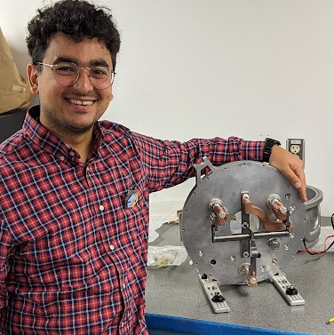
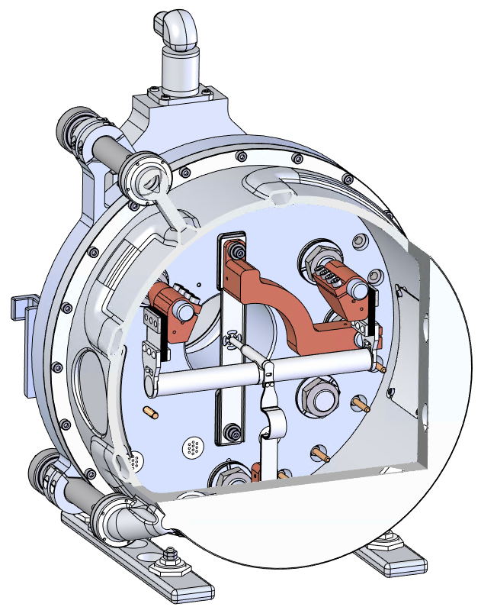
Hermetic Target Vessel (HTV) capabilities
APTW HTV
ISOLDE-style, high-power target vessel
Improved DC current delivery
  Increasing temperature
  Thicker target heaters to reduce likelihood of breaking
  Bigger diameters possible
  Compatible with beam rastering (rotating)
Mass markers for offline/pre-delivery tuning
Gas injection
  For plasma ion source (FEBIAD)
  To support radioactive molecule production
All-metal sealing solution is possible
50 kW protons @ 500 MeV
Gate valve
HTV
back plate
HTV cup
Gas injection
P⁺ beam window
Mass markers conductors
Feet for landing
Ion source
Target

Slide 22
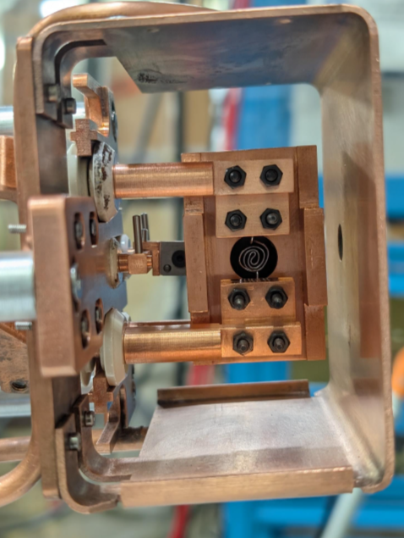
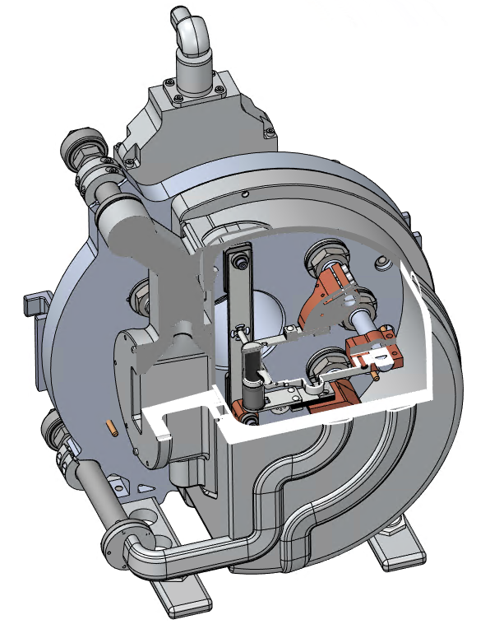
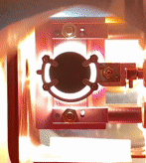
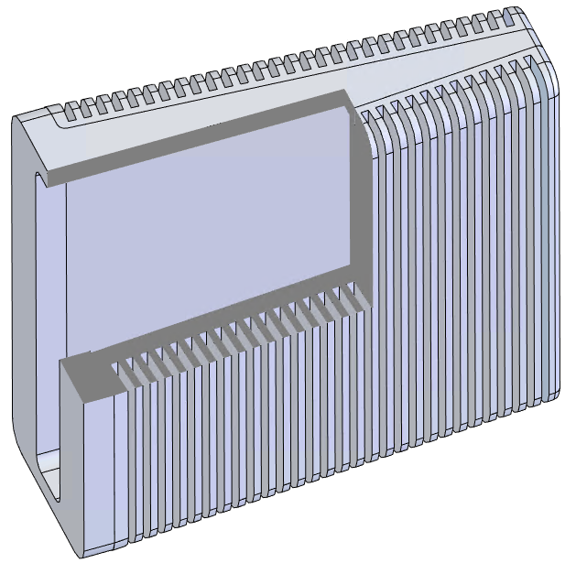
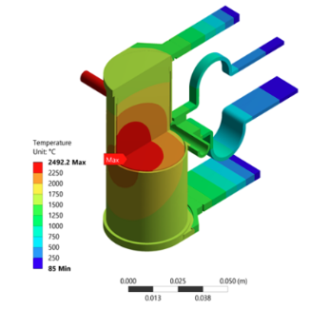
AETE HTV, target and converter
100 kW electrons @ 30 MeV
AETE HTV
AETE converter
e-
e-
γ
e-
Ion Source
Converter
Target
25 kW e⁻ beam power

Slide 23
Medical facility for ²²⁵Ac production
ISOL vessel

Slide 24
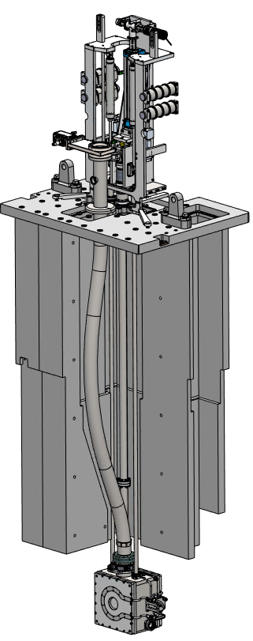
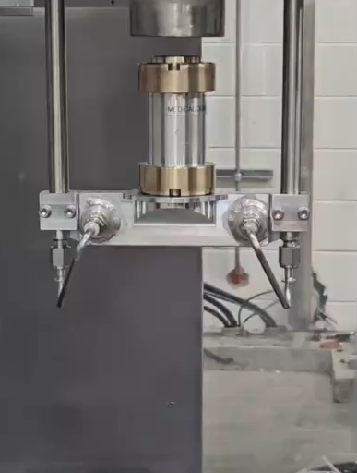
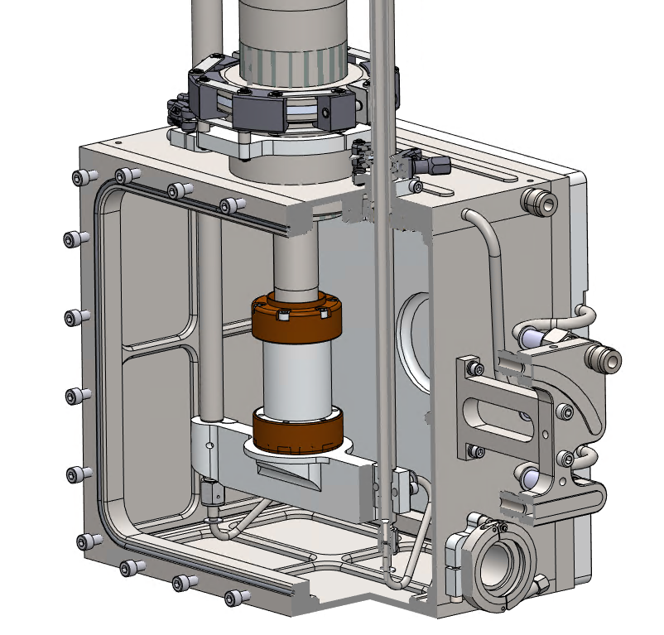
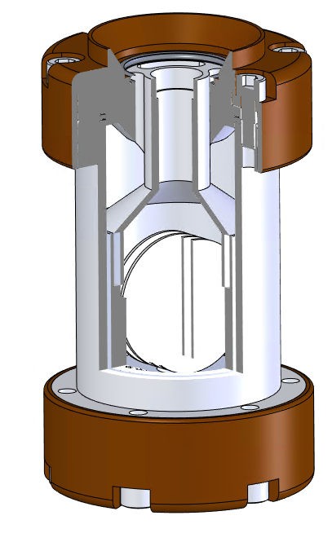
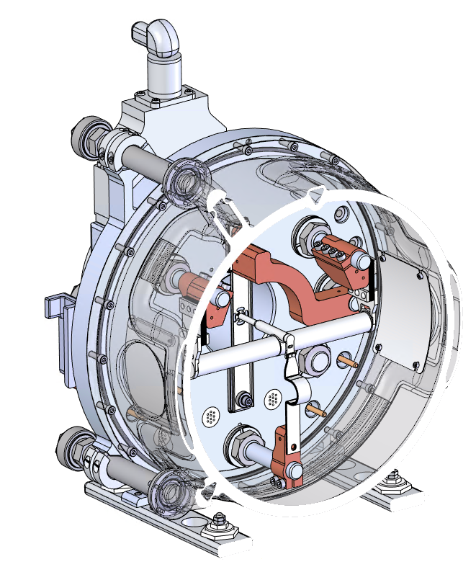
Medical facility for ²²⁵Ac production
Hundreds of co-produced isotopes including
²²⁵Ra, ²²⁵Ac, ²²⁴Ra, ²²³Ra, ²¹³Bi, ²¹²Pb, ²¹²Bi
Few tens of GBq of ²²⁵Ac produced per week, 10d after EoB
Pneumatically transferred into hot cell for extraction
Th
pellets
APTW medical rabbit and enclosure
Medical module
ISOL vessel

Slide 25
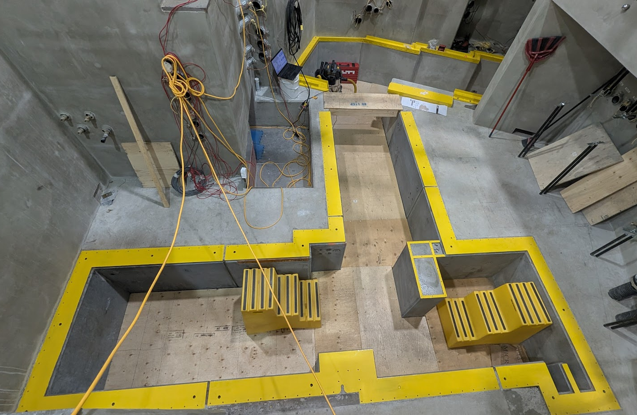
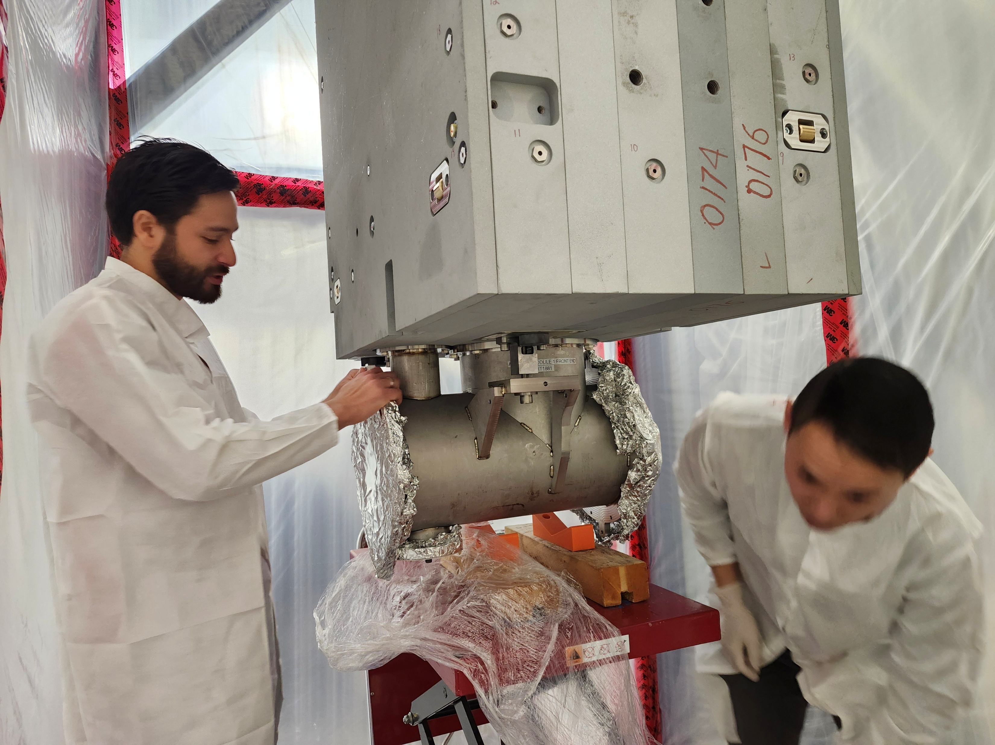
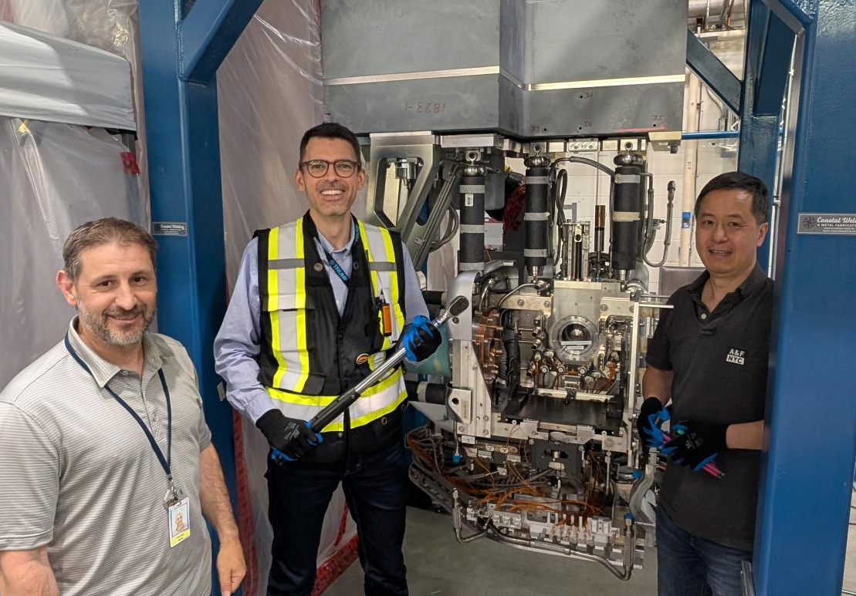
Timeline
Today
2026
2027
2028
2029
Q1
Q2
Q3
Q4
Q1
Q2
Q3
Q4
Q1
Q2
Q3
Q4
Q1
Q2
Target hall infrastructure ready to receive modules
Driver beam lines installed
Proton station ready to receive modules
Controls and safety systems installed
Ready to start commissioning with beam
Ready to transition to operations
Electron station ready to receive modules
On track to deliver 5000 RIB-hours in 1 year
LS 26

Slide 26
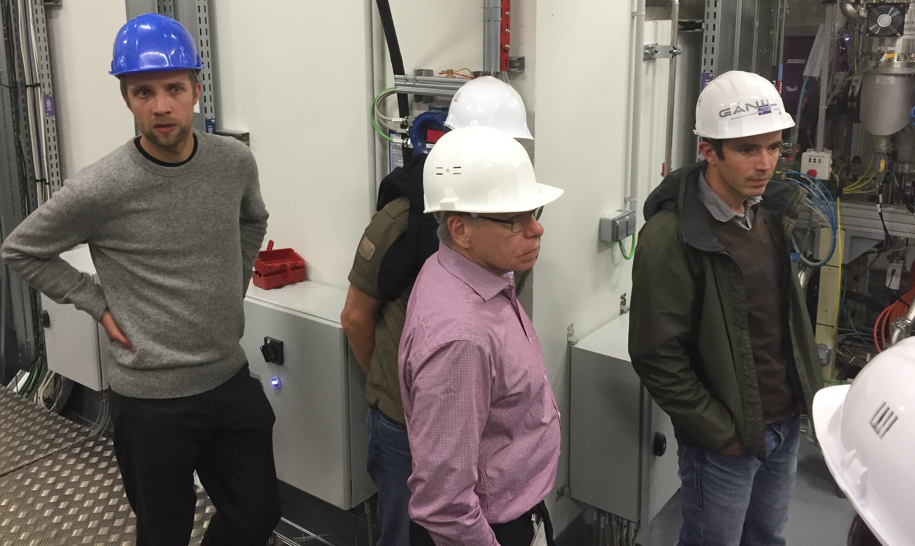
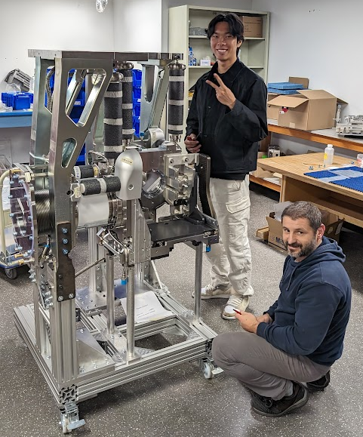



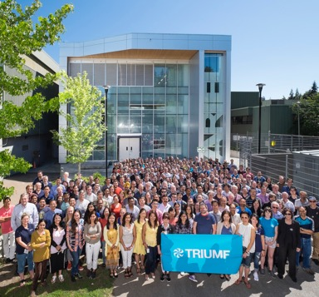
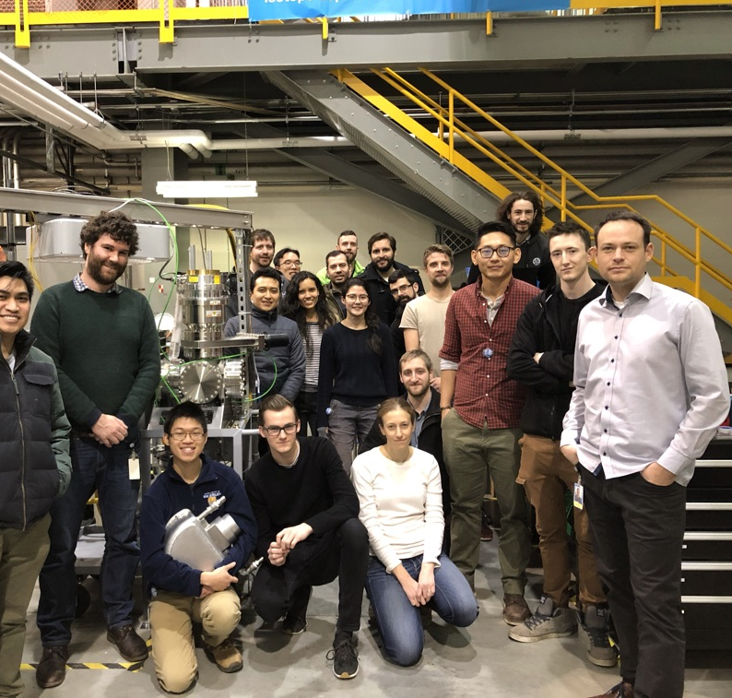
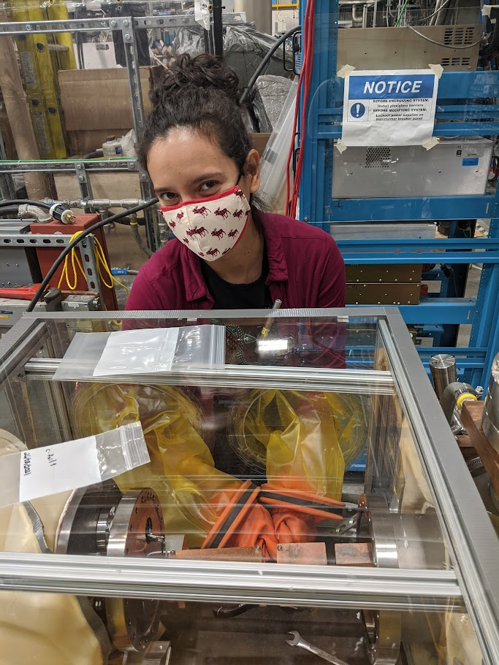
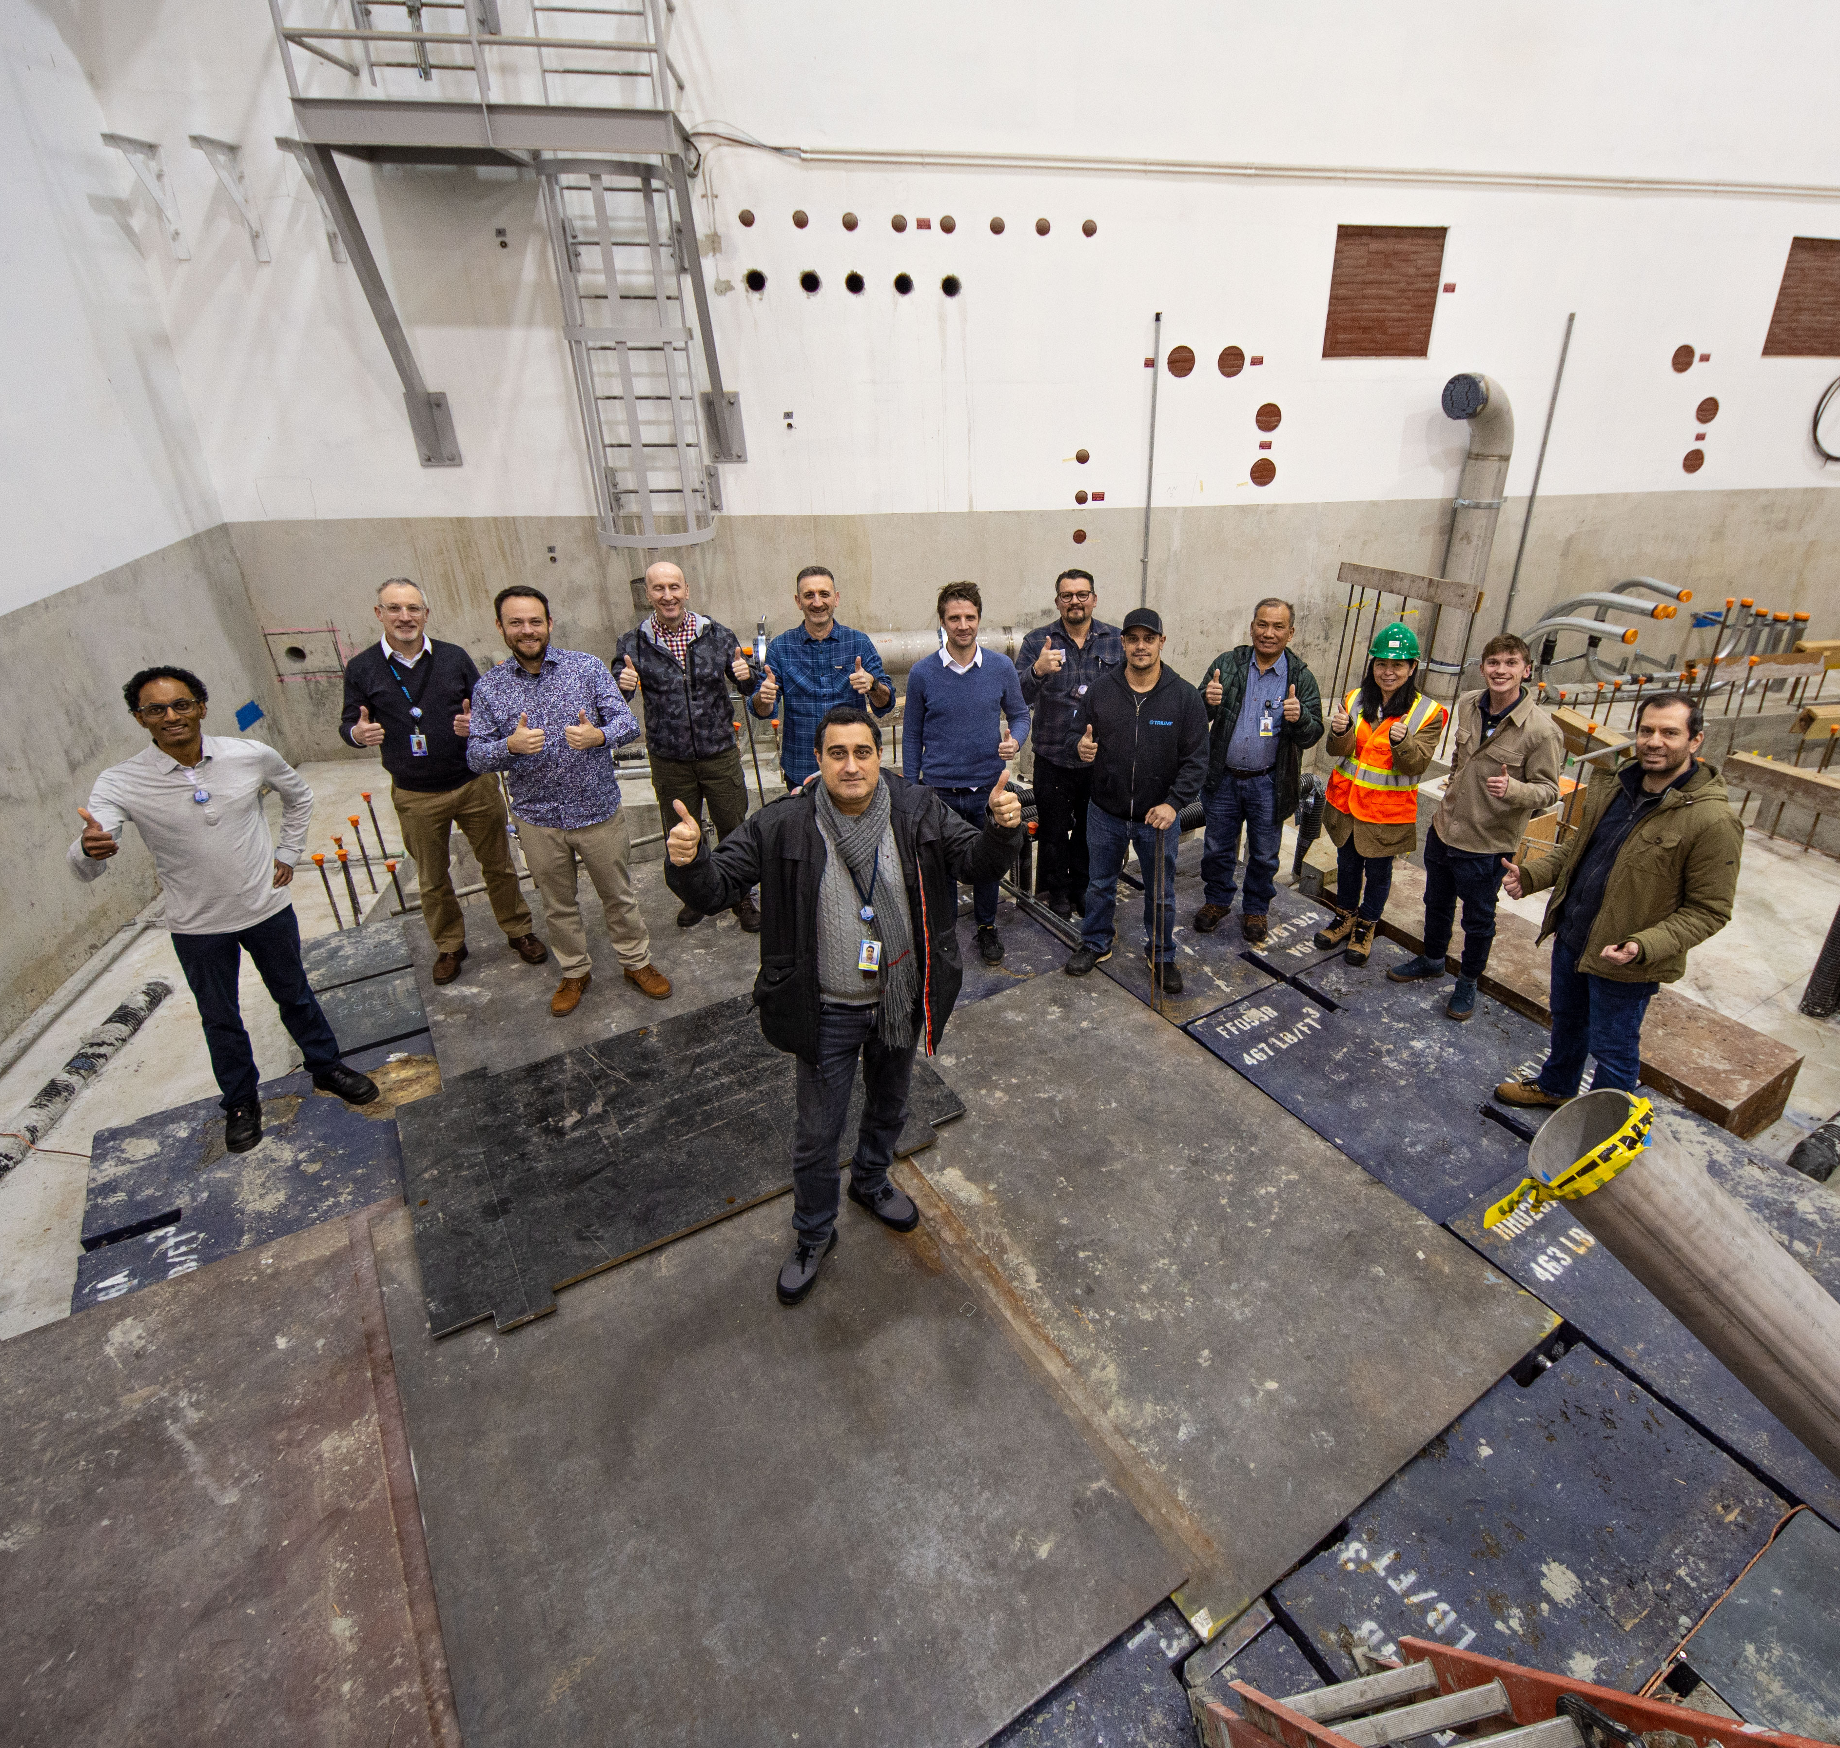
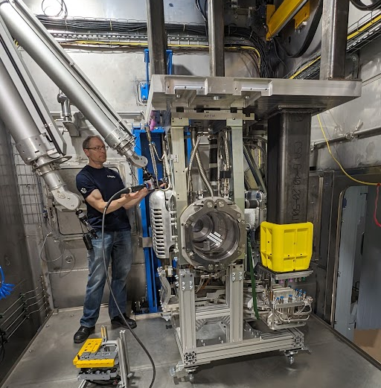
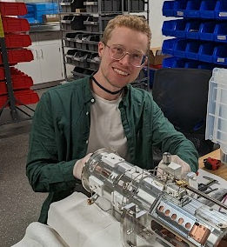
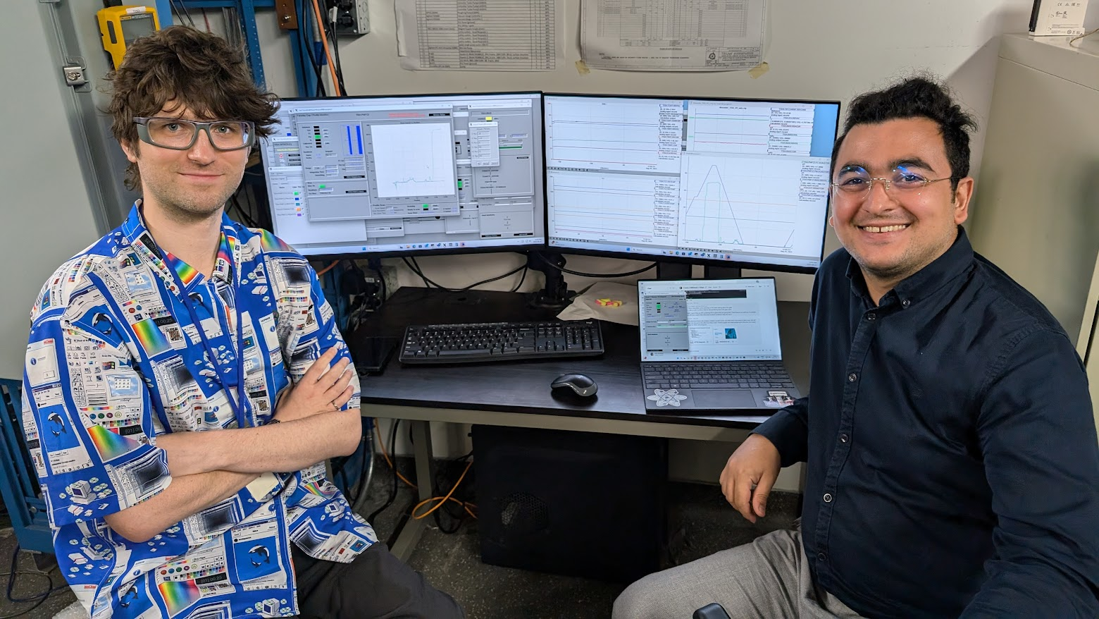
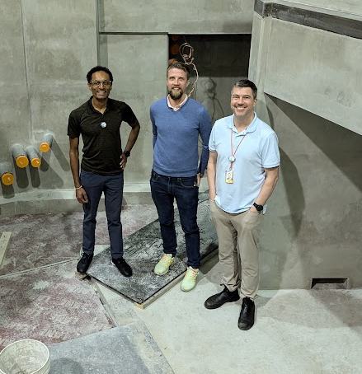
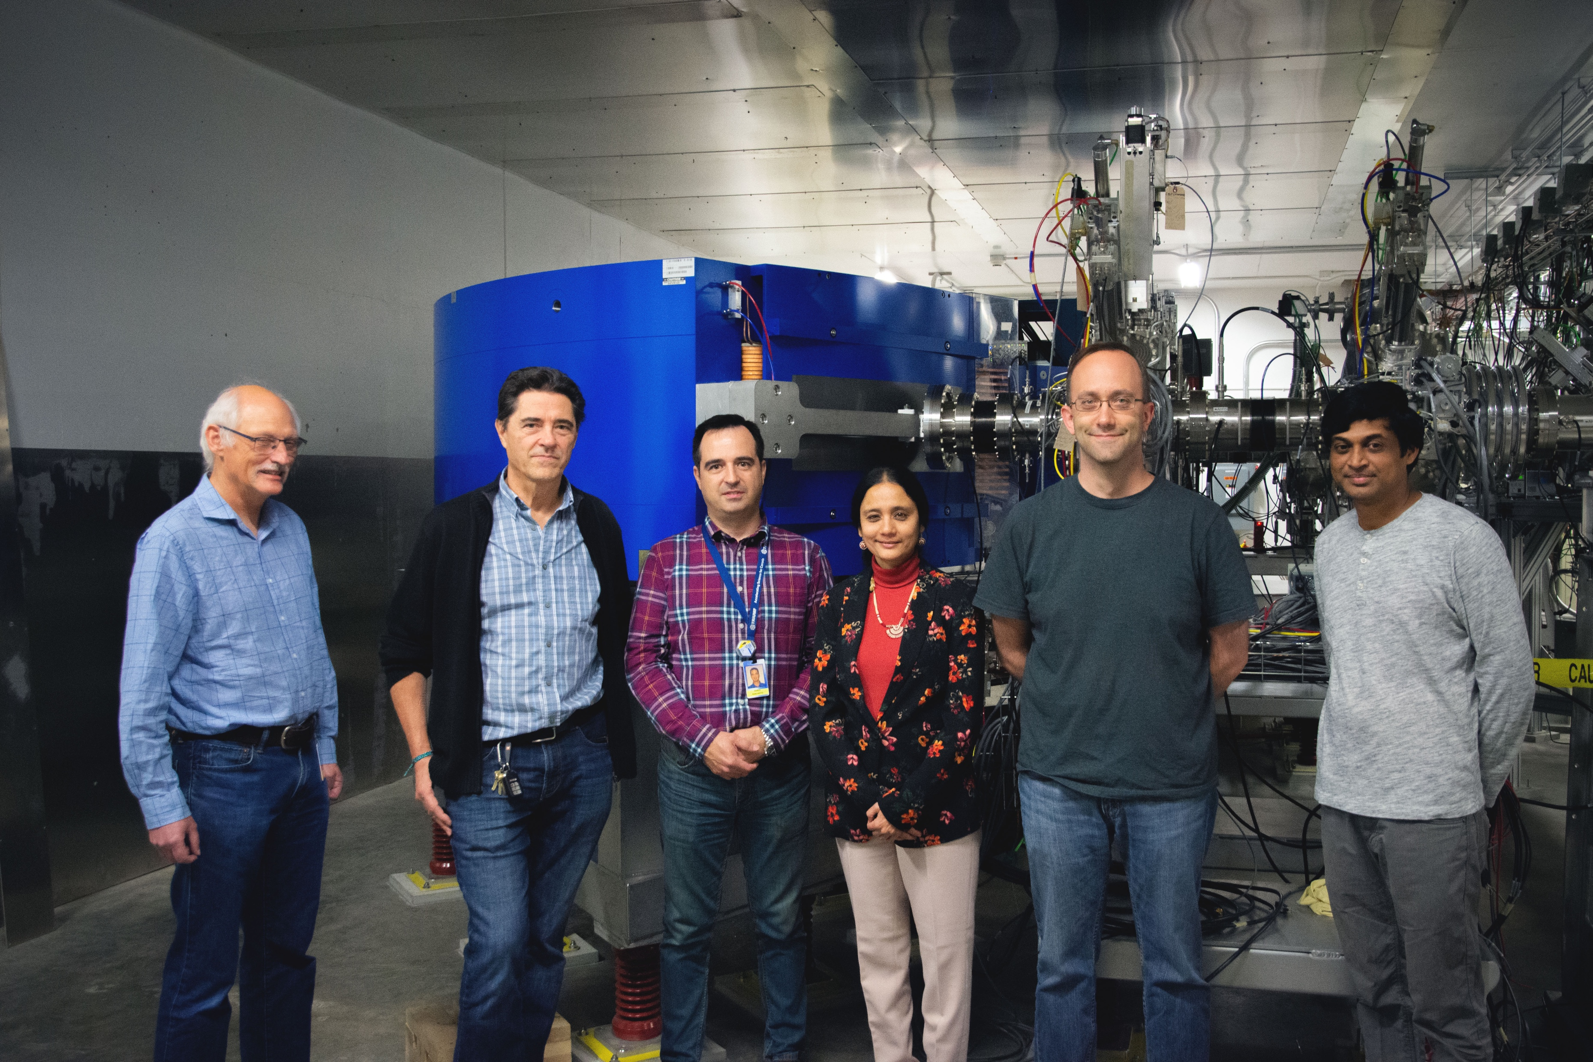





Several contributors through the years

Slide 27
Backup

Slide 28
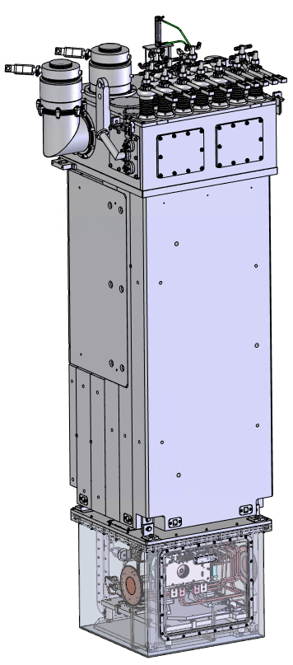
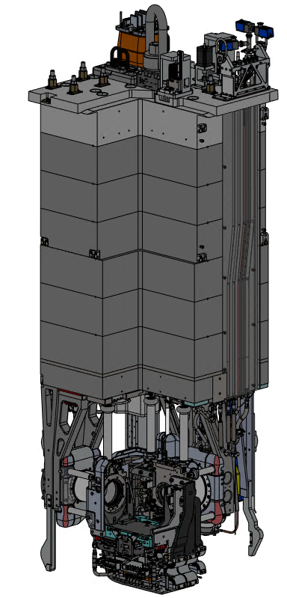
ISAC vs ARIEL target module – services
Service connections
Service connections
Shielding
Shielding
Front end
+
Target
Front end
+
Target
Vacuum volume
Vacuum volume
All services routed within tall vacuum volume
All services routed in GN₂

Slide 29
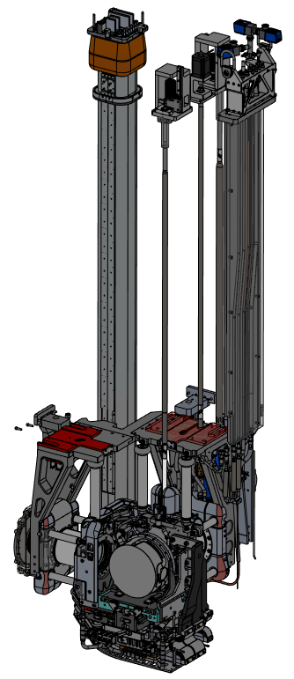
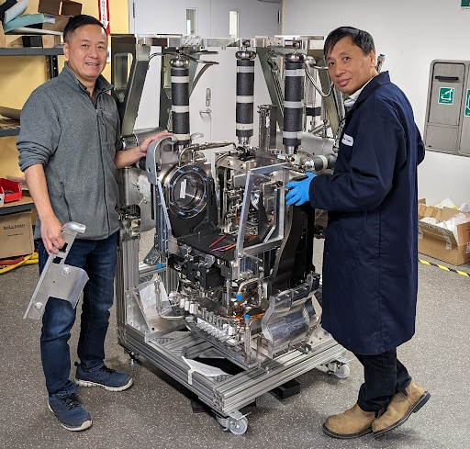
ARIEL target module – services
Ground services: roughing line, water cooling
Actuation: GND electrode movement, Gate Valves (x2)
High Voltage Feed Through (HVFT)
Front End:
  Beam lines connections
  Structural supports (HV breaks)
  “Last meter” service delivery
  Pneumatic target vessel engagement mechanism
Hermetic Target Vessel (HTV)

Slide 30
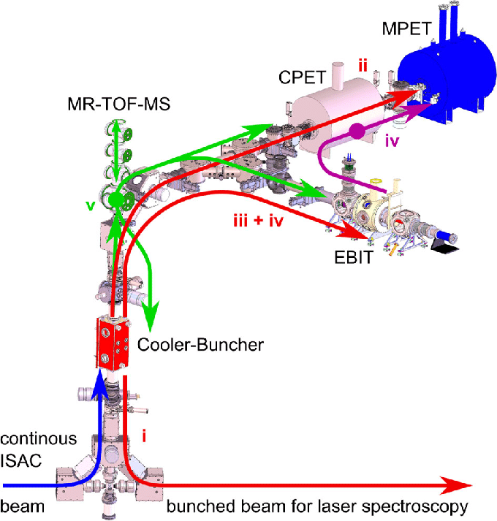
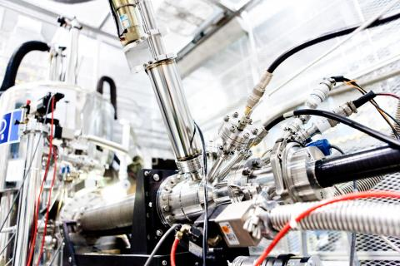


Experimental hall – available hardware
Spectroscopy γ, β, n (GRIFFIN and DESCANT, LE)
Precision mass measurements (TITAN, LE)
β-NMR (LE)
Atomic laser trap (TRINAT, LE)
Recoil separator (DRAGON, ME)
Recoil detector (TUDA, ME)
Radiochemistry (ASPIRE, ME)
Gamma-ray spectrometer (TIGRESS, HE)
Recoil separator (EMMA, HE)
Recoil detector (IRIS, HE)
β-NMR
TITAN
TIGRESS + EMMA
GRIFFIN

Slide 31



HVFT
Two concentric Al sheaths
  • inner held at HV
  • outer at GND
Interior services held at HV: design voltage 75kV
  Bus bars Al 6101 T64 (biased up to 3kV): 1000A, 2400A
  Mass Markers: 6 (3 pairs) biased up to 3kV, and 80A
  Water conduits: 4
  Gas pipes: 2
  Air lines: 6
    Piston RIB in
    Piston RIB out
    Piston converter in
    Piston converter out
    RIB pillow inflation
    Driver pillow inflation
  Spare lines: 5
  Vacuum lines (spares): 2
    RIB differential pumping
    Converter differential pumping
  Services Route: 1
Filled with S2 glass fibre reinforced CTD-403 resin (green/orange)

Slide 32



Front End – front and back

Slide 33




ISAC – The Highest Power ISOL Facility in the World
Shielding
Containment Box
ISAC target module moved by remote handling crane
Target module transport to target station
ISAC target module in hot cell

Slide 34


ARIEL Hermetic Target Vessel - APTW
APTW HTV
AETE HTV
50 kW protons @ 500 MeV
100 kW electrons @ 30 MeV
e-
γ
e-
Ion Source
Thin Ta layer (converter)
Thick Al body (e- absorption and heat removal fins)
Converter
Target

Slide 35


ISAC Radioisotope Beams Since 1998
Target ion source service connections
target container ~2000 °C
(Ø 20 mm, 60 cm³)
Water-cooled heat
shields
500 MeV
protons
ion sources:
surface
resonant lasers
FEBIAD
IG-LIS
target materials:
UC_{x}
UO₂
ThO
Nb
Ta
TaC
NiO
ZrC
TiC
SiC
  → Jens Lassen,
  Mon, oral
  → Fernando Maldonado,
  PS-1-19
  → Corina Andreoiu, PS-1-3

Slide 36


ARIEL Targetry: Green-Field ISOL Technology
ISAC inspired:
Module, crane, hot-cell-based handling paradigm
Compact shielding with radiation hard components at beam level and sensitive equipment on top of shielding
Externally inspired:
Hermetic target unit
Flexible and efficient direct target exchange
New:
GGy – level radiation hard technology
Consistent remote repair and decommissioning
Reduced material activation
Superior power management
Improved HV design and reliability
Prototype tests completed

Slide 37


Electron-Driven ISOL Power Management
Target
Converter
_{e}-
γ
Ion source
Separator
++
++
++
++++
++
A
++
A
++
A
A
A
A
A
++
A
magnet
++
Radioactive ion beams
A
++
A
++
A
++
A
++
γ
A
60 kV Target and ion source
2000 ºC
e⁻ LINAC
e⁻ 30 MeV, 100 kW
→ Thinner target or change of orientation
→ ISAC target cooling fins not viable

Slide 38

ARIEL Targetry Systems
Remote-controlled crane
Hot cell facilities
Symbiotic medical target in APTW beam dump
module storage
AETE
APTW
spent target storage
ASTM
drivers beam tunnel
RIB
RIB
2000 t of steel and concrete
Modular RH high-power infrastructure

Slide 39

RIB path at target elevation (underground)
Destinations
APTW
AETE

Slide 40

RIB path in CANREB and ISAC-I (ground floor)

Slide 41

https://50stories.triumf.ca

Slide 42

Proven Modular Design Paradigm for Target Station

