Slide 1

Chasing a Rare Higgs Decay: From the LHC to the High Luminosity LHC using Neural Nets
Sam Moir supervised by Thomas Koffas
CAP Congress - 2026

Slide 2
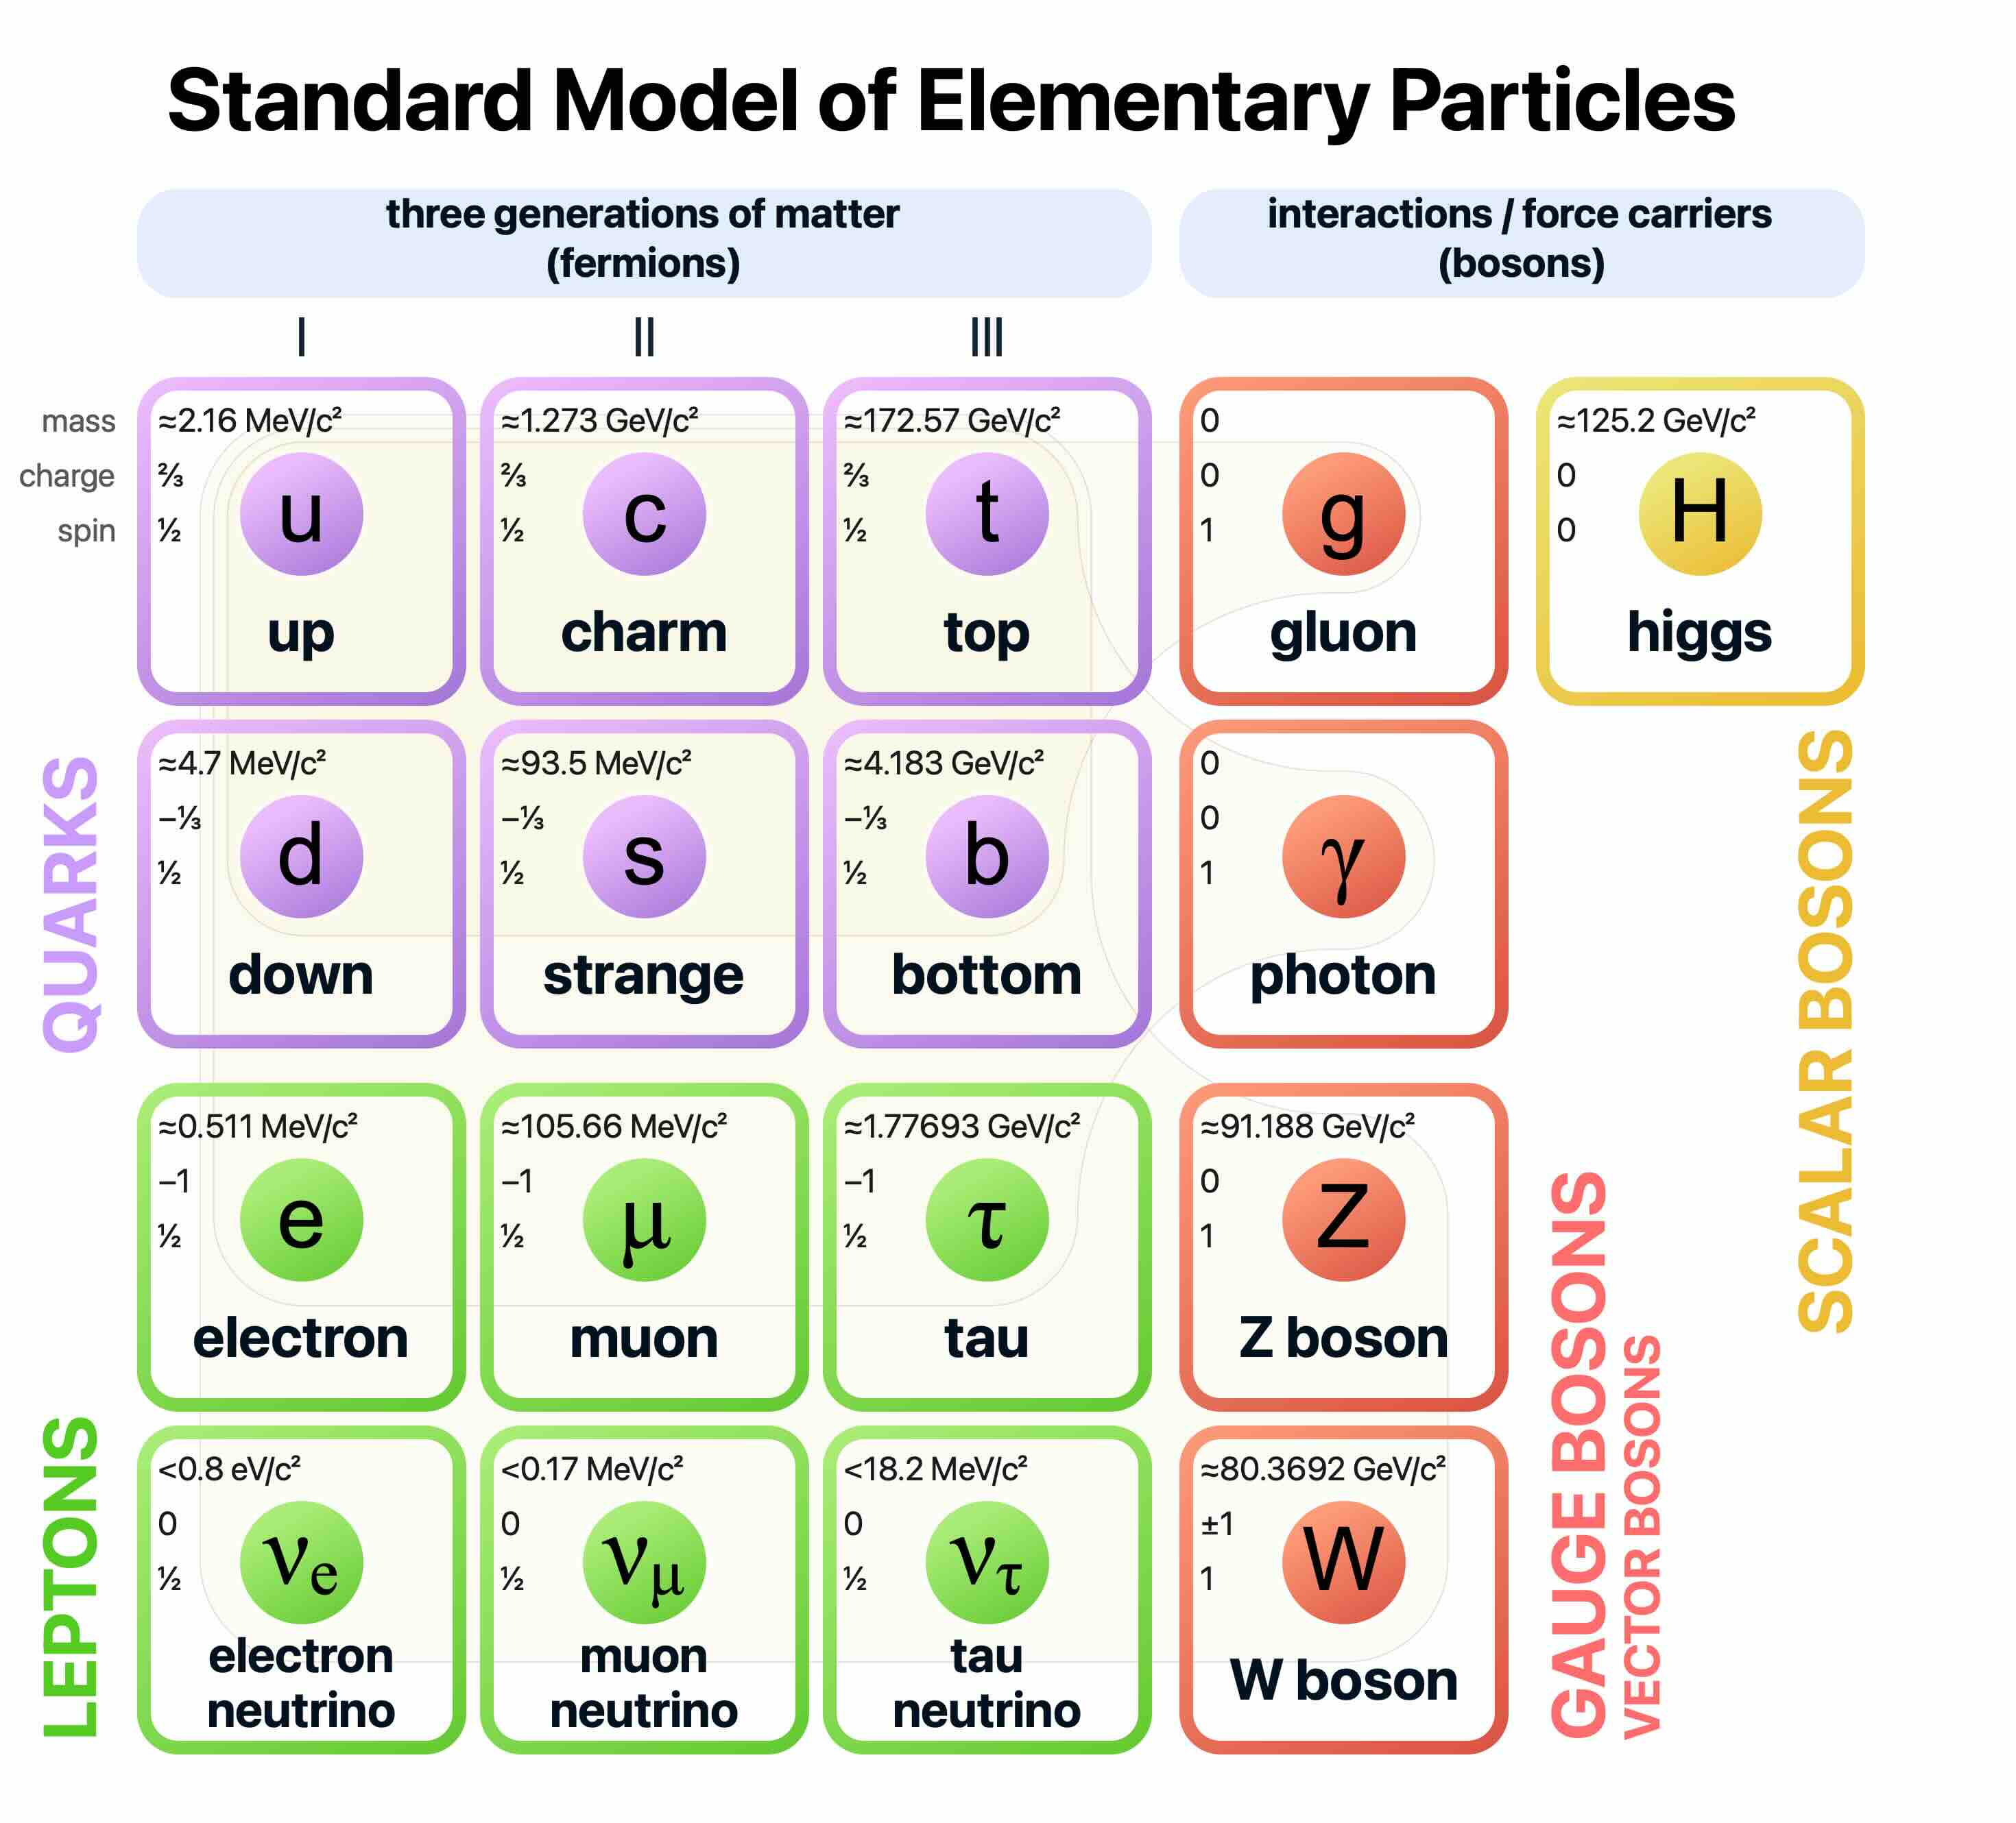
The Standard Model
Successful
  High agreement with experiment
Descriptive
  Explains 3/4 fundamental forces and all matter
By Cush via Wikimedia.
Notes:
Shorten Time here

Slide 3
The Standard Model
Successful
  High agreement with experiment
Descriptive
  Explains 3/4 fundamental forces and all matter
Incomplete
  Gravity
  Dark matter
By Cush via Wikimedia.
Notes:
Shorten Time here

Slide 4
The Standard Model
Successful
  High agreement with experiment
Descriptive
  Explains 3/4 fundamental forces and all matter
Incomplete
  Gravity
  Dark matter
Two angles:
  Direct searches
  Precision measurements
By Cush via Wikimedia.
Notes:
Shorten Time here

Slide 5
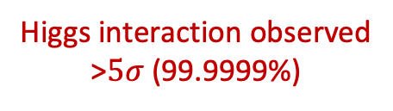
The Standard Model
Successful
  High agreement with experiment
Descriptive
  Explains 3/4 fundamental forces and all matter
Incomplete
  Gravity
  Dark matter
Two angles:
  Direct searches
  Precision measurements (Higgs couplings!)
By Cush via Wikimedia.
Higgs interaction observed
>$5σ$ (99.9999%)
Notes:
Shorten Time here

Slide 6
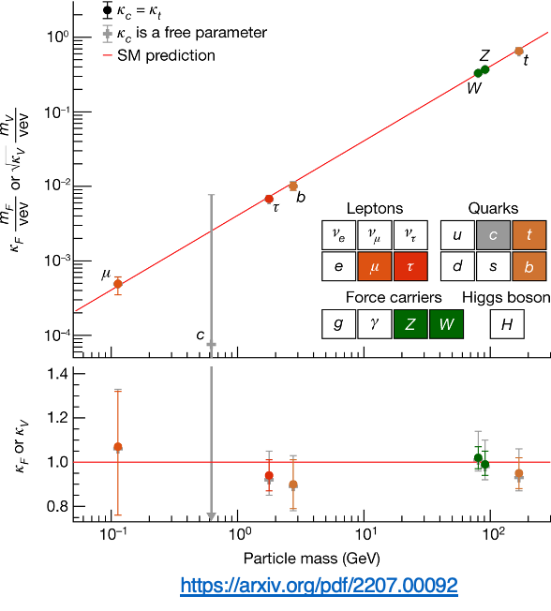
Higgs boson
Mass dictates Higgs coupling
  Gen II particles couple less strongly than Gen III
Confirming Higgs decaying to two muons would be a big discovery!
  Charm quark is experimentally challenging
Notes:
Shorten Time here

Slide 7
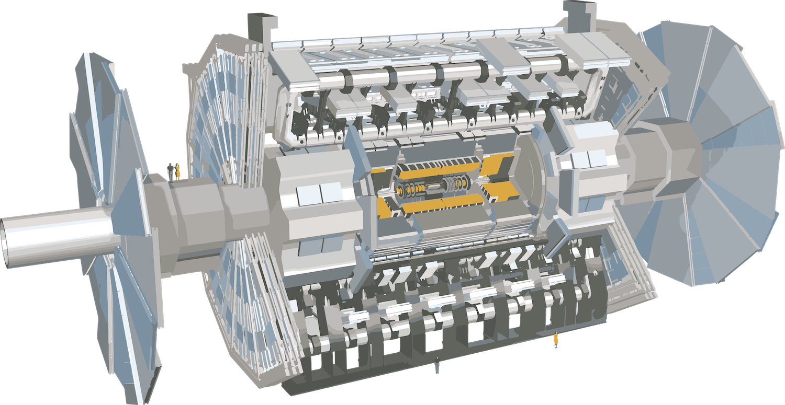

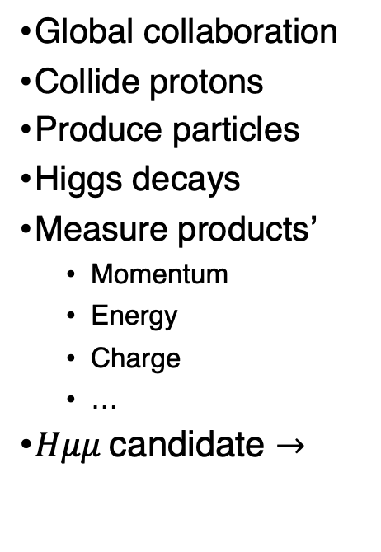



LHC and ATLAS
Global collaboration
Collide protons
Produce particles
Higgs decays
Measure products’
  Momentum
  Energy
  Charge
  …
$Hμμ$ candidate $→$
$$μ$$
$$j$$
$$μ$$
$$j$$
Notes:
Shorten Time here (should be 6 mins max by end here)

Slide 8
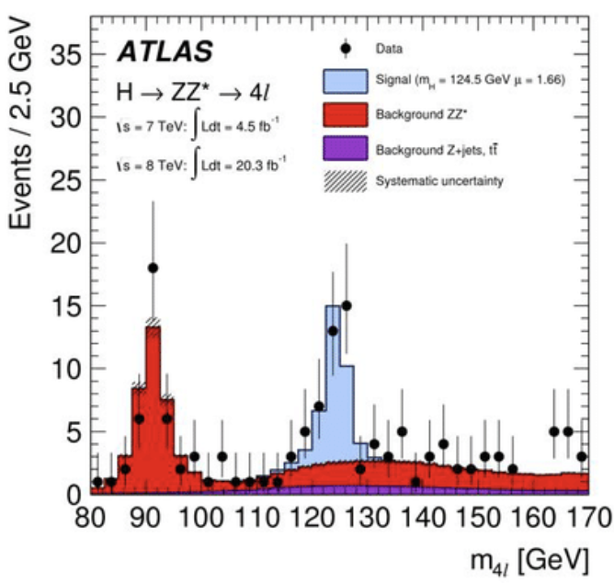
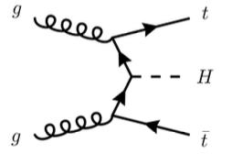



Reconstructing a $H→μμ$ decay
DOI: 10.1088/1742-6596/706/2/022002
Get resonance energy from muons
Sharp peak around Higgs mass (125 GeV) indicates Higgs presence
Jet info helps reconstruct full event
Reconstructed
From
protons
In the
detector
b-jets
light jets
muons
$$t\overline{t}H→μμ$$
Notes:
Try to walk through ”without H, we would only see red. with H, we see peak at blue.”

Slide 9
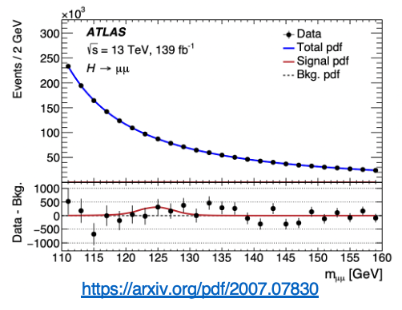
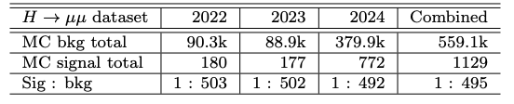
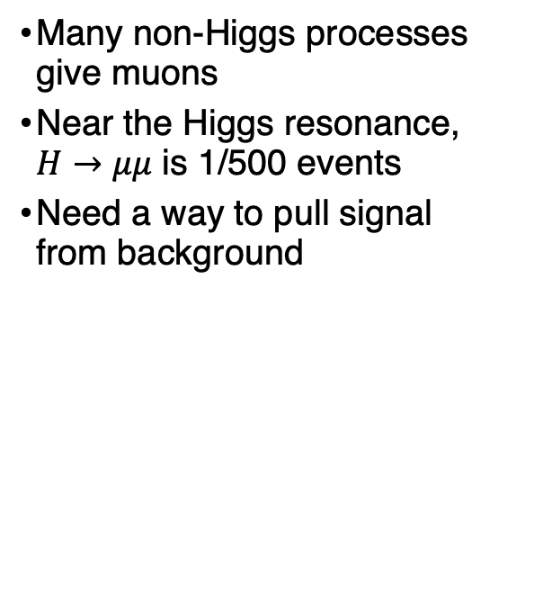
The background issue
Many non-Higgs processes give muons
Near the Higgs resonance, $H→μμ$ is 1/500 events
Need a way to pull signal from background
Notes:
Highlight multiplier on y-axis while speaking

Slide 10

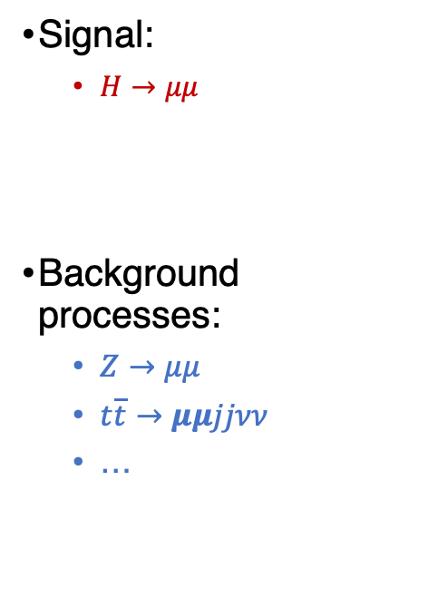
Extracting using distributions
Signal:
  $H→μμ$
Background processes:
  $Z→μμ$
  $t\overline{t}→μμjjνν$
  …
Events
Signal
$$m_{μμ}$$
Events
Background
$$m_{μμ}$$

Slide 11


Signal Extraction
Blind signal window
Fit to sidebands
Unblind & subtract fit
Profit
Events $→$
180
90k
Invariant mass $→$
= background
= signal

Slide 12
Signal Extraction
Blind signal window
Fit to sidebands
Unblind & subtract fit
Profit
Events $→$
180
Invariant mass $→$
= background
= signal

Slide 13

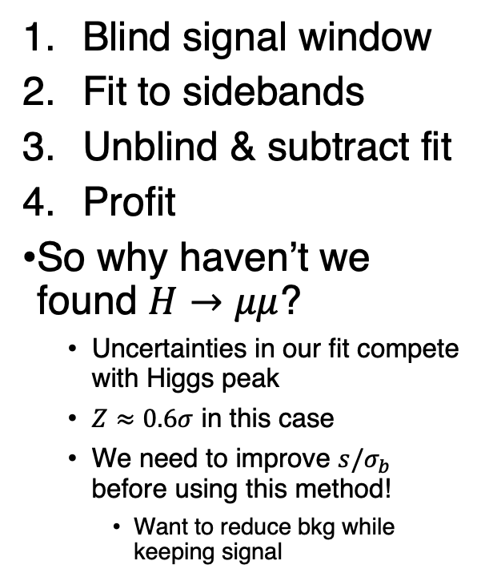
Signal Extraction
Blind signal window
Fit to sidebands
Unblind & subtract fit
Profit
So why haven’t we found $H→μμ$?
  Uncertainties in our fit compete with Higgs peak
  $Z≈0.6σ$ in this case
  We need to improve $s/σ_{b}$ before using this method!
    Want to reduce bkg while keeping signal
Events $→$
180
$${±σ}_{b}=300$$
Invariant mass $→$
= background
= signal

Slide 14


Using ML to extract $H→μμ$ signal
Boosted Decision Trees (BDTs)
“Dumb”
  We can control exactly what it uses and doesn’t use
  It won’t find deep connections between input features
Very good for low-information environments
Deep Neural Nets (DNNs)
“Smart”
  It will find deep connections between input features
  We can’t control exactly what it uses
Very good for high-information environments

Slide 15
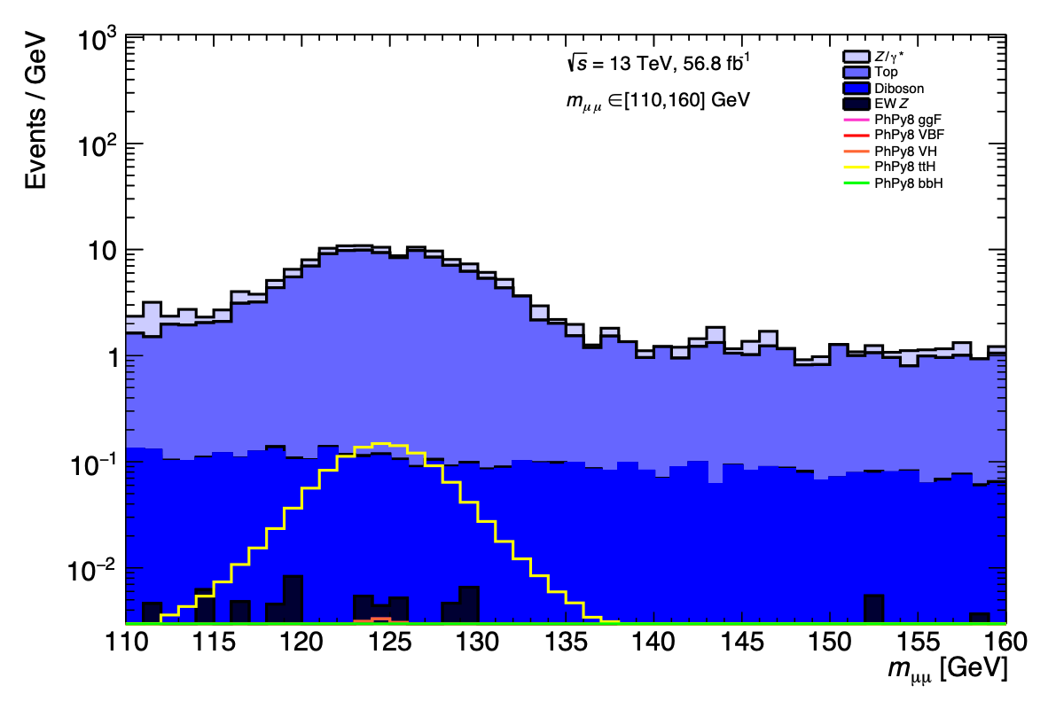
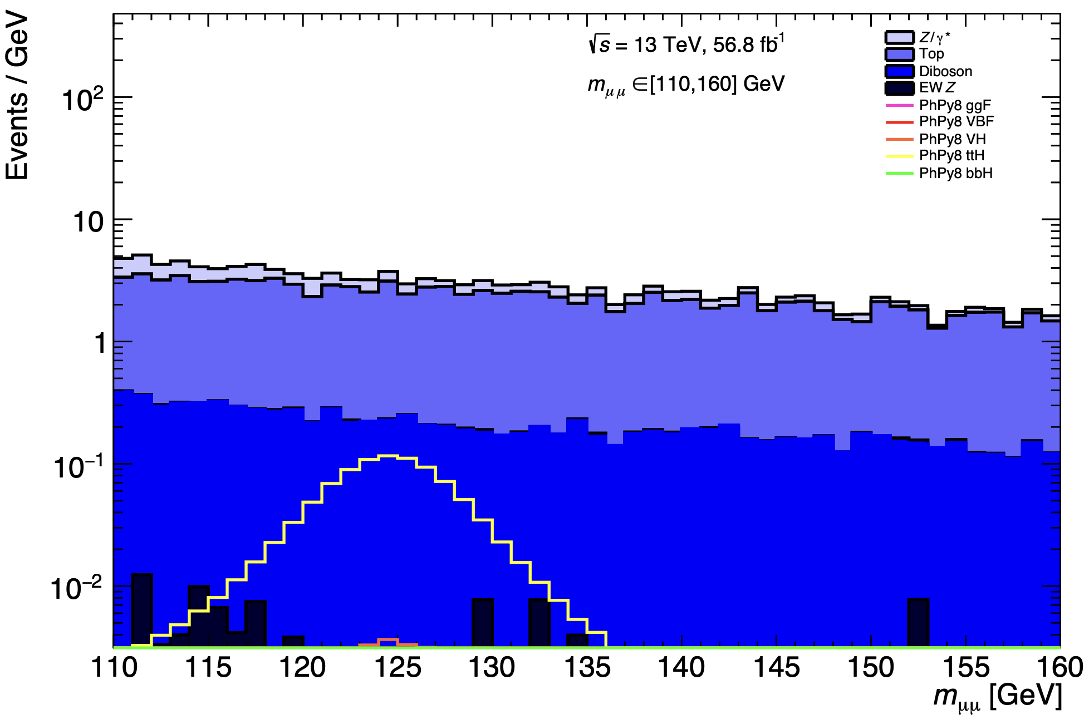




Taming the DNN: the DisCo loss function
$L({\vec{y}}_{pred},{\vec{y}}_{true})=L_{BCE}({\vec{y}}_{pred},{\vec{y}}_{true})+α⋅{dCorr}_{{\vec{y}}_{true}=0}^{2}({\vec{m}}_{μμ},{\vec{y}}_{pred})$
    $L_{BCE}$: Standard DNN training term
    $α$: DisCo parameter controlling loss due to background shaping
    ${dCorr}^{2}$: Distance Correlation function
$L_{BCE}$ alone
Full $L_{DisCo}$
?
!

Slide 16

The ttH category
Higgs production modes have distinct signatures
ttH’s signature involves many information-rich jets
  Ideal for DisCo NN!
NNs love this!
b-jets
light jets
muons
$$t\overline{t}H→μμ$$
Notes:
Check time here (should be 12 mins)

Slide 17

Improvements to the ttH category
Sometimes the top quarks can produce muons during their decay chain
Ian Ramirez-Berend gave a talk this morning
  Recap: My trained NNs + his muon selections = big success!
  We were able to improve NN selection efficiency by ~20%
1
b-jets
2
light jets
muons
$$ν_{μ}$$
3
3 muons!

Slide 18

How long until discovery?
Marginal improvements to analysis will not bring us to confirmation, we simply need more data
The LHC Run 4 (early 2030s) pumps up the data collection ($\sim 5×$ more yearly compared to Run 2/3)
NN training below is pessimistic due to lack of training data. Could be improved significantly with more sims!
  Discovery extremely likely before 2037, even with only NNs

Slide 19
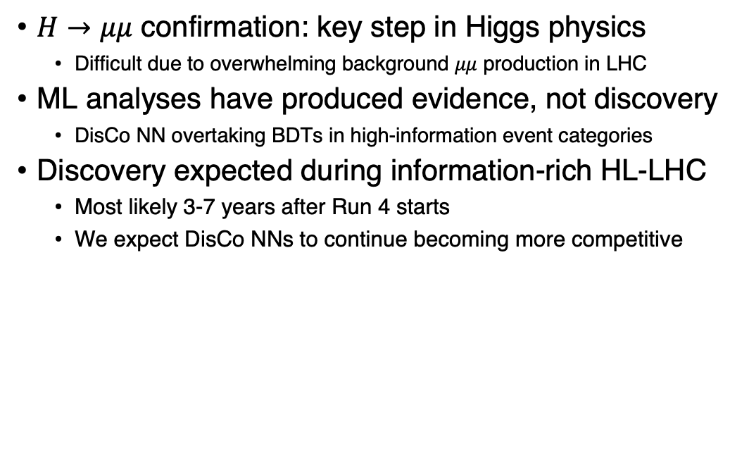
Conclusion
$H→μμ$ confirmation: key step in Higgs physics
  Difficult due to overwhelming background $μμ$ production in LHC
ML analyses have produced evidence, not discovery
  DisCo NN overtaking BDTs in high-information event categories
Discovery expected during information-rich HL-LHC
  Most likely 3-7 years after Run 4 starts
  We expect DisCo NNs to continue becoming more competitive
Notes:
Maybe add Carleton shield on things we’ll contribute to

Slide 20
Backup

Slide 21
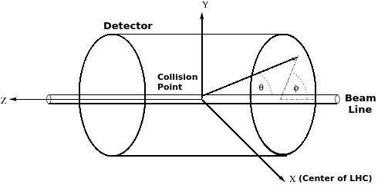
Coordinate system at ATLAS

Slide 22
Constructing invariant mass
s

Slide 23
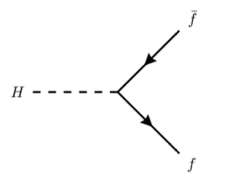
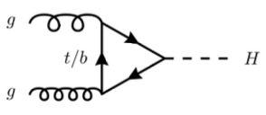
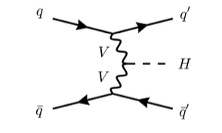
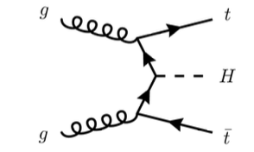




Higgs Feynman diagrams
$$ggF$$
$$H→f\overline{f}$$
$$ttH$$
$$VBF$$

Slide 24
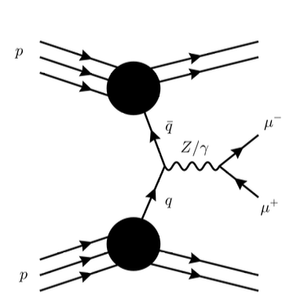
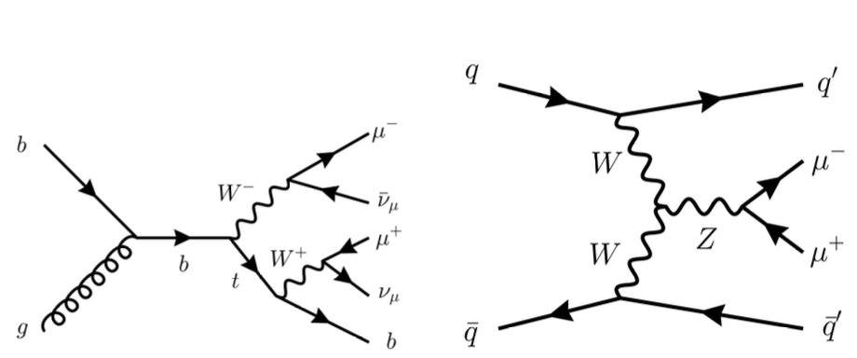
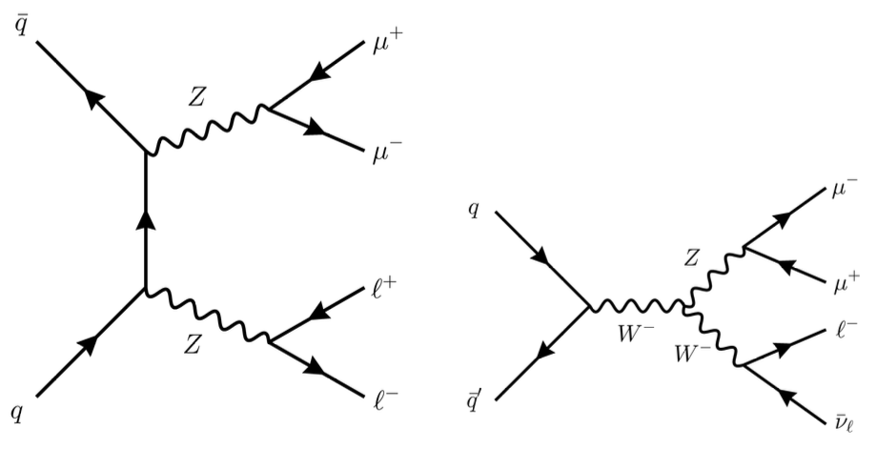

Background Feynman diagrams
$$Z/γ^{∗}→μμ$$
EWZ
single-top
Diboson
decays

Slide 25
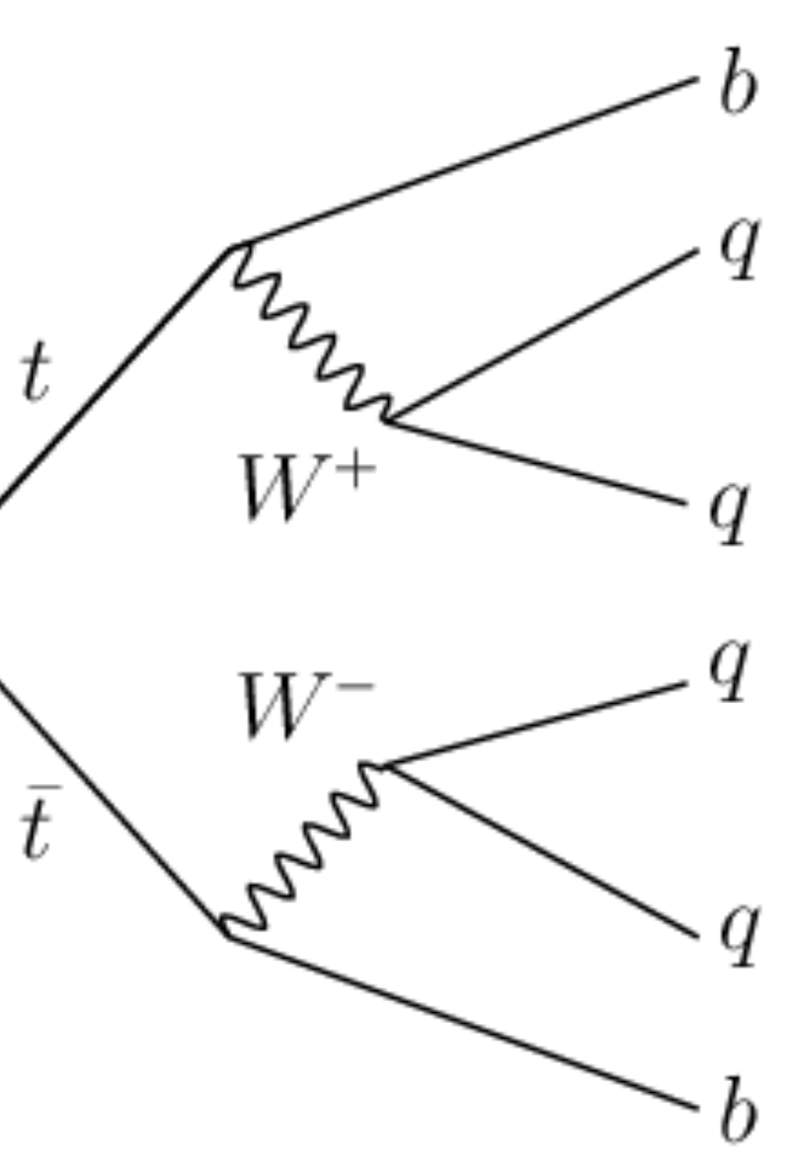


Top decay diagrams
$$l^{−}$$
$$ν_{l}$$

Slide 26
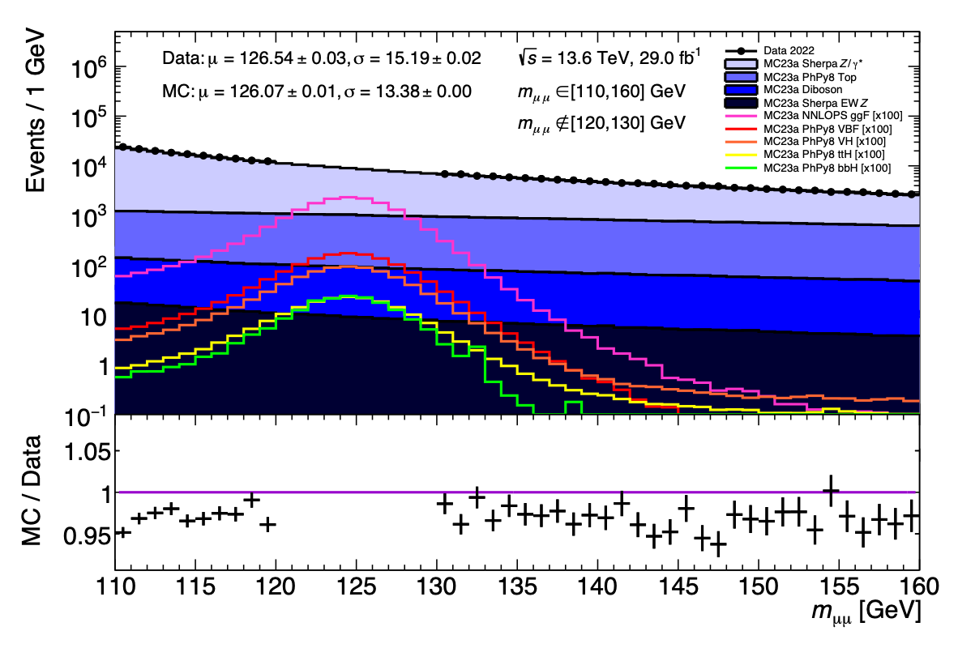
2022 data vs mc23a simulation comparison

Slide 27





Going deeper on Ian’s muon reconstruction
$$μ^{−}$$
Could be Higgs, use
W to reco
$$W^{−}$$
$$\overline{ν}$$
$$μ^{−}$$
$$μ^{+}$$
Must be Higgs

Slide 28
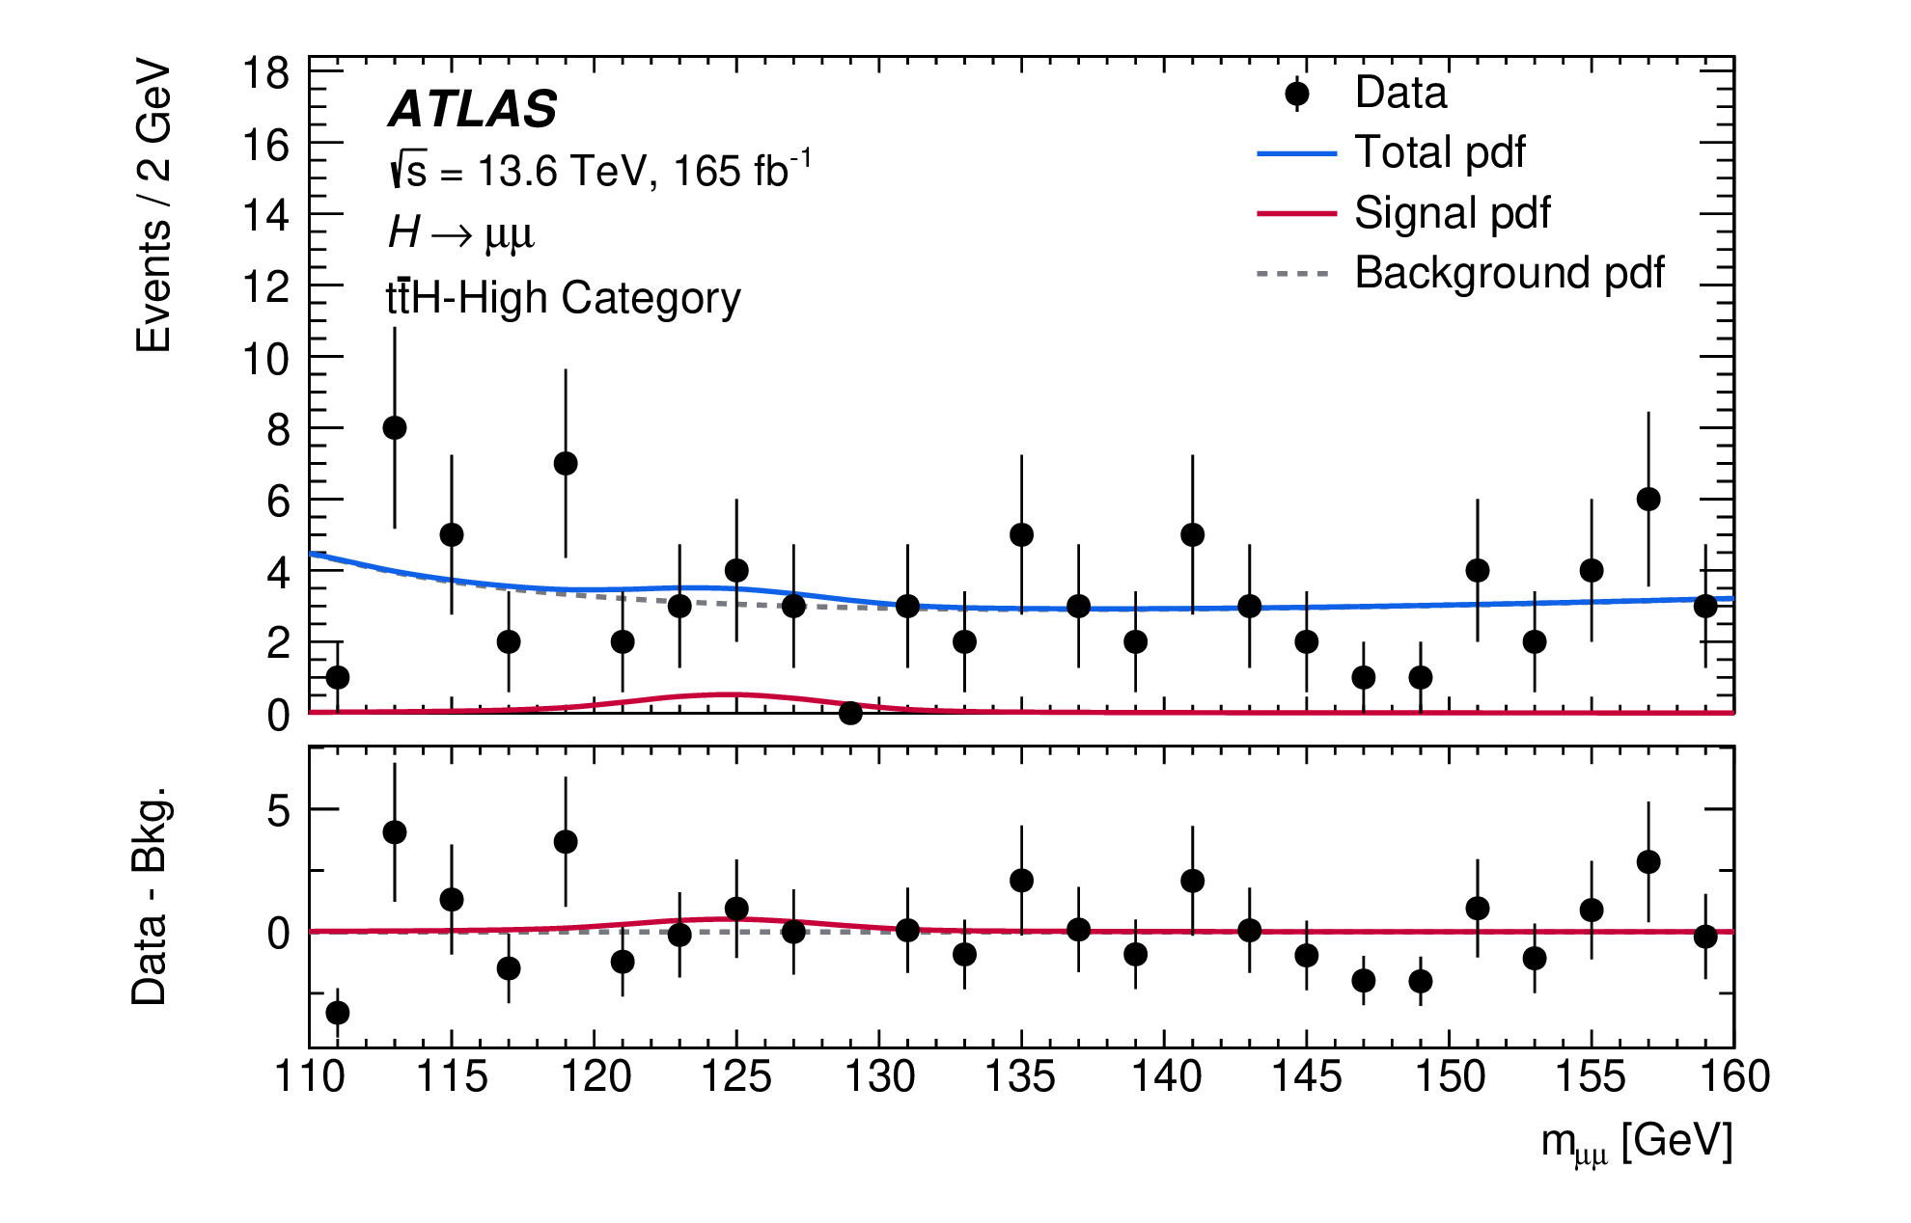
The ttH-high category plotted
https://doi.org/10.48550/arXiv.2507.03595

Slide 29
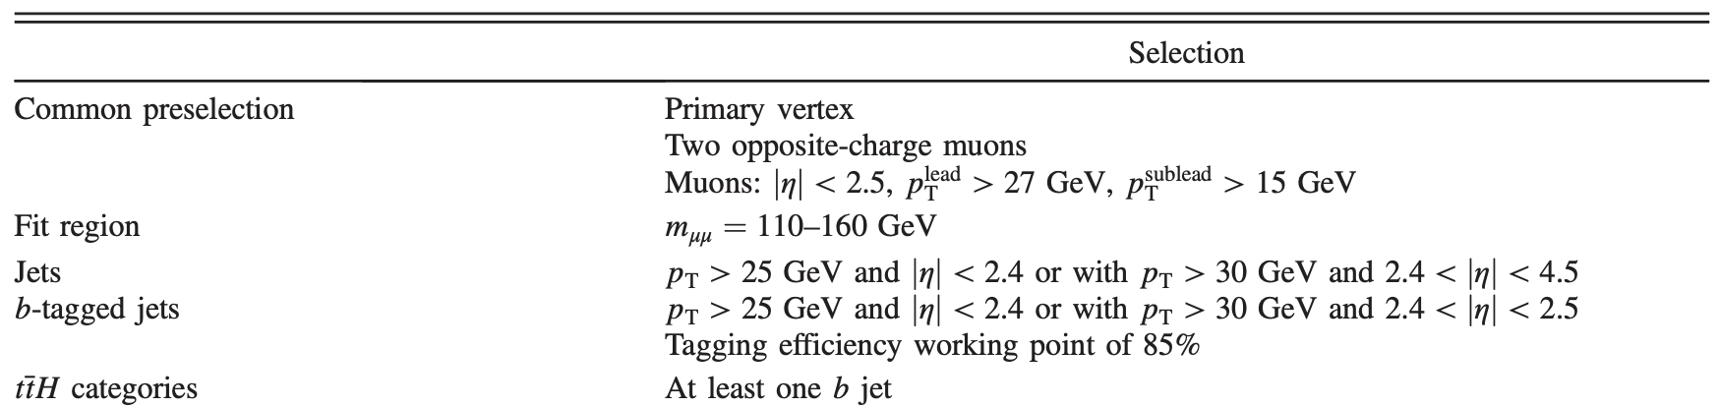
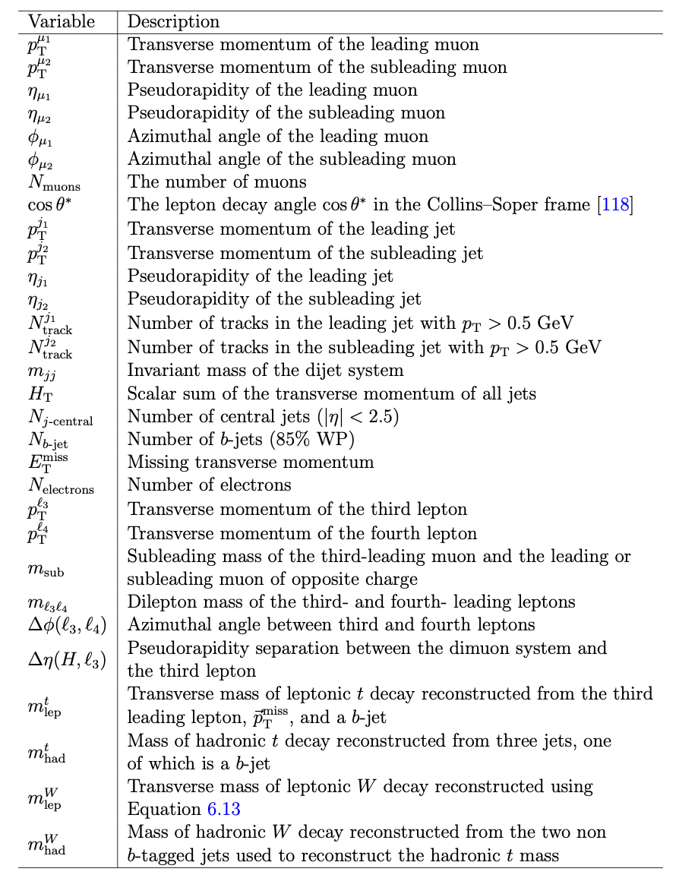
Selections + training vars used in ttH
ATLAS Work in Progress

Slide 30
ttH NN samples
All samples simulated to match data from 2022-2024
Training:
  Signal: ttH, tH
  Background: Drell-Yan, EWZ, top, diboson
Scoring:
  Signal: ttH, tH, tWH, VBF, ggF, WpH, WmH, ZH, ggZH, bbH
  Background: Drell-Yan, EWZ, top, diboson

Slide 31
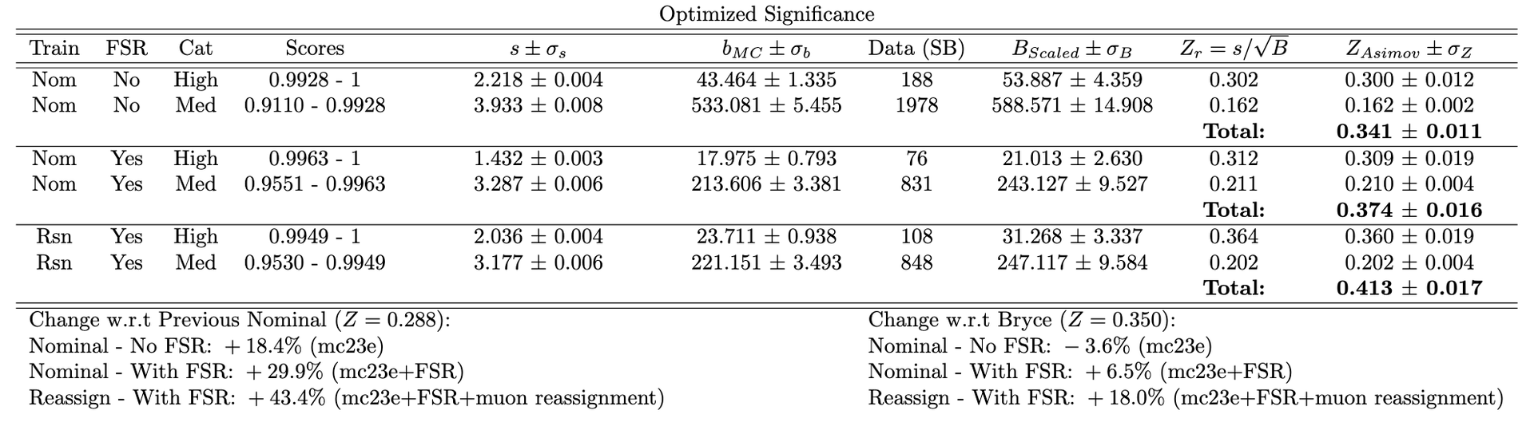
Most recent ttH numbers
ATLAS Work in Progress

Slide 32
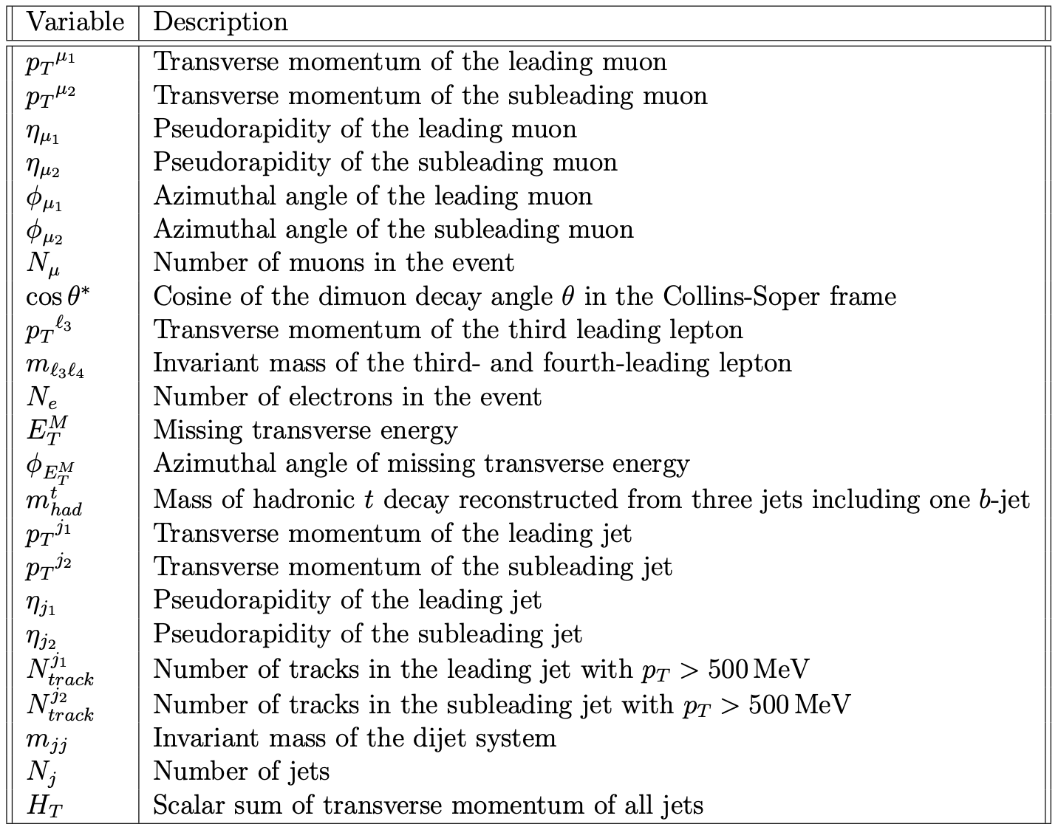
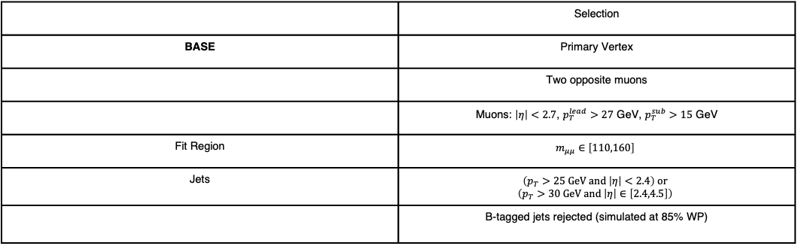
Selections + training vars used in prospects
 | Selection
BASE | Primary Vertex
 | Two opposite muons
 | Muons: $\left|η\right|<2.7$, $p_{T}^{lead}>27$ GeV, $p_{T}^{sub}>15$ GeV
Fit Region | $$m_{μμ}∈\left[110,160\right]$$
Jets | $$\left(p_{T}>25 GeV and \left|η\right|<2.4\right) or$$ $$\left(p_{T}>30 GeV and \left|η\right|∈\left[2.4,4.5\right]\right)$$
 | B-tagged jets rejected (simulated at 85% WP)

Slide 33
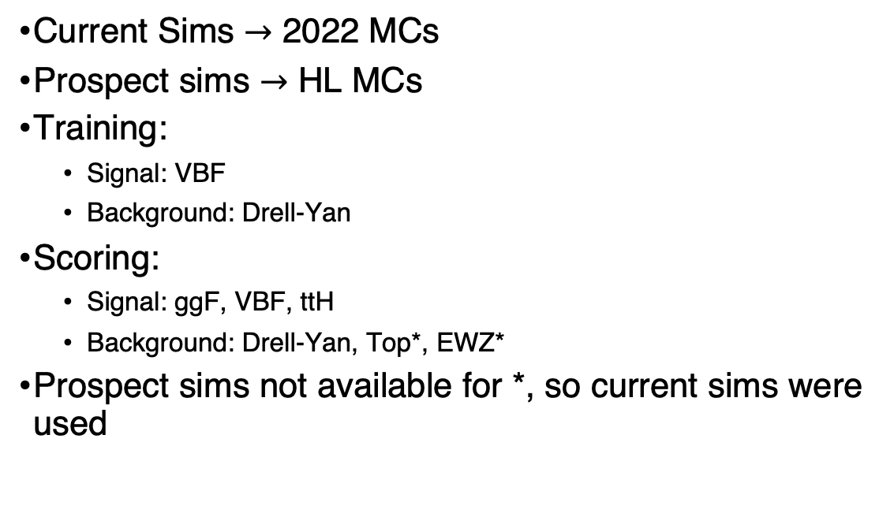
Prospect training samples
Current Sims $→$ 2022 MCs
Prospect sims $→$ HL MCs
Training:
  Signal: VBF
  Background: Drell-Yan
Scoring:
  Signal: ggF, VBF, ttH
  Background: Drell-Yan, Top*, EWZ*
Prospect sims not available for *, so current sims were used

Slide 34


Background shaping
Pre-NN
Background
Signal
Combined
Events $→$
Invariant mass $→$

Slide 35
Background shaping
Post-NN: NN selects background in signal region
Background
Signal
Combined
Events $→$
Invariant mass $→$

Slide 36
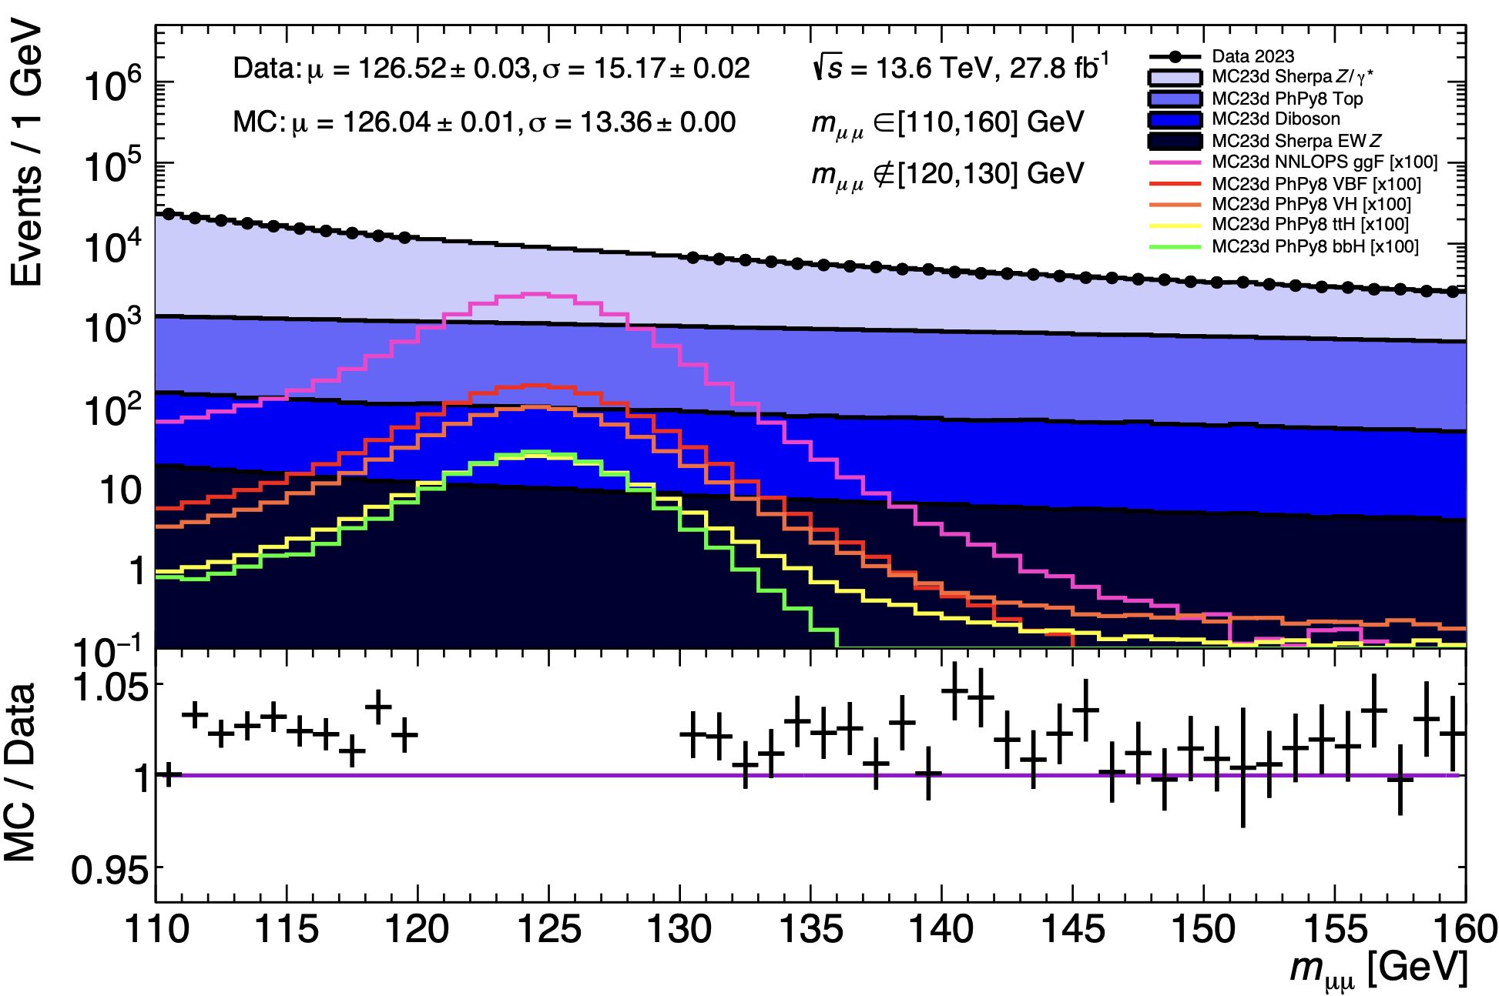
Why is background shaping bad?
Want to subtract background
  Need to know background from sidebands

Slide 37
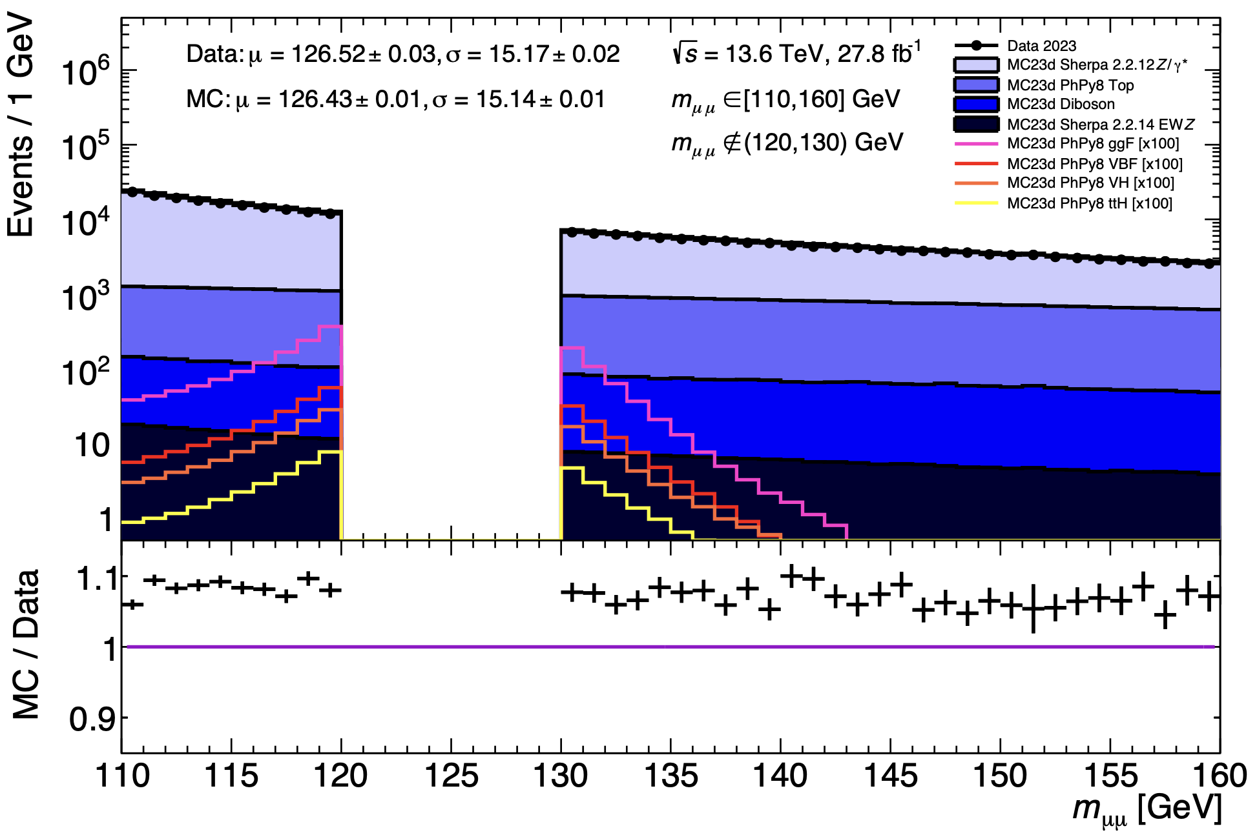
Why is background shaping bad?
Want to subtract background
  Need to know background from sidebands

Slide 38
Unshaped background
Pre-NN
Background
Signal
Combined
Events $→$
Invariant mass $→$

Slide 39
Unshaped background
Post-NN: NN selects background evenly
Background
Signal
Combined
Events $→$
Invariant mass $→$

Slide 40
Unshaped background
Events $→$
Invariant mass $→$

