Slide 1


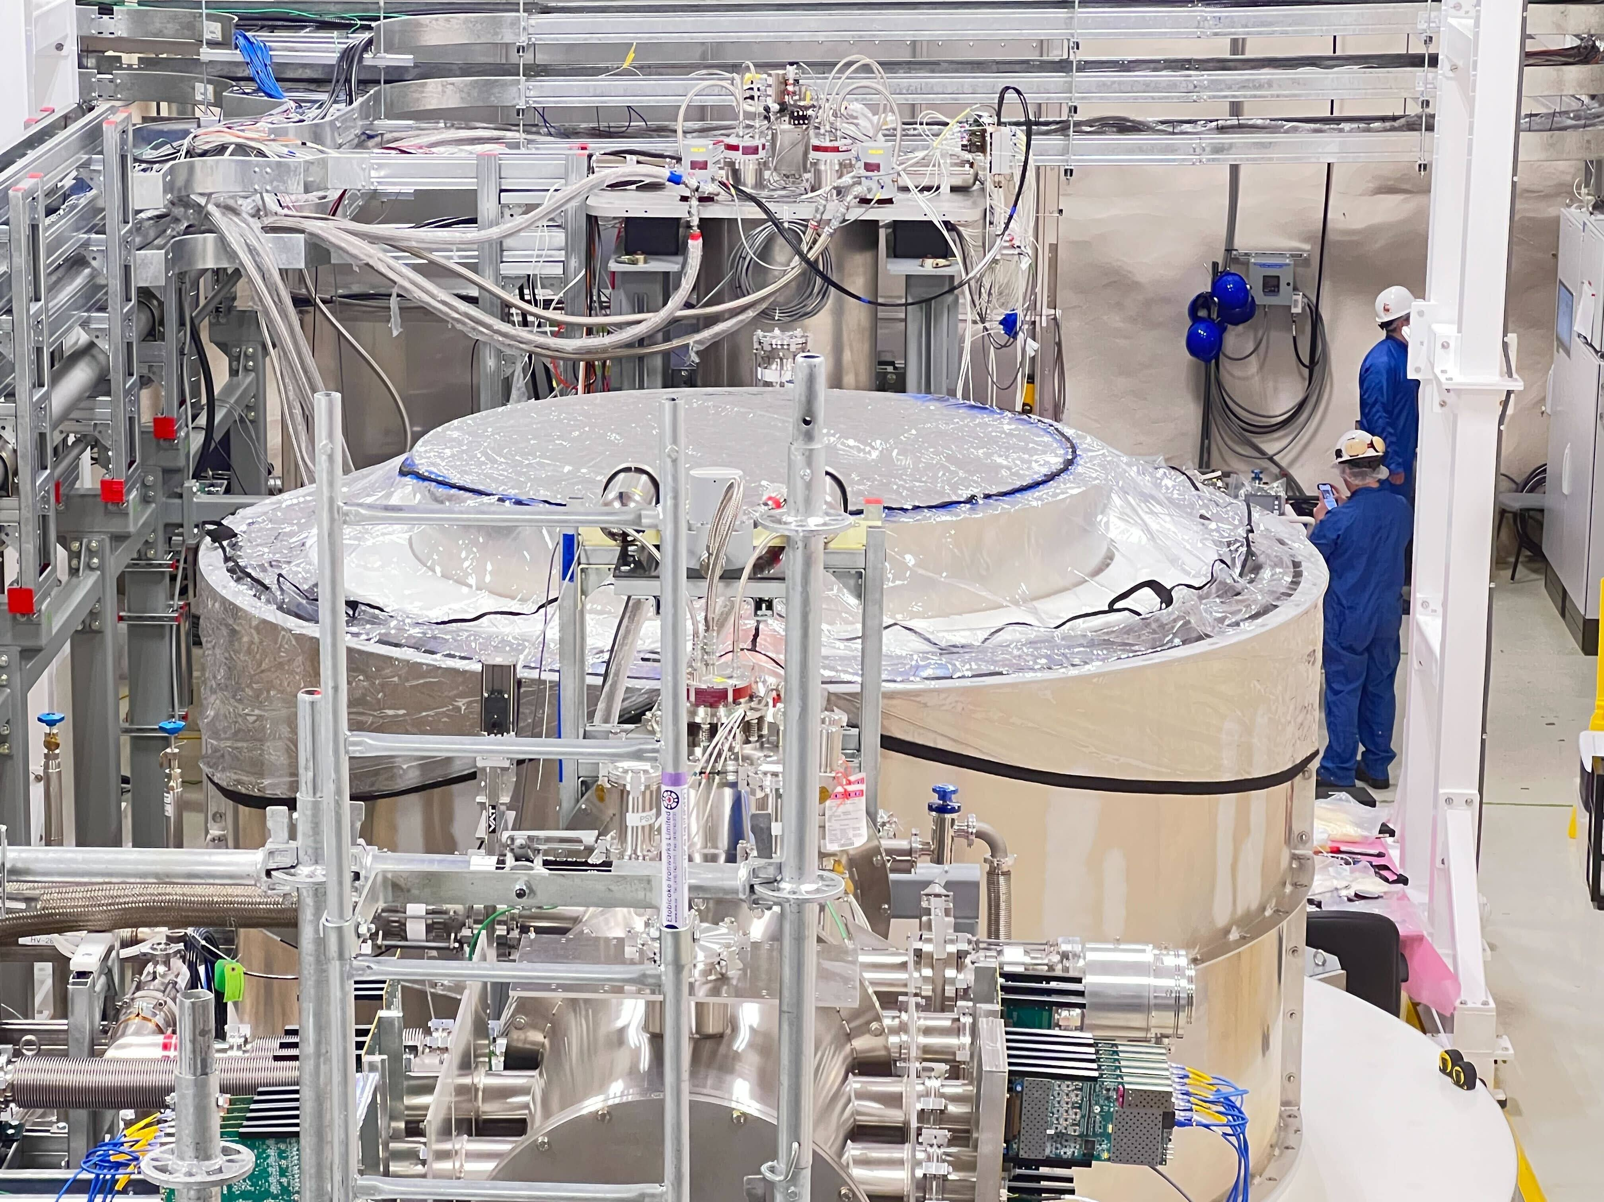
Performance results of Ge high-voltage detectors tested at the CUTE facility
Ruchi Soni
On behalf of the SuperCDMS collaboration
Supervisor: Wolfgang Rau

Slide 2
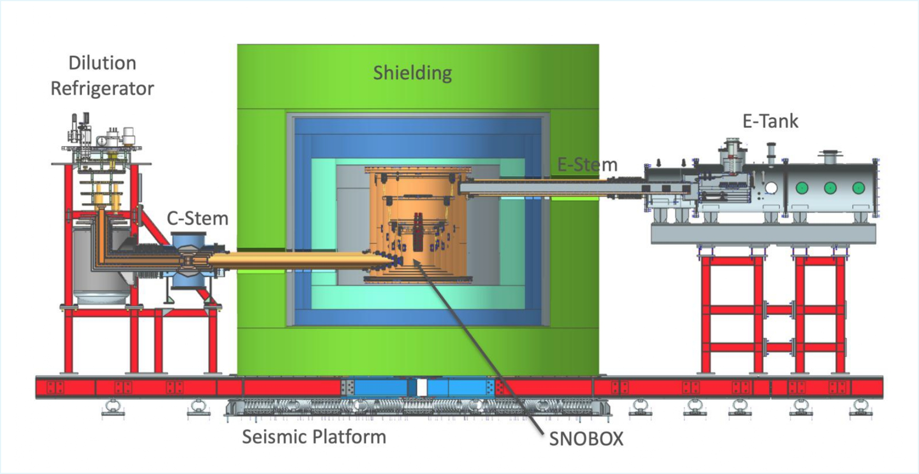
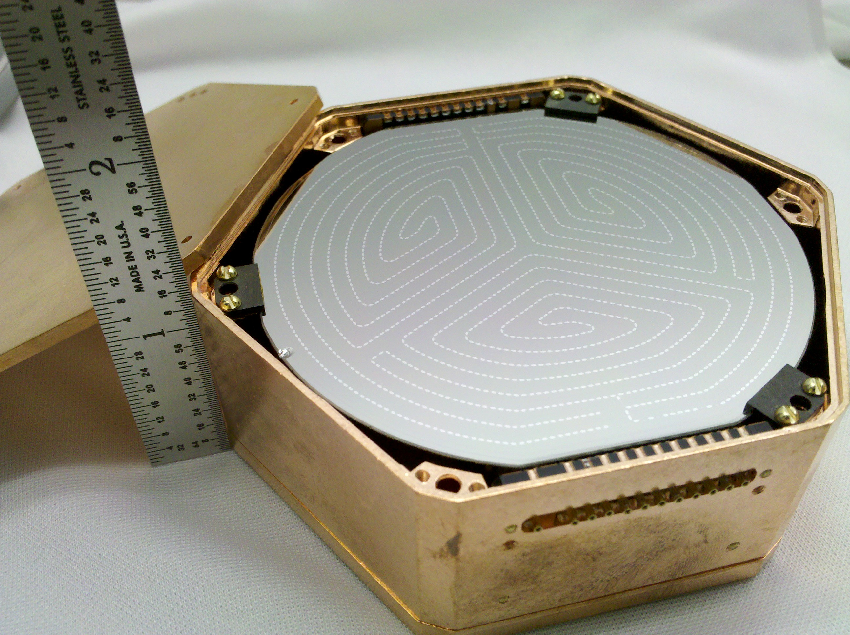
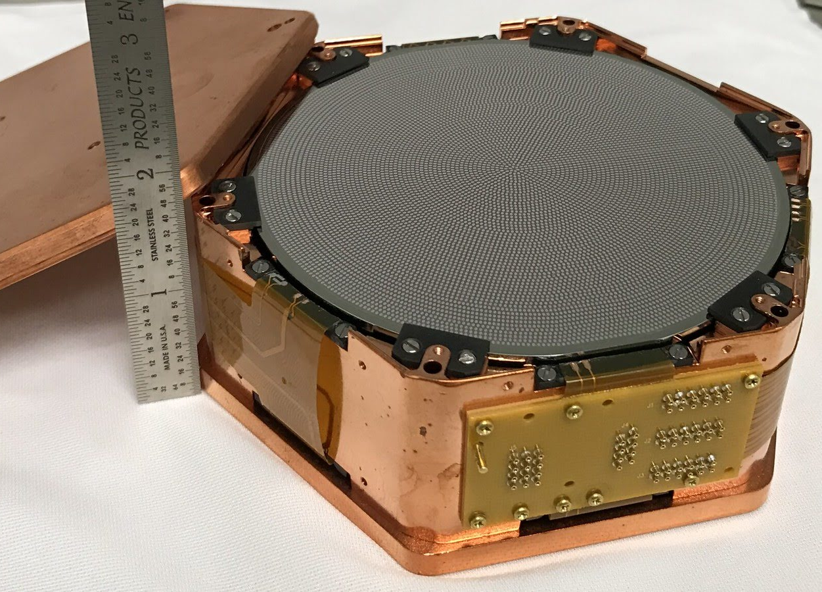
SuperCDMS at SNOLAB
Goal: search for low-mass (sub-GeV) dark matter with cryogenic particle detectors at SNOLAB
Two detector designs with Ge and Si targets
iZIPs | High Voltage (HV)
Charge and phonon readout, nuclear recoil discrimination | Phonon readout only, offers low energy threshold
iZIP
HV

Slide 3
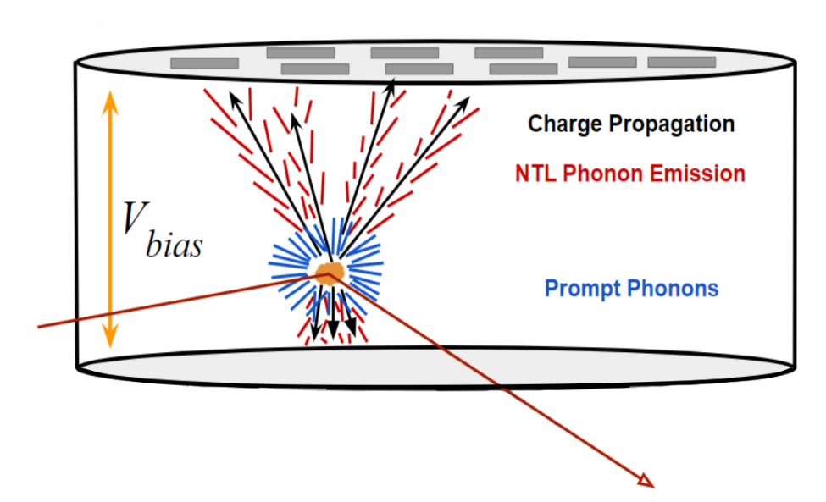

HV Detector Operation Principle
Neganov-Trofimov-Luke (NTL) Effect: phonon signal amplification
$$E_{T}=E_{r}+E_{NTL}=E_{r}+n_{eh}eV_{b}$$
Recoil/Interaction Energy
Total Phonon Energy
# of e-h pairs
Applied Voltage

Slide 4
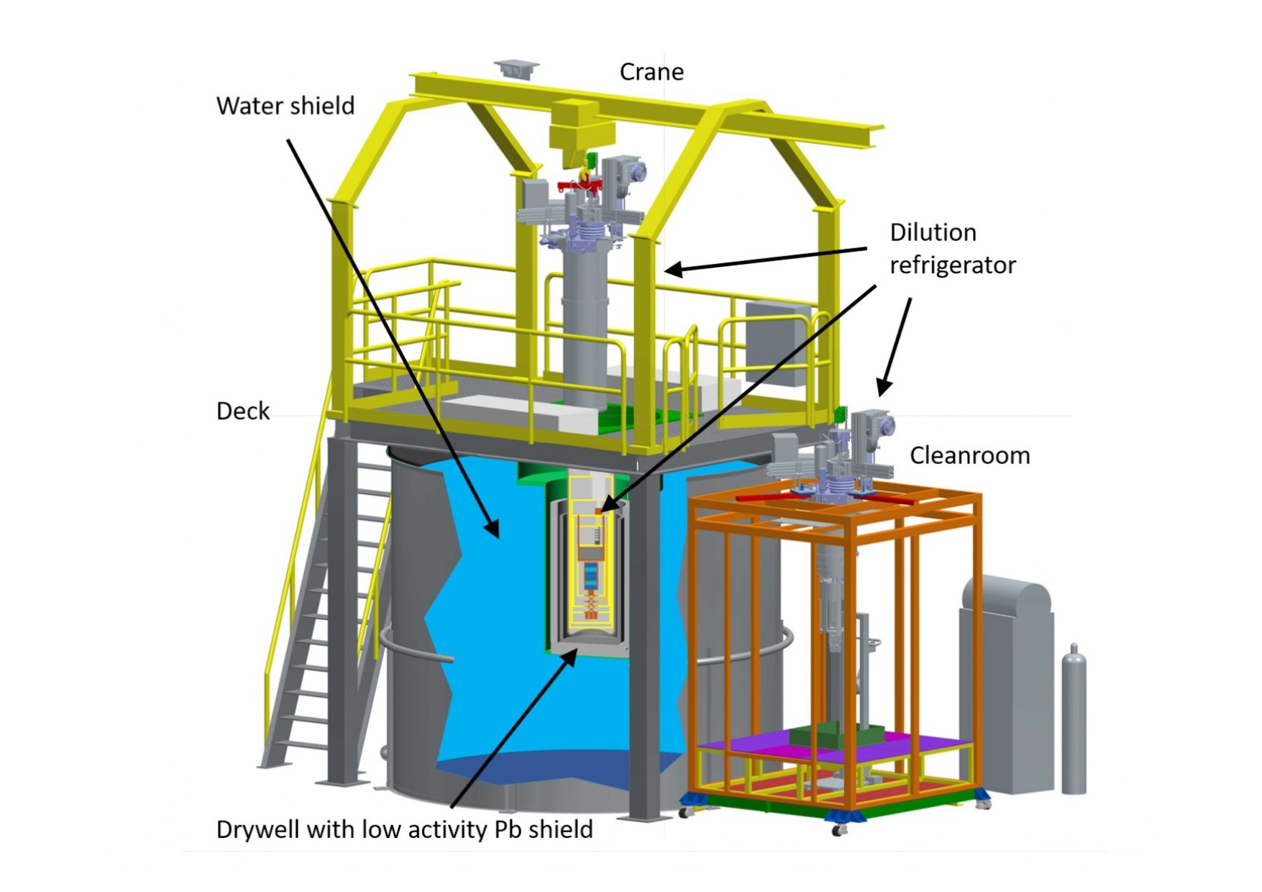
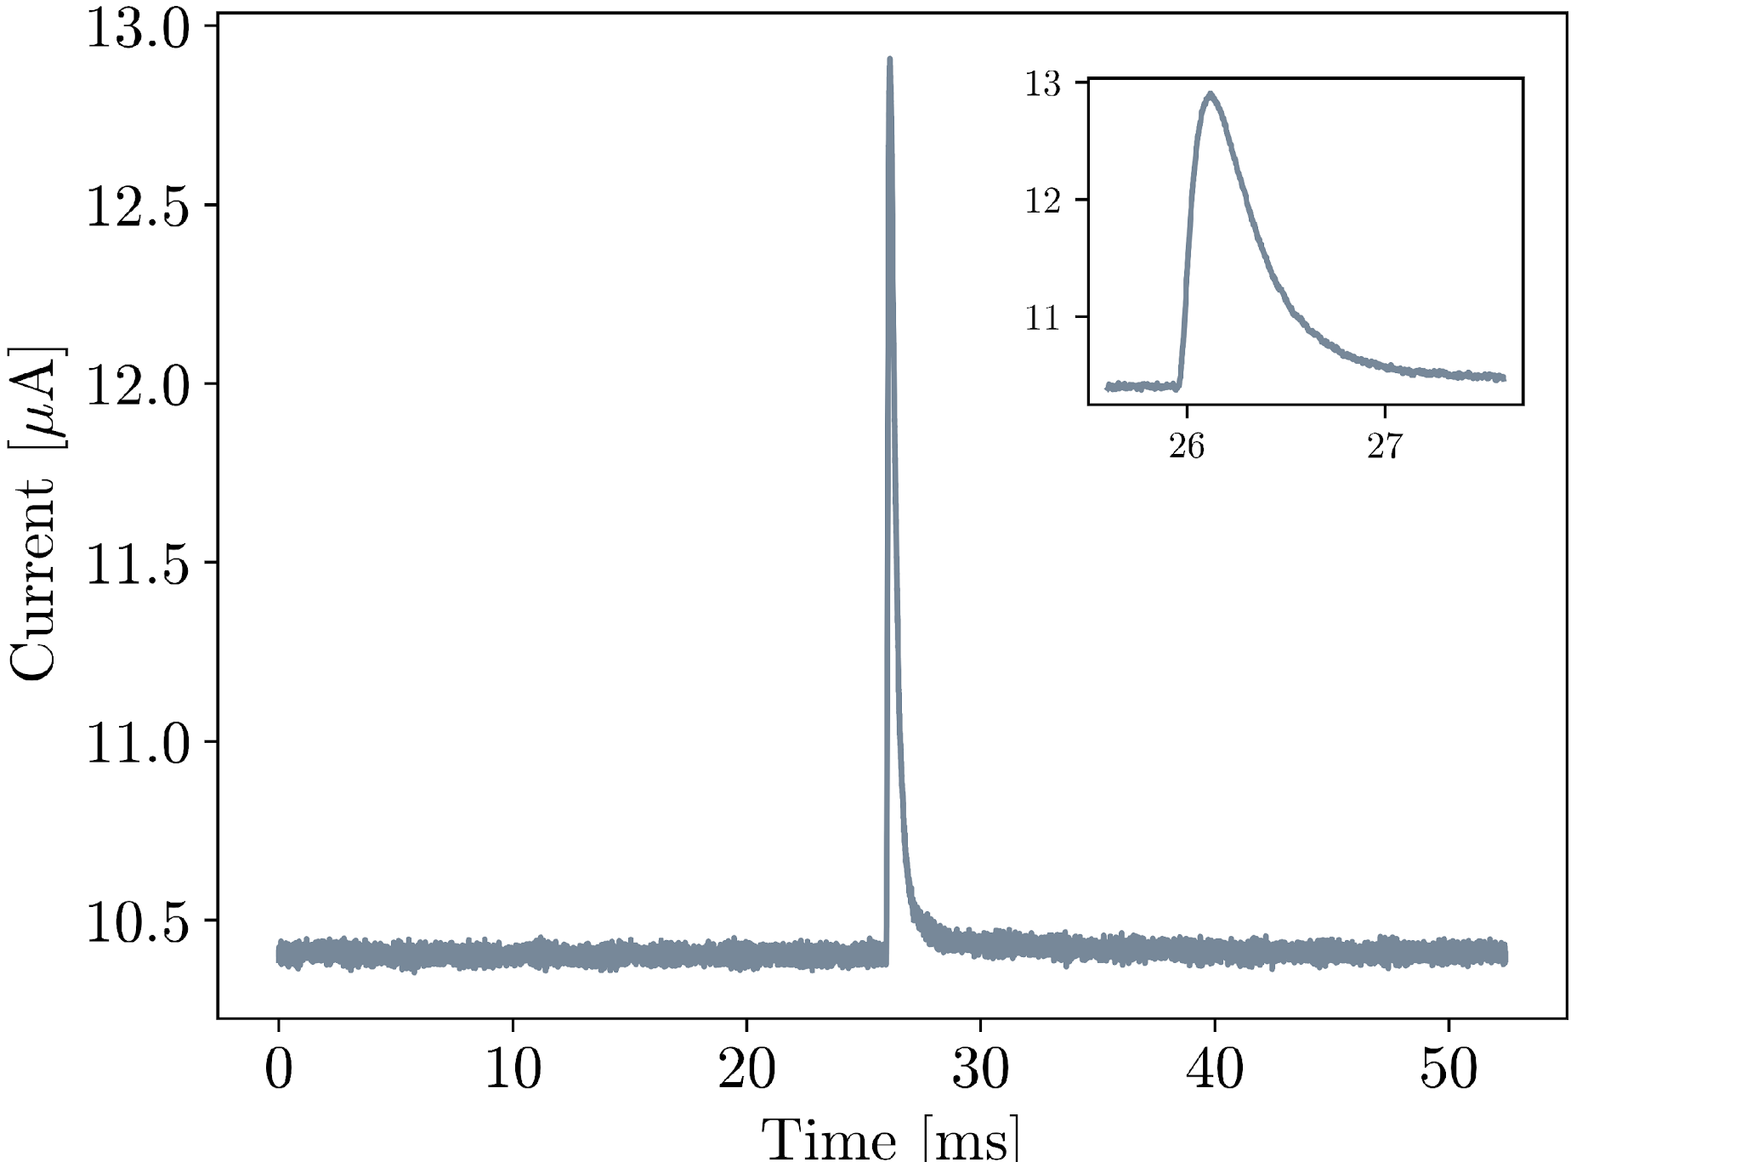
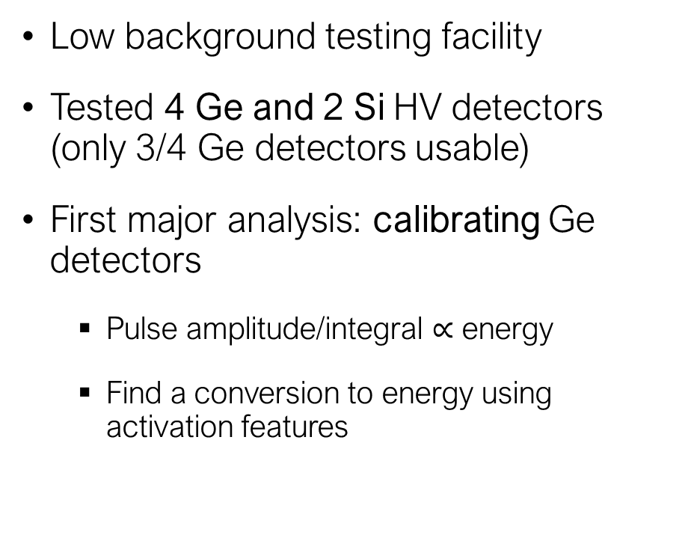
Detector Testing at CUTE
Low background testing facility
Tested 4 Ge and 2 Si HV detectors
(only 3/4 Ge detectors usable)
First major analysis: calibrating Ge detectors
  Pulse amplitude/integral $∝$ energy
  Find a conversion to energy using activation features
Raw pulse in a phonon sensor

Slide 5
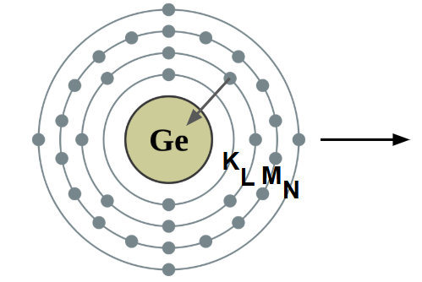
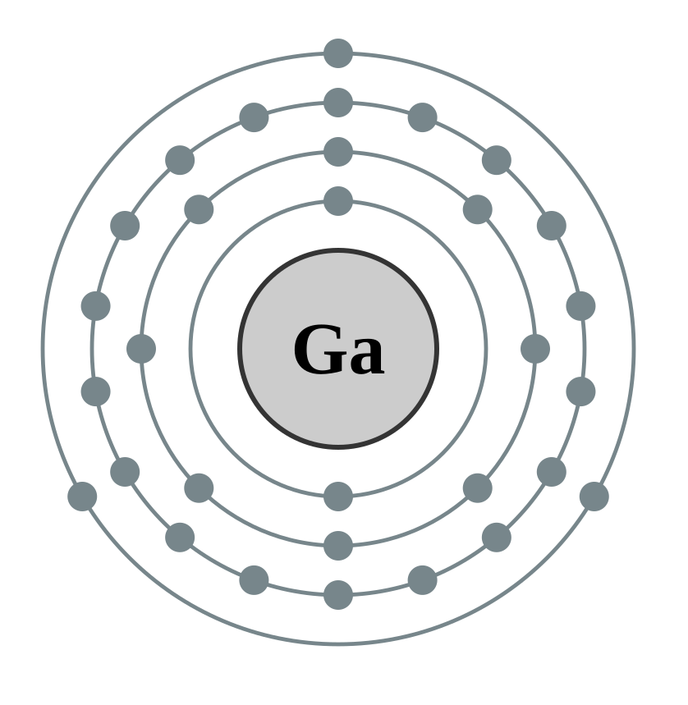
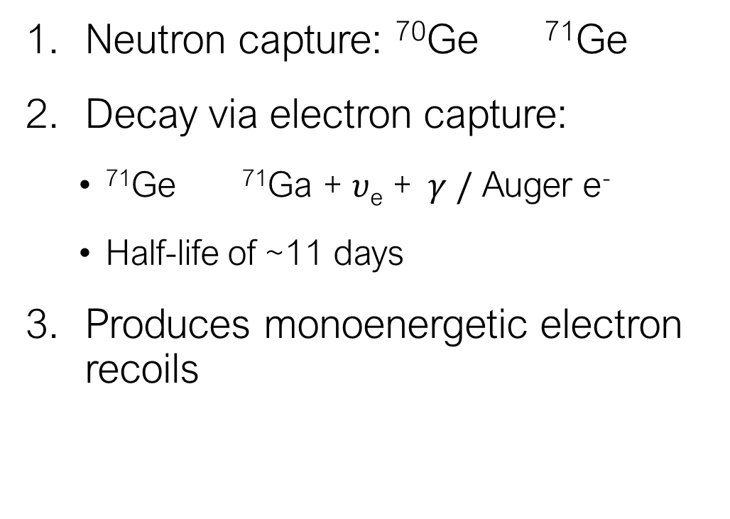
Ge Activation
Neutron capture: ⁷⁰Ge ⁷¹Ge
Decay via electron capture:
  ⁷¹Ge ⁷¹Ga + $υ$_{e} +$γ /$ Auger e⁻
  Half-life of ~11 days
Produces monoenergetic electron recoils
Shell | Peak Position [keV]
K | 10.37
L | 1.30
M | 0.160

Slide 6
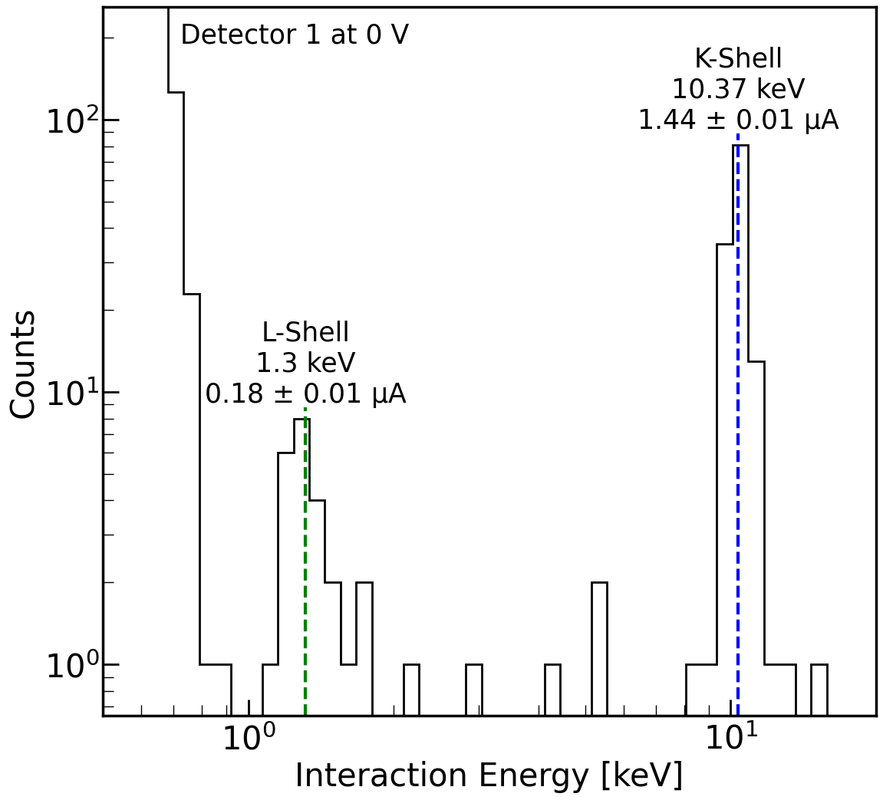
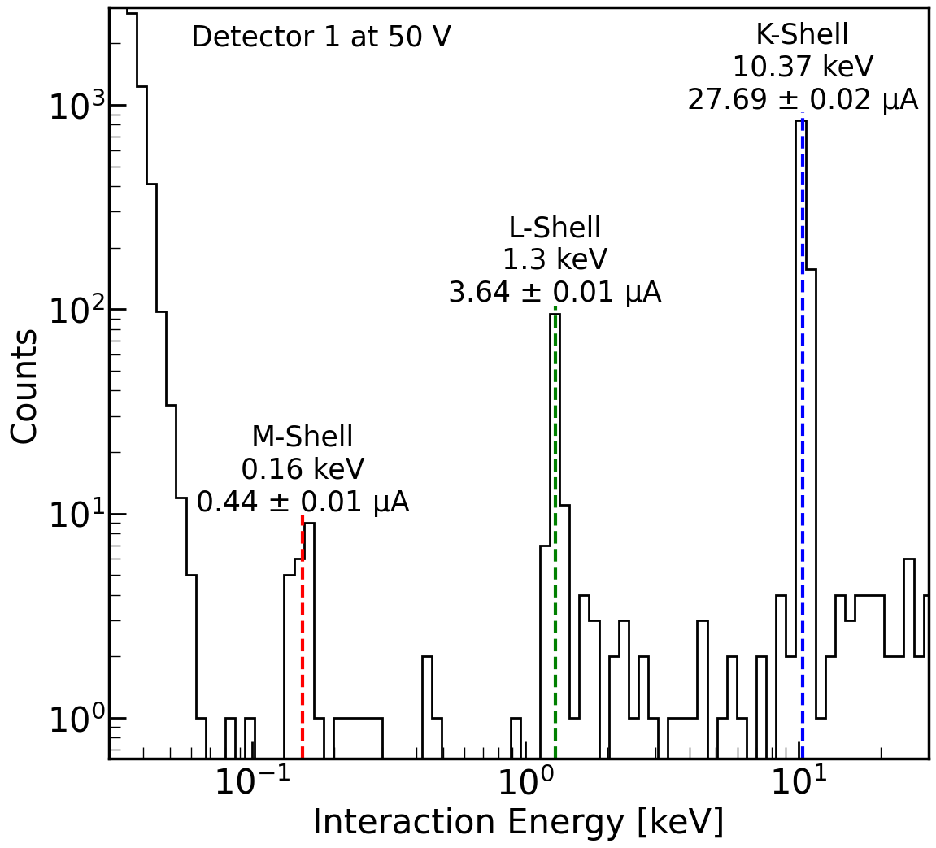
Low Energy Calibration and Detector Resolution
Gaussian fits to activation peaks after quality cuts yield calibration factors
Goal energy resolution: 50 eV
Detector | Best measured resolution [eV]
1 | 89.2 ± 0.7
3 | 80.2 ± 1.0
6 | 167 ± 14
Notes:
Identified and quantified the noise and removing it will allow us to reach the goal

Slide 7
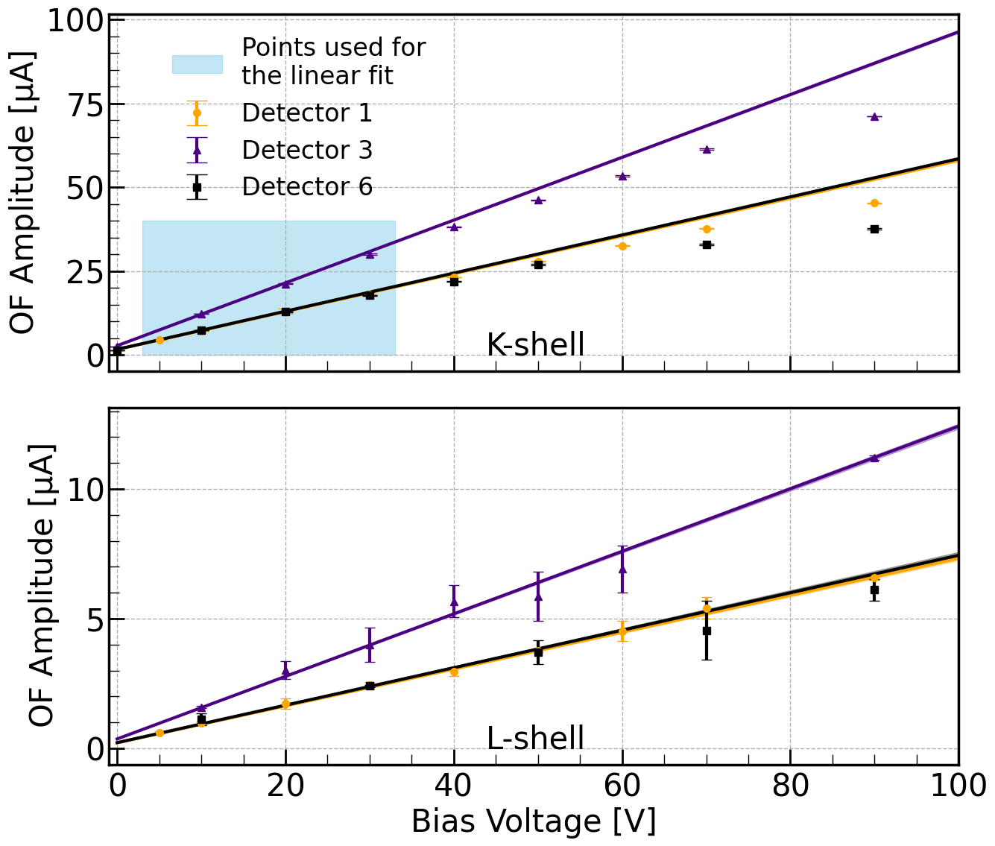
Effect of applying voltage
Expectation: peak position evolves linearly with voltage
(NTL effect)
Observation: L-shell consistent with linearity, K-shell is non-linear due to saturation

Slide 8
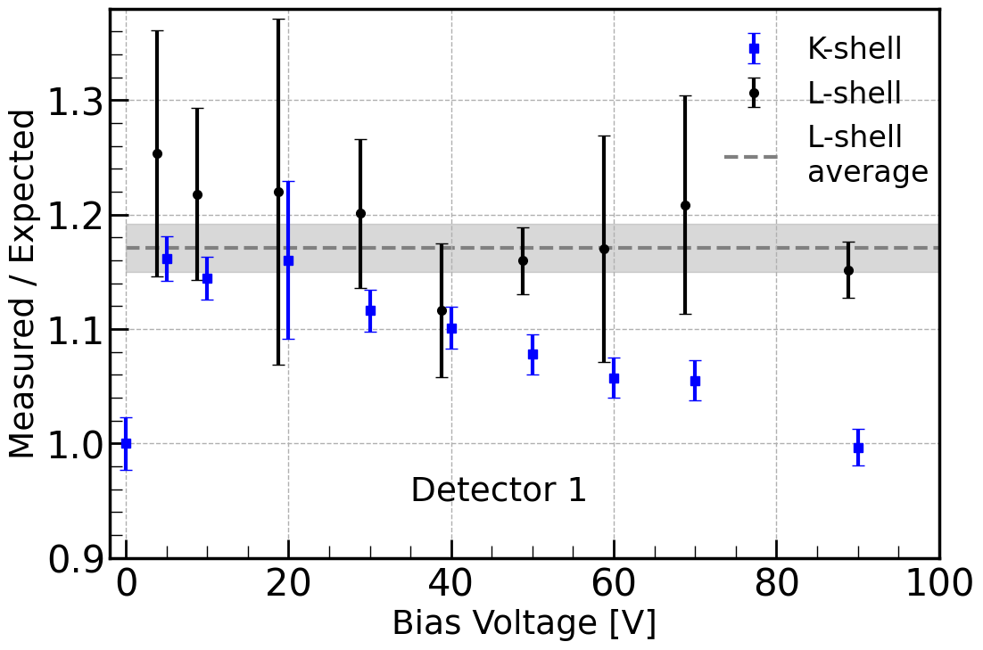
Effect of applying voltage
Expectation: peak position evolves linearly with voltage
(NTL effect)
Observation: L-shell consistent with linearity, K-shell is non-linear
Amplification via the NTL effect was larger than expected by about 17%

Slide 9
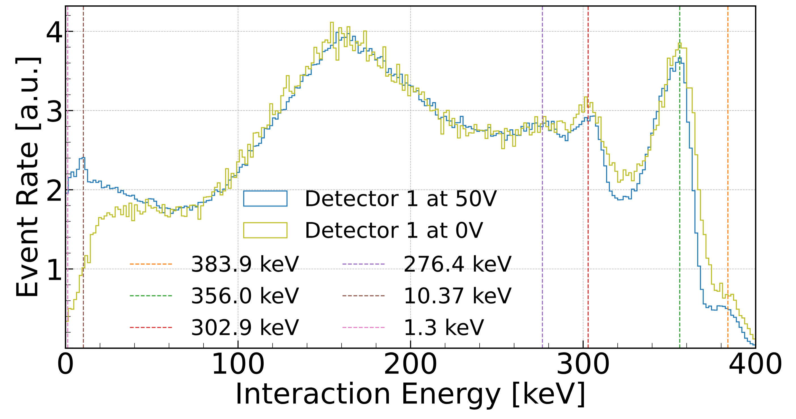
High Energy Calibration
Spectral peaks from ¹³³Ba source used to calibrate at high energies
Despite of saturation at these high energies, we can calibrate using the pulse integral

Slide 10
Conclusions
Successfully calibrated and characterized Ge detectors in the low and high energy regions
Voltage dependence of detector response up to 90 V was examined
Additional electronic filtering developed to reduce the noise and improve resolution for SuperCDMS SNOLAB
Publication in progress

Slide 11
BACKUP

Slide 12
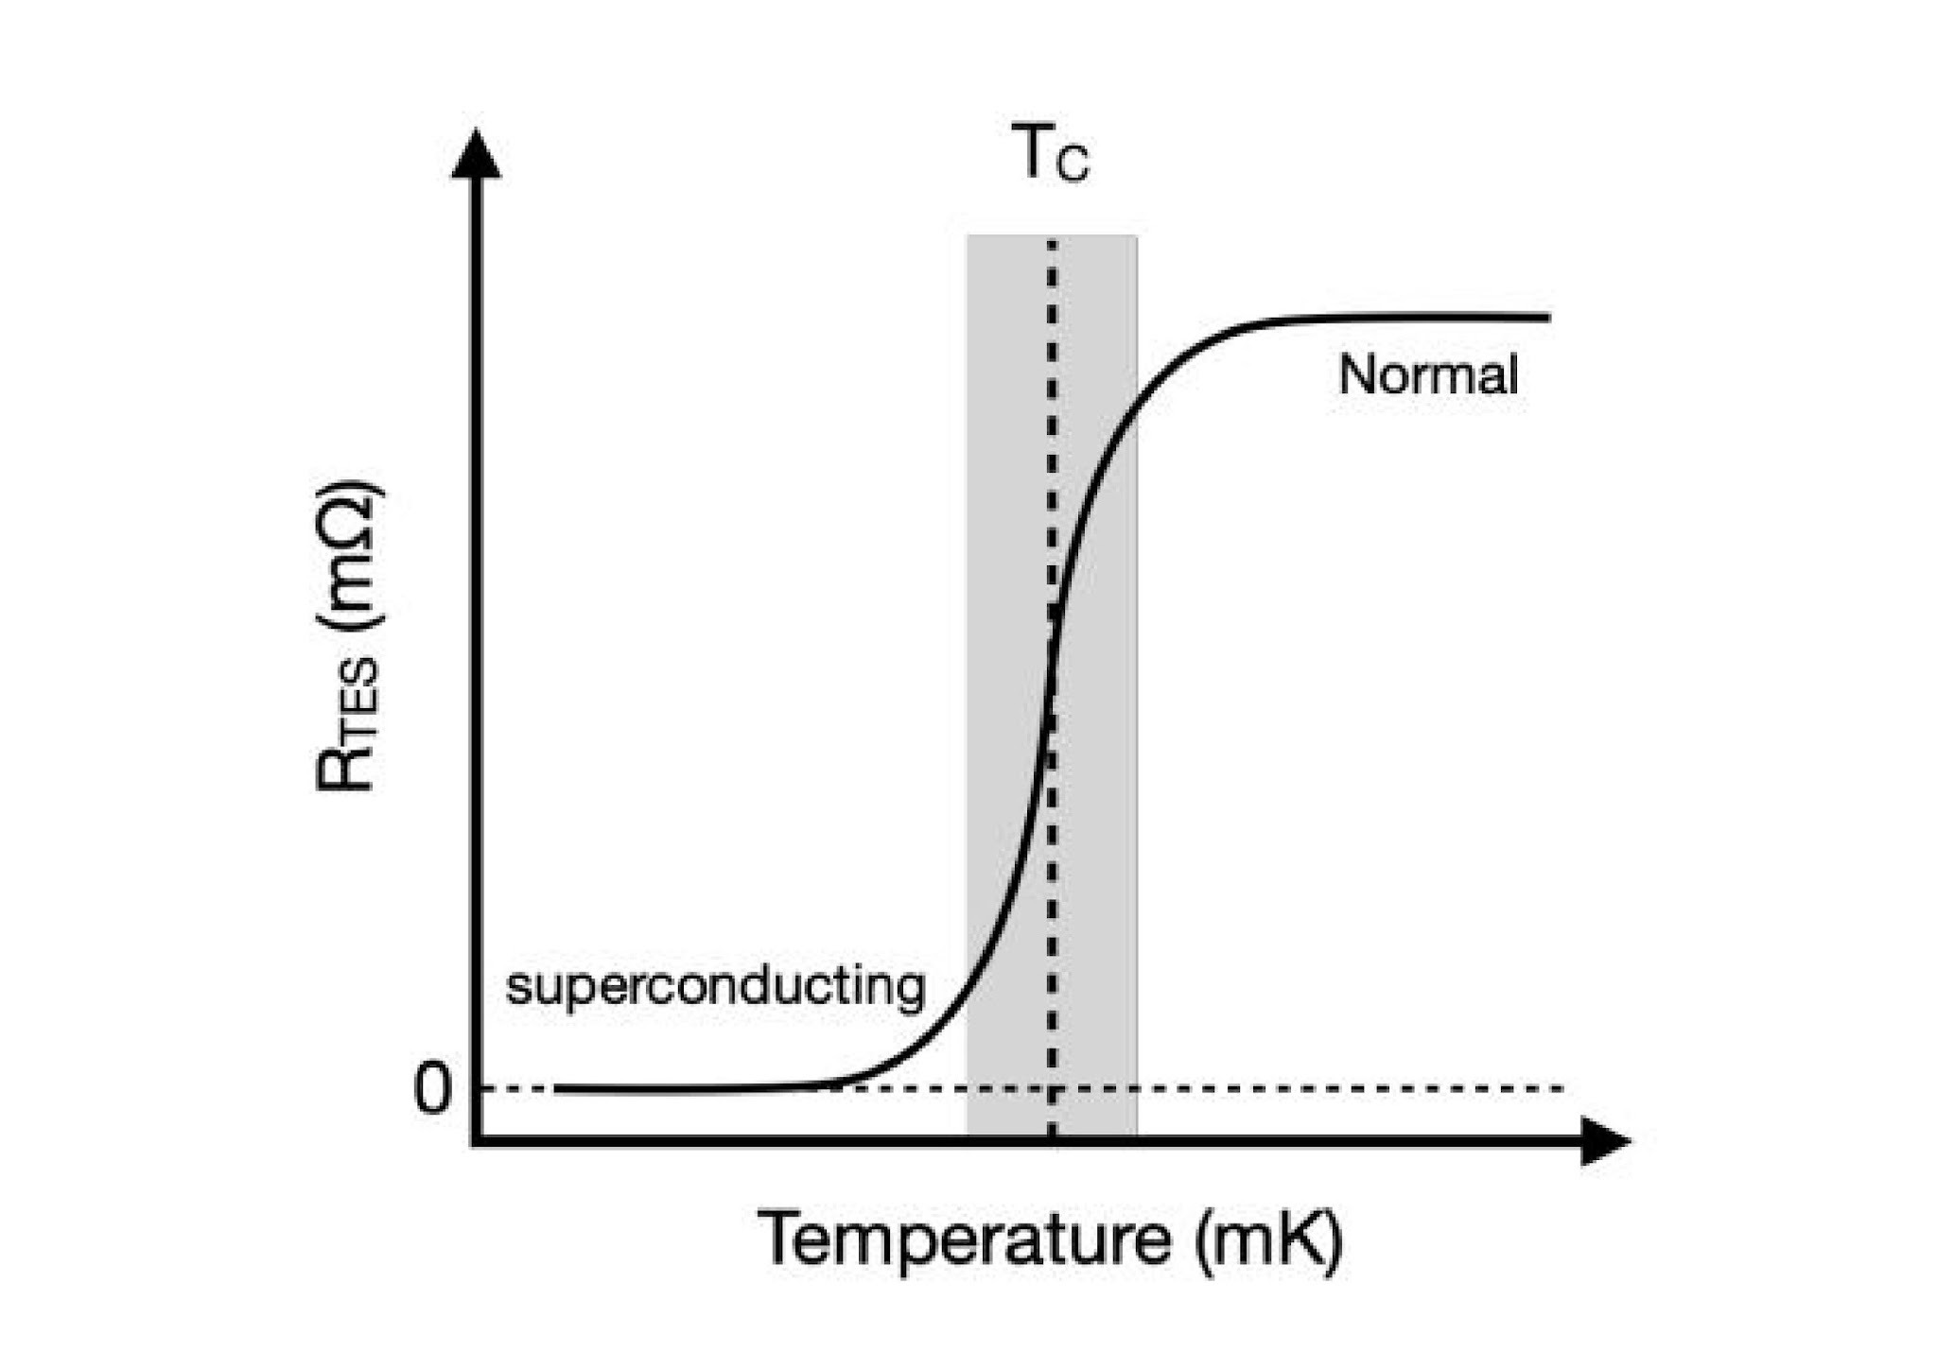
Transition Edge Sensors (TES)
Phonon readout is through tungsten TESs

Slide 13
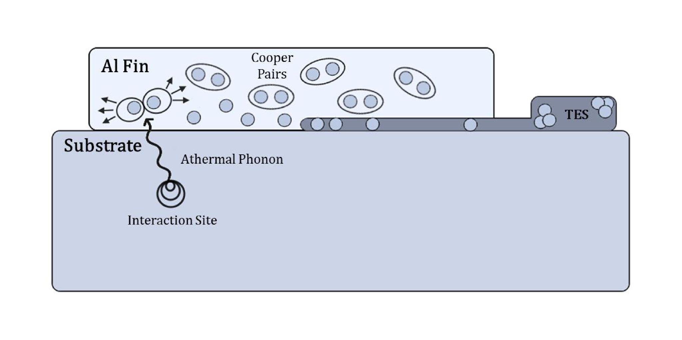
Phonon Readout
Quasiparticle-trap-assisted Electrothermal feedback TESs (QETs) to maximize the surface area for phonon collection without increasing TES heat capacity
Al fins have a much higher T_{c} (~1.2 K) so remains superconducting
Phonon energy must be at least 350 𝜇eV (binding energy of Al)

Slide 14
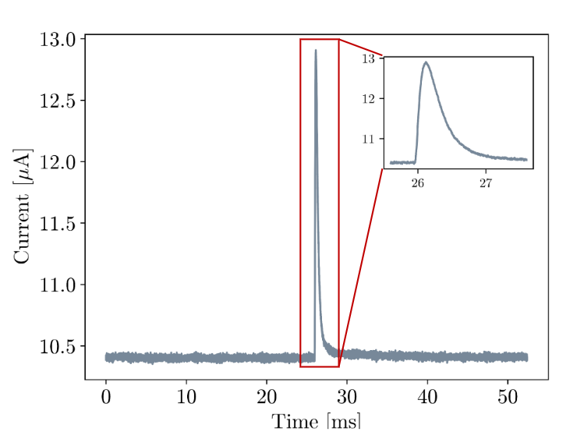
Data Collection and Processing
Each energy deposit measured as a raw pulse collected in units of current
Optimal filter applied to each trace as data is processed to extract the amplitude and other useful quantities
Optimal filter: fits a fixed pulse shape to each event in frequency domain; frequency weighted by the signal-to-noise ratio

Slide 15
SuperCDMS Shielding
Outer Neutron Shield: 60 cm Water Tanks top and sides, high density polyethylene bottom
Radon barrier
Gamma Shield: 20 cm low activity lead
Inner Neutron Shield: 30 cm polyethylene
Six copper cans act as an additional shield and couple to the stages of the dilution fridge

Slide 16
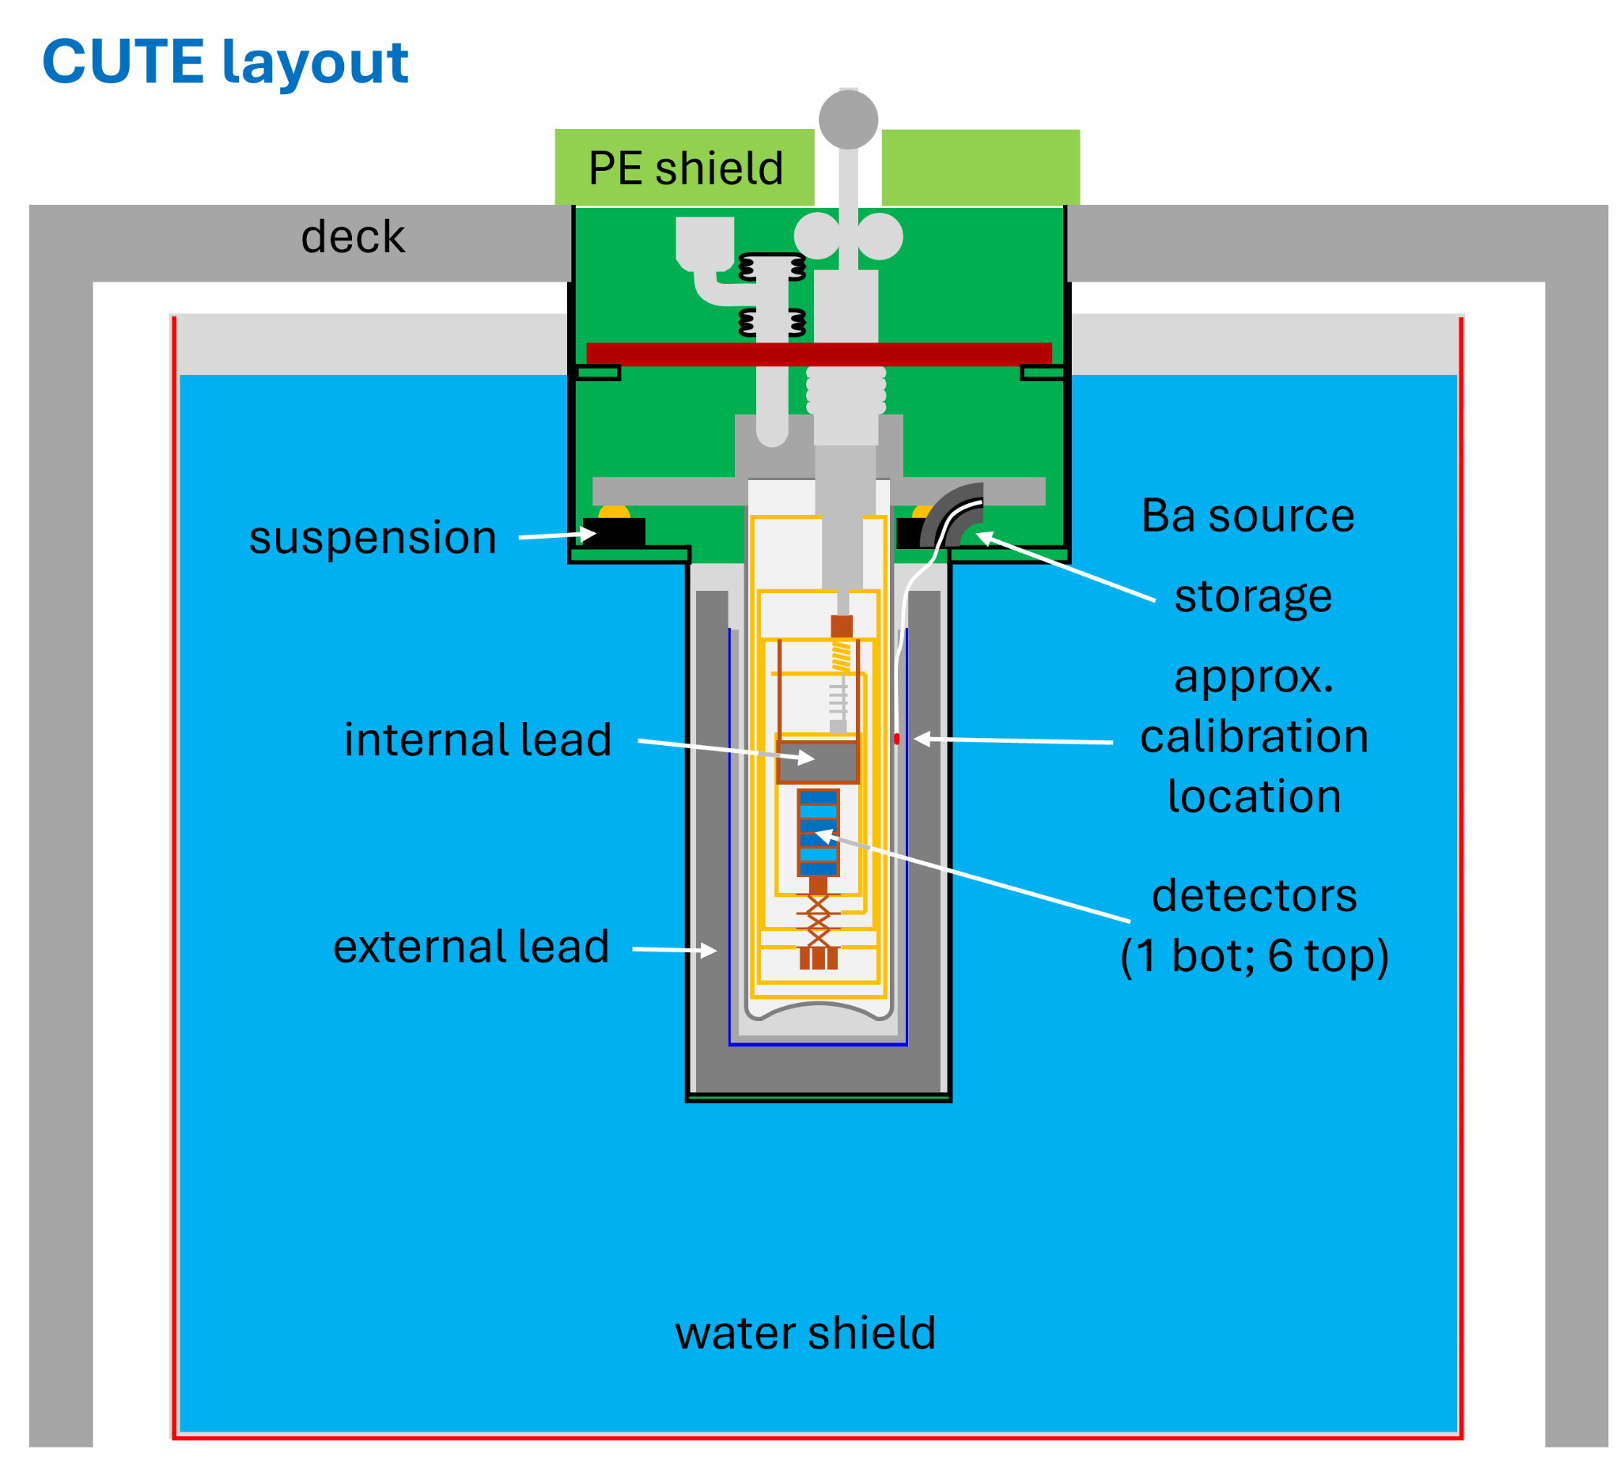
CUTE Shielding
Payload is easily accessible
Outer water tank, sides and bottom
Two layers of lead shielding inside
Polyethylene shield at the top that can be moved away
Lead plug inside at the top
Nested copper cans

Slide 17
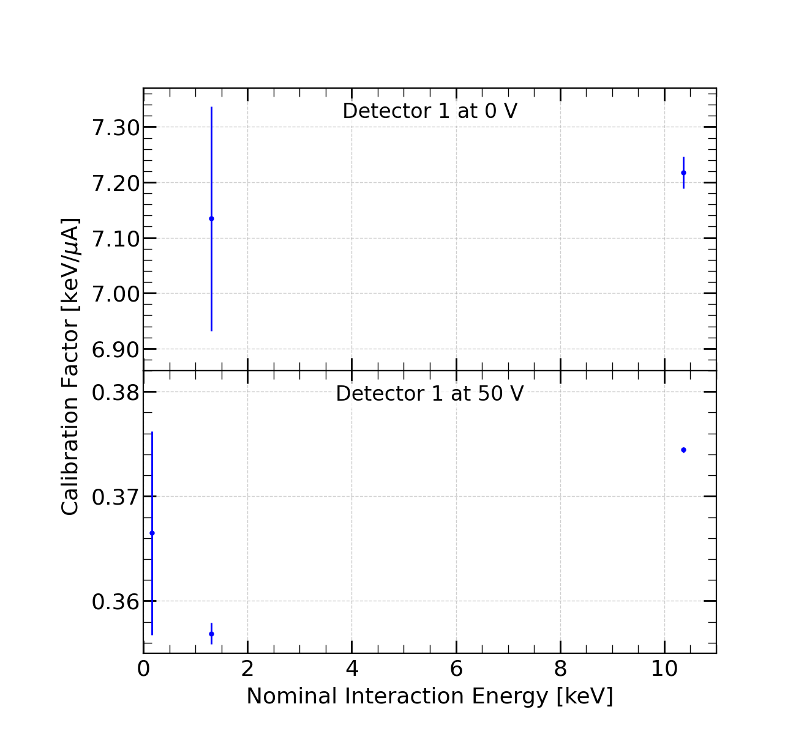
Low Energy Calibration
Performed an unbinned NLL fit to each activation peak
Extract a linear calibration factor
For 50 V data, had to linearize the energy scale using the integral estimator (which was found to be linear to higher energies than the amplitude)

