Slide 1
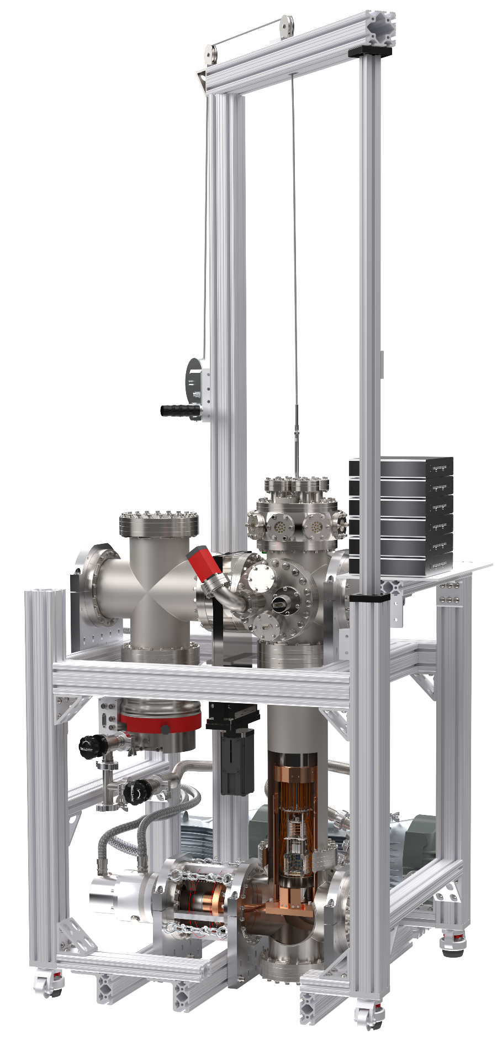

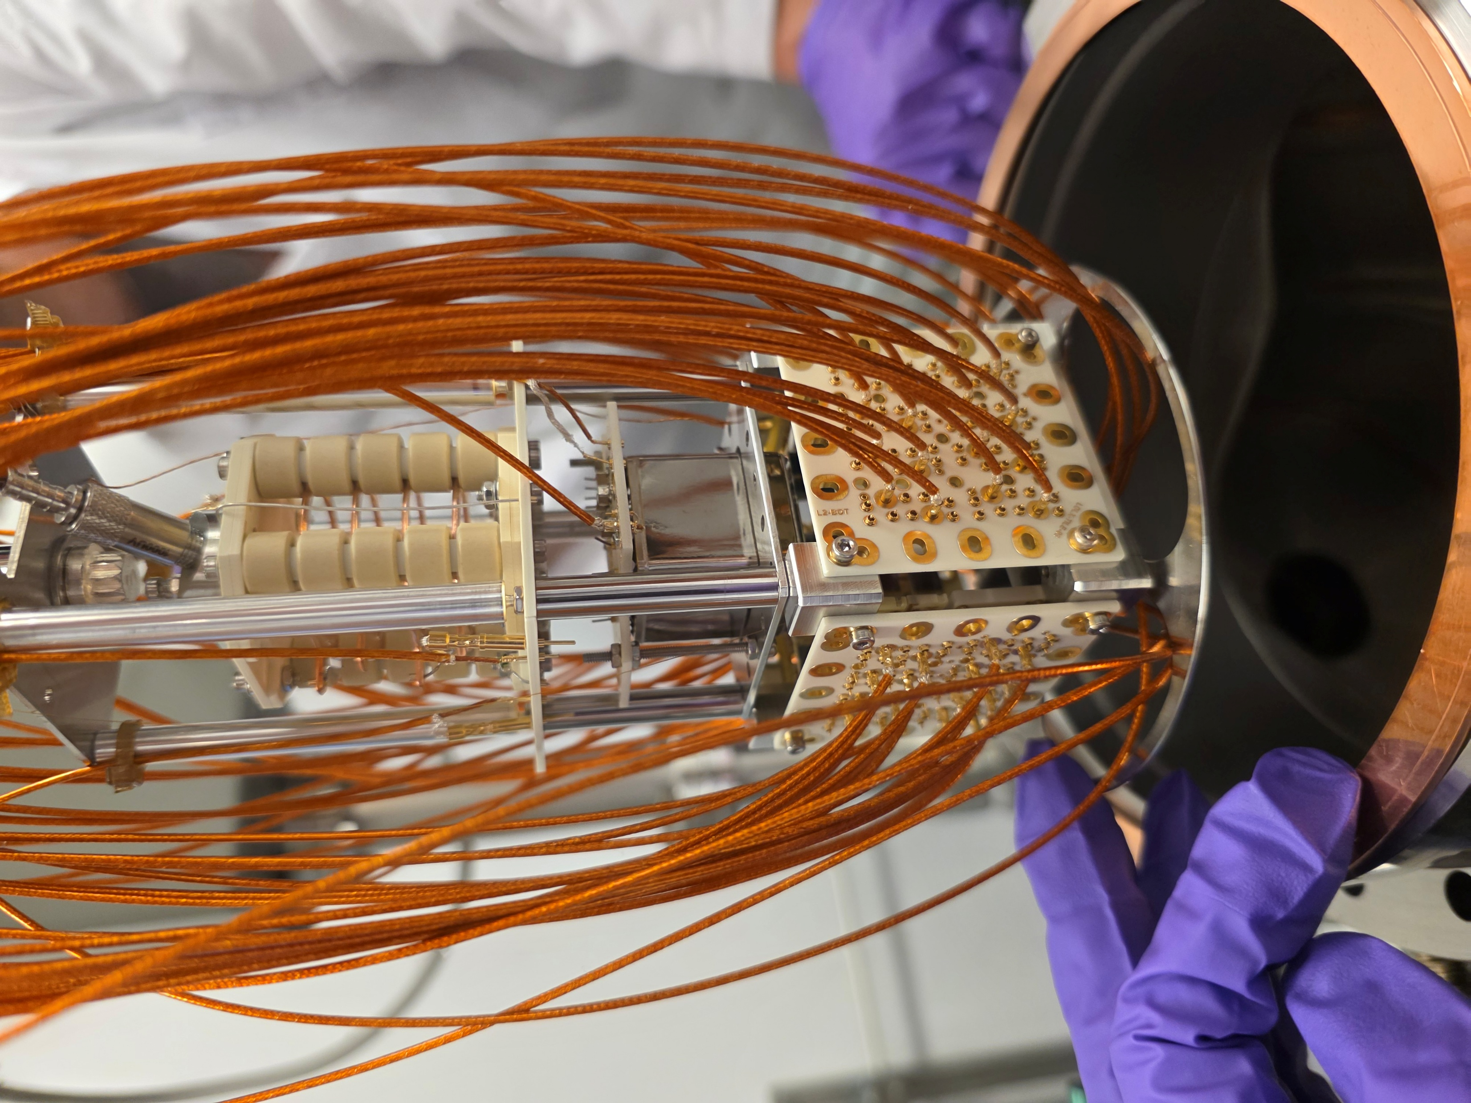
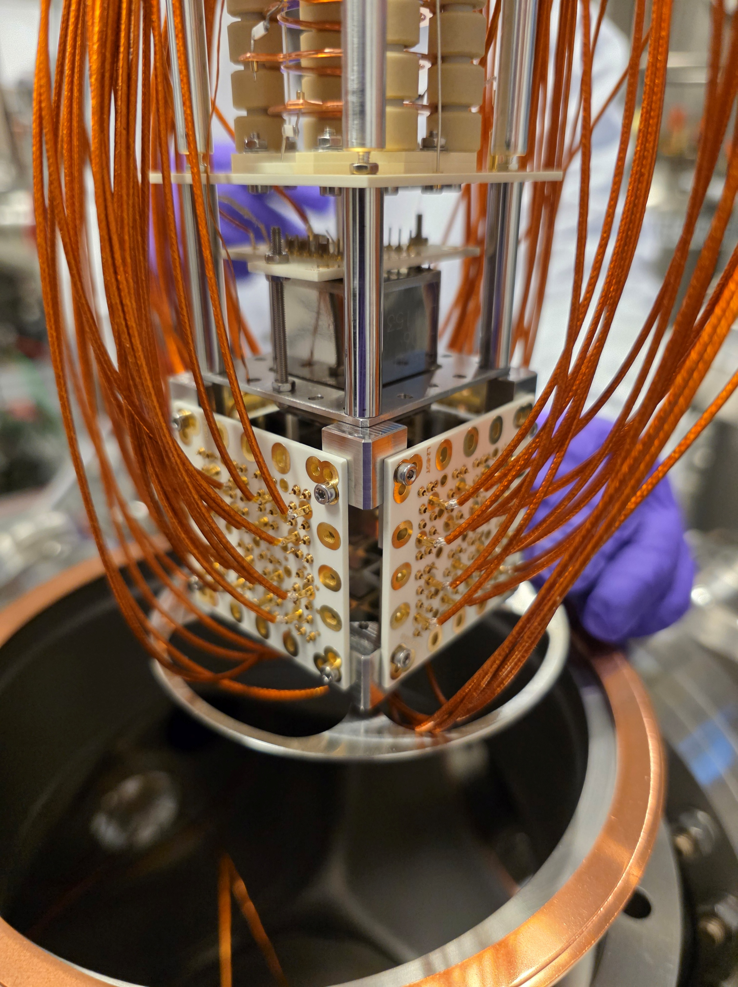


In Situ Comparison of Silicon Photomultiplier Performance in Liquid Xenon with LoLX 2
Frédéric Girard, McGill University
On behalf of the LoLX collaboration
2026 CAP Congress

Slide 2
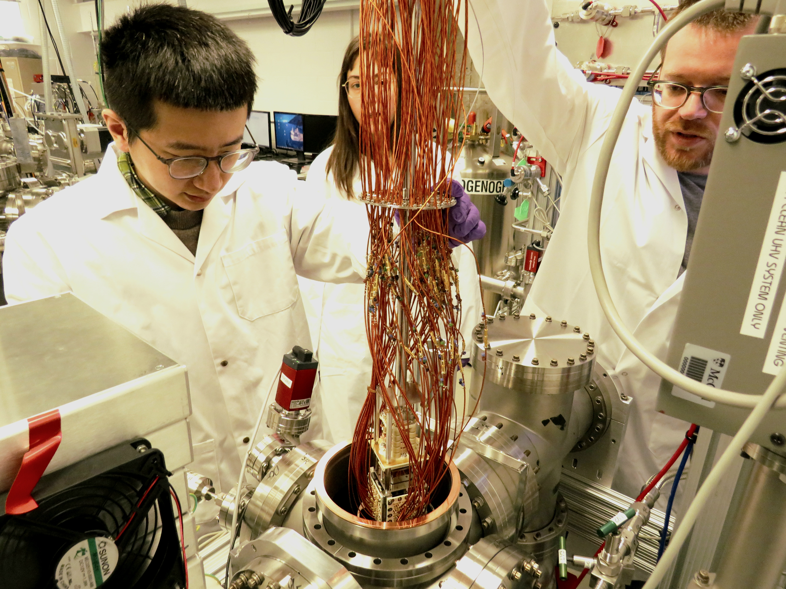

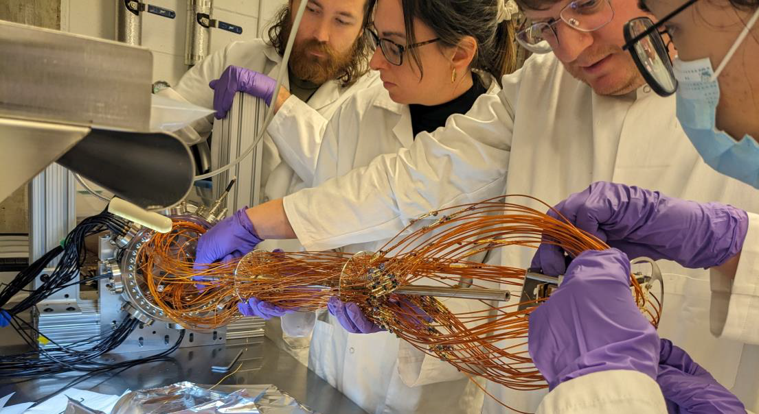






Light-only Liquid Xenon Collaboration
Detector located at McGill University, Montréal, Canada
Design, development, operation and analysis: McGill and TRIUMF
Photosensor development: U. Sherbrooke and TRIUMF
DAQ: TRIUMF and INFN
Simulations: Carleton, TRIUMF, McGill
Frédéric Girard
2026 CAP Congress
Notes:
The short answer is: "we don't know". The wrong answer is: "we have no idea".
In fact it’s existence is supported by cosmological and astrophysical observations. For example, during the merger of galaxy clusters, the intergalactic gasses highlighted in pink, interacted, slowing down and warming up, emitting x-ray radiation. Stars and dark matter on the other hand passed through unaffected. The technique of weak gravitational lensing can be used to determine the mass distribution of non-luminous matter, highlighted in blue. With this we can show that dark matter accounts for 85% of the total mass of the clusters.
In fact it is known from cosmic microwave background models that there should exist 5x more dark matter than baryonic matter.

Slide 3
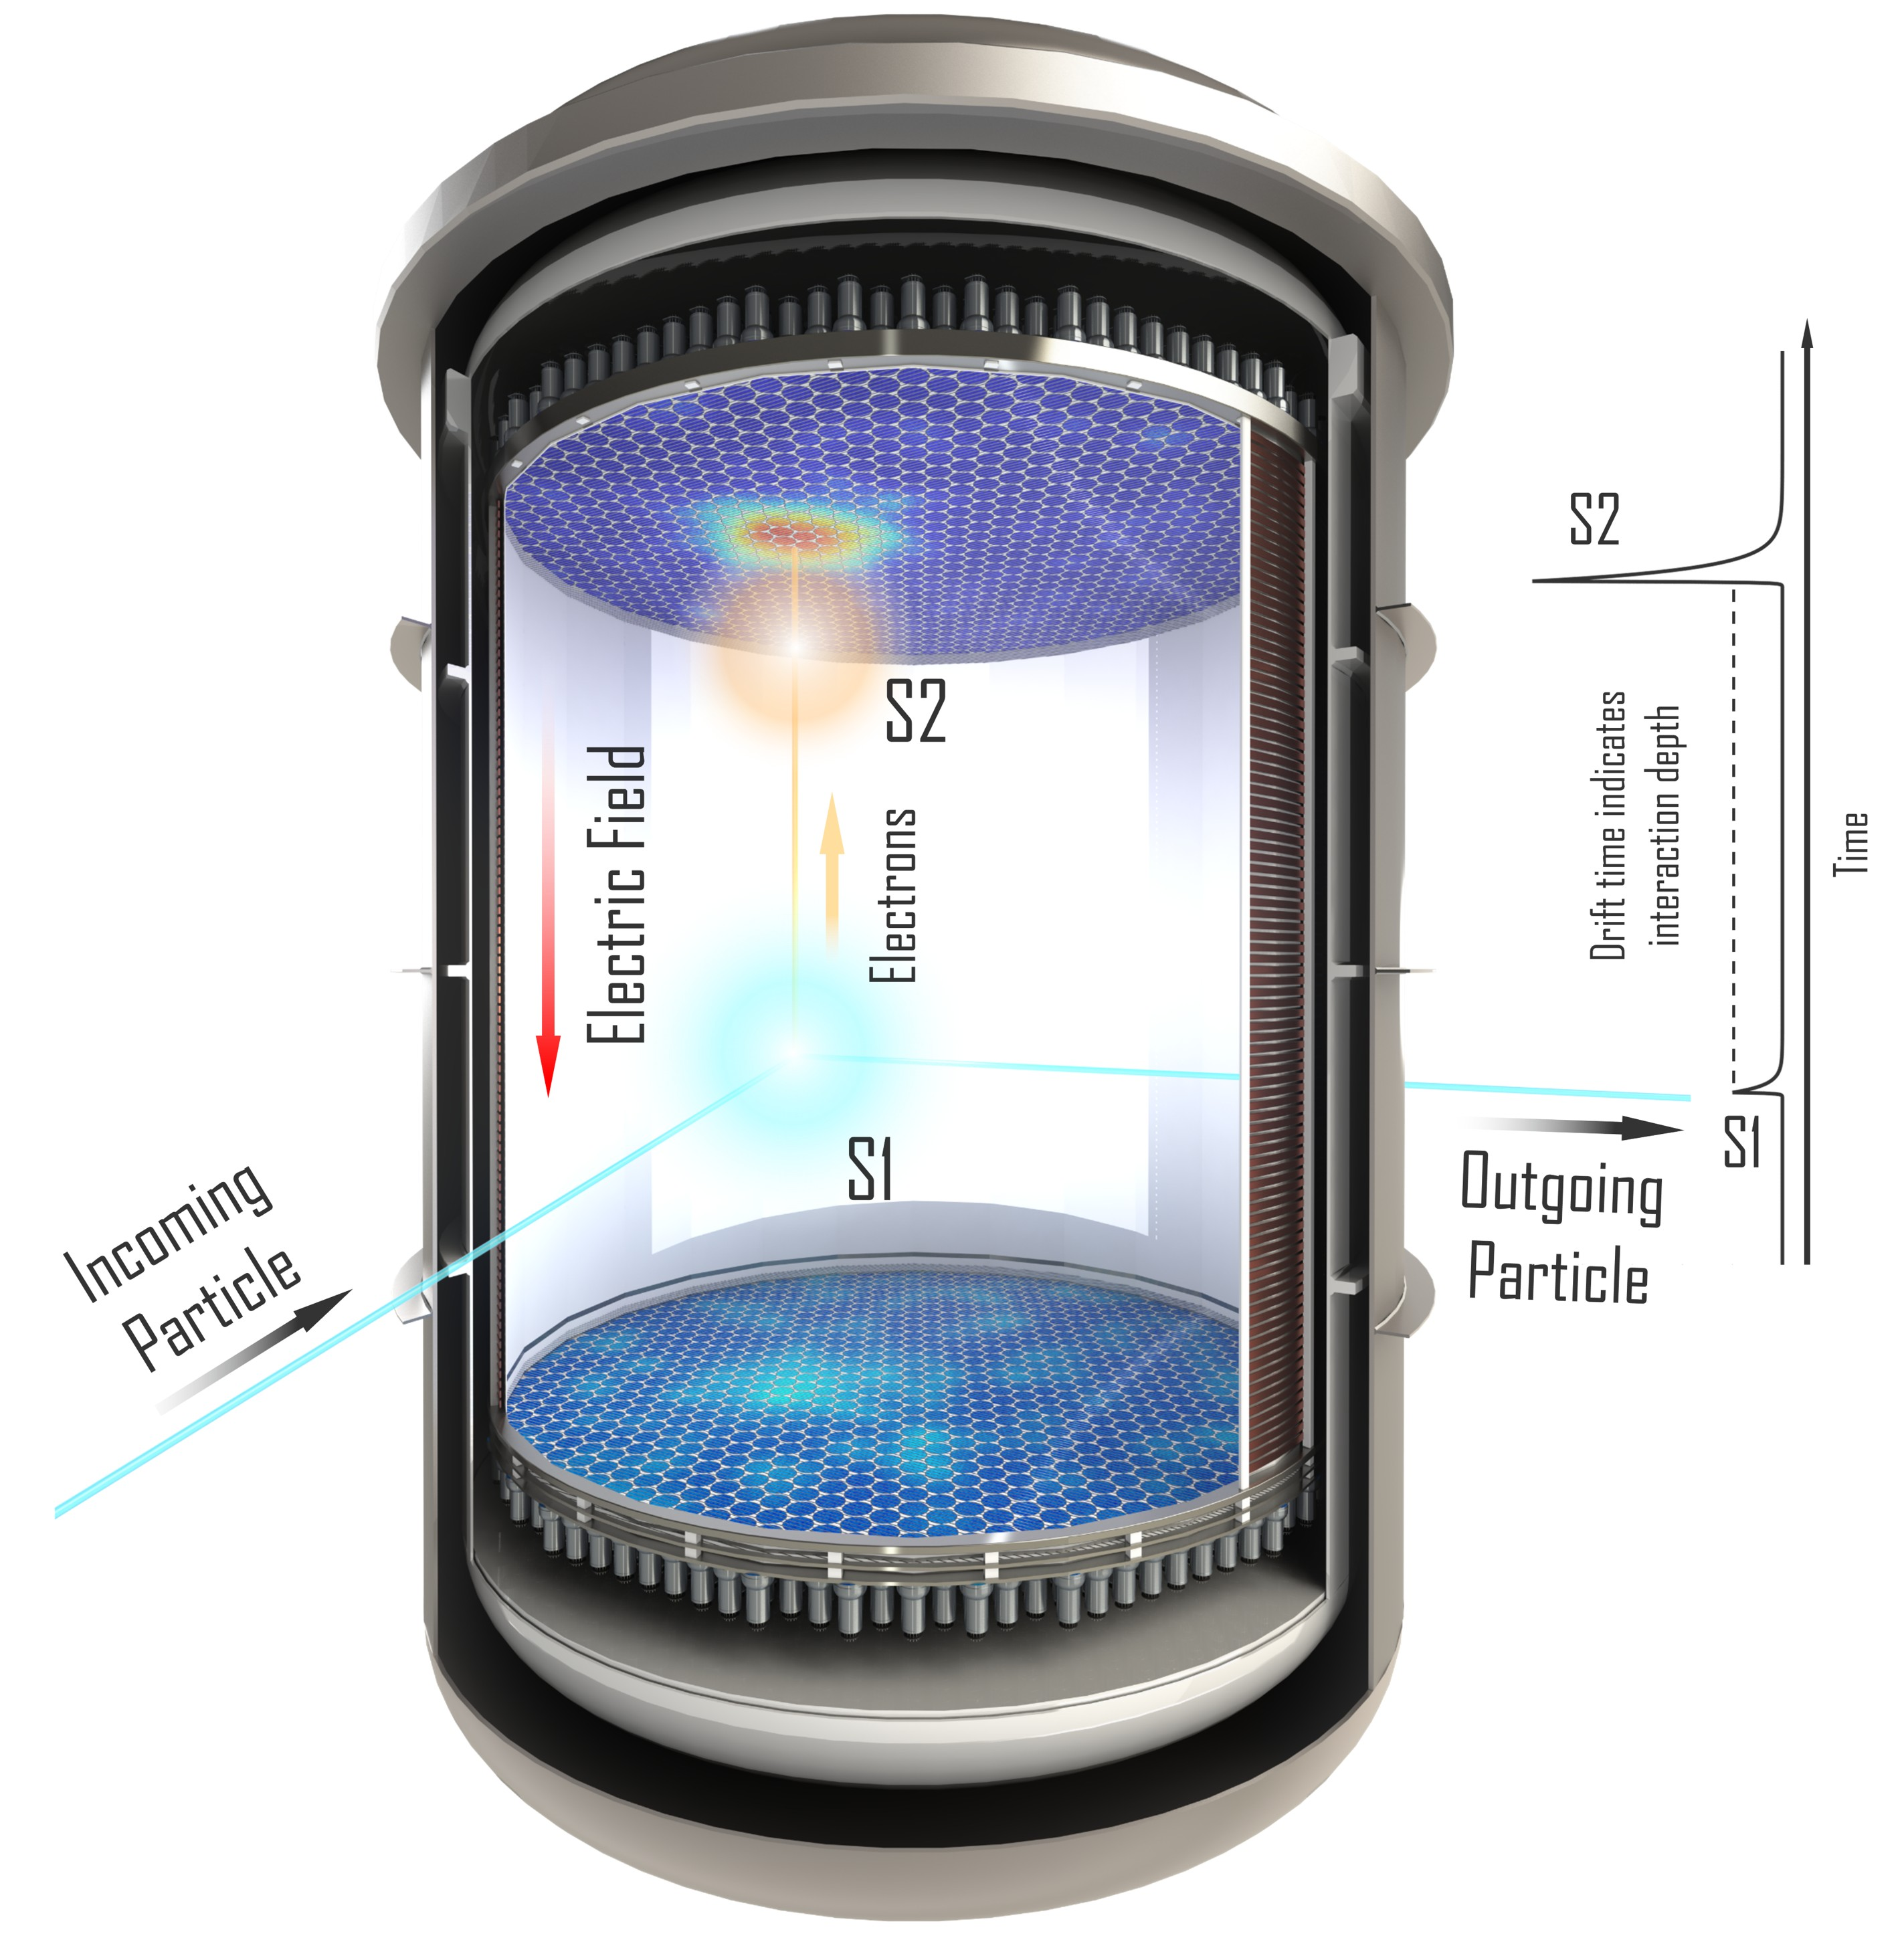
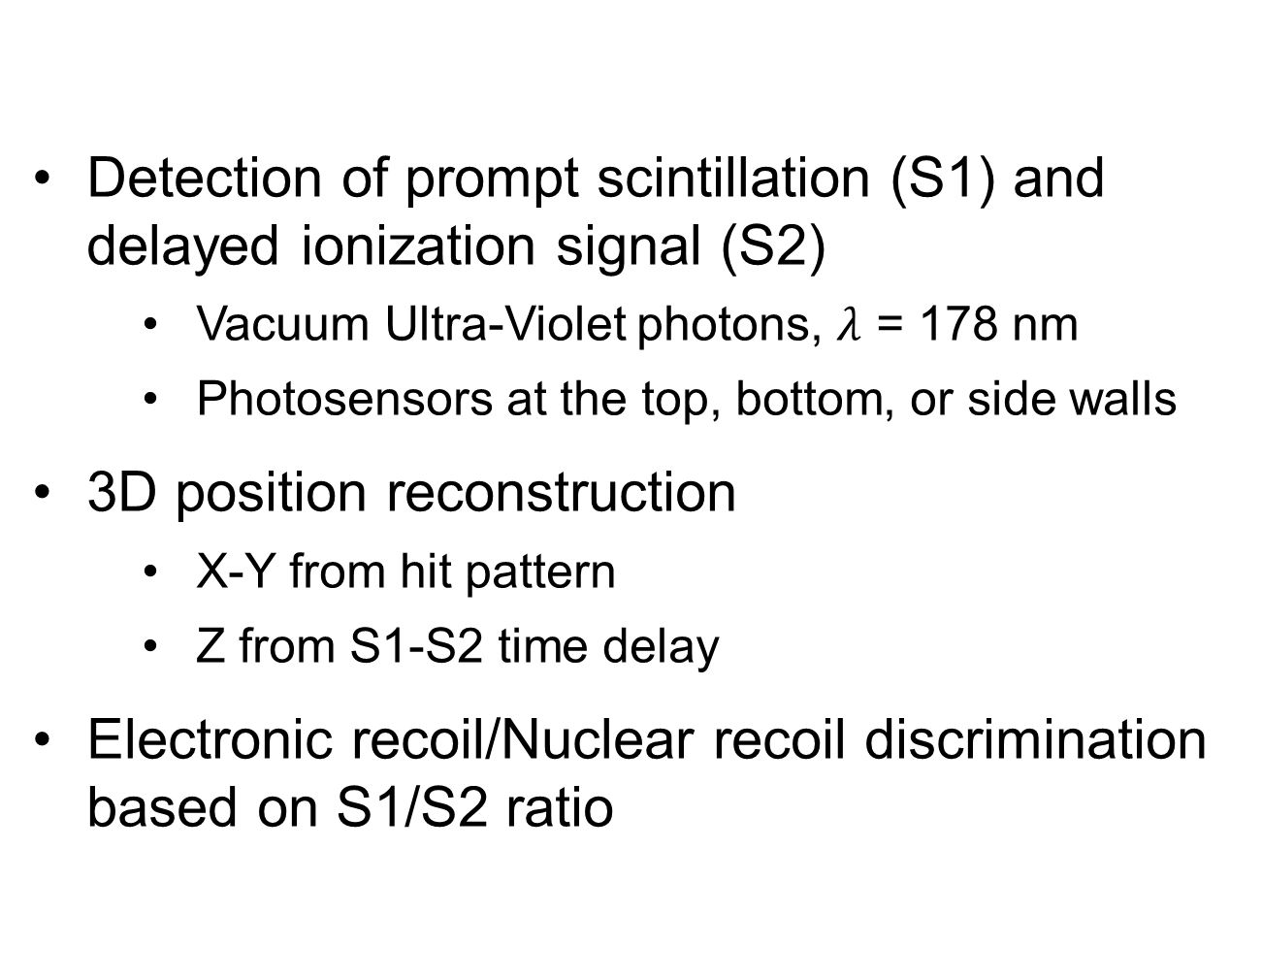
Xenon Time Projection Chamber
Detection of prompt scintillation (S1) and delayed ionization signal (S2)
  Vacuum Ultra-Violet photons, $λ$ = 178 nm
  Photosensors at the top, bottom, or side walls
3D position reconstruction
  X-Y from hit pattern
  Z from S1-S2 time delay
Electronic recoil/Nuclear recoil discrimination based on S1/S2 ratio
Frédéric Girard
2026 CAP Congress
Notes:
The short answer is: "we don't know". The wrong answer is: "we have no idea".
In fact it’s existence is supported by cosmological and astrophysical observations. For example, during the merger of galaxy clusters, the intergalactic gasses highlighted in pink, interacted, slowing down and warming up, emitting x-ray radiation. Stars and dark matter on the other hand passed through unaffected. The technique of weak gravitational lensing can be used to determine the mass distribution of non-luminous matter, highlighted in blue. With this we can show that dark matter accounts for 85% of the total mass of the clusters.
In fact it is known from cosmic microwave background models that there should exist 5x more dark matter than baryonic matter.

Slide 4
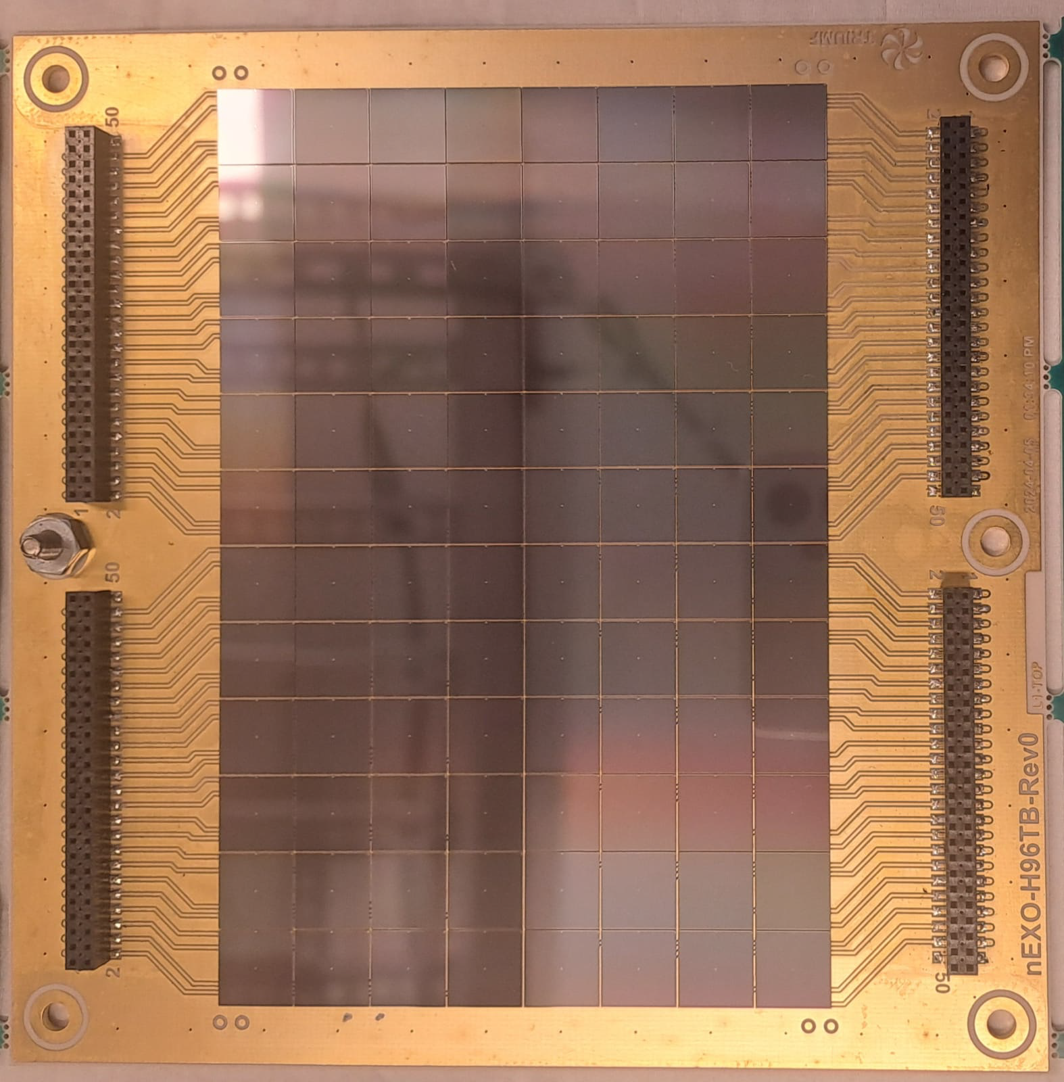
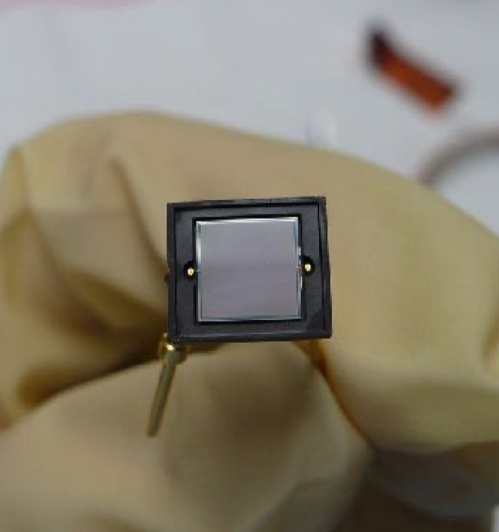
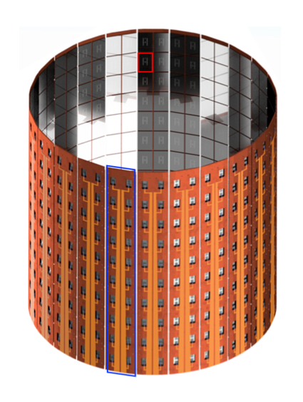

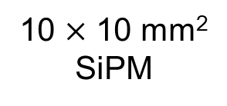
LoLX 2 Goals
10 $×$ 10 mm² SiPM
96-SiPM nEXO tile
Photosensor R&D for next-generation low background experiments (nEXO, PIONEER, XLZD)
  Direct comparison of SiPM performance in LXe
  Study of external crosstalk
  Long-term photosensor stability at cryogenic temperature
Study of optical properties of LXe and validation of simulations
  LXe scintillation
  Cherenkov radiation in LXe
20-tile stave
46 080 SiPMs in nEXO
Frédéric Girard
2026 CAP Congress
Notes:
The short answer is: "we don't know". The wrong answer is: "we have no idea".
In fact it’s existence is supported by cosmological and astrophysical observations. For example, during the merger of galaxy clusters, the intergalactic gasses highlighted in pink, interacted, slowing down and warming up, emitting x-ray radiation. Stars and dark matter on the other hand passed through unaffected. The technique of weak gravitational lensing can be used to determine the mass distribution of non-luminous matter, highlighted in blue. With this we can show that dark matter accounts for 85% of the total mass of the clusters.
In fact it is known from cosmic microwave background models that there should exist 5x more dark matter than baryonic matter.

Slide 5
LoLX 2 Goals
Fill Factor: 60%
Photosensor R&D for next-generation low background experiments (nEXO, PIONEER, XLZD)
  Direct comparison of SiPM performance in LXe
  Study of external crosstalk
  Long-term photosensor stability at cryogenic temperature
Study of optical properties of LXe and validation of simulations
  LXe scintillation
  Cherenkov radiation in LXe
Fill Factor: 80%
Frédéric Girard
2026 CAP Congress
Notes:
The short answer is: "we don't know". The wrong answer is: "we have no idea".
In fact it’s existence is supported by cosmological and astrophysical observations. For example, during the merger of galaxy clusters, the intergalactic gasses highlighted in pink, interacted, slowing down and warming up, emitting x-ray radiation. Stars and dark matter on the other hand passed through unaffected. The technique of weak gravitational lensing can be used to determine the mass distribution of non-luminous matter, highlighted in blue. With this we can show that dark matter accounts for 85% of the total mass of the clusters.
In fact it is known from cosmic microwave background models that there should exist 5x more dark matter than baryonic matter.

Slide 6
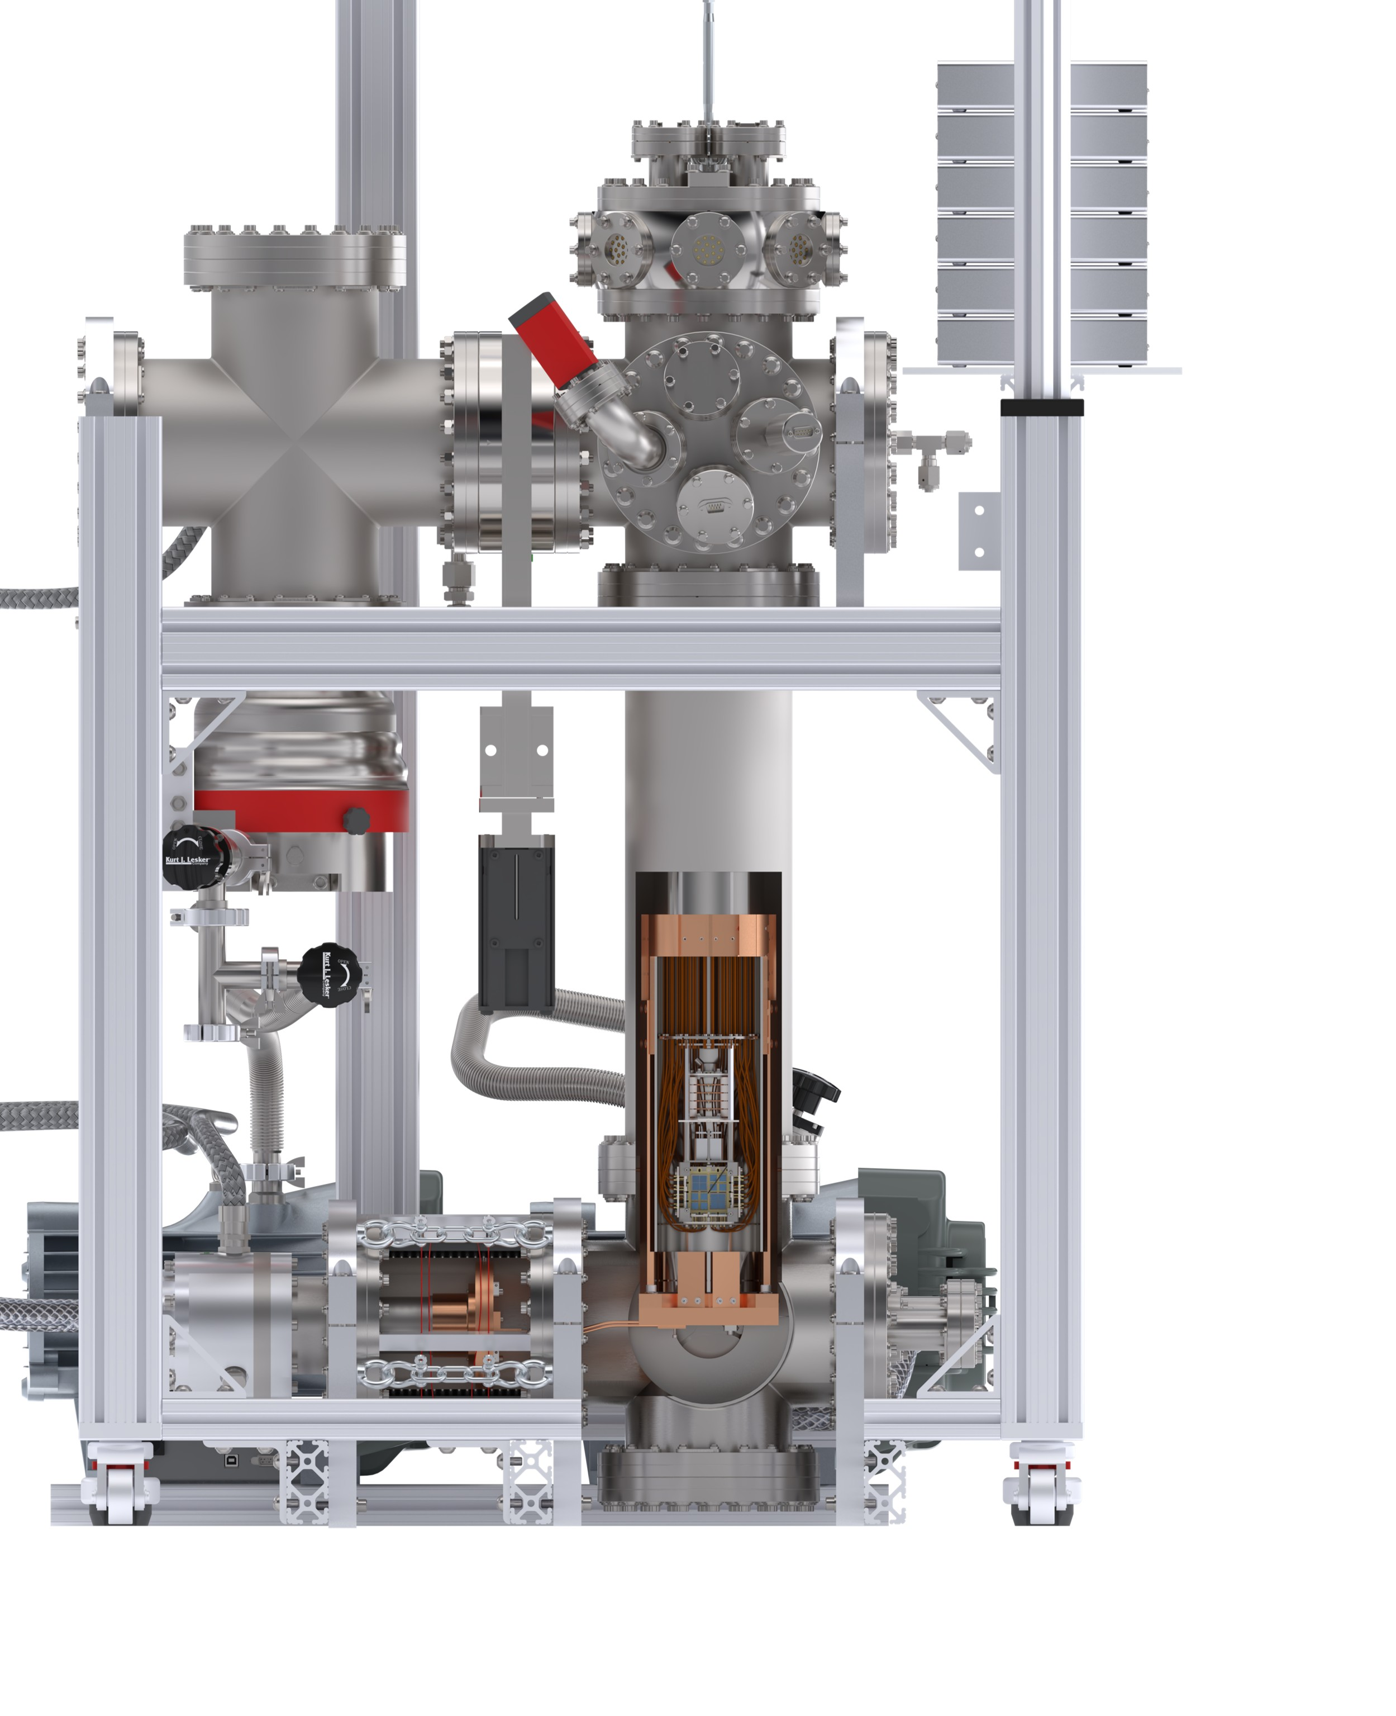
LoLX 2 Overview
Cable Feedthroughs
Gate Valve
Double-walled cryostat
  5 kg LXe total
  Hosts the detector at 165 K
  Detector inserted from the top
Cooling from Gifford-McMahon cryocooler
  Copper cooling plates surround the inner vessel
Gas handling system
  Purification during filling with hot metal getter (MonoTorr PS3-MT3)
  Storage in stainless steel cylinders
  Xe recuperation with cryopumping
Double Walled Cryostat
Turbomolecular Pump
Detector
Cold Head
GM Cryocooler
Frédéric Girard
2026 CAP Congress
Notes:
The short answer is: "we don't know". The wrong answer is: "we have no idea".
In fact it’s existence is supported by cosmological and astrophysical observations. For example, during the merger of galaxy clusters, the intergalactic gasses highlighted in pink, interacted, slowing down and warming up, emitting x-ray radiation. Stars and dark matter on the other hand passed through unaffected. The technique of weak gravitational lensing can be used to determine the mass distribution of non-luminous matter, highlighted in blue. With this we can show that dark matter accounts for 85% of the total mass of the clusters.
In fact it is known from cosmic microwave background models that there should exist 5x more dark matter than baryonic matter.

Slide 7
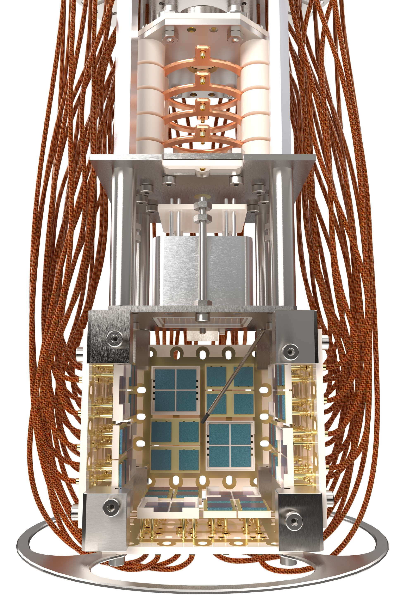
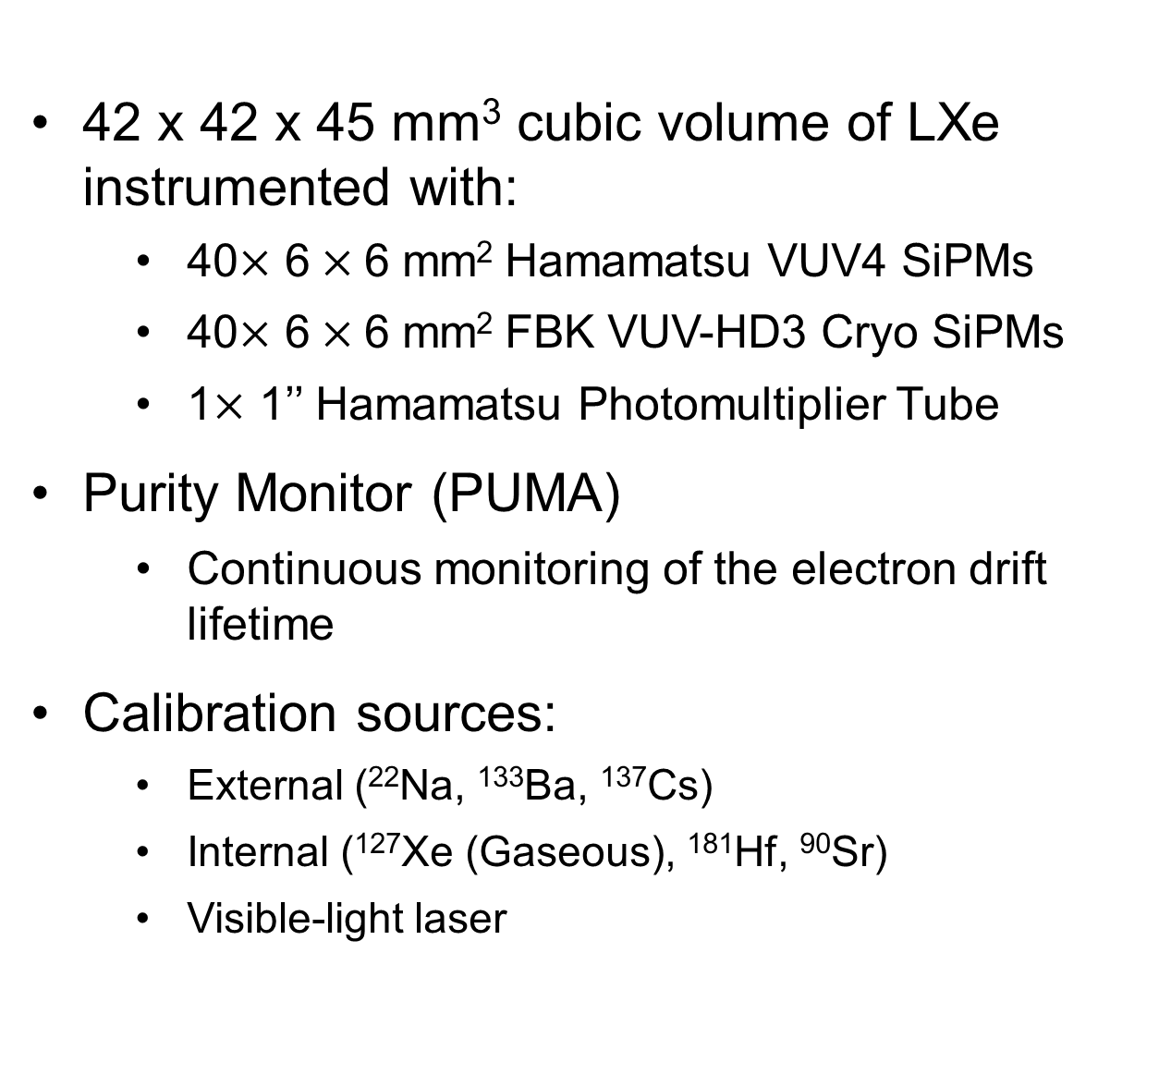


LoLX 2 Detector
Xenon Purity
Monitor (PUMA)
42 x 42 x 45 mm³ cubic volume of LXe instrumented with:
  40$×$ 6 $×$6 mm² Hamamatsu VUV4 SiPMs
  40$×$ 6 $×$6 mm² FBK VUV-HD3 Cryo SiPMs
  1$×$ 1’’ Hamamatsu Photomultiplier Tube
Purity Monitor (PUMA)
  Continuous monitoring of the electron drift lifetime
Calibration sources:
  External (²²Na, ¹³³Ba, ¹³⁷Cs)
  Internal (¹²⁷Xe (Gaseous), ¹⁸¹Hf, ⁹⁰Sr)
  Visible-light laser
R8520-406 SEL Photomultiplier Tube
Hamamastsu VUV4 SiPMs ($×$40)
Calibration sources (¹³¹Hf, ⁹⁰Sr)
FBK VUV-HD3 Cryo SiPMs ($×$40)
40 mm
Frédéric Girard
2026 CAP Congress
Notes:
The short answer is: "we don't know". The wrong answer is: "we have no idea".
In fact it’s existence is supported by cosmological and astrophysical observations. For example, during the merger of galaxy clusters, the intergalactic gasses highlighted in pink, interacted, slowing down and warming up, emitting x-ray radiation. Stars and dark matter on the other hand passed through unaffected. The technique of weak gravitational lensing can be used to determine the mass distribution of non-luminous matter, highlighted in blue. With this we can show that dark matter accounts for 85% of the total mass of the clusters.
In fact it is known from cosmic microwave background models that there should exist 5x more dark matter than baryonic matter.

Slide 8
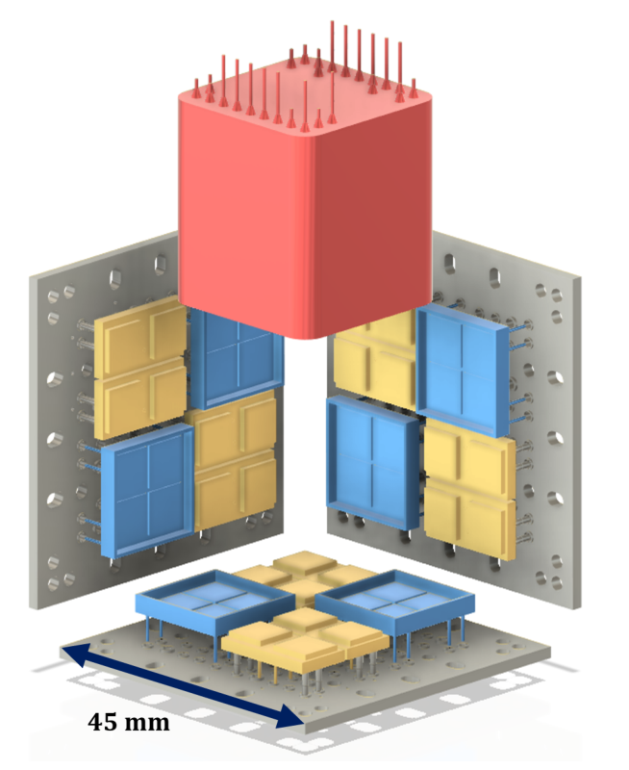
Performance of FBK VUV-HD3 and HPK VUV4 SiPMs in the Light-only Liquid Xenon (LoLX) Detector
arXiv:2510.15270 (submitted to JINST)
Direct comparison of photodetector performance in LXe
SiPM calibration using visible-light laser and external gamma source
Operational overvoltage: 3 V_{OV}
  Optimized for correlated-avalanche noise and energy resolution for nEXO [Eur. Phys. J. C (2022) 82 :1125]
Active photosensors in this study
  34 FBK SiPMs (yellow)
  35 HPK SiPMs (blue)
  1 HPK PMT (red)
Frédéric Girard
2026 CAP Congress
Notes:
The short answer is: "we don't know". The wrong answer is: "we have no idea".
In fact it’s existence is supported by cosmological and astrophysical observations. For example, during the merger of galaxy clusters, the intergalactic gasses highlighted in pink, interacted, slowing down and warming up, emitting x-ray radiation. Stars and dark matter on the other hand passed through unaffected. The technique of weak gravitational lensing can be used to determine the mass distribution of non-luminous matter, highlighted in blue. With this we can show that dark matter accounts for 85% of the total mass of the clusters.
In fact it is known from cosmic microwave background models that there should exist 5x more dark matter than baryonic matter.

Slide 9
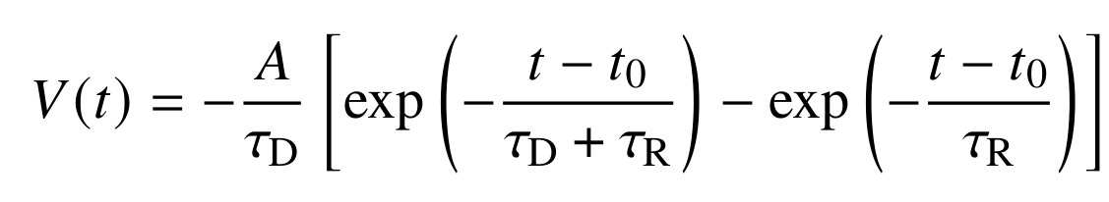
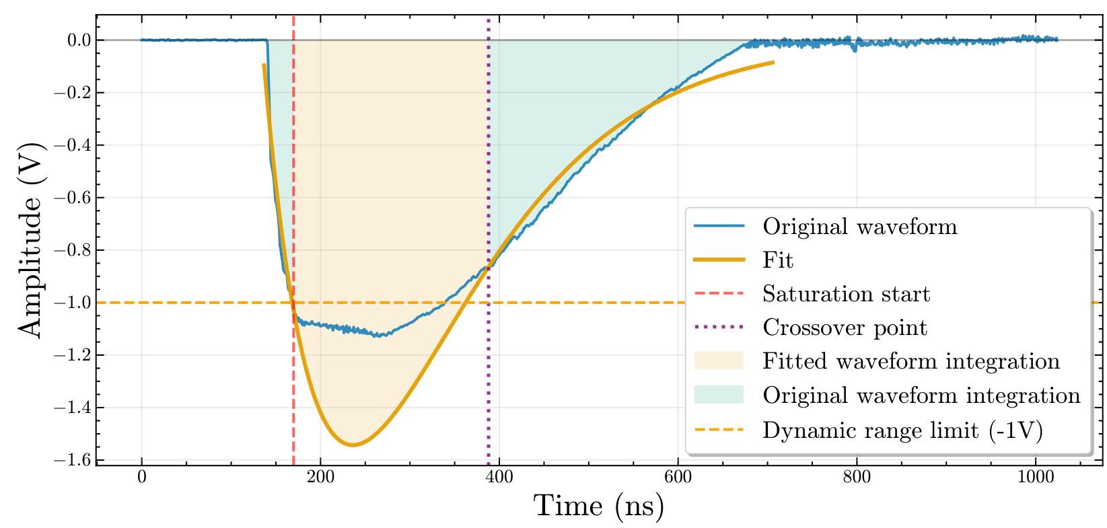
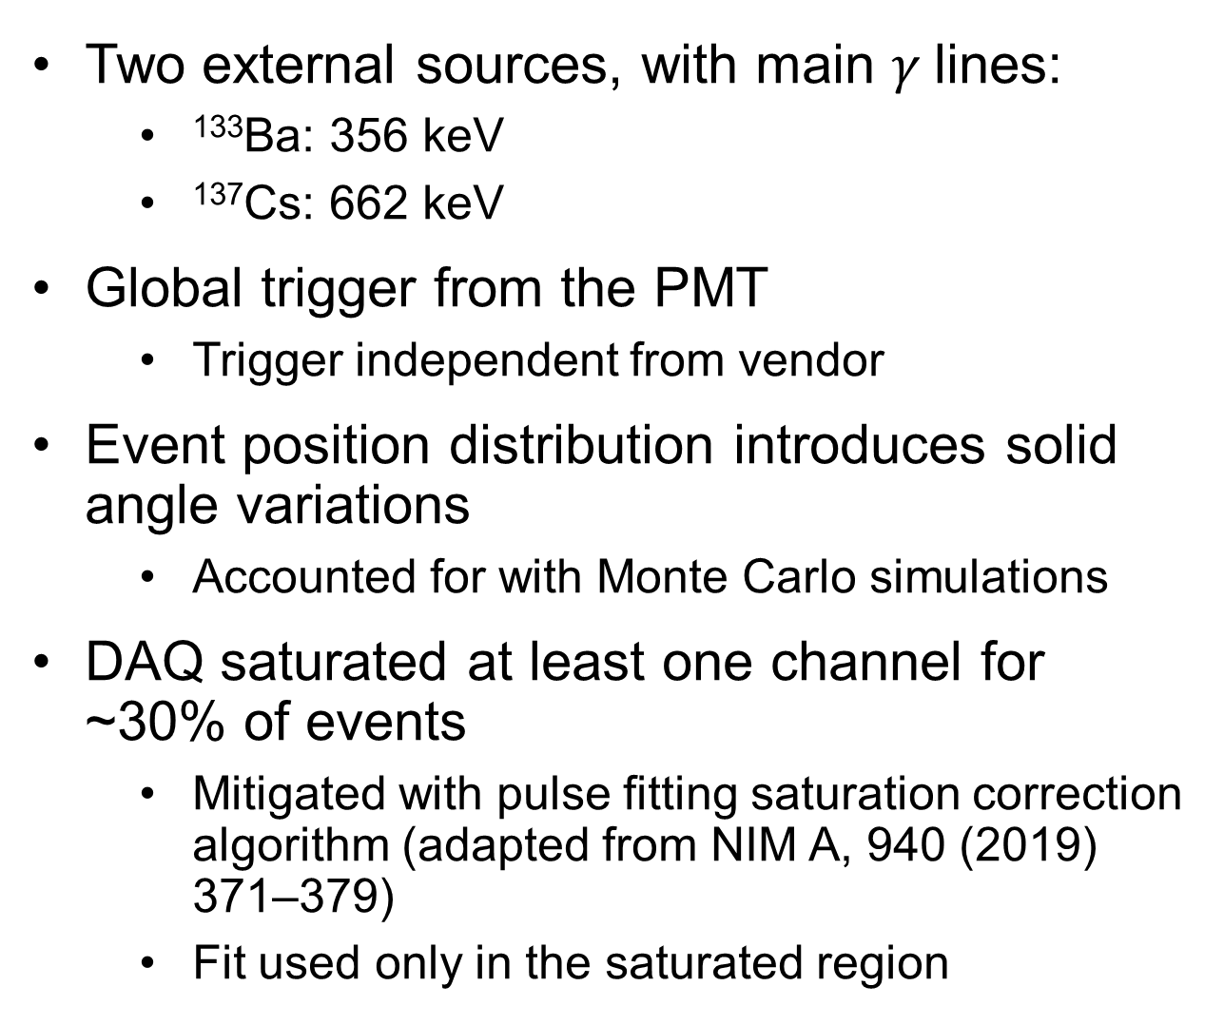
External Source Measurements
Two external sources, with main $γ$lines:
  ¹³³Ba: 356 keV
  ¹³⁷Cs: 662 keV
Global trigger from the PMT
  Trigger independent from vendor
Event position distribution introduces solid angle variations
  Accounted for with Monte Carlo simulations
DAQ saturated at least one channel for ~30% of events
  Mitigated with pulse fitting saturation correction algorithm (adapted from NIM A, 940 (2019) 371–379)
  Fit used only in the saturated region
Preliminary
Example of the pulse fitting saturation correction
arXiv:2510.15270 (submitted to JINST)
Frédéric Girard
2026 CAP Congress
Notes:
The short answer is: "we don't know". The wrong answer is: "we have no idea".
In fact it’s existence is supported by cosmological and astrophysical observations. For example, during the merger of galaxy clusters, the intergalactic gasses highlighted in pink, interacted, slowing down and warming up, emitting x-ray radiation. Stars and dark matter on the other hand passed through unaffected. The technique of weak gravitational lensing can be used to determine the mass distribution of non-luminous matter, highlighted in blue. With this we can show that dark matter accounts for 85% of the total mass of the clusters.
In fact it is known from cosmic microwave background models that there should exist 5x more dark matter than baryonic matter.

Slide 10
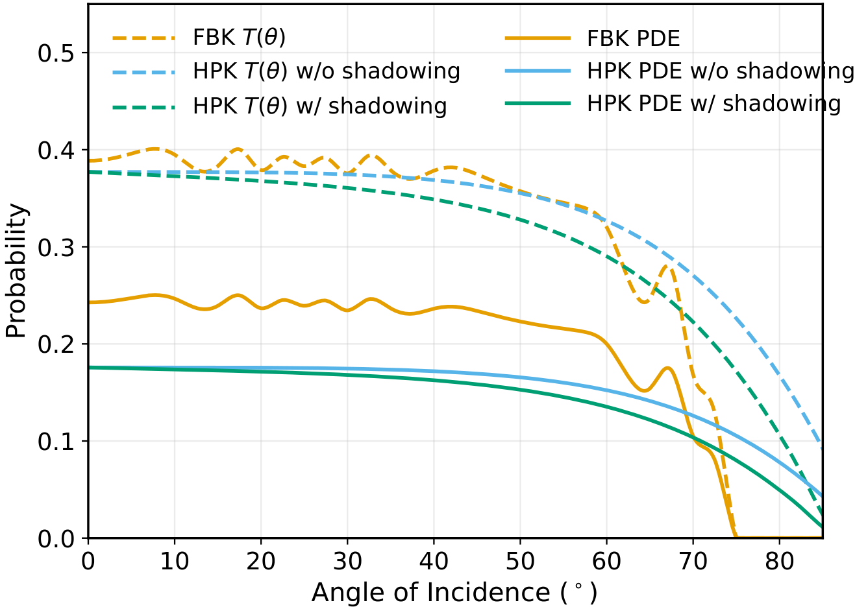
Simulation pipeline
Detector response modeled with multi-stage simulation pipeline
  Geant4: Particle interaction and energy deposition
  NEST: LXe scintillation
  CHROMA: GPU-based light transport
PDE offset governed by geometric fill factor
  FBK: 0.8
  HPK: 0.6
FBK optical transmission probability cut-off caused by thin-film interference
HPK shadowing caused by surface topology
HPK quartz window treated separately in CHROMA
See talk by Xiang Li!
Preliminary
Angular dependence of optical transmission probability and photodetection efficiency
arXiv:2510.15270 (submitted to JINST)
Frédéric Girard
2026 CAP Congress
Notes:
The short answer is: "we don't know". The wrong answer is: "we have no idea".
In fact it’s existence is supported by cosmological and astrophysical observations. For example, during the merger of galaxy clusters, the intergalactic gasses highlighted in pink, interacted, slowing down and warming up, emitting x-ray radiation. Stars and dark matter on the other hand passed through unaffected. The technique of weak gravitational lensing can be used to determine the mass distribution of non-luminous matter, highlighted in blue. With this we can show that dark matter accounts for 85% of the total mass of the clusters.
In fact it is known from cosmic microwave background models that there should exist 5x more dark matter than baryonic matter.

Slide 11
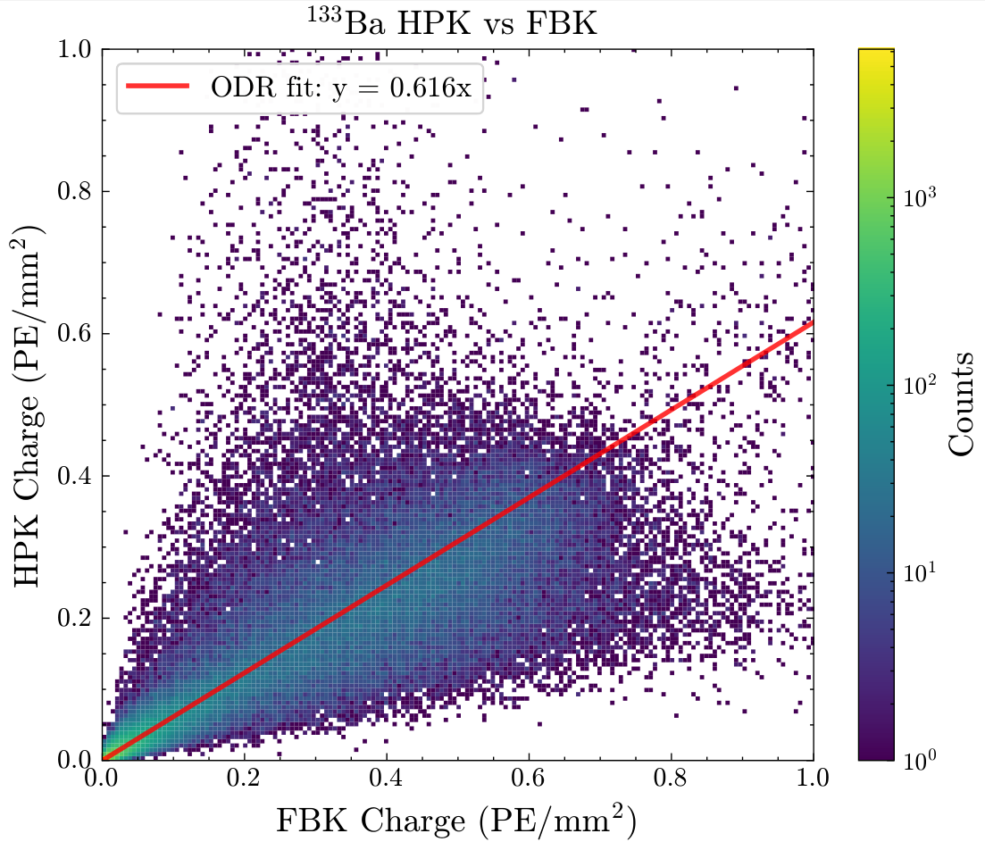
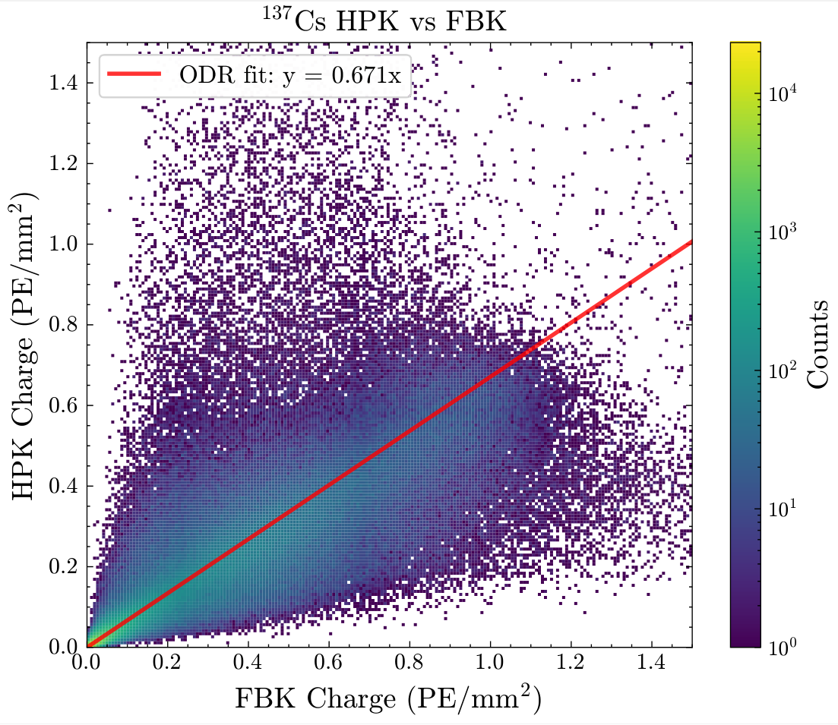
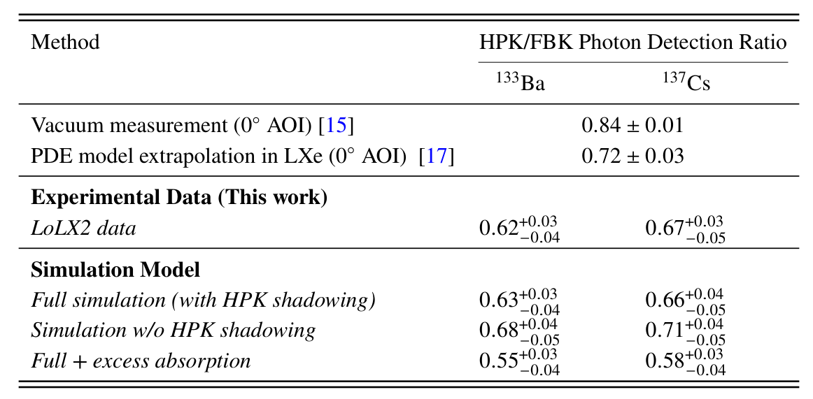
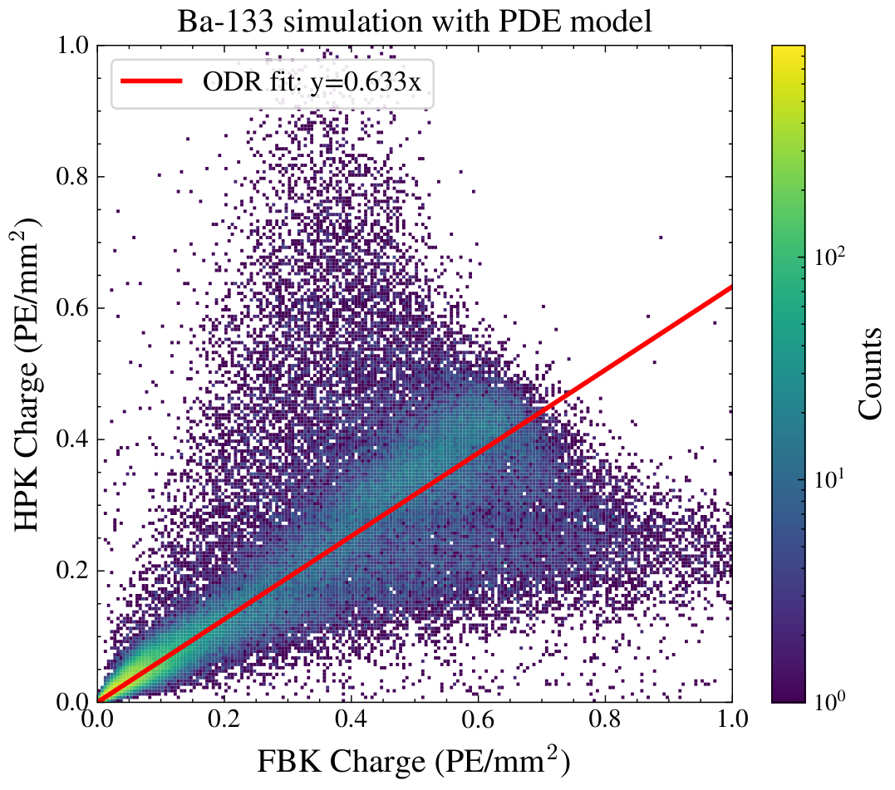
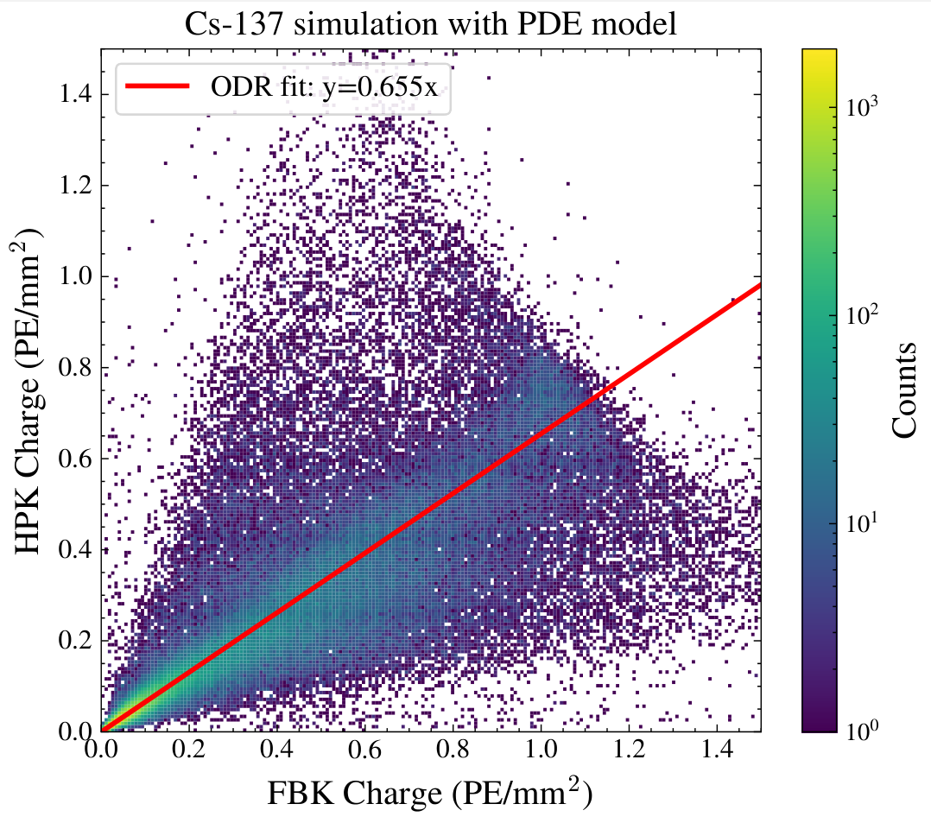
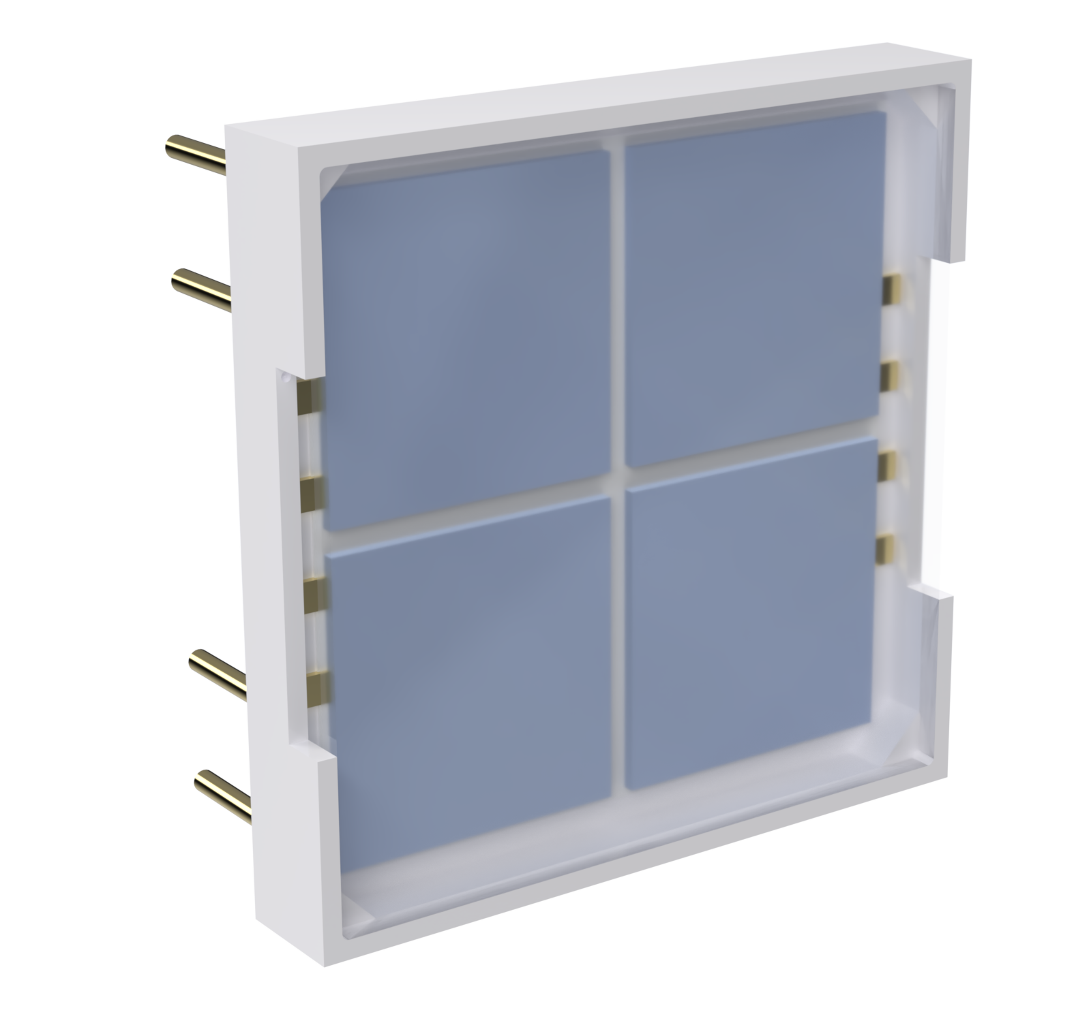
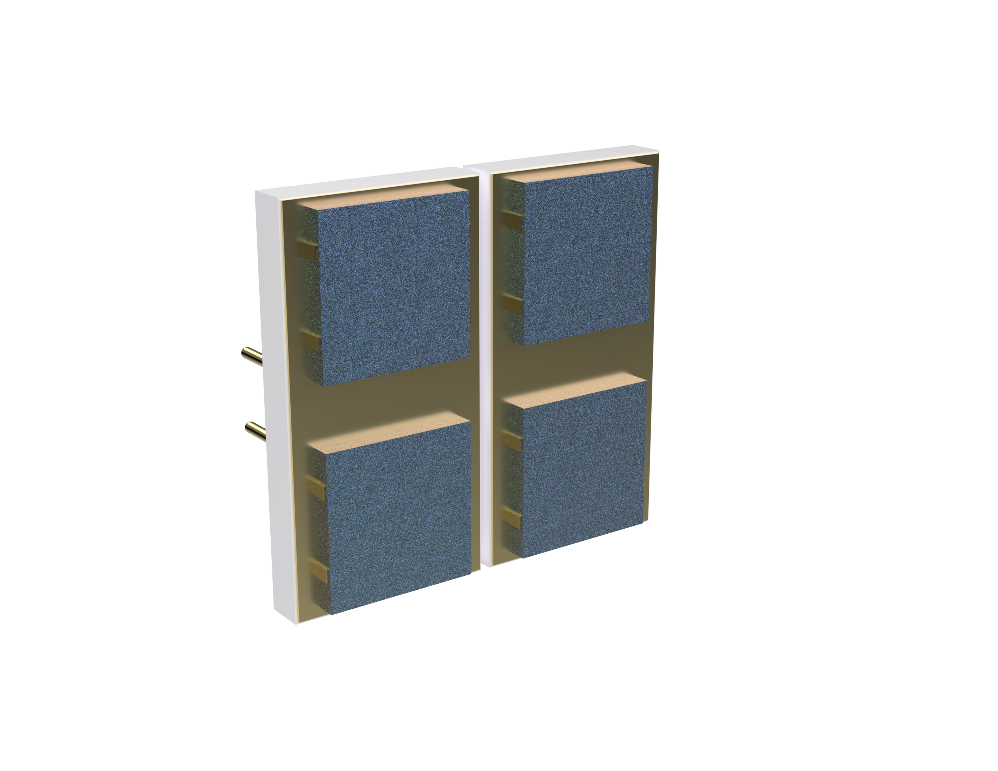
Experimental and Simulations Comparison of SiPM Response to LXe Scintillation
Preliminary
¹³³Ba
¹³⁷Cs
Preliminary
Preliminary
Collected charge normalized to the total nominal active area
Experimental
Preliminary
Preliminary
Simulations
HPK
FBK
arXiv:2510.15270 (submitted to JINST)
Frédéric Girard
2026 CAP Congress
Notes:
The short answer is: "we don't know". The wrong answer is: "we have no idea".
In fact it’s existence is supported by cosmological and astrophysical observations. For example, during the merger of galaxy clusters, the intergalactic gasses highlighted in pink, interacted, slowing down and warming up, emitting x-ray radiation. Stars and dark matter on the other hand passed through unaffected. The technique of weak gravitational lensing can be used to determine the mass distribution of non-luminous matter, highlighted in blue. With this we can show that dark matter accounts for 85% of the total mass of the clusters.
In fact it is known from cosmic microwave background models that there should exist 5x more dark matter than baryonic matter.

Slide 12
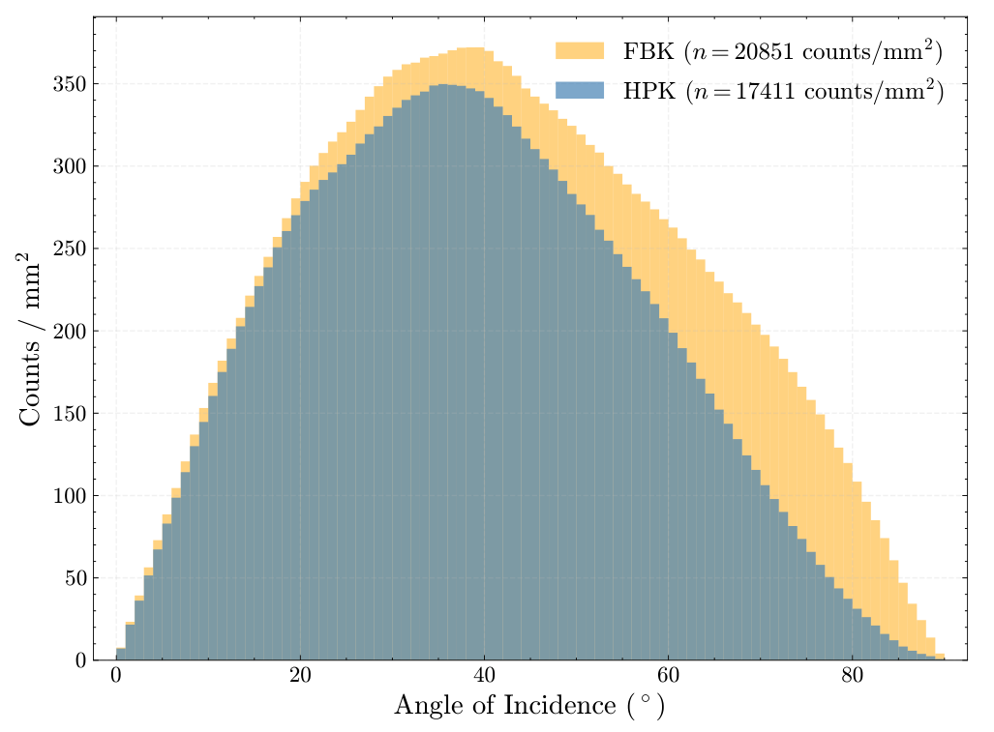
Experimental and Simulations Comparison of SiPM Response to LXe Scintillation
Preliminary
Collected charge normalized to the total nominal active area
Shadowing from SiPM packaging
The effective photon detection ratio is a convolution of:
  the intrinsic angle dependent efficiency of the SiPMs
  system-level photon transport
HPK
FBK
arXiv:2510.15270 (submitted to JINST)
Frédéric Girard
2026 CAP Congress
Notes:
The short answer is: "we don't know". The wrong answer is: "we have no idea".
In fact it’s existence is supported by cosmological and astrophysical observations. For example, during the merger of galaxy clusters, the intergalactic gasses highlighted in pink, interacted, slowing down and warming up, emitting x-ray radiation. Stars and dark matter on the other hand passed through unaffected. The technique of weak gravitational lensing can be used to determine the mass distribution of non-luminous matter, highlighted in blue. With this we can show that dark matter accounts for 85% of the total mass of the clusters.
In fact it is known from cosmic microwave background models that there should exist 5x more dark matter than baryonic matter.

Slide 13
What’s next for LoLX?
Frédéric Girard
2026 CAP Congress
Notes:
The short answer is: "we don't know". The wrong answer is: "we have no idea".
In fact it’s existence is supported by cosmological and astrophysical observations. For example, during the merger of galaxy clusters, the intergalactic gasses highlighted in pink, interacted, slowing down and warming up, emitting x-ray radiation. Stars and dark matter on the other hand passed through unaffected. The technique of weak gravitational lensing can be used to determine the mass distribution of non-luminous matter, highlighted in blue. With this we can show that dark matter accounts for 85% of the total mass of the clusters.
In fact it is known from cosmic microwave background models that there should exist 5x more dark matter than baryonic matter.

Slide 14
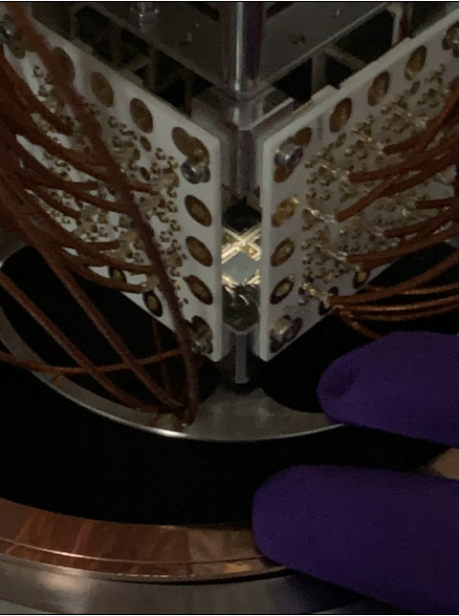
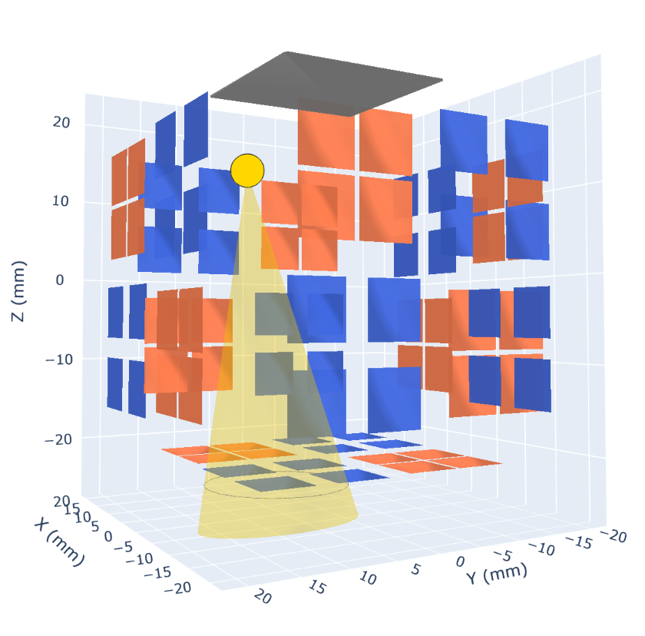
Angle-Dependent External Crosstalk Measurements in LXe
Illuminate a single SiPM with pulsed visible-light laser
  99% of light seen by source SiPM
Measure correlated events in other SiPMs produced by IR photons produced during the initial photo-avalanche
  With vs. Without source SiPM active
Estimate the probability of photons produced in the photo-avalanche process to be detected in a different SiPM
Measurement in Progress - Stay tune!
Source SiPM illuminated by light from optical fiber
External crosstalk principle
Frédéric Girard
2026 CAP Congress
Notes:
The short answer is: "we don't know". The wrong answer is: "we have no idea".
In fact it’s existence is supported by cosmological and astrophysical observations. For example, during the merger of galaxy clusters, the intergalactic gasses highlighted in pink, interacted, slowing down and warming up, emitting x-ray radiation. Stars and dark matter on the other hand passed through unaffected. The technique of weak gravitational lensing can be used to determine the mass distribution of non-luminous matter, highlighted in blue. With this we can show that dark matter accounts for 85% of the total mass of the clusters.
In fact it is known from cosmic microwave background models that there should exist 5x more dark matter than baryonic matter.

Slide 15
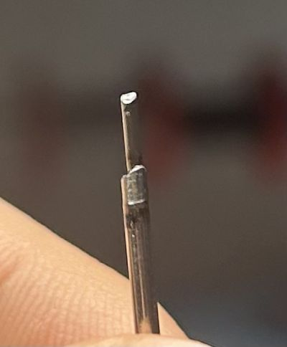
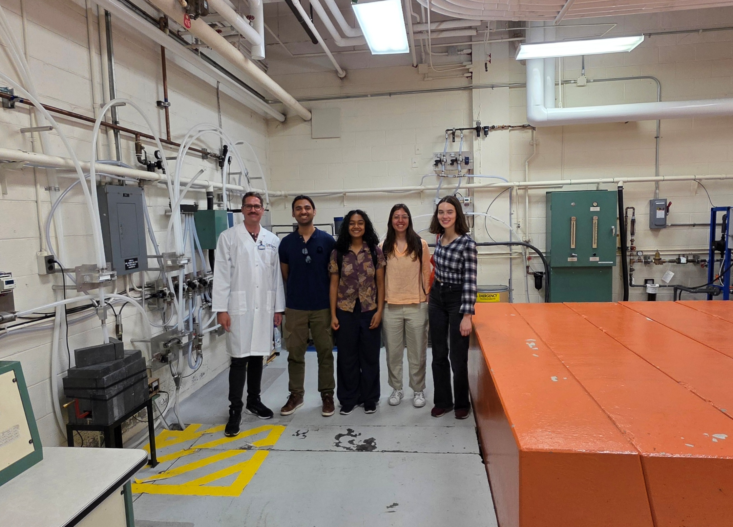
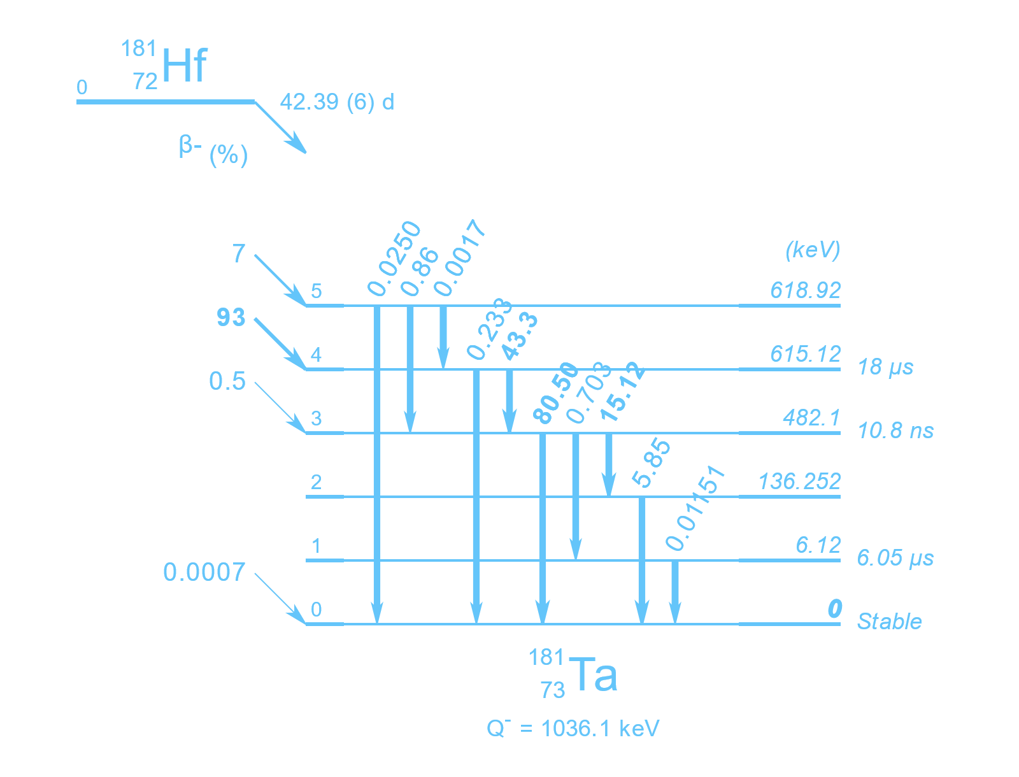
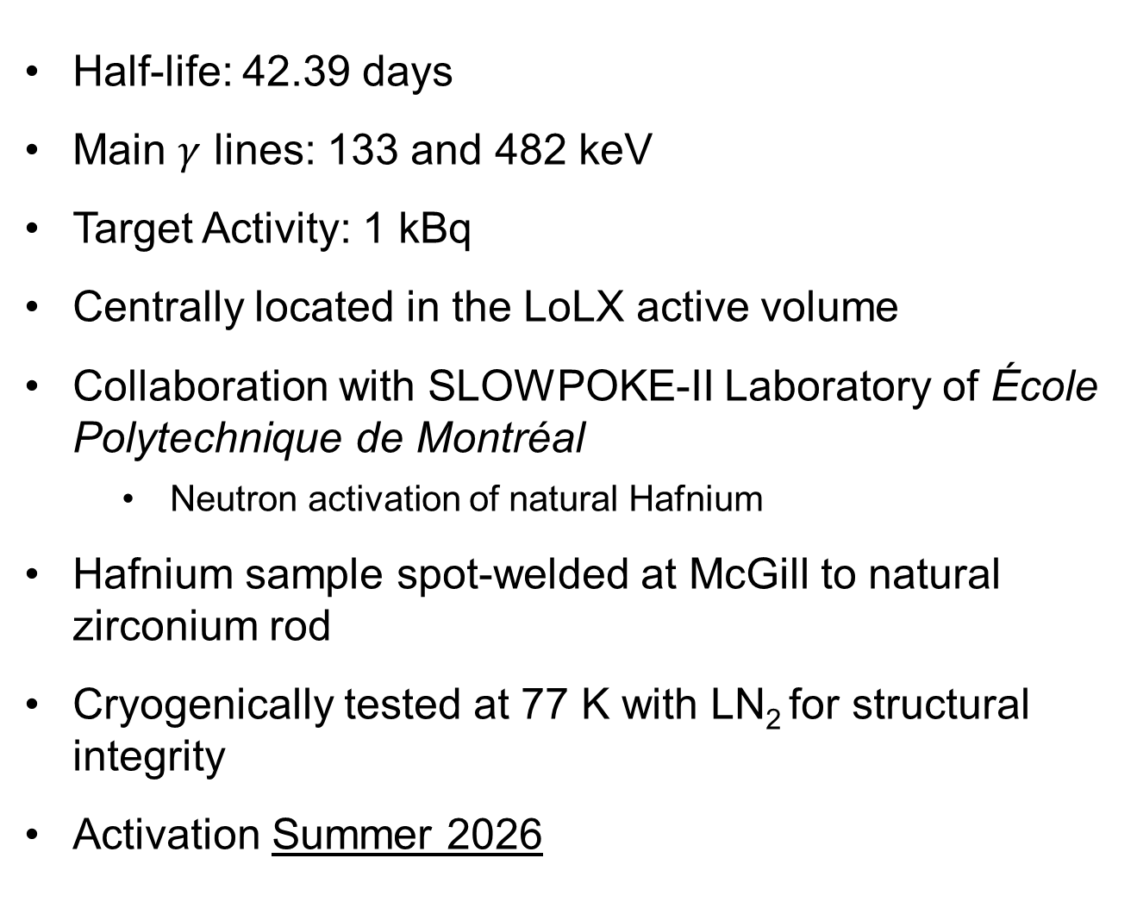
¹⁸¹Hf Source Activation
Half-life: 42.39 days
Main $γ$ lines: 133 and 482 keV
Target Activity: 1 kBq
Centrally located in the LoLX active volume
Collaboration with SLOWPOKE-II Laboratory of École Polytechnique de Montréal
  Neutron activation of natural Hafnium
Hafnium sample spot-welded at McGill to natural zirconium rod
Cryogenically tested at 77 K with LN₂ for structural integrity
Activation Summer 2026
^{nat}Hf welded to a Zn rod
Visit of the SLOWPOKE-II reactor. Darren Hall (SLOWPOKE-II Lab Director), Naman Walia, Sandhya Rotto, Irina Nitu, Eleanor Allen
Frédéric Girard
2026 CAP Congress
Notes:
The short answer is: "we don't know". The wrong answer is: "we have no idea".
In fact it’s existence is supported by cosmological and astrophysical observations. For example, during the merger of galaxy clusters, the intergalactic gasses highlighted in pink, interacted, slowing down and warming up, emitting x-ray radiation. Stars and dark matter on the other hand passed through unaffected. The technique of weak gravitational lensing can be used to determine the mass distribution of non-luminous matter, highlighted in blue. With this we can show that dark matter accounts for 85% of the total mass of the clusters.
In fact it is known from cosmic microwave background models that there should exist 5x more dark matter than baryonic matter.

Slide 16
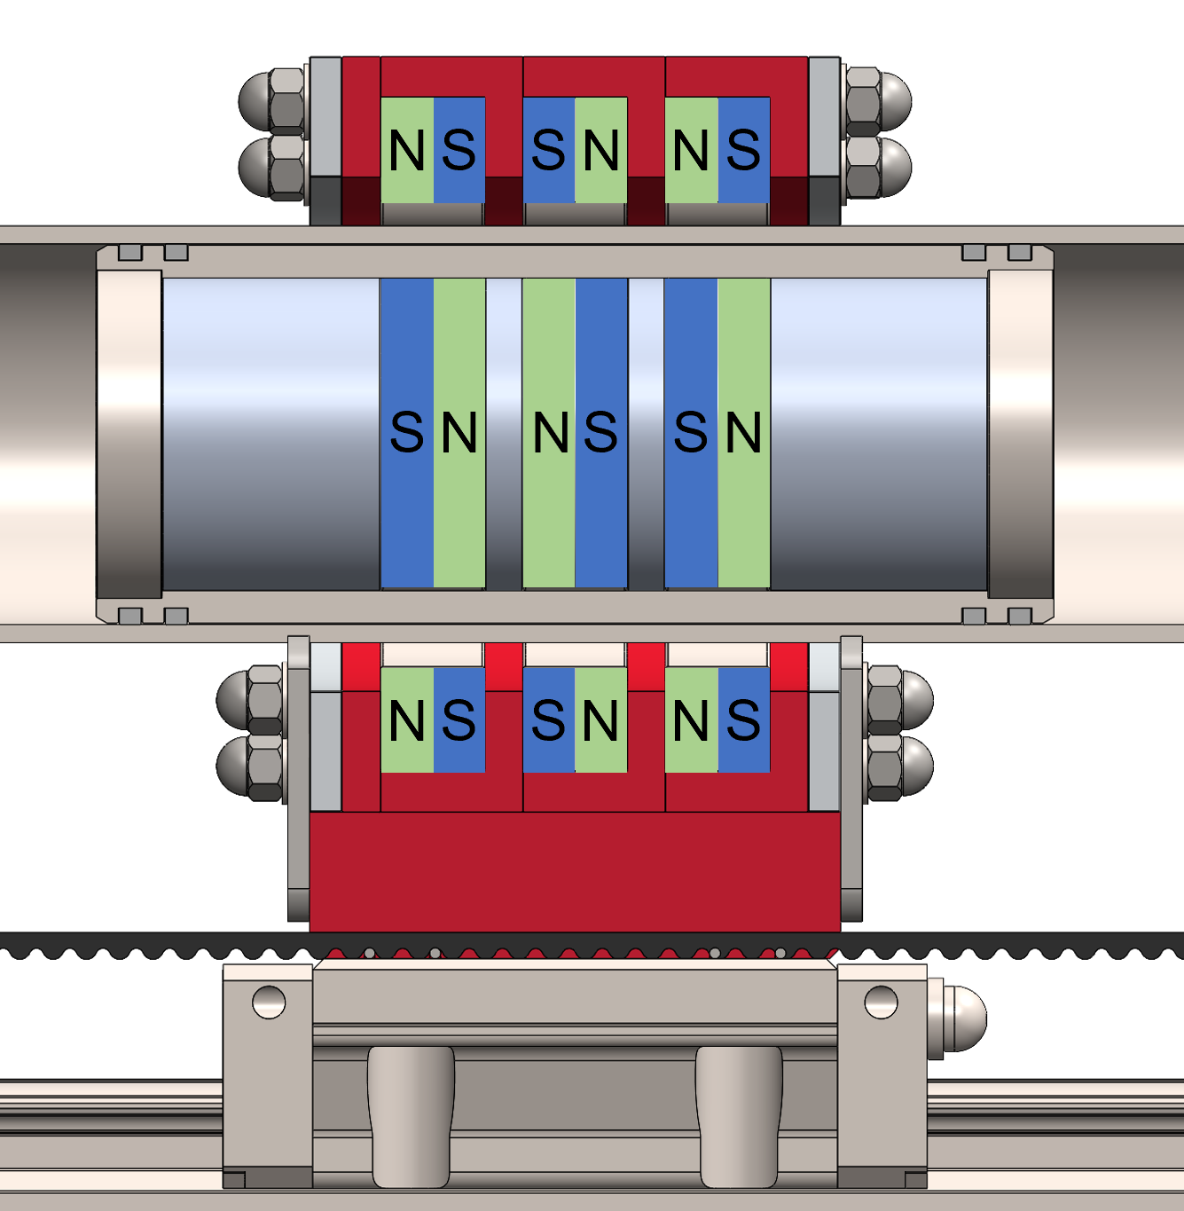
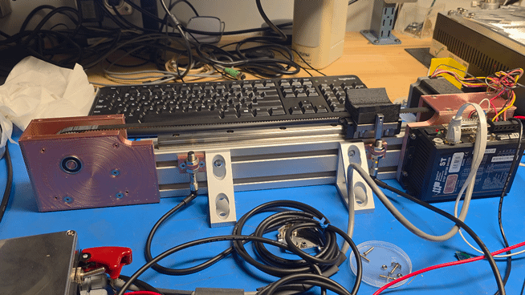
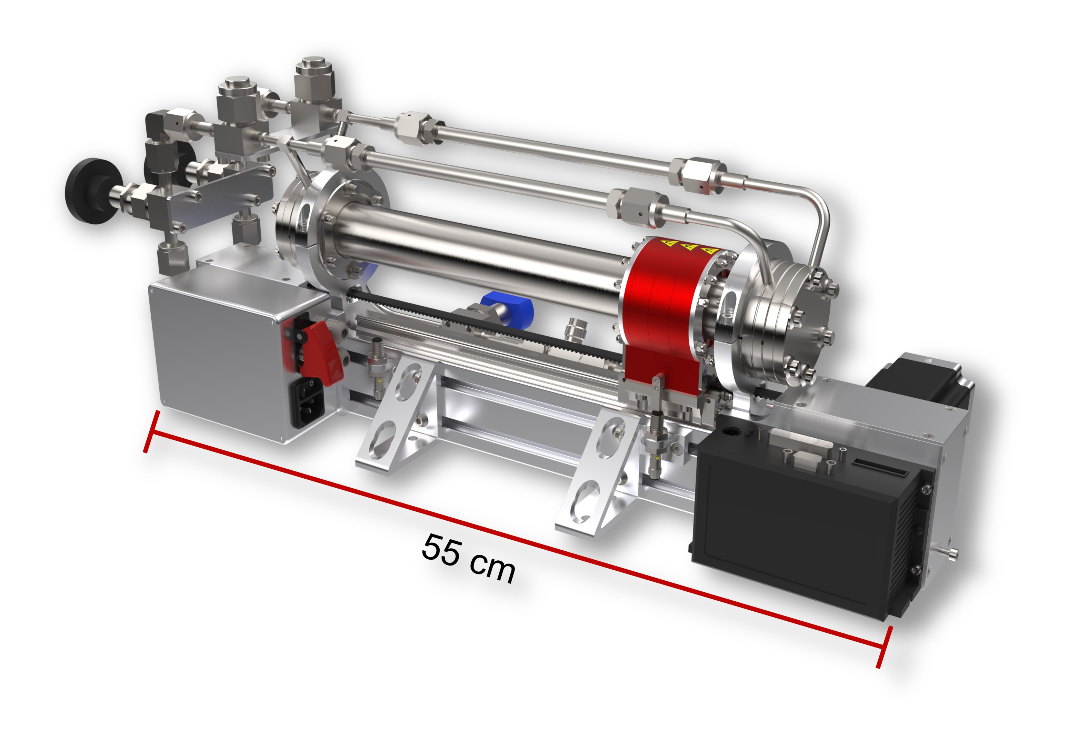
Purification System Upgrade:
Xenon Gas Magnetic Pump
Piston
We are designing a low-cost, high-purity magnetically driven piston pump
Inspired by similar pumps designs built by the EXO-200 [Rev. Sci. Instrum. 82, 105114 (2011)] and XENON [Eur. Phys. J. C (2018) 78:604] experiments, and design from nEXO collaborators at SLAC
Target Xe flow: 5 slpm
All wetted surfaces 316L stainless steel
Ultra-high molecular weight polyethylene piston rings
High-toque stepper motor with programable drive unit
Will allow for the continuous purification of xenon in LoLX
First motion tests
Magnetic piston assembly
Particulate filters
Outer magnet ring
Power supply
Linear bearing
High-torque stepper motor
Stepper motor drive
Frédéric Girard
2026 CAP Congress
Notes:
The short answer is: "we don't know". The wrong answer is: "we have no idea".
In fact it’s existence is supported by cosmological and astrophysical observations. For example, during the merger of galaxy clusters, the intergalactic gasses highlighted in pink, interacted, slowing down and warming up, emitting x-ray radiation. Stars and dark matter on the other hand passed through unaffected. The technique of weak gravitational lensing can be used to determine the mass distribution of non-luminous matter, highlighted in blue. With this we can show that dark matter accounts for 85% of the total mass of the clusters.
In fact it is known from cosmic microwave background models that there should exist 5x more dark matter than baryonic matter.

Slide 17
Summary
We have measured the relative photon detection efficiency of Hamamatsu VUV4 and FBK VUV-HD3 Cryo in LXe
We observed a PDE 33-38% lower for the HPK SiPMs compared to the FBKs
  Discrepancy much bigger than from normal incidence vacuum measurements
  Lower fill factor
  Shadowing effects for low grazing angles
We successfully reproduced these PDE ratios with comprehensive optical simulations
This discrepancy with normal incidence vacuum measurements highlights the need for complete simulations for large scales experiments
Thank you!
Frédéric Girard
2026 CAP Congress
Notes:
The short answer is: "we don't know". The wrong answer is: "we have no idea".
In fact it’s existence is supported by cosmological and astrophysical observations. For example, during the merger of galaxy clusters, the intergalactic gasses highlighted in pink, interacted, slowing down and warming up, emitting x-ray radiation. Stars and dark matter on the other hand passed through unaffected. The technique of weak gravitational lensing can be used to determine the mass distribution of non-luminous matter, highlighted in blue. With this we can show that dark matter accounts for 85% of the total mass of the clusters.
In fact it is known from cosmic microwave background models that there should exist 5x more dark matter than baryonic matter.

Slide 19
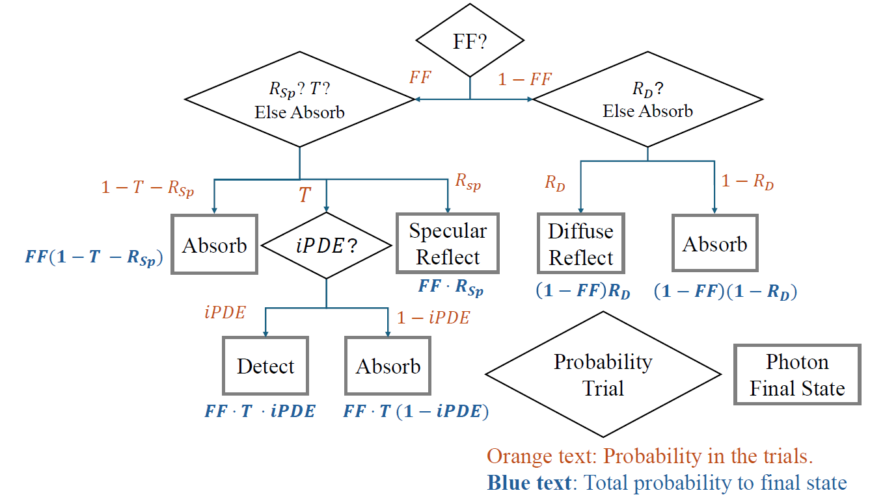
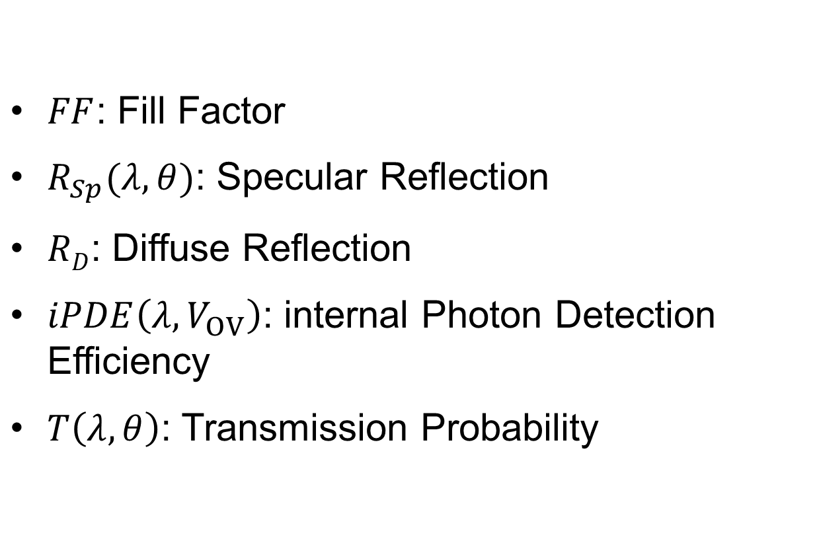
Bernouli trial photon detection scheme
$FF$: Fill Factor
$R_{Sp}(λ,θ)$: Specular Reflection
$RD$: Diffuse Reflection
$iPDE\left(λ,V_{OV}\right)$: internal Photon Detection Efficiency
$T\left(λ,θ\right)$: Transmission Probability
$$PDE\left(λ,θ,V_{OV}\right)=FF⋅T\left(λ,θ\right)⋅iPDE\left(λ,V_{OV}\right)$$
arXiv:2510.15270 (submitted to JINST)
Frédéric Girard
2026 CAP Congress
Notes:
The short answer is: "we don't know". The wrong answer is: "we have no idea".
In fact it’s existence is supported by cosmological and astrophysical observations. For example, during the merger of galaxy clusters, the intergalactic gasses highlighted in pink, interacted, slowing down and warming up, emitting x-ray radiation. Stars and dark matter on the other hand passed through unaffected. The technique of weak gravitational lensing can be used to determine the mass distribution of non-luminous matter, highlighted in blue. With this we can show that dark matter accounts for 85% of the total mass of the clusters.
In fact it is known from cosmic microwave background models that there should exist 5x more dark matter than baryonic matter.

