Slide 1
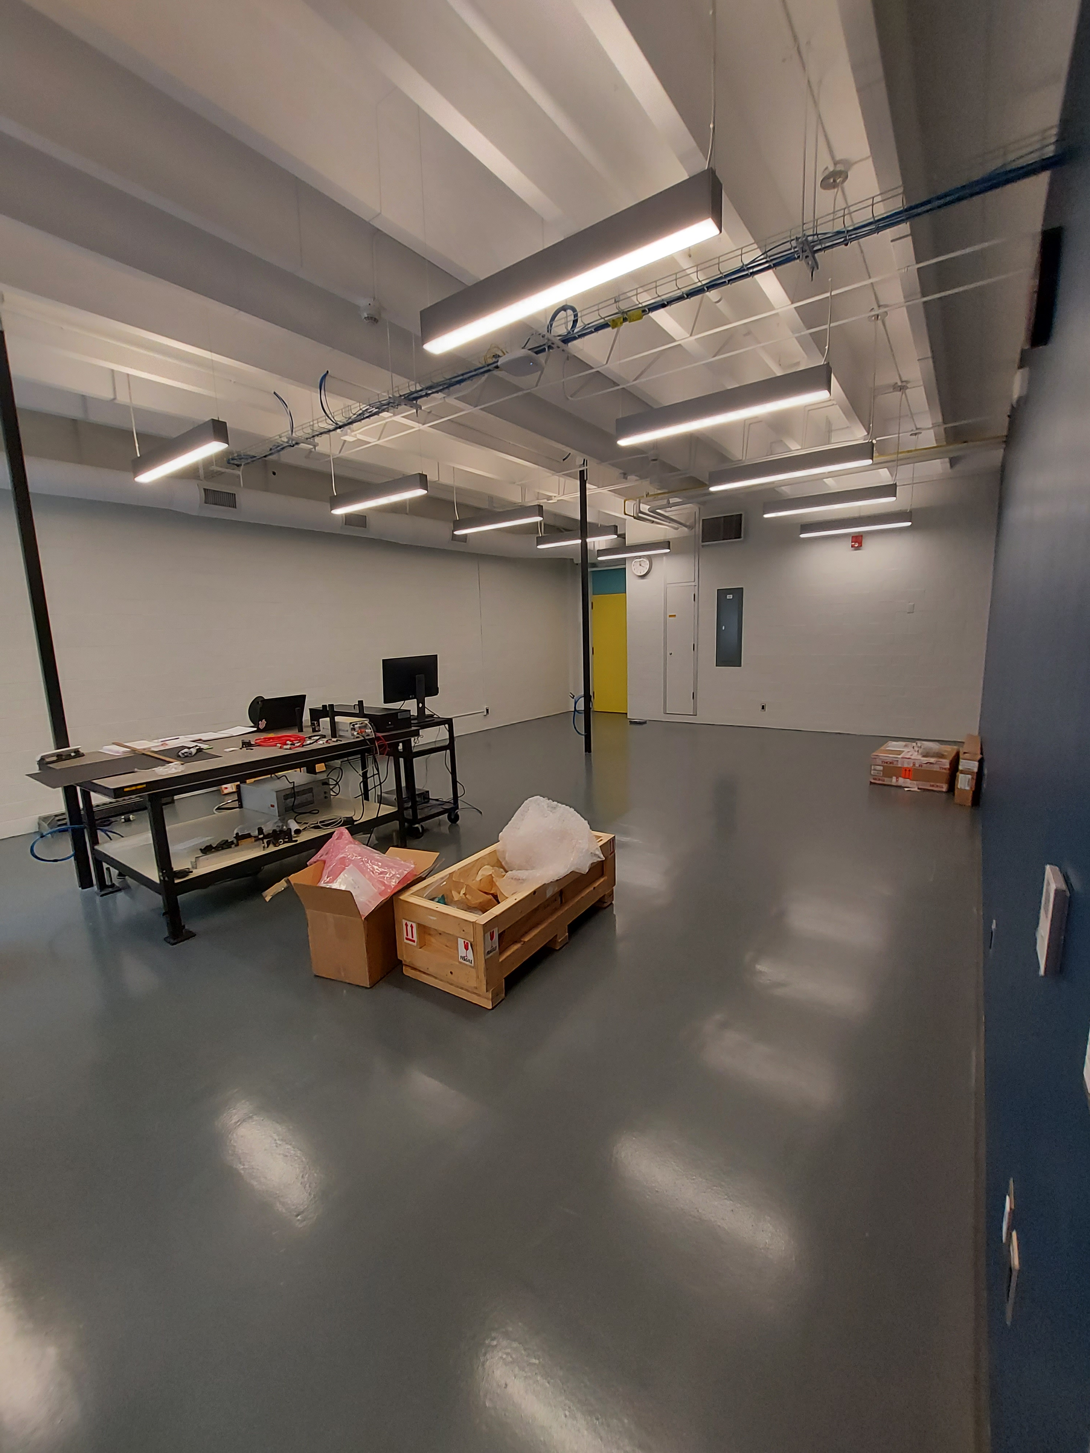
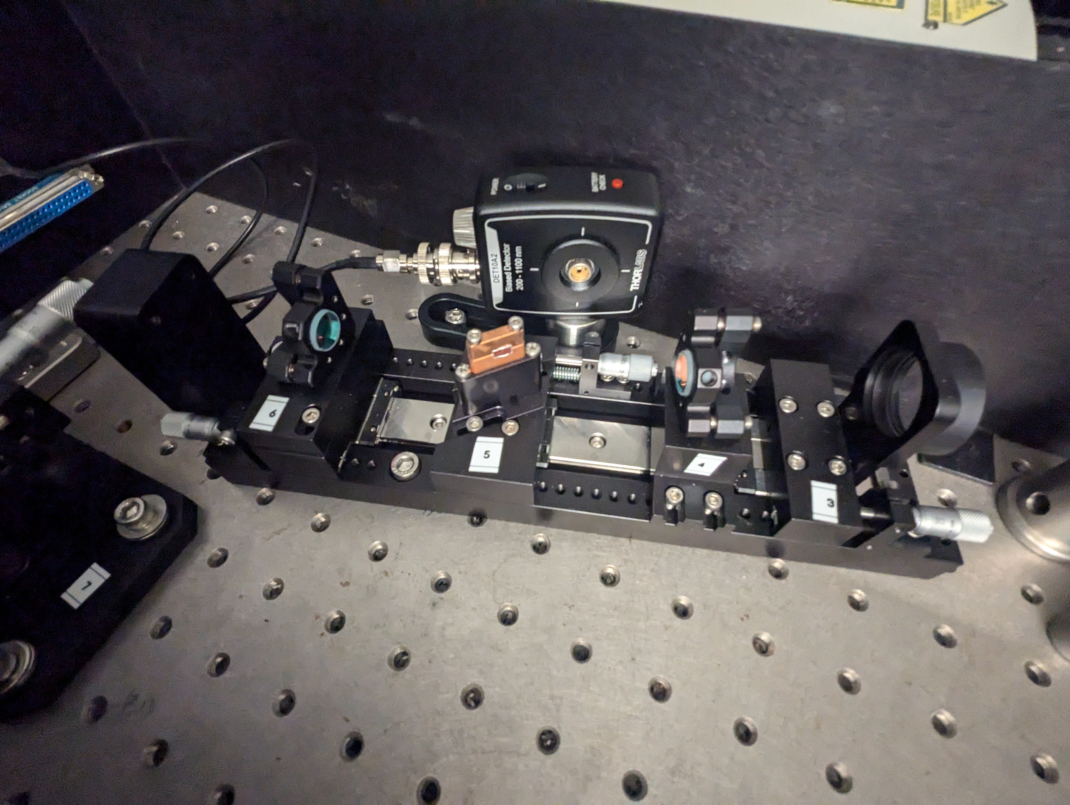
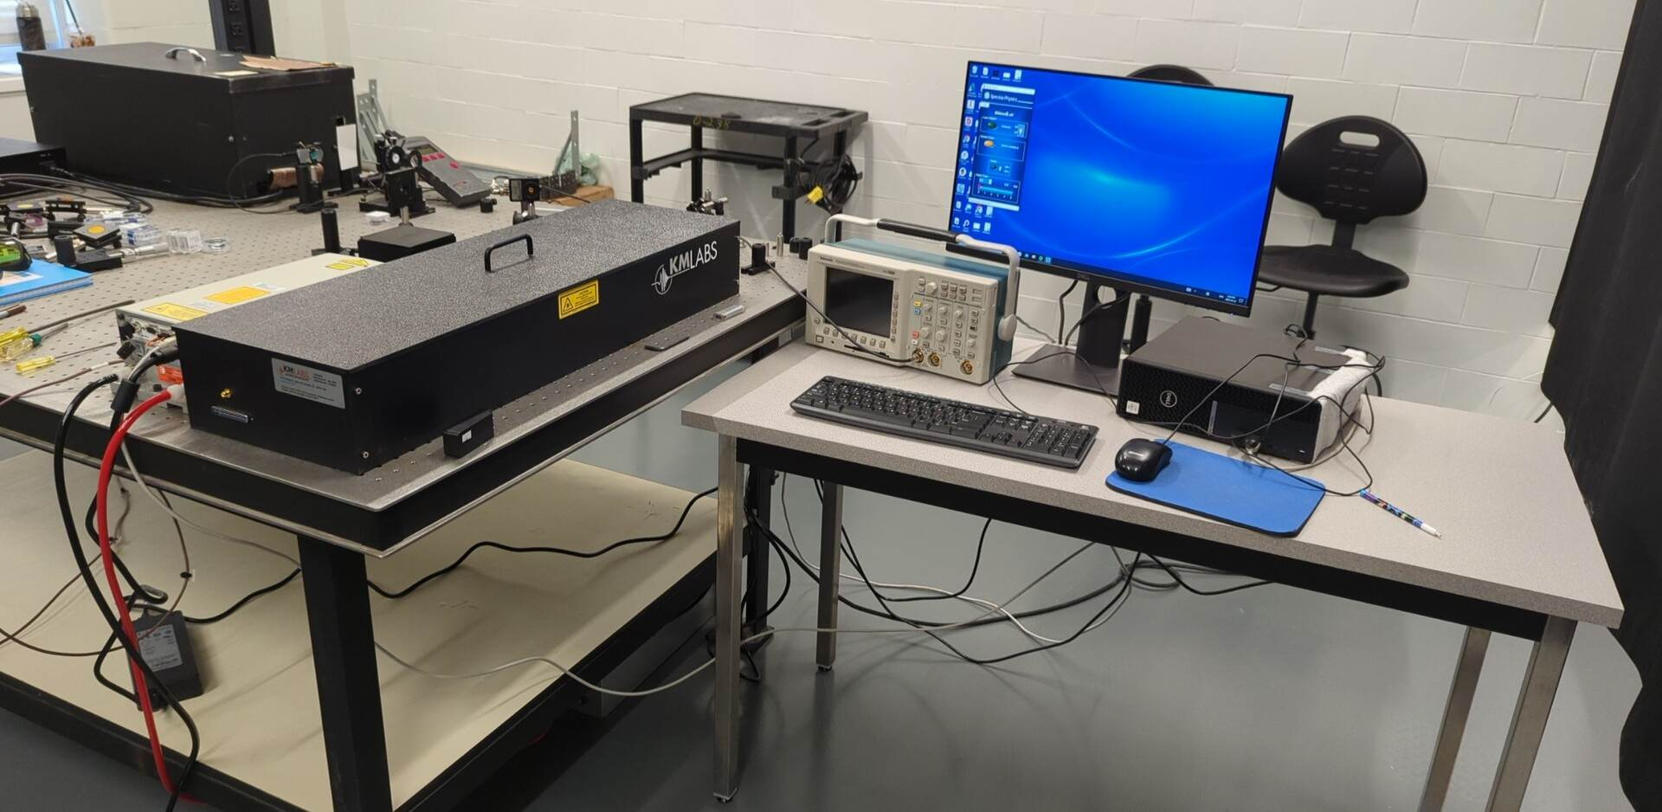
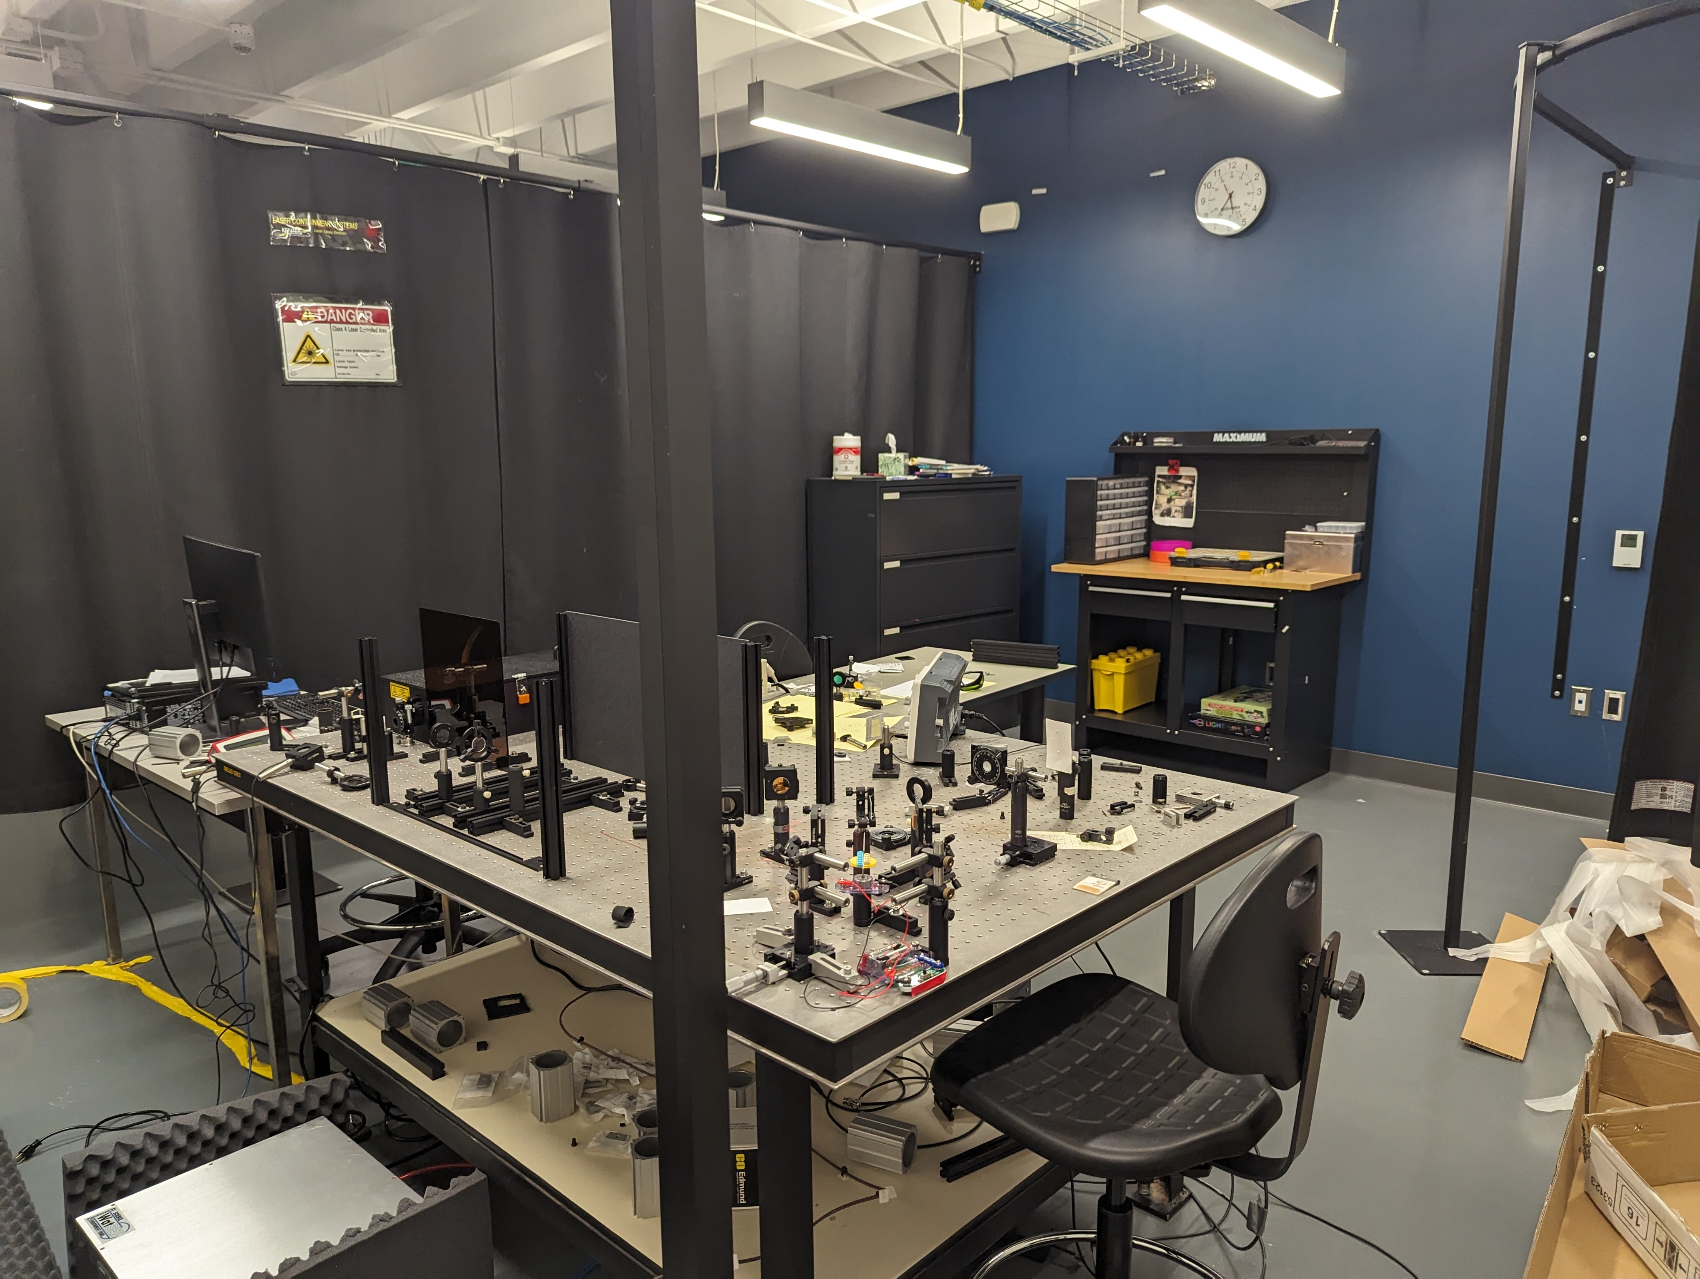
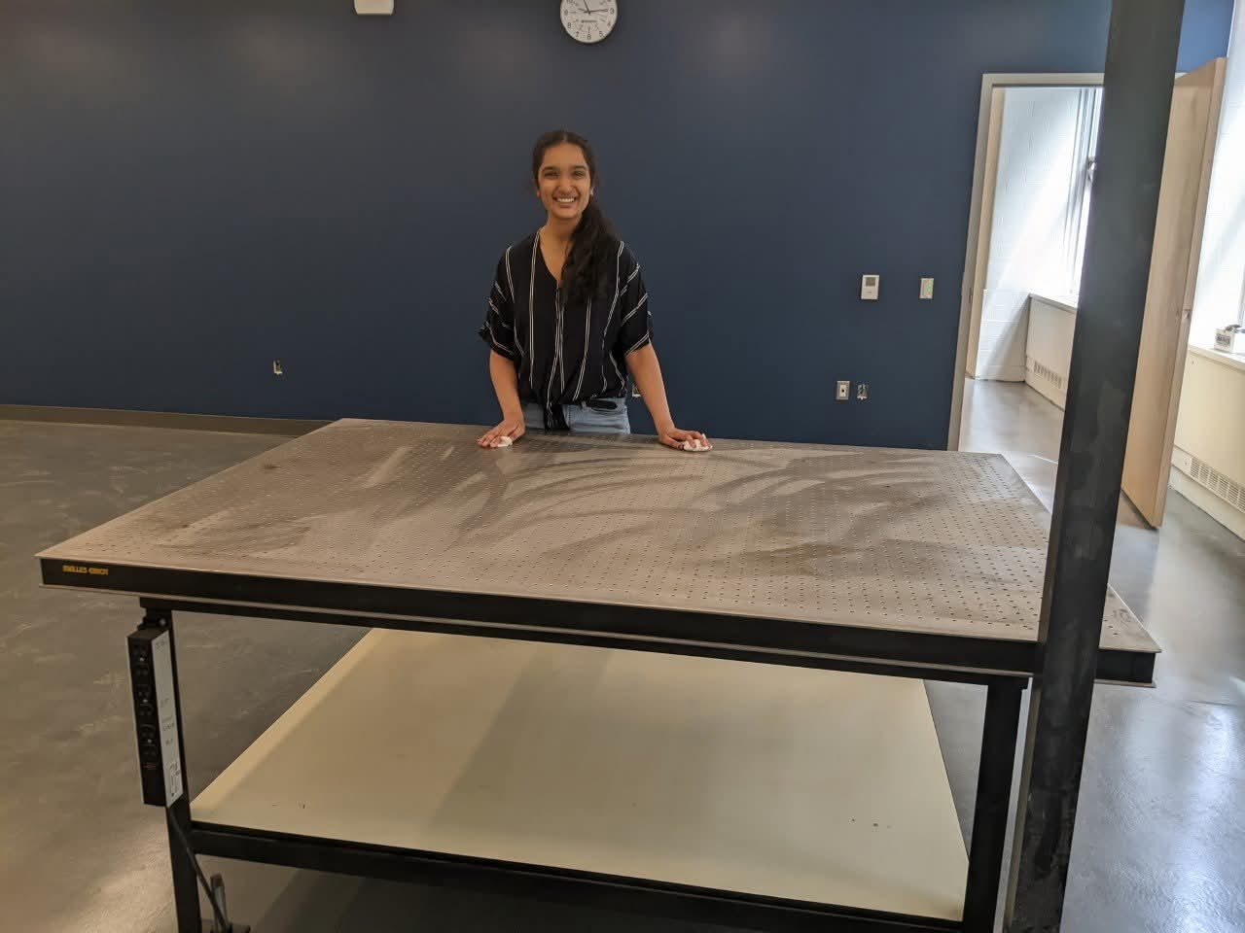
An introductory undergraduate experiment in Second Harmonic Generation
Urja Henry Nandivada (UWaterloo)
June 22nd 2026
CAP 2026 Presentation

Slide 2
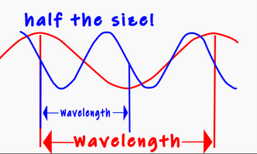
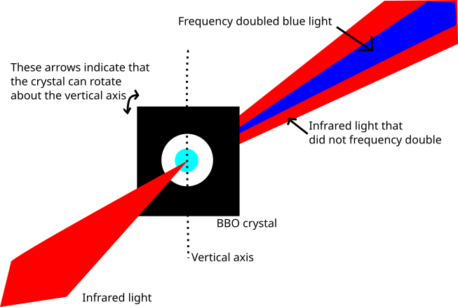
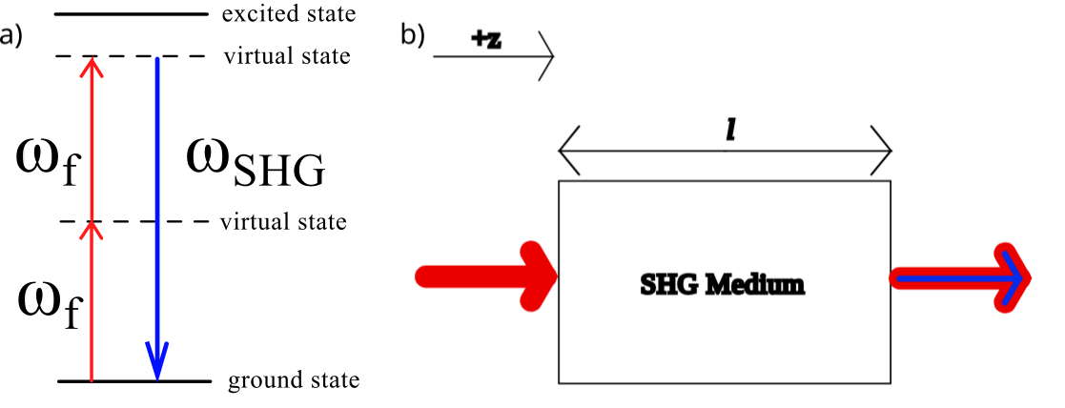
Second Harmonic Generation aka Frequency Doubling
Non-centrosymmetric medium

Slide 3
The Experimental Question
The frequency doubling phenomenon can be described by a lot of different variables. Which of them drive the process itself?
Notes:
The experimental question we present to students is, "Is frequency doubling dependent on the pulse energy, peak power, or laser intensity?".
This question presents key words and important variables to give students reference points to use when making their investigation. To answer this, students will develop three experiments concerned with the ratios of three variables pertaining to the fundamental infrared and second harmonic blue light. This is a quantitatively challenging experiment that needs to be appropriate for students who have completed one physics laboratory course at the undergraduate level. Before students can approach this question in the laboratory, they need to understand what these variables look like on any train of short pulses, what devices can be used in the experiment, and if these variables can be measured or calculated.

Slide 4
Why do this work?
Students need to learn how to learn from experiment^{[1,2]}
Our students largely view theoretical pursuits as the “default” path in physics careers^{[3,4]}
[3] E. M. Smith, M. M. Stein, and N. G. Holmes, How expectations of confirmation influence students’ experimentation decisions in introductory labs, Phys. Rev. Phys. Educ. Res. 16, 010113 (2020).
[4] E. F. Redish, J. M. Saul, and R. N. Steinberg, Student Expectations in Introductory Physics A…, 1998.

Slide 5
Our Key Andragogical Principles
The question is meant to be exciting to students
01
Students should return to these concepts in future years of study
03
Subject mastery is not expected before or after experiment completion
02

Slide 6
What should students learn from this experiment if subject mastery is not required?
How to identify relevant variables that impact properties in a system
That experimental methods can develop understanding in a way theory can’t
That questions can be answered by developing measurable techniques in the lab instead of through independent analysis at home
That doing labs can be fun
Notes:
How to answer an experimental question
SHG is intensity dependent
The pulse energy is the only variable of the three that the students can directly measure.
Students approximate pulse duration and won’t require a measurement of the peak power (since they are inferring a ratio of the FWHM of each colour)
Students cannot directly measure the intensity and must use the beam area instead to determine the dependence

Slide 7
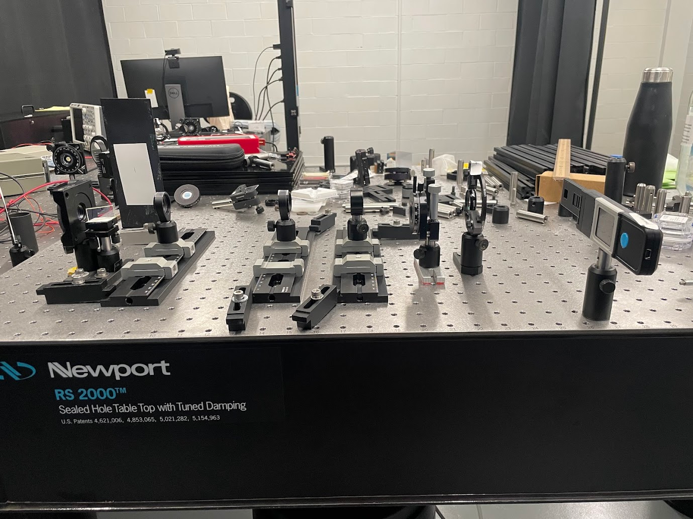
Delivering the experiment
Delivering in advanced laboratory (for now)
  Needed to test the durability with students who have some experience
  We need to see how ready our students are to work at a higher level of inquiry in this type of course
Notes:
To make sure students can independently perform their work with expensive and delicate equipment, it's important to make sure the experiment can withstand the well-intentioned hands of new learners (instructors included). For this reason, we made sure that the experiment uses robust and durable equipment, the tasks are safe and feasible, and the experiment is quick to set up and prepare. We need to make sure that the experiment can withstand repeated use over a continuous laboratory session and that the class-IV laser light doesn't harm those working in the laboratory. It also needs to be quick to set up since the equipment we are working with is sensitive. If the oscillator stops mode-locking it needs to be easy to restart so that students don't get interrupted when working.
This was the first undergraduate experiment using a Class-IV Laser within the Department of Physics and Astronomy at the University of Waterloo. Given that Class-IV laser systems are typically restricted from undergraduate use, this experiment was introduced at the upper year level. This approach aimed to engage students with prior experience in laboratory safety practices, thereby enabling them to critically evaluate and provide insights on the designed safety protocols.
This was also the first open inquiry experiment offered to undergraduate students in any of our physics programs. Since upper year students are not yet trained on moving through higher levels of inquiry, we chose to offer this experiment using guided inquiry instruction, so more information on experimental procedures and design was given to upper year students.

Slide 8
Next Steps
Deliver this experiment (and more) in our lab stream
Assess student epistemology in all our lab courses
Develop andragogy driven by epistemic themes emergent in our students
Notes:
Originally, the experiment designed during this project would have been on optical autocorrelation. During this project's early stages, it was determined that the frequency doubling phenomenon occurring within the intensity autocorrelator was in itself an exciting topic for inquiry work. The optical autocorrelator will now be used to develop a second experiment that builds off of the one presented in this thesis and the experiment will be held in the upper year advanced/modern physics laboratory. This defense presented the first experiment developed for the GWLC, and provides a foundation for the development of experiments in the laboratory revision project. Beyond its local context, this work may also be valuable to educators looking to transition from confirmation inquiry work to project-based courses that teach using authentic inquiry. By introducing inquiry learning in the introductory laboratory through an experiment on SHG, this project offers a basis for integrating complex physics phenomena into introductory undergraduate curricula in a pedagogically meaningful way.

Slide 9

This work was partially funded by:
The Dean's Undergraduate Teaching Initiative
Waterloo Science Endowment Fund
Sinclair Foundation
Notes:
This concludes the defense of my thesis! With that I would like to thank you all for attending, my committee for partaking this project, especially Dr. Strickland who had started this project well before it became what it is today all the way back in 2018. This was a very interesting topic that combined physics education with graduate level optics work, so I would also like to thank Dr. Cummings for her involvement to ensure this work was done through discipline based education research. Dr. Sanderson and Dr. Campbell have also been significant contributors through course work and shared lab space.

Slide 10
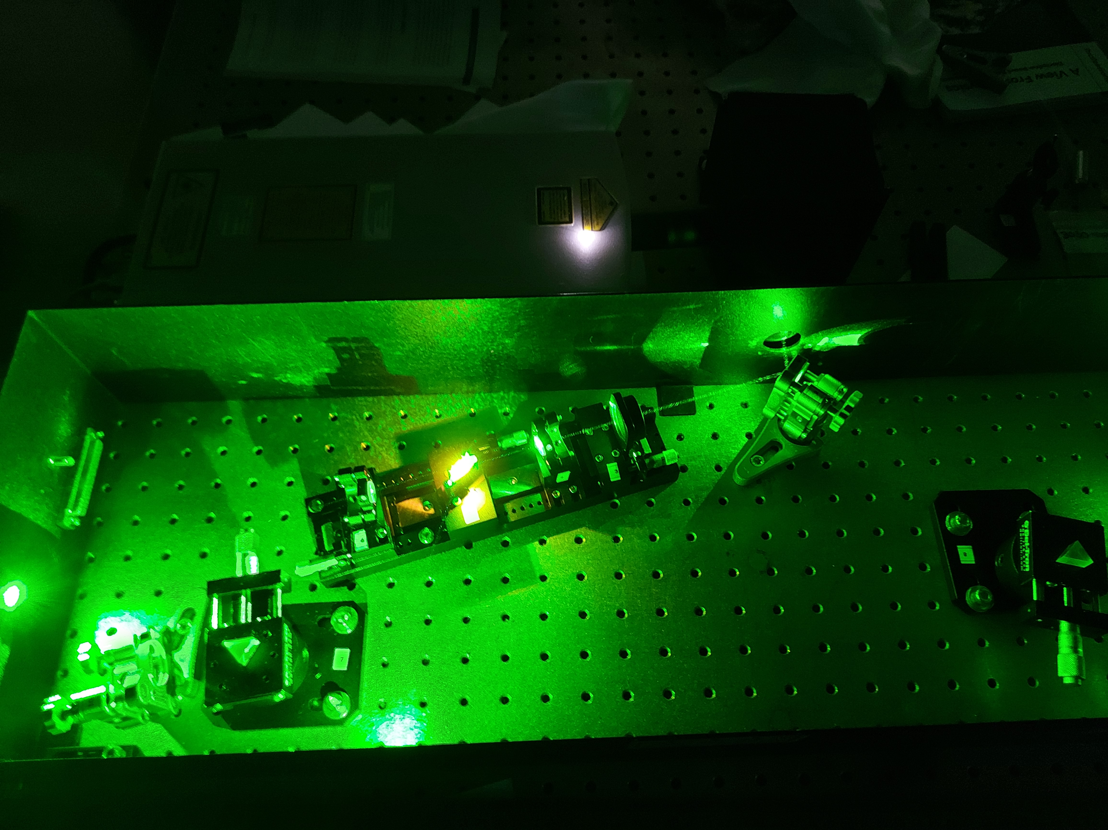
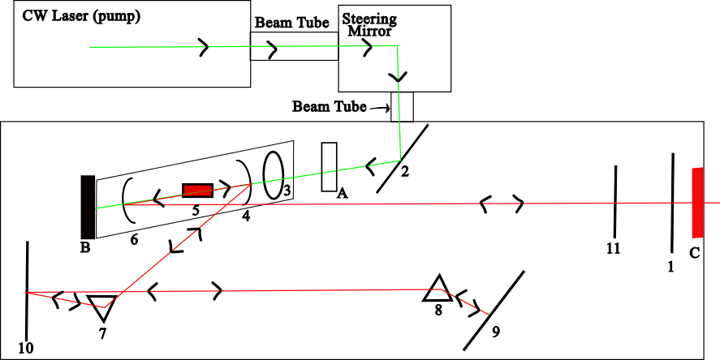
The laser system
Notes:
Most of this defense covers the physics education research and background to the experiment, but a significant amount of time in this project went to building this laser. It is more appropriate to call it a titanium Sapphire oscillator that uses kerr lens modelocking to emit light in a train of femtosecond pulses Students can't interact with the oscillator directly due to safety regulations. To generate the infrared pulsed light used in our experiment, we started with a continuous wave green laser to pump the oscillator. Within the Ti:Sapphire crystal, the infrared light is generated and then lased with mirrors 1 and 9 forming the lasing cavity. The pulses were generated as the light passed through the two prisms. Once the light exited the enclosure, it enters our experimental workspace. The precision needed to align the components was quite high and the system needed to be calibrated iteratively and so initial lasing alignmnent and modelocking alignment took a significant amount of effort. In addition to the delicate equipment, modelocking is a sensitive process. In spite of modelocking favouring the pulsed light over a continuous wave, it was easy to lose mode-locking, which means that the oscillator stops emitting light as intense bursts of short pulses and instead emits light as a less intense continuous wave. We didn't just pick this behemoth of a laser to show off to our students, there are several practical benefits to using a femtosecond laser. Second harmonic generation can be generated from a continuous wave source, but efficiency is lower in these cases. We want our students to work with as much SHG light as possible, so we want an efficient system. Once lasing was achieved the first time and then once modelocking was achieved the first time, realignment was much quicker since the stable alignment parameters had been established.

Slide 11
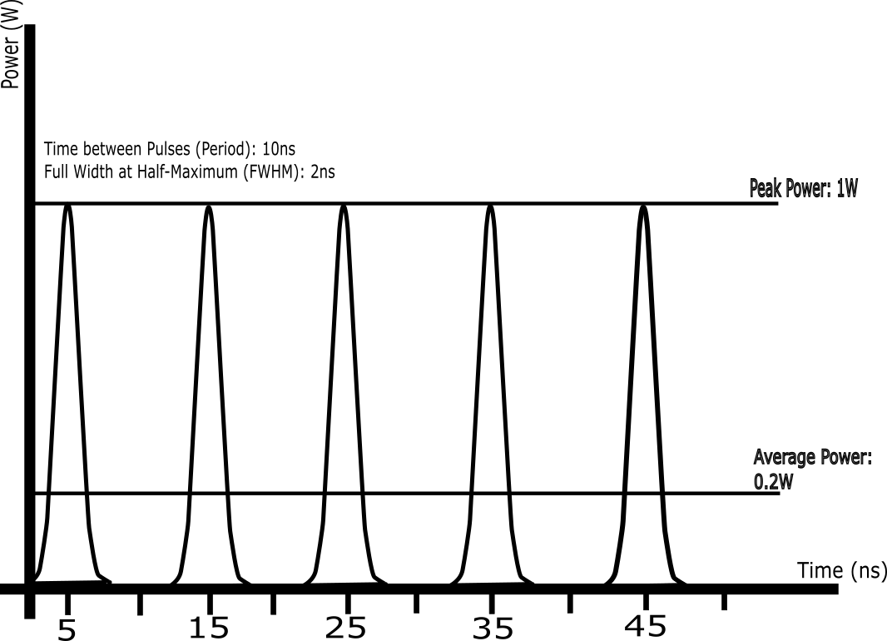
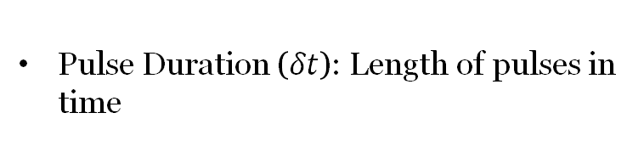
Preparing our Students: A Hypothetical Train of Short Pulses
Pulse Period ($ΔT$): Time between pulses
Pulse Duration ($δt$): Length of pulses in time
Notes:
Just like we will do with our students, our understanding starts with five hypothetical pulses obtained from a much longer hypothetical train. The plot they are presented on is of the instantaneous power output of the pulses over time. These pulses are spaced apart in time and the spacing is the pulse period, represented by the variable $\Delta$T. The Greek letter delta indicates that this variable represents an interval rather than an instant of time. The blue arrows indicate the pulse period on the hypothetical train. These pulses also have a duration that is known as the pulse duration and is represented by the lowercase delta and t.

Slide 12
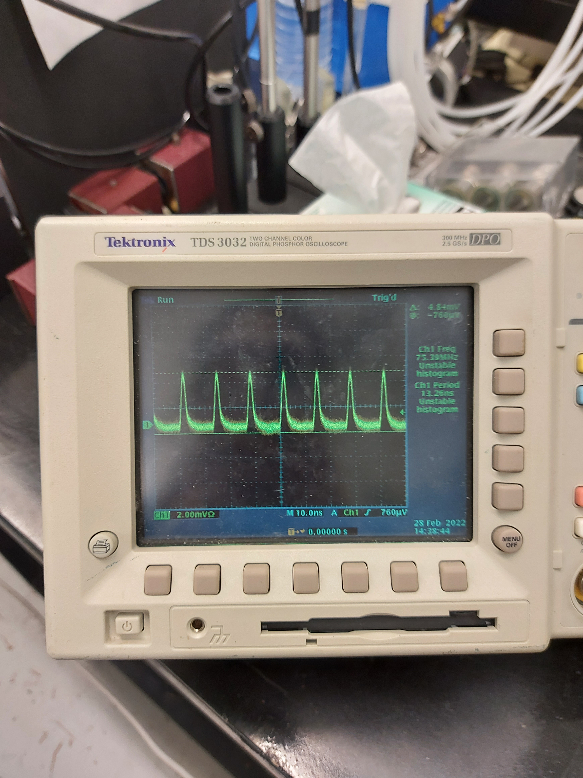
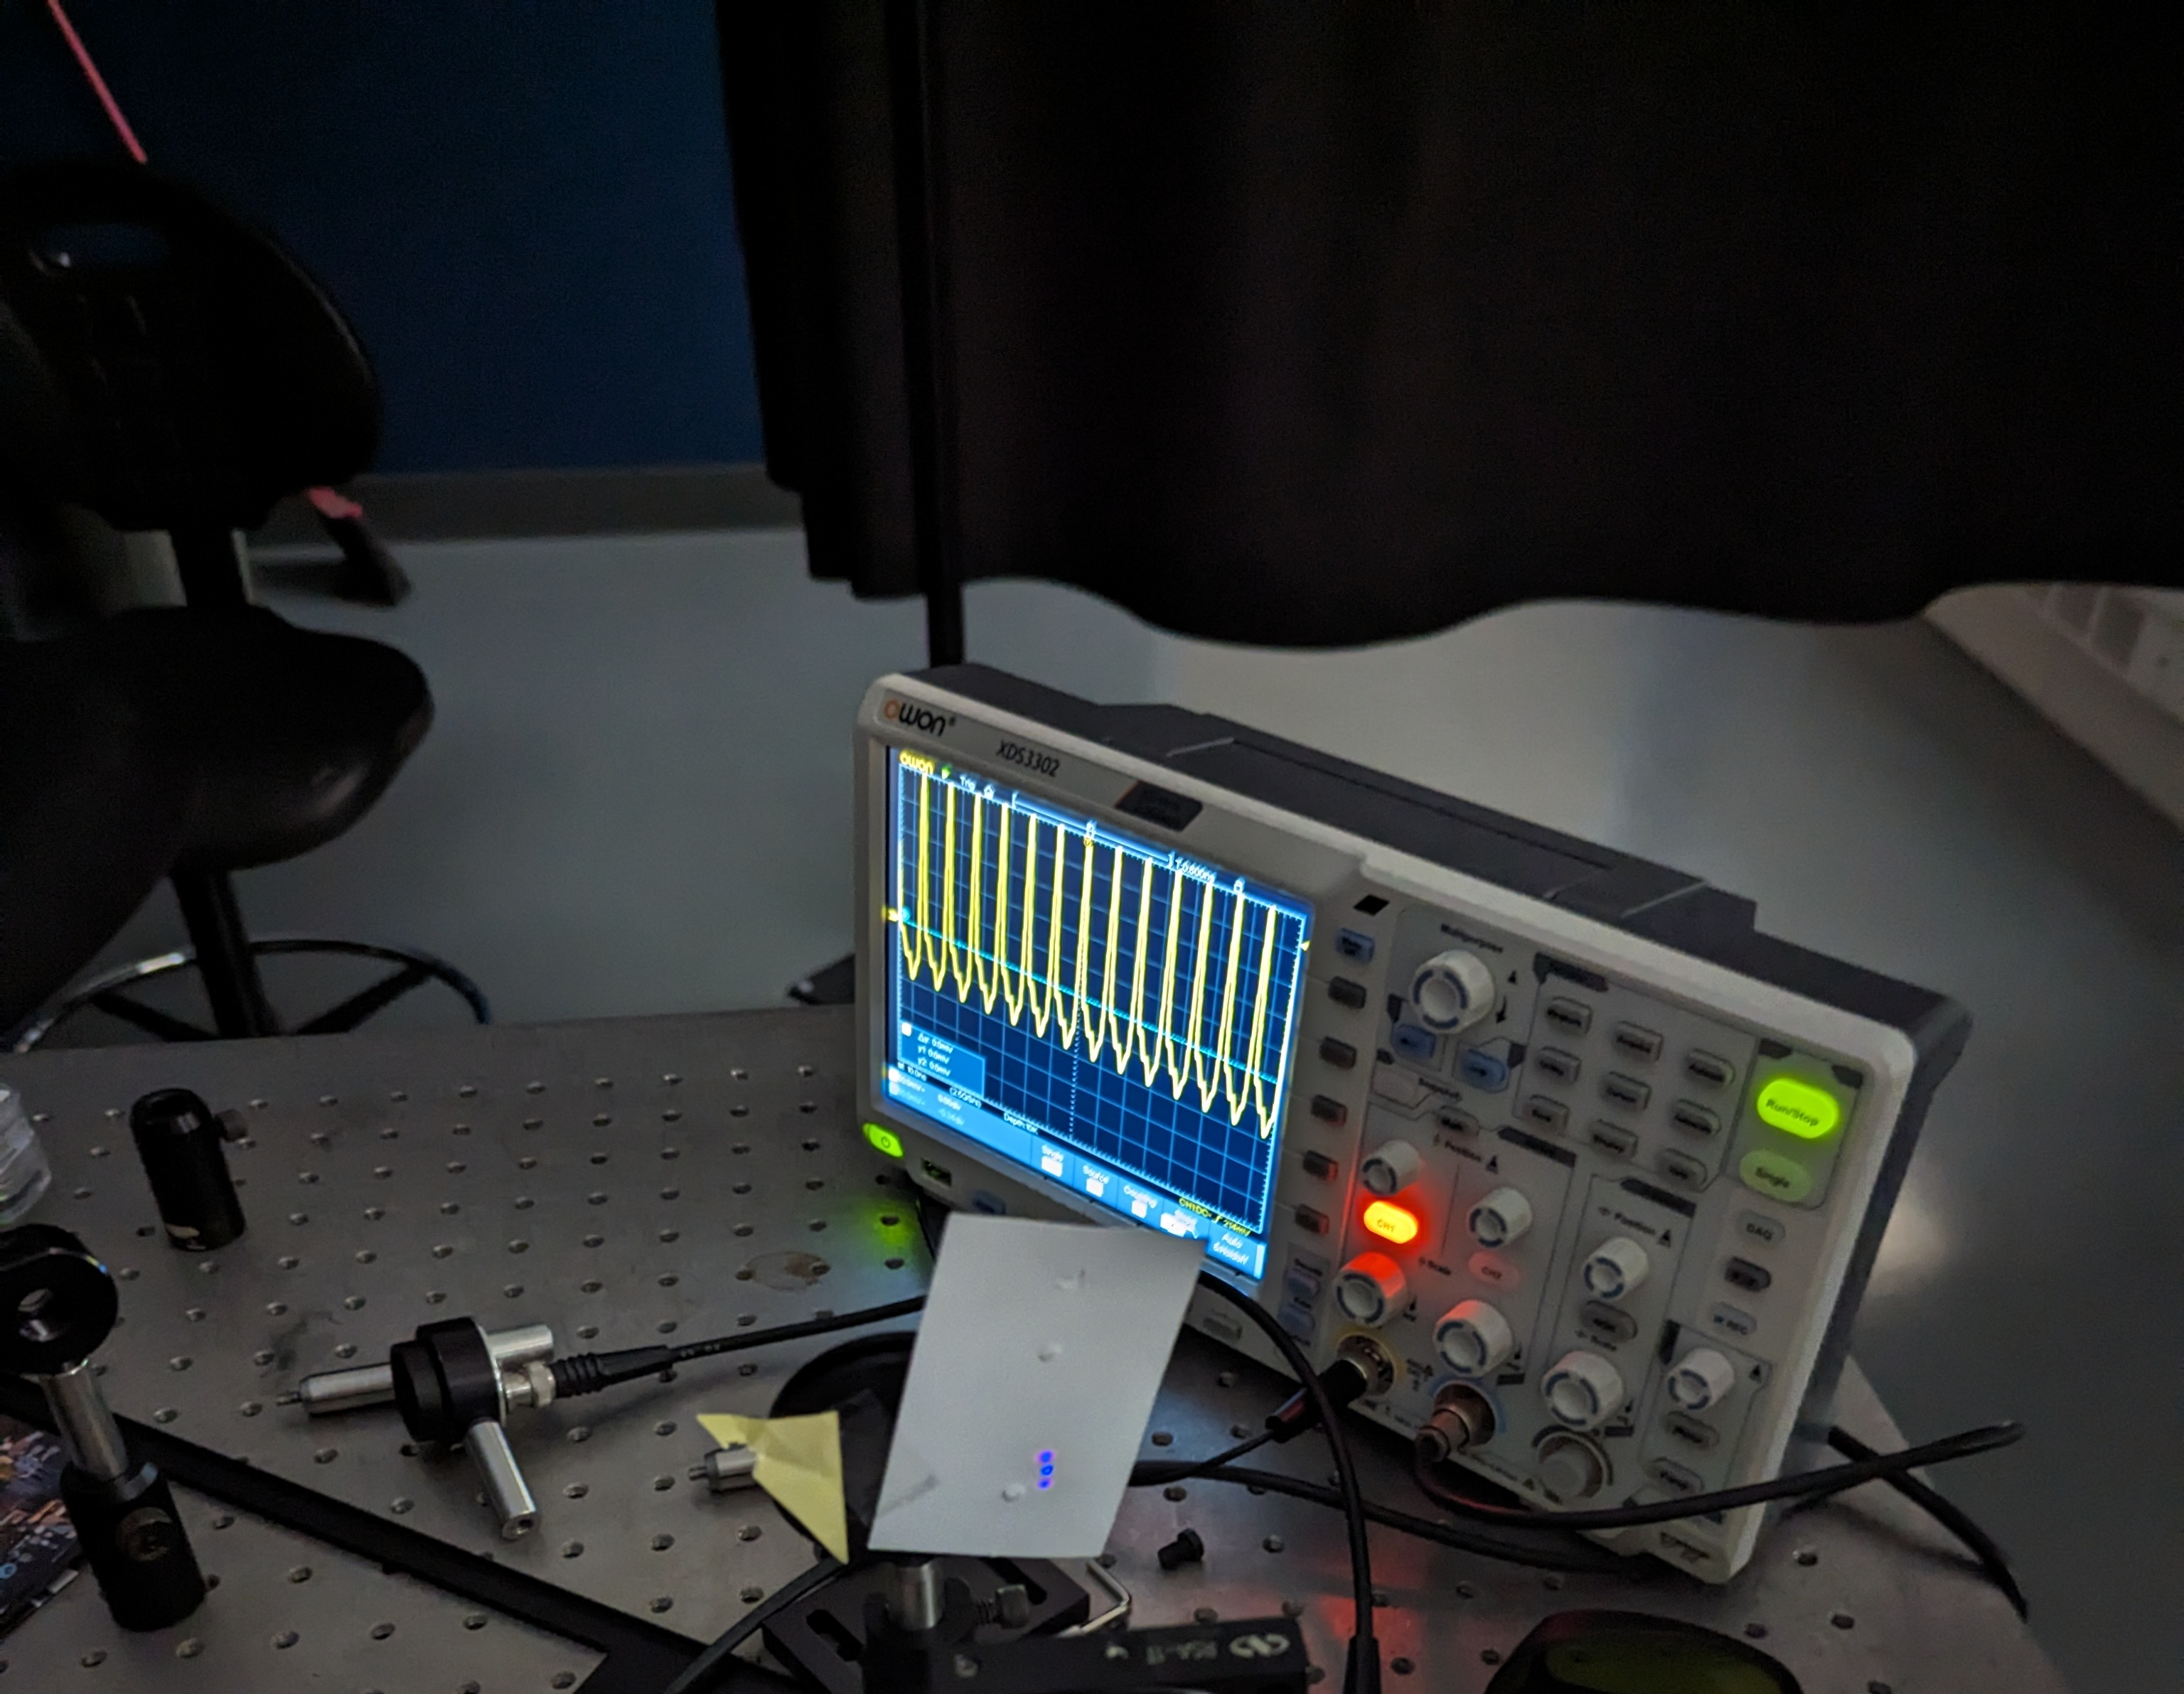
Pulses measured in the lab
Nanosecond: 1 billionth of a second
Femtosecond: 1 millionth of one billionth of a second (one quadrillionth)
Pulse duration cannot be measured!
But the pulse period can!
Notes:
In a research lab, pulses are detected using a photodetector which converts an optical signal to an electronic signal, which is then displayed on an oscilloscope. The display is referred to as an oscilloscope trace. The trace on the screen is a function of time. Converting an optical signal to an electronic signal takes time to do, so the signal gets transformed and the response time of this process is on the nanosecond scale. Remember that pulses are emitted on the femtosecond scale, which is much smaller than a nanosecond. This means that the pulse duration cannot be measured in the laboratory. The pulse width shown on the screen does not correspond to the actual pulse duration However, the distance between pulses, the pulse period, is on the nanosecond scale and so it can be measured using an oscilloscope and photodetector.

Slide 13

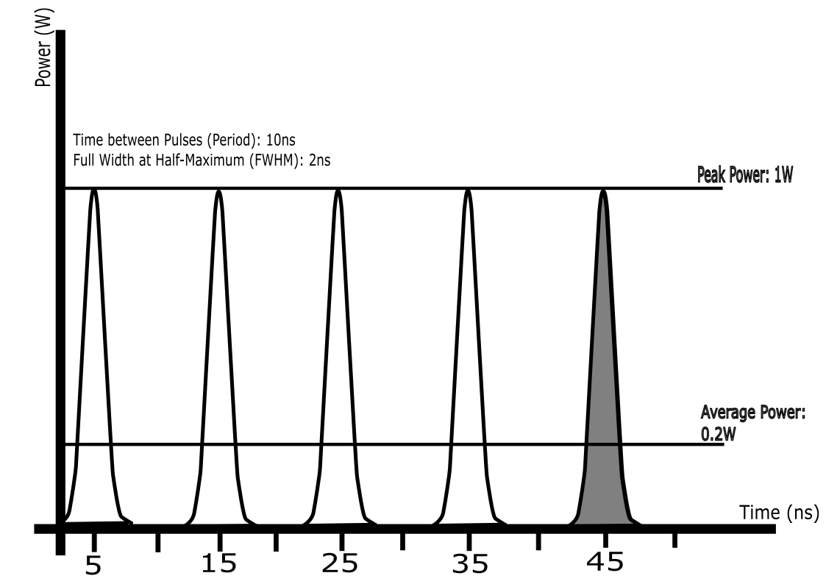
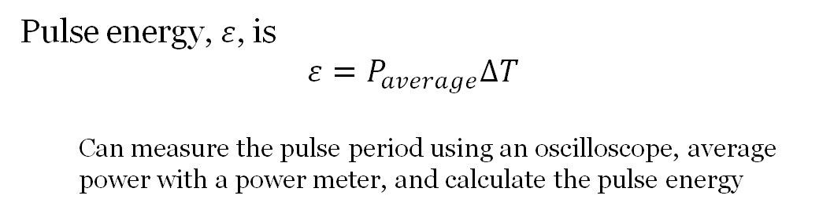
Pulse Energy and Average Power
The definite integral of a function will give you the area under the curve of the function
Integrating the power with limits spanning one pulse period will give you the pulse energy
On the power-time plot, the pulse energy of a single pulse can be seen as the shaded area under the curve of one pulse
Pulse energy, $ε$, is
$$ε=P_{average}ΔT$$
  Can measure the pulse period using an oscilloscope, average power with a power meter, and calculate the pulse energy
Notes:
The pulse period is important because it can be used to calculate the pulse energy. The pulse energy cannot be directly measured, it has to be calculated from other measurements that can be made. From what students learn in high school, they know that power is equal to some energy transfer over the time interval corresponding to that transfer of energy. What they learn in their first term is that power is the derivative of energy with respect to time, and energy is the integral of power with respect to time. How does this help our students?
Well, the definite integral of a function will give the area under the curve of the function. Integrating the power of this hypothetical plot with limits spanning one pulse period will result in the pulse energy. On the power-time plot, the pulse energy of a single pulse can be seen as the shaded area under the curve of one pulse.
The pulse energy $\varepsilon$, is given by the equation, $\varepsilon= P_{average}\Delta T$.
The pulse period can be measured using an oscilloscope, the average power with a power meter, and the pulse energy can be calculated as a result of this.

Slide 14
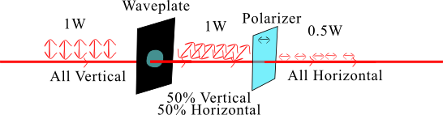
Modifying pulse energy
$$ε=P_{average}ΔT$$
Notes:
Okay we can measure the pulse energy, but in order to determine if it drives the SHG process, we need to be able to change it too. How do we do this? We need to change the average power. We can do this with a half-waveplate and a polarizer. These two optics can work together to change the amount of light that is allowed to pass through the experimental apparatus and therefore the average power as measured by the power meter.
Extra material:
When light interacts with a waveplate, the way it perceives the atoms making up the waveplate changes depending on the light's geometric orientation, also known as polarization. This can cause the light to travel through the waveplate at different speeds. The waveplate has an optic axis which is a reference we can use to characterize the interaction between the light and the waveplate. If the polarization of the light lines up with the optic axis of the waveplate, then all the light travels through at the same speed. However, if the optic axis of the waveplate and the polarization of the light differ, things get interesting. To consider this scenario, the light is going to be split up into components formed by a basis of two perpendicular directions.
In our set up, the orientation is vertical. If the optic axis of the waveplate is diagonal to the light by some angle, then we can split the incoming light into components that are perpendicular to and parallel to the optic axis. The component that is parallel to the optic axis will travel through the waveplate at some speed, and the component that is perpendicular will do so at another speed. We won't be able to see anything change with our eyes, but what happens is that the overall geometric orientation of the light changes. The light emerges from the waveplate with some component that is vertical and some component that is horizontal. When discussing the polarization of a light wave, a common basis to use is a horizontal direction and a vertical direction. Using the Pythagorean theorem, the two bases can be squared and summed to give the resultant polarization vector corresponding to the light wave travelling through the waveplate.
Then, if we put a polarizer in front of the waveplate, light at a certain orientation gets filtered out. Let's assume that the horizontal component is allowed to pass through the polarizer, and the vertical component is blocked. If we rotate the waveplate, the magnitude of the horizontal and vertical components change as a result of the trigonometry of the system. That means that rotating the waveplate changes the amount of light that is allowed to pass through the polarizer and therefore the average power detected by the power meter.

Slide 15
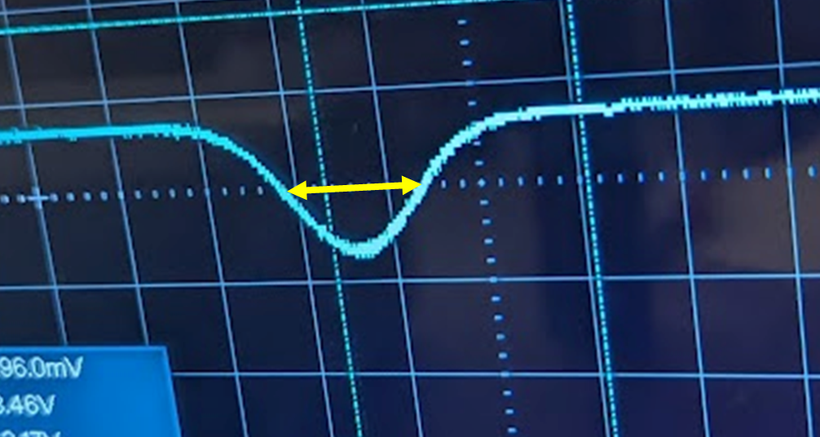
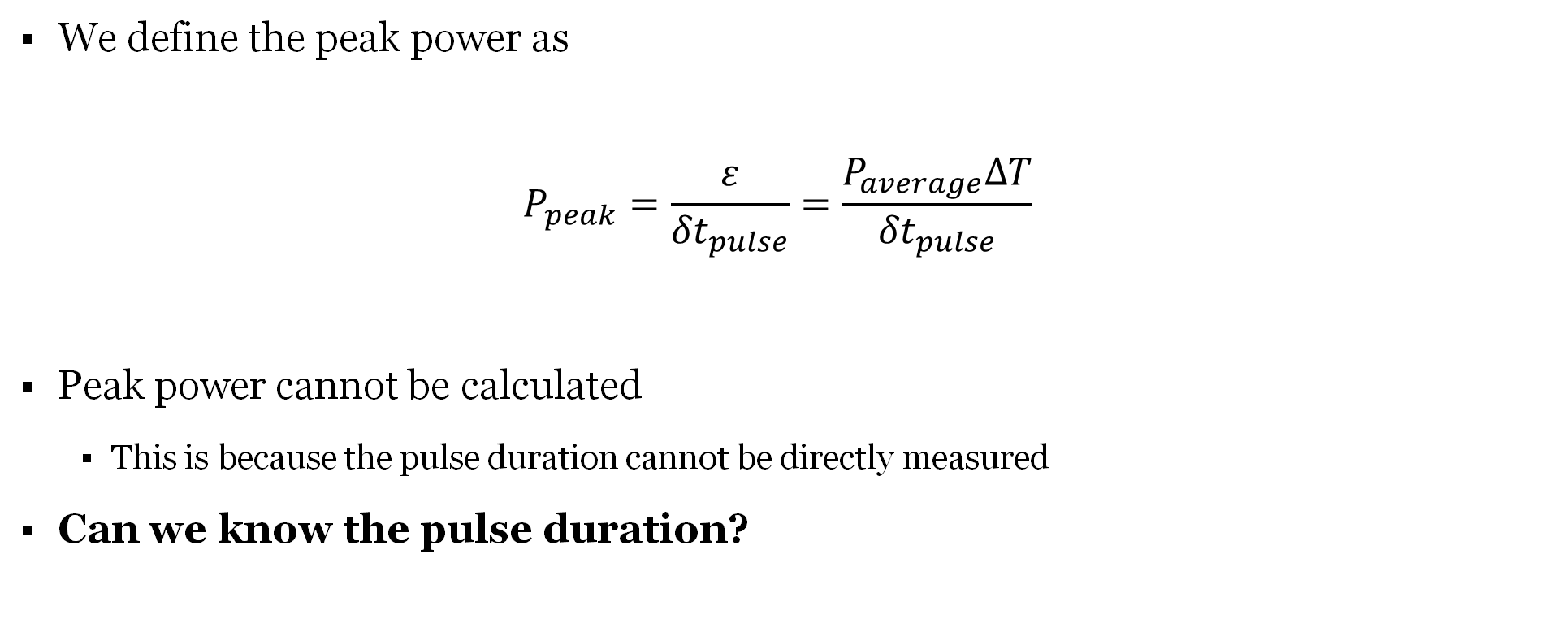
Peak Power for a Short Pulse Laser
We define the peak power as
$$P_{peak}=\frac{ε}{{δt}_{pulse}}=\frac{P_{average}ΔT}{{δt}_{pulse}}$$
Peak power cannot be calculated
  This is because the pulse duration cannot be directly measured
Can we know the pulse duration?
Notes:
Lets move on to another driving variable in the SHG process, the peak power. Being a quantity of power, the peak power is also the pulse energy divided by a time interval. Unlike the time interval used for the average power, this time interval is significantly smaller than the pulse period. The appropriate interval is the pulse duration. In other words, the pulse duration is related to the peak power. This relationship is $P_{peak} = \frac{\varepsilon}{\delta t_{pulse}}$.
We cannot measure the pulse duration, as discussed before, which means we cannot calculate the peak power. So what do we do? The solution to this problem is to approximate the pulse duration using a device called an intensity autocorrelator. This device takes a short pulse train and provides a function of the pulse train known as an autocorrelation. An autocorrelation can be seen on an oscilloscope. The trace of the autocorrelation has a width associated with it, measured by finding the time difference between the two points that correspond with half the trace's maximum value, aptly called the full width at half maximum value. The yellow arrows indicate the full width at half maximum value of this trace of an autocorrelation. This is important because pulses themselves also have a width approximated at their half max value, and the width of the trace of the autocorrelation is proportional to the full width half max of the pulse, in other words, the pulse duration.

Slide 16
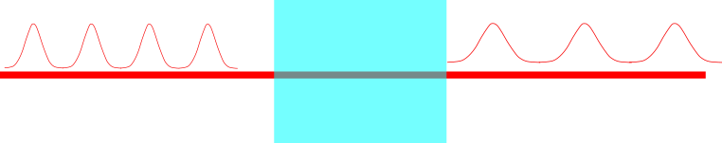


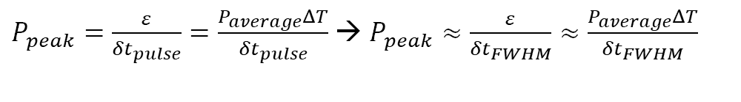
From Peak Power to Pulse Duration
$P_{peak}=\frac{ε}{{δt}_{pulse}}=\frac{P_{average}ΔT}{{δt}_{pulse}}$ → $P_{peak}≈\frac{ε}{{δt}_{FWHM}}≈\frac{P_{average}ΔT}{{δt}_{FWHM}}$
We can only do this for red light though!! What do we do?!?!?!?!
$$P_{peak,original}≈\frac{ε}{{δt}_{FWHM}}$$
$$P_{peak,changed}≈\frac{ε}{{2δt}_{FWHM}}≈\frac{P_{peak,original}}{2}$$
$$τ→2τ$$
Average power and pulse period remain the same
Pulse duration will change as light travels through glass
Notes:
Because of the relationship between the peak power and the pulse duration, an experiment concerned with the ratios of the pulse durations of infrared and blue light can be conducted to determine if the SHG process is driven by the peak power.
Now we know how to characterize the pulse duration, we need to know how to change this. We change the pulse duration by passing the light through a block of glass to approximately double the pulse duration. When the pulse duration changes as the laser travels through the glass, the peak power also changes without the pulse energy changing. If the pulse duration of the infrared light doubles, the peak power halves. Knowing how to change the pulse duration of the infrared light, the students need to determine if the blue light's pulse duration also changes as a result.
The problem now with this experiment is that we can only approximate the pulse duration of the infrared light. We cannot approximate the pulse duration of the blue light because the autocorrelator can only use infrared light to generate an autocorrelation. The solution to this is found using a property of Gaussian beams and students can overcome this difficulty using the result of the next experiment.

Slide 17
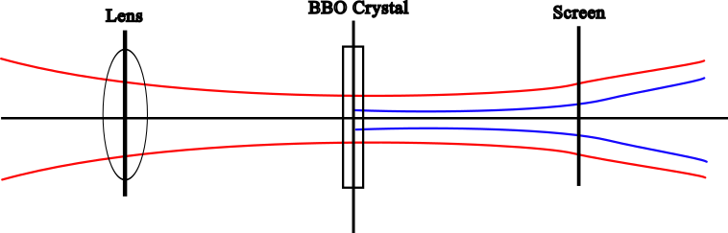
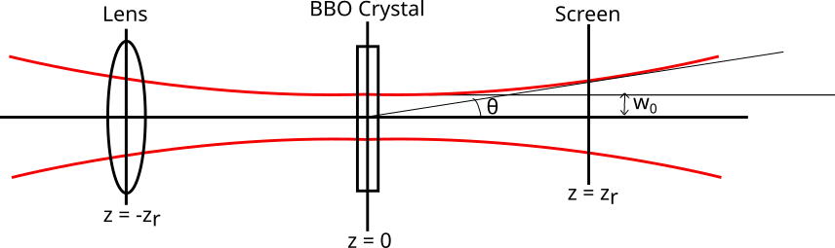
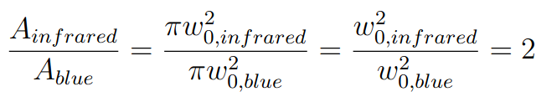
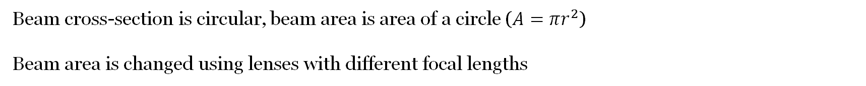
Modifying Beam Area
Beam cross-section is circular, beam area is area of a circle ($A=πr^{2}$)
Beam area is changed using lenses with different focal lengths
Notes:
Laser beams focus to a circle, so the cross-sectional area of the beam can be calculated using the formula for the area of the circle. Laser beams are focused using lenses, and the focal length of a lens will determine the area of the beam at its focus. Since we are investigating the relationship between the laser intensity of the infrared and blue light, we need to find the relationship between the two areas at the point where the frequency doubling process happens, within the crystal. This can be done in certain labs, but not with the configuration we have available. To circumvent this, we have students use the fact that beams diverge and have a divergence angle, and use that divergence angle to then calculate the area of the beam. When students calculate the beam areas of the infrared and blue beams, they will notice that it differs by approximately a factor of 2. This is a property of Gaussian beams!

Slide 18

Sufficient Measurements?
Double the pulse energy of the infrared light and determine the change in the pulse energy of the blue light as a result
$$ε_{blue} α ε_{red}^{2}$$
$$A_{blue}αA_{red}$$
$$δt_{blue} α δt_{red}$$
Double the beam area of the infrared light and determine the change in the beam area of the blue light as a result
Double the pulse duration of the infrared light and infer what happens to the pulse duration of the blue light as a result
Notes:
Our students will be working through this experiment using open inquiry instruction. One of the features of this kind of instruction is that we give students the resources they need to determine how many measurements will be sufficient for this experiment. We don’t expect them to take a million points of data, part of the experimental process is knowing when you’ve taken enough measurements to get a significant result that can be further tested to continue learning. For this experiment, we expect students to take each variable corresponding to the infrared light, change it by a factor of two, and then observe how that variable corresponding to the blue light changes.
From these experiments, students should conclude that changing the pulse energy of the infrared light will change the pulse energy of the blue quadratically, changing the beam area of the infrared will change the beam area of the blue linearly, and infer that changing the pulse duration of the infrared will change the pulse duration of the blue light linearly as well.

Slide 19
References
[1] W. K. Adams, C. E. Wieman, and D. Schwartz, Teaching Expert Thinking, (2008).
[2] R. Azevedo, J. G. Cromley, and D. Seibert, Does adaptive scaffolding facilitate students’ ability to regulate their learning with hypermedia?, Contemporary Educational Psychology 29, 344 (2004).
[3] S. Backus, C. G. Durfee III, M. M. Murnane, and H. C. Kapteyn, High power ultrafast lasers, Review of Scientific Instruments 69, 1207 (1998).
[4] H. Banchi and R. Bell, The Many Levels of Inquiry, Science and Children 46, 26 (2008).
[5] K. Barat, Laser Safety in Specialized Applications (AIP Publishing LLC, 2021).
[6] N. Bloembergen and P. S. Pershan, Light Waves at the Boundary of Nonlinear Media, Phys. Rev. 128, 606 (1962).
[7] R. Boyd, Nonlinear Optics, 4th ed. (Elsevier, 2020).
[8] T. Brixner, S. Mueller, A. Müller, A. Knote, W. Schnepp, S. Truman, A. Vetter, and S. von Mammen, femtoPro: virtual-reality interactive training simulator of an ultrafast laser laboratory, Appl Phys B 129, 78 (2023).
[9] D. T. Brookes, E. Ektina, and G. Planinsic, Implementing an epistemologically authentic approach to student-centered inquiry learning, Phys. Rev. Phys. Educ. Res. 16, 020148 (2020).
[10] L. B. Buck, S. L. Bretz, and M. H. Towns, Characterizing the Level of Inquiry in the Undergraduate Laboratory, Journal of College Science Teaching 38, 52 (2008).
[11] B. Cai, L. A. Mainhood, R. Groome, C. Laverty, and A. McLean, Student behavior in undergraduate physics laboratories: Designing experiments, Phys. Rev. Phys. Educ. Res. 17, 020109 (2021).
[12] T. K. F. Chiu, Fostering Student STEM Interest and Identity Using Self-Determination Theory (2022).
[13] J. Crone, The University of Waterloo Honours Physics Curriculum Map, (2024).
[14] S. Cwik and C. Singh, Self-efficacy and perceived recognition by peers, instructors, and teaching assistants in physics predict bioscience majors’ science identity, PLOS ONE 17, e0273621 (2022).
[15] T. D. Donnelly and C. Grossman, Ultrafast phenomena: A laboratory experiment for undergraduates, American Journal of Physics 66, 677 (1998).
[16] M. Eblen-Zayas, The Impact of Metacognitive Activities on Student Attitudes towards Experimental Physics, in (American Association of Physics Teachers (AAPT), 2016), pp. 104–107.
[17] E. Etkina, D. T. Brookes, and G. Planinsic, Investigative Science Learning Environment: When Learning Physics Mirrors Doing Physics (Morgan & Claypool Publishers, 2019).
[18] P. A. Franken, A. E. Hill, C. W. Peters, and G. Weinreich, Generation of Optical Harmonics, (1961).
[19] M. Goeppert-Mayer, Über Elementarakte Mit Zwei Quantensprüngen - Göppert‐Mayer - 1931 - Annalen Der Physik - Wiley Online Library, 1931.
[20] J. R. Hoehn and H. J. Lewandowski, Investigating undergraduate students’ views about the process of experimental physics, Phys. Rev. Phys. Educ. Res. 18, 020146 (2022).
[21] N. G. Holmes, The Invention Support Environment : Using Metacognitive Scaffolding and Interactive Learning Environments to Improve Learning from Invention, University of British Columbia, 2011.
[22] . N. G. Holmes, Structured Quantitative Inquiry Labs : Developing Critical Thinking in the Introductory Physics Laboratory, University of British Columbia, 2015.
[23] N. G. Holmes and C. E. Wieman, Introductory physics labs: We can do better, Physics Today 71, 38 (2018).
[24] W. Kaiser and C. G. B. Garrett, Two-Photon Excitation in $CaF_{2}:Eu^{2+}$, Phys. Rev. Lett. 7, 229 (1961).
[25] H. C. Kapteyn and M. M. Murnane, FEMTOSECOND LASERS: THE NEXT GENERATION, Optics &amp; Photonics News, OPN 5, 20 (1994).
[26] M. B. Kienlen, N. T. Holte, H. A. Dassonville, A. M. C. Dawes, K. D. Iversen, R. M. McLaughlin, and S. K. Mayer, Collimated blue light generation in rubidium vapor, American Journal of Physics 81, 442 (2013).
[27] J. Korminski et al., AAPT Recommendations for the Undergraduate Physics Laboratory Curriculum, AAPT, 2014.
[28] M. D. Matlin and D. J. McGee, Photorefractive nonlinear optics in the undergraduate physics laboratory, American Journal of Physics 65, 622 (1997).
[29] M. M. Murnane, H. C. Kapteyn, J. Zhou, C. P. Huang, D. Garvey, and M. T. Asaki, Advances in Femtosecond Pulse Generation through the Use of Solid-State Lasers, in OSA Annual Meeting (1993), Paper WD.1 (Optica Publishing Group, 1993), p. WD.1.
[30] K. ‐E. Peiponen, R. U. Maheswari, T. Jaaskelainen, and C. Gu, Demonstrating nonlinear optical phenomena with Chinese tea, American Journal of Physics 61, 937 (1993).
[31] I. Roll, N. Holmes, J. Day, and D. Bonn, Evaluating metacognitive scaffolding in Guided Invention Activities, Instructional Science 40, 691 (2012).
[32] I. S. Ruddock, Nonlinear optical second harmonic generation, Eur. J. Phys. 15, 53 (1994).

Slide 20
References
[33] R. M. Ryan and E. L. Deci, Intrinsic and extrinsic motivation from a self-determination theory perspective: Definitions, theory, practices, and future directions, Contemporary Educational Psychology 61, 101860 (2020).
[34] D. L. Schwartz and T. Martin, Inventing to Prepare for Future Learning: The Hidden Efficiency of Encouraging Original Student Production in Statistics Instruction, Cognition and Instruction 22, 129 (2004).
[35] A. Siegman, Lasers (University Science Books, 1986).
[36] E. M. Smith, M. M. Stein, and N. G. Holmes, Surprise! Shifting Students Away from Model-Verifying Frames in Physics Labs, in 2018 Physics Education Research Conference Proceedings (2019).
[37] E. M. Smith, M. M. Stein, and N. G. Holmes, How expectations of confirmation influence students’ experimentation decisions in introductory labs, Phys. Rev. Phys. Educ. Res. 16, 010113 (2020).
[38] D. E. Spence, P. N. Kean, and W. Sibbett, 60-fsec pulse generation from a self-mode-locked Ti:sapphire laser, Opt. Lett., OL 16, 42 (1991).
[39] Lecture 8 - Nonlinear Optics with Gaussian Beams (n.d.).
[40] N. Sulaiman, B. Pollard, and H. J. Lewandowski, Impact on students’ views of experimental physics from a large introductory physics lab course: Physics Education Research Conference, PERC 2020, Physics Education Research Conference, PERC 2020 533 (2020).
[41] M. Sullivan, S. Desmarais, E. Pacheco, M. Hamalian, E. Moutsopoulos, H. Patel, S. Scala, Y. Sudhu, and C. Schnitzer, Femtosecond laser spectroscopy, autocorrelation, and second harmonic generation: an experiment for undergraduate students, Eur. J. Phys. 40, 035302 (2019).
[42] E. Teichmann, H. J. Lewandowski, and M. Alemani, Investigating students’ views of experimental physics in German laboratory classes, Phys. Rev. Phys. Educ. Res. 18, 010135 (2022).
[43] R. D. F. Turchiello, L. A. A. Pereira, and S. L. Gómez, Low-cost nonlinear optics experiment for undergraduate instructional laboratory and lecture demonstration, American Journal of Physics 85, 522 (2017).
[44] B. R. Wilcox and H. J. Lewandowski, Developing skills vs reinforcing concepts in physics labs: Insight from E-CLASS, Phys. Rev. Phys. Educ. Res. 13, 010108 (2017).
[45] B. R. Wilcox and H. J. Lewandowski, Students’ views about the nature of experimental physics, Physical Review Physics Education Research 13, (2017).
[46] D. G. Wu, A. B. Heim, M. Sundstrom, C. Walsh, and N. G. Holmes, Instructor interactions in traditional and nontraditional labs, Phys. Rev. Phys. Educ. Res. 18, 010121 (2022).
[47] E. Zeek, S. Backus, R. Bartels, H. Kapteyn, and M. Murnane, Measurement of the Autocorrelation Factor for Common Pulses, in Conference on Lasers and Electro-Optics (1999), Paper CTuK11 (Optica Publishing Group, 1999), p. CTuK11.
[48] T. R. Zhang, H. R. Choo, and M. C. Downer, Phase and group velocity matching for second harmonic generation of femtosecond pulses, Appl. Opt., AO 29, 3927 (1990).
[49] J. Zhou, G. Taft, C. Shi, H. C. Kapteyn, M. M. Murnane, and M. Kokta, Intracavity Pulse-Duration Measurements in a Sub-10 Fs Ti:Sapphire Laser Oscillator, in Ultrafast Phenomena (1994), Paper MA.2 (Optica Publishing Group, 1994), p. MA.2.
[50] B. M. Zwickl, T. Hirokawa, N. Finkelstein, and H. J. Lewandowski, Development and results from a survey on students view of experiments in lab classes and research, 2013 PERC Proceedings, AAPT 381 (2013).
[51] B. M. Zwickl, T. Hirokawa, N. Finkelstein, and H. J. Lewandowski, Epistemology and expectations survey about experimental physics: Development and initial results, Phys. Rev. ST Phys. Educ. Res. 10, 010120 (2014).
[52] Laser Safety (SO1066) | Safety Office | University of Waterloo, https://uwaterloo.ca/safety-office/training/laser-safety.
[53] Valid Assessment of Learning in Undergraduate Education…, https://www.aacu.org/value.
[54] Frequently Asked Questions for the KMLabs Inc. Ti:Sapphire Oscillators: Griffin, Cascade, Halcyon, MTS, Chinook &TS Laser Systems (KMLabs Inc., 2006).
[55] Inquiry and Analysis VALUE Rubric, (2009).
[56] Integrative Learning VALUE Rubric, (2009).
[57] Teamwork VALUE Rubric, (2009).
[58] Spectra-Physics Confidential Information Pre-Installation Guide For Millennia eV 5W/10W/15W Systems, Spectra-Physics, Inc., 2014.
[59] Instruction Manual - Collegiate Ti:Sapphire Laser Kit (KMLabs Inc., 2014).

Slide 21
Experiment Limitations
Experiment is concerned with the ratios of peak powers and laser intensities
The pulse duration and beam area directly relate to peak power and laser intensity (neither of which can be measured or calculated in our laboratory)
The use of pulse duration and beam area create a sufficient experiment that keeps students focused on the overall goal
Important especially when considering the time limitations within the laboratory
Notes:
There are some other challenges that are posed to the students as a result of the experimental configuration, like not being able to measure the area of the beam at its focus. That can feasibly be overcome by using the divergence of the beam.

Slide 22
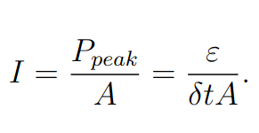
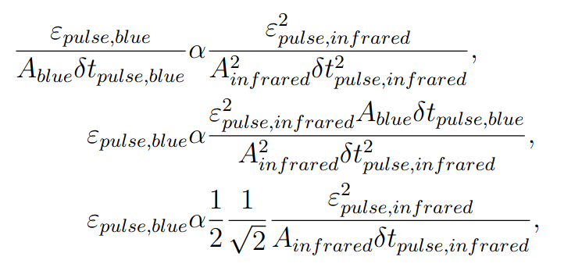



What variable drives the SHG process? How will students know that?
$$I_{red}≈\frac{ε_{pulse,red}}{δt_{FWHM,red}A_{red}}$$
$$A_{red}→\frac{1}{2}A_{red};ε_{pulse,blue}→2ε_{pulse,blue};I_{red}→2I_{red}$$
$$I_{blue}→4I_{blue}$$
Notes:
So which variable drives the SHG process? Remember that all three are directly related to each other in a very specific way. If the experiment is done properly, students will observe a quadratic relationship between the pulse energies, and a linear relationship between the pulse duration and beam area. When the pulse duration or beam area of the infrared light changes, the pulse energy of the blue light will also change, even if the pulse energy of the infrared light remains constant. From these observations and knowing that the pulse energy, peak power, and laser intensity are all directly related to each other, students should be able to conclude that frequency doubling is an intensity-dependent process.
In fact, SHG efficiency scales with the square of the intensity. So why do we only get a quadratic relationship with the pulse energy? Take a look at that equation again. The pulse energy of the infrared and pulse energy of the blue are quadratically dependent, but the pulse duration and beam area are linear. However, since the pulse energy is quadratic, and the peak power and laser intensity relate to the pulse energy, they are also quadratic in relation. Students won't see this because in each experiment to isolate each variable, they are working with the components that change linearly. Another way to show that the peak power and intensity change quadratically is to consider it this way: When the beam area of the infrared light, and subsequently the blue light, reduces by a factor of 2, the pulse energy of the blue light will increase by a factor of 2. This means that as the intensity of the infrared increased by a factor of 2, the intensity of the blue increased by a factor of 4 as a result of the multiple variables impacting the blue intensity.

Slide 23
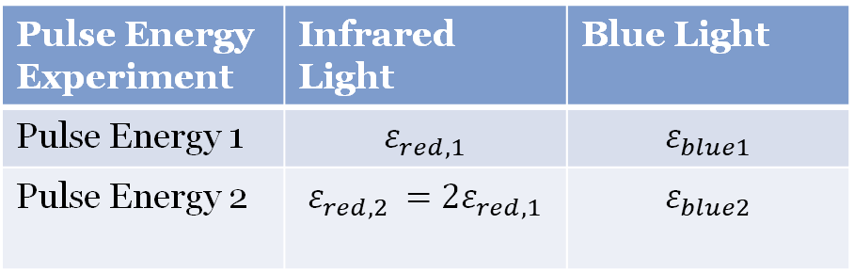
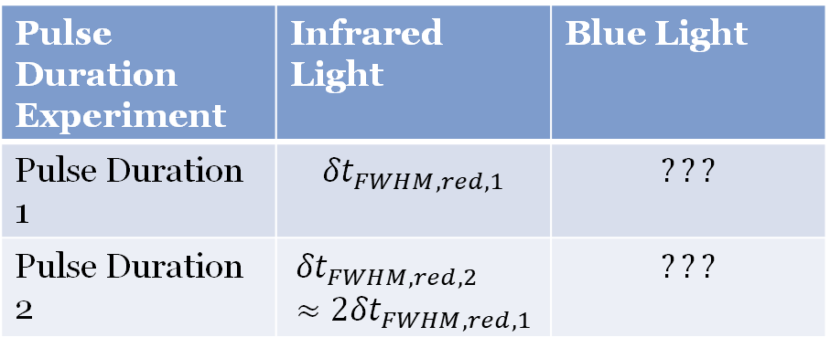
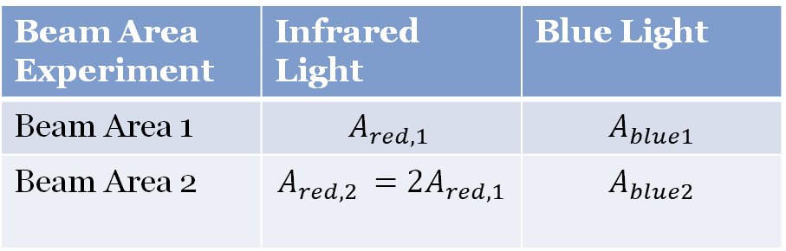
Sufficient Measurements?
Pulse Energy Experiment | Infrared Light | Blue Light
Pulse Energy 1 | $$ε_{red,1}$$ | $$ε_{blue1}$$
Pulse Energy 2 | $$ε_{red,2 }=2ε_{red,1}$$ | $$ε_{blue2}$$
Double the pulse energy of the infrared light and calculate the pulse energy of the blue light
Beam Area Experiment | Infrared Light | Blue Light
Beam Area 1 | $$A_{red,1 }$$ | $$A_{blue1}$$
Beam Area 2 | $$A_{red,2 }=2A_{red,1}$$ | $$A_{blue2}$$
Double the beam are of the infrared light and calculate the beam area of the blue light
Pulse Duration Experiment | Infrared Light | Blue Light
Pulse Duration 1 | $${δt}_{FWHM,red,1}$$ | $$???$$
Pulse Duration 2 | $${δt}_{FWHM,red,2 }≈2{δt}_{FWHM,red,1}$$ | $$???$$
Double the pulse duration of the infrared light and infer what happens to the pulse duration of the blue light
Notes:
Our students will be working through this experiment using open inquiry instruction. One of the features of this kind of instruction is that we give students the resources they need to determine how many measurements will be sufficient for this experiment. We don’t expect them to take a million points of data, part of the experimental process is knowing when you’ve taken enough measurements to get a significant result that can be further tested to continue learning. For this experiment, we expect students to use two values for the pulse energy of the infrared light that correspond with the pulse energy of the generated blue light. These two values must be a factor of two apart, one must be double the other. We also want them to calculate two beam areas, again one the double of the other. Finally, we want them to approximate the infrared pulse duration twice. Once with the light emitted by the oscillator directly and once after its been sent through the glass block.

Slide 24
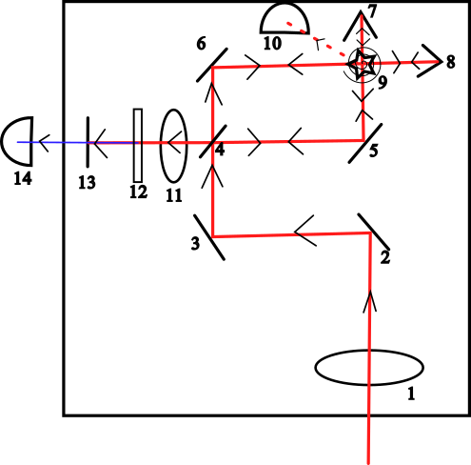
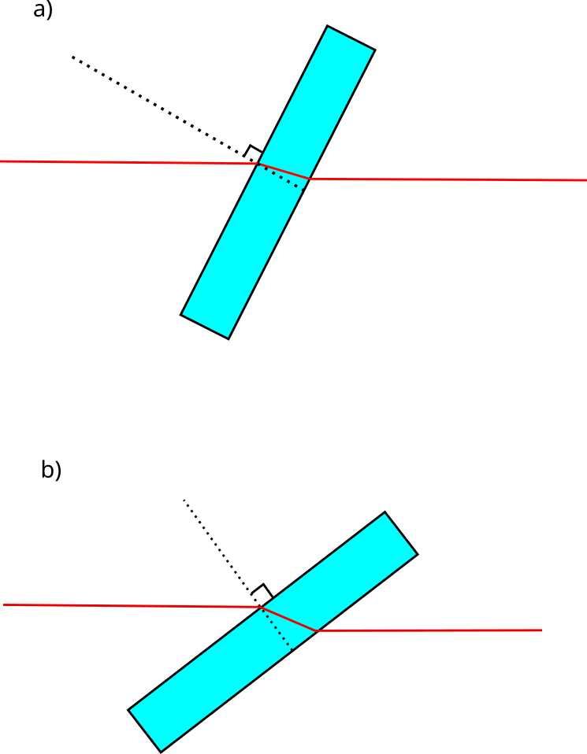
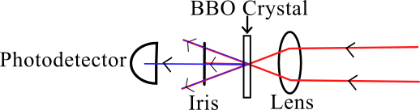
The intensity autocorrelator
Notes:
Constructing experiment – intensity autocorrelator (be careful with this slide)
Since the periscope caused the polarization of the light to rotate by 90$^{\circ}$, a half-waveplate (Optic (1) in Figure \ref{fig:autocorrelator}) was needed to rotate the polarization to match the phasematching angle of the BBO crystal used in the intensity autocorrelator.
The beam reflected off of two gold mirrors (Optics (2) and (3) in Figure \ref{fig:autocorrelator}) before it interacted with the beamsplitter (optic (4) in Figure \ref{fig:autocorrelator}) that split the light into two beams. In each beam path, the beam reflects off a mirror, (either optics (5) or (6) in Figure \ref{fig:autocorrelator} depending on the path), and the beams reflect off of paired gold mirrors, (optics (7) and (8) in Figure \ref{fig:autocorrelator}). The paired mirrors are mounted perpendicularly to each other so that the beam can be raised or lowered while remaining parallel to the optical bench. They travel back towards the beamsplitter, with one path slightly higher than before and the other slightly lower. The path that travels slightly lower travels through the rotating glass plate (optic (9) in Figure \ref{fig:autocorrelator}) which causes a time delay between the two beams. The other beam passes over the plate to ensure that only one of the beams gets delayed in time by some delay $\tau$, which changes as the glass rotates. The amount the delay changes is dependent on the angle by which the light is incident onto the plate. As the plate rotates, the incident angle changes and thus $\tau$ changes. This is shown in Figure \ref{fig:rotating glass}.

Slide 25
Inquiry Learning
Confirmation
Criterion | Provided?
Problem/Question | Yes
Theory/Background | Yes
Procedure/Design | Yes
Results Analysis | Yes
Results Communication | Yes
Discussion | Yes
Notes:
Inquiry work is defined on a continuum ranging from limited or low levels to high levels. The higher the level, the closer the work is to authentic inquiry, which is how one would characterize the experimental process scientists perform.
In confirmation inquiry work, students are evaluated on their ability to obtain the correct, pre-determined result. These labs are effective in the reinforcement of analytical methods required for experimental work in physics. Often, if the purpose of a laboratory activity is to experience an unfamiliar phenomenon or learn a particular laboratory technique, confirmation inquiry methods are used.
What should the experiment cover
Inquiry learning
There are several reasons to teach this experiment using inquiry-based approaches

Slide 26
Inquiry Learning
Structured
Criterion | Provided?
Problem/Question | Yes
Theory/Background | Yes
Procedure/Design | Yes
Results Analysis | Yes
Results Communication | No
Discussion | No
Notes:
In structured inquiry labs, the question, theory, procedures, and results analysis methods are provided, but students must communicate results and draw conclusions from their experiment independently.
What should the experiment cover
Inquiry learning
There are several reasons to teach this experiment using inquiry-based approaches

Slide 27
Inquiry Learning
Guided
Criterion | Provided?
Problem/Question | Yes
Theory/Background | Yes
Procedure/Design | Yes
Results Analysis | No
Results Communication | No
Discussion | No
Notes:
In guided inquiry, the experimental question, theory, and procedures are presented to students and students are responsible for analyzing and communicating their own results and determining conclusions independently.
What should the experiment cover
Inquiry learning
There are several reasons to teach this experiment using inquiry-based approaches

Slide 28
Inquiry Learning
Authentic
Criterion | Provided?
Problem/Question | No
Theory/Background | No
Procedure/Design | No
Results Analysis | No
Results Communication | No
Discussion | No
Notes:
The final level of inquiry is authentic inquiry, which is where the student can independently develop all six characteristics of inquiry-based laboratory work. Project based courses are an example of authentic inquiry work.
What should the experiment cover
Inquiry learning
There are several reasons to teach this experiment using inquiry-based approaches

Slide 29
thesis
This open inquiry experiment on second harmonic generation aims to improve student engagement in the introductory physics laboratory by encouraging intrinsic motivation through conceptual challenges and student-driven exploration.
Notes:
Undergraduate labs need high level inquiry experiments to engage students and give them opportunity to develop the skills they need to become experimentalists
In this project, I present an experiment designed for the introductory physics laboratory using Second Harmonic Generation
The questions we are looking to answer are:
Can Second Harmonic Generation (SHG) be used to develop an inquiry-based experiment at the introductory undergraduate level?
Can undergraduate physics students get excited towards the physics laboratory as a direct result of completing this experiment?

Slide 30
What should the experiment be about?
A conceptually rich topic
A question that Interests Students
Notes:
What should the experiment cover
Nonlinear optics
The pulse energy is the only variable of the three that the students can directly measure.
Students approximate pulse duration and won’t require a measurement of the peak power (since they are inferring a ratio of the FWHM of each colour)
Students cannot directly measure the intensity and must use the beam area instead to understand the

Slide 31
What concepts do we expect students to return to in future years?
Concepts relating to SHG appearing in future courses
Further applications that are used in other fields of research
Nonlinear optics

Slide 32
High Levels of Inquiry for a Conceptually Challenging Experiment
Are students capable of producing an experiment that answers a conceptually challenging experimental question? Is exciting them enough?
What should students learn from this experiment if subject mastery is not required?
What concepts do we expect students to return to in future years?
Notes:
Naturally, one of the biggest concerns with introducing high levels of inquiry into the classroom along with conceptually rich topics are whether or not our students are being set up for success. This is a big question that can be addressed many ways. To do this using Physics Education Research, we are going to break down the big concern at hand into these three questions.
Teaching the experiment – what should students expect to accomplish?
Students are expected to drive the experimental process by asking questions and designing experiments that change the pulse energy, peak power, and laser intensity of the fundamental infrared light to observe what happens to the SHG blue light
Students are looking to determine which variable is responsible for the generation of light at the second harmonic
All nonlinear processes are intensity dependent, but students won’t know this theory
They should be able to determine that the process is intensity dependent when they observe the pulse energy for SHG light change in all three experiments, even in the experiments where the pulse energy of the infrared light is held constant

Slide 33
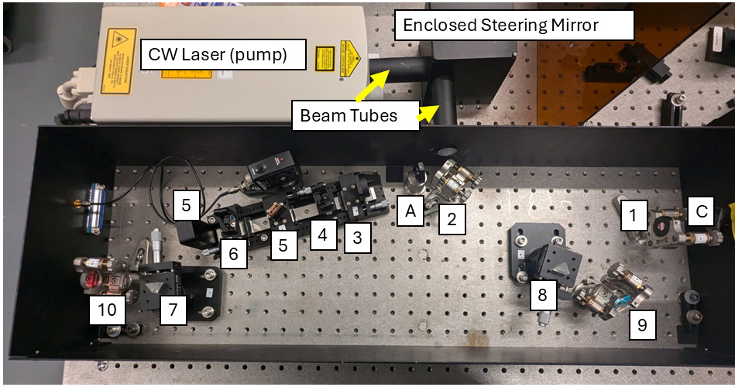
The laser system
Notes:
Constructing experiment – laser system
The laser system is composed of a mode-locked Ti:Sapphire oscillator pumped by a CW laser. Mode-locked Ti:Sapphire lasers were developed by Spence et al. in 1991, but this oscillator designed by Kapteyn and Murnane and developed throughout the early 1990s \cite{spence_60-fsec_1991,murnane_advances_1993,zhou_intracavity_1994}. The cavity is asymmetric, and the asymmetry of the cavity is necessary to produce high-power TEM$_{00}$ mode-locked pulses \cite{murnane_advances_1993}. The mode-locked oscillator was built using the Kapteyn-Murnane Labs Titanium Sapphire Collegiate Kit (TS Kit) \cite{noauthor_instruction_2014,noauthor_frequently_2006}. This kit was purchased because of its quality and because it was more cost effective than other Ti:Sapphire oscillators, so it fit within the project's budget. The oscillator is Kerr Lens Mode-Locked. The infrared pulsed light emitted from the mode-locked oscillator is p-polarized and has a wavelength range of 800$\pm$50nm with pulses that vary around 100$\pm$50fs. The 532nm light from the pump laser was blocked from exiting the cavity using a filter (optic (C) in Figure \ref{fig:femtosecond laser}).
The mode-locked oscillator is pumped by the Spectra-Physics Millennia eV 5W laser that produces CW light at 532nm \cite{noauthor_spectra-physics_2014}. The CW laser is a diode pumped, Class-IV laser and produces a beam with a TEM$_{00}$ profile \cite{noauthor_spectra-physics_2014}. This laser uses a closed-loop chiller that operates using distilled water at about 20$\pm0.5^{\circ}$C \cite{noauthor_spectra-physics_2014}. To operate the laser, 120-240 VAC electrical service is required. This laser must be placed on an optical bench with enough free space around the laser to prevent overheating \cite{noauthor_spectra-physics_2014}. The light exiting the CW laser is vertically polarized, or s-polarized \cite{noauthor_spectra-physics_2014}.
The oscillator was built up from noise following the procedure given in the manual \cite{noauthor_instruction_2014,noauthor_frequently_2006}. The Ti:Sapphire oscillator was pumped by linear, horizontally polarized light, or p-polarized light. A half-waveplate was used to rotate the s-polarized 532nm light from the CW laser into p-polarized light. P-polarization was used because the Ti:Sapphire crystal (optic (5) in Figure \ref{fig:femtosecond laser}) and the prisms (optics (7) and (8) in Figure \ref{fig:femtosecond laser}) were cut at Brewster angles such that there was near zero loss for p-polarized light. Light that was s-polarized could have been used to pump the oscillator, but a higher pump power would have been required (this could have over-pumped the system and led to double pulsing which would damage the optics). A system pumped with the p-polarized 532nm beam has less loss than a system pumped with an s-polarized beam, so light at p-polarization was used for a safer and more efficient system.
The pump beam was directed into the TS Kit using two mirrors, one outside the TS Kit and one inside the kit. Two mirrors are usually used together to align a beam. One mirror, usually the mirror farther from the beam's target, sets the position of the beam and the other, usually closer to the target, sets the angle. The steering mirror, which is outside the TS Kit (and labelled as such in Figure \ref{fig:femtosecond laser}) is used to set the position of the beam as it travels through the rail sub-assembly. The sub-assembly contains a focusing lens, Curved Mirror 1, the Ti:Sapphire crystal, and Curved Mirror 2 (optics (3) to (6) in figure \ref{fig:femtosecond laser}). The alignment mirror (optic (2) in Figure \ref{fig:femtosecond laser}) sets the angle of the 532nm beam as it travels into the oscillator's enclosure. Moving either mirror changes both the position and the angle of the beam at the same time, but iteratively adjusting both mirrors will give proper beam alignment as long as one mirror is strictly used to set the position and the other is used to set the angle. A beam alignment tool was provided to efficiently align the pump beam. During this stage, only the minimum power of the pump was used which was about 0.2W.
Once the 532nm beam was aligned through the rail sub-assembly, it did not clip any edge of the Ti:Sapphire crystal, but did not pass through the exact centre of the crystal either. This was expected based on the information provided in the manual \cite{noauthor_instruction_2014}. The 532nm pump beam was able to pass through the exact centre of Curved Mirror 1 and slightly to the side of the centre of Curved Mirror 2. The beam's position on Curved Mirror 1 and 2 were both confirmed using the provided beam alignment tool. The stability of the cavity depended on the positions of the curved mirrors and the crystal, as the radii of curvature of the mirrors and their distance from each other determined the cavity's stability parameters.
Infrared light was generated in the TS Kit when the atoms in the Ti:Sapphire crystal were excited by the 532nm CW beam. The atoms absorbed the 532nm light and emitted coherent infrared fluorescence. There were two retroreflected fluorescence beams that were emitted by the crystal used to initiate lasing. One beam was retroreflected from the Output Coupler, and the other from the End Reflector Mirror (optics (1) and (9), respectively, in Figure \ref{fig:femtosecond laser}). To align the cavity to achieve lasing, the retroreflected fluorescence spots were overlapped. An alignment laser was not needed for the construction of the Ti:Sapphire oscillator, since it has a very high gain and produces fluorescence spots that are in the visible spectrum.

Slide 34
More on SHG

Slide 35
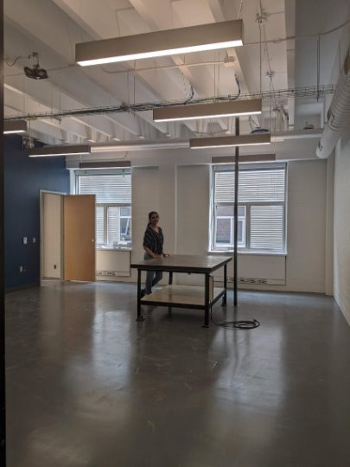
What do students do in an undergraduate laboratory?
Notes:
There are many different perspectives that instructors bring to an undergraduate laboratory. Some view it as a space to primarily reinforce lecture content, and others focus the learning goals on developing experimentalist habits of mind. Both these educational foci are important for student development, but have their own pros and cons with regards to student learning and especially engagement with physics.
It is especially difficult to engage students within the laboratory with experiments that can effectively present conceptual challenges, since those that do involve skill beyond the reach of the average beginner. So that was the challenge we dared to take on in our project. How do we design an experiment that can conceptually challenge our students, interest them enough to keep them engaged with experimental physics, and use techniques that are appropriate for the average beginner?

Slide 36
Significance of Student Agency
Agency is a student’s ability to independently set and accomplish a goal
Provides an active role in their own learning: they realize the control they have in the outcome of a course
Motivates them to learn – they identify (and sometimes define their own) Intended Learning Outcomes (ILOs)
Notes:
We do this by designing experiments that focus on student agency. Student agency is the student’s ability to independently set and accomplish a goal, and this determines their role in their own learning, giving them control over what they can do in a course. This in turn motivates them to learn since they can identify a purpose and objective for their learning.
The conclusion to take away from this presentation is that we need to ensure student agency is being addressed in our course design in two ways: the method of teaching and the content being delivered. The results of our remodel demonstrated that the skills-based lab method of teaching consistently improves perceived agency in students taking the physics 1 lab.

Slide 37
Are students capable of producing an experiment that answers a conceptually challenging experimental question through open inquiry work?
Given: problem, background
Need: all other elements of an undergraduate experiment
Notes:
What will they need to do?
How will they need to do it?

Slide 38
Upper Year Experiment

Slide 39
Determining The purpose of the introductory laboratory
Criterion | Perspective 1 | Perspective 2
Purpose of the physics laboratory within a curriculum | Lies “in its effectiveness in cultivating right habits of work, in its demand for system, care, and accuracy on the part of the pupil”[1] | To enhance student understanding of lecture content[3]
Value the laboratory brings to student learning | The laboratory allows students to understand how fundamental physical ideas enable most modern technologies and therefore to appreciate the role that physicists can play in developing practical solutions to societal problems.[2] | that students will better understand the physics if they conduct experiments and see for themselves how the physics principles work in real life.[3]
Notes:
"Its right to exist is to be found rather in its effectiveness in cultivating right habits of work, in its demand for system, care, and accuracy on the part of the pupil.
The value of the laboratory must depend in no small measure on the character of the problems proposed, as well as the manner of solving them.
Not many qualitative exercises are adapted to securing the results mentioned above, and many quantitative ones involve skill beyond the reach of the beginner."¹
This quote was from a 1913 textbook offering laboratory experiments that enhanced education back in the day. Just over 100 years later, the message remains similar, but strengthened by the knowledge gathered over 100 years of physics education research.
Its right to exist is to be found rather in its effectiveness in cultivating right habits of work, in its demand for system, care, and accuracy on the part of the pupil.
The value of the laboratory must depend in no small measure on the character of the problems proposed, as well as the manner of solving them.[1]
The laboratory allows students to understand how fundamental physical ideas enable most modern technologies and therefore to appreciate the role that physicists can play in developing practical solutions to societal problems.[2]
“At many institutions, introductory labs are aligned with the introductory lecture course. The intended goal is to enhance student understanding of lecture content, and the underlying rationale is that students will better understand the physics if they conduct experiments and see for themselves how the physics principles work in real life.”[3]

Slide 40
Determining The purpose of the introductory laboratory
Criterion | Perspective 1 | Perspective 2
Purpose of the physics laboratory within a curriculum | Lies “in its effectiveness in cultivating right habits of work, in its demand for system, care, and accuracy on the part of the pupil”[1] | To enhance student understanding of lecture content[3]
Value the laboratory brings to student learning | The laboratory allows students to understand how fundamental physical ideas enable most modern technologies and therefore to appreciate the role that physicists can play in developing practical solutions to societal problems.[2] | that students will better understand the physics if they conduct experiments and see for themselves how the physics principles work in real life.[3]
Lies “in its effectiveness in cultivating right habits of work, in its demand for system, care, and accuracy on the part of the pupil”[1]
Notes:
"Its right to exist is to be found rather in its effectiveness in cultivating right habits of work, in its demand for system, care, and accuracy on the part of the pupil.
The value of the laboratory must depend in no small measure on the character of the problems proposed, as well as the manner of solving them.
Not many qualitative exercises are adapted to securing the results mentioned above, and many quantitative ones involve skill beyond the reach of the beginner."¹
This quote was from a 1913 textbook offering laboratory experiments that enhanced education back in the day. Just over 100 years later, the message remains similar, but strengthened by the knowledge gathered over 100 years of physics education research.
Its right to exist is to be found rather in its effectiveness in cultivating right habits of work, in its demand for system, care, and accuracy on the part of the pupil.
The value of the laboratory must depend in no small measure on the character of the problems proposed, as well as the manner of solving them.[1]
The laboratory allows students to understand how fundamental physical ideas enable most modern technologies and therefore to appreciate the role that physicists can play in developing practical solutions to societal problems.[2]
“At many institutions, introductory labs are aligned with the introductory lecture course. The intended goal is to enhance student understanding of lecture content, and the underlying rationale is that students will better understand the physics if they conduct experiments and see for themselves how the physics principles work in real life.”[3]

Slide 41
Determining The purpose of the introductory laboratory
Criterion | Perspective 1 | Perspective 2
Purpose of the physics laboratory within a curriculum | Lies “in its effectiveness in cultivating right habits of work, in its demand for system, care, and accuracy on the part of the pupil”[1] | To enhance student understanding of lecture content[3]
Value the laboratory brings to student learning | The laboratory allows students to understand how fundamental physical ideas enable most modern technologies and therefore to appreciate the role that physicists can play in developing practical solutions to societal problems.[2] | that students will better understand the physics if they conduct experiments and see for themselves how the physics principles work in real life.[3]
To enhance student understanding of lecture content[3]
Notes:
"Its right to exist is to be found rather in its effectiveness in cultivating right habits of work, in its demand for system, care, and accuracy on the part of the pupil.
The value of the laboratory must depend in no small measure on the character of the problems proposed, as well as the manner of solving them.
Not many qualitative exercises are adapted to securing the results mentioned above, and many quantitative ones involve skill beyond the reach of the beginner."¹
This quote was from a 1913 textbook offering laboratory experiments that enhanced education back in the day. Just over 100 years later, the message remains similar, but strengthened by the knowledge gathered over 100 years of physics education research.
Its right to exist is to be found rather in its effectiveness in cultivating right habits of work, in its demand for system, care, and accuracy on the part of the pupil.
The value of the laboratory must depend in no small measure on the character of the problems proposed, as well as the manner of solving them.[1]
The laboratory allows students to understand how fundamental physical ideas enable most modern technologies and therefore to appreciate the role that physicists can play in developing practical solutions to societal problems.[2]
“At many institutions, introductory labs are aligned with the introductory lecture course. The intended goal is to enhance student understanding of lecture content, and the underlying rationale is that students will better understand the physics if they conduct experiments and see for themselves how the physics principles work in real life.”[3]

Slide 42
Determining The purpose of the introductory laboratory
Criterion | Perspective 1 | Perspective 2
Purpose of the physics laboratory within a curriculum | Lies “in its effectiveness in cultivating right habits of work, in its demand for system, care, and accuracy on the part of the pupil”[1] | To enhance student understanding of lecture content[3]
Value the laboratory brings to student learning | The laboratory allows students to understand how fundamental physical ideas enable most modern technologies and therefore to appreciate the role that physicists can play in developing practical solutions to societal problems.[2] | that students will better understand the physics if they conduct experiments and see for themselves how the physics principles work in real life.[3]
To enhance student understanding of lecture content[3]
The laboratory allows students to understand how fundamental physical ideas enable most modern technologies and therefore to appreciate the role that physicists can play in developing practical solutions to societal problems.[2]
Notes:
"Its right to exist is to be found rather in its effectiveness in cultivating right habits of work, in its demand for system, care, and accuracy on the part of the pupil.
The value of the laboratory must depend in no small measure on the character of the problems proposed, as well as the manner of solving them.
Not many qualitative exercises are adapted to securing the results mentioned above, and many quantitative ones involve skill beyond the reach of the beginner."¹
This quote was from a 1913 textbook offering laboratory experiments that enhanced education back in the day. Just over 100 years later, the message remains similar, but strengthened by the knowledge gathered over 100 years of physics education research.
Its right to exist is to be found rather in its effectiveness in cultivating right habits of work, in its demand for system, care, and accuracy on the part of the pupil.
The value of the laboratory must depend in no small measure on the character of the problems proposed, as well as the manner of solving them.[1]
The laboratory allows students to understand how fundamental physical ideas enable most modern technologies and therefore to appreciate the role that physicists can play in developing practical solutions to societal problems.[2]
“At many institutions, introductory labs are aligned with the introductory lecture course. The intended goal is to enhance student understanding of lecture content, and the underlying rationale is that students will better understand the physics if they conduct experiments and see for themselves how the physics principles work in real life.”[3]

Slide 43
Determining The purpose of the introductory laboratory
Criterion | Perspective 1 | Perspective 2
Purpose of the physics laboratory within a curriculum | Lies “in its effectiveness in cultivating right habits of work, in its demand for system, care, and accuracy on the part of the pupil”[1] | To enhance student understanding of lecture content[3]
Value the laboratory brings to student learning | The laboratory allows students to understand how fundamental physical ideas enable most modern technologies and therefore to appreciate the role that physicists can play in developing practical solutions to societal problems.[2] | that students will better understand the physics if they conduct experiments and see for themselves how the physics principles work in real life.[3]
that students will better understand the physics if they conduct experiments and see for themselves how the physics principles work in real life.[3]
Notes:
"Its right to exist is to be found rather in its effectiveness in cultivating right habits of work, in its demand for system, care, and accuracy on the part of the pupil.
The value of the laboratory must depend in no small measure on the character of the problems proposed, as well as the manner of solving them.
Not many qualitative exercises are adapted to securing the results mentioned above, and many quantitative ones involve skill beyond the reach of the beginner."¹
This quote was from a 1913 textbook offering laboratory experiments that enhanced education back in the day. Just over 100 years later, the message remains similar, but strengthened by the knowledge gathered over 100 years of physics education research.
Its right to exist is to be found rather in its effectiveness in cultivating right habits of work, in its demand for system, care, and accuracy on the part of the pupil.
The value of the laboratory must depend in no small measure on the character of the problems proposed, as well as the manner of solving them.[1]
The laboratory allows students to understand how fundamental physical ideas enable most modern technologies and therefore to appreciate the role that physicists can play in developing practical solutions to societal problems.[2]
“At many institutions, introductory labs are aligned with the introductory lecture course. The intended goal is to enhance student understanding of lecture content, and the underlying rationale is that students will better understand the physics if they conduct experiments and see for themselves how the physics principles work in real life.”[3]

Slide 44
Determining The purpose of the introductory laboratory
Criterion | Perspective 1 | Perspective 2
Purpose of the physics laboratory within a curriculum | Lies “in its effectiveness in cultivating right habits of work, in its demand for system, care, and accuracy on the part of the pupil”[1] | To enhance student understanding of lecture content[3]
Value the laboratory brings to student learning | The laboratory allows students to understand how fundamental physical ideas enable most modern technologies and therefore to appreciate the role that physicists can play in developing practical solutions to societal problems.[2] | that students will better understand the physics if they conduct experiments and see for themselves how the physics principles work in real life.[3]
Notes:
"Its right to exist is to be found rather in its effectiveness in cultivating right habits of work, in its demand for system, care, and accuracy on the part of the pupil.
The value of the laboratory must depend in no small measure on the character of the problems proposed, as well as the manner of solving them.
Not many qualitative exercises are adapted to securing the results mentioned above, and many quantitative ones involve skill beyond the reach of the beginner."¹
This quote was from a 1913 textbook offering laboratory experiments that enhanced education back in the day. Just over 100 years later, the message remains similar, but strengthened by the knowledge gathered over 100 years of physics education research.
Its right to exist is to be found rather in its effectiveness in cultivating right habits of work, in its demand for system, care, and accuracy on the part of the pupil.
The value of the laboratory must depend in no small measure on the character of the problems proposed, as well as the manner of solving them.[1]
The laboratory allows students to understand how fundamental physical ideas enable most modern technologies and therefore to appreciate the role that physicists can play in developing practical solutions to societal problems.[2]
“At many institutions, introductory labs are aligned with the introductory lecture course. The intended goal is to enhance student understanding of lecture content, and the underlying rationale is that students will better understand the physics if they conduct experiments and see for themselves how the physics principles work in real life.”[3]

Slide 45
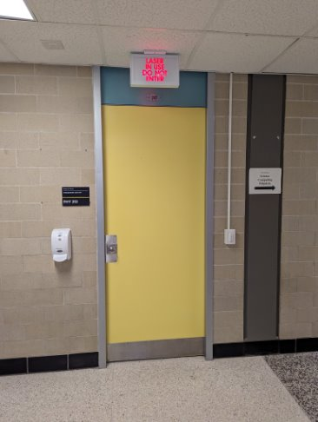
The Safety and the Feasibility
Notes:
Constructing experiment (safety and feasibility)

Slide 46
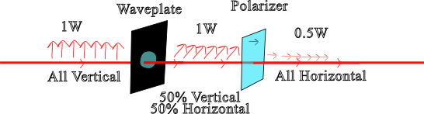
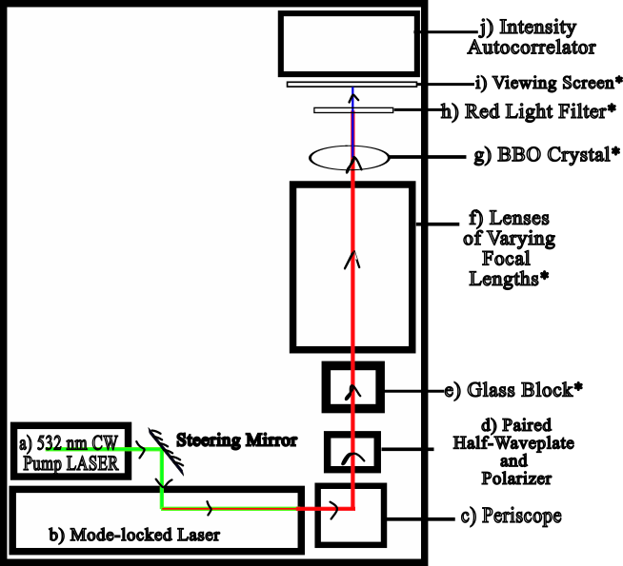
What the Students Use
Notes:
Constructing experiment – optics students can work with
After exiting the femtosecond laser, the light first interacts with a periscope (optic (c) in Figure \ref{fig:muonsworkspace}) which raises the beam while keeping it parallel to the optical table. Since the beam exits the TS Kit at 59mm above the optical bench and most optics in the experimental workspace were mounted higher than that, raising the beam was necessary to allow the light to interact with the rest of the optics in the workspace. The periscope can safely alter the beam height while keeping the beam parallel to the table. The periscope also rotates the polarization of the beam, so the beam became s-polarized after exiting the periscope. After the beam height is raised vertically, it passes through a paired half-waveplate and linear polarizer (optic (d) in Figure \ref{fig:muonsworkspace}). The half-waveplate and linear polarizer are paired together so that the pulse energy of the mode-locked pulse train can be changed. The glass block (optic (e) in Figure \ref{fig:muonsworkspace}) is made of K9 glass and is used to double the pulse duration of the infrared light emitted from the ultrafast laser. Bi-Convex Lenses with different focal lengths (optics (f) in Figure \ref{fig:muonsworkspace}) are used to focus the beam within the centre of the BBO Crystal (optic (g) in Figure \ref{fig:muonsworkspace}). The SHG light generated within the crystal. Since not all the infrared fundamental light converts into blue SHG light, a filter optic (h) in Figure \ref{fig:muonsworkspace}) is placed in the beam's path to block the red light exiting the BBO crystal. The viewing screen (optic (i) in Figure \ref{fig:muonsworkspace}) blocks all the light from exiting the experimental workspace while the intensity autocorrelator is not in use. Between optics (e) and (f), a power meter is attached on a rail to move in and out of the beam path. Another power meter is placed behind optic (h). Power meters are in place to measure the average power of both the infrared and blue beams.

Slide 47
Teaching Students
Narrative
Development of experimental components
Notes:
Presents a narrative to students that encourages them to go on a “journey” in a sense with the goal being to have fun working with a system that is entirely brand new to them
Work is evaluated less heavily on data collection and analysis more heavily on development of experimental questions, procedure, and ability to produce meaningful peer-to-peer interactions that reflect the skills and competencies of practicing experimental physicists

Slide 48
How to characterize inquiry learning in the undergraduate laboratory
Criterion | Definition
Problem/Question | The question that the experiment will answer
Theory/Background | Relevant information to contextualize question
Procedure/Design | Method used to perform experiment
Results Analysis | Analysis used to interpret results
Results Communication | Methods used to present analysis
Discussion | Conclusion, error analysis, next steps in experimentation

Slide 49
Different Types of Degrees in PER
There is a precedent of two paths in Physics Education Research (PER): Educational Degrees, and Physics Degrees
Physics Degrees allow for PER Researchers to work in Physics Departments
  A common point that educators need to collaborate with physicists in order to effectively ameliorate physics education
    They need a person to talk to
    The reverse is just as important, physicists need to collaborate with educators
Higher level education in PER is needed with a heavy physics influence

Slide 50
How do we pursue a PER PhD in Physics in Canada?
    Project itself
      See Natasha Holmes’ Dissertation!
      Supervised by Donna Strickland and Joanne O’Meara
    Qualifying/Comprehensive Exam
      What questions would we ask?
        Nonlinear Optics
        Statistics
    Pertinence
      Why now?
      Why here at UW?
    Funding
      NSERC/SSHRC CGS-D
      CAP Allan Carswell Award
      CAP Stevensson Memorial Scholarship
      Helen Rose STEM Award ($10 000)
      Other sources (Interdepartmental/Inter faculty efforts)
      Work as a lab demonstrator and subsidize funding via tuition waivers
      Long term: New Frontiers in Research Fund and NSERC CREATE

