Slide 1



Comparison of the Experiences of Female and Male Students in Labatorials
Lydie Lachance Djilo Kamdem
Calvin S. Kalman
Mandana Sobhanzedah
Reference: https://www.acs.org/education/policies/middle-and-high-school-chemistry/laboratory/laboratory-experience.html

Slide 2
Motivation & Background
Marshman et al. (2018)
Physics self-efficacy in introductory courses – female vs male students
Sokoloff et al. (2007)
Traditional physics labs-unengaging and tedious
Kalman et al. (2020)
Labatorials - labs and tutorials vs conceptual understanding and engagement.

Slide 3
Research Questions
For Female and Male Students:
Social interactions in labatorials vs the learning experience?​
Elements of labatorials vs a satisfying experience?​
Labatorials vs students' perspectives on physics?​
Self-efficacy evolvement vs labatorials?​
Labatorials vs conceptual understanding?

Slide 4
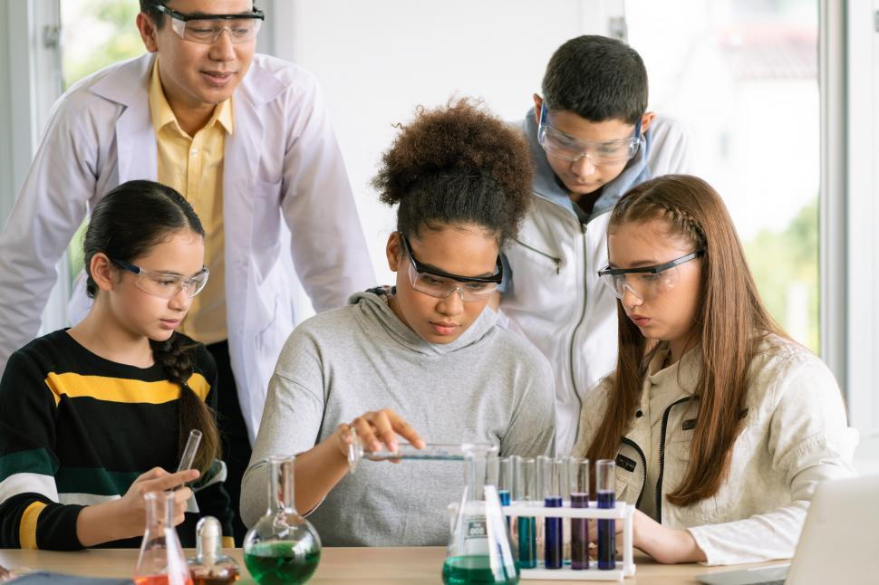
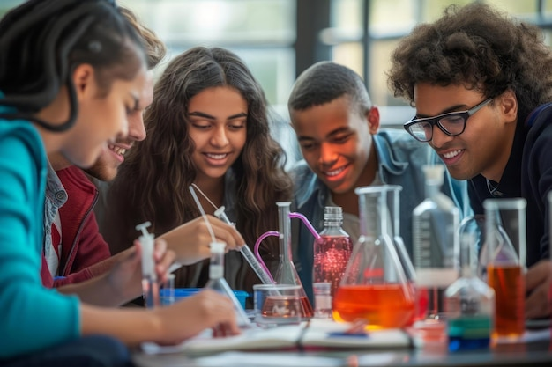
What Are Labatorials?
Key Features:
Collaborative problem solving
Experiments-Worksheets
Emphasis on reasoning rather than procedure
3 female & 2 male students
Reference: https://freerangestock.com/photos/147854/group-of-students-doing-science.html
3 male & 2 female students
Reference:https://www.freepik.com/premium-ai-image/group-students-working-together-science-project-using-lab-equipment-sharing-ideas_318563444.htm

Slide 5
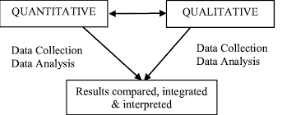
Methodology
Mixed-Methods Design
QUANTITATIVE
QUALITATIVE
Data Collection
Data Analysis
Data Collection
Data Analysis
Results compared, integrated & interpreted
https://www.researchgate.net/figure/A-Visual-Diagram-of-the-Mixed-Methods-Concurrent-Triangulation-Strategy-The-researchers_fig1_280860447

Slide 6
Qualitative Findings
Interviews
Different Engagement Styles:
Female Students:
Discussion oriented
Collaborative
Concept-driven
More likely to seek help
"Girls actually talk to each other more and ask help from each other more often."
Male Students: ​
​
Independent
Task-focused ​
Math/procedure-driven
More likely to work alone​
"Guys normally would rather try to figure it out by themselves."

Slide 7
Qualitative Findings
Interviews
Major Themes - Female students repeatedly described:
Collaboration - Supportive discussions​
"Everyone was so supportive... and because of that, I was very confident." ​
Psychological Safety - Shared struggles and encouragement from peers​​
"That feeling of security helps." ​​
Self-Efficacy - Increased confidence ​​​
​​​Confidence developed socially.
​​​

Slide 8
Qualitative Findings
Observed Interaction Patterns
​
Female Students​
High levels of interaction from the beginning
Frequently engaged in collaborative discussion ​
Strong engagement with peers ​
Active apparatus manipulation, particularly in mixed-gender groups
Male Students​
More likely to take leadership roles ​
Greater tendency to work independently ​
Strong interest in apparatus manipulation and computations ​
Interaction increased over time
​Collaborative Interactions​
↓​
Psychological Safety & Confidence

Slide 9
Quantitative Findings
Conceptual Learning Outcomes
N = 86-87 students
Normalized Gains
Female Students: g = 0.38
Male Students: g = 0.40
Figure 1: Conceptual pre/post Quizzes scores

Slide 10
Quantitative Findings
Course Performance​
Figure 2: Reflective Writing Patterns

Slide 11
Quantitative Findings
Course Performance​
Figure 3: Postlab Patterns

Slide 12
Quantitative Findings
Course Performance​
Figure 4: Course Total Scores

Slide 13
Quantitative Findings
Survey
Female students reported substantially more challenges.​
​
Yet... Learning outcomes remained equivalent.​
Figure 5a: Survey - Barriers

Slide 14
Quantitative Findings
Survey
High perception of equity and inclusivity.
Figure 5b: Survey – Contributions' Value

Slide 15
Integrated Discussion
Mixed-Methods Interpretation
Higher Barriers
↓
Labatorial Features (Collaboration +Discussion + Reflection)
↓
Psychological Safety & Self-Efficacy
↓
Comparable Learning Outcomes
The collaborative structure of labatorials may help mitigate barriers commonly associated with introductory physics environments.​

Slide 16
Future Work
Future Work
Longitudinal tracking of confidence and retention
Investigation of group composition effects

Slide 17
Summary
Main Findings
Female students reported lower confidence and higher anxiety
Female students outperformed male students in reflective writing
Female students achieved learning gains equal to male students
Students perceived labatorials as equitable and supportive
Questions?

