Slide 1
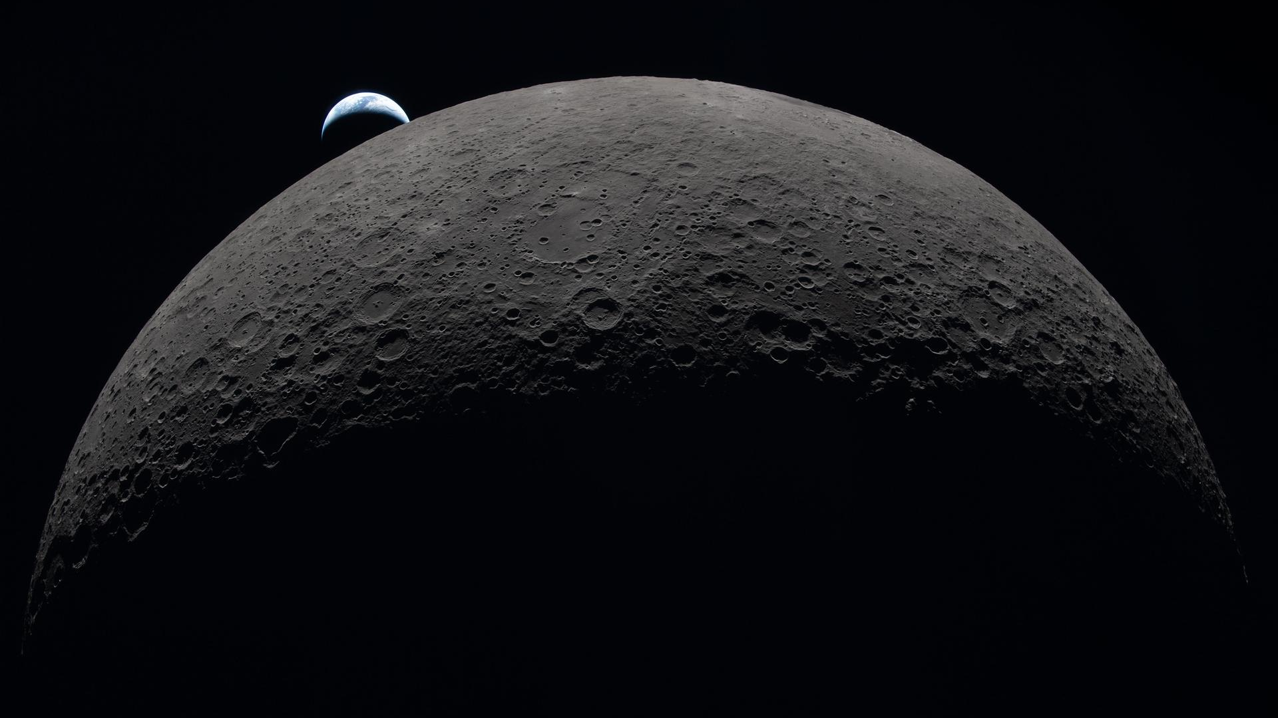

Piloting Inquiry-Based Learning in First-Year Physics for Engineers
Dr. Eamonn Corrigan
Assistant Professor – Teaching Stream
CAP Congress 2026

Slide 2
Why redesign these courses?
Alignment with 1st year engineering
Project-based integrated learning course
Adaptation for the age of AI
Easy for students to offload thinking
Need to intentionally support the development of expert-like reasoning
Update with the latest PER findings
Problem first approach to active learning
Use of cognitive apprenticeship model

Slide 3
Central course philosophy:
As often as possible, I want the students to DO physics

Slide 4
Changing course components
Course Updates

Slide 5
Changing course components
Learning physics through inquiry
Inquiry based labs
Course Updates
Online learning supports
Improved data collection
Implementation of UDL princicples

Slide 6
Changing course components
Learning physics through inquiry
Inquiry based labs
Course Updates
Online learning supports
Improved data collection
Implementation of UDL principles

Slide 7
Let’s look at an example
Learning physics through inquiry
Inquiry based labs
Course Updates
Online learning supports
Improved data collection
Implementation of UDL principles

Slide 8
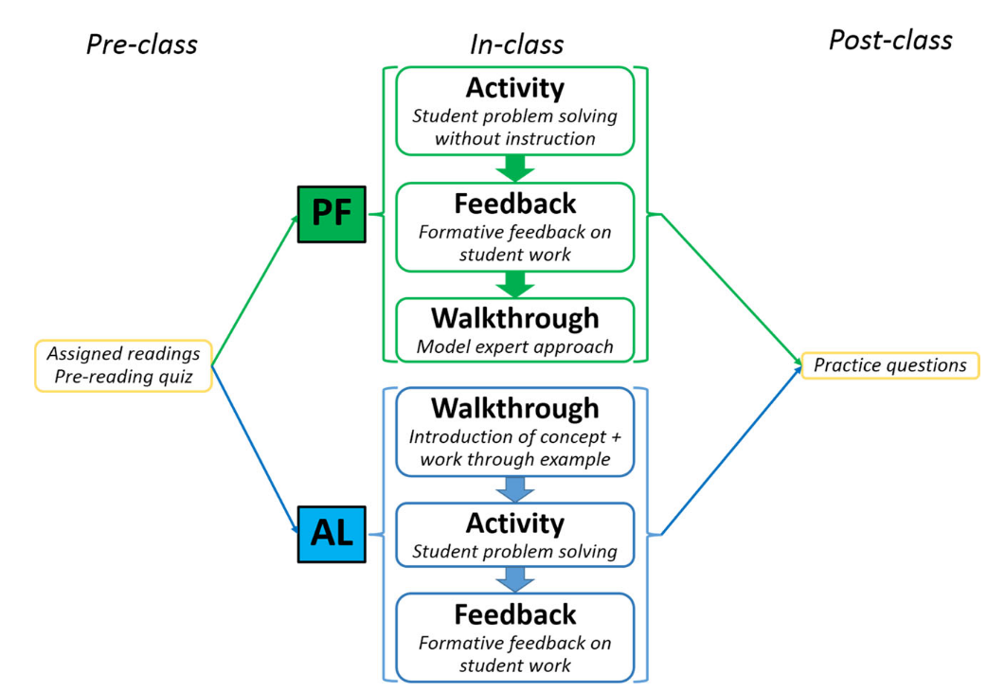
Choosing an approach to active learning
[1] Chowira et al. (2019)

Slide 9
Choosing an approach to active learning
[1] Chowira et al. (2019)

Slide 10
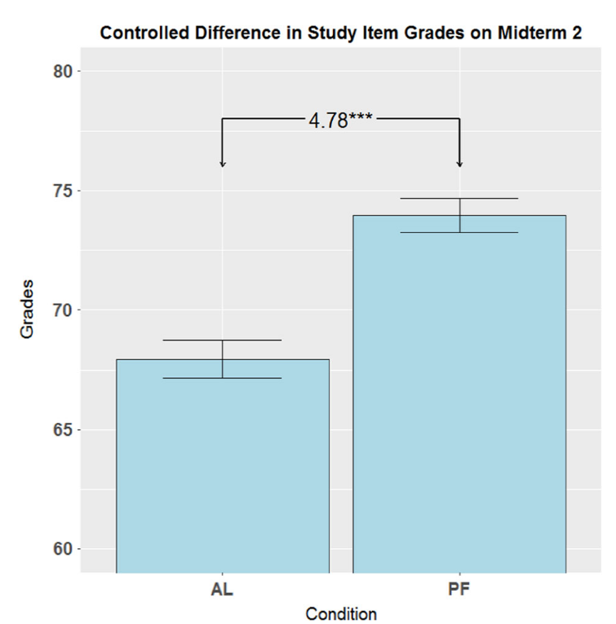
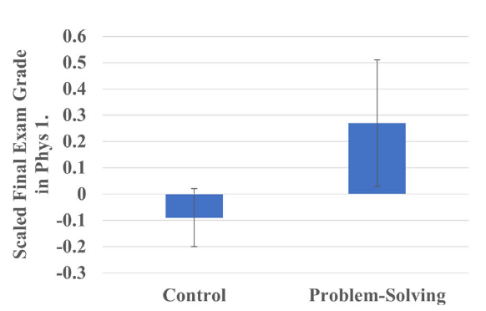
Productive failure is superior to traditional active learning
[2] Burkholder et al. (2023)
[1] Chowira et al. (2019)

Slide 11
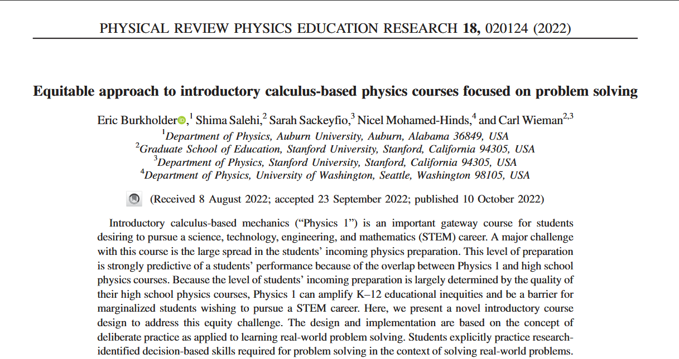
Instruction through real-world problem solving and inquiry

Slide 12
Core course philosophy:
As often as possible, I want the students to DO physics

Slide 13
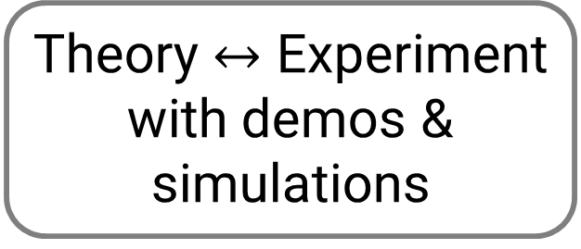
As often as possible, I want the students to DO physics
Model building with iterative complexity
Exploring real-world problems
Theory $↔$ Experiment
with demos & simulations

Slide 14
As often as possible, I want the students to DO physics
Let’s look an example, how I now teach torque
Model building with iterative complexity
Exploring real-world problems
Theory $↔$ Experiment
with demos & simulations

Slide 15
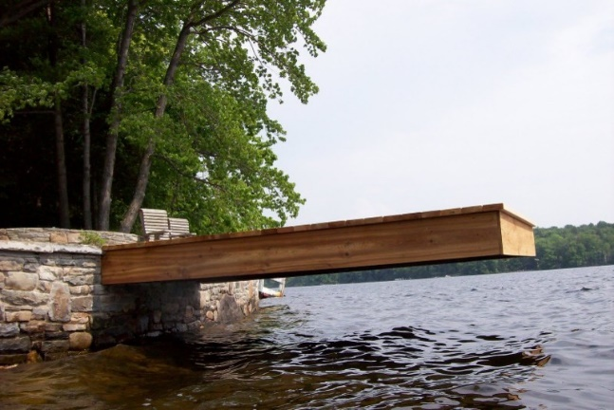

Context for sample torque investigation
Course context
Week 2 of the semester
Students have done 1D and 2D forces
Only equilibrium, no acceleartion

Slide 16
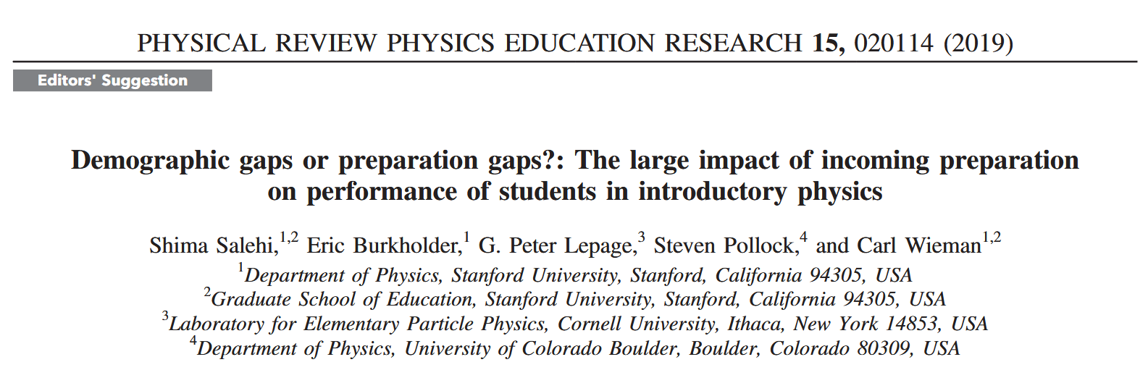
First year inequities are explained by K-12 preparation
“although there appear to be gaps in exam performance if one considers only demographic variables (gender, underrepresented minority, first generation), once… incoming preparation [is] controlled for, there is no longer a demographic gap.”

Slide 17
So don’t repeat K-12 education
Kinematics
Traditional order of topics
Largely a repeat of grade 12 physics
First new topic (torque), >1 month into the course
Static equilibrium
Newton’s Laws
Torque
New order of topics
Begin with static equilibrium
Highly applicable to engineers
Nothing moves (yet)
Torque in week 2… this isn’t just grade 12 again
Torque
Laws of motion
Static Equilibrium
Kinematics

Slide 18
Scaffolding as cognitive apprenticeship
Using a cognitive apprenticeship model
Scaffold an investigation to guide students’ thinking
Thinking process of an expert is made exclicit^{[3]}
Directly challenge their existing model of static equilibrium
[3] Collins, Brown, & Holum (1991)

Slide 19
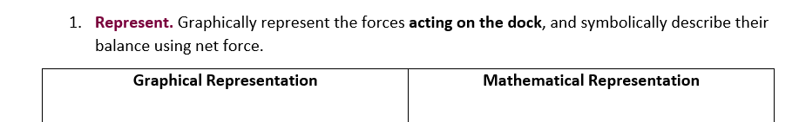
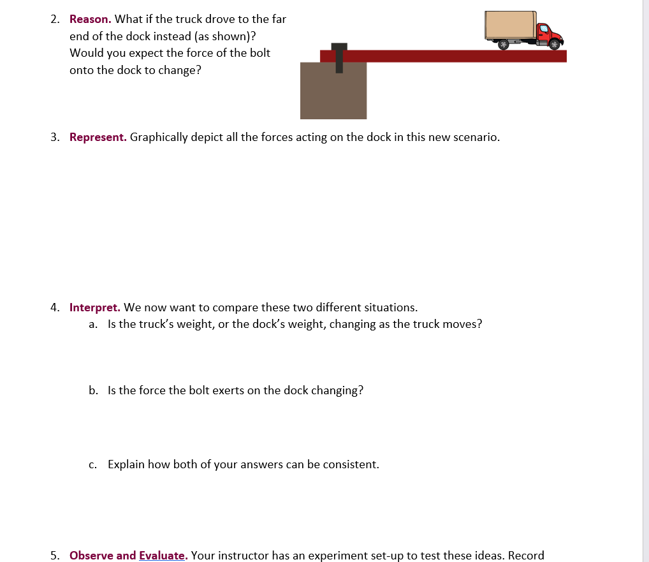
Investigating static equilibrium

Slide 20
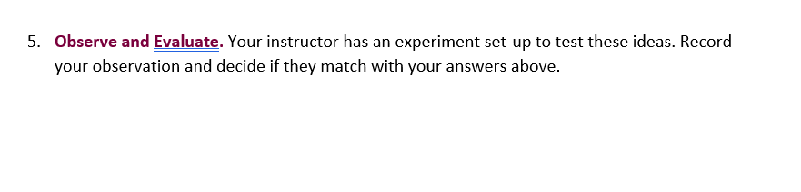
Context for sample torque investigation

Slide 21
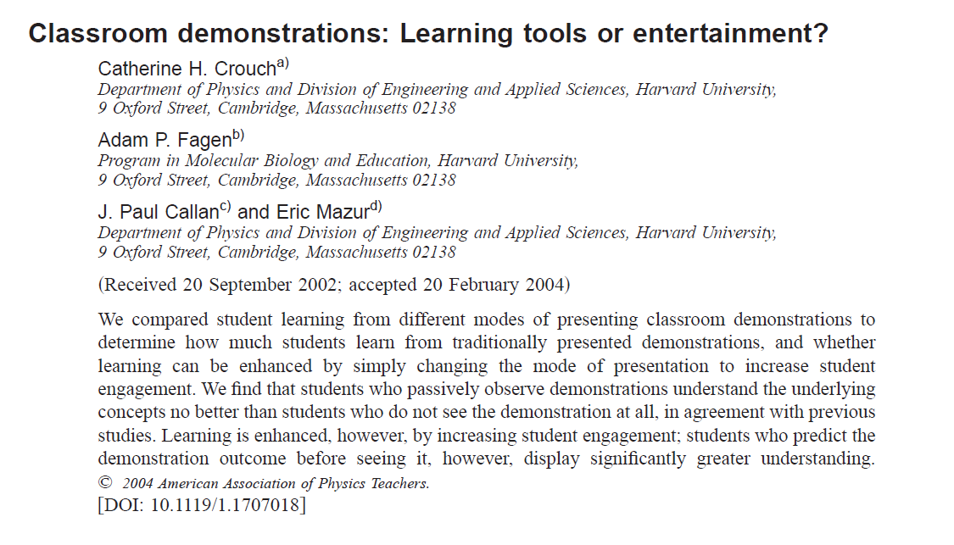
Teaching with demos experiments

Slide 22
Teaching with demos experiments
“We find that students who passively observe demonstrations understand the underlying concepts no better than students who do not see the demonstration at all, in agreement with previous studies”

Slide 23
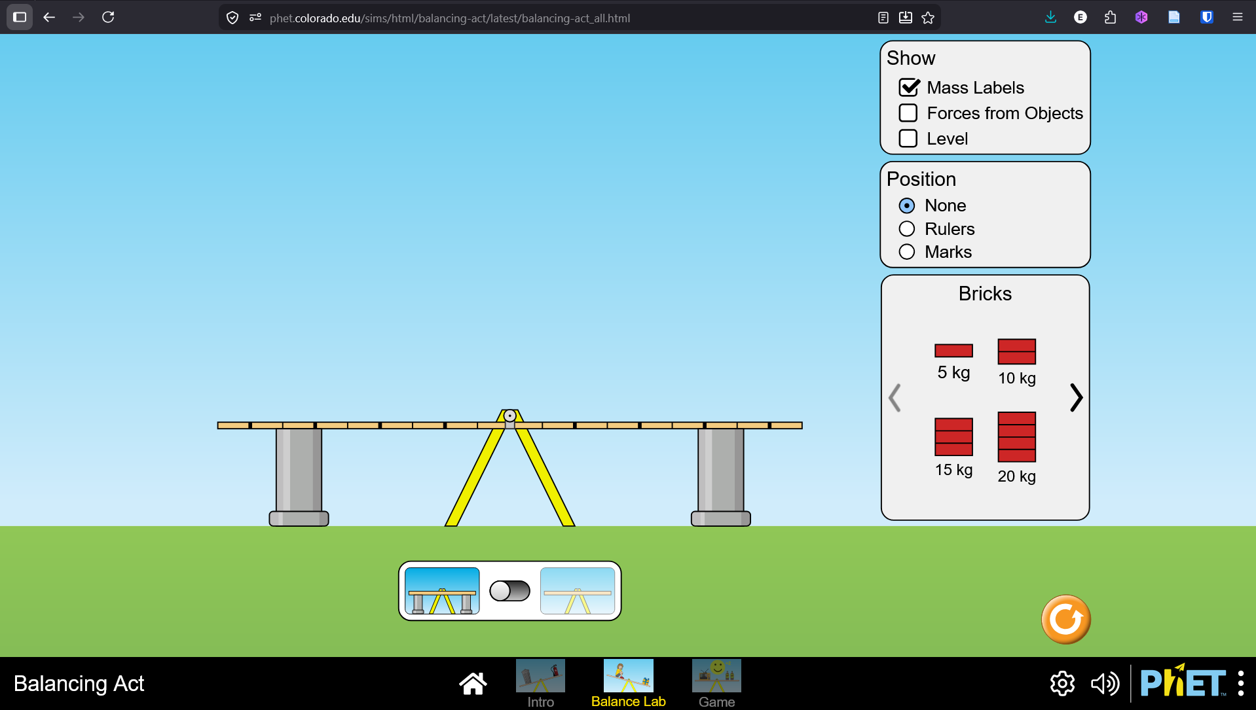
Student build their model with simulations
PhET Balancing Lab simulation
Continue investigation in groups
Some prompting questions, but largely left to explore
End up with our preliminary model for torque
Make predictions with model… and test immediately
Experiment with choice of pivot

Slide 24
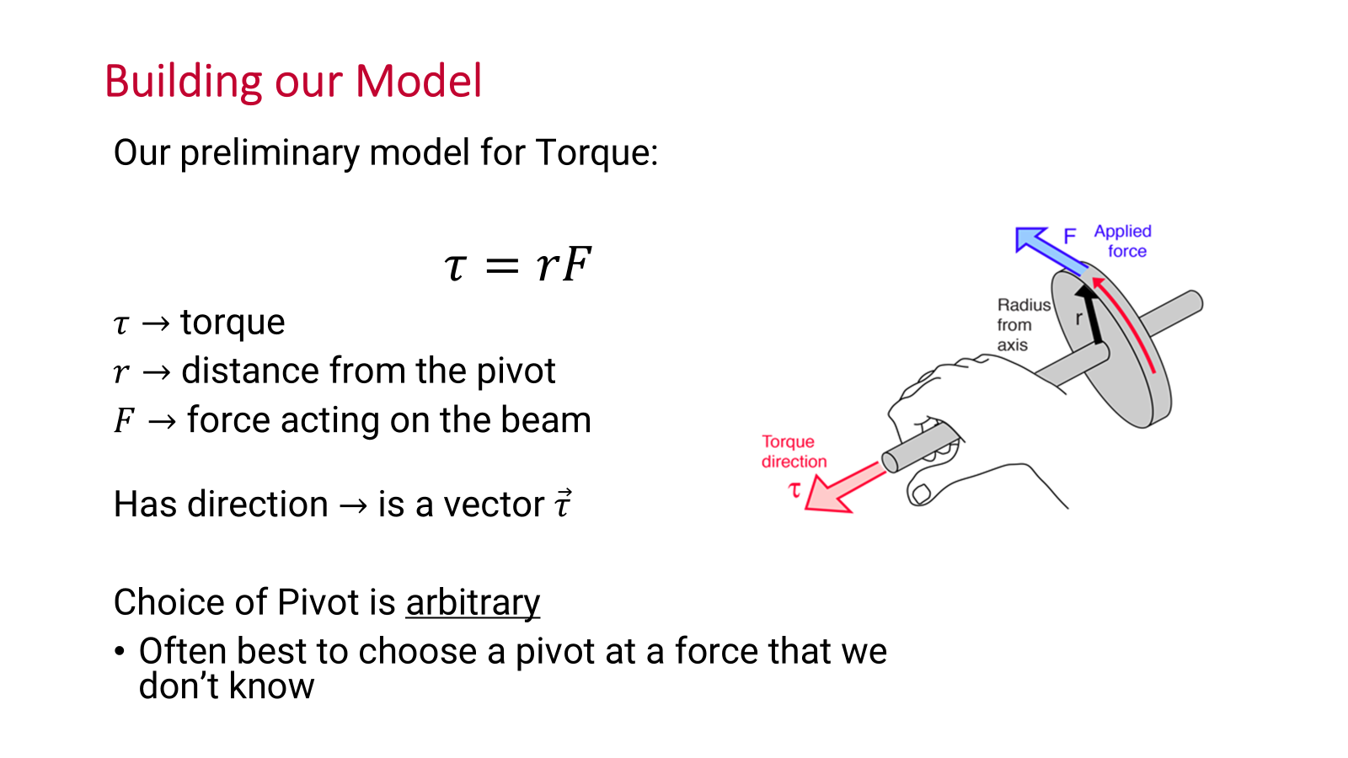
The model we built together

Slide 25
But what about the labs?
Learning physics through inquiry
Inquiry based labs
Course Updates
Online learning supports
Improved data collection methods
Implementation of UDL principles

Slide 26
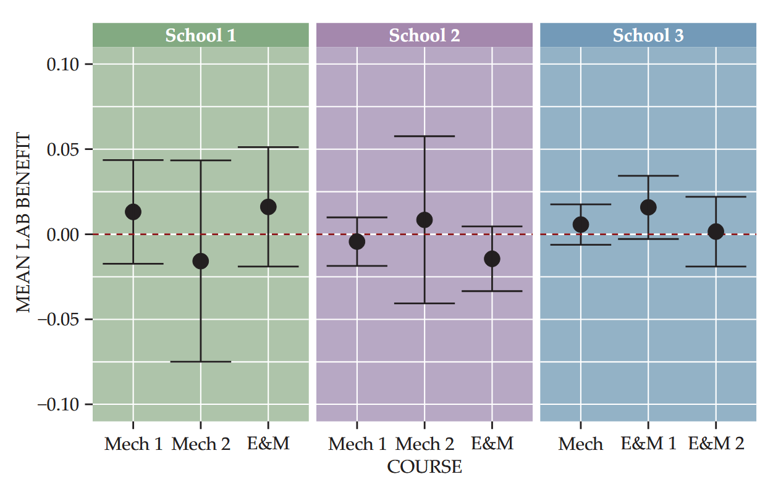
We know that labs don’t effectively teach content
Common belief for students^{[4,5]} and faculty^{[6]} that labs Reinforce Lecture Content
Research shows this is simply not effective^{[6]}
[6] Holmes & Wieman (2018)
[4] Hu et al., (2017), [5] Smith, Stein, Walsh, et al., (2020)

Slide 27
Traditional labs lead to flawed behaviour and thinking
Students believe primary goal is to “Verify Theory” ^{[7]}
Mindset
Behaviour
Students leave 1st year labs acting and thinking less like experts compared to when they started^{[5]}
Students show lower critical thinking, blindly following instructions ^{[8]}
Students will engage in unethical behaviour, prioritizing confirmation^{[9]}
[7] Mohtar et al. (2015); [5] Smith et al. (2020); [8] Walsh et al. 2022; [9]Smith et al. 2020

Slide 28





TA focus groups identified the same flaws
Students Don’t Think
Students Don’t Develop Experimental Skills
01
02
04
03
Structural Issues With Lab Design and TAs
Flawed Approach to Learning
Notes:
Canada is ~0.481% of the world’s population and have won 4 prizes since 2000

Slide 29
TA focus groups identified the same flaws
Students Don’t Think
Students Don’t Develop Experimental Skills
01
02
04
03
Structural Issues With Lab Design and TAs
Flawed Approach to Learning
Notes:
Canada is ~0.481% of the world’s population and have won 4 prizes since 2000

Slide 30
Explicit activities to build effective & equitable groups
Teamwork as LO
Guide don’t tell
Group formation activities in lab to support collaboration
Everywhere you would normally give an instruction, ask a question
Most labs run over two-week x2 hours. Giving space to interate
Labs done in Jupyter notebooks; integrate simple python coding
Assigned groups with rotating roles to address gender imbalances
Time for iteration
Integrated coding
Equity in tasks

Slide 31
Overview of 1D03 Labs
Lab Number | Physics Topic | Central Learning Outcome
Unit 1 Session 1 | Simple Pendulum | Obtaining a high-quality measurement • Reducing uncertainty • Calculating and reporting statistics from repeated trials
Unit 1 Session 2 | - | Comparing measurements • Deciding whether results agree within uncertainty • Interpreting variability and disagreement
Unit 2 | Objects in flight | Testing a theoretical model • Comparing data to predictions • Evaluating whether the model explains the data
Unit 3 Session 1 | Stretchy things | Designing a model-testing experiment • Using least-squares fitting • Developing a research question and plan
Unit 3 Session 2 | - | Implementing and communicating an investigation • Carrying out the experimental design • Analyzing and presenting results

Slide 32
Overview of 1D03 Labs
Lab Number | Physics Topic | Central Learning Outcome
Unit 1 Session 1 | Simple Pendulum | Obtaining a high-quality measurement • Reducing uncertainty • Calculating and reporting statistics from repeated trials
Unit 1 Session 2 | - | Comparing measurements • Deciding whether results agree within uncertainty • Interpreting variability and disagreement
Unit 2 | Objects in flight | Testing a theoretical model • Comparing data to predictions • Evaluating whether the model explains the data
Unit 3 Session 1 | Stretchy things | Designing a model-testing experiment • Using least-squares fitting • Developing a research question and plan
Unit 3 Session 2 | - | Implementing and communicating an investigation • Carrying out the experimental design • Analyzing and presenting results

Slide 33
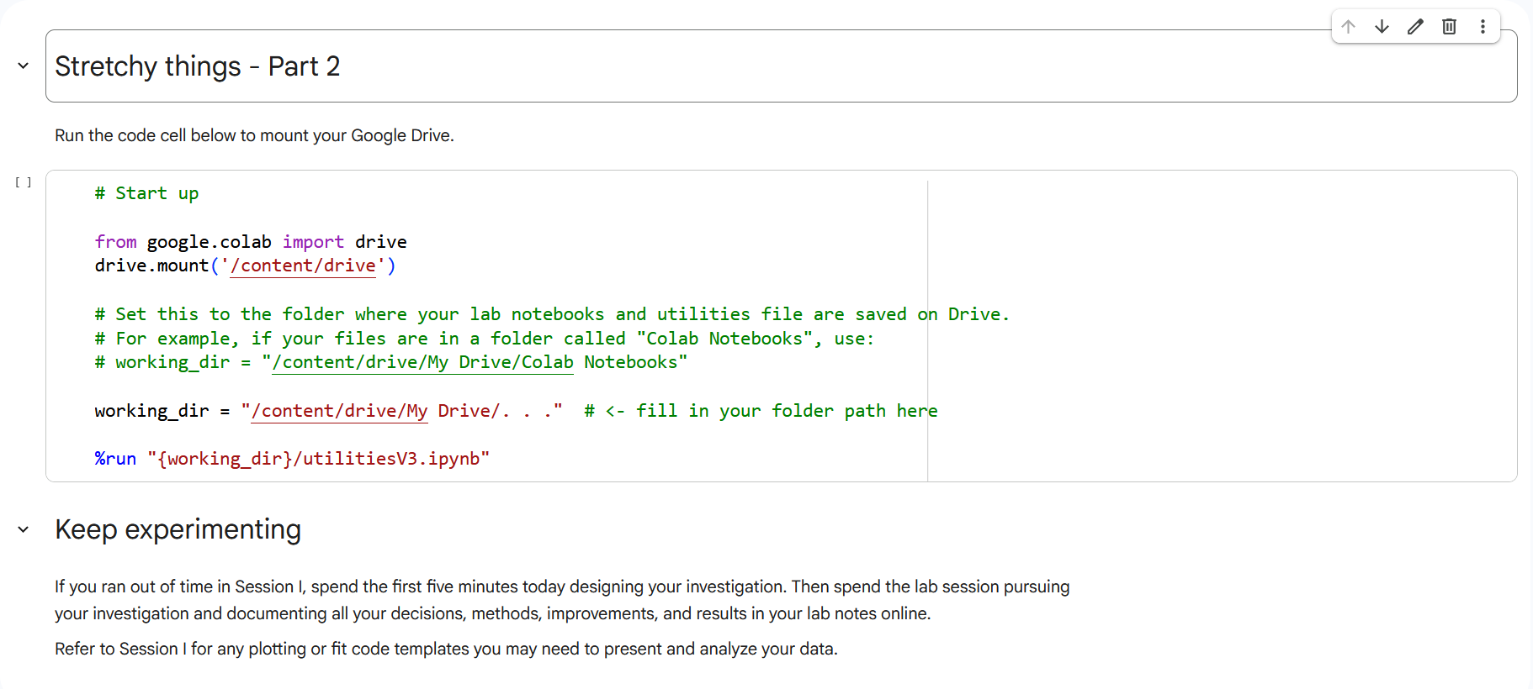

Sample of what this looks like, lab #5

Slide 34
We can teach our students to DO physics, not just solve rote equations
Inquiry-based labs
Real-world problem solving, model building & inquiry
Begin with complex, real-world phenomena rather than isolated equations
Explicitly build iterative models
Scaffold collaborative student investigations
Prioritize skill development over reinforcing content
Avoid verification and confirmation
Provide space for students to think and interate
Questions?

Slide 35
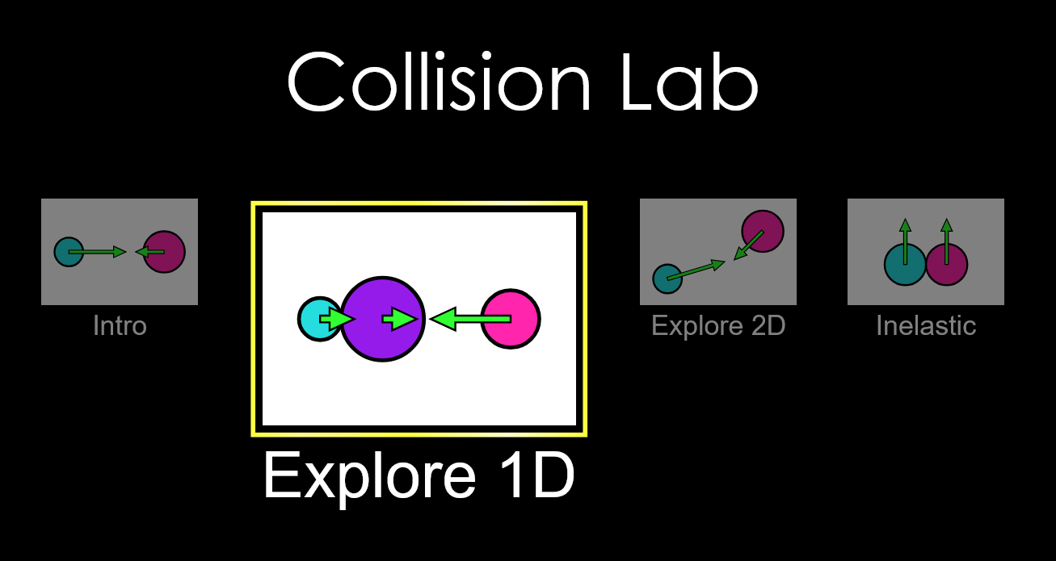
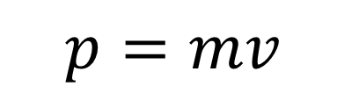
Testing our model: Linear Momentum
Linear Momentum
$$p=mv$$
Google: “Phet collision lab”
Choose Explore 1D

Slide 36








Testing our model: Linear Momentum
Predict what you think will happen… then test it!
Experiment #1
Ball 2 starts from rest, ball 1 hits it but does NOT stick (make sure the elasticity slider is set to elastic). They have the same mass
Before:
After:
?
1
2
1
2
$${\vec{v}}_{1}=1m/s$$
$${\vec{v}}_{2}=0$$
$${\vec{v}}_{1}=?$$
$${\vec{v}}_{2}=?$$
$$m_{1}=1kg$$
$$m_{1}=1kg$$
$$m_{1}=1kg$$
$$m_{1}=1kg$$

Slide 37
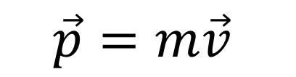
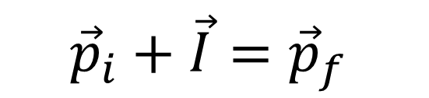
Testing our model: Linear Momentum
Linear Momentum
Momentum into the System:
Positive Impulse
Momentum out of the system
Negative Impulse
$$\vec{p}=m\vec{v}$$
$$momentum is conserved, only for an isolated system$$
$${\vec{p}}_{i}+\vec{I}={\vec{p}}_{f}$$

Slide 38
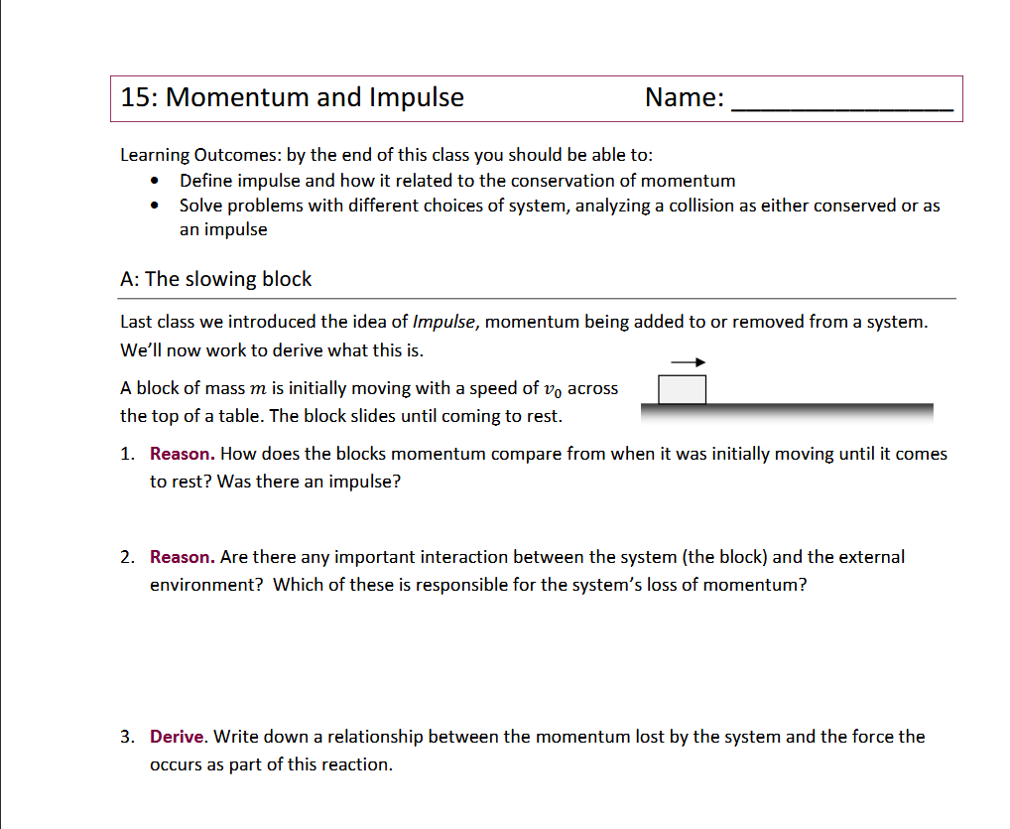

Slide 39

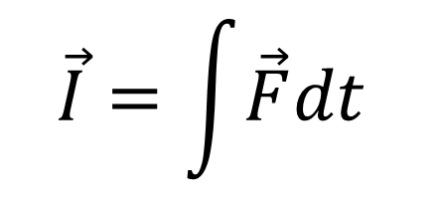
Testing our model: Linear Momentum
Linear Momentum
Momentum into the System:
Positive Impulse
Momentum out of the system
Negative Impulse
$$\vec{p}=m\vec{v}$$
$$\vec{F}=\frac{d\vec{p}}{dt}$$
$$\vec{I}=\int{\vec{F}dt}$$
$$momentum is conserved, only for an isolated system$$
$${\vec{p}}_{i}+\vec{I}={\vec{p}}_{f}$$

Slide 40
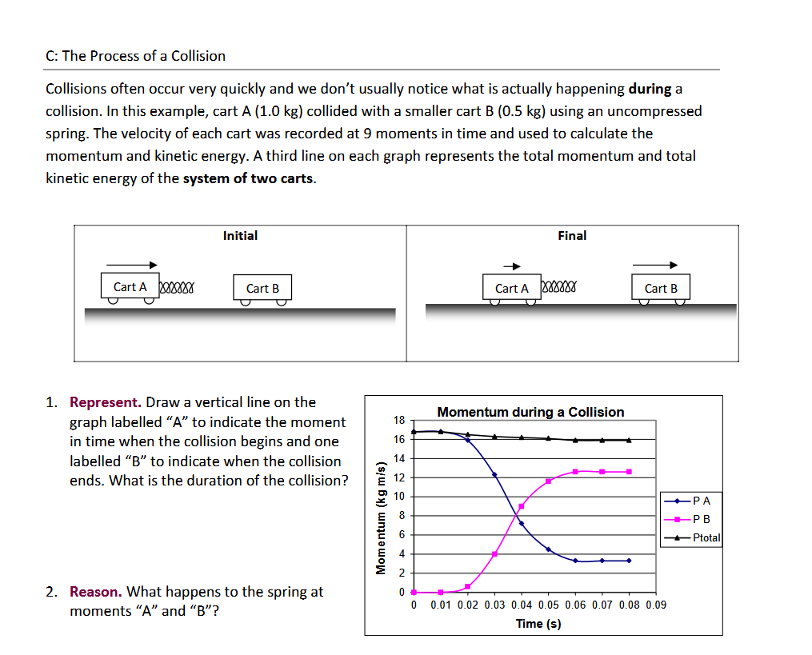

Slide 41
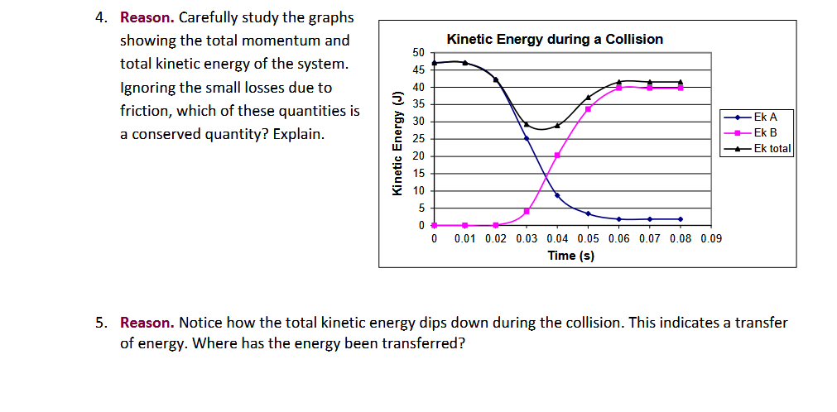

Slide 42
Momentum in 2D
Just two 1D problems at Once

Slide 43
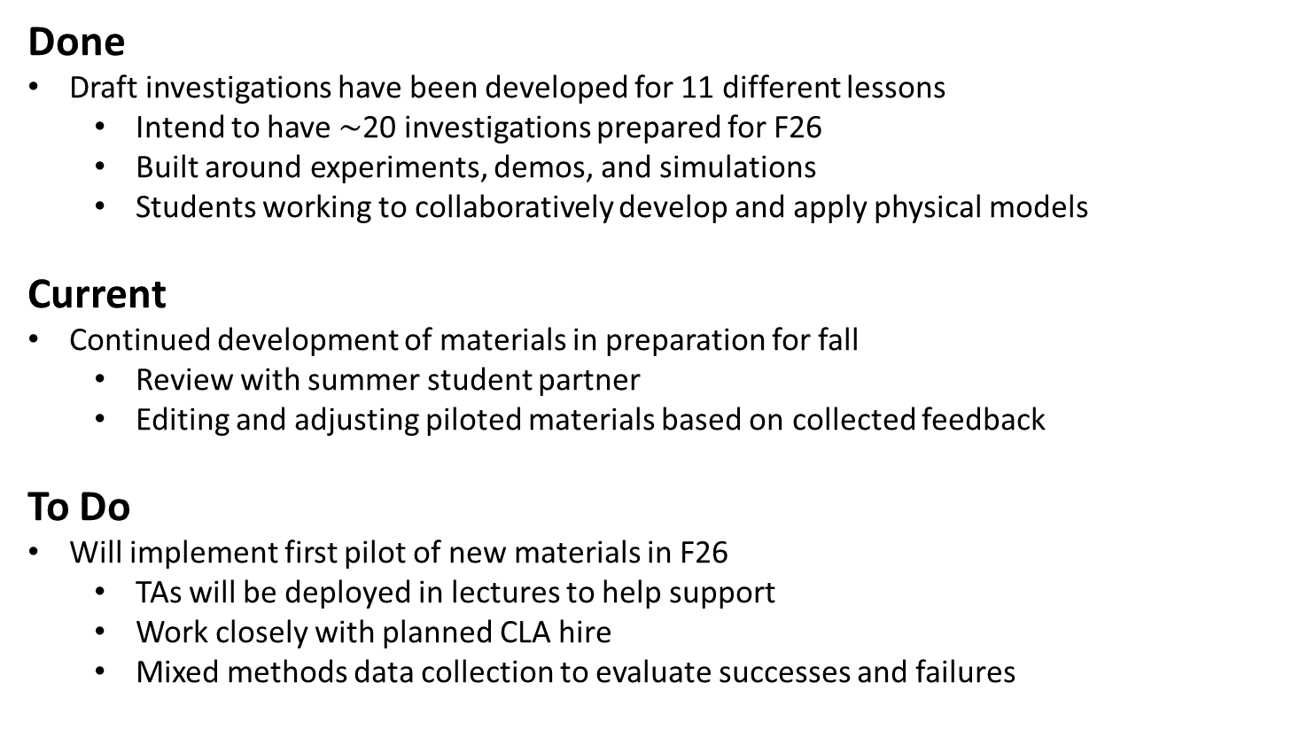
Pilot of new lecture materials in 1D03 Sp26
Done
Draft investigations have been developed for 11 different lessons
  Intend to have $\sim$20 investigations prepared for F26
  Built around experiments, demos, and simulations
  Students working to collaboratively develop and apply physical models
Current
Continued development of materials in preparation for fall
  Review with summer student partner
  Editing and adjusting piloted materials based on collected feedback
To Do
Will implement first pilot of new materials in F26
  TAs will be deployed in lectures to help support
  Work closely with planned CLA hire
  Mixed methods data collection to evaluate successes and failures

