Slide 1
Fermilab Accelerators and Demonstrator Concept
October 28, 2025
Robert Zwaska
Fermilab
* Thanks to Diktys Stratakis for Demonstrator Slides

Slide 2
Summary
Fermilab operates an accelerator complex providing up to 1 MW of proton beam for neutrino and muon experiments
A continuous campaign of improvements has pushed beam power and reliability
Ageing infrastructure has impacted beam delivery
Upgrades are underway for DUNE and future accelerator-based experiments
A Muon Collider Demonstrator Facility is desired
The Muon Collider is very ambitious in several ways
A concept for a cooling demonstrator is being studied for Fermilab

Slide 3
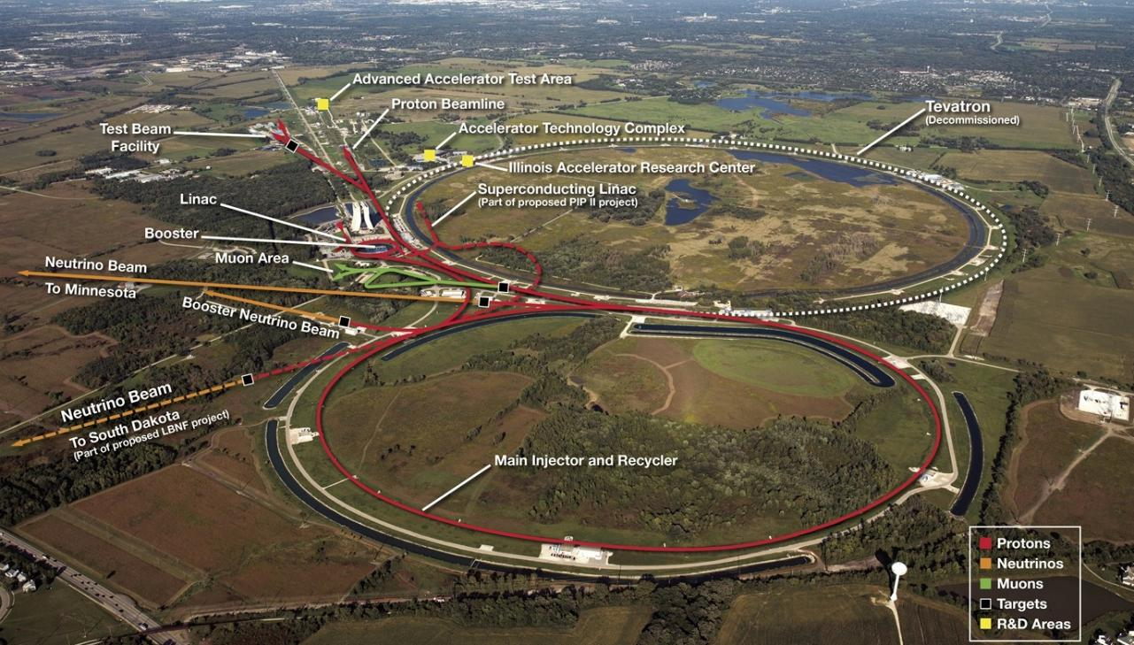
Fermilab Accelerator Complex

Slide 4
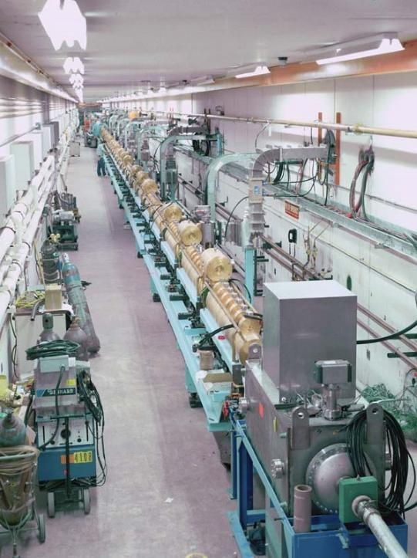
The Fermilab Linac
Linear (copper) Accelerator
Accelerates H⁻ ions
750 keV → 400 MeV
Thousands to millions of volts
Beam bunched at 200 MHz
~ 1.5 Billion ions / bunch
RF of 200 & 800 MHz
Distance between drift tubes changes with beam velocity
Pulse length of ~ 80 μs
Many particles for short periods of time – more efficient operation
To be retired Jan. 2028

Slide 5
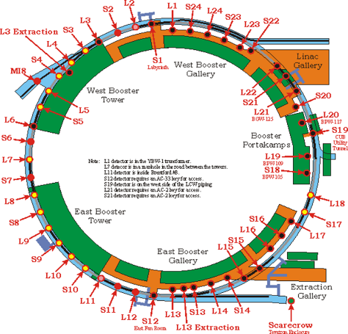
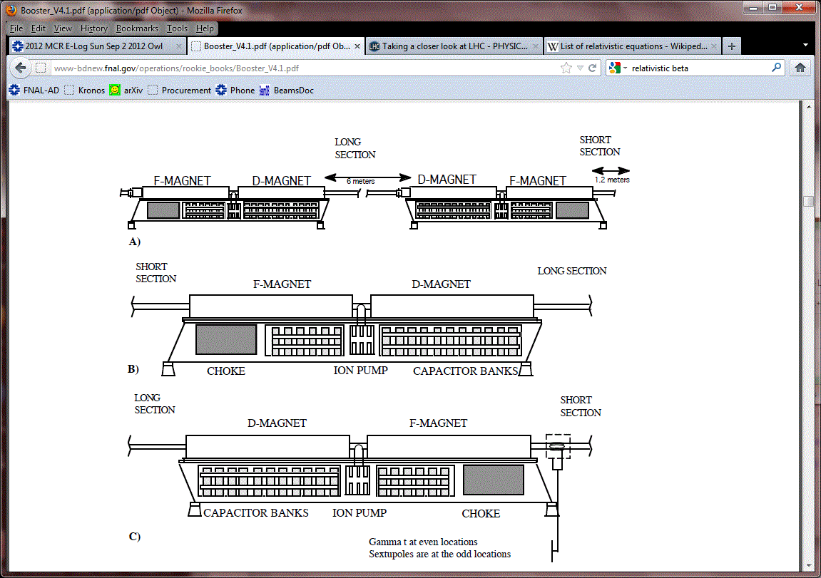
Booster Overview
H⁻ ions stripped and multi-turn injected onto the Booster
Protons are accelerated from 400 MeV to 8 GeV in 33 msec
Fast cycling synchrotron
Fast magnet ramping
Frequency of 15 Hz
Single turn extraction
Many systems upgraded over the decades
Booster
Booster
Circumference (m) | 474
Harmonic Number | 84
Kinetic Energy (GeV) | 0.4 - 8
Momentum (GeV/c) | 0.954 - 8.9
Revolution period (μsec) | τ_{(inj)} 2.77 – τ_{(ext)} 1.57
Frequency (MHz) | 37.9 - 52.8
Batch size | 4.5 E12
Focussing period | FDooDFo (24 total)
Combined Function Magnets

Slide 6
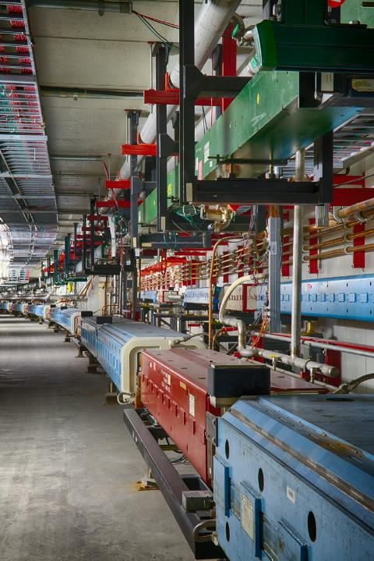
Main Injector & Recycler
Main Injector: 120 GeV Fast-cycling synchrotron
360 main dipole magnets
200 main quadrupole magnets
108 sextupoles, 66 octupoles, corrector dipoles/ quads, specialty injection and extraction magnets
Twenty 53-MHz RF cavities to accelerate beam
170 DC and 360 ramped magnet supplies with total of 140 MVA, 40 specialty pulsed magnet supplies
Recycler: 8 GeV Storage Ring
Originally built for antiproton storage, repurposed for proton stacking
Combined function, permanent magnets
RF cavities for stacking proton beams

Slide 7
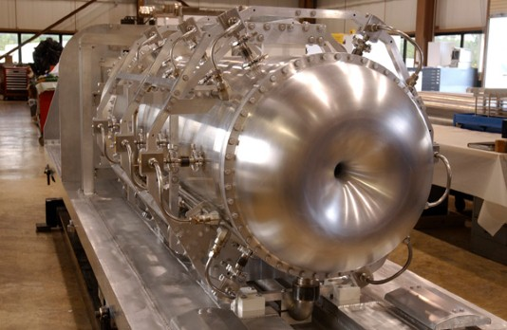
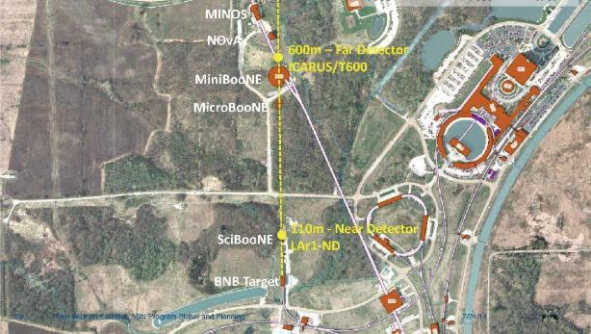
Booster Neutrino Beam (BNB)
Uses 8 GeV beam from the Fermilab Booster, operating since 2002
Up to ~ 30 kW of beam (5e12 ppp)
Beryllium target integrated with single focusing horn
Services a suite of experiments at Fermilab: the Short Baseline Neutrino (SBN) program
BNB capability with PIP-II will be preserved after the long shutdown

Slide 8
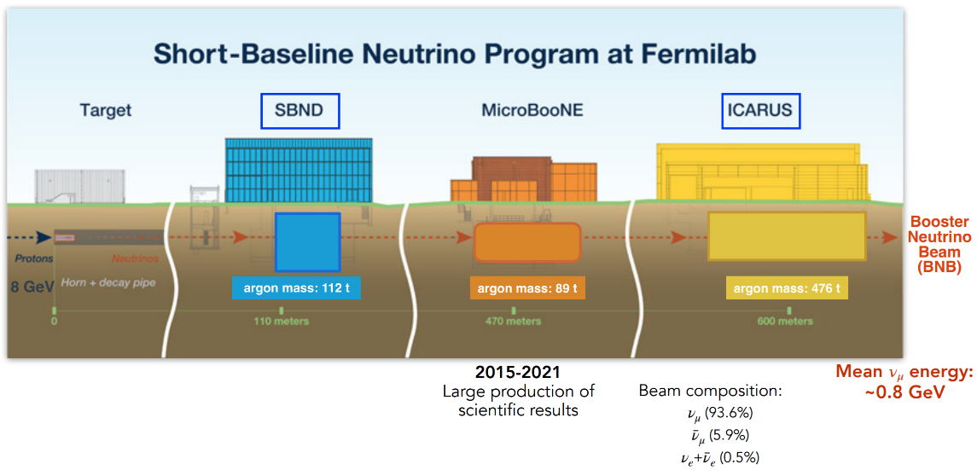
SBN Program

Slide 9
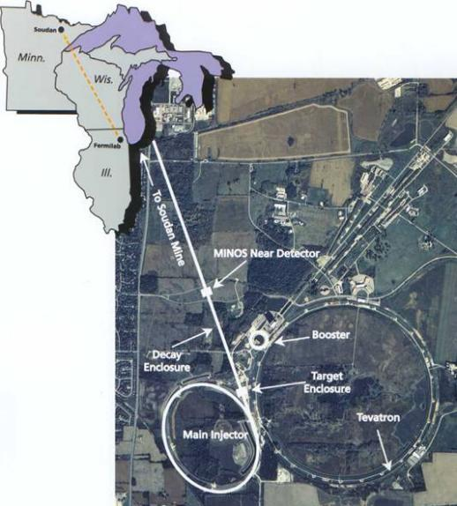
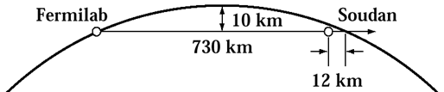
The NuMI Facility: “Neutrinos (ν –> Nu) at the Main Injector”
Intense muon-neutrino beam directed towards Minnesota
Main Injector supplies 50–70e12 120GeV protons every 1.2 seconds
Designed for 400 kW, operated up to 900 kW
Multiple upgrade projects to 1 MW
Each pulse produces about 2x10¹⁴ ν _{μ}
~ 20,000,000 Pulses per year
Direct beam 3º down
Commissioned in 2005, expect to run to ~ 2027
“Long-baseline”
Neutrino beam
Near Detectors
Far Detectors: 5400 tons & 14000 tons
5

Slide 10
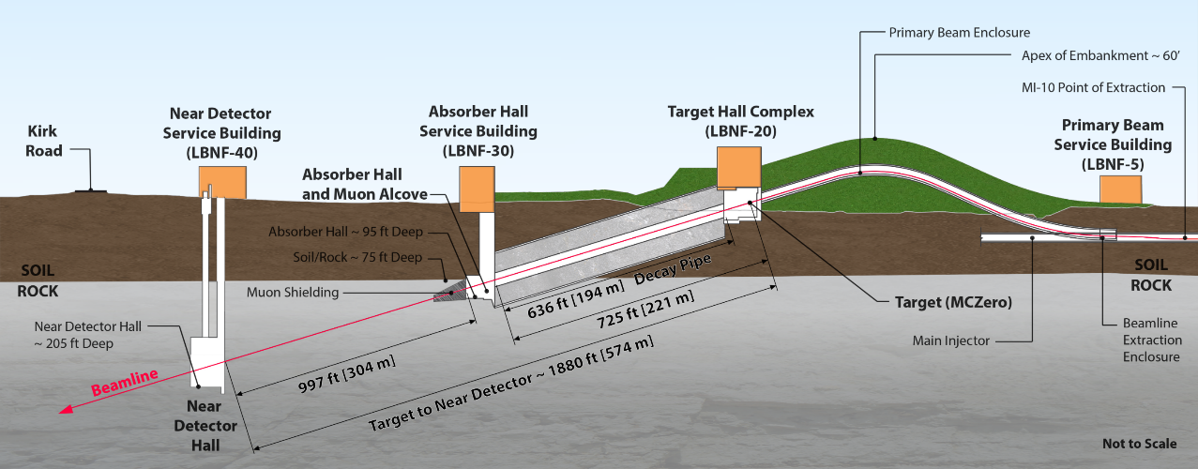
The LBNF Beam
Facility designed for initial beam power of 1.2 MW, upgradeable to 2.4 MW

Slide 11
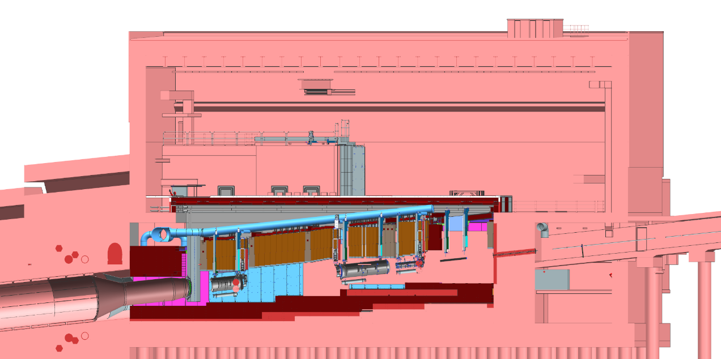
Section View of Target Complex – Target Hall
Target Hall
Work Cell
Hatch Covers
←Beam
Primary Beam Enclosure
N₂ Gas
He Gas
Decay Pipe
Primary Beam Window
Decay Pipe Upstream Window
Horn A with Target
Cooling
Panels
Steel Shielding
Horn B
Baffle
Horn C

Slide 12
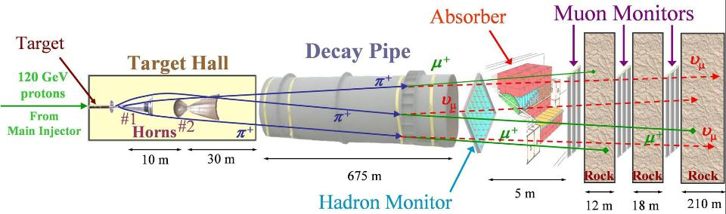
The NuMI Beam “Neutrinos at the Main Injector”
Absorbs ~ 40 % of beam power
Allows high-energy muons to penetrate
2 m diameter
Roughly decay length for 10 GeV π⁺
He-filled
1 meter long, C target
Produces π⁺, K⁺ mesons
400 kW design average power
700 kW upgrade for NOvA
1 Megawatt Upgrade 2021
σ ∼ 1 mm
Pulsed focusing horns
Toroidal magnetic field
Parabolic inner conductor profile
Focus meson momentum band
Measure hadron & muon fluxes
Arrays measure distributions
Notes:
Go light on horn description, other details

Slide 13
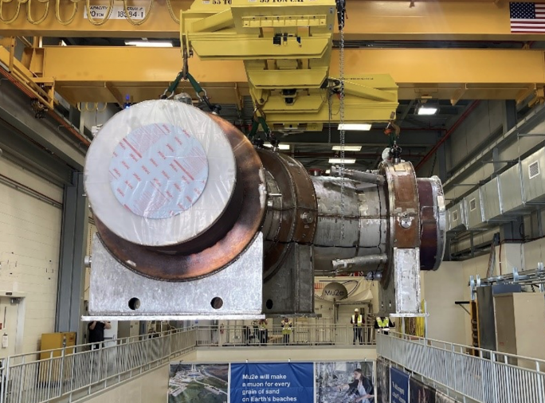
Mu2e: Muon to Electron Conversion Experiment
Two transport solenoids and production solenoid were installed into the Mu2e experimental hall
Looking forward to detector solenoid
Detectors components starting to install
Beamline has been commissioning
Electrostatic septa operated for slow extraction
AC Dipoles being installed for extinction
Plan to have a 4 month physics run before the long shutdown

Slide 14
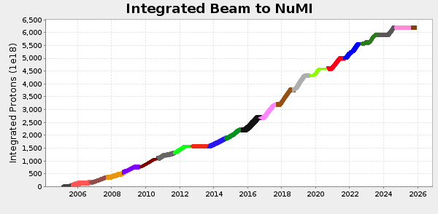
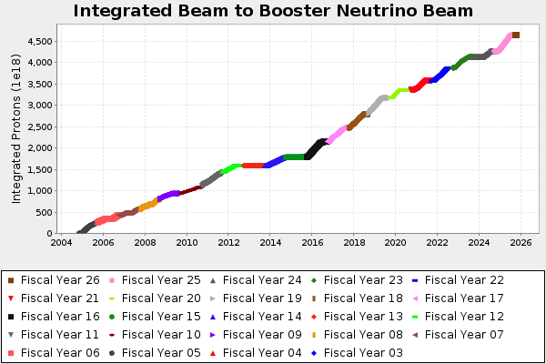
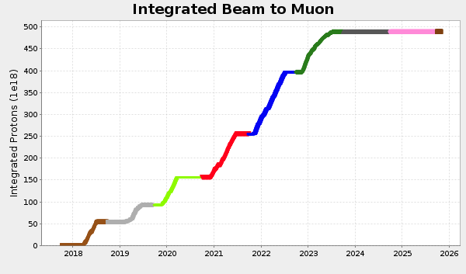
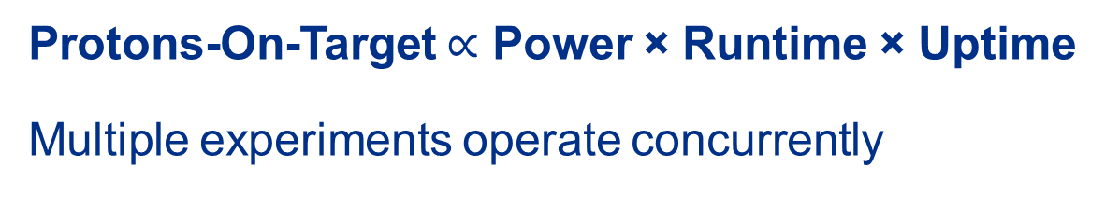
Accelerator Complex function - beam delivery to science users
Protons-On-Target $∝$ Power × Runtime × Uptime
Multiple experiments operate concurrently

Slide 15
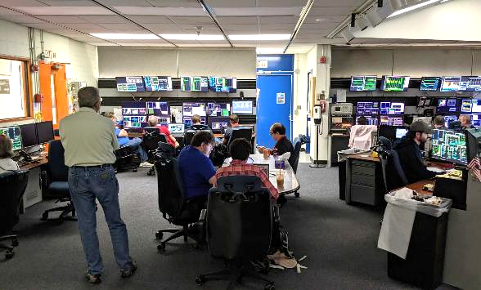
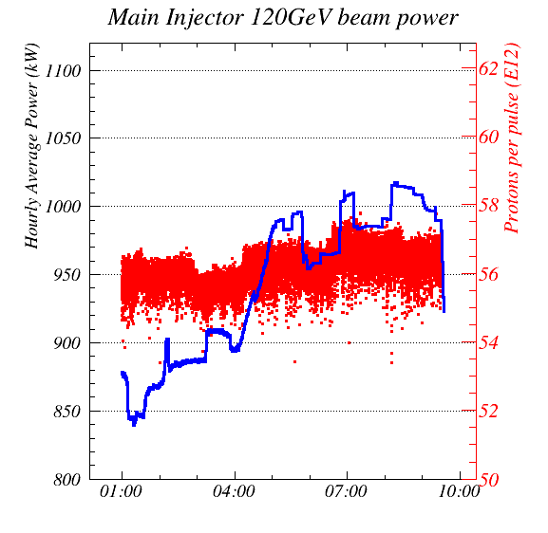
1 MW Test Run: June 26, 2024
AD was granted an 8-hr window for up to 4-hr of running exceeding One Megawatt
Summer temperatures necessitated work during a cool and calm period
Individual machines pushed their capabilities to near-MW the few days before
Full operations & machine teams reported at 4am along with technical department personnel at the appropriate locations
At 6:53 machine conditions stabilized to allow 1 MW running, so the 4-hr period started at 5:53 am
Improvements were made over the next few hours and 1.018 MW (1-hr average) was achieved at 8:21 am.
BNB ran at full intensity in this period. Experiment concluded at 9:30 am
Much was learned from the run in terms of machine tuning and vulnerabilities.

Slide 16
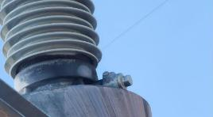
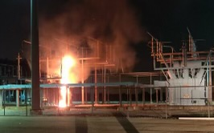
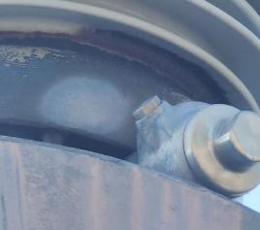
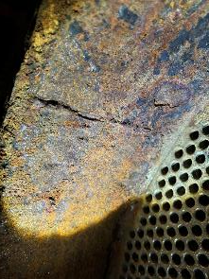
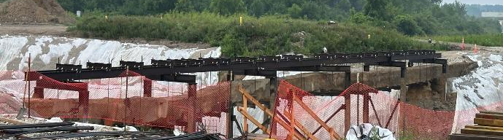
Major Issues Impacting Beam Operations
Master/Kautz Rd bushing recall/failure
Kautz Road transform failure
August of 2024
Main Interconnecting duct bank between Master Sub Station and Kautz Rd.
Main Injector heat exchanger corrosion issue

Slide 17
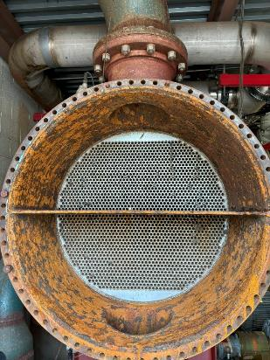
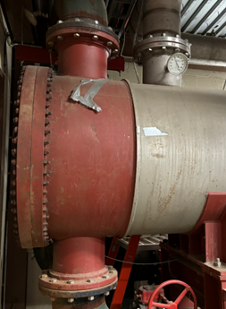
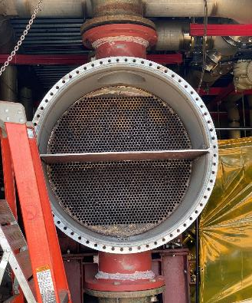
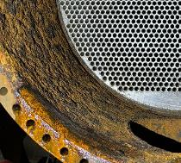
MI Heat Exchanger Corrosion
Before End Channel Repair.
After End Channel Replacement
At the end of the 2024 Summer Shutdown, the corrosion issue was found.
Solution was to replace the end channels on the impacted heat exchangers.
All heat exchangers have been repaired/replaced as of September 2025.

Slide 18
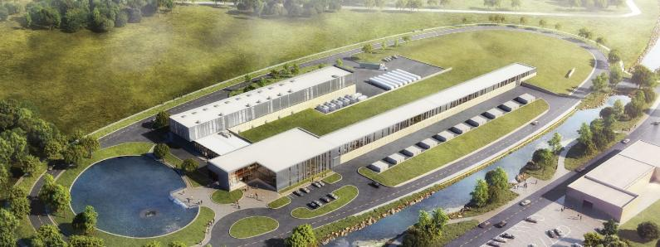
Proton Improvement Plan II (PIP-II)
Increase Main Injector beam power to 1.2 MW.
Replace the existing 400 MeV linac with a new 800 MeV superconducting linac => increase in Booster intensity.
Provide a platform to increase LBNF power to 2.4 MW
Provide path for a 100 kW Mu2e-II
Provide capability for 1.6 MW at 800 MeV, CW beam
Platform for high duty-factor / power operations to multiple experiments

Slide 19
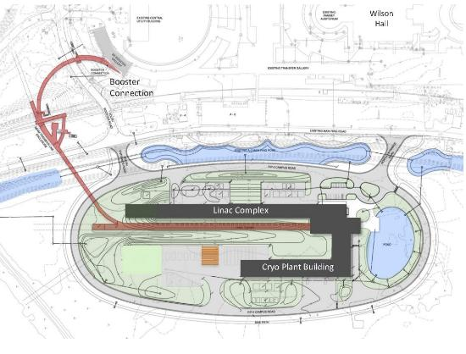
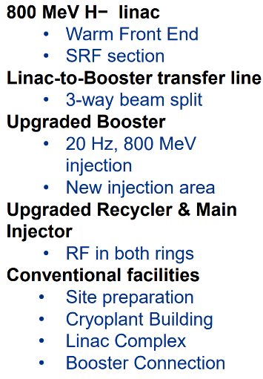
19
19
PIP-II Linac & Upgrades (1.2 MW power on target)
Project started in 2016 (CD-0)
First beam in Booster: 2029 (plan)
MI 1.2 MW beam on target: 2031 (plan)
Notes:
19
19
19
19
19
19

Slide 20
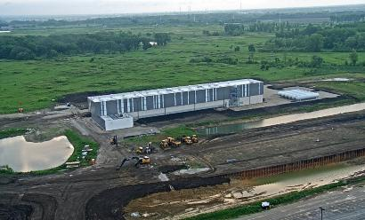
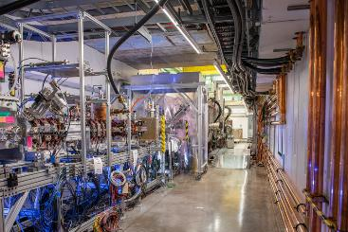
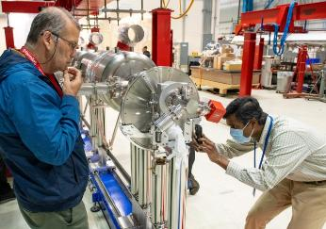


PIP-II Project construction
PIP-II received DOE CD-3 approval for start of construction/execution on April 18, 2023
Linac complex construction is actively underway
Front end of PIP-II linac constructed and successfully tested with beam
PIP-II cryoplant building complete
Extensive in-kind and partner contributions arriving
Magnets provided by
PIP-II is the first particle accelerator built in the U.S. with significant international contributions

Slide 21
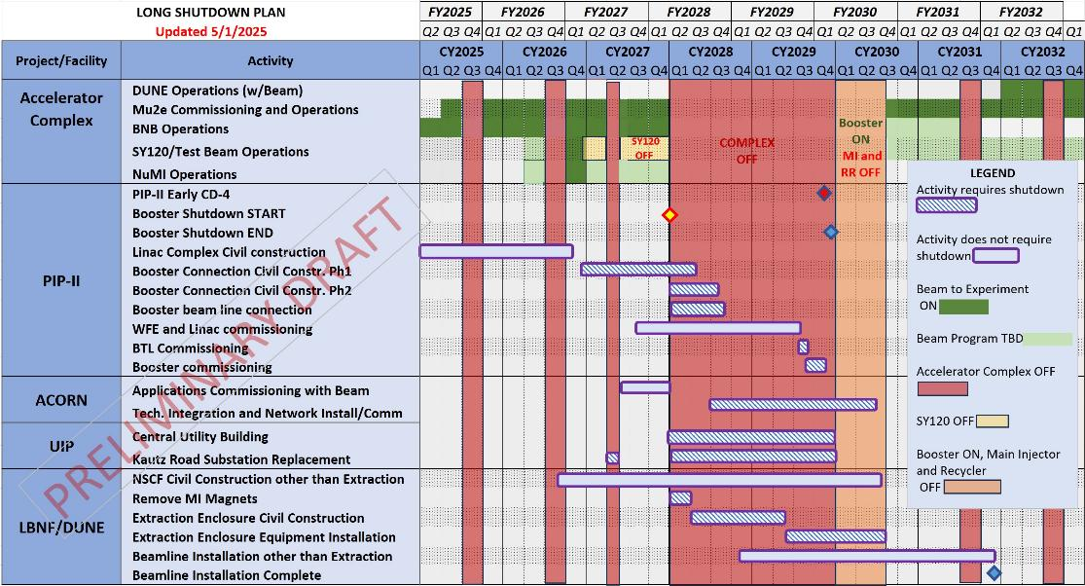
Mid-Term Accelerator Plans

Slide 22
Accelerator Complex Evolution (ACE) plan – beyond 1.2 MW
Our vision is centered on the ACE plan that has two components
The Main Injector reliability improvements, cycle time shortening, and target systems upgrade to be started in the 2020’s called ACE-MIRT – without construction of new machines after PIP-II
Will accelerate the achievement of the DUNE science goals with respect to the original PIP-II plan
Improve reliability and safety of the key machines for the future of accelerator complex
Further, design a Next Accelerator Upgrade that builds upon the existing complex and enables Muon Collider R&D, and potentially a path to the collider
Enables the next set of experiments (beyond DUNE and Mu2e)
Capability of Muon Collider R&D, including a demonstrator facility
Provide a robust and reliable platform for the future evolution of the Fermilab accelerator complex
2+ MW
Multi-MW

Slide 23
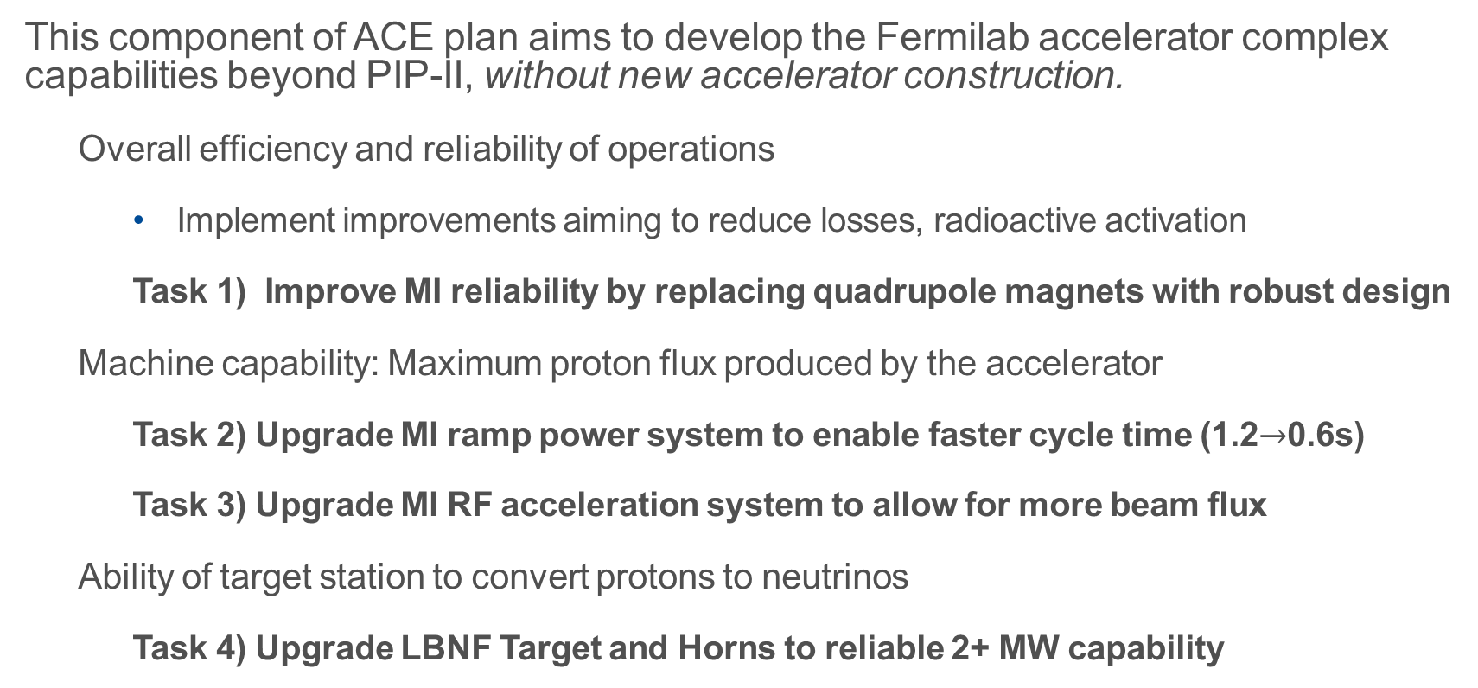
ACE-MIRT scope to enable 2+ MW Accelerator Complex Evolution
This component of ACE plan aims to develop the Fermilab accelerator complex capabilities beyond PIP-II, without new accelerator construction.
Overall efficiency and reliability of operations
Implement improvements aiming to reduce losses, radioactive activation
Task 1) Improve MI reliability by replacing quadrupole magnets with robust design
Machine capability: Maximum proton flux produced by the accelerator
Task 2) Upgrade MI ramp power system to enable faster cycle time (1.2$→$0.6s)
Task 3) Upgrade MI RF acceleration system to allow for more beam flux
Ability of target station to convert protons to neutrinos
Task 4) Upgrade LBNF Target and Horns to reliable 2+ MW capability

Slide 24
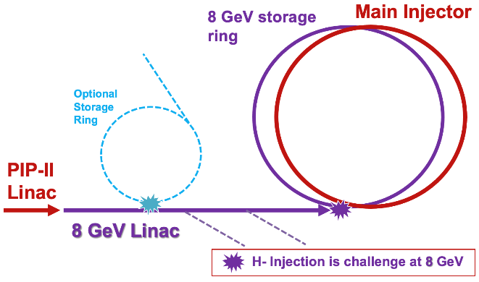
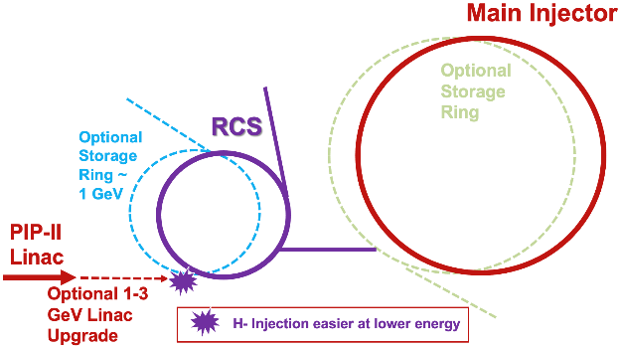
Numerous concepts for future proton accelerators
Scenarios were developed informed by studies from the past and input to Snowmass/P5
Robust and capable 2.4MW accelerator complex for LBNF.
Opportunities for high-power experiments at 1, 2, 8 GeV
A platform for accelerator test facilities and demonstrators for future accelerators and colliders
Community engagement and design studies will continue

Slide 25
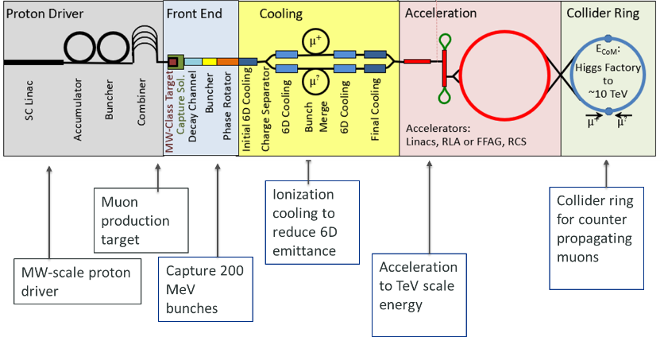
Muon Collider Demonstrator
Many challenges throughout the proposed complex
Numerous technologies to be demonstrated
Ionization cooling is one of the more novel approaches, and requires a great deal of integration

Slide 26
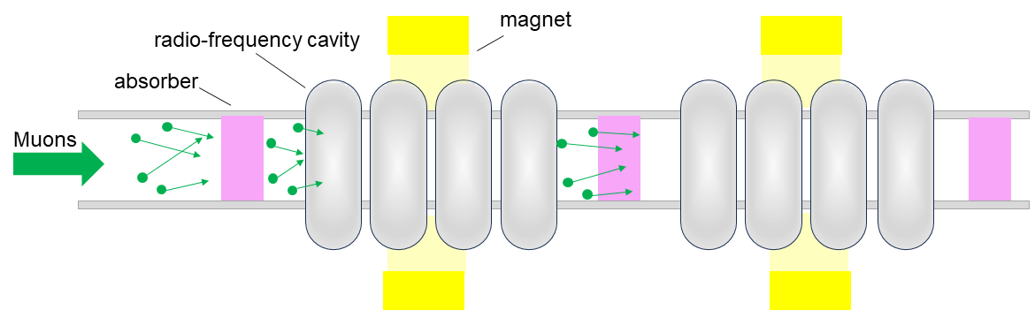
Concept of ionization cooling
x1000 cells!
Not identical
one cell (~ 1m)
Considerations for MuC cooling:
Beam size must be small at the absorber to reduce scattering
Absorbers with low Z and large energy loss must be selected
Magnetic field has to increase in strength over distance to keep cooling
The magnetic field, makes normal conducting (NC) cavities the only option

Slide 27
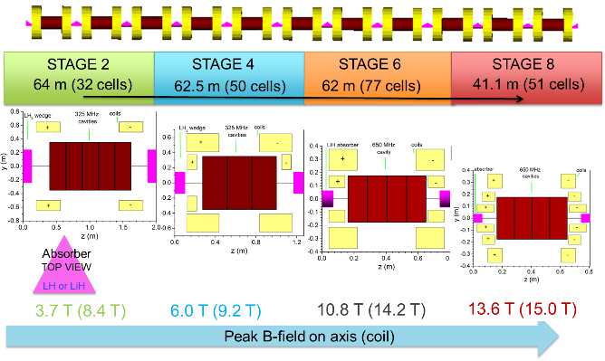
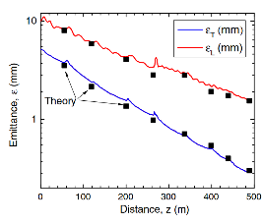
Design & simulation studies for cooling
During the MAP-era a complete design of a Muon Collider cooling system was developed; further improved by the IMCC
Simulation findings look promising but more R&D is needed to benchmark assumptions

Slide 28
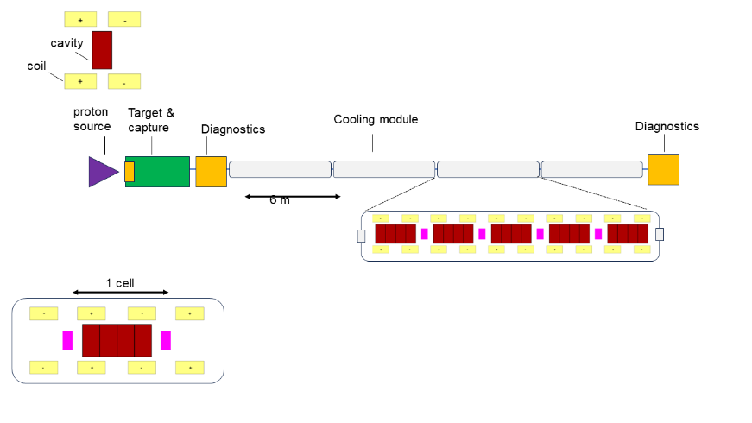

Muon demonstrator staging
Detailed parameters will depend on available funding and resources
RF studies in B-fields
Material studies & cryogenic Cu
Phase-I
Cell integration studies
Cell resembles late 6D cooling stages
Reuse components from Phase I
Phase-II
Full demonstrator with beam
Coils producing 7T axial fields
Potential to achieve 50% 6D cooling
Phase-III

Slide 29
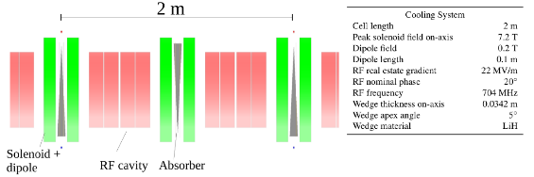
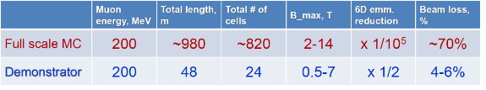
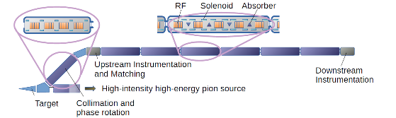
Full demonstrator with beam
Design in progress
Muon source, target and transport
Beam transport
Cooling channel
Investing commonalities with other applications
C. Rogers, Phys. Sci. Forum 2023, 8(1), 37
Fermilab with access to high-power proton beams and technological expertise, is a good candidate for a Cooling Demonstrator

Slide 30
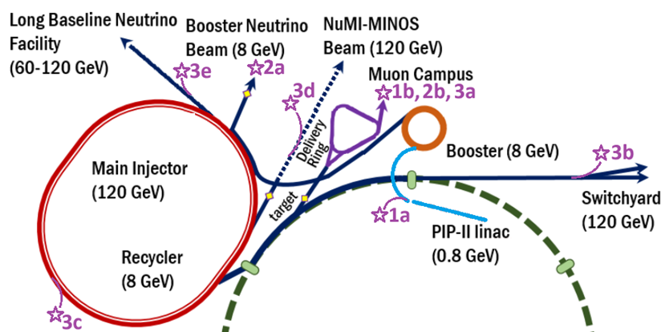
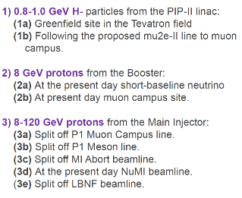
Candidate locations at Fermilab

Slide 31
Summary
Fermilab operates an accelerator complex providing up to 1 MW of proton beam for neutrino and muon experiments
A continuous campaign of improvements has pushed beam power and reliability
Ageing infrastructure has impacted beam delivery
Upgrades are underway for DUNE and future accelerator-based experiments
A Muon Collider Demonstrator Facility is desired
The Muon Collider is very ambitious in several ways
A concept for a cooling demonstrator is being studied for Fermilab

Slide 32
Thank you!

