Slide 1
Detector Considerations for ν Physics at a μ Collider Facility
Jaehoon Yu
University Of Texas at Arlington
Good ν’s : ν physics at a Muon Collider Workshop
Oct. 27 – 30, 2025

Slide 2
How do we design a HEP experiment?
Identify physics goals to accomplish and the backgrounds to mitigate
Determine the capabilities and parameters for an experiment to meet the goals
Decide on the beam and the best detector technologies to meet the parameters
Perform R&D for beam and detectors
Design and build prototype detectors and perform testing
Design and build the full-scale experiment

Slide 3
Neutrino Oscillation Probability
L = 1300km

Slide 4
What do we need for ν osc.?
Need to measure the flux of each ν flavor before & after the oscillations and compare them
Need to have high flux neutrino beams + Excellent ND
Need to be able to see e or μ resulting from ν_{e} and ν_{μ} charged current interactions
Need to be able to identify particles w/ high confidence
Need to have a precision 3D tracking
Need precision energy and momentum measurement with as low E threshold as possible
Still provide enough scattering centers for stats.

Slide 5
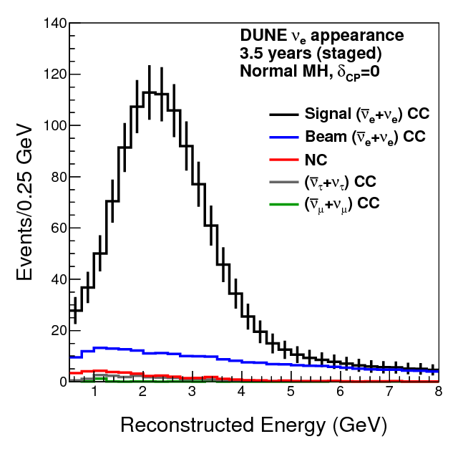
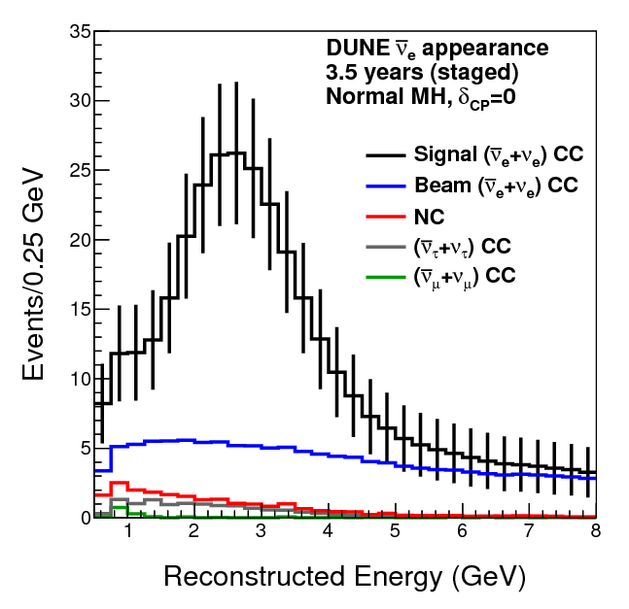
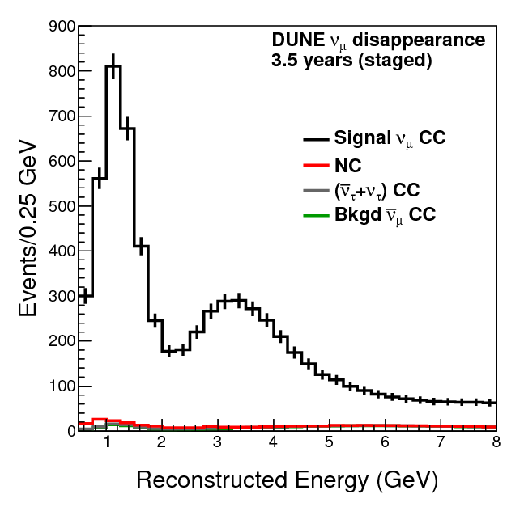
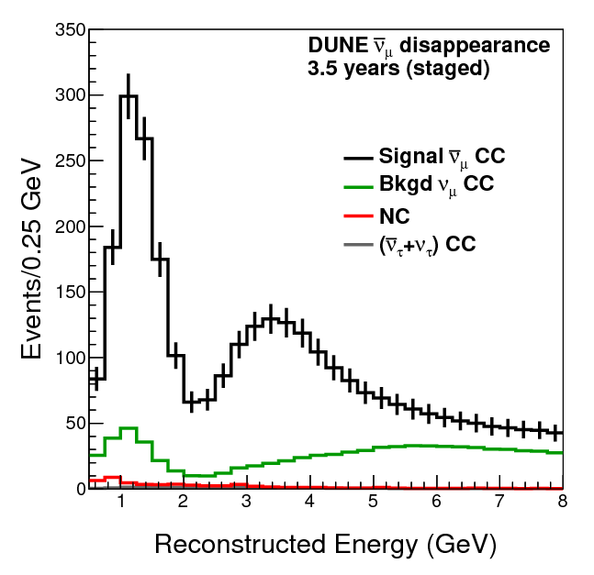
Neutrino Flux
ν_{e}
ν_{e}
ν_{μ}
ν_{μ}
DUNE Conceptual Design Report (CDR) arXiv:1512.06148

Slide 6
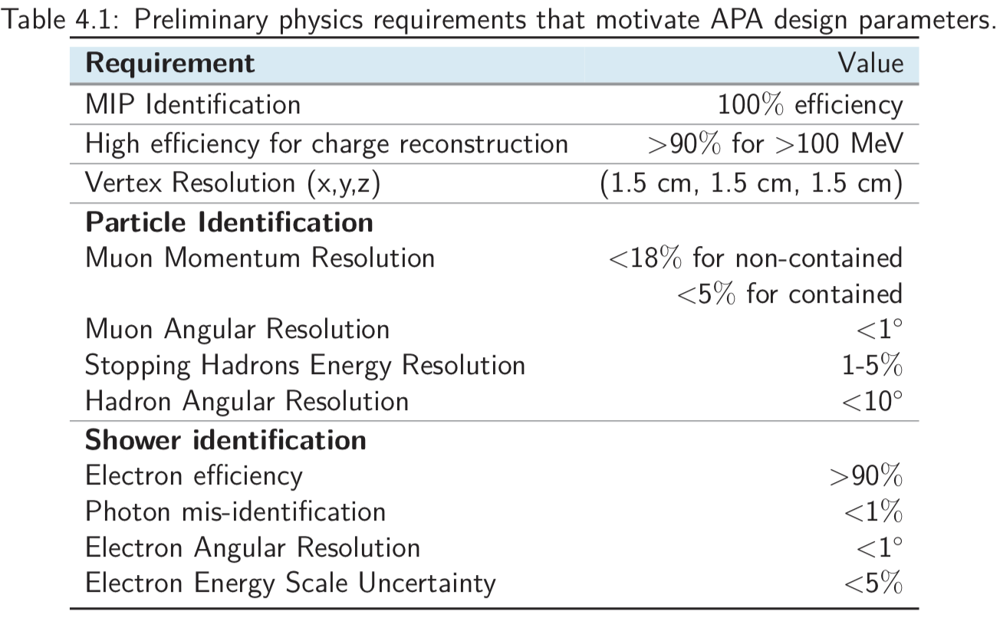

DUNE Physics Requirements

Slide 7
Considerations for a ν Experiment
Neutrino cross sections are small ~10⁻³⁸ E_{ν}
What should we do to increase statistics?
Increase the number of incident neutrinos
Increase the neutrino energy
Increase thickness of materials to interact with neutrinos ➔ Detectors with dense material
Beam can be made to enrich a specific flavor of ν’s in the optimal energy range
Focus and sign select charged mesons

Slide 8
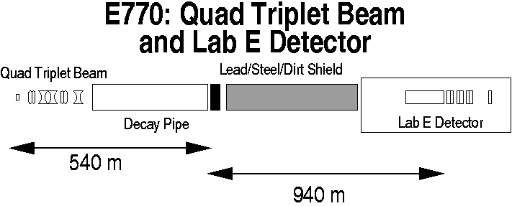
How to make a ν Beam?
Good beam focusing
Good target
Sufficient dump
p
Long decay region
Use large number of protons on target to produce and focus as many secondary hadrons (π, K, D, etc) as possible
Let charged π and K’s decay in-flight for ν_{μ} beam
π→μ+ν_{μ} (99.99%), K→μ+ν_{μ} (63.5%)
Other flavors of neutrinos are harder to make
Let the beam go through shield and dirt to filter out μ and remaining hadrons, except for ν
Dominated by ν_{μ}

Slide 9
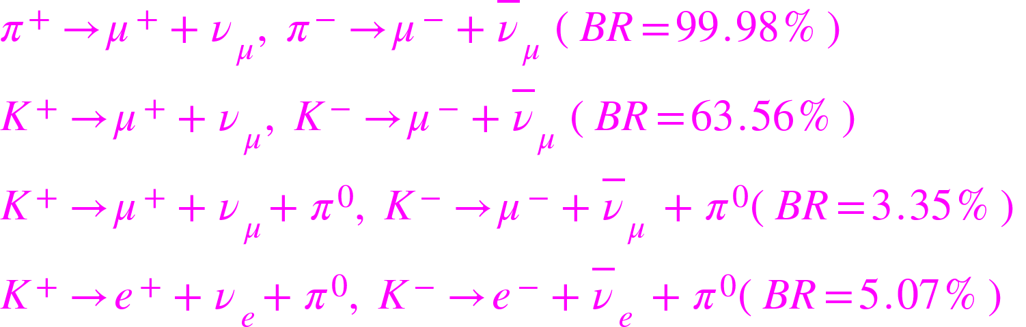
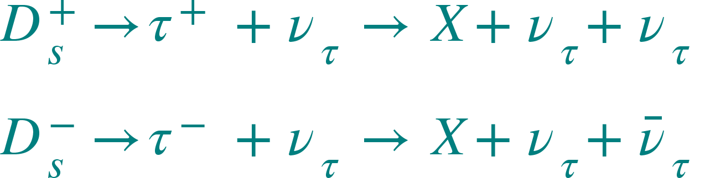
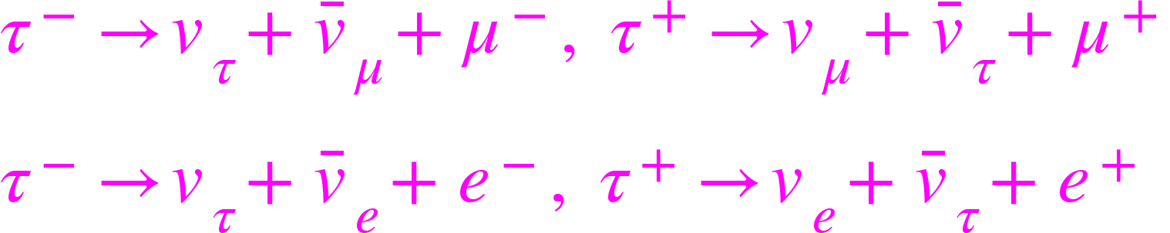
Primary Sources of ν Beams
Traditional source of neutrino beams are from meson decays
Source of tau neutrinos (D_{s} decay to τ, BR = 5.79% )
Detection through τ decays in the detector (precision tracking!)

Slide 10
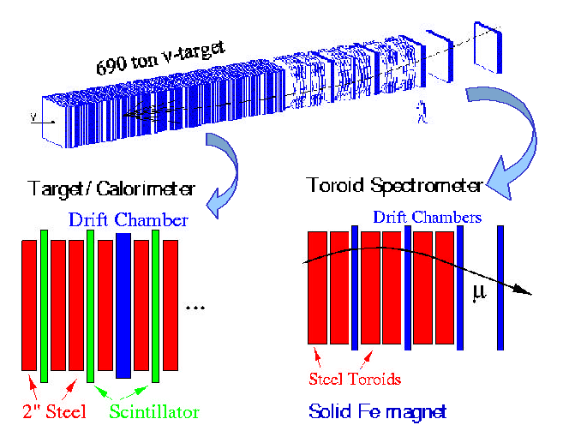
A Typical Past Neutrino Detector
Purposed to probe the internal structure of the nucleons (DIS)
Large amount of material in the path of neutrinos
Insufficient capabilities for precision ν oscillation measurements, can’t tell ν_{e} ➔ Some other technology needed
ν_{τ} requires identification of τ leptonic decays (ν_{τ}ν_{μ}μ/ ν_{τ}ν_{e}e)

Slide 11
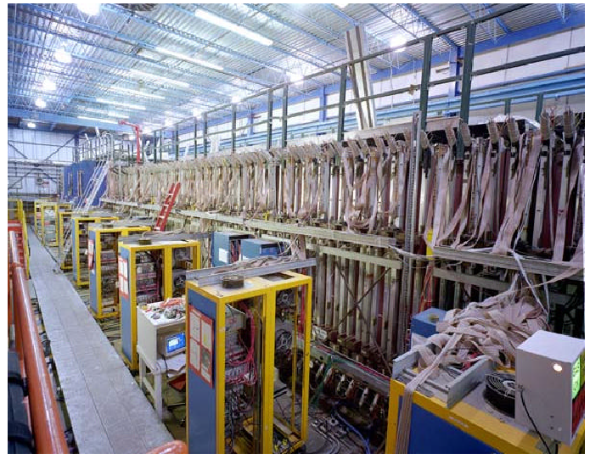
The NuTeV Detector
A picture from 1998. The detector has been dismantled to make room for other experiments, such as DØ

Slide 12
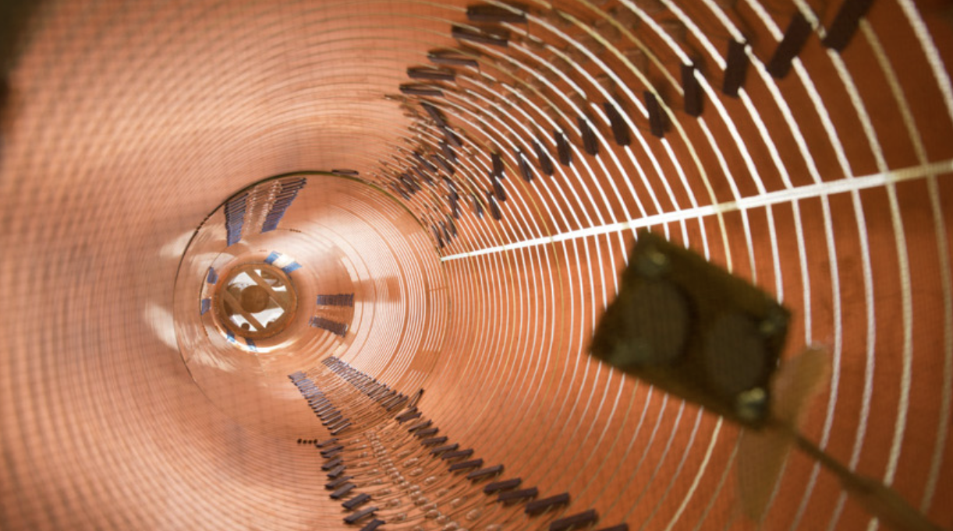
What is a Time Projection Chamber?
A precise particle tracking detector with 3D imaging capability and an energy measurement capability
Initially developed in mid-1970’s at SLAC for a tracking detector in e⁺e⁻ collider experiments with a gas mixture
Field Shaping Ring

Slide 13
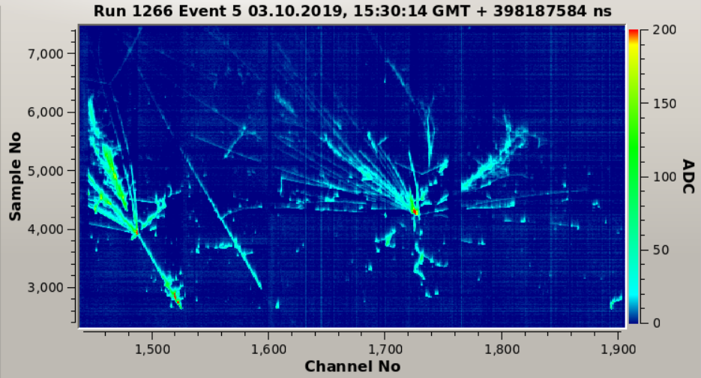
Why TPC?
High 3D spatial resolution 50 ~ 200μm
High pattern recognition efficiency (close to 100%) with good multiple track separation ➔ excellent PID
Over 99.5% 4π reconstruction efficiency
Excellent E measurements & low E thresholds
Good timing resolution
Fast recovery after triggering
Compatible with high magnetic field
Reliable in operation
E_{LEM} = 32 kV/cm
P = 1010 mbar

Slide 14
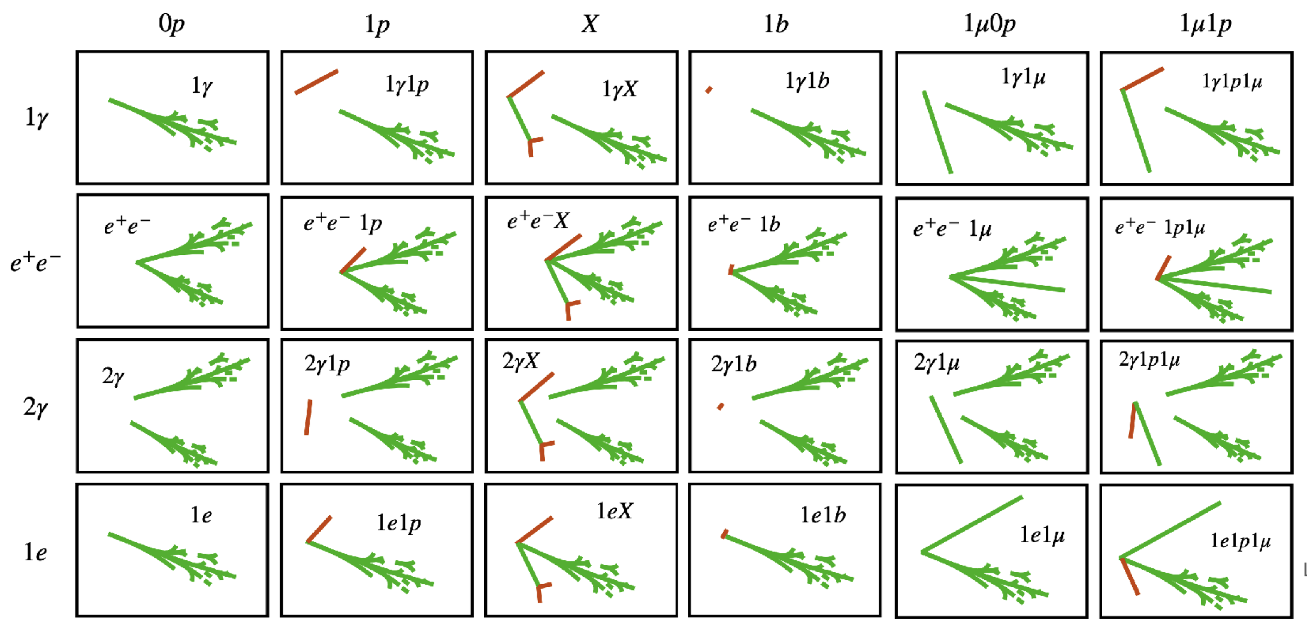
LArTPC Performance from μBooNE
D. Caratelli & B. Littlejohn

Slide 15
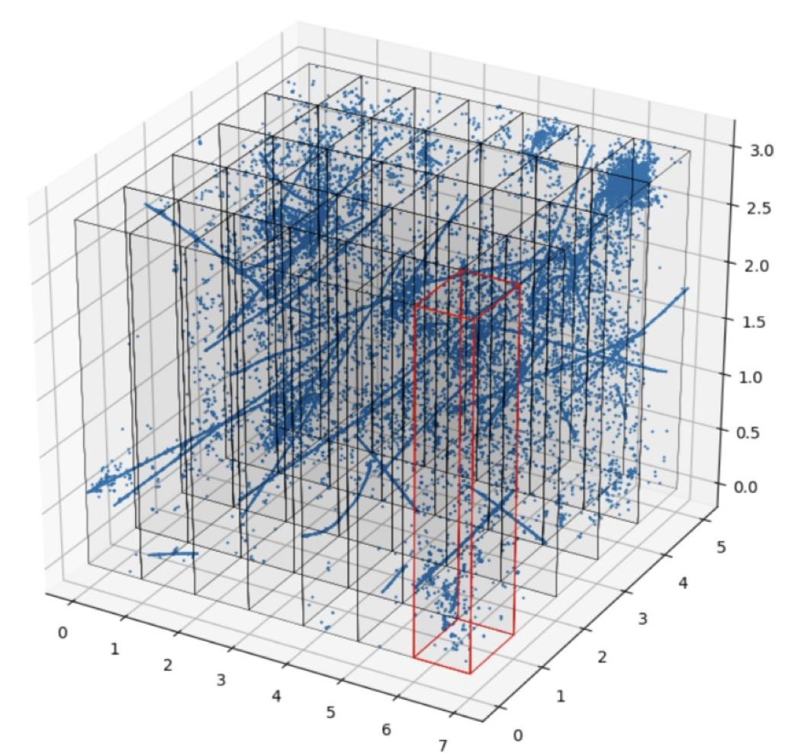
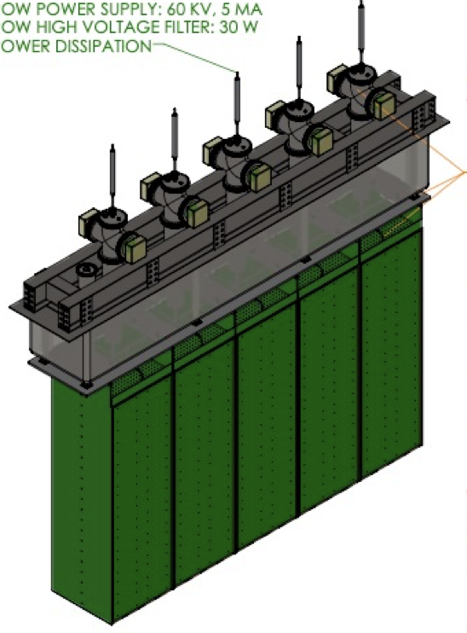
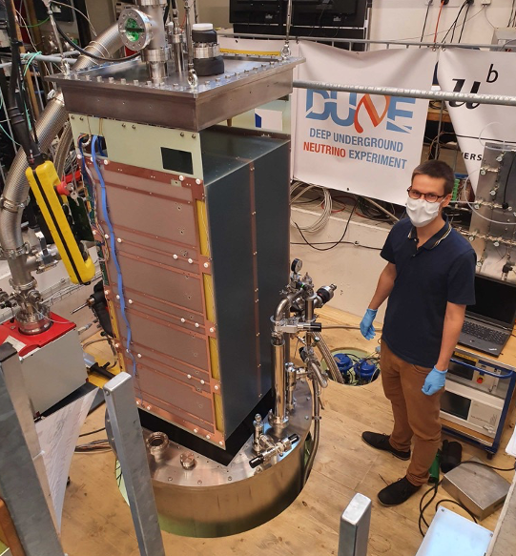
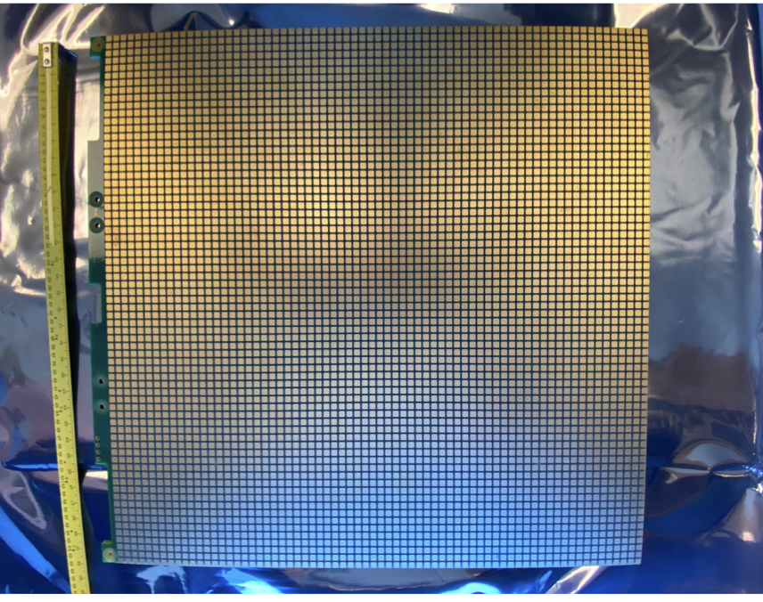
DUNE ND Ar Cube
DUNE ND – 3m (H) x7m(W)x5m(L) – consists of 35 Ar cube modules in 7 banks of 5 modules with pixelate (10⁷ pixels, 4mm pitch) readout design ➔ each module is 3m (H)x1m(W)x1m(L)
D. Dwyer

Slide 16
Traditional ν Exp. Beams & Trigger
To minimize the impact of cosmic rays, the proton beams are injected in successive short pulses, called the pings
Detectors receive the accelerator timing information to open the ”gates” for them to trigger and record the interesting events
Use scintillation lights from the ν-N interaction as the initial trigger

Slide 17
What are possible ν physics?
Further precision measurements of neutrino properties, including the oscillation (matter effect?) and CPV properties ➔ Would be good if we could use an existing experimental facility, such as DUNE
Can we measure the neutrino mass, since we can see both neutrinos and anti-neutrinos of e and μ species?
High precision ν-N cross section measurement at various energies?
But definitely BSM topics involving ν
Would be even better if we had discovered (a) new particle(s)

Slide 18
Low E ν Interactions
QE & RES dominates ν-N interactions in E_{ν} range where the two oscillation maxima reside, for the case of DUNE ➔ Critical for more precision detection & BSM
Large uncertainties for ν-N x-sec calc.
Intense ν beam at μ-col could provide precision x-sec measurements
Higher E_{ν} dominated by DIS and somewhat better understood

Slide 19
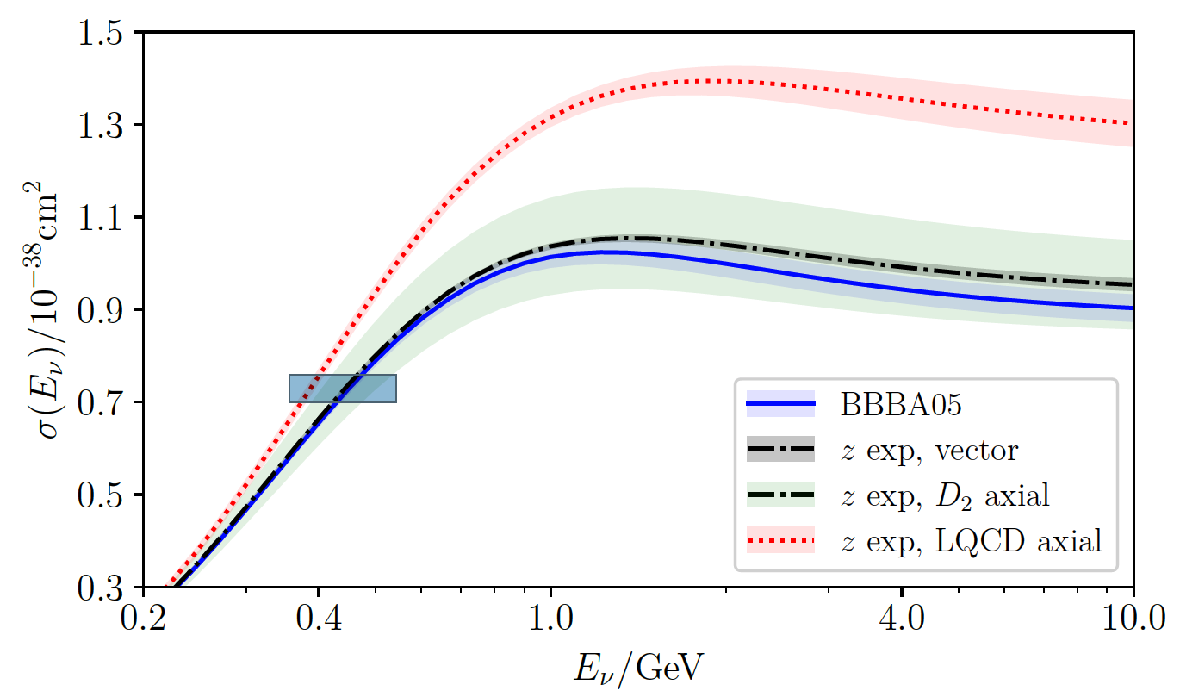
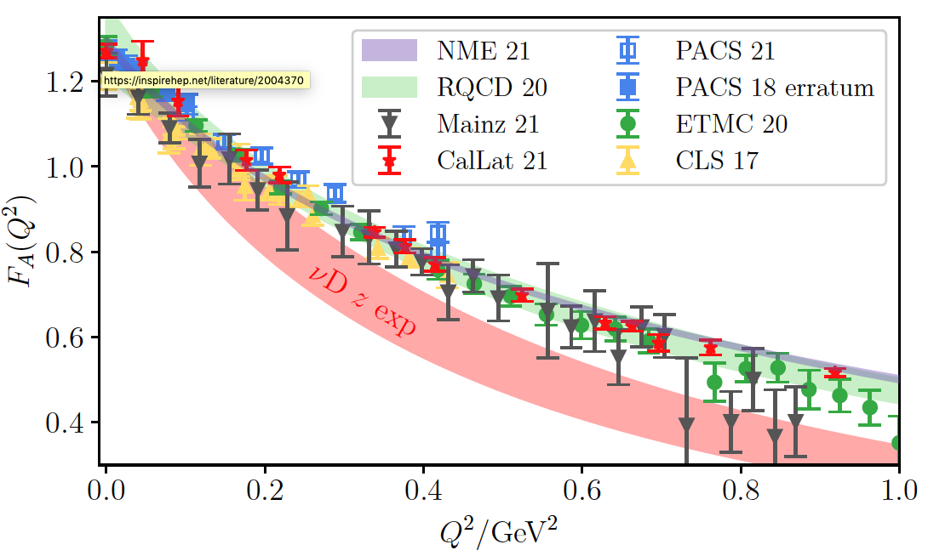
ν-N interaction Modeling Uncertainty
ν+n
A. Kronfeld
2GeV ν_{μ}+Ar
C. Andreopoulos

Slide 20
ν Event Rates
Previous experiments : very low rates in both ND and FD (few hundreds of events in FD in a year)
Event rates for DUNE LArND : 10⁸ ν_{μ} CC/yr
Event rates for Mu Col : 1.7~5.4x10⁹ CC/yr in E+HCAL
Accounting the ρ and V difference, rate is similar to DUNE ND
Given the rates and higher neutrino energies, a paradigm change of detection method necessary ➔ DUNE ND style, cubed modular detectors with pixelated readout with a self triggering capability
Self-triggering pixel readout chip (Q-Pix) R&D on going

Slide 21
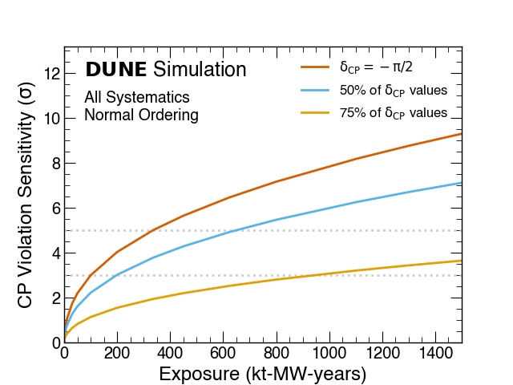
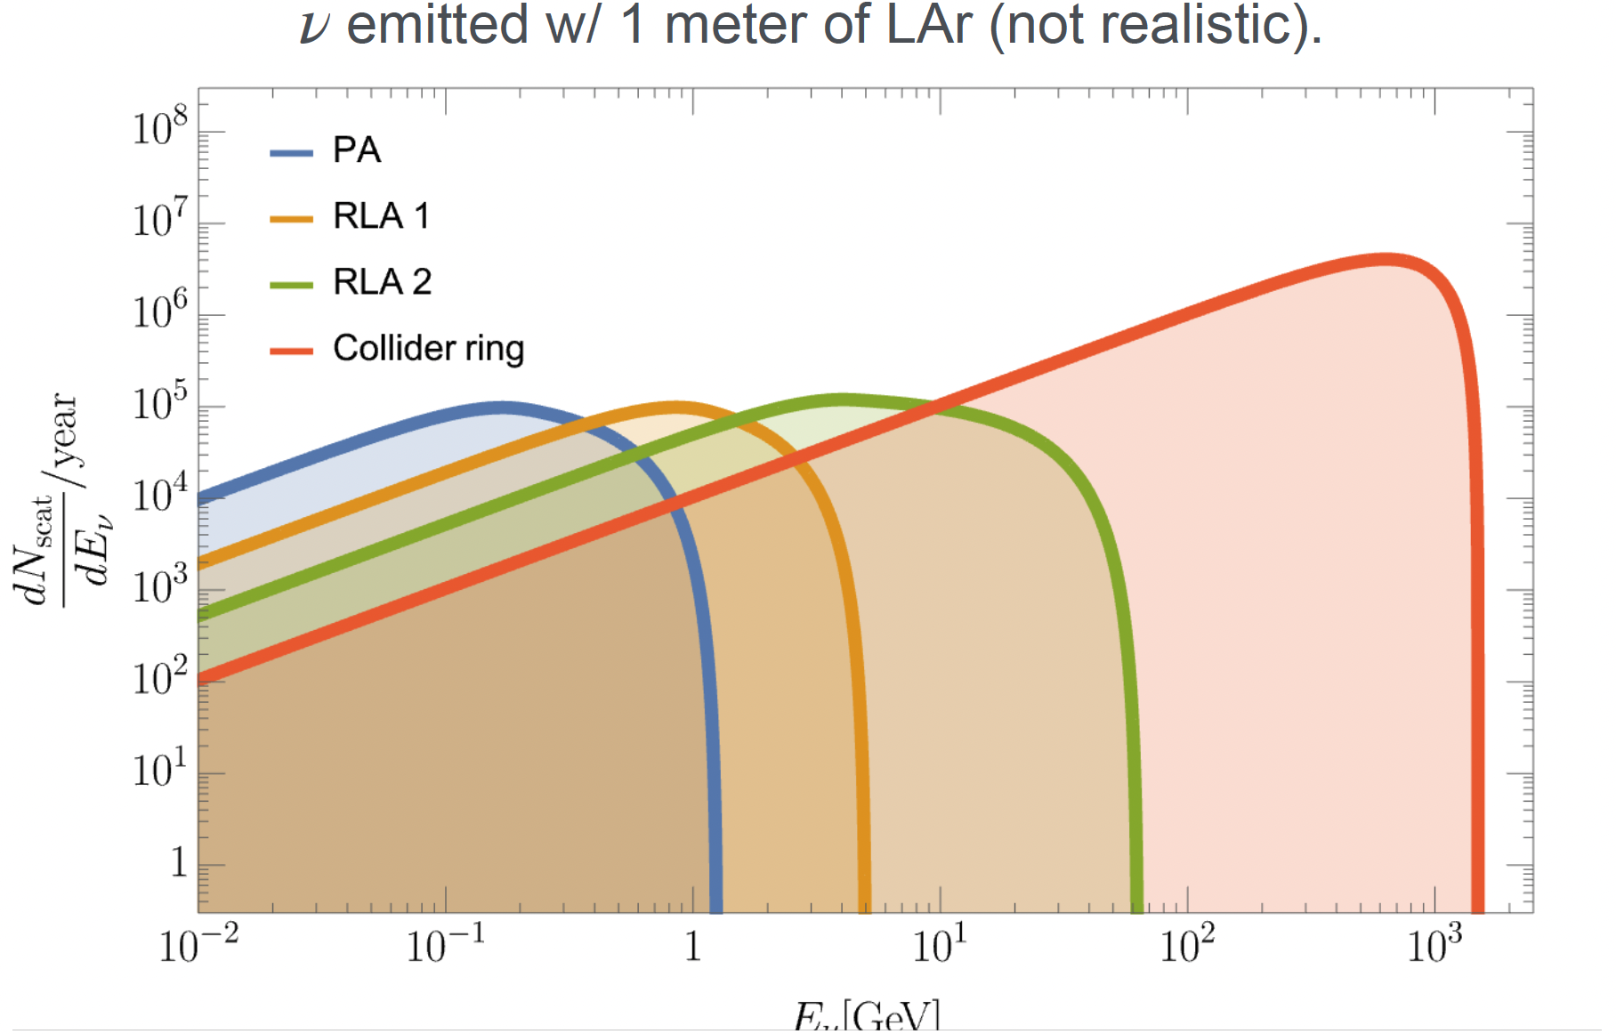
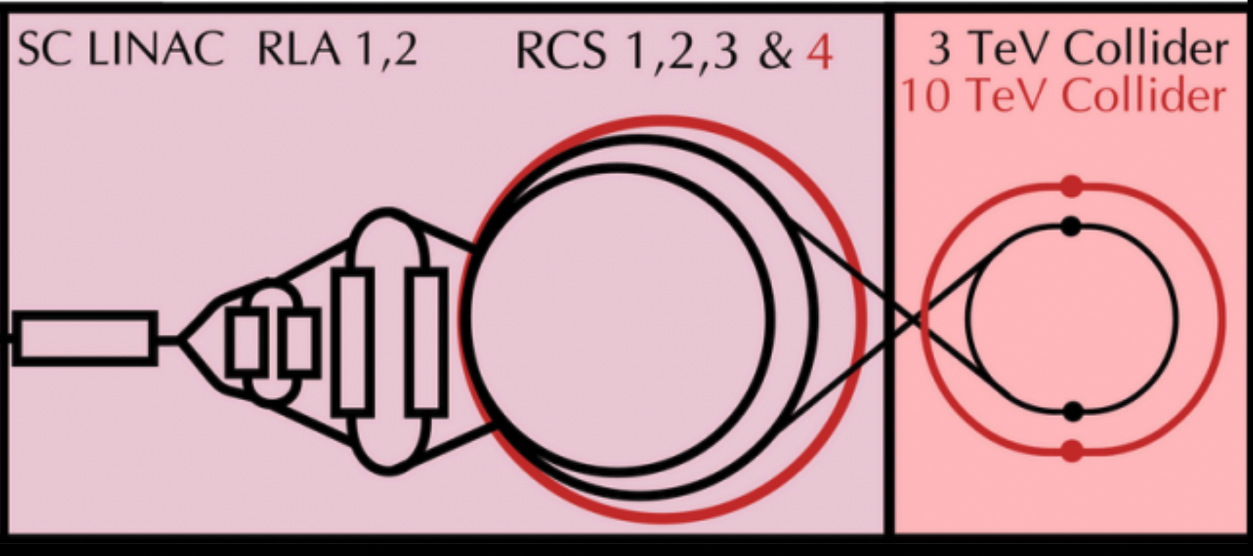
Taking Advantage of Existing Exp.
We will still need to do precision measurements of ν properties
Taking advantage of better understood beams of both ν species and the existing DUNE ND and FD, along with the deep underground nature (N_{μ}<10⁻⁸/s/cm²) of DUNE essential
The straight section, however, needs to be built with the correct angle to aim DUNE (1300km) or HK (13,000km, stiffer)
~20 yrs post DUNE
R. Taylor

Slide 22
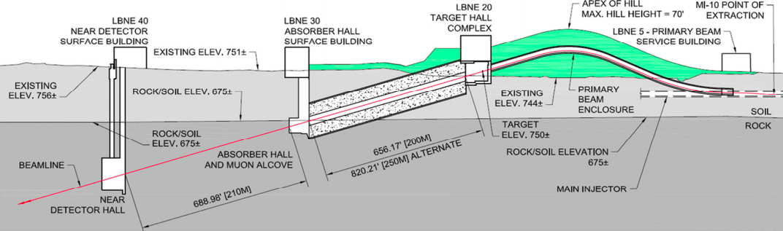
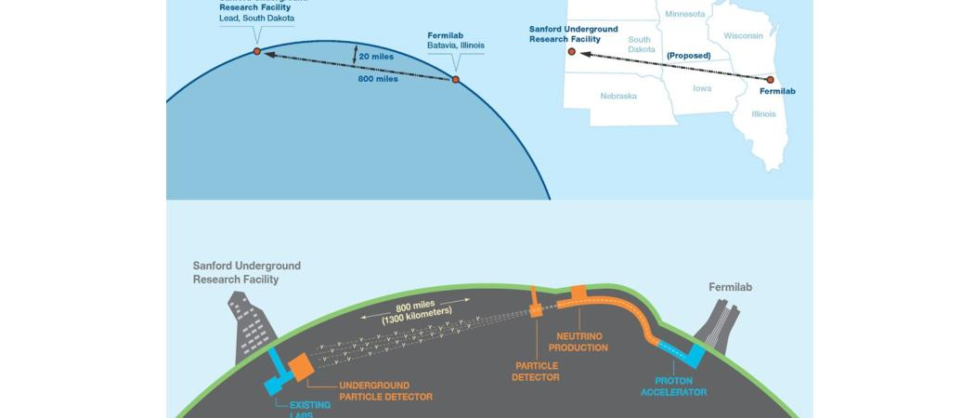
Anatomy of DUNE
~58’
5.8º
P beam raised 58’ for correct beam angle
Long Baseline
Cosmic μ < 1/100M/s/cm²

Slide 23
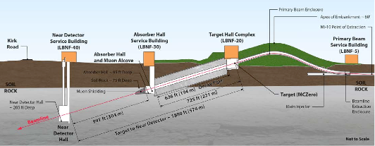
Consideration for Race-Track Style
We will still need to do precision measurements of ν properties
Taking advantage of better understood beams of both ν species and the existing DUNE ND and FD, along with the deep underground nature (N_{μ}<10⁻⁸/s/cm²) of DUNE essential
The storage ring, however, needs to be built with the correct angle to aim DUNE or HK (even stiffer!)
5.8º

Slide 24
Detectors along a straight section?
A dedicated ν−slice detector can be placed sufficiently away from the collider ring to ensure neutron absorption ➔ FASER experience would be helpful in estimating the backgrounds
Could also contemplate such dedicated detector near the straight section of a race-tracked storage ring, RLA or the collider ring with a straight section for high intensity ν beams
LAr TPC ν det.
LAr TPC ν det.

Slide 25
ν Detector Requirements @μ-col
Fast timing and excellent timing resolution ➔ needed to overcome the pile-up events from particles unassociated with the collisions
Excellent position and vertex resolution
Capability to provide the directional information ➔ is the event caused by the ν circling clockwise or counter-clockwise?
Excellent energy and mass resolutions
Ability to measure momentum and the sign of the charge
Self-triggering capability to capture ν interactions unrelated to the collision
Ideal if located underground
Should be able to take advantage of AI ➔ pixels may be better than the wire-based geometry

Slide 26
How is ν Experiment Different @ μ-col?
Systematics from the ν flux not an issue
ν event statistics similar to DUNE ND
Detector related systematics still remain
Understanding the ν-N interactions essential for expected physics topics at a μ-col facility ν-experiments
ν’s become serious backgrounds, especially for high E_{μ} collider facility

Slide 27
Summary
Precision detector experiences at DUNE and other next gen ν exp. would be essential for μ-col facility ν-exp
Essential to have good ideas on physics goals
Which facility?
Final states?
Background?
Need to determine the detector requirements for the goal
Need to establish detector R&D plan to meet the requirements in a timely fashion
Need to have a much better understanding of the ν-N interaction modeling

