Slide 1

Where Dark Sector Physics Meets Muon Colliders
Doojin Kim
(doojin.kim@usd.edu)
Good ν’s: Neutrino Physics at a Muon Collider
University of Pittsburgh, Pittsburgh, PA
October 27th, 2025

Slide 2
Outline
Introduction
Motivations, dark-sector physics
Case I: Central Physics
Direct detection of DM
Dark-Sector Physics Opportunities at Muon Colliders
Case II: Dark-Sector Slice
Simulations, kinematic observables, required detector capabilities
Case III: Electron Beam-Dump
Simulations, production/detection channels, sensitivity estimates
Conclusions
Future directions, take-home messages

Slide 3
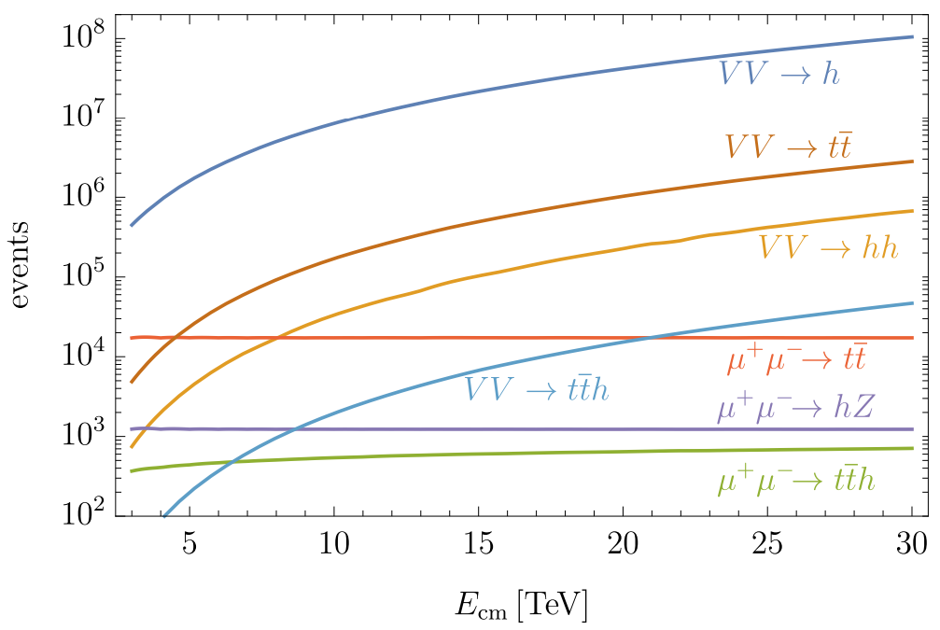
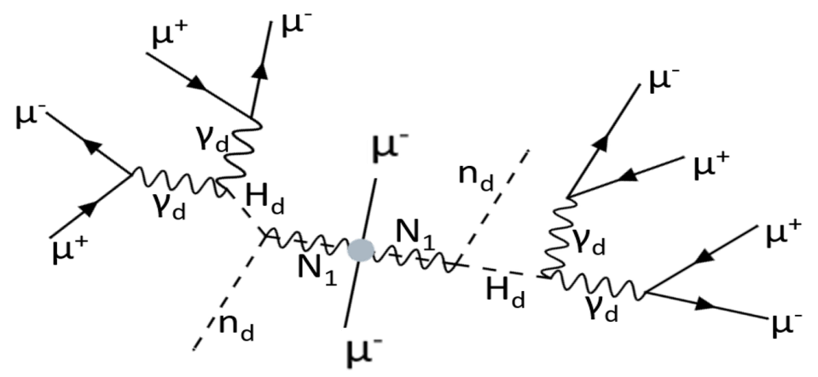
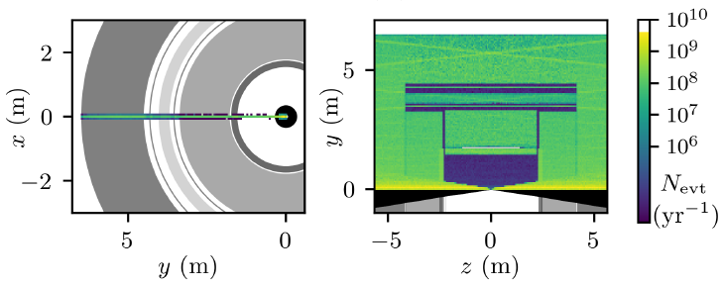
Various Physics Opportunities at Muon Colliders
Higgs physics
[Aimè et al. (Muon Collider Physics Summary), 2203.07256; Chiesa et al., JHEP (2020); Han, Liu, Low, Wang, PRD (2021); Han, Kilian, Kreher, Ma, Reuter, JHEP (2021); Forslund, Meade, JHEP (2024); Celada, Han, Kilian, Kreher, Ma, JHEP (2024); Johnson, DK, Singh, in progress; ++ ]
Neutrino slice
[Bojorquez-Lopez, Hostert, Argüelles, Liu, PRL (2025)]
BSM physics
[Aimè et al. (IMC), EPS-HEP2023; Han, Li, Su, Su, Wu, PRD (2021); Altmannshofer, Gadam, Profumo, PRD (2023); Gutíerrez-Rodríguez, Martínez-Martínez, Hernandez-Ruíz, EPJP (2024); Airen, Broadberry, Marques-Tavares, Ricci, JHEP (2025); ++ ]
Dark-Sector Physics?!
[Dutta, Karthikeya, Kelly, DK, Sathyan, in progress]
(See also Bhaskar Dutta’s talk)

Slide 4
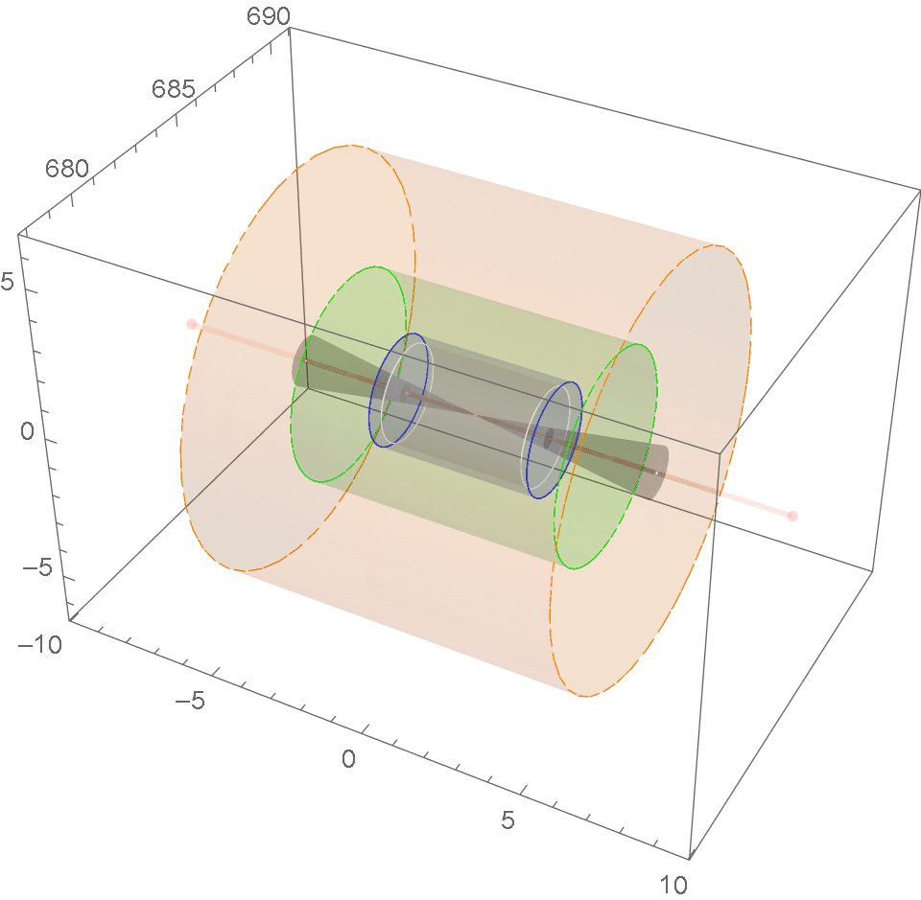

Case I: Central Physics
$$μ^{+}μ^{−}→γA^{′}, A′→μ^{+}μ^{−}$$

Slide 5
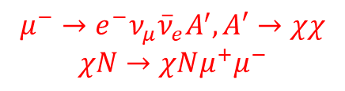
Case II: Dark-Sector Slice
$$μ^{−}→e^{−}ν_{μ}{\overline{ν}}_{e}A^{′}, A′→χχ$$
$$χN→χNμ^{+}μ^{−}$$

Slide 6
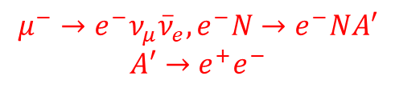
Case III: Electron “Beam-Dump”
$$μ^{−}→e^{−}ν_{μ}{\overline{ν}}_{e},e^{−}N→e^{−}NA′$$
$$A′→e^{+}e^{−}$$

Slide 7
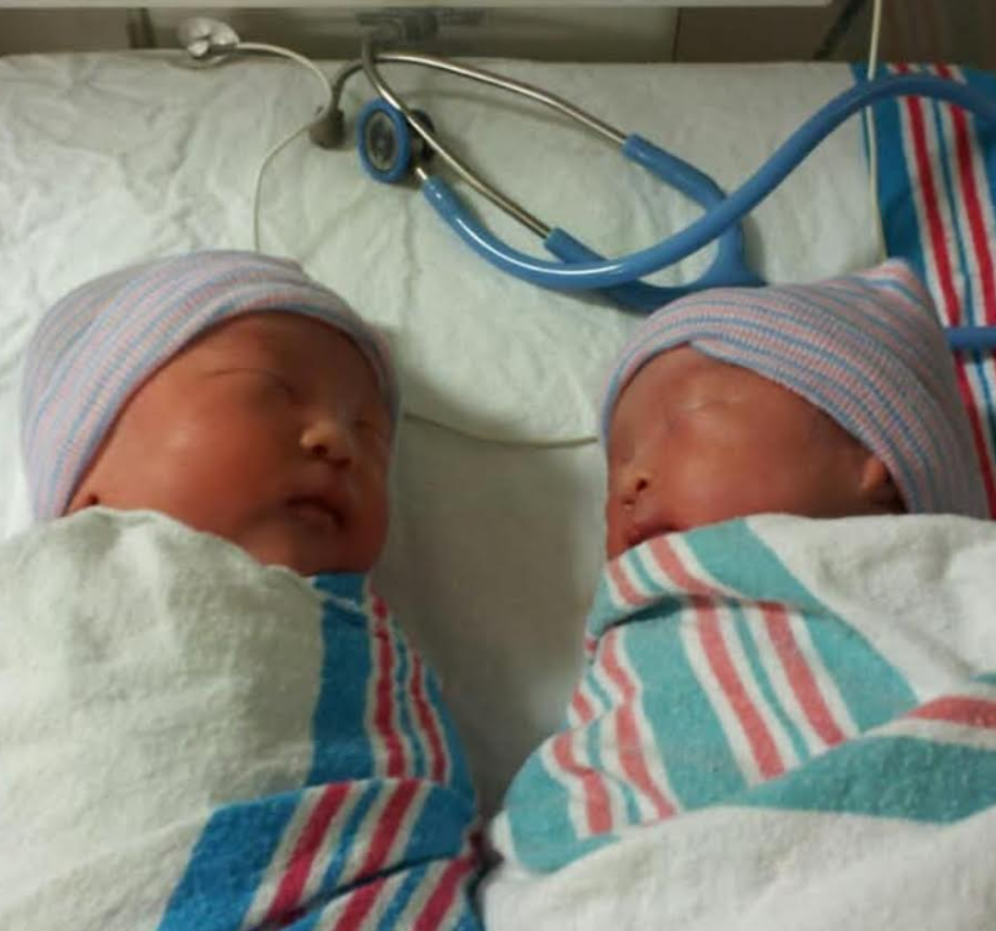

Neutrinos as Backgrounds to Dark-Sector Physics Signals
DM?
Neutrino?
DM
Neutrino
Both dark matter and neutrinos are
  very weakly interacting,
  leaving experimental signatures via scattering.
Neutrinos usually fake light dark matter signals.
Studies to improve signal-over-background
(new rejection schemes, new channels, new sources, etc)

Slide 8
Outline
Introduction
Motivations, dark-sector physics
Case I: Central Physics
Direct detection of DM
Dark-Sector Physics Opportunities at Muon Colliders
Case II: Dark-Sector Slice
Simulations, kinematic observables, required detector capabilities
Case III: Electron Beam-Dump
Simulations, production/detection channels, sensitivity estimates
Conclusions
Future directions, take-home messages

Slide 9
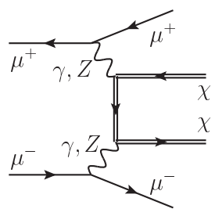
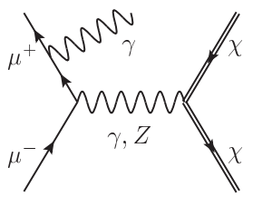
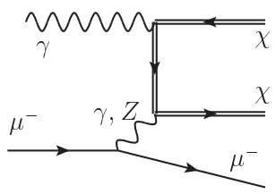






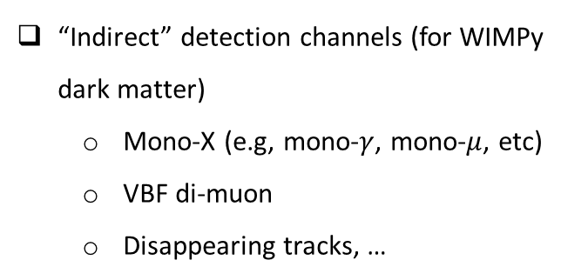

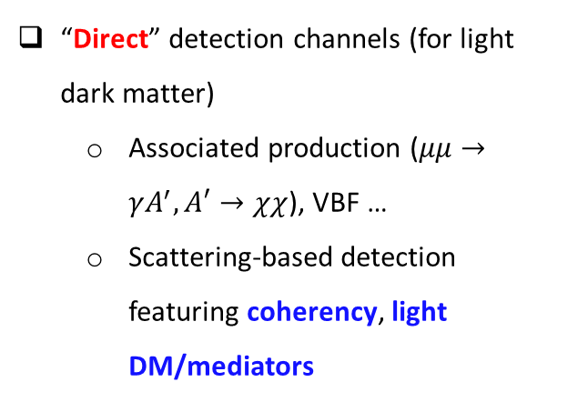






Dark-Matter Physics Opportunities in the Central Region
“Indirect” detection channels (for WIMPy dark matter)
  Mono-X (e.g, mono-$γ$, mono-$μ$, etc)
  VBF di-muon
  Disappearing tracks, …
[Han, Liu, Wang, Wang, PRD (2021)]
“Direct” detection channels (for light dark matter)
  Associated production ($μμ→γA^{′}, A′→χχ$), VBF …
  Scattering-based detection featuring coherency, light DM/mediators
$$χ$$
$$χ$$
$$χ$$
$$χ$$
$$φ$$
$$Z′$$
$$μ$$
$$Z′(→μμ)$$
$$γ$$
$$μ$$
$$γ$$
$$μ$$
$$N$$
$$N$$
$$N$$
$$N$$
[Dutta, Karthikeyan, Kelly, DK, Sathyam, in progress]

Slide 10
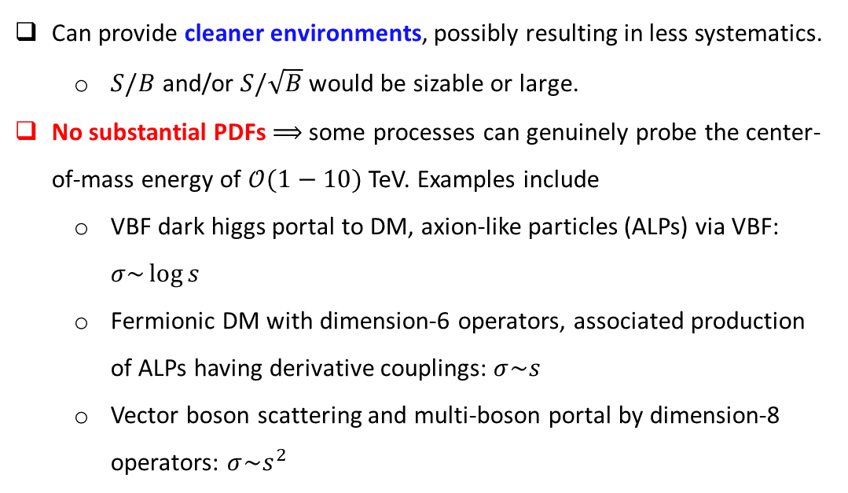
Muon Colliders vs. LHC
Can provide cleaner environments, possibly resulting in less systematics.
  $S/B$ and/or $S/\sqrt{B}$ would be sizable or large.
No substantial PDFs $⟹$ some processes can genuinely probe the center-of-mass energy of $𝒪(1−10)$ TeV. Examples include
  VBF dark higgs portal to DM, axion-like particles (ALPs) via VBF: $σ\sim \log{s}$
  Fermionic DM with dimension-6 operators, associated production of ALPs having derivative couplings: $σ\sim s$
  Vector boson scattering and multi-boson portal by dimension-8 operators: $σ\sim s^{2}$

Slide 11
Outline
Introduction
Motivations, dark-sector physics
Case I: Central Physics
Direct detection of DM
Dark-Sector Physics Opportunities at Muon Colliders
Case II: Dark-Sector Slice
Simulations, kinematic observables, required detector capabilities
Case III: Electron Beam-Dump
Simulations, production/detection channels, sensitivity estimates
Conclusions
Future directions, take-home messages

Slide 12
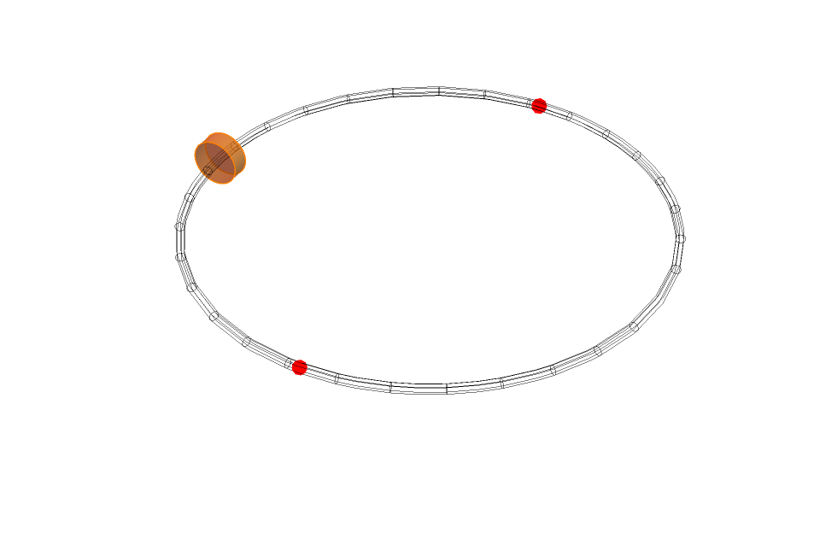






Simulation of the Dark-Sector Slice: Light Dark Matter
Assuming circular collider rings,
Positive and negative muons injected from a common side,
Discarding decay events occurring beyond half the lab-frame lifetime,
Generating below decay events:
Accepting dark matter entering detector geometry based on [Bartosik et al. (Muon Collider), 2203.07964]
$$e$$
$$A′$$
$$χ$$
(Not to scale)
$$μ$$
$$ν$$
$$χ$$
$$ν$$

Slide 13
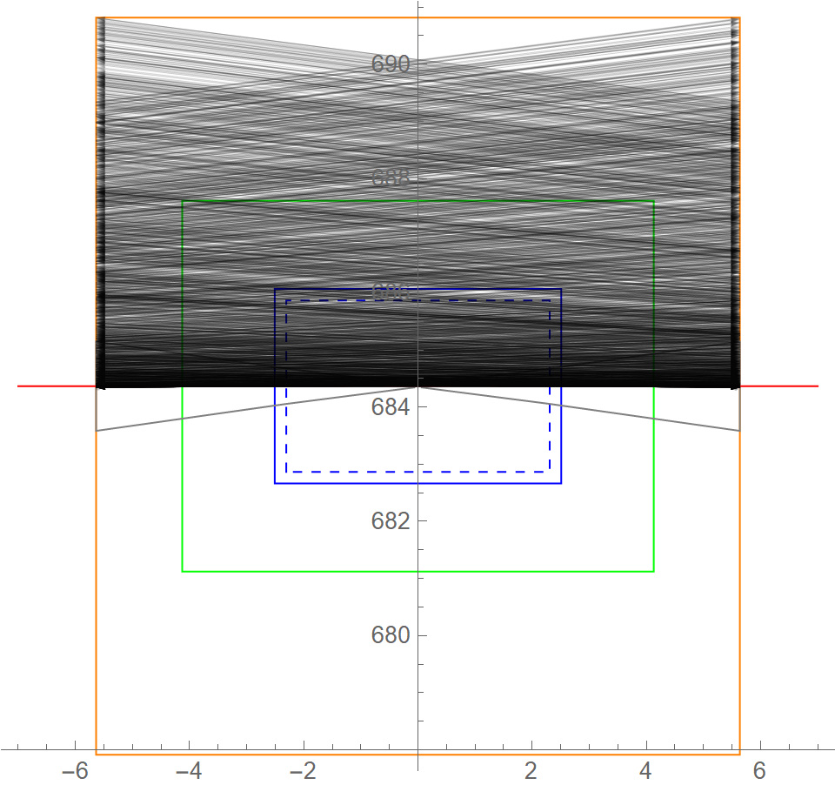
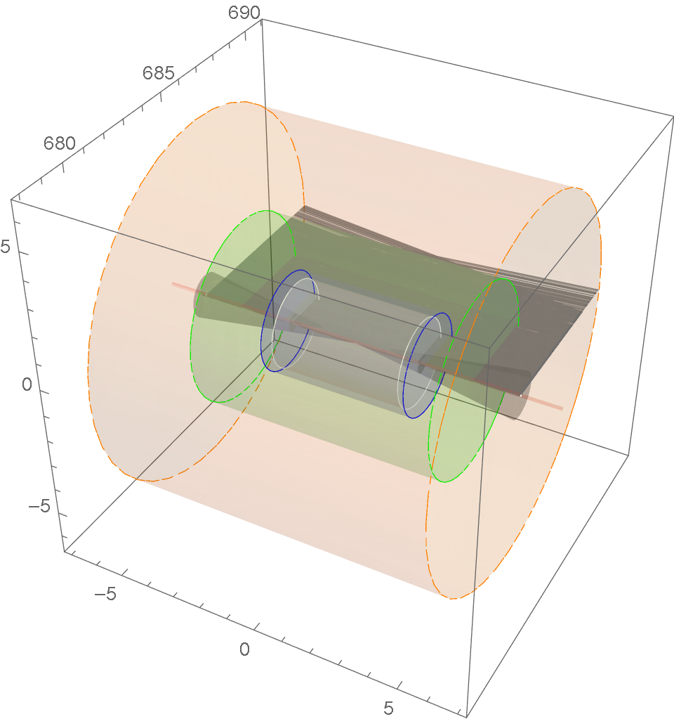
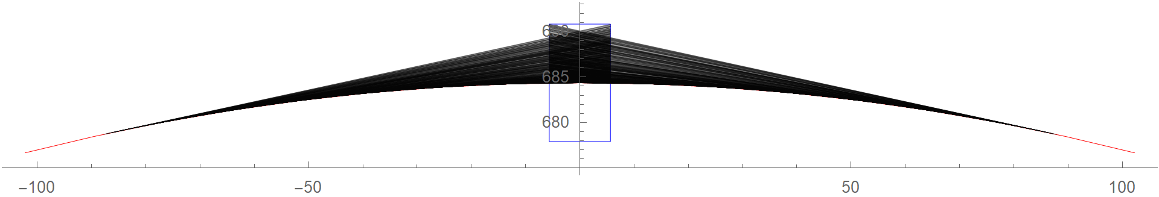
Dark-Sector Slice: $\sqrt{s}=3$ TeV

Slide 14
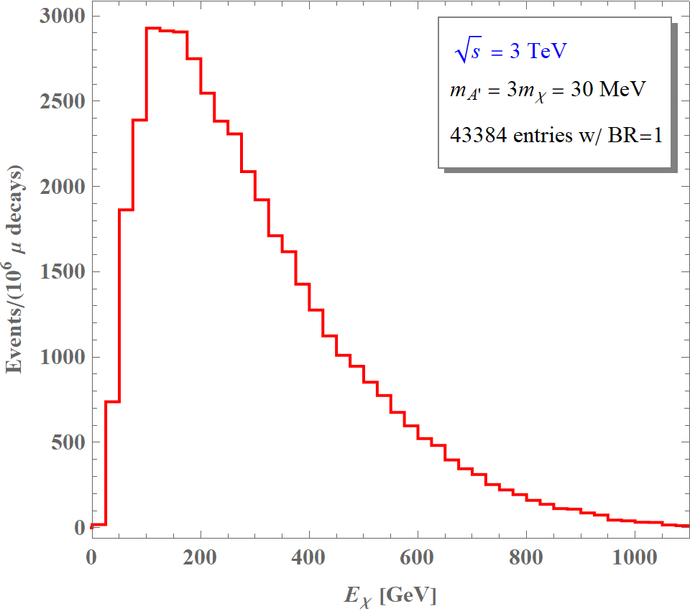
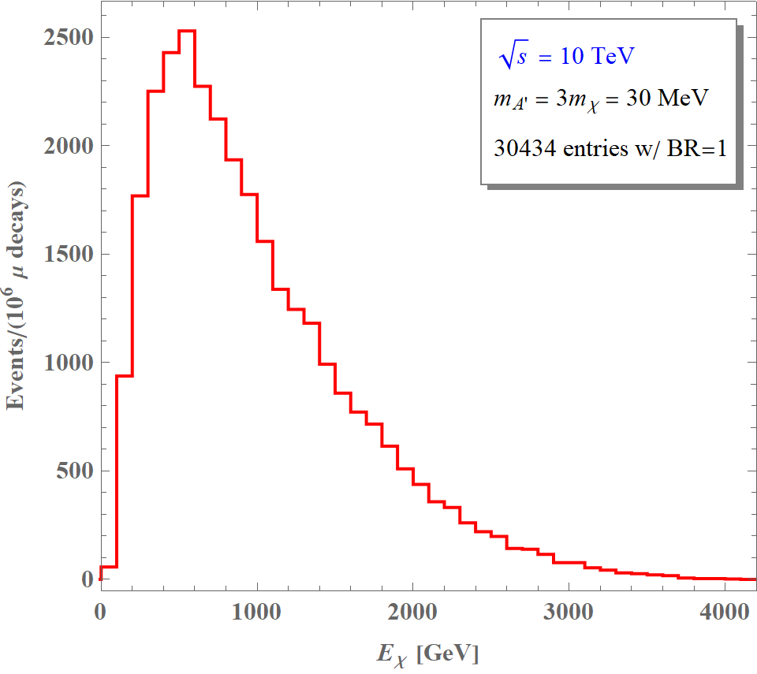
Dark Matter Flux at the Detector
[Dutta, Karthikeyan, Kelly, DK, Sathyam, in progress]

Slide 15












Various Search Channels and Physics Opportunities
$$χ$$
$$χ$$
$$χ$$
$$χ$$
$$χ$$
$$χ$$
$$ℓ^{(′)}$$
$$Z′$$
$$ℓ^{(′)}$$
$$Z′$$
$$φ$$
$$Z′$$
$$γ$$
$$ℓ$$
$$γ$$
$$φ$$
$$ℓ$$
$$γ$$
$$ℓ$$
$$N$$
$$N$$
$$N$$
$$N$$
$$N$$
$$N$$
$$χ$$
$$χ$$
$$χ$$
$$ℓ^{(′)}$$
$$χ$$
$$χ′$$
$$Z′$$
$$Z′$$
$$ℓ$$
$$Z′$$
$$ℓ$$
Many more…
$$e$$
$$e/p$$
$$e$$
$$γ$$
$$e/p$$
Plus searches for visibly decaying mediators

Slide 16
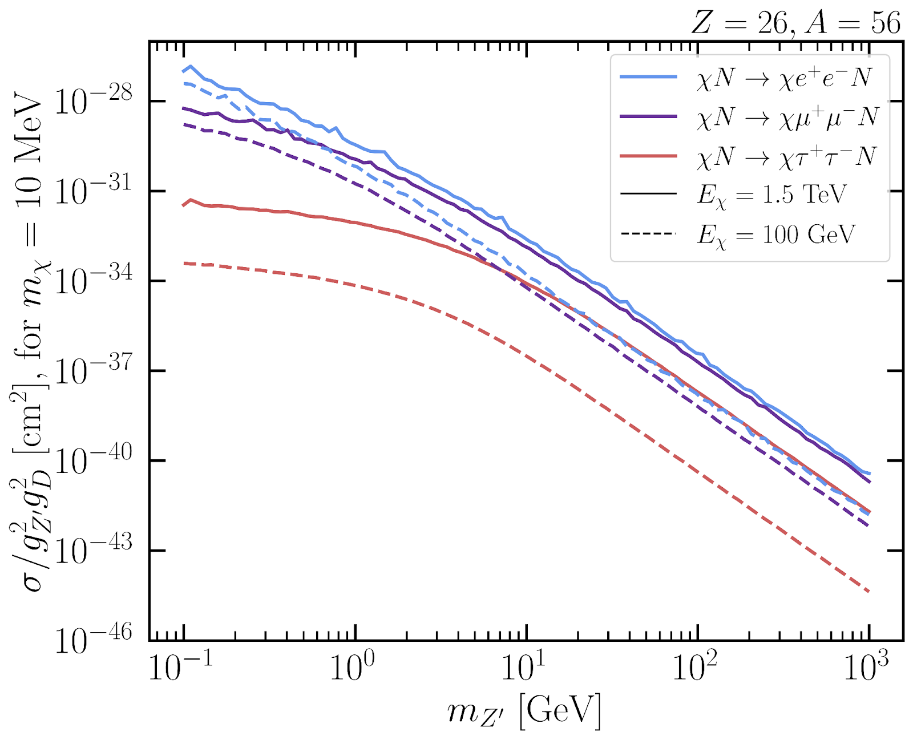
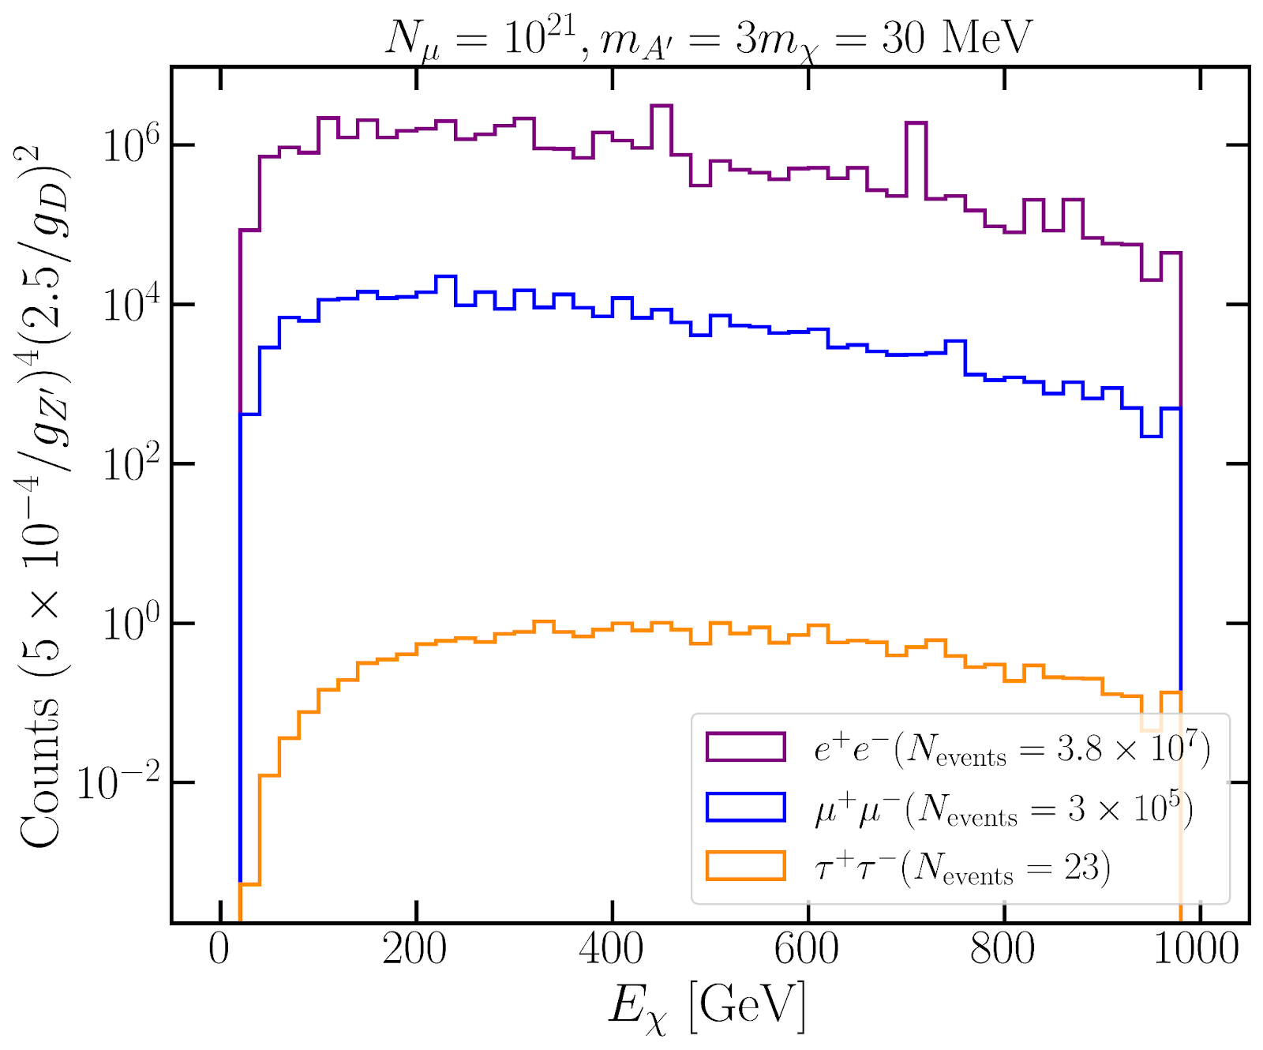
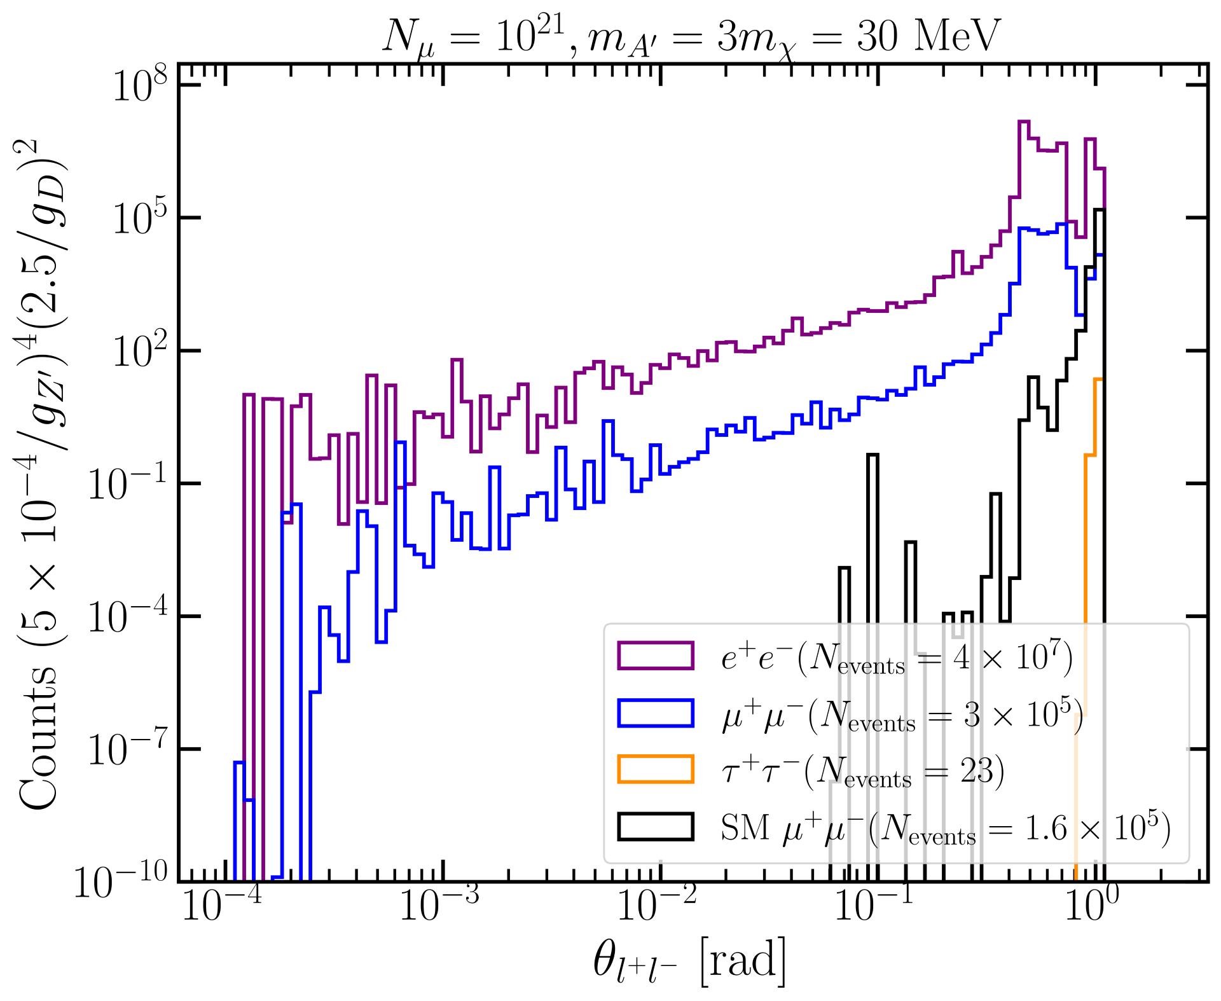
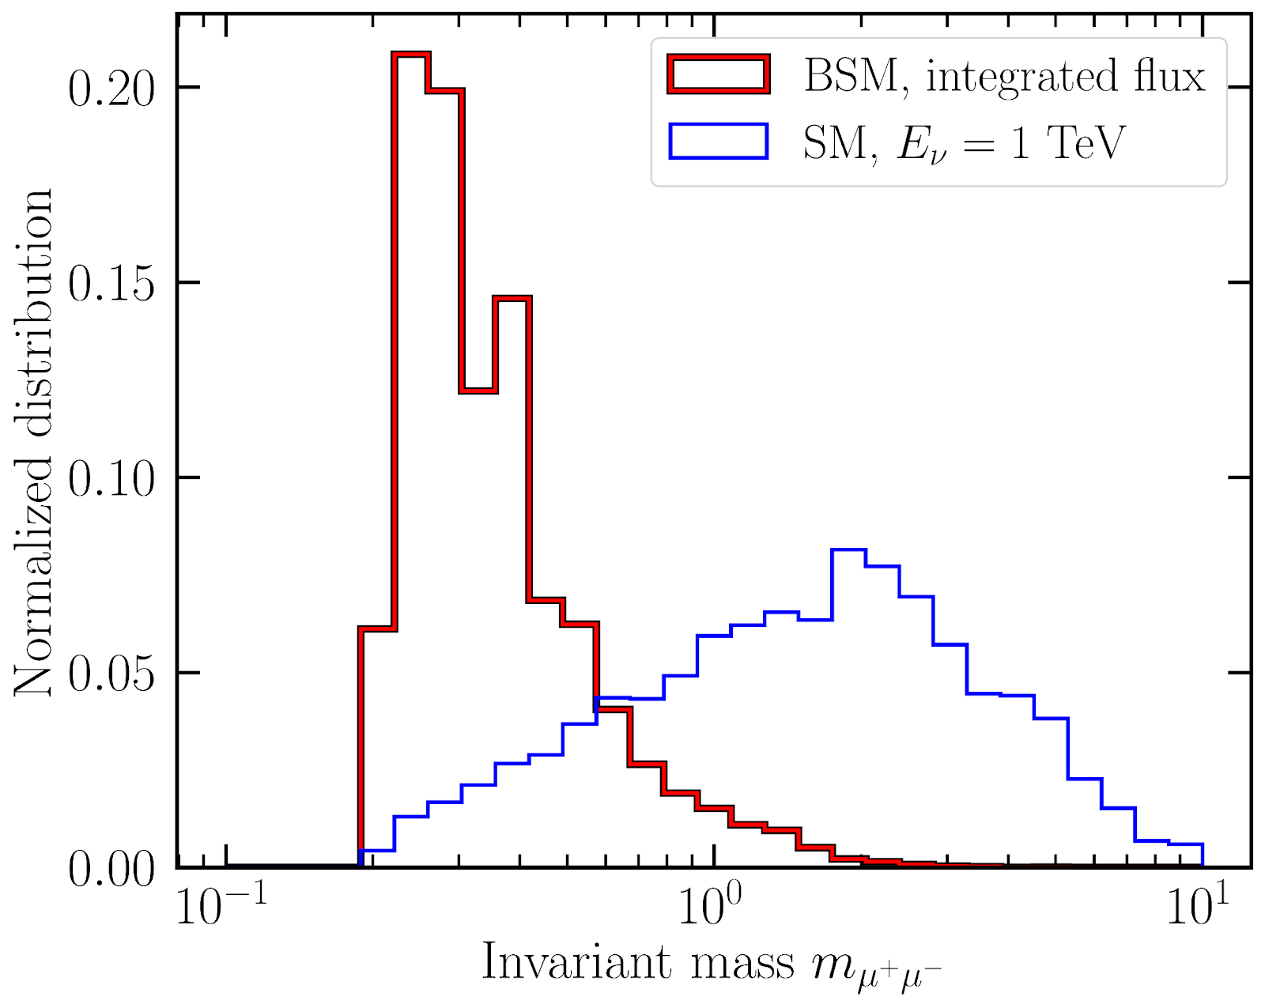
Neutrino Signals vs. Dark-Matter Signals

Slide 17
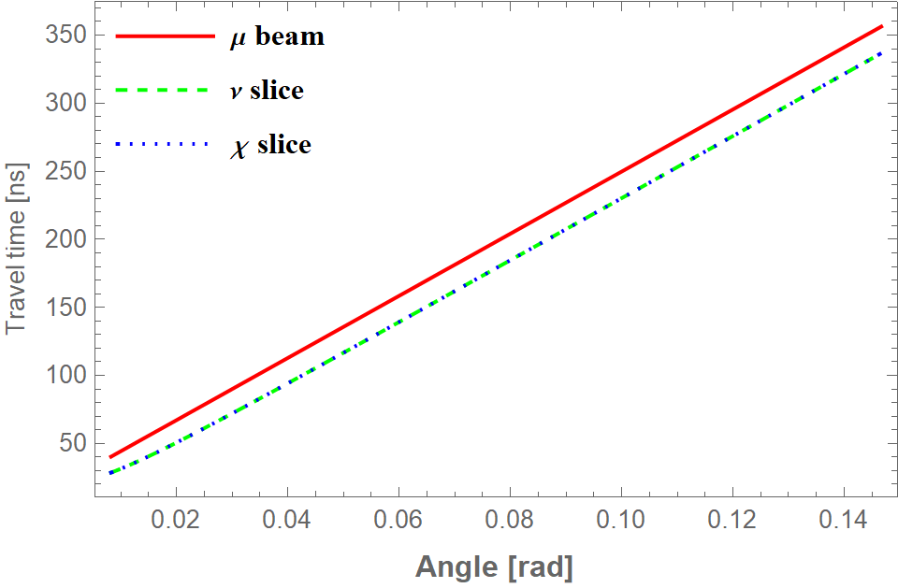
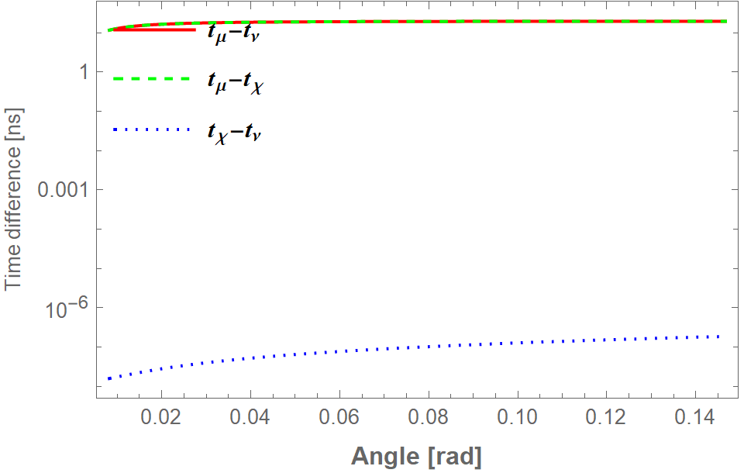
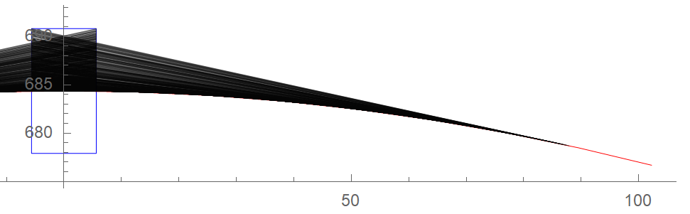
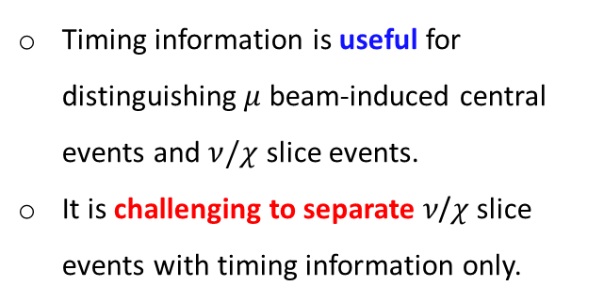
The Use of Timing Information
Timing information is useful for distinguishing $μ$ beam-induced central events and $ν/χ$ slice events.
It is challenging to separate 𝜈/𝜒 slice events with timing information only.

Slide 18
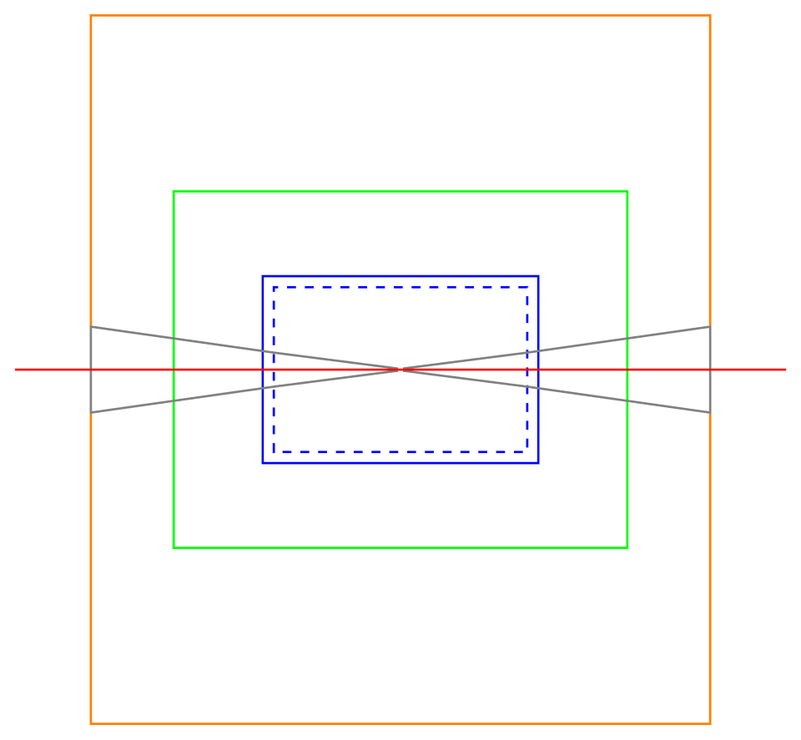






Need for Capability Detectors and Dedicated Triggers
No tracker info.
Disconnected(?) tracks
Electrons in muon system
$$μ^{−}$$
$$e^{+}$$
$$μ^{−}$$
$$e^{−}$$
$$μ^{+}$$
$$μ^{+}$$
(not just restricted to dark-matter signals but applicable to mediator signals)
Energy resolution
Angular resolution with/without tracker information
Correlating displaced vertices

Slide 19
Outline
Introduction
Motivations, dark-sector physics
Case I: Central Physics
Direct detection of DM
Dark-Sector Physics Opportunities at Muon Colliders
Case II: Dark-Sector Slice
Simulations, kinematic observables, required detector capabilities
Case III: Electron Beam-Dump
Simulations, production/detection channels, sensitivity estimates
Conclusions
Future directions, take-home messages

Slide 20
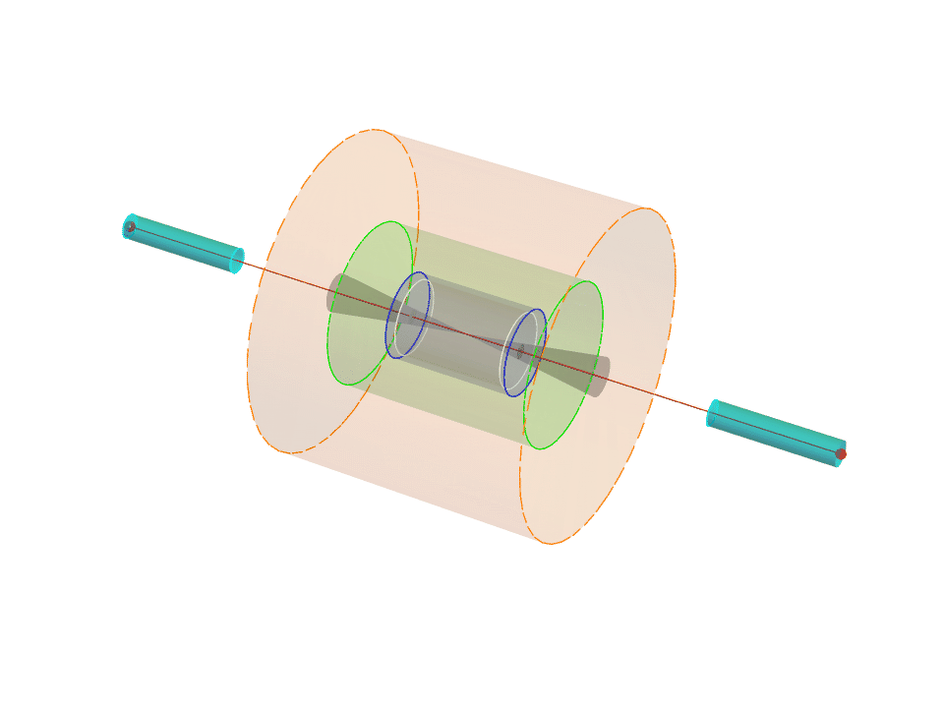
Simulation of the Electron Beam-Dump
Assuming circular collider rings,
Positive and negative muons injected from a common side,
Discarding decay events occurring beyond half the lab-frame lifetime,
Assuming that the last magnets are placed 4 m away from the detector region,
Accepting the muon decay events occurring between the two last magnets,
Accepting electrons oriented toward detector geometry based on [Bartosik et al. (Muon Collider), 2203.07964]

Slide 21
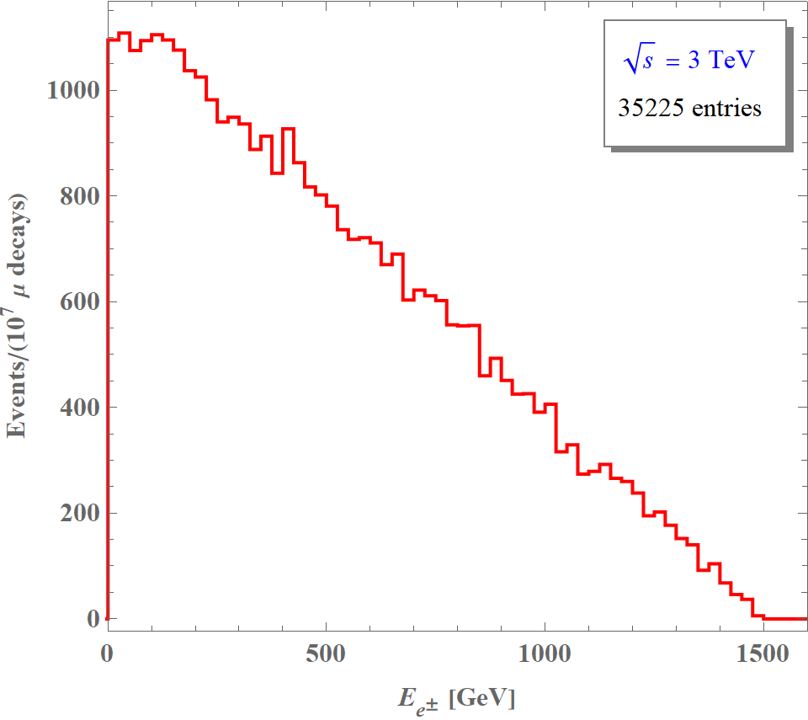
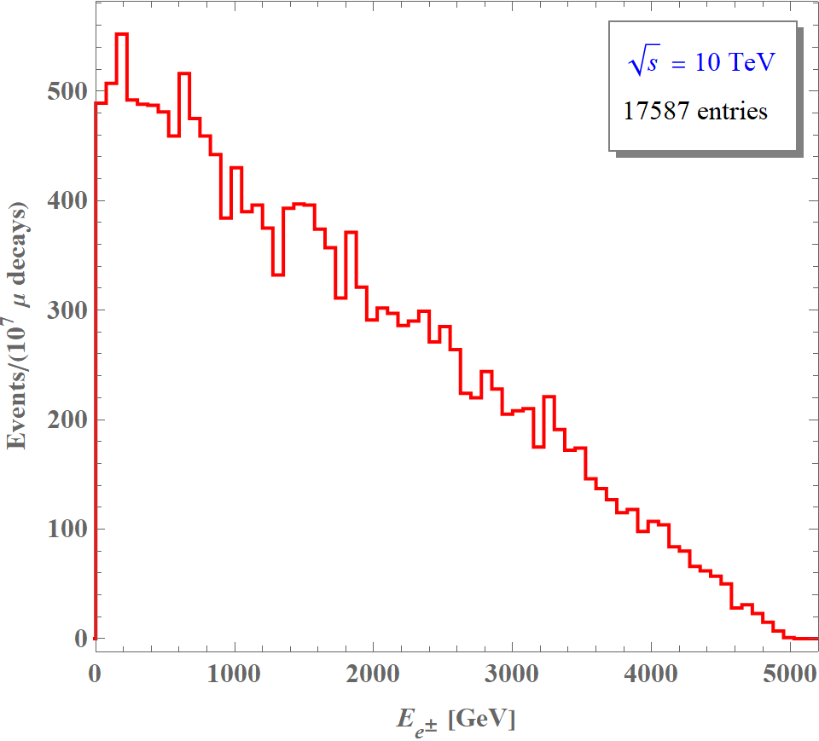
Electron Flux
[Dutta, Karthikeyan, Kelly, DK, Sathyam, in progress]

Slide 22


















Benchmark Study: Production thru Detection of Dark Photon
Production
Detection
Primary $e^{±}$
$$e^{−}$$
$$μ^{−}$$
$$A′$$
$$A′$$
$$e^{+}$$
$$A′$$
$$N$$
$$μ^{+}$$
Secondary $e^{±}$
$$q$$
$$γ$$
$$A′$$
$$A′$$
$$\overline{q}$$
$$A′$$
$$N$$
$$e^{−}$$
$$μ^{−}$$
Secondary $e^{+}$
$$A′$$
$$A′$$
$$A′$$
$$e^{+}$$
$$A′$$
$$μ^{+}$$
$$N$$
$$N$$
$$e^{−}$$
$$γ$$
Secondary $γ$
$$γ$$
$$A′$$
$$A′$$
…
…
$$e^{−}$$
$$e^{−}$$

Slide 23
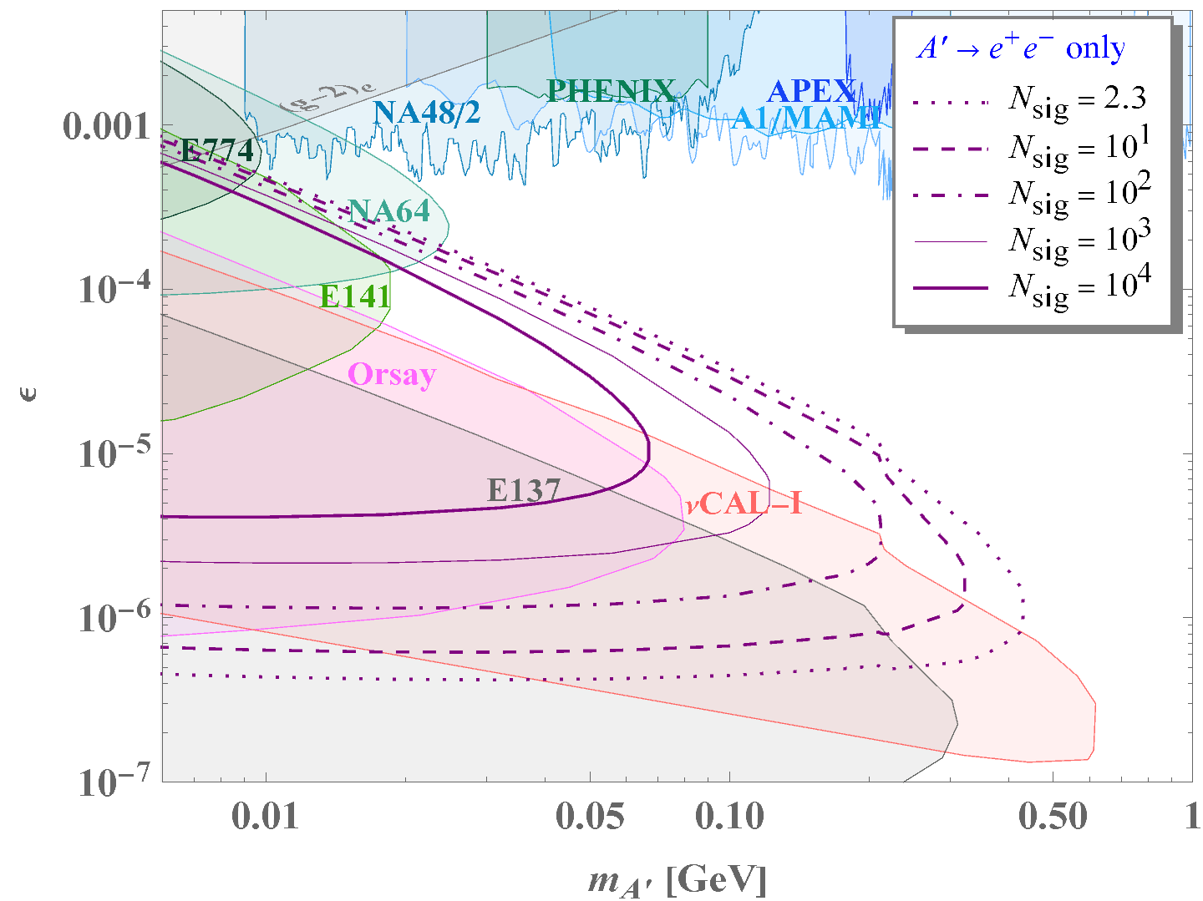

Benchmark Study: Dark Photon
Preliminary
$\sqrt{s}=3$ TeV
[Dutta, Karthikeyan, Kelly, DK, Sathyam, in progress]

Slide 24
Additional Opportunities
Light (leptophilic) Z’
Axion-like particles interacting with photons or electrons
Additional dark matter (from mediator decays)
In combination with
similar physics opportunities in Case II

Slide 25
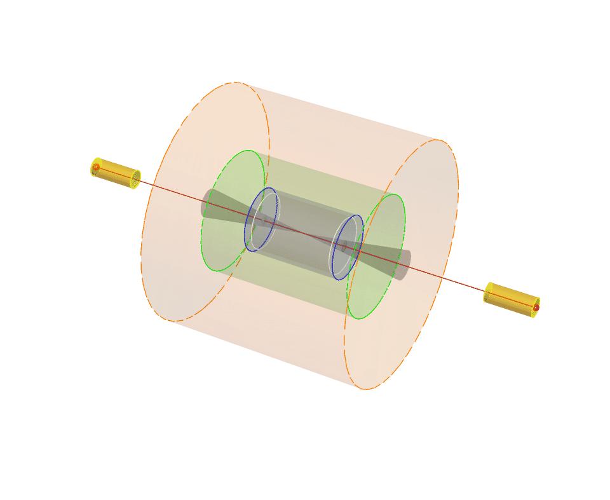
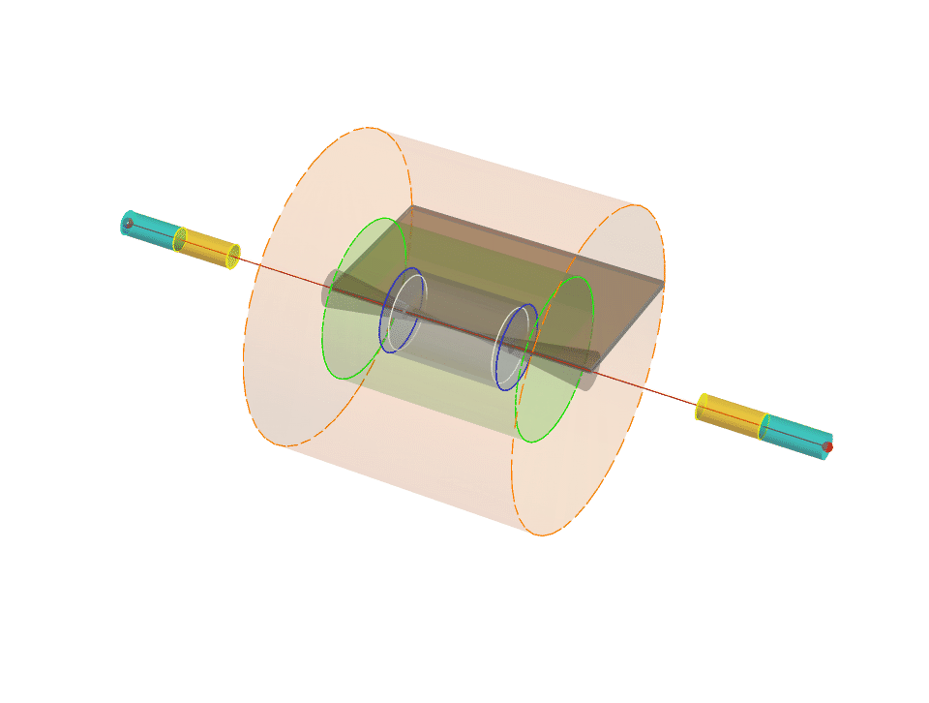


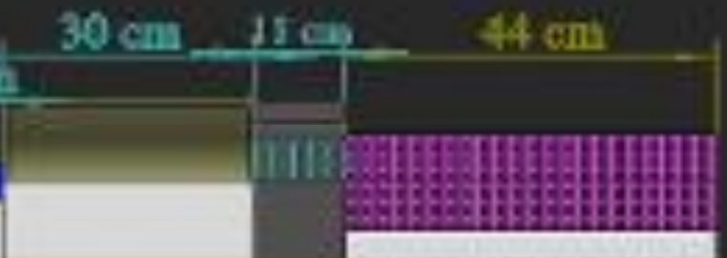




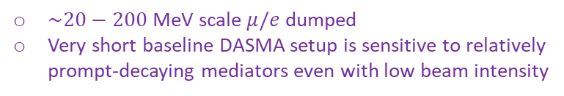



Further Thoughts
1) Positron dump
2) “Inward” electron dump
$e^{−}$ dump
Neutrino/dark-sector slice
$$μ^{−}$$
$$e^{+}$$
$$μ^{+}$$
$$A′$$
$e^{+}$ dump
target $e^{−}$
Bending magnet
3) Muon cooling demonstrator + DAMSA
MuC cooling
demonstrator
detector (< 1 m)
$→μ$
$\sim 20−200$MeV scale $μ/e$ dumped
Very short baseline DASMA setup is sensitive to relatively prompt-decaying mediators even with low beam intensity
nuSTORM

Slide 26
Outline
Introduction
Motivations, dark-sector physics
Case I: Central Physics
Direct detection of DM
Dark-Sector Physics Opportunities at Muon Colliders
Case II: Dark-Sector Slice
Simulations, kinematic observables, required detector capabilities
Case III: Electron Beam-Dump
Simulations, production/detection channels, sensitivity estimates
Conclusions
Future directions, take-home messages

Slide 27
Future Directions
Combining contributions from the dark-sector slice and the electron beam-dump to estimate the overall sensitivity
Refining the simulation code to incorporate more precise beam parameters and detector specifications
Estimating signal sensitivity at muon system/HCAL and via exotic signatures (e.g., E&M signals at muon system)
Developing dedicated triggers and detector capabilities to maximize signal acceptance and isolate signals.

Slide 28
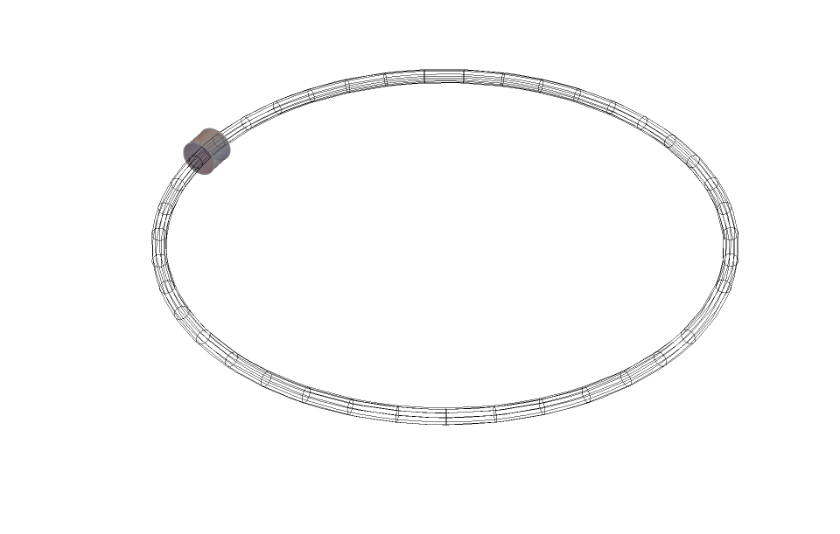
Take-Home Messages
Wherever there are neutrino physics opportunities, there are dark-sector physics opportunities.
Muon colliders offer unique opportunities to explore dark-sector physics from multiple perspectives.
  Central physics
  Dark-sector slice
  Electron beam-dump
Carefully designed detectors are strongly motivated to capture these dark-sector signals and to distinguish them from SM backgrounds, including neutrino-induced events.
We are more than happy to discuss further ideas!
Thank you!

