Slide 1

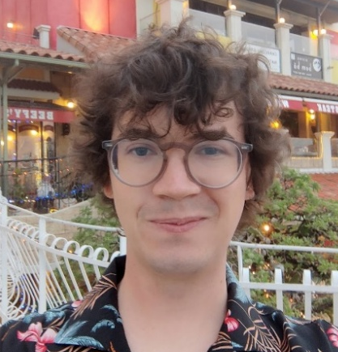

09/09/26
CP-violation or Nuclear Excitation
The Role of Neutrino Interaction Model Uncertainties on Accelerator-Based Neutrino Oscillation Measurements
Stephen Dolan
stephen.joseph.dolan@cern.ch
Based on the content of a new review paper: arXiv:2605.28671
Collaborators: L. Pickering, P. Stowell, C. Wilkinson, C. Wret
And on a submission for JPhysG Emerging Leaders: arXiv:2605.28696
Collaborators: J. McKean, L. Munteanu

Slide 2
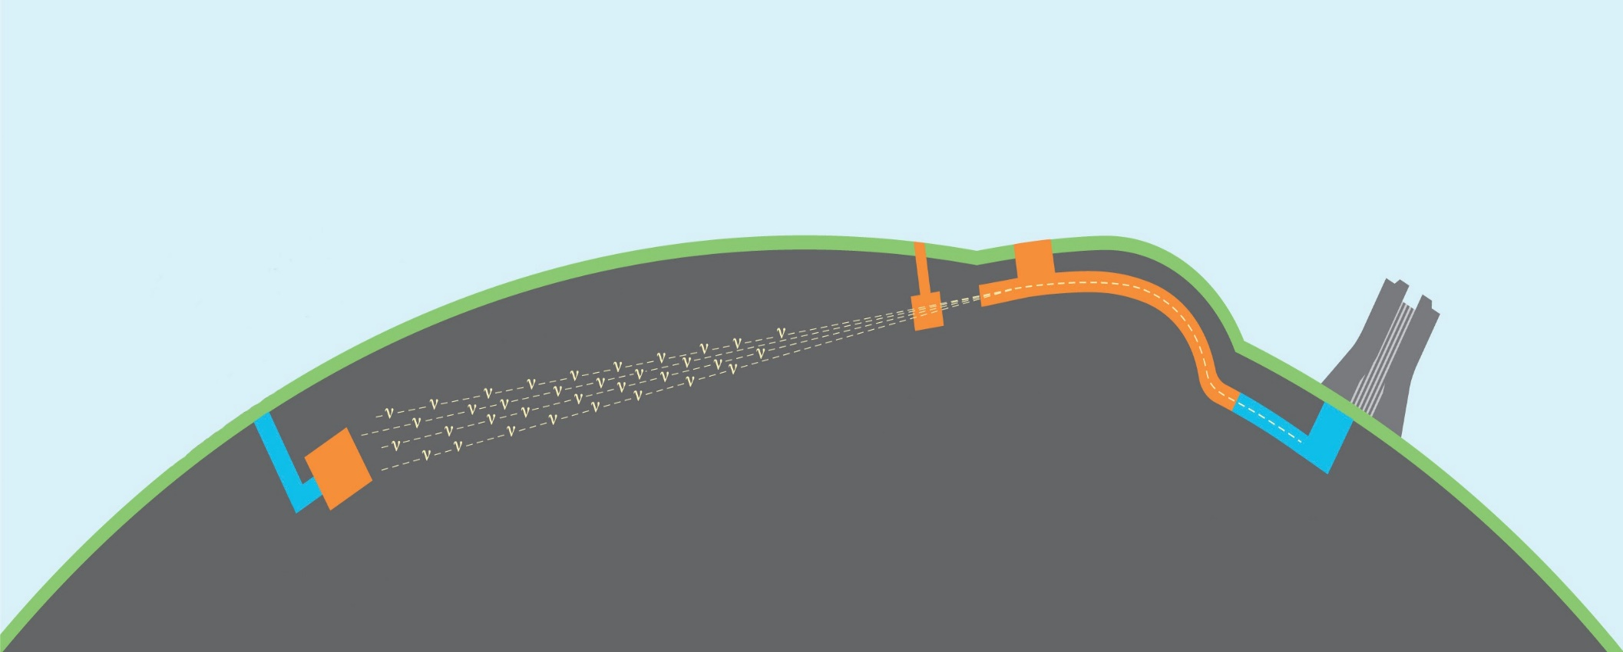
Accelerator-Based Experiments
Near Detector
Far Detector
Many 100s of km
Particle Accelerator

Slide 3

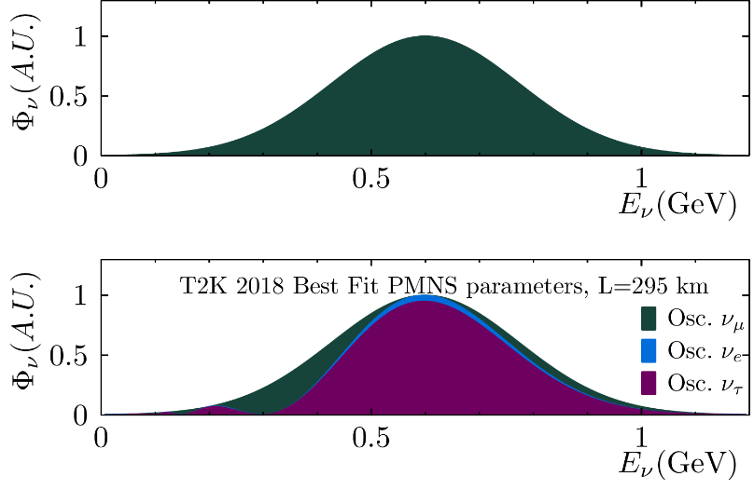


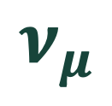
Accelerator-Based Experiments
Near Detector
Far Detector
Many 100s of km
Particle Accelerator
$$Φ_{ν}$$
$$ν_{μ}$$
$$E_{ν}$$
0.6-2.2 GeV

Slide 4
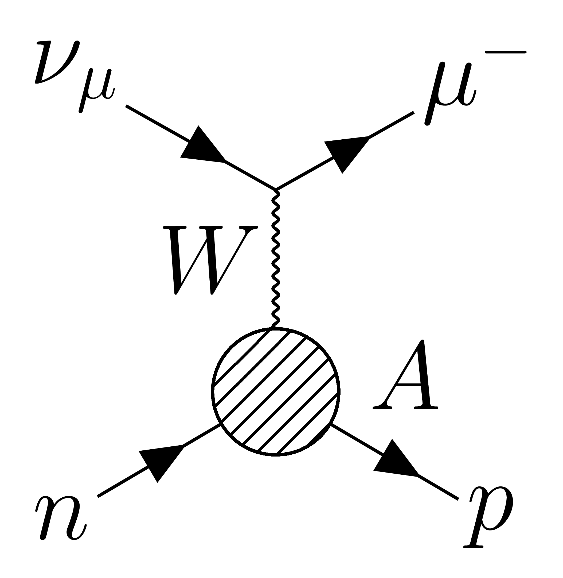
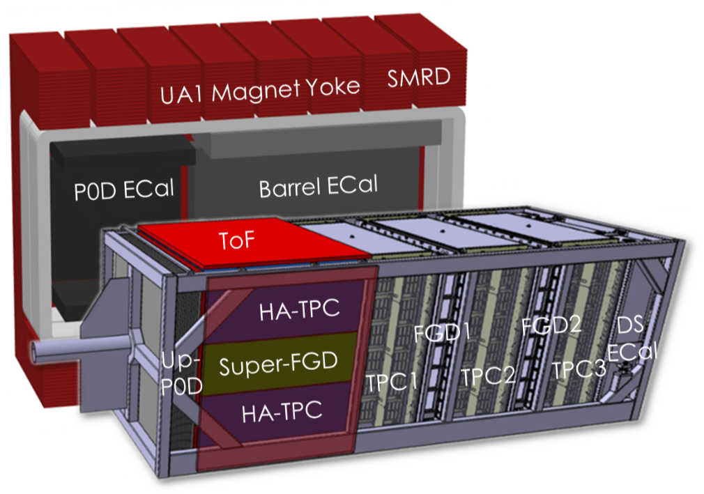
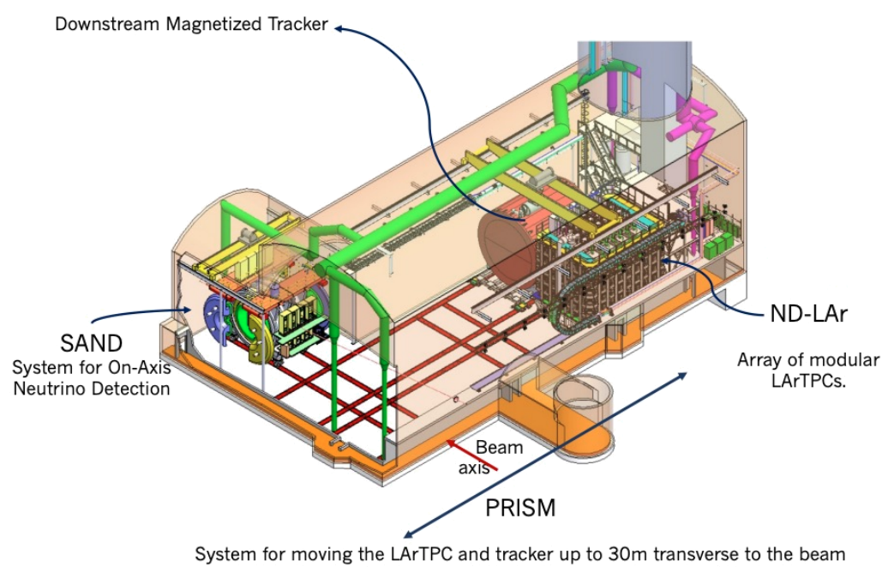
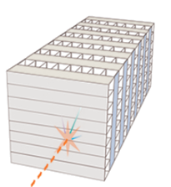

Accelerator-Based Experiments
Near Detector
Far Detector
Many 100s of km
Particle Accelerator
$$Φ_{ν}$$
$$ν_{μ}$$
$$E_{ν}$$
At the near detector
$$N_{μ}\left(E_{ν}\right)∝σ\left(E_{ν}\right)Φ_{ν}\left(E_{ν}\right)ε(E_{ν})$$
Interaction cross section
Detector effects
Neutrino flux

Slide 5
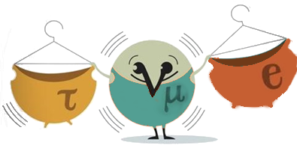
Accelerator-Based Experiments
Near Detector
Far Detector
Many 100s of km
Particle Accelerator
$$Φ_{ν}$$
$$ν_{μ}$$
$$E_{ν}$$
At the near detector
$$N_{μ}\left(E_{ν}\right)∝σ\left(E_{ν}\right)Φ_{ν}\left(E_{ν}\right)ε(E_{ν})$$
Interaction cross section
Detector effects
Neutrino flux

Slide 6
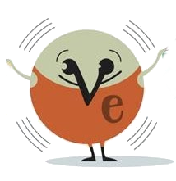
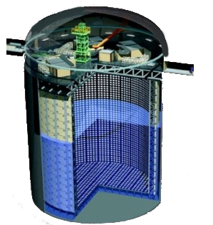
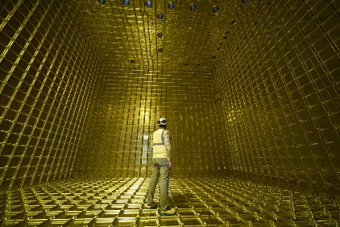
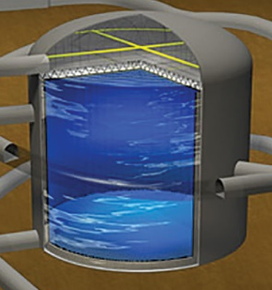
Accelerator-Based Experiments
Near Detector
Far Detector
Many 100s of km
Particle Accelerator
$$Φ_{ν}$$
$$ν_{μ}$$
$$E_{ν}$$
At the near detector
$$N_{μ}\left(E_{ν}\right)∝σ\left(E_{ν}\right)Φ_{ν}\left(E_{ν}\right)ε(E_{ν})$$
Interaction cross section
Detector effects
Neutrino flux

Slide 7
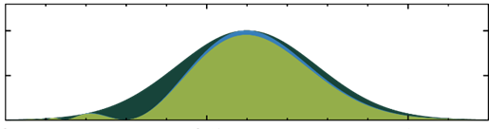
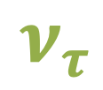

Accelerator-Based Experiments
Near Detector
Far Detector
Many 100s of km
Particle Accelerator
$$Φ_{ν}$$
$$ν_{μ}$$
$$ν_{e}$$
$$ν_{τ}$$
$$E_{ν}$$
$$E_{ν}$$
At the near detector
$$N_{μ}\left(E_{ν}\right)∝σ\left(E_{ν}\right)Φ_{ν}\left(E_{ν}\right)ε(E_{ν})$$
Interaction cross section
Detector effects
Neutrino flux

Slide 8
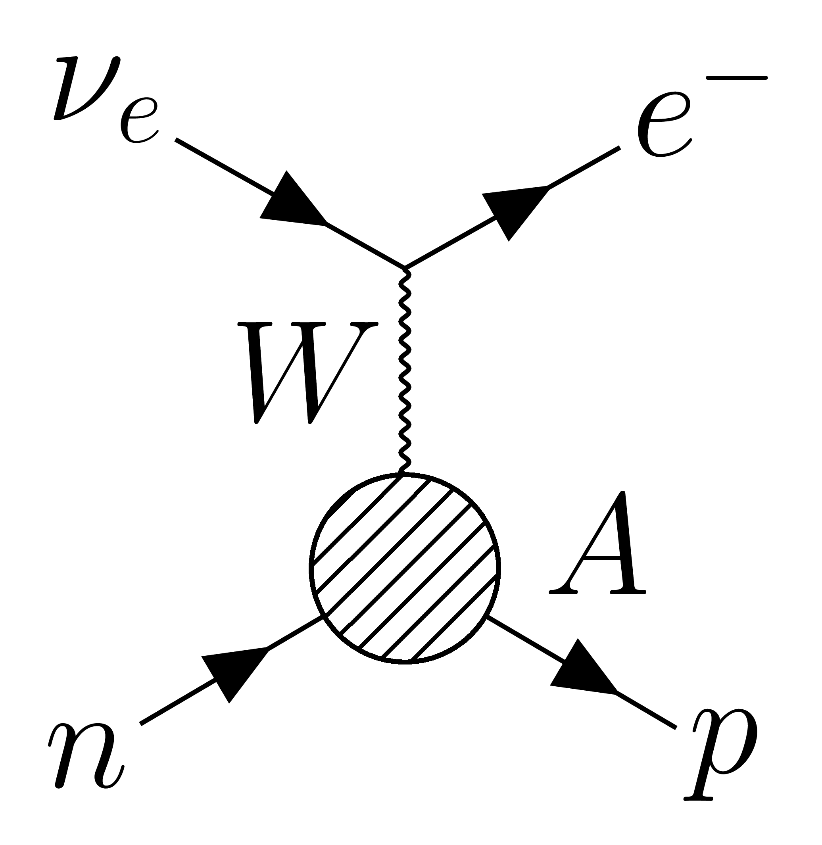
Accelerator-Based Experiments
Near Detector
Far Detector
Many 100s of km
Particle Accelerator
$$Φ_{ν}$$
$$ν_{μ}$$
$$ν_{e}$$
$$ν_{τ}$$
$$E_{ν}$$
$$E_{ν}$$
At the near detector
At the far detector
$$N_{μ}\left(E_{ν}\right)∝σ\left(E_{ν}\right)Φ_{ν}\left(E_{ν}\right)ε(E_{ν})$$
$$N_{μ}\left(E_{ν}\right)∝P(ν_{μ}→ν_{μ})σ\left(E_{ν}\right)Φ_{ν}\left(E_{ν}\right)ε(E_{ν})$$
Interaction cross section
Detector effects
$$N_{e}\left(E_{ν}\right)∝P(ν_{μ}→ν_{e})σ\left(E_{ν}\right)Φ_{ν}\left(E_{ν}\right)ε(E_{ν})$$
Neutrino flux
Oscillation probability

Slide 9

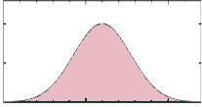
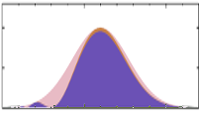
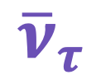
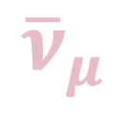
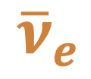

Accelerator-Based Experiments
Near Detector
Far Detector
Many 100s of km
Particle Accelerator
$$Φ_{ν}$$
$${\overline{ν}}_{μ}$$
$${\overline{ν}}_{e}$$
$${\overline{ν}}_{τ}$$
$$E_{ν}$$
$$E_{ν}$$
At the near detector
At the far detector
$$N_{μ}\left(E_{\overline{ν}}\right)∝σ\left(E_{\overline{ν}}\right)Φ_{\overline{ν}}\left(E_{\overline{ν}}\right)ε(E_{\overline{ν}})$$
$$N_{μ}\left(E_{\overline{ν}}\right)∝P({\overline{ν}}_{μ}→{\overline{ν}}_{μ})σ\left(E_{\overline{ν}}\right)Φ_{\overline{ν}}\left(E_{\overline{ν}}\right)ε(E_{\overline{ν}})$$
Interaction cross section
Detector effects
$$N_{e}\left(E_{\overline{ν}}\right)∝P({\overline{ν}}_{μ}→{\overline{ν}}_{e})σ\left(E_{\overline{ν}}\right)Φ_{\overline{ν}}\left(E_{\overline{ν}}\right)ε(E_{\overline{ν}})$$
Neutrino flux
Oscillation probability

Slide 10

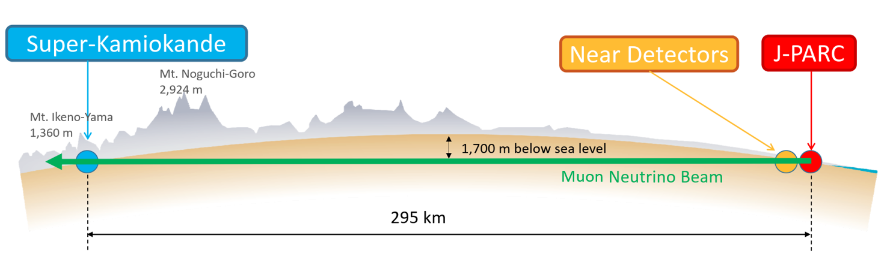
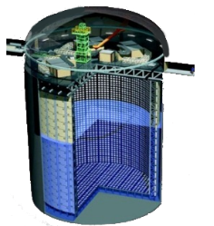
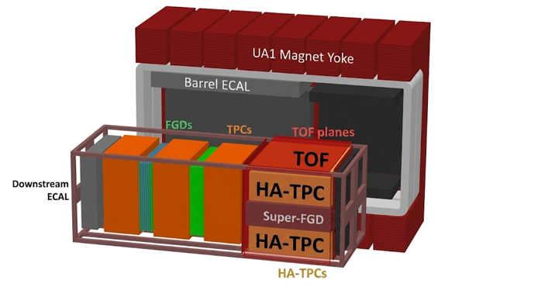
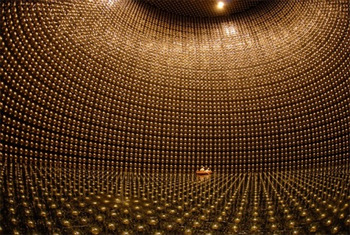
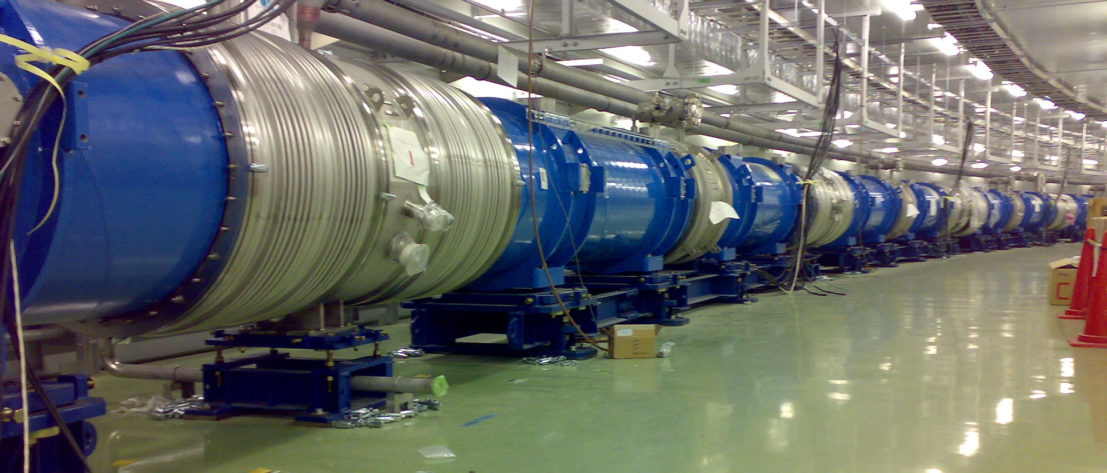
Current results: T2K, NOvA

Slide 11
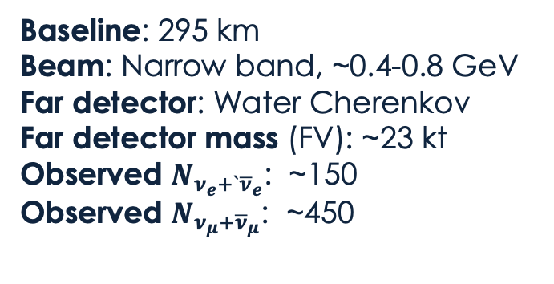
Current results: T2K, NOvA
Baseline: 295 km
Beam: Narrow band, ~0.4-0.8 GeV
Far detector: Water Cherenkov
Far detector mass (FV): ~23 kt
Observed $N_{ν_{e}+`{\overline{ν}}_{e}}$: ~150
Observed $N_{ν_{μ}+{\overline{ν}}_{μ}}$: ~450

Slide 12

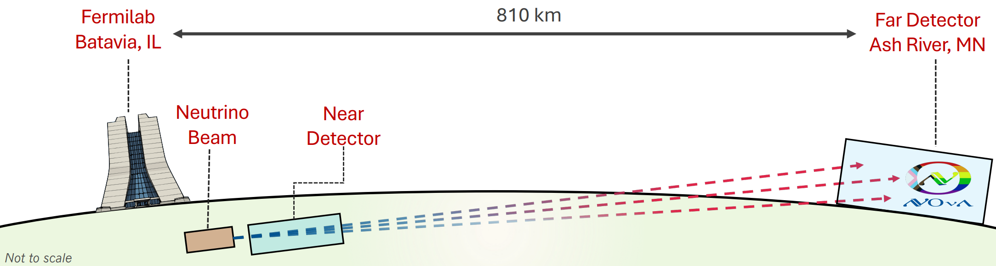
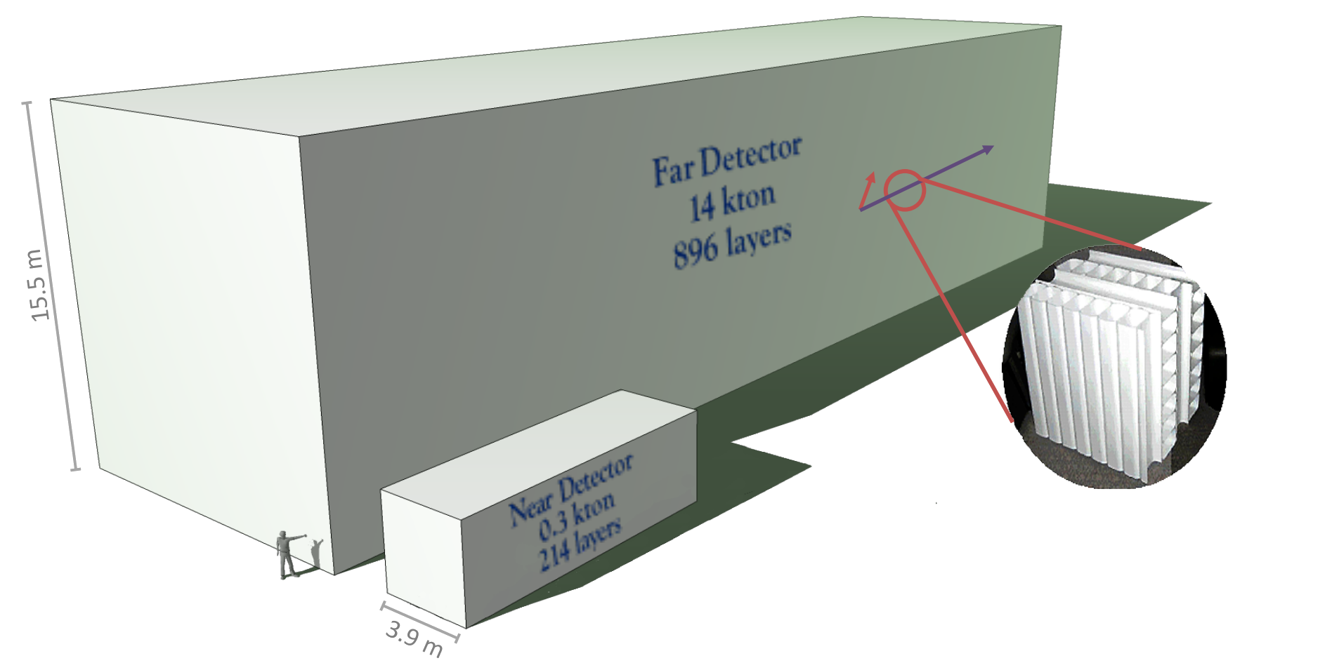
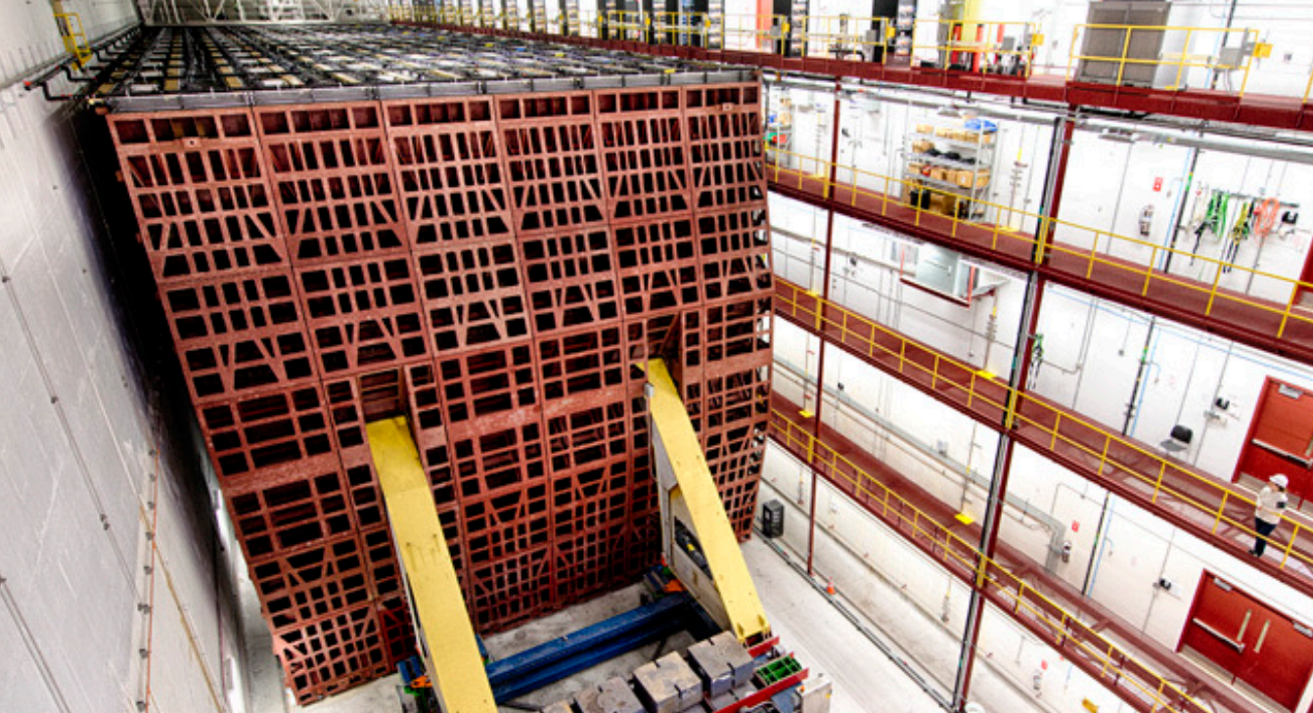
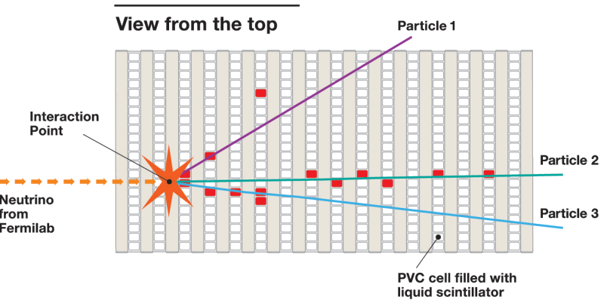
Current results: T2K, NOvA
Baseline: 295 km
Beam: Narrow band, ~0.4-0.8 GeV
Far detector: Water Cherenkov
Far detector mass (FV): ~23 kt
Observed $N_{ν_{e}+`{\overline{ν}}_{e}}$: ~150
Observed $N_{ν_{μ}+{\overline{ν}}_{μ}}$: ~450

Slide 13
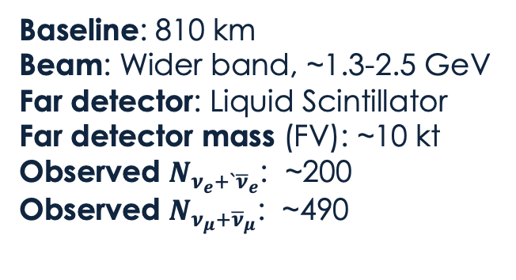
Current results: T2K, NOvA
Baseline: 295 km
Beam: Narrow band, ~0.4-0.8 GeV
Far detector: Water Cherenkov
Far detector mass (FV): ~23 kt
Observed $N_{ν_{e}+`{\overline{ν}}_{e}}$: ~150
Observed $N_{ν_{μ}+{\overline{ν}}_{μ}}$: ~450
Baseline: 810 km
Beam: Wider band, ~1.3-2.5 GeV
Far detector: Liquid Scintillator
Far detector mass (FV): ~10 kt
Observed $N_{ν_{e}+`{\overline{ν}}_{e}}$: ~200
Observed $N_{ν_{μ}+{\overline{ν}}_{μ}}$: ~490

Slide 14
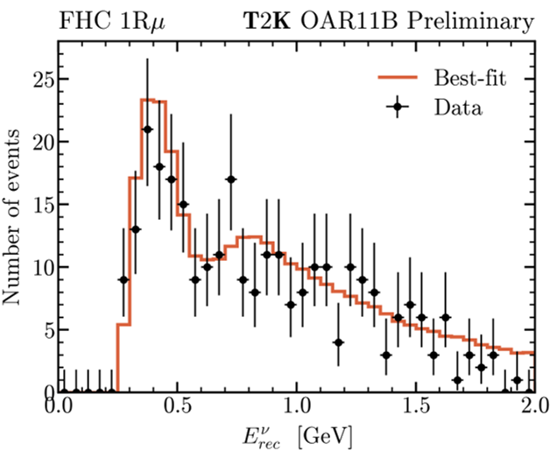
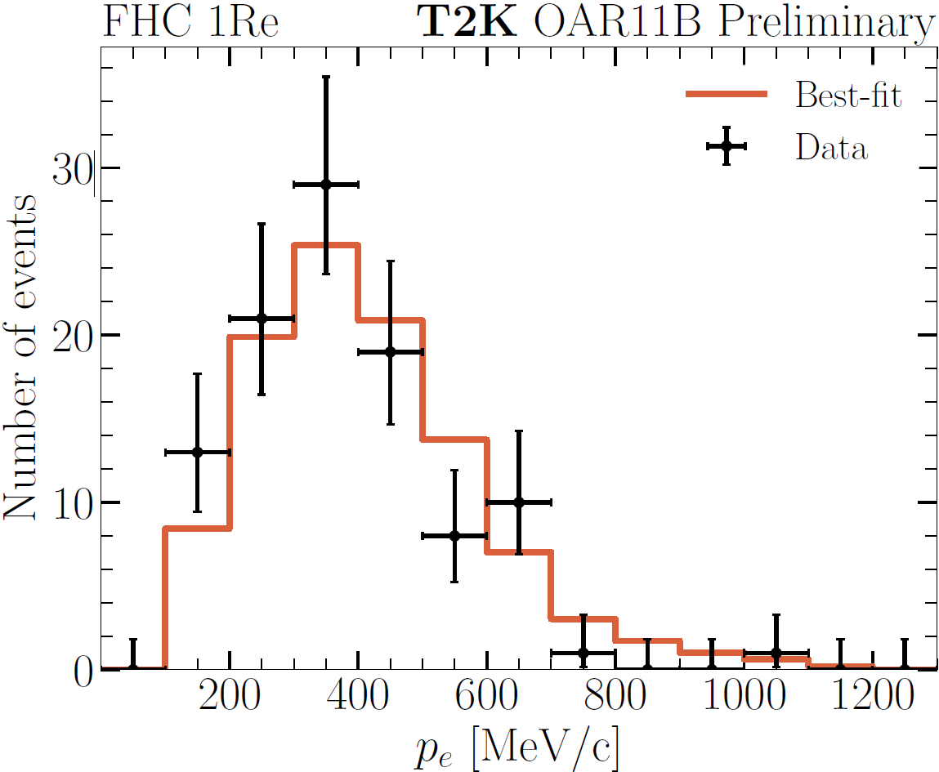
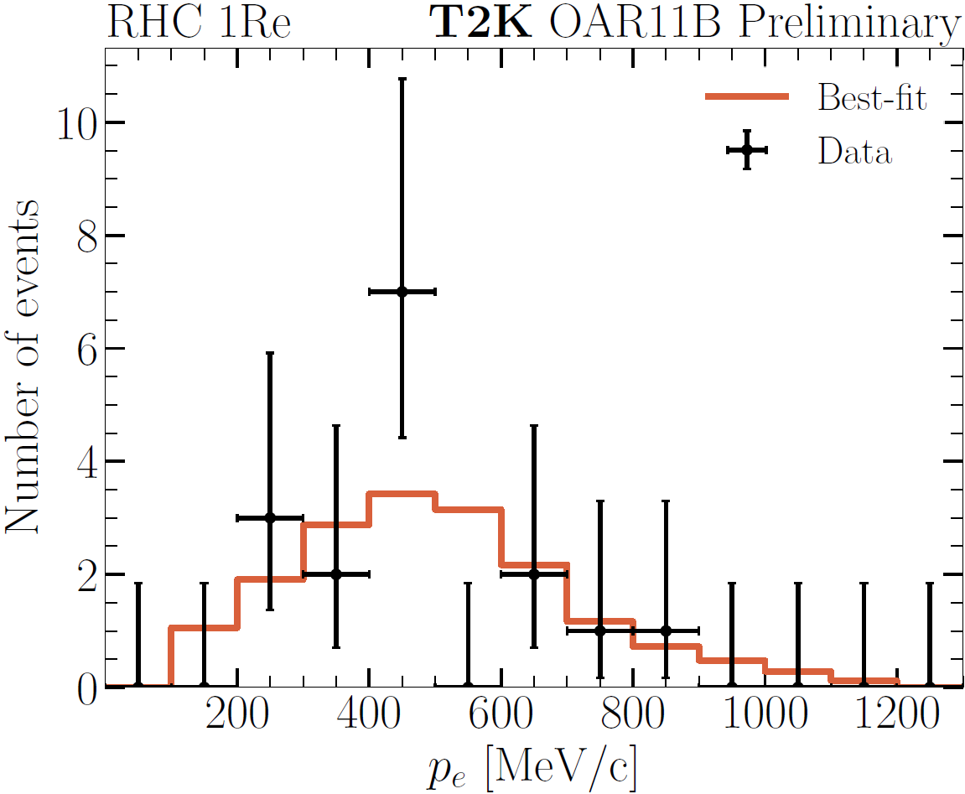

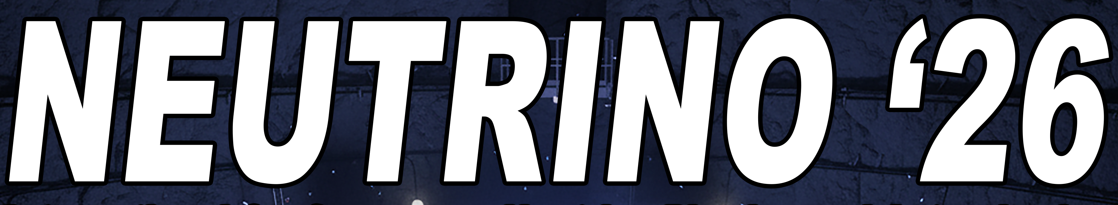







Current results: T2K, NOvA
$$ν_{μ}→ν_{μ}$$
$$ν_{μ}→ν_{e}$$
$$θ_{23}$$
$$θ_{13}$$
$$θ_{13}$$
$$Δm_{32}^{2}$$
$$δ_{CP}$$
S. King
S. King

Slide 15


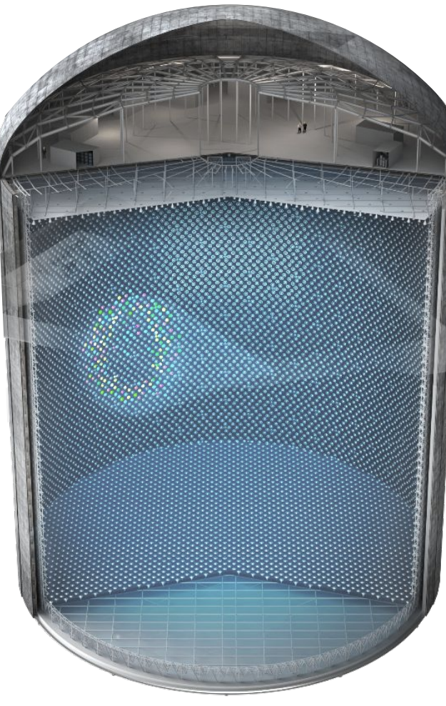
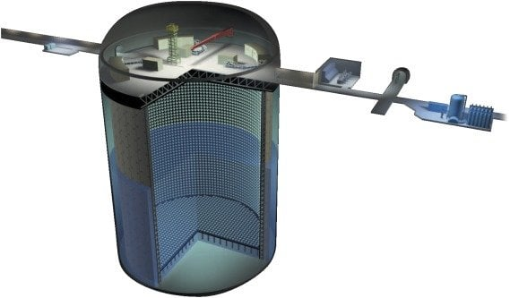
Coming soon for LBL neutrinos

Slide 16


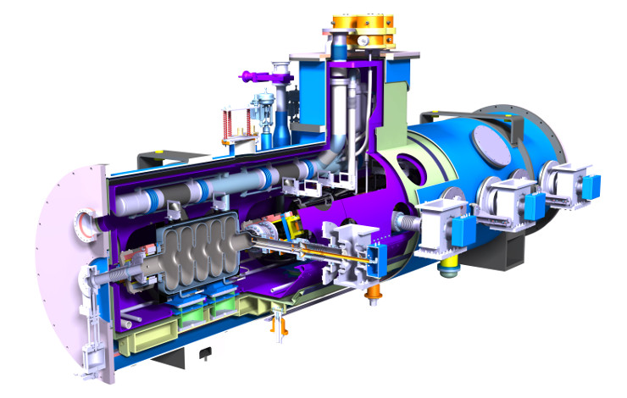
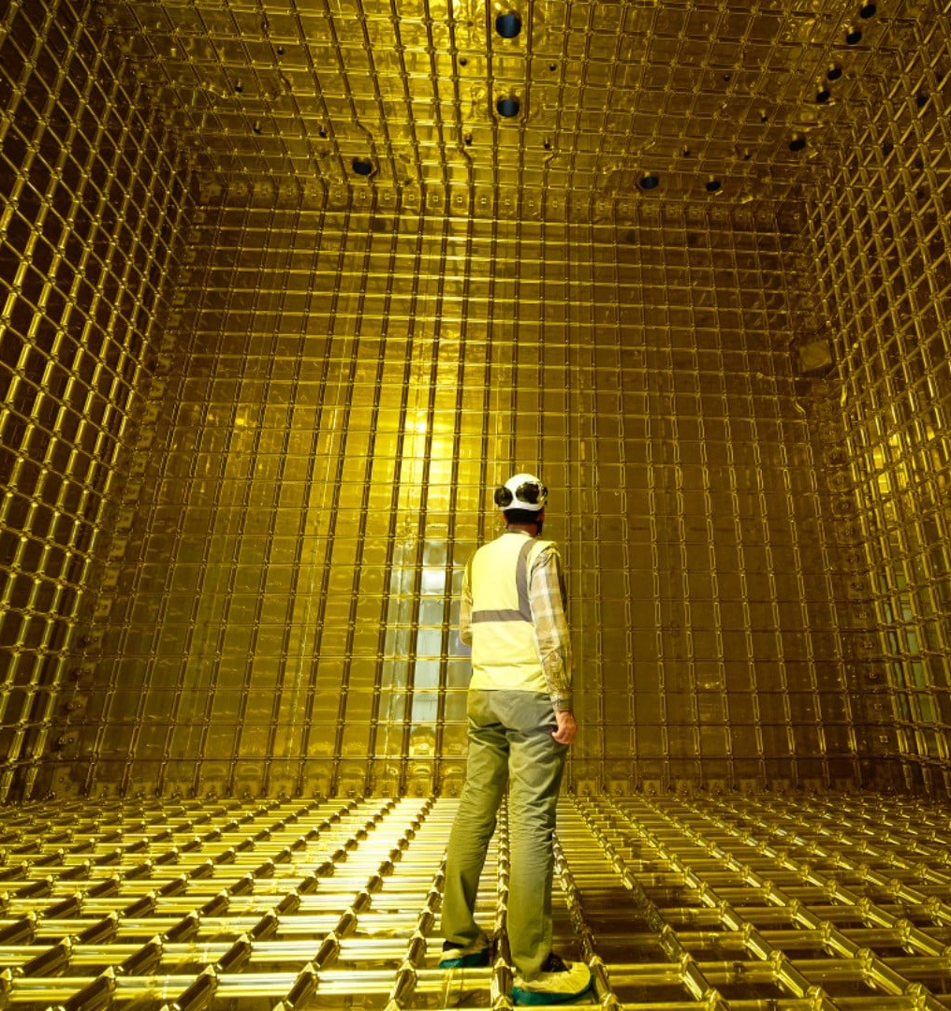
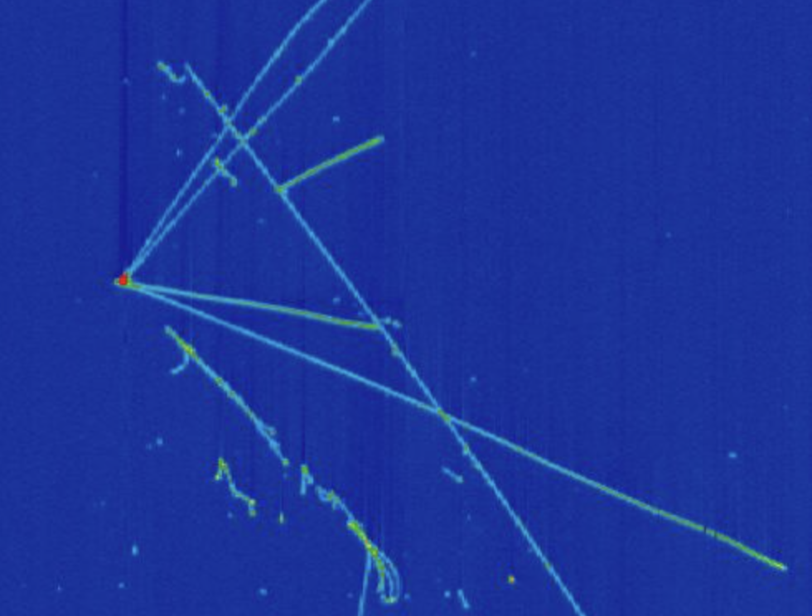
Coming soon for LBL neutrinos
New beam
New detectors
New technology

Slide 17


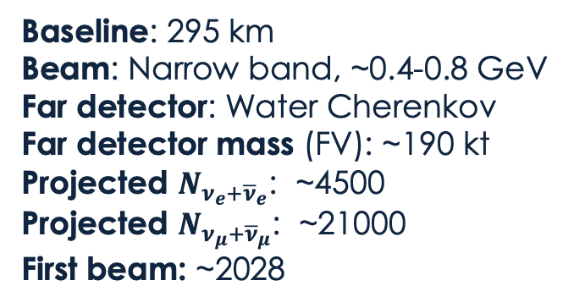
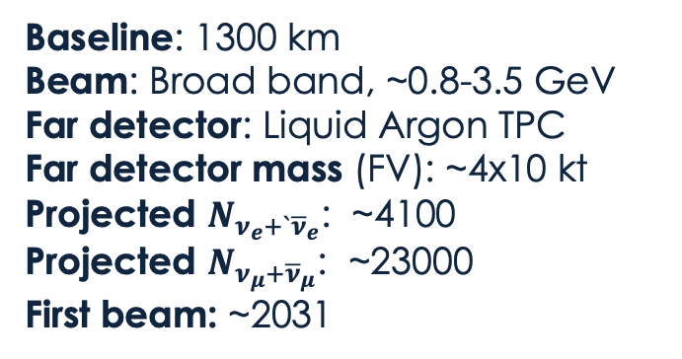
Coming soon for LBL neutrinos
Baseline: 295 km
Beam: Narrow band, ~0.4-0.8 GeV
Far detector: Water Cherenkov
Far detector mass (FV): ~190 kt
Projected $N_{ν_{e}+{\overline{ν}}_{e}}$: ~4500
Projected $N_{ν_{μ}+{\overline{ν}}_{μ}}$: ~21000
First beam: ~2028
Baseline: 1300 km
Beam: Broad band, ~0.8-3.5 GeV
Far detector: Liquid Argon TPC
Far detector mass (FV): ~4x10 kt
Projected $N_{ν_{e}+`{\overline{ν}}_{e}}$: ~4100
Projected $N_{ν_{μ}+{\overline{ν}}_{μ}}$: ~23000
First beam: ~2031
New beam
New detectors
New technology

Slide 18
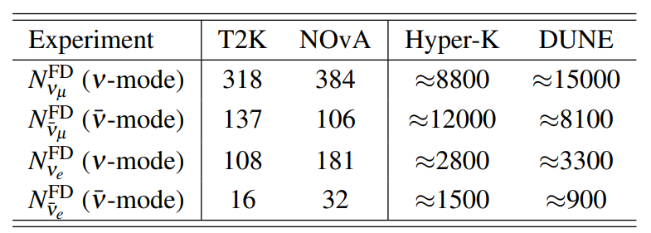
Coming soon for LBL neutrinos
Baseline: 295 km
Beam: Narrow band, ~0.4-0.8 GeV
Far detector: Water Cherenkov
Far detector mass (FV): ~190 kt
Projected $N_{ν_{e}+{\overline{ν}}_{e}}$: ~4500
Projected $N_{ν_{μ}+{\overline{ν}}_{μ}}$: ~21000
First beam: ~2028
Baseline: 1300 km
Beam: Broad band, ~0.8-3.5 GeV
Far detector: Liquid Argon TPC
Far detector mass (FV): ~4x10 kt
Projected $N_{ν_{e}+`{\overline{ν}}_{e}}$: ~4100
Projected $N_{ν_{μ}+{\overline{ν}}_{μ}}$: ~23000
First beam: ~2031
New beam
New detectors
New technology
Projected statistics in far-detector samples
arXiv:2605.28671

Slide 19
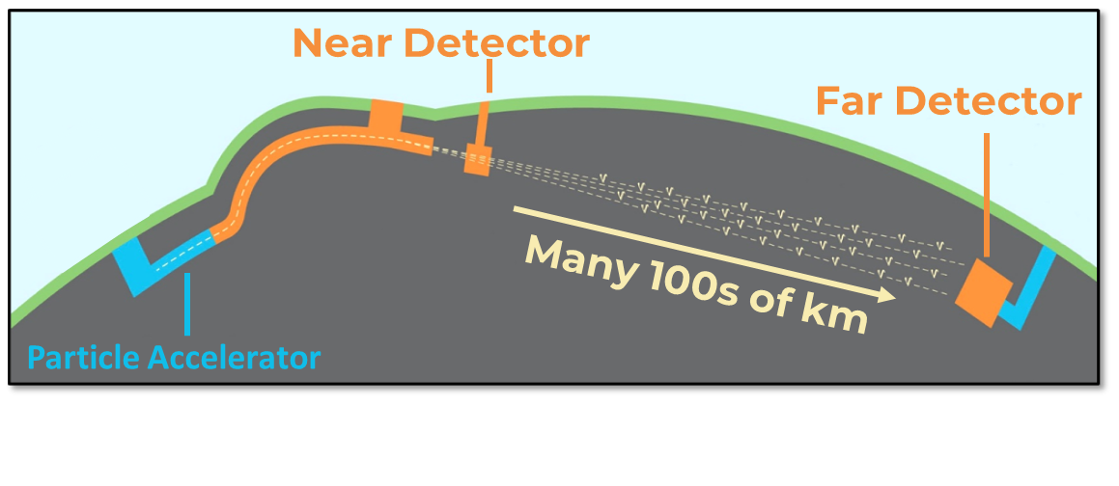
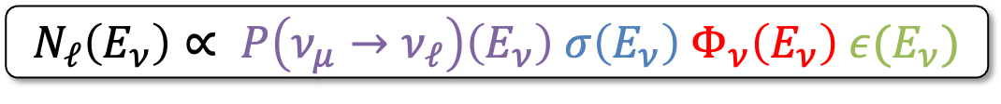
What about systematics?
$$N_{ℓ}\left(E_{ν}\right)∝ P\left(ν_{μ}→ν_{ℓ}\right)\left(E_{ν}\right) σ\left(E_{ν}\right) Φ_{ν}\left(E_{ν}\right) ε(E_{ν})$$
Oscillation Probability
Incoming neutrino flux
Far detector event rate
Interaction Cross Section
Detector Efficiency

Slide 20

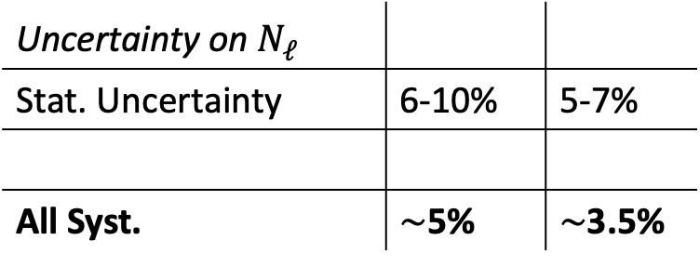
What about systematics?
Current long-baseline experiments
Uncertainty on $N_{ℓ}^{}$
Stat. Uncertainty | 6-10% | 5-7%
All Syst. | $\sim$5% | $\sim$3.5%
$$N_{ℓ}\left(E_{ν}\right)∝ P\left(ν_{μ}→ν_{ℓ}\right)\left(E_{ν}\right) σ\left(E_{ν}\right) Φ_{ν}\left(E_{ν}\right) ε(E_{ν})$$
Oscillation Probability
Incoming neutrino flux
Far detector event rate
Interaction Cross Section
Detector Efficiency

Slide 21
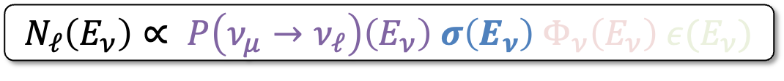
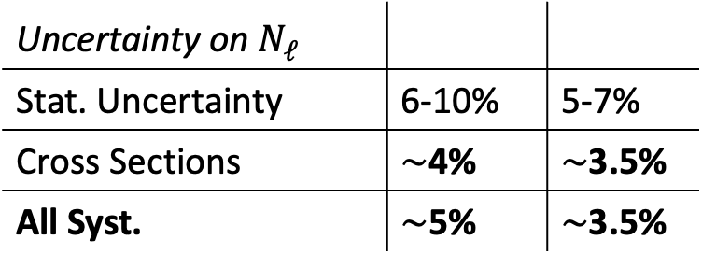
What about systematics?
Current long-baseline experiments
Uncertainty on $N_{ℓ}^{}$
Stat. Uncertainty | 6-10% | 5-7%
Cross Sections | $\sim$4% | $\sim$3.5%
All Syst. | $\sim$5% | $\sim$3.5%
$$N_{ℓ}\left(E_{ν}\right)∝ P\left(ν_{μ}→ν_{ℓ}\right)\left(E_{ν}\right) σ\left(E_{ν}\right) Φ_{ν}\left(E_{ν}\right) ε(E_{ν})$$
Oscillation Probability
Incoming neutrino flux
Far detector event rate
Interaction Cross Section
Detector Efficiency

Slide 22


What about systematics?
Current long-baseline experiments
Uncertainty on $N_{ℓ}^{}$
Stat. Uncertainty | 6-10% | 5-7%
Cross Sections | $\sim$4% | $\sim$3.5%
All Syst. | $\sim$5% | $\sim$3.5%
Large contribution to syst. uncertainties from cross-section modelling
Syst. uncertainties remains small compared to stat. uncertainties

Slide 23

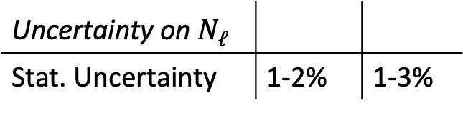
What about systematics?
Current long-baseline experiments
Future experiments
Uncertainty on $N_{ℓ}^{}$
Stat. Uncertainty | 6-10% | 5-7%
Cross Sections | $\sim$4% | $\sim$3.5%
All Syst. | $\sim$5% | $\sim$3.5%
Uncertainty on $N_{ℓ}^{}$
Stat. Uncertainty | 1-2% | 1-3%

Slide 24

What about systematics?
Current long-baseline experiments
Future experiments
Uncertainty on $N_{ℓ}^{}$
Stat. Uncertainty | 6-10% | 5-7%
Cross Sections | $\sim$4% | $\sim$3.5%
All Syst. | $\sim$5% | $\sim$3.5%
Uncertainty on $N_{ℓ}^{}$
Stat. Uncertainty | 1-2% | 1-3%
Likely large contribution to syst. uncertainties from cross-section modelling
Current syst. uncertainties are larger than projected stat. uncertainties
Improved understanding of neutrino interactions is necessary to avoid being prematurely limited by systematic uncertainties
Plenty of details: arXiv:2605.28671

Slide 25
Where are we so far?
Current neutrino oscillation experiments are mostly statistics limited
Systematic uncertainties related to neutrino-nucleus interactions are often dominant and are unacceptably large for the next generation of experiments

Slide 26
Where are we so far?
Current neutrino oscillation experiments are mostly statistics limited
Systematic uncertainties related to neutrino-nucleus interactions are often dominant and are unacceptably large for the next generation of experiments
Key question:
  What do we need to better understand to reduce uncertainties on oscillation measurements?

Slide 27


Event rates to oscillation parameters
Our physics of interest
$$P\left(ν_{μ}→ν_{ℓ}\right)\left(E_{ν}\right) Φ_{ν}\left(E_{ν}\right)$$
Plot from L. Pickering

Slide 28
Event rates to oscillation parameters
What we would like to measure
$$N_{ℓ}\left(E_{ν}\right)=P\left(ν_{μ}→ν_{ℓ}\right)\left(E_{ν}\right) σ\left(E_{ν}\right) Φ_{ν}\left(E_{ν}\right) ε(E_{ν})$$
Plot from L. Pickering

Slide 29
Event rates to oscillation parameters
What we can actually measure
$$N_{ℓ}\left(E_{Rec.}\right)=P\left(ν_{μ}→ν_{ℓ}\right)\left(E_{ν}\right) σ\left(E_{ν}\right) Φ_{ν}\left(E_{ν}\right) ε\left(E_{ν}\right) S(E_{ν}{,E}_{Rec.})$$
Plot from L. Pickering

Slide 30

Event rates to oscillation parameters
Animations from L. Munteanu
For a precision probe of oscillation parameters, reconstructing the shape of the oscillated spectrum is crucial
What we can actually measure
$$N_{ℓ}\left(E_{Rec.}\right)=P\left(ν_{μ}→ν_{ℓ}\right)\left(E_{ν}\right) σ\left(E_{ν}\right) Φ_{ν}\left(E_{ν}\right) ε\left(E_{ν}\right) S(E_{ν}{,E}_{Rec.})$$
Plot from L. Pickering
Notes:
Try to find a nice way of saying all this …

Slide 31
Event rates to oscillation parameters
Animations from L. Munteanu
For a precision probe of oscillation parameters, reconstructing the shape of the oscillated spectrum is crucial
Require a good control over cross section energy dependence and energy reconstruction!
What we can actually measure
$$N_{ℓ}\left(E_{Rec.}\right)=P\left(ν_{μ}→ν_{ℓ}\right)\left(E_{ν}\right) σ\left(E_{ν}\right) Φ_{ν}\left(E_{ν}\right) ε\left(E_{ν}\right) S(E_{ν}{,E}_{Rec.})$$
Plot from L. Pickering

Slide 32


Event rates to oscillation parameters
Animations from L. Munteanu
For a precision probe of oscillation parameters, reconstructing the shape of the oscillated spectrum is crucial
Require a good control over cross section energy dependence and energy reconstruction!
Constraints on $δ_{CP}$ rely on differences between electron neutrino and anti-neutrino appearance
But we mainly measure muon neutrino interactions at the near detector

Slide 33

Event rates to oscillation parameters
Animations from L. Munteanu
For a precision probe of oscillation parameters, reconstructing the shape of the oscillated spectrum is crucial
Require a good control over cross section energy dependence and energy reconstruction!
Constraints on $δ_{CP}$ rely on differences between electron neutrino and anti-neutrino appearance
But we mainly measure muon neutrino interactions at the near detector
A good modelling of $ν_{e}/ν_{μ}$ and $ν/\overline{ν}$ cross section ratio is essential

Slide 34


Event rates to oscillation parameters
Another challenge: not all events are signal events

Slide 35
Can we constrain all this with the near detector?

Slide 36


Near detector constraints
Near Detector (ND)
Far Detector (FD)
Many 100s of km
Particle Accelerator
The flux of seen by ND is very different from the oscillated $ν_{μ}$ or $ν_{e}$ at the FD

Slide 37


Near detector constraints
Near Detector (ND)
Far Detector (FD)
Many 100s of km
Particle Accelerator
The flux of seen by ND is very different from the oscillated $ν_{μ}$ or $ν_{e}$ at the FD
Since we do not know $E_{ν}$ for every interaction, the ND constrains the cross section averaged over the ND flux

Slide 38


Near detector constraints
Near Detector (ND)
Far Detector (FD)
Many 100s of km
Particle Accelerator
The flux of seen by ND is very different from the oscillated $ν_{μ}$ or $ν_{e}$ at the FD
Since we do not know $E_{ν}$ for every interaction, the ND constrains the cross section averaged over the ND flux
This can be very different than the cross section averaged over the FD flux

Slide 39
Near detector constraints
Near Detector (ND)
Far Detector (FD)
Many 100s of km
Particle Accelerator
The flux of seen by ND is very different from the oscillated $ν_{μ}$ or $ν_{e}$ at the FD
Since we do not know $E_{ν}$ for every interaction, the ND constrains the cross section averaged over the ND flux
This can be very different than the cross section averaged over the FD flux
We rely on modelling the energy dependence of cross sections to extrapolate from ND to FD

Slide 40

Near detector constraints
T2K ND: ND280 - mostly carbon
T2K FD: Super-K - water
Further complications in extrapolating from ND to FD
The ND and FD targets are not always the same
We rely on modelling the target dependence of cross sections

Slide 41
Near detector constraints
Small ND vs large FD
Further complications in extrapolating from ND to FD
The ND and FD targets are not always the same
We rely on modelling the target dependence of cross sections
The ND and FD acceptance are not always the same
We rely on modelling the angular dependence of cross sections

Slide 42





Near detector constraints
Eur.Phys.J.C 86 (2026) 2, 170
Plot by L. Munteanu
$ν_{e}$ flux is more than100x less than $ν_{μ}$
(low stats + challenging backgrounds)
$ν_{e}$ event rate shape at ND is very different to that expected at FD
Further complications in extrapolating from ND to FD
The ND and FD targets are not always the same
We rely on modelling the target dependence of cross sections
The ND and FD acceptance are not always the same
We rely on modelling the angular dependence of cross sections
We do not have many $ν_{e}$ at the ND and they do not match the flux of $ν_{e}$ at the FD
We rely on modelling the flavour dependence of cross sections

Slide 43
Six things we need to model
(a non exhaustive list)

Slide 44
Six things we need to model
(a non exhaustive list)
The smearing of our neutrino energy reconstruction
  So we can infer the shape of the oscillated spectrum

Slide 45
Six things we need to model
(a non exhaustive list)
The smearing of our neutrino energy reconstruction
  So we can infer the shape of the oscillated spectrum
The energy dependence of neutrino cross sections
  So we know how to extrapolate from our near to far detectors

Slide 46
Six things we need to model
(a non exhaustive list)
The smearing of our neutrino energy reconstruction
  So we can infer the shape of the oscillated spectrum
The energy dependence of neutrino cross sections
  So we know how to extrapolate from our near to far detectors
The target dependence of neutrino cross sections
  So we can use the full power of near detector constraints

Slide 47
Six things we need to model
(a non exhaustive list)
The smearing of our neutrino energy reconstruction
  So we can infer the shape of the oscillated spectrum
The energy dependence of neutrino cross sections
  So we know how to extrapolate from our near to far detectors
The target dependence of neutrino cross sections
  So we can use the full power of near detector constraints
The angular dependence of neutrino cross sections
  So we can use the full power of near detector constraints

Slide 48

Six things we need to model
(a non exhaustive list)
The smearing of our neutrino energy reconstruction
  So we can infer the shape of the oscillated spectrum
The energy dependence of neutrino cross sections
  So we know how to extrapolate from our near to far detectors
The target dependence of neutrino cross sections
  So we can use the full power of near detector constraints
The angular dependence of neutrino cross sections
  So we can use the full power of near detector constraints
Differences in the cross section for $ν_{e}/ν_{μ}$ and $ν/\overline{ν}$
  So we can use $ν_{e}$appearance to probe CP-violation

Slide 49

Six things we need to model
(a non exhaustive list)
The smearing of our neutrino energy reconstruction
  So we can infer the shape of the oscillated spectrum
The energy dependence of neutrino cross sections
  So we know how to extrapolate from our near to far detectors
The target dependence of neutrino cross sections
  So we can use the full power of near detector constraints
The angular dependence of neutrino cross sections
  So we can use the full power of near detector constraints
Differences in the cross section for $ν_{e}/ν_{μ}$ and $ν/\overline{ν}$
  So we can use $ν_{e}$appearance to probe CP-violation
Background contributions at the far detector
  So we can isolate the oscillation signal

Slide 50
Where are we so far?
Current neutrino oscillation experiments are mostly statistics limited
Systematic uncertainties related to neutrino-nucleus interactions are often dominant and are unacceptably large for the next generation of experiments
Current and planned experiments rely on some specific aspects of neutrino interaction models when extrapolating constraints from near to far detectors

Slide 51
Where are we so far?
Current neutrino oscillation experiments are mostly statistics limited
Systematic uncertainties related to neutrino-nucleus interactions are often dominant and are unacceptably large for the next generation of experiments
Current and planned experiments rely on some specific aspects of neutrino interaction models when extrapolating constraints from near to far detectors
Another key question:
  How well do we control these specific aspects of neutrino interaction modelling?

Slide 52
Answering with model spread
  How well do we control these specific aspects of neutrino interaction modelling?
To answer this, we would ideally
Choose one robust model that describes global data
Vary a comprehensive set of parameters within their theory+data driven limits
See the uncertainty band in e.g. neutrino energy dependence

Slide 53
Answering with model spread
  How well do we control these specific aspects of neutrino interaction modelling?
To answer this, we would ideally
Choose one robust model that describes global data
Vary a comprehensive set of parameters within their theory+data driven limits
See the uncertainty band in e.g. neutrino energy dependence
This is not useful / possible since:
No model can describe global data
No model has a comprehensive uncertainty parameterisation
For existing incomplete parameterisations, there’re often not well-defined limits

Slide 54
Answering with model spread
  How well do we control these specific aspects of neutrino interaction modelling?
To answer this, we would ideally
Choose one robust model that describes global data
Vary a comprehensive set of parameters within their theory+data driven limits
See the uncertainty band in e.g. neutrino energy dependence
This is not useful / possible since:
No model can describe global data
No model has a comprehensive uncertainty parameterisation
For existing incomplete parameterisations, there’re often not well-defined limits
Alternative fall-back approach: model spread
Choose many models that span current theory models
See their spread in how they predict in e.g. neutrino energy dependence

Slide 55

Neutrino energy reconstruction
We need to know:
The smearing of our neutrino energy reconstruction
  So we can infer the shape of the oscillated spectrum
Model spread

Slide 56

Neutrino energy reconstruction
We need to know:
The smearing of our neutrino energy reconstruction
  So we can infer the shape of the oscillated spectrum
arXiv:2605.28671
Model spread
Proportion of $E_{ν}$ reconstructed within 200 MeV of the true $E_{ν}$ differs by more than 100%

Slide 57



Energy dependence
We need to know:
The energy dependence of neutrino cross sections
  So we know how to extrapolate from our near to far detectors
arXiv:2605.28671
Show significant (~20%) differences in the cross section in key regions and on its evolution with $E_{ν}$
For Hyper-K
For DUNE

Slide 58

Target dependence
We need to know:
The target dependence of neutrino cross sections
  So we can use the full power of near detector constraints
arXiv:2605.28671
Show fairly small (~5%) differences in the cross section in key regions

Slide 59



Angular dependence
We need to know:
The angular dependence of neutrino cross sections
  So we can use the full power of near detector constraints
arXiv:2605.28671
CCINC,
DUNE,
${\overline{ν}}_{μ}$ flux
Cross section relative to$θ_{μ}=0$
($θ_{μ}$ is the angle between the outgoing muon and the incoming neutrino)
Show significant (~30%) differences in the cross section in key regions

Slide 60


$ν_{e}/ν_{μ}$differences
We need to know:
Differences in the cross section for $ν_{e}/ν_{μ}$
  So we can use $ν_{e}$appearance to probe CP-violation
arXiv:2605.28671
Show fairly small (~3-5%) differences in the cross-section ratio in key regions

Slide 61


$ν/\overline{ν}$differences
We need to know:
Differences in the cross section for $ν_{e}/ν_{μ}$ (and $ν/\overline{ν}$)
  So we can use $ν_{e}$appearance to probe CP-violation
arXiv:2605.28671
Show significant (~30%) differences in the cross section at Hyper-K and DUNE peak energies!
For Hyper-K
For DUNE

Slide 62

Background contirbutions
We need to know:
Background contributions at the far detector
  So we can isolate the oscillation signal
arXiv:2605.28671
Ratio of NC background cross section to the CC cross section we try to constrain at the ND
Show significant (~20%) differences in the cross section at Hyper-K and DUNE peak energies!
For Hyper-K
For DUNE

Slide 63
Where are we so far?
Current neutrino oscillation experiments are mostly statistics limited
Systematic uncertainties related to neutrino-nucleus interactions are often dominant and are unacceptably large for the next generation of experiments
Current and planned experiments rely on some specific aspects of neutrino interaction models when extrapolating constraints from near to far detectors
Current models differ substantially in their predictions of some of the cross sections that matter most for neutrino oscillation experiments

Slide 64







Confronting the challenge
Improved near detector capabilities
Engagement with the nuclear theory community
GiBUU
Dedicated lepton-nucleus cross-section measurement programs

Slide 65
What do we need from theory?
(a non exhaustive list of my own thoughts)

Slide 66
What do we need from theory?
(a non exhaustive list of my own thoughts)
Exclusive resonant pion production models with the same level of sophistication as the latest QE models
  Work with experts to put them in generators

Slide 67
What do we need from theory?
(a non exhaustive list of my own thoughts)
Exclusive resonant pion production models with the same level of sophistication as the latest QE models
  Work with experts to put them in generators
Models of QE, pion production and S/DIS with a consistent treatment of nuclear effects

Slide 68
What do we need from theory?
(a non exhaustive list of my own thoughts)
Exclusive resonant pion production models with the same level of sophistication as the latest QE models
  Work with experts to put them in generators
Models of QE, pion production and S/DIS with a consistent treatment of nuclear effects
Realistic and comprehensive uncertainty parameterisations
  Covering fundamental model ingredients
  AND, as much as possible, on approximations made

Slide 69
What do we need from theory?
(a non exhaustive list of my own thoughts)
Exclusive resonant pion production models with the same level of sophistication as the latest QE models
  Work with experts to put them in generators
Models of QE, pion production and S/DIS with a consistent treatment of nuclear effects
Realistic and comprehensive uncertainty parameterisations
  Covering fundamental model ingredients
  AND, as much as possible, on approximations made
Help with hadronization
  We’re already well past the point where PYTHIA is enough

Slide 70
What do we need from theory?
(a non exhaustive list of my own thoughts)
Exclusive resonant pion production models with the same level of sophistication as the latest QE models
  Work with experts to put them in generators
Models of QE, pion production and S/DIS with a consistent treatment of nuclear effects
Realistic and comprehensive uncertainty parameterisations
  Covering fundamental model ingredients
  AND, as much as possible, on approximations made
Help with hadronization
  We’re already well past the point where PYTHIA is enough
More means to benchmark FSI cascade models
  Comparing microscopic QE to cascades is great, can we go further?
  More internally consistent “hard scatter” + FSI models like GiBUU

Slide 71
Summary
Next-generation neutrino oscillation experiments have unique potential to push back the frontiers of particle physics
Their ability to do this hinges on the extent to which we can model certain aspects of neutrino interactions
  Near detector data does not remove the need for accurate modelling
Current neutrino interaction models are likely not sufficient for DUNE or Hyper-K to reach their ultimate sensitivity
  The current uncertainty parameterisations are definitely not sufficient
Developing the models we need for the future relies on close collaboration between experimentalists and theorists

Slide 72
Backups

Slide 73


What can we measure: PMNS
Pontecorvo-Maki-Nakagawa-Sakata
$$\left(\begin{matrix}ν_{e} \\ ν_{μ} \\ ν_{τ}\end{matrix}\right)=U_{PMNS}\left(\begin{matrix}ν_{1} \\ ν_{2} \\ ν_{3}\end{matrix}\right)$$
Three-flavour mixing

Slide 74
What can we measure: PMNS
Pontecorvo-Maki-Nakagawa-Sakata
$$\left(\begin{matrix}ν_{e} \\ ν_{μ} \\ ν_{τ}\end{matrix}\right)=U_{PMNS}\left(\begin{matrix}ν_{1} \\ ν_{2} \\ ν_{3}\end{matrix}\right)$$
Three-flavour mixing
  The phase of the oscillation depends on:
  The difference in neutrino mass state masses
  The distance travelled (L) over the neutrino energy (E)

Slide 75



What can we measure: PMNS
Pontecorvo-Maki-Nakagawa-Sakata
$$\left(\begin{matrix}ν_{e} \\ ν_{μ} \\ ν_{τ}\end{matrix}\right)=U_{PMNS}\left(\begin{matrix}ν_{1} \\ ν_{2} \\ ν_{3}\end{matrix}\right)$$
$$U_{PMNS}=$$
Three-flavour mixing
  The phase of the oscillation depends on:
  The difference in neutrino mass state masses
  The distance travelled (L) over the neutrino energy (E)
  The amplitude of the oscillation depends on:
  The PMNS neutrino mixing matrix elements

Slide 76

What can we measure: PMNS
Pontecorvo-Maki-Nakagawa-Sakata
$$\left(\begin{matrix}ν_{e} \\ ν_{μ} \\ ν_{τ}\end{matrix}\right)=U_{PMNS}\left(\begin{matrix}ν_{1} \\ ν_{2} \\ ν_{3}\end{matrix}\right)$$
$$U_{PMNS}=$$
$$Δm_{32}^{2}$$
What long-baseline experiments can measure
  One of the mass splittings: $Δm_{32}^{2}$
Note the difference in y-axis scale!
Animations from L. Munteanu

Slide 77


What can we measure: PMNS
Pontecorvo-Maki-Nakagawa-Sakata
$$\left(\begin{matrix}ν_{e} \\ ν_{μ} \\ ν_{τ}\end{matrix}\right)=U_{PMNS}\left(\begin{matrix}ν_{1} \\ ν_{2} \\ ν_{3}\end{matrix}\right)$$
$$U_{PMNS}=$$
$$Δm_{32}^{2}$$
What long-baseline experiments can measure
  One of the mass splittings: $Δm_{32}^{2}$
Including its sign!
Normal Ordering (NO)
Inverted Ordering (IO)

Slide 78




What can we measure: PMNS
Pontecorvo-Maki-Nakagawa-Sakata
$$\left(\begin{matrix}ν_{e} \\ ν_{μ} \\ ν_{τ}\end{matrix}\right)=U_{PMNS}\left(\begin{matrix}ν_{1} \\ ν_{2} \\ ν_{3}\end{matrix}\right)$$
$$U_{PMNS}=$$
$$Δm_{32}^{2}$$
What long-baseline experiments can measure
  One of the mass splittings: $Δm_{32}^{2}$
*Accelerator-based experiments typically use external constraints on $θ_{13}$ from reactor measurements. This helps to break degeneracies with other parameters.
  Two of the mixing angles: $θ_{23}$, $θ_{13}$*
Animations from L. Munteanu

Slide 79

What can we measure: PMNS
Pontecorvo-Maki-Nakagawa-Sakata
$$\left(\begin{matrix}ν_{e} \\ ν_{μ} \\ ν_{τ}\end{matrix}\right)=U_{PMNS}\left(\begin{matrix}ν_{1} \\ ν_{2} \\ ν_{3}\end{matrix}\right)$$
$$U_{PMNS}=$$
$$Δm_{32}^{2}$$
What long-baseline experiments can measure
  One of the mass splittings: $Δm_{32}^{2}$
  Two of the mixing angles: $θ_{23}$, $θ_{13}$
  One CP-Violating phase: $δ_{CP}$
Animations from L. Munteanu

Slide 80
A possible timeline
2029 – Combinations of experiments provide 3σ determination of neutrino mass ordering 🎉
2030 – Hyper-K provides 5σ evidence for CP-violation 🎉
2033 – DUNE provides 5σ verification of the neutrino mass ordering 🎉

Slide 81
A possible timeline
2029 – Combinations of experiments provide 3σ determination of neutrino mass ordering 🎉
2030 – Hyper-K provides 5σ evidence for CP-violation 🎉
2033 – DUNE provides 5σ verification of the neutrino mass ordering 🎉
2035 – DUNE and Hyper-K PMNS parameter fits have significant tension 😱

Slide 82
A possible timeline
2029 – Combinations of experiments provide 3σ determination of neutrino mass ordering 🎉
2030 – Hyper-K provides 5σ evidence for CP-violation 🎉
2033 – DUNE provides 5σ verification of the neutrino mass ordering 🎉
2035 – DUNE and Hyper-K PMNS parameter fits have significant tension 😱
2036 – It turns out to be an issue with cross-section modelling 😅

Slide 83

A possible timeline
2029 – Combinations of experiments provide 3σ determination of neutrino mass ordering 🎉
2030 – Hyper-K provides 5σ evidence for CP-violation 🎉
2033 – DUNE provides 5σ verification of the neutrino mass ordering 🎉
2035 – DUNE and Hyper-K PMNS parameter fits have significant tension 😱
2036 – It turns out to be an issue with cross-section modelling 😅
2039 – DUNE and Hyper-K inferences of $P(ν_{μ}→ν_{ℓ})$ disagree with no clear explanation …

Slide 84

Conclusions
Long-baseline neutrino oscillation measurements are confronting some of the primary open questions in HEP
Next years: To precision PMNS measurements …
What is the neutrino mass ordering?
Is there CP-violation in the lepton sector? How much (via $δ_{CP}$)?
Are there symmetries in the PMNS parameters (e.g. $μ,τ$ in $ν_{3}$)
Next decades: … and beyond
Is the PMNS 3$ν$ paradigm sufficient to describe global data?
If not, what kind of deviations do we see?
What this needs
Successful realisation of DUNE and Hyper-K
Their consideration alongside global oscillation data
A dedicated effort to confront potentially limiting systematics

