Slide 1
Simulation of Single-Pion Production Reactions
Using the ANL-Osaka DCC Model in the NEUT Neutrino Event Generator
Introduction to NEUT Single-Pion Productions
Implementation of DCC model into NEUT
Investigation of nuclear models
The 15th International Workshop on the Physics of Excited Nucleons – 9th September, 2026

Slide 2
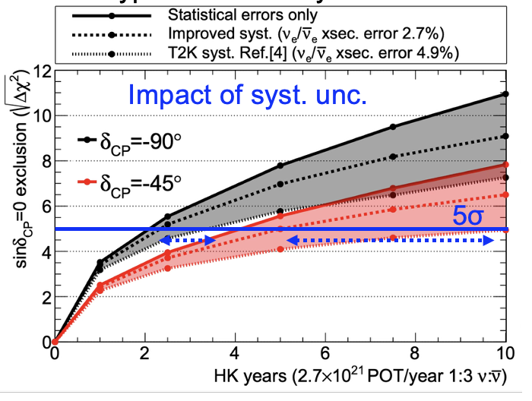
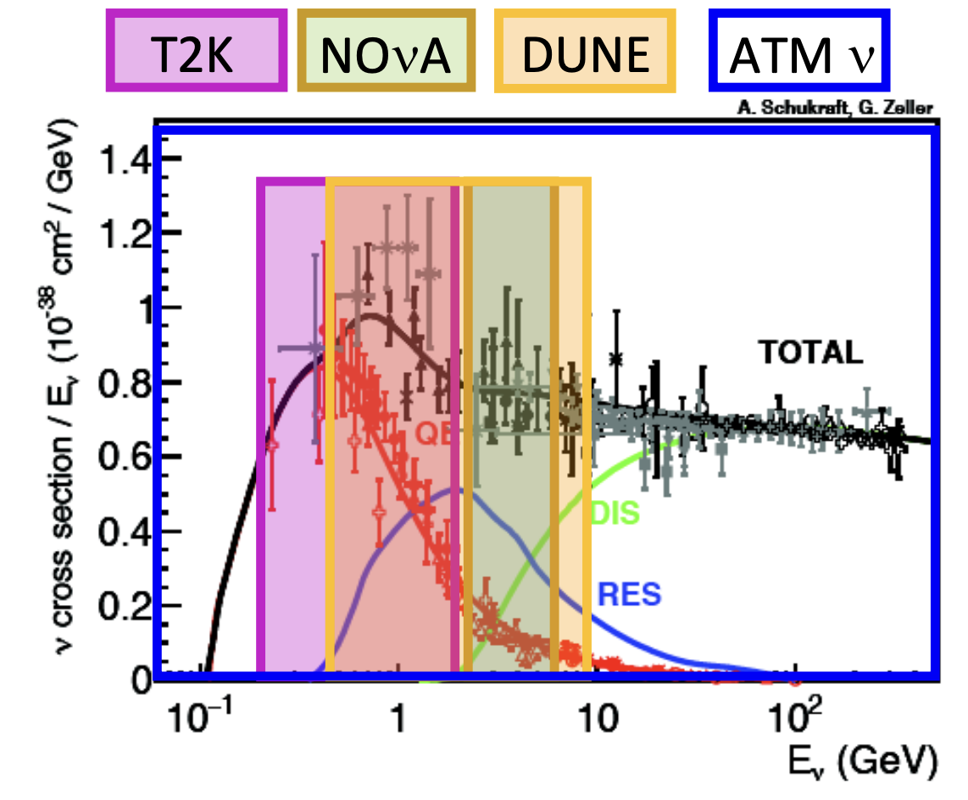
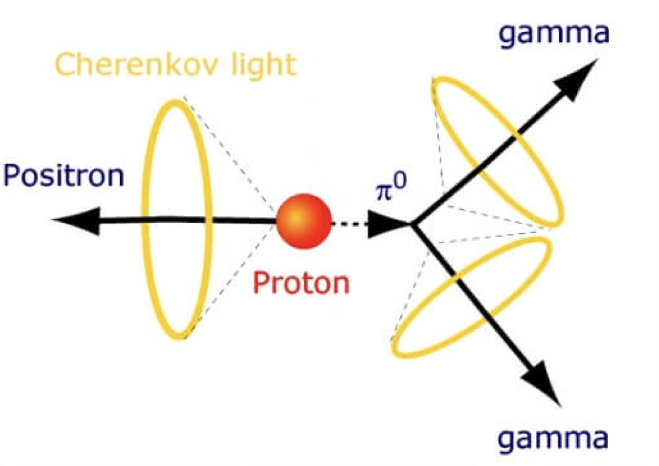
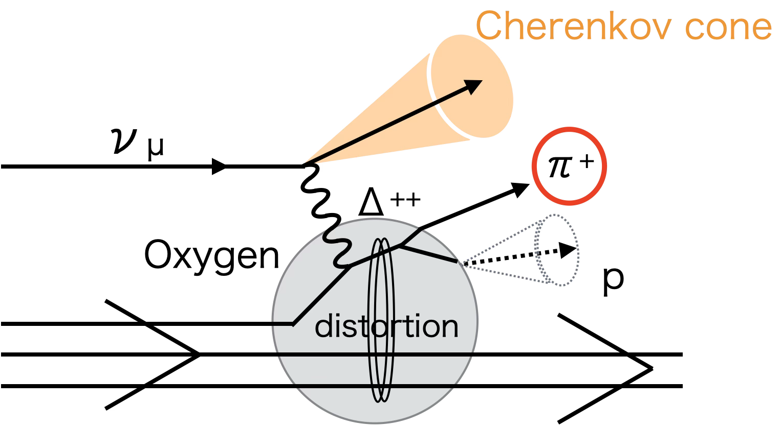
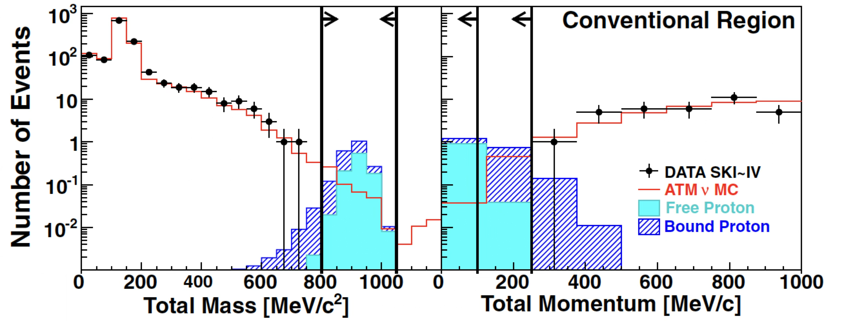
Role of Single-Pion Production (SPP) in ν physics
Partially adapted from arXiv:2505.15019
sub-dominant channel in ν osc. exp.
Major BG in nucleon decay search.
SPP
Select “back-to-back” events, but atm. ν BG remains.
Key: π absence/presence, and its kinematics
signal region
Partially adapted from Phys. Rev. D 102, 112011 (2020)
Neutrino experiments are entering into a high-precision era.
  c.f.) Hyper-Kamiokande, DUNE, JUNO, etc.
Precise prediction of SPP by event generator is required.

Slide 3
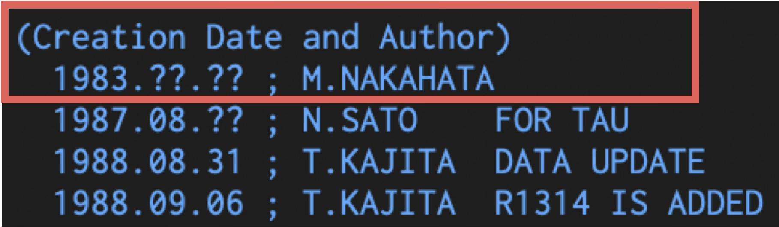

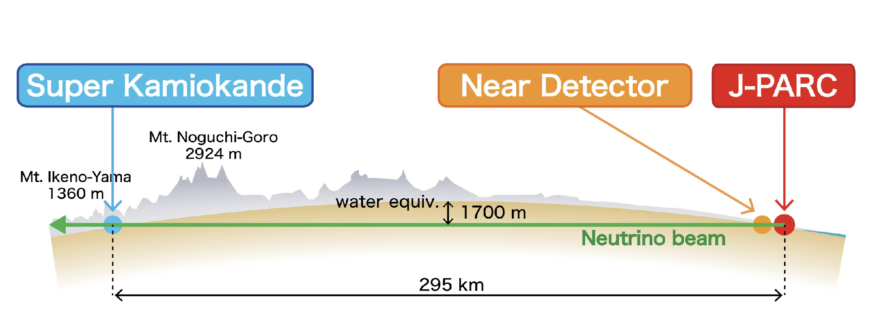
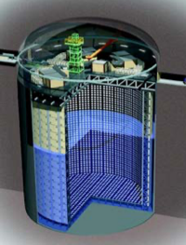

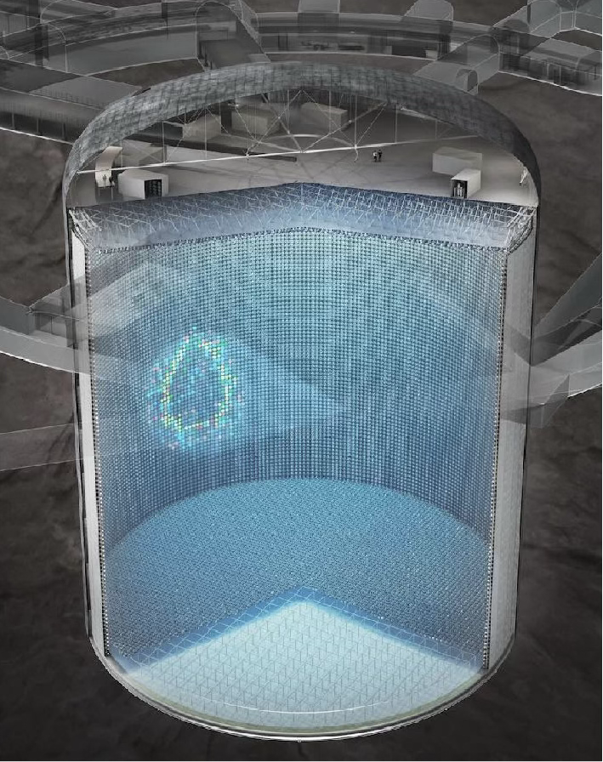

NEUT neutrino event generator
Born for the Kamiokande experiment (NOT Super-K) in the 1980s.
Mainly used in experiments in Japan: Super-K and T2K.
  The primary target is water, but it can be used for carbon, iron, etc.
Not open to public yet.
  Contact us if you are interested in.
  We have started discussion to make it public among developers.
Aiming for Hyper-K and other next-generation neutrino experiments, we keep developing NEUT.
Y. Hayato and L. Pickering,
Eur. Phys. J. Special Topics 230, 4469 (2021).

Slide 4
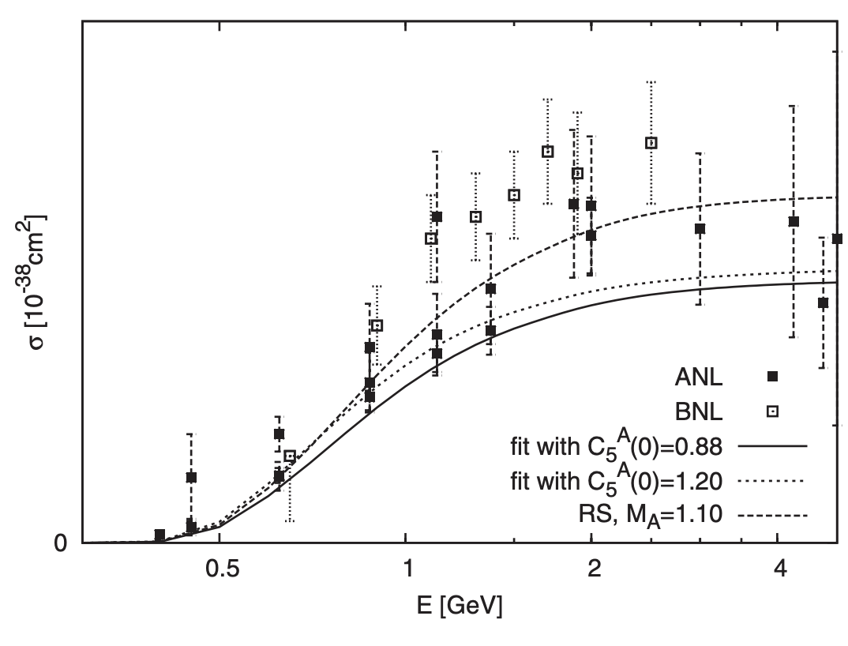
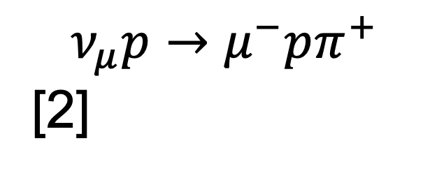
SPP in NEUT
Rein-Sehgal (RS) model has been used for long-time.
  with Graczyk-Sobczyk form factor
  with Berger-Sehgal lepton mass effects.
  It accounts for interference among resonances.
  Nonresonant background is included incoherently.
    Interference terms are not included.
Several state-of-the-art SPP models were (are being) implemented.
  ANL-Osaka Dynamical Coupled-Channels (DCC) model
  MK model and HNV model ← ongoing
$$ν_{μ}p→μ^{−}pπ^{+}$$
[2]
[1] D. Rein and L. M. Sehgal, Ann. Phys. (N.Y.) 133, 79 (1981).
[2] Graczyk-Sobczyk, PRD 77, 053001 (2008).
[3] C. Berger and L. M. Sehgal, Phys. Rev. D 76, 113004 (2007).
[4] S. X. Nakamura et al., Phys. Rev. D 92, 074024 (2015).

Slide 5
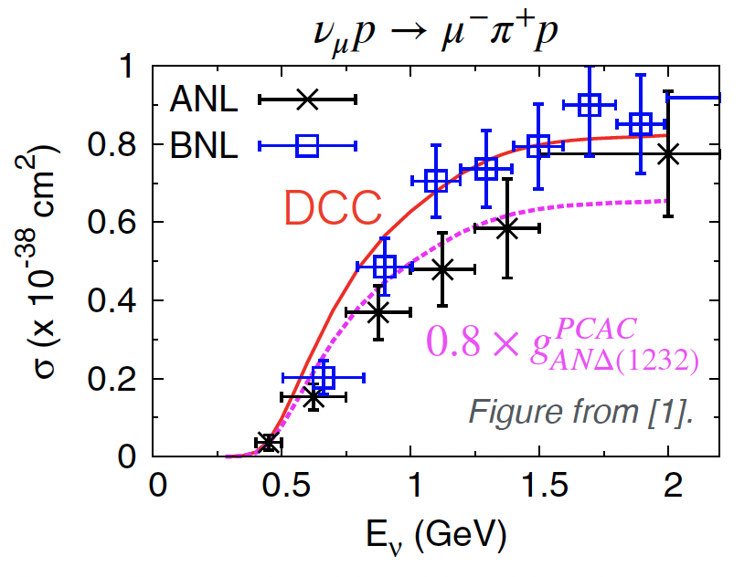
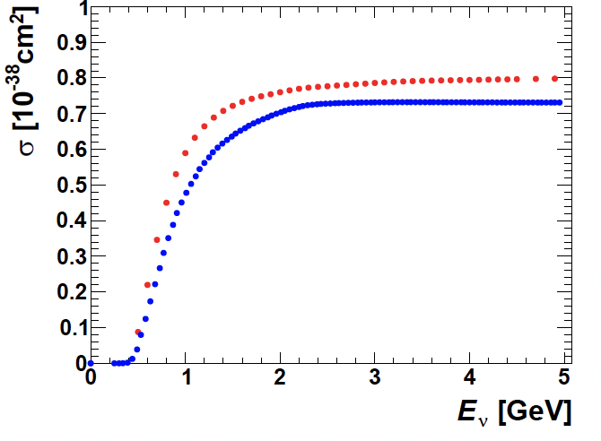
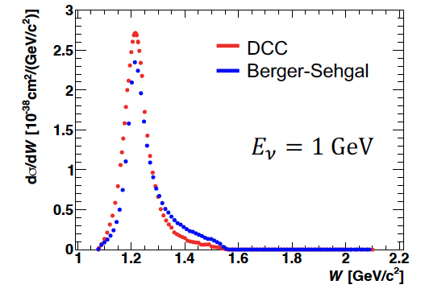
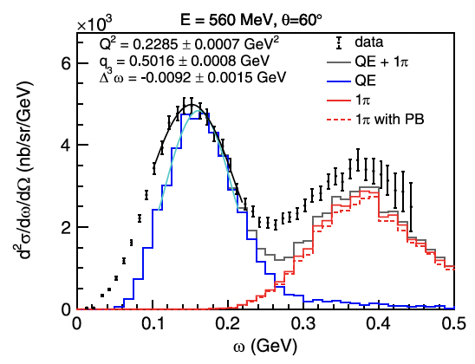
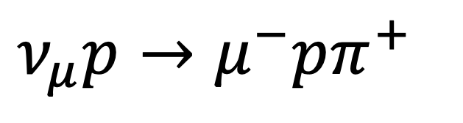
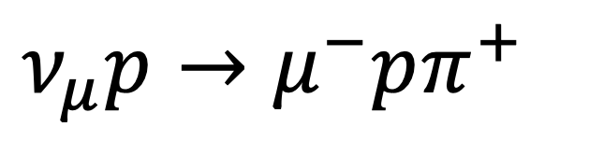
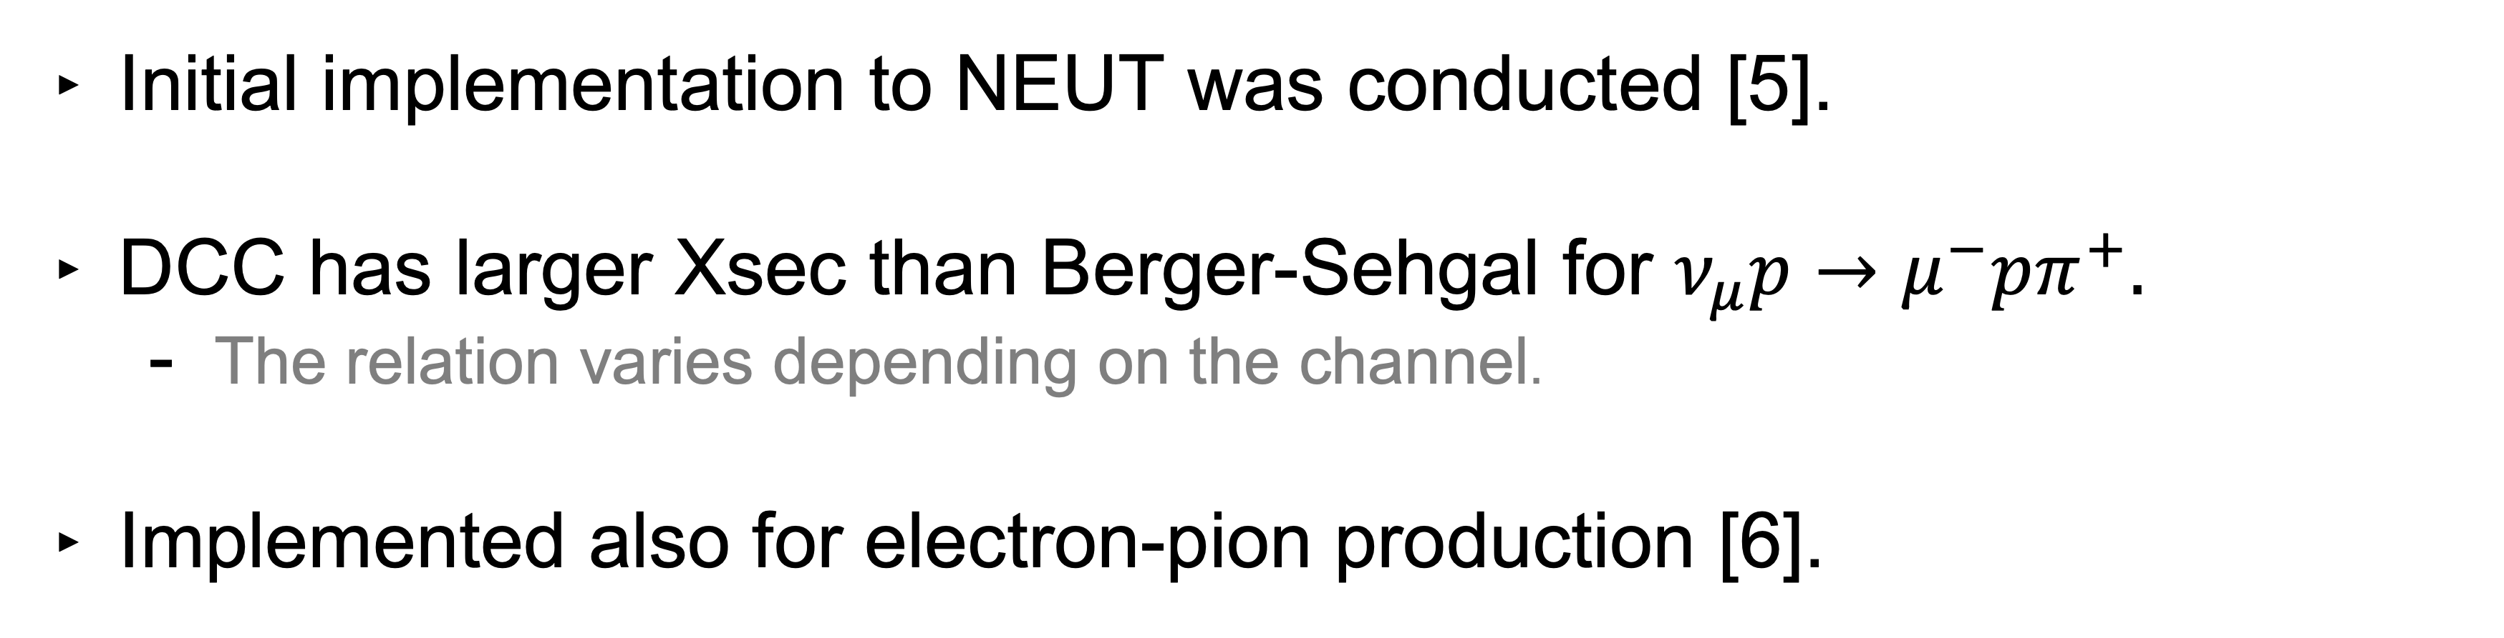

Previously, the ANL-Osaka DCC model in NEUT
Initial implementation to NEUT was conducted [5].
DCC has larger Xsec than Berger-Sehgal for $ν_{μ}p→μ^{−}pπ^{+}.$
    The relation varies depending on the channel.
Implemented also for electron-pion production [6].
[5] K. Yamauchi et al.,
Proc. Sci. TAUP2023 (2024) 340
[6] S. Abe, PRD 111, 033006 (2025).
$$ν_{μ}p→μ^{−}pπ^{+}$$
$$ν_{μ}p→μ^{−}pπ^{+}$$
$$\left(e,e’\right)$$
DCC
Berger-Sehgal
DCC

Slide 6
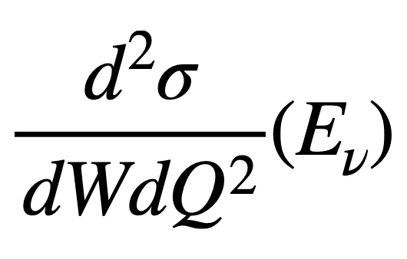
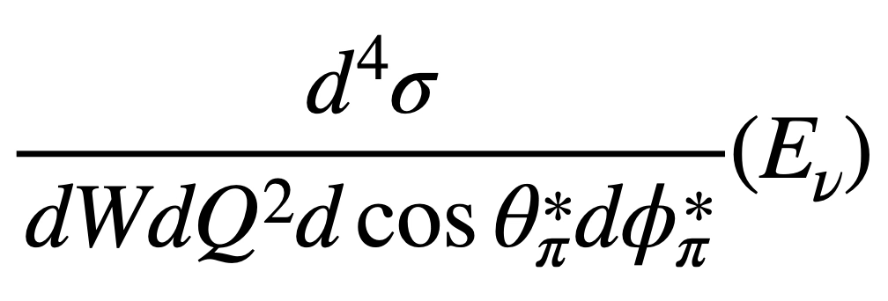
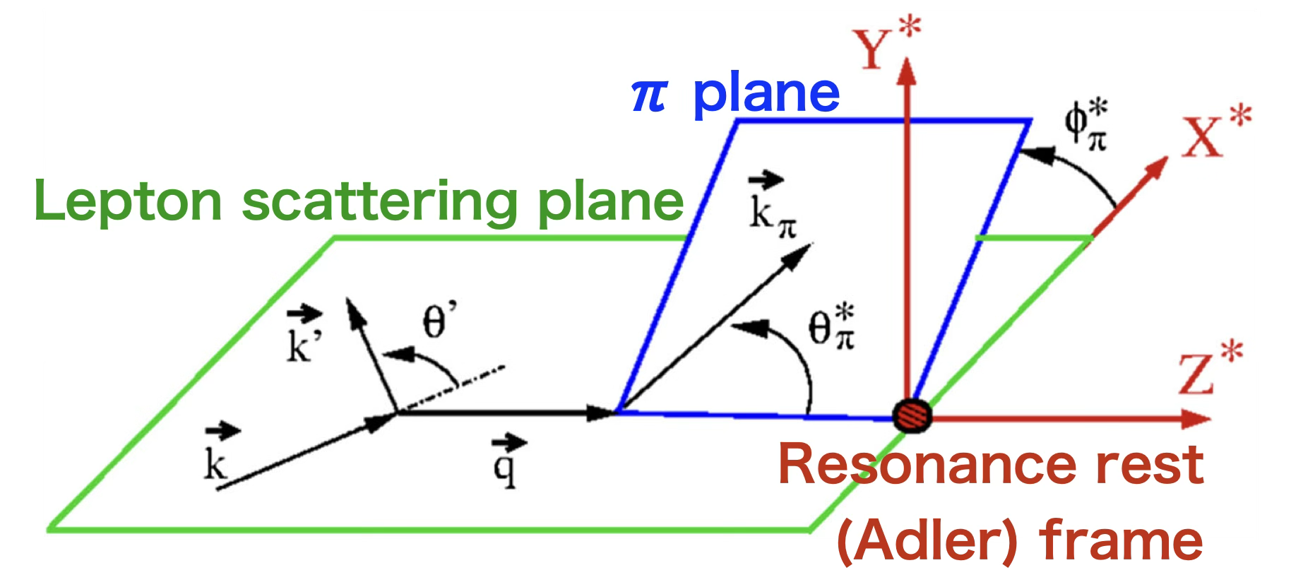
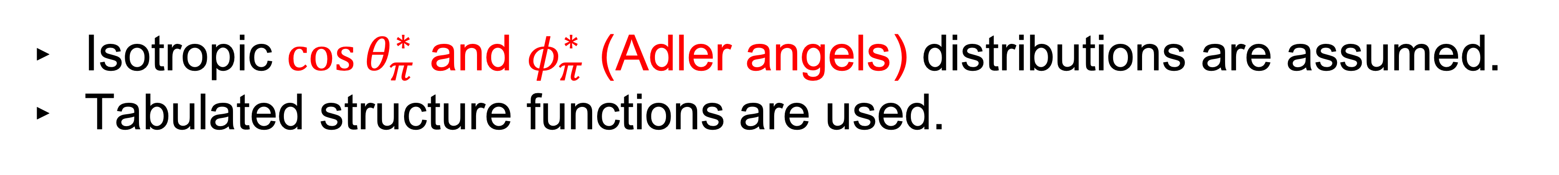
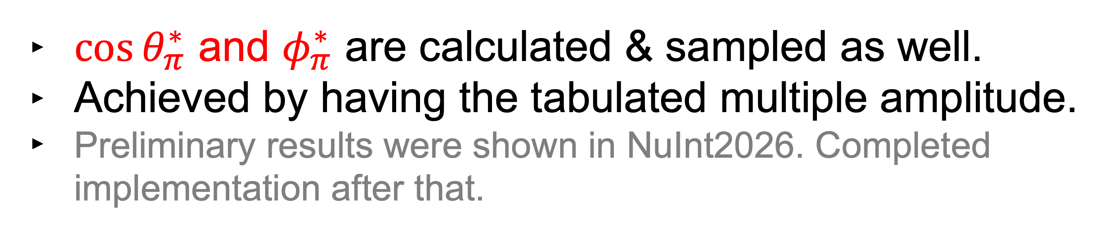
Recent updates on DCC model in NEUT
Previous
Isotropic ${\cos{θ}}_{π}^{∗}$ and $φ_{π}^{∗}$ (Adler angels) distributions are assumed.
Tabulated structure functions are used.
New
${\cos{θ}}_{π}^{∗}$ and $φ_{π}^{∗}$ are calculated & sampled as well.
Achieved by having the tabulated multiple amplitude.
Preliminary results were shown in NuInt2026. Completed implementation after that.
Additional dimensions make event sampling slow.
But, after optimization, it’s sufficiently fast.
  ~10 min/100k evts.
  c.f.) previous: ~2-3 min/100k evts.
J. E. Sobczyk et al., Phys. Rev. D 98, 073001 (2018).

Slide 7
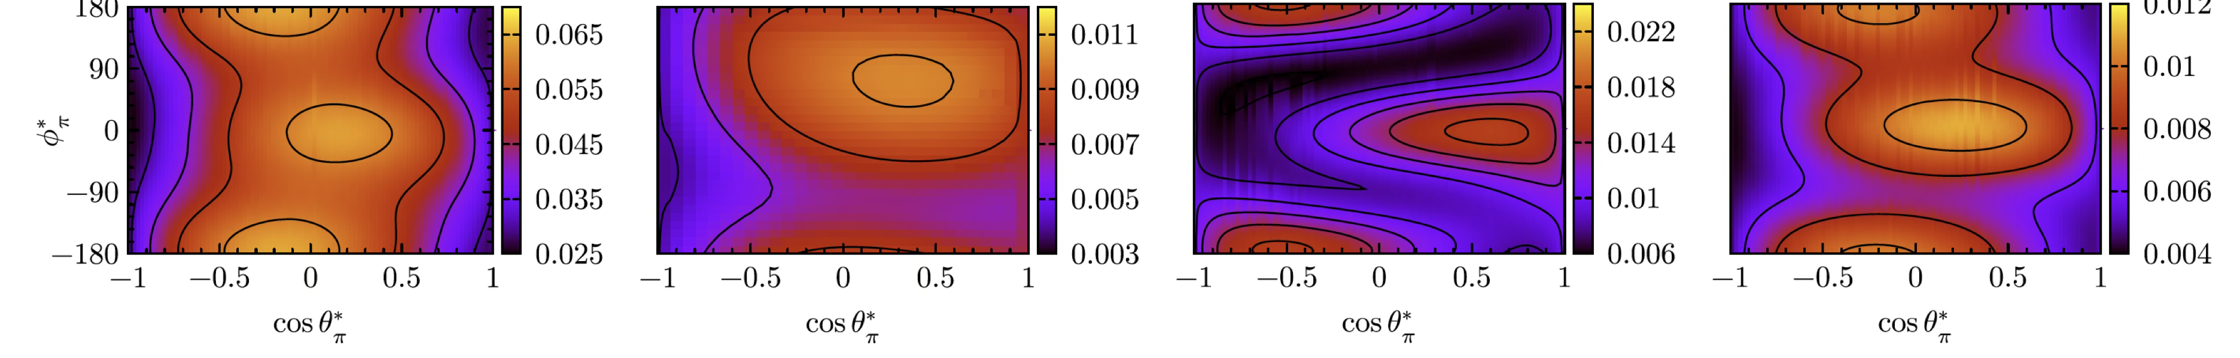
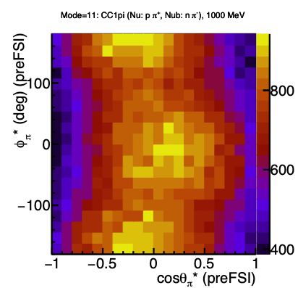
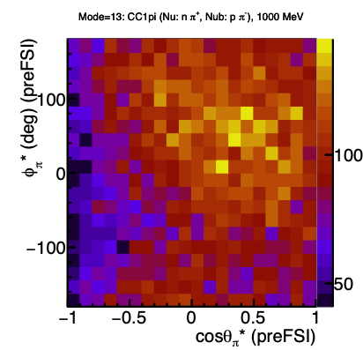
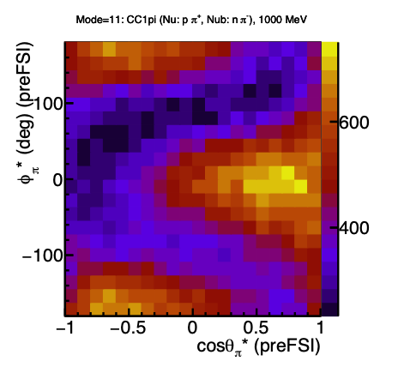
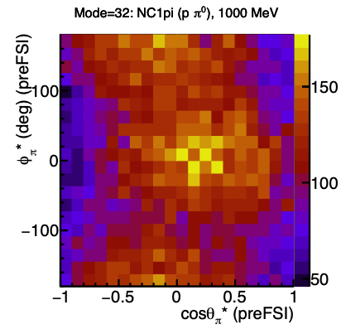
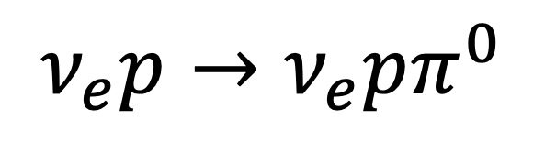
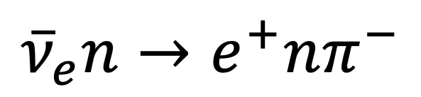
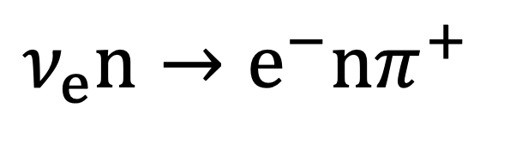
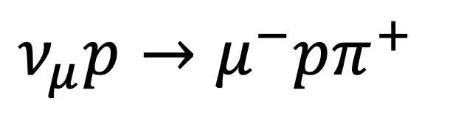
Adler angle sampling in NEUT
Theoretical calculation: PRD 98, 073001 (2018)
Ev = 1 GeV.
$$ν_{μ}p→μ^{−}pπ^{+}$$
$$ν_{e}n→e^{−}nπ^{+}$$
$${\overline{ν}}_{e}n→e^{+}nπ^{−}$$
$$ν_{e}p→ν_{e}pπ^{0}$$
NEUT generated events
Z-axis : nunmbe of events per bin
Successful implementation.

Slide 8
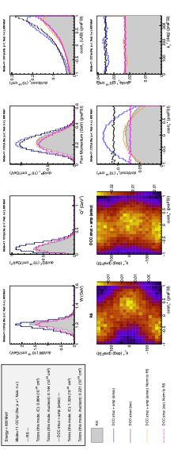
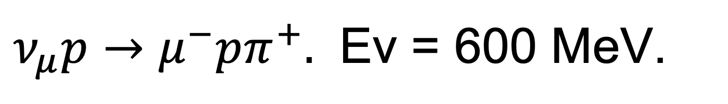
DCC vs Berger-Sehgal
$ν_{μ}p→μ^{−}pπ^{+}.$ Ev = 600 MeV.
Berger-Sehgal (BS)
New DCC (aniso)
Previous DCC (iso)
New DCC (aniso). Norm to BS.
Previous DCC (iso). Norm to BS.
Inclusion of Adler angle dist. Distorts pion kinematics.
  Momentum: slightly larger.
  Angle: Forward pions are reduced.

Slide 9
Investigation on nuclear model in SPP

Slide 10
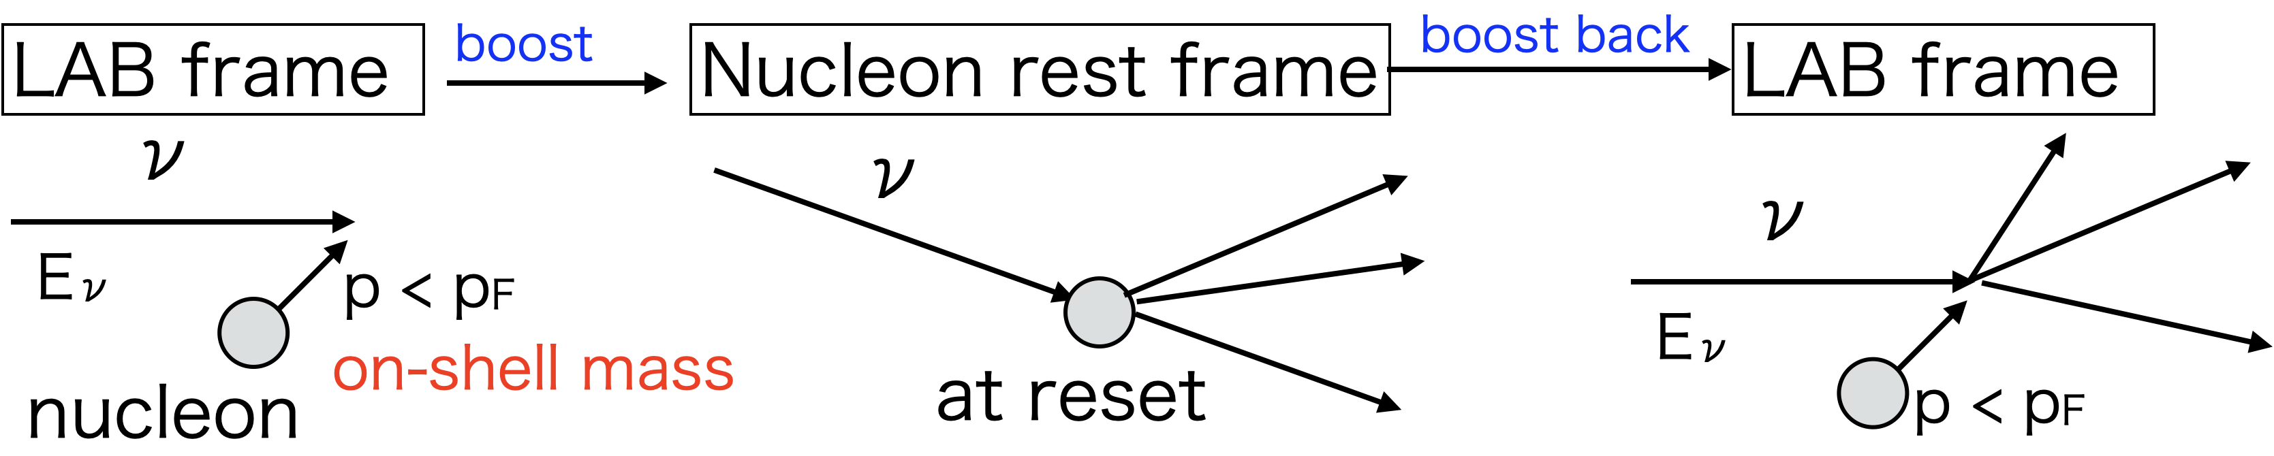
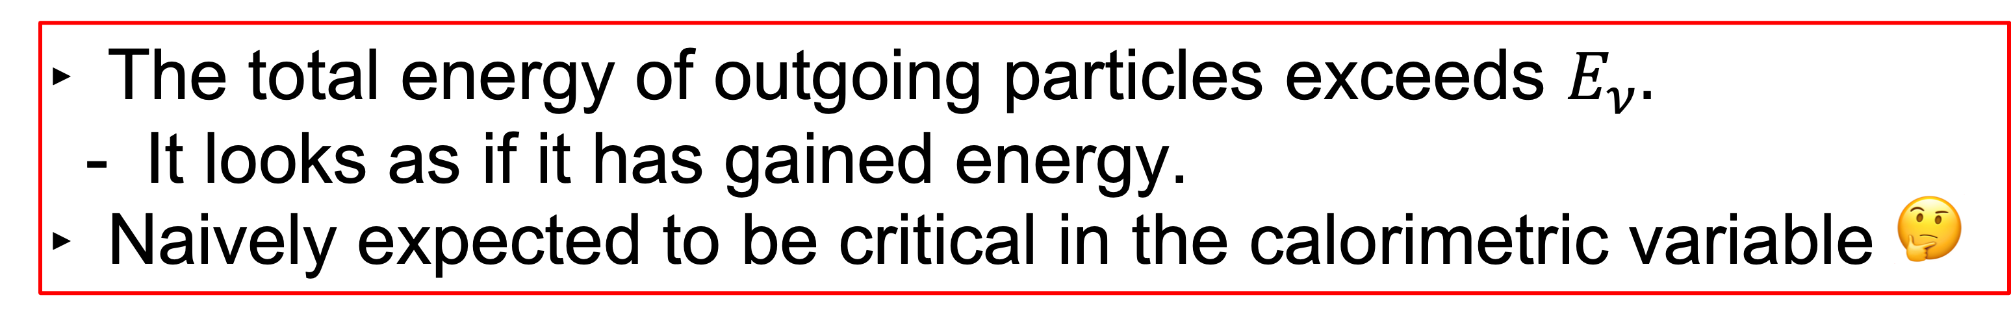
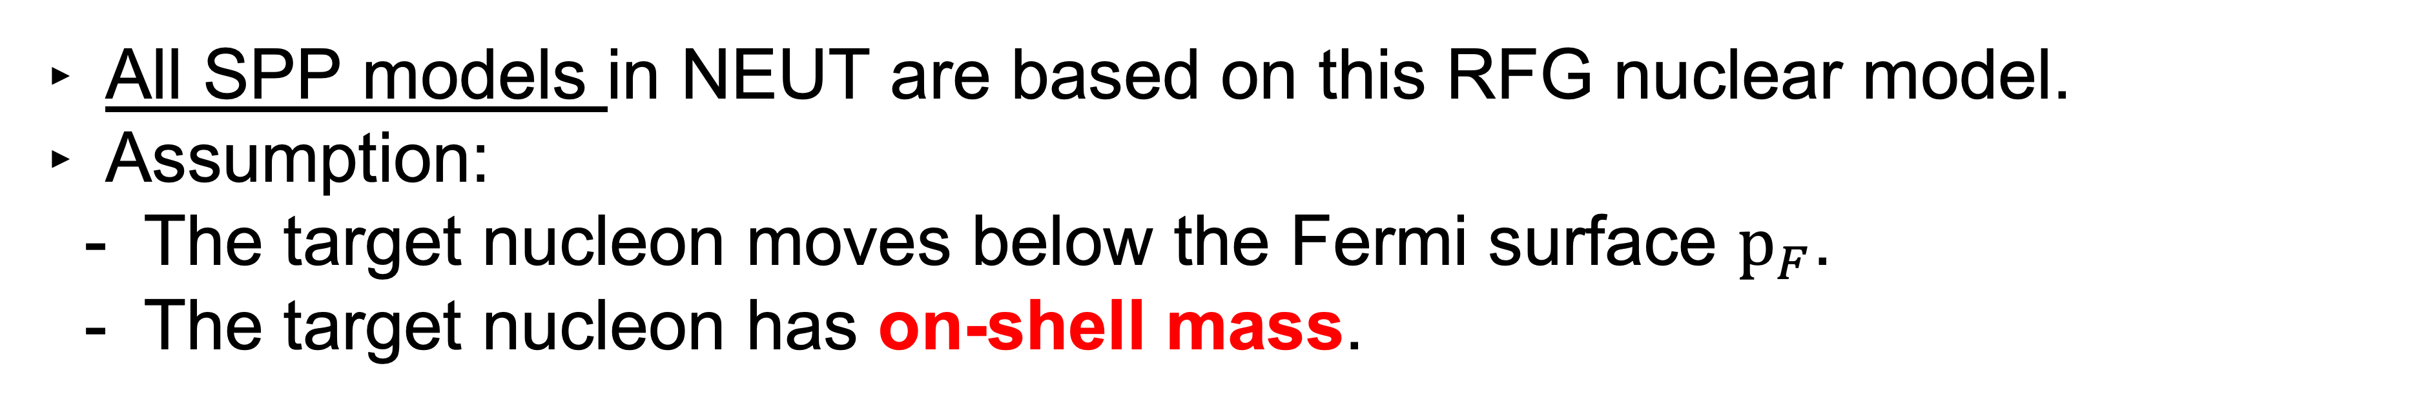
Relativistic Fermi gas (RFG) model in NEUT SPP
All SPP models in NEUT are based on this RFG nuclear model.
Assumption:
  The target nucleon moves below the Fermi surface $p_{F}$.
  The target nucleon has on-shell mass.
Therefore...
The total energy of outgoing particles exceeds $E_{ν}.$
  It looks as if it has gained energy.
Naively expected to be critical in the calorimetric variable 🤔

Slide 11
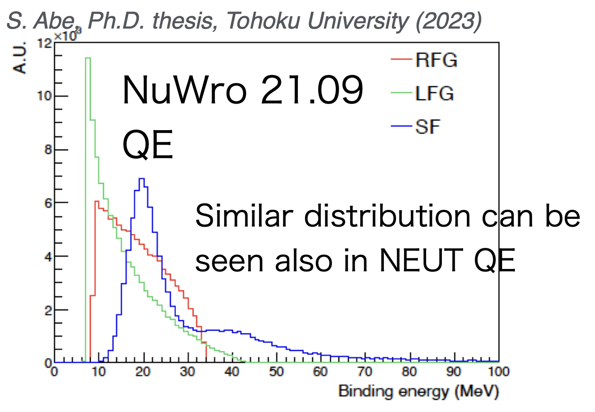
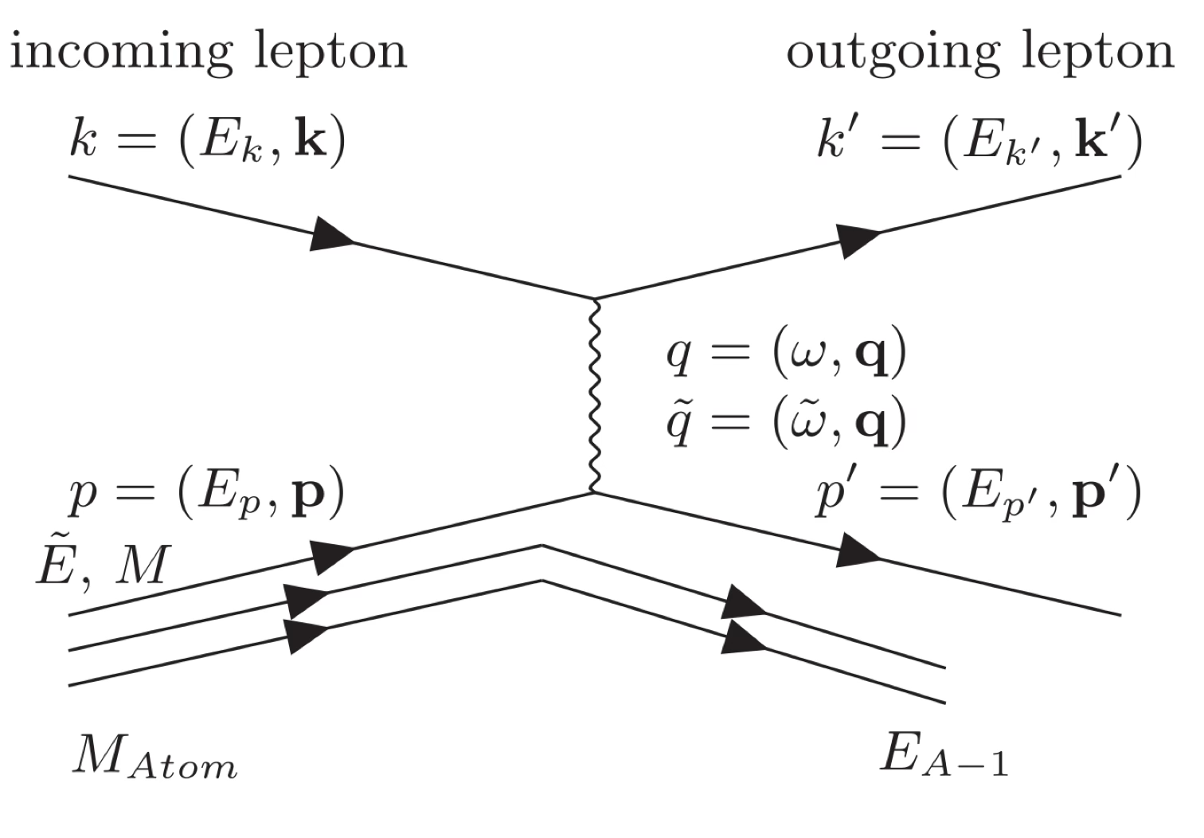
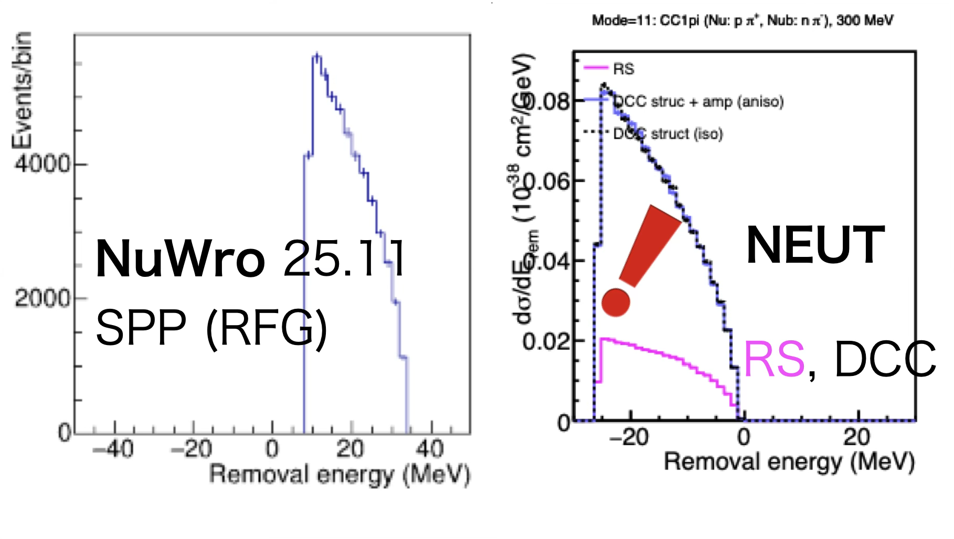
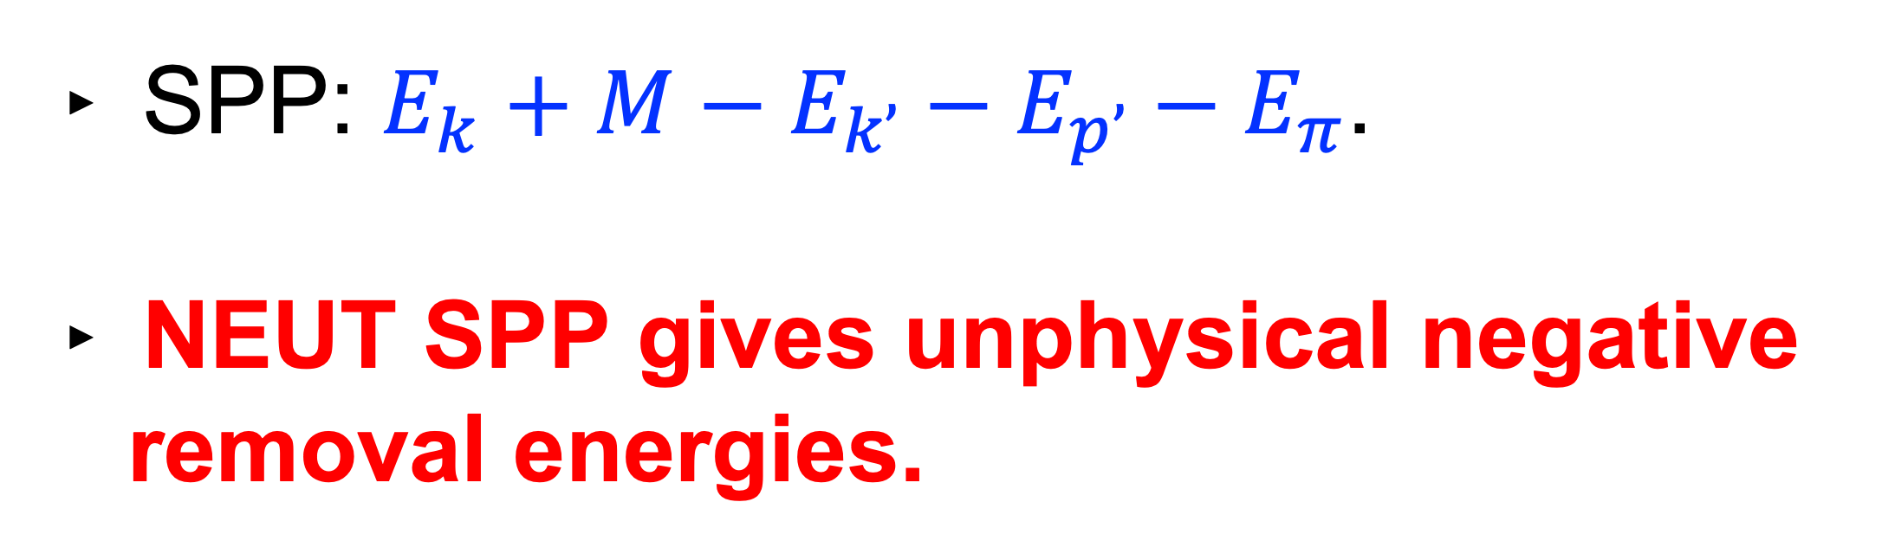
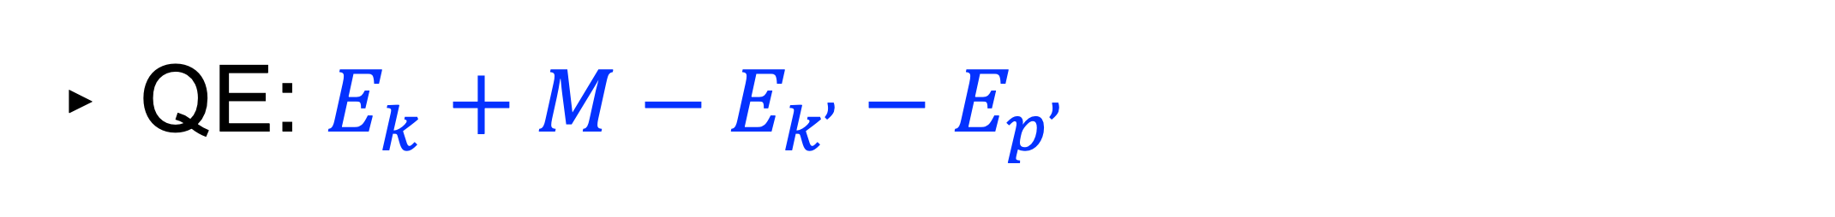
Removel energy in Fermi gas models in NEUT SPP
QE: $E_{k}+M−E_{k’}−E_{p’}$
neglecting nuclear recoil E.
SPP: $E_{k}+M−E_{k’}−E_{p’}−E_{π}$.
NEUT SPP gives unphysical negative removal energies.

Slide 12
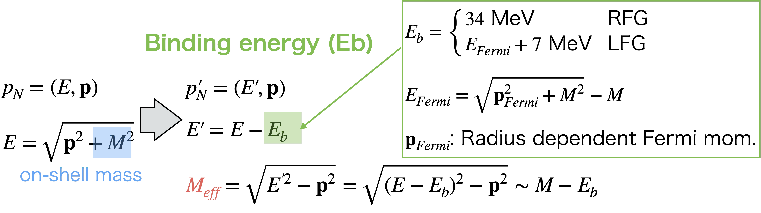
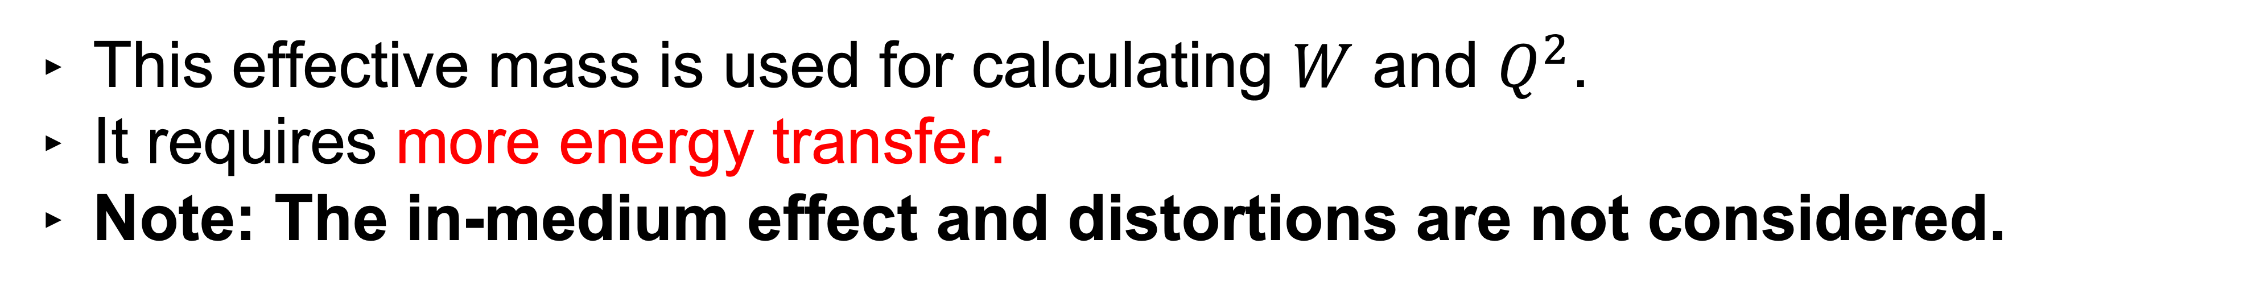
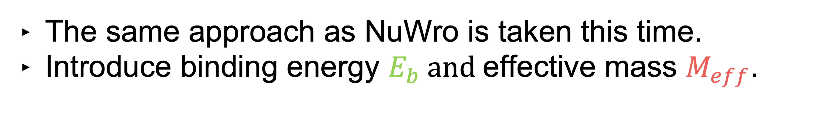
Implement ad-hoc “binding energy"
The same approach as NuWro is taken this time.
Introduce binding energy $E_{b} and$effective mass $M_{eff}$.
This effective mass is used for calculating $W$ and $Q^{2}$.
It requires more energy transfer.
Note: The in-medium effect and distortions are not considered.

Slide 13
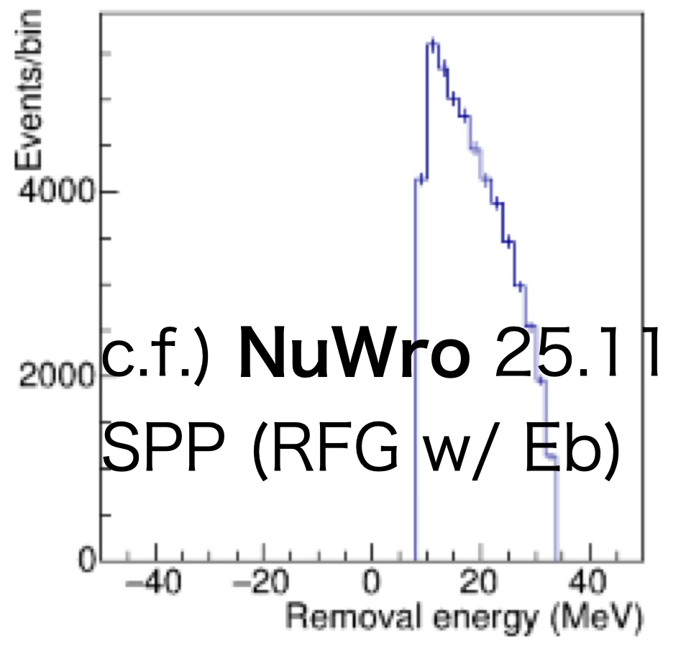
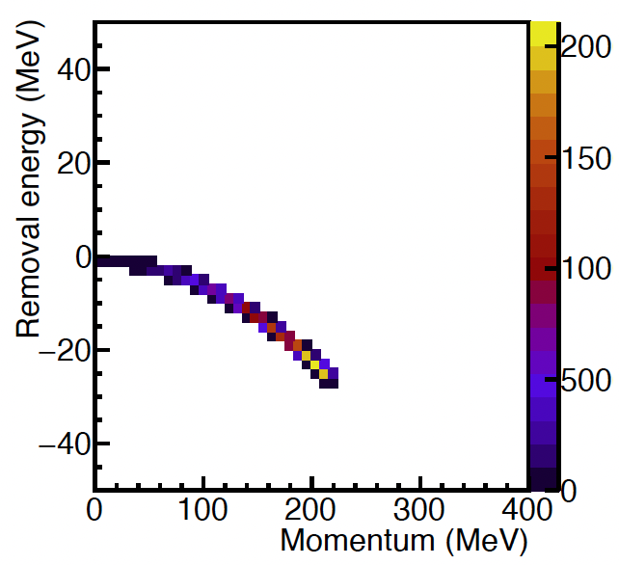
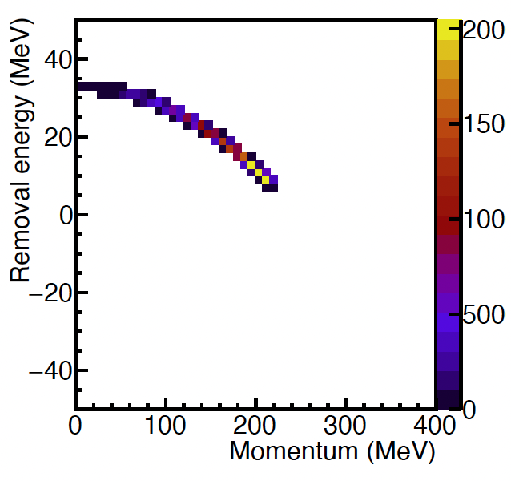
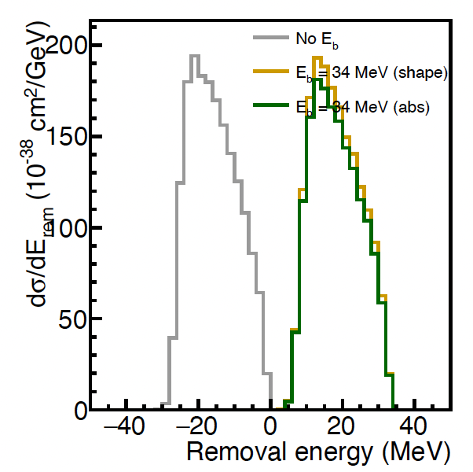
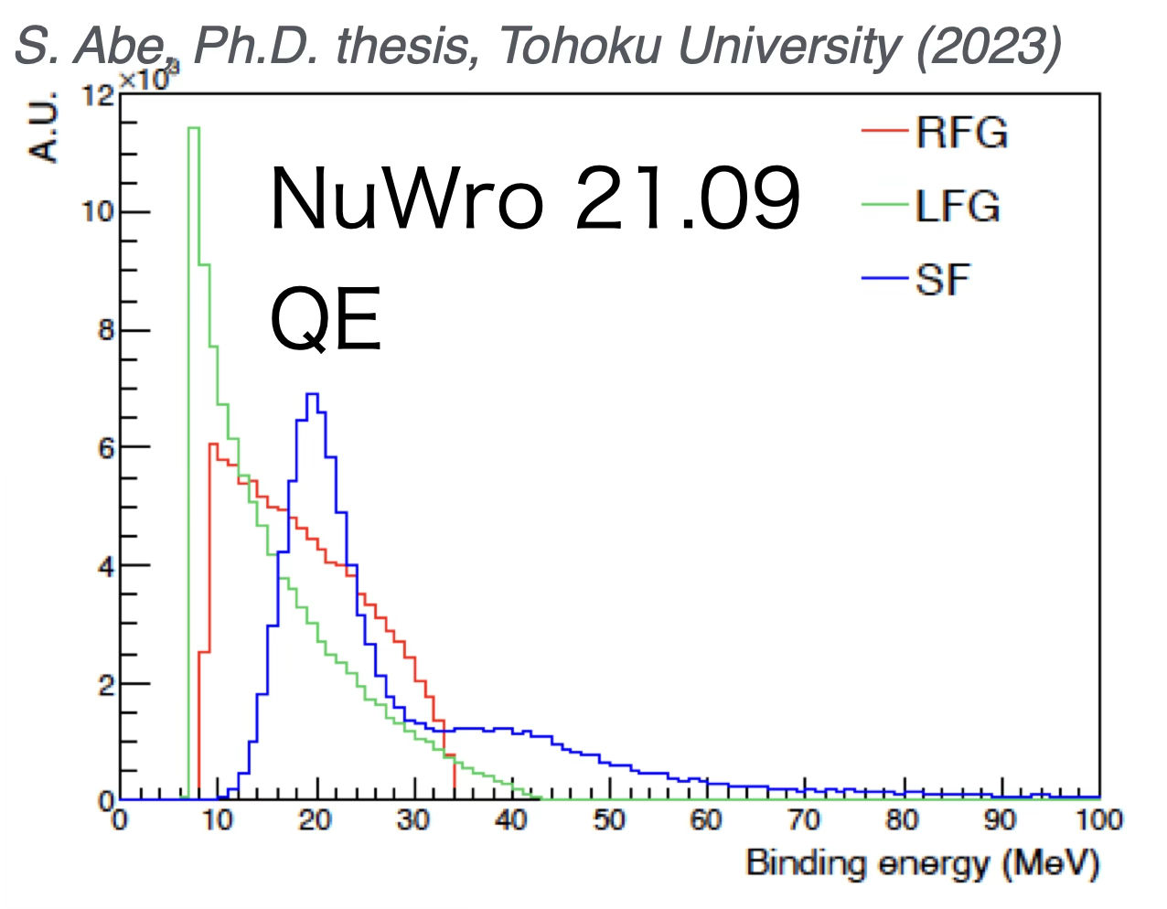



Target nucleon profile (Removal E and momentum)
Two Fermi Gas models (RFG and LFG) are implemented.
Previous (w/o Eb)
New (w/ Eb)
1D
RFG
LFG
Well known distributions → Sucessful implementation.

Slide 14




Target nucleon profile (Removal E and momentum)
Spectral Function (SF) is implemented.
$\overset{˜}{E}$: Removal energy
$Δ\overset{˜}{E}$: Correction for neutron. 2.76 MeV for carbon.
Preliminary
Carbon
Apply shift for neutron energy.
Preliminary

Slide 15






Impact on total Xsec
The total Xsec is suppressed by the $E_{b}$ at low-Ev.
Dashed: LFG w/ $E_{b}$
Solid: Free nucleon.
Xsec of LFG is ~60-70% of free nucleon at Ev=600 MeV.
(LFG w/ $E_{b}$) / (Free nucleon)
$$ν_{μ}$$
$${\overline{ν}}_{μ}$$

Slide 16



Impact on differential Xsec (pre-FSI)
w/o Eb
w/ Eb (normalized to w/o Eb)
w/ Eb
$ν_{μ}p→μ^{−}pπ^{+}$ at 600 MeV.
LFG (RFG gives similar trend)
Norm. decrease
$Q^{2}$ decrease
Pion has little change in shape under this nuclear model.
More energy transfer
Lepton changes drastically:
Lower lepton momentum
& Xsec suppression by ~30%

Slide 17

Impact on (e,e’)
Incorporating binding energy $E_{b}$ shifts the peak in energy transfer $ω$.
Preliminary
Preliminary
Preliminary

Slide 18

Impact on (e,e’)
Incorporating binding energy $E_{b}$ shifts the peak in energy transfer $ω$.
SF peaks at more larger $ω$. Peak height become a little small.
  Roughly consistent behavior with Noemi et al., PRC 100, 045503 (2019).
Preliminary
Preliminary
Preliminary

Slide 19


Challenge 1: Distortion and in-medium effect
Distortion and in-medium effects should give non-negligible impact, but are absent in NEUT.
Is there any way to apply the distortion or in-medium effect to NEUT-DCC?
  An ad-hoc method would be sufficient for the first step...?
NEUT simulation
c.f.) RDWIA based on ED-RMF
Preliminary
J. García-Marcos, PRC 109, 024608 (2024).
ω (MeV)

Slide 20
Challenge 2: Reweighing
    (amplitude) = (nonresonant) + (bare resonant) + (meson-cloud)
    Change resonance coupling strength.
DCC multipole amplitude is tabulated.
Therefore, it’s impossible to evaluate model uncertainty by “reweight”.
Start discussion how to achieve “reweight” in NEUT-DCC.
  The amplitude has several terms.
    nonresonant, bare resonant, and meson-could.
  By splitting these, part of reweighting is feasible.
Differential Xsec
Total amplitude
Current
tabulated
New (plan)
nonresonant
Total amplitude
bare resonant
on-the-fly
Change coupling strength of resonances
meson-cloud
tabulated
aa

Slide 21
Summary
NEUT has more SPP model choise rather than RS recently.
Full DCC model, including Adler angle sampling, was implemented.
NEUT SPP models were based on naive nuclear models.
Newly introduced binding energy, the same approach as NuWro.
  SF, LFG, and RFG are implemented.
  Significant impact on lepton kinematics is observed.
  Impacts on SK/T2K/HK observables are to be investigated.
There are big challenging topics!
  NEUT-DCC reweighting for uncertainty estimation.
  Nuclear effects (distortion and in-medium effects of delta) for high-precision prediction.

Slide 22
backup

Slide 23


Comparison with other calculation: 620 MeV, 60°
NEUT-DCC
N. Rocco et al. DCC with SF
PRC 100, 045503 (2019).
Preliminary

Slide 24
Comparison with other calculation: 620 MeV, 60°
PRC 100, 045503 (2019).

Slide 25


Comparison with other calculation: 730 MeV, 37°
N. Rocco et al. DCC.
PRC 100, 045503 (2019).
RFG w/o Eb
SF PWIA (probably QE only)

Slide 26

Comparison with other calculation: 730 MeV, 37°
N. Rocco et al. DCC.
(private commnun.)
total = the same as black line in Fig.11.

Slide 27
Comparison with other calculation: 730 MeV, 37°

Slide 28


Comparison with other calculation: 560 MeV, 60°
N. Rocco et al. DCC.
(private commnun.)

Slide 29
Comparison with other calculation: 560 MeV, 60°

Slide 30


Comparison with other calculation: 680 MeV, 60°
N. Rocco et al. DCC.
(private commnun.)

Slide 31
Comparison with other calculation: 680 MeV, 60°

Slide 32


Momentum

