Slide 1



The Quark-Diquark Structure of Baryons
Clara Tourbez
NSTAR 2026

Slide 2
Comparison of Two Frameworks
Quark-diquark approximation:
Three-body model:

Slide 3

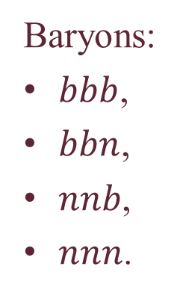

Scope of the Study
Constituent picture:
Baryon = 3 interacting valence quarks,
Solve Schrödinger-like equations,
Interactions = potential.
Computed quantities:
Masses,
Wave functions,
Characteristic distances.
Studied systems:
Baryons:
$bbb$,
$bbn$,
$nnb$,
$nnn$.
States:
Ground states,
L=8,
All spin states,
All isospin states.
$$r_{Dq}$$
$$r_{qq}$$

Slide 4
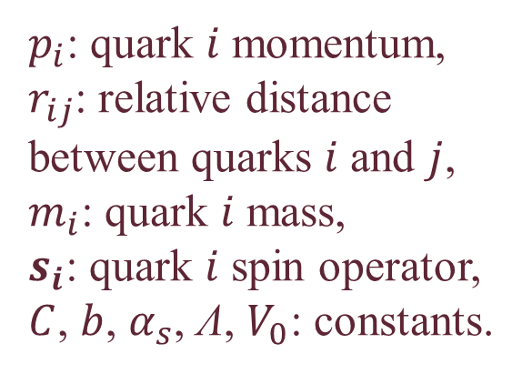
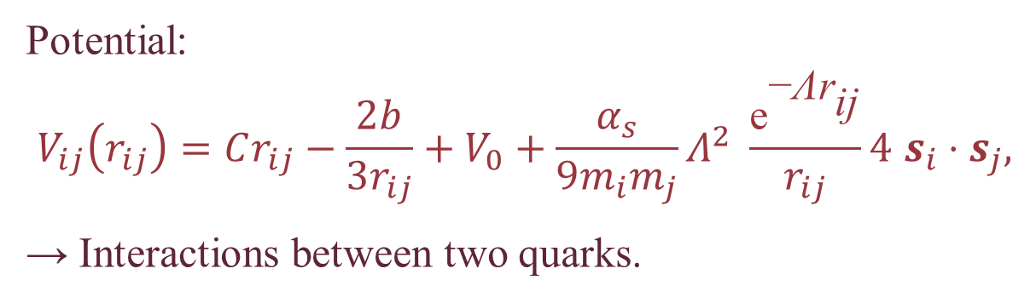
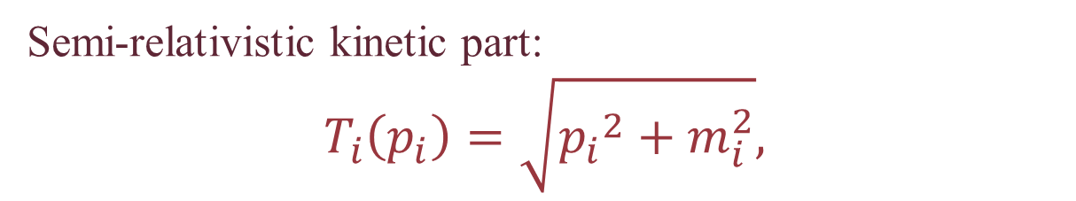
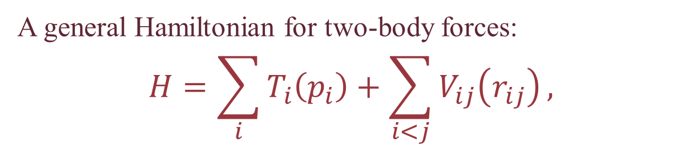
The Three-Body Hamiltonian
A general Hamiltonian for two-body forces:
$$H=\sum_{i}{T_{i}\left(p_{i}\right)}+\sum_{i<j}{V_{ij}\left(r_{ij}\right)},$$
Semi-relativistic kinetic part:
$$T_{i}\left(p_{i}\right)=\sqrt{{p_{i}}^{2}+m_{i}^{2}},$$
Potential:
$$V_{ij}\left(r_{ij}\right)=Cr_{ij}−\frac{2b}{3r_{ij}}+V_{0}+\frac{α_{s}}{9m_{i}m_{j}}Λ^{2} \frac{{\text{e}}^{\text{−}\text{Λ}{\text{r}}_{\text{ij}}}}{r_{ij}}4 s_{i}⋅s_{j},$$
→ Interactions between two quarks.
$p_{i}$: quark $i$ momentum,
$r_{ij}$: relative distance between quarks $i$ and $j$,
$m_{i}$: quark $i$ mass,
$s_{i}$: quark $i$ spin operator,
$C$, $b$, $α_{s}$, $\text{Λ}$, $V_{0}$: constants.

Slide 5
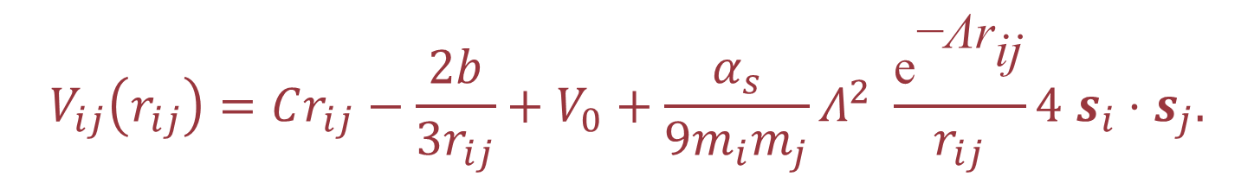
The Quark-Quark Potential
Standard interactions:
$$V_{ij}\left(r_{ij}\right)=Cr_{ij}−\frac{2b}{3r_{ij}}+V_{0}+\frac{α_{s}}{9m_{i}m_{j}}Λ^{2} \frac{{\text{e}}^{\text{−}\text{Λ}{\text{r}}_{\text{ij}}}}{r_{ij}}4 s_{i}⋅s_{j}.$$
Central
-
Cornell
Spin
-
Yukawa

Slide 6
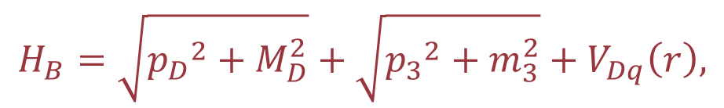
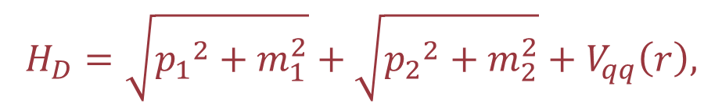
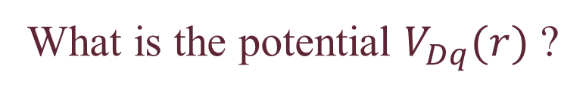

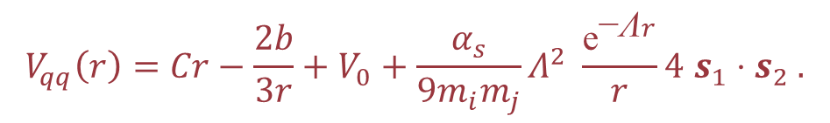
The Quark-Diquark Hamiltonians
2
1
Same form as for the three-body model
3
Diquark:
Quark-diquark:
$$H_{D}=\sqrt{{p_{1}}^{2}+m_{1}^{2}}+\sqrt{{p_{2}}^{2}+m_{2}^{2}}+V_{qq}\left(r\right),$$
$$H_{B}=\sqrt{{p_{D}}^{2}+M_{D}^{2}}+\sqrt{{p_{3}}^{2}+m_{3}^{2}}+V_{Dq}\left(r\right),$$
$$V_{qq}\left(r\right)=Cr−\frac{2b}{3r}+V_{0}+\frac{α_{s}}{9m_{i}m_{j}}Λ^{2} \frac{{\text{e}}^{\text{−}\text{Λ}r}}{r}4 s_{1}⋅s_{2} .$$
What is the potential $V_{Dq}(r)$ ?
$$H_{D}→M_{D} \& Ψ_{D}$$

Slide 7
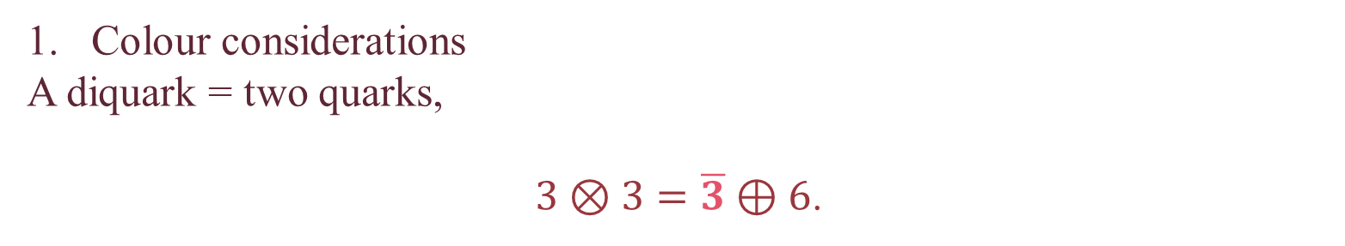
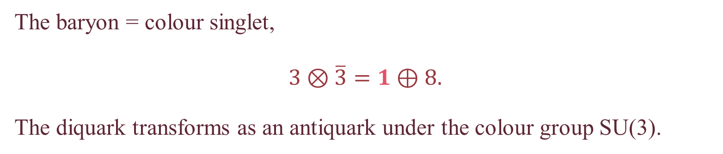
The Quark-Diquark Potential
Colour considerations
A diquark = two quarks,
$3⊗3=\overline{3}⊕6$.
The baryon = colour singlet,
$$3⊗\overline{3}=1⊕8.$$
The diquark transforms as an antiquark under the colour group SU(3).
First assumption:
$$V_{Dq}=V_{\overline{q}q}=2 V_{qq}.$$
Diquark not point-like

Slide 8
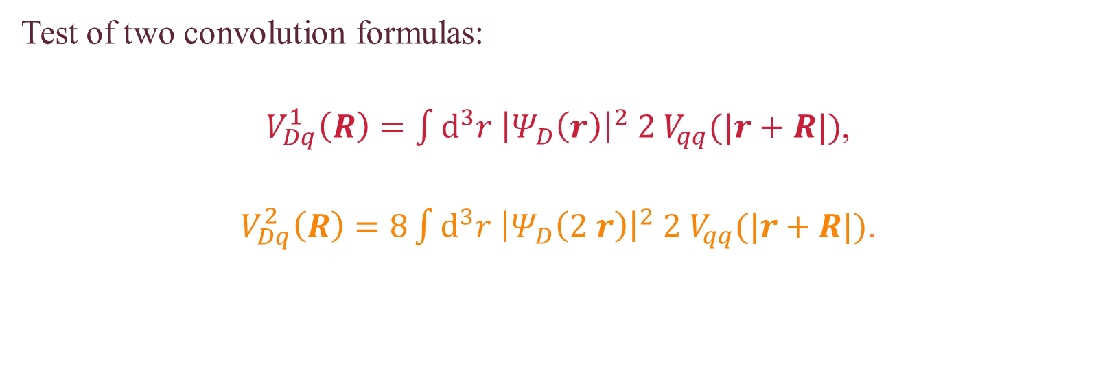
The Quark-Diquark Potential
Spatial extension considerations
Convolution with colour density.
Test of two convolution formulas:
$V_{Dq}^{1}\left(R\right)=\int{d^{3}r {\left|Ψ_{D}\left(r\right)\right|}^{2} 2 V_{qq}(|r+R|)}$,
$V_{Dq}^{2}\left(R\right)=8\int{d^{3}r {\left|Ψ_{D}\left(2 r\right)\right|}^{2} 2 V_{qq}(|r+R|)}$.
[1]
New procedure including the colour density from [2].
[1] Giannuzzi, Phys. Rev. D 79, 094002 (2009),
[2] Nazarov, Phys. Rev. B 87, 165125 (2013).

Slide 9




Methods
For the quark-diquark approximation
For the three-body model
Lagrange mesh method (LMM)
Oscillator basis expansion (OBE)
$$\left(n_{D},l_{D},n_{Dq},l_{Dq}, S_{D},I_{D}\right)$$
$$\left(n_{ρ},l_{ρ},n_{λ},l_{λ}, S_{12},I_{12}\right)$$
2
1
2
1
$$λ$$
$$ρ$$
3
3

Slide 10





Methods: Practical Application
Baryon properties
Dominant components
3-body
Eigenstates
Quark-diquark
$$M_{qqq}$$
$$α\left|Φ_{α}\right\rangle +β\left|Φ_{β}\right\rangle +…$$
$$\left|Φ_{α}\right\rangle , \left|Φ_{β}\right\rangle$$
$$M_{Dq}^{α},M_{Dq}^{β}$$
$${\left|α\right|}^{2}≥{\left|β\right|}^{2}≥…$$

Slide 11
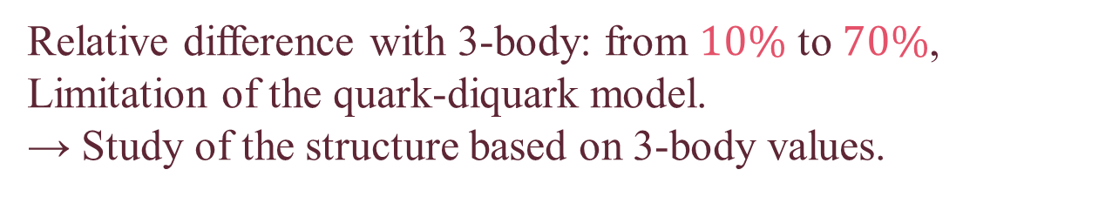




Results: Characteristic Distances
Study of baryon structures:
Mean values of $ρ$ and $λ$ for 3-body $⟺$ $r_{qq}$ and $r_{Dq}$ for quark-diquark.
$$r_{qq}$$
$$ρ$$
$$λ$$
$$r_{Dq}$$
Relative difference with 3-body: from $10\%$ to $70\%$,
Limitation of the quark-diquark model.
→ Study of the structure based on 3-body values.

Slide 12








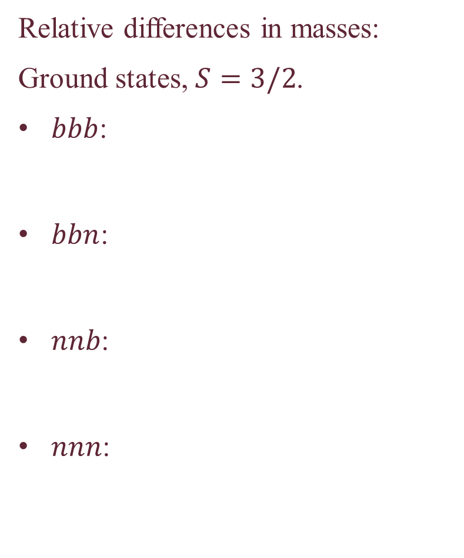


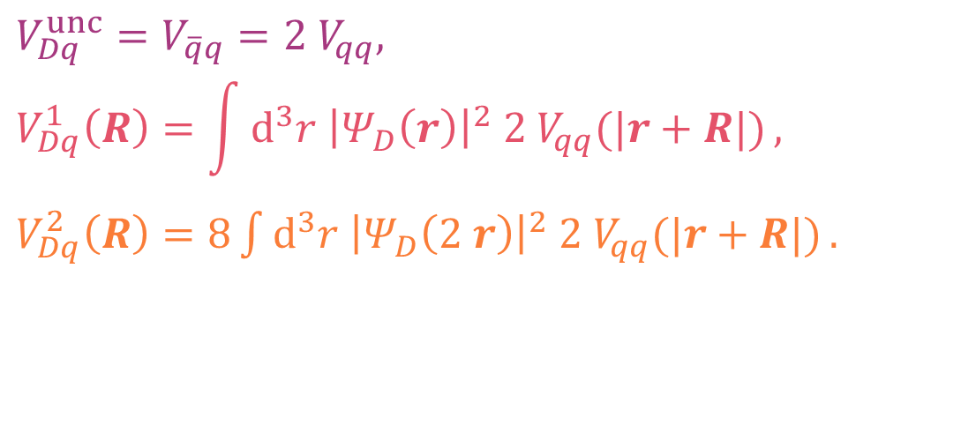


Results: Convolution for $V_{Dq}$
Relative differences in masses:
Ground states, $S=3/2$.
$bbb$:
$bbn$:
$nnb$:
$nnn$:
$$≈4\%$$
$$≈3\%$$
$$≈1\%$$
$$≈2\%$$
$$≈2\%$$
$$≈0.2\%$$
$$V_{Dq}^{unc}=V_{\overline{q}q}=2 V_{qq},$$
$$V_{Dq}^{1}\left(R\right)=\int{d^{3}r {\left|Ψ_{D}\left(r\right)\right|}^{2} 2 V_{qq}(|r+R|)},$$
$V_{Dq}^{2}\left(R\right)=8\int{d^{3}r {\left|Ψ_{D}\left(2 r\right)\right|}^{2} 2 V_{qq}(|r+R|)}.$
$$≈6\%$$
$$≈11\%$$
$$≈3\%$$
$$≈14\%$$
$$≈36\%$$
$$≈6\%$$
Only for identical particles in the diquark!

Slide 13


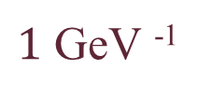

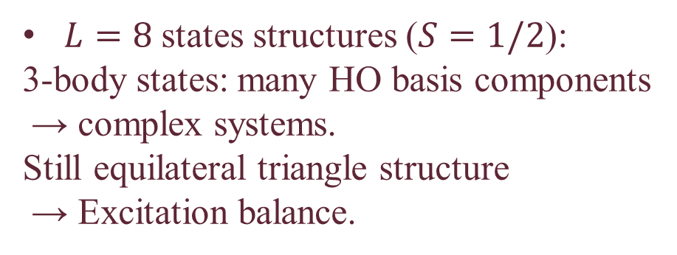
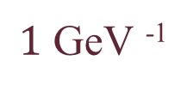
Results: Three Identical Particles
$b$:
$n$:
Ground states structures ($S=3/2$):
Symmetries → Equilateral triangles.
$L=8$ states structures ($S=1/2$):
3-body states: many HO basis components
→ complex systems.
Still equilateral triangle structure
→ Excitation balance.
$1$ GeV ⁻¹
$1$ GeV ⁻¹

Slide 14
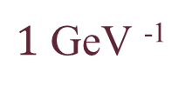
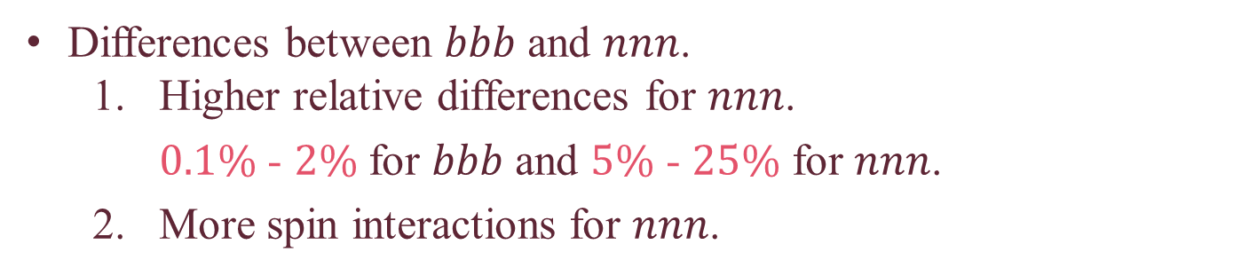
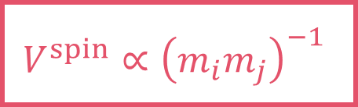


Results: Three Identical Particles
Differences between $bbb$ and $nnn$.
  Higher relative differences for $nnn$.
    $0.1\%$ - $2\%$ for $bbb$ and $5\%$ - $25\%$ for $nnn$.
  More spin interactions for $nnn$.
$$V^{spin}∝{\left(m_{i}m_{j}\right)}^{−1}$$
$1$ GeV ⁻¹
$$S=1/2$$
$$S=3/2$$

Slide 15
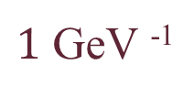


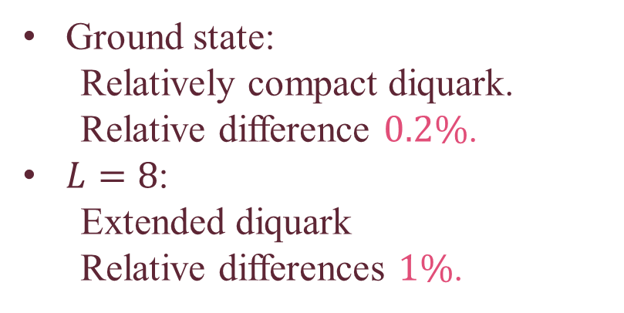
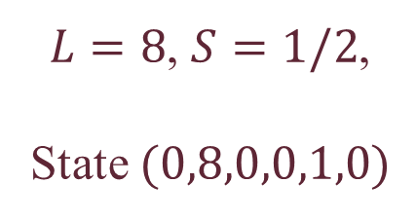

Results: $bbn$
$$\left(n_{ρ},l_{ρ},n_{λ},l_{λ}, S_{12},I_{12}\right)$$
$1$ GeV ⁻¹
Ground state, $S=3/2$
Ground state:
  Relatively compact diquark.
  Relative difference $0.2\%$.
$L=8$:
  Extended diquark
  Relative differences $1\%$.
$L=8$, $S=1/2$,
State $(0,8,0,0,1,0)$

Slide 16
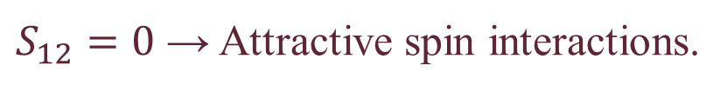



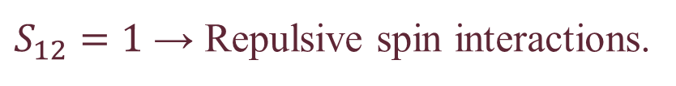
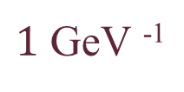

Results: $nnb$
$$\left(n_{ρ},l_{ρ},n_{λ},l_{λ}, S_{12},I_{12}\right)$$
Highlight of intra-diquark spin interactions:
Ground states with $S=1/2.$
$S_{12}=1$ → Repulsive spin interactions.
$S_{12}=0$ → Attractive spin interactions.
$1$ GeV ⁻¹
State $\left(0,0,0,0,1,1\right)$
$$3.7\%$$
State $\left(0,0,0,0,0,0\right)$
$$4.8\%$$

Slide 17
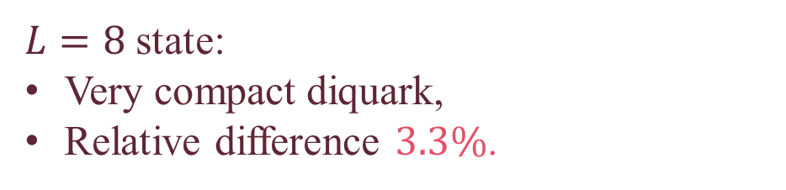


Results: $nnb$
$$\left(n_{ρ},l_{ρ},n_{λ},l_{λ}, S_{12},I_{12}\right)$$
$L=8$ state:
Very compact diquark,
Relative difference $3.3\%$.
$1$ GeV ⁻¹
State $\left(0,0,0,8,0,0\right)$

Slide 18

Take Home Message
Key Results:
Direct computation not working for distances,
New convolution formula,
Spin impact on quark-diquark structure,
Globally reasonable results for masses,
Compact diquark not necessary.

Slide 19

Take Home Message
Outlooks:
New procedure to compute distances,
Improvement of spin interactions,
Diquark in a superposition of states,
Application to more complex systems.
Main Reference:
C. Tourbez, C. Chevalier, and C. Semay, Eur. Phys. J. A 62, 101 (2026).

Slide 21
Introduction
Constituent approach:
Baryon = 3 interacting valence quarks,
Solve Schrödinger-like equations,
Interactions = potential.
Types of interactions between quarks:
Central-colour short range,
Central-colour long range (confinement),
Spin-colour.

Slide 22
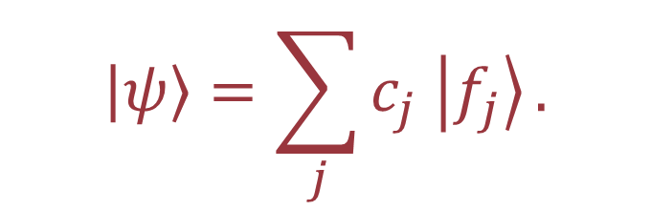

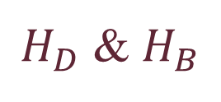

Methods: Lagrange Mesh
For the quark-diquark approximation
$H_{D}$ & $H_{B}$
$$H\left|ψ\right\rangle =E\left|ψ\right\rangle .$$
$$\left|ψ\right\rangle =\sum_{j}{c_{j} \left|f_{j}\right\rangle }.$$
Expansion of $|ψ⟩$:
To simplify the computations.

Slide 23


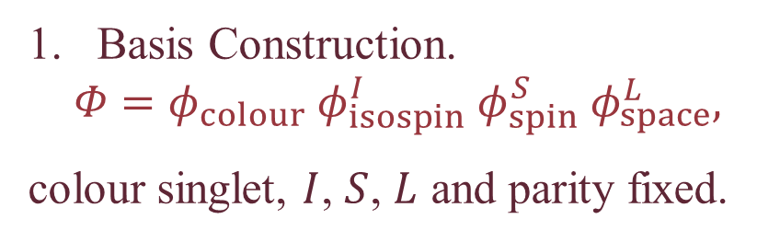


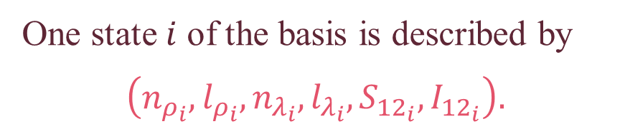

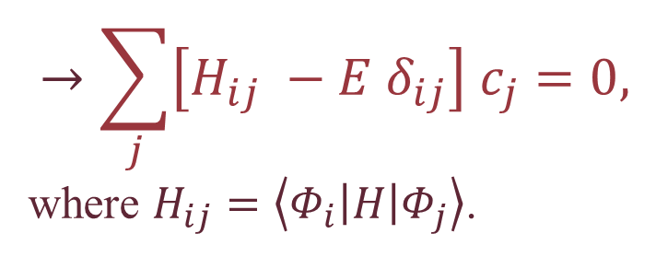
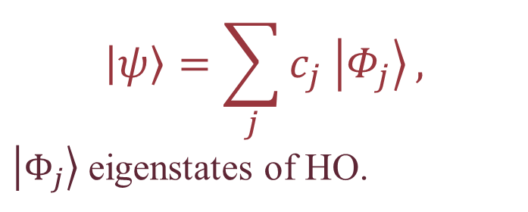
Methods: Oscillator Basis Expansion
For the three-body model
Basis Construction.
$$Φ=φ_{colour} φ_{isospin}^{I} φ_{spin}^{S} φ_{space}^{L},$$
colour singlet, $I$, $S$, $L$ and parity fixed.
$$H\left|ψ\right\rangle =E\left|ψ\right\rangle ,$$
$$\left|ψ\right\rangle =\sum_{j}{c_{j} \left|Φ_{j}\right\rangle },$$
$\left|Φ_{j}\right\rangle$ eigenstates of HO.
One state $i$ of the basis is described by
$$\left(n_{ρ_{i}},l_{ρ_{i}},n_{λ_{i}},l_{λ_{i}}, S_{{12}_{i}},I_{{12}_{i}}\right).$$
2
1
$$λ$$
$$ρ$$
$$ρ$$
$$λ$$
3
$$→\sum_{j}{\left[H_{ij} −E δ_{ij}\right] c_{j}}=0,$$
where $H_{ij}=\left\langle Φ_{i}\left|H\right|Φ_{j}\right\rangle$.
Matrix element computation.
Hamiltonian matrix diagonalisation.

Slide 24

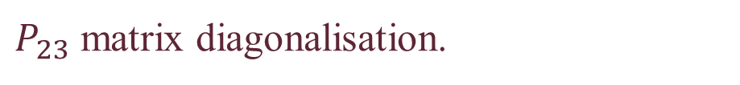


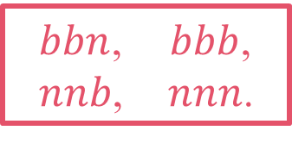
Methods: Oscillator Basis Expansion
$bbn$,
$nnb$,
$bbb$,
$nnn$.
What about the symmetries ?
→ Pauli principle
Two identical quarks:
2
1
$$\left[H_{ho} , P_{12}\right]=0,$$
Just one condition on the eigenvalues.
3
Three identical quarks:
2
1
$\left[H_{ho} , P_{12}\right]=0$ & $\left[H_{ho} , P_{23}\right]=0,$
$P_{23}$ matrix diagonalisation.
3

Slide 25
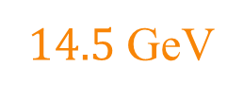


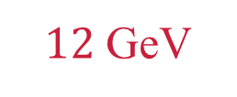
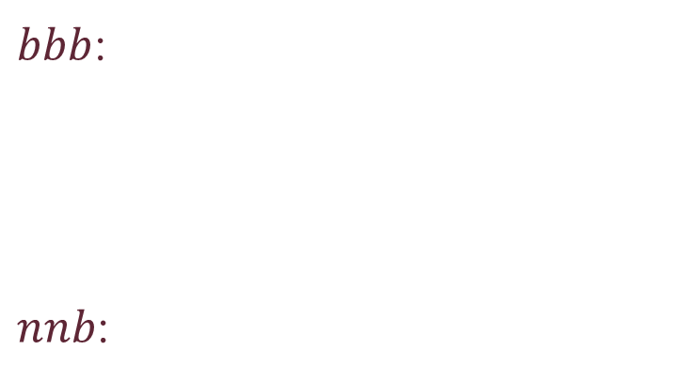

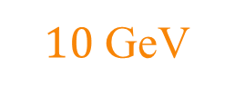

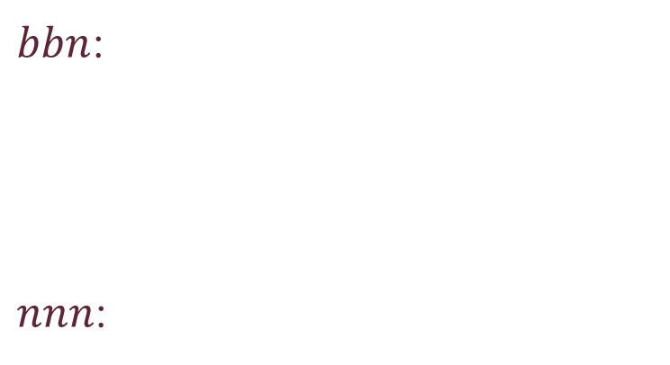

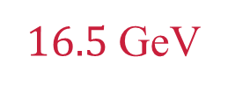
Results: Quantitative Considerations
Approximated mass values for 3-body model:
Ground state / $L=8$
$bbb$:
$nnb$:
$14.5$ GeV
$16.5$ GeV
$bbn$:
$nnn$:
$10$ GeV
$12$ GeV
$6$ GeV
$8$ GeV
$1$ GeV
$3.5$ GeV

Slide 26
Take Home Message
Outlooks:
New procedure to compute distances,
Convolution for different particles,
Diquark in a superposition of states,
Application to more complex systems.
Main References:
C. Tourbez, C. Chevalier, and C. Semay, Eur. Phys. J. A 62, 101 (2026).
Potential:
R. K. Bhaduri, L. E. Cohler, and Y. Nogami, Il Nuovo Cimento A 65, 376 (1981),
L. Theußl, R. F. Wagenbrunn, B. Desplanques, and W. Plessas, Eur. Phys. J. A 12, 91 (2001).
Convolution:
F. Giannuzzi, Phys. Rev. D 79, 094002 (2009).
Colour density:
V. U. Nazarov, Phys. Rev. B 87, 165125 (2013).
Lagrange Mesh:
D. Baye, Phys. Rep. 565, 1 (2015).
OBE:
C. Chevalier and S. Youcef Khodja, Few-Body Syst. 65, 86 (2024).

Slide 28
The Quark Interactions
Y-junction:
Types of interactions studied:
Central-colour short range,
Central-colour long range (confinement),
Spin-colour.
Two-body interactions.
Example for confinement:
Y-junction model,
Delta model.
Delta:

Slide 29
The Quark-Diquark Model
Concept:
Split the three-body system in two two-body systems
→ Approximative model
A two-quark system = The diquark
A quark-diquark system

Slide 30
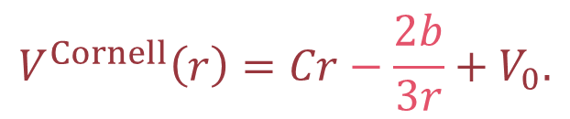
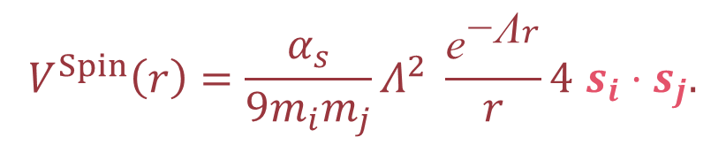
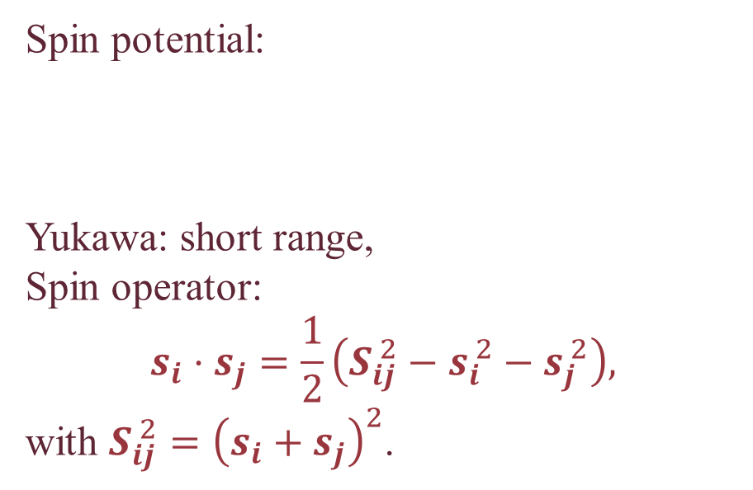
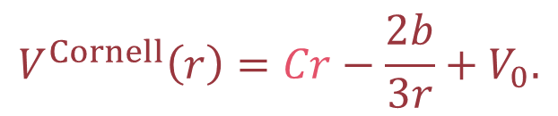
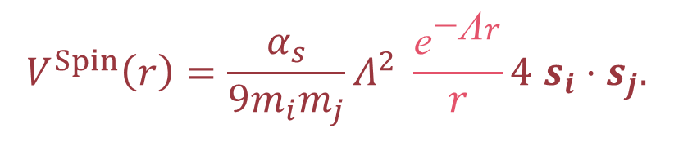
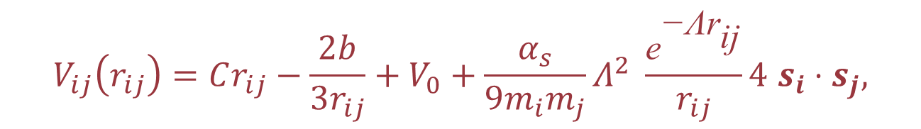
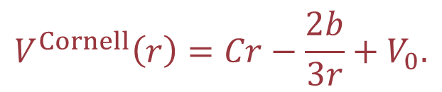





The Quark-Quark Potential
$$V_{ij}\left(r_{ij}\right)=Cr_{ij}−\frac{2b}{3r_{ij}}+V_{0}+\frac{α_{s}}{9m_{i}m_{j}}Λ^{2} \frac{{\text{e}}^{\text{−Λ}{\text{r}}_{\text{ij}}}}{r_{ij}}4 s_{i}⋅s_{j},$$
$$V_{ij}\left(r_{ij}\right)=Cr_{ij}−\frac{2b}{3r_{ij}}+V_{0}+\frac{α_{s}}{9m_{i}m_{j}}Λ^{2} \frac{{\text{e}}^{\text{−Λ}{\text{r}}_{\text{ij}}}}{r_{ij}}4 s_{i}⋅s_{j},$$
$$V_{ij}\left(r_{ij}\right)=Cr_{ij}−\frac{2b}{3r_{ij}}+V_{0}+\frac{α_{s}}{9m_{i}m_{j}}Λ^{2} \frac{{\text{e}}^{\text{−Λ}{\text{r}}_{\text{ij}}}}{r_{ij}}4 s_{i}⋅s_{j},$$
Cornell’s potential:
Linear part: long range central-colour,
Coulombian part: short range central-colour,
Constant: To reproduce experimental data.
Spin potential:
Yukawa: short range,
Spin operator:
$$s_{i}⋅s_{j}=\frac{1}{2}\left(S_{ij}^{ 2}−s_{i}^{ 2}−s_{j}^{ 2}\right),$$
with $S_{ij}^{ 2}={\left(s_{i}+s_{j}\right)}^{2}$.
$$V^{Spin}\left(r\right)=\frac{α_{s}}{9m_{i}m_{j}}Λ^{2} \frac{{\text{e}}^{\text{−Λ}r}}{r}4 s_{i}⋅s_{j}.$$
$$V^{Spin}\left(r\right)=\frac{α_{s}}{9m_{i}m_{j}}Λ^{2} \frac{{\text{e}}^{\text{−Λ}r}}{r}4 s_{i}⋅s_{j}.$$
$$V^{Spin}\left(r\right)=\frac{α_{s}}{9m_{i}m_{j}}Λ^{2} \frac{{\text{e}}^{\text{−Λ}r}}{r}4 s_{i}⋅s_{j}.$$
$$V^{Cornell}\left(r\right)=Cr−\frac{2b}{3r}+V_{0}.$$
$$V^{Spin}\left(r\right)=\frac{α_{s}}{9m_{i}m_{j}}Λ^{2} \frac{{\text{e}}^{\text{−Λ}r}}{r}4 s_{i}⋅s_{j}.$$
$$V^{Cornell}\left(r\right)=Cr−\frac{2b}{3r}+V_{0}.$$
$$V^{Cornell}\left(r\right)=Cr−\frac{2b}{3r}+V_{0}.$$
$$V^{Cornell}\left(r\right)=Cr−\frac{2b}{3r}+V_{0}.$$

Slide 31









Methods: Lagrange Mesh
Set of orthonormal functions $f_{j}(x)$,
  $$f_{j}\left(x_{k}\right)∝δ_{jk},$$
$f_{j}$: regularized Lagrange functions.
For the quark-diquark model
$$H\left|ψ\right\rangle =E\left|ψ\right\rangle ,$$
$H=H_{D}$ or $H_{B}$.
$$f_{i}\left(x\right)={\left(−1\right)}^{i}x_{i}^{−1/2} x{\left(x−x_{i}\right)}^{−1} L_{N}\left(x\right) \text{exp}\left(−\frac{x}{2}\right)$$
$$\left|ψ\right\rangle =\sum_{j}{c_{j} \left|f_{j}\right\rangle },$$
$$\left\langle r | f_{j}\right\rangle =\frac{f_{j}(r/h)}{\sqrt{h} r} Y_{lm}(\hat{r})$$
Gauss approx.
$$\left\langle f_{i} | f_{j}\right\rangle ≈δ_{ij}$$
Mesh method:
Mesh points $x_{k}$, $k∈\{1,…,N\}$,
Finally, we have to solve:
$$\sum_{j=1}^{N}{\left[T_{ij}+V\left(hx_{i}\right)δ_{ij}−Eδ_{ij}\right]c_{j}=0},$$
with $T_{ij}≈⟨f_{i}\left|T\right|f_{j}⟩$ computable.
$$L_{N}\left(x_{k}\right)=0,$$
$L_{N}$: Laguerre polynomial of degree $N$.

Slide 32







Methods: Oscillator Basis Expansion
Matrix element computation.
$$\left\langle Φ_{i}\left|H\right|Φ_{j}\right\rangle = ?$$
$$H=\sum_{k}{T_{k}}+\sum_{k<l}{V_{kl}},$$
$$T_{k}\left(p\right)=\sqrt{p^{2}+m_{k}^{2}},$$
$$H_{ij}=\left\langle Φ_{i}\left|V_{12}\right|Φ_{j}\right\rangle +\left\langle Φ_{i}\left|V_{23}\right|Φ_{j}\right\rangle +\left\langle Φ_{i}\left|V_{13}\right|Φ_{j}\right\rangle$$
  $$+\left\langle Φ_{i}\left|T_{1}\right|Φ_{j}\right\rangle +\left\langle Φ_{i}\left|T_{2}\right|Φ_{j}\right\rangle +\left\langle Φ_{i}\left|T_{3}\right|Φ_{j}\right\rangle .$$
$$V_{kl}\left(r\right)=Cr−\frac{2b}{3r}+V_{0}+\frac{α_{s}}{9m_{k}m_{l}}Λ^{2} \frac{{\text{e}}^{\text{−Λ}r}}{r}4 s_{k}⋅s_{l}.$$
Eigenstate example:
$$\frac{1}{\sqrt{2}} \left(0,0,0,0,1,1\right)+\frac{1}{\sqrt{2}} \left(0,0,0,0,0,0\right)$$
Hamiltonian matrix diagonalisation.
$$\left(n_{i},l_{i},ν_{i},λ_{i}, S_{{12}_{i}},I_{{12}_{i}}\right)$$

Slide 33

Methods: Oscillator Basis Expansion
What about the diquark symmetries ?
Type | Isospin ($I_{12}$) | Spin ($S_{12}$) | Space ($L_{12}$)
$$bb$$ | S (0) | S (1) | S (pair)
 | S (0) | A (0) | A (impair)
$$nn$$ | S (1) | S (1) | S (pair)
 | A (0) | S (1) | A (impair)
 | S (1) | A (0) | A (impair)
 | A (0) | A (0) | S (pair)

Slide 34






Spin factors
$$s_{i}⋅s_{j}=\frac{1}{2}\left(S_{ij}^{ 2}−s_{i}^{ 2}−s_{j}^{ 2}\right),$$
$S_{ij}^{ 2}={\left(s_{i}+s_{j}\right)}^{2}$.
Diquark:
Quark-diquark:
$$s_{1}⋅s_{2}=\frac{1}{2}\left(S_{D}^{ 2}−s_{1}^{ 2}−s_{2}^{ 2}\right).$$
$$S_{D}⋅s_{3}=\frac{1}{2}\left(S_{B}^{ 2}−S_{D}^{ 2}−s_{3}^{ 2}\right).$$
$$S_{B}$$ | $$S_{D}$$ | $$S_{D}⋅s_{3}$$
$$\frac{3}{2}$$ | $$1$$ | $$\frac{1}{2}$$
$$\frac{1}{2}$$ | $$1$$ | $$−1$$
$$\frac{1}{2}$$ | $$0$$ | $$0$$
$$S_{D}$$ | $$s_{1}⋅s_{2}$$
$$1$$ | $$\frac{1}{4}$$
$$0$$ | $$−\frac{3}{4}$$

Slide 35






Results: $nnb$
$$\left(n_{i},l_{i},ν_{i},λ_{i}, S_{{12}_{i}},I_{{12}_{i}}\right)$$
Highlight of intra-diquark spin interactions:
Fundamental states with $S=1/2$,
Total isospin $I=I_{12}=1$ or $0$.
Symmetry constraints:
$1$ GeV ⁻¹
Space (L): S (0) & Colour: A.
Isospin ($I_{12}$) | Spin ($S_{12}$)
S (1) | S (1)
A (0) | A (0)
State $\left(0,0,0,0,1,1\right)$
$$≈0.7\%$$
State $\left(0,0,0,0,0,0\right)$
$$≈2.4\%$$
$$V^{spin}∝s_{1}⋅s_{2}=\left\{\begin{aligned}\frac{1}{4} if S_{12}=1, \\ −\frac{3}{4} if S_{12}=0.\end{aligned}\right.$$

Slide 36





Results: Summary
Three Identical particles:
Equilateral triangle structure,
$L=8$ complex states.
$bbn$:
Compact diquark for fundamental,
Very extended diquark for $L=8$,
Good correspondence for both.
$bbb$:
Globally more compact,
Good correspondence,
Minimal spin impact.
$nnb$:
Important intra-diquark spin interactions,
Non-compact diquark for fundamental,
Very compact diquark for $L=8$,
Better results for less compact diquark.
$nnn$:
Extended,
Not very favourable,
More spin impact.

