Slide 1


Hidden-Charm Pentaquark Baryon Resonances in Regge Phenomenology: Spectra and Threshold Patterns
Presented by
VANDAN K. PATEL
Under the Supervision of
Prof. A.K. Rai
(Professor)
15th International Workshop on the Physics of Excited Nucleons
(NSTAR 2026)
Department of Physics
Sardar Vallabhbhai National Institute of Technology
Surat– 395 007

Slide 2
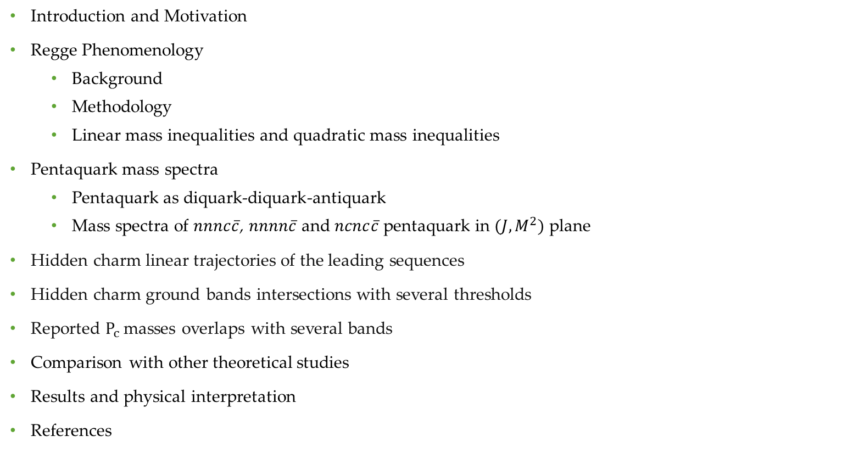
Outline
Introduction and Motivation
Regge Phenomenology
  Background
  Methodology
  Linear mass inequalities and quadratic mass inequalities
Pentaquark mass spectra
  Pentaquark as diquark-diquark-antiquark
  Mass spectra of $nnnc\overline{c}$, $nnnn\overline{c}$ and $ncnc\overline{c}$ pentaquark in $(J,M^{2})$ plane
Hidden charm linear trajectories of the leading sequences
Hidden charm ground bands intersections with several thresholds
Reported $P_{c}$ masses overlaps with several bands
Comparison with other theoretical studies
Results and physical interpretation
References

Slide 3
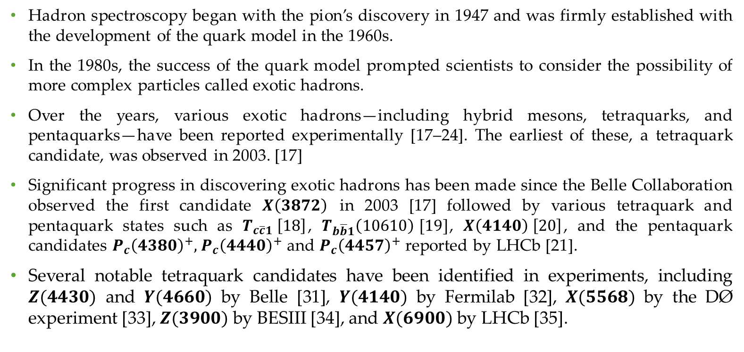
Introduction and Motivation
Hadron spectroscopy began with the pion’s discovery in 1947 and was firmly established with the development of the quark model in the 1960s.
In the 1980s, the success of the quark model prompted scientists to consider the possibility of more complex particles called exotic hadrons.
Over the years, various exotic hadrons—including hybrid mesons, tetraquarks, and pentaquarks—have been reported experimentally [17–24]. The earliest of these, a tetraquark candidate, was observed in 2003. [17]
Significant progress in discovering exotic hadrons has been made since the Belle Collaboration observed the first candidate $X\left(3872\right)$ in 2003 [17] followed by various tetraquark and pentaquark states such as $T_{c\overline{c}1} \left[18\right]$, $T_{b\overline{b}1}\left(10610\right) [19]$, $X\left(4140\right) \left[20\right]$, and the pentaquark candidates $P_{c}{\left(4380\right)}^{+},$ $P_{c}{\left(4440\right)}^{+}$ and $P_{c}{\left(4457\right)}^{+}$ reported by LHCb [21].
Several notable tetraquark candidates have been identified in experiments, including $Z(4430)$ and $Y(4660)$ by Belle [31], $Y(4140)$ by Fermilab [32], $X(5568)$ by the DØ experiment [33], $Z(3900)$ by BESIII [34], and $X(6900)$ by LHCb [35].

Slide 4
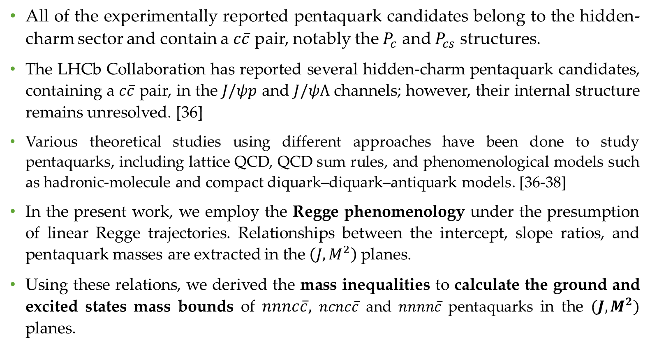
All of the experimentally reported pentaquark candidates belong to the hidden-charm sector and contain a $c\overline{c}$ pair, notably the $P_{c}$ and $P_{cs}$ structures.
The LHCb Collaboration has reported several hidden-charm pentaquark candidates, containing a $c\overline{c}$ pair, in the $J/ψp$ and $J/ψΛ$ channels; however, their internal structure remains unresolved. [36]
Various theoretical studies using different approaches have been done to study pentaquarks, including lattice QCD, QCD sum rules, and phenomenological models such as hadronic-molecule and compact diquark–diquark–antiquark models. [36-38]
In the present work, we employ the Regge phenomenology under the presumption of linear Regge trajectories. Relationships between the intercept, slope ratios, and pentaquark masses are extracted in the $\left(J,M^{2}\right)$ planes.
Using these relations, we derived the mass inequalities to calculate the ground and excited states mass bounds of $nnnc\overline{c},$ $ncnc\overline{c}$ and $nnnn\overline{c}$ pentaquarks in the $(J,M^{2})$ planes.

Slide 5
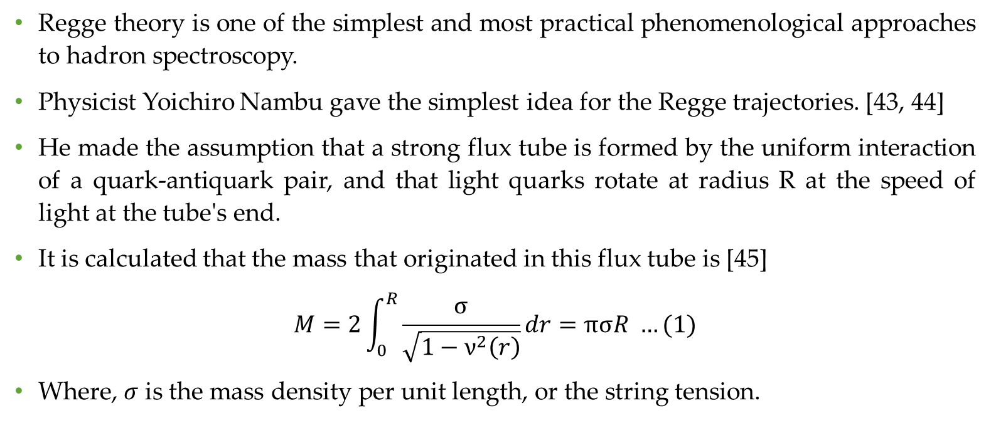
Regge Phenomenology
Background
Regge theory is one of the simplest and most practical phenomenological approaches to hadron spectroscopy.
Physicist Yoichiro Nambu gave the simplest idea for the Regge trajectories. [43, 44]
He made the assumption that a strong flux tube is formed by the uniform interaction of a quark-antiquark pair, and that light quarks rotate at radius R at the speed of light at the tube's end.
It is calculated that the mass that originated in this flux tube is [45]
$$M=2\int_{0}^{R}{\frac{σ}{\sqrt{1−ν^{2}\left(r\right)}}dr}=πσR …(1)$$
Where, $σ$ is the mass density per unit length, or the string tension.

Slide 6
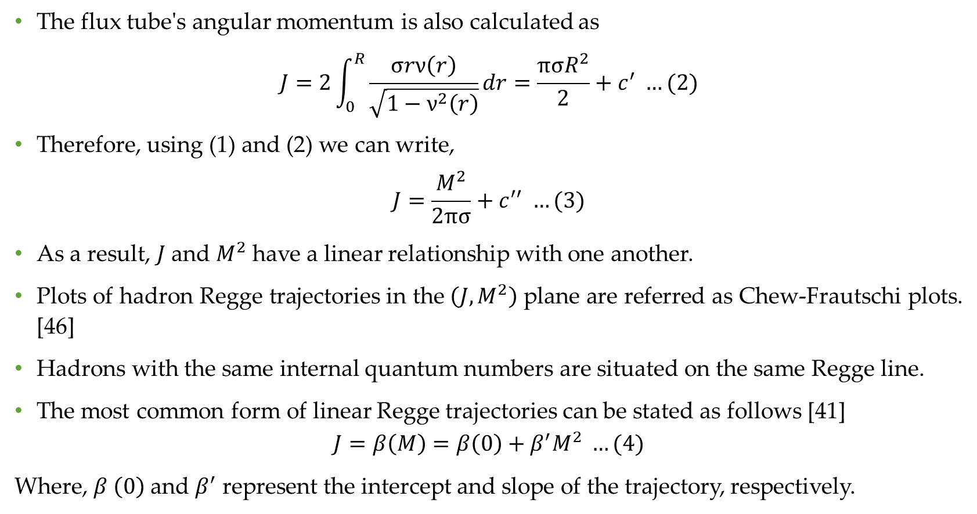
The flux tube's angular momentum is also calculated as
$$J=2\int_{0}^{R}{\frac{σrν\left(r\right)}{\sqrt{1−ν^{2}\left(r\right)}}dr}=\frac{πσR^{2}}{2}+c^{′} …(2)$$
Therefore, using (1) and (2) we can write,
$$J=\frac{M^{2}}{2πσ}+c^{′′} …(3)$$
As a result, $J$ and $M^{2}$ have a linear relationship with one another.
Plots of hadron Regge trajectories in the $\left(J,M^{2}\right)$ plane are referred as Chew-Frautschi plots. [46]
Hadrons with the same internal quantum numbers are situated on the same Regge line.
The most common form of linear Regge trajectories can be stated as follows [41]
$$J=β\left(M\right)=β\left(0\right)+β^{′}M^{2} …(4)$$
Where, $β \left(0\right)$ and $β^{′}$ represent the intercept and slope of the trajectory, respectively.

Slide 7
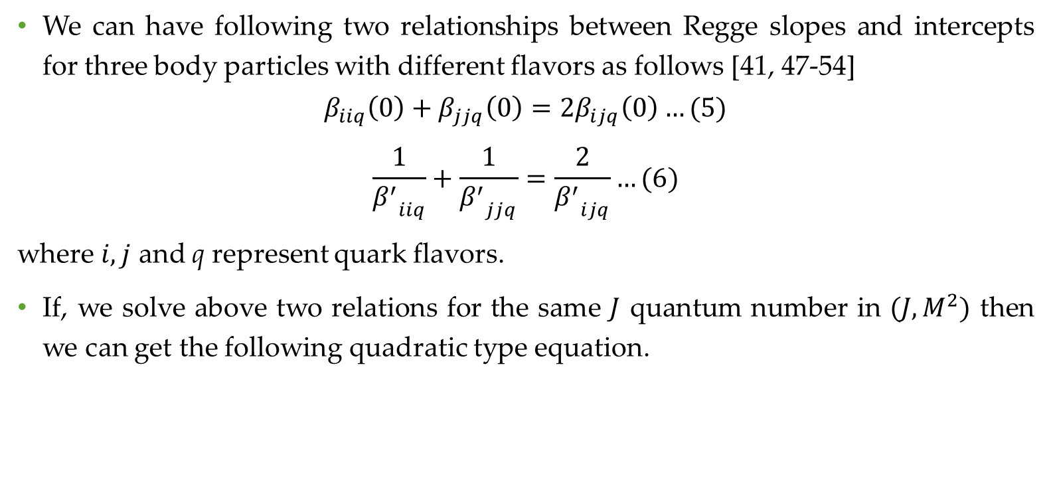
Regge Phenomenology
Methodology
We can have following two relationships between Regge slopes and intercepts for three body particles with different flavors as follows [41, 47-54]
$$β_{iiq}\left(0\right)+β_{jjq}\left(0\right)=2β_{ijq}\left(0\right)…(5)$$
$$\frac{1}{{β^{′}}_{iiq}}+\frac{1}{{β^{′}}_{jjq}}=\frac{2}{{β^{′}}_{ijq}}…(6)$$
where $i,j$ and q represent quark flavors.
If, we solve above two relations for the same $J$ quantum number in $(J,M^{2})$ then we can get the following quadratic type equation.

Slide 8
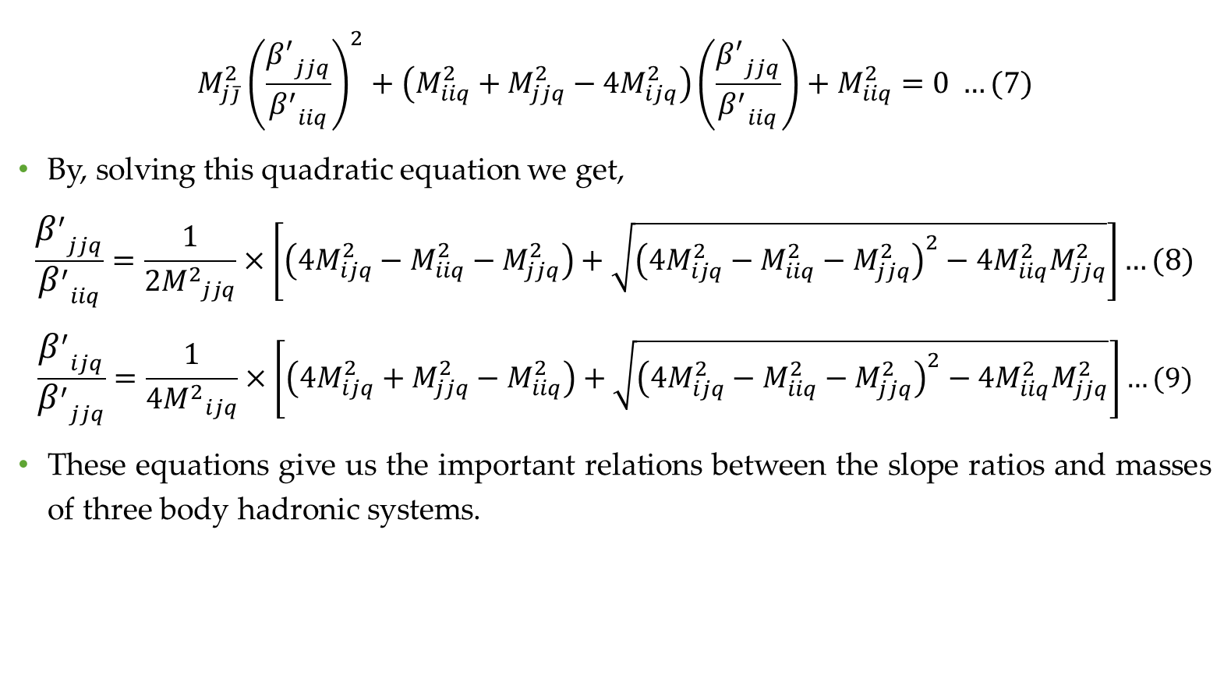
$${M_{j\overline{j}}^{2}\left(\frac{{β^{′}}_{jjq}}{{β^{′}}_{iiq}}\right)}^{2}+\left(M_{iiq}^{2}+M_{jjq}^{2}−4M_{ijq}^{2}\right)\left(\frac{{β^{′}}_{jjq}}{{β^{′}}_{iiq}}\right)+M_{iiq}^{2}=0 …(7)$$
By, solving this quadratic equation we get,
$$\frac{{β^{′}}_{jjq}}{{β^{′}}_{iiq}}=\frac{1}{2{M^{2}}_{jjq}}×\left[\left(4M_{ijq}^{2}−M_{iiq}^{2}−M_{jjq}^{2}\right)+\sqrt{{\left(4M_{ijq}^{2}−M_{iiq}^{2}−M_{jjq}^{2}\right)}^{2}−4M_{iiq}^{2}M_{jjq}^{2}}\right]…(8)$$
$$\frac{{β^{′}}_{ijq}}{{β^{′}}_{jjq}}=\frac{1}{4{M^{2}}_{ijq}}×\left[\left(4M_{ijq}^{2}+M_{jjq}^{2}−M_{iiq}^{2}\right)+\sqrt{{\left(4M_{ijq}^{2}−M_{iiq}^{2}−M_{jjq}^{2}\right)}^{2}−4M_{iiq}^{2}M_{jjq}^{2}}\right]…(9)$$
These equations give us the important relations between the slope ratios and masses of three body hadronic systems.

Slide 9
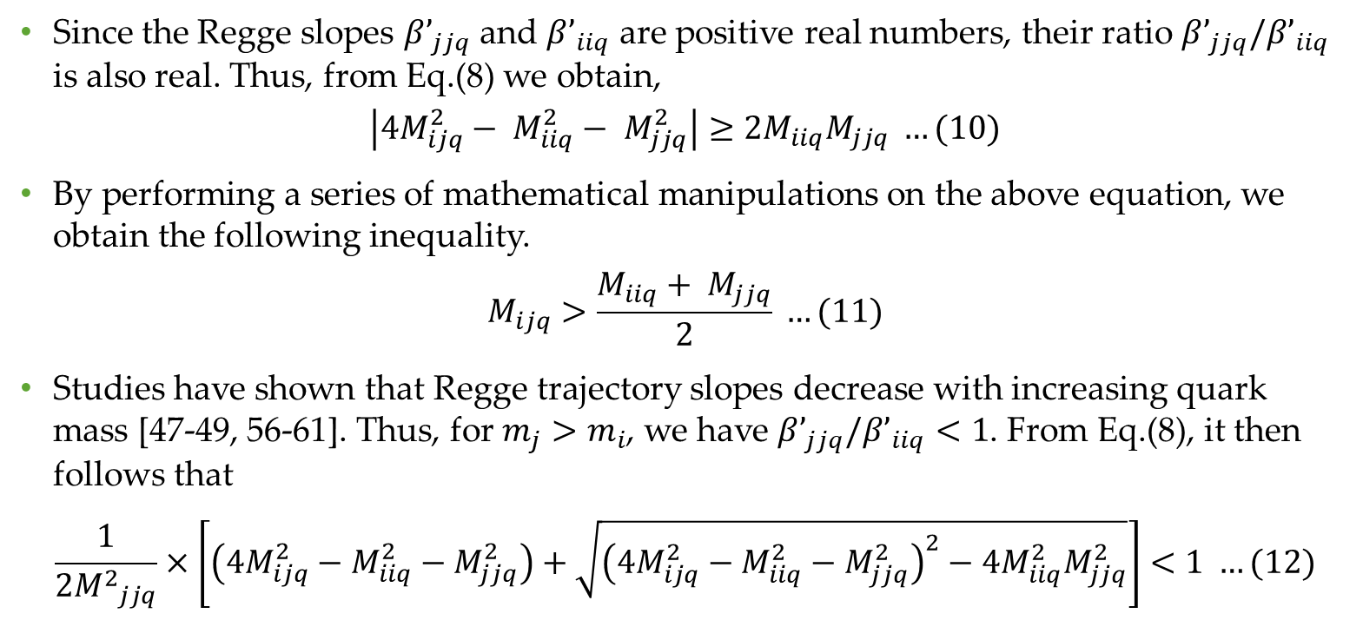
Linear mass inequalities and quadratic mass inequalities
Since the Regge slopes $β’_{jjq}$ and $β’_{iiq}$ are positive real numbers, their ratio $β’_{jjq}/β’_{iiq}$ is also real. Thus, from Eq.(8) we obtain,
$$\left|4M_{ijq}^{2}− M_{iiq}^{2}− M_{jjq}^{2}\right|≥2M_{iiq}M_{jjq} …(10)$$
By performing a series of mathematical manipulations on the above equation, we obtain the following inequality.
$$M_{ijq}>\frac{M_{iiq}+ M_{jjq}}{2} …(11)$$
Studies have shown that Regge trajectory slopes decrease with increasing quark mass [47-49, 56-61]. Thus, for $m_{j}>m_{i}$, we have $β’_{jjq}/β’_{iiq}<1$. From Eq.(8), it then follows that
$$\frac{1}{2{M^{2}}_{jjq}}×\left[\left(4M_{ijq}^{2}−M_{iiq}^{2}−M_{jjq}^{2}\right)+\sqrt{{\left(4M_{ijq}^{2}−M_{iiq}^{2}−M_{jjq}^{2}\right)}^{2}−4M_{iiq}^{2}M_{jjq}^{2}}\right]<1 …(12)$$

Slide 10
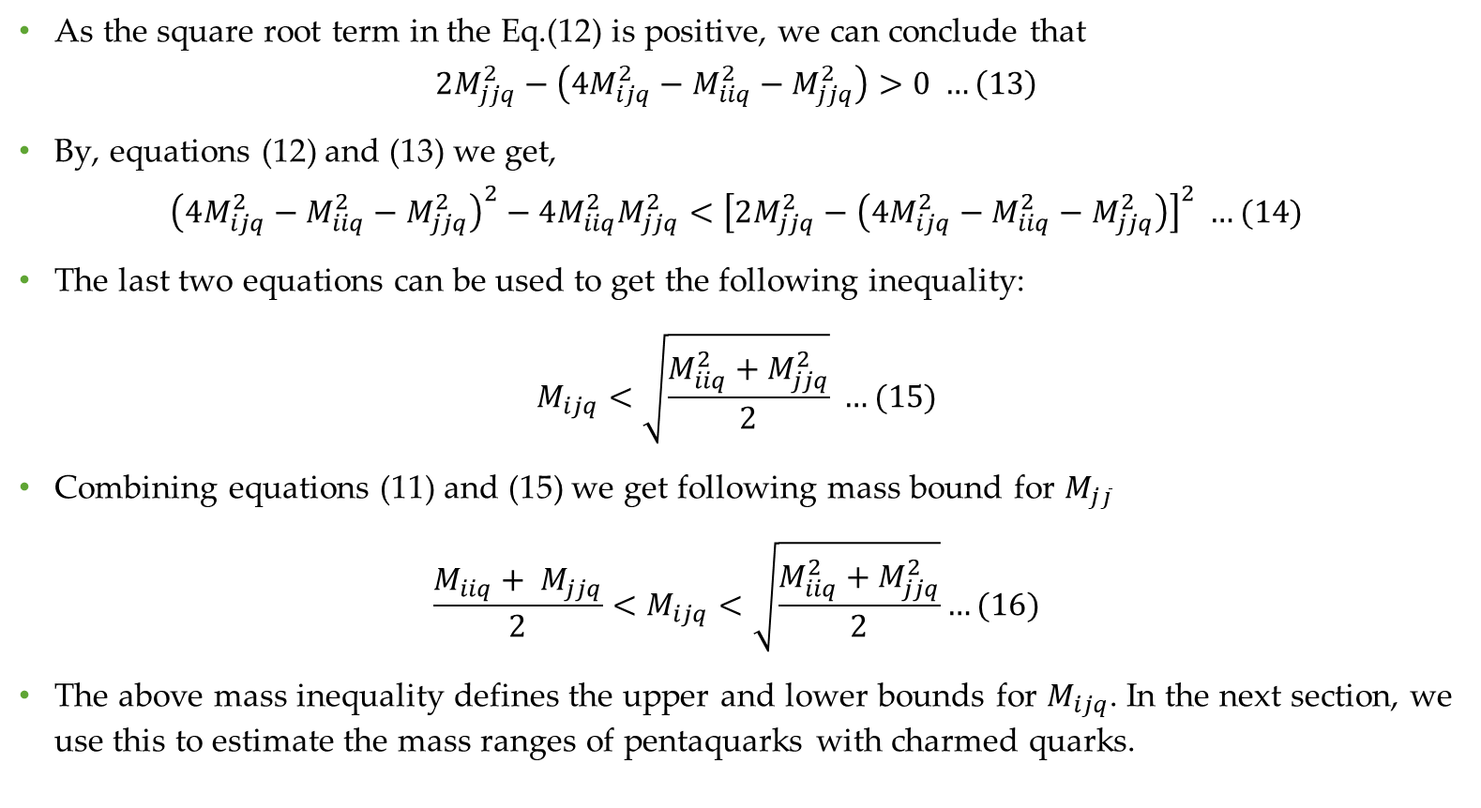
As the square root term in the Eq.(12) is positive, we can conclude that
$$2M_{jjq}^{2}−\left(4M_{ijq}^{2}−M_{iiq}^{2}−M_{jjq}^{2}\right)>0 …\left(13\right)$$
By, equations (12) and (13) we get,
$${\left(4M_{ijq}^{2}−M_{iiq}^{2}−M_{jjq}^{2}\right)}^{2}−4M_{iiq}^{2}M_{jjq}^{2}<{\left[2M_{jjq}^{2}−\left(4M_{ijq}^{2}−M_{iiq}^{2}−M_{jjq}^{2}\right)\right]}^{2} …(14)$$
The last two equations can be used to get the following inequality:
$$M_{ijq}<\sqrt{\frac{M_{iiq}^{2}+M_{jjq}^{2}}{2}} …(15)$$
Combining equations (11) and (15) we get following mass bound for $M_{j\overline{j}}$
$$\frac{M_{iiq}+ M_{jjq}}{2}<M_{ijq}<\sqrt{\frac{M_{iiq}^{2}+M_{jjq}^{2}}{2}}…(16)$$
The above mass inequality defines the upper and lower bounds for $M_{ijq}$. In the next section, we use this to estimate the mass ranges of pentaquarks with charmed quarks.

Slide 11
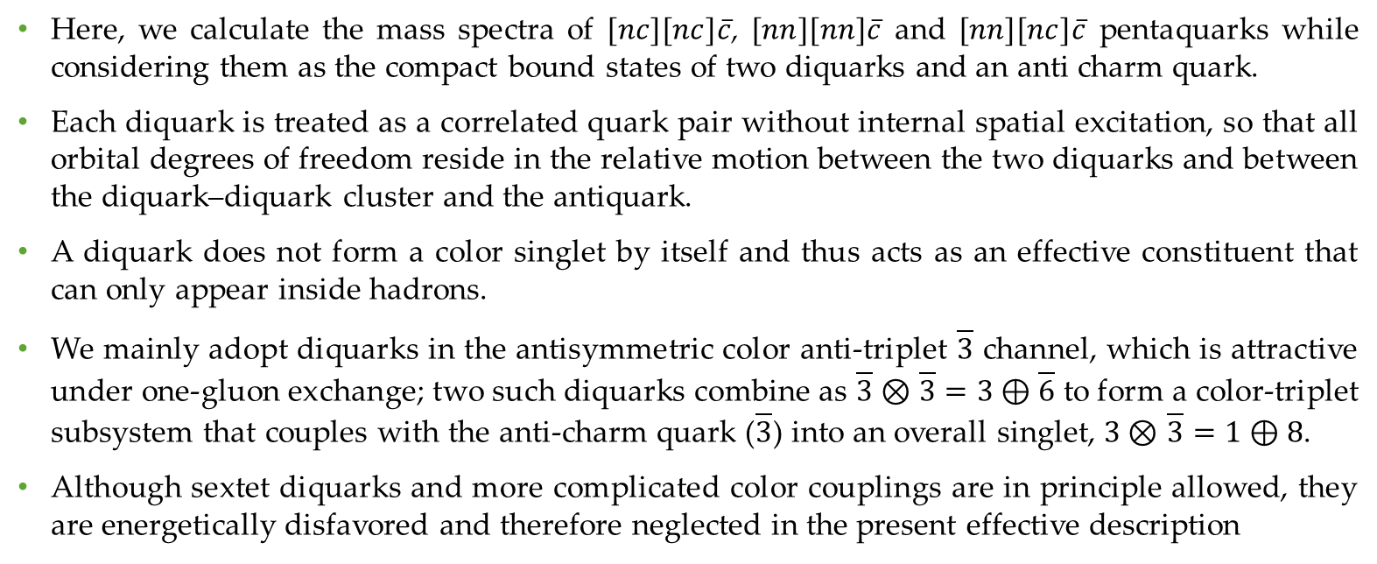
Pentaquark mass spectra
  The five-quark state in the diquark-diquark-antiquark picture
Here, we calculate the mass spectra of $[nc][nc]\overline{c}$, $[nn][nn]\overline{c}$ and $[nn][nc]\overline{c}$ pentaquarks while considering them as the compact bound states of two diquarks and an anti charm quark.
Each diquark is treated as a correlated quark pair without internal spatial excitation, so that all orbital degrees of freedom reside in the relative motion between the two diquarks and between the diquark–diquark cluster and the antiquark.
A diquark does not form a color singlet by itself and thus acts as an effective constituent that can only appear inside hadrons.
We mainly adopt diquarks in the antisymmetric color anti-triplet $\overline{3}$ channel, which is attractive under one-gluon exchange; two such diquarks combine as $\overline{3}⊗$ $\overline{3}=3⊕\overline{6}$ to form a color-triplet subsystem that couples with the anti-charm quark ($\overline{3}$) into an overall singlet, $3⊗$ $\overline{3}=1⊕8$.
Although sextet diquarks and more complicated color couplings are in principle allowed, they are energetically disfavored and therefore neglected in the present effective description
Notes:
A tetraquark in a color singlet state can arise from two distinct diquark-antidiquark pairings: (i) a color anti-triplet diquark paired with a color triplet anti-diquark, or (ii) a color sextet diquark paired with a color anti-sextet anti diquark. So, if we consider tetraquark as two body system made up of diquark and anti-diquark then we can use equation (18), to calculate mass spectra of tetraquark.

Slide 12
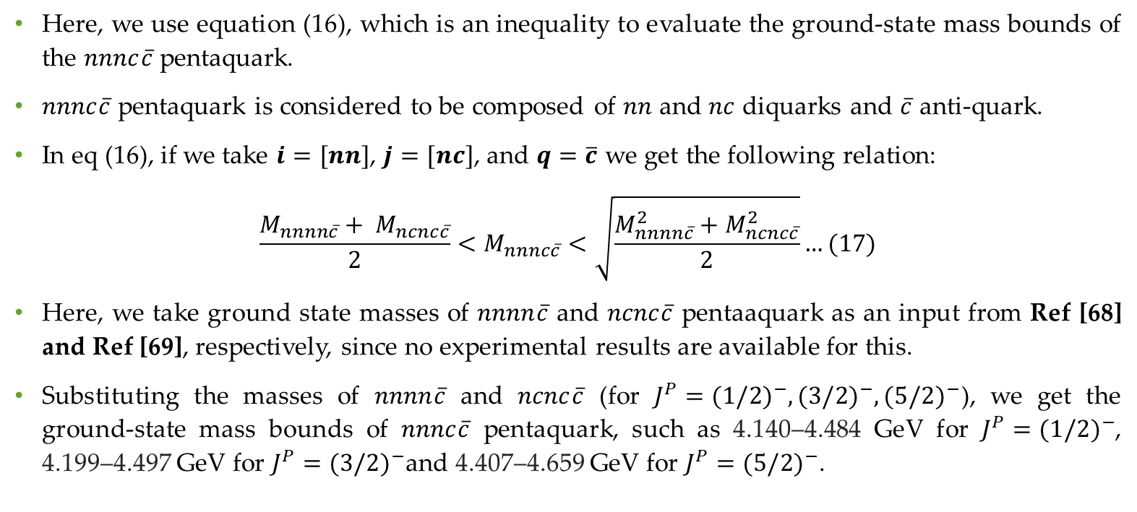
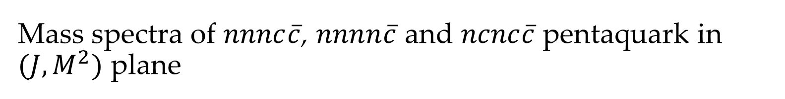
Mass spectra of $nnnc\overline{c}$, $nnnn\overline{c}$ and $ncnc\overline{c}$ pentaquark in $(J,M^{2})$ plane
Here, we use equation (16), which is an inequality to evaluate the ground-state mass bounds of the $nnnc\overline{c}$ pentaquark.
$nnnc\overline{c}$ pentaquark is considered to be composed of $nn$ and $nc$ diquarks and $\overline{c}$ anti-quark.
In eq (16), if we take $i=[nn]$, $j=[nc]$, and $q=\overline{c}$ we get the following relation:
$$\frac{M_{nnnn\overline{c}}+ M_{ncnc\overline{c}}}{2}<M_{nnnc\overline{c}}<\sqrt{\frac{M_{nnnn\overline{c}}^{2}+M_{ncnc\overline{c}}^{2}}{2}}…(17)$$
Here, we take ground state masses of $nnnn\overline{c}$ and $ncnc\overline{c}$ pentaaquark as an input from Ref [68] and Ref [69], respectively, since no experimental results are available for this.
Substituting the masses of $nnnn\overline{c}$ and $ncnc\overline{c}$ (for $J^{P}={(1/2)}^{−},{(3/2)}^{−},{(5/2)}^{−}$), we get the ground-state mass bounds of $nnnc\overline{c}$ pentaquark, such as 4.140–4.484 GeV for $J^{P}={(1/2)}^{−}$, 4.199–4.497 GeV for $J^{P}={(3/2)}^{−}$and 4.407–4.659 GeV for $J^{P}={(5/2)}^{−}$.

Slide 13
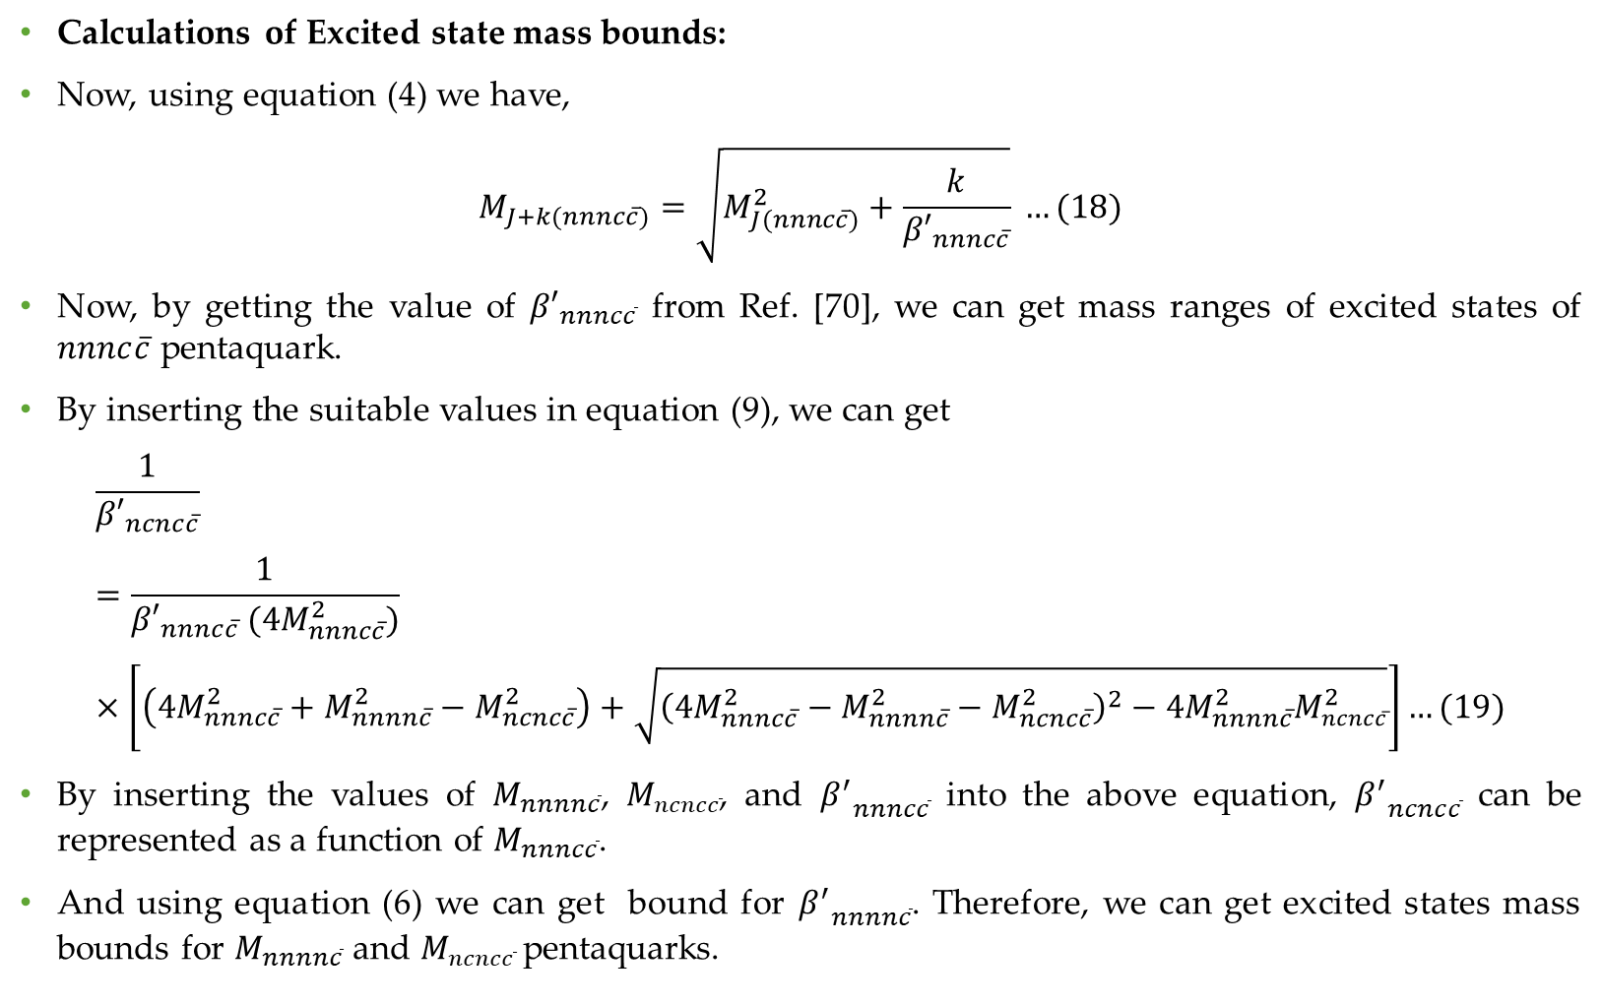
Calculations of Excited state mass bounds:
Now, using equation (4) we have,
$$M_{J+k(nnnc\overline{c})}=\sqrt{M_{J(nnnc\overline{c})}^{2}+\frac{k}{{β′}_{nnnc\overline{c}}}} …(18)$$
Now, by getting the value of ${β′}_{nnnc\overline{c}}$ from Ref. [70], we can get mass ranges of excited states of $nnnc\overline{c}$ pentaquark.
By inserting the suitable values in equation (9), we can get
$$\frac{1}{{β′}_{ncnc\overline{c}}}=\frac{1}{{β′}_{nnnc\overline{c}} (4M_{nnnc\overline{c}}^{2})}×\left[\left(4M_{nnnc\overline{c}}^{2}+M_{nnnn\overline{c}}^{2}−M_{ncnc\overline{c}}^{2}\right)+\sqrt{{\left(4M_{nnnc\overline{c}}^{2}−M_{nnnn\overline{c}}^{2}−M_{ncnc\overline{c}}^{2}\right)}^{2}−4M_{nnnn\overline{c}}^{2}M_{ncnc\overline{c}}^{2}}\right]…(19)$$
By inserting the values of $M_{nnnn\overline{c}}$, $M_{ncnc\overline{c}}$, and ${β^{′}}_{nnnc\overline{c}}$ into the above equation, ${β^{′}}_{ncnc\overline{c}}$ can be represented as a function of $M_{nnnc\overline{c}}$.
And using equation (6) we can get bound for ${β^{′}}_{nnnn\overline{c}}$. Therefore, we can get excited states mass bounds for $M_{nnnn\overline{c}}$ and $M_{ncnc\overline{c}}$ pentaquarks.

Slide 14
Hidden-charm $nnnc\overline{c}$: predicted S-F spectra
Spin family | S | P | D | F
Doublet s = 1/2 | 1/2⁻ | 3/2⁺ | 5/2⁻ | 7/2⁺
 | 4.140–4.484 | 4.352–4.680 | 4.554–4.868 | 4.747–5.049
Quartet s = 3/2 | 3/2⁻ | 5/2⁺ | 7/2⁻ | 9/2⁺
 | 4.199–4.497 | 4.418–4.702 | 4.627–4.898 | 4.826–5.087
Sextet s = 5/2 | 5/2⁻ | 7/2⁺ | 9/2⁻ | 11/2⁺
 | 4.407–4.659 | 4.644–4.885 | 4.870–5.100 | 5.086–5.306
Masses in GeV; each cell gives Jᴾ and its mass interval. Leading stretched sequences only.
10 / 18
Notes:
Planned delivery: 1:25.
This is the principal numerical table. The three ground envelopes are 4.140–4.484, 4.199–4.497 and 4.407–4.659 GeV. All S–F columns here are obtained from the inverse-bound construction with the independently specified slope calibration. Highlight the first P-wave doublet band, now 4.352–4.680 GeV after the corrected reference pairing. The intervals are model-input envelopes, not confidence intervals. They enclose separate C-input scenarios and preserve correlations within each scenario before taking the outer envelope. Do not read every cell aloud.
[Sources]
Corrected NSTAR calculation report, NSTAR_2026_Hidden_Charm_Regge_Report_Corrected.pdf; equations, input tables, Tables 1 and 5–16.
H.-T. An et al., Phys. Rev. D 100, 056004 (2019), Table V. https://doi.org/10.1103/PhysRevD.100.056004
H.-T. An, K. Chen and X. Liu, Phys. Rev. D 105, 034018 (2022), Table VIII. https://doi.org/10.1103/PhysRevD.105.034018
A. Ali et al., Mass spectrum of the hidden-charm pentaquarks in the compact diquark model, JHEP 10 (2019) 256, Table 8. https://doi.org/10.1007/JHEP10(2019)256
Visual reference and authentic SVNIT logo: user-supplied Vandan RPS 6.pptx.
[/Sources]

Slide 15
Anti-charmed $nnnn\overline{c}$: predicted P-F spectra
Spin family | S input | P | D | F
Doublet s = 1/2 | 1/2⁻ | 3/2⁺ | 5/2⁻ | 7/2⁺
 | 3.032 | 3.234–3.315 | 3.424–3.576 | 3.604–3.818
Quartet s = 3/2 | 3/2⁻ | 5/2⁺ | 7/2⁻ | 9/2⁺
 | 3.043 | 3.254–3.339 | 3.453–3.610 | 3.641–3.863
Sextet s = 5/2 | 5/2⁻ | 7/2⁺ | 9/2⁻ | 11/2⁺
 | 3.249 | 3.480–3.564 | 3.697–3.854 | 3.901–4.124
Masses in GeV; each cell gives Jᴾ and its mass interval. Leading stretched sequences only.
11 / 18
Notes:
Planned delivery: 0:40.
The anti-charmed S-wave column contains theoretical input anchors. Only the P–F entries are excited-state predictions in this table. Their slopes are transferred from B using the paired roots consistent with the finite bound. The endpoint-sector excitations depend on this root prescription. The source input isospins remain distinct scenarios; the outer envelope does not claim one isospin-resolved trajectory. Each cell carries the J and parity appropriate to its orbital step.
[Sources]
Corrected NSTAR calculation report, NSTAR_2026_Hidden_Charm_Regge_Report_Corrected.pdf; equations, input tables, Tables 1 and 5–16.
H.-T. An et al., Phys. Rev. D 100, 056004 (2019), Table V. https://doi.org/10.1103/PhysRevD.100.056004
H.-T. An, K. Chen and X. Liu, Phys. Rev. D 105, 034018 (2022), Table VIII. https://doi.org/10.1103/PhysRevD.105.034018
A. Ali et al., Mass spectrum of the hidden-charm pentaquarks in the compact diquark model, JHEP 10 (2019) 256, Table 8. https://doi.org/10.1007/JHEP10(2019)256
Visual reference and authentic SVNIT logo: user-supplied Vandan RPS 6.pptx.
[/Sources]

Slide 16
Multicharm $ncnc\overline{c}$: predicted P-F spectra
Spin family | S input | P | D | F
Doublet s = 1/2 | 1/2⁻ | 3/2⁺ | 5/2⁻ | 7/2⁺
 | 5.2490–5.5695 | 5.417–5.775 | 5.581–5.972 | 5.739–6.164
Quartet s = 3/2 | 3/2⁻ | 5/2⁺ | 7/2⁻ | 9/2⁺
 | 5.3552–5.5838 | 5.529–5.798 | 5.697–6.005 | 5.860–6.205
Sextet s = 5/2 | 5/2⁻ | 7/2⁺ | 9/2⁻ | 11/2⁺
 | 5.5647–5.7327 | 5.755–5.967 | 5.938–6.193 | 6.117–6.411
Masses in GeV; each cell gives Jᴾ and its mass interval. Leading stretched sequences only.
Model-input envelopes, not statistical confidence intervals
12 / 18
Notes:
Planned delivery: 0:40.
The C-sector S-wave column contains theoretical input anchors. Only the P–F entries are excited-state predictions in this table. Their slopes are transferred from B using the paired roots consistent with the finite bound. The endpoint-sector excitations depend on this root prescription. The source input isospins remain distinct scenarios; the outer envelope does not claim one isospin-resolved trajectory. Each cell carries the J and parity appropriate to its orbital step.
[Sources]
Corrected NSTAR calculation report, NSTAR_2026_Hidden_Charm_Regge_Report_Corrected.pdf; equations, input tables, Tables 1 and 5–16.
H.-T. An et al., Phys. Rev. D 100, 056004 (2019), Table V. https://doi.org/10.1103/PhysRevD.100.056004
H.-T. An, K. Chen and X. Liu, Phys. Rev. D 105, 034018 (2022), Table VIII. https://doi.org/10.1103/PhysRevD.105.034018
A. Ali et al., Mass spectrum of the hidden-charm pentaquarks in the compact diquark model, JHEP 10 (2019) 256, Table 8. https://doi.org/10.1007/JHEP10(2019)256
Visual reference and authentic SVNIT logo: user-supplied Vandan RPS 6.pptx.
[/Sources]

Slide 17
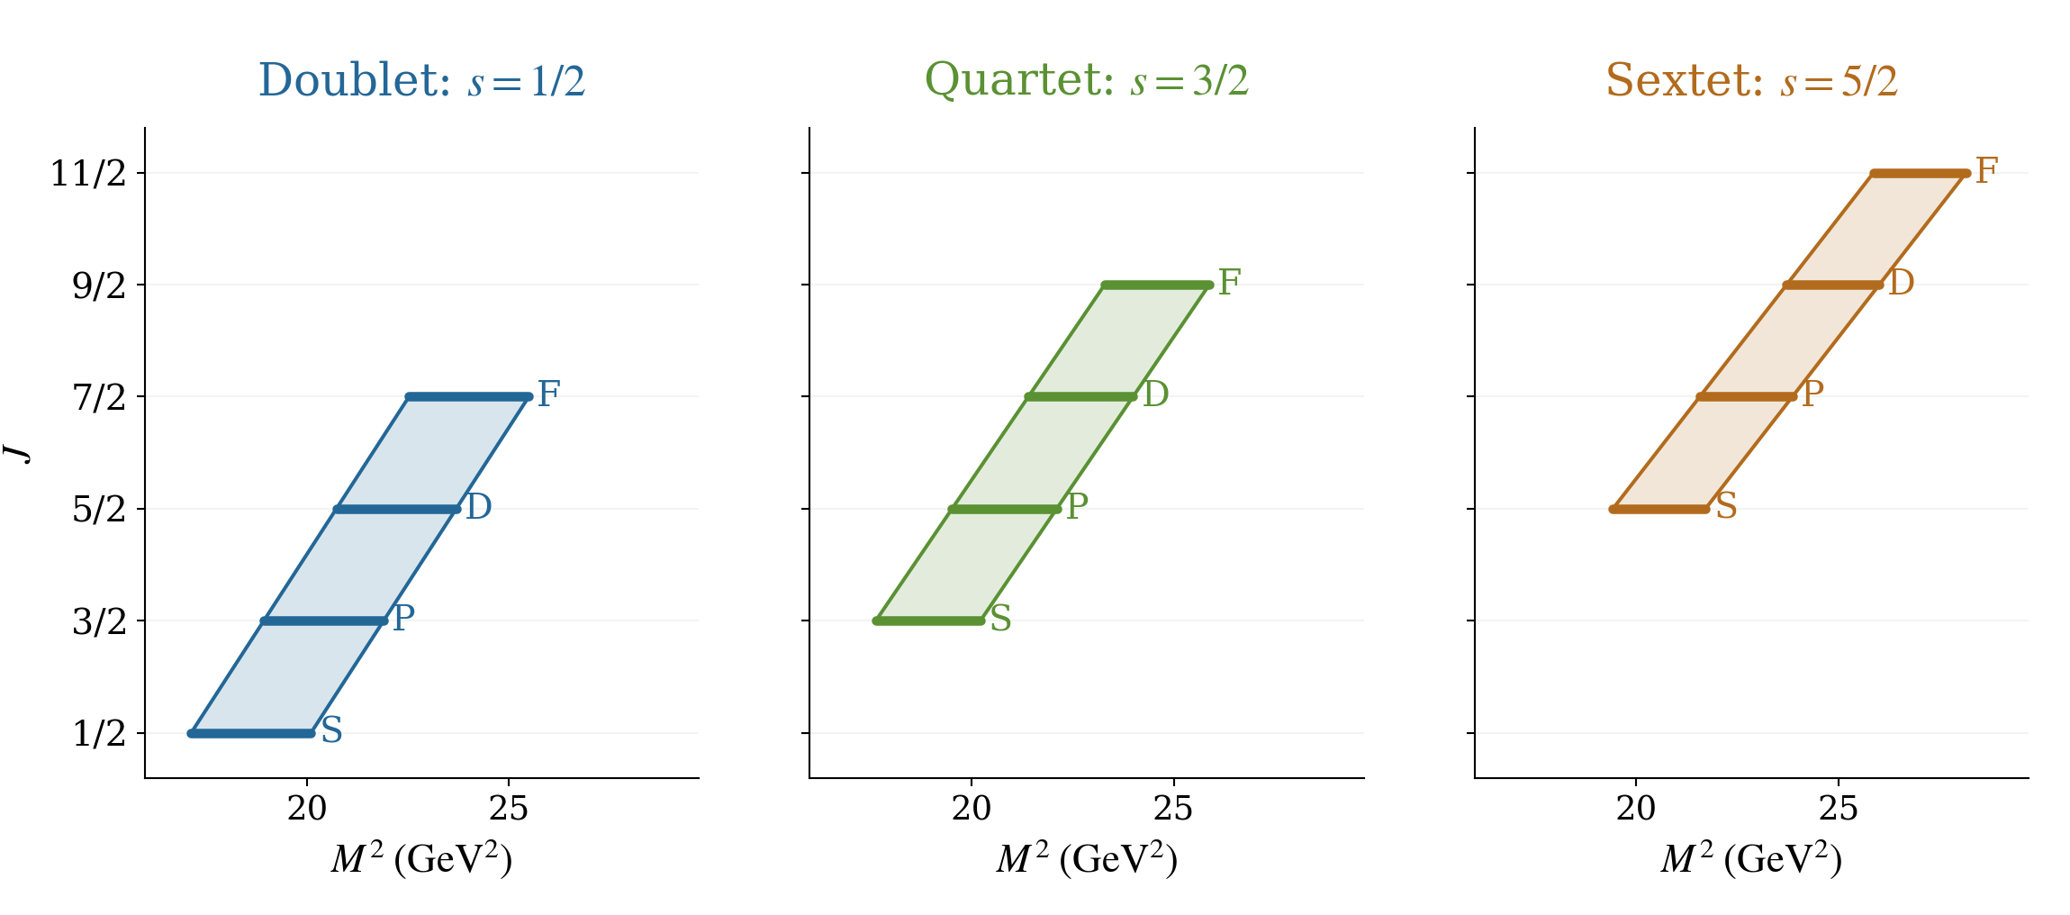
Hidden charm linear trajectories of the leading sequences
The straight-line ordering follows from the assumed Regge form
13 / 18
Notes:
Planned delivery: 0:40.
Each panel represents one leading family in the (J,M squared) plane. The coloured region spans the allowed ground intercepts at its central calibrated slope. The S, P, D and F positions mark the relevant discrete orbital steps; the connecting line describes the assumed trajectory. A fixed Delta J gives a fixed Delta M squared, while mass gaps themselves become smaller at larger mass. This pattern is a consequence of the linear model and is not independent evidence confirming linearity. Different families can overlap in mass because their ground intercepts and slopes differ.
[Sources]
Corrected NSTAR calculation report, NSTAR_2026_Hidden_Charm_Regge_Report_Corrected.pdf; equations, input tables, Tables 1 and 5–16.
Visual reference and authentic SVNIT logo: user-supplied Vandan RPS 6.pptx.
[/Sources]

Slide 18
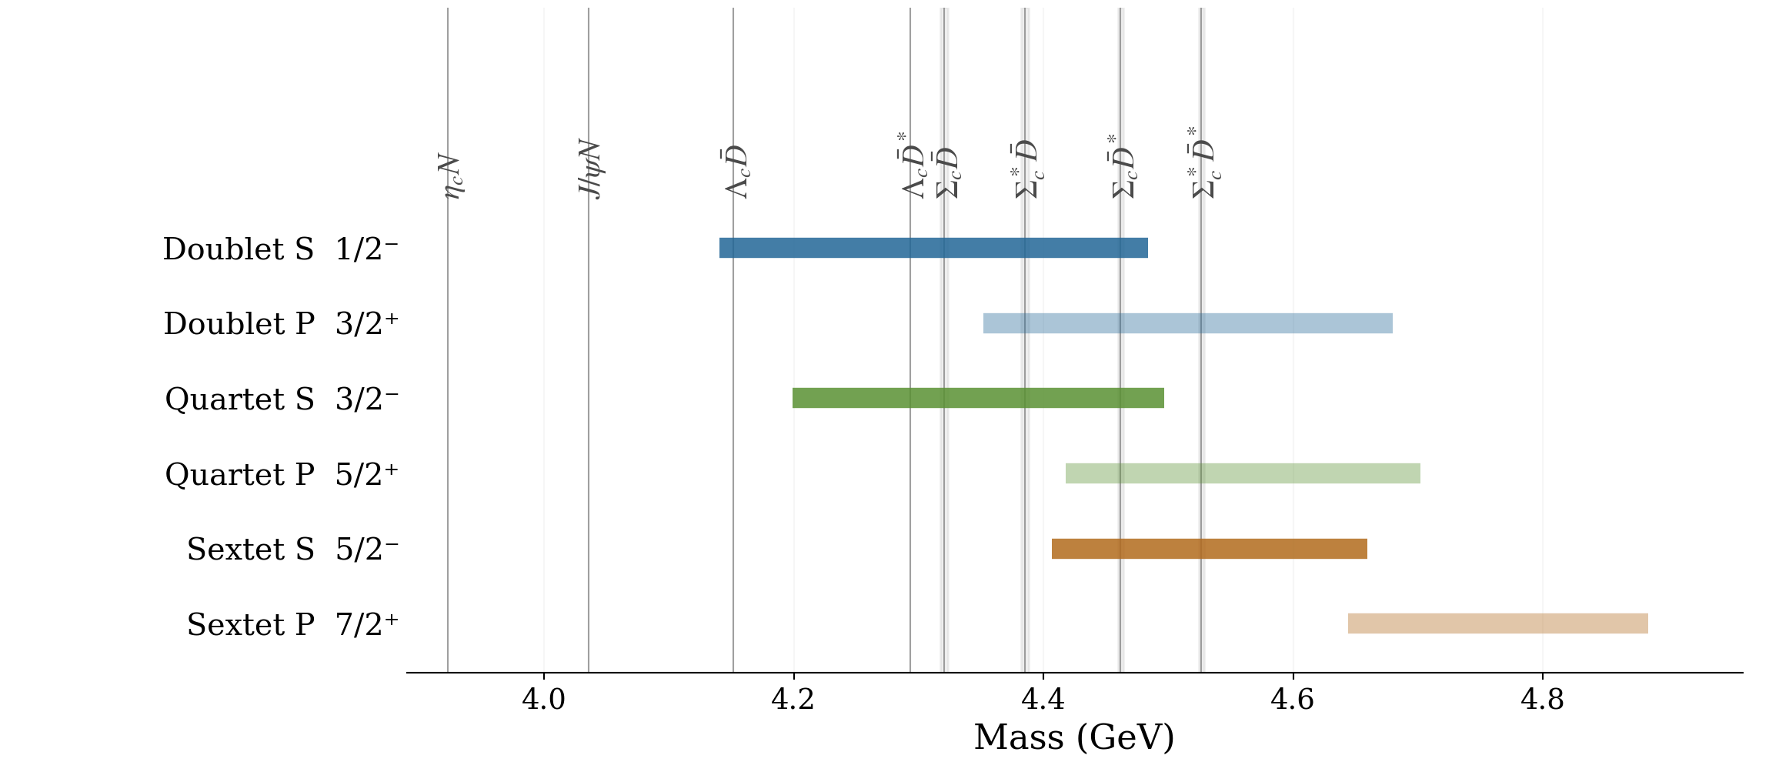
Hidden charm ground bands intersections with several thresholds
Thresholds: sums of PDG 2026 central masses; constituent widths are not folded in
14 / 18
Notes:
Planned delivery: 1:30.
Compare the horizontal predicted S and P bands with the vertical two-body thresholds. All nominal hidden-charm S bands are above eta_c N and J/psi N. The Sigma_c-star D-star threshold at about 4.524–4.529 GeV is above the entire doublet and quartet S bands, while it lies inside the sextet S envelope. Several P bands cross additional open-charm thresholds. A band crossing a threshold means that its lower and upper portions allow different kinematic conclusions; it does not imply that one state spans the whole interval. Charge-combination threshold spans are shown where applicable. Isospin and nonzero dynamical couplings must also permit a decay. No claim about compact or molecular structure follows from threshold proximity alone.
[Sources]
Corrected NSTAR calculation report, NSTAR_2026_Hidden_Charm_Regge_Report_Corrected.pdf; equations, input tables, Tables 1 and 5–16.
PDG 2026 central masses, meson and baryon summary tables. https://pdg.lbl.gov/2026/tables/rpp2026-sum-mesons.pdf ; https://pdg.lbl.gov/2026/tables/rpp2026-sum-baryons.pdf
Visual reference and authentic SVNIT logo: user-supplied Vandan RPS 6.pptx.
[/Sources]

Slide 19
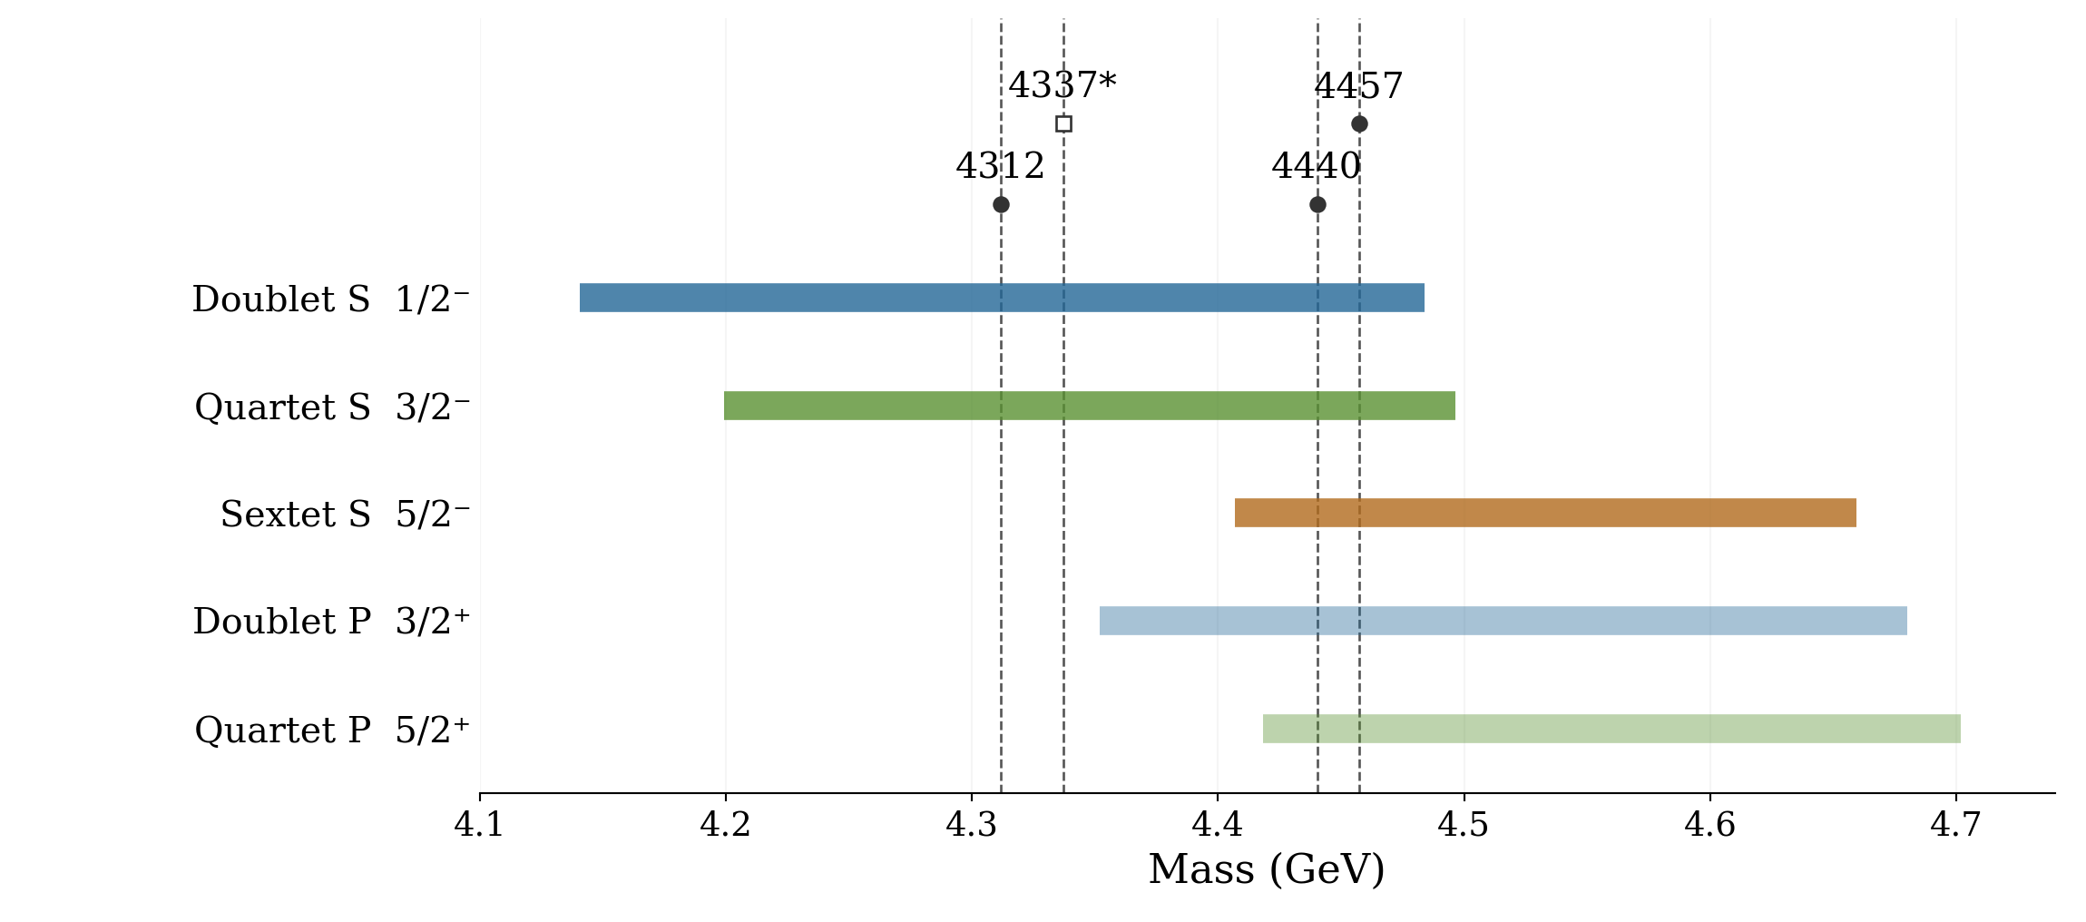
Reported $P_{c}$ masses overlaps with several bands
2019 observations; * Pc(4337): evidence in the 2022 analysis
16 / 18
Notes:
Planned delivery: 1:05.
The comparison is purely numerical. The 4312 and 4337 central masses lie in the doublet and quartet S envelopes. The 4440 and 4457 central masses lie in all three S envelopes and the doublet and quartet P envelopes. The 4337 contribution is labelled evidence, not given the same observational status as the 2019 peaks. Broad model-input envelopes make assignments nonunique. Also the orbital parameter in the Ali model was calibrated using the 4440 and 4457 structures; the quartet reference P mass is 4.457 GeV. Therefore the P-band overlaps are partly calibration-linked and cannot be called independent successful predictions. Measurements of spin/parity and channel couplings would discriminate more strongly.
[Sources]
Corrected NSTAR calculation report, NSTAR_2026_Hidden_Charm_Regge_Report_Corrected.pdf; equations, input tables, Tables 1 and 5–16.
LHCb Collaboration, Phys. Rev. Lett. 122, 222001 (2019). https://doi.org/10.1103/PhysRevLett.122.222001
LHCb Collaboration, Phys. Rev. Lett. 128, 062001 (2022). https://doi.org/10.1103/PhysRevLett.128.062001
A. Ali et al., Mass spectrum of the hidden-charm pentaquarks in the compact diquark model, JHEP 10 (2019) 256, Table 8. https://doi.org/10.1007/JHEP10(2019)256
Visual reference and authentic SVNIT logo: user-supplied Vandan RPS 6.pptx.
[/Sources]

Slide 20
Comparison of the lowest hidden-charm masses with other theoretical studies
State | Jᴾ | Present work | Extended CMI [89] | Diquark model [90] | Coupled-channel [91] | QCD sum rules [92]
1²S_{1/2} | 1/2⁻ | 4.140–4.484 | 4.327 | 4.238 | 4.313 | 4.20 ± 0.11
1⁴S_{3/2} | 3/2⁻ | 4.199–4.497 | 4.367 | 4.284 | 4.369 | 4.34 ± 0.11
1⁶S_{5/2} | 5/2⁻ | 4.407–4.659 | 4.546 | 4.451 | 4.522 | 4.38 ± 0.11

Slide 21
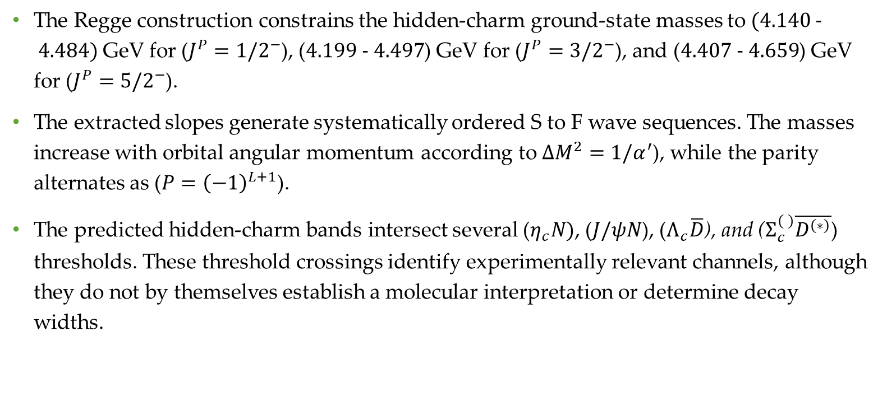
Results and physical interpretation
The Regge construction constrains the hidden-charm ground-state masses to $(4.140 − 4.484)$GeV for ($J^{P}=1/2^{−}$), ($4.199 − 4.497$) GeV for ($J^{P}=3/2^{−}$), and ($4.407 − 4.659$) GeV for ($J^{P}=5/2^{−}$).
The extracted slopes generate systematically ordered S to F wave sequences. The masses increase with orbital angular momentum according to $ΔM^{2}=1/α^{′}$), while the parity alternates as ($P={\left(−1\right)}^{L+1}$).
The predicted hidden-charm bands intersect several ($η_{c}N)$, ($J/ψN$), ($Λ_{c}\overline{D}$), and ($Σ_{c}^{( )}\overline{D^{\left(∗\right)}}$) thresholds. These threshold crossings identify experimentally relevant channels, although they do not by themselves establish a molecular interpretation or determine decay widths.

Slide 22
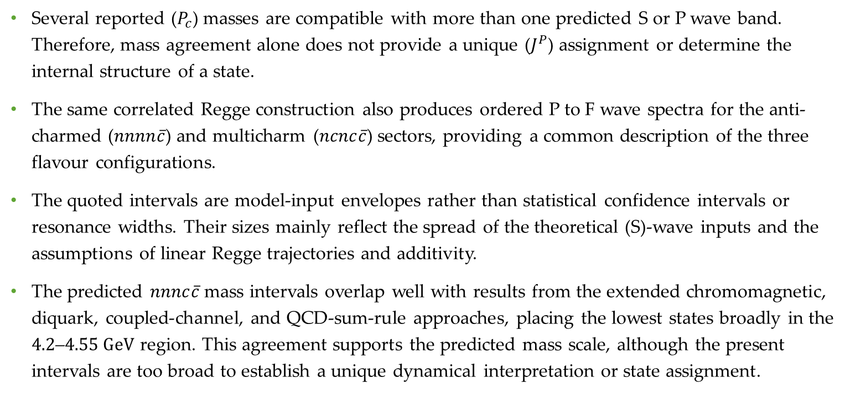
Several reported ($P_{c}$) masses are compatible with more than one predicted S or P wave band. Therefore, mass agreement alone does not provide a unique ($J^{P}$) assignment or determine the internal structure of a state.
The same correlated Regge construction also produces ordered P to F wave spectra for the anti-charmed ($nnnn\overline{c}$) and multicharm ($ncnc\overline{c}$) sectors, providing a common description of the three flavour configurations.
The quoted intervals are model-input envelopes rather than statistical confidence intervals or resonance widths. Their sizes mainly reflect the spread of the theoretical (S)-wave inputs and the assumptions of linear Regge trajectories and additivity.
The predicted $nnnc\overline{c}$ mass intervals overlap well with results from the extended chromomagnetic, diquark, coupled-channel, and QCD-sum-rule approaches, placing the lowest states broadly in the $4.2\text{–}4.55 GeV$ region. This agreement supports the predicted mass scale, although the present intervals are too broad to establish a unique dynamical interpretation or state assignment.

Slide 23
References
[1] M. Gell-Mann, Phys. Lett. 8, 214 (1964).
[2] G. Zweig, CERN Reports No. 8182/TH.401 and No. 8419/TH.412 (1964).
[3] R. Aaij et al. (LHCb Collaboration), Phys. Rev. Lett. 122(1), 012001 (2019).
[4] R. Aaij et al. (LHCb Collaboration), Phys. Rev. Lett. 121, 072002 (2018).
[5] R. Aaij et al. (LHCb Collaboration), Phys. Rev. Lett. 124, 082002 (2020).
[6] R. Aaij et al. (LHCb Collaboration), Phys. Rev. Lett. 128, 162001 (2022).
[7] A. Poluektov et al. (Belle), Phys. Rev. D 81, 112002 (2010).
[8] T. Lesiak (Belle), AIP Conf. Proc. 814, no.1, 493-497 (2006).
[9] M. Ablikim et al. (BESIII), Phys. Rev. D 100, 032004 (2019).
[10] M. Ablikim et al. (BESIII), Phys. Rev. D 101, 032008 (2020).
[11] M. Ablikim et al. (BESIII Collaboration), Phys. Lett. B 813, 136059 (2021).
[12] M. Ablikim et al. (BESIII Collaboration), Phys. Rev. D 103, 072007 (2021).

Slide 24
[13] K. Aoki et al. (2021), arXiv:2110.04462 [nucl-ex].
[14] R. Chaturvedi and A. K. Rai, Eur. Phys. J. A 58, 228 (2022).
[15] J. Oudichhya, K. Gandhi, and A. K. Rai, Phys. Rev. D 108, 014034 (2023).
[16] A. K. Rai, B. Patel, and P. C. Vinodkumar, Phys. Rev. C 78, 055202 (2008).
[17] S. K. Choi et al. (Belle Collaboration), Phys. Rev. Lett. 91, 262001 (2003).
[18] M. Ablikim et al. (BESIII Collaboration), Phys. Rev. D 102, 012009 (2020), arXiv:2004.13788 [hep-ex].
[19] P. Krokovny et al. (Belle Collaboration), Phys. Rev. D 88, 052016 (2013), arXiv:1308.2646 [hep-ex].
[20] R. Aaij et al. (LHCb Collaboration), Phys. Rev. Lett. 118, 022003 (2017).
[21] R. Aaij et al. (LHCb Collaboration), Phys. Rev. Lett. 115, 072001 (2015).
[22] T. Aaltonen et al. (CDF Collaboration), Phys. Rev. Lett. 102, 242002 (2009).
[23] R. Aaij et al. (LHCb Collaboration), Phys. Rev. D 85, 091103 (2012).
[24] V. M. Abazov et al. (D0 Collaboration), Phys. Rev. D 89, 012004 (2014).
[25] S. Chatrchyan et al. (CMS Collaboration), Phys. Lett. B 734, 261 (2014).
[26] T. Aaltonen et al. (CDF Collaboration), Mod. Phys. Lett. A 32, 1750139 (2017).
[27] R. Aaij et al. (LHCb Collaboration), Phys. Rev. D 95, 012002 (2017).
[28] C. Lodha and A. K. Rai, Few-Body Syst. 65, 99 (2024).

Slide 25
[29] E. Klempt and J. M. Richard, Rev. Mod. Phys. 82, 1095-1153 (2010).
[30] H. X. Chen, W. Chen, X. Liu, and S. L. Zhu, Phys. Rept. 639, 1 (2016).
[31] C. Alexandrou, J. Berlin, J. Finkenrath, T. Leontiou, and M. Wagner, Phys. Rev. D 101, 034502 (2020).
[32] H. Huang, C. Deng, X. Liu, Y. Tan, and J. T. Ping, Symmetry 15, 1298 (2023).
[33] S. Godfrey and N. Isgur, Phys. Rev. D 32, 189 (1985).
[34] V. R. Debastiani and F. S. Navarra, Chin. Phys. C 43, 013105 (2019).
[35] Y. Bai, S. Lu, and J. Osborne, Phys. Lett. B 798, 134930 (2019).
[36] W. Chen, H. X. Chen, X. Liu, T. G. Steele, and S. L. Zhu, Phys. Lett. B 773, 247 (2017).
[37] A. Francis, R. J. Hudspith, R. Lewis, and K. Maltman, Phys. Rev. Lett. 118, 142001 (2017).
[38] M. Karliner, S. Nussinov, and J. L. Rosner, Phys. Rev. D 95, 034011 (2017).
[39] R. Aaij et al. (LHCb Collaboration), Sci. Bull. 65, 1983 (2020).
[40] R. Tiwari and A. K. Rai, Few-Body Syst. 64, 20 (2023).
[41] X. H. Guo, K. W. Wei, and X. H. Wu, Phys. Rev. D 78, 056005 (2008).
[42] K. W. Wei, B. Chen, N. Liu, Q. Q. Wang, and X. H. Guo, Phys. Rev. D 95, 116005 (2017).
[43] Y. Nambu, Phys. Rev. D 10, 4262 (1974).
[44] Y. Nambu, Phys. Lett. B 80, 372 (1979).

Slide 26
[45] H. X. Chen, W. Chen, X. Liu, Y.-R. Liu, and S.-L. Zhu, Rep. Prog. Phys. 80, 076201(2017).
[46] G. F. Chew and S. C. Frautschi, Phys. Rev. Lett. 7, 394 (1961); 8, 41 (1962).
[47] A. B. Kaidalov, Z. Phys. C 12, 63 (1982).
[48] D.-M. Li, B. Ma, Y.-X. Li, Q.-K. Yao, and H. Yu, Eur. Phys. J. C 37, 323 (2004).
[49] L. Burakovsky, T. Goldman, and L. P. Horwitz, Phys. Rev. D 56, 7119 (1997); J.Phys. G 24, 771 (1998).
[50] L. Burakovsky and T. Goldman, Phys. Lett. B 434, 251 (1998).
[51] K. Kawarabayashi, S. Kitakado, and H. Yabuki, Phys. Lett. B 28, 432 (1969).
[52] N. A. Kobylinsky, E. S. Martynov, and A. B. Prognimak, Ukr. Fiz. Zh. 24, 969(1979).
[53] R. C. Brower, J. Ellis, M. G. Schmidt, and J. H. Weis, Nucl. Phys. B 128, 175(1977).
[54] V. V. Dixit and L. A. P. Balazs, Phys. Rev. D 20, 816 (1979).
[55] W. Chen, H.-X. Chen, X. Liu, T. G. Steele, and S.-L. Zhu, Phys. Lett. B 773, 247(2017).
[56] M. M. Brisudov´a, L. Burakovsky, and T. Goldman, Phys. Rev. D 61, 054013 (2000).
[57] J. L. Basdevant and S. Boukraa, Z. Phys. C 30, 103 (1986).
[58] K. Igi and S. Yazaki, Phys. Lett. B 74, 257 (1978).
[59] F. Iachello, N. C. Mukhopadhyay, and L. Zhang, Phys. Rev. D 44, 898 (1991).
[60] S. Filipponi, G. Pancheri, and Y. Srivastava, Phys. Rev. Lett. 80, 1838 (1998); S. Filipponi and Y. Srivastava, Phys. Rev. D 58, 016003 (1998).

Slide 27
[61] W. Cassing, L. A. Kondratyuk, G. I. Lykasov, and M. V. Rzjanin, Phys. Lett. B 513, 1 (2001).
[62] D. Ebert, R. N. Faustov, and V. O. Galkin, Eur. Phys. J. C 71, 1825 (2011).
[63] K. Chen, Y. Dong, X. Liu, et al., Eur. Phys. J. C 78, 20 (2018).
[64] D. Ebert, R. N. Faustov, and V. O. Galkin, Phys. Rev. D 84, 014025 (2011).
[65] A. Selem and F. Wilczek, New Trends in HERA Physics 2005, pp. 337–356 (2005).
[66] G. Cotugno, R. Faccini, A. D. Polosa, and C. Sabelli, Phys. Rev. Lett. 104, 132005 (2010).
[67] J. K. Chen, Eur. Phys. J. A 57, 238 (2021).
[68] H.-T. An, K. Chen, and X. Liu, Physical Review D 105, 034018 (2022).
[69] H.-T. An, Q.-S. Zhou, Z.-W. Liu, Y.-R. Liu, and X. Liu, Physical Review D 100, 056004 (2019).
[70] A. Ali, I. Ahmed, M. J. Aslam, A. Ya. Parkhomenko, and A. Rehman, Journal of High Energy Physics 10, 256 (2019).
[71] Z. G. Wang, Eur. Phys. J. C 77, 432 (2017).
[72] R. N. Faustov, V. O. Galkin, and E. M. Savchenko, Universe 7, 94 (2021).
[73] P. Lundhammar and T. Ohlsson, Phys. Rev. D 102, 054018 (2020).
[74] V. R. Debastiani and F. S. Navarra, Chin. Phys. C 43, 013105 (2019).
[75] M. A. Bedolla, J. Ferretti, C. D. Roberts, and E. Santopinto, Eur. Phys. J. C 80, 1004 (2020).
[76] X. Z. Weng et al., Phys. Rev. D 103, 034001 (2021).

Slide 28
[77] R. J. Lloyd and J. P. Vary, Phys. Rev. D 70, 014009 (2004).
[78] M. C. Gordillo, F. De Soto, and J. Segovia, Phys. Rev. D 102, 114007 (2020).
[79] A. Berezhnoy, A. Luchinsky, and A. Novoselov, Phys. Rev. D 86, 034004 (2012).
[80] J. Ader, J. Richard, and P. Taxil, Phys. Rev. D 25, 2370 (1982).
[81] M. S. Liu et al., Phys. Rev. D 100, 016006 (2019).
[82] J. Zhao, S. Shi, and P. Zhuang, Phys. Rev. D 102, 114001 (2020).
[83] Z. Zhao et al., Phys. Rev. D 103, 116027 (2021).
[84] R. Zhu, Nucl. Phys. B 966, 115393 (2021).
[85] W. Chen, H.-X. Chen, X. Liu, T. G. Steele, and S.-L. Zhu, Phys. Lett. B 773, 247 (2017).
[86] F.-X. Liu, M.-S. Liu, X.-H. Zhong, and Q. Zhao, Phys. Rev. D 104, 116029 (2021).
[87] S. Navas et al. (Particle Data Group), Phys. Rev. D 110, 030001 (2024).
[88] X. Liu, H. Huang, J. Ping et al., Eur. Phys. J. C 81, 950 (2021).
[89] X.-Z. Weng et al., Phys. Rev. D 100, 016014 (2019).
[90] P.-P. Shi, F. Huang and W.-L. Wang, Eur. Phys. J. A 57, 237 (2021).
[91] S. Clymton, H.-C. Kim and T. Mart, Phys. Rev. D 110, 094014 (2024).
[92] Z.-G. Wang, Eur. Phys. J. C 86, 209 (2026).

Slide 29
Thank You

