Slide 1
Effect of the lightest scalar meson as a dilaton on hadron-hadron scatterings
Yong-Liang Ma
Nanjing University
Talk @ The 15th International Workshop on the Physics of Excited Nucleons (NSTAR 2026)
September 7th to 11th, 2026, Seville, Spain

Slide 2
Outline
Introduction
Chiral-scale effective field theory
Hadron-hadron scattering at leading order
    Pion-Pion scattering
    Pion-N scattering
Summary and discussion

Slide 3
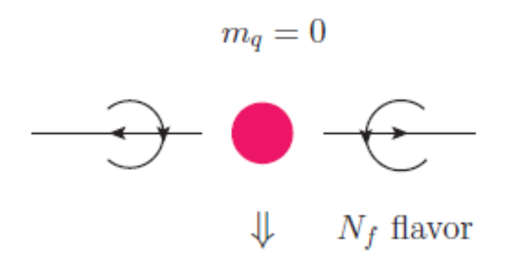
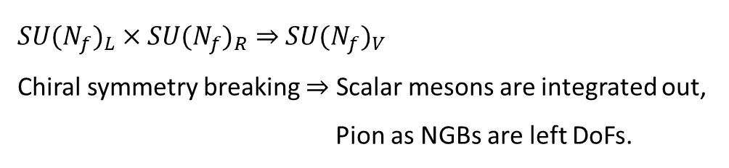
I. Introduction
Symmetry and symmetry breaking play dominant roles in particle and nuclear physics.
Chiral symmetry and chiral symmetry breaking controls the dynamics of light hadron physics at low energy.
${SU(N_{f})}_{L}×{SU(N_{f})}_{R}⇒$ ${SU(N_{f})}_{V}$
Chiral symmetry breaking $⇒$ Scalar mesons are integrated out,
Pion as NGBs are left DoFs.

Slide 4
I. Introduction
ChPT (Chiral EFT), anchored on the fundamental symmetriess of QCD, self-consistent power counting, achieved great successes in the description of hadron dynamics;
S. Weinberg, Physica A 96 (1979) 1-2, 327-340; Phys.Lett.B 251 (1990) 288-292; Nucl.Phys.B 363 (1991) 3-18.
R. Machleidt, D.R. Entem, Phys.Rept. 503 (2011) 1-75.
Finite nuclei as well as infinite nuclear matter at low density can be fairly accurately accessed by nuclear EFTs, ``pionless or pionful, (sEFT)” anchored on relevant symmetries and invariances .

Slide 5
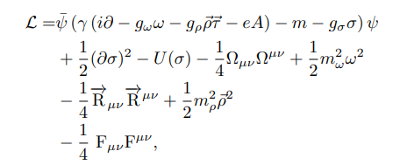
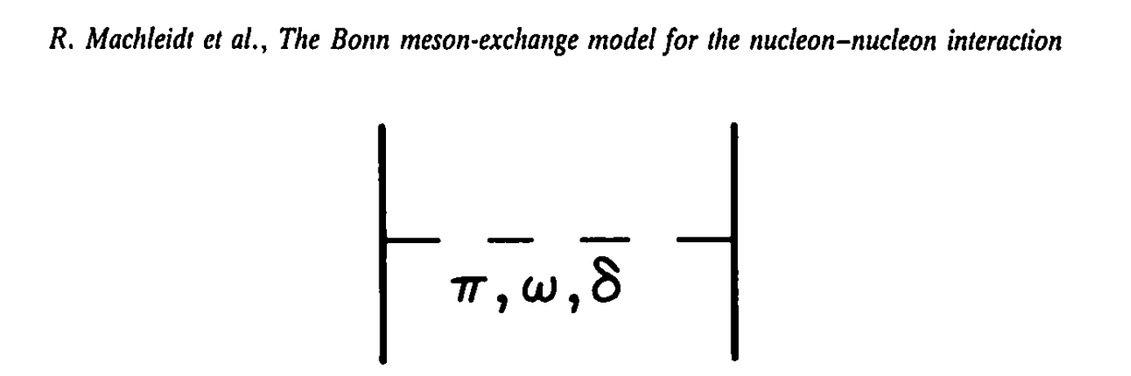

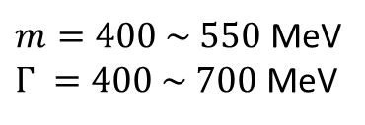
I. Introduction
Scalar meson with $m_{σ} ≅600$ MeV, very important in particle & nuclear physics.
Known long time ago.
$m=400 \sim 550$ MeV
$Γ =400 \sim 700$ MeV
PDG for $f_{0}(500)$:
But, a local bosonic field works;
e.g., Bonn boson exchange potential;
RMF
B. D. Serot and J. D. Walecka, Adv. Nucl. Phys. 16, 1 (1986)

Slide 6
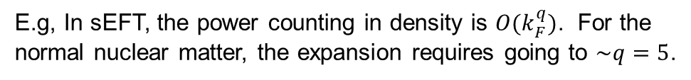
I. Introduction
Standard EFTs, as befits their premise, are expected to break down at some high density (and low temperature) relevant to, say, the interior of massive stars.
E.g, In sEFT, the power counting in density is $O(k_{F}^{q})$. For the normal nuclear matter, the expansion requires going to $\sim q=5$.
J. W. Holt, M. Rho and W.Weise, 1411.6681
It is interesting to include the lightest scalar meson in ChPT (a) as an explicit degree of freedom, (b) anchored on symmetries of QCD, and (c) with self-consistent power counting (errors can be estimated).

Slide 7

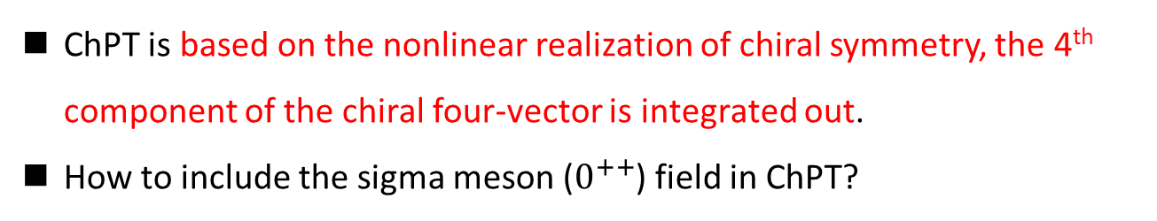

I. Introduction
ChPT is based on the nonlinear realization of chiral symmetry, the 4th component of the chiral four-vector is integrated out.
How to include the sigma meson ($0^{++}$) field in ChPT?
Trace anomaly in effective models：
anomaly match
Trace anomaly in QCD
Trace anomaly EFT
$$θ_{μ}^{μ}=\frac{β(g)}{2g}G_{μv}G^{μv}∝χ^{4}$$
Dilaton compensator;
A source of scalar meson in EFT
$$δ_{D}V(χ) ∝χ^{4}$$

Slide 8
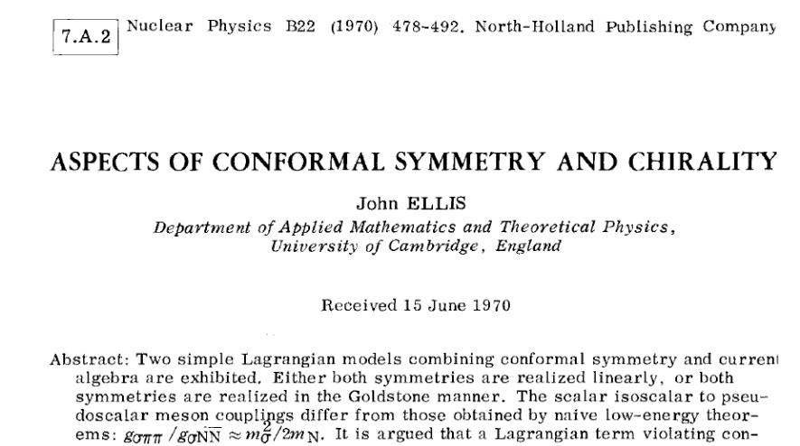
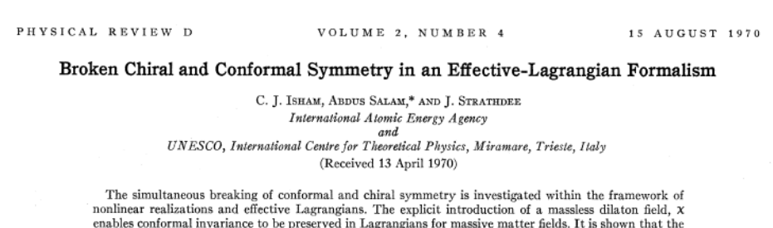
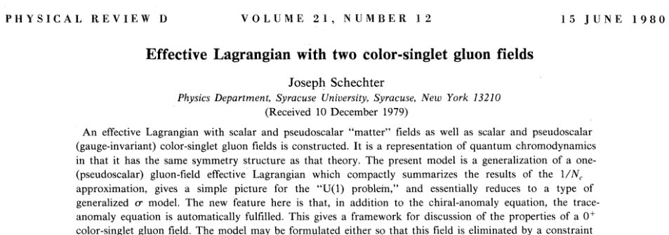

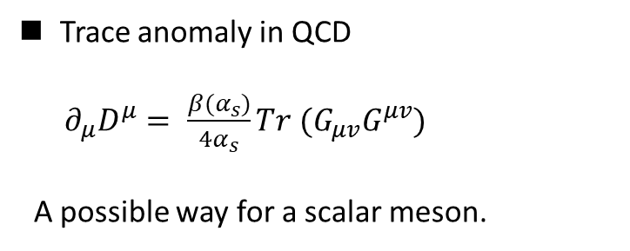
I. Introduction
Trace anomaly in QCD
$∂_{μ}D^{μ}= \frac{β(α_{s})}{4α_{s}}Tr (G_{μv}G^{μv})$
A possible way for a scalar meson.
Anomaly matching: $θ_{μ}^{μ}=−\frac{m_{σ}^{2}}{4f_{σ}^{2}}χ^{4}$
How to construct an EFT with power counting mechanism like, e.g., NGB in ChPT?

Slide 9
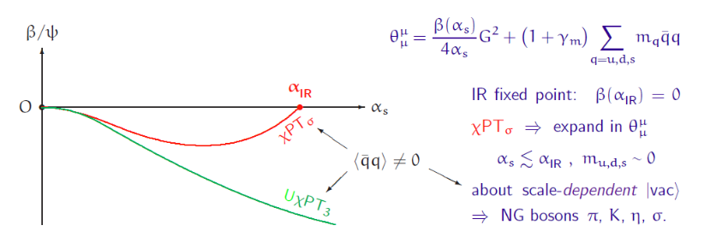
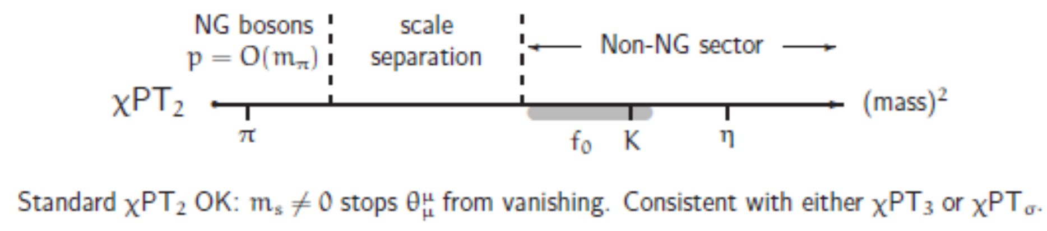
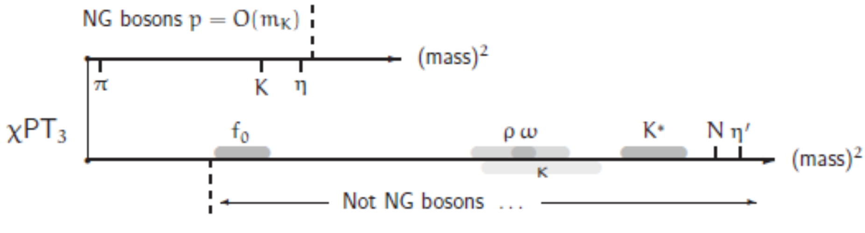
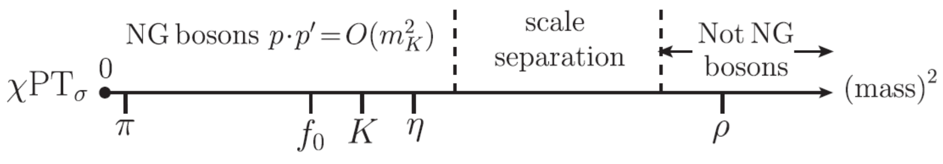
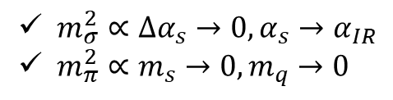
II. Chiral-scale effective field theory
A resolution
Possible realization:
Different types of ChPT:
$m_{σ}^{2}∝∆α_{s}→0,α_{s}→α_{IR}$
$m_{π}^{2}∝m_{s}→0,m_{q}→0$
Crewther and Tunstall , PRD91(2015), 034016, e-Print: 1312.3319

Slide 10
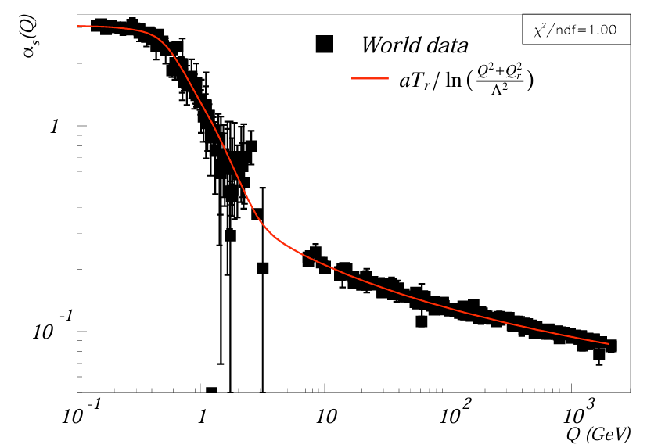
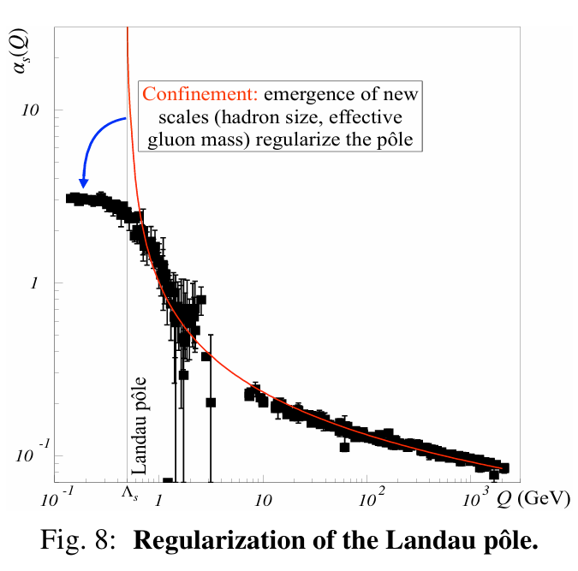
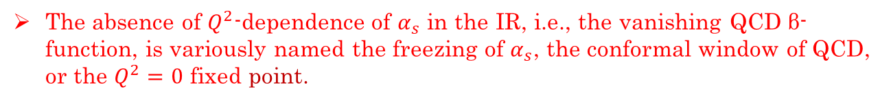
II. Chiral-scale effective field theory
A. Deur, e-Print: 2502.06535 [hep-ph].
The absence of $Q^{2}$-dependence of $α_{s}$ in the IR, i.e., the vanishing QCD β-function, is variously named the freezing of $α_{s}$, the conformal window of QCD, or the $Q^{2}=0$ fixed point.

Slide 11
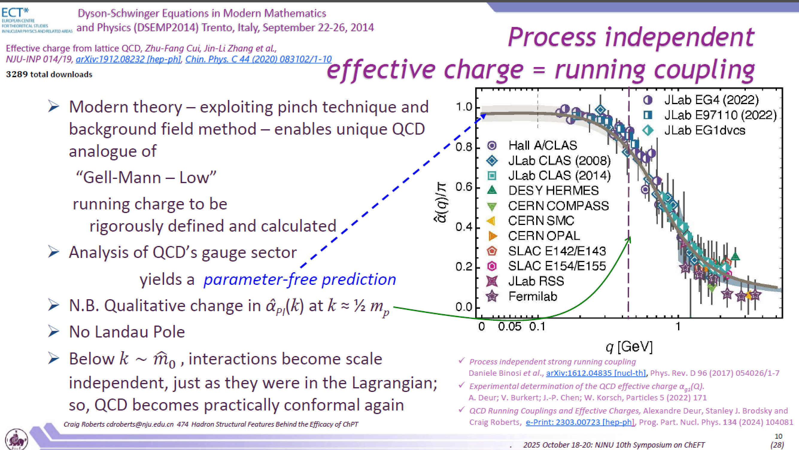
II. Chiral-scale effective field theory
Slide borrowed from C. Roberts

Slide 12
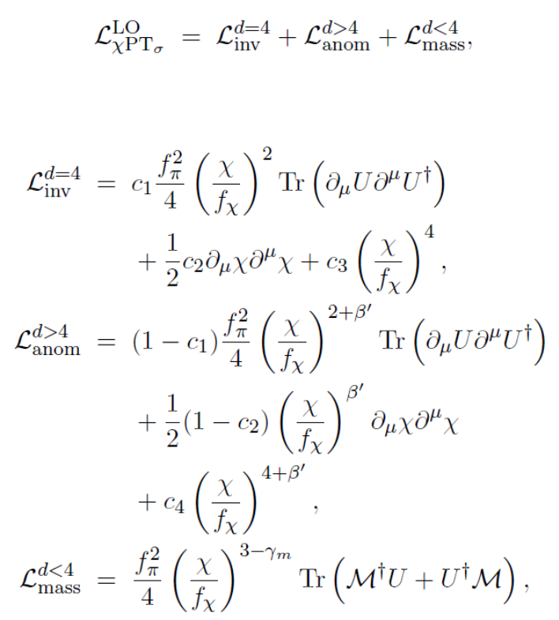

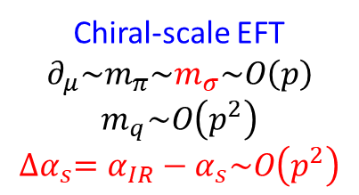
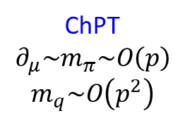
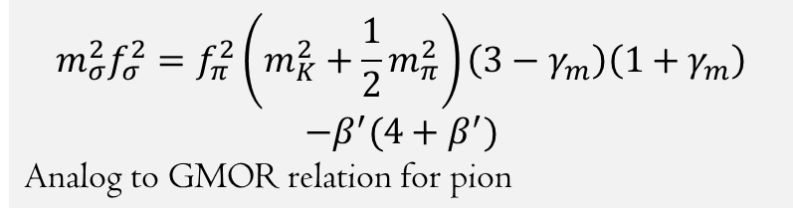
II. Chiral-scale effective field theory
$$m_{σ}^{2}f_{σ}^{2}=f_{π}^{2}\left(m_{K}^{2}+\frac{1}{2}m_{π}^{2}\right)\left(3−γ_{m}\right)\left(1+γ_{m}\right)$$
$$−β^{′}(4+β^{′})$$
Analog to GMOR relation for pion
Both $γ_{m}$ and $β^{′}$ are evaluated at $α_{IR}$
Order counting
ChPT
$$∂_{μ}\sim m_{π}\sim O\left(p\right)$$
$$m_{q}\sim O\left(p^{2}\right)$$
Chiral-scale EFT
$$∂_{μ}\sim m_{π}\sim m_{σ}\sim O\left(p\right)$$
$$m_{q}\sim O\left(p^{2}\right)$$
$${∆α}_{s}=α_{IR}−α_{s}\sim O\left(p^{2}\right)$$

Slide 13
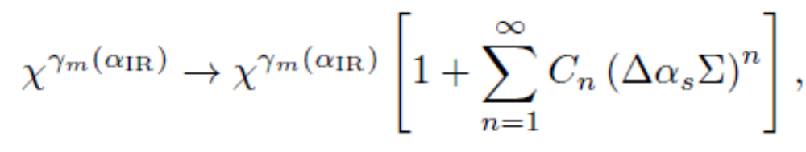
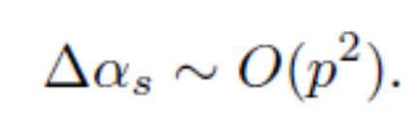
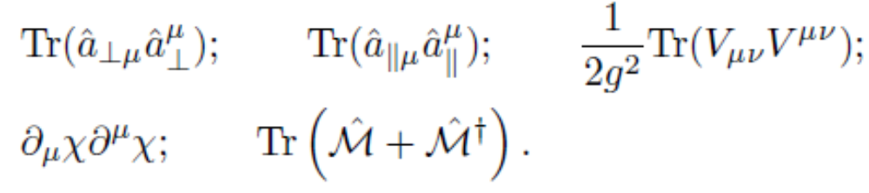
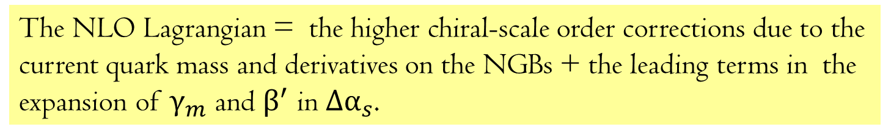
II. Chiral-scale effective field theory
The NLO Lagrangian = the higher chiral-scale order corrections due to the current quark mass and derivatives on the NGBs + the leading terms in the expansion of $γ_{m}$ and $β^{′}$ in $Δα_{s}$.

Slide 14
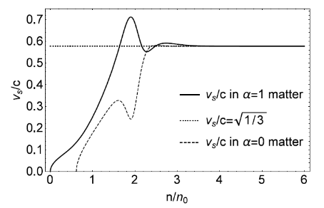
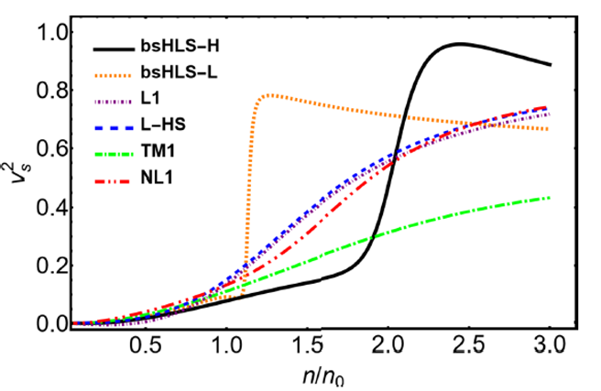
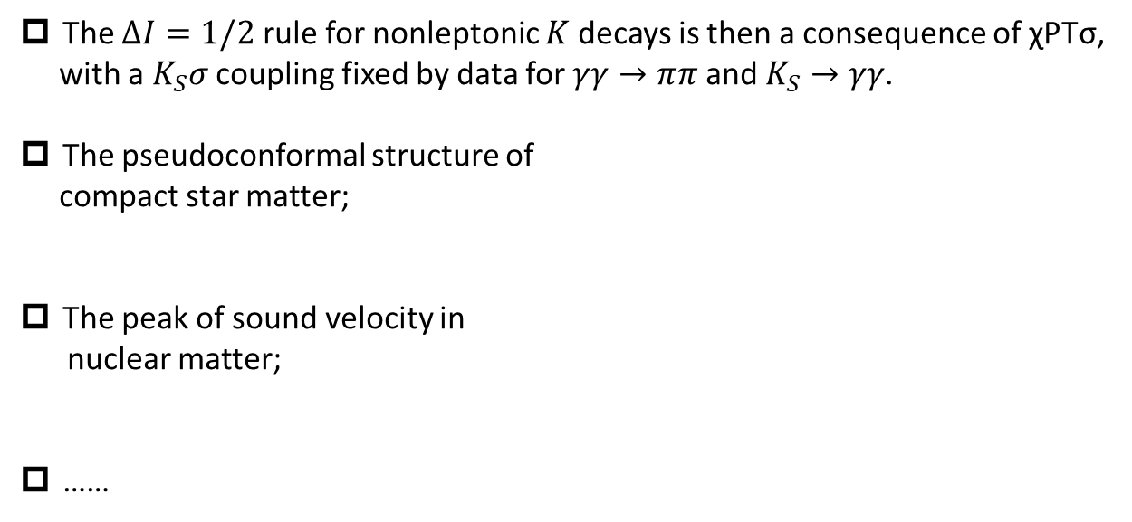
II. Chiral-scale effective field theory
This theory has been successfully used in several aspects:
The $∆I=1/2$ rule for nonleptonic $K$ decays is then a consequence of χPTσ,
with a $K_{S}σ$ coupling fixed by data for $γγ→ππ$ and $K_{S}→γγ$.
The pseudoconformal structure of
compact star matter;
The peak of sound velocity in
nuclear matter;
……
Crewther and Tunstall , PRD91(2015), 034016, e-Print: 1312.3319
W. G. Paeng, T. T. S. Kuo, H. K. Lee, YLM, M. Rho, arXiv: 1704.02775.
L. Q. Zhang, Y. Ma and YLM, 2410.04142; 2412.19023.

Slide 15
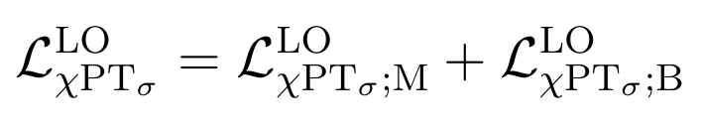
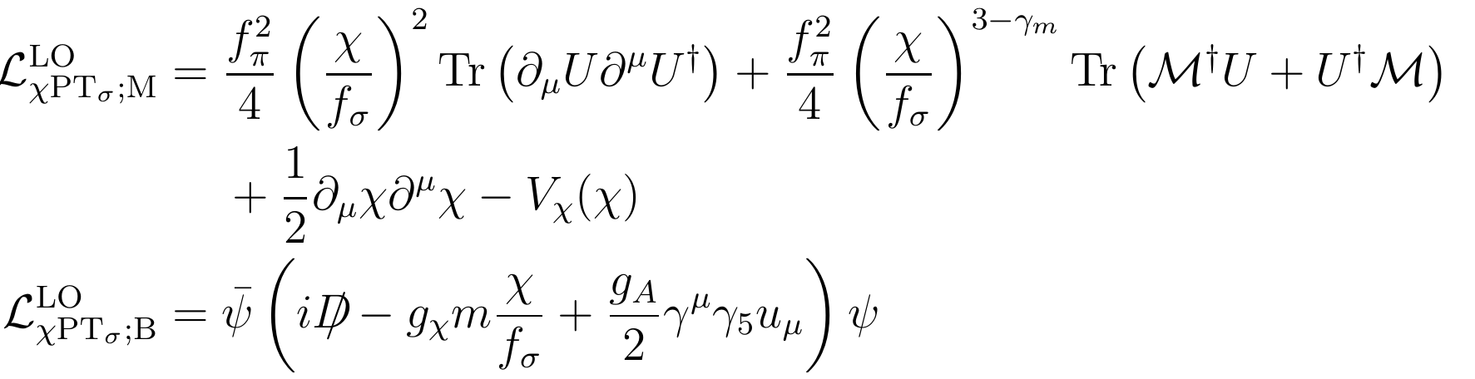
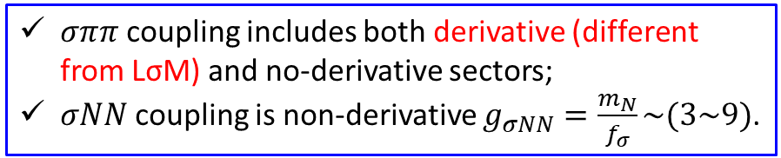
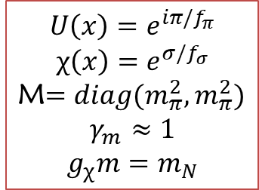
III. Hadron-hadron scattering
Consider the leading order Lagrangian:
$$U\left(x\right)=e^{iπ/f_{π}}$$
$$χ\left(x\right)=e^{σ/f_{σ}}$$
M$=diag(m_{π}^{2},m_{π}^{2})$
$$γ_{m}≈1$$
$$g_{χ}m=m_{N}$$
$σππ$ coupling includes both derivative (different from LσM) and no-derivative sectors;
$σNN$ coupling is non-derivative $g_{σNN}=\frac{m_{N}}{f_{σ}}\sim (3\sim 9)$.

Slide 16
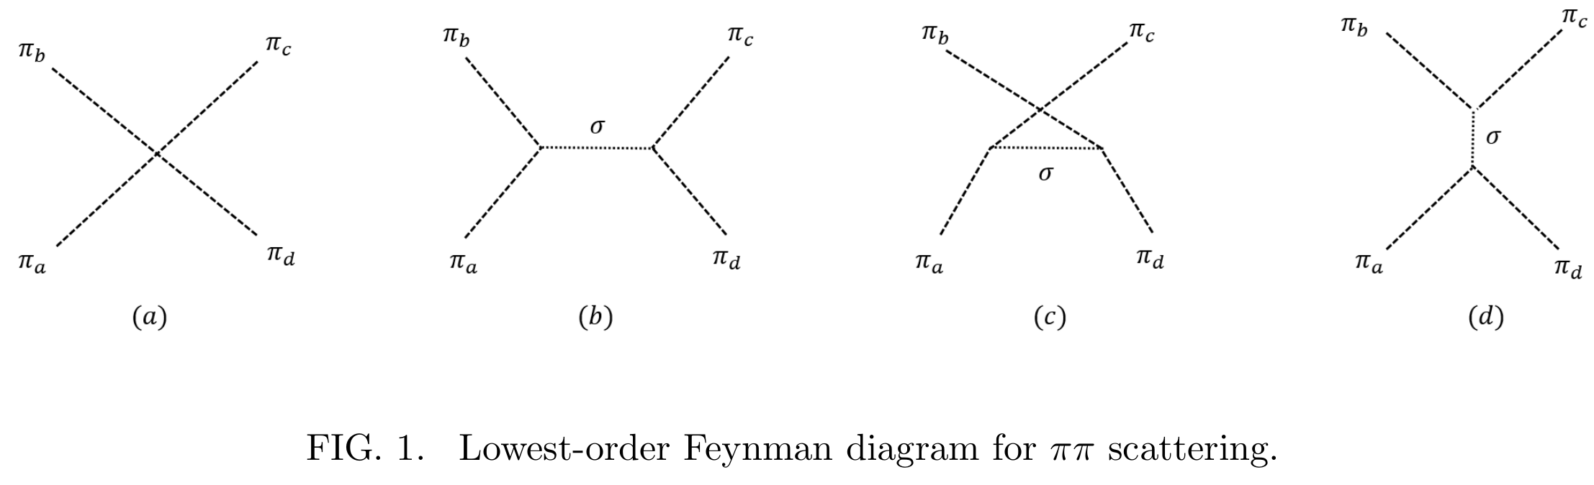
III. Hadron-hadron scattering
Pion-Pion scattering
Standard ChPT
New contribution from dilaton scalar

Slide 17
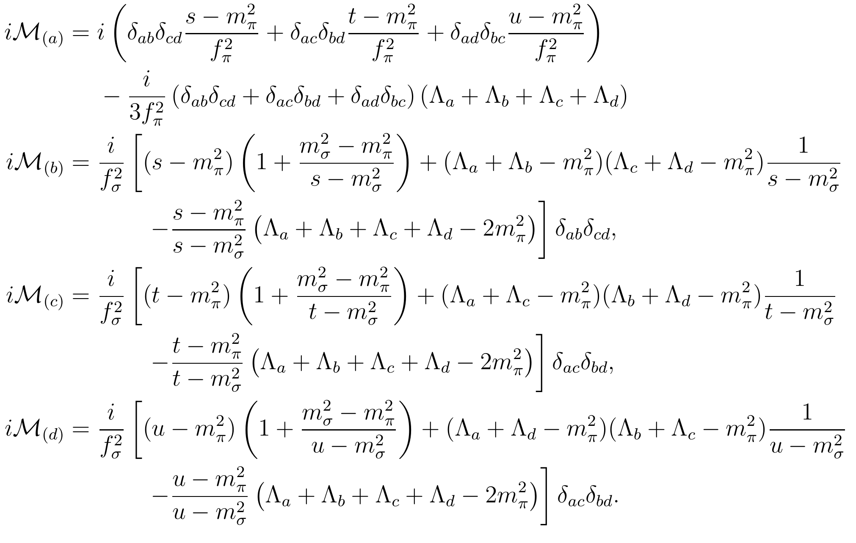
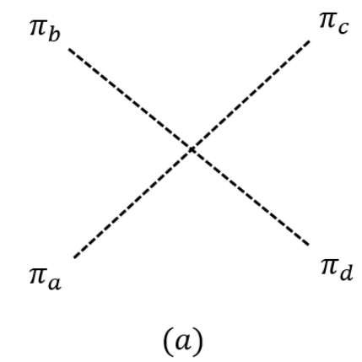
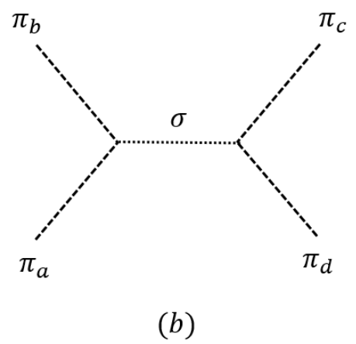
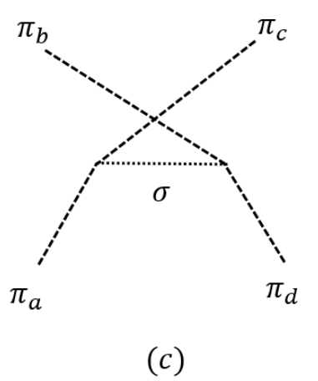
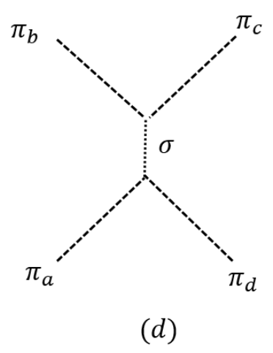
III. Hadron-hadron scattering

Slide 18
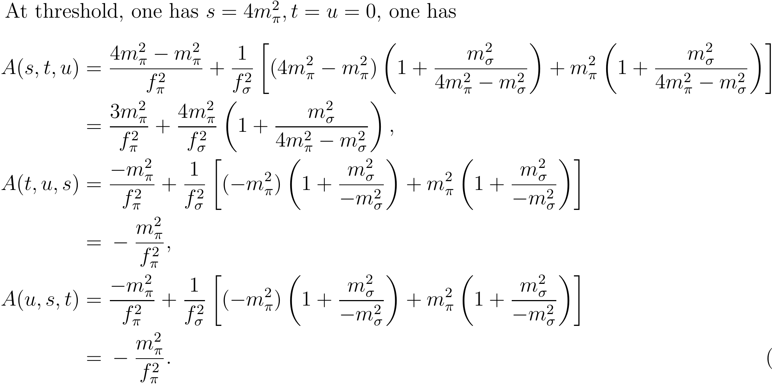
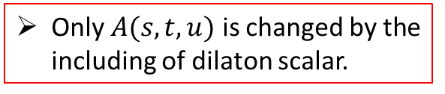
III. Hadron-hadron scattering
In general, the $T$-matrix element for this scattering process can be parameterized as
Only $A(s,t,u)$ is changed by the including of dilaton scalar.

Slide 19
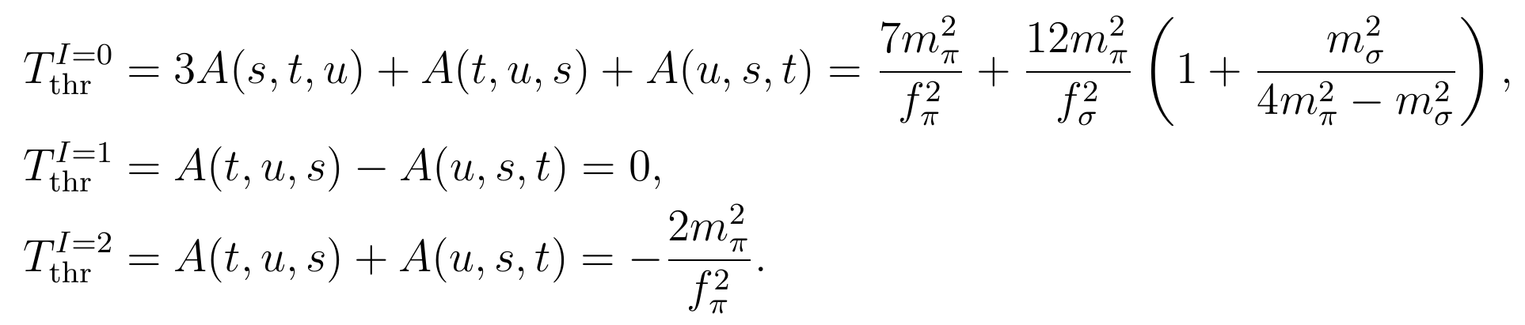
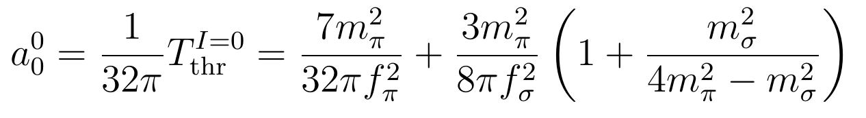
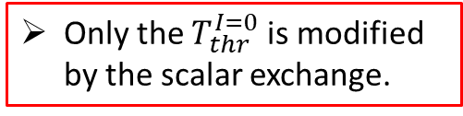
III. Hadron-hadron scattering
We finally obtain :
Only the $T_{thr}^{I=0}$ is modified by the scalar exchange.

Slide 20
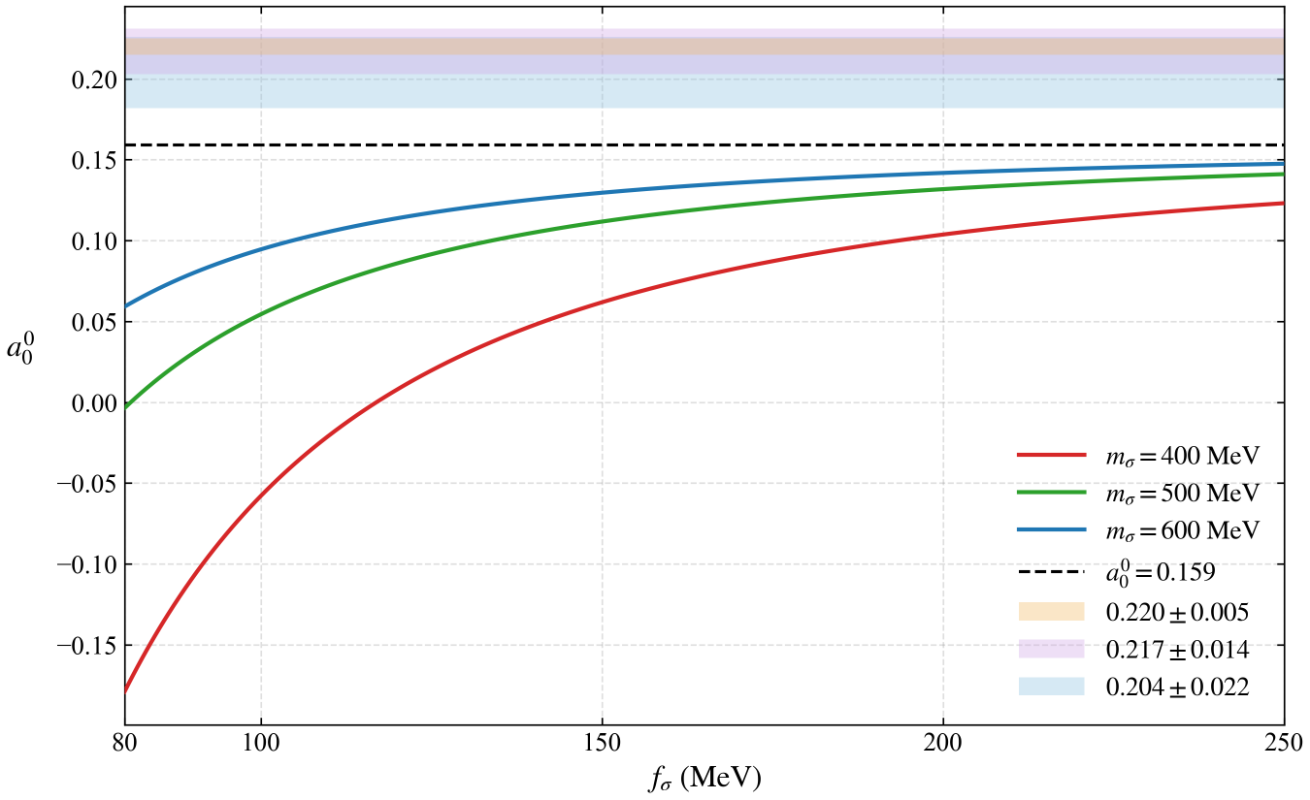

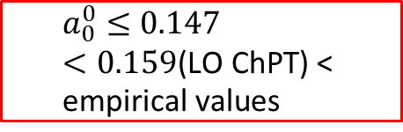
III. Hadron-hadron scattering
$$<0$$
$$a_{0}^{0}≤0.147<0.159\text{(}\text{LO} \text{ChPT}\text{) < }\text{empirical} \text{values}$$
G. Colangelo, et al., Phys. Lett. B 488 (2000) 261268; G. Colangelo, et al., Nuclear Phys. B 603 (2001) 125,179.
G. Colangelo, et al., Eur. Phys. J. C 59 (2009) 777793.
M. Kermani, et al., (CHAOS Collaboration), Phys. Rev. C 58 (1998) 34313441.

Slide 21
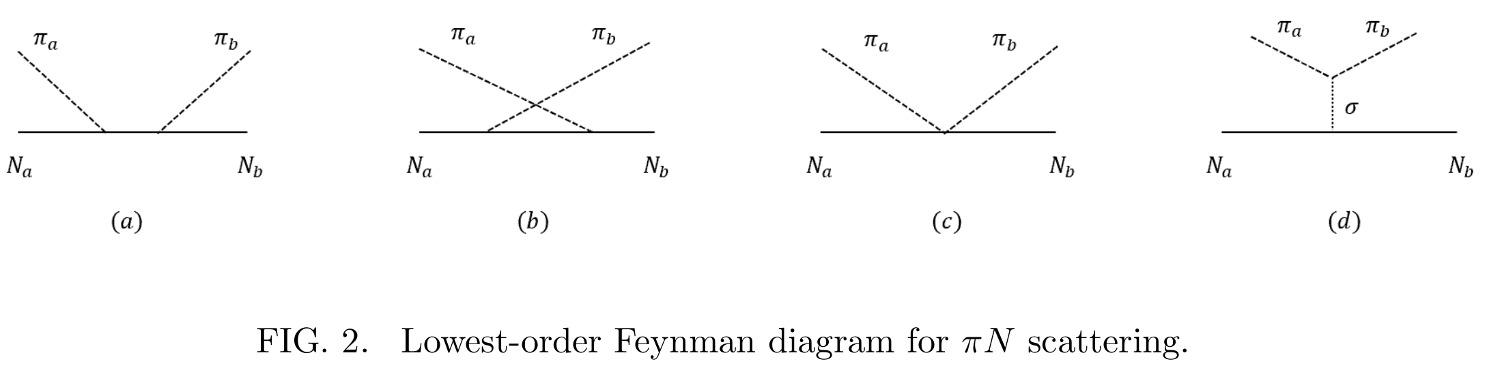
III. Hadron-hadron scattering
Pion-Nucleon scattering
ChPT
New contribution from dilaton scalar

Slide 22
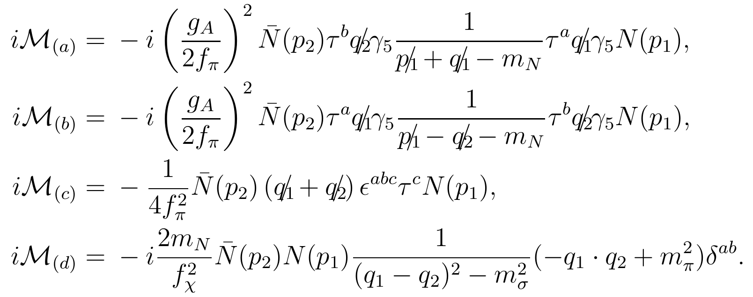



III. Hadron-hadron scattering
Matrix elements:
Linear sigma model
$$g_{σNN}=g_{πNN}, g_{σππ}=\frac{g_{πNN}}{2m_{N}}(m_{σ}^{2}−m_{π}^{2})$$

Slide 23





III. Hadron-hadron scattering
Only the $A^{+}(v,v_{B})$ is modified by the scalar exchange.

Slide 24


III. Hadron-hadron scattering
The scattering length:
Since the contribution from the dilaton scalar is proportional to $(2m_{N}v_{B}+m_{π}^{2})→0$ for the threshold process, the scattering length at LO of ChPT is intact. In agreement with W-T relation

Slide 25
IV. Summary and discussion
The dilaton implemented chiral EFT---chiral-scale EFT---provides a (possible) framework for hadron processes including the lightest scalar meson.
Several phenomena have been discussed in the literature (pseudoconformal structure, peak of SV);
At LO, hadron-hadron scatterings are discussed, the iso-scalar channel of pion-pion scattering is improved, no contradiction is found for other processes;
Just started, further analysis including higher/loop orders, nonperturbative calculations, ……, will be done later.

Slide 26
Thank you for your attention!

