Slide 1




NSTAR 2026 Conference
Analysis of ω(782) Electroproduction at CLAS12
Zhaozhong Shi (on behalf of the CLAS12 Collaboration)
Lamar University
09/07/2026
1

Slide 2

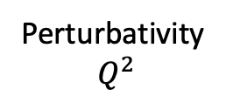

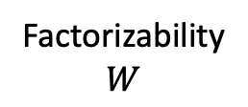


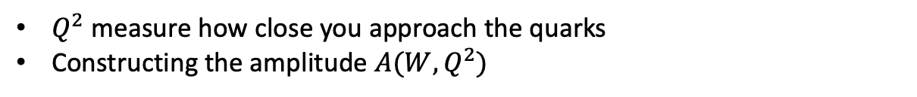


Territory Map Electron-Proton Scattering
Perturbativity
$Q^{2}$
High Energy/Perturbative QCD: DIS/PDF
Coupled Channels/Partial Wave Amplitudes
Non-Perturbative QCD Focus: GPD, Deep Exclusive Physics
Exclusive $ω\left(782\right)$ Electroproduction
1.0 GeV²
Transition Region
Soft Diffractive Physics/Photoproduction
$N^{∗}$ Structure
$$R_{1}$$
$$R_{2}$$
$$R_{3}$$
$$R_{4}$$
~2.2 GeV
~2.5 GeV
Factorizability
$$W$$
$Q^{2}$ measure how close you approach the quarks
Constructing the amplitude $A(W,Q^{2})$
2

Slide 3
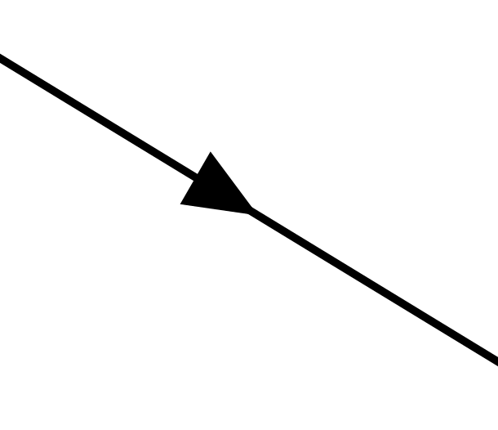
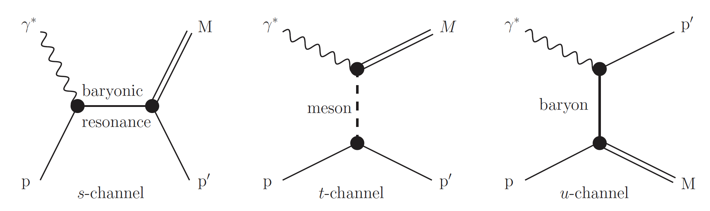


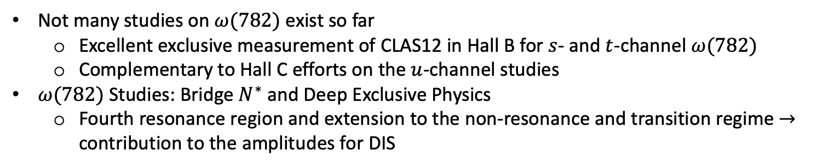



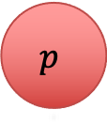

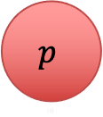

$γ^{∗}p→ωp$ Meson Physics Studies
$$e^{−}$$
$$e^{−}$$
Reactions
$$ω$$
$$p$$
$$p$$
$$R_{i}$$
$$R_{B}$$
$N^{∗}$ Spectroscopy
Forward Scattering
Diffractive Physics
Backward Scattering
Hall C Efforts
Not many studies on $ω(782)$ exist so far
  Excellent exclusive measurement of CLAS12 in Hall B for $s$- and $t$-channel $ω(782)$
  Complementary to Hall C efforts on the $u$-channel studies
$ω(782)$ Studies: Bridge $N^{∗}$ and Deep Exclusive Physics
  Fourth resonance region and extension to the non-resonance and transition regime $→$ contribution to the amplitudes for DIS
3

Slide 4
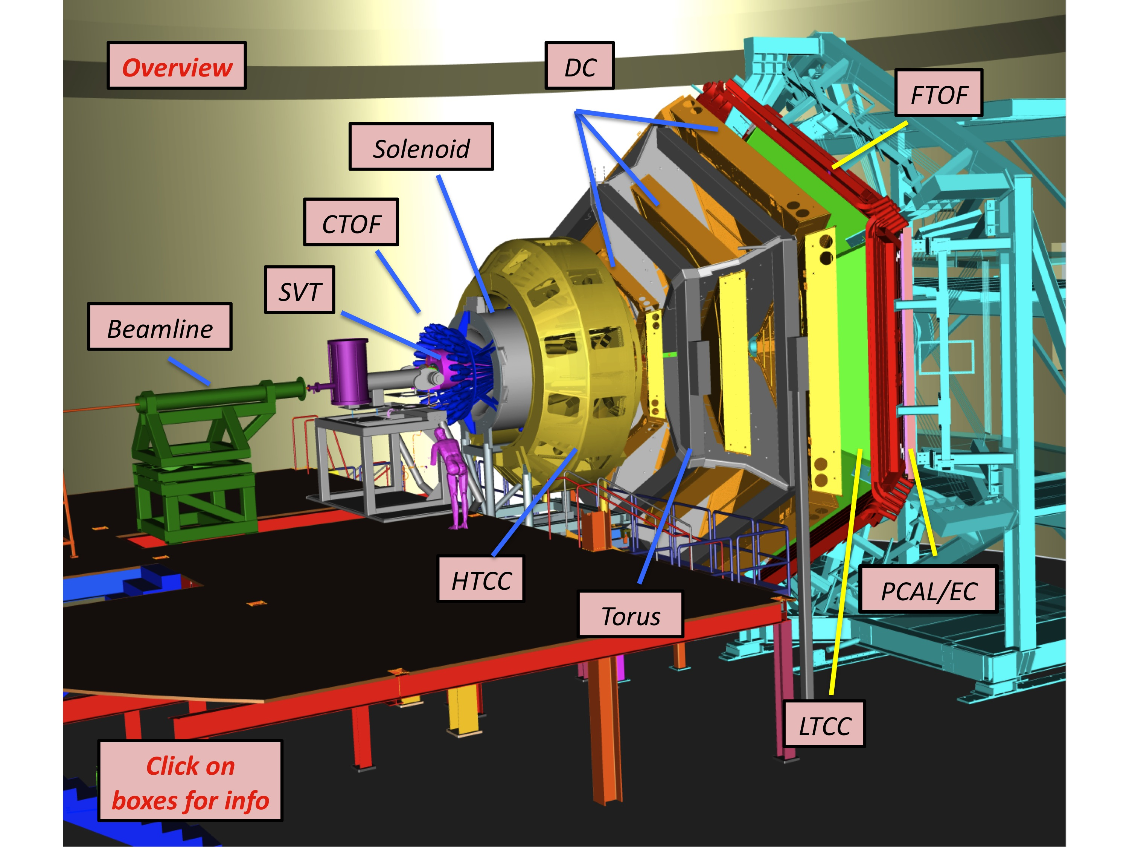
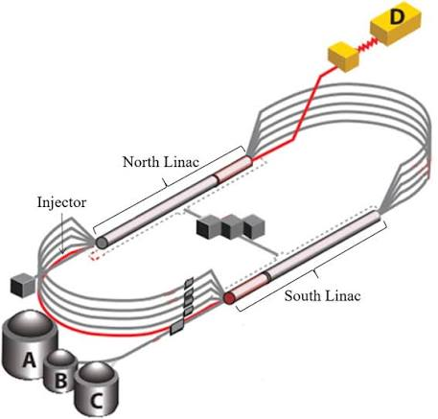
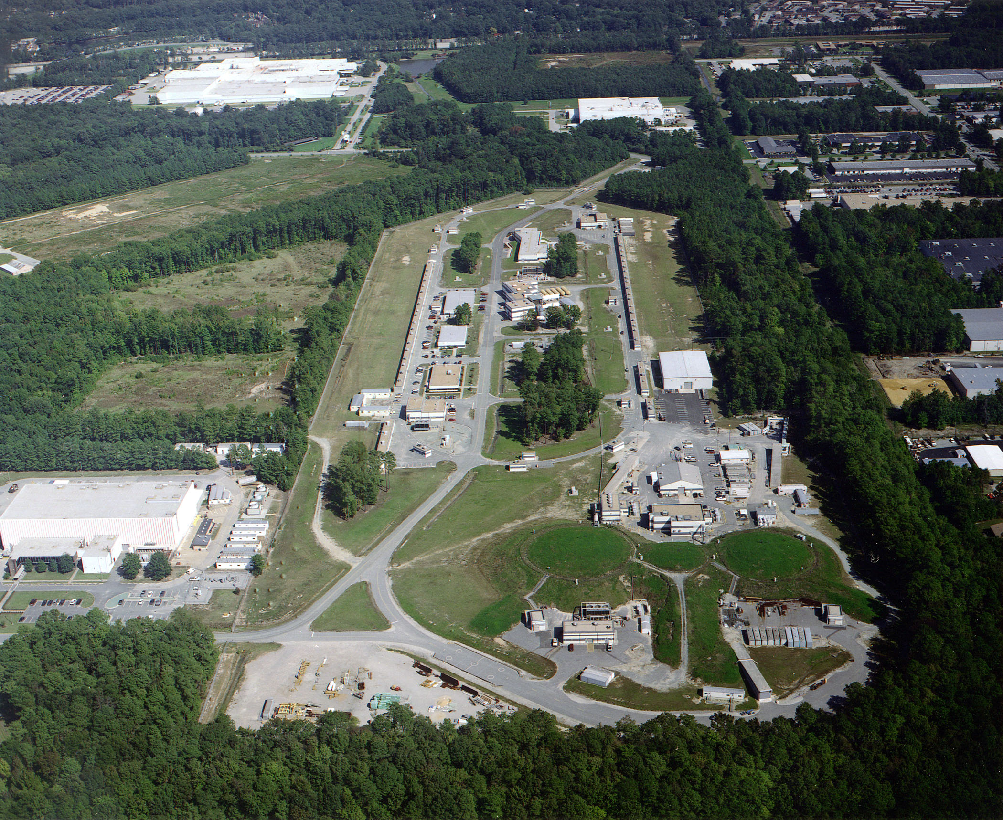
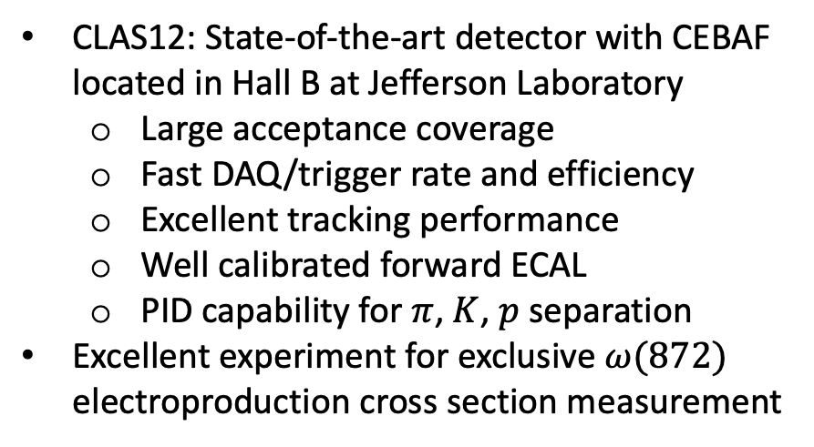
CLAS12 in Hall B at CEBAF at Jefferson Laboratory
CLAS12: State-of-the-art detector with CEBAF located in Hall B at Jefferson Laboratory
  Large acceptance coverage
  Fast DAQ/trigger rate and efficiency
  Excellent tracking performance
  Well calibrated forward ECAL
  PID capability for $π$, $K$, $p$ separation
Excellent experiment for exclusive $ω(872)$ electroproduction cross section measurement
4

Slide 5














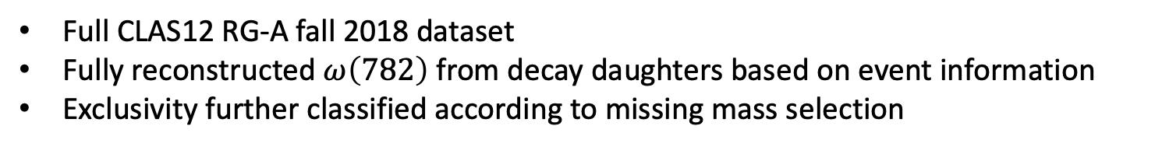



Decay Topology and Analysis Strategies
$ep→e^{′}p^{′}ω→π^{+}π^{−}π^{0}→$ $π^{+}π^{−}γγ$
$$ep→e^{′}p^{′}ω→γπ^{0}→γγγ$$
$$e^{′}$$
$$e^{′}$$
$$π^{+}$$
$$γ$$
$$γ$$
$$γ$$
$$ω$$
$$π^{0}$$
$$ω$$
$$γ$$
$$π^{0}$$
$$π^{−}$$
$$γ$$
$$p^{′}$$
$$p^{′}$$
Channel 1 BR = 89.2%
Channel 2 BR = 8.33%
Full CLAS12 RG-A fall 2018 dataset
Fully reconstructed $ω\left(782\right)$ from decay daughters based on event information
Exclusivity further classified according to missing mass selection
5

Slide 6
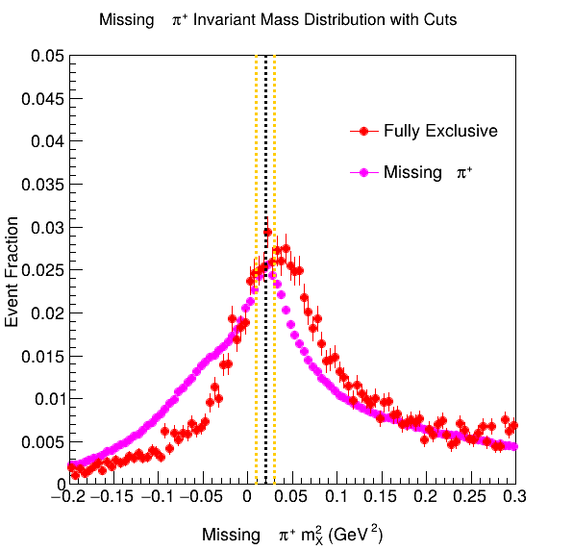
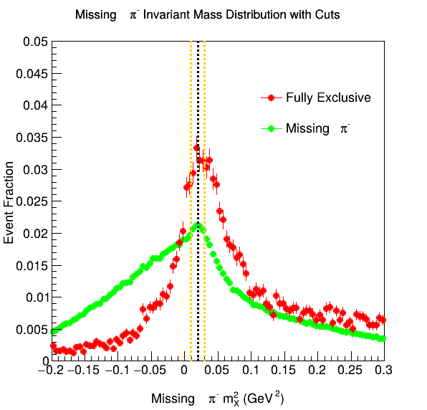
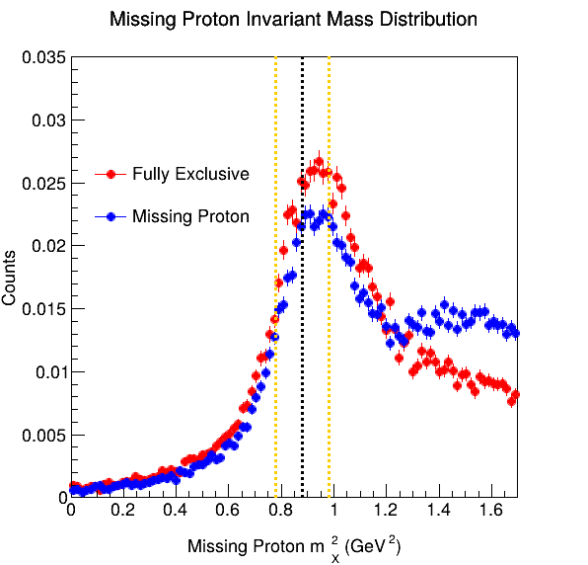
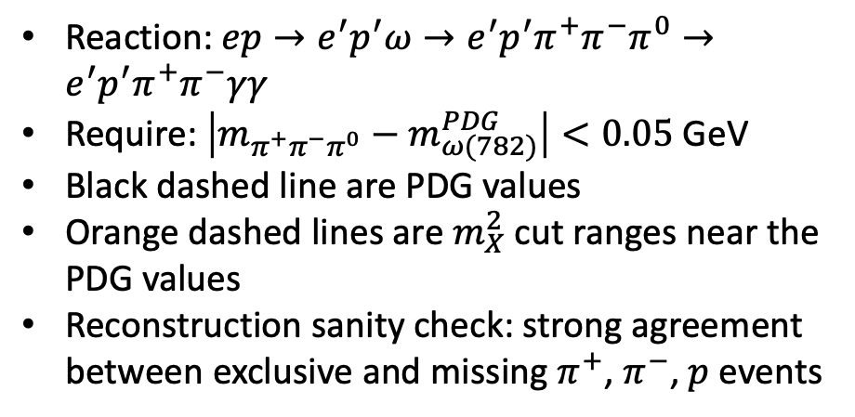
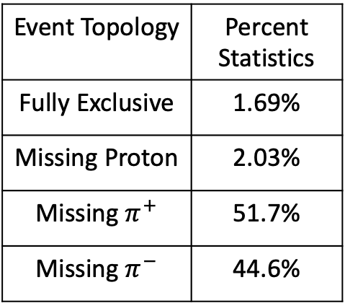
Missing Mass Distributions
Event Topology | Percent Statistics
Fully Exclusive | 1.69%
Missing Proton | 2.03%
Missing $π^{+}$ | 51.7%
Missing $π^{−}$ | 44.6%
Reaction: $ep→e^{′}p^{′}ω→e^{′}p^{′}π^{+}π^{−}π^{0}→e^{′}p^{′}π^{+}π^{−}γγ$
Require: $\left|m_{π^{+}π^{−}π^{0}}−m_{ω(782)}^{PDG}\right|<0.05$ GeV
Black dashed line are PDG values
Orange dashed lines are $m_{X}^{2}$ cut ranges near the PDG values
Reconstruction sanity check: strong agreement between exclusive and missing $π^{+}$, $π^{−}$, $p$ events
6

Slide 7
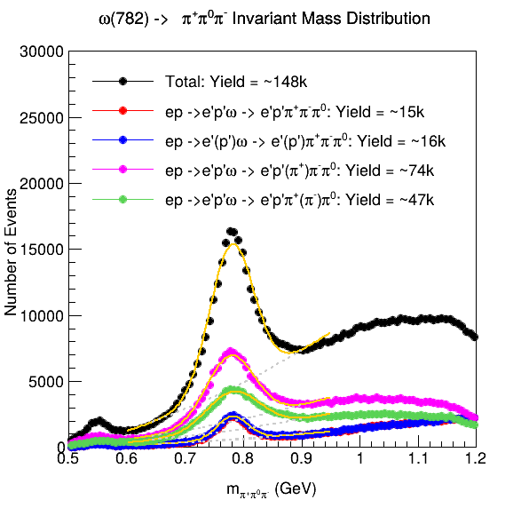
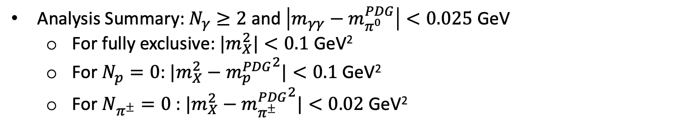
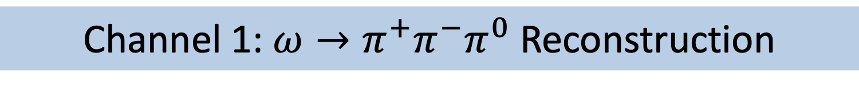

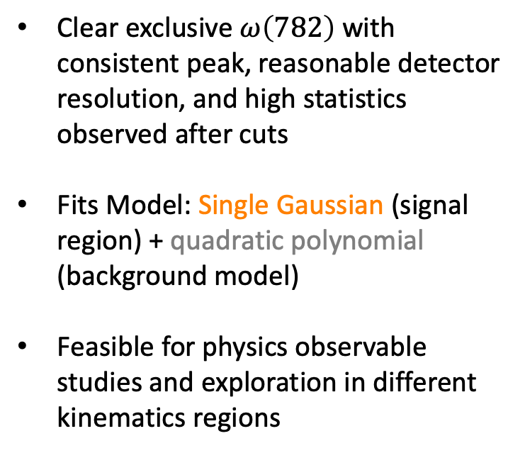
Channel 1: $ω→π^{+}π^{−}π^{0}$ Reconstruction
Analysis Summary: $N_{γ}≥2$ and $\left|m_{γγ}−m_{π^{0}}^{PDG}\right|<0.025$ GeV
  For fully exclusive: ${|m}_{X}^{2}|<0.1$ GeV²
  For $N_{p}=0$: ${|m}_{X}^{2}−{m_{p}^{PDG}}^{2}|<0.1$ GeV²
  For $N_{π^{±}}=0$: ${|m}_{X}^{2}−{m_{π^{±}}^{PDG}}^{2}|<0.02$ GeV²
Clear exclusive $ω\left(782\right)$ with consistent peak, reasonable detector resolution, and high statistics observed after cuts
Fits Model: Single Gaussian (signal region) + quadratic polynomial (background model)
Feasible for physics observable studies and exploration in different kinematics regions
$$η(550)$$
7

Slide 8
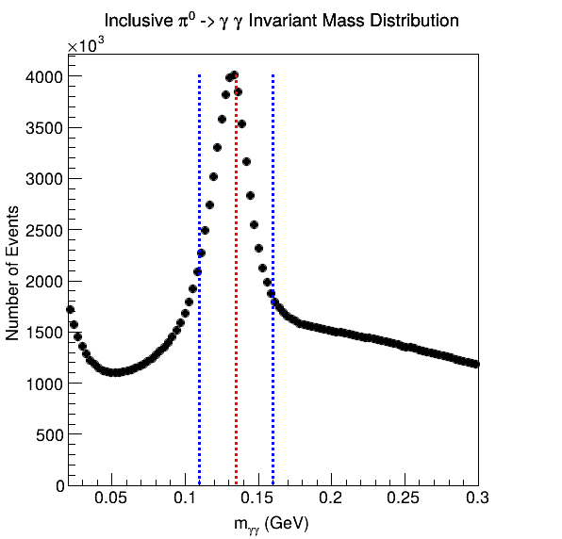
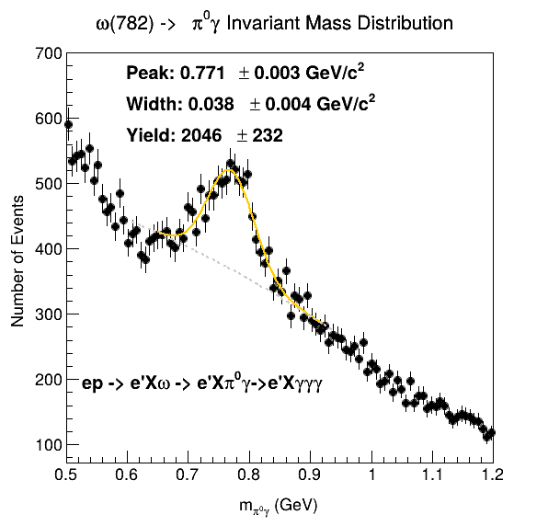
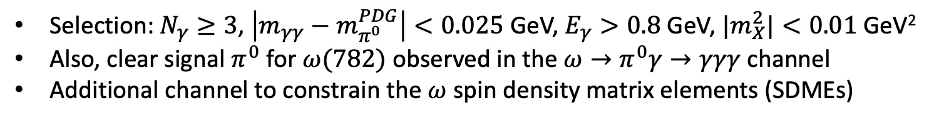
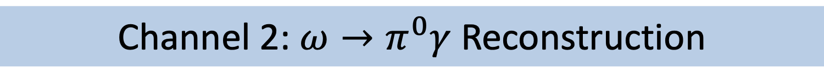
Channel 2: $ω→π^{0}γ$ Reconstruction
Selection: $N_{γ}≥3$, $\left|m_{γγ}−m_{π^{0}}^{PDG}\right|<0.025$ GeV, $E_{γ}>0.8$ GeV, ${|m}_{X}^{2}|<0.01$ GeV²
Also, clear signal $π^{0}$ for $ω(782)$ observed in the $ω→π^{0}γ→γγγ$ channel
Additional channel to constrain the $ω$ spin density matrix elements (SDMEs)
8

Slide 9
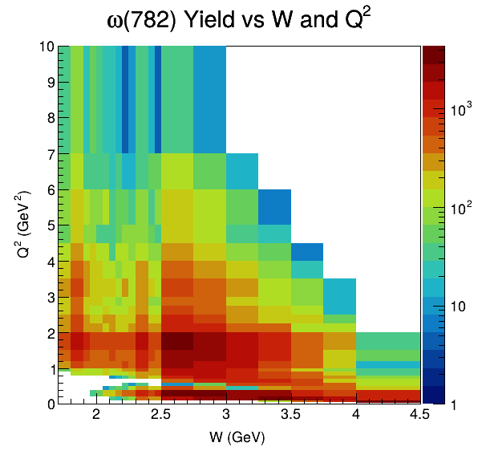
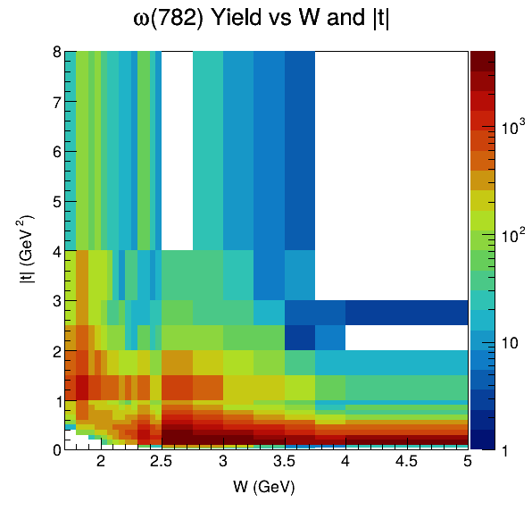
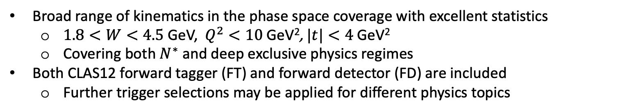
$ω(782)$ Signal Statistics Kinematics Distributions
Broad range of kinematics in the phase space coverage with excellent statistics
  $1.8<W<4.5$ GeV, $Q^{2}<10$ GeV², $|t|<4$ GeV²
  Covering both $N^{∗}$ and deep exclusive physics regimes
Both CLAS12 forward tagger (FT) and forward detector (FD) are included
  Further trigger selections may be applied for different physics topics
9

Slide 10
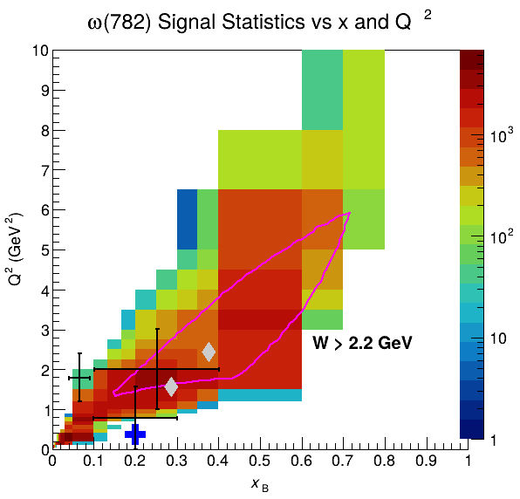
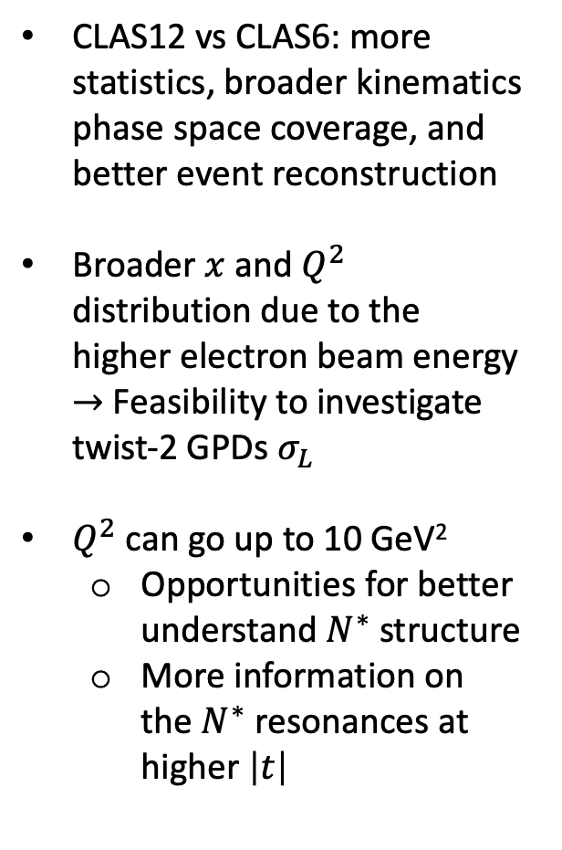
Direct Comparison with Other Experiments
CLAS12 vs CLAS6: more statistics, broader kinematics phase space coverage, and better event reconstruction
Broader $x$ and $Q^{2}$ distribution due to the higher electron beam energy $→$ Feasibility to investigate twist-2 GPDs $σ_{L}$
$Q^{2}$ can go up to 10 GeV²
  Opportunities for better understand $N^{∗}$ structure
  More information on the $N^{∗}$ resonances at higher $\left|t\right|$
HERMES
CLAS6
CORNELL
Fpi-2
DESY
Hall C (2004)
Eur. Phys. J. A 24 (2005) 445-458
Phys. Rev. Lett. 123 (2019) 182501
10

Slide 11
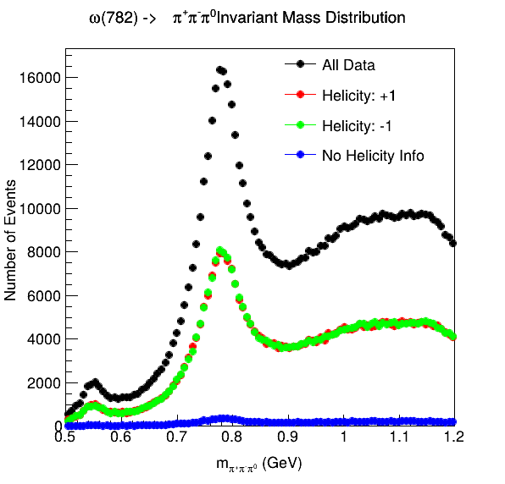
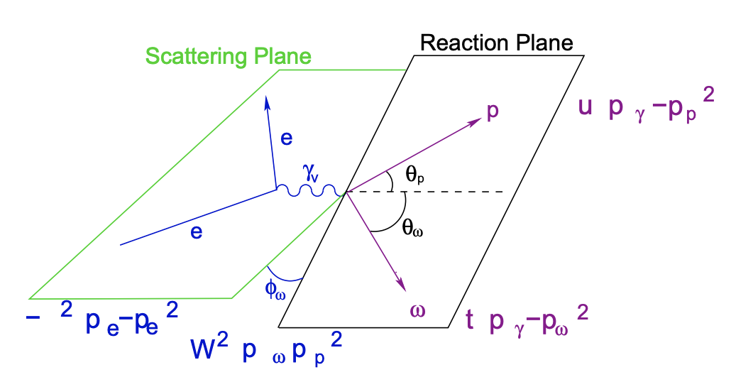
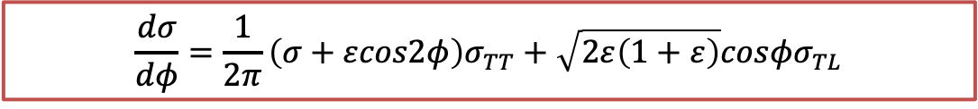
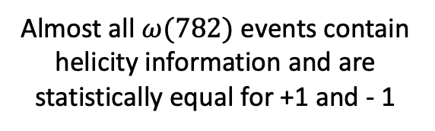
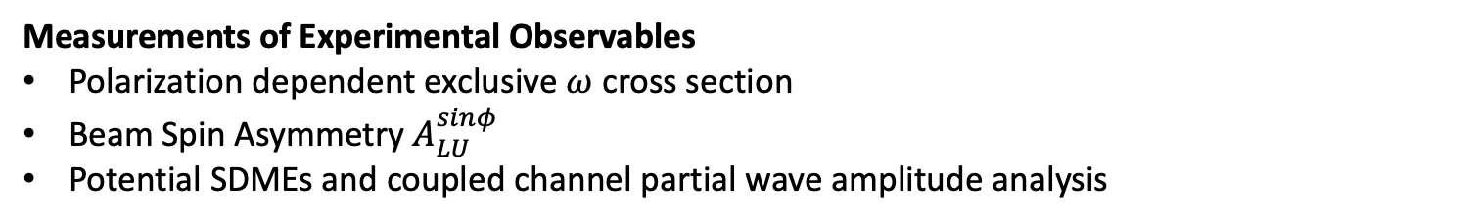

$ω(782)$ Physical Observable Outlook
Measurements of Experimental Observables
Polarization dependent exclusive $ω$ cross section
Beam Spin Asymmetry $A_{LU}^{sinφ}$
Potential SDMEs and coupled channel partial wave amplitude analysis
$$\frac{dσ}{dφ}=\frac{1}{2π}\left(σ+εcos2φ\right)σ_{TT}+\sqrt{2ε\left(1+ε\right)}cosφσ_{TL}$$
Trento $φ$ Convention
Excellent statistics of longitudinally polarized electron beam with ±1 helicity
Almost all $ω(782)$ events contain helicity information and are statistically equal for +1 and - 1
11

Slide 12
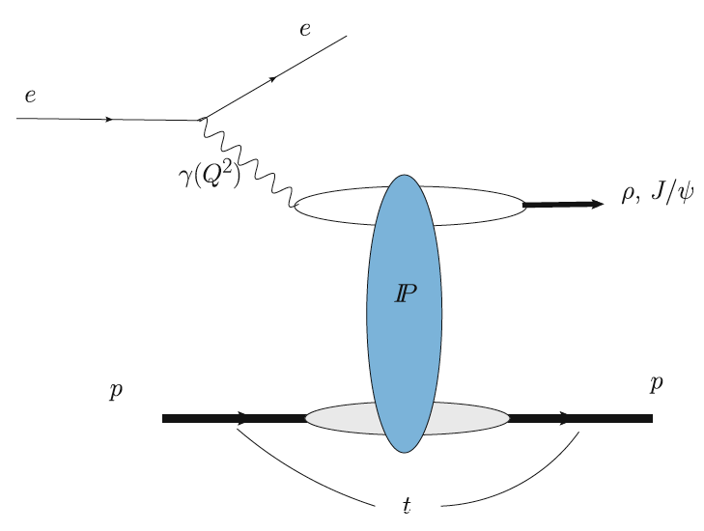
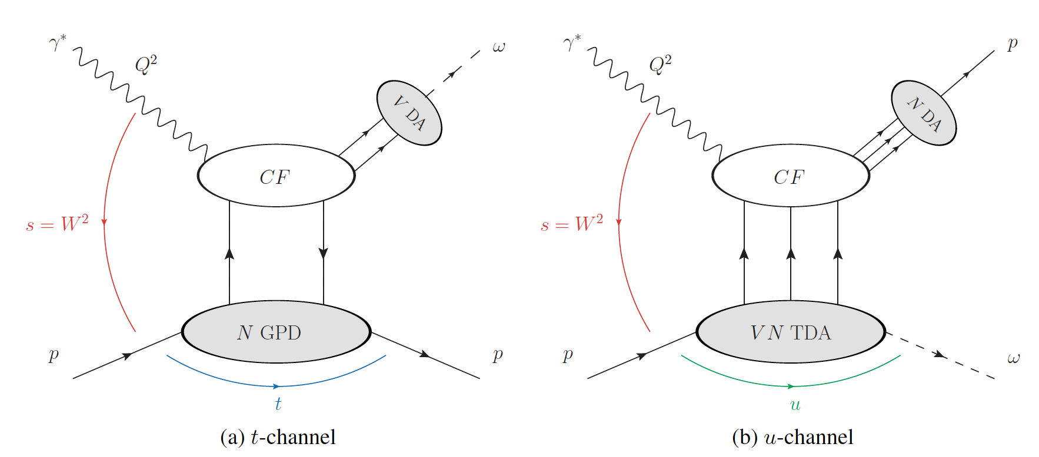
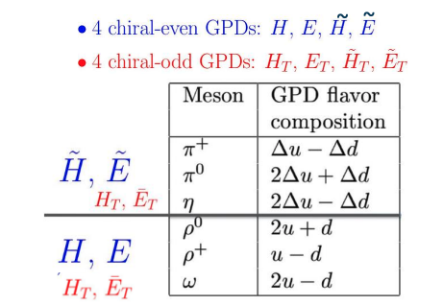
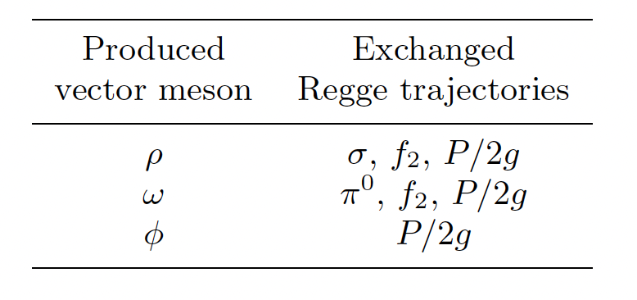

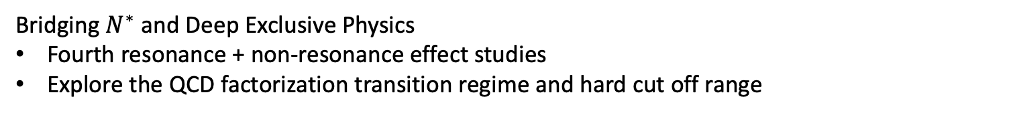




Bridging Forward with $N^{∗}$ Physics
$u−d$Flavor Decomposed GPDs
Regge Phenomenology
$$q$$
$ρ$, $ω$
$$\overline{q}$$
$0^{−},0^{+},$ …
Bridging $N^{∗}$ and Deep Exclusive Physics
Fourth resonance + non-resonance effect studies
Explore the QCD factorization transition regime and hard cut off range
12

Slide 13
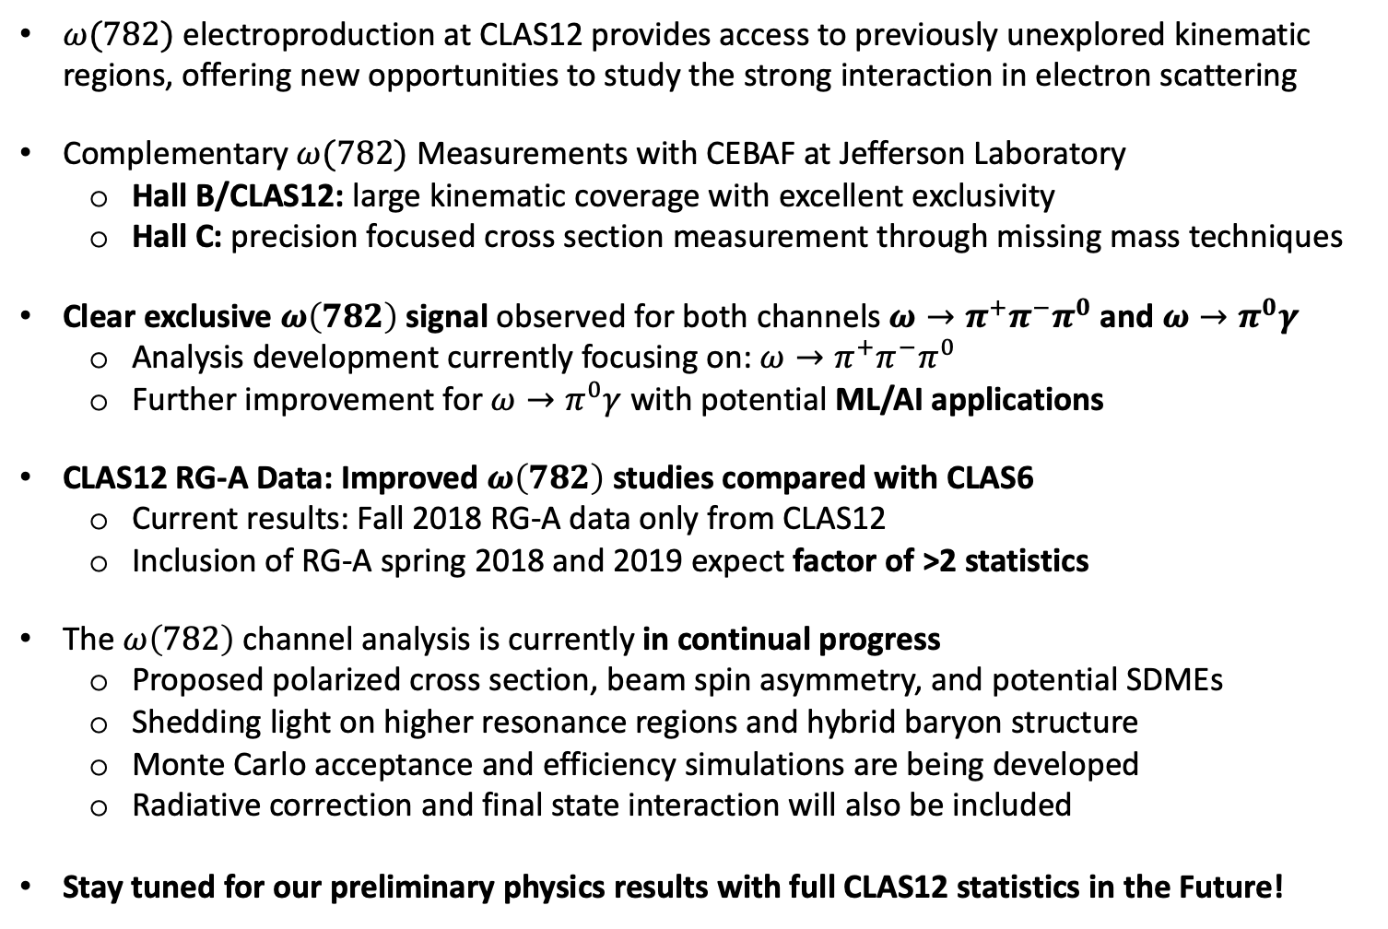
Summary
$ω(782)$ electroproduction at CLAS12 provides access to previously unexplored kinematic regions, offering new opportunities to study the strong interaction in electron scattering
Complementary $ω(782)$ Measurements with CEBAF at Jefferson Laboratory
  Hall B/CLAS12: large kinematic coverage with excellent exclusivity
  Hall C: precision focused cross section measurement through missing mass techniques
Clear exclusive $ω\left(782\right)$ signal observed for both channels $ω→π^{+}π^{−}π^{0}$ and $ω→π^{0}γ$
  Analysis development currently focusing on: $ω→π^{+}π^{−}π^{0}$
  Further improvement for $ω→π^{0}γ$ with potential ML/AI applications
CLAS12 RG-A Data: Improved $ω\left(782\right)$ studies compared with CLAS6
  Current results: Fall 2018 RG-A data only from CLAS12
  Inclusion of RG-A spring 2018 and 2019 expect factor of >2 statistics
The $ω\left(782\right)$channel analysis is currently in continual progress
  Proposed polarized cross section, beam spin asymmetry, and potential SDMEs
  Shedding light on higher resonance regions and hybrid baryon structure
  Monte Carlo acceptance and efficiency simulations are being developed
  Radiative correction and final state interaction will also be included
Stay tuned for our preliminary physics results with full CLAS12 statistics in the Future!
13

Slide 14
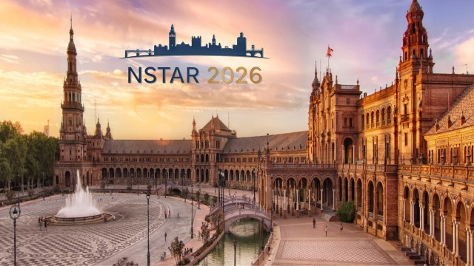

Thank You
This work is supported by:
NSF Grant PHY-2310034
JLab-University Bridge Program under the direction of the DOE
14

Slide 15
Back Up
15

Slide 16
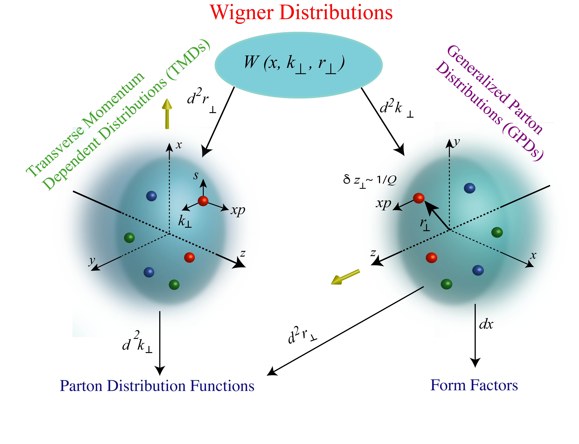
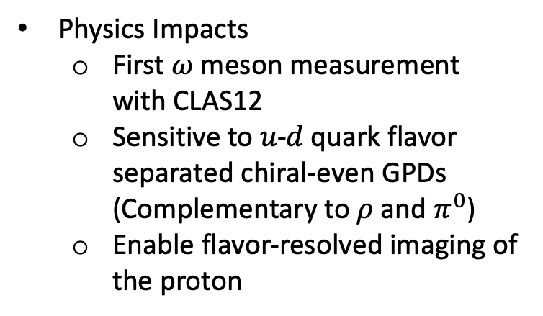
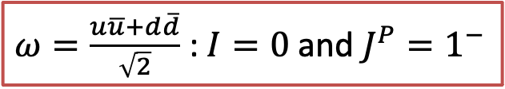
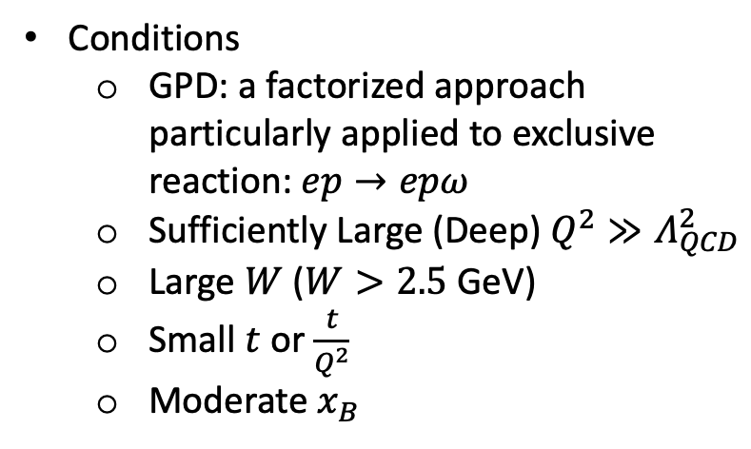
Handbag Diagrams: GPD/TDA Type of Physics
$ω=\frac{u\overline{u}+d\overline{d}}{\sqrt{2}}$ : $I=0$ and $J^{P}=1^{−}$
Conditions
  GPD: a factorized approach particularly applied to exclusive reaction: $ep→epω$
  Sufficiently Large (Deep) $Q^{2}≫Λ_{QCD}^{2}$
  Large $W$ ($W>2.5$ GeV)
  Small $t$ or $\frac{t}{Q^{2}}$
  Moderate $x_{B}$
Physics Impacts
  First $ω$ meson measurement with CLAS12
  Sensitive to 𝑢-𝑑 quark flavor separated chiral‑even GPDs (Complementary to $ρ$ and $π^{0}$)
  Enable flavor‑resolved imaging of the proton
16

Slide 17
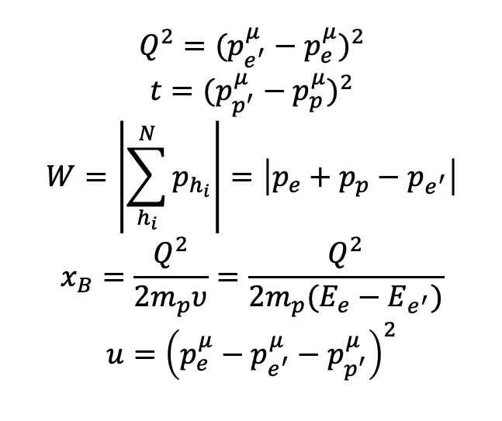
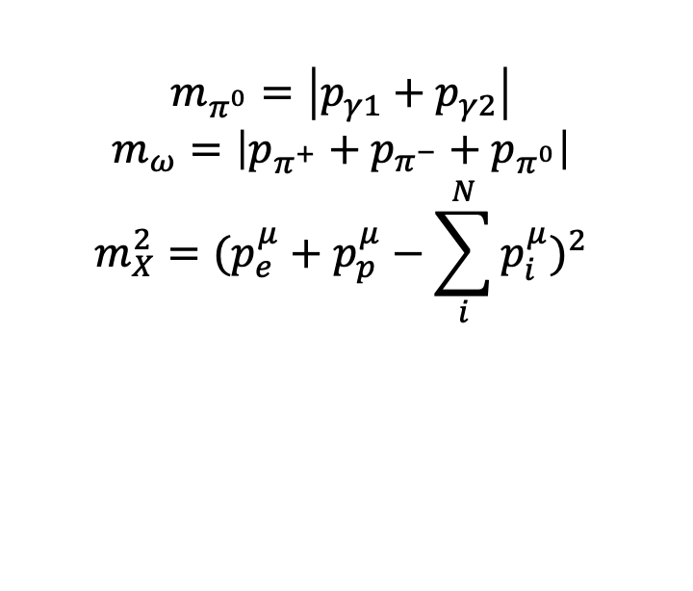
Kinematics Definition
π⁺
π^{ο}
ω
Quantization axis
Φ
p
φ
π⁻
Plane of Photon Polarization
Production Plane
Decay Plane
Kinematics definitions for $ep→e^{′}p^{′}ω→e^{′}p^{′}π^{+}π^{−}π^{0}$
$$Q^{2}={(p_{e^{′}}^{μ}−p_{e}^{μ})}^{2}$$
$$t={(p_{p^{′}}^{μ}−p_{p}^{μ})}^{2}$$
$$W=\left|\sum_{h_{i}}^{N}{p_{h_{i}}}\right|=\left|p_{e}+p_{p}−p_{e^{′}}\right|$$
$$x_{B}=\frac{Q^{2}}{2m_{p}υ}=\frac{Q^{2}}{2m_{p}(E_{e}−E_{e^{′}})}$$
$$u={\left(p_{e}^{μ}−p_{e^{′}}^{μ}−p_{p^{′}}^{μ}\right)}^{2}$$
$$m_{π^{0}}=\left|p_{γ1}+p_{γ2}\right|$$
$$m_{ω}=\left|p_{π^{+}}+p_{π^{−}}+p_{π^{0}}\right|$$
$$m_{X}^{2}={(p_{e}^{μ}+p_{p}^{μ}−\sum_{i}^{N}{p_{i}^{μ}})}^{2}$$
17

Slide 18
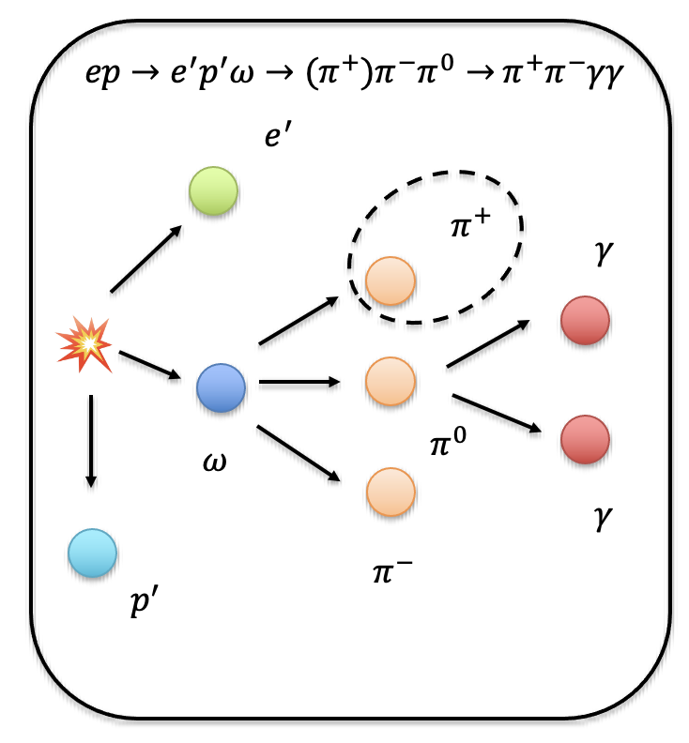


$ω(782)$ Reconstruction with Missing $π^{±}$
Algorithms
Select events with exactly 1 proton, 1 electron, 1 $π^{+}$ or $π^{−}$, and at least 2 photons
Calculate the missing 4 vector
  $$p_{π^{∓ }}^{μ}=p_{e}^{μ}+p_{p}^{μ}−p_{e^{′}}^{μ}−p_{p^{′}}^{μ}−p_{π^{±}}^{μ}−p_{π^{0}}^{μ}$$
  $$p_{ω}^{μ}=p_{π^{∓ }}^{μ}+p_{π^{±}}^{μ}+p_{π^{0}}^{μ}$$
Mass definitions:
  $m_{π^{0}}=\sqrt{{p_{π^{0}}^{μ}p}_{μ}^{π^{0}}}$
  $m_{π^{±}}=\sqrt{{p_{π^{±}}^{μ}p}_{μ}^{π^{±}}}$
Mass forcing
  If $\left|m_{π^{0}}−m_{π^{0}}^{PDG}\right|<0.025$ GeV, we force the $m_{π^{0}}$ to be $m_{π^{0}}^{PDG}$for $p_{ω}^{μ}$ calculations
PID Cuts Options
No Cuts
$\left|m_{π^{0}}−m_{π^{0}}^{PDG}\right|<0.025$ GeV
$\left|m_{π^{0}}−m_{π^{0}}^{PDG}\right|<0.025$ GeV AND $\left|m_{π^{±}}^{2}−{\left(m_{π^{±}}^{PDG}\right)}^{2}\right|<0.005$ GeV
Exclusion: $\left|m_{π^{0}}−m_{π^{0}}^{PDG}\right|<0.025$ GeV AND $\left|m_{π^{±}}^{2}−{\left(m_{π^{±}}^{PDG}\right)}^{2}\right|>0.1$ GeV
18

Slide 19


Cut UnZoom and Background Check (Torus - 1)
Peaking shape for $m_{X}^{2}$ near 0: $π^{+}$ and $π^{−}$ no $γ$
  Either not accepting the $γγ$ from $π^{0}$ by the ECAL
  Or it is simply $ρ→π^{+}π^{−}$ which fundamentally does not have $γ$
  Break into 3 cases: Enforcing $π^{0}$, Enforcing $ρ$, and excluding everything
19

Slide 20


$ρ^{0}→π^{+}π^{−}$ Background Rejection
Indeed, the $ρ$ meson cases dominates if there is no $\left|m_{X}^{2}\right|<0.1$ GeV² cuts
  Need to trace deeper into missing photon studies to extract additional $ω$ from the $ρ$ meson decay background
If we enforce $\left|m_{π^{0}}^{2}−{\left(m_{π^{0}}^{PDG}\right)}^{2}\right|<0.025$ GeV, we are able to see the clear $ω(782)$
20

Slide 21


$ω(782)$ Summary for Torus + 1 and Torus-1
Not worthing doing the missing $π^{0}$ channel for now because the gain in statistics is not that much compared to the effort of dealing with the systematics
21

Slide 22








$ω$ Analysis To Do List
Include Missing Pions to Enhance the $ω$ Yield
MC Generation and $ω$ Yield Optimization
Efficiency Correction and Physics Measurements
22

