Slide 1


Analysis of CLAS12 Single Pion ep → e’nπ⁺ Electroproduction
Noah Smith

Slide 2
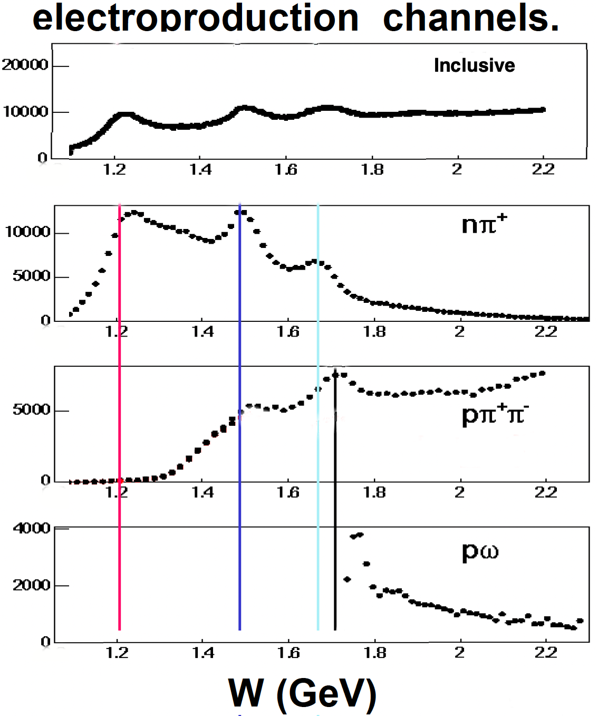
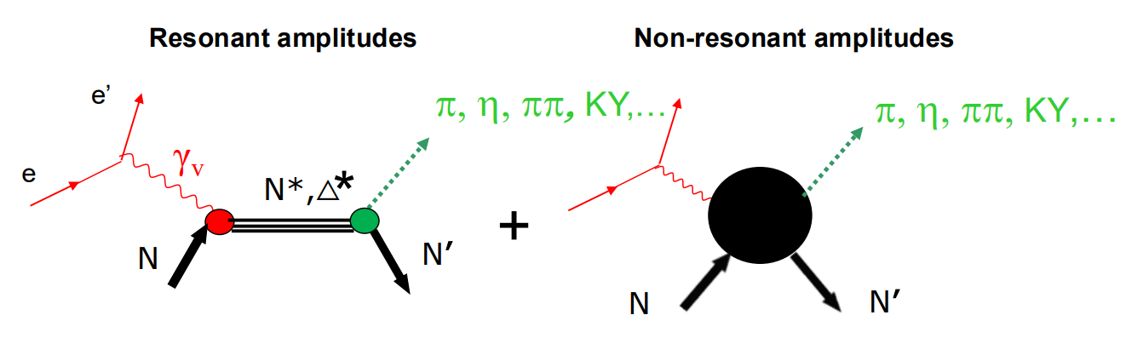
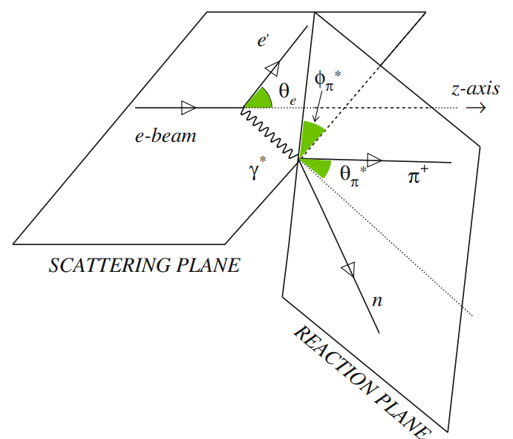
N* Structure in Experiments of CLAS12
N* structure as a window into strong QCD. Extract γ_{v}pN* electrocouplings from exclusive meson electroproduction observables with CLAS
nπ⁺ → dominant channel in 1st and 2nd resonance regions with significant contributions in the 3rd.
Goal: Extract differential cross sections & beam spin asymmetry for ep→e’nπ⁺.
P
N
P
N
D.S. Carman, K. Joo , V.I. Mokeev, Strong QCD Insights from Excited Nucleon Structure
Studies with CLAS and CLAS12
K. Park, M. Guidal, R. Gothe, et al. Deep exclusive π+ electroproduction off the proton at CLAS
V.I. Mokeev, Baryon Transition Form Factors from Experiment

Slide 3
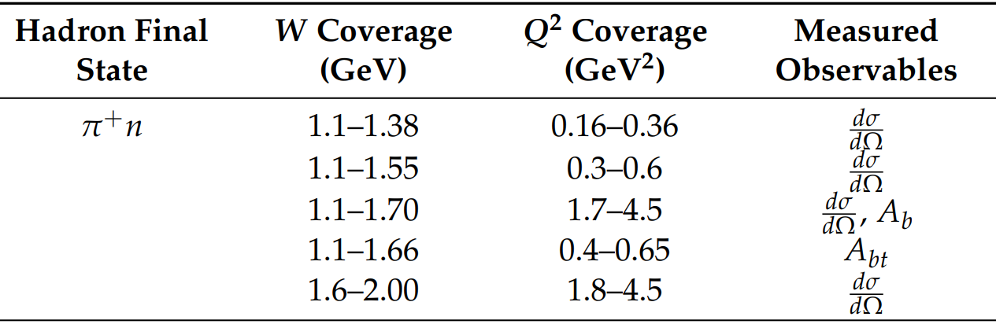
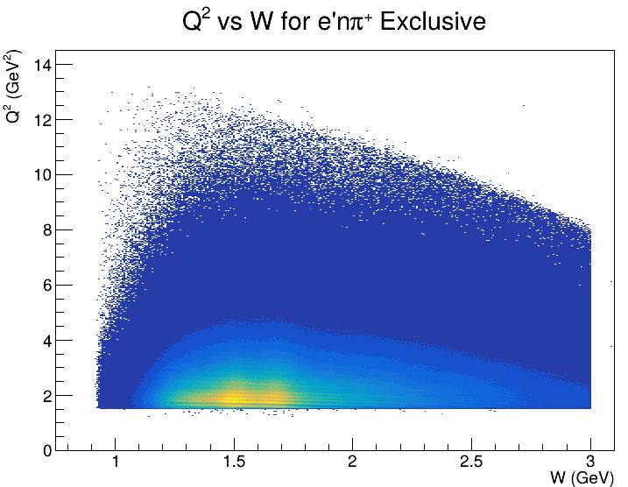
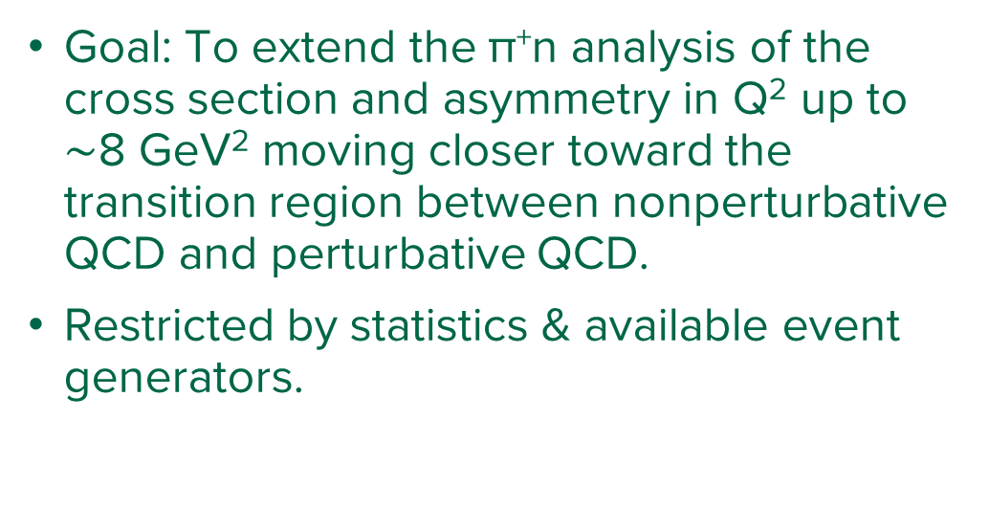
Previous Analysis & Aims of Current Work
Goal: To extend the π⁺n analysis of the cross section and asymmetry in Q² up to $\sim$8 GeV² moving closer toward the transition region between nonperturbative QCD and perturbative QCD.
Restricted by statistics & available event generators.

Slide 4
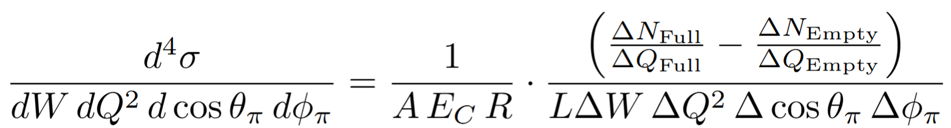
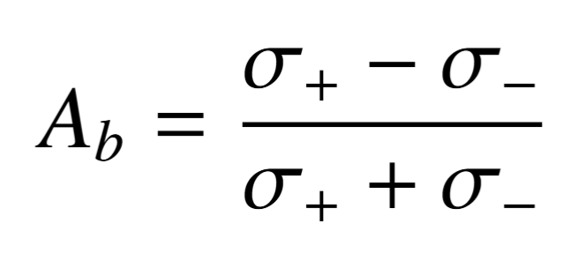
Differential Cross Section
ΔN_{Full} and ΔN_{Empty}: The number of good single pion events in a given bin for a full target and empty target run.
ΔQ_{Full} and ΔQ_{Empty}: The total charge collected by the Faraday cup for each bin.
A: The acceptance correction which accounts for the loss of good events through detector efficiency, geometrical acceptance, and particle identification cuts.
E_{c}: Correction due to efficiency difference of simulation and experiment.
R: Radiative correction as the electron may radiate a photon during its interaction with the proton.
L: Integrated luminosity which represents the number of potential interactions.
→
Will look at polarization dependence of the integrated cross section which factors into higher order corrections for the electrocouplings.

Slide 5
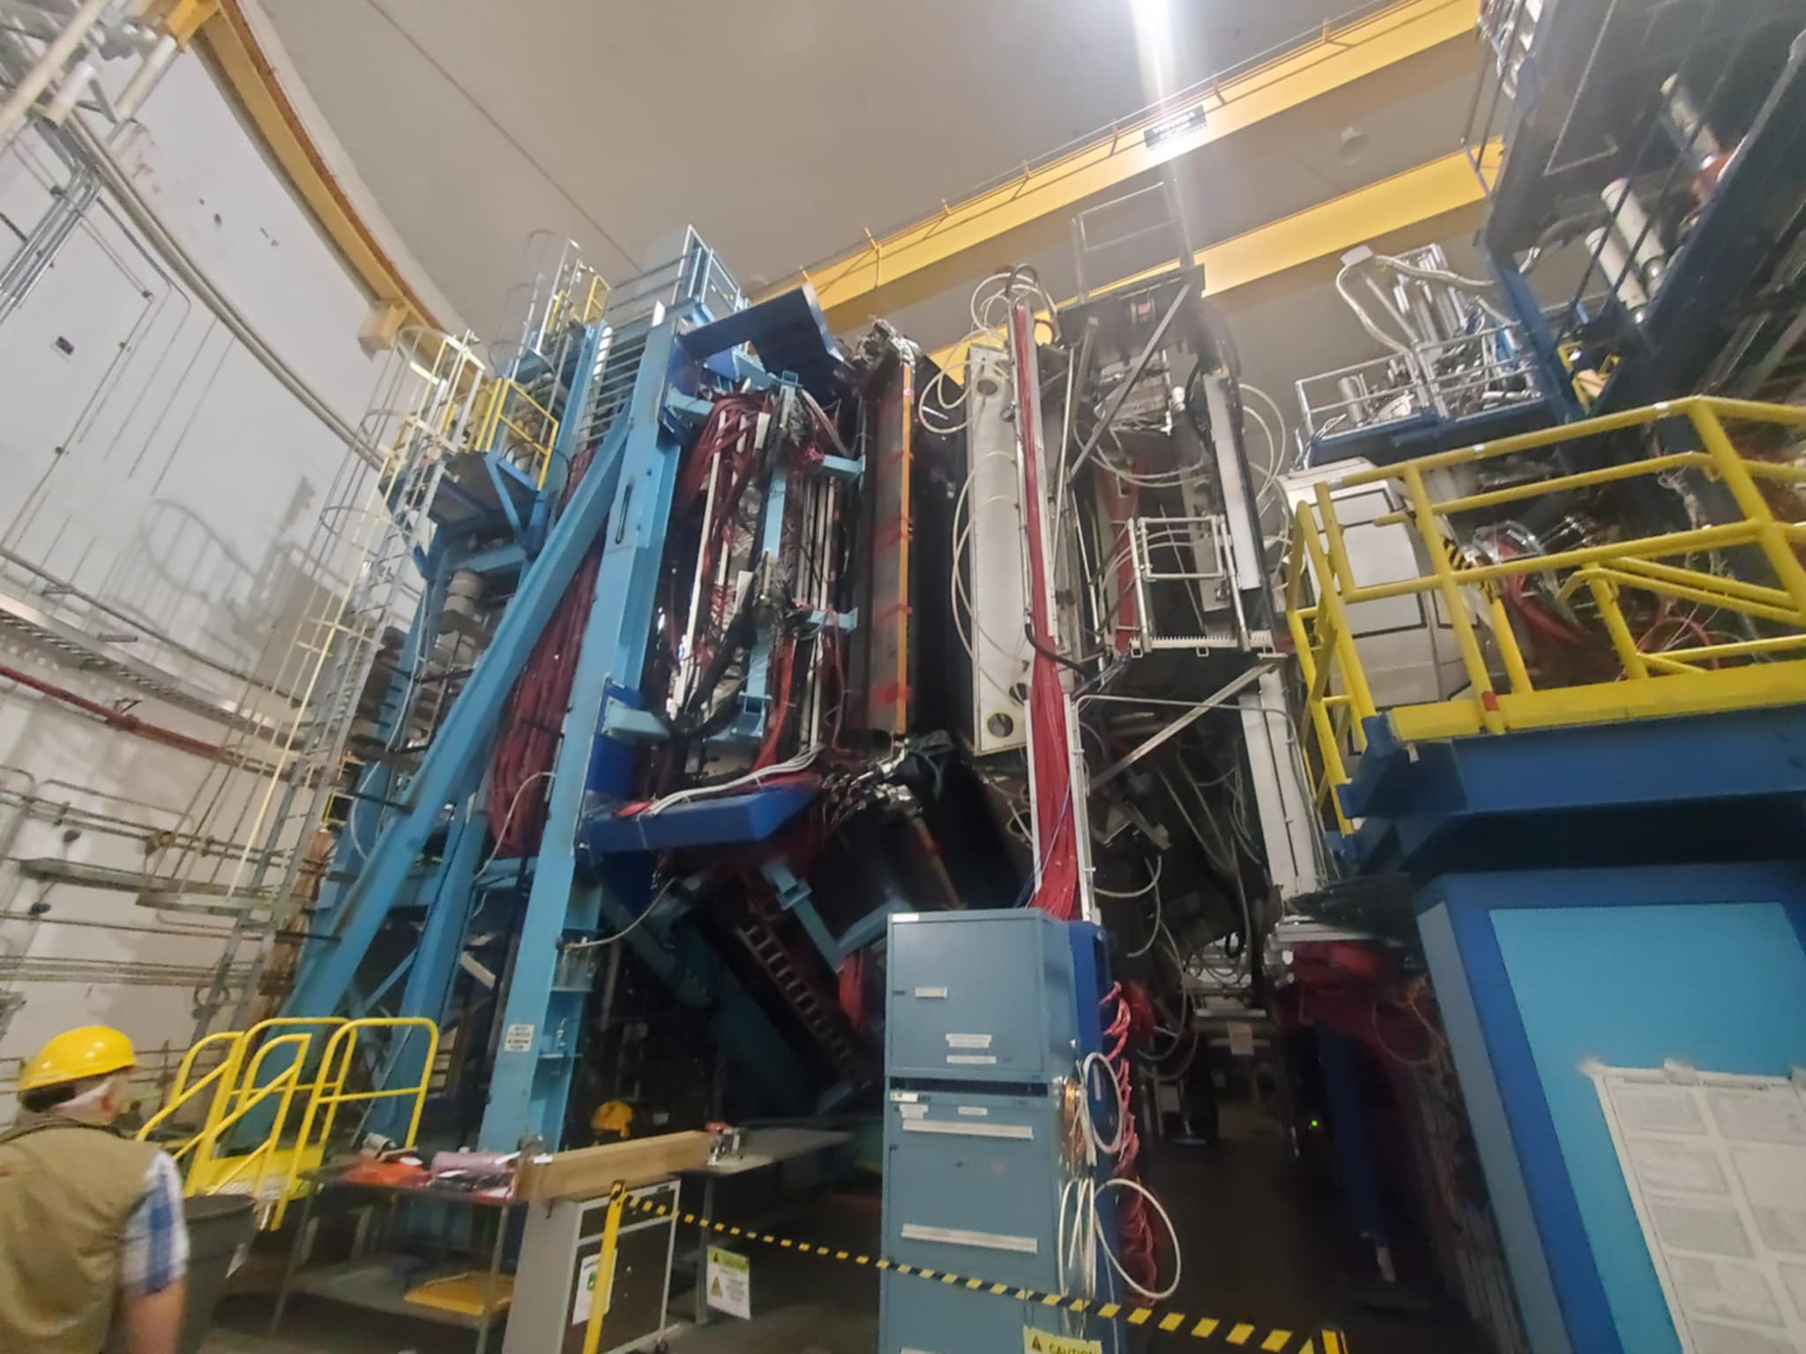
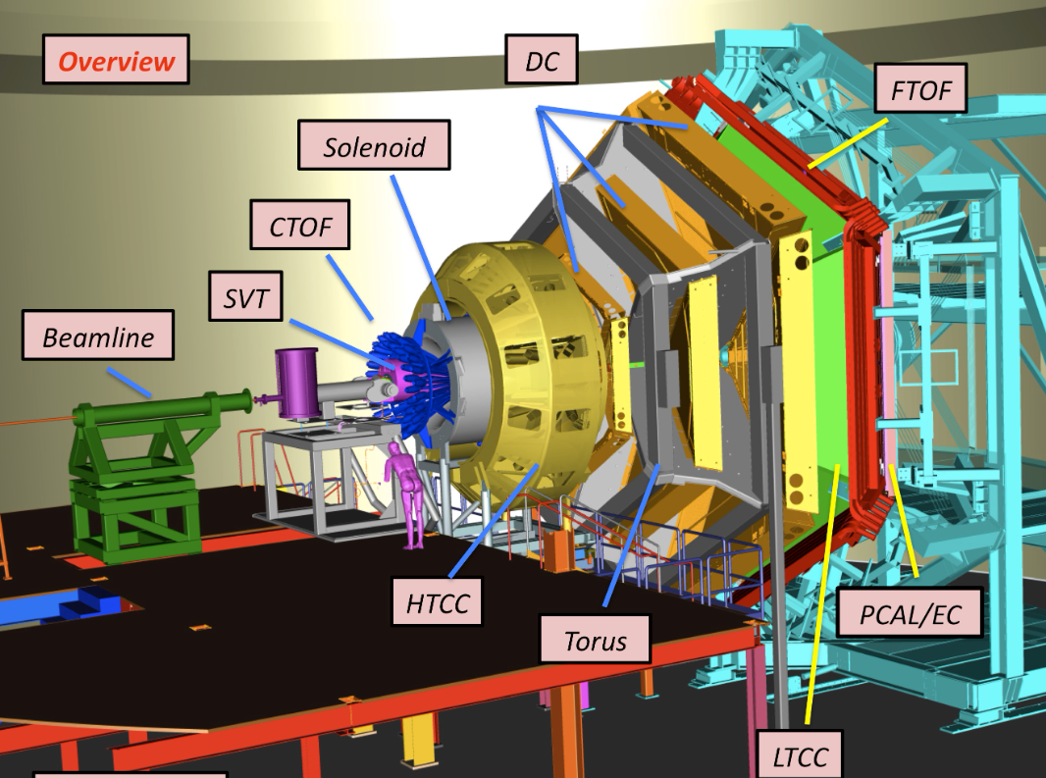
CLAS12 Detector System
https://www.jlab.org/physics/hall-b/clas12
10³⁵ cm⁻² sec⁻¹ luminosity, 1.5 < Q² < 10 GeV² coverage.
Current data presented from fall2018 10.6 GeV beam energy.
Forward Detector covers 5⁰-35⁰, Central detector covers 35⁰-125⁰

Slide 6
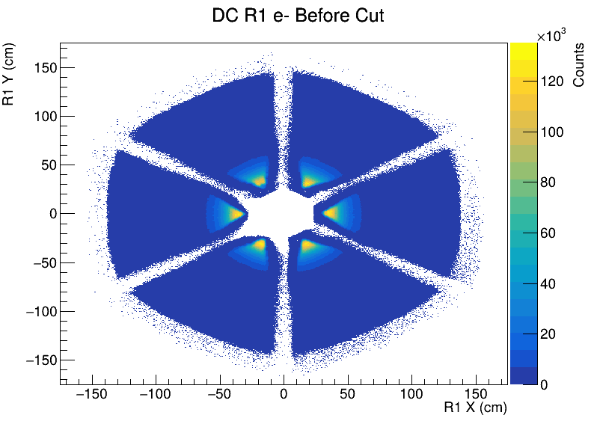
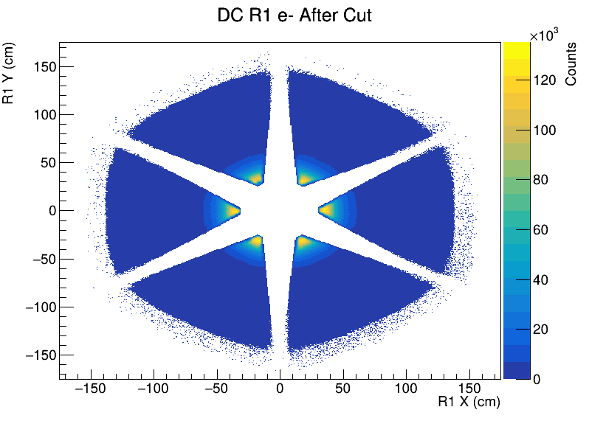
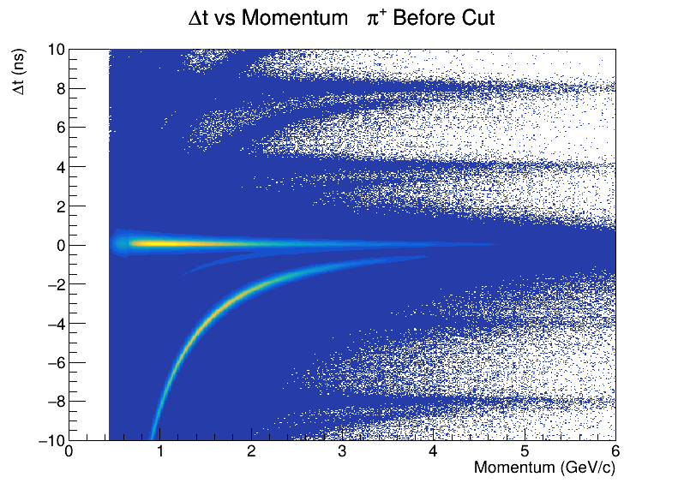
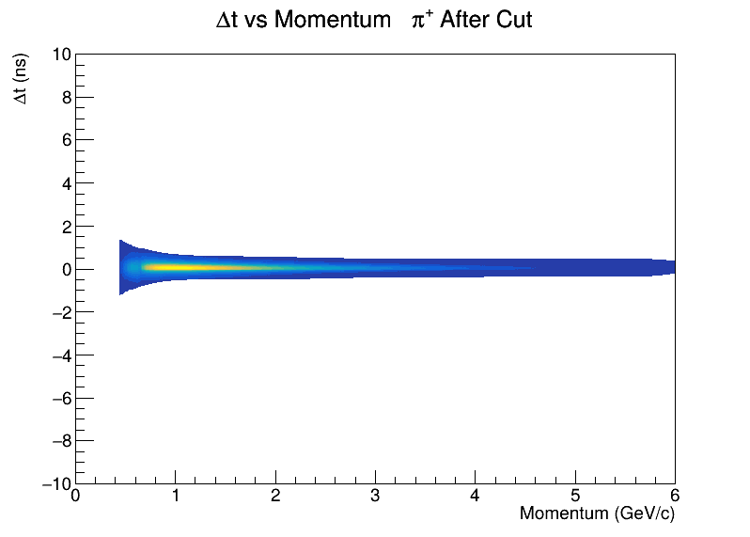
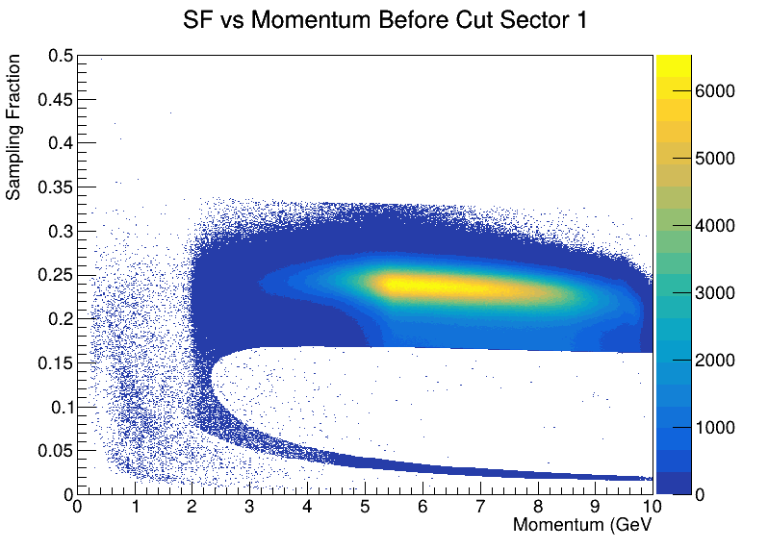
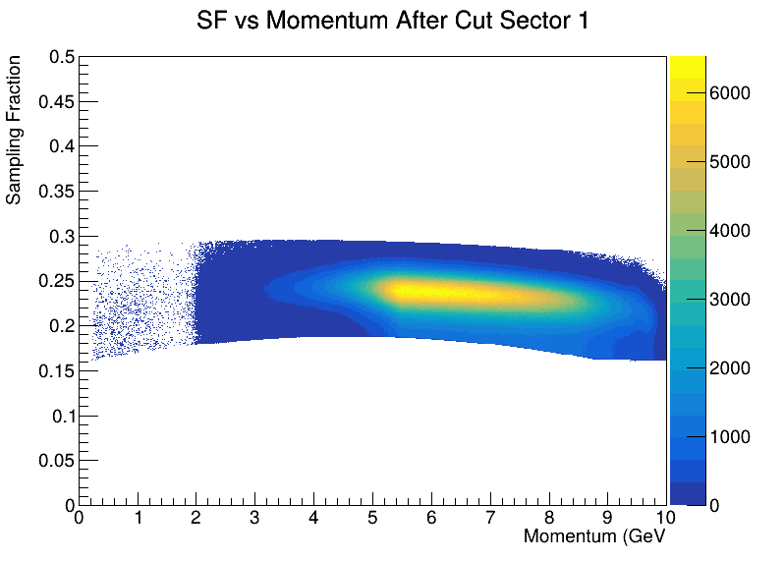
Event Selection
Hadron
Vertex z coordinate
DC & PCAL Fiducial
Momentum > 0.45 GeV
Δt & pid χ² cut – both cut on Δt but the first cuts near zero, the second minimizes Δt for each particle.
Electron
Vertex z coordinate
DC & PCAL Fiducial
Momentum > 0.45 GeV
Sampling fraction
Number of photoelectrons in the HTCC

Slide 7
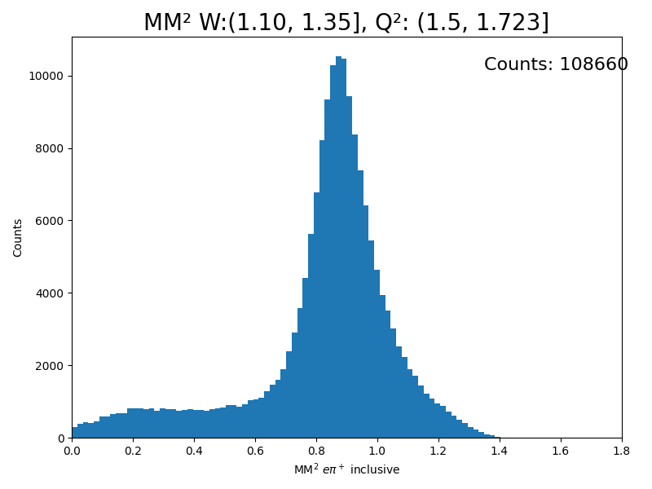
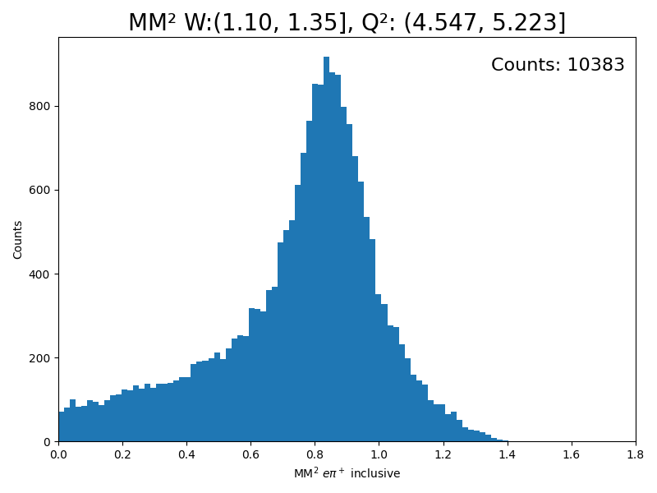
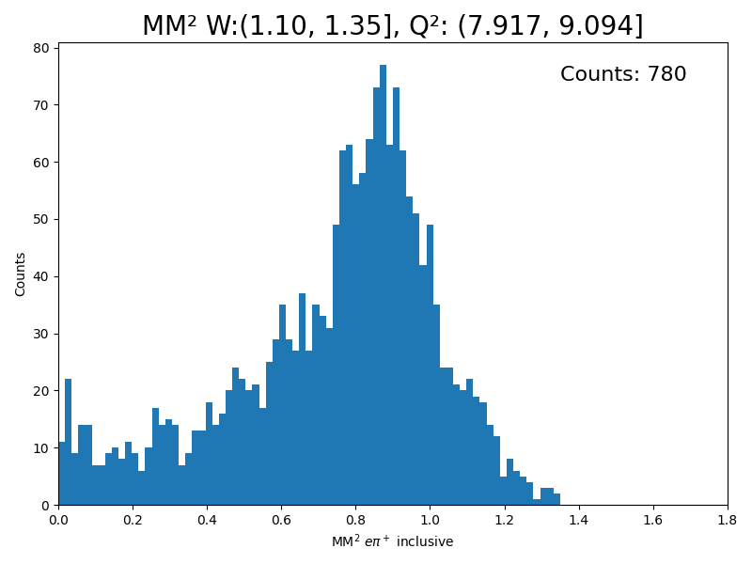
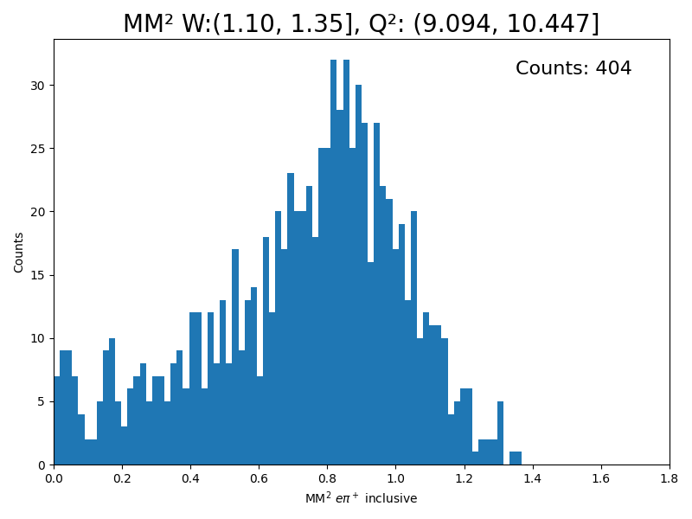
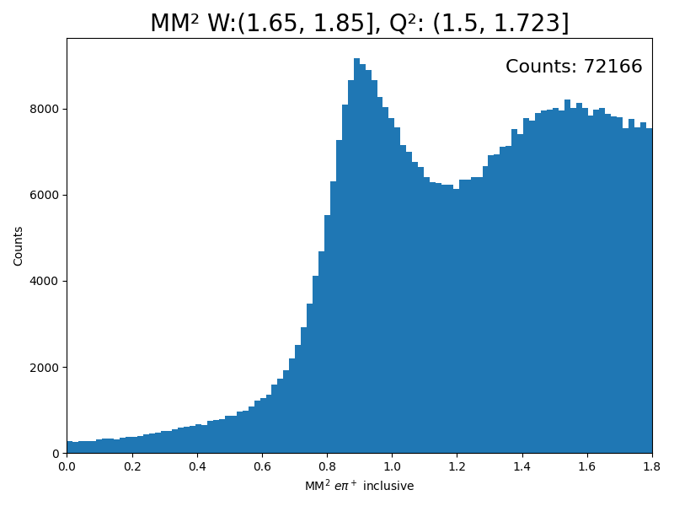
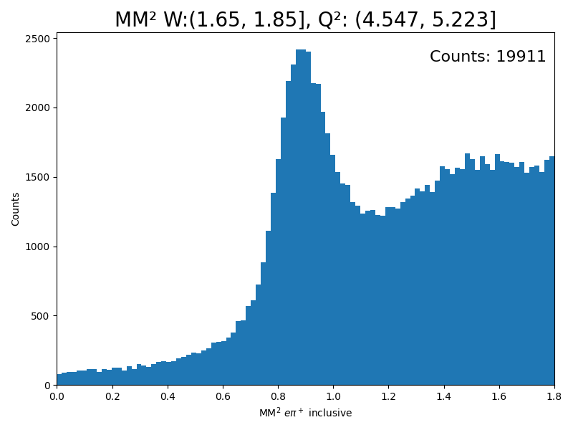
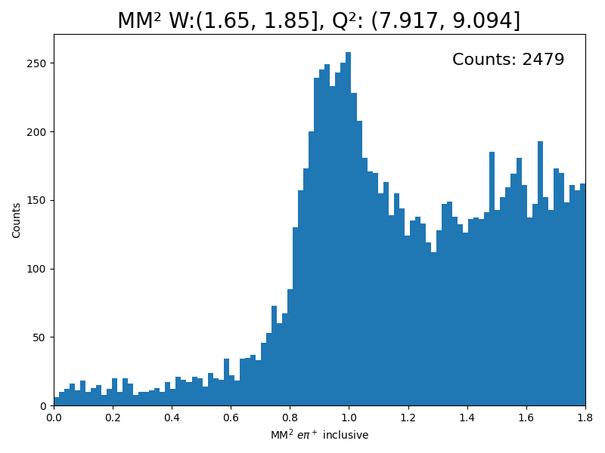
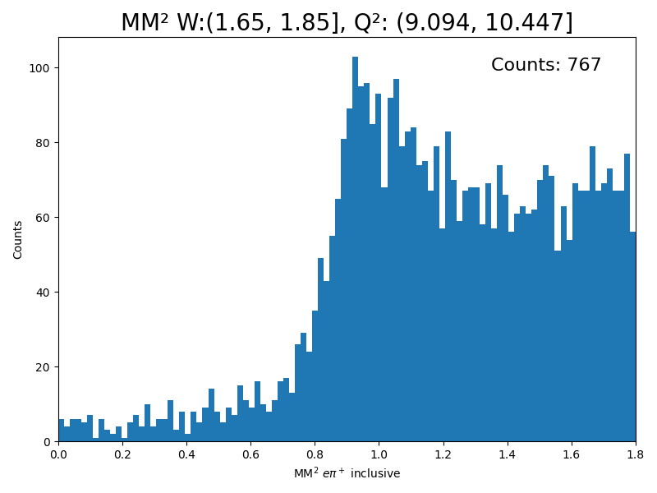
Event Selection
Fit peak to select neutron and count e’nπ⁺ exclusive events.
Work on background subtraction, determine appropriate binning especially for high Q².

Slide 8
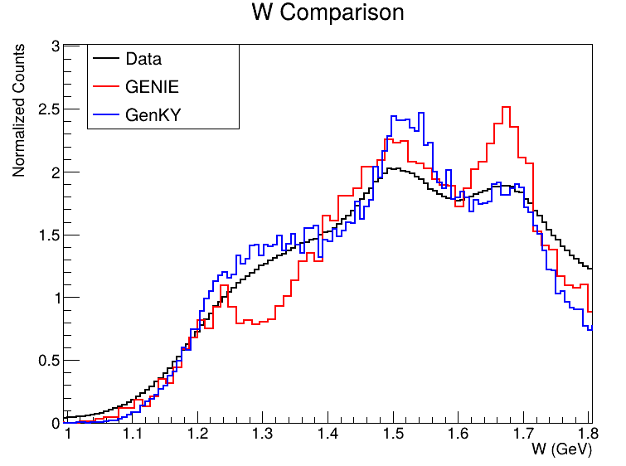
Simulation
GENIE → Uses Berger Sehgal model for resonance production, Bodek and Yang for nonresonant production. Implementation of MAID to come in the future.
genKYandOnePion → Fit to data up to 1.8 GeV in W and 5 GeV² in Q² and extrapolated beyond.
C. Andreopoulos, J. Berger, J. Hewes, M. Roda, Genie Physics & User Manual
V. Klimenko, D.S. Carman, V.I. Mokeev, The genKYandOnePion Event Generator
Aao_gen in the future, based on MAID 2000
https://github.com/JeffersonLab/aao_gen

Slide 9
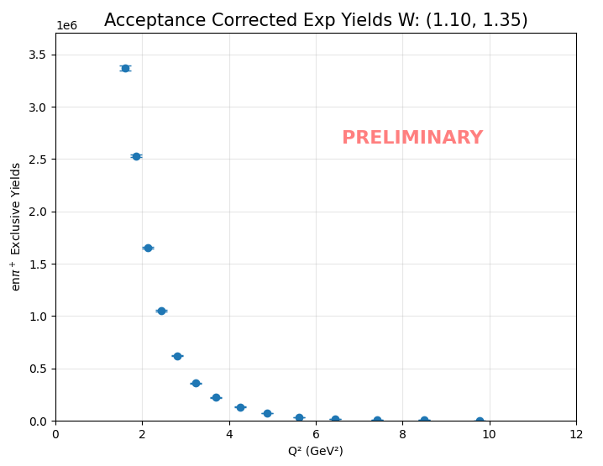

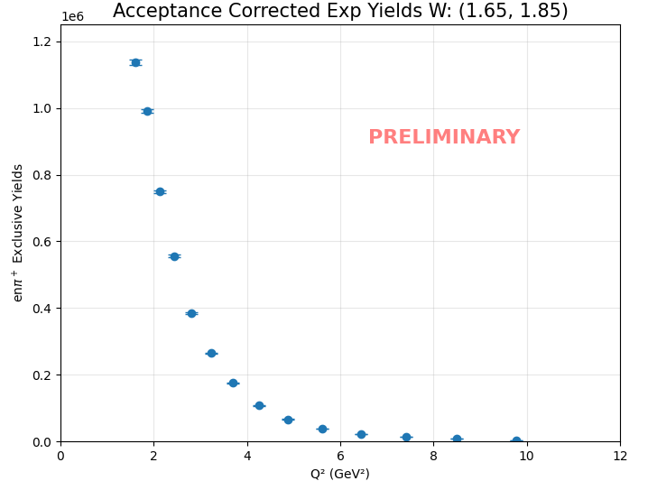
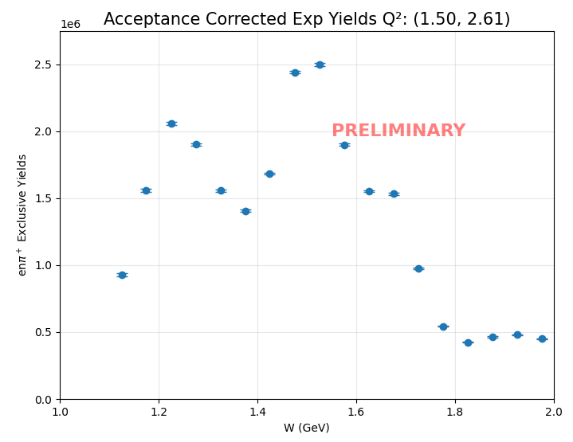
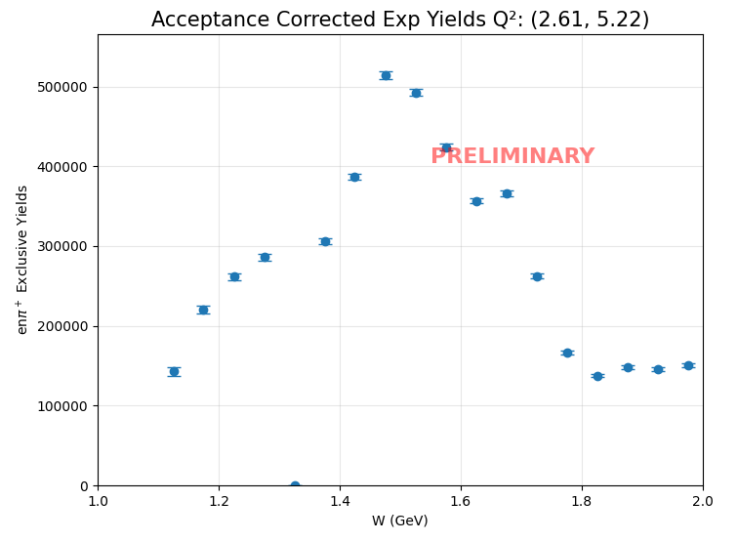
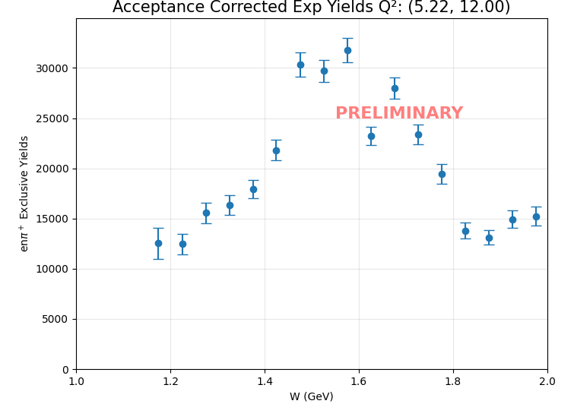
Yields

Slide 10
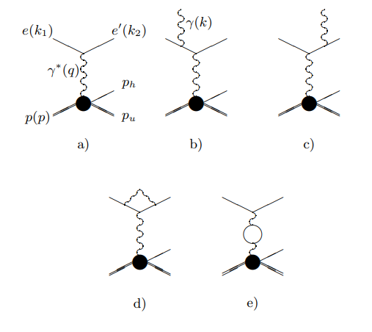
Next
Radiative Corrections & EXCLURAD – Takes into account Hadron radiation which is crucial for exclusive meson production.
A. Afanasev, I. Akushevich, V. Burkert, K. Joo, QED Radiative Corrections in Processes of Exclusive Pion Electroproduction
Energy & Momentum Corrections – Energy lost in detector interactions
Bin Centering – The distribution across each differential cross section bin is not necessarily linear, so the center of the bin may not be the average.
Bin Migration – Due to measurement uncertainties, events can end up in neighboring bins. Is take care of if event generator is reasonably close to the shape of the measured cross section.

