Slide 1



CLAS12 Double-Pion Electroproduction in the Resonance Region
Alexis Osmond
September 7, 2026

Slide 2
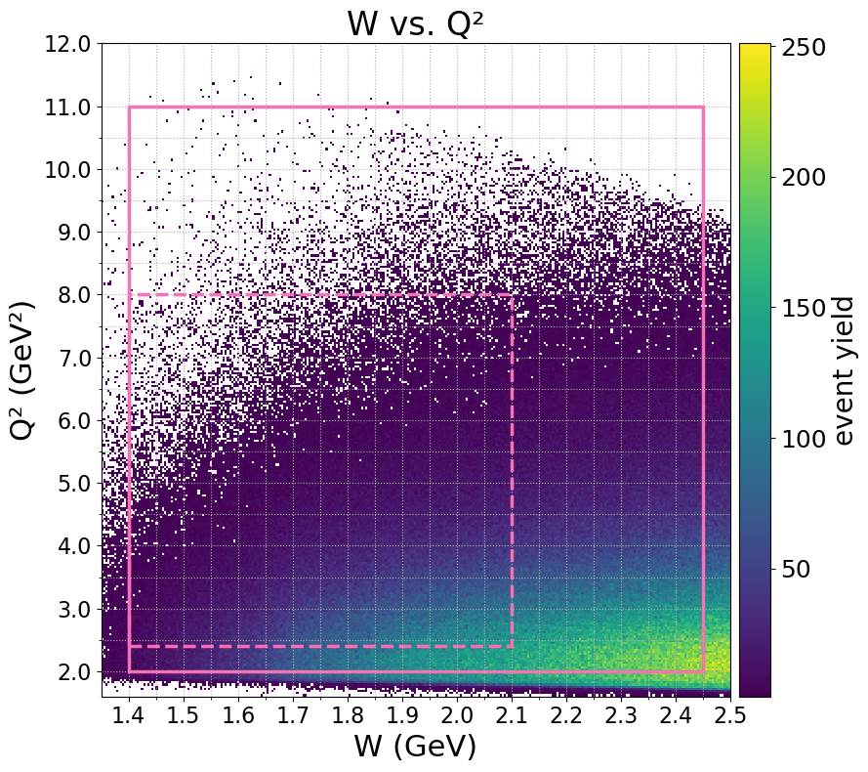
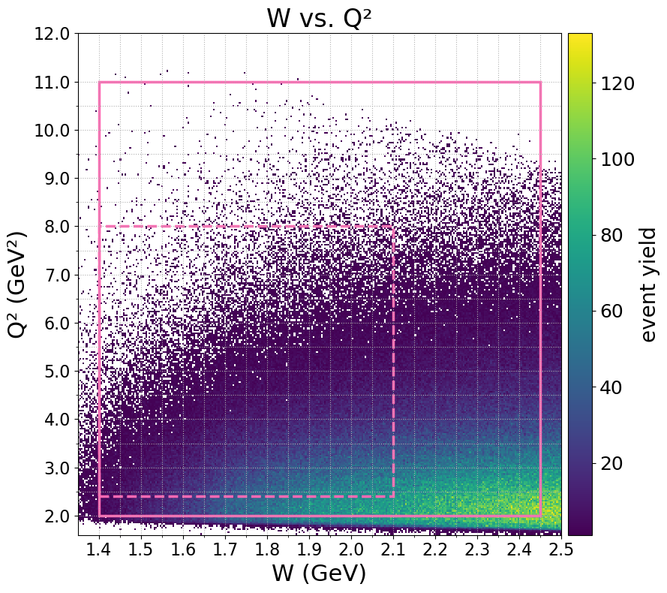
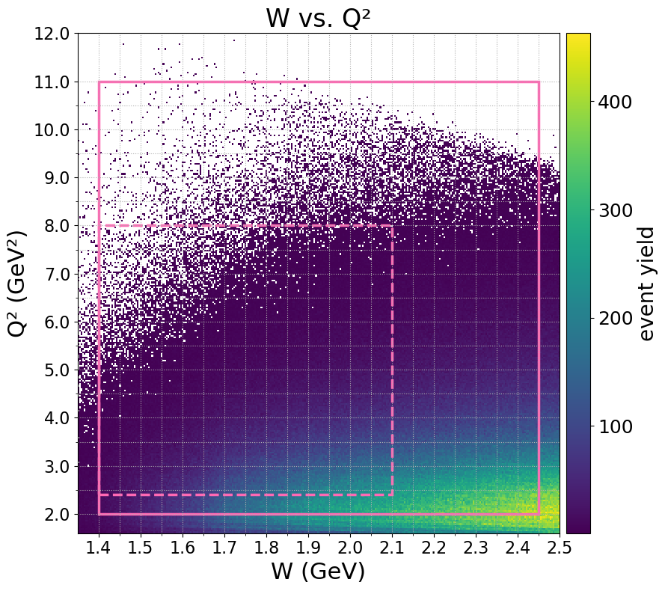

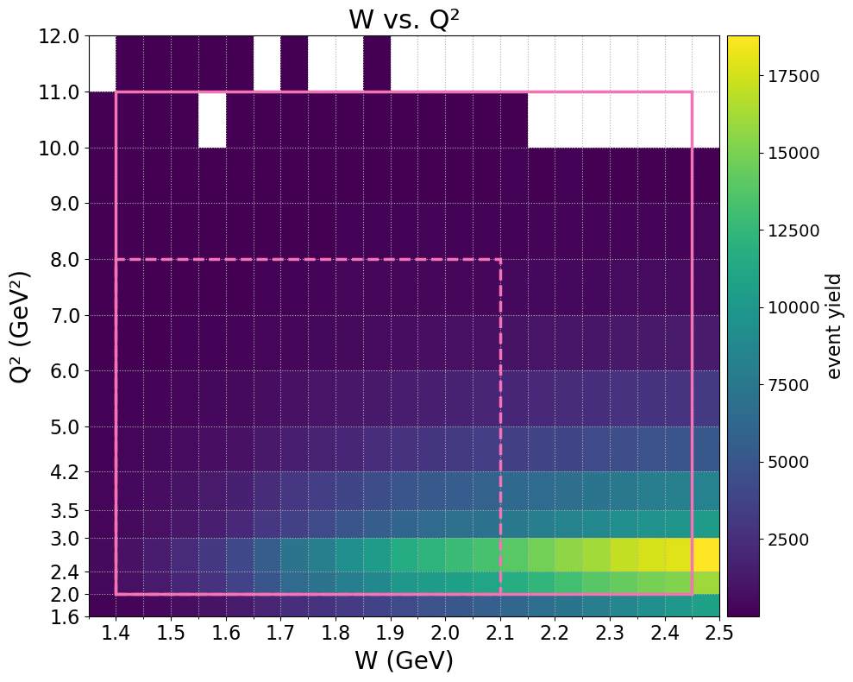
Outline
Double-Pion Electroproduction & CLAS12
Signal and Background Investigation
  Particle Misidentification
  Enhanced Understanding of Signal and Background Shapes
Cross Sections
Summary & Outlook
W-Q² range included in this analysis, showing Spring 2019 inbending experiment data

Slide 3
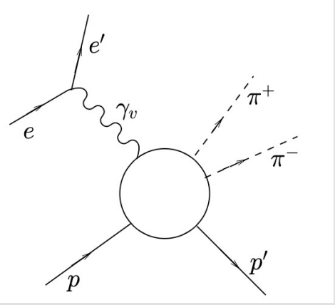

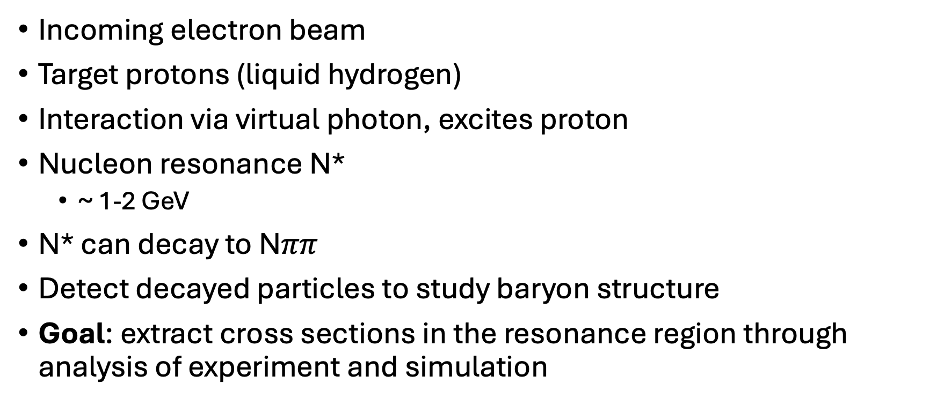
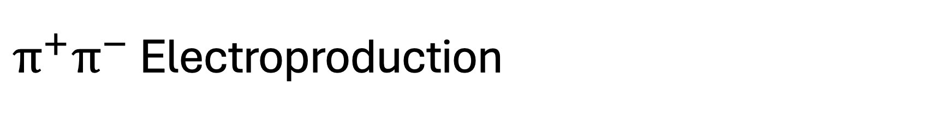
$π^{+}π^{−}$ Electroproduction
Incoming electron beam
Target protons (liquid hydrogen)
Interaction via virtual photon, excites proton
Nucleon resonance N*
  ~ 1-2 GeV
N* can decay to N$ππ$
Detect decayed particles to study baryon structure
Goal: extract cross sections in the resonance region through analysis of experiment and simulation

Slide 4
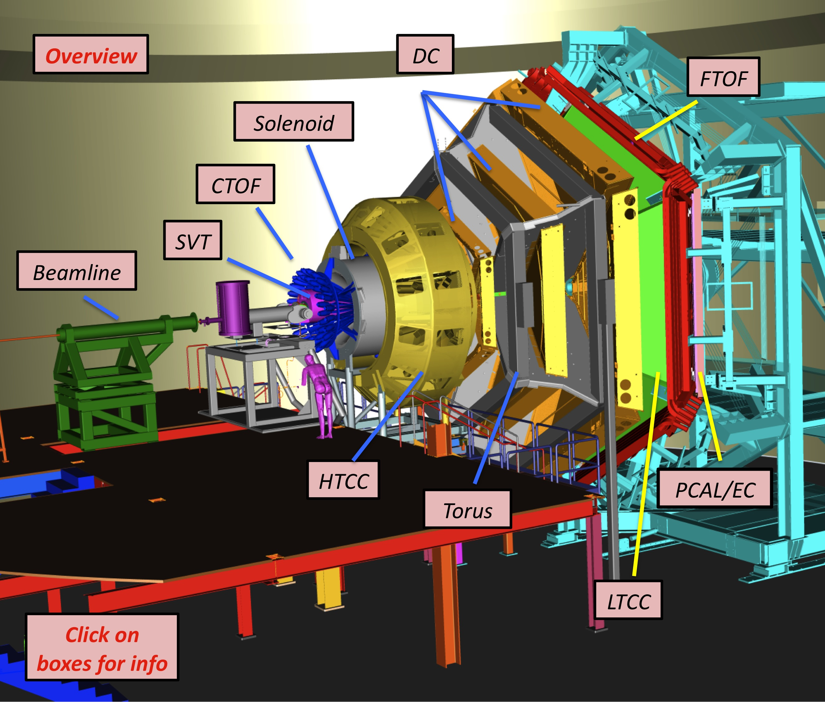
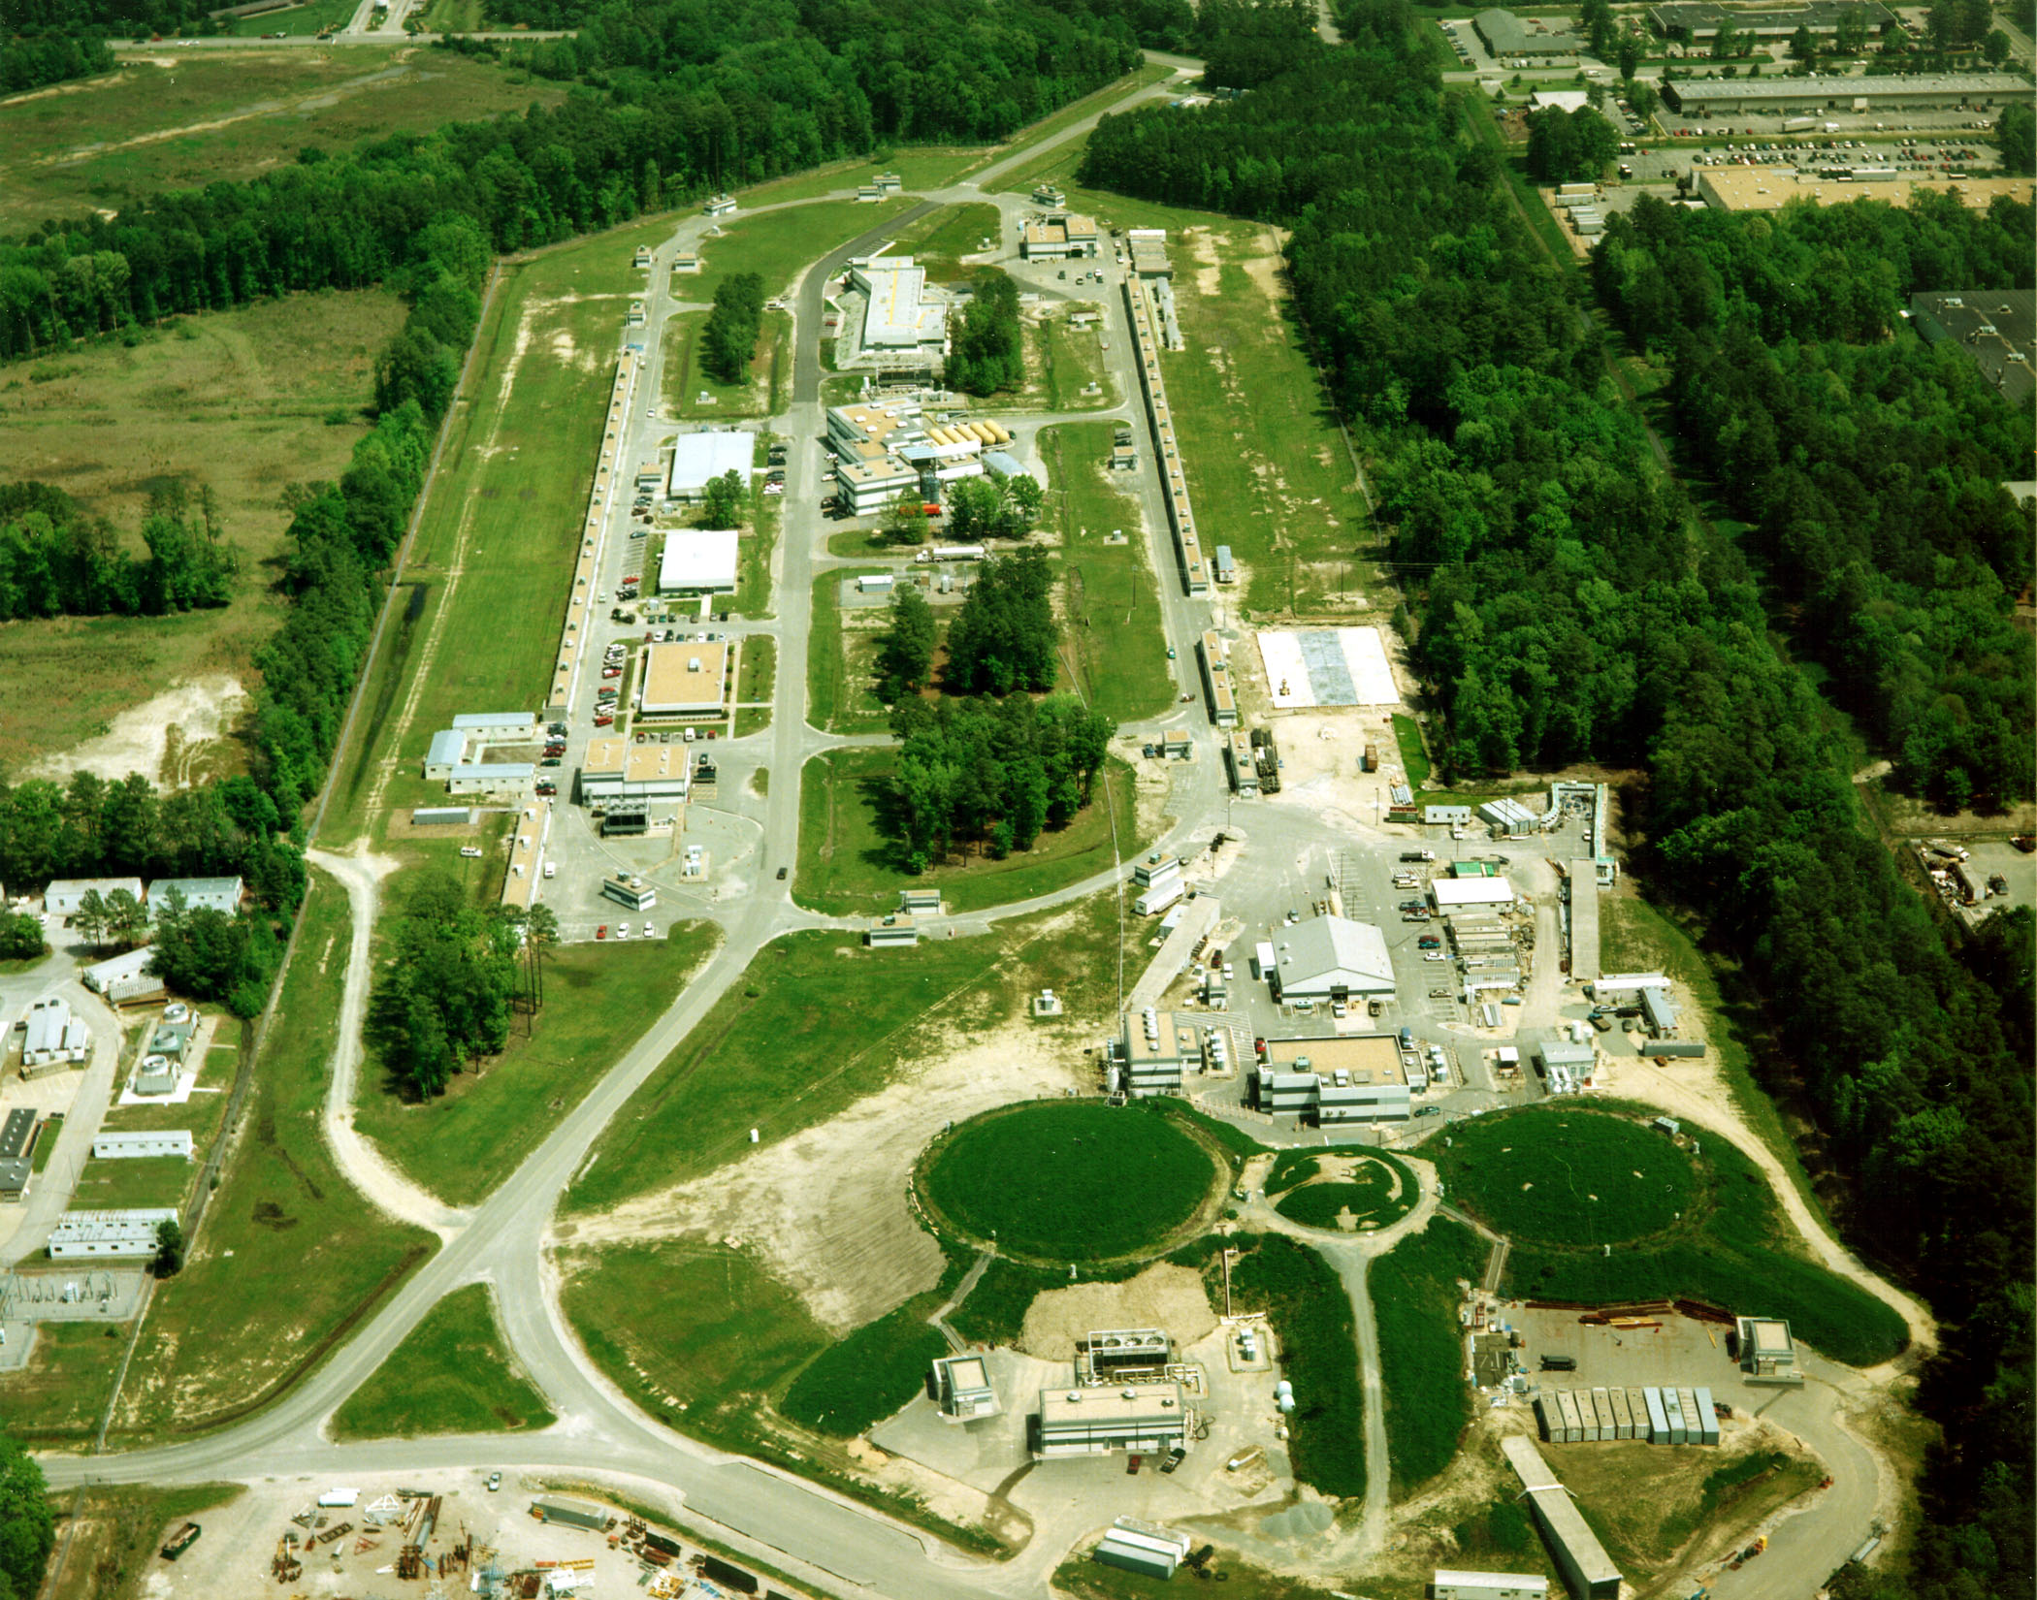
CLAS12 Detector
CEBAF Large Acceptance Spectrometer (CLAS12)
10-11 GeV electron beam
Target surrounded by detectors
Determine detector resolution and sources of background
Deeper understanding of baryon structure
Hall B
Thomas Jefferson National Accelerator Facility
(JLab) Newport News, VA

Slide 5
Signal and Background Investigation
Notes:
GOAL: better separation of signal and background → less uncertainty in cross sections

Slide 6
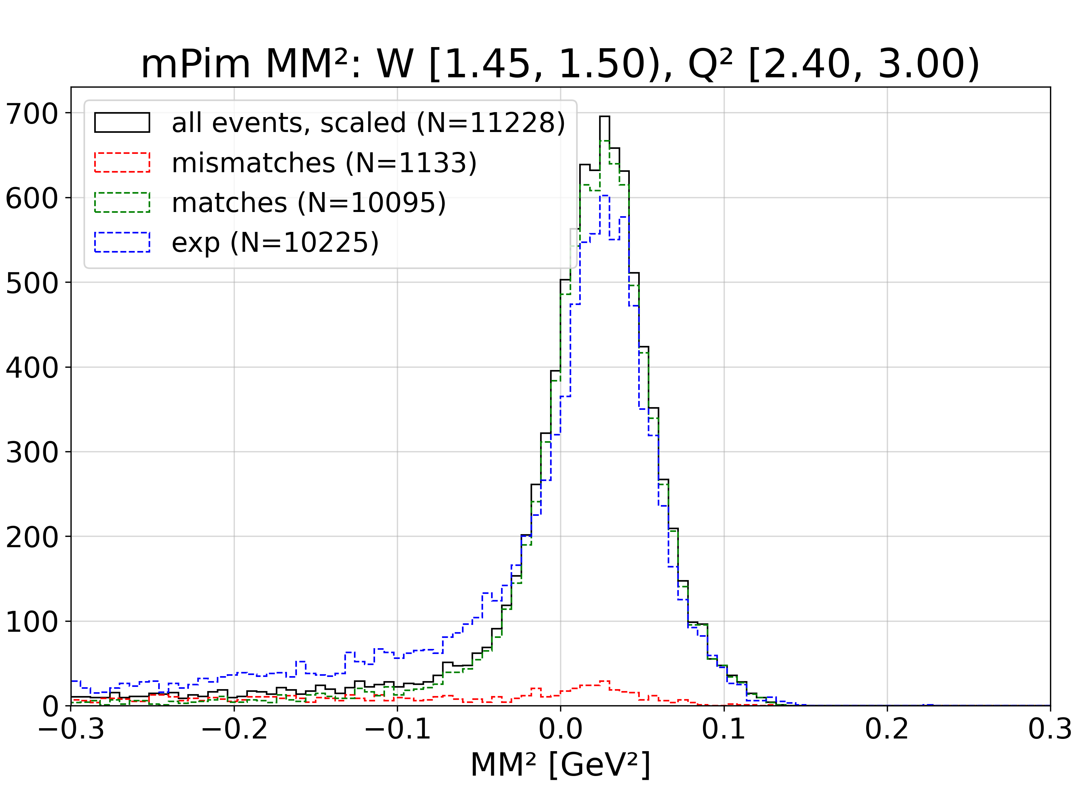
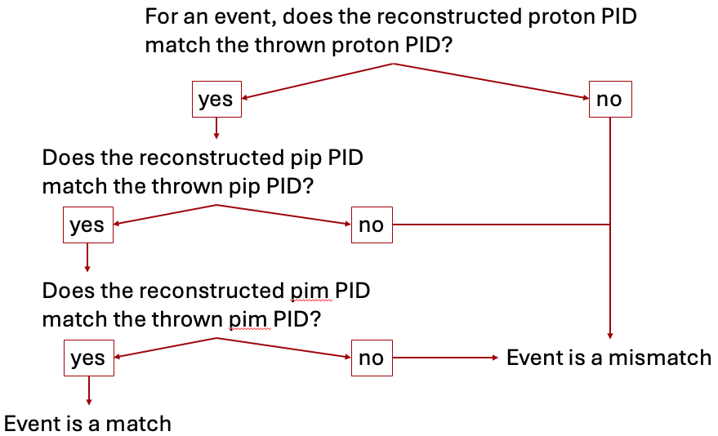
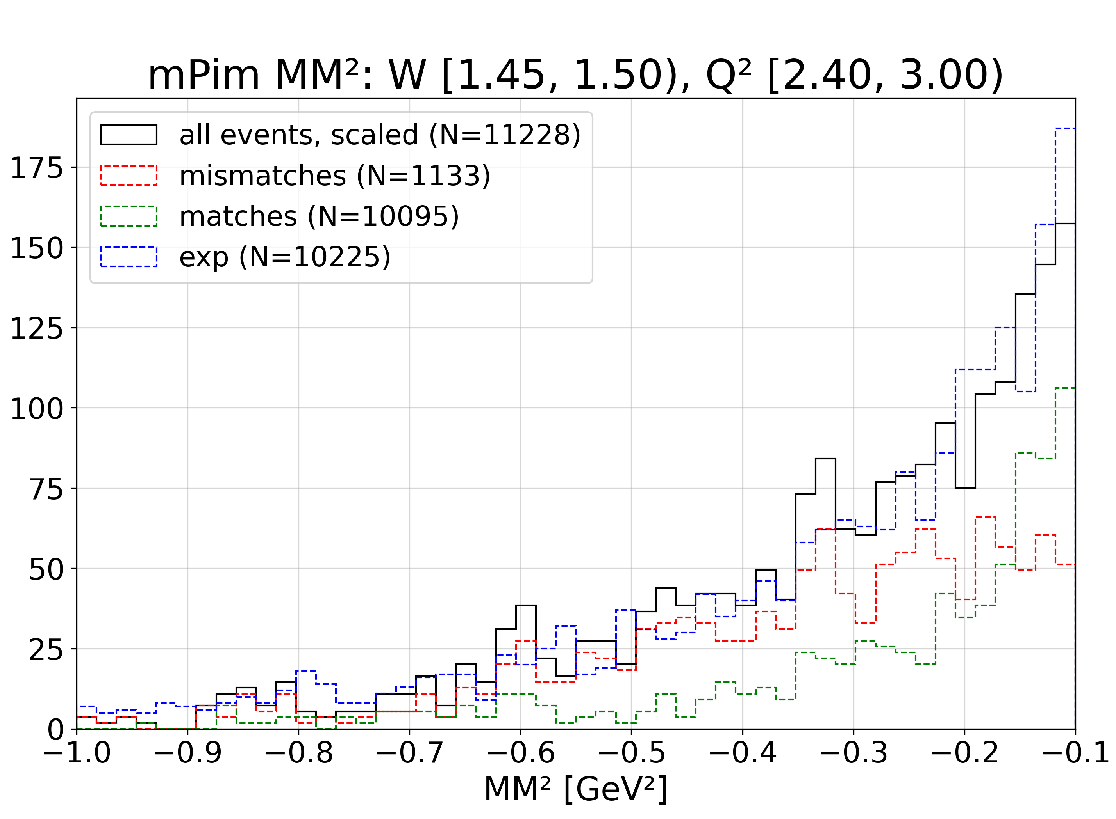
Particle Misidentification
Simulation-based study
  Includes background merging and smearing
  Showing Spring 2019 inbending
Determine the number of mismatches in the left tail
Mismatches dominate the left tail

Slide 7
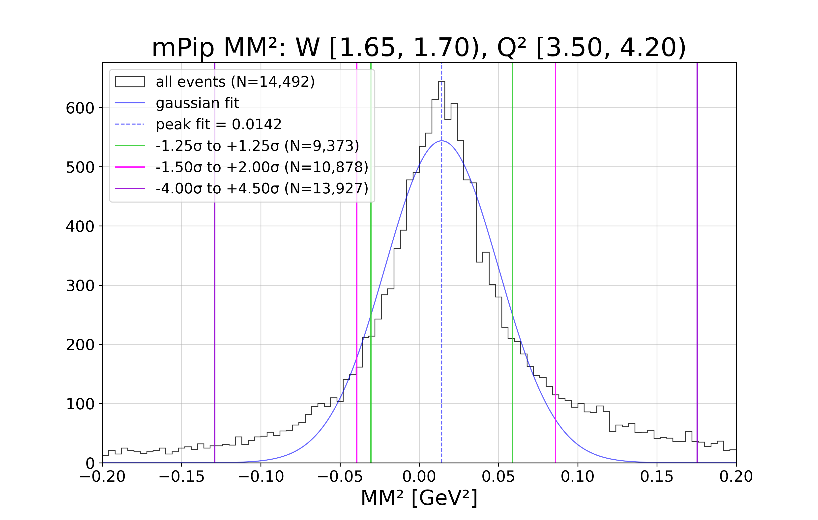
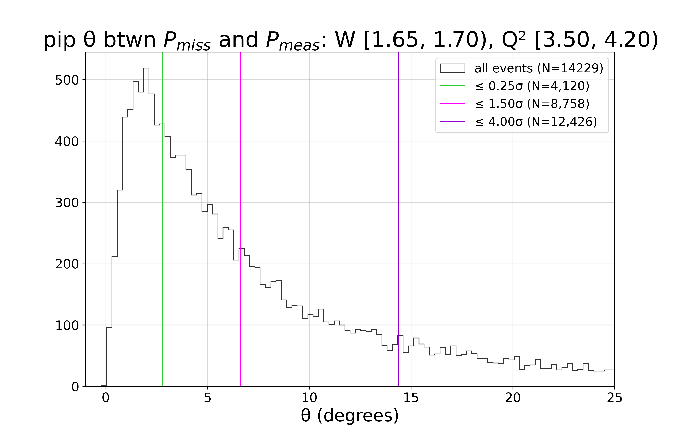
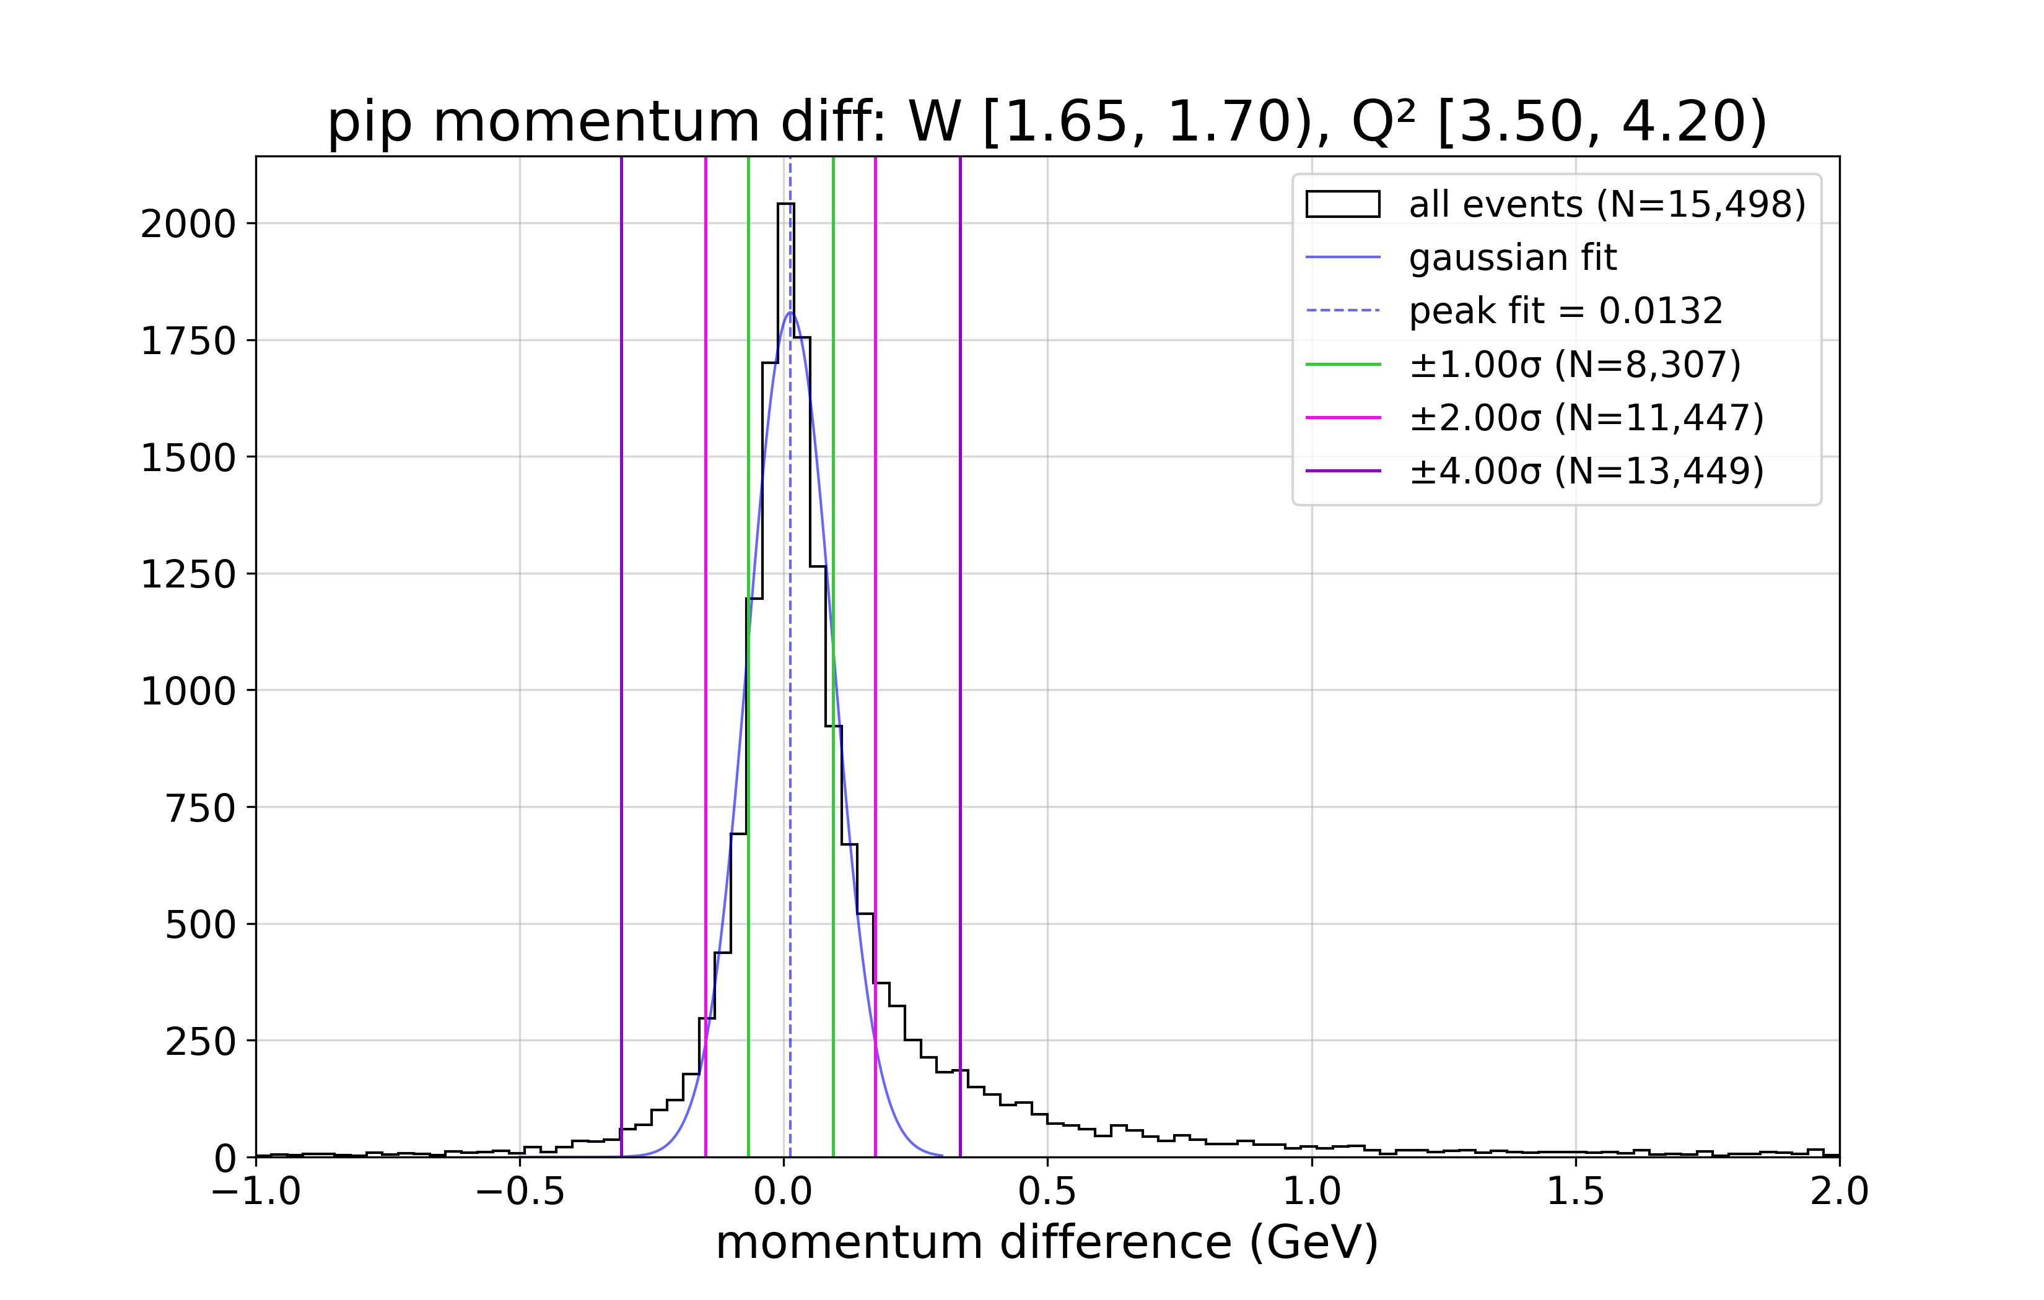
Enhanced Signal and Enhanced Background
For exclusive topology, mPim MM² histograms
Type of cut | MM² | Theta, θ | Momentum, p
Enhanced signal | -4.0σ, +4.5σ cut inside excl, mProt, mPip | 4.0σ cut inside prot, pip, pim | 4.0σ cut inside prot, pip, pim
Enhanced background | 1.25σ cut outside excl, mProt, mPip | No cut applied | No cut applied
(a) MM²
(b) theta
(c) momentum
Figures: examples of sigma cut regions.

Slide 8
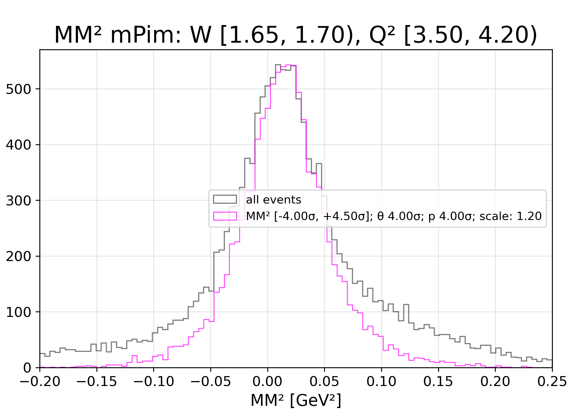
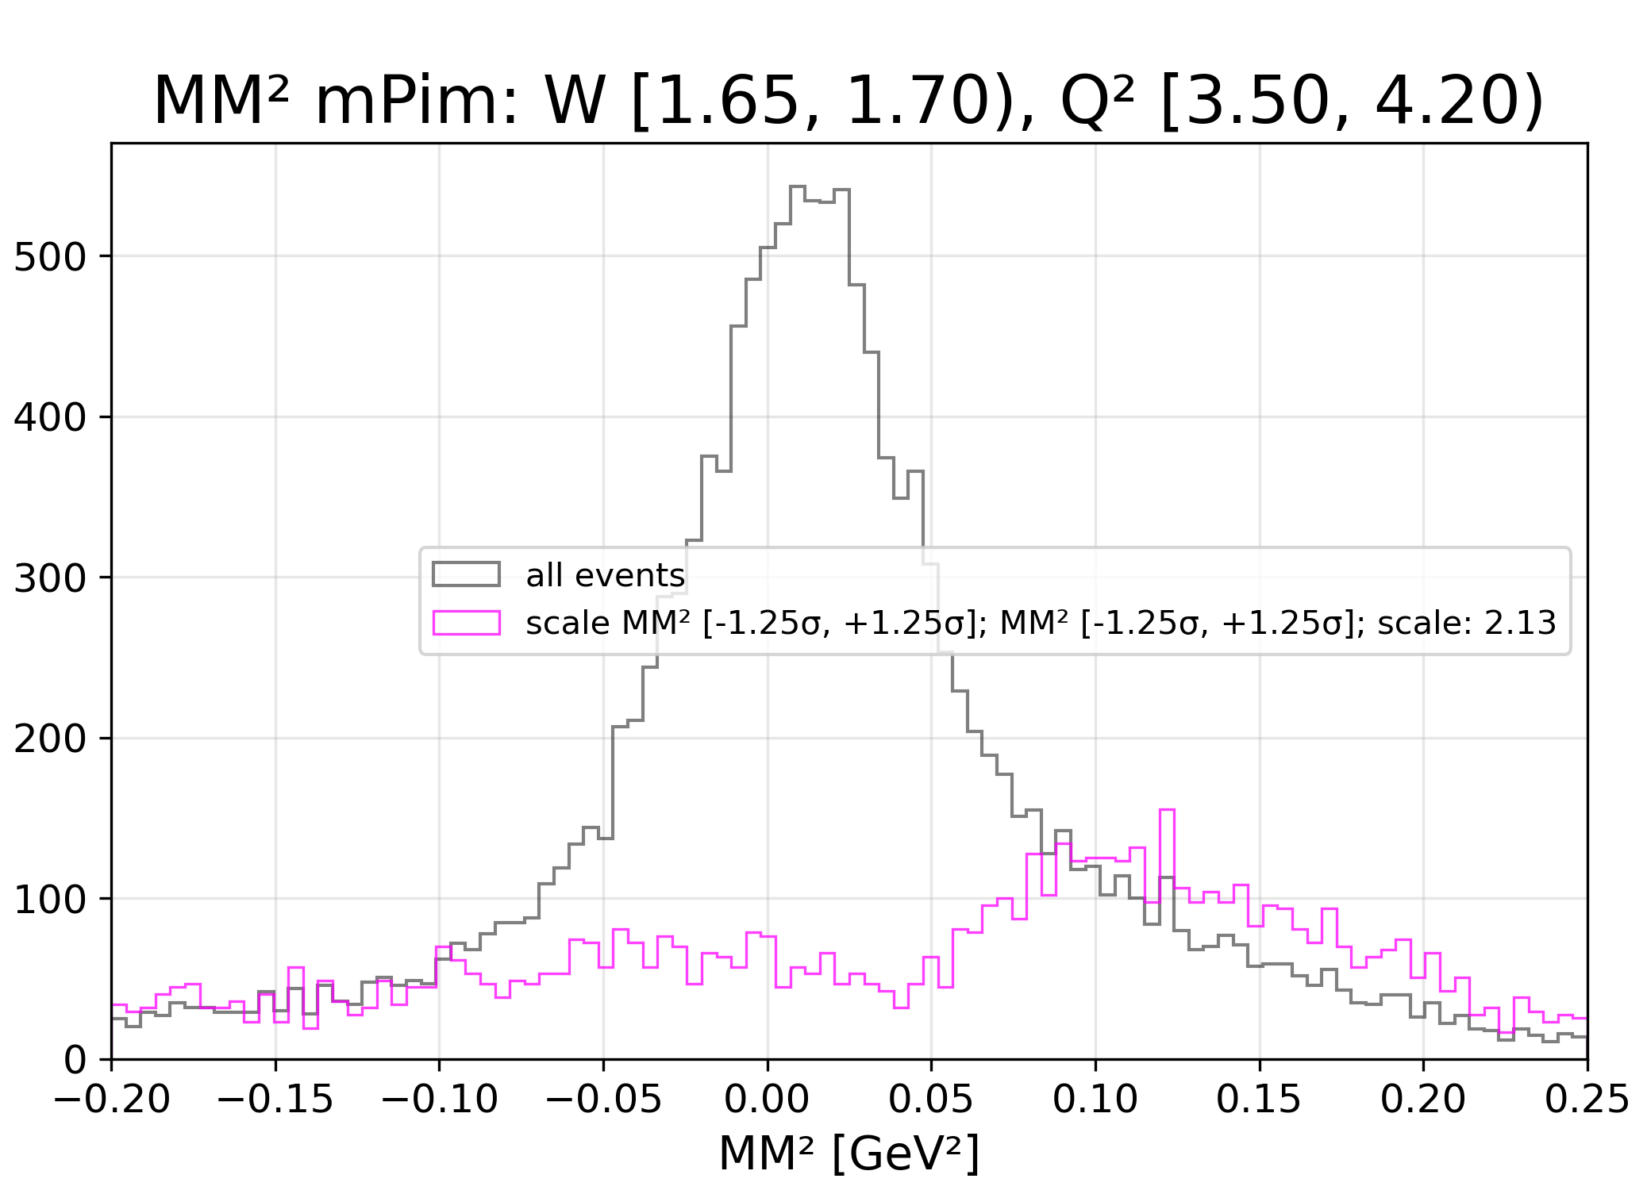
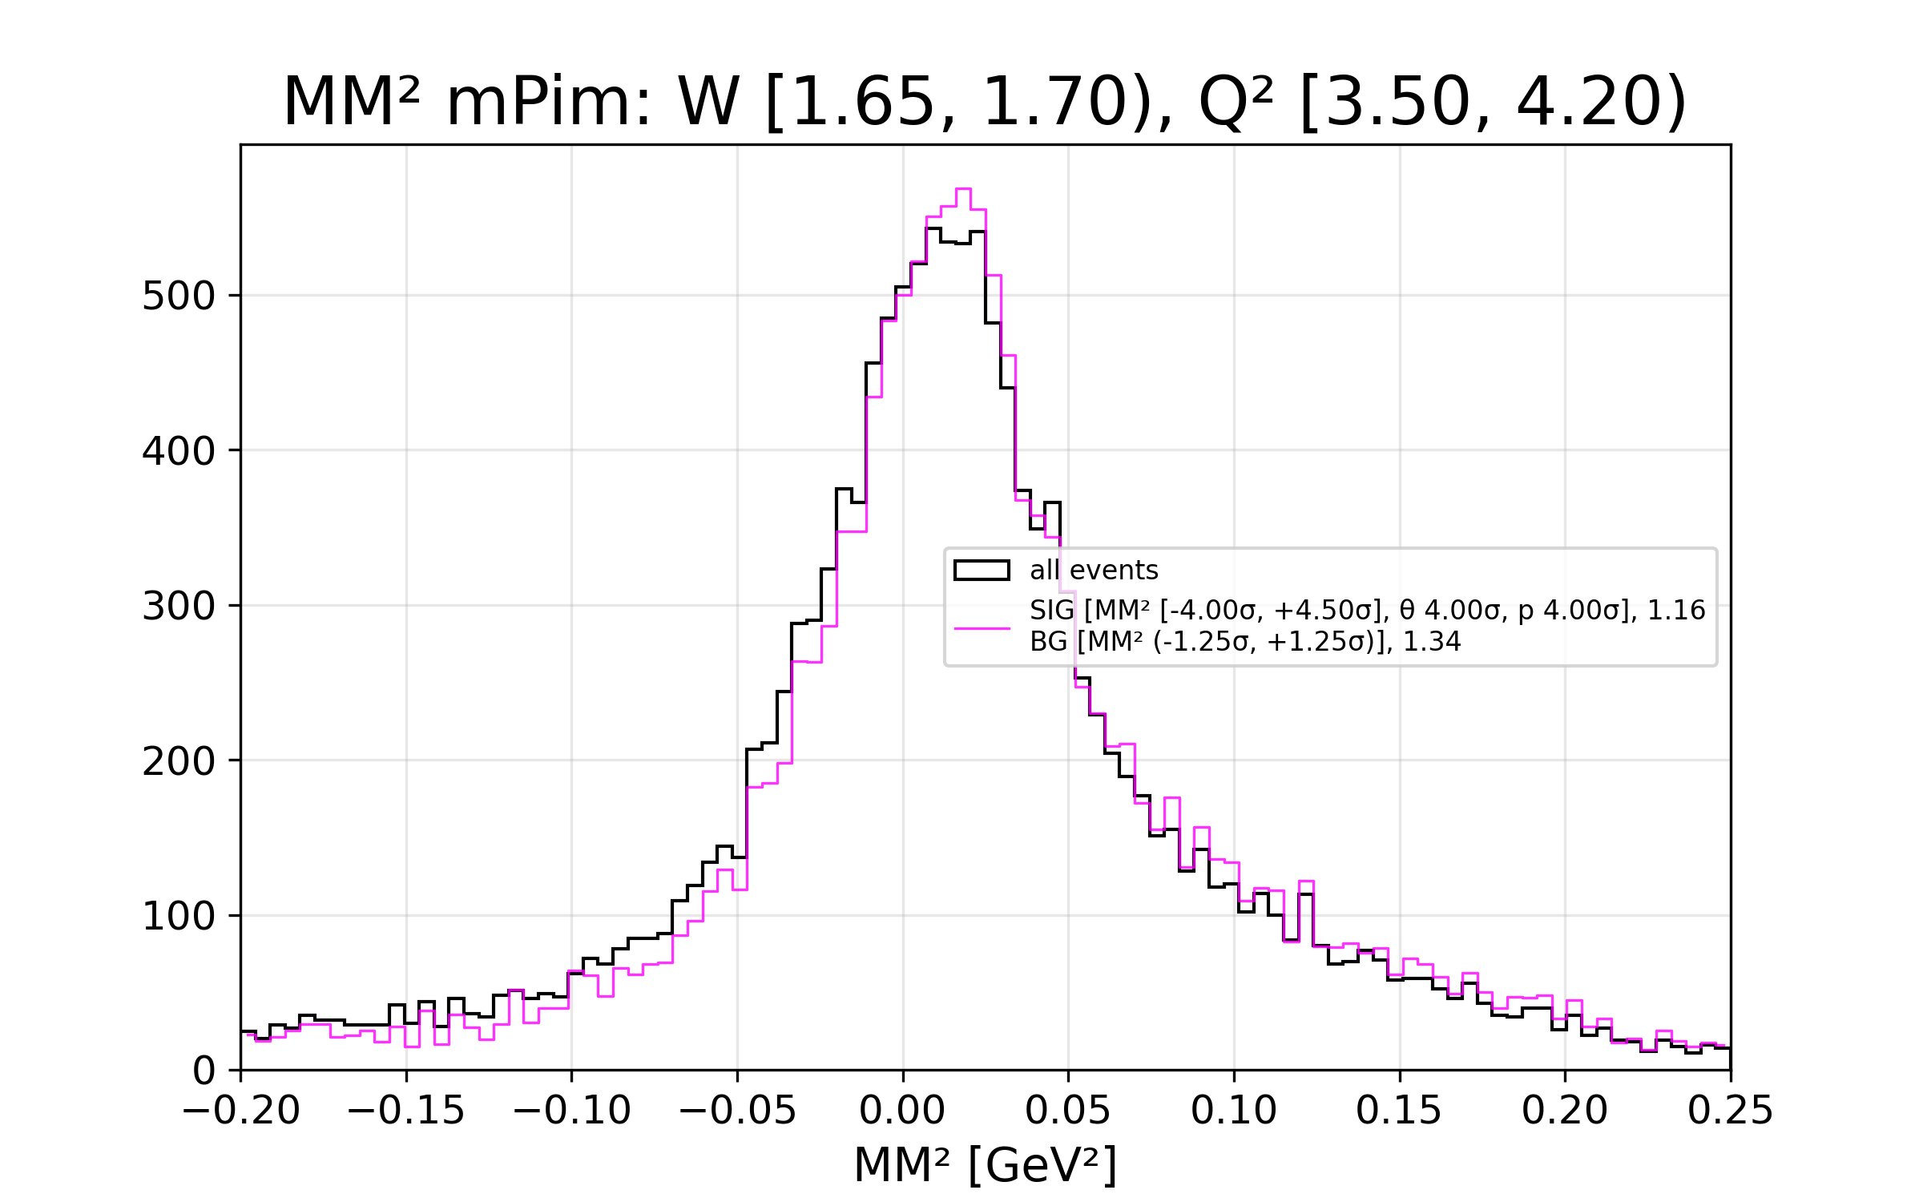
Enhanced Signal and Enhanced Background
enhanced signal
enhanced bg
Experiment-based study
  Showing Spring 2019 inbending
Enhanced signal scaled by maximum
Enhanced background scaled by integral in the outer tail regions (outside ±1.25σ)
Enhanced signal + enhanced bg scaled by A*signal + B*bg
Separation of enhanced signal and enhanced bg leads to less uncertainty in cross sections
enhanced signal + enhanced bg

Slide 9
Cross Sections

Slide 10
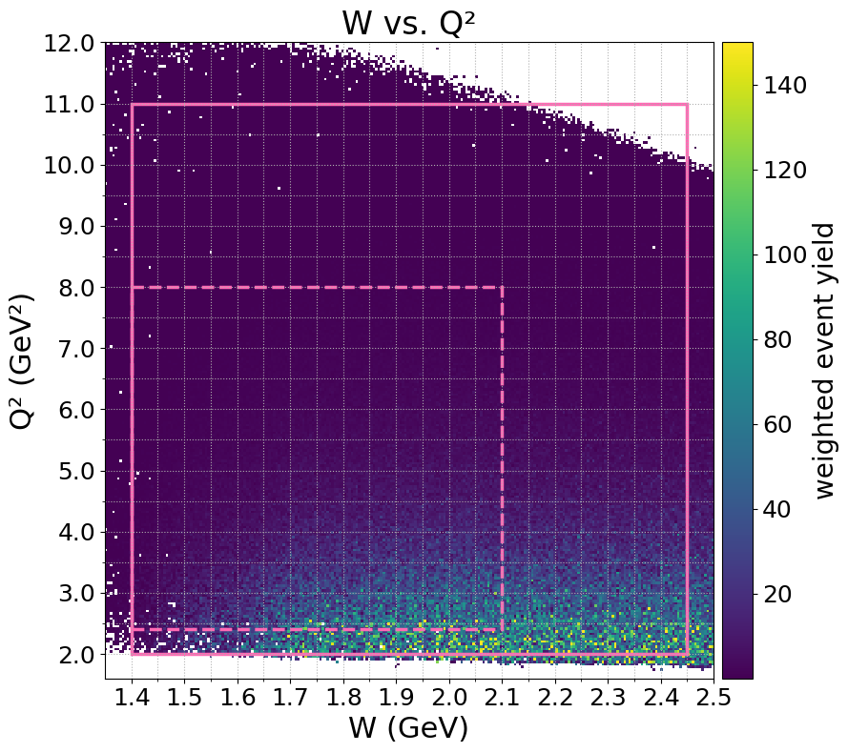
TWOPEG: TwoPion Event Generator
For 𝜋⁺𝜋⁻ electroproduction off protons
  Julia Skorodumina
Event generation weighted by cross section
No background sources, but can include background merging
Unique to TWOPEG: has experiment extrapolated cs, can calculate simulation cs
~25 TB simulation for each run period (6 run periods)
W-Q² range included in this analysis (histogram shows Fall 2018 inbending simulation)

Slide 11
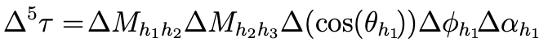
Integrated Cross Sections
Experiment cross sections to be done, need:
  ✅ Acceptance factor
  Efficiency correction factor – in progress
  Radiative correction factor – in progress
  Hadronic five-dimensional phase space cell
  Faraday cup data and number of good events in full and empty target
  Luminosity calculation
  Nine single-differential cross sections for three sets of hadronic variables
✅ Preliminary simulation cross sections from TWOPEG
  Increasing statistics - in progress
  Additional datasets included - in progress

Slide 12
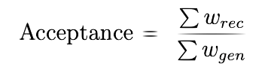
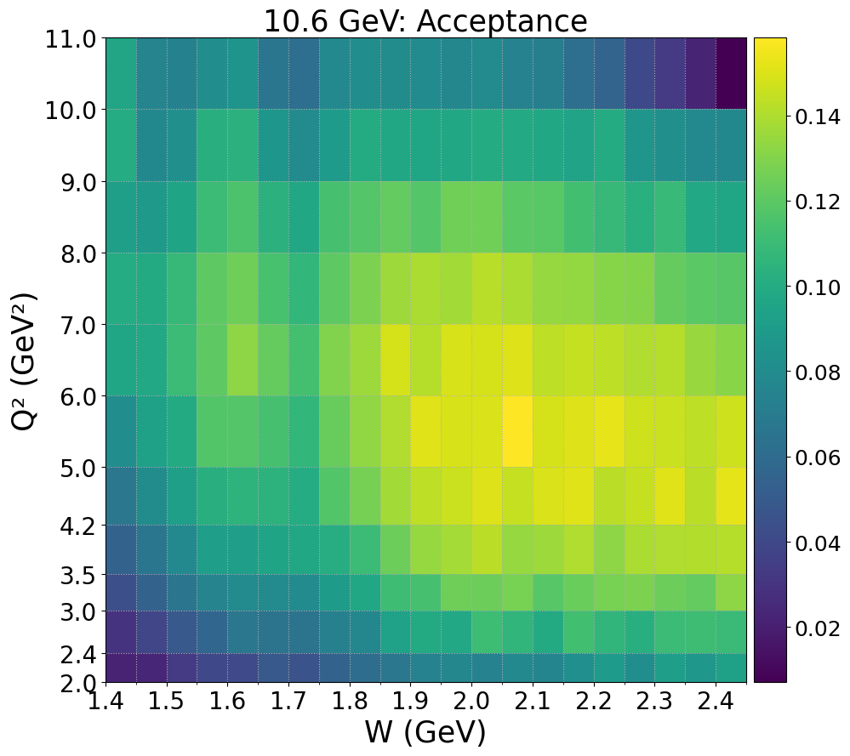
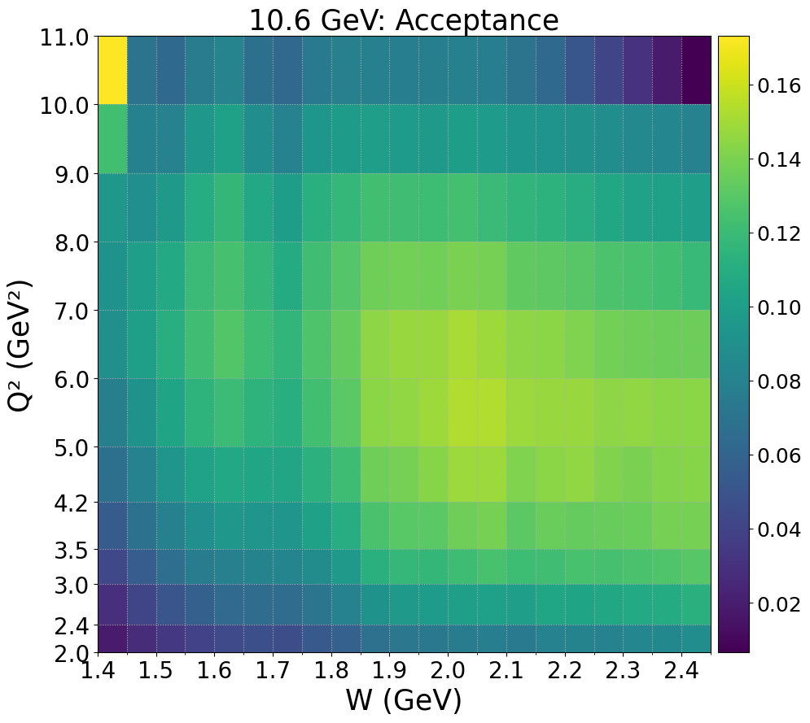
Acceptance
Started with 10.6 GeV Fall 2018 inbending sim
Measure of simulated events that would be seen by the detectors
Artificially large acceptance (yellow bin, low W, high Q²)
  Limited number of significant figures
  Weights assigned zero due to lack of precision
  TWOPEG precision increased in December 2025 by Julia Skorodumina
  Similar effect seen in 22 GeV sim
Can calculate needed luminosity, charge, and time

Slide 13
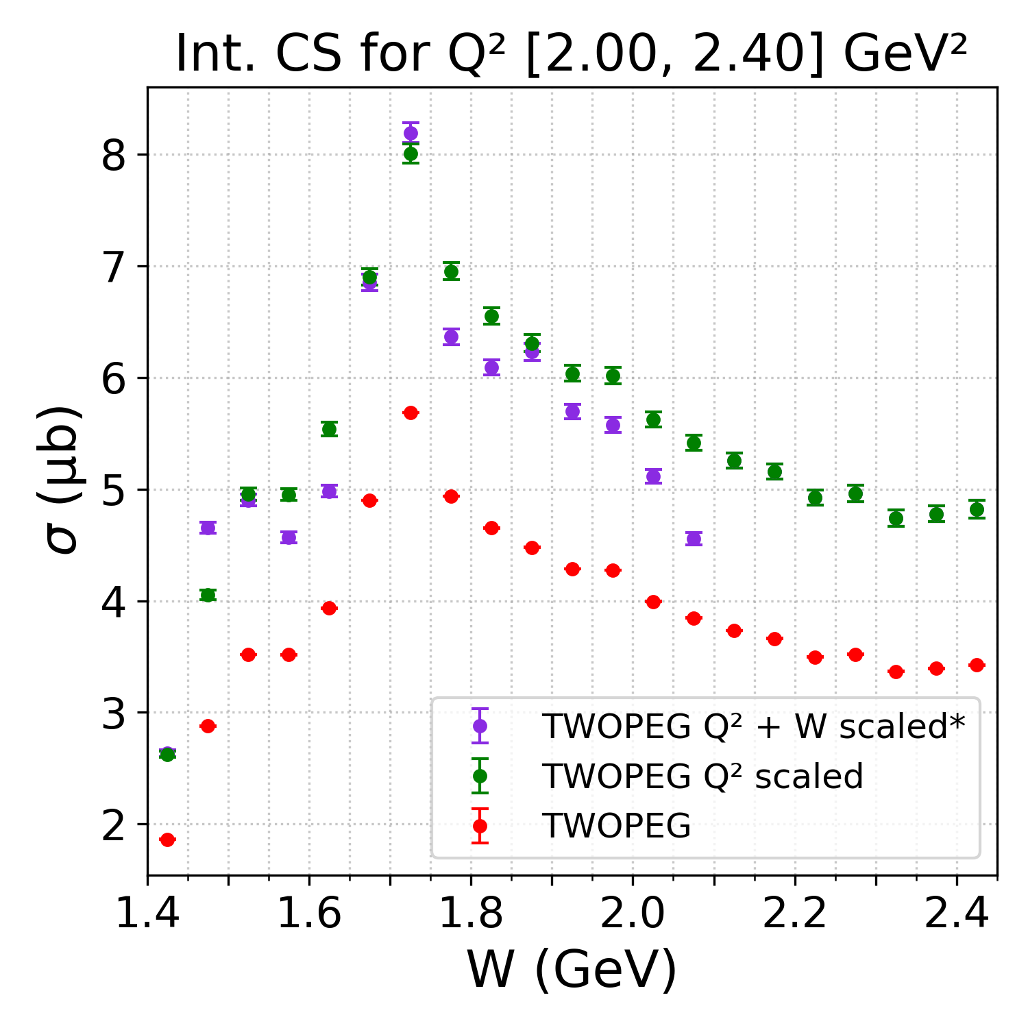
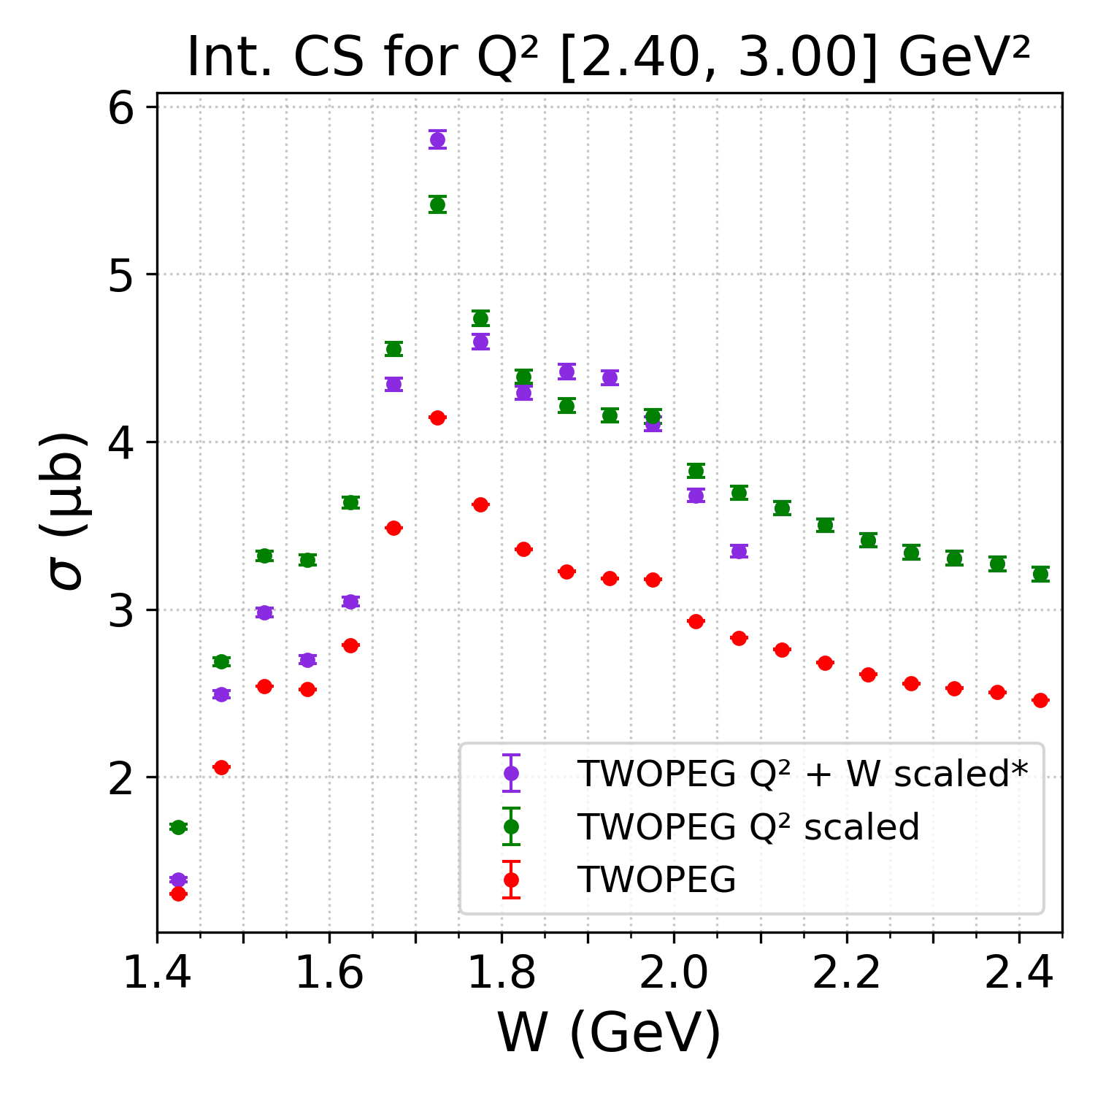
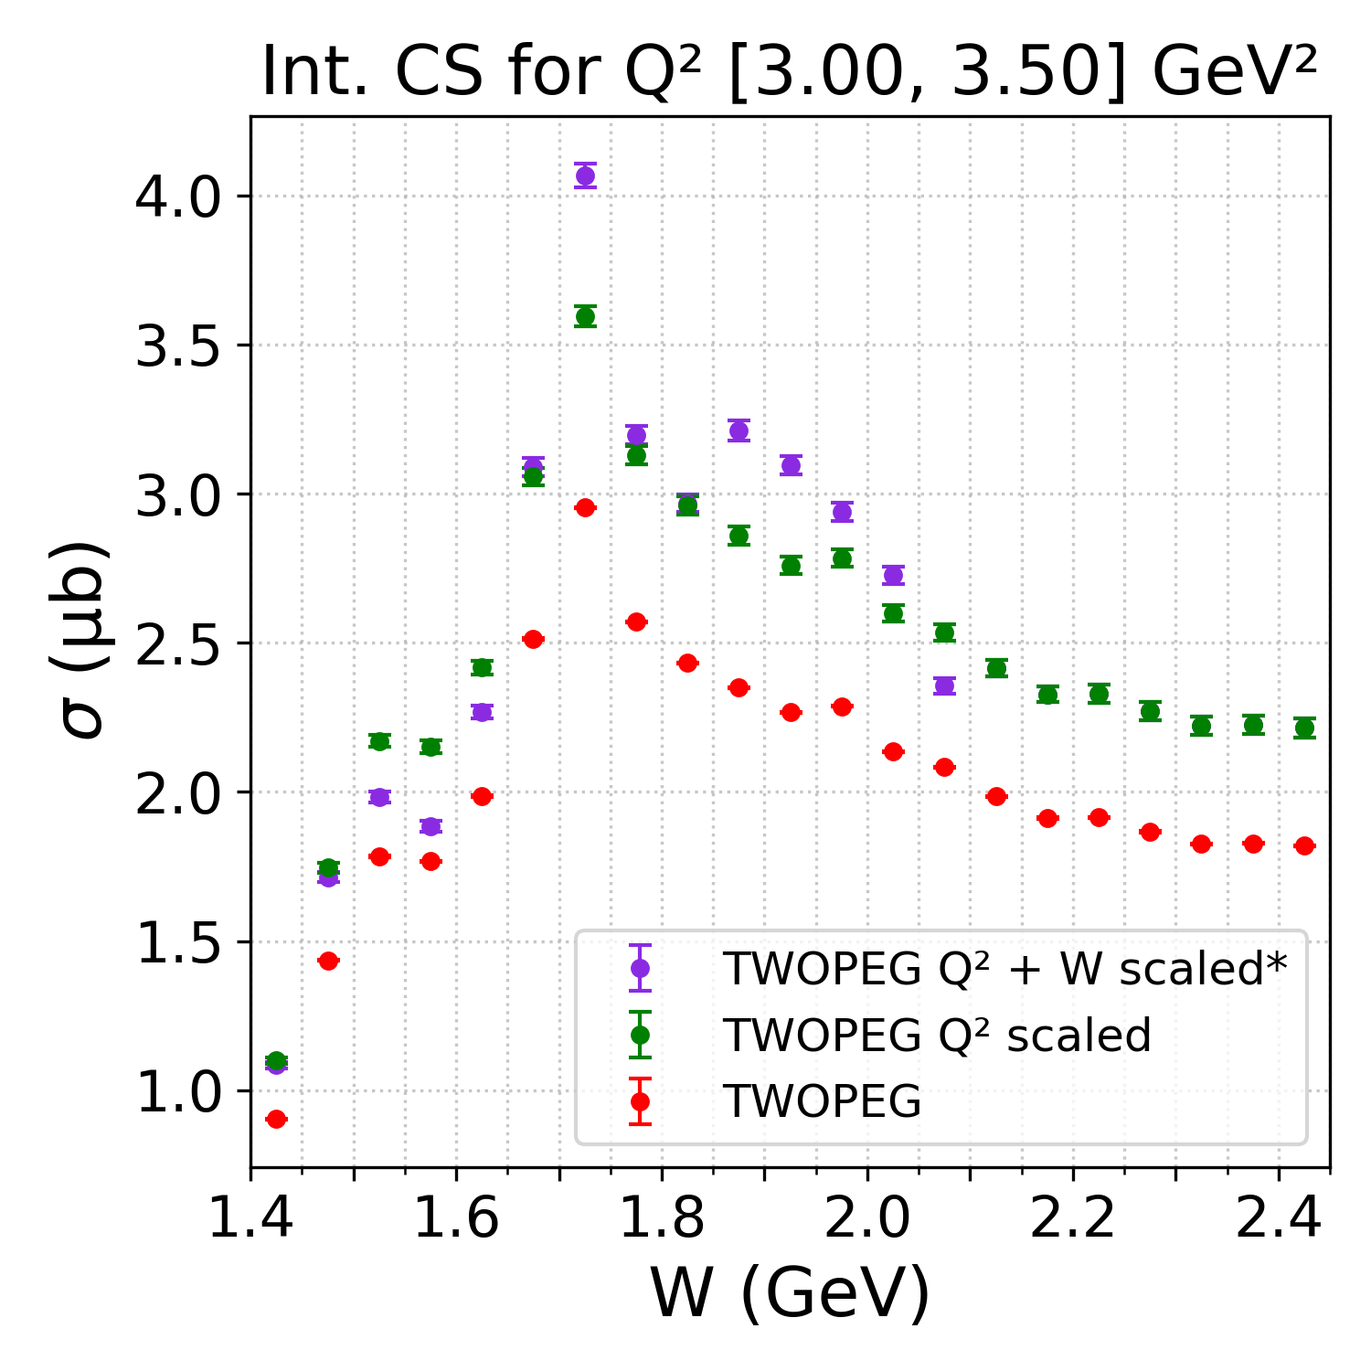
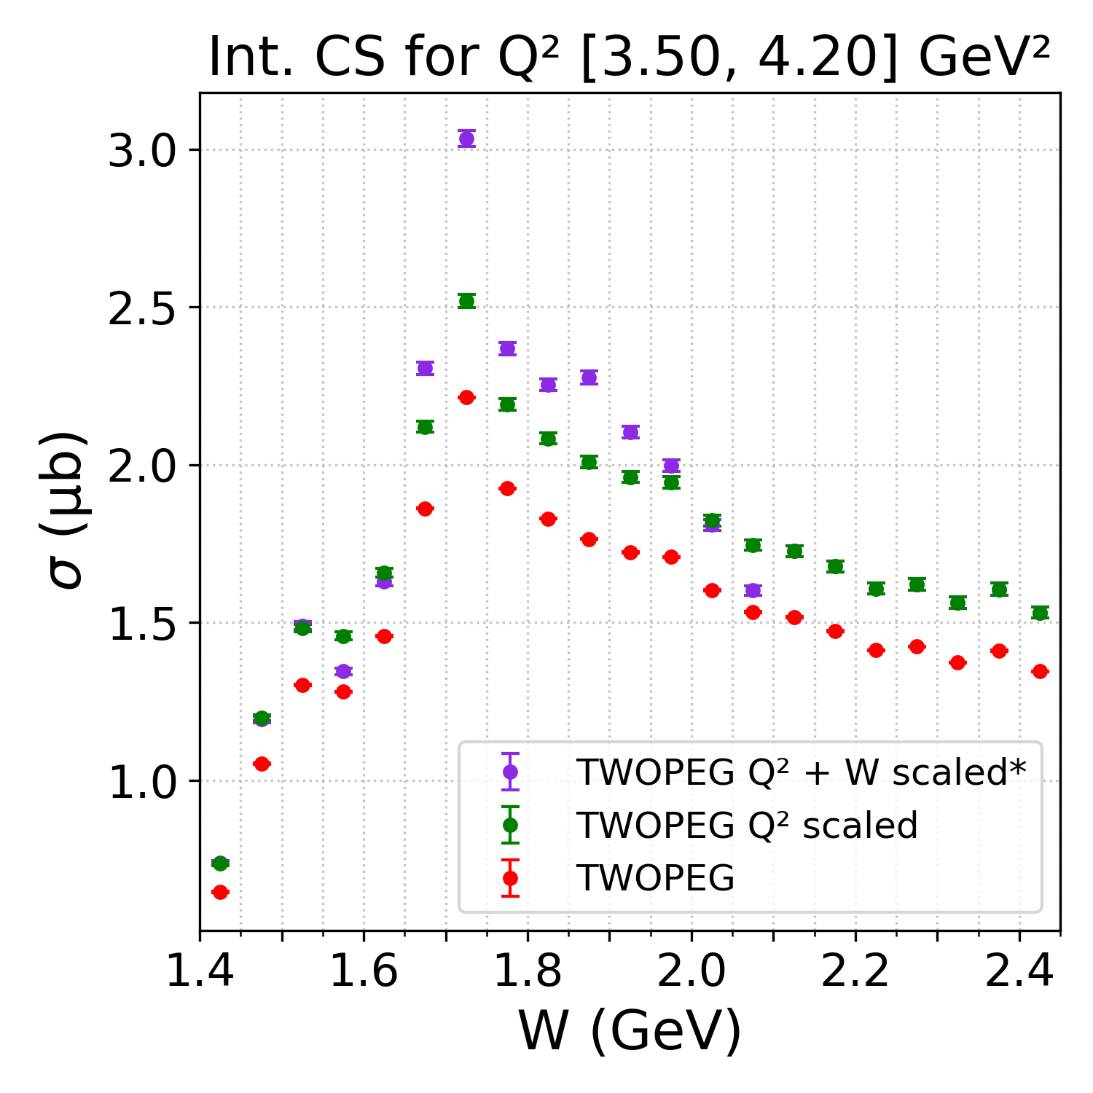
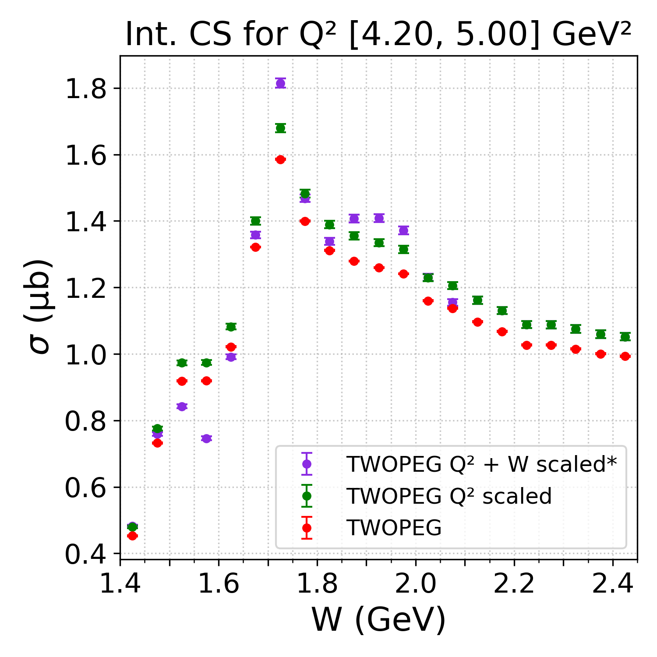
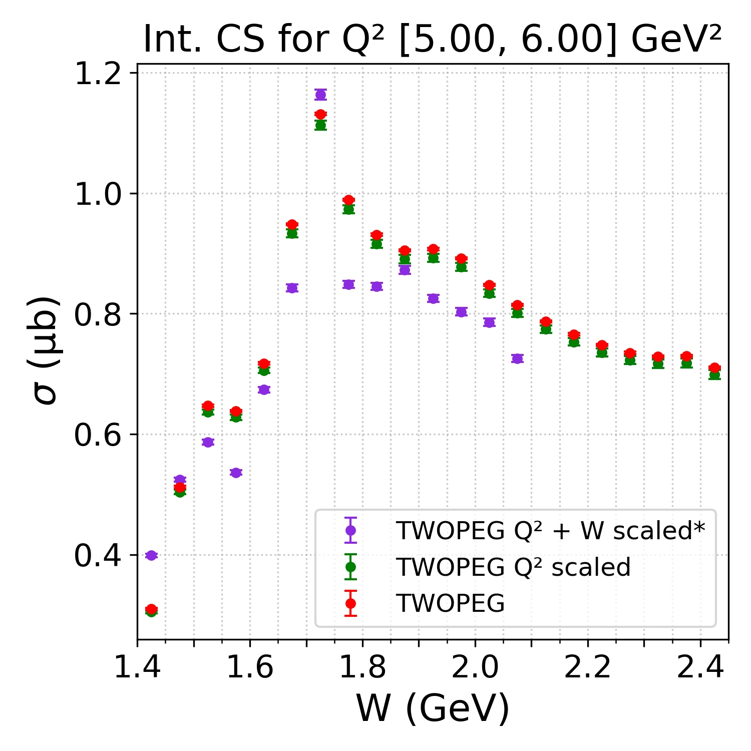
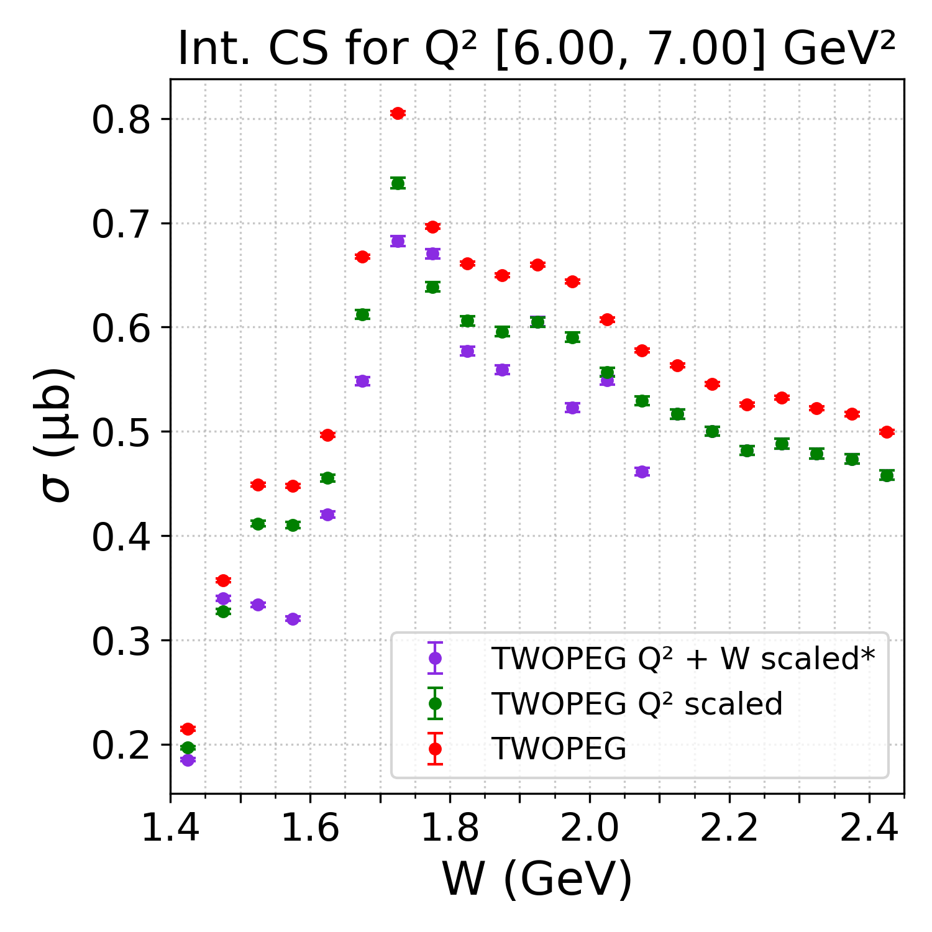
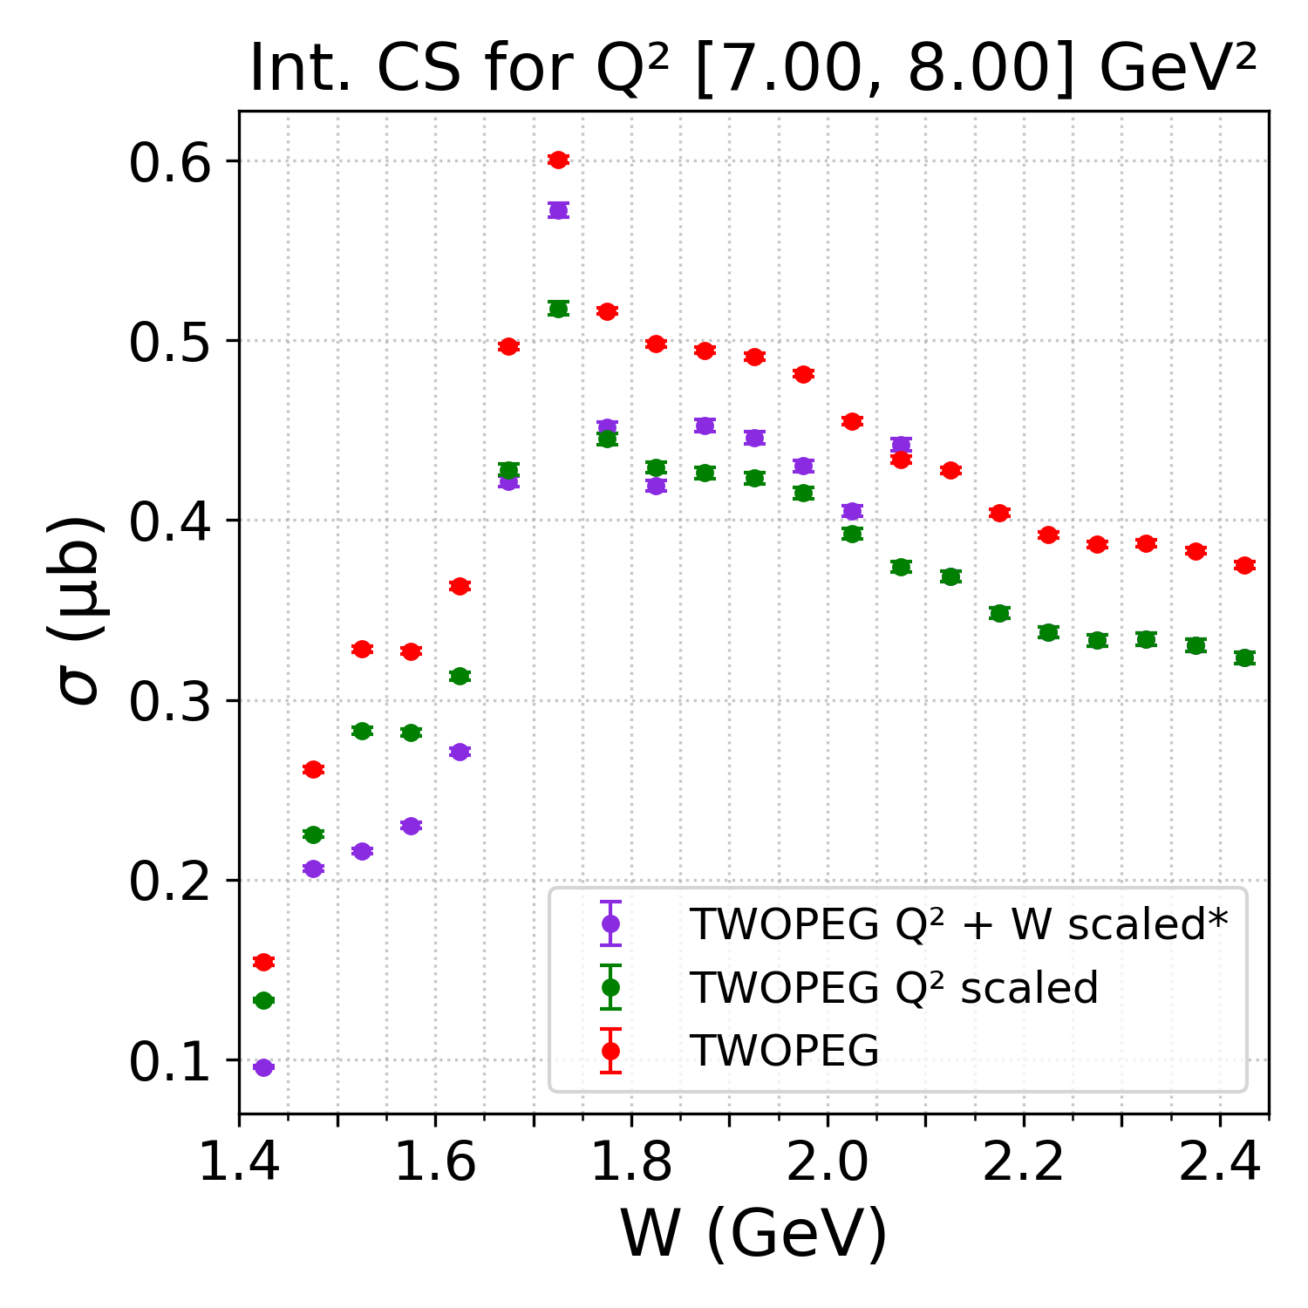
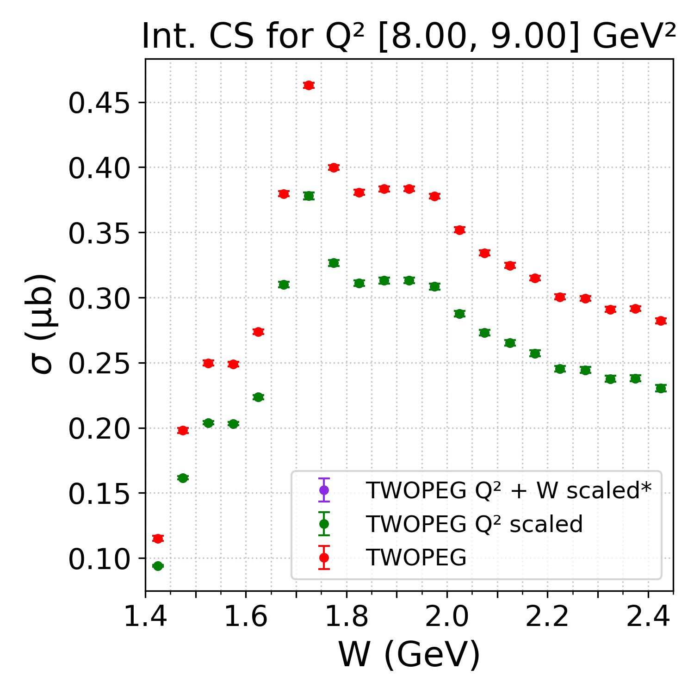
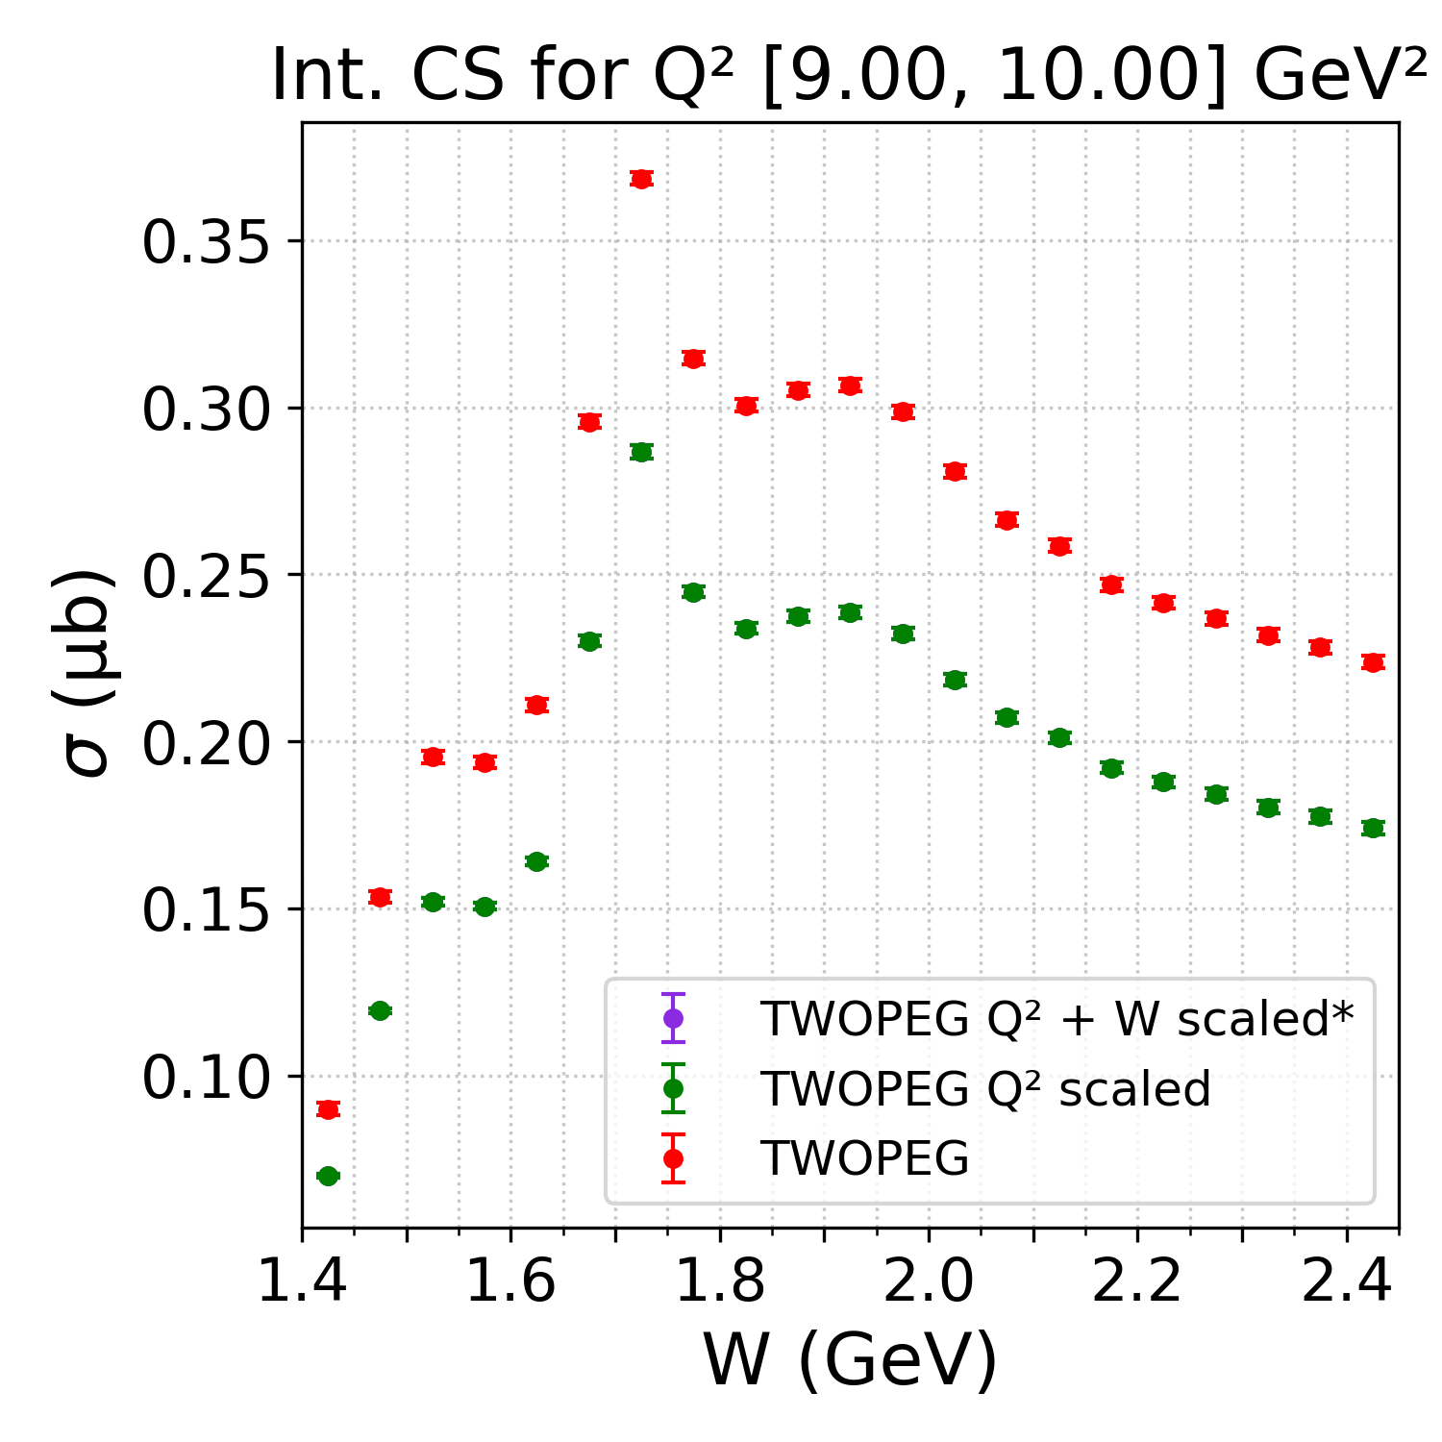
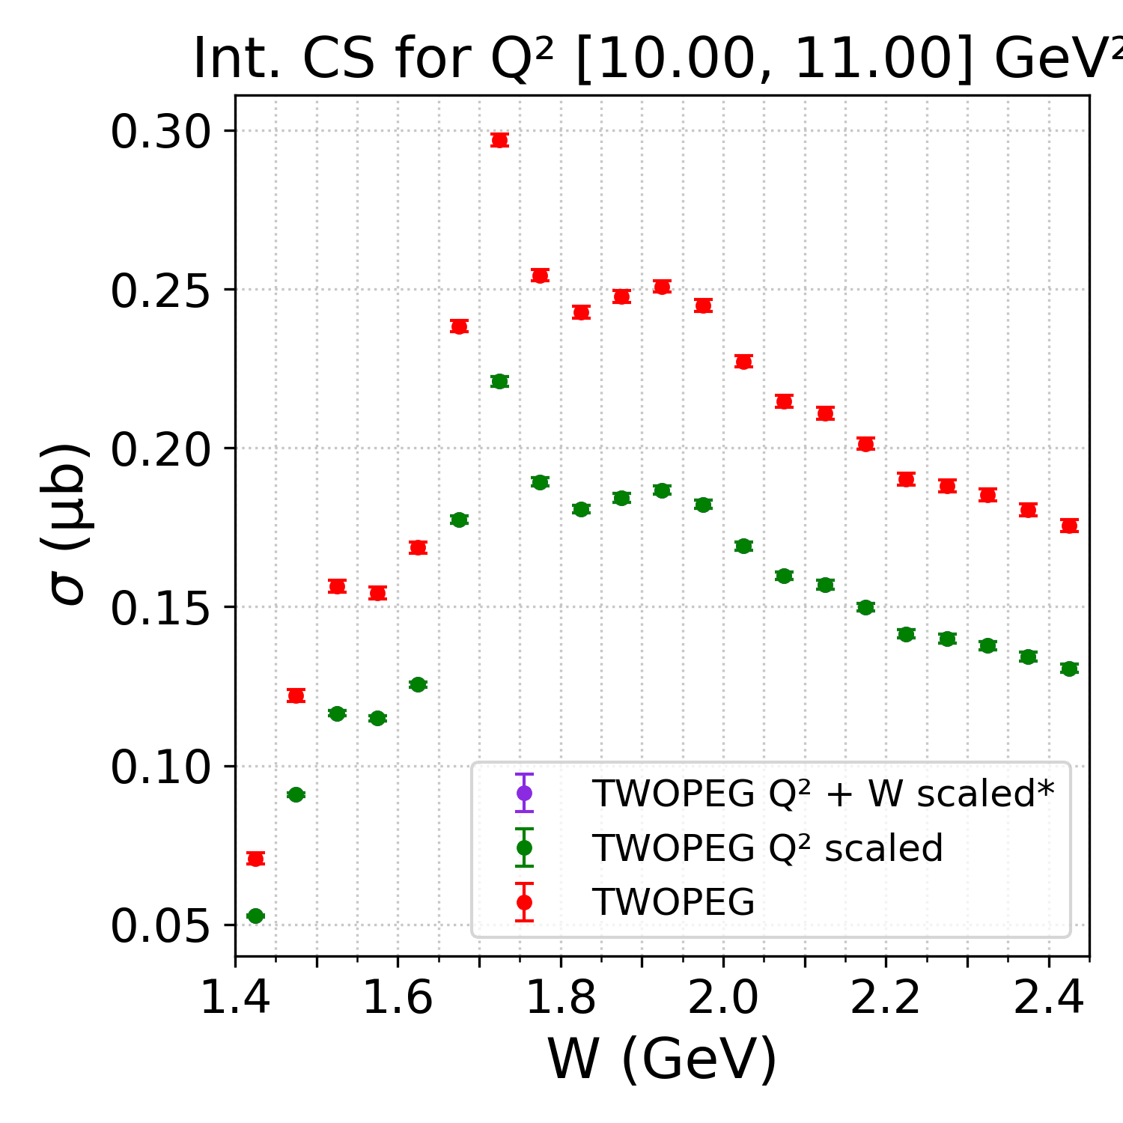
Integrated Cross Sections
MODEL.
*W scaled where scale factors available (up to W 2.1 GeV)
PRELIMINARY

Slide 14
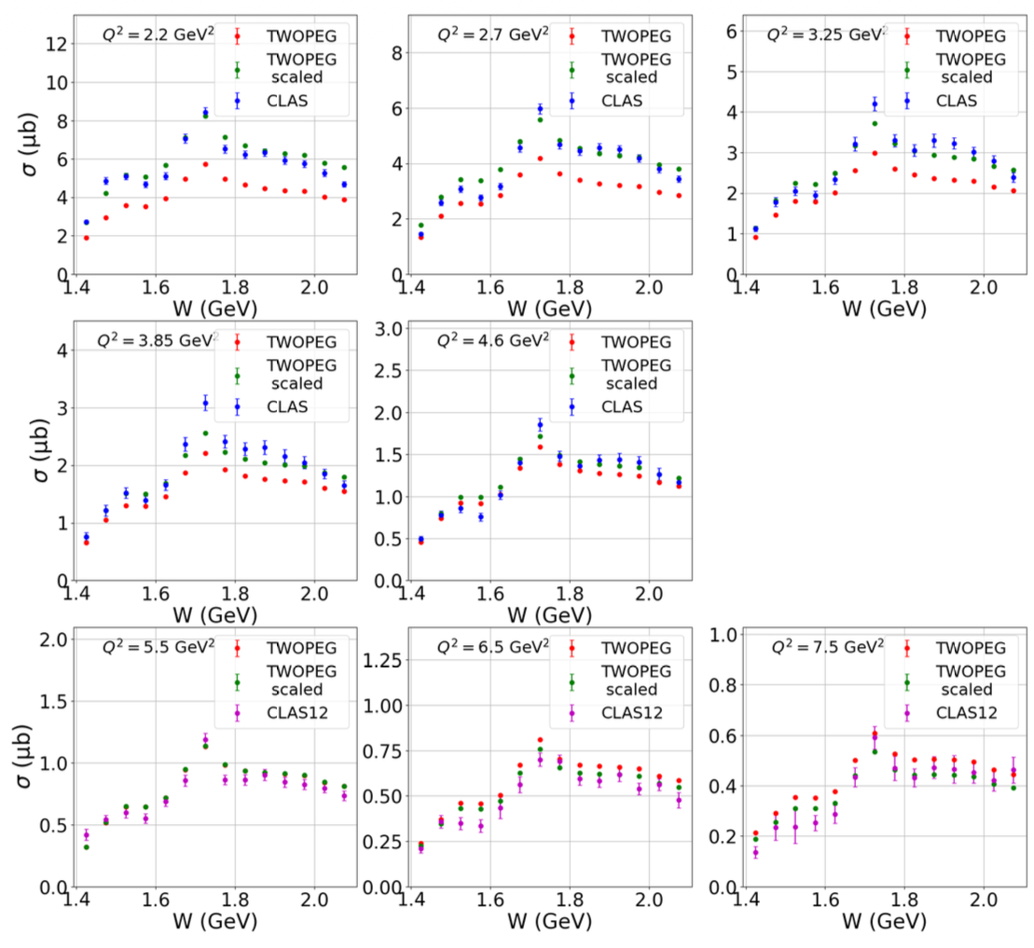
MODEL.
DATA + MODEL.
Dr. Krishna Neupane’s cross sections (will be on arXiv soon)
MODEL | DATA + MODEL
TWOPEG | TWOPEG
TWOPEG Q² scaled | TWOPEG scaled
TWOPEG Q² + W scaled* | CLAS/CLAS12
PRELIMINARY
*W scaled where scale factors available (up to W 2.1 GeV)
FIG. 14. Integrated cross sections for various Q2 bins comparing the measured CLAS/CLAS12 data (blue/magenta points), the original TWOPEG model (red points), and the adjusted/scaled TWOPEG (green points) cross sections.

Slide 15
Summary & Outlook
Matching PIDs show a significant resolution broadening
Left tail has large contribution from resolution
Further into the tail → mismatch PIDs dominate
MM², theta, and momentum cuts can be used to improve the signal and background shapes
Combining the enhanced signal and enhanced background represents all the events in each W-Q² bin well
Outlook
  Correction factors
  Improved cross sections for a larger W-Q² range than the previous study
  Combine statistics of exclusive and missing particle topologies for all RGA run periods
enhanced signal + enhanced bg

Slide 16
References
Jefferson Lab. CLAS12. https://www.jlab.org/physics/hall-b/clas12
Neupane, Krishna. “First CLAS12 Double-Pion (Nππ) Electroproduction Analysis.” University of South Carolina, 2025.
Krishna Neupane et al. (2026) under CLAS Collaboration Review
Thank you!

