Slide 1

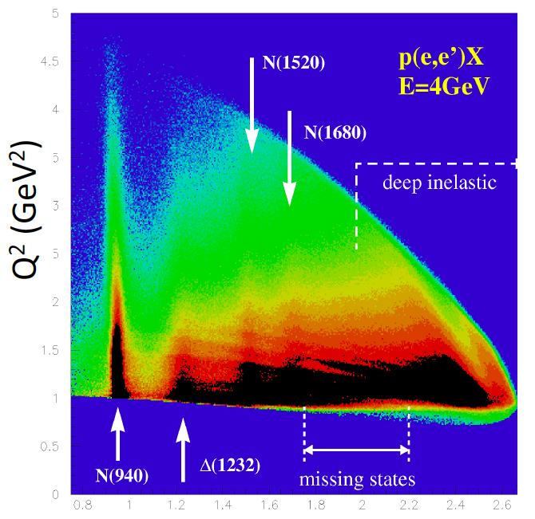
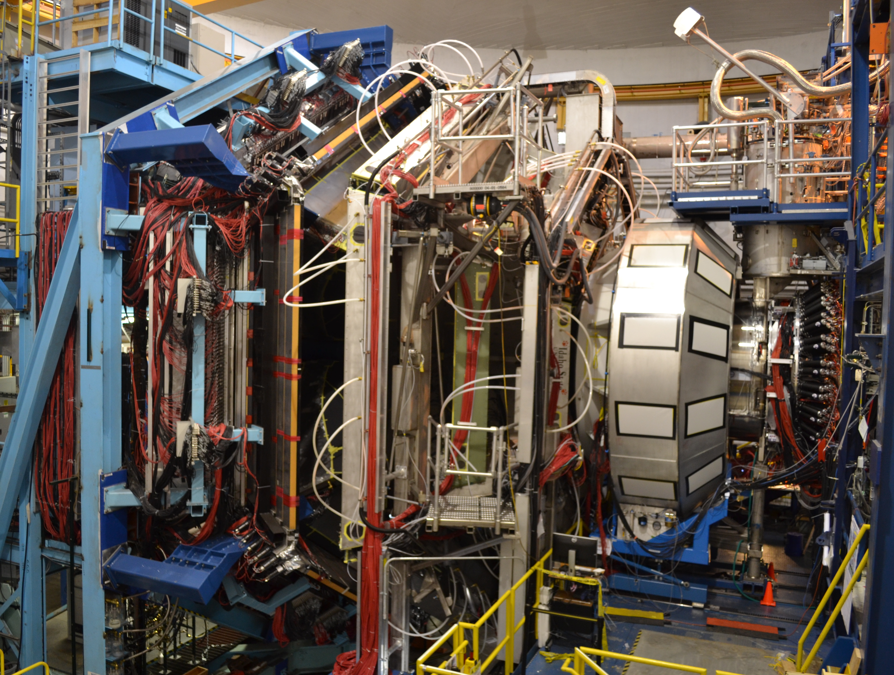
Hybrid Baryon Spectroscopy with CLAS12 at Jefferson Lab
Annalisa D’Angelo
University of Rome Tor Vergata & INFN Rome Tor Vergata
Exotic Hadron Spectroscopy with CLAS/CLAS12 at Jefferson Lab
Annalisa D’Angelo
University of Rome Tor Vergata & INFN Rome Tor Vergata
Outline:
Physics case: hybrid baryons and the role of the glue
Hybrid baryons signature
KY and ππ electroproduction in CLAS12
Current Status
Outlook & conclusions
W (GeV)

Slide 2
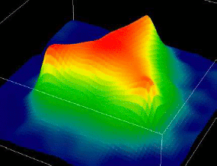
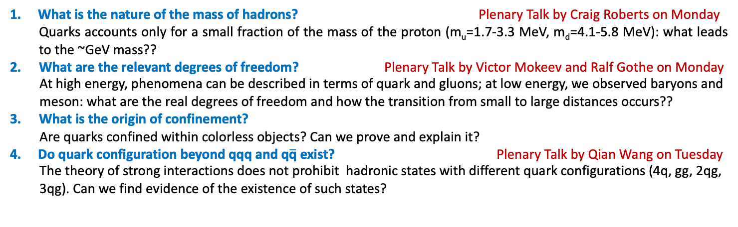
Critical QCD Question Addressed in Hadron Spectroscopy
What is the nature of the mass of hadrons? Plenary Talk by Craig Roberts on Monday
Quarks accounts only for a small fraction of the mass of the proton (m_{u}=1.7-3.3 MeV, m_{d}=4.1-5.8 MeV): what leads to the ~GeV mass??
What are the relevant degrees of freedom? Plenary Talk by Victor Mokeev and Ralf Gothe on Monday
At high energy, phenomena can be described in terms of quark and gluons; at low energy, we observed baryons and meson: what are the real degrees of freedom and how the transition from small to large distances occurs??
What is the origin of confinement?
Are quarks confined within colorless objects? Can we prove and explain it?
Do quark configuration beyond qqq and q$\overline{\text{q}}$ exist? Plenary Talk by Qian Wang on Tuesday
The theory of strong interactions does not prohibit hadronic states with different quark configurations (4q, gg, 2qg, 3qg). Can we find evidence of the existence of such states?
<< 0.1 fm
0.1 – 1 fm
> 1 fm
π
p
Quarks and Gluons
Effective Degrees of Freedom
Mesons & Baryons

Slide 3
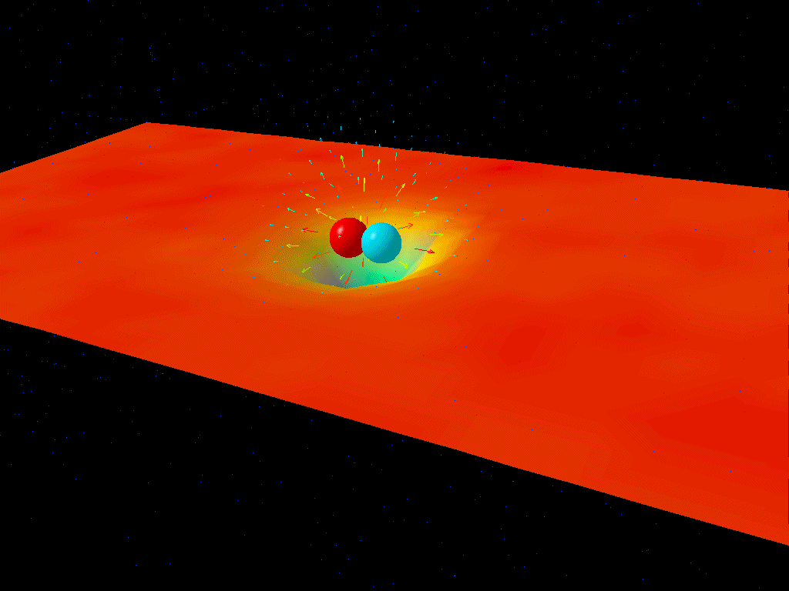
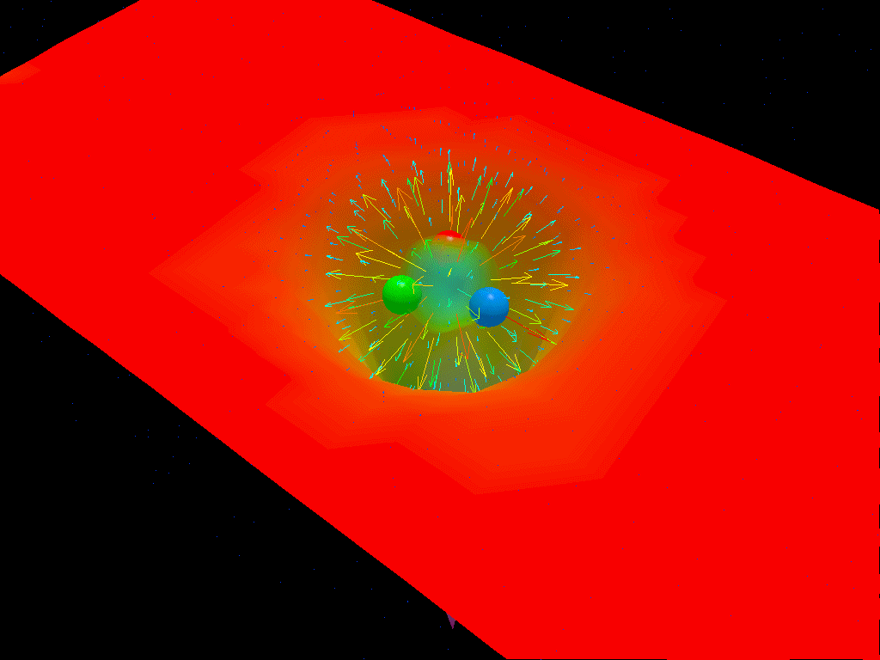
Critical QCD Question Addressed in Hadron Spectroscopy
The light meson and N* spectrum: what is the role of glue?
Search for hybrid hadronic states
Mesons
Baryons
Derek B. Leinweber – University of Adelaide

Slide 4
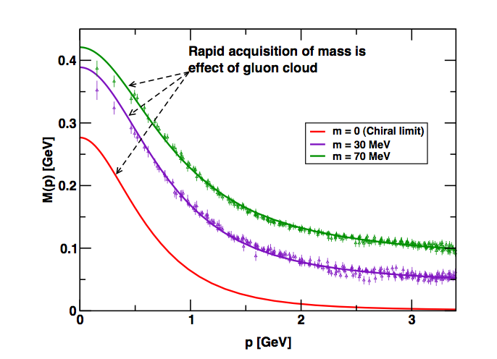
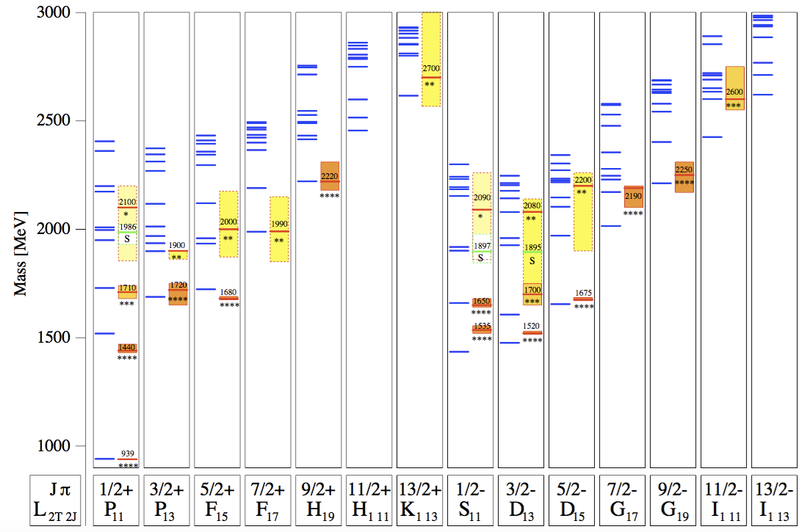
Constituent quark models and SU(6)xO(3)
Current-quarks of perturbative QCD evolve into constituent quarks at low momentum Connection between constituent and current quarks.
numerical simulations
of unquenched lattice QCD
(Bowman et al.)
Dyson-Swinger equation
(Bhagwat et al.)
Missing Baryons
U. Löring, B. Metsch, H.R. Petry, Eur. Phys. J. A 10, 395 (2001)
QCD-inspired Constituent Quark models: states classified by isospin, parity and spin within each oscillator band. Many projected q³ states are still missing or uncertain.

Slide 5
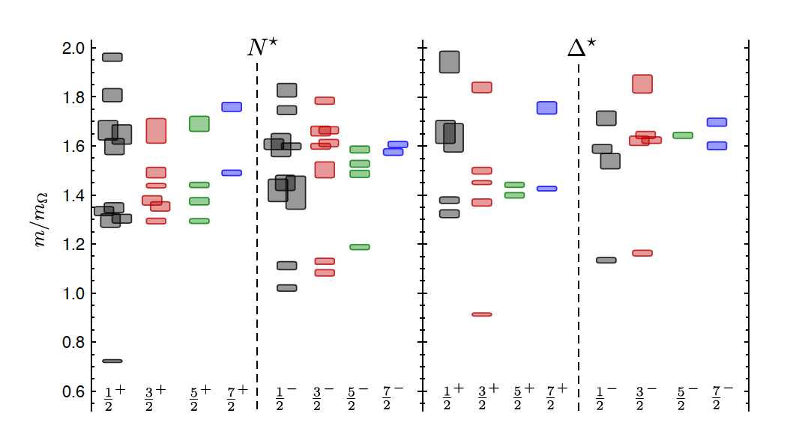
LQCD N* & Δ Spectra
Exhibit the SU(6)×O(3)-symmetry features
Counting of levels consistent with non-rel. quark model
Striking similarity with quark model
No parity doubling
4
5
3
1
2
3
2
1
1
1
2
2
1
Δ(1232)
N(938)
Problems are not solved!
Robert G. Edwards, Jozef J. Dudek, David G. Richards, Stephen J. Wallace
Phys.Rev. D84 (2011) 074508

Slide 6
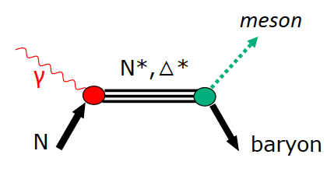
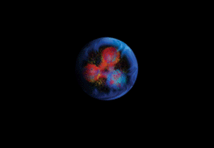
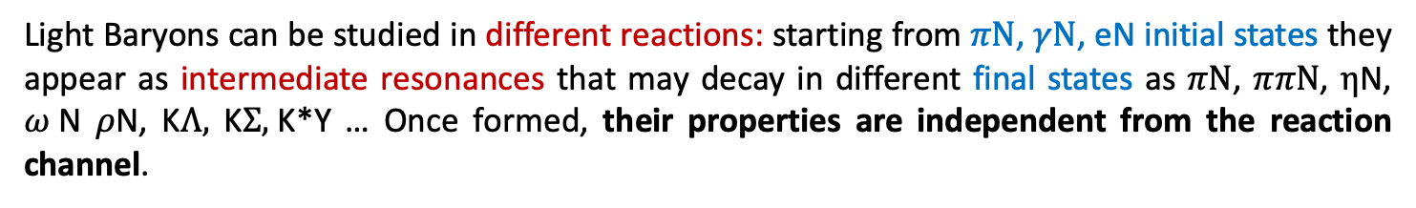
How to access light baryon excited states
Light Baryons can be studied in different reactions: starting from $πN$, $γN$, eN initial states they appear as intermediate resonances that may decay in different final states as $πN$, $ππN$, $η$N, $ω$N $ρ$N, K$Λ,$ K$Σ,$K*Y … Once formed, their properties are independent from the reaction channel.
e’
e
*

Slide 7
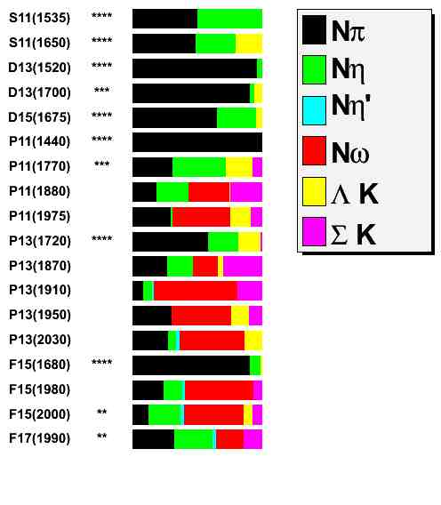
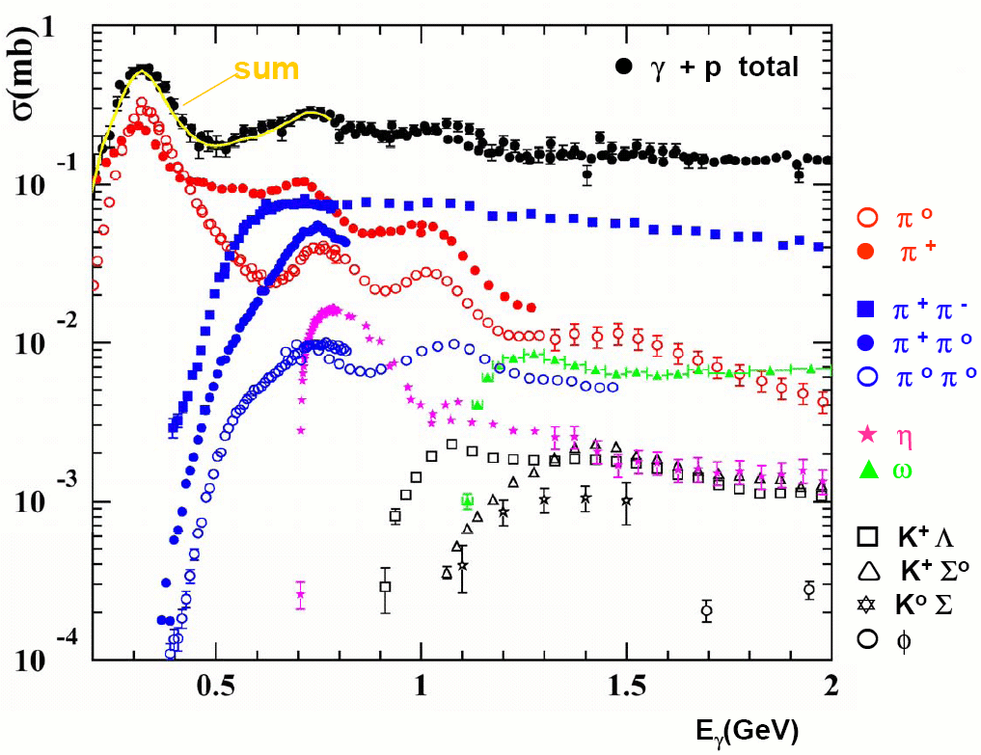

Establishing the N* and Δ Spectrum
Search all channels: not just πN
Photonuclear cross sections
(1/2)⁻
(1/2)⁻
(3/2)⁻
(3/2)⁻
(5/2)⁻
(1/2)⁺
(1/2)⁺
(1/2)⁺
(1/2)⁺
(3/2)⁺
(3/2)⁺
(3/2)⁺
(3/2)⁺
(3/2)⁺
(5/2)⁺
(5/2)⁺
(5/2)⁺
(7/2)⁺
Nπ
Nη
Nη`
Nω
ΛK
ΣK
Study these states in electroproduction and extend to higher masses

Slide 8
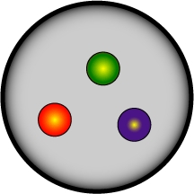
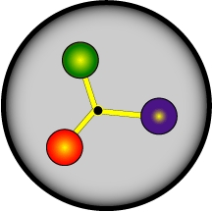
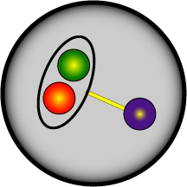

CLAS12 N* Program – meson electro-production
The N* program is one of the key physics foundations of Hall B
CLAS12 was designed to measure cross sections and spin observables over a broad kinematic range for exclusive reaction channels:
πN, ωN, φN, ηN, η’N, ππN, KY, K*Y, KY*
- N* parameters do not depend on how they decay
- Different final states have different hadronic decay parameters and different backgrounds
- Agreement offers model-independent support for findings
The program goal is to probe the spectrum of N* states and their structure
- Probe the underlying degrees of freedom of the nucleon through studies of the Q² evolution of the production amplitudes
N* degrees of freedom??

Slide 9
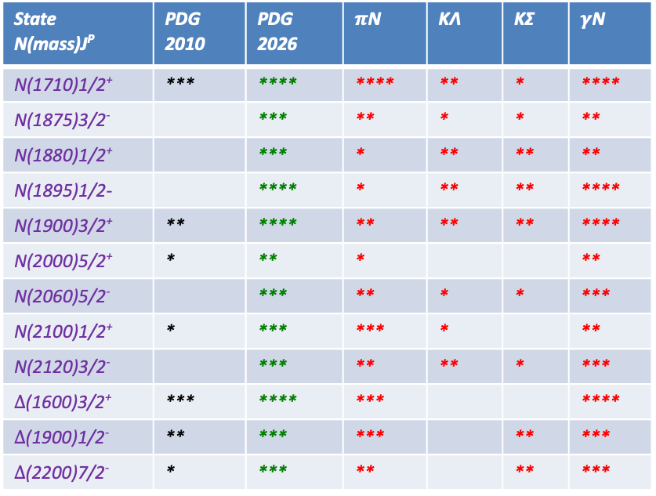
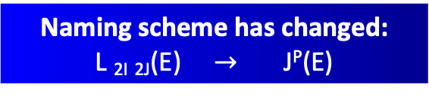
Updated Spectrum of Baryon Resonances
From 2000 to 2010 no new Baryon resonances in PDG. πN- scattering data and π-photoproduction only.
A. Anisovich et al. EPJ A 48, 15 (2012)
State N(mass)J^{P} | PDG 2010 | PDG 2026 | $π$N | KΛ | KΣ | $γ$N
N(1710)1/2⁺ | *** | **** | **** | ** | * | ****
N(1875)3/2⁻ |  | *** | ** | * | * | **
N(1880)1/2⁺ |  | *** | * | ** | ** | **
N(1895)1/2- |  | **** | * | ** | ** | ****
N(1900)3/2⁺ | ** | **** | ** | ** | ** | ****
N(2000)5/2⁺ | * | ** | * |  |  | **
N(2060)5/2⁻ |  | *** | ** | * | * | ***
N(2100)1/2⁺ | * | *** | *** | * |  | **
N(2120)3/2⁻ |  | *** | ** | ** | * | ***
$Δ$(1600)3/2⁺ | *** | **** | *** |  |  | ****
$Δ$(1900)1/2⁻ | ** | *** | *** |  | ** | ***
$Δ$(2200)7/2⁻ | * | *** | ** |  | ** | ***
Multi-channel models now include many photoproduction data. e.g. Bonn-Gatchina PWA analysis
PRL 119, 062004, (2017)
Naming scheme has changed:
L _{2I} _{2J}(E) $→$ J^{P}(E)
Results from photoproduction now add to the PDG tables and determine properties of baryon resonances
Decisive impact from CLAS KY photoproduction data
Extend studies to KY electroproduction and to higher masses

Slide 10
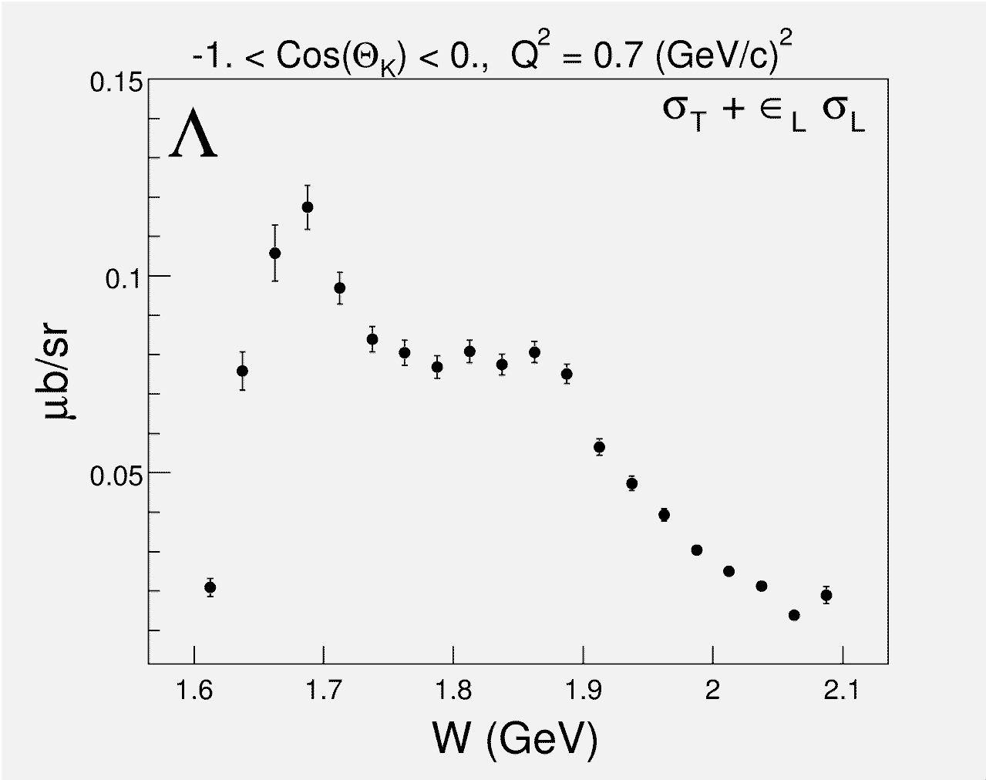
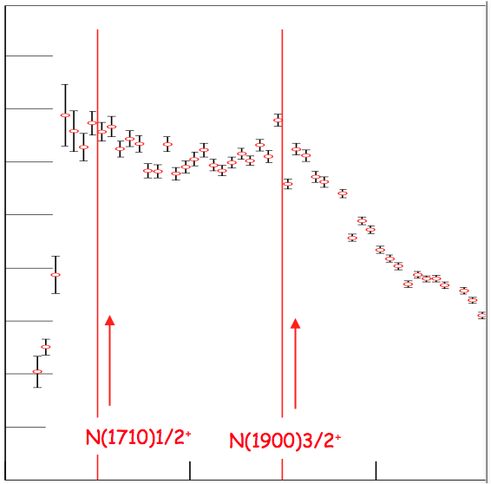
Studying Baryons in γ*p → KΛ/Σ ?
Photoproduction
Electroproduction
1.6
1.4
1.2
1.0
0.8
0.6
0.4
0.2
N(1710)1/2⁺
N(1900)3/2⁺
N(1710)1/2⁺
N(1900)3/2⁺
1.6
1.8
2.0
W (GeV)
Strangeness electroproduction is a fertile ground in studying S=0 baryon states with masses above 1.6 GeV.

Slide 11
Hybrid Baryons: Baryons with Explicit Gluonic Degrees of Freedom
Hybrid hadrons with dominant gluonic contributions are predicted to exist by QCD.
Experimentally:
Hybrid mesons |qqg> states may have exotic quantum numbers J^{PC} not available to pure |qq> states 0⁻⁻ , 1⁻⁺, ….GlueX, MesonEx, COMPASS, PANDA ….
Hybrid baryons |qqqg> have the same quantum numbers J^{P} as |qqq>
electroproduction with CLAS12 (Hall B).
Theoretical predictions:
        MIT bag model - T. Barnes and F. Close, Phys. Lett. 123B, 89 (1983).
        QCD Sum Rule - L. Kisslinger and Z. Li, Phys. Rev. D 51, R5986 (1995).
        Flux Tube model - S. Capstick and P. R. Page, Phys. Rev. C 66, 065204 (2002).
        LQCD - J.J. Dudek and R.G. Edwards, PRD85, 054016 (2012).

Slide 12
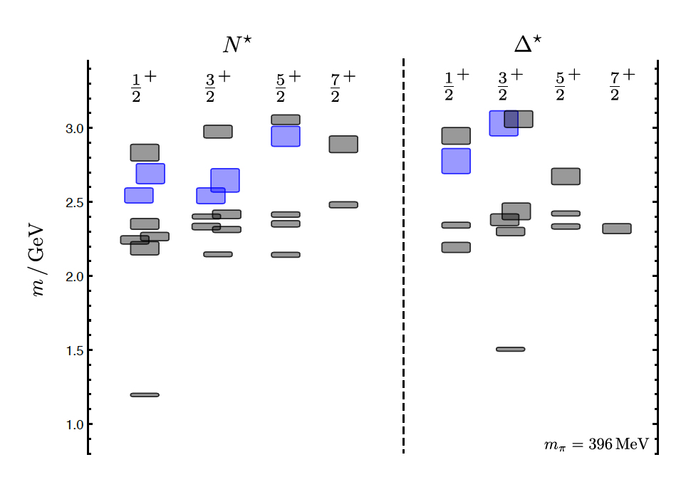
Hybrid Baryons in LQCD
J.J. Dudek and R.G. Edwards, PRD85, 054016 (2012)
regular states
clustered
in mass
hybrid states
LQCD
1.3GeV
The nucleon mass is shifted ~300 MeV to higher masses
N
Hybrid states have same J^{P} values as qqq baryons. How to identify them?
Overpopulation of N 1/2⁺ and N 3/2⁺ states compared to QM projections. ?
A_{1/2} (A_{3/2}) and S_{1/2} show different Q² evolution. Can we do it?

Slide 13
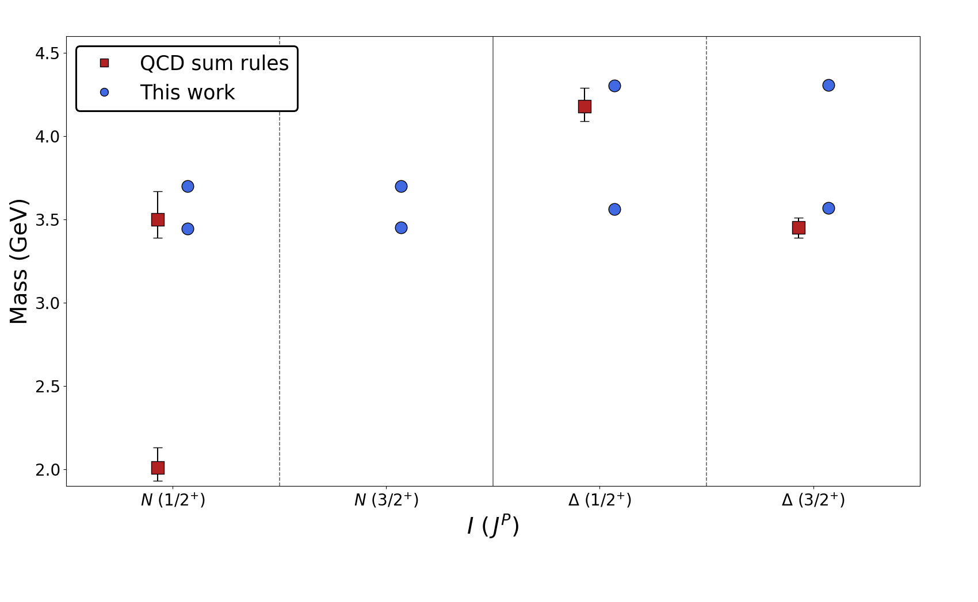
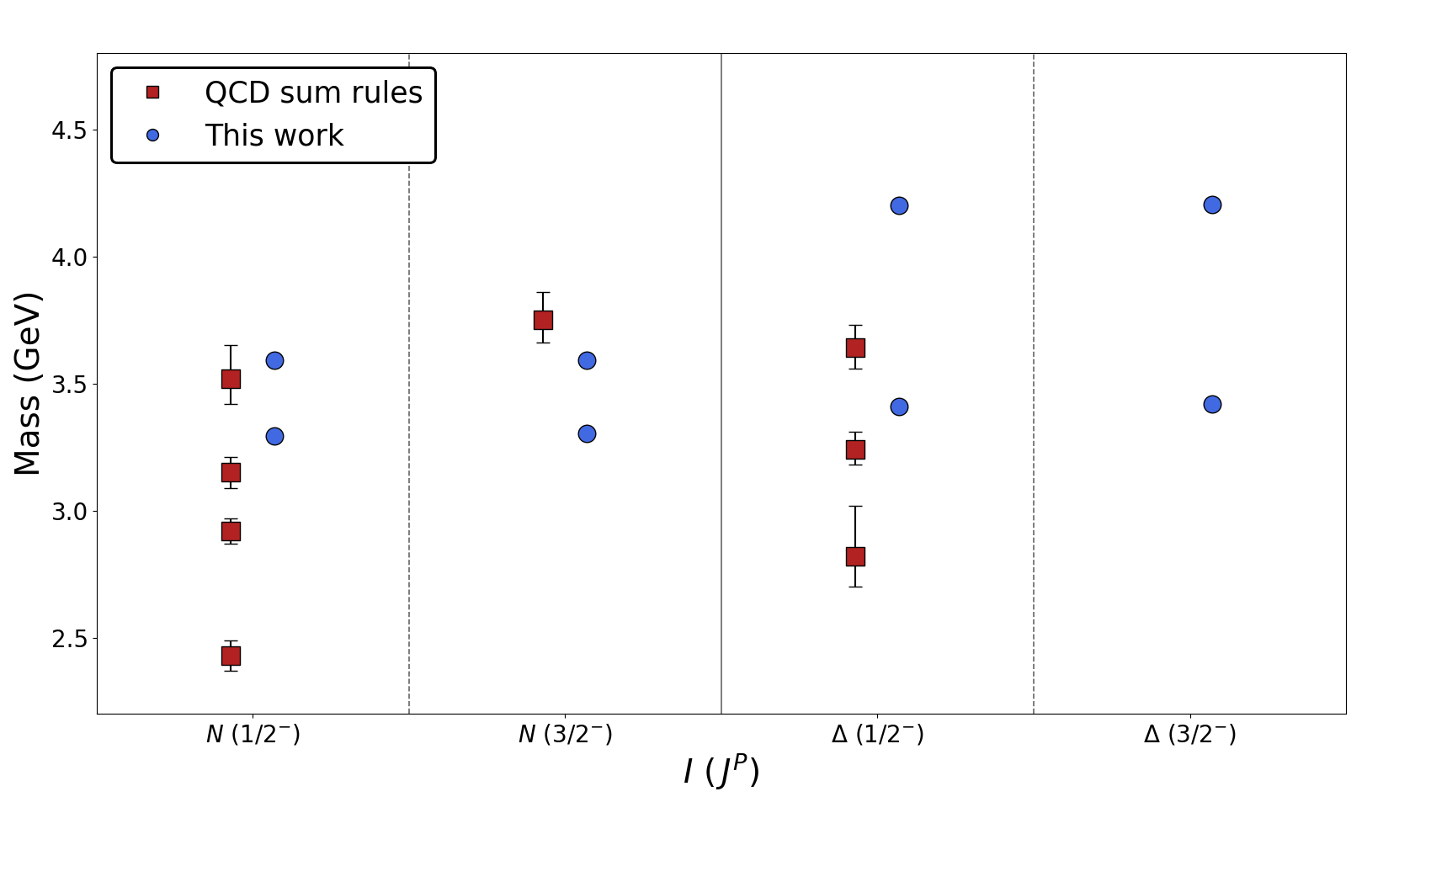
Hybrid Baryons in QCD Sum Rules and CQM
qqqg light hybrid baryons spectra have been calculated within the QCD sum rules and the CQM frameworks
the lowest-lying hybrid baryon is predicted to be the positive-parity N 1/2⁺ of 2.01 GeV mass decaying into conventional baryon plus meson final states: N f₀(980)/a₀(980), Δ(1232) π/ρ
Talk by Joachin Viseur on Wednesday
QCD sum rules
CQM
QCD sum rules
CQM
Positive parity states
Negative parity states
QCD Sum Rules
Qi-Nan Wang, et al. PRD 113, 014033 (2026)
Predictions of masses for light hybrid baryons
Joachim Viseur M. et al., arXiv:2606.14451 [hep-ph]
Light hybrid baryons in the constituent model of QCD
CQM

Slide 14
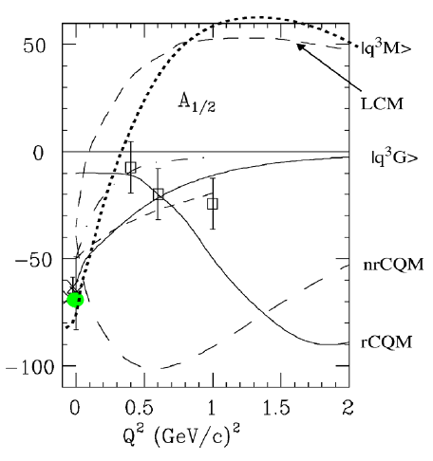
Electrocouplings of the ‘Roper’ in 2002
N(1440)1/2⁺
In 2002 Roper amplitude A_{1/2} measurements were more consistent with hybrid state
but data were limited with large uncertainties.
Lowest mass hybrid baryon should be J^{P} =1/2⁺ (same as Roper)

Slide 15
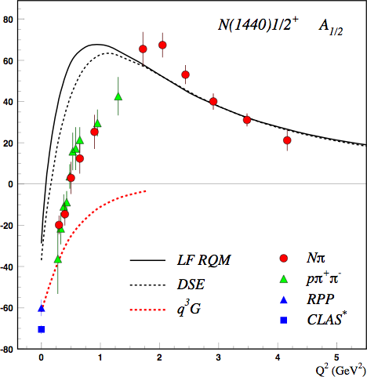
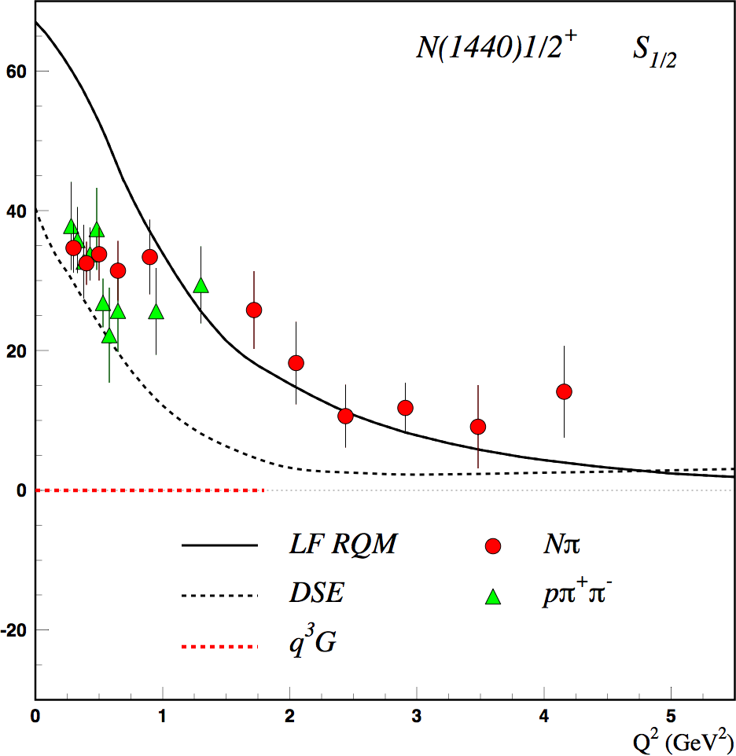
Separating q³g from q³ States?
Precise CLAS results on electro-couplings clarified nature of the Roper
V.D. Burkert et al, Prog.Part.Nucl.Phys. 146 (2026) 104214
J. Segovia et al., PRL 115, 171801 (2015)
V. Burkert C.D. Roberts, Rev. Mod. Phys. 91, 011003 (2019)
G. Ramalho, Mod. Phys. 91, 011003 (2026)
q³
q³
q³g
V. Burkert and C. Roberts
q³g
EFT
q³
A_{1/2} and S_{1/2} amplitudes at high Q² >2 GeV² indicate 1st radial q³ excitation
Significant meson-baryon coupling at small Q²
For hybrid “Roper”, A_{1/2}(Q²) drops off faster with Q² and S_{1/2}(Q²) ~ 0.

Slide 16
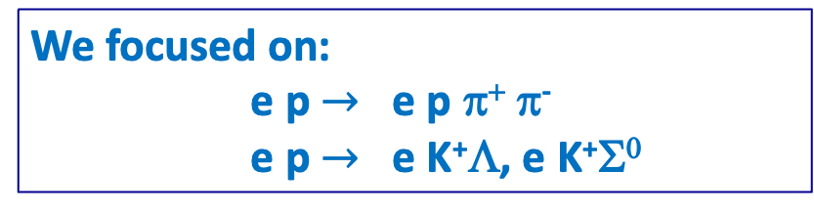
Hybrid Baryon Signatures
Based on available knowledge, the signatures for hybrid baryons consist of:
• Extra resonances with J^{p}=1/2⁺ and J^{p}=3/2⁺, with masses > 1.8 GeV and decays into Nππ or KY final states.
•A drop of the transverse helicity amplitudes A_{1/2}(Q²) and A_{3/2}(Q²) faster than for ordinary three quark states, because of extra glue-component in valence structure.
•A suppressed longitudinal amplitude S_{1/2}(Q²) in comparison with transverse electro-excitation amplitude (J^{P}=1/2⁺).
We focused on:
e p $→$ e p π⁺ π⁻
e p $→$ e K⁺Λ, e K⁺Σ⁰
The study will include other multi meson channels.

Slide 17
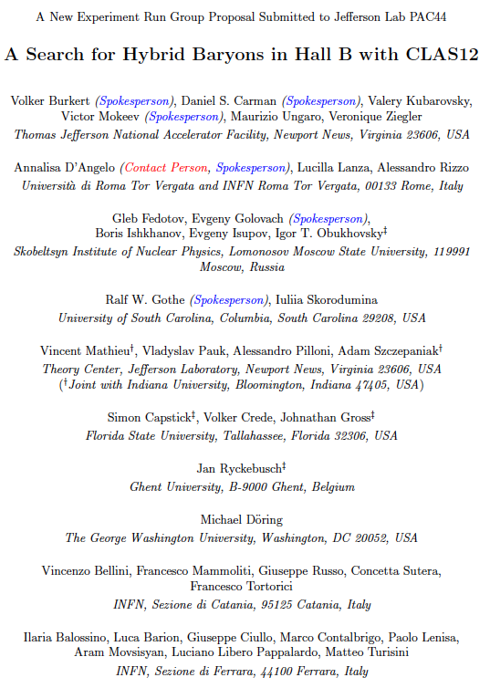
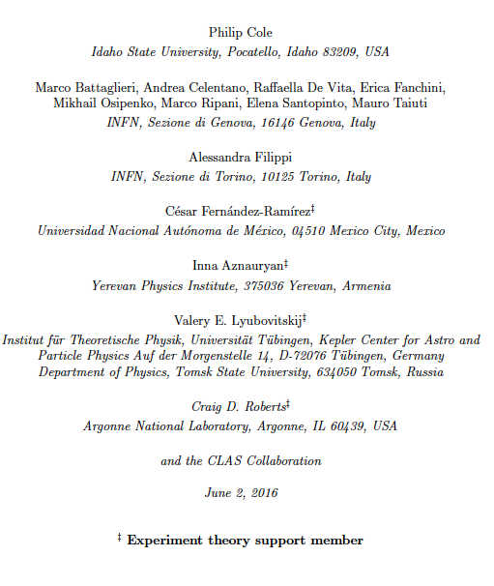

Approved with A- Rating
100 PAC days Assigned to Run Group K
50 PAC DAYS data taken in
Fall 2018 and Spring 2024

Slide 18
Analysis Tools for Electromagnetic Excitation of Baryons
Single Meson Analysis
Unitary Isobar Model & Fixed-t Dispersion Relations approaches (Kaon-MAID)
Regge-and Resonance Model (Gent Group)
Prague Isobar Model http://www.ujf.cas.cz/en/departments/department-of-theoretical-physics/isobar-model.html
Double Meson Analysis
J-M Reaction Model
Multi-channel Analysis
Bonn-Gatchina multi-channel PWA
Julich-Bonn-Washington coupled-channel framework
Argonne-Osaka dynamically coupled-channel model
JPAC Analysis Tools for high mass states using Regge & Veneziano Approach

Slide 19
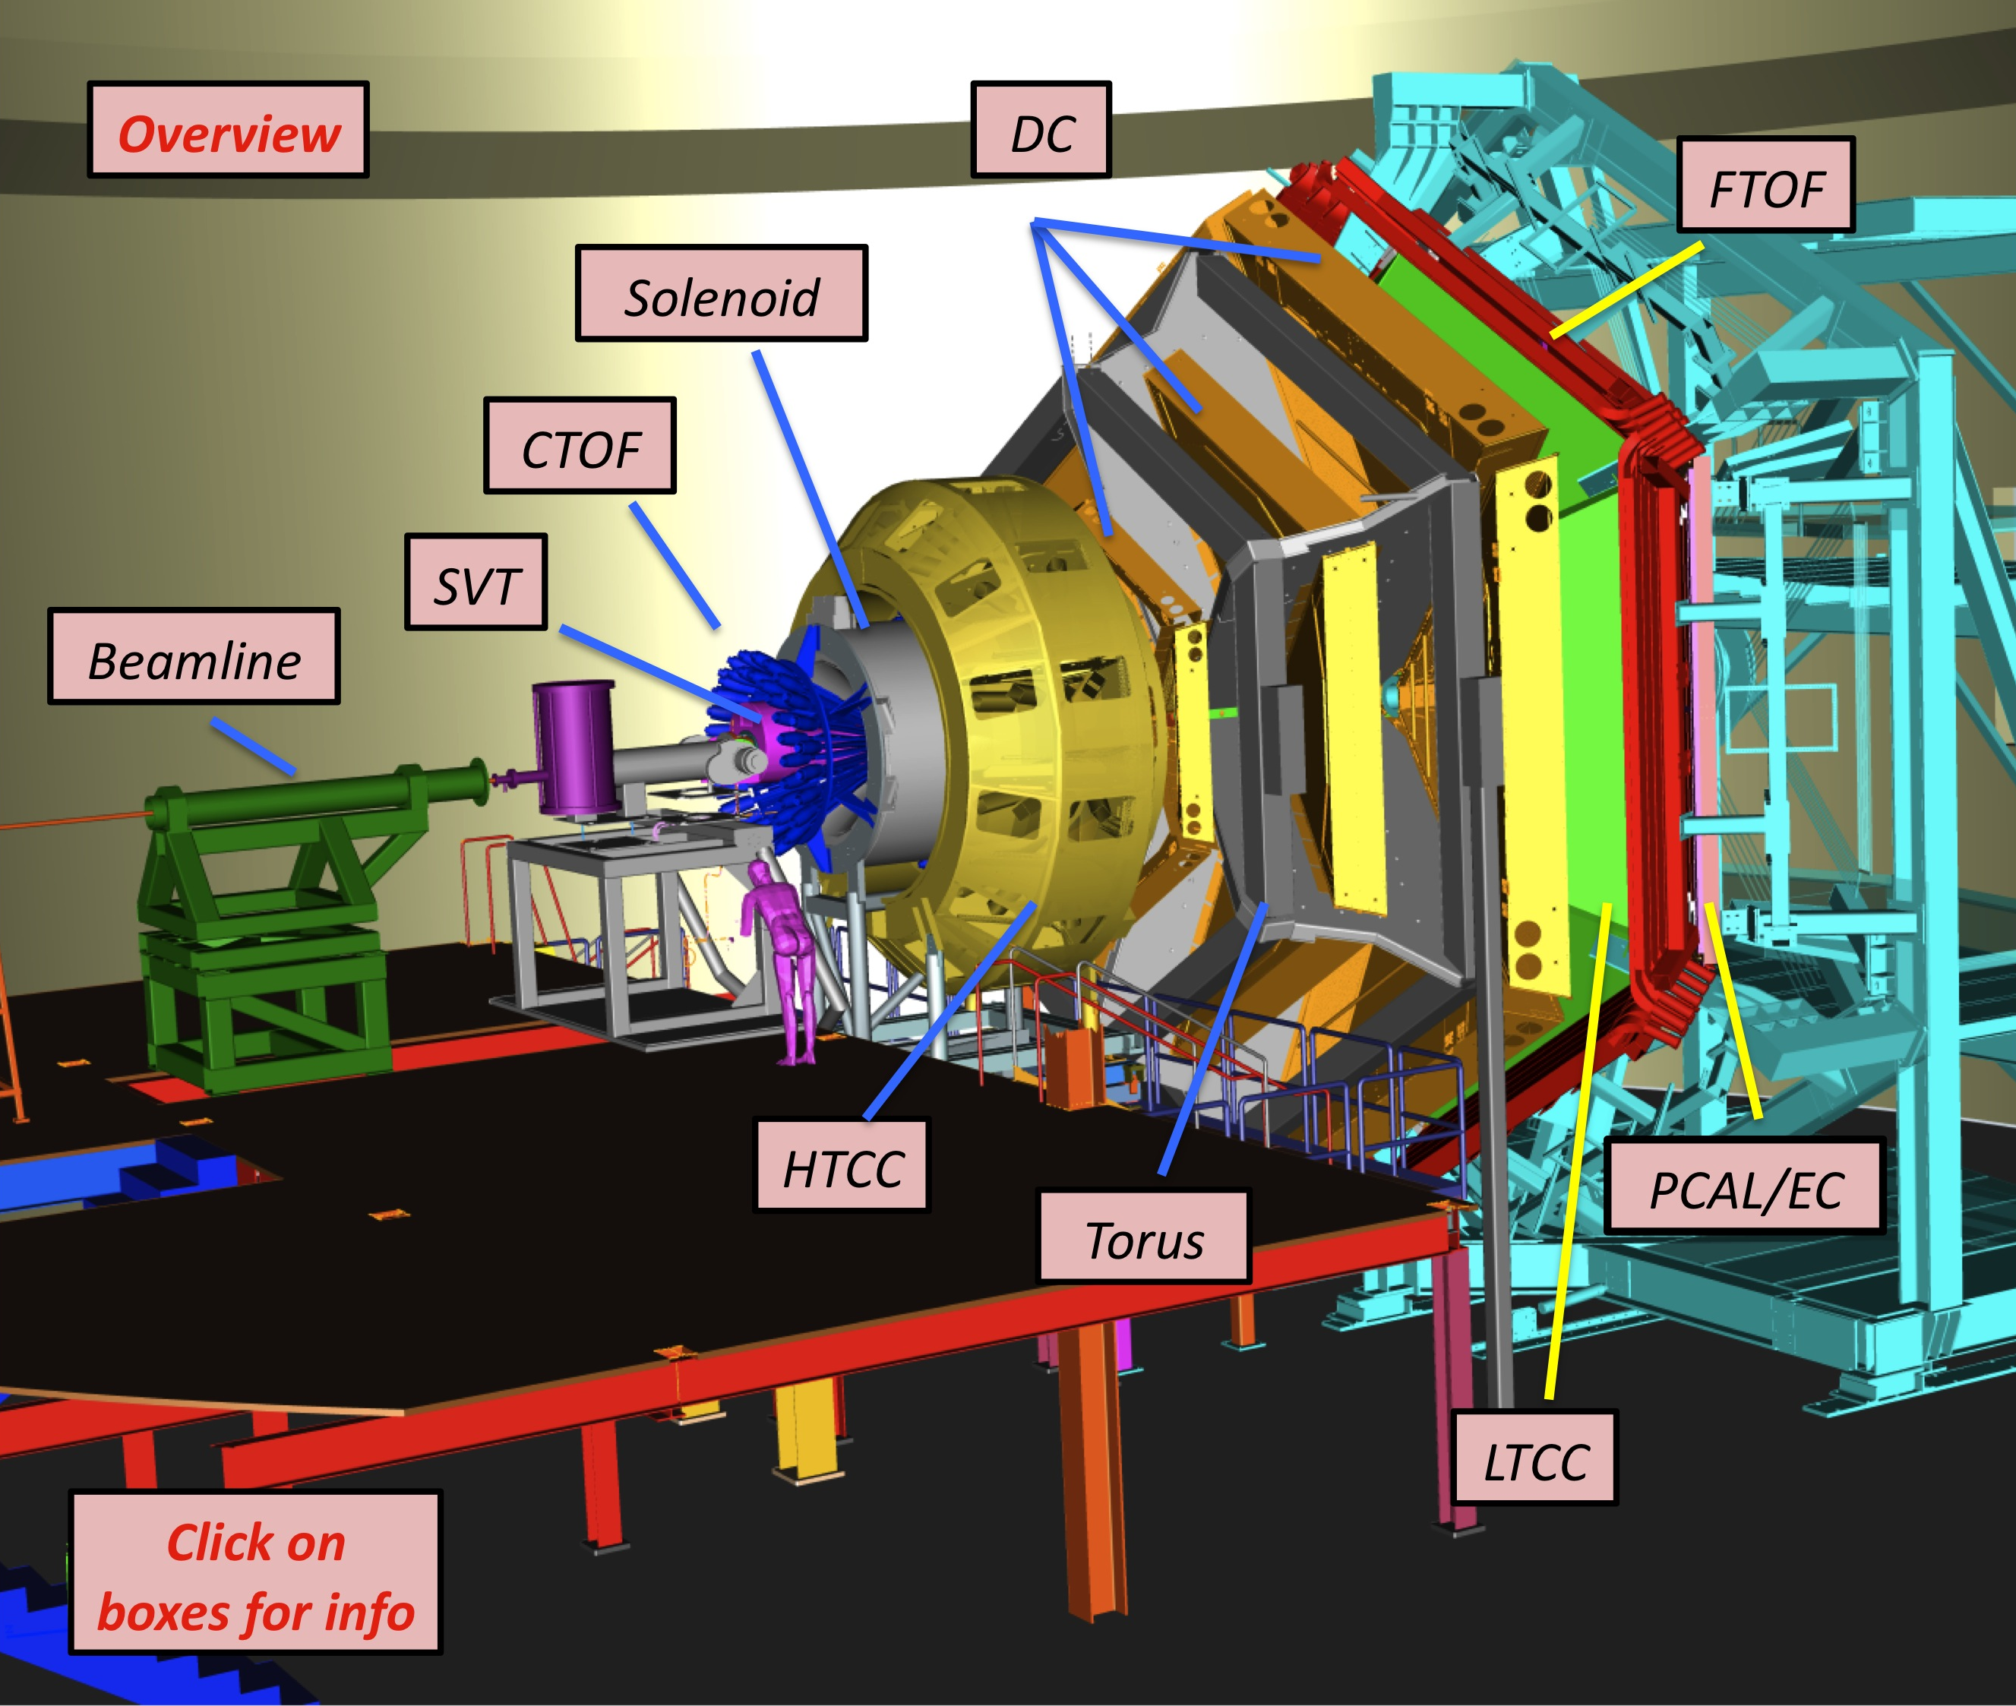
Equipment
CLAS12
Hall B
Forward Detector (FD)
  - TORUS magnet
  HT Cherenkov Counter
  Drift chamber system
  LT Cherenkov Counter
  Forward TOF System
  Pre-shower calorimeter
  E.M. calorimeter
Central Detector (CD)
  SOLENOID magnet
  Silicon Vertex Tracker
  Central Time-of-Flight
Beamline
  Cryo Target
  Moller polarimeter
  - Shielding
  Photon Tagger
Upgrade to the baseline
- Central Neutron Detector
  MicroMegas
  Forward Tagger
  RICH detector
  Polarized target
MM
CND
FT
RICH

Slide 20
CLAS12 Spectrometer
beam

Slide 21

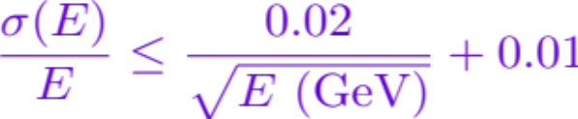
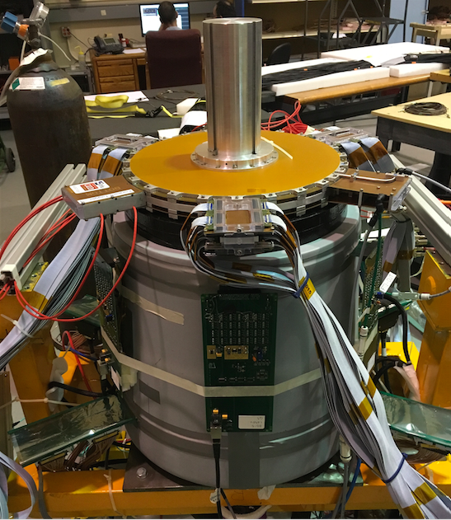
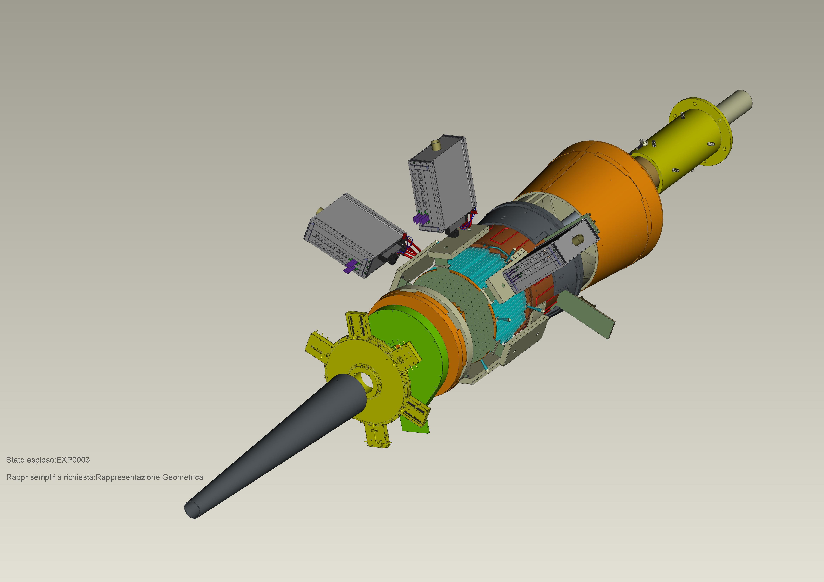
Forward Tagger
CLAS12
Hall B
FT designed to detect electrons and photons at small angles
FT-Cal: calorimeter to measure electron energy/momentum
  FT-Hodo: scintillation hodoscope to veto photons & backsplash
FT-Trk: micro-mega detector to measure electron angles, polarization plane
calorimeter
tracker
hodoscope

Slide 22
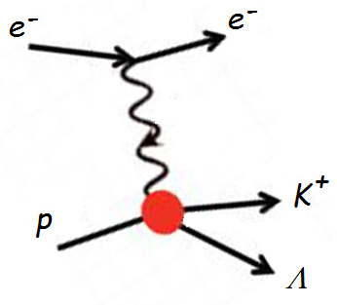
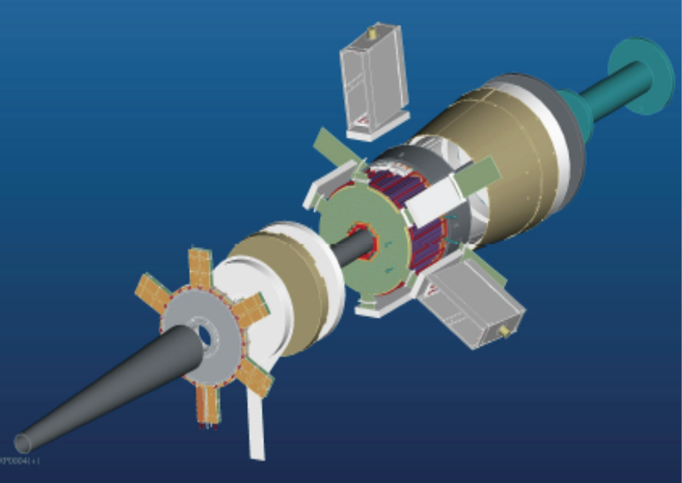
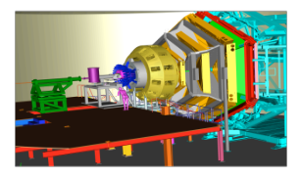
The Experiment
ϑ > 6°
ϑ > 6°
CLAS12
p
π⁺
π⁺
π⁻
Scattered electrons are be detected:
in the Forward Tagger for angles from 2.5° to 4.5°
in the Forward Detector of CLAS12 for scattering angles greater than about 6°
Charged hadrons are measured in the full range from 6° to 130°
FT allows to probe the crucial Q² range where hybrid baryons may be identified due to their fast dropping A_{1/2}(Q²) amplitude and the suppression of the scalar S_{1/2}(Q²) amplitude.
W < 3 GeV Q² range of interest: 0.05 - 2 GeV² $Q^{2}=4E_{Beam}E_{e’}\sin^{2}\frac{θ}{2}$ $⇒ θ<5^{o}$

Slide 23
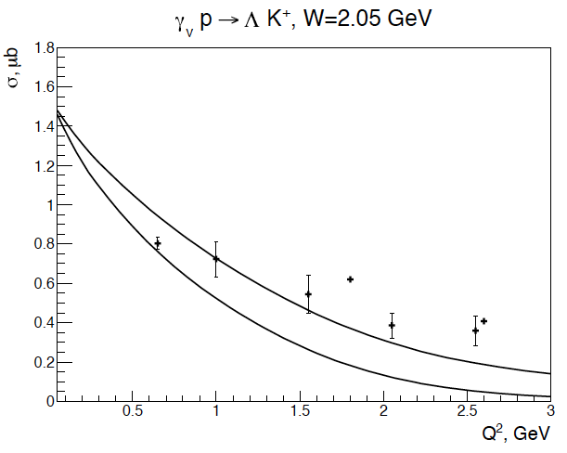
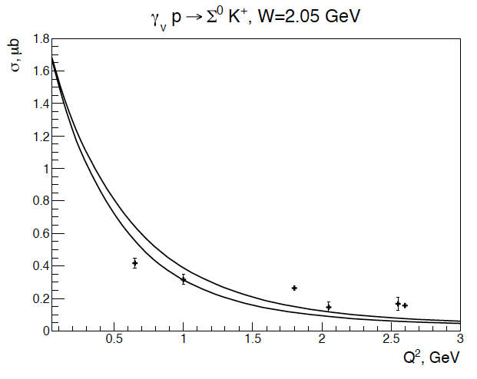
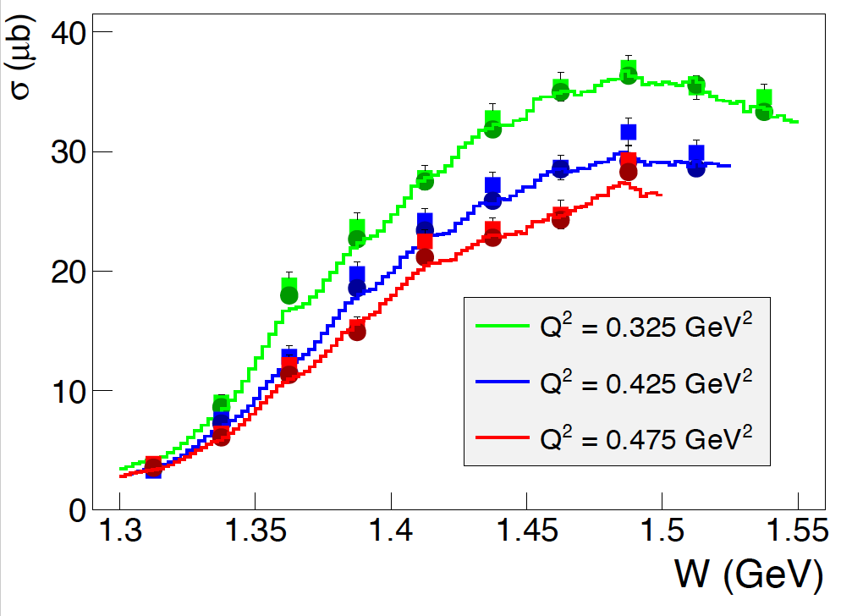
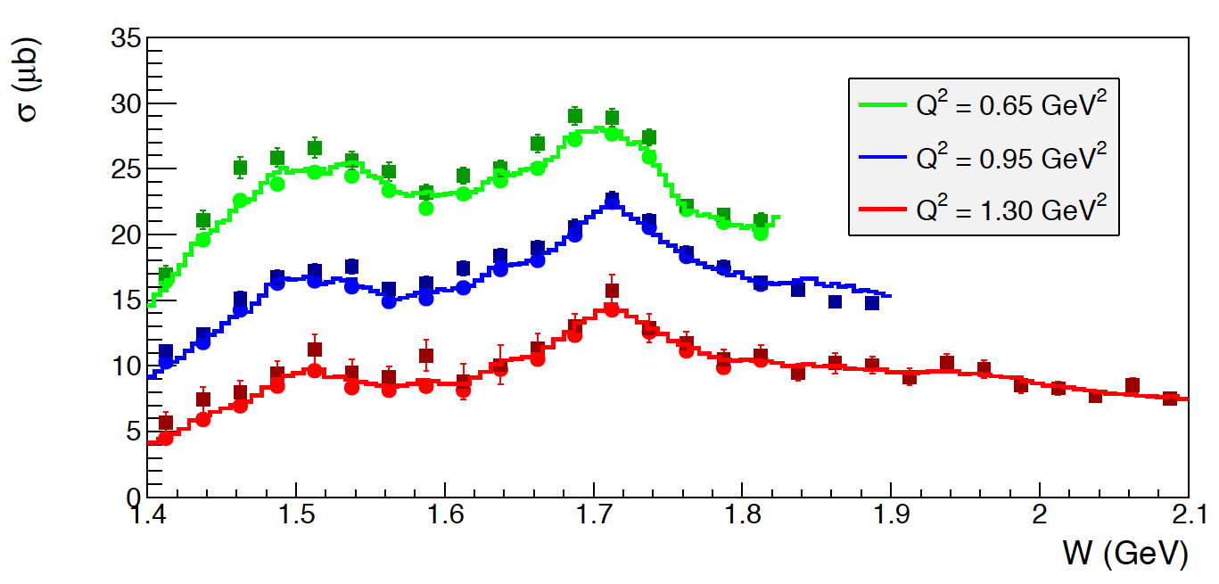
Event Simulation in CLAS12
e p e p π⁺ π⁻
e p e K⁺Y
JLab - Moscow (JM) model
Regge + Resonance (RPR) Gent model
Development of a realistic event generator using the available models.
Simulation of quasi-data events.
Full MC events reconstruction to determine final resolutions and efficiencies.

Slide 24
Quasi – Data Analysis
A hypothetical hybrid baryon contribution added at the amplitude level to the model RPR-2011:
M_{R} = 2.2 GeV Γ_{R}=0.25 GeV J^{P} = 1/2 ⁺ (J^{P} = 3/2 ⁺)
The reaction cross section has been calculated with and without the hybrid baryon resonance contribution to determine:
Minimum beam time needed to obtain statistical uncertainty for cross sections comparable with CLAS photoproduction data.
      100 days of beam time
The Legendre moments of the unseparated and polarization interference components of the cross section.
    Search for distinctive structures due to the added resonance.
The statistical sensitivity to hybrid baryons electro-couplings.
      Minimum electro-coupling values with 100 days of beam time.
The capability of extracting the added resonance parameters from expected data.
      Blind analysis of quasi-data.

Slide 25
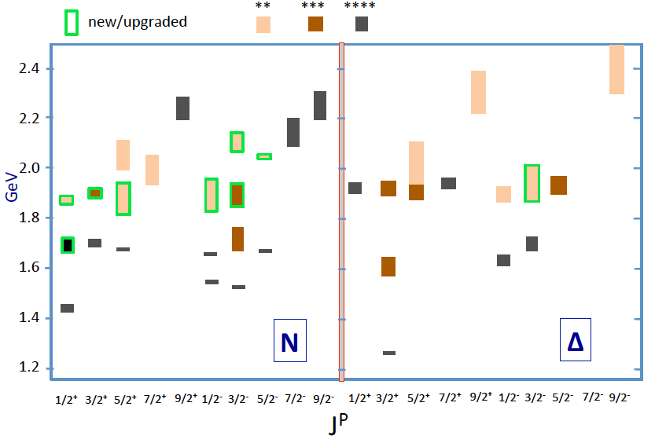
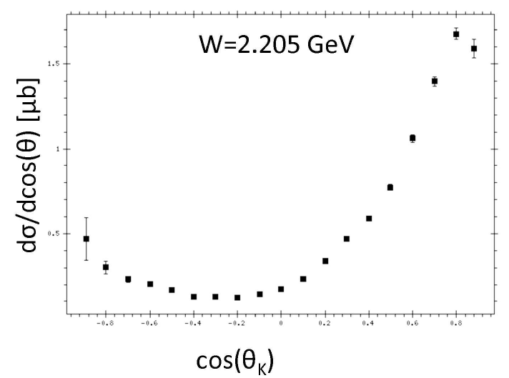
Statistics and Binning Requirements
Samples of γp -> K⁺Λ cross section used in BnGa analysis that discovered new baryon states in the W range 1.85 – 2.2 GeV mass region.
Statistical precision ranges from
2% - 7%.
ΔW=10 MeV, Δcos θ* = 0.1
Similar statistics needed to:
Separate structure functions in φ
Find new excited baryon states
Map Q² dependence of amplitudes
Total KΛ data in 50+50 days: 518.4x10⁶ events
Number of bins: 960x10³
<N> = 540 evts/bin
σ_{N}/N = 4.3%
 | Range | Bin | #bins
W (GeV) | 1.8-3.0 | 0.01 | 120
cos θ* | -1 to +1 | 0.1 | 20
φ [º] | 0 - 360 | 18 | 20
Q²(GeV²) | 0.05 - 2 | 0.02/0.1 | 5/15

Slide 26
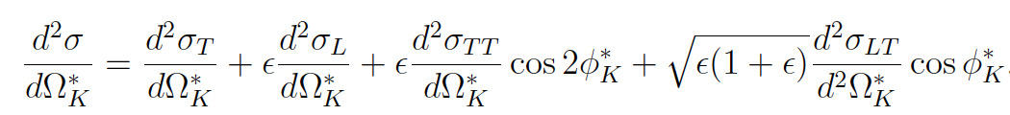
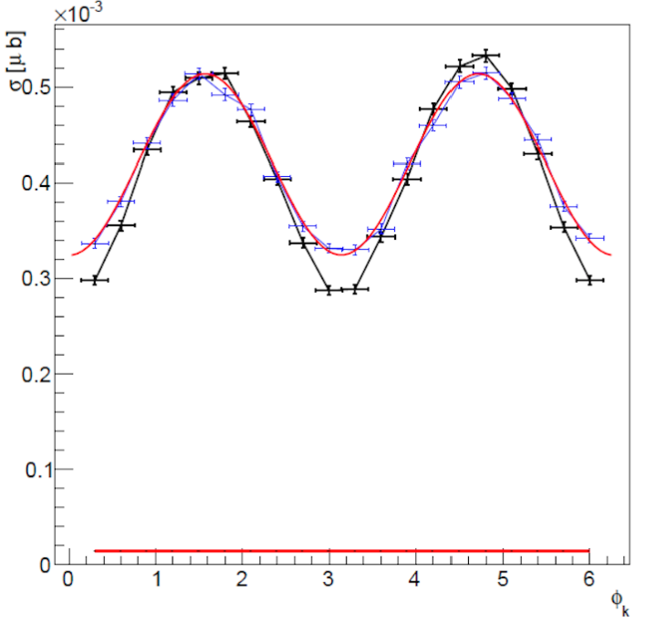
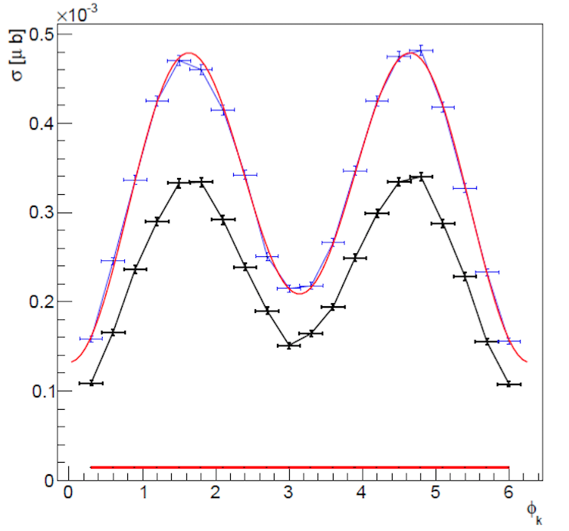
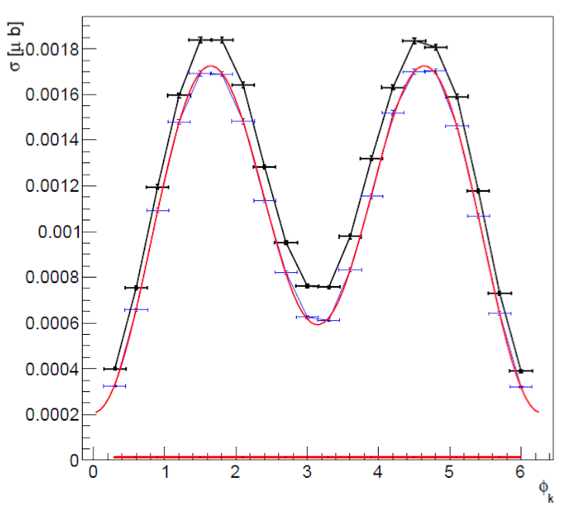
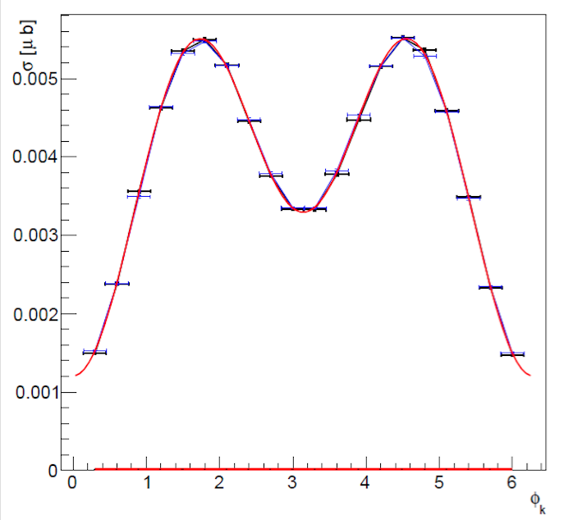
Simulation of Model + Hybrid Contributions
e p e K⁺Y
σ_{U} = σ_{T} + εσ_{L}
Black points RPR 2011 model Blue points RPR 2011 + hybrid resonance
Q² = 0.1 GeV² W=2.2 GeV E_{e} = 6.6 GeV (M_{R} = 2.2 GeV Γ_{R}=0.25 GeV A_{1/2} = 15 10⁻³ GeV^{-1/2})
cos θ_{K}= - 0.7
cos θ_{K}= - 0.2
cos θ_{K}= 0.3
cos θ_{K}= 0.8
The extraction of the unseparated cross section dσ_{U} and the interference cross sections dσ_{TT} and dσ_{LT} rely on a fit of the azimuthal dependence of the differential cross section at fixed bins of: W, Q² , cos θ*.

Slide 27
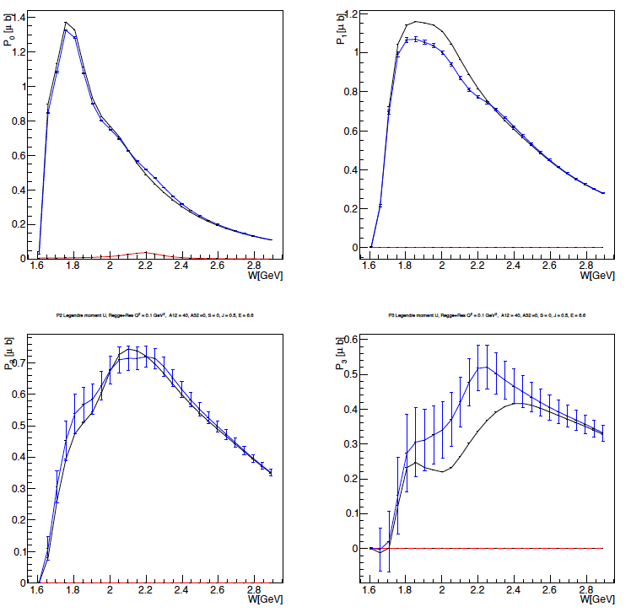
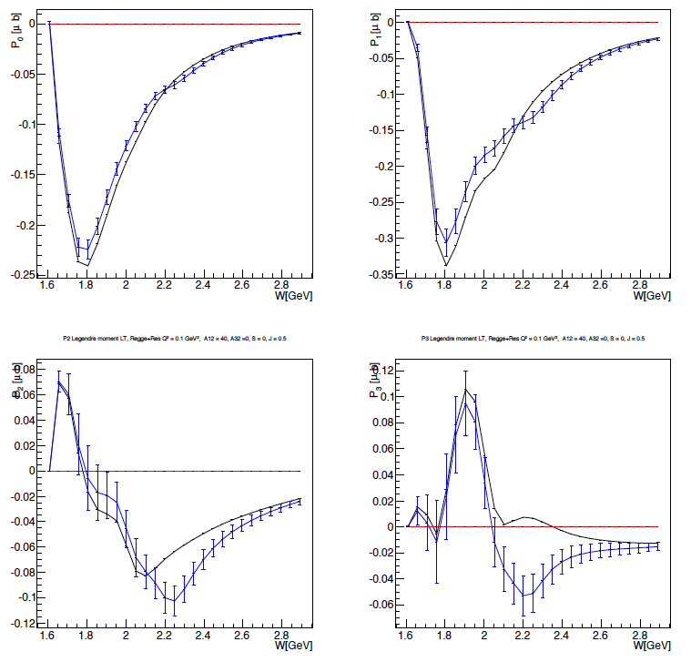

Extraction of Legendre Moments
e p e K⁺Λ
First Legendre Moments
Black curves RPR 2011 model
Blue points RPR 2011 + Resonance
σ_{U}
σ_{LT}
σ_{TT}
P1
P1
P0
P1
P0
P0
P3
P3
P2
P3
P2
P2
J = ½ Regge + Res. Q² = 1 GeV² M_{res} = 2.2 GeV A_{1/2} = 0.04 GeV^{-1/2} S_{1/2} = 0
Significant structures appear in most of the Legendre moments at the value of
W = 2.2 GeV, corresponding to the mass of the added hybrid baryon

Slide 28

Statistical Sensitivity of Resonance Electrocouplings
e p e p π⁺ π⁻
e p e K⁺Y
JLab - Moskow (JM) model
Regge + Resonance (RPR-2011) Gent model
Fixing the resonance parameters: M_{res} = 2.2 GeV, Γ_{res} = 0.25 GeV, S_{1/2} = 0
and varying A_{1/2, 3/2} Minimum values for hybrid baryons electrocouplings
$$χ^{2}/d.p.=\frac{1}{N_{d.p.}}\sum_{W,cosθ∗,φ}{\frac{{\left({dσ}_{mod}−{dσ}_{mod+res}\right)}^{2}}{\left({dσ}_{mod}−{dσ}_{mod+res}\right)/N_{ev}}}$$
pπ ⁺π ⁻
K⁺Λ
Q² (GeV²) | 0. | 0.65 | 1.3
A_{1/3} x 10⁻³(GeV^{-1/2}) | 22 | 20 | 11
Q² (GeV²) | J_{R} = 1/2 |  | J_{R} = 3/2
X 10⁻³ (GeV^{-1/2}) | A_{1/2} | S_{1/2} | A_{1/2} | A_{3/2} | S_{1/2}
0.1 | 9.5 | 9.5 | 13 | 8.5 | 8.5
0.5 | 14 | 16 | 15 | 15 | 10
1.0 | 13 | 19 | 14 | 14 | 7.5
To be compared with N(1440)1/2⁺
Q² (GeV²) | 0. | 0.65 | 1.3
A_{1/3} x 10⁻³(GeV^{-1/2}) | -70 | 10 | 30

Slide 29



Bonn-Gatchina Analysis Example
Resonance Parameters Extraction: Resonance Mass
ep $→$ e p π⁺π⁻
Δ(1950)7/2⁺
Δ(2200)7/2⁻
dσ_{q.d.} = JM model + “hybrid resonance”
dσ_{th} = JM model + variable mass resonance
J⁺ = ½⁺ M_{res} = 2.2 GeV Γ_{res} = 0.25 GeV
S_{1/2} = 0, A_{1/2} = statistical threshold value
Q² = 0.0 GeV²
Q² = 0.65 GeV²
Q² = 1.0 GeV²
χ² scan over the resonance mass
Notes:
Example of a 2-resonance analysis in
the γp -> Nπ, KΣ, pπ⁰π⁰, pπ⁰η channels that involves all available cross section and polarization observables.
The Figure shows the χ² difference Δχ² when a new state Δ(M_{R})7/2⁺ (full line) or Δ(M_{R})7/2⁻ (dashed line) are added, and the resonance mass M_{R} is scanned in a large range. The fit includes the full known spectrum of resonances except the one in question. The existence of the state near 1900 MeV (a well known state) is confirmed and a new (missing) state near 2200 MeV is evident.
(The Δχ² is normalized to 0 at the minimum for better comparison, and two different y scales are used for the two resonance scans.)

Slide 30


Blind Extraction: J^{P}=1/2⁺ + J^{P}=3/2⁺
Two hybrid baryon resonances with J^{p} = 1/2⁺ and J^{p} = 3/2⁺ were inserted in the ep $→$ e K⁺Λ Gent RPR2011 reaction amplitude and quasi-data were generated $→$ dσ_{q.d.}
A blind analysis has been then attempted trying to extract the resonances J^{P} spin-parities and
7 unknown parameters: M_{res}¹ Γ_{res}¹ A_{1/2}¹
M_{res}² Γ_{res}² A_{1/2}² A_{3/2}²
Searching the minimum of the quantity:
dσ_{th} were calculated using the Gent RPR2011 amplitudes including two resonances
J^{p} = 1/2⁺ and J^{p} = 3/2⁺, whose parameters values were scanned in the range:
$$χ^{2}/d.p.=\frac{1}{N_{d.p.}}\sum_{W,cosθ∗,φ}{\frac{{\left({dσ}_{th}−{dσ}_{q.d}\right)}^{2}}{\left({dσ}_{q.d.}\right)/N_{ev}}}$$
2.0 < W < 2.5 GeV -0.05 < A_{1/2}< +0.05 GeV^{-1/2}
0.1 < Γ < 0.4 GeV -0.05 < A_{3/2} < +0.05 GeV^{-1/2}
at a fixed Q² = 0.5 GeV²
S_{1/2} = 0

Slide 31

Blind Extraction: J^{P}=1/2⁺ + J^{P}=3/2⁺
Two hybrid baryon resonances with J^{p} = 1/2⁺ and J^{p} = 3/2⁺ were inserted in the ep $→$ e K⁺Λ Gent RPR2011 reaction amplitude and quasi-data were generated $→$ dσ_{q.d.}
A blind analysis has been then attempted trying to extract the resonances J^{P} spin-parities and
7 unknown parameters: M_{res}¹ Γ_{res}¹ A_{1/2}¹
M_{res}² Γ_{res}² A_{1/2}² A_{3/2}²
Iterative procedure:
The algorithm calculates the χ² value over a 7-dim parameters coarse grid, covering the full range
The combination of parameters corresponding to the minimum χ² value is found
χ² value is calculated over a finer 7-dim parameters grid, around the minimum
The procedure is repeated three times.

Slide 32



Blind Extraction: J^{P}=1/2⁺ + J^{P}=3/2⁺
Two hybrid baryon resonances with J^{p} = 1/2⁺ and J^{p} = 3/2⁺ were inserted in the ep $→$ e K⁺Λ Gent RPR2011 reaction amplitude and quasi-data were generated $→$ dσ_{q.d.}
Typical 3-dim map of χ² as a function of the two resonance masses, evolving in time for increasing A_{1/2} (A_{3/2}) strength.
χ ² minimum

Slide 33

Blind Extraction: J^{P}=1/2⁺ + J^{P}=3/2⁺
Two hybrid baryon resonances with J^{p} = 1/2⁺ and J^{p} = 3/2⁺ were inserted in the ep $→$e K⁺Λ Gent RPR2011 reaction amplitude and quasi-data were generated $→$ dσ_{q.d.}
A blind analysis has been then attempted trying to extract the resonances J^{P} spin-parities and
7 unknown parameters: M_{res}¹ Γ_{res}¹ A_{1/2}¹
M_{res}² Γ_{res}² A_{1/2}² A_{3/2}²
Hybrid Baryons parameters are well reconstructed.
Blind Resonance Parameters | Extracted Resonance Parameters
M_{res}¹ = 2.30 GeV | M_{res}¹ = 2.32 GeV
Γ_{res} ¹ = 0.30 GeV | Γ_{res} ¹ = 0.30 GeV
A_{1/2} ¹ = 0.020 GeV^{-1/2} | A_{1/2} ¹ = 0.019 GeV^{-1/2}
M_{res}² = 2.45 GeV | M_{res}² = 2.45 GeV
Γ_{res} ² = 0.35 GeV | Γ_{res} ² = 0.31 GeV
A_{1/2} ² = - 0.015 GeV^{-1/2} | A_{1/2} ² = - 0.014 GeV^{-1/2}
A_{3/2} ² = 0.04 GeV^{-1/2} | A_{3/2} ² = 0.038 GeV^{-1/2}

Slide 34



Run Group K - Run Conditions
OFF @ 6.5 GeV
Torus Current | 100% (3375 A) - negative outbending
Solenoid | -100 %
FT | ON @ 7.5 GeV -> OFF @ 6.5 GeV, 8.5 GeV
MM RICH | ON
FMT | OFF
Beam/Target | Polarized electrons, unpolarized LH₂ target
Luminosity | ~ 5 10 ³⁴ cm⁻²s⁻¹ @ 7.5 GeV 10 ³⁵ cm⁻²s⁻¹ @ 6.5, 8.5 GeV FULL LUMINOSITY

Slide 35

Run Group K Production
E=7.5GeV
Fall 2018
E=6.5GeV
SPRING 2024
Machine down
FT-OFF
FT- OFF
FT- ON
E=6.4 GeV
E=8.5 GeV
45mC of accumulated charge
Fall 2018
Beam Energy | Beam Current | Collected Events
7.5 GeV | 35 nA | 3.5 G
7.5 GeV | 45 nA | 4.3 G
6.5 GeV | 60 nA | 7.8 G
193mC of accumulated charge
EVENTS
15.6 G
Spring 2024
Beam Energy | Beam Current | Collected Events
6.4 GeV | 65 nA | 38.3 G
8.5 GeV | 75 nA | 21.7 G
EVENTS
60 G
Statistics increased by a factor 4
Total of 75.6 G events

Slide 36


RG-K Spr24 KY Validation Studies
By: Daniel Carman
6.4 GeV
High-quality data available
8.5 GeV
11.5 MeV
15.4 MeV

Slide 37

Run Group K On-going analyses
Student/Scientist | Topic
Chiara Ammendola - Roma | $${ep→e′K}^{+}Λ\left(1520\right)$$
Joshua Artem Tan - JLAB/ Sangbaek Lee | DVCS Beam Spin Asymmetry
Story Frantzen - MIT | DV$π^{0}$p
Bianca Gualtieri - FIU | $${ep→e^{′}K}^{+}K^{+}Ξ^{−}$$
Tatsuhiro Ishige | $${ep→e′K}^{+} Λ\left(1405\right)$$
Maggie Kerr | TCS
Anastasya Pavlova – MSU | $${ep→e′π}^{0}p$$
Stepan Savkin – MSU | $${ep→e′π}^{+}π^{−}p$$
Yijie Wang - MIT | DVCS Cross Section and Elastic Scattering xsec
Harut Avagyan | SIDIS
Dan Carman/Lucilla Lanza | ${ep→e′K}^{+}Y [Λ\left(1116\right), Σ\left(1193\right)$]
Krishna Neupane/Bhawani Singh | DV $K^{+}K^{−}p$
Dan Carman plenary talk on Monday
Most analyses profit from the availability of data at 6.5, 8.5 and 10.5 GeV combining RGK and RGA data

Slide 38
Summary
We started a program to search for new states of baryonic matter: hybrid baryons.
Complementing the international program to search for hybrid mesons.
Identification of hybrid baryons will verify fundamental expectations of strong QCD on the role of glue.
Search for these states in exclusive channels covers the kinematical range: Q² > 0.05 GeV², W< 3 GeV.
100 days beam time with CLAS12 are expected to provide the statistical sensitivity to measure the baryon resonances electro-couplings for two major electroproduction channels pπ⁺π⁻ and K⁺Y and eventually find new excited states.
The experiment has been approved with A- rating and has been assigned 100 PAC days, 50 of which have been accumulated during fall 2018 and spring 2024
Amplitude analysis will be developed with the theoretical support groups to establish the existence and properties of new resonances in the 1.8 GeV < M < 3.0 GeV mass region.

