Slide 1
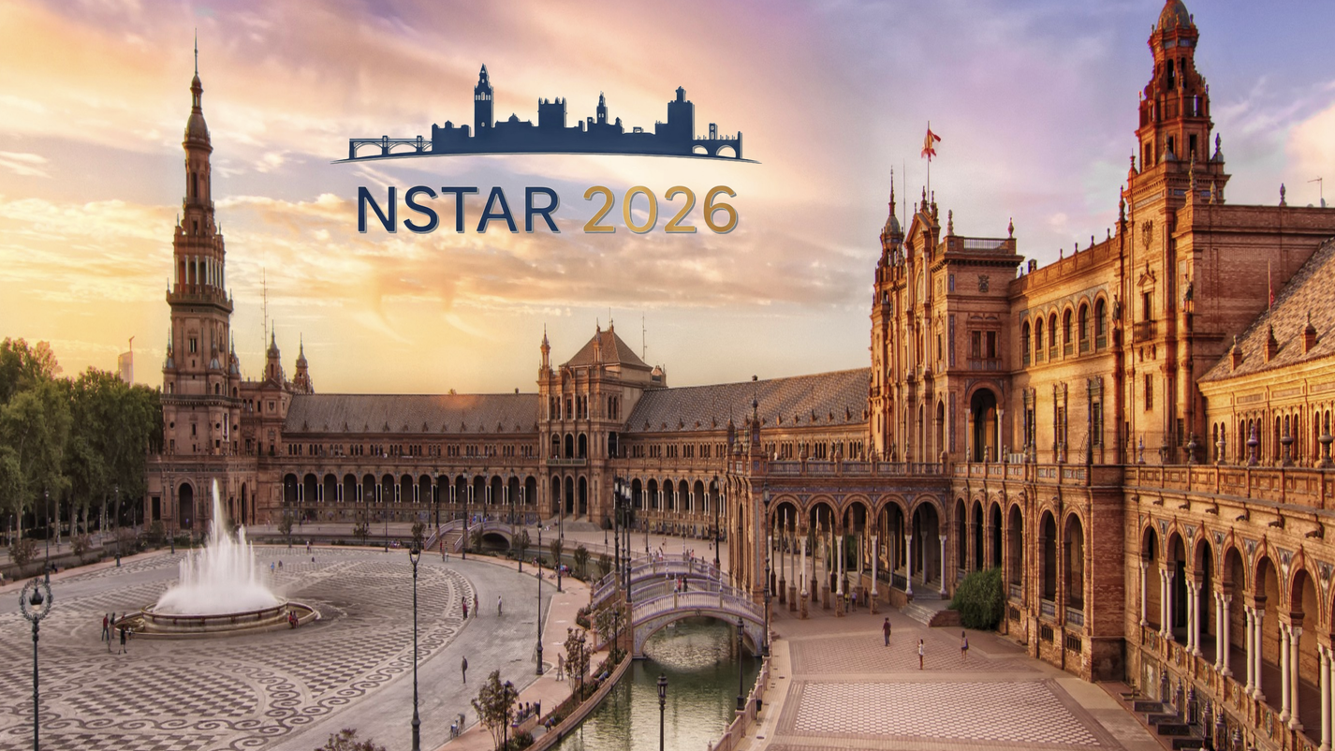
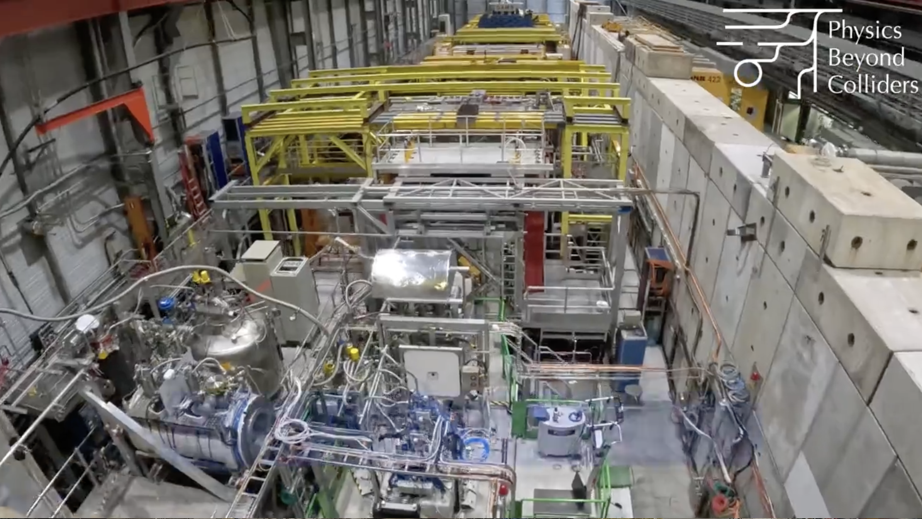
Series of talks: From COMPASS to AMBER:
From Proton Spin Crisis to Hadron Mass Puzzle
Complementary(?!) insights into the pseudoscalar meson and baryon structure from AMBER
10/09/2026, Sevilla, España
Outlook
Intro to AMBER
AMBER science question
Proton charge-radius measurement
4. Properties of unstable particles @AMBER:
  Drell-Yan pairs and J/Psi production
  Prompt Photons
  Hadron radii
5. CERN North Area + M2 beam line consolidation and upgrade
6. Conclusions
Dr. Oleg Yu. Denisov, senior researcher INFN section of Turin (Italy)
on behalf of the AMBER Collaboration
Materials/slides of Vincent Andrieux, Craig Roberts, Alessandro Bacchetta, Paolo Zuccon, Stephane Platchkov, Alexey Guskov, Stefan Wallner, Jan Friedrich, Stephan Paul, Stefan Diehl, Michela Chiosso, Bernhard Ketzer and other Colleagues have been used in this talk

Slide 2
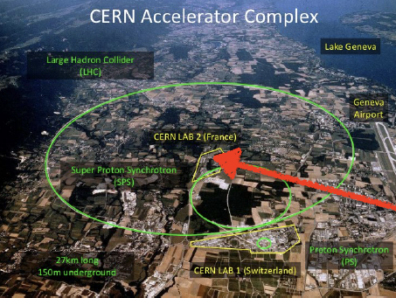
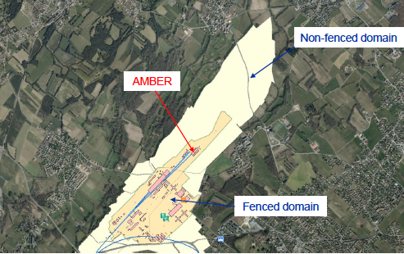
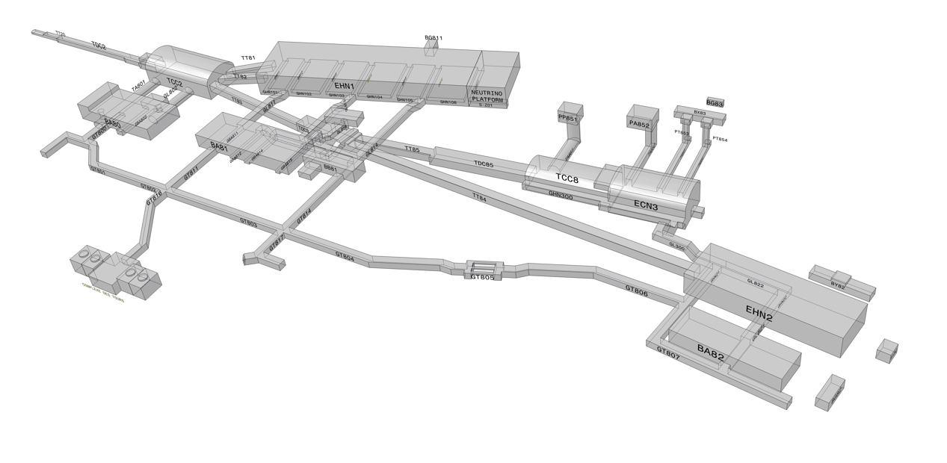
AMBER facility is a successor of the COMPASS in a long row of
Experiments which took place in the EHN2 experimental hall of the CERN North Area Laboratory (aka CERN-Prevessin or CERN Lab 2)
NA4 ➔ EMC ➔ NMC ➔ SMC ➔COMPASS ➔ AMBER
T6
XSCI.X0611185
Known because of contribution to the study of the proton structure and proton spin structure (Proton Spin Crisis and EMC effect)

Slide 3
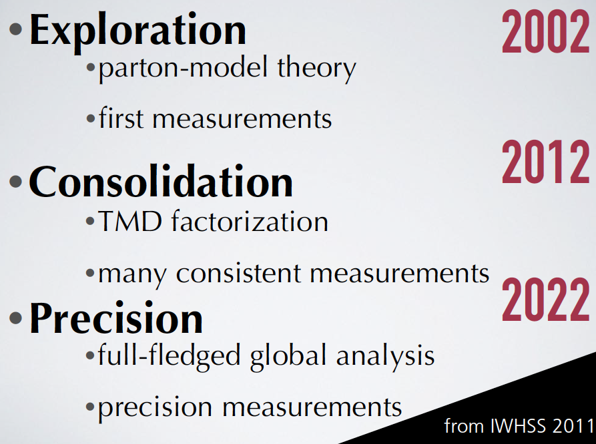
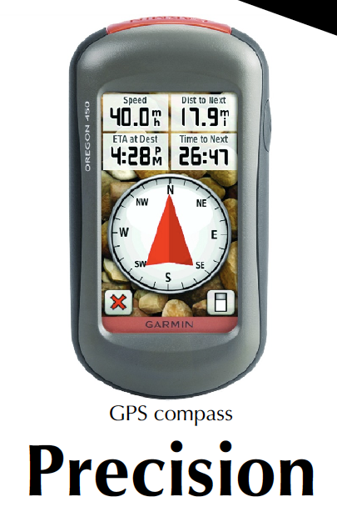
AMBER Science Question
COMPASS & Co legacy:
  Proton spin crisis is over: much more precise data on ΔΣ + ΔG, there is a very clear recipe to fill up the missing part of the proton spin – angular momentum ➔ 3D case ➔ TMDs and GPDs
  Huge progress on Transversity
  Unique pion diffractive scattering data set
We found ourselves (TMDs sector as example) in Precision phase (Alessandro Bacchetta)
More data to come in the next years from COMPASS, JLab, RHIC and later from high-luminosity facilities
Proton SPIN&Co cannot be anymore the main AMBER Science Question because of:
  We did what we could
  A number of high luminosity programs (LHCb-Spin, SpinQuest, Jlab, EiC, EicC) will provide data in next years
  Everything what can be done elsewhere but at CERN must be done elsewhere
  Wider physics program to attract new groups
➔

Slide 4
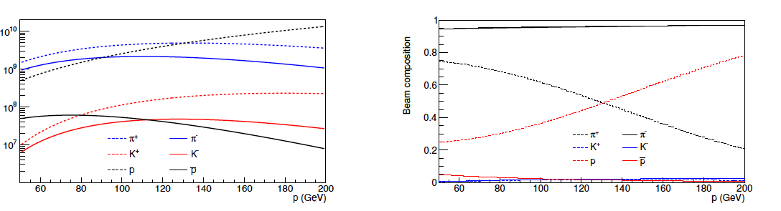
Setting up of the strong physics case for AMBER facility was greatly simplified by uniqueness of the CERN SPS AMBER/EHN2 secondary beams
Basic features of the AMBER/EHN2 secondary beams (CERN SPS 400 GeV primary proton beam):
Hadron+/- beams, momentum range 50 – 250 GeV, up to 2x10⁸ /sec
Muon+/- beams, momentum range 50 – 250 GeV, up to 5x10⁷ /sec
Electron/positron beams 20-60 GeV, up to 10⁵ /sec
After ~10 years long effort, dozen of international workshops and hundreds of local meetings we came to conclusion:
High energy/High intensity Pion+/- and Kaon+/- beams are UNIQUE to study structure of UNSTABLE Particles.

Slide 5
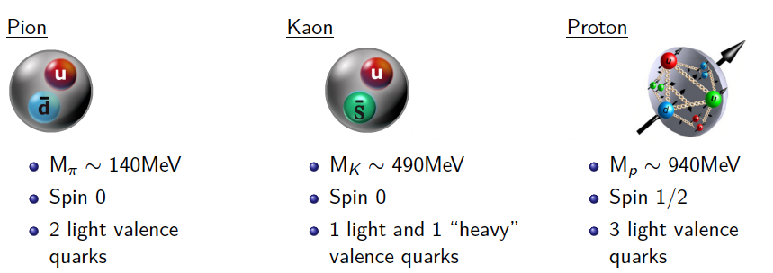
AMBER science questions
Emergence of the Hadron Mass Phenomenon
Taking into account unique meson beam opportunities
at EHN2 we Identify AMBER as a key contributor to the study
of the Emergence of the Hadron Mass Phenomenon
How does all the visible matter in the universe come about and what defines its mass scale?
Great discovery of the Higgs-boson unfortunately does not help to answer this question, because:
    The Higgs-boson mechanism produces only a
    small fraction of all visible mass
    The Higgs-generated mass scales explain neither the “huge” proton mass nor the ‘nearly-masslessness’ of the pion
Higgs generated masses of the valence quarks:
M_{(u+d)}~7 MeV M_{(u+s)}~100 MeV M_{(u+u+d)}~10 MeV
As Higgs mechanism produces a few percent of visible mass,
where does the rest comes from?

Slide 6
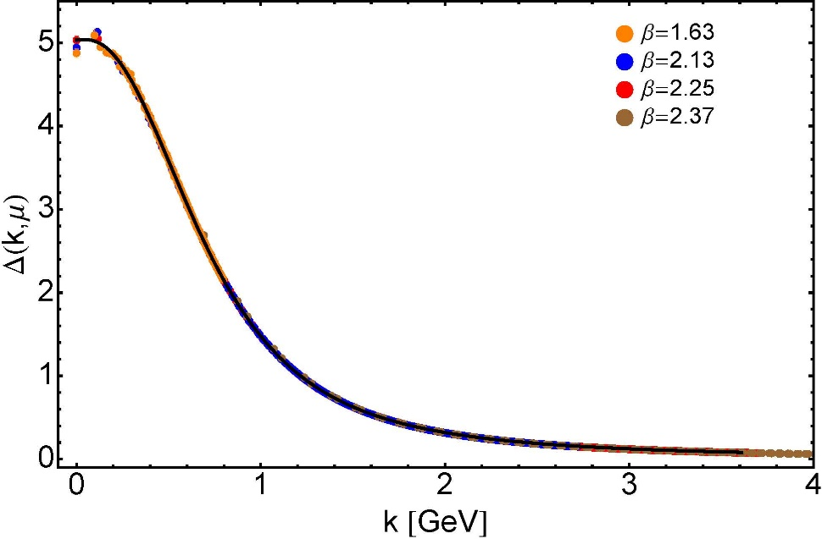

EHM phenomenon
What are the underlying mechanisms?
Intuitively one can expect that the answer to the question lies within SM, in particular within QCD.
Why? Because of the dynamical mass generation in continuum QCD.
As quark can emit and absorb gluons
it acquires its mass in infrared region
because of the gluon “self-mass-
generation” mechanism, so the visible
(or emergent) mass of hadrons must
be dominated by gluon component
Truly “mass from nothing” phenomenon:
Initially massless gluon produces dressed gluon fields which “generates” mass function that is large at infrared momenta
Dynamical mass generation in continuum quantum chromodynamics
J.M. Cornwall, Phys. Rev. D 26 (1981) 1453 … ~ 1000 citations
Gluon propagator … continuum and lattice QCD agree
In order to “proof” that QCD underlies the EHM phenomenon we have to compare Lattice and Continuum QCD calculations with experimental data by measuring:
Quark and Gluon PDFs and PDAs of the pion/kaon/proton
Hadron’s radii (confinement)
Excited-meson spectra
(Constituent quarks)
Dressed-quark mass function M(p)

Slide 7
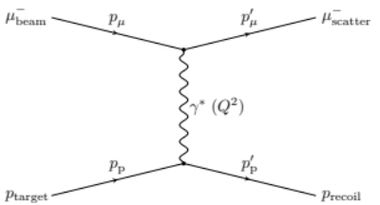
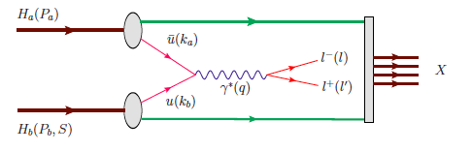
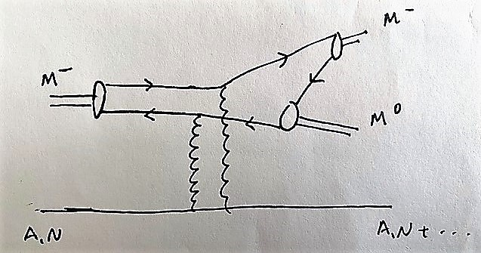
AMBER probes
Questions to be answered:
      Mass difference pion/proton/kaon
      Mass generation mechanism (emergent mass vs. Higgs)
      Internal quark-gluon structure and dynamics,
      especially important pion/kaon/proton striking differences
  Methods:
A series of workshops entitled
“Perceiving of the EHM through AMBER@CERN(SPS)” we organised
In 2019-2022:
https://indico.cern.ch/event/1021402/
Drell-Yan (compl. to
Sullivan) and J/𝜳
Prompt Photon Production
Diffractive scattering
Elastic scattering

Slide 8
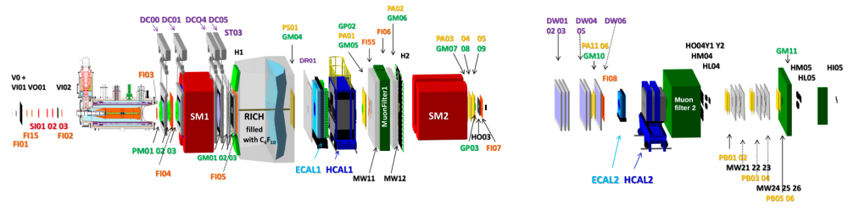
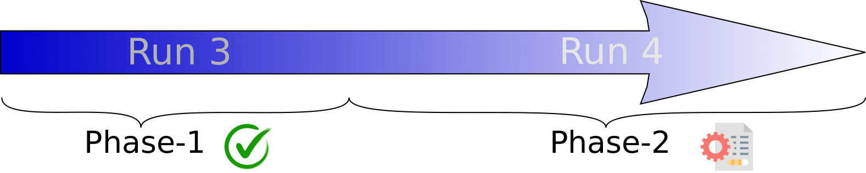
Apparatus for Meson and Baryon Experimental Research
(AMBER, CERN, SPS, NA66)
Presently 35 institutes from 14 countries, new collaborators are welcome.
2023 -2032
2033 -2041
Conventional hadron/muon beams
Improved hadron(kaon) beams
Proton Radius Measurement
Antimatter production cross section
Pion and kaon structure (PDFs) via DY and
J/Psi production
Phase-1 Proposal approved by RB on 02/12/2020
High precision strange-meson spectrum
Kaon and pion charge radii
Kaon induced Primakoff reaction
Prompt Photons Production
Phase-2 Proposal submission in 2027/28

Slide 9
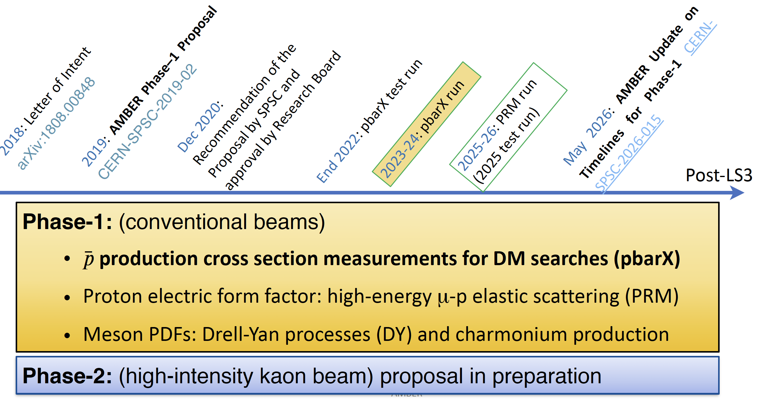
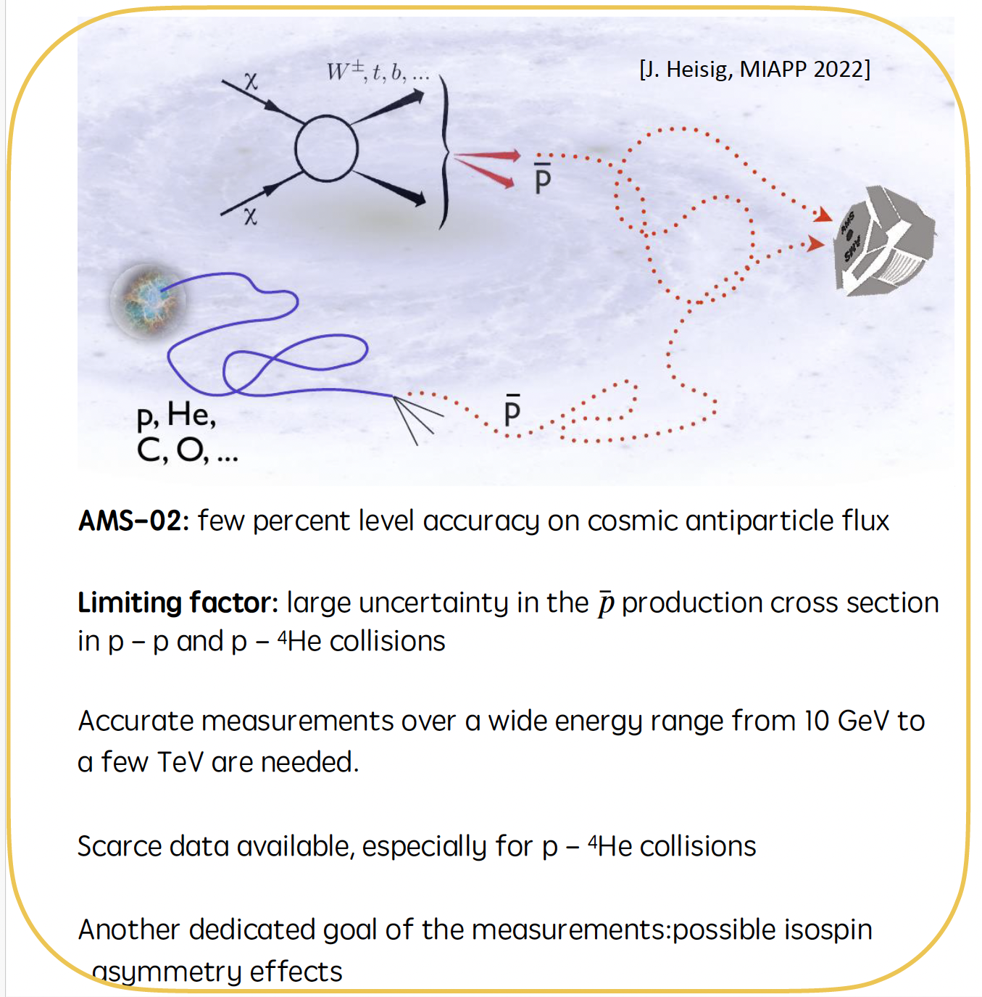
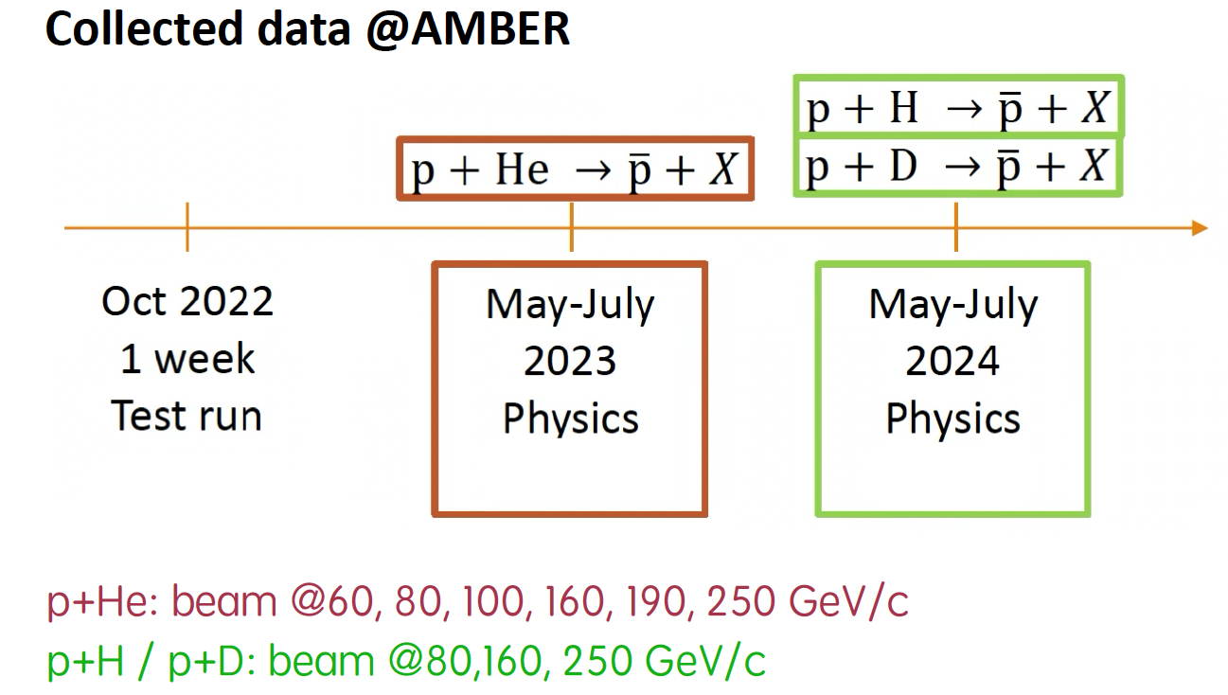
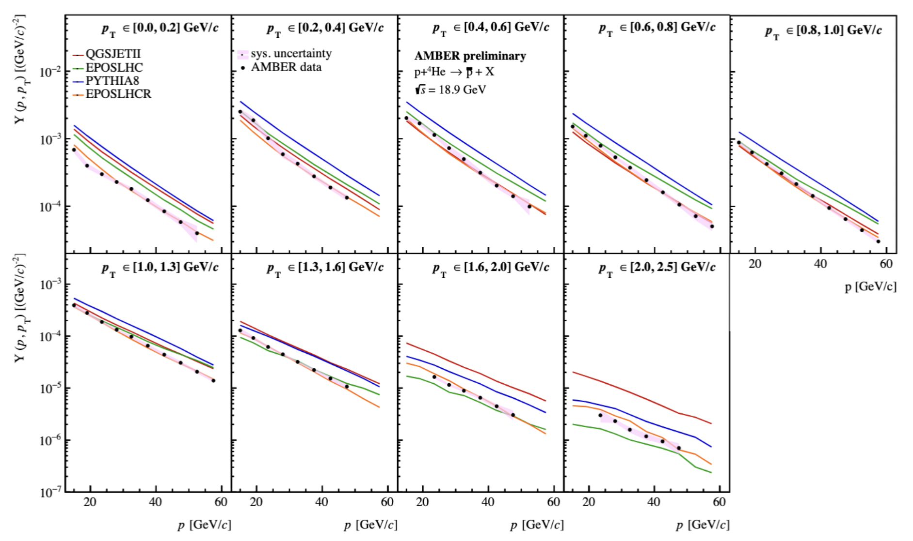
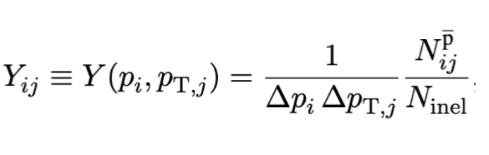
What was achieved by AMBER so far:
I. Antimatter Production Cross-section measurement (APX)

Slide 10
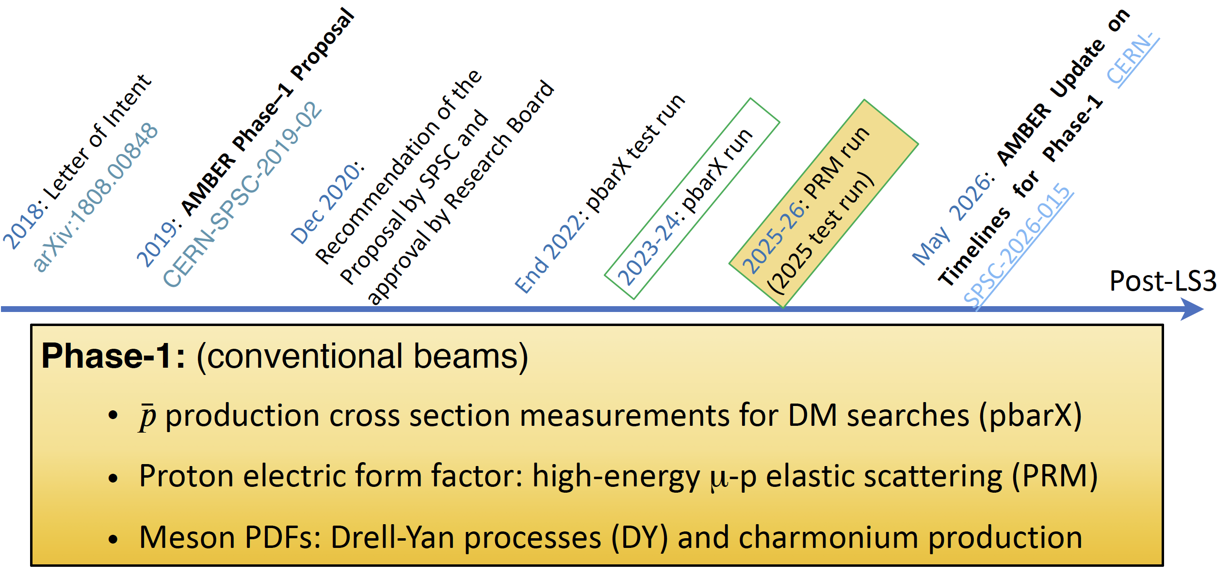
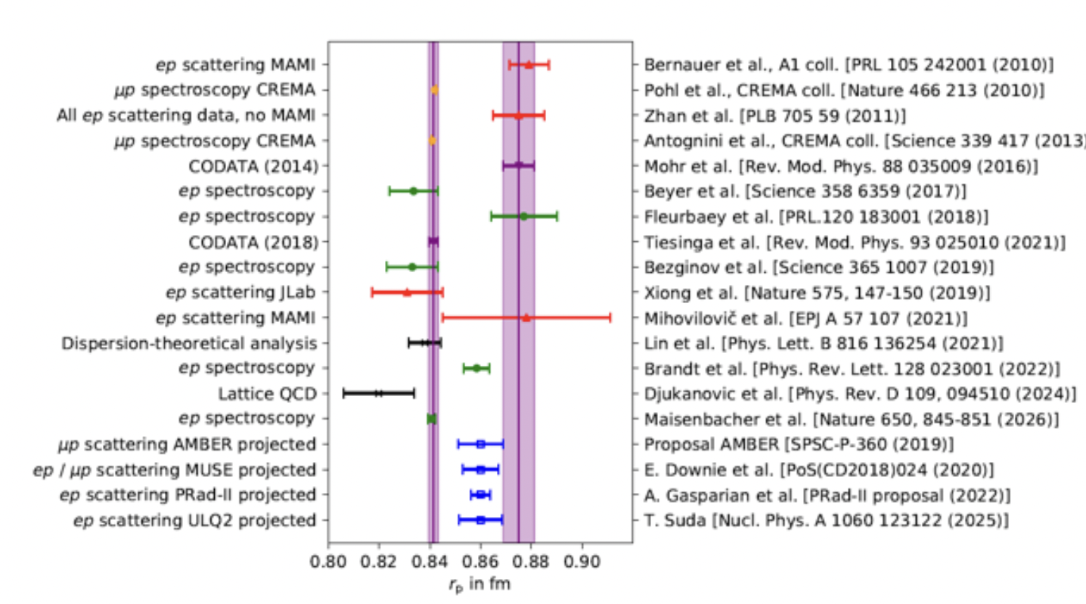
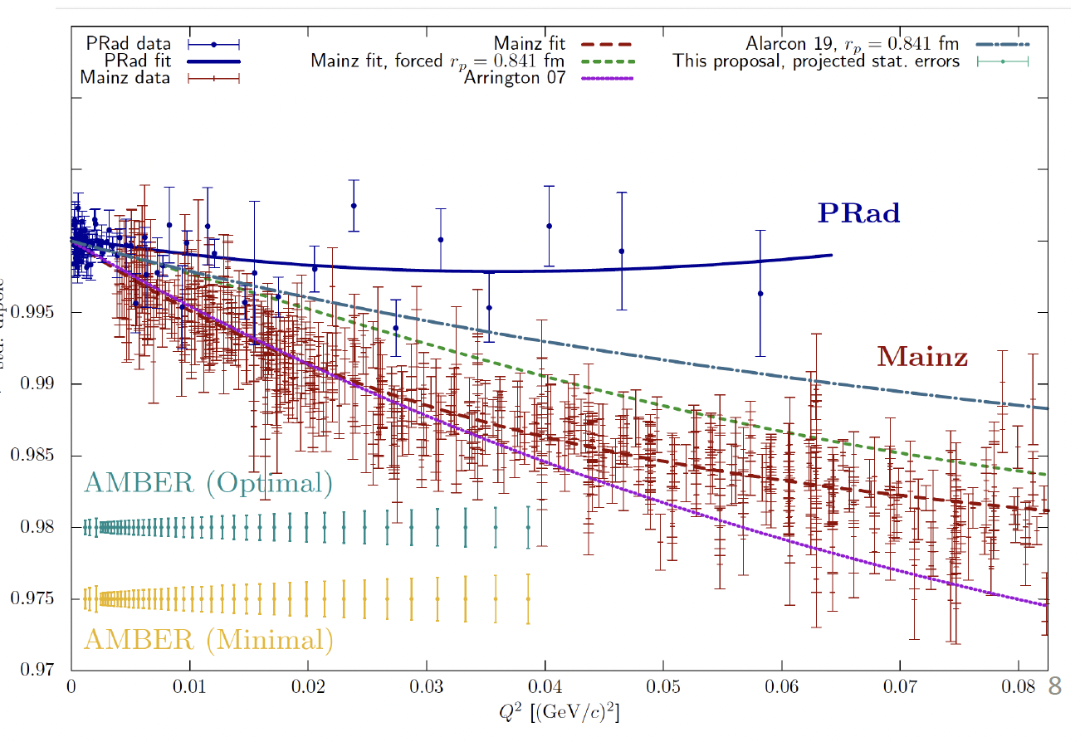
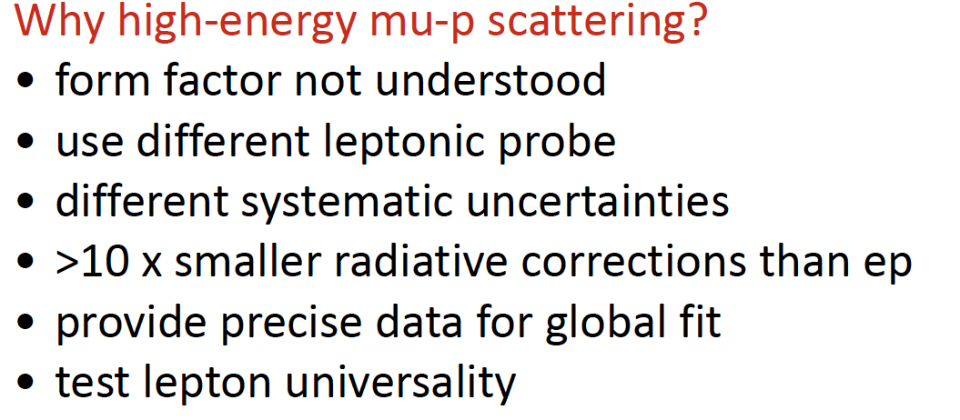
What was achieved by AMBER so far:
II. Proton Charge-Radius measurement (PRM) (1)

Slide 11
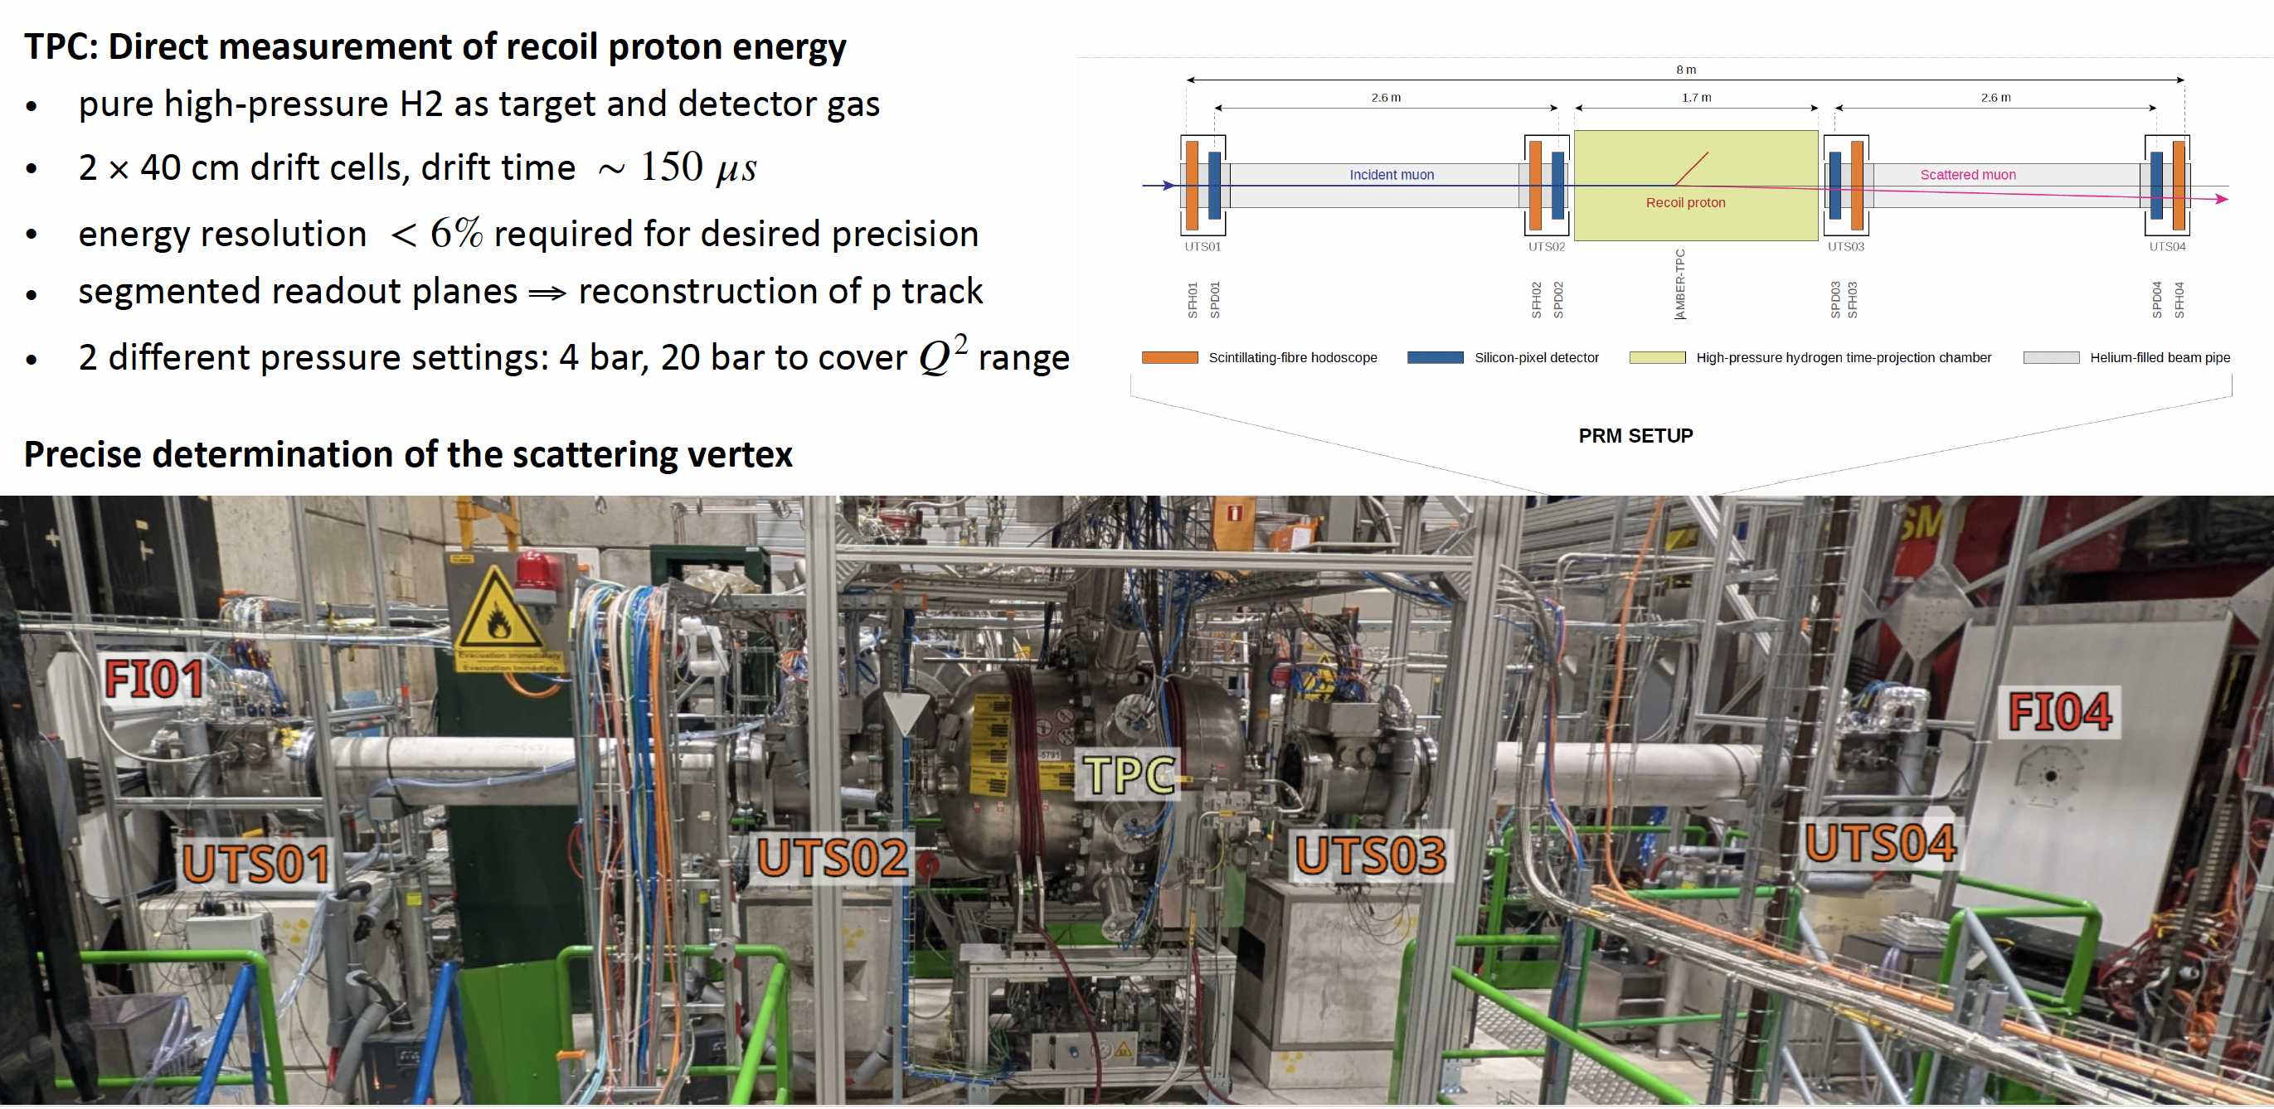
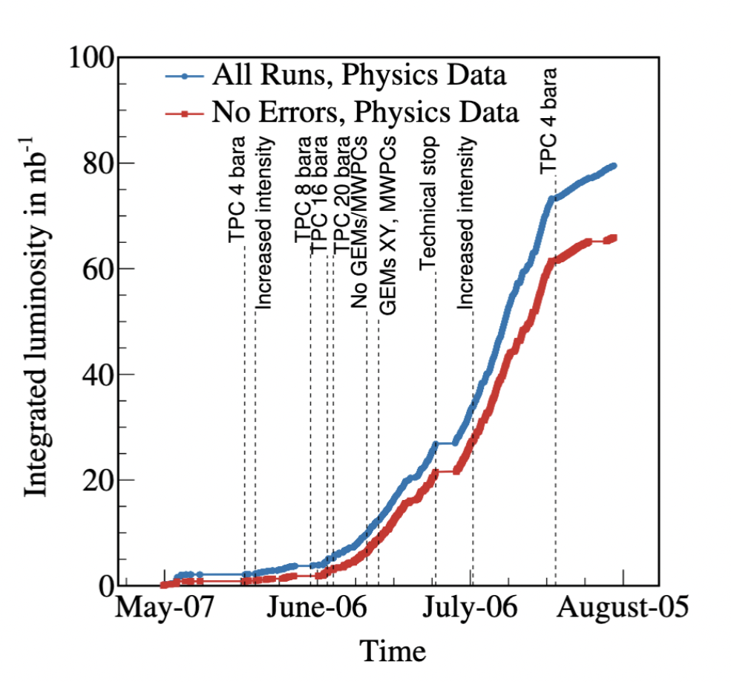
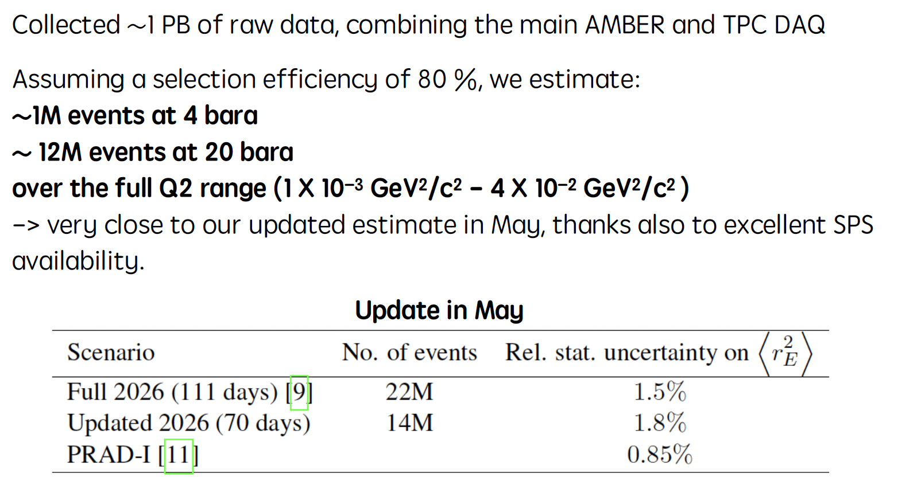
What was achieved by AMBER so far:
II. Proton Charge-Radius measurement (PRM) (2)

Slide 12
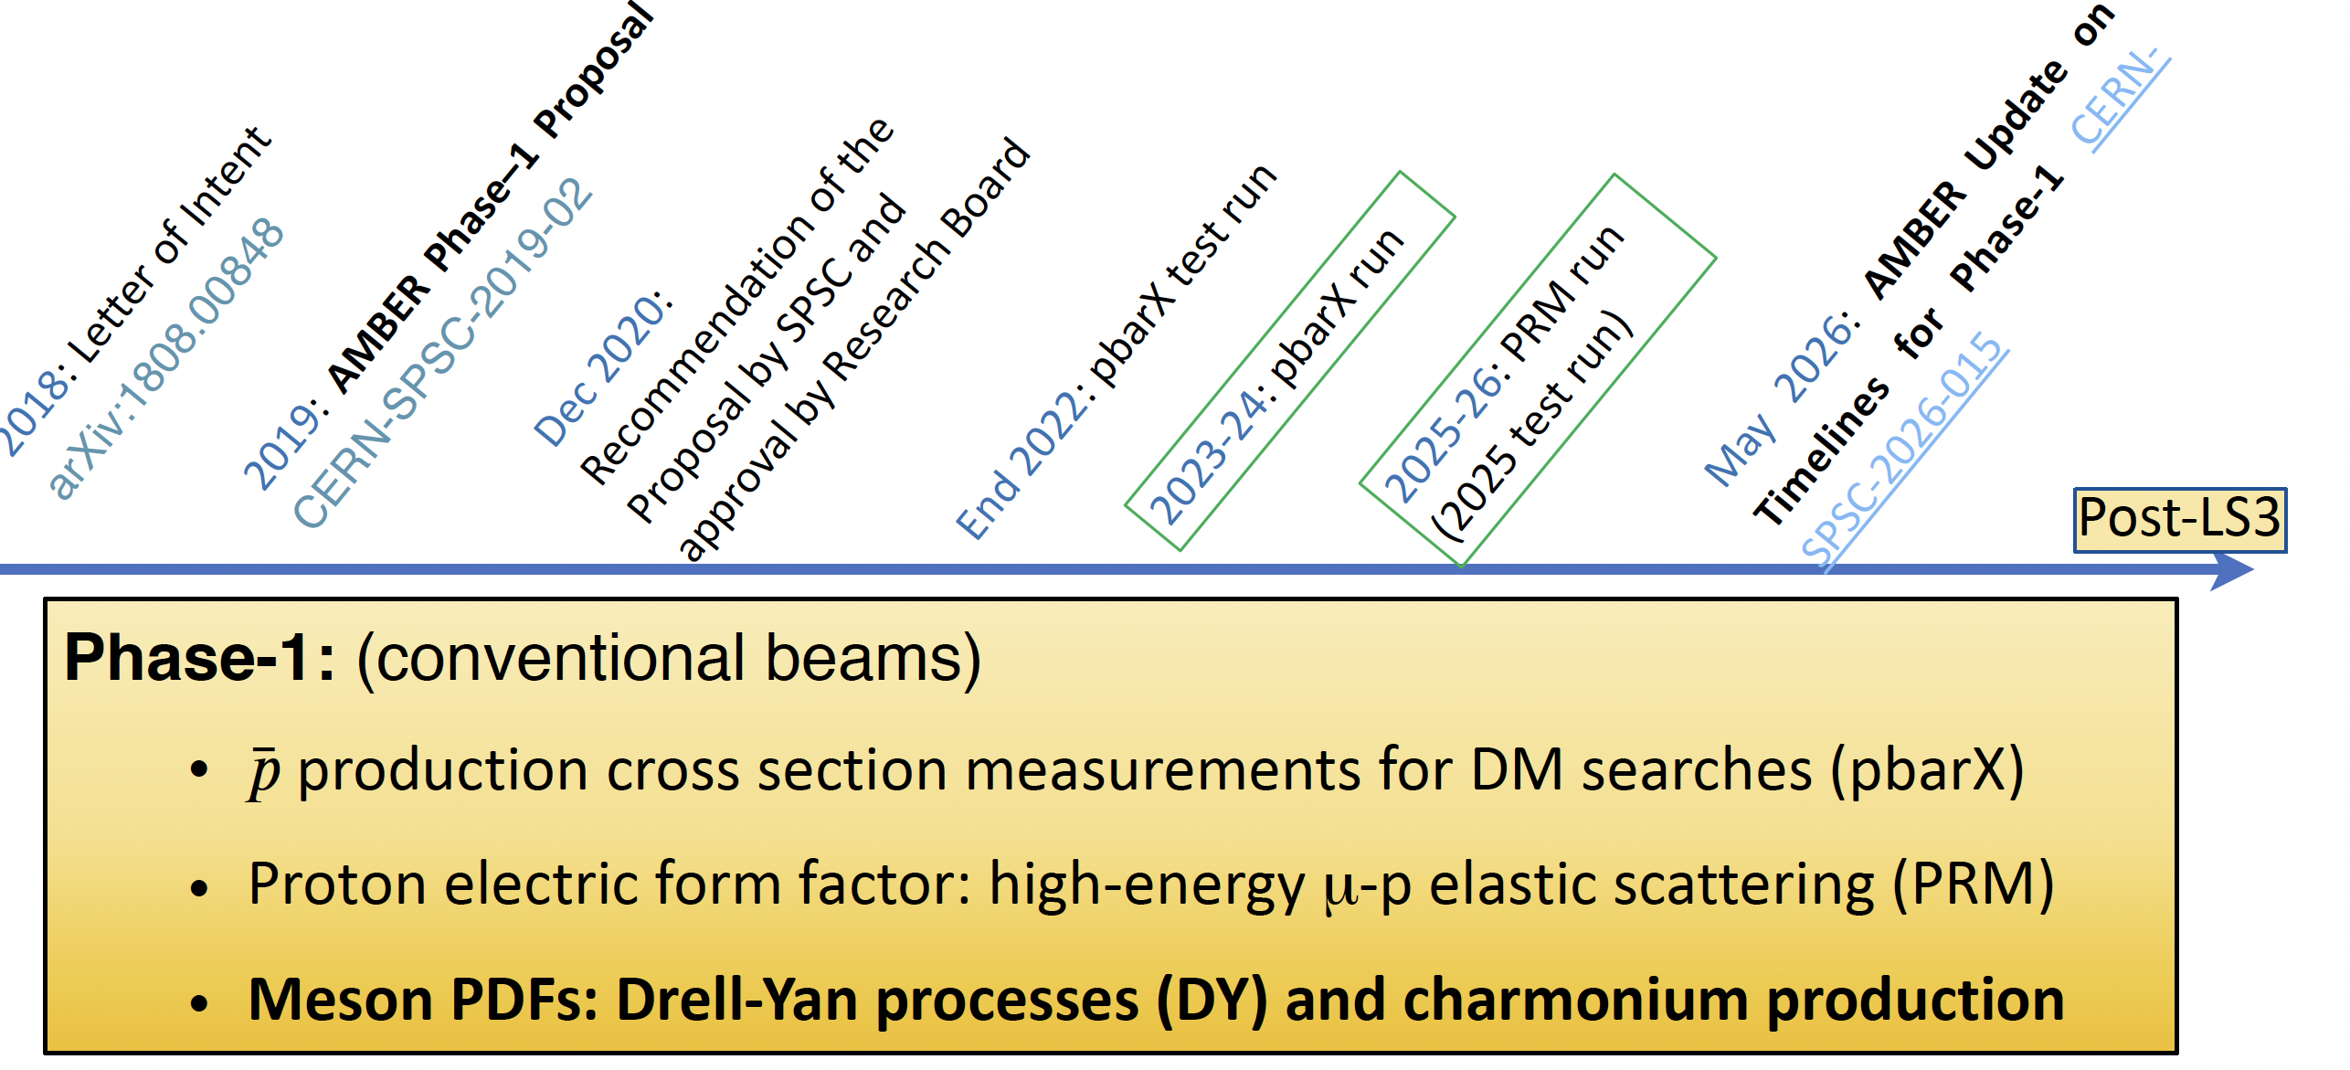
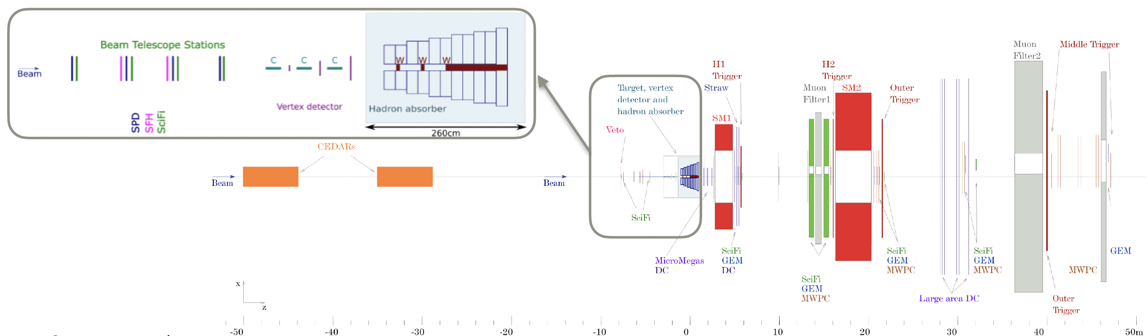
Preparation to the Phase-1 Drell-Yan experiment
AMBER Drell-Yan set-up

Slide 13
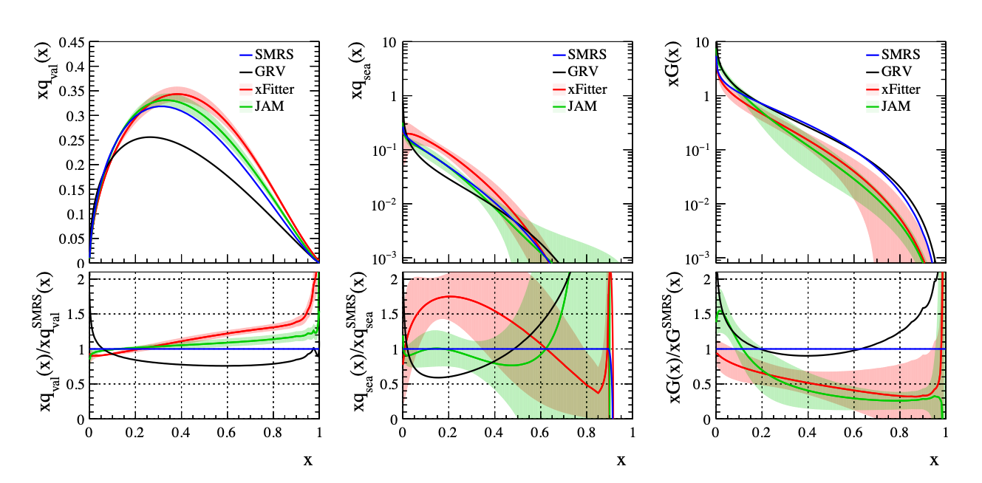
Pion induced Drell-Yan at AMBER
Status of the knowledge of the Pion structure
valence sea gluons
Pion structure status:
Scarce data, poor knowledge of valence, sea and glue basically unknown
Mostly heavy nuclear targets: large nuclear effects
For some experiments, no information on absolute cross sections
Two experiments (E615, NA3) have measured so far with both pion beam sign, but only one (NA3) has used its data to separate sea-valence quark contributions
Discrepancy between different experiments (i.e. NA10, E615)
Old data, no way to reanalyse them using modern approaches

Slide 14
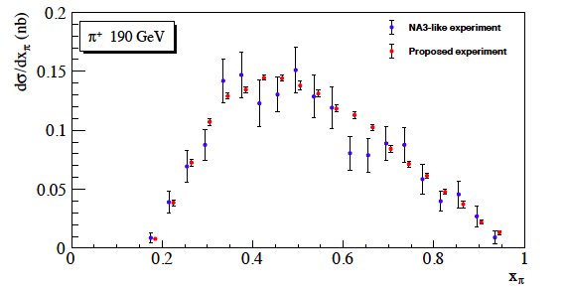
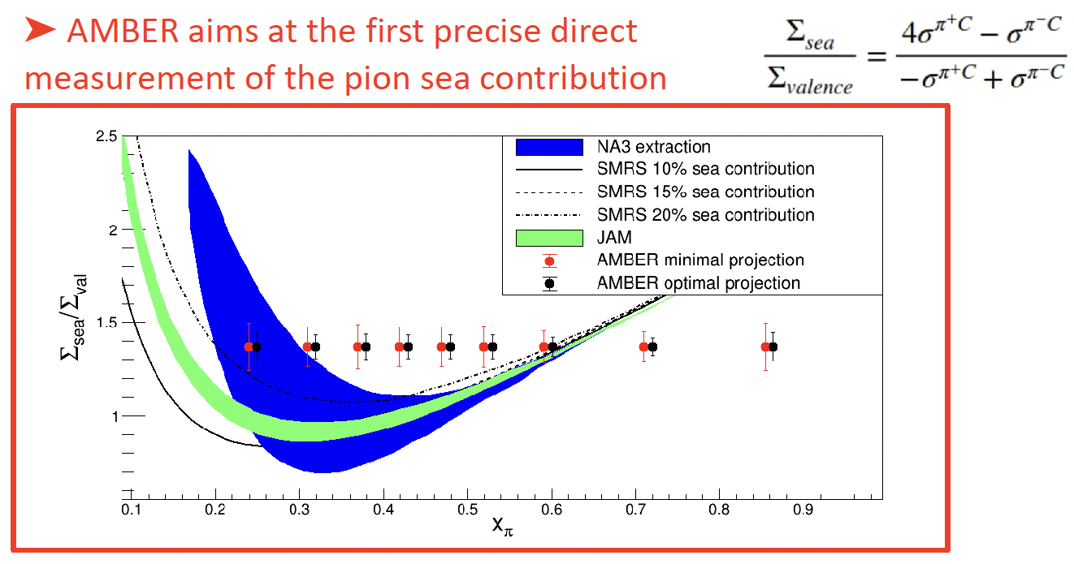
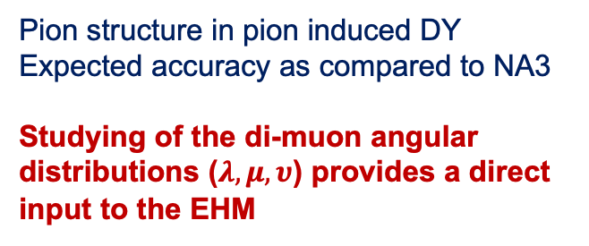
Probing valence and sea quark contents of pion at AMBER
Expected statistics after first 2 years of data taking
High-energy pion/kaon beams exclusively at CERN:
  ﻿﻿Pion-and kaon-induced Drell-Yan dimuon production
  ﻿﻿Will provide the largest pion and kaon induced DY and
  data sample within this decade
  ﻿﻿Isoscalar ¹²C target → minimize nuclear effects
  ﻿﻿pos. and neg. beams → Simultaneous access to the
  valence, sea and gluon content inside the pion
  ﻿﻿Dimuon mass resolution ~ 100 MeV
Pion structure in pion induced DY
Expected accuracy as compared to NA3
Studying of the di-muon angular distributions ($λ, μ, υ$) provides a direct input to the EHM

Slide 15
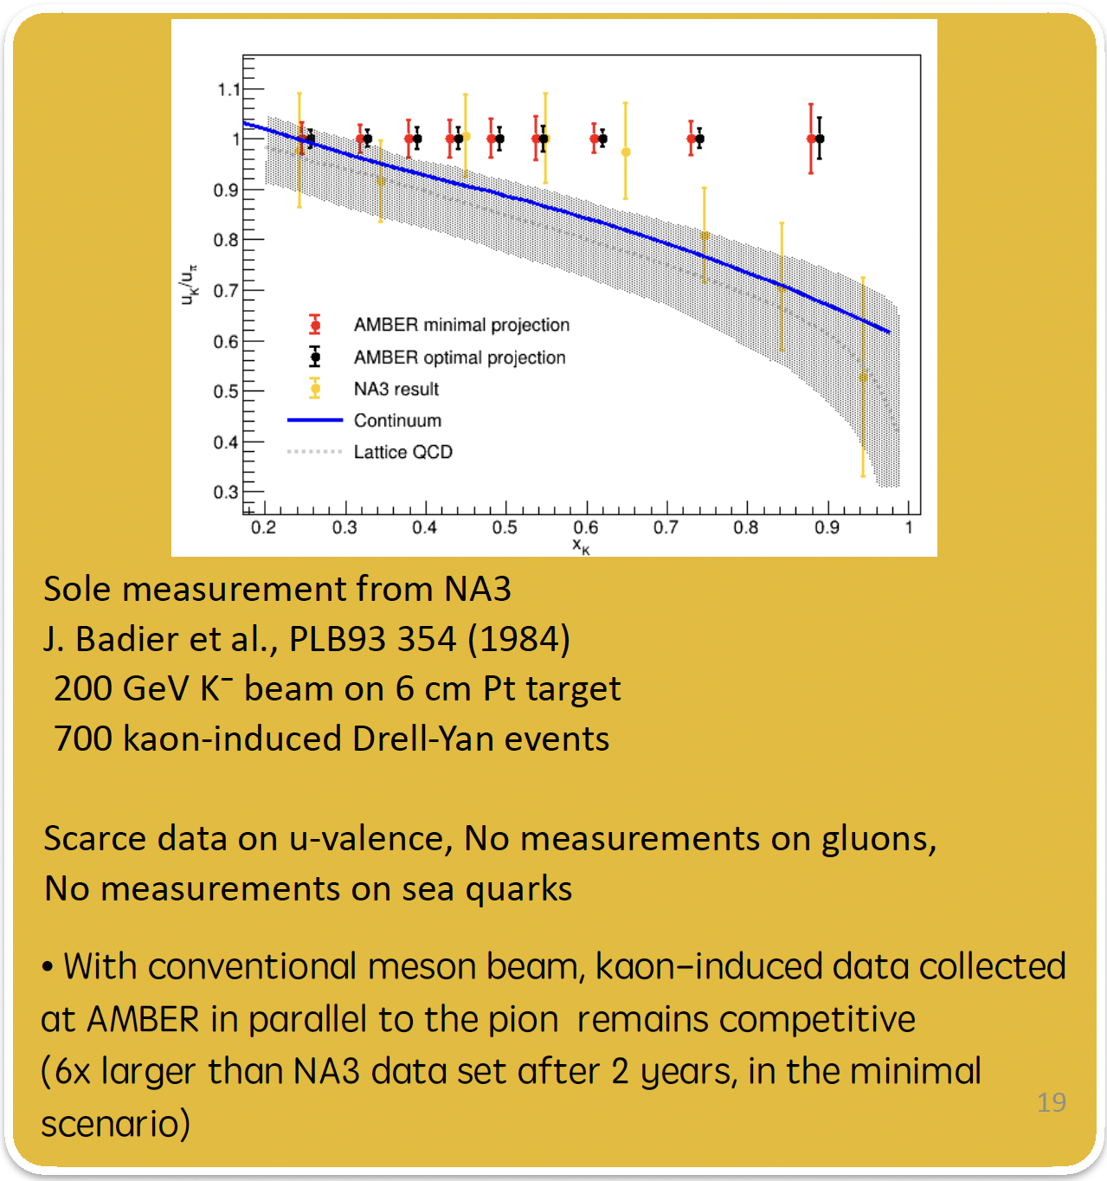
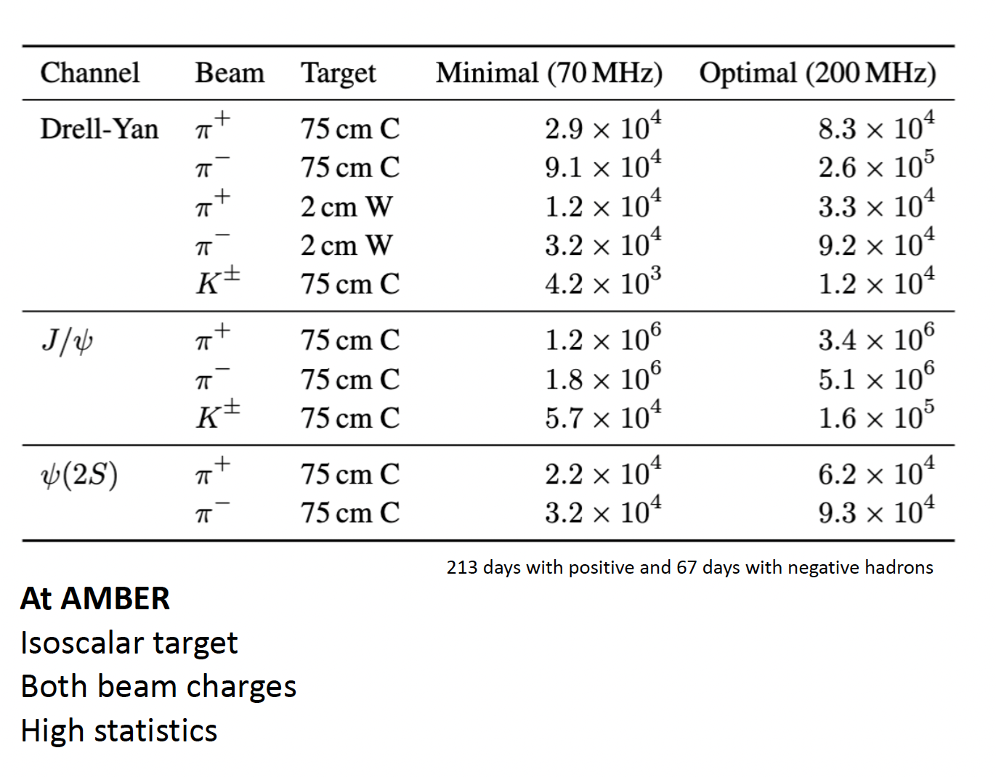
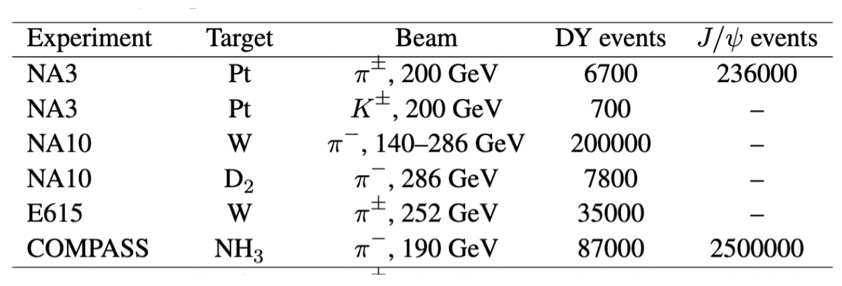
Probing kaon structure via Drell-Yan at AMBER

Slide 16
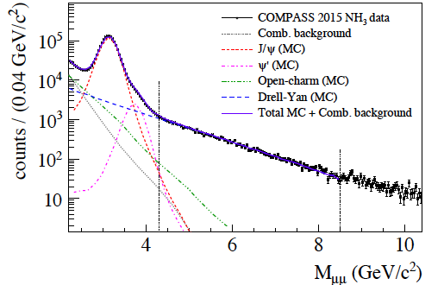
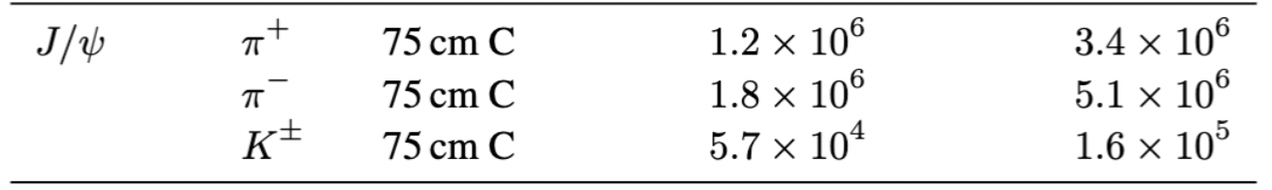
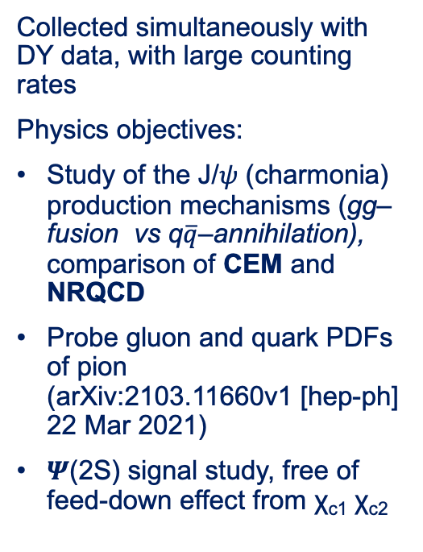
Pion induced J/𝜓 at AMBER
Collected simultaneously with DY data, with large counting rates
Physics objectives:
Study of the J/𝜓 (charmonia) production mechanisms (gg–fusion vs q$\overline{q}$–annihilation), comparison of CEM and NRQCD
Probe gluon and quark PDFs of pion (arXiv:2103.11660v1 [hep-ph] 22 Mar 2021)
𝜳(2S) signal study, free of feed-down effect from χ_{c1} χ_{c2}
Cheung and Vogt, priv. comm.
Improved CEM, CT10 + GRS99 global
fit for proton/pion

Slide 17
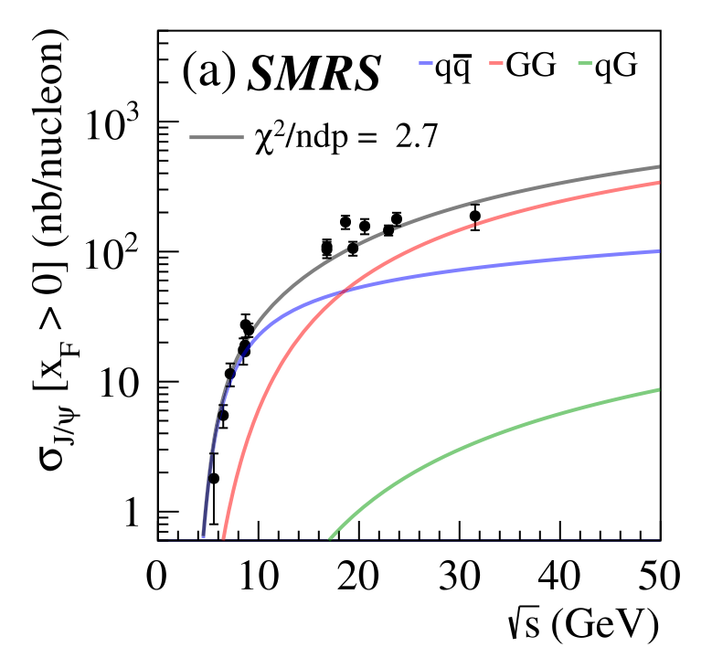
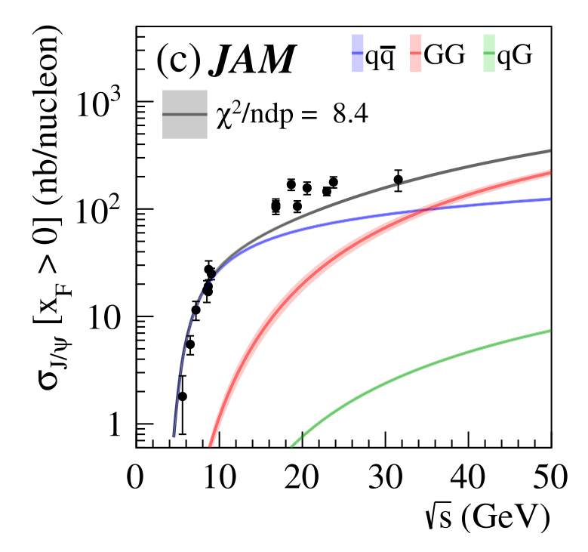
Pion induced J/𝜓 at AMBER
Model dependence of the J/𝜓 production cross section
Relative contribution
From quarks and gluons
Very uncertain
SMRS vs JAM fits: strong dependence on the PDFs

Slide 18
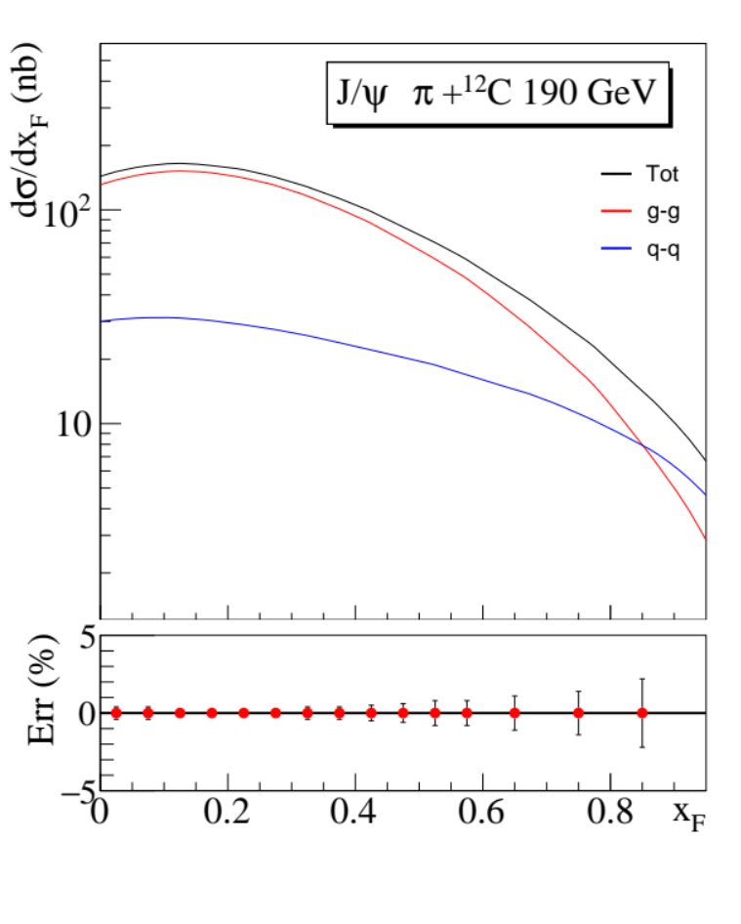
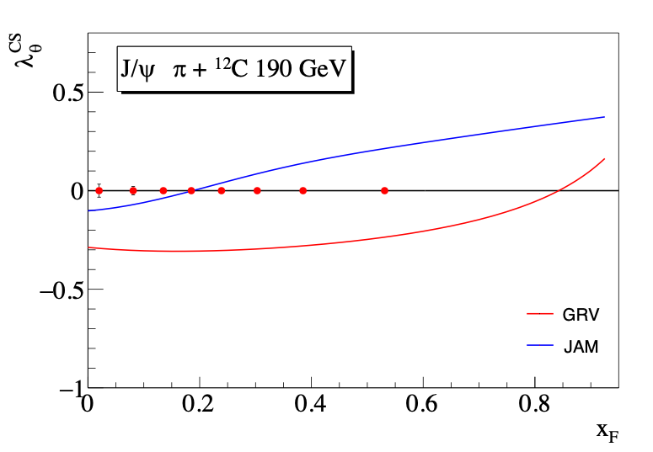
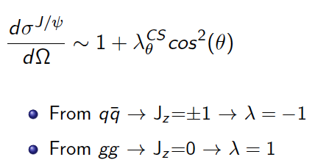
Gluon distribution in the pion through J/𝜓 production
Cross section (ICEM)
CHEUNG AND VOGT,
PRIV. COMM., 2020
Polarization (ICEM)
Both x_{F}-distribution and polarization depend on the relative amount of of quark/gluon content

Slide 19
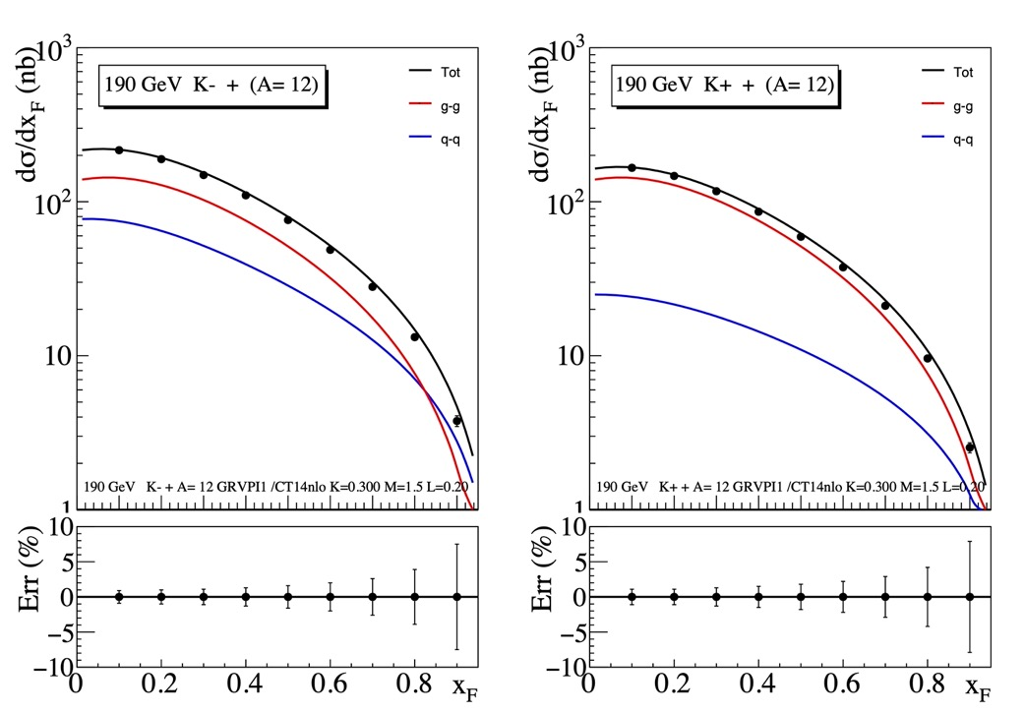
AMBER - kaon induced J/Psi production
Nb of events: 25 000 K⁻ 32 000 K⁺
Identify the kaon component with the CEDARs
  positive beam (K = 1.5%)
  negative beam (K = 2.4%)
  Expected statistics
    210 days of positive beam (K+)
    70 days of negative beam (K−)
    CEDARs efficiency: 60%

Slide 20
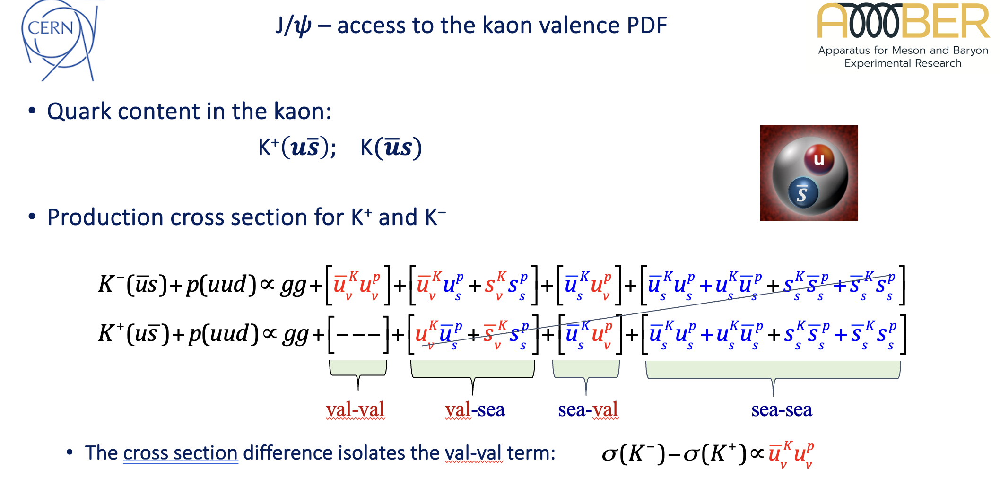
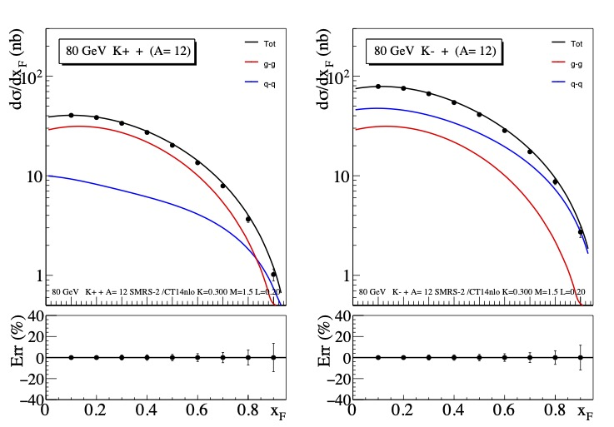
K⁻ and K⁺ -induced J/𝜓 cross sections direct access to the kaon valence PDF
K⁺ beam
K⁻ beam
-

Slide 21
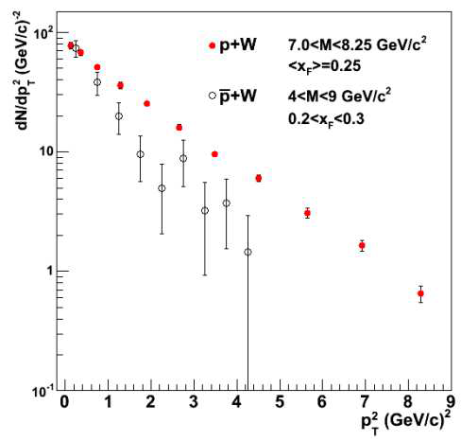
Antiproton induced Drell-Yan
Study the difference between valence and sea quark TMD PDFs
Chiral quark soliton models suggest that the transverse momentum width of sea quarks in a proton may be as much as three times broader than that of the valence distribution
C. A. Aidala et al., Phys. Rev. D 89, 094002 (2014)
W. Oliver, H. R. Gustafson, L. W. Jones, M. Longo, T. Roberts, et al., AIP Conf.Proc. 45, 93 (1978).
E. Anassontzis, S. Katsanevas, E. Kiritsis, P. Kostarakis, C. Kourkoumelis, et al.,
Phys.Rev. D38, 1377 (1988).
➔ Compare transverse momentum distributions for pA and pbarA DY collisions
➔Use exactly the same beam energy + same x1, x2 and Q.
pA case: (quark-in-proton) X (antiquark-in-A) TMD PDFs
pbarA case: (antiquark-in-antiproton) X (quark-in-A) TMD PDFs
➔ Difference pf PT distributions probes difference between valence and sea quarks

Slide 22
AMBER (Kaon and pion charge radius)
Precise measurements of pion and kaon radii will reveal the compositeness (confinement) scale for (near) Nambu-Goldstone bosons. At the moment there is basically no precise experimental information on kaon charge radius.
Oleg Denisov

Slide 23
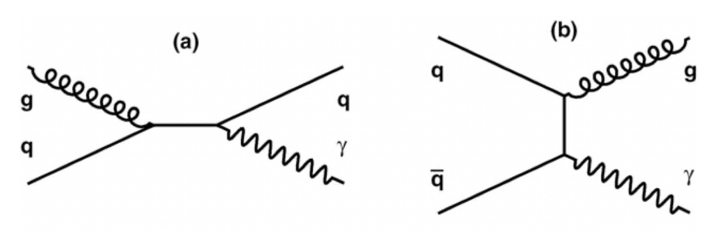
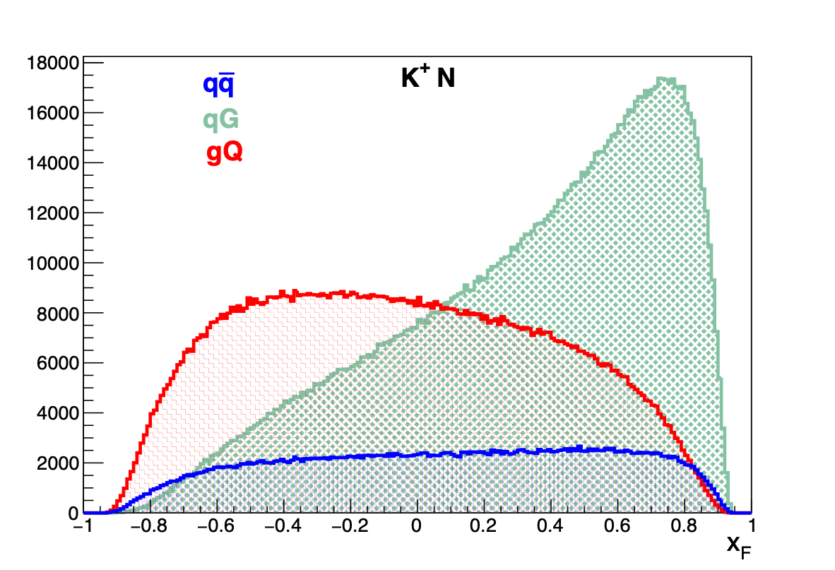








Prompt Photons Production measurement at AMBER
Prompt photons probe – direct access to the gluon content of the kaon.
At the moment there is no experimental information about gluon contribution in kaon.
$$σ_{K^{−}}−σ_{K^{+}}∼{\overline{u}}_{K}U_{N}$$
$$σ_{K^{+}} at x_{F}<0 sensitive to gluon content$$
150 days of data taking shared between positive (T₊=120 days) and negative (T₋ =30 days) hadron beams with a duty factor of 70%
25 000 and 18 000 prompt photons with p_{T} > 3 GeV/c
MC-based and data-driven minimum bias background subtraction
Oleg Denisov

Slide 24




Hadron spectroscopy AMBER (kaon enriched beam)
AMBER QCD Facility, goal for Kaon induced Spectroscopy to
Collect 10-20x10⁶ K⁻ $π$⁺$π$⁻ events using high-intensity high-energy
kaon beam:
Optimised Conventional Hadron beam line
Higher wrt COMPASS beam intensity
Better pion/kaon beam particles separation
Much more powerful pid in the final state

Slide 25

AMBER Long-Term running plan + Proposal Phase-2
We are in the beginning of a very long journey – consider to join if you see your interests…
AMBER WEB Page:
https://amber.web.cern.ch/

Slide 26
Summary: AMBER at CERN SPS
We did a great job in COMPASS to understood better the proton spin structure, we are leaving a floor to the next generation high-luminosity facilities
We are very happy that we managed with the approval of AMBER Phase-1 to provide long-term future for hadron physics at CERN (it was quite an effort taking into account uneasy neighbourhood of the LHC..)
We are solid collaboration of 35 Institutions from 14 countries, ~180 physicists. Still we are looking for new motivated and skilful collaborators
Data taking of the AMBER Phase-1 is ongoing
Focus is on EHM related studies but of course we will measure as well unpolarised TMD PDFs of unstable particles.

Slide 27

Next AMBER-organized event:
Physics At AMBER (PAW) & IWHSS at Camogli, Portofino Coast, Italia

Slide 28
Spares

Slide 29


AMBER Phase-1 running plan
Milestones:
May 1st 2023, 2024 – Antimatter production Run (Std. DAQ)
Sep. 1st 2024 – PRM Test (FriDAQ, very limited setup)
July 1st – Oct. 31st 2025 – PRM Pilot (FriDAQ, limited setup)
March 15th - Aug. 8th 2026 – PRM Physics (FriDAQ, PRM setup)
Sep. 1st 2025, 2026 – DY Test (FriDAQ, all trackers + mu id)
Sep. 1st 2029 – DY test Run (FriDAQ, full Drell-Yan setup)
April 30th – Oct. 31st 2030/31 – DY Physics Run
Approved AMBER Phase-1 Program:
AXS: 4 months
Drell-Yan: 2 years
PRM: 1 + 1 year (conditionally)
Long Shutdown 3

Slide 30

Status of the AMBER Facility preparations:
North Area Consolidation Program

Slide 31





Status of the AMBER Facility preparations:
AMBER/EHN2 beam line upgrade: vacuum improvements and beam line instrumentation
Vacuum will be improved in 33
Locations (total length is 77 m out
of ~ 1’200 m of M2 beam line)

Slide 32



Status of the AMBER Facility preparations:
Secondary Beam Pid improvement
We (AMBER and CERN Beam Dep.) are improving on both hardware (mechanics, read out electronics) and methods.
In 2023 we run a full hadron intensity beam test (~10⁸ hadrons/s) for CEDARs & new beam telescope and for the first time we clearly see kaon peak in likelihood distribution

Slide 33



Status of the AMBER Facility preparations:
2024 APX run preparation

Slide 34




Currently thanks to the contribution of number of Labs/Experiments (BEPC, BNL, CERN, Fermilab, JLab …) Spin puzzle is resolved
Drell-Yan
SIDIS
pp collisions
e⁺e⁻ collisions

Slide 35
Principles to be respected while preparing new experiment at CERN
Once we are started to think about successor of COMPASS and continuation of hadron physics at CERN apart of reasoning mentioned above we were guided by few CERN-established principles:
High scientific value of the proposed measurements, i.e. importance of science questions to be addressed by the experiment
Results awaited by a broad scientific community
Uniqueness of the proposed experiments, everything what could be done somewhere else but at CERN should be done somewhere else
Results, once achieved should define the state of the art in the field for a long time
Former two are sort of common, latter two are rather CERN-specific.

Slide 36

AMBER more than 15 years-long effort
We have started to work on physics program
of possible COMPASS successor > 15 years ago.
A Number of Workshops has been organized,
for detail see AMBER web page:
https://amber.web.cern.ch/
LoI submitted in January 2019
http://arxiv.org/abs/1808.00848
Apparatus for Meson and Baryon Experimental Research
> 270 authors

Slide 37

AMBER PHASE-1 (proposal submitted in Sep. 2019, approved in Dec. 2020)
PHASE-1
Conventional hadron and
muon beams
2022 ➔ 2025
LoI submitted in January 2019
http://arxiv.org/abs/1808.00848
Apparatus for Meson and Baryon Experimental Research
Improved conventional
Hadron/Hadron beam
2027➔2030
PHASE-2
Improved conventional
Hadron/Hadron
and muon beam
2029 and beyond

Slide 38

EHM phenomenon
Is it enough to study the proton to understand SM?
The answer is obviously NOT (SM paradigm):
  proton is described by QCD … 3 valence quarks
  pion is also described by QCD … 1 valence quark
  and 1 valence antiquark
  expect m_{p} ≈ 1.5 × m_{π} … but, instead m_{p} ≈ 7 × m_{π}
Proton and pion/kaon difference:
  In the chiral limit the mass of the proton remains
  basically the same
  Chiral limit mass of pion and kaon is “0” by definition
  (Nambu-Goldstone bosons)
  Different gluon content expected for pion and kaon
  Contribution from interplay with Higgs mechanism is different
Thus it is equally important to study the internal structure and dynamics
of pions, kaons and protons

Slide 39


Proton Radius Measurement at AMBER
(hadron structure ➔ confinement ➔ EHM)
AMBER
statistical precision of the proposed measurement, down to Q² = 0,001 GeV²/c², Cross section is normalised to the G_{D} - dipole form factor
Oleg Denisov

Slide 40

Proton Radius Measurement at AMBER
(confinement)
A number of experiments is on the way in different laboratories
There is a synergy between PRES at MAMI (E_{e} = 720 MeV) and AMBER (E$μ=100 GeV)$:
  The same type of active target (hydrogen filled TPC) will be used for both experiment
  The same Q² range will be covered (10⁻³ - 4x10⁻² GeV²)
  Mutual calibration of the transferred momentum
Significant advantage of the AMBER measurement is much lower radiative corrections: for soft bremsstrahlung photon energy E$γ$/E_{beam} ~ 0.01 QED corrections amount to ~15-20% for electrons and to ~1.5% for muons (AMBER will be able to make a control measurement with Electromagnetic Calorimeters).
AMBER
If compared to the muon scattering experiment at PSI (MUSE):
Much cleaner experimental conditions (pure muon beam with less than 10⁻⁶ admixture of hadrons)
Much higher beam momentum, thus contribution from magnetic form factor is suppressed (0.1-0.2 GeV/c vs 100 GeV/c)
Small statistical errors achievable with the proposed running time
Oleg Denisov

Slide 41



Goal-4: Flavor dependence of the EMC effect
Prediction: Cloët, Benz and Thomas (2009):
    “...for N≠Z nuclei, the u and d quarks have distinct nuclear modifications. ”
$$\frac{σ_{W}^{π−}−σ_{W}^{π+}}{σ_{C}^{π−}−σ_{C}^{π+}}$$
d_{A} quarks
u_{A} quarks
Can be accessed ONLY through parity-violating DIS (JLAB) or with AMBER@CERN

Slide 42

Antimatter Production Cross-Section measurement at AMBER
New AMS(2) data – the antiparticle flux is well known now (few % pres.)
(http://dx.doi.org/10.1103/PhysRevLett.117.091103)
Two types of processes contribute – SM interactions
(proton on the inter-stellar matter with the production for example of antiprotons) and contribution from dark particle – antiparticle annihilation;
In order to detect a possible excess in the antiparticles
flux a good knowledge of inclusive cross sections of
p-He interaction with antiparticles in the f.s. is a must,
currently the typical precision is of 30-50%.
AMBER proton beam: from a few tens of GeV/c up to 250 GeV/c, in the pseudo-rapidity range 2.4 < $η$ < 5.6. Goal is to measure the double differential (momentum and pseudo-rapidity) antiproton production cross section from p+H and p+He at different proton momenta (50, 100, 190, 250 GeV/c).
In 2023 we had successfully performed first data taking with He for six
Incoming proton momentum in the range 60 – 250 GeV

Slide 43

AMBER antimatter production cross section
The impact of the proposed p + p measurements on constraining the production of cosmic anti-protons versus their kinetic energy. Each curve represents the fraction of anti-proton production phase space as constrained by AMBER cross section measurements in p-p, p-He and He-p channels, compared to NA61 (p-p) and LHCb (p-He) measurements
p-H channel, in three different energy ranges
100-190 GeV/c
50-190 GeV/c
AMBER
LHCb
AMBER
NA61 (20-158 GeV/c)
50 - 250 GeV/c
p-He and He-p channels
43
10/09/26
43

Slide 44






Primakoff at AMBER:
Chiral Anomaly and Polarizabilities (kaon enriched beam)
Dominik Ecker’s talk of 08/06/23

Slide 45



Drell-Yan experiment preparation I
Drell-Yan process is a low cross-section process:
High intensity hadron beam
Carbon and Tungsten nuclear targets
Hadron absorber to protect Spectrometer from a very high secondary flux
Vertex Detector to compensate loses in resolution because of the absorber in order to improve mass and space resolution

Slide 46




Drell-Yan experiment preparation II
Proposal by LANL group to reuse PHENIX Silicon Vertex Detector
Active silicons mini-strip sensors plus front-end ASIC,
the FPHX chip bonded directly on sensors

Slide 47

Drell-Yan experiment preparation III
Toward doubling of the incoming beam intensity (TO)

Slide 48




Status of the AMBER Facility preparations:
AMBER Spectrometer Upgrades 2
High-pressure hydrogen filled active TPC (PRM)
Combined scintillating fibres / silicon tracking system (4 stations) (PRM)
Triggerless electromagnetic calorimeter electronics (PRM)
High rate capable silicon-based vertex detector (DY)
New high-purity and high efficiency di-muon trigger (DY)

Slide 49




Status of the AMBER Facility preparations:
AMBER Spectrometer Upgrades 1
New triggerless DAQ system, new front-end electronics and trigger logic compatible with triggerless readout
New large-size PixelGEM detectors
New large-area micro-pattern gaseous detectors (MicroMegas)
High-rate-capable CEDARs detectors (beam line)
A new RICH-0 detector to extend significantly phase space coverage (lower momenta)

Slide 50

Unified Tracking Station

