Slide 1
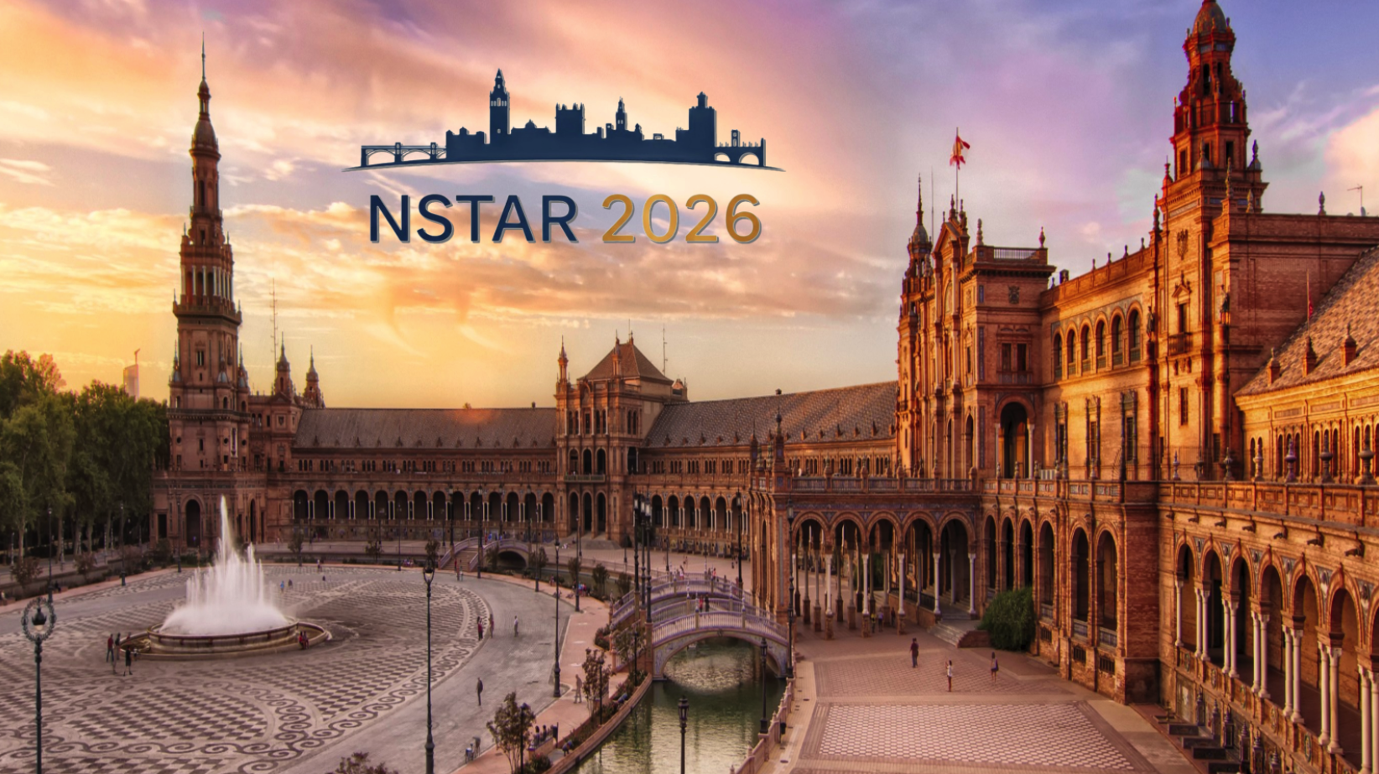
Meson Structure Through an Algebraic Lens
Adnan Bashir
University of Huelva, Huelva, Spain︎

Slide 2
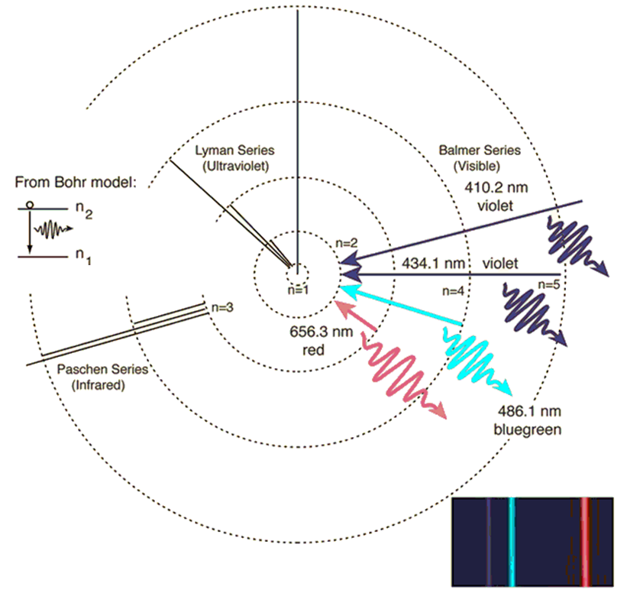
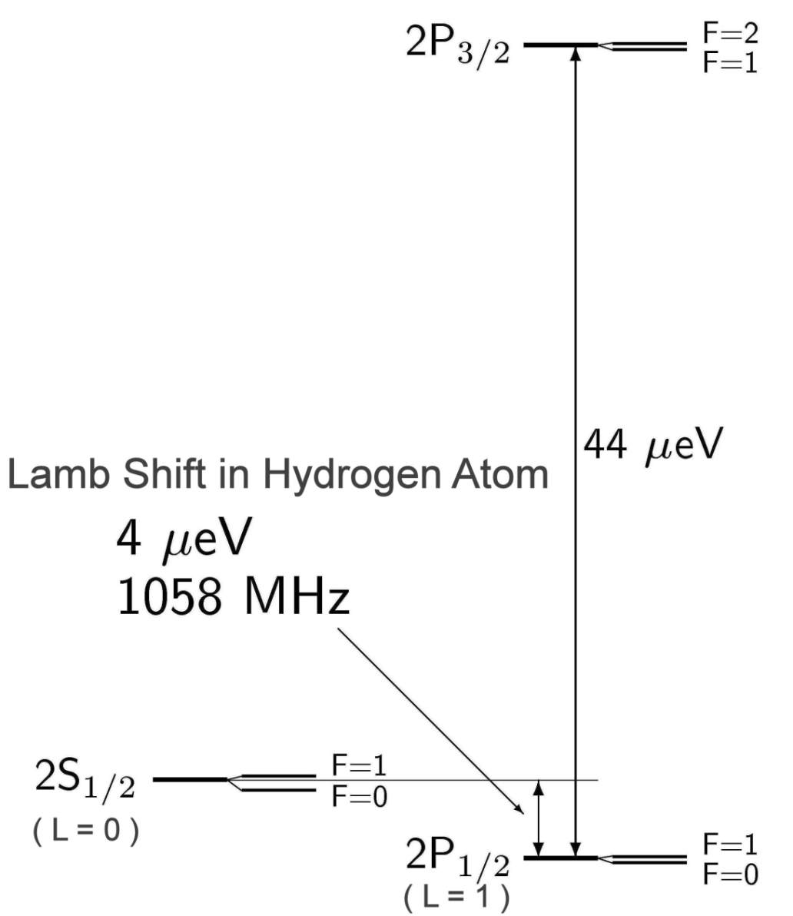
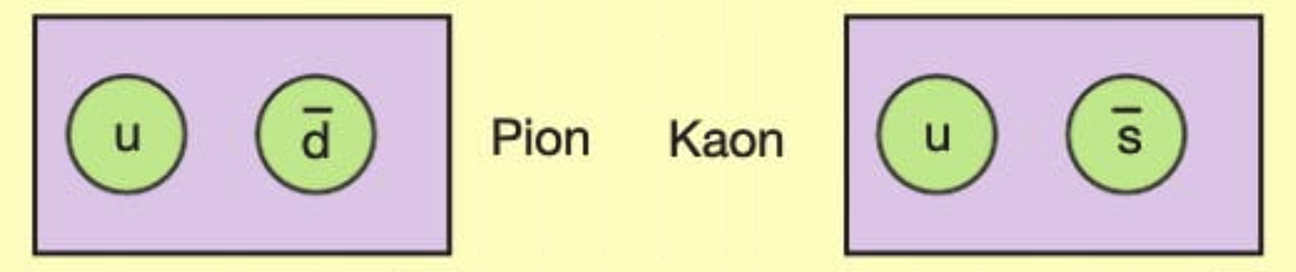
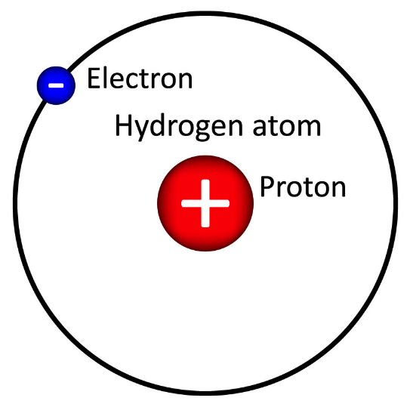
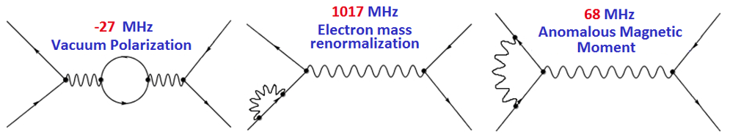
Two particle bound states
𝜋 and the K are the lightest two-body bound states in QCD. Unraveling their internal structure is a bigger challenge.
If you don’t understand the pion, you don’t understand anything (in QCD).
Dyson: If you don’t understand the Hydrogen
atom you don’t understand anything (in QED) .
Pions are unique: Simultaneously, they are the lightest bound states of u and d quarks and also the Pseudo Nambu-Goldstone-Salam-Weinberg bosons, associated with dynamical chiral symmetry breaking.
Renormalized QED

Slide 3
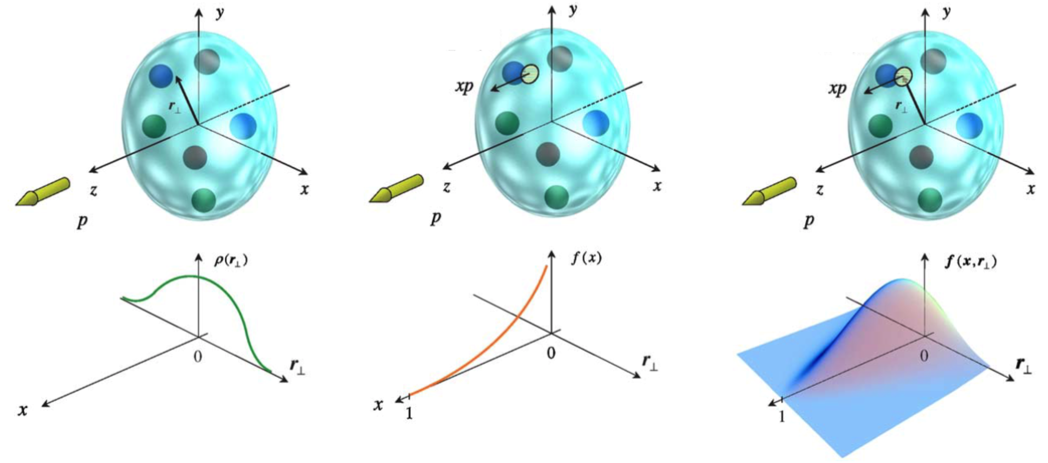
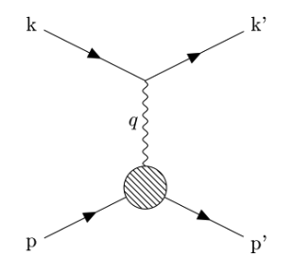
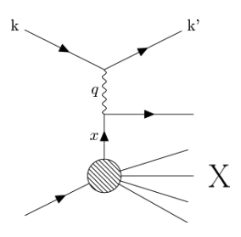
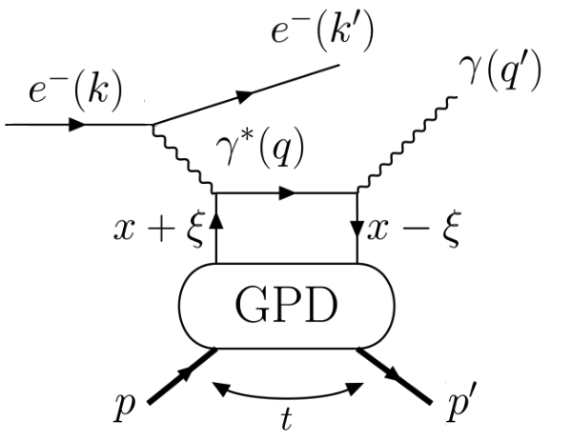
3D Structure of Mesons
Form Factors
Parton Distributions
Generalized Parton Distributions
Hofstadter, et. al., Phys. Rev. 91, 422 (1953)
Hofstadter, Rev. Mod. Phys. 28, 214 (1956)
Feynman, Phys. Rev. Lett. 23, 1415 (1969)
Ji, Phys. Rev. D 55, 7114 (1997)
Radyushkin, Phys. Lett. B 380, 417 (1996)

Slide 4
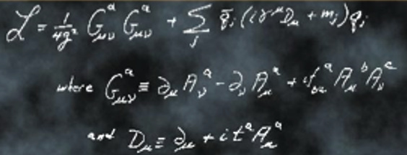

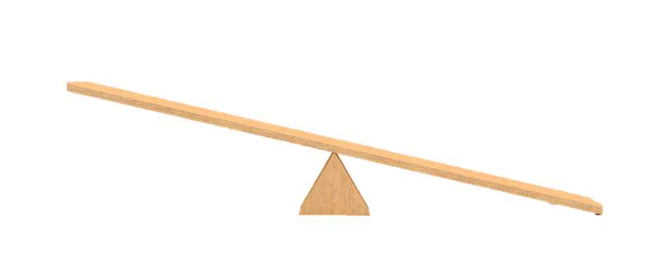




QCD: Emergent Phenomena
QCD is characterized by two emergent phenomena:
confinement and emergent hadron mass (EHM).
Quarks and gluons do not reach detectors.
Formation of color-singlet bound states: “Hadrons”
mesons, baryons, tetraquarks, molecules
Emergence of hadron masses (EHM) from QCD dynamics
$\sim 2\%$ of $M_{p}$
$\sim 98\%$ of $M_{p}$ strong QCD
$m_{u,d}≈5−10$ MeV
$M_{p,n}≈940$ MeV

Slide 5
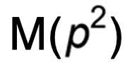
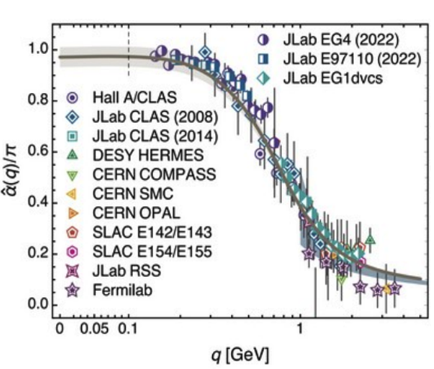
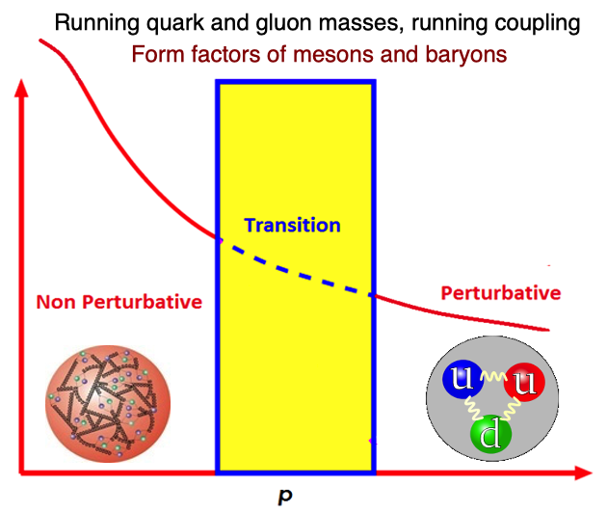
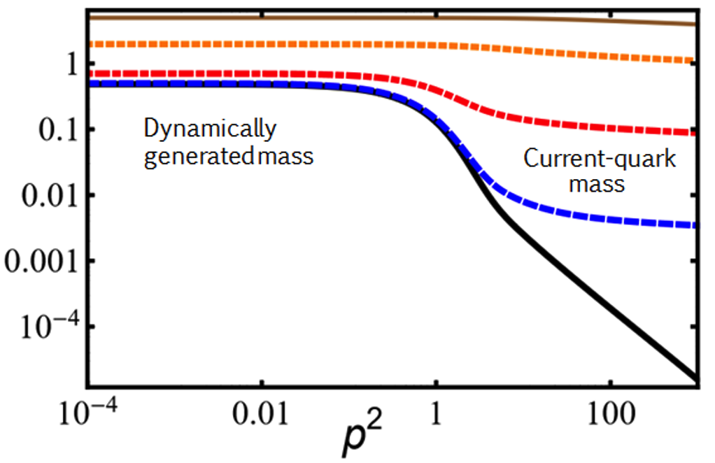
QCD: Emergent Phenomena
Origins of confinement and dynamical mass generation can perhaps be traced back to the Green functions of quarks and gluons.
These emergent phenomena of QCD, non-existent in perturbation theory are naturally linked to the infrared enhancement of the strong running coupling.
The effects of of the pattern of dynamical mass generation are traceable in the Q² evolution of the 𝜋 and K form factors explored and planned in the JLab and the EIC.

Slide 6
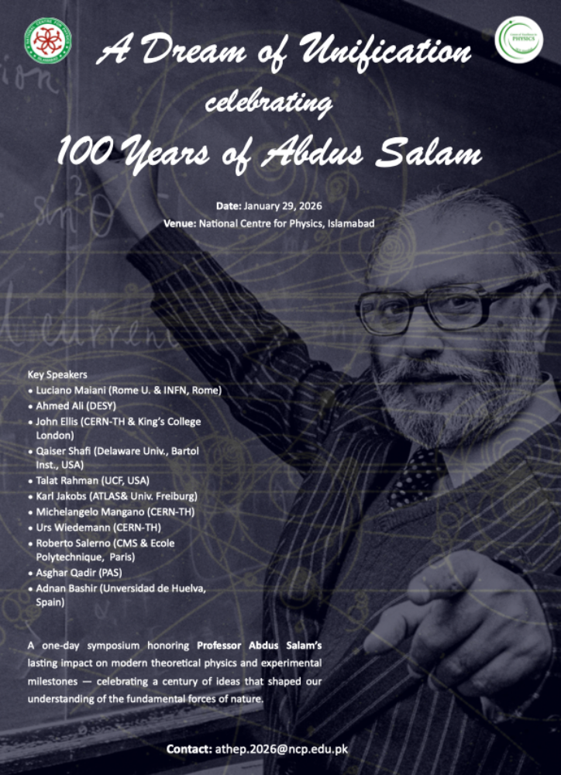
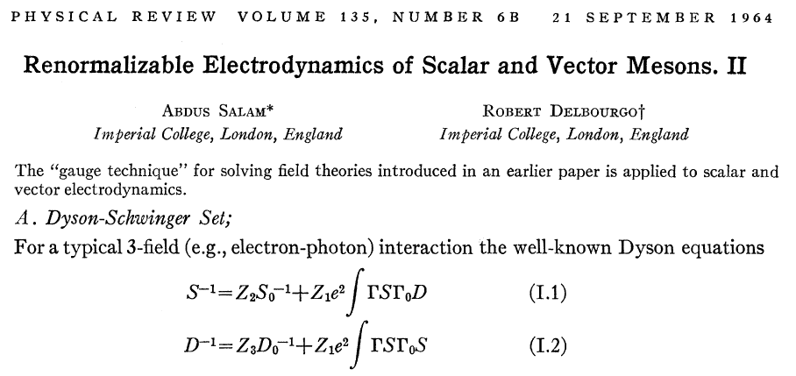
Schwinger-Dyson Equations
Gauge Technique – Non Perturbative Solutios
A. Salam, R. Delbourgo, Phys. Rev. 135 (1964) 6, B1398.
DCSB - Non-perturbative QED
P.I. Fomin, V.A. Miransky, Phys. Lett. B64 (1976) 166.
DCSB – Non-abelian Gauge Theories
V. Miransky, V. Gusynin, Y. Sitenko, Phys. Lett. B100 (1981) 157
DCSB – MT Model - Vector Mesons
P. Maris, P. Tandy, Phys. Rev. C60 (1999)
SDE: electron propagator

Slide 7
Towards Algebraic Models
Sophisticated Truncations
Numerically Demanding
QCD-akin Predictions
Talk: Angel Miramontes
QCD Green Functions
Mesons – Static, FFs, PDAs, PDFs
Precision Tests of the Standard Model
Schwinger-Dyson Equations
Most Observables
Mesons, Baryons, Excited States
LFWFs, GPDs, TMDs,
PDFs, FFs
Contact Interaction
Algebraic Models
Simple Implementation
Insightful – Mindful
Talks: Axel Ahiezer, Luis Albino
Moderate Simplicity
QCD-like Predictions
Luis Albino, Khépani Raya

Slide 8

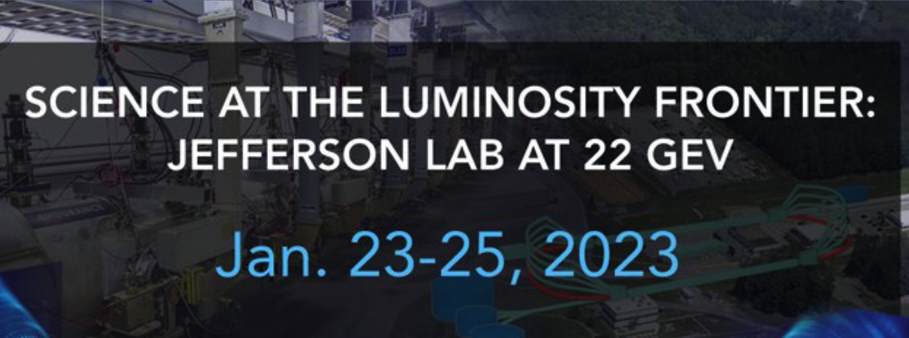
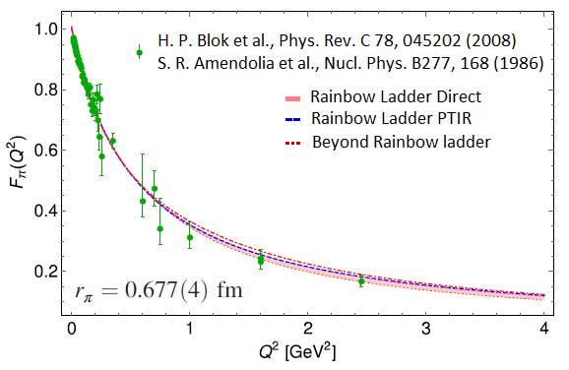

𝜋 Electromagnetic Form Factor
The pion form factor can be potentially be measured till Q² ~ 6-8 in the 12 GeV upgrade of the
Thomas Jefferson National Accelerator Facility.
The emergent pion mass mechanism will be explored through the pion form factor
measurements for Q²: 10-40 GeV² at the Electron Ion Collider.
A. Miramontes, AB, K. Raya, P. Roig,
Phys. Rev. D 105 (2022) 7, 074013

Slide 9
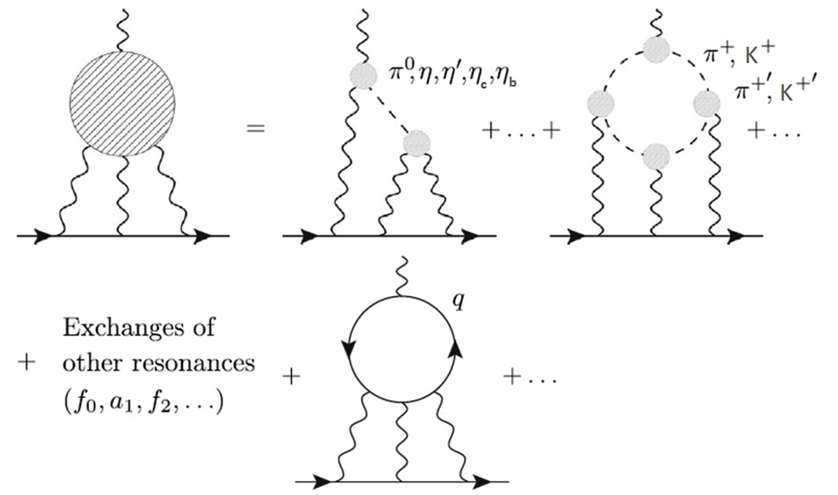
QCD - Hadronic Light by Light Scattering
“Contribution of neutral pseudoscalar mesons
to a_{𝛍}^{HLbL}​ within a Schwinger-Dyson equations approach to QCD”,
K. Raya, AB, P. Roig,
Phys. Rev. D101 (2020) 7, 074021.
“Pion and Kaon box contribution to a_{μ}^{HLbL}’’
A. Miramontes, AB, K. Raya, P. Roig,
Phys. Rev. D105 (2022) 7, 074013.
“The anomalous magnetic moment of the muon in the Standard Model”
T. Aoyama et. al.,
Phys. Rept. 887 (2020) 1-166.
“The anomalous magnetic moment of the muon in the Standard Model: an update”
R. Aliberti et. al.,
Phys. Rept. 1143 (2025) 1-158.

Slide 10
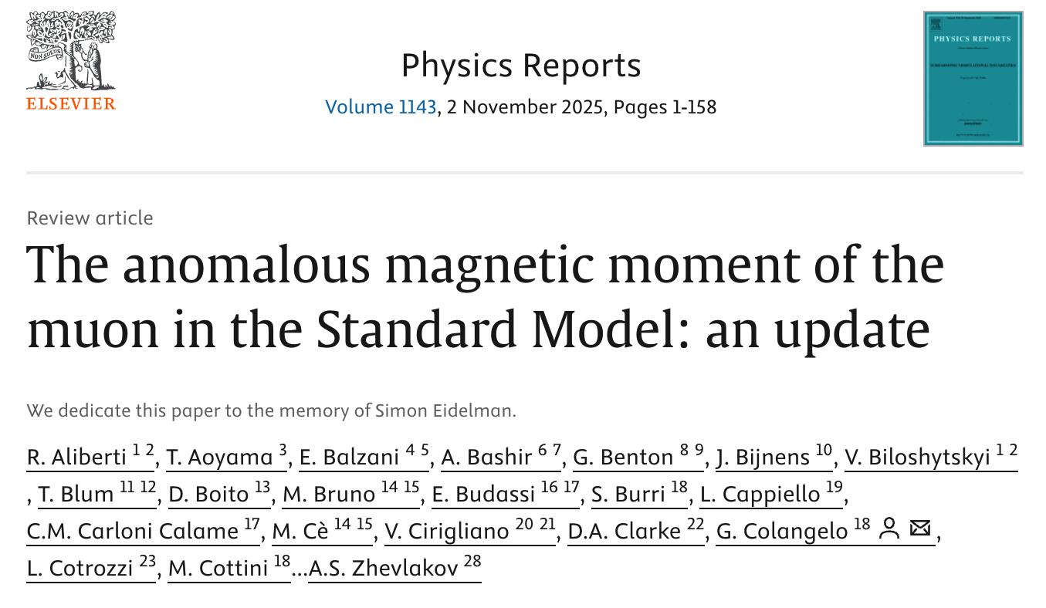
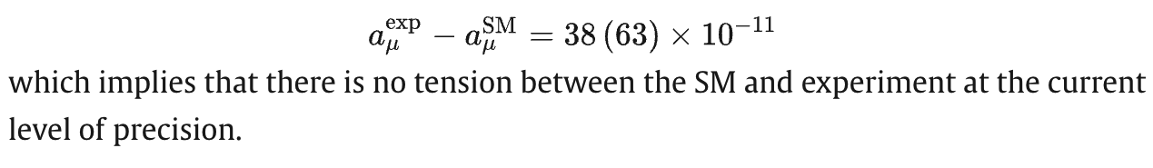
From SDEs to the Precision Frontiers
Angel S. Miramontes, AB, Chrstian S. Fischer, Pablo Roig, e-Print: 2607.12918 [hep-ph]

Slide 11
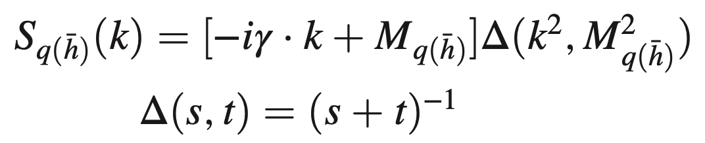
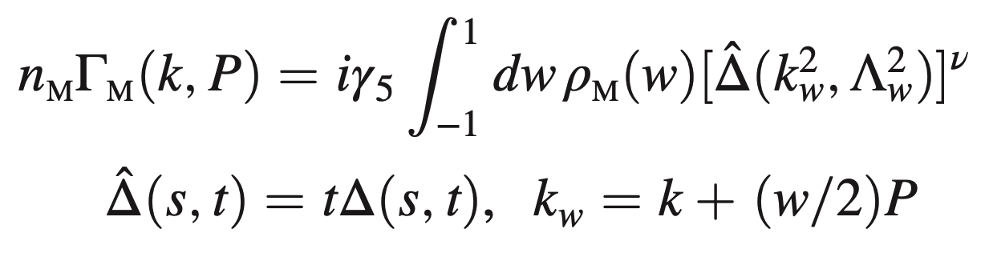

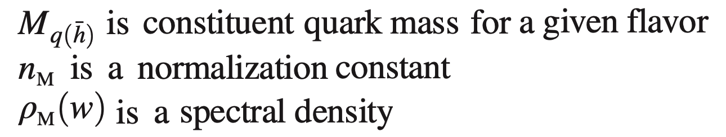

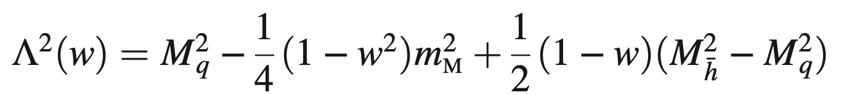
The Algebraic Model (AM)
It retains the constant term from original models, setting it to M_{q}.
There is a term linear in w with the coefficient (M_{h}² − M_{q}²). For same flavored quarks, it ceases to contribute by construction.
There is a quadratic term w² with coefficient m_{M}². The condition
It guarantees the positivity of
The quark propagator:
Bethe-Salpeter Amplitude:

Slide 12
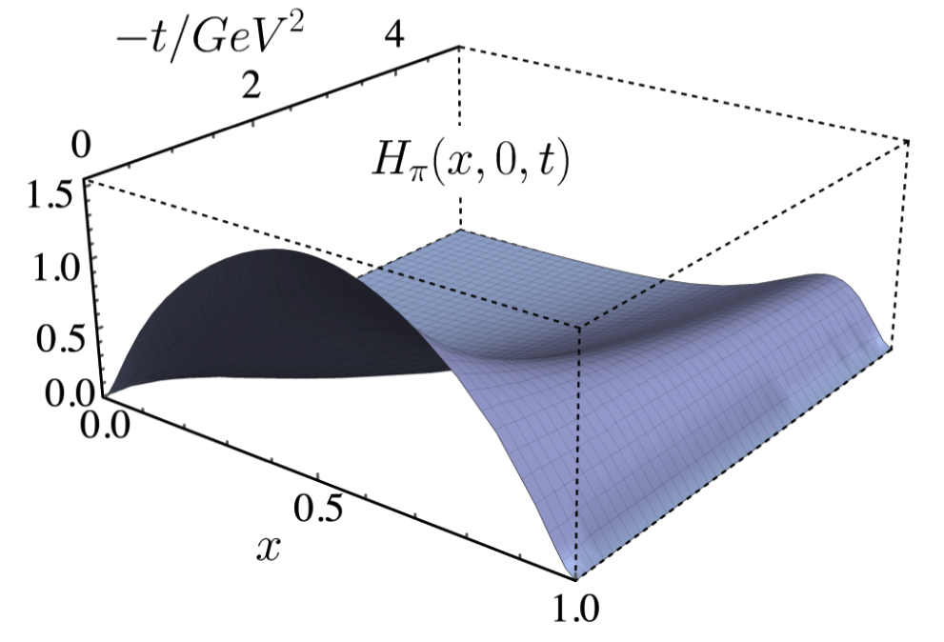
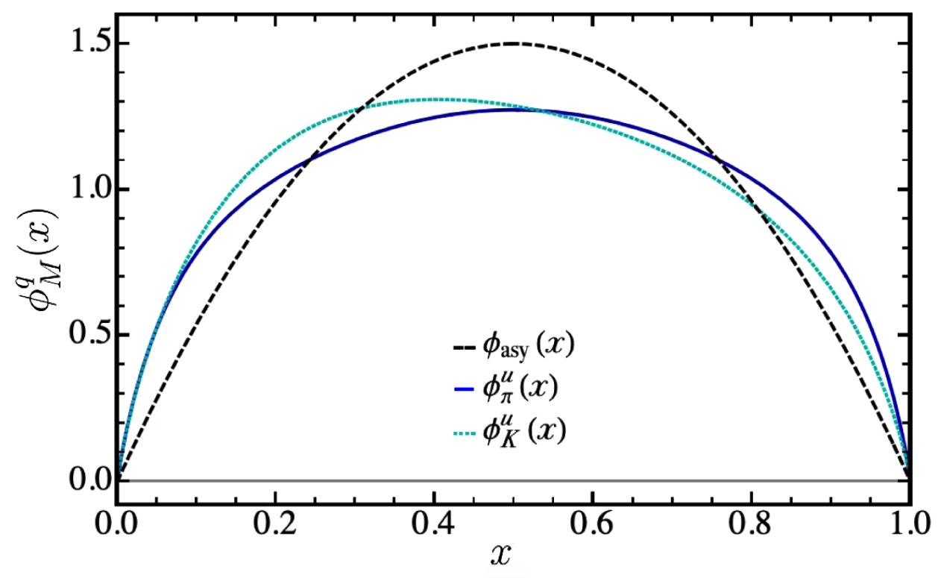

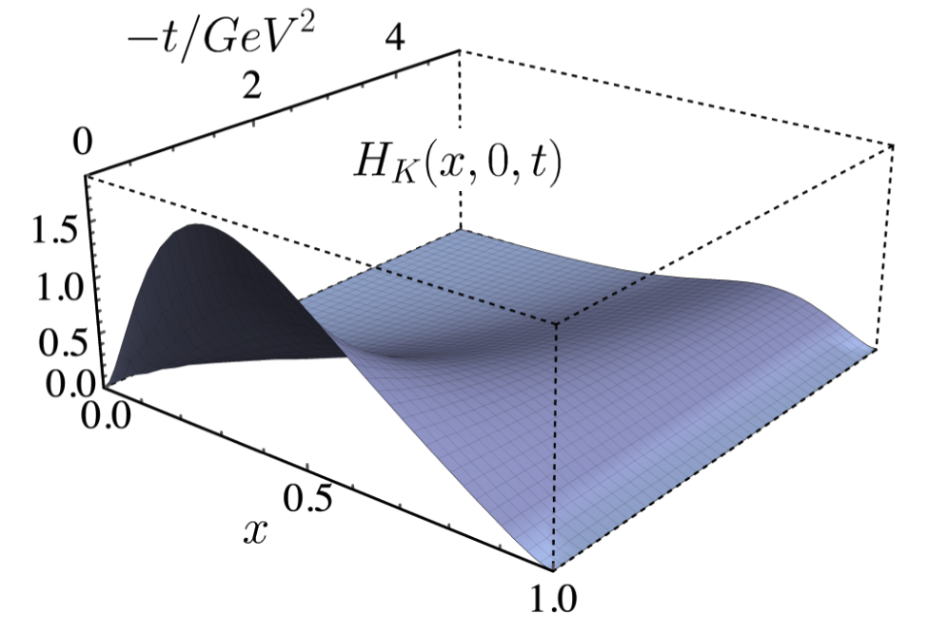
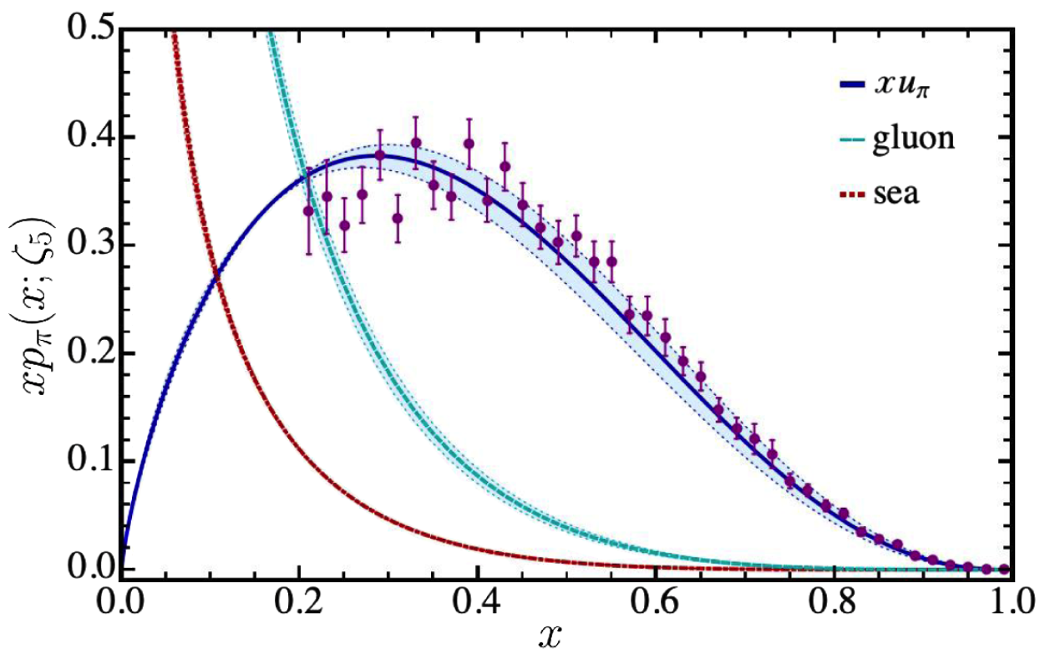
From the GPDs to the PDFs
DGLAP Evolution Equations
L. Albino, M. Higuera, K. Raya, AB
Phys. Rev. D 106 (2022) 3, 034003

Slide 13
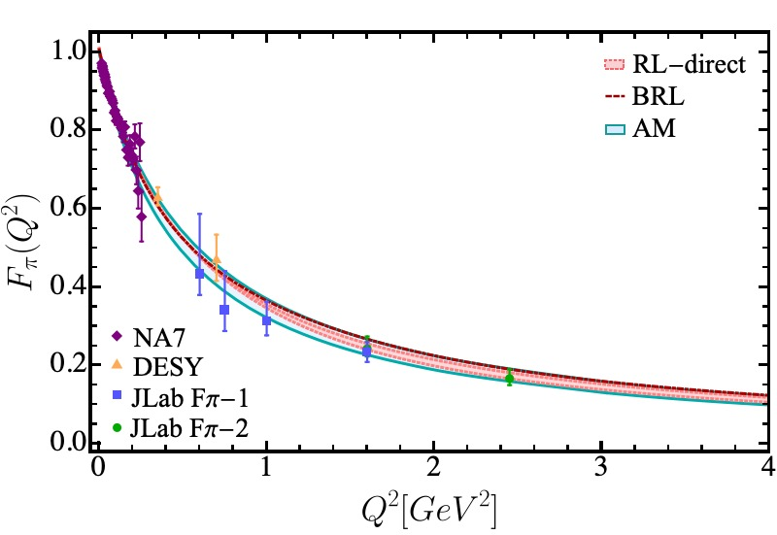
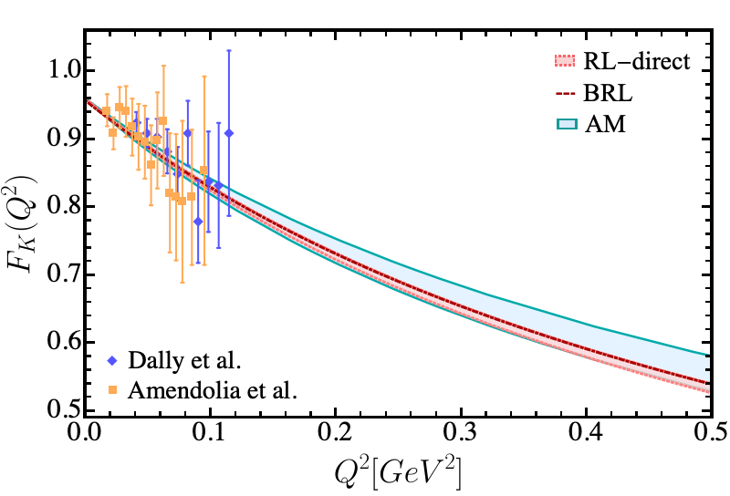
The Form Factors with Algebraic Models
The electromagnetic form factors using our algebraic model can be obtained either through the knowledge of the GPDs or the direct evaluation of the triangle diagram.
A. Miramontes, AB, K. Raya, P. Roig, Phys. Rev. D 105 (2022) 7, 074013
I.M. Higuera, R.J. Hernández, K.Raya, AB, Phys. Rev. D 110 (2024) 3, 034013

Slide 14
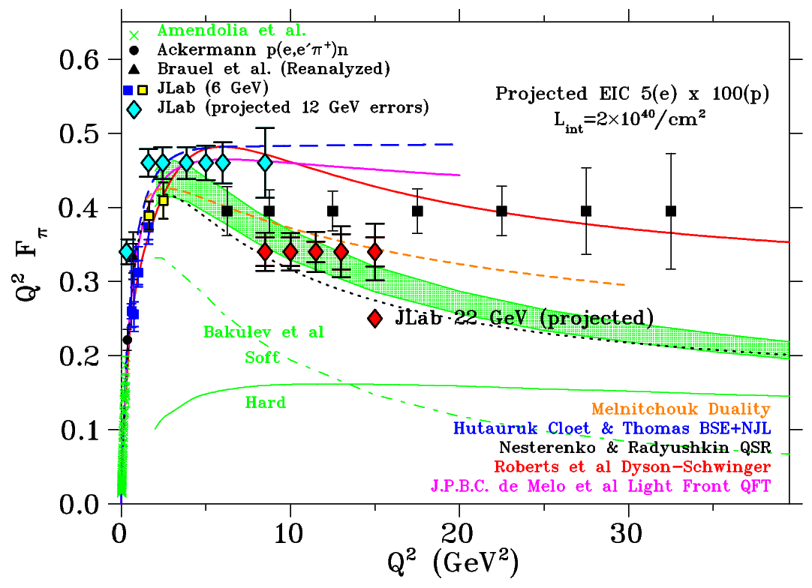
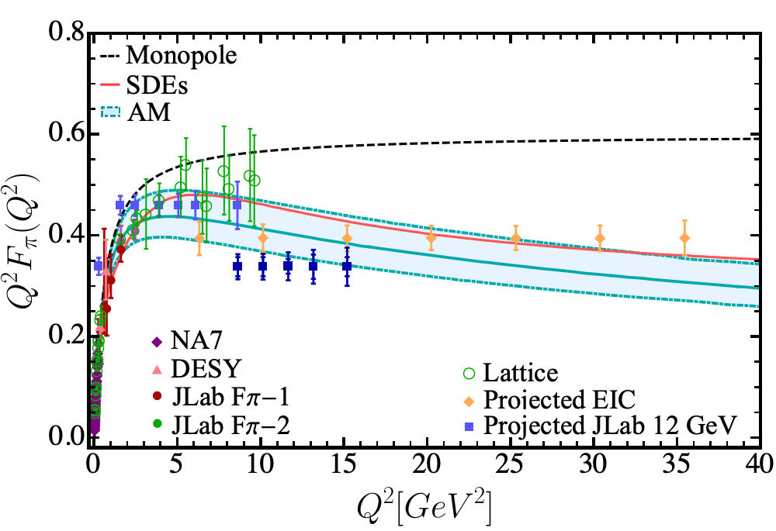
The Form Factors with Algebraic Models
We can extend the analysis of the Algebraic Model to larger Q² range: 0-40 GeV².
I.M. Higuera, R..J. Hernández, K.Raya, AB, Phys. Rev. D 110 (2024) 3, 034013
H-T Ding, X. Gao, A.D. Hanlon, S. Mukherjee, P. Petreczky, Q, Shi, et. al., Phys. Rev Lett. 133 (2024) 18, 181902

Slide 15
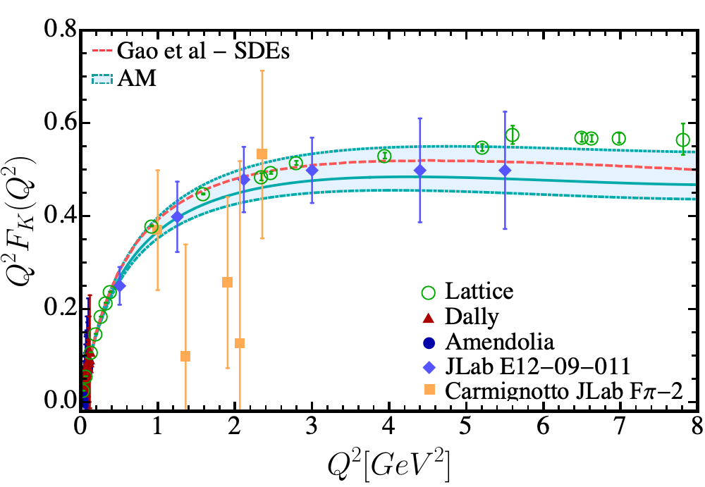
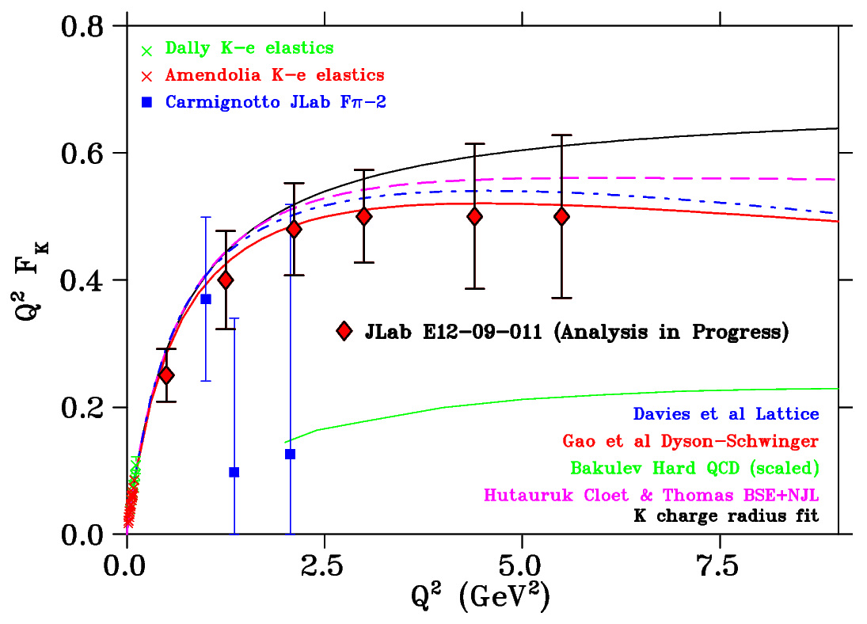
The Form Factors with Algebraic Models
There is an analysis underway of the kaon electromagnetic form factor till 5.5 GeV² of the data obtained in JLab E12-09-011 experiment.
I.M. Higuera, R..J. Hernández, K.Raya, AB, Phys. Rev. D 110 (2024) 3, 034013
H-T Ding, X. Gao, A.D. Hanlon, S. Mukherjee, P. Petreczky, Q, Shi, et. al., Phys. Rev Lett. 133 (2024) 18, 181902

Slide 16
Algebraic Models – Further Applications
Electromagnetic and two-photon transition form factors of the pseudoscalar mesons: An algebraic model computation
I.M. Higuera-Angulo, R.J. Hernández-Pinto, K. Raya, AB,
Phys. Rev. D 110 (2024) 3, 034013 • e-Print: 2407.06461 [hep-ph]
Algebraic model to study the internal structure of pseudoscalar mesons with heavy-light quark content
B. Almeida-Zamora, J.J. Cobos-Martínez, AB, K. Raya, J. Rodríguez-Quintero, J. Segovia,
Phys. Rev. D 109 (2024) 1, 014016 • e-Print: 2309.17282 [hep-ph]
Light-front wave functions of vector mesons in an algebraic model
B. Almeida-Zamora, J.J. Cobos-Martínez, AB, K. Raya, J. Rodríguez-Quintero, J. Segovia,
Phys. Rev. D 107 (2023) 7, 074037 • e-Print: 2303.09581 [hep-ph]
Unified description of pseudoscalar meson structure from light to heavy quarks
Bilgai Almeida-Zamora, Luis Albino, AB, Jesús Javier Cobos-Martínez, Jorge Segovia,
Symmetry 18 (2026) 6, 1017 • e-Print: 2602.10775 [hep-ph]
Light-Front wave functions of Open-Flavor vector mesons in an algebraic model
B. Almeida-Zamora, Luis Albino, et. al. in progress

Slide 17
Summary and Outlook
We have shown how algebraic models inspired by Schwinger–Dyson and Bethe–Salpeter equations provide a simple yet powerful framework for describing meson structure, from LFWFs and GPDs to PDFs and electromagnetic form factors.
The same interaction that produces the pion qq channel generates strong scalar 0+ diquark correlations.
Correspondingly, the vector-meson 1⁻ channel is related through the Bethe–Salpeter kernel to the axial-vector 1⁺ diquark channel.
These diquark correlations are the essential building blocks of the quark–diquark Faddeev description of the nucleon and its excitations.
Therefore, if the algebraic framework can be extended to realistic scalar and axial-vector
diquark amplitudes and their internal structure, the machinery we have developed for
mesons—LFWFs, form factors, PDFs and GPDs — provides a natural route toward N→N*
transition form factors. [David Rodríguez]

Slide 18
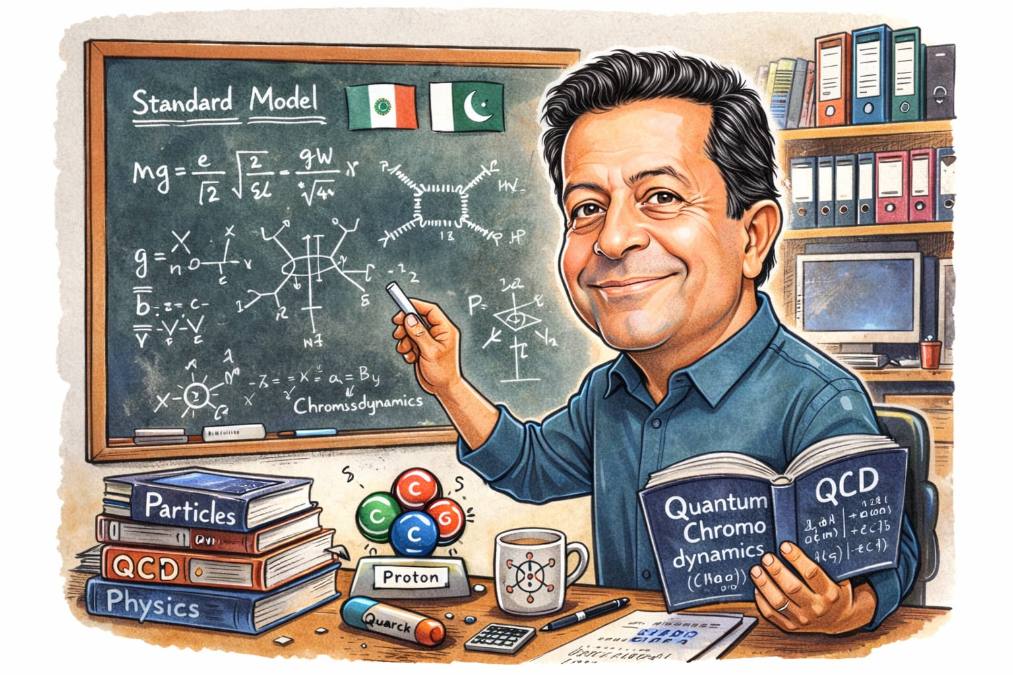
Thank you for your attention

