Slide 1
Present and Future of Baryons with the
CBELSA/TAPS experiment at ELSA
R. Beck
for the CBELSA/TAPS collaboration
NSTAR 2026 , Sevilla, September 7th – 11th 2026
Introduction
Impact of the new polarization data
Problem with a unique PWA solution
Future plans of the CBELSA/TAPS experiment
Summary

Slide 2
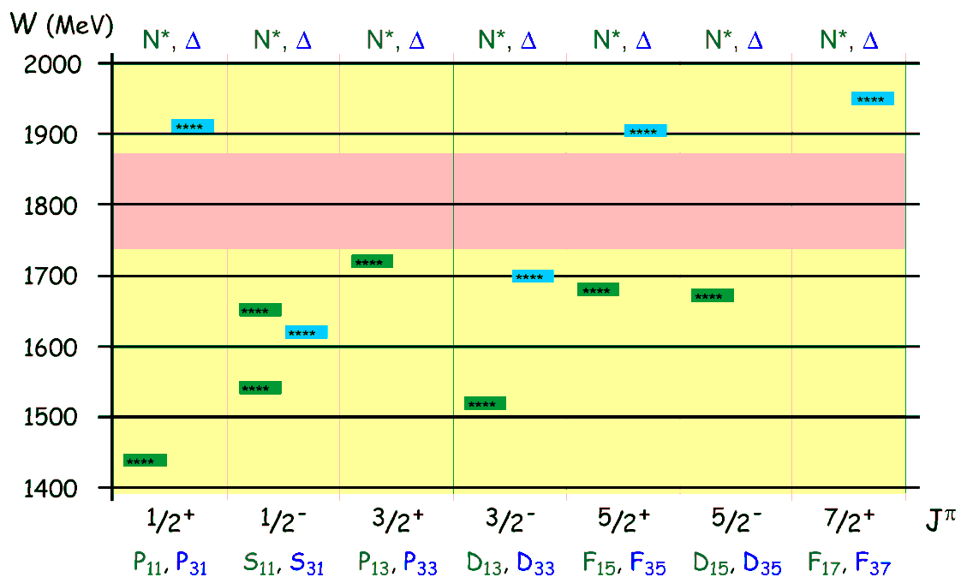

Introduction
Experiments at ELSA: focus on baryon spectroscopy, meson photoproduction
Excitation spectra: information about interaction and dynamics between constituents
Nucleon Excitation Spectrum
mesons
mesons
π
N*,△*
N
baryon
photon
mesons
γ
N*,△*
N
baryon
only 7 N* and 5 Δ* well established in the mass region 1400 MeV < W < 2000 MeV
Energy pattern for the dominant states
Various nucleon models predict many more states
- Constituent Quark Models
- weak coupling to πN final state
- Dynamic Models , Lattice QCD
- incomplete data base
V. Mokeev
D. Carman
C. Morningstar

Slide 3
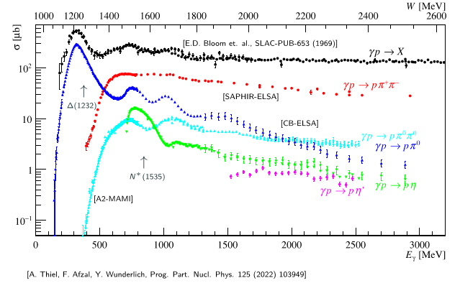
Introduction
Worldwide effort at ELSA (Bonn), JLab (USA), MAMI (Mainz), Spring8 (Japan), ……….
Precision data for different final states
(pπ⁰, nπ⁺, pη , K⁺Λ, pπ⁰π⁰....)
Polarization experiments (beam, target and recoil)
“complete data base”
To constrain PWA −> unique PWA solution
Photoproduction reactions are an
excellent tool to probe excitation
Resonances contribute with different
strength to distinct channels
A. Thiel, F. Afzal, Y. Wunderlich Prog. Part. Nuc. Phys. 125 (2022) 103649

Slide 4
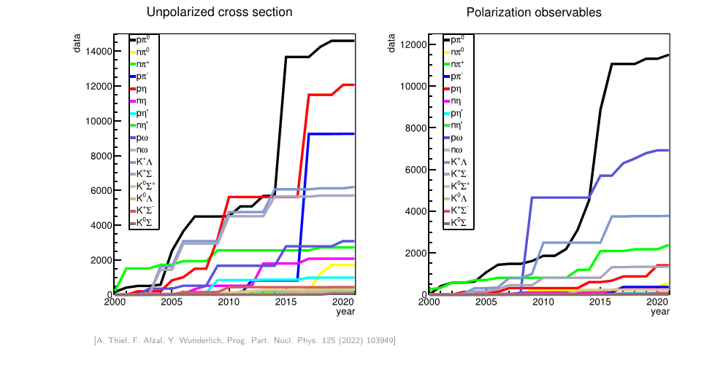
Introduction
Status 2022: Data Base
A. Thiel, F. Afzal, Y. Wunderlich Prog. Part. Nuc. Phys. 125 (2022) 103649

Slide 5
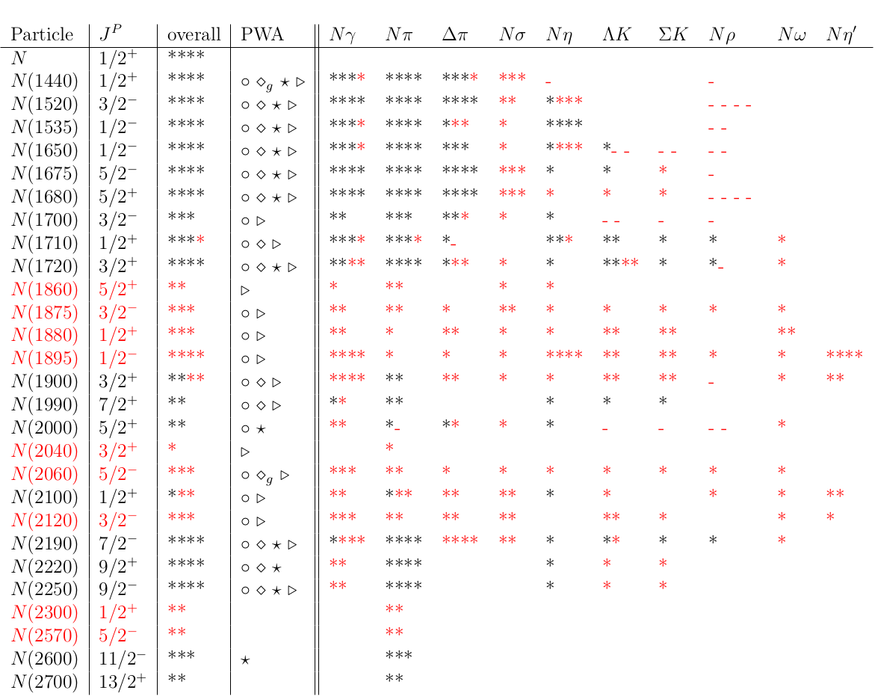
Introduction
Status 2022: Light Baryon Resonances
final states
Until 2010: only results from πN
scattering used in the PDG
PWA groups:
BnGa, JüBo. SAID, MAID
include photoproduction data
Now: new values from the PWA fits
are entering the PDG

Slide 6
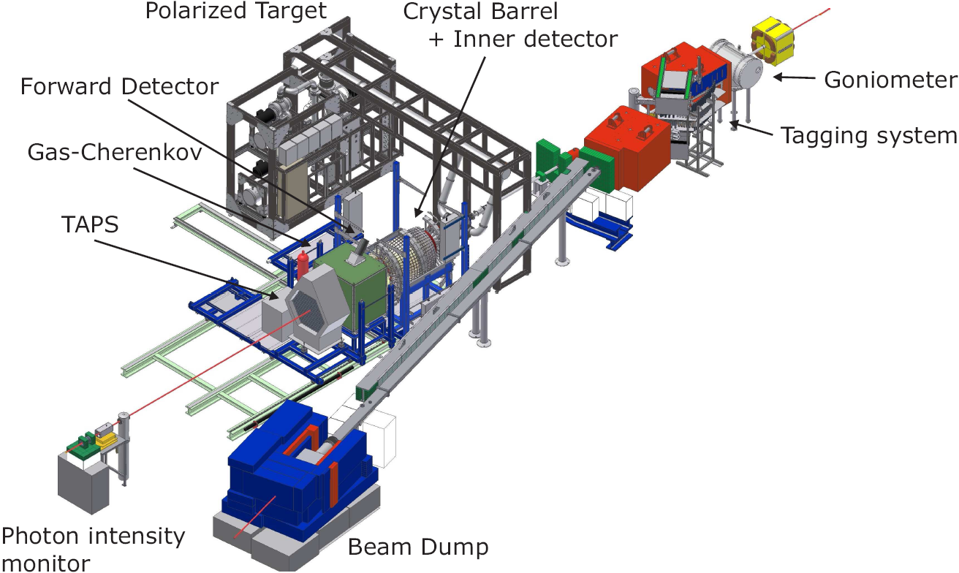
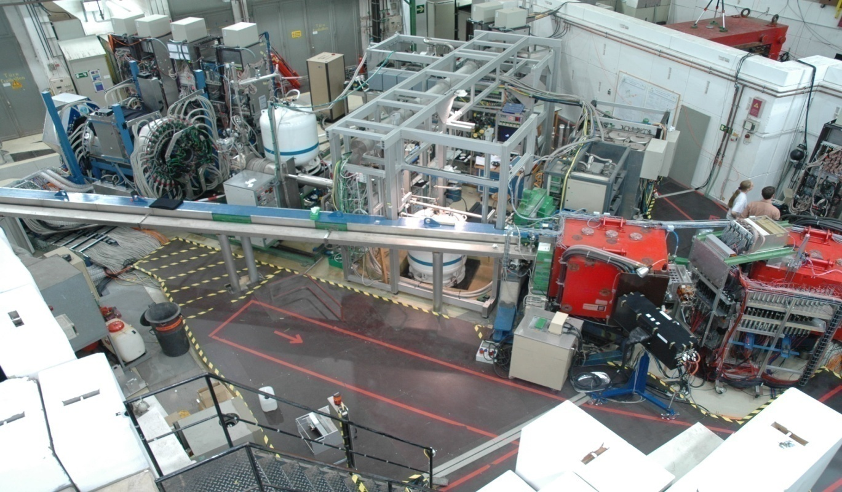
CBELSA/TAPS Experiment
Important:
Polarized beam from ELSA
Polarized targets
4π detector setup

Slide 7
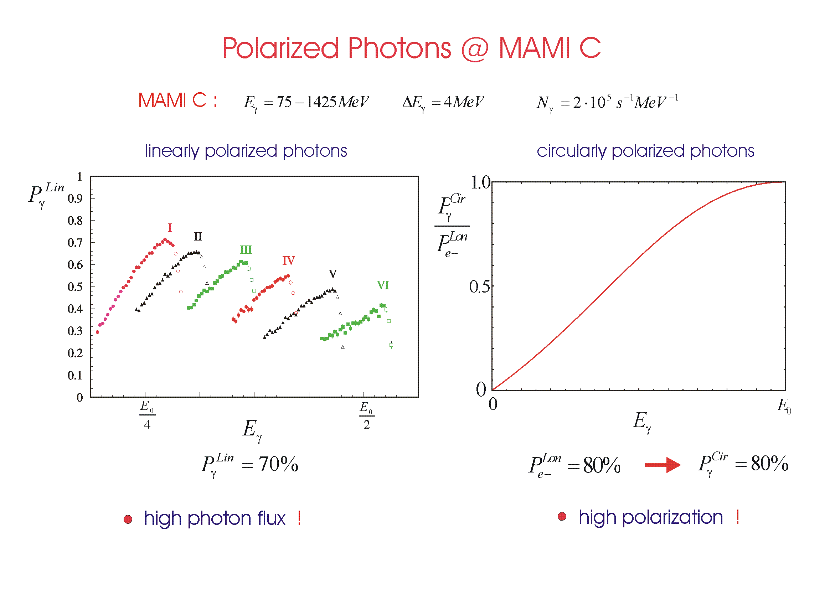
Polarized Photons at ELSA
Linearly polarized photons:
- coherent bremsstrahlung
- diamond radiator
Circularly polarized photons:
- longitudinally polarized electrons
- helicity transfer to photon
Linearly polarized photons
Circularly polarized photons
high polarization at low photon energies
high polarization at high photon energies
Important new development: use of elliptically polarized photons at MAMI, JLab and ELSA
Longitudinally polarized electrons on a diamond radiator
F. Afzal et al., Phys. Rev. Lett. 132 (2024)12, 121902

Slide 8



Problem with a Unique PWA Solution
8 well chosen observables have to be measured to determine the production amplitudes (F₁,F₂,F₃ and F₄)
π- threshold until Δ⁺(1232)- region
additional constraints:
(a) s- and p- wave approximation truncated PWA
(b) Fermi- Watson theorem
same I, J in the final state
same scattering phase δ_{IJ}
two observables sufficient for “complete data base”
differential cross section : dσ/dΩ
beam asymmetry : Σ
above ππ- threshold
- Fermi- Watson theorem not valid any more
- More observable needed to get a unique partial wave solution
- Different final states are important -> coupled PWA are essential

Slide 9
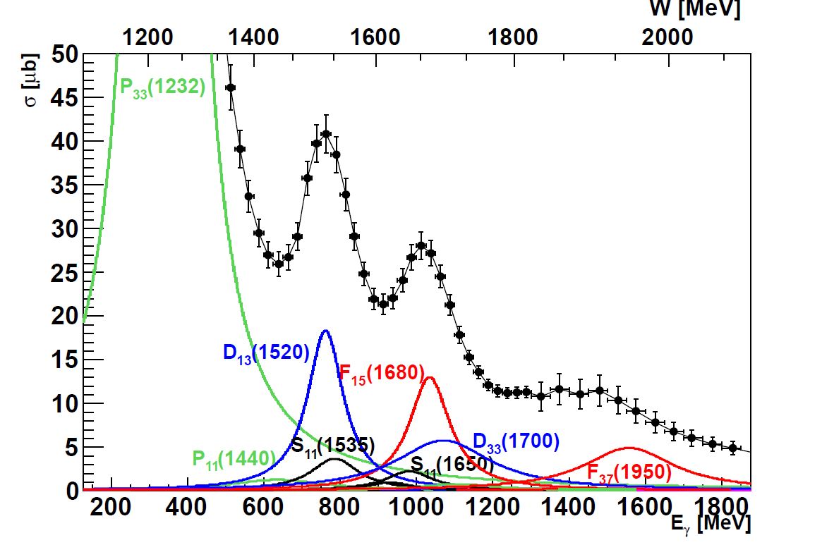
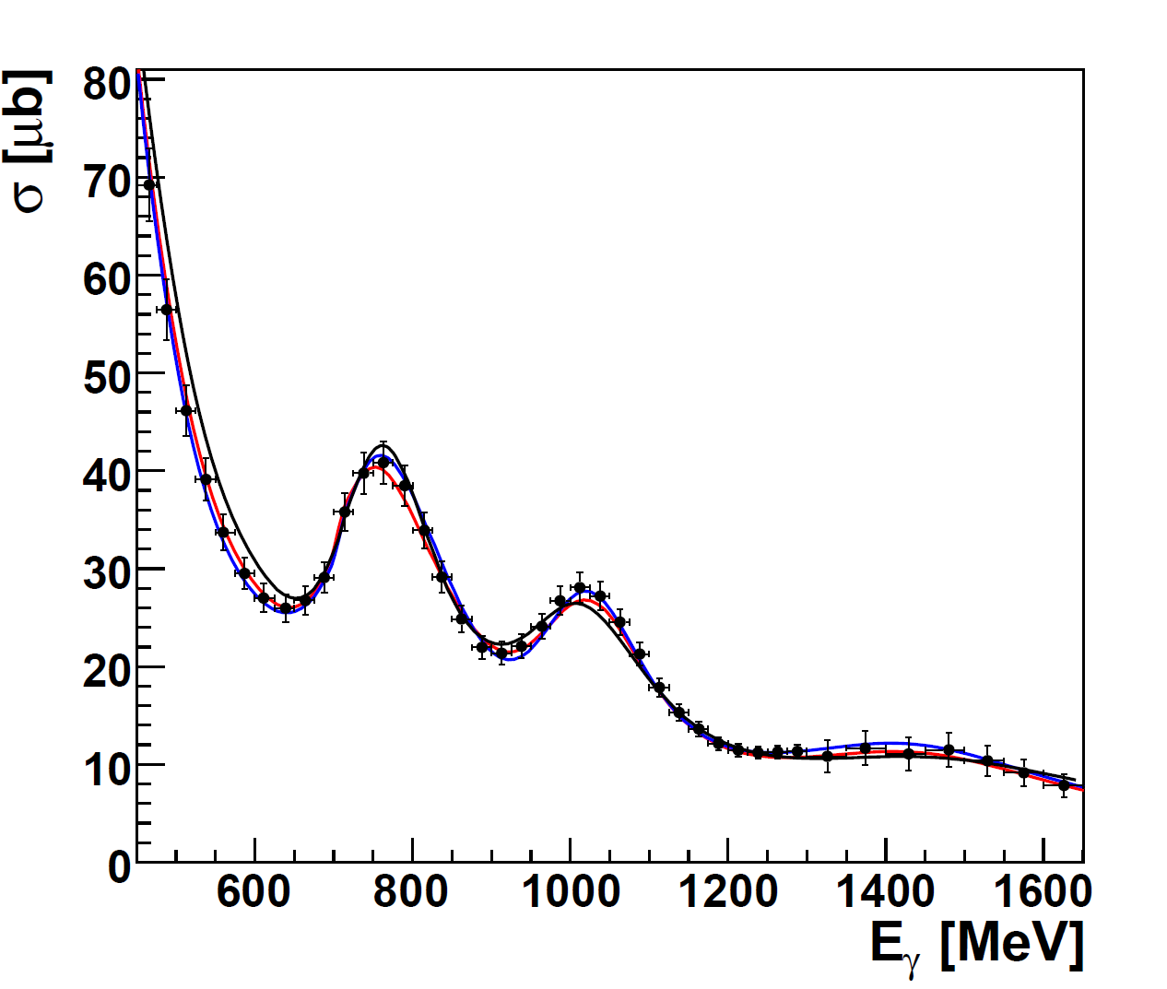

Problem with a Unique PWA Solution
2. resonance region
3. resonance region
Total cross section:
Partial wave analysis:
__ BnGa Bonn-Gatchina group
__ SAID Washington group
__ MAID Mainz group
Total cross section:
σ_{tot} ~ |A(P₃₃)|² + |A(D₁₃)|² + |A(F₁₅)|² + …..
no interferences between resonances

Slide 10

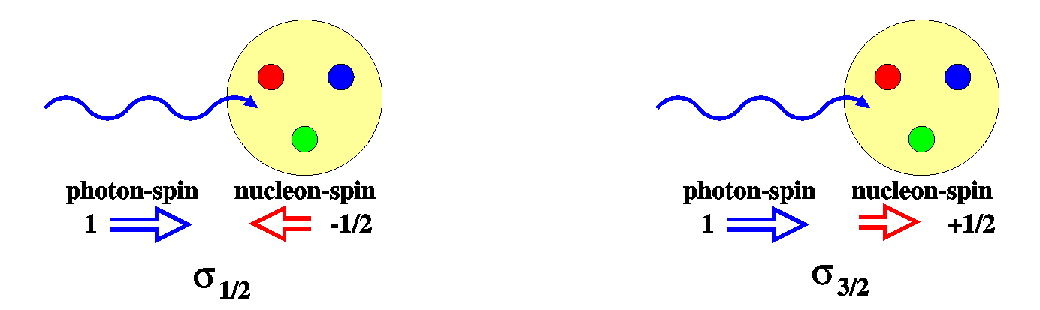
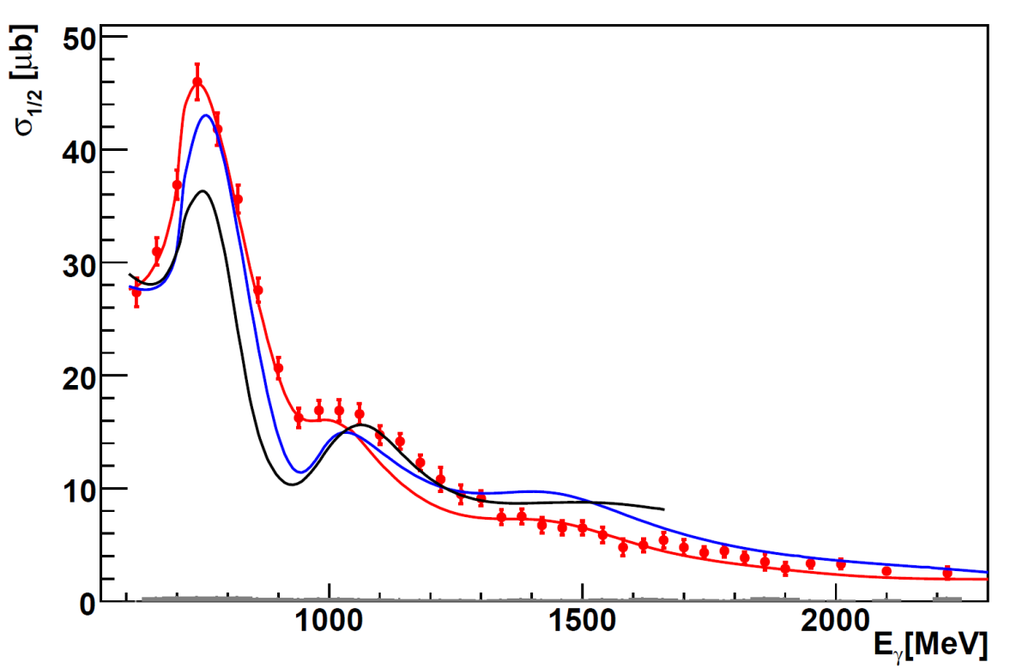
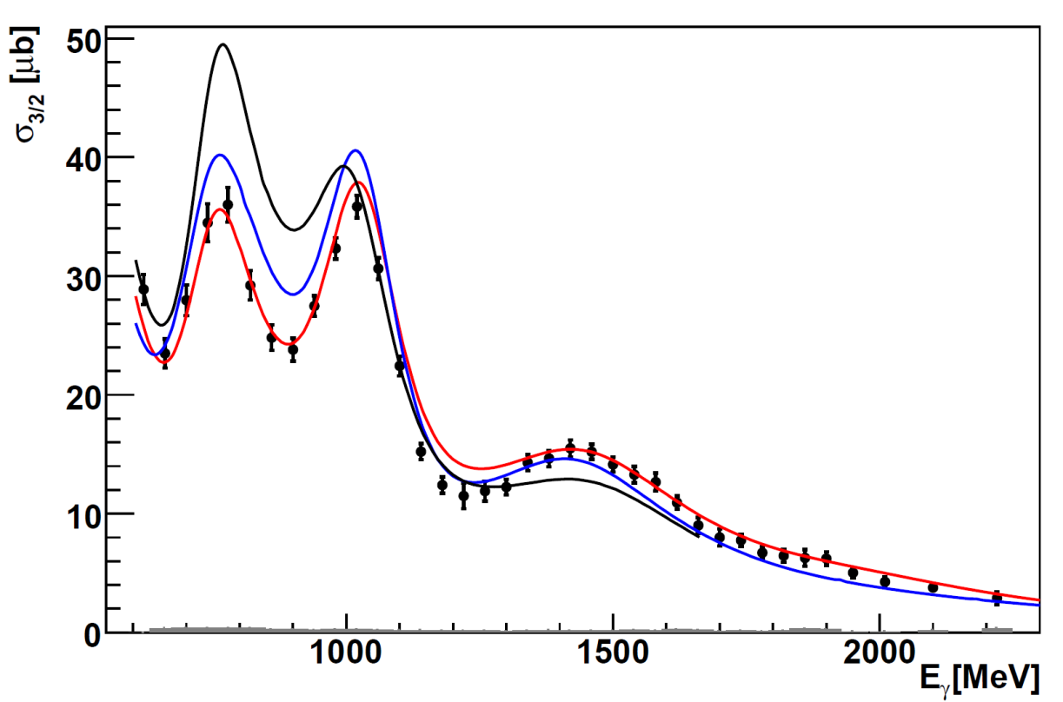
Helicity Dependent Cross Section for pπ⁰
reaction:
circularly polarized photons
longitudinally polarized proton
CBELSA/TAPS , M. Gottschall, PRL 112 (2014), 012003
σ_{1/2}
2. resonance region
σ_{3/2}
2. resonance region
3. resonance region
3. resonance region
4. resonance region
Helicity dependent cross section
σ_{1/2} ~ |A(P₃₃)|² + |A(D₁₃)|² + |A(F₁₅)|² + …..
+ Interference terms with same Lπ
like E₁₊ M₁₊ for P₃₃ or E₂₋ M₂₋ for D₁₃
4. resonance region
Partial wave analysis predictions :
__ BnGa
__ SAID
__ MAID

Slide 11

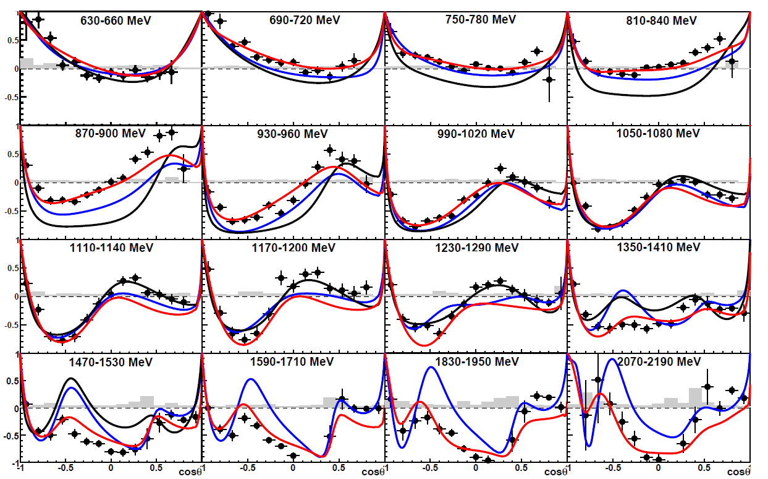
CBELSA/TAPS: Helicity Asymmetry E for pπ⁰
reaction:
CBELSA/TAPS, M. Gottschall, PRL 112 (2014), 012003
σ_{1/2} - σ_{3/2}
E =
σ_{1/2} + σ_{3/2}
Angular distributions
Sensitive to interference terms with different Lπ
Highest sensitivity to small resonance contributions
Partial wave analysis
prediction:
__ BnGa
__ SAID
__ MAID

Slide 12
Impact of the new polarization data
2. resonance region
3. resonance region
Which L_{max} is seen in the new polarization data ? −> Search for missing resonances
L_{max} = 0 , S-wave , resonances in S-wave: S₁₁(1535) , S₁₁(1650) , S₃₁(1620)
L_{max} = 1 , P-wave , resonances in P-wave: P₁₁(1440) , P₁₃(1710) , P₃₃(1232) , P₃₁(?) ,
L_{max} = 2 , D-wave , resonances in D-wave: D₁₃(1520), D₁₅(1680), D₃₃(1700) , D₃₅(?),
L_{max} = 3 , F-wave , resonances in F-wave: F₁₅(1680) , F₁₇(?) , F₃₅(?) , F₃₇(1950)
L_{max} = 4 , G-wave , resonances in G-wave: G₁₇(?) , G₁₉(?) , G₃₇(?) , G₃₉(?)

Slide 13
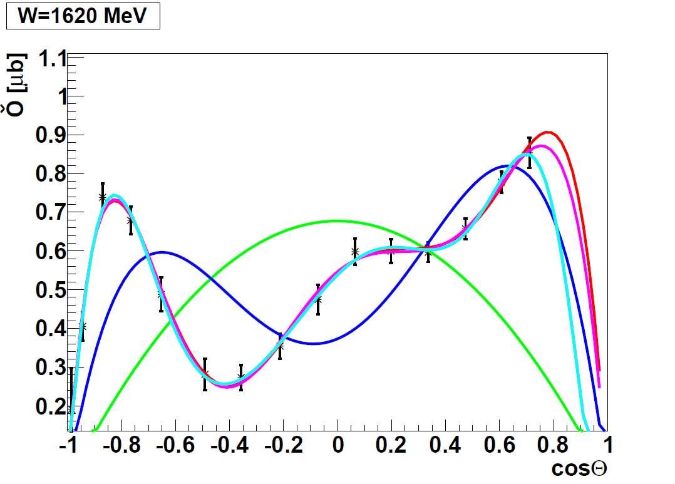
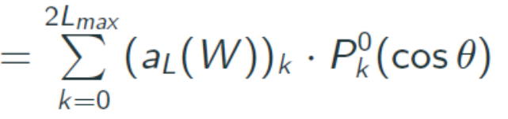
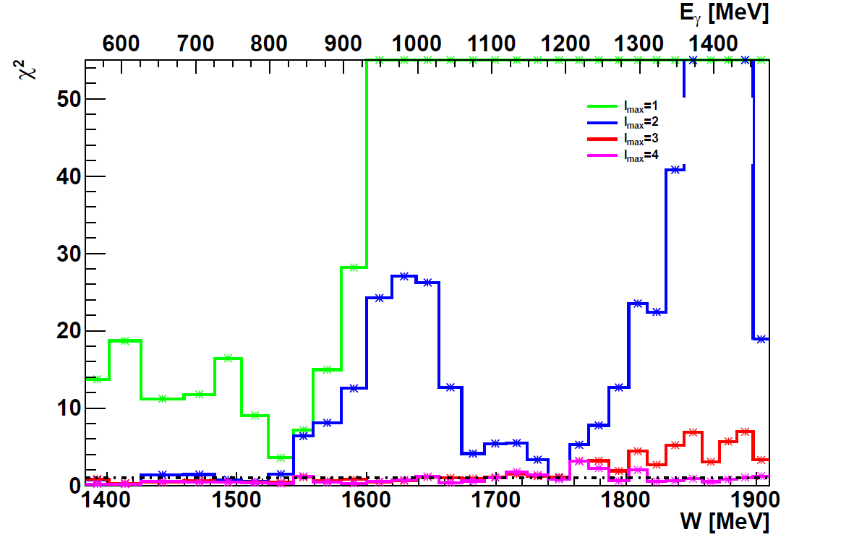
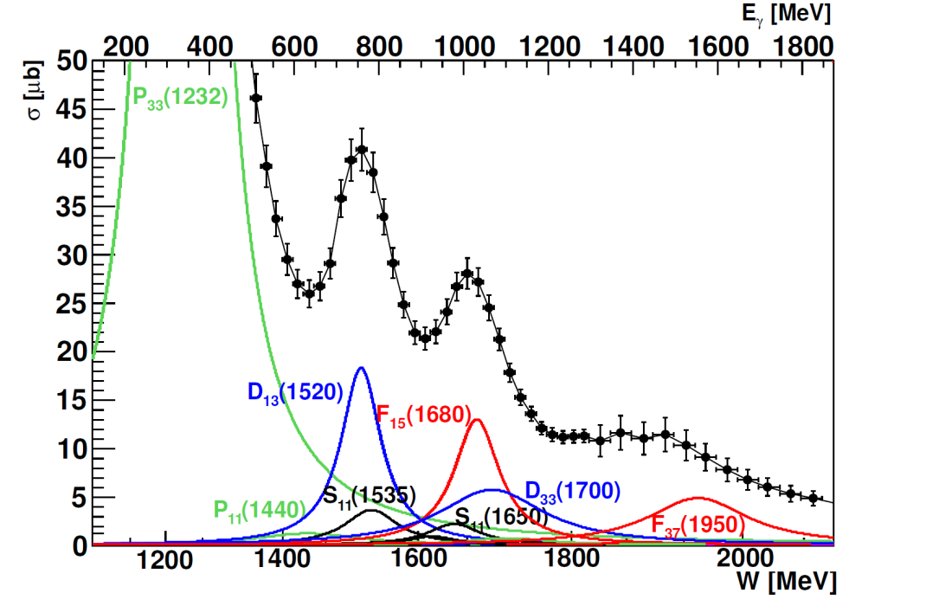
L_{max} Interpretation of Σ- Asymmetry in pπ⁰
___ L_{max} = 1
GRAAL data
___ L_{max} = 2
___ L_{max} = 3
Σ
___ L_{max} = 4

Slide 14
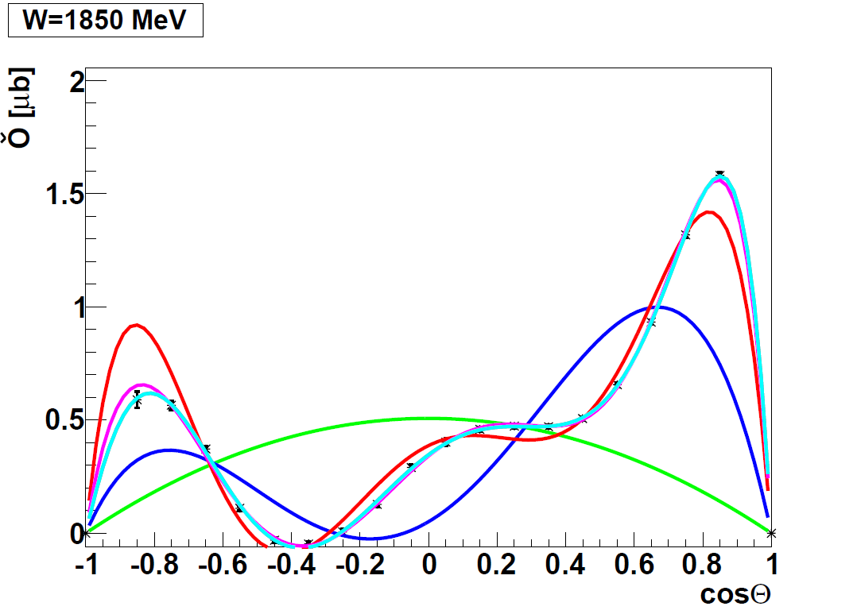
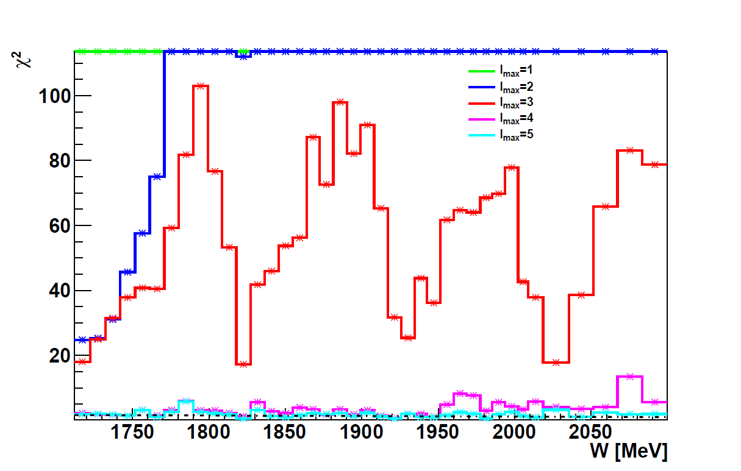
L_{max} Interpretation of Σ- Asymmetry in pπ⁰
CBELSA/TAPS
CLAS
Significant L = 3 signal seen
above W = 1500 MeV
Below L ≤ 2 seems to be sufficient
L = 4 signal above W = 1700 MeV
___ L_{max} = 1
___ L_{max} = 2
___ L_{max} = 3
___ L_{max} = 4
High precision data for Σ from
CBELSA/TAPS
CLAS

Slide 15
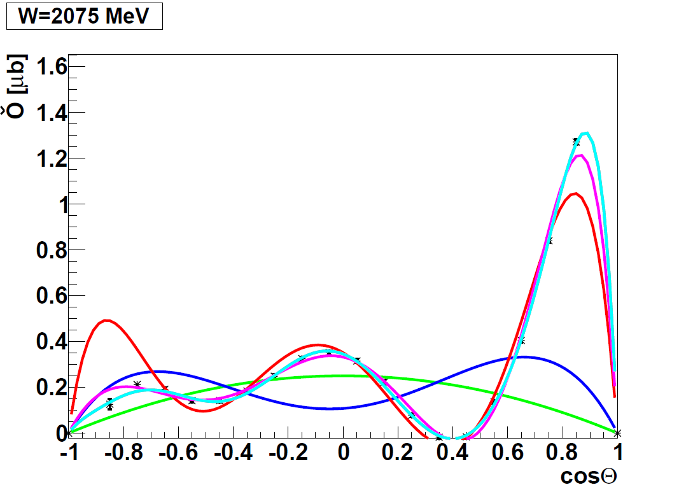
L_{max} Interpretation of Σ- Asymmetry in pπ⁰
CBELSA/TAPS
CLAS
Significant L = 3 signal seen
above W = 1500 MeV
Below W =1500 MeV
L ≤ 2 seems to be sufficient
L = 4 signal above W = 1700 MeV
___ L_{max} = 1
___ L_{max} = 2
___ L_{max} = 3
___ L_{max} = 4
High precision data for Σ from
CBELSA/TAPS
CLAS

Slide 16
L_{max} Interpretation of Σ- Asymmetry in pπ⁰
CBELSA/TAPS
CLAS
___ L_{max} = 1
Precision data are required
- for large L contributions
- full angular coverage and good angular resolution
- small systematic error in angular dependence
___ L_{max} = 2
___ L_{max} = 3
___ L_{max} = 4
___ L_{max} = 5

Slide 17
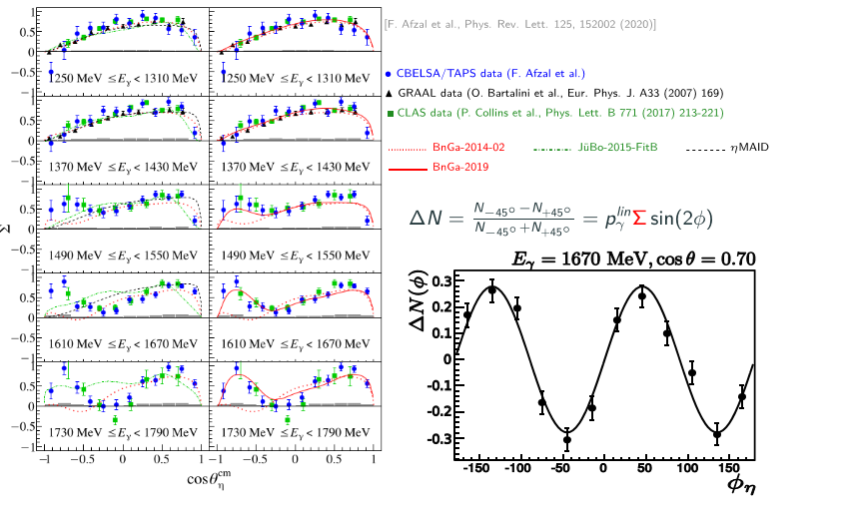
L_{max} Interpretation of Σ- Asymmetry in pη

Slide 18
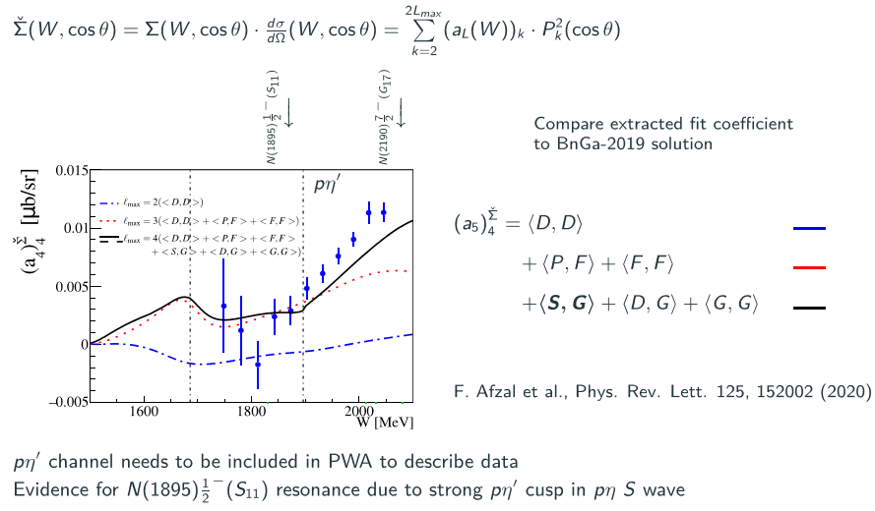
L_{max} Interpretation of Σ- Asymmetry in pη

Slide 19
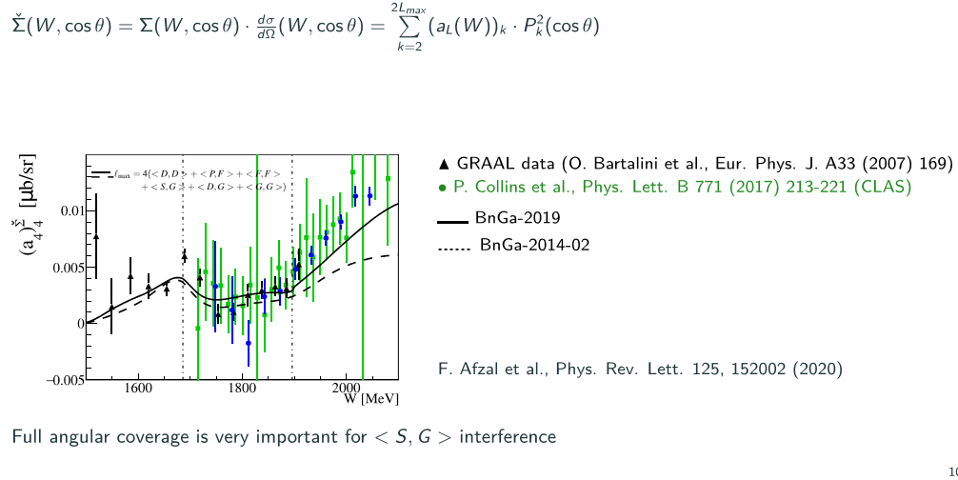
L_{max} Interpretation of Σ- Asymmetry in pη

Slide 20
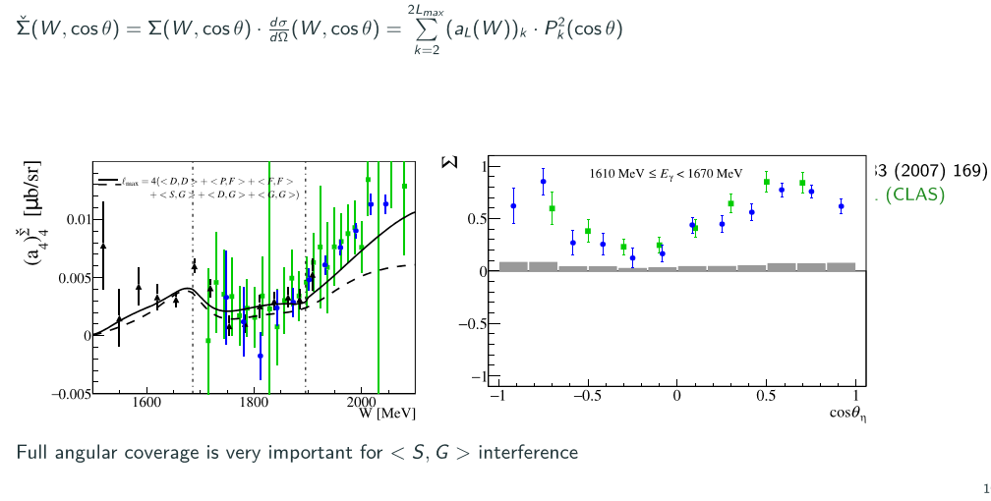
L_{max} Interpretation of Σ- Asymmetry in pη
GRAAL
CLAS
CBELSA/TAPS

Slide 21
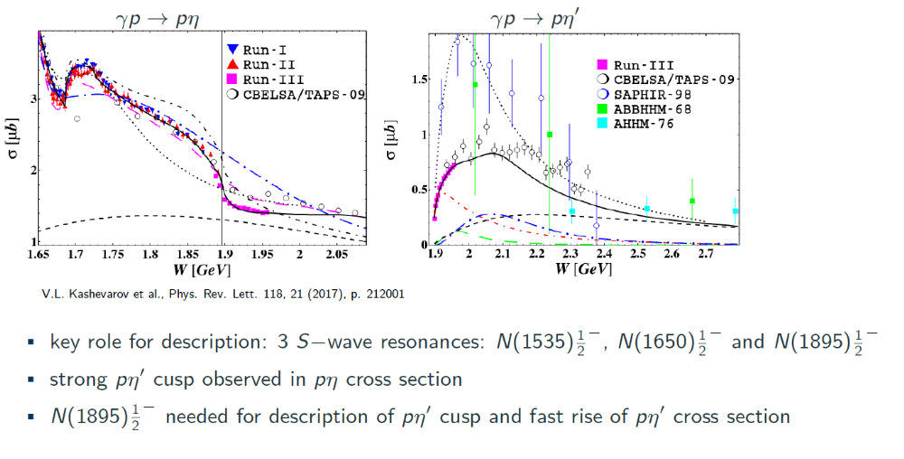
Third s-wave resonance N(1895)^{½}
Precise MAMI data for pη and pη’

Slide 22
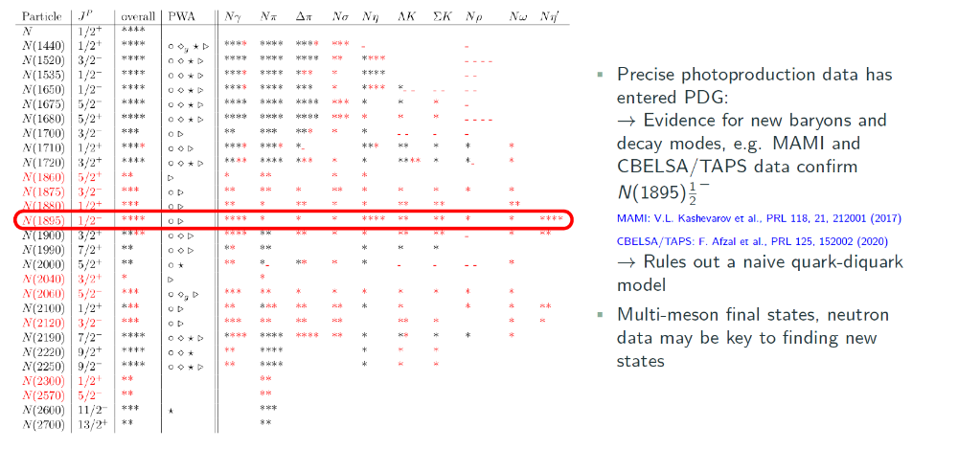
Impact of the polarization data

Slide 23
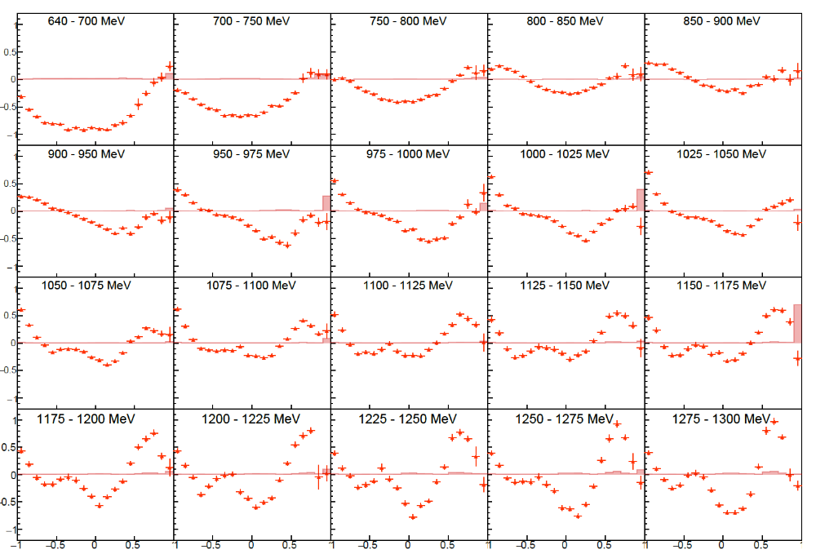
New precise target asymmetry data in pπ⁰
CBELSA/TAPS: S. Ciupka, PhD Thesis (2026), final data, to be published

Slide 24
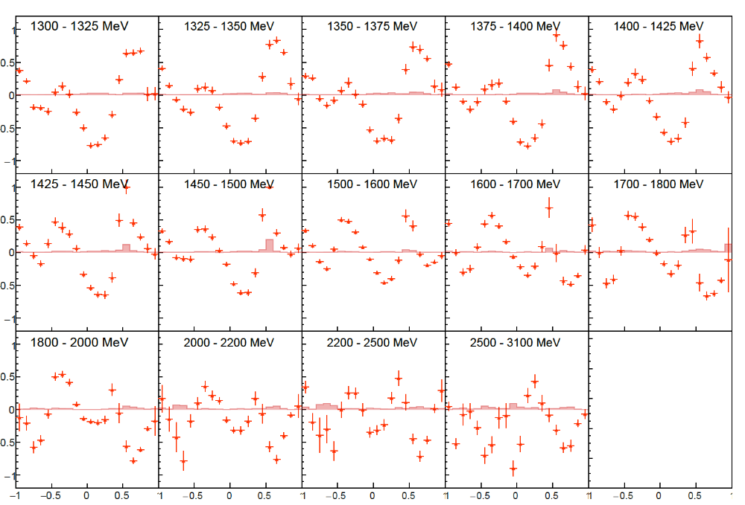
New precise target asymmetry data in pπ⁰
S. Ciupka, PhD Thesis (2026), final data, to be published

Slide 25
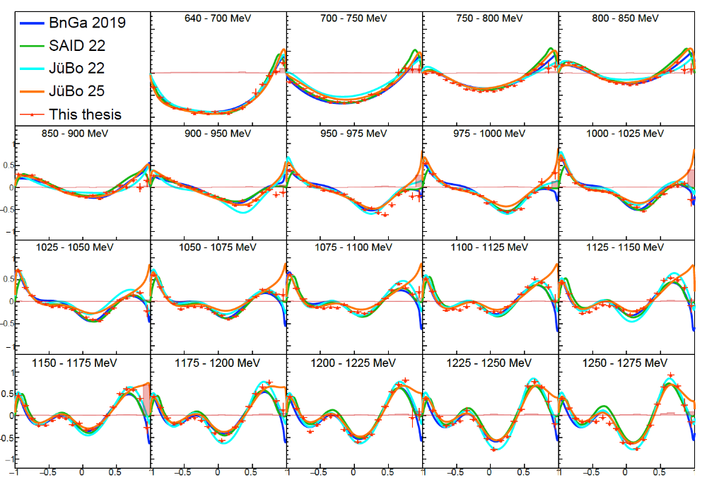
New precise target asymmetry data in pπ⁰
S. Cuipka, PhD Thesis (2026), final data, to be published

Slide 26
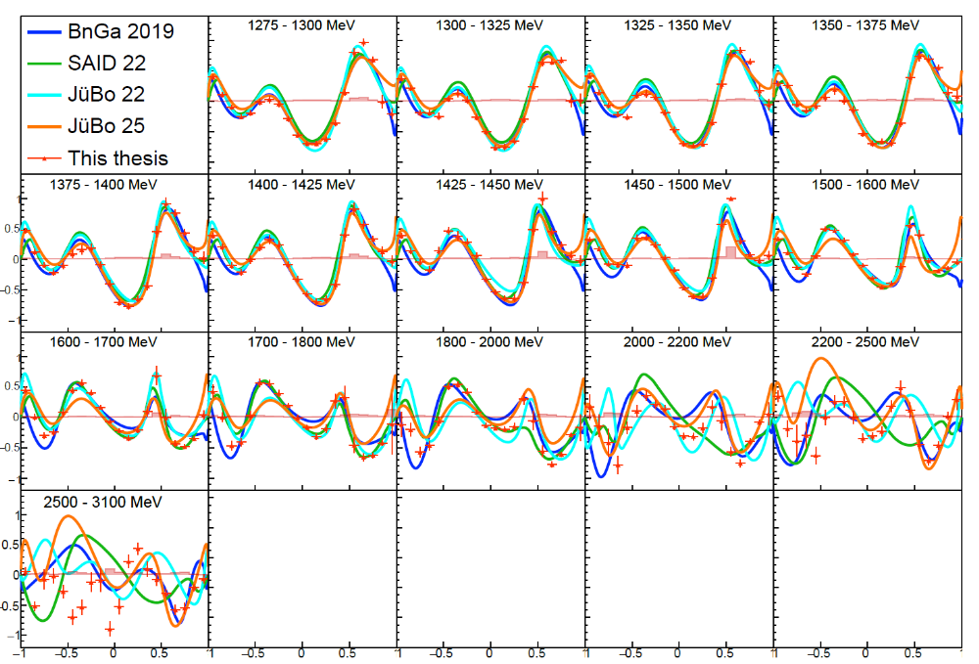
New precise target asymmetry data in pπ⁰
S. Ciupka, PhD Thesis (2026), final data, to be published

Slide 27
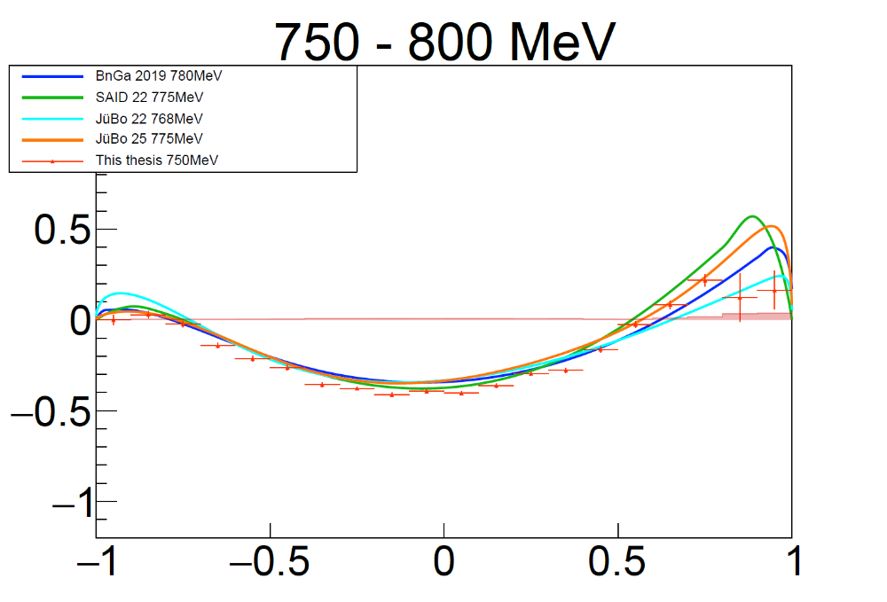
New precise target asymmetry data in pπ⁰
CBELSA/TAPS: S. Ciupka, PhD Thesis (2026), final data, to be published
Existing data on T constrain
the PWA solutions
CBELSA/TAPS
J. Hartmann et al., 2017
CLAS
H. Jiang et al., 2025

Slide 28
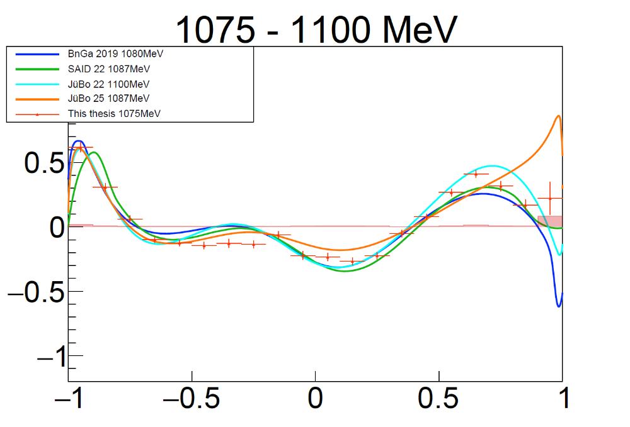
New precise target asymmetry data in pπ⁰
CBELSA/TAPS: S. Ciupka, PhD Thesis (2026), final data, to be published
Medium energy range
Extreme forward and
Backward angle ?

Slide 29
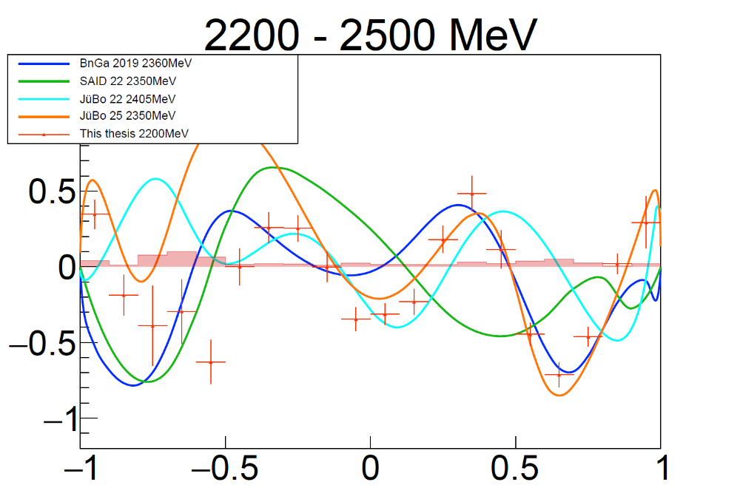
New precise target asymmetry data in pπ⁰
CBELSA/TAPS: S. Ciupka, PhD Thesis (2026), final data, to be published
High energy region
Prediction of PWAs in
discrepancy with new
data

Slide 30
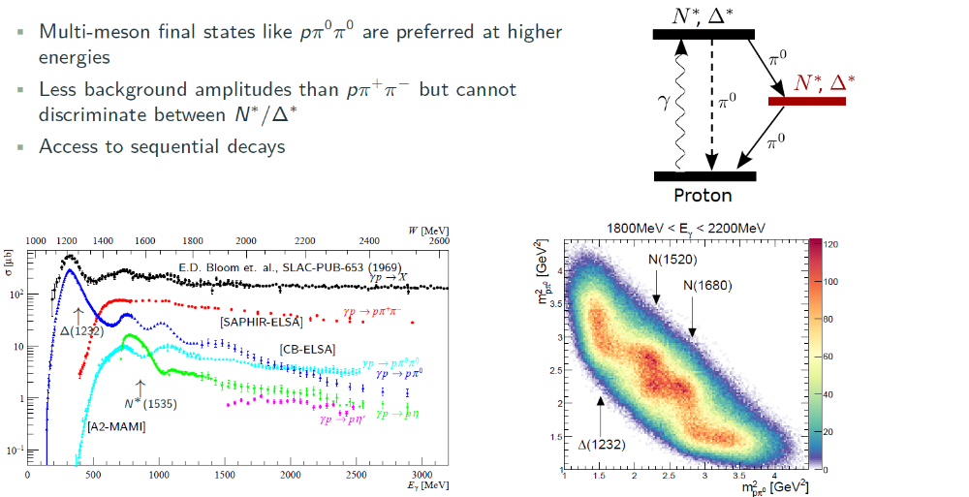
Importance of cascade decays in N ππ
Neutron data in π⁰π⁰ and π⁰η
Proton data in π⁰π⁰ and π⁰η
N. Reinertz, PhD Thesis, will finish in 2027
T. Seifen, et al., Eur. Phys. J. A.61 (2025) 7, 173
Talk: L. Reschke
N. Stausberg, PhD Thesis (2025), final data, to be published

Slide 31


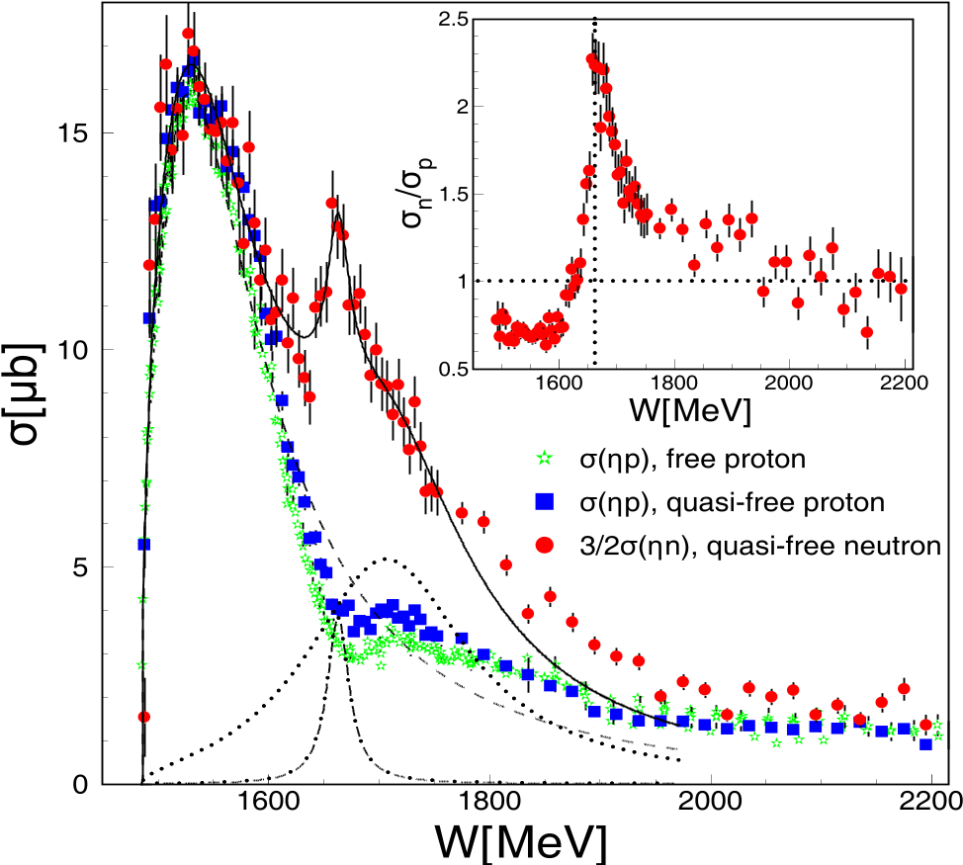
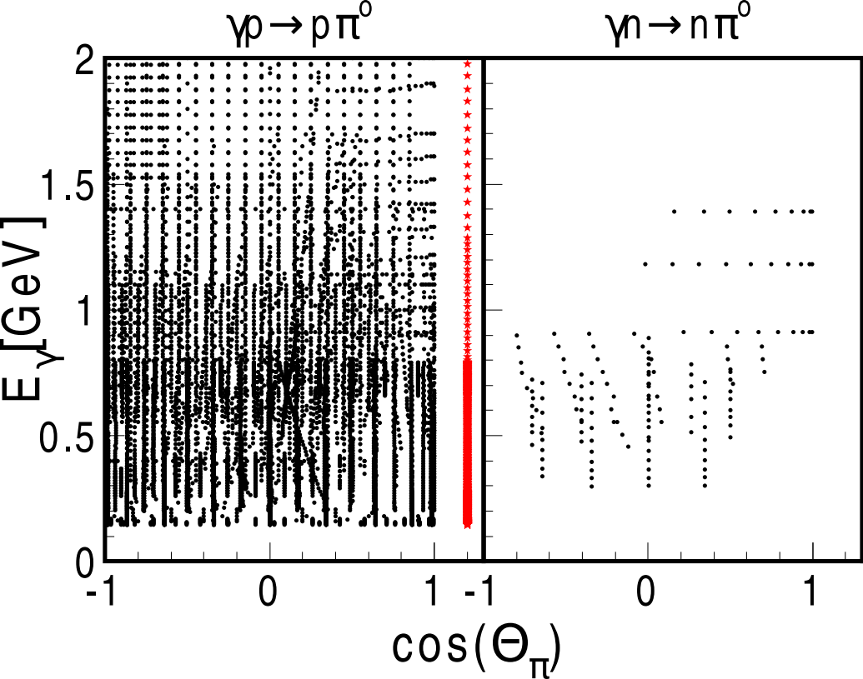
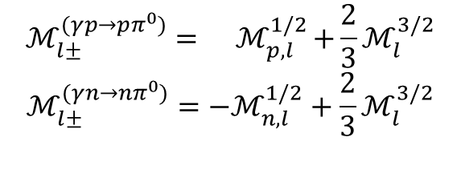
Spectroscopy off the Neutron
Nucleon resonances (Isospin I =1/2) couple differently to Neutron and Proton
$$ℳ_{l±}^{(γp→pπ^{0})}={ ℳ}_{p,l}^{1/2}+\frac{2}{3}ℳ_{l}^{3/2}$$
$$ℳ_{l±}^{(γn→nπ^{0})}=−ℳ_{n,l}^{1/2}+\frac{2}{3}ℳ_{l}^{3/2}$$
CBELSA/TAPS, I. Jaegle, PRL 100 (2008), 252002
CBELSA/TAPS experiment has been upgraded for measurements on the neutron

Slide 32
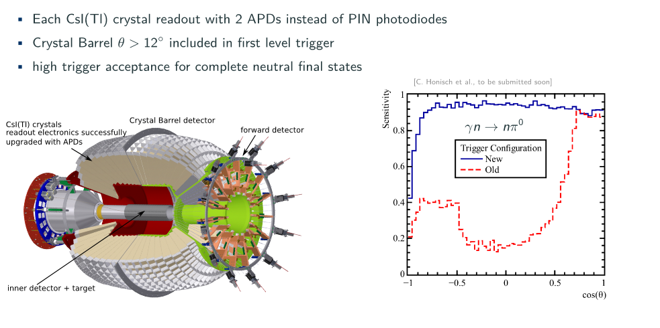
Upgrade of the CBELSA/TAPS-Experiment
C. Honisch et al., arXiv:2212.12364
Since NSTAR 2022 :
New data on T, P, H off the proton for different final states
New data on T, P, H off the neutron for different final states

Slide 33
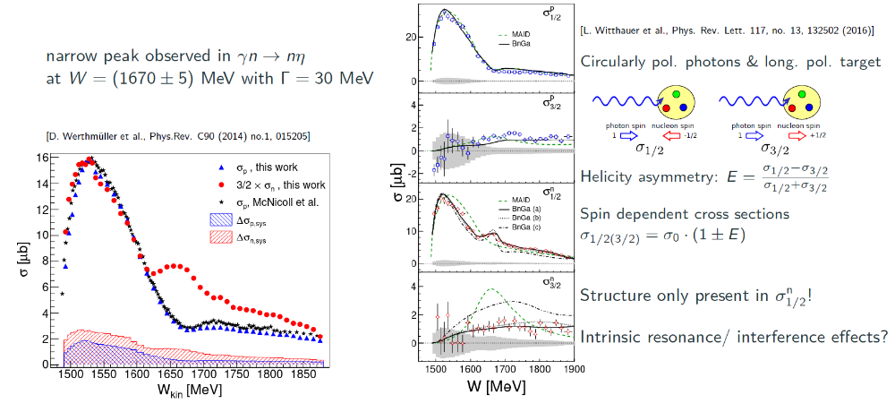
Measurements off Neutron: narrow peak in nη

Slide 34
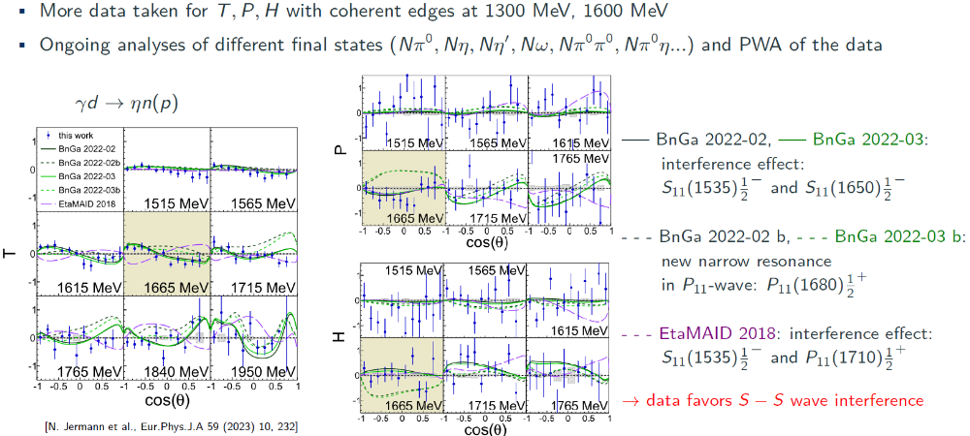
Measurements off Neutron: narrow peak in nη
N. Jerman et al. Eur. Phys. J. A 59 (2023) 10, 232

Slide 35
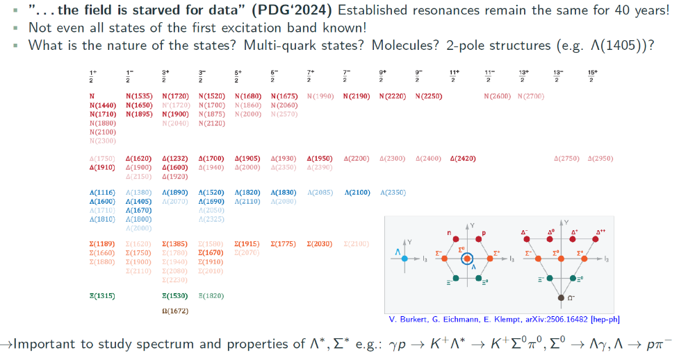
Baryon Spectroscopy Future at ELSA

Slide 36
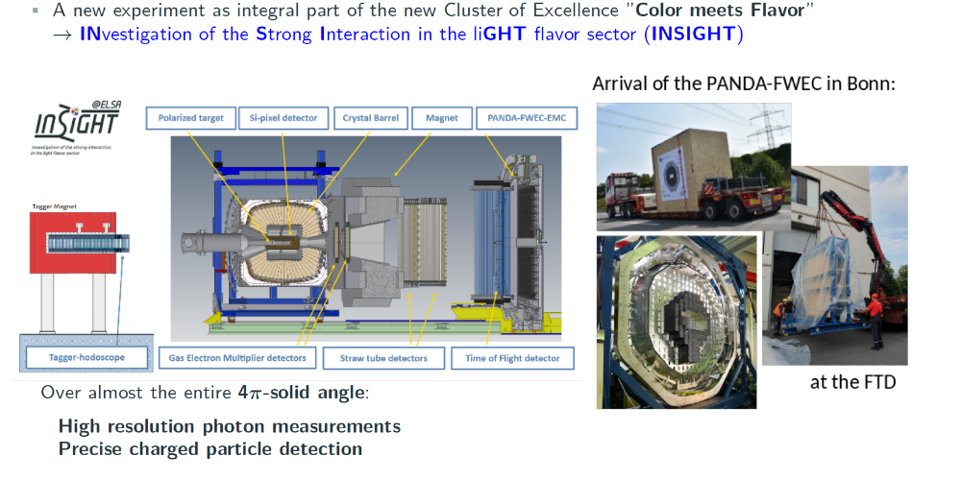
Major Upgrade of CBELSA/TAPS-Experiment
Talk on Thursday: U. Thoma
Funding:
- Major detector upgrade
- ELSA infrastructure
- a new Professor position in accelerator physics

Slide 37
Summary
Precise polarization data from ELSA, JLab and MAMI
- polarization data are essential to get unique PWA- solution
- full angular coverage and precision is important to find high spin states
- different final states are important, coupled channel analysis
Impact of the new polarization data
- the new polarization data constrain the possible PWA solutions
- new states have been found, for example N(1895)^{1/2 -}
Baryon Spectroscopy Future at ELSA
In the high W-mass region
p η , p η‘ , Ν ππ and K⁺ Λ , K⁺ Σ⁰ will be important
- the necessary precision in the data is still missing
Major upgrade of CBELSA/TAPS experiment
- new INSIGHT experiment
Talk:N. Kolanus
Talk:T. Jude
Talk: U. Thoma
Talk: L. Reschke

Slide 38
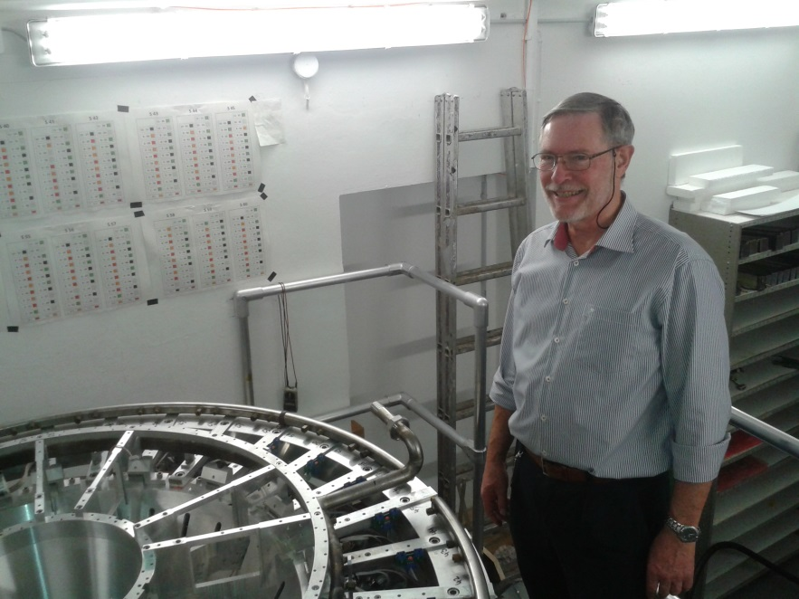
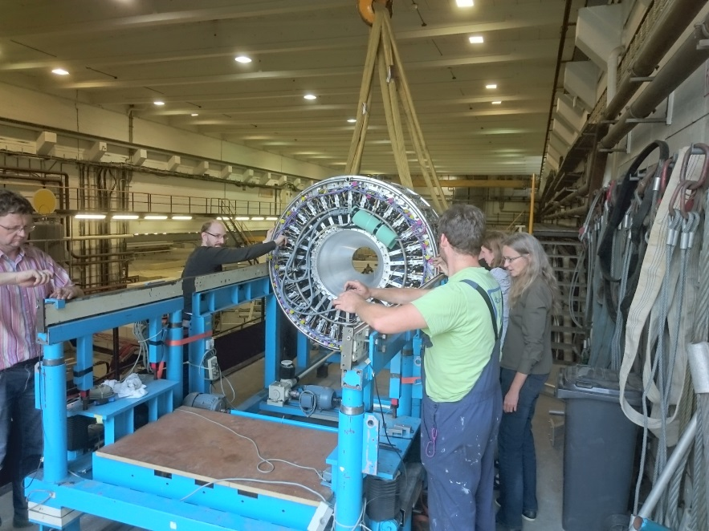
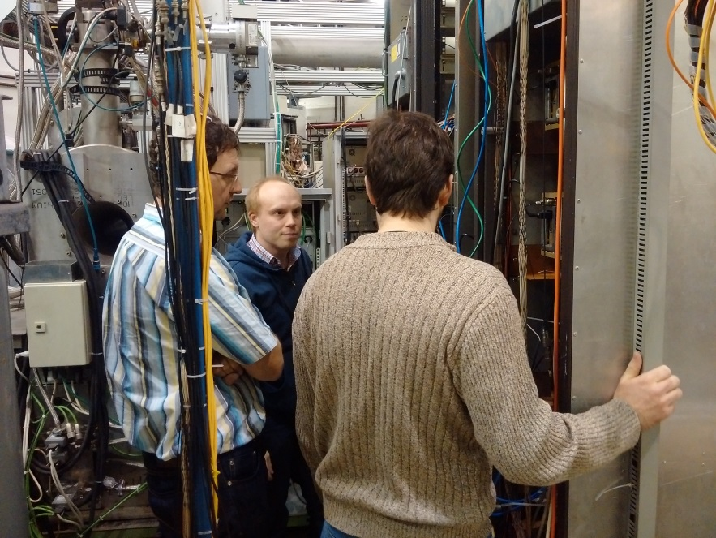
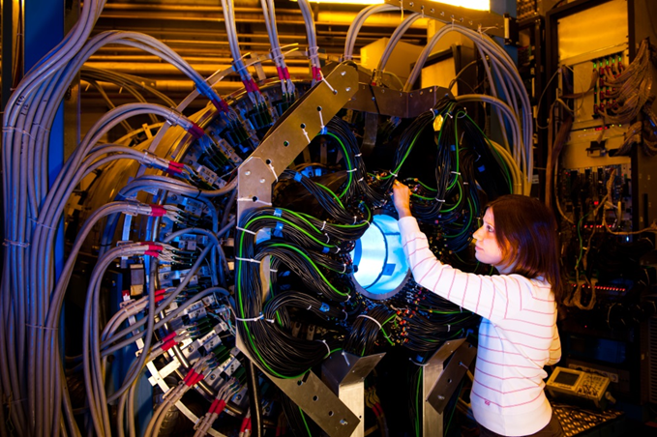
Thank you for your attention

Slide 39
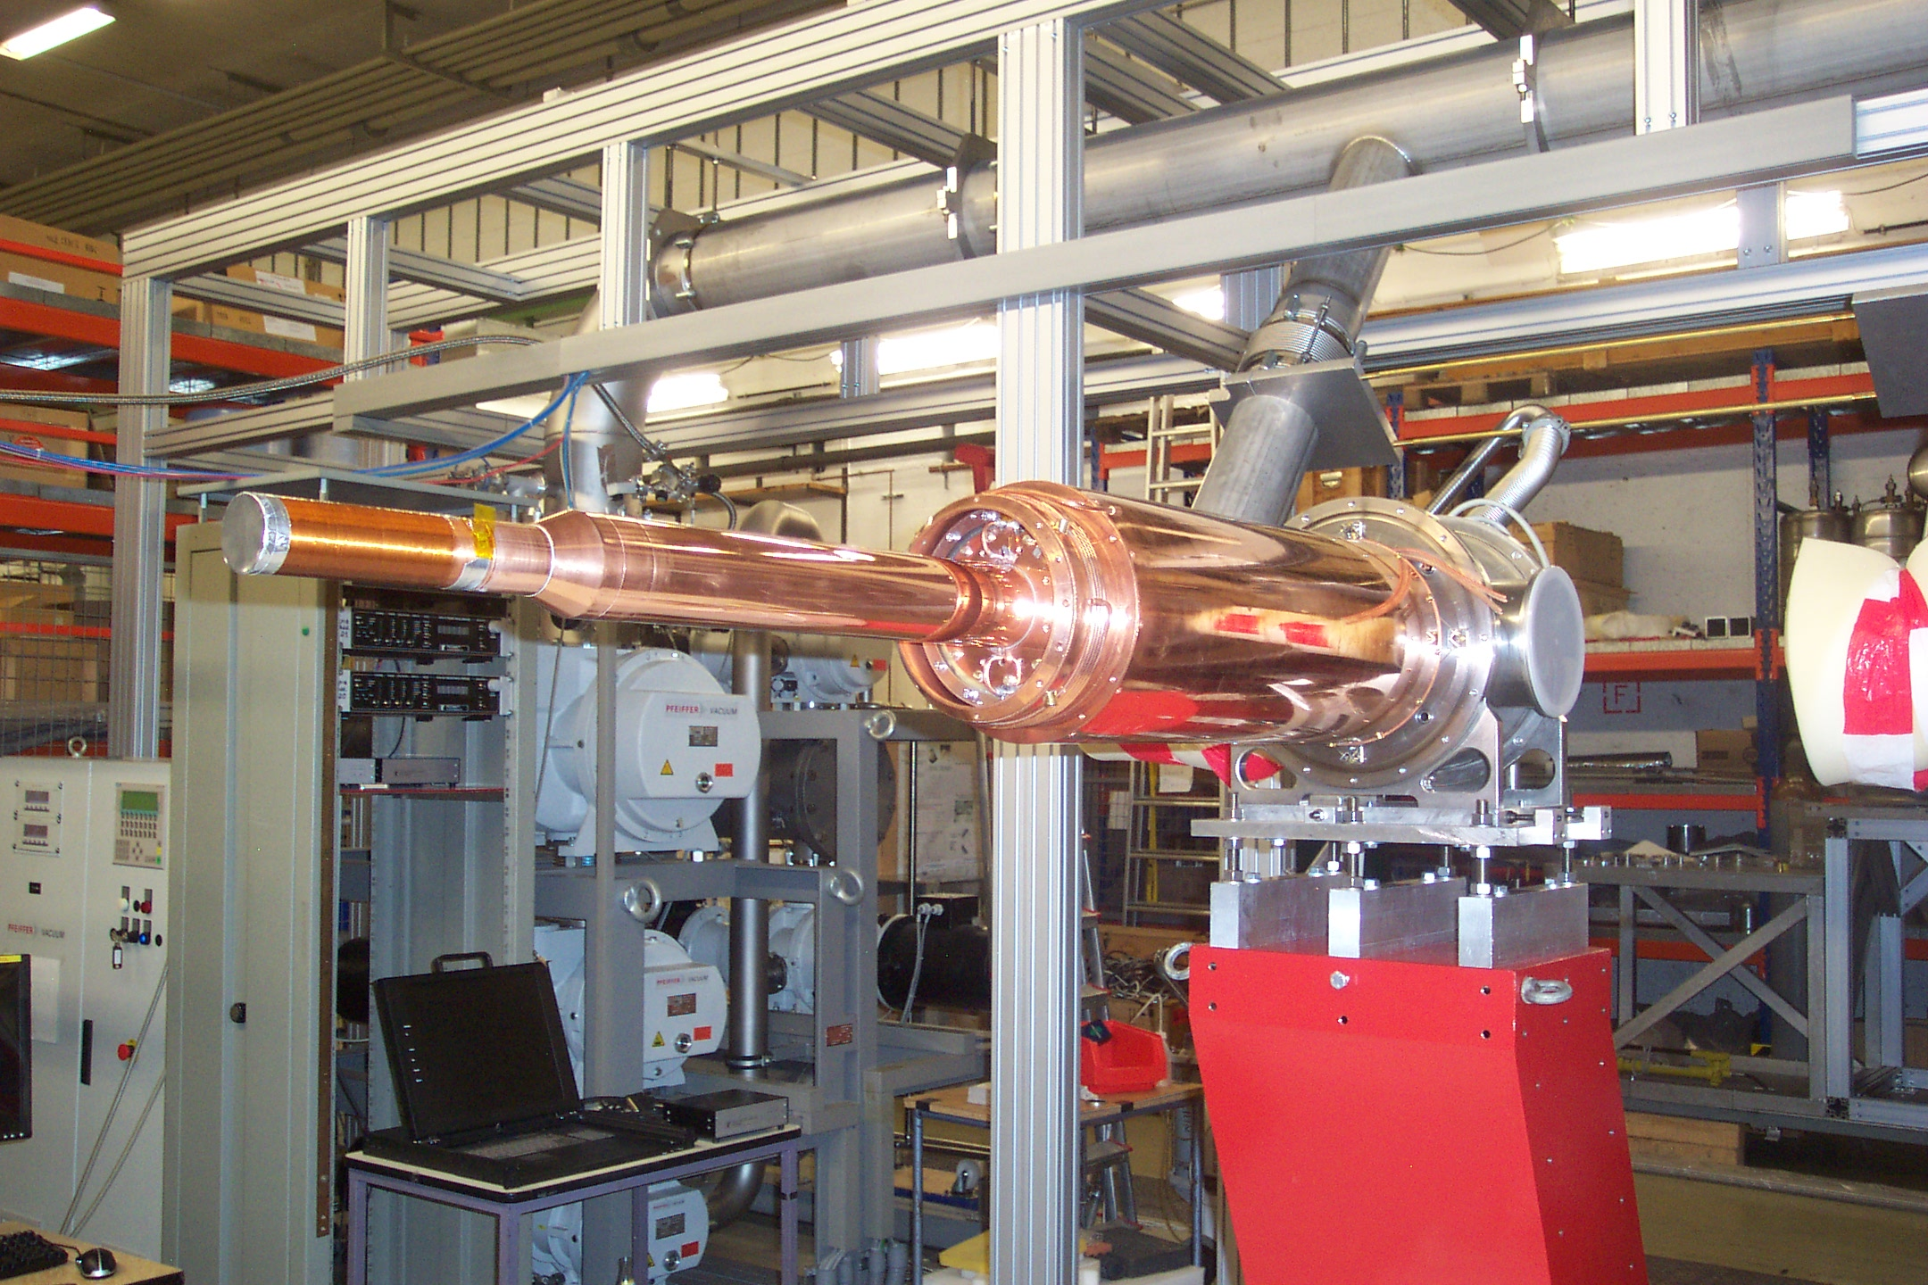
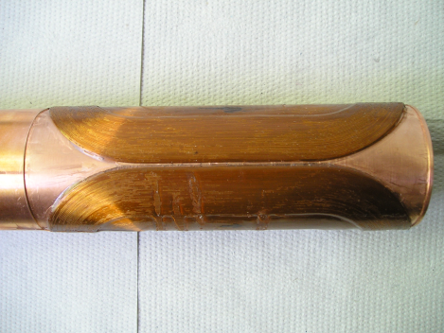
Mainz-Dubna Polarized Target at ELSA
Mainz-Dubna polarized target :
³He⁴He Dilution refrigerator (Mainz, JINR Dubna)
based on Bonn Frozen spin target design
Frozen spin target (25 mK at 0.6 T)
Transverse holding coil (saddle coil at 1.2 K)
Since 2010 in operation with the Crystal Ball
at MAMI, since 2017 in Bonn
Operated and maintained by Bonn, Bochum, Dubna and Mainz polarized target groups (H. Dutz, G. Reichertz, Y. Usov and A. Thomas)
Great Thanks to Mainz !
Common effort of the Bonn, Bochum, Dubna and Mainz polarized target groups
New second ³He⁴He Dilution refrigerator at Bonn finished and under tests
Corona and the Ukrainian war delayed the final tests

Slide 40
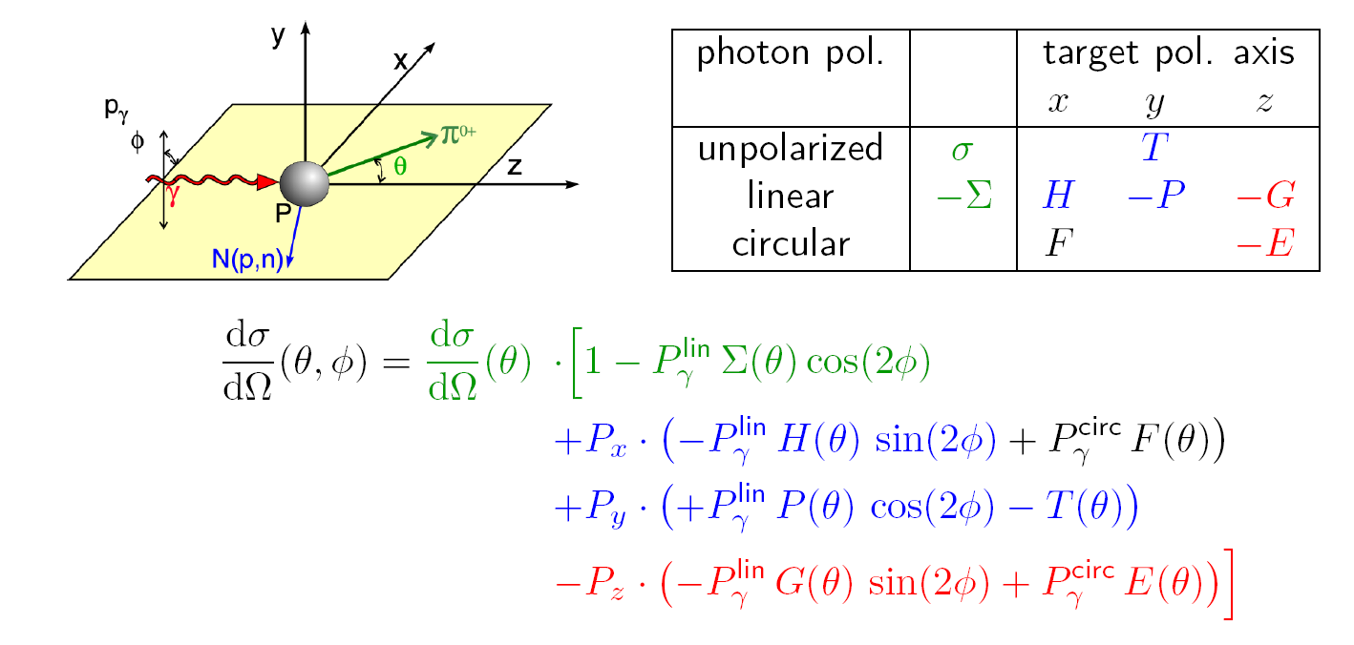

Beam-Target Polarization Observables
photoproduction of pseudoscalar mesons with polarized beam and target :
all three single polarization observables Σ, P , T and cross section σ
4 double polarization observables G , E , F and H
can be measured
ELSA- Experiments:
Data on all three single pol. observables Σ, P , T and diff. cross section σ
and on four double polarization observables G , E and H and (F)
for and

Slide 41
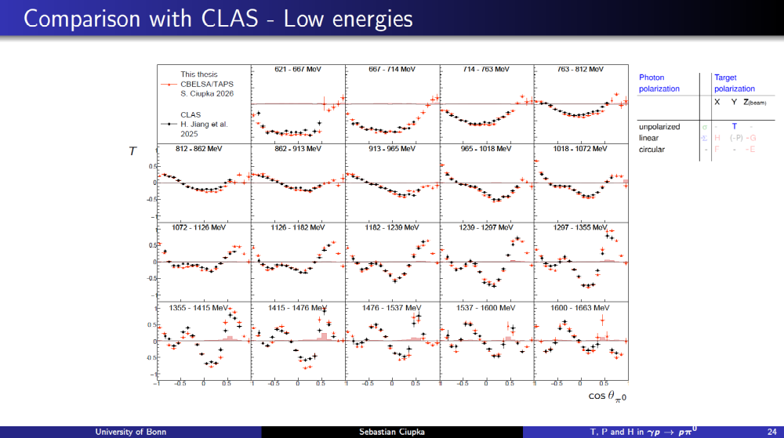

Slide 42


