Slide 1

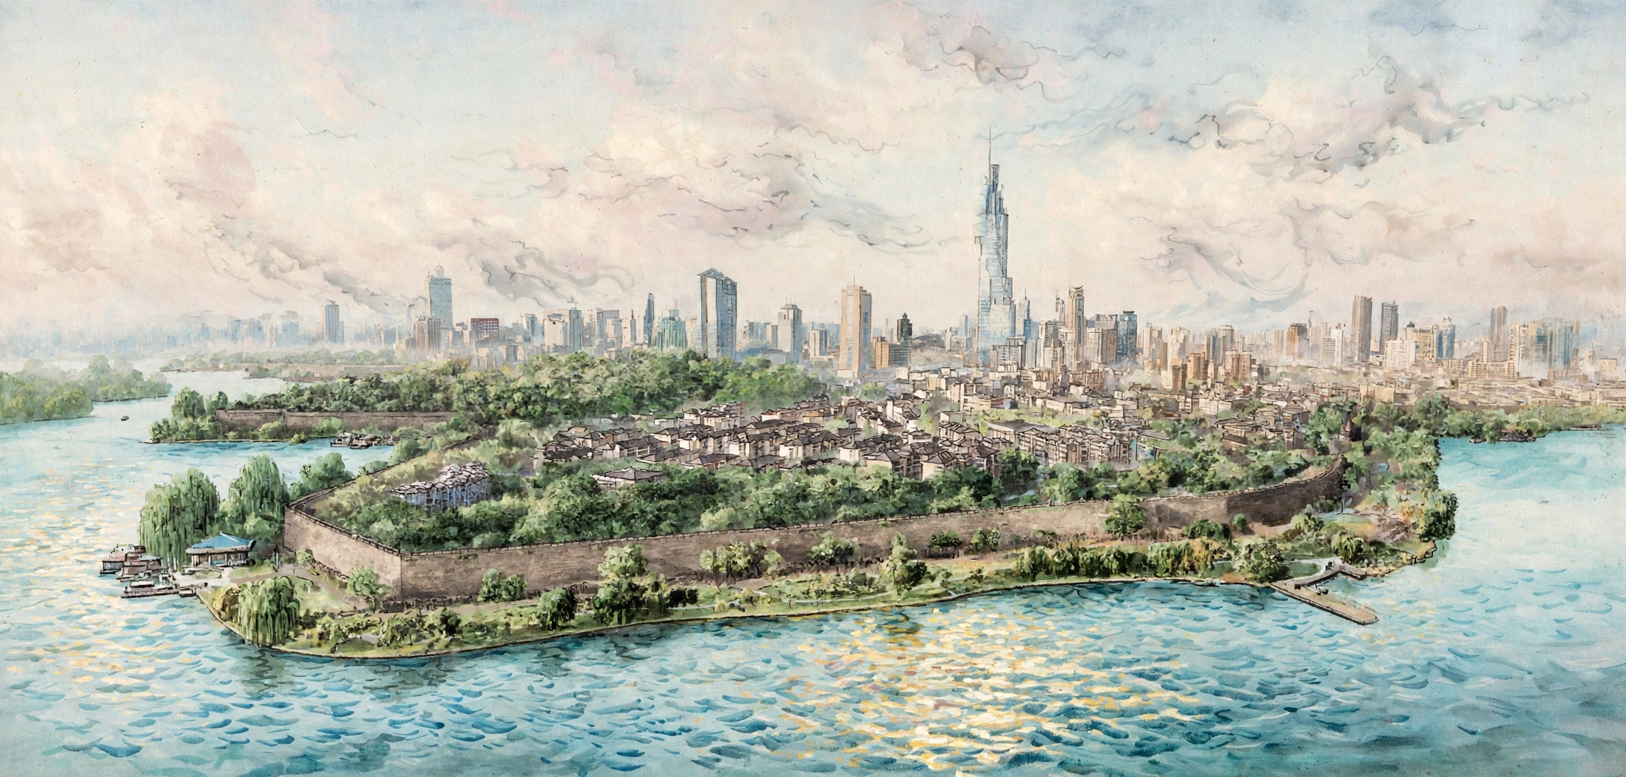
Grant no. 12135007
Craig Roberts … http://inp.nju.edu.cn/
Insights into N Resonances using CSMs
Notes:
25+5

Slide 2
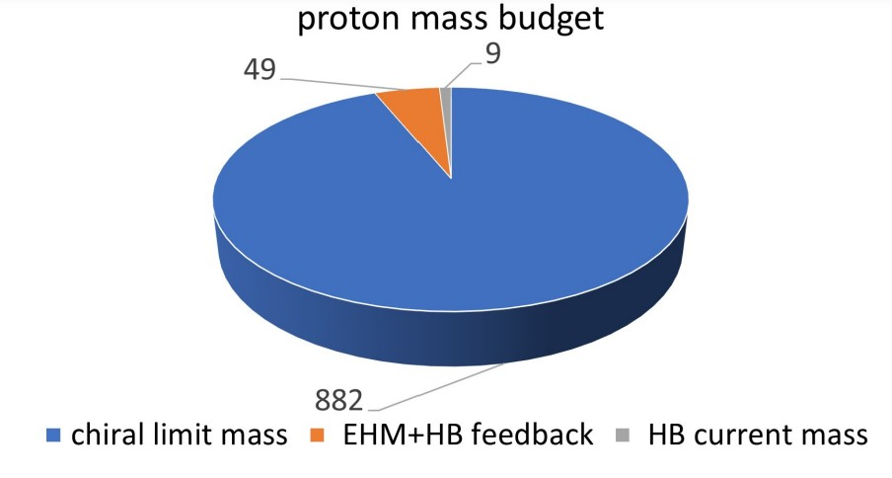
Emergence of Hadron Mass
Standard Model of Particle Physics has one obvious mass-generating mechanism
= Higgs Boson … impacts are critical to evolution of Universe as we know it
But … Proton mass budget … only 9 MeV/939 MeV is directly from Higgs
Evidently, there is another phenomenon in Nature that is very effective in producing mass:
Emergent Hadron Mass (EHM)
  Alone, it produces 94% of the proton’s mass
  Remaining 5% is generated by constructive interference between EHM and Higgs-boson
What is EHM?
Does it have a reductionist explanation,
i.e. like a Swiss watch, can it be explained by mere “mechanics”
If so, what is it and does it lie within the Standard Model?

Slide 3
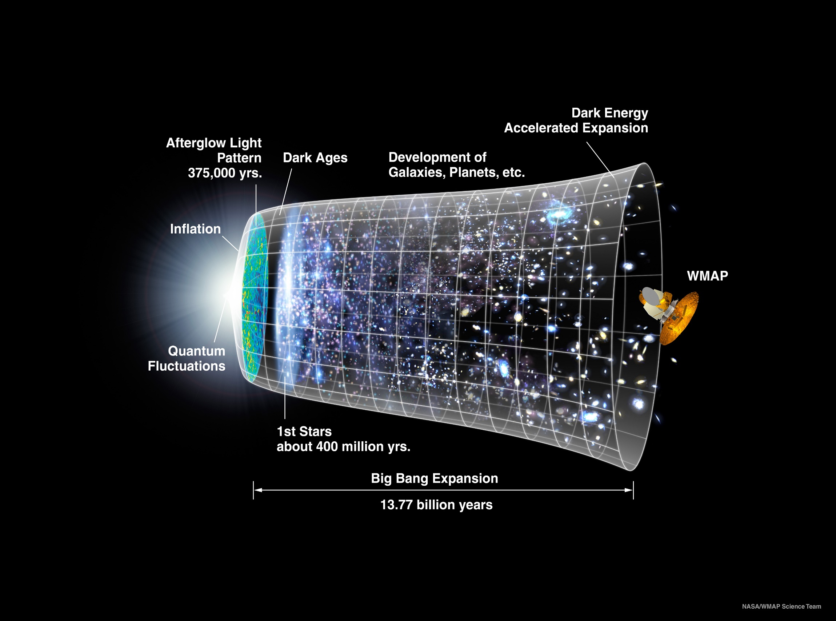
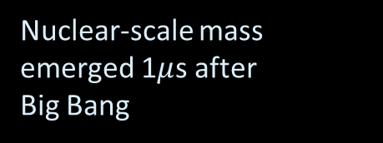
Our Universe
Nuclear-scale mass emerged 1$μ$s after
Big Bang
Its appearance was crucial to the formation of the Universe as we know it

Slide 4









Fundamental Science Questions for 21st Century
How do Hadron Masses Emerge?
How do Hadron Spins Emerge?
What role, if any, do gluons play
in producing emergent features of strong interactions?
To answer these questions
  International community is operating, building, and planning an array of high-intensity facilities with the potential for delivering answers
Can’t build a Theory of Everything
before status of QCD is decided
Notes:
20+5

Slide 5


Origin of Mass: The Frontier of Physics
In the Beginning…

Slide 6
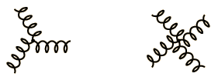
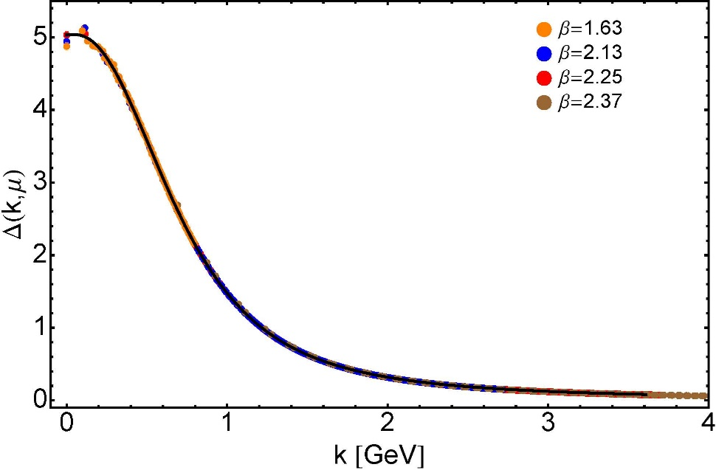
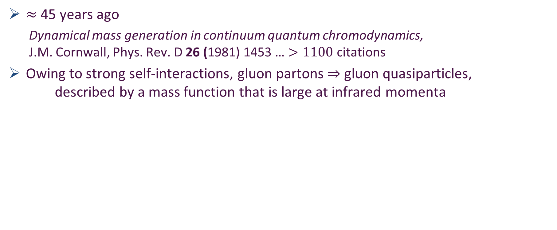
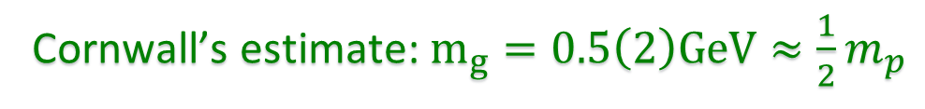

Ancient History
Cornwall’s estimate: $m_{g}=0.5\left(2\right)GeV≈\frac{1}{2}m_{p}$
$≈$ 45 years ago
  Dynamical mass generation in continuum quantum chromodynamics,
  J.M. Cornwall, Phys. Rev. D 26 (1981) 1453 … $>1100$ citations
Owing to strong self-interactions, gluon partons $⇒$ gluon quasiparticles,
described by a mass function that is large at infrared momenta
3-gluon vertex
4-gluon vertex
$$\frac{1}{m_{g}^{2}}$$
Truly mass from nothing
An interacting theory, written in terms of massless gluon fields, produces dressed gluon fields that are characterised by a mass function that is large at infrared momenta
Gluon propagator … continuum and lattice QCD agree
QCD fact
Continuum theory and lattice simulations agree
Empirical verification?

Slide 7
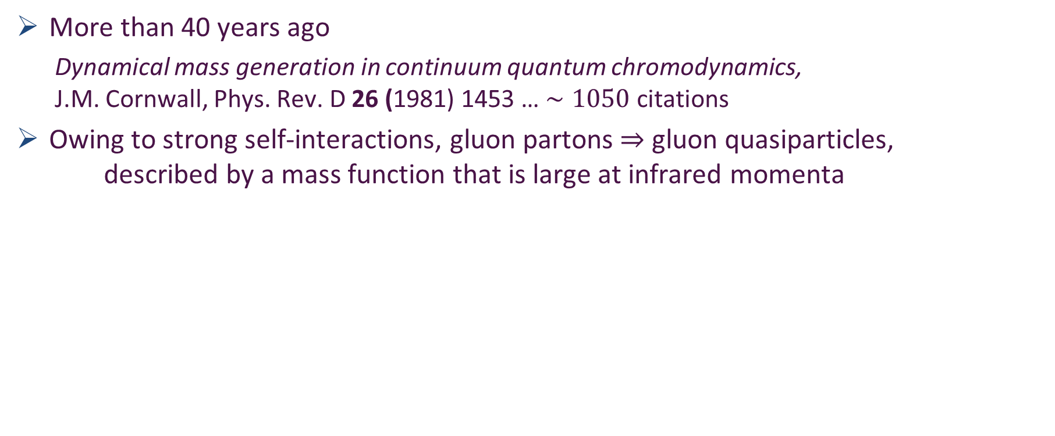
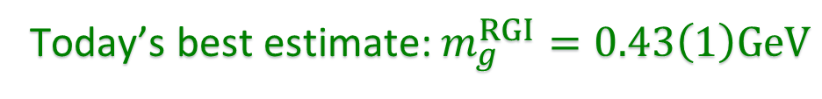

Ancient History
D. Binosi, Emergent Hadron Mass in Strong Dynamics, Few Body Syst. 63 (2022) 42.
M. N. Ferreira, J. Papavassiliou, Gauge Sector Dynamics in QCD, Particles 6 (1) (2023) 312–363.
D. Binosi, Gauge Symmetry Beyond Perturbation Theory: BRST and anti-BRST Structure, Background Fields, and Infrared Dynamics of Yang--Mills Theory, Particles 9 (2026) 2, 59
Today’s best estimate: $m_{g}^{RGI}=0.43\left(1\right)GeV$
EHM means
Gluons are massive via Schwinger Mechanism
More than 40 years ago
  Dynamical mass generation in continuum quantum chromodynamics,
  J.M. Cornwall, Phys. Rev. D 26 (1981) 1453 … $∼1050$ citations
Owing to strong self-interactions, gluon partons $⇒$ gluon quasiparticles,
described by a mass function that is large at infrared momenta
Gauge Invariance and Mass,
J. S. Schwinger
Phys. Rev. 125 (1962) 397-398
It is argued that the gauge invariance of a vector field does not necessarily imply zero mass for an associated particle if the current vector coupling is sufficiently strong.
3-gluon vertex
4-gluon vertex
$$\frac{1}{m_{g}^{2}}$$
Truly mass from nothing
An interacting theory, written in terms of massless gluon fields, produces dressed gluon fields that are characterised by a mass function that is large at infrared momenta
Gluon propagator … continuum and lattice QCD agree
QCD fact
Continuum theory and lattice simulations agree
Empirical verification?

Slide 8

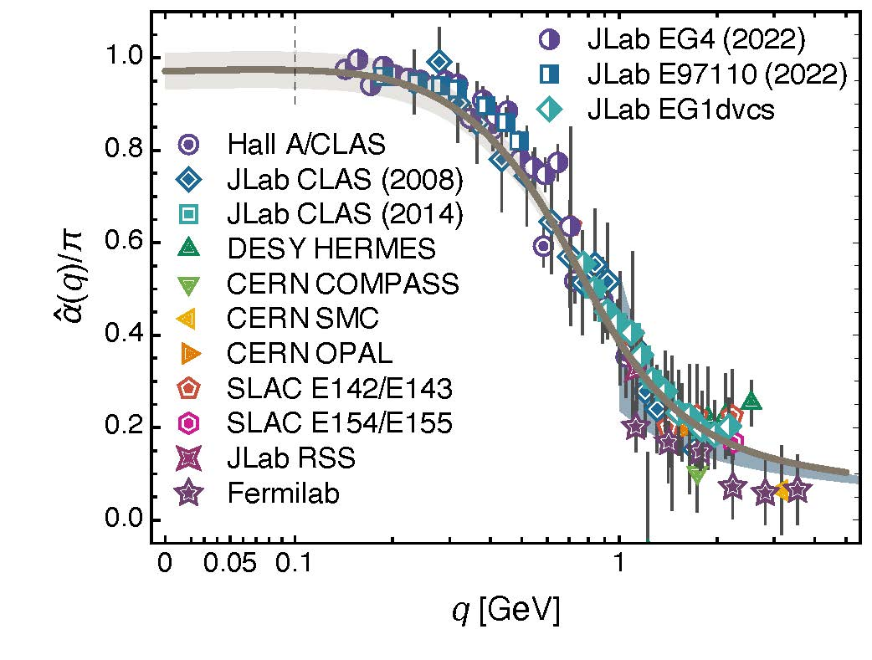
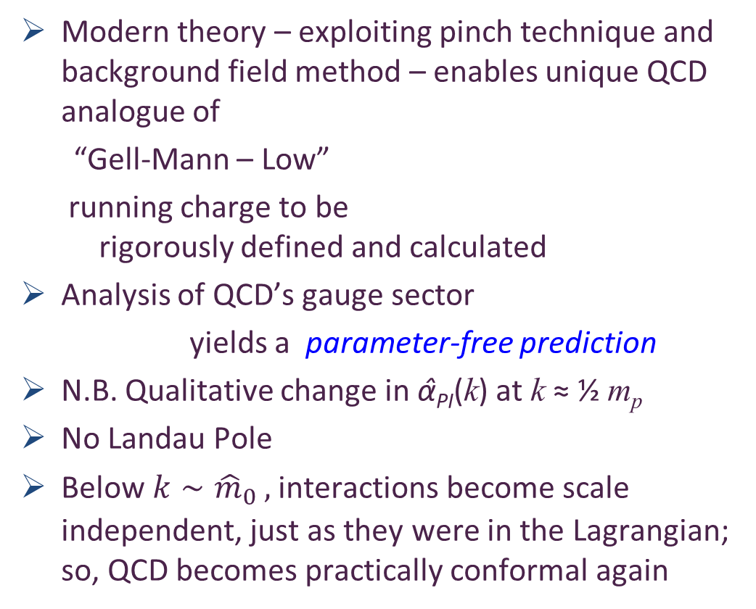

Process independent effective charge = running coupling
W orkshop on Dyson-Schwinger Equations in Modern Mathematics
and Physics (DSEMP2014) Trento, Italy, September 22-26, 2014
Effective charge from lattice QCD, Jin-Li Zhang et al.,
NJU-INP 014/19, arXiv:1912.08232 [hep-ph], Chin. Phys. C 44 (2020) 083102/1-10
$3684$ total downloads
Modern theory – exploiting pinch technique and background field method – enables unique QCD analogue of
“Gell-Mann – Low”
  running charge to be
  rigorously defined and calculated
Analysis of QCD’s gauge sector
  yields a parameter-free prediction
N.B. Qualitative change in α̂_{PI}(k) at k ≈ ½ m_{p}
No Landau Pole
Below $k∼{{\hat{m}}_{0}}_{ },$interactions become scale independent, just as they were in the Lagrangian; so, QCD becomes practically conformal again
Process independent strong running coupling
Daniele Binosi et al., arXiv:1612.04835 [nucl-th], Phys. Rev. D 96 (2017) 054026/1-7
Experimental determination of the QCD effective charge α_{g1}(Q).
A. Deur; V. Burkert; J.-P. Chen; W. Korsch, Particles 5 (2022) 171
QCD Running Couplings and Effective Charges, Alexandre Deur, Stanley J. Brodsky and Craig Roberts, e-Print: 2303.00723 [hep-ph], Prog. Part. Nucl. Phys. 134 (2024) 104081

Slide 9
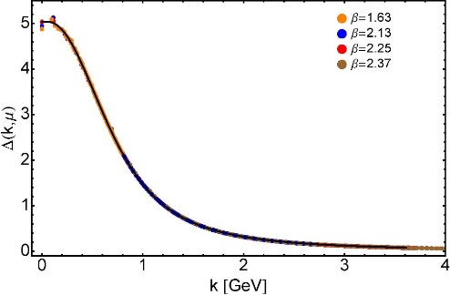

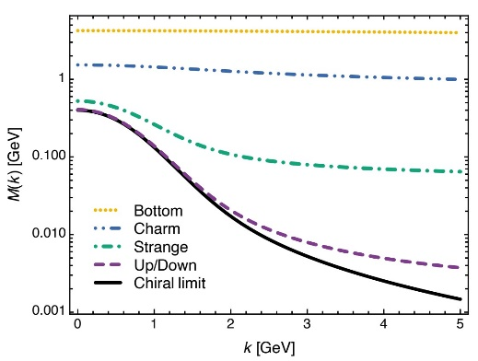
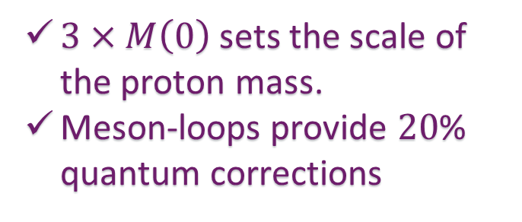
EHM Basics
Absent Higgs boson couplings, QCD Lagrangian is scale invariant
Yet …
  Massless gluons become massive
  A momentum-dependent charge is produced
  Massless quarks become massive
EHM is expressed in
    EVERY strong interaction observable
Challenge to Theory =
    Elucidate all observable consequences of these phenomena
    and highlight the paths to measuring them
Challenge to Experiment =
    Test the theory predictions so that
    the boundaries of the Standard Model can finally be drawn
Three pillars of EHM
$3×M\left(0\right)$ sets the scale of the proton mass.
Meson-loops provide $20$% quantum corrections

Slide 10


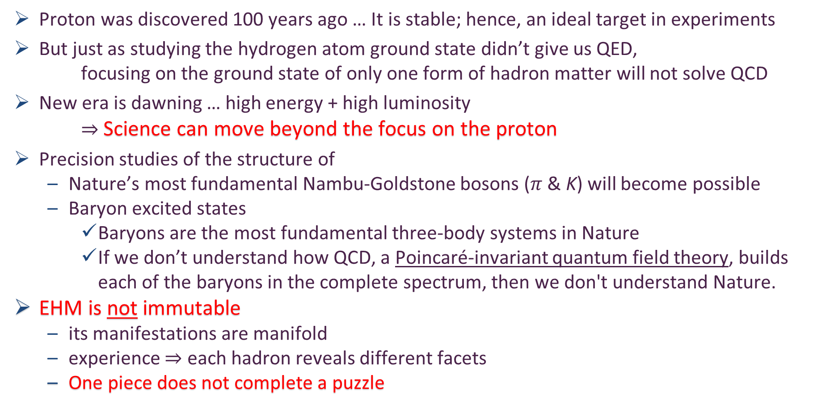
Charting EHM
Proton was discovered 100 years ago … It is stable; hence, an ideal target in experiments
But just as studying the hydrogen atom ground state didn’t give us QED,
focusing on the ground state of only one form of hadron matter will not solve QCD
New era is dawning … high energy + high luminosity
$⇒$ Science can move beyond the focus on the proton
Precision studies of the structure of
  Nature’s most fundamental Nambu-Goldstone bosons ($π$ & K) will become possible
  Baryon excited states
    Baryons are the most fundamental three-body systems in Nature
    If we don’t understand how QCD, a Poincaré-invariant quantum field theory, builds each of the baryons in the complete spectrum, then we don't understand Nature.
EHM is not immutable
  its manifestations are manifold
  experience $⇒$ each hadron reveals different facets
  One piece does not complete a puzzle
AMBER @ CERN
EIC
EicC & SCT & CEPC
JLab12 & JLab20+
QCD @ FAIR

Slide 11
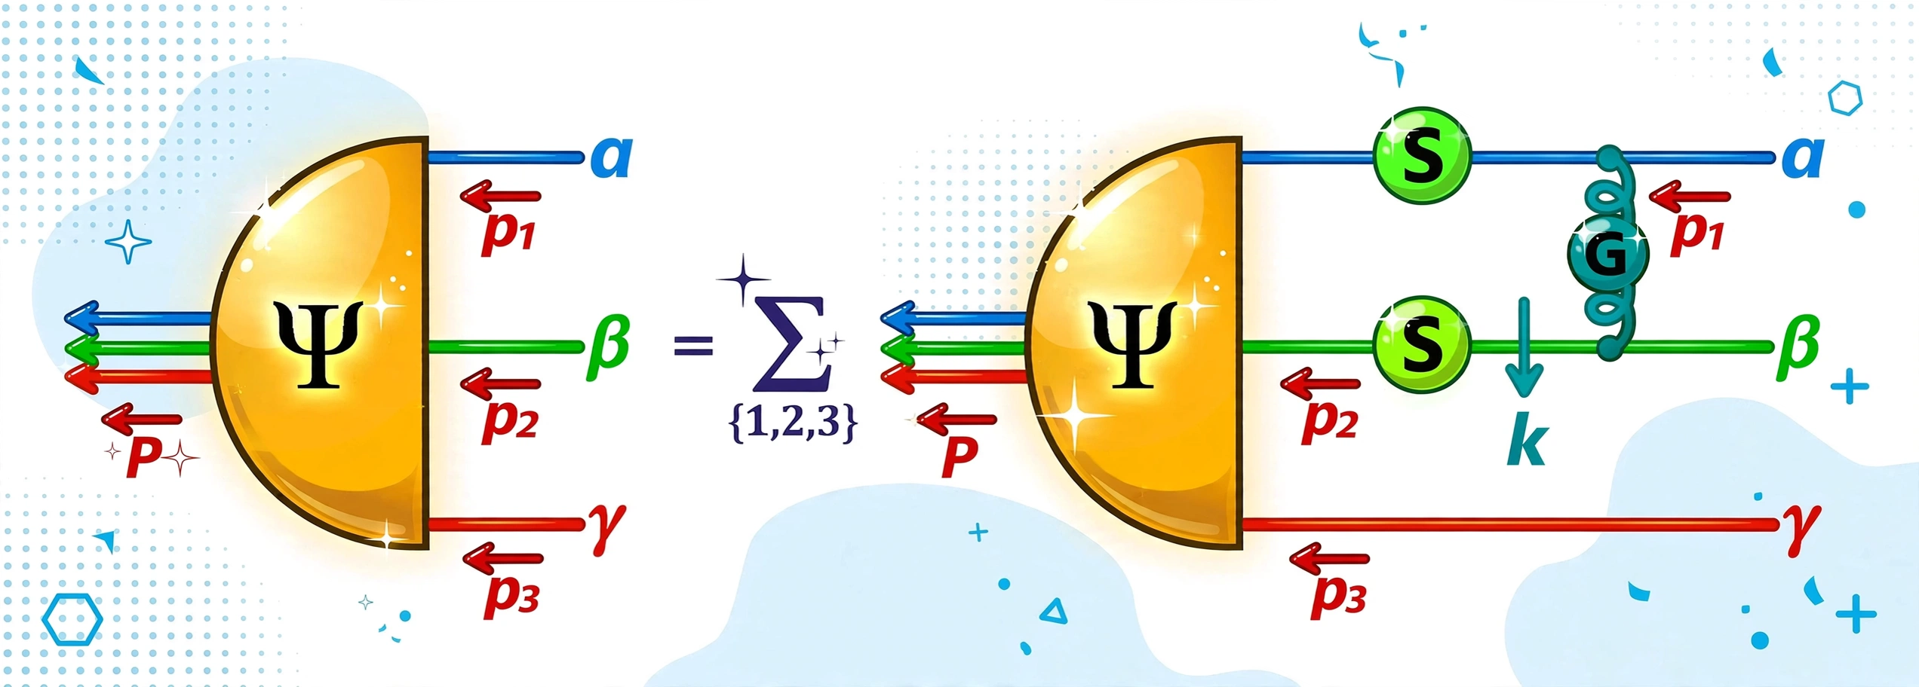
Faddeev Equation for Baryons
Nucleon mass from a covariant three-quark Faddeev equation
G. Eichmann et al., Phys. Rev. Lett. 104 (2010) 201601
Poincaré-covariant analysis of heavy-quark baryons
Si-Xue Qin (秦思学) et al., Phys.Rev. D 97 (2018) 114017/1-13
Nucleon Gravitational Form Factors,
Z.-Q. Yao (姚照千) et al., Eur. Phys. J. A 61 (2025) 92/1-13

Slide 12

Nucleon as a Bound State
Nucleon charge and magnetisation distributions: flavour separation and zeroes,
Zhao-Qian Yao (姚照千) et al., e-Print: 2403.08088 [hep-ph], Fund. Res. 6 (2026) 1409-1416
Nucleon bound-state problem can be addressed
in any approach that provides access to the three-quark six-point Schwinger function
  Using CSMs, one begins with the Poincaré-invariant Faddeev equation
Modern such analyses use precisely the same approach (approximation and interaction) as that employed for pion and kaon electromagnetic form factors
  Thus, one arrives at unifying set of parameter-free predictions for all pion and kaon and nucleon elastic electromagnetic and gravitational form factors and their species separations to large values of momentum transfer
  All predictions link observables directly with fundamental QCD Schwinger functions and thereby expose novel expressions of emergent phenomena in QCD.

Slide 13
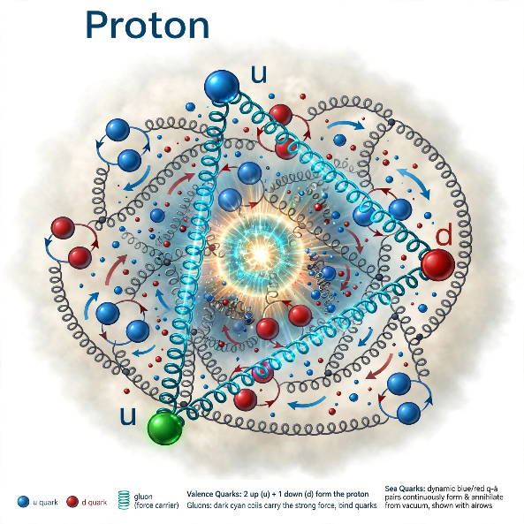
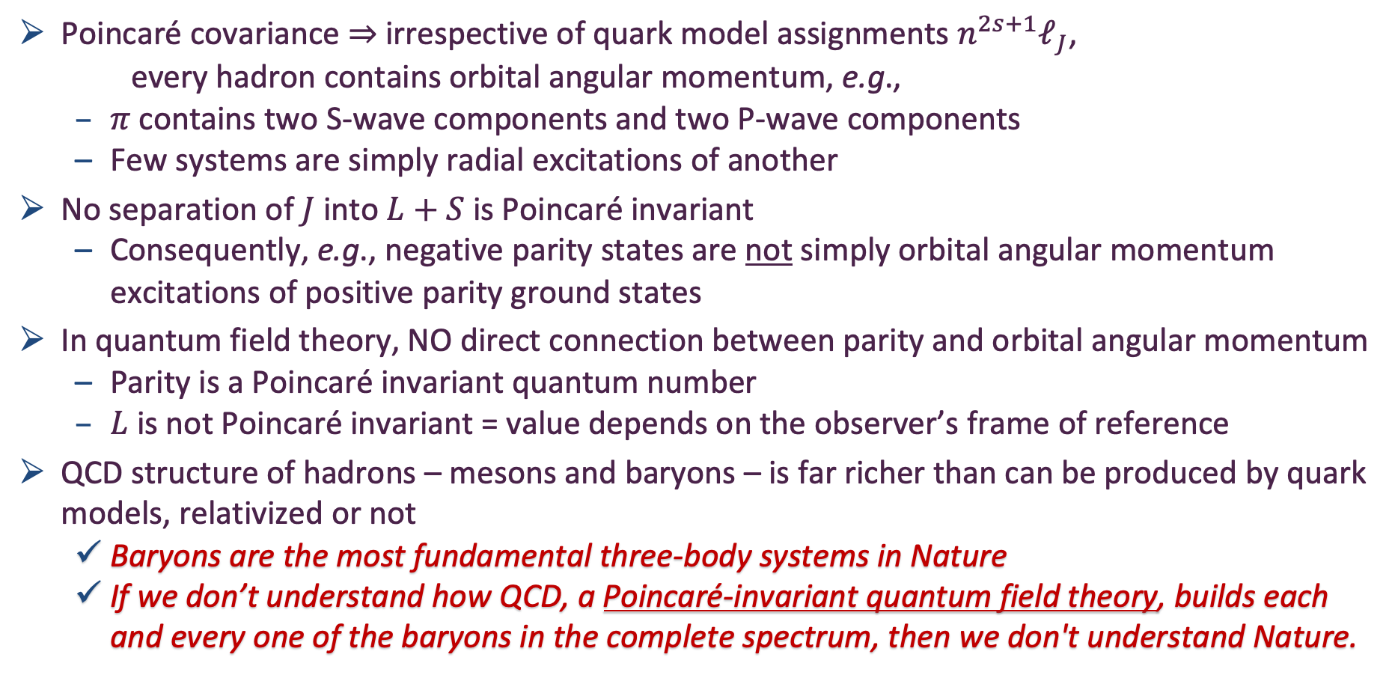
Baryon Structure
Physically Meaningless
Poincaré covariance $⇒$ irrespective of quark model assignments $n^{2s+1}ℓ_{J}$,
every hadron contains orbital angular momentum, e.g.,
  $π$ contains two S-wave components and two P-wave components
  Few systems are simply radial excitations of another
No separation of $J$ into $L+S$ is Poincaré invariant
  Consequently, e.g., negative parity states are not simply orbital angular momentum excitations of positive parity ground states
In quantum field theory, NO direct connection between parity and orbital angular momentum
  Parity is a Poincaré invariant quantum number
  $L$ is not Poincaré invariant = value depends on the observer’s frame of reference
QCD structure of hadrons – mesons and baryons – is far richer than can be produced by quark models, relativized or not
  Baryons are the most fundamental three-body systems in Nature
  If we don’t understand how QCD, a Poincaré-invariant quantum field theory, builds each and every one of the baryons in the complete spectrum, then we don't understand Nature.

Slide 14
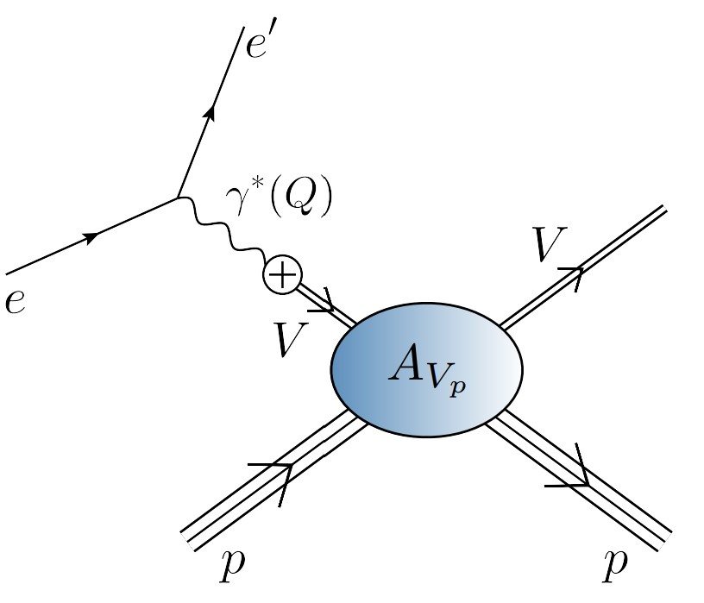
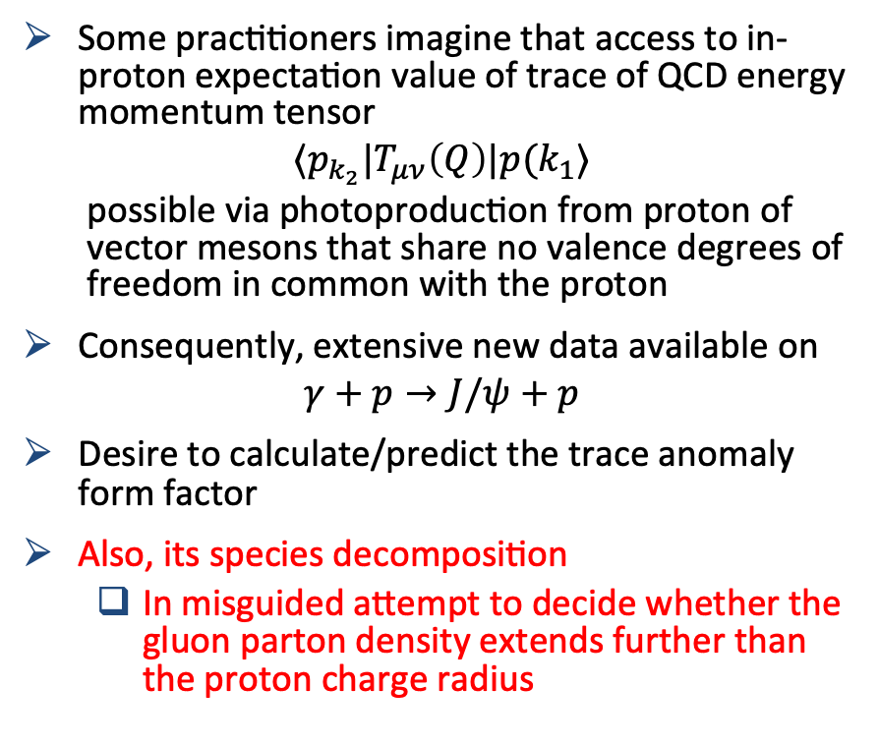
EHM Measurements: How does nucleon mass arise?
… Trace Anomaly Form Factor
Some practitioners imagine that access to in-proton expectation value of trace of QCD energy momentum tensor
$$⟨p_{k_{2}}|T_{μν}\left(Q\right)|p(k_{1}⟩$$
  possible via photoproduction from proton of vector mesons that share no valence degrees of freedom in common with the proton
Consequently, extensive new data available on
$$γ+p→J/ψ+p$$
Desire to calculate/predict the trace anomaly form factor
Also, its species decomposition
  In misguided attempt to decide whether the gluon parton density extends further than the proton charge radius
VMD assumption

Slide 15
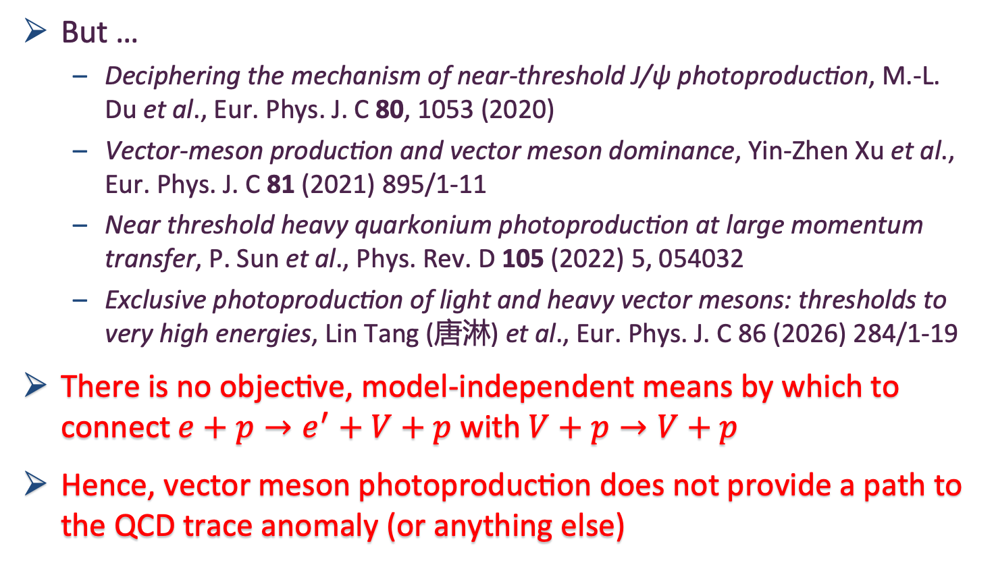
EHM Measurements: How does nucleon mass arise?
But …
  Deciphering the mechanism of near-threshold J/ψ photoproduction, M.-L. Du et al., Eur. Phys. J. C 80, 1053 (2020)
  Vector-meson production and vector meson dominance, Yin-Zhen Xu et al., Eur. Phys. J. C 81 (2021) 895/1-11
  Near threshold heavy quarkonium photoproduction at large momentum transfer, P. Sun et al., Phys. Rev. D 105 (2022) 5, 054032
  Exclusive photoproduction of light and heavy vector mesons: thresholds to very high energies, Lin Tang (唐淋) et al., Eur. Phys. J. C 86 (2026) 284/1-19
There is no objective, model-independent means by which to connect $e+p→e^{′}+V+p$ with $V+p→V+p$
Hence, vector meson photoproduction does not provide a path to the QCD trace anomaly (or anything else)

Slide 16
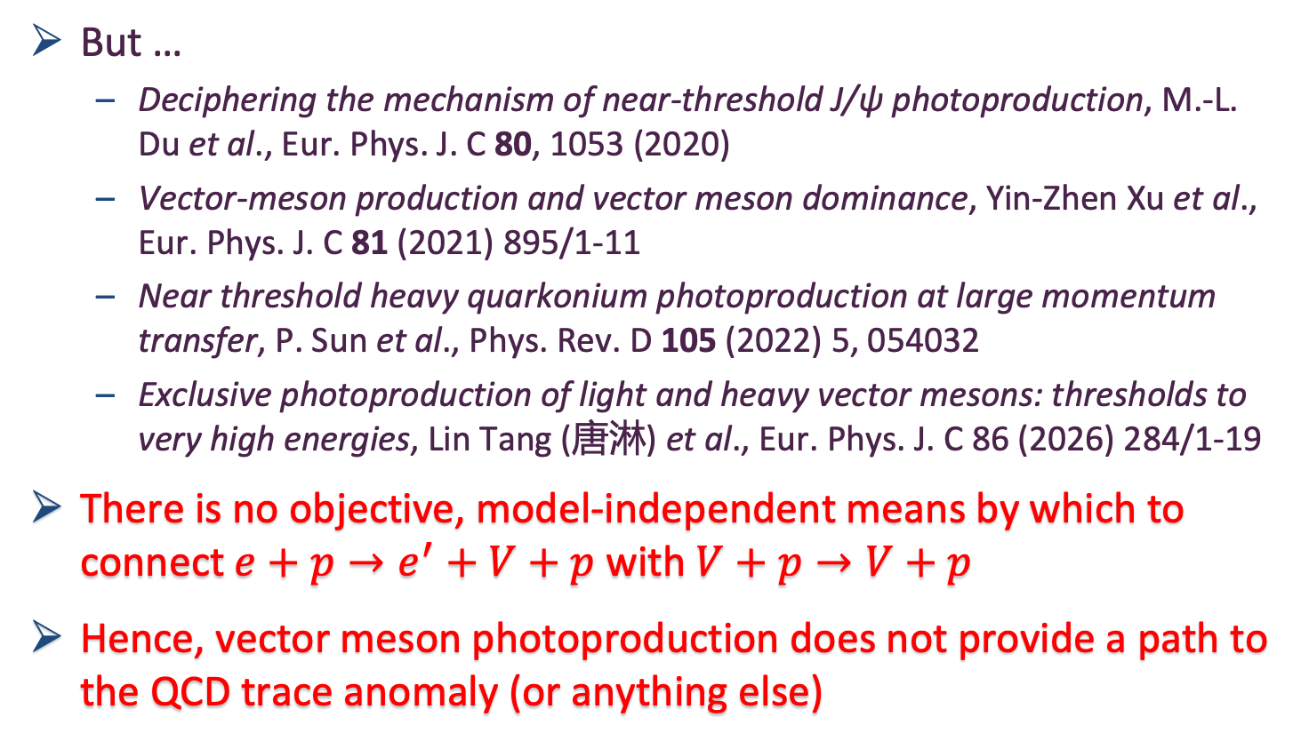
EHM Measurements: How does nucleon mass arise?
But …
  Deciphering the mechanism of near-threshold J/ψ photoproduction, M.-L. Du et al., Eur. Phys. J. C 80, 1053 (2020)
  Vector-meson production and vector meson dominance, Yin-Zhen Xu et al., Eur. Phys. J. C 81 (2021) 895/1-11
  Near threshold heavy quarkonium photoproduction at large momentum transfer, P. Sun et al., Phys. Rev. D 105 (2022) 5, 054032
  Exclusive photoproduction of light and heavy vector mesons: thresholds to very high energies, Lin Tang (唐淋) et al., Eur. Phys. J. C 86 (2026) 284/1-19
There is no objective, model-independent means by which to connect $e+p→e^{′}+V+p$ with $V+p→V+p$
Hence, vector meson photoproduction does not provide a path to the QCD trace anomaly (or anything else)
Notwithstanding, hadron GFFs
might be accessible
via DVCS and GPDs

Slide 17
Hadron Gravitational Form Factors
Forces inside hadrons: pressure, surface tension, mechanical radius, and all that,
M. V. Polyakov, P. Schweitzer, Int. J. Mod. Phys. A 33 (2018) 26
  “The physics related to the form factors of the energy momentum tensor spans a wide spectrum of problems, and includes
  gravitational physics,
  hard exclusive reactions,
  hadronic decays of heavy quarkonia,
  and the physics of exotic hadrons described as hadroquarkonia.
  It also provides access to the “last global unknown property:” the D-term.
  We review the physics associated with the form factors of the energy-momentum tensor and the D-term, their interpretations in terms of mechanical properties, their applications, and the current experimental status.”

Slide 18
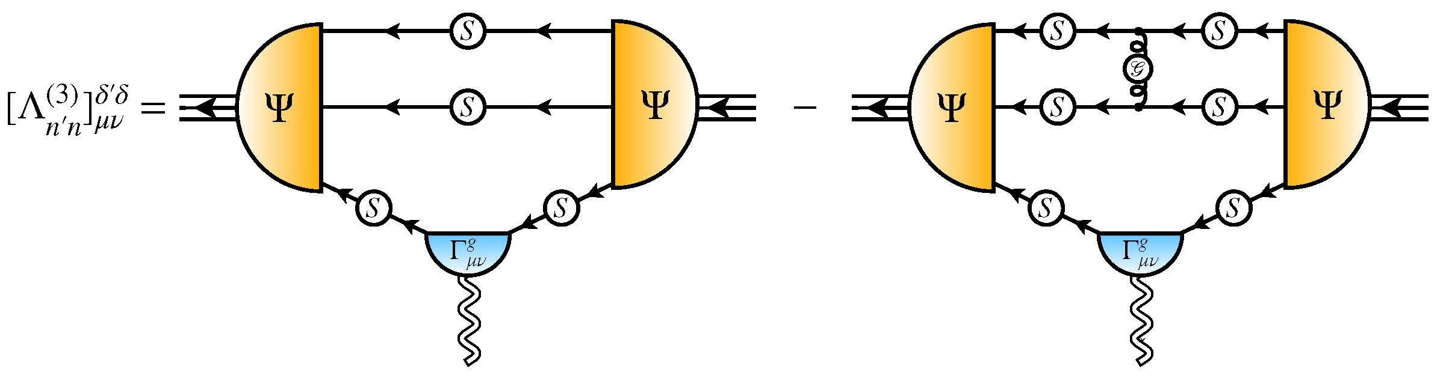
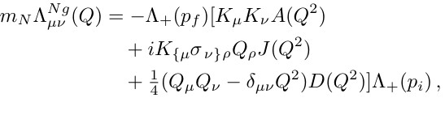
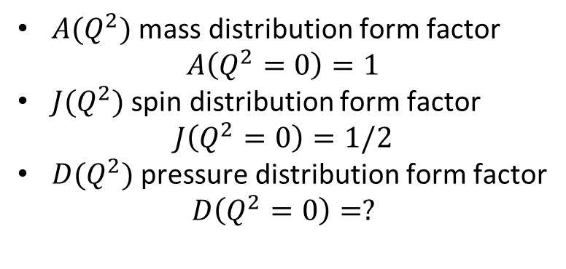
Nucleon Gravitational Form Factors
Current … completing solution of Faddeev equation, then all elements are known
Current …
$A(Q^{2})$ mass distribution form factor
$$A\left(Q^{2}=0\right)=1$$
$J(Q^{2})$ spin distribution form factor
$$J\left(Q^{2}=0\right)=1/2$$
$D(Q^{2})$ pressure distribution form factor
$$D\left(Q^{2}=0\right)=?$$
Last unknown/unmeasured global property of nucleon
Nucleon Gravitational Form Factors, Z.-Q. Yao (姚照千) et al., e-Print: 2409.15547 [hep-ph], Eur. Phys. J. A 61 (2025) 92/1-13

Slide 19
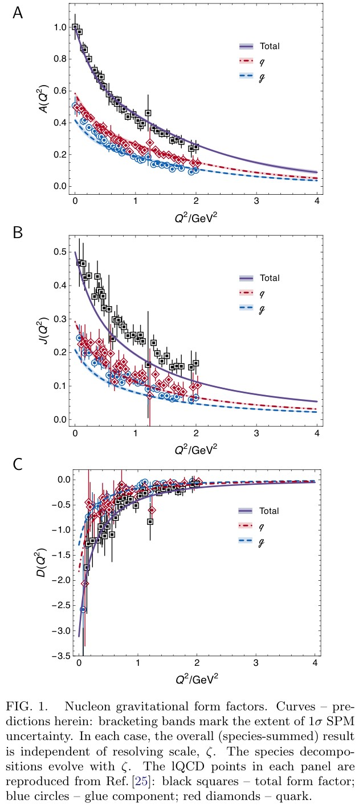
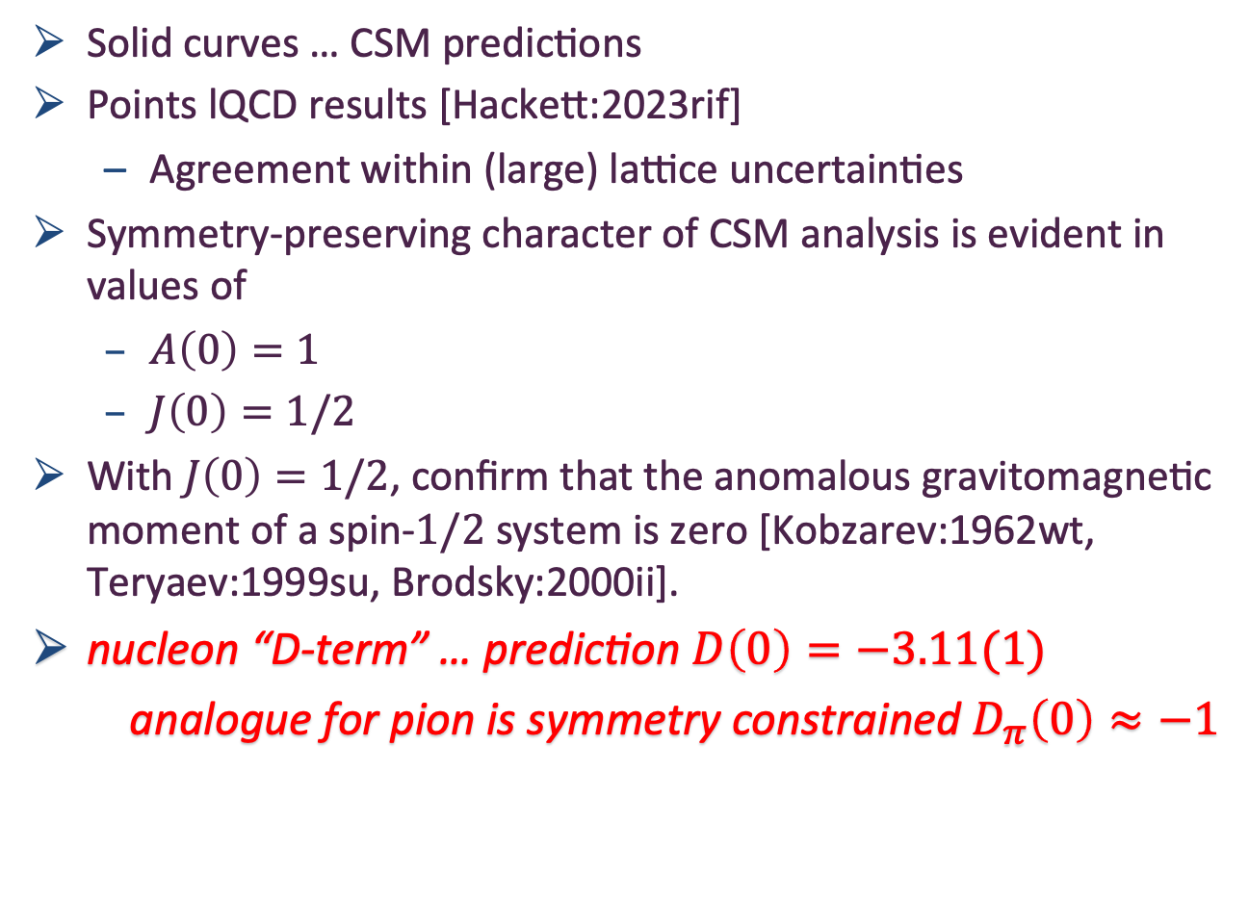
Predicted GFFs
Solid curves … CSM predictions
Points lQCD results [Hackett:2023rif]
  Agreement within (large) lattice uncertainties
Symmetry-preserving character of CSM analysis is evident in values of
  $A\left(0\right)=1$
  $J\left(0\right)=1/2$
With $J\left(0\right)=1/2$, confirm that the anomalous gravitomagnetic moment of a spin-$1/2$ system is zero [Kobzarev:1962wt, Teryaev:1999su, Brodsky:2000ii].
nucleon “D-term” … prediction $D\left(0\right)=−3.11(1)$
analogue for pion is symmetry constrained $D_{π}\left(0\right)≈−1$

Slide 20
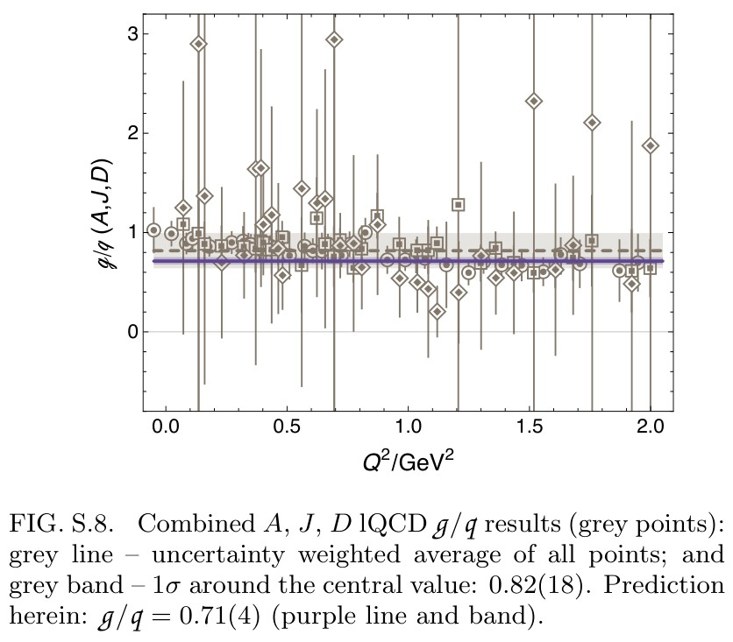

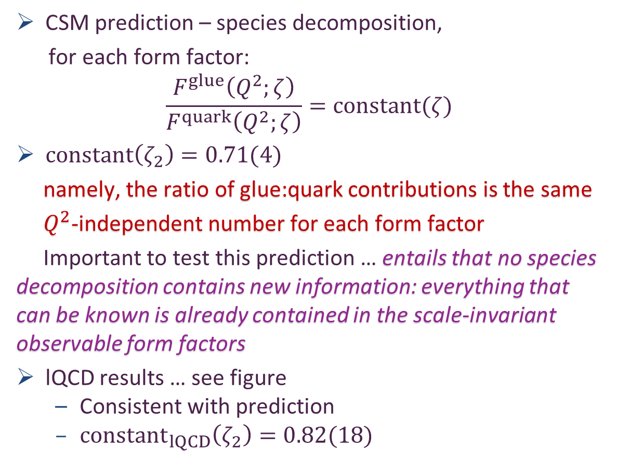
GFF Species Decomposition (scale dependent, $ζ_{2}=2GeV$)
CSM prediction – species decomposition,
for each form factor:
$$\frac{F^{glue}\left(Q^{2};ζ\right)}{F^{quark}\left(Q^{2};ζ\right)}=constant(ζ)$$
$constant\left(ζ_{2}\right)=0.71(4)$
namely, the ratio of glue:quark contributions is the same
$Q^{2}$-independent number for each form factor
Important to test this prediction … entails that no species decomposition contains new information: everything that can be known is already contained in the scale-invariant observable form factors
lQCD results … see figure
  Consistent with prediction
  ${constant}_{lQCD}\left(ζ_{2}\right)=0.82(18)$

Slide 21
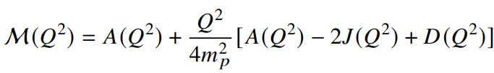

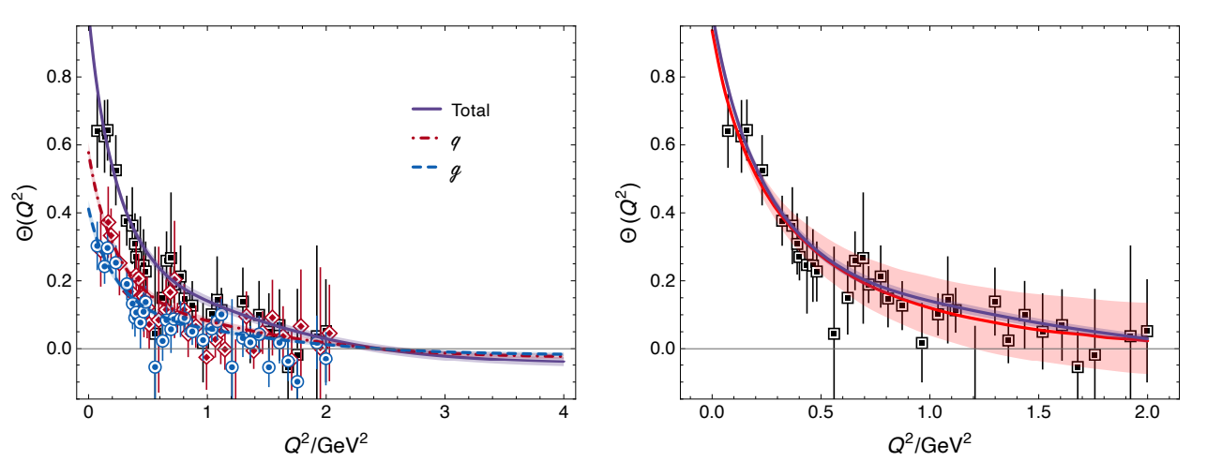
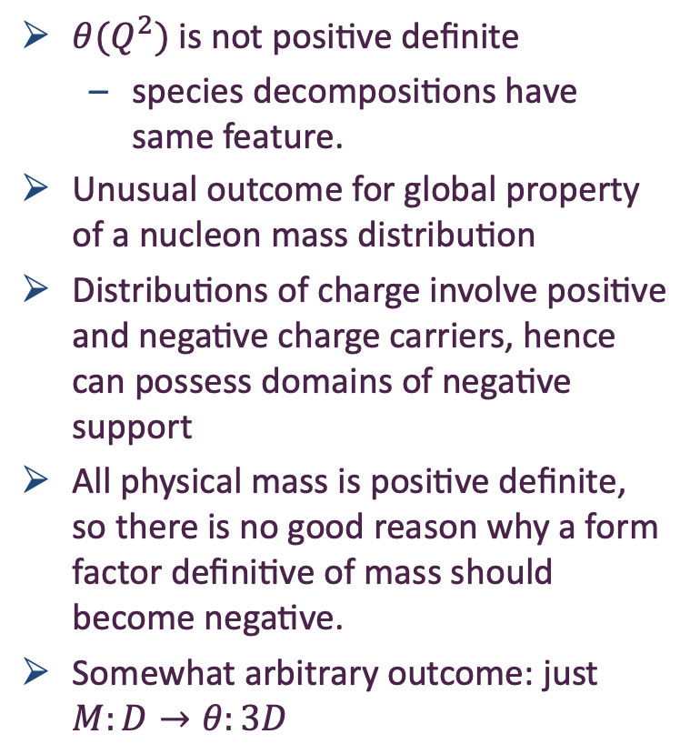
Trace Anomaly Form Factor
Mass-energy density form factor
  Nonnegative function = good for a mass distribution
In-proton expectation value of QCD trace anomaly:
$θ(Q^{2})$ is not positive definite
  species decompositions have same feature.
Unusual outcome for global property of a nucleon mass distribution
Distributions of charge involve positive and negative charge carriers, hence can possess domains of negative support
All physical mass is positive definite, so there is no good reason why a form factor definitive of mass should become negative.
Somewhat arbitrary outcome: just $M:D→θ:3D$

Slide 22

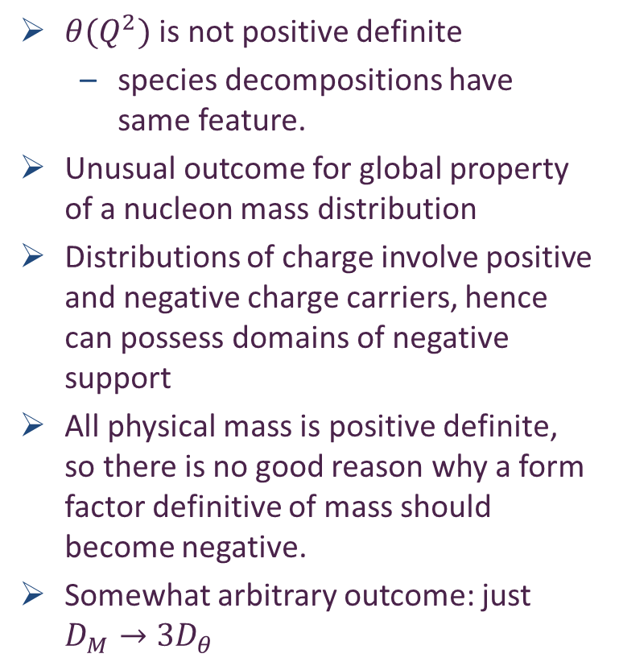
Trace Anomaly Form Factor
Mass-energy density form factor
  Nonnegative function = good for a mass distribution
In-proton expectation value of QCD trace anomaly:
$θ(Q^{2})$ is not positive definite
  species decompositions have same feature.
Unusual outcome for global property of a nucleon mass distribution
Distributions of charge involve positive and negative charge carriers, hence can possess domains of negative support
All physical mass is positive definite, so there is no good reason why a form factor definitive of mass should become negative.
Somewhat arbitrary outcome: just $D_{M}→3D_{θ}$
Objective interpretation of this result = one particular combination of proton gravitational form factors has a larger slope than another chosen combination of electromagnetic form factors.
No sense in which this means that gluons are distributed over a larger spacetime volume than quarks because total form factor, being scale invariant, does not express information about a subjective species decomposition.

Slide 23
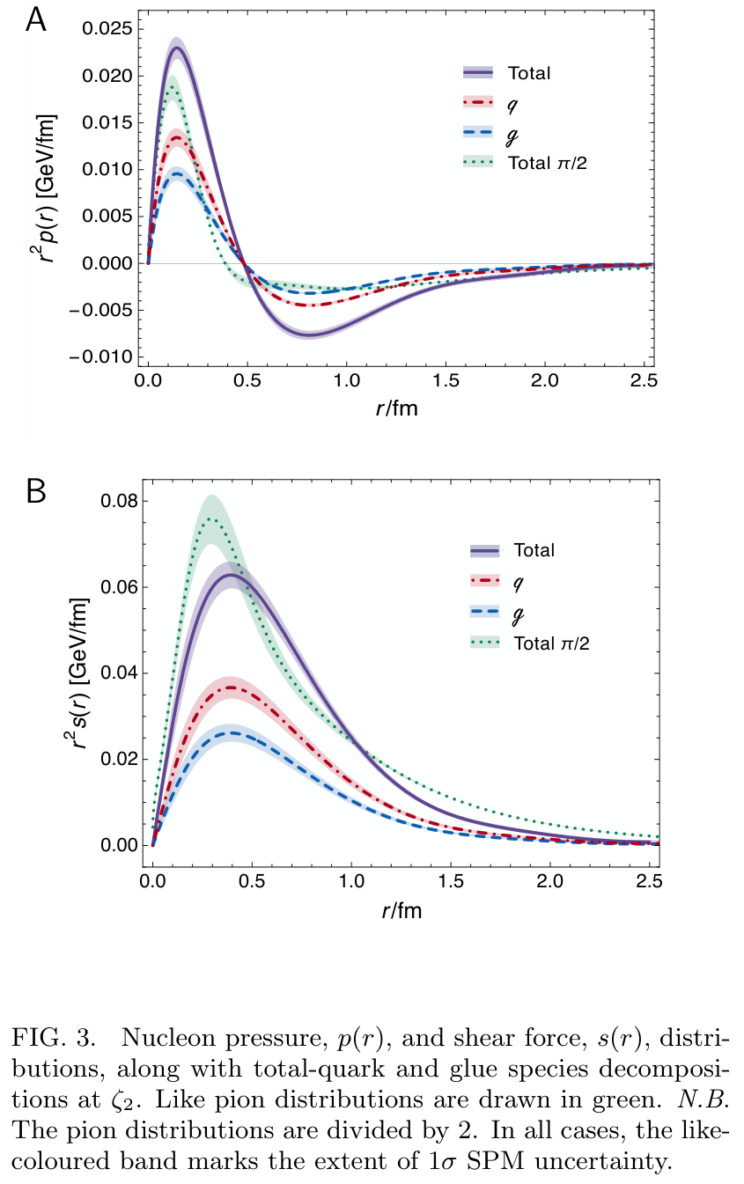
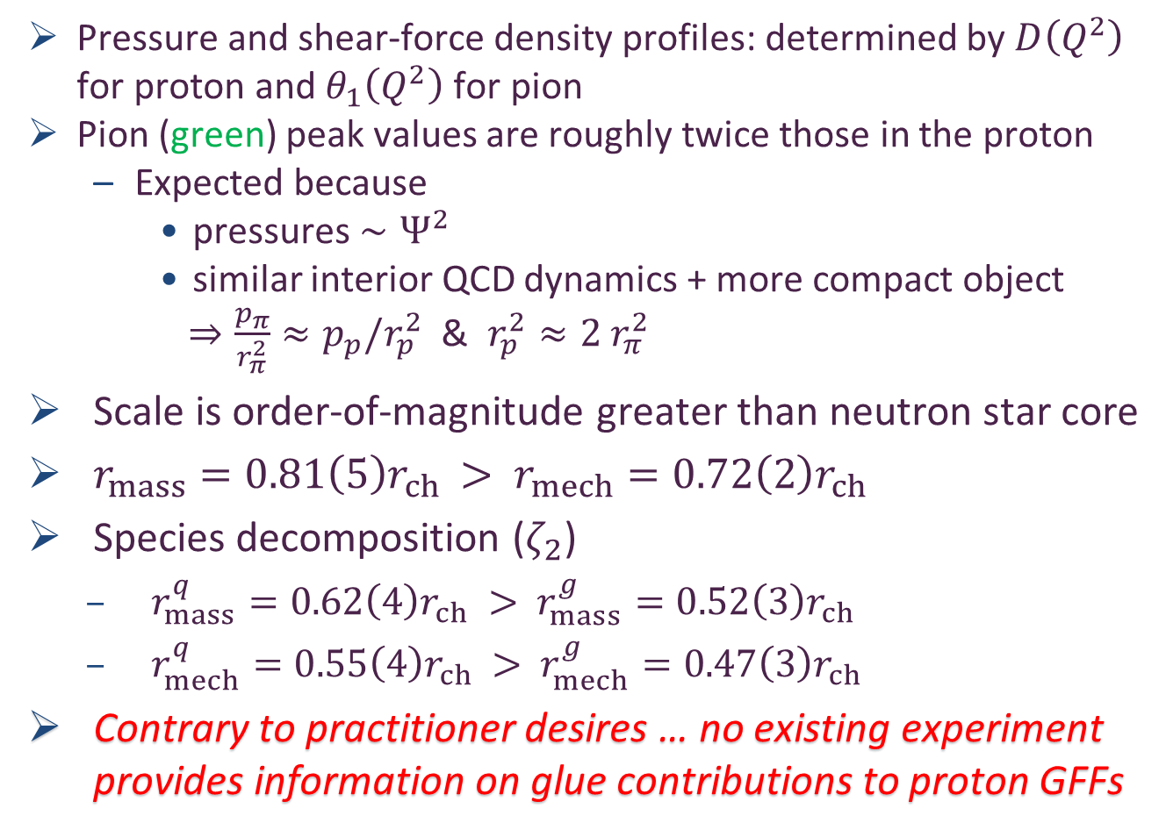
Proton Pressure Profiles
Pressure and shear-force density profiles: determined by $D\left(Q^{2}\right)$ for proton and $θ_{1}\left(Q^{2}\right)$ for pion
Pion (green) peak values are roughly twice those in the proton
  Expected because
    pressures $∼Ψ^{2}$
    similar interior QCD dynamics + more compact object
    $⇒\frac{p_{π}}{r_{π}^{2}}≈p_{p}/r_{p}^{2}$ & $r_{p}^{2}≈2{ r}_{π}^{2}$
Scale is order-of-magnitude greater than neutron star core
$r_{mass}=0.81\left(5\right)r_{ch}$ $>$ $r_{mech}=0.72\left(2\right)r_{ch}$
Species decomposition ($ζ_{2}$)
  $r_{mass}^{q}=0.62\left(4\right)r_{ch}$ $>$ $r_{mass}^{g}=0.52\left(3\right)r_{ch}$
  $r_{mech}^{q}=0.55\left(4\right)r_{ch}$ $>$ $r_{mech}^{g}=0.47\left(3\right)r_{ch}$
Contrary to practitioner desires … no existing experiment provides information on glue contributions to proton GFFs
Exclusive photoproduction of light and heavy vector mesons: thresholds to very high energies, Lin Tang (唐淋) et al., e-Print: 2510.08845 [hep-ph], Eur. Phys. J. C 86 (2026) 284/1-19.

Slide 24
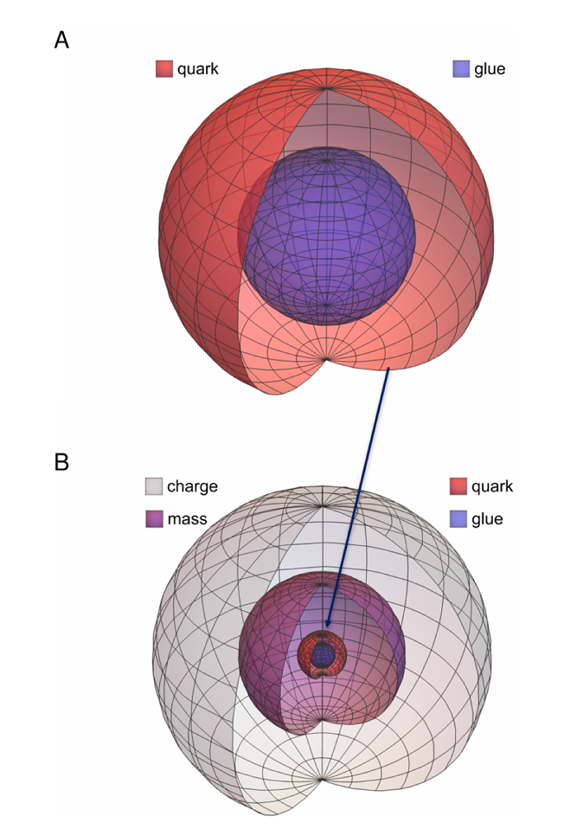
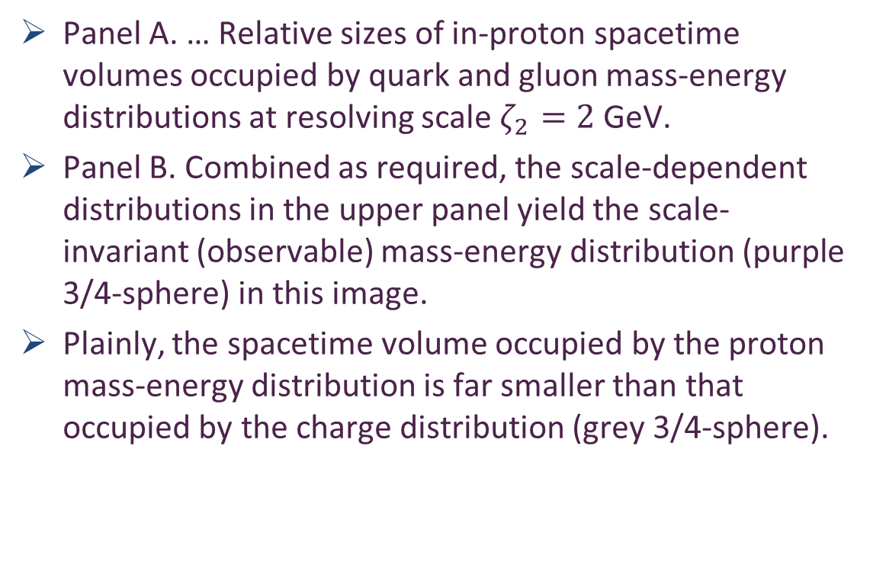
Relative Spacetime Volumes
Panel A. … Relative sizes of in-proton spacetime volumes occupied by quark and gluon mass-energy distributions at resolving scale $ζ_{2}=2$ GeV.
Panel B. Combined as required, the scale-dependent distributions in the upper panel yield the scale-invariant (observable) mass-energy distribution (purple 3/4-sphere) in this image.
Plainly, the spacetime volume occupied by the proton mass-energy distribution is far smaller than that occupied by the charge distribution (grey 3/4-sphere).

Slide 25

Structure of Baryons
Poincaré covariant Faddeev equation sums all possible exchanges and interactions that can take place between three dressed-quarks
As seen … direct solution of Faddeev equation using rainbow-ladder truncation is now possible, but remains challenging problem – algorithms and numerical analysis

Slide 26
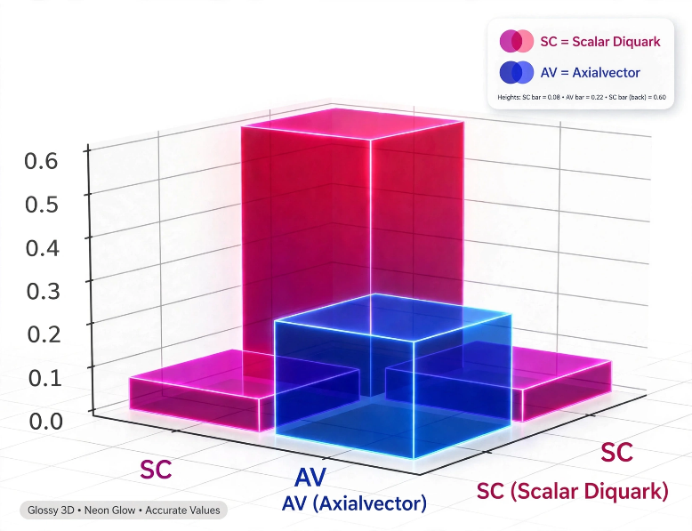
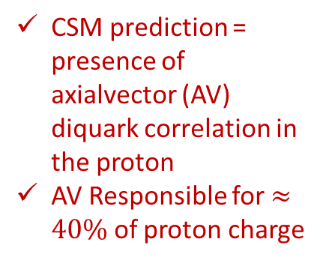
Structure of Baryons
Solution delivers
Poincaré-covariant
proton wave function
Poincaré covariant Faddeev equation sums all possible exchanges and interactions that can take place between three dressed-quarks
As seen … direct solution of Faddeev equation using rainbow-ladder truncation is now possible, but remains challenging problem – algorithms and numerical analysis
For many/most applications, diquark approximation to quark+quark scattering kernel is used
Prediction: owing to EHM, strong diquark (quark + quark) correlations exist
within baryons - proton & neutron … both scalar and axial-vector diquarks are present
CSM prediction = presence of axialvector (AV) diquark correlation in the proton
AV Responsible for $≈40\%$ of proton charge

Slide 27
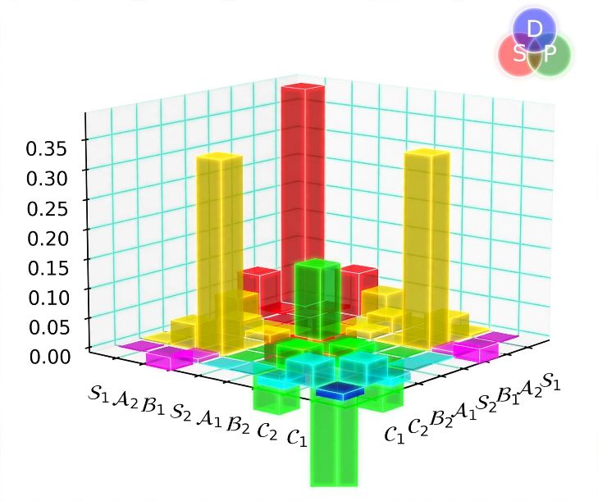
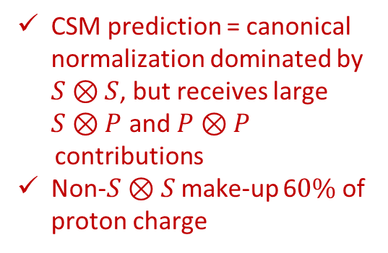
Structure of Baryons
Solution delivers
Poincaré-covariant
proton wave function
Poincaré covariant Faddeev equation sums all possible exchanges and interactions that can take place between three dressed-quarks
As seen … direct solution of Faddeev equation using rainbow-ladder truncation is now possible, but remains challenging problem – algorithms and numerical analysis
For many/most applications, diquark approximation to quark+quark scattering kernel is used
Prediction: owing to EHM:
proton wave function is not just S-wave, but contains strong P-wave contributions
baryon wave functions
necessarily contain
orbital angular momentum
CSM prediction = canonical normalization dominated by $S⊗S$, but receives large $S⊗P$ and $P⊗P$
contributions
Non-$S⊗S$make-up 6$0\%$ of proton charge

Slide 28
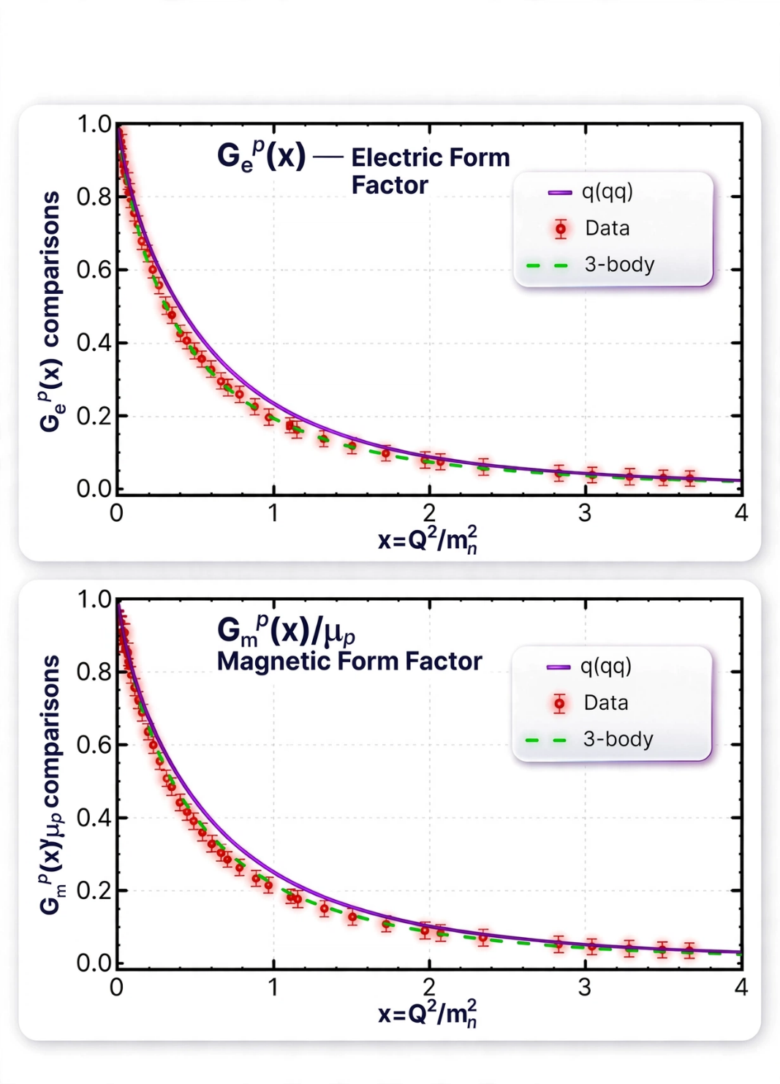

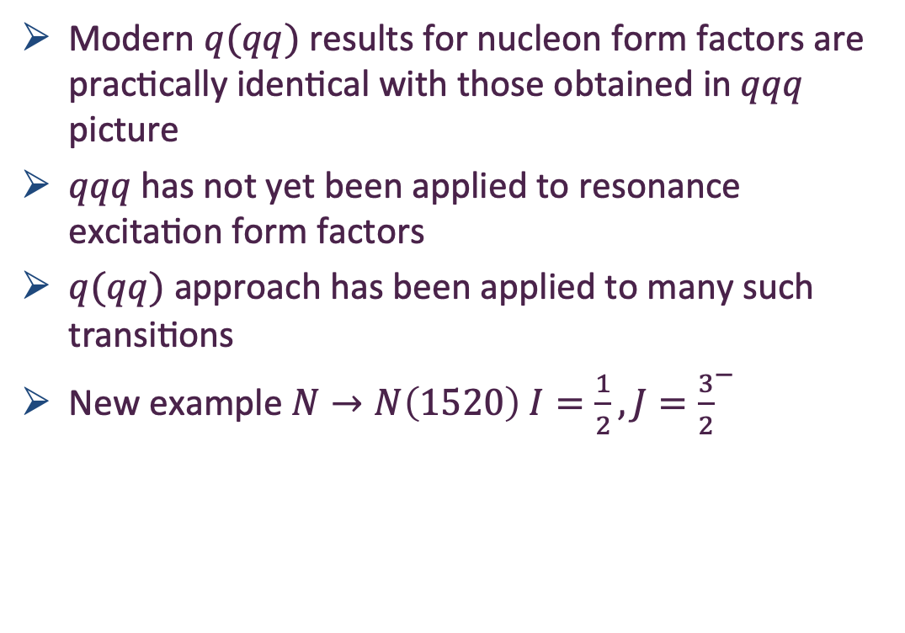
Modern $q(qq)$ formulation of baryon problem
Quark + Diquark Description of Nucleon Elastic Electromagnetic Form Factors, Peng Cheng (程鹏) et al., e-Print: 2507.13484 [hep-ph], Eur. Phys. J. A (2025) 61:255/1-20
Modern $q(qq)$ results for nucleon form factors are practically identical with those obtained in $qqq$ picture
$qqq$ has not yet been applied to resonance excitation form factors
$q(qq)$ approach has been applied to many such transitions
New example $N→N\left(1520\right) I=\frac{1}{2}, J={\frac{3}{2}}^{−}$

Slide 29
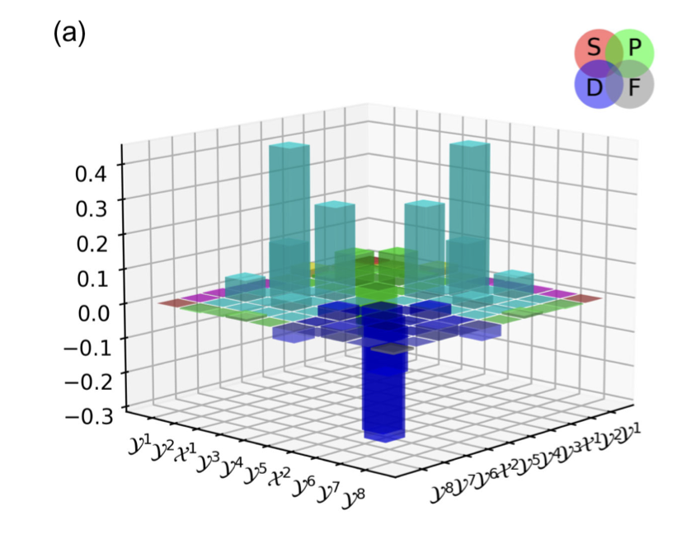

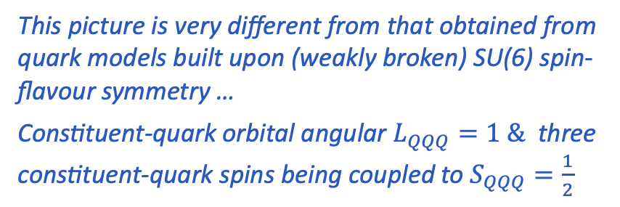
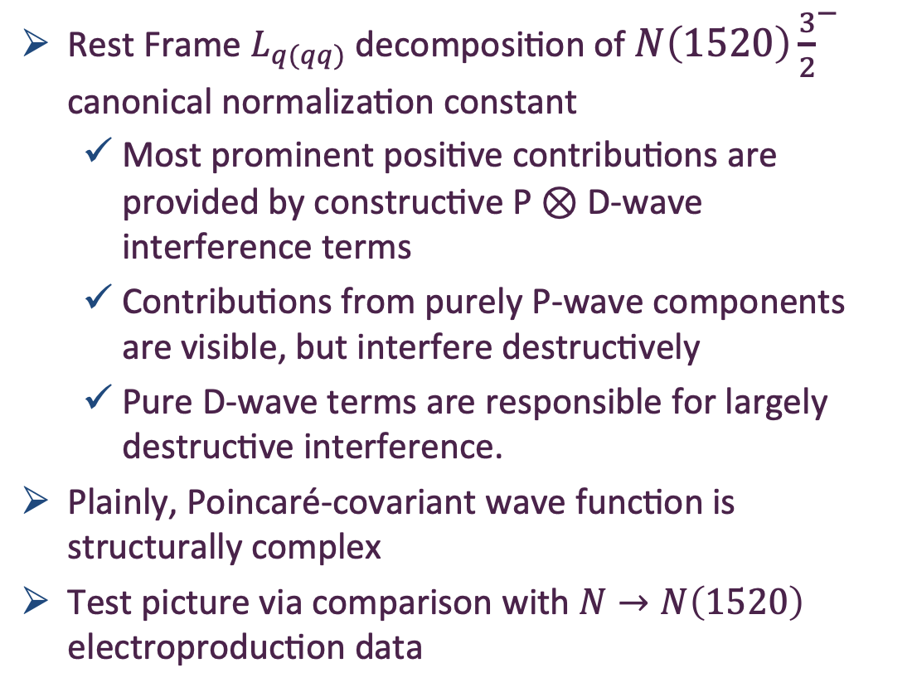
CSMs & $N\left(1520\right){\frac{3}{2}}^{−}$Structure
Wave functions of (I, JP) = (1/2,3/2∓) baryons, Langtian Liu (刘浪天), Chen Chen (陈晨) and Craig D. Roberts, e-Print: 2208.12353 [hep-ph], Phys. Rev. D 107 (2023) 014002/1-15
Rest Frame $L_{q(qq)}$ decomposition of $N\left(1520\right){\frac{3}{2}}^{−}$ canonical normalization constant
  Most prominent positive contributions are provided by constructive P ⊗ D-wave interference terms
  Contributions from purely P-wave components are visible, but interfere destructively
  Pure D-wave terms are responsible for largely destructive interference.
Plainly, Poincaré-covariant wave function is structurally complex
Test picture via comparison with $N→N\left(1520\right)$ electroproduction data
This picture is very different from that obtained from quark models built upon (weakly broken) SU(6) spin-flavour symmetry …
Constituent-quark orbital angular $L_{QQQ}=1 \&$ three constituent-quark spins being coupled to $S_{QQQ}=\frac{1}{2}$

Slide 30
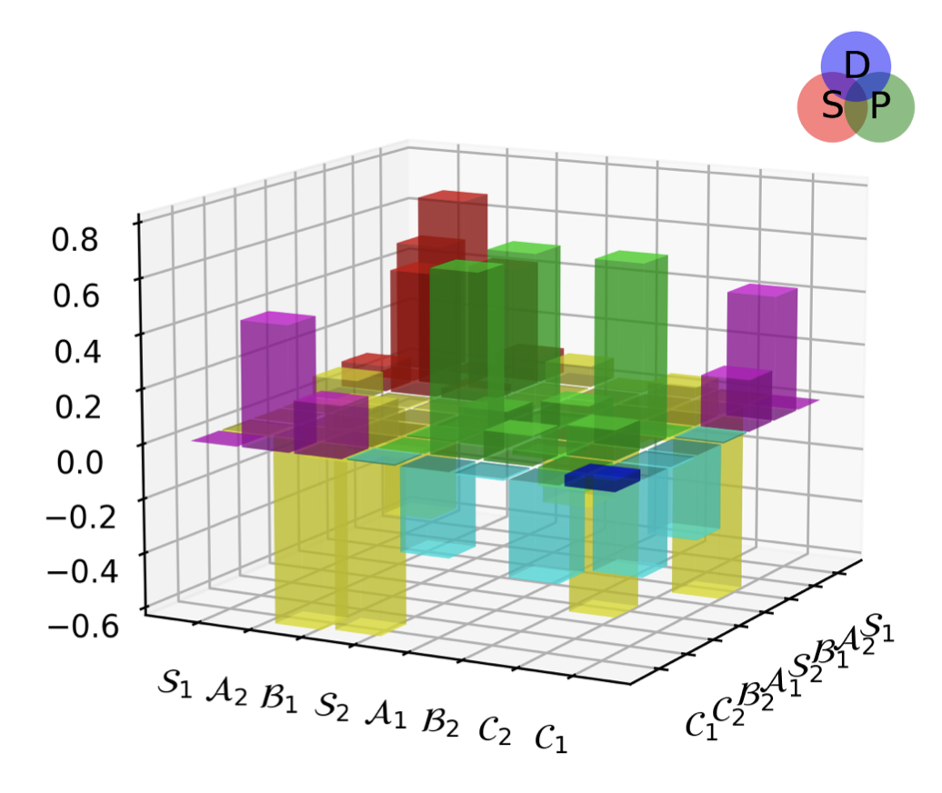
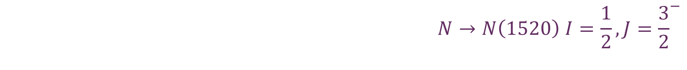
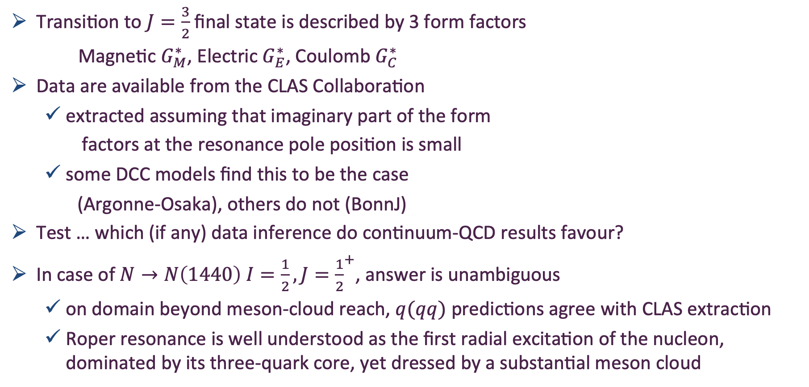
$$N→N\left(1520\right) I=\frac{1}{2}, J={\frac{3}{2}}^{−}$$
Insights into Nucleon Resonances via Continuum Schwinger Function Methods, Peng Cheng (程鹏), Langtian Liu (刘浪天), Ya Lu (陆亚) and Craig D. Roberts, e-Print: 2512.09160 [hep-ph], Acta Physica Polonica B 57 (2026) 2-A13. Contribution to a special issue of Acta Physica Polonica that celebrates the 90th birthday of L. David Roper
Peng Cheng (程鹏) et al., in progress
Transition to $J=\frac{3}{2}$ final state is described by 3 form factors
Magnetic $G_{M}^{∗}$, Electric $G_{E}^{∗}$, Coulomb $G_{C}^{∗}$
Data are available from the CLAS Collaboration
  extracted assuming that imaginary part of the form
  factors at the resonance pole position is small
  some DCC models find this to be the case
  (Argonne-Osaka), others do not (BonnJ)
Test … which (if any) data inference do continuum-QCD results favour?
In case of $N→N\left(1440\right) I=\frac{1}{2}, J={\frac{1}{2}}^{+}$, answer is unambiguous
  on domain beyond meson-cloud reach, $q(qq)$ predictions agree with CLAS extraction
  Roper resonance is well understood as the first radial excitation of the nucleon, dominated by its three-quark core, yet dressed by a substantial meson cloud

Slide 31





$$N→N\left(1520\right) I=\frac{1}{2}, J={\frac{3}{2}}^{−}$$
Insights into Nucleon Resonances via Continuum Schwinger Function Methods, Peng Cheng (程鹏), Langtian Liu (刘浪天), Ya Lu (陆亚) and Craig D. Roberts, e-Print: 2512.09160 [hep-ph], Acta Physica Polonica B 57 (2026) 2-A13. Contribution to a special issue of Acta Physica Polonica that celebrates the 90th birthday of L. David Roper
Peng Cheng (程鹏) et al., in progress
Using precisely same framework as used for $N→N\left(1440\right) I=\frac{1}{2}, J={\frac{1}{2}}^{+}$
  Built upon the Three Pillars of
  Emergent Hadron Mass
  Extensively benchmarked
Parameter-free predictions
Fair agreement with CLAS extractions
  Including zero in $G_{E}^{∗}$
  As with Roper, $∃$ room for meson-baryon FSIs on $x≤2$
Validation of structurally complex Faddeev amplitude for $N\left(1520\right) (\frac{1}{2}, {\frac{3}{2}}^{−})$
$$G_{M}^{∗}$$
$$G_{E}^{∗}$$
$$G_{C}^{∗}$$

Slide 32


$$N→N\left(1520\right) I=\frac{1}{2}, J={\frac{3}{2}}^{−}$$
Insights into Nucleon Resonances via Continuum Schwinger Function Methods, Peng Cheng (程鹏), Langtian Liu (刘浪天), Ya Lu (陆亚) and Craig D. Roberts, e-Print: 2512.09160 [hep-ph], Acta Physica Polonica B 57 (2026) 2-A13. Contribution to a special issue of Acta Physica Polonica that celebrates the 90th birthday of L. David Roper
Peng Cheng (程鹏) et al., in progress
Using precisely same framework as used for $N→N\left(1440\right) I=\frac{1}{2}, J={\frac{1}{2}}^{+}$
  Built upon the Three Pillars of
  Emergent Hadron Mass
  Extensively benchmarked
Parameter-free predictions
Fair agreement with CLAS extractions
  Including zero in $G_{E}^{∗}$
  As with Roper, $∃$ room for meson-baryon FSIs on $x≤2$
Validation of structurally complex Faddeev amplitude for $N\left(1520\right) (\frac{1}{2}, {\frac{3}{2}}^{−})$
Strong evidence in support of JM reaction model’s ability to deliver empirical access to internal structure of nucleon resonances and, so, test theory understanding
$$G_{M}^{∗}$$
$$G_{E}^{∗}$$
$$G_{C}^{∗}$$

Slide 33


Synergy of Experiment, Phenomenology, Theory
Gather all pieces of the puzzle … Reveal the source of Nature’s basic mass-scale
Continuum strong interaction theory is maturing
  Expanding array of parameter-free predictions for the nucleon
  And all the other hadrons whose properties express the full meaning of QCD
    Structure of Nature’s most fundamental Nambu-Goldstone bosons
    Structure of baryons, e.g., $Q^{2}$-dependence of nucleon resonance transition form factors
      Spectrum is insufficient – many models give same spectrum, but transition form factors discriminate between pictures.
Understanding how QCD’s simplicity explains the emergence of hadron mass and structure requires investment in facilities that can deliver precision data on much more than one of Nature’s hadrons.
AMBER@CERN, CEPC, EIC, EicC, JLab22, LHeC, QCD@FAIR, STCF, could …
  Deliver precise structure data on a wide range of hadrons with distinctly different quantum numbers
  Thereby move Science into a new realm of understanding.

Slide 34
Emergent Hadron Mass
Grant no. 12135007
QCD is unique amongst known fundamental theories of natural phenomena
  The degrees-of-freedom used to express the scale-free Lagrangian are not directly observable
  Massless gauge bosons become massive, with no “human” interference
  Gluon mass ensures a stable, infrared completion of the theory through the appearance of a running coupling that saturates at infrared momenta, being everywhere finite
  Massless fermions become massive, producing
    Massive baryons and simultaneously Massless mesons
These emergent features of QCD are expressed in every strong interaction observable
They can also be revealed via
EHM interference with Nature’s other known source of mass = Higgs
We are capable of building facilities that can validate these concepts, proving QCD to be
the 1st well-defined four-dimensional quantum field theory ever contemplated
This may open doors that lead far beyond the Standard Model

Slide 35



Can’t build a Theory of Everything
before status of QCD is decided
$${\text{L}}_{Nature}= ?$$
There are theories of many things,
But is there a theory of everything?
Thankyou

Slide 36


Slide 37


Quantum Chromodynamics
Current mass
generated by
Higgs boson
couplings into QCD
$$L= \frac{1}{4}G_{μν}^{a}\left(x\right)G_{μν}^{a}\left(x\right)+\overline{ψ}\left[γ⋅∂_{x}+m+ig \frac{λ^{a}}{2}γ⋅A^{a}\left(x\right)\right]ψ\left(x\right)$$
$$G_{μν}^{a}\left(x\right)=∂_{μ}A_{ν}^{a}(x)−∂_{ν}A_{μ}^{a}(x)−f^{abc}A_{μ}^{b}{(x)A}_{ν}^{c}(x)$$
No mass term
for gluons
One-line Lagrangian – expressed in terms of
massless gluon ($A_{μ}^{a}$) and Higgs-mass quark ($ψ$) partons
Which are NOT the degrees-of-freedom measured in detectors
Gluon and Quark Confinement
Advantages of the Color Octet Gluon Picture,
H. Fritzsch, Murray Gell-Mann, H. Leutwyler, Phys. Lett. B 47 (1973) 365-368
“The quarks come in three "colors," but all physical states and interactions are supposed to be singlets with respect to the SU(3) of color. Thus, we do not accept theories in which quarks are real, observable particles; nor do we allow any scheme in which the color non-singlet degrees of freedom can be excited.”

Slide 38


Quantum Chromodynamics
Current mass
generated by
Higgs boson
couplings into QCD
100-times smaller than proton mass
$$L= \frac{1}{4}G_{μν}^{a}\left(x\right)G_{μν}^{a}\left(x\right)+\overline{ψ}\left[γ⋅∂_{x}+m+ig \frac{λ^{a}}{2}γ⋅A^{a}\left(x\right)\right]ψ\left(x\right)$$
$$G_{μν}^{a}\left(x\right)=∂_{μ}A_{ν}^{a}(x)−∂_{ν}A_{μ}^{a}(x)−f^{abc}A_{μ}^{b}{(x)A}_{ν}^{c}(x)$$
No mass term
for gluons
One-line Lagrangian – expressed in terms of
massless gluon ($A_{μ}^{a}$) and Higgs-mass quark ($ψ$) partons
Which are NOT the degrees-of-freedom measured in detectors
Gluon and Quark Confinement
Questions
What are the (asymptotic) detectable degrees-of-freedom?
How are they built from the Lagrangian degrees-of-freedom?
Is QCD really the theory of strong interactions?
Is QCD really a theory … or just another EFT?
$⇒$ Implications far beyond Standard Model
Hadrons
= protons, pions, etc.

Slide 39




All-orders evolution
All-Orders Evolution of Parton Distributions: Principle, Practice, and Predictions
Pei-Lin Yin (尹佩林), NJU-INP 075/23, e-Print: 2306.03274 [hep-ph]
P1 – In the context of Refs. [73, 74], there exists at least one effective charge, $α_{1ℓ}(k^{2})$, which, when used to integrate the leading-order perturbative DGLAP equations, defines an evolution scheme for parton DFs that is all-orders exact.
CSM Process-Independent charge serves this purpose
Hadron scale, $ζ_{H}$
  Scale at which all properties of a given hadron are carried by valence degrees-of-freedom

Slide 40

AO Evolution
Principle
  Hadron scale, $ζ_{H}$, is rigorously defined in connection with a Grunberg charge, in terms of which leading-order DGLAP evolution is promoted to the status of an all-orders exact procedure.
  The AO scheme is not a model, and neither is $ζ_{H}$.
  Instead, the AO approach, involving and defining $ζ_{H}$, is complete by definition.
As explained by Grunberg, there is always an effective (process-dependent) effective charge for which the AO propositions are true.
  Consequently, there is no room for doubt about the existence of $ζ_{H}$.
Crucially, such a Grunberg effective charge is
  consistent with the renormalization group;
  renormalization scheme independent;
  everywhere analytic and finite;
  and supplies an infrared completion of any standard running coupling.

Slide 41

AO Evolution
Crucially, such a Grunberg effective charge is
  consistent with the renormalization group;
  renormalization scheme independent;
  everywhere analytic and finite;
  and supplies an infrared completion of any standard running coupling.
These features entail that all calculations of a DF at a scale within a domain of pQCD applicability are compatible with this effective charge.
Moreover, and especially important, is the fact that one does not need to know the pointwise form of the effective charge
  Its existence alone is sufficient to deliver
  the definition of $ζ_{H}$ and all attendant consequences
  N.B. glue and sea DFs are identically zero at $ζ_{H}$

Slide 42
AO Evolution
The potential issue with a Grunberg effective charge is
that reference to a specific process may make it globally useless
We know that is not the case
  The class of process-dependent (Grunberg) charges,
    defined in connection with the AO scheme,
    may be characterized by our unique, predicted process-independent effective charge
Thus far, the AO class of charges – in particular, our PI charge – has served in the same form for all known parton DFs
  Namely, for a large array of structure functions and fragmentation processes.
This is a very broad domain of applicability for one single Grunberg charge.

Slide 43


GFF Species Decomposition (scale dependent, $ζ_{2}=2GeV$)
Considering light quarks alone:
$$D^{u+d}\left(0;ζ_{2}\right)=−1.73(5)$$
Inference from available DVCS data
$$D_{DVCS}^{u+d}\left(0;ζ_{2}\right)=−1.63(29)$$
CSM prediction is also in pointwise agreement with curve inferred from that data … see figure
BEG: Inference from existing DVCS data
V. D. Burkert, L. Elouadrhiri, F.-X. Girod, The pressure
distribution inside the proton, Nature 557 (7705) (2018) pp. 396–399.

Slide 44




Exclusive photoproduction of light and heavy vector mesons
Exclusive photoproduction of light and heavy vector mesons: thresholds to very high energies, Lin Tang (唐淋), Hui-Yu Xing (邢惠瑜) et al., NJU-INP 105/25, e-Print: 2510.08845 [hep-ph], Eur. Phys. J. C 86 (2026) 284/1-19.
$e+p→e^{′}+V+p$
If one cannot reasonably use the VMD model, what alternative is there?
Proposal
  Diffractive, so use Pomeron
$γ→q\overline{q}+P→V$ transition
  Photon Fluctuation: incoming photon fluctuates into a (virtual) $q\overline{q}$ pair.
  Diffractive Scattering: $q\overline{q}$ pair interacts with proton via exchange of Pomeron
  Meson Formation: $q\overline{q}$ subsequently coalesces into the final-state, on-shell vector meson
$$V$$

Slide 45



$V$ photoproduction: from threshold to very high energies
Parameter-free CSM calculation of quark loop structure and momentum dependence
  9 independent Poincaré covariants; yet $q_{α}[δ_{μν}+P_{μ}P_{ν}/m_{J/ψ}^{2}]$ term is overwhelmingly dominant.
  Nonetheless, keep all terms
Four Pomeron parameters
  Pomeron trajectory: $α_{0}, α_{1}$
  $…$ fixed 20 years ago by high-$W$ data from HERA
  Pomeron – valence-quark coupling:
    $β_{ℓ}$ $…$ fixed by HERA high-$W$ $γp→ρ^{0}p$ photoproduction differential cross-section
    $β_{c}…$ fixed by HERA high-$W$ $γp→J/ψp$ forward differential cross-section
Hereafter, all predictions
$$V$$

Slide 46


$J/ψ$ photoproduction: from threshold to very high energies
Exclusive photoproduction of light and heavy vector mesons: thresholds to very high energies, Lin Tang (唐淋), Hui-Yu Xing (邢惠瑜) et al., NJU-INP 105/25, e-Print: 2510.08845 [hep-ph], Eur. Phys. J. C 86 (2026) 284/1-19.
Some modern proposals for reaction model:
  $γ+p→c+\overline{c}+P+p→J/ψ+p$
    Exposes $c+\overline{c}$ content of the dressed photon
    Couples the intermediate $c+\overline{c}$system to
    proton’s valence quarks via Pomeron exchange
  VMD-based GPD treatment …
  desire to gain access to in-proton gluon gravitational form factors
  Coupled channels treatment – $P+ J/ψ p rescattering$
    S. Sakinah, T. S. H. Lee, H.-M. Choi, Dynamical Model of J/Ψ photoproduction on the nucleon – arXiv:2403.01958 [nucl-th]
    Suggestion = Final state interactions dominate cross-section near-threshold, so obscuring any connection with in-proton gluon distributions and/or gluon gravitational form factors.
If GPD scheme valid at all, then only very near threshold.
All $W$ unification impossible

Slide 47


$J/ψ$ photoproduction: threshold differential cross-section
GPD model (dotted blue)
  overfitting issue
  concave differential cross-section with max. at low $\left|t\right|$
  trying to reconcile GlueX and $J/ψ$-007 data (some tension)
  all other reaction models produce convex $\frac{dσ}{dt}$
$P+J/ψ$ $p$ rescattering
  dashed green – $χ_{dof}^{2}=8$
$P+quark loop$
  solid purple – $χ_{dof}^{2}=7$

Slide 48


$J/ψ$ photoproduction: threshold differential cross-section
GPD model (dotted blue)
  overfitting issue
  concave differential cross-section with max. at low $\left|t\right|$
  trying to reconcile GlueX and $J/ψ$-007 data (some tension)
  all other reaction models produce convex $\frac{dσ}{dt}$
$P+J/ψ$ $p$ rescattering
  dashed green – $χ_{dof}^{2}=8$
$P+quark loop$
  solid purple – $χ_{dof}^{2}=7$

Slide 49


$J/ψ$ photoproduction: total cross-section, threshold to high-$W$
GPD model (dotted blue)
  Inapplicable on $W>5$ GeV
  $χ_{dof}^{2}=2.5$ near threshold
$P+J/ψ$ $p$ rescattering
  dashed green – $χ_{dof}^{2}=1.7$
$P+quark loop$
  solid purple – $χ_{dof}^{2}=1.4$

Slide 50


$J/ψ$ photoproduction: total cross-section, threshold to high-$W$
Reported ZEUS uncertainty in W is large, but uncertainty in $σ$ is small
Distorts $χ^{2}$
GPD model (dotted blue)
  Inapplicable on $W>5$ GeV
  $χ_{dof}^{2}$ undefined
$P+J/ψ$ $p$ rescattering
  dashed green
    ZEUS+H1 $χ_{dof}^{2}=2.1$
    H1 $χ_{dof}^{2}=1.6$
$P+quark loop$
  solid purple
    ZEUS +H1 $χ_{dof}^{2}=3.5$
    H1 $χ_{dof}^{2}=1.0$

Slide 51


$J/ψ$ photoproduction: from threshold to very high energies
Two reaction models provide viable unification
  differential and total cross-section data
GPD model does NOT
  Premature to connect γ + p → J/ψ + p photoproduction data with anything derived from/connected with GPDs
  Theory predicts that proton mass radius < proton charge radius – see Empirical Determination of the Pion Mass Distribution, Y-Z. Xu (徐胤禛) et al., NJU-INP 070/23, e-Print: 2302.07361 [hep-ph], Chin. Phys. Lett. Express 40 (2023) 041201/1-7.
Best description of data is provided by CSM reaction model
  $(W,t)$ dependence of quark loop is important to differential cross-section near threshold
    Quark structure of $J/ψ$ controls reaction
    No sensitivity to glue in proton

Slide 52
$J/ψ$ photoproduction: from threshold to very high energies
Do not pretend that reaction model described is complete
– but it is viable because it is sufficient
Analysis is valuable in highlighting that one should be wary of any attempts to over-interpret existing γ + p → J/ψ + p data in terms of desirable things
Such desires should be tempered whilst more realistic reaction models are built, and higher precision data are accumulated
Mutual feedback can lead to tightly constrained phenomenology, which may be used in understanding γ + p → J/ψ + p process & building solid bridge between data and proton properties.

