Slide 1

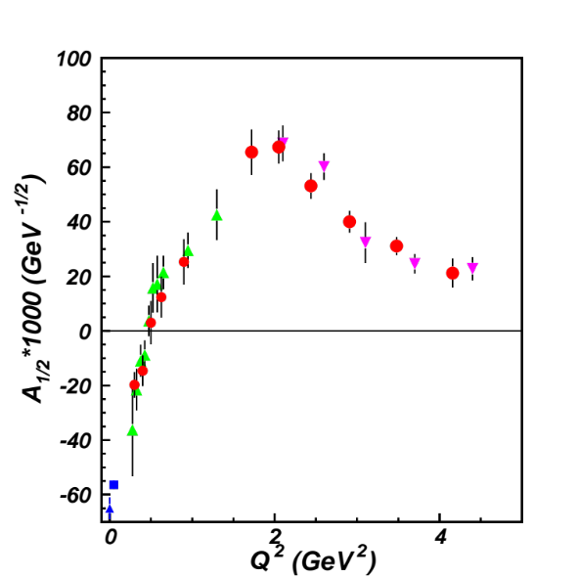
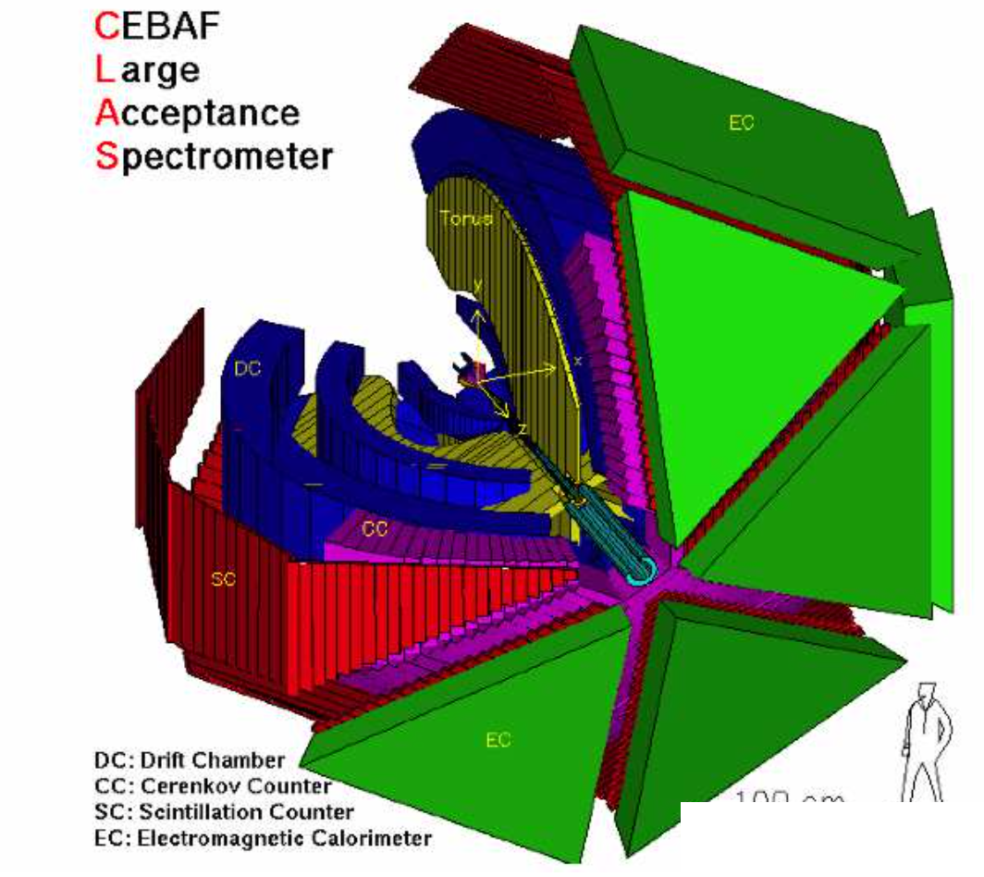
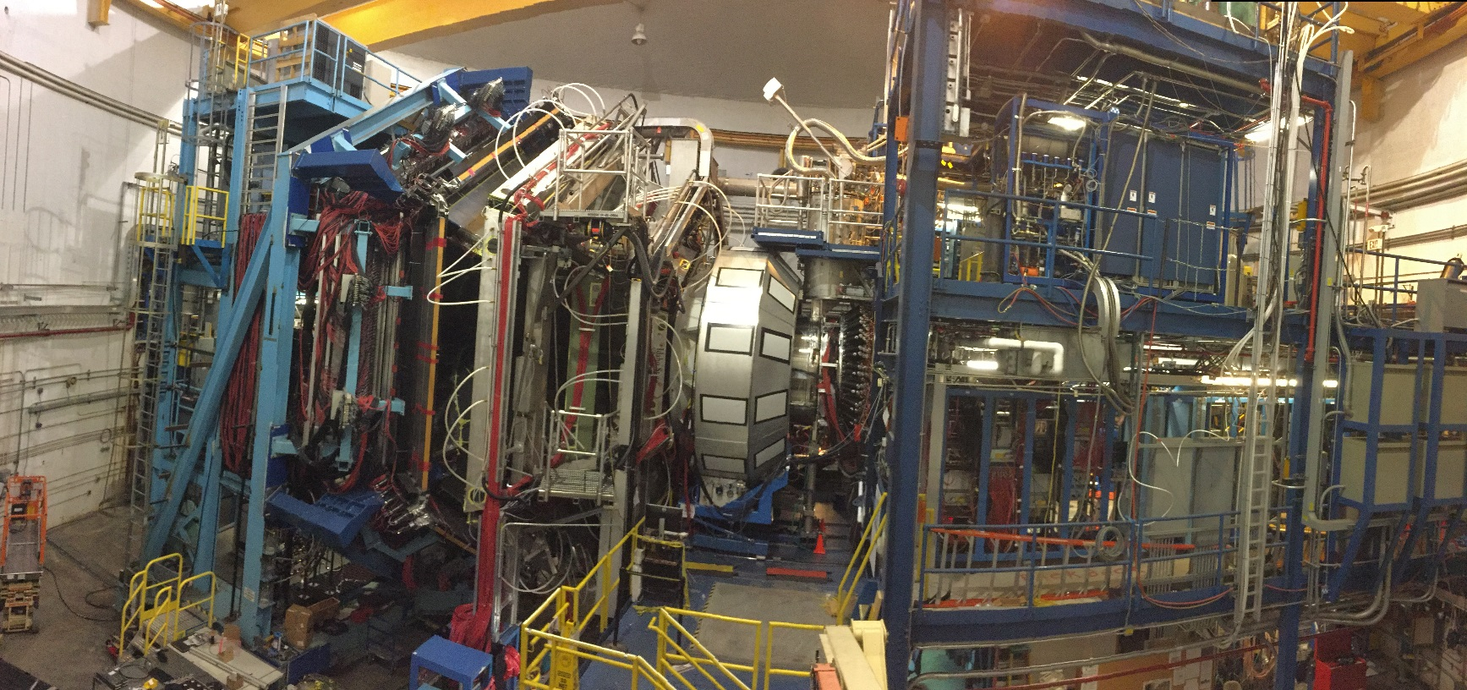
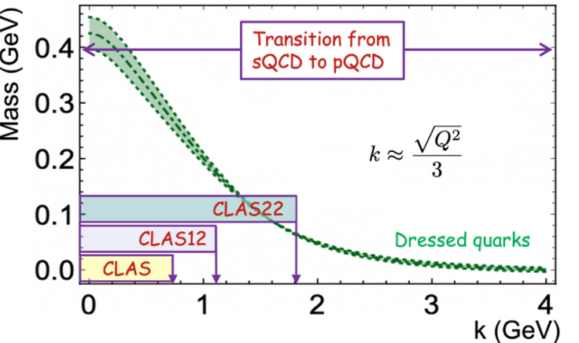


N* Electroexcitation and Strong QCD from the Data of Experiments at JLab
pπ⁺π⁻ CLAS
2023
N* structure as a window into strong interaction in the regime of comparable-to-unity QCD running coupling (strong QCD=sQCD)
γ_{v}pN* electrocouplings from exclusive meson electroproduction with CLAS
Quark core vs. meson-baryon cloud interplay
Insight into emergence of hadron mass (EHM) from N* electroexcitation, N and π elastic form factors
New opportunities with CLAS12 and beyond: high luminosity with large acceptance
V.I. Mokeev, University of South Carolina
and Jefferson Lab (CLAS Collaboration)
15th International Workshop on the Physics of Excited Nucleons
1

Slide 2
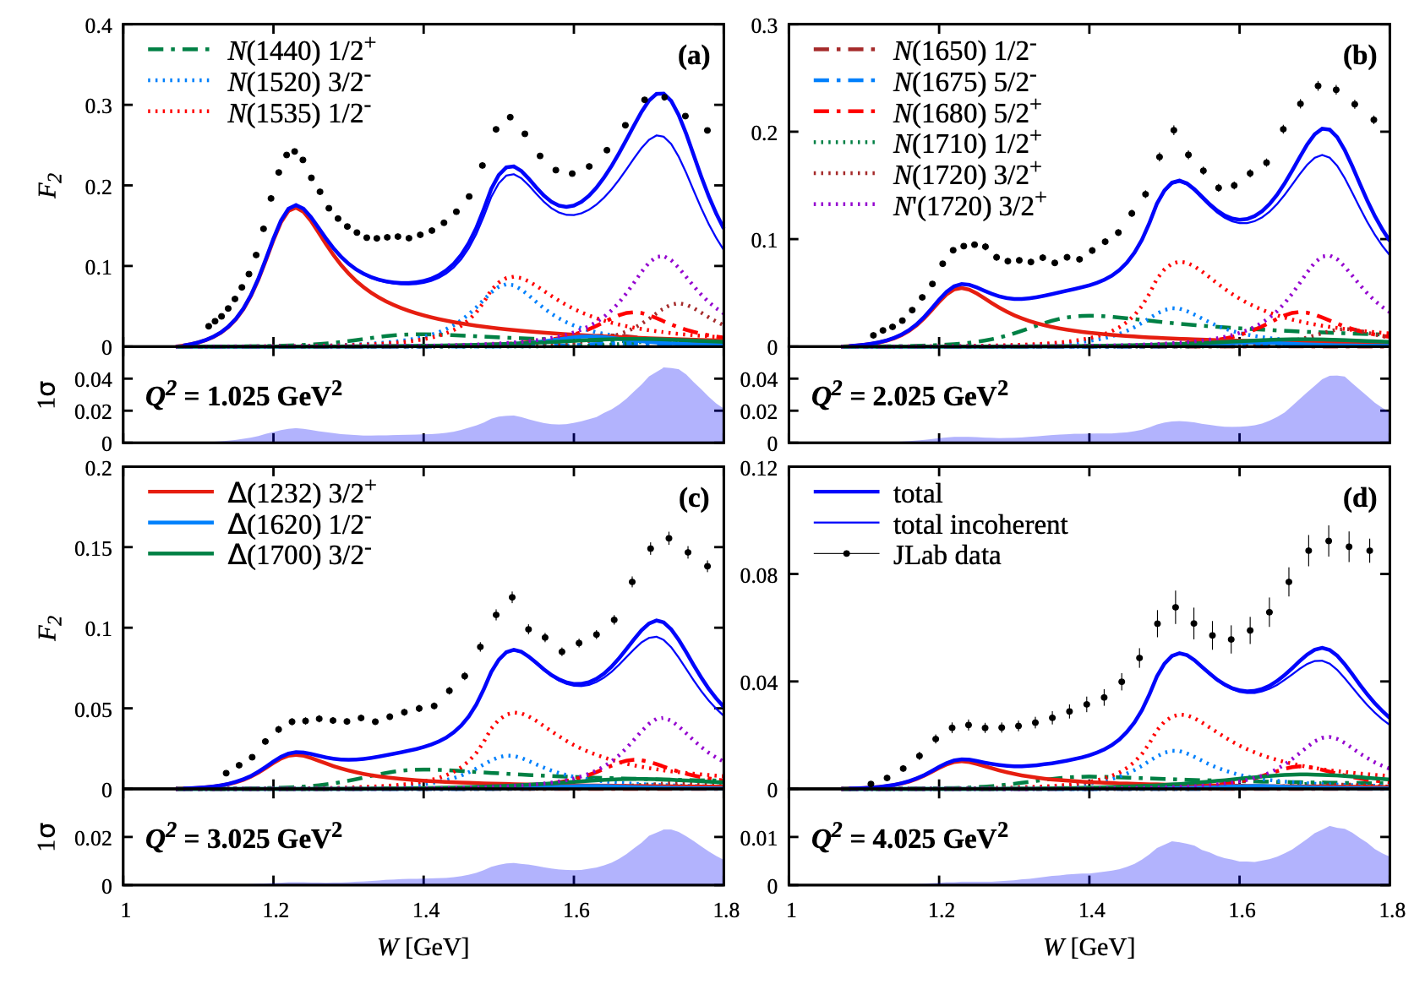
Resonant Contributions to Inclusive F₂(W,Q²) Structure Function
CLAS data: M. Osipenko et al., PRD 67, 092001 (2003)
Hall C data: Y. Liang, Ph.D., American Univ. (2003)
Interpolation of the CLAS/world data: V. Chesnokov et al., Phys Part. Nucl. 53, 184 (2022)
Nucleons as bound systems of quark/gluons that are in permanent creation/annihilation processes possess a rich spectrum of excited states (N*)
N* have been observed in photo-, electro-, and hadroproduction with consistent masses and hadronic decay widths
N* contributions computed with γ_{v}pN* electrocouplings from CLAS data:
A.N. Hiller Blin et al, PRC100, 035201 (2019);
A.N. Hiller Blin et al, PRC104, 025201 (2021)
Differences in the structure of the resonances that contribute to the three resonance-like maxima result in their different evolution with Q².
Nucleons and their resonances are the most fundamental three-body systems in Nature. If we don’t understand how QCD builds each state in the complete spectrum, then our understanding of the sQCD regime remains incomplete.
2

Slide 3
N* Structure in Experiments of 6/12 GeV Eras at Hall B
The experimental program on the studies of N* structure in exclusive meson photo-/electroproduction with CLAS/CLAS12 seeks to determine:
  γ_{v}pN* electrocouplings at photon virtualities Q² up to 10 GeV² for most excited proton states in the mass range <2.5 GeV through analyzing the data of meson electroproduction channels in the N* region.
A unique source of information on many facets of sQCD in generating excited nucleon states with different structural features:
V.D. Burkert et al, Prog. Part. Nucl. Phys. 146, 104214 (2026)
P. Cheng, L. Liu, Ya Lu, and C. D. Roberts, Acta Phys. Polon. B57 2-A13 (2026)
V.I. Mokeev and D.S. Carman Few Body Syst. 63, 59 (2022)
V.D. Burkert and C.D. Roberts, Rev. Mod. Phys. 91, 011003 (2019)
  Explore emergence of hadron mass (EHM) and structure in the transition from the pQCD to the sQCD regime.
An important part of the efforts to address challenging problem on the nature of > 98% of hadron mass from the data on the N*/N structure, analyzed combined with the results on the meson structure:
P. Achenbach, D.S. Carman, R.W. Gothe, K. Joo, V.I. Mokeev, and C.D. Roberts, Symmetry 7,1106 (2025)
M. Ding, C.D. Roberts, and S.M. Schmidt, Particles 6, 57 (2023)
D.S. Carman, R.W. Gothe, V.I. Mokeev. and C.D. Roberts, Particles 6, 416 (2023)

Slide 4
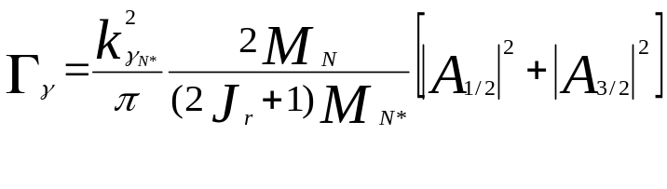
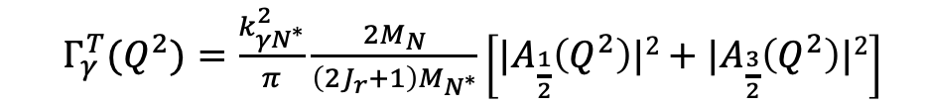
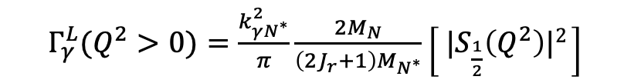
N* Photo-/Electroexcitation Amplitudes (γ_{r,v}pN* Photo-/Electrocouplings)
and their Extraction from Exclusive Photo-/Electroproduction Data
Resonant amplitudes
Non-resonant amplitudes
e’
π, η, ππ, KY,…
π, η, ππ, KY,…
γ_{v}
e
*
N*,△
+
N
N’
N
N’
Real A_{1/2}(Q²), A_{3/2}(Q²), S_{1/2}(Q²)
I.G. Aznauryan and V.D. Burkert, Prog. Part. Nucl. Phys. 67, 1 (2012)
Definition of N* photo-/electrocouplings
employed in CLAS data analyses:
$Γ_{γ}^{T}(Q^{2})=\frac{k_{γN^{∗}}^{2}}{π}\frac{2M_{N}}{\left(2J_{r}+1\right)M_{N^{∗}}}\left[{|A}_{\frac{1}{2}}\left(Q^{2}\right)|2+{|A}_{\frac{3}{2}}\left(Q^{2}\right)|2\right]$
$Γ_{γ}^{L}(Q^{2}>0)=\frac{k_{γN^{∗}}^{2}}{π}\frac{2M_{N}}{\left(2J_{r}+1\right)M_{N^{∗}}}\left[{ |S}_{\frac{1}{2}}\left(Q^{2}\right)|2 \right]$
  Consistent results on γ_{r,v}pN* photo-/electrocouplings from different meson photo-/electroproduction channels allow us to validate the capabilities of the reaction models for reliable extraction of these quantities.

Slide 5
Summary of Published CLAS Data on Exclusive Meson Electroproduction off Protons in N* Excitation Region
Hadronic final state | Covered W-range, GeV | Covered Q²-range, GeV² | Measured observables
π⁺n | 1.1-1.38 1.1-1.55 1.1-1.70 1.6-2.00 | 0.16-0.36 0.3-0.6 1.7-4.5 1.8-4.5 | dσ/dΩ dσ/dΩ dσ/dΩ, A_{b} dσ/dΩ
π⁰p | 1.1-1.38 1.1-1.68 1.1-1.39 1.1-1.80 | 0.16-0.36 0.4-1.8 3.0-6.0 0.4-1.0 | dσ/dΩ dσ/dΩ, A_{b},A_{t},A_{bt} dσ/dΩ dσ/dΩ, A_{b}
ηp | 1.5-2.3 | 0.2-3.1 | dσ/dΩ
K⁺Λ | thresh-2.6 | 1.40-3.90 0.70-5.40 | dσ/dΩ P⁰, P′
K⁺Σ⁰ | thresh-2.6 | 1.40-3.90 0.70-5.4 | dσ/dΩ P′
π⁺π⁻p | 1.3-1.6 1.4-2.1 1.4-2.0 | 0.2-0.6 0.5-1.5 2.0-5.0 | Nine 1-fold differential cross sections
dσ/dΩ−CM angular
distributions
A_{b},A_{t},A_{bt}-longitudinal
beam, target, and
beam-target asym-
metries
P⁰, P′ –recoil and
transferred polarization
of strange baryon
Around 150,000
data points!
Almost full coverage
of the final state hadron emission angles in CM-frame
The measured observables from CLAS are stored in the
CLAS Physics Data Base http://clas.sinp.msu.ru/cgi-bin/jlab/db.cgi
Notes:
Исследования процессов электровозбуждения N* во всех эксклюзивных каналах электророждения мезонов в резонансной области стало возможным в экспериментах на детекторе CLAS , где была получена доминирующая чеать результатов по реакциям эксклюзивного электророждения мезонов на нуклонах.

Slide 6
Approaches for Extraction of γ_{v}pN* Electrocouplings from the Meson Electroproduction Data
Analyses of different meson electroproduction channels independently:
π⁺n and π⁰p channels:
Unitary Isobar Model (UIM) and Fixed-t Dispersion Relations (DR)
I.G. Aznauryan, Phys. Rev. C67, 015209 (2003)
I.G. Aznauryan et al. (CLAS), Phys. Rev. C80, 055203 (2009)
I.G. Aznauryan et al. (CLAS), Phys. Rev. C91, 045203 (2015)
ηp channel:
Extension of UIM and DR
I.G. Aznauryan, Phys. Rev. C68, 065204 (2003)
Data fit at W<1.6 GeV, assuming N(1535)1/2⁻ dominance
H. Denizli et al. (CLAS), Phys. Rev. C76, 015204 (2007)
π⁺π⁻p channel:
Data driven JLab-MSU meson-baryon model (JM)
V.I. Mokeev, V.D. Burkert et al., Phys. Rev. C80, 045212 (2009)
V.I. Mokeev et al. (CLAS), Phys. Rev. C86, 035203 (2012)
V.I. Mokeev, V.D. Burkert et al., Phys. Rev. C93, 054016 (2016)
V.I. Mokeev et al., Phys. Rev. C108, 025204 (2023)=JM23
Global coupled-channel analysis of γ_{r,v}N , πN, ηN, ππN, KΛ, KΣ exclusive channels:
H. Kamano, Few Body Syst. 59, 24 (2018) Argonne-Osaka
H. Kamano, JPS Conf. Proc. 13, 010012 (2017) Argonne-Osaka
See T. Sato talk on Monday, September 7 at 10:30 am
M. Mai et al., Phys. Rev. C106, 015201 (2022)=Julich-Bonn-Washington
Yu-Fei Wang et al, Phys. Rev. Lett. 133, 101901 (2024)=Julich-Bonn-Washington.
See M. Mai talk on Tuesday, September 8 at 10:30 am, M. Doering talk on Tuesday, September 8 at 6:00 pm
JANR
JM
Notes:
Для извлечания амплитуд электровозбуждения N* из сечений и поляризационных асимметрий реакций эксклюзивного электророждения мезонов на
протонах были развиты как подходы для извлечения параметров N* из независимого анализа различных эксклюзивных каналов, так и из совместного анализа данных всех каналов в рамках многоканальных моделей реакций

Slide 7
Nucleon Resonance Electrocouplings from Data on Exclusive Meson Electroproduction of 6 GeV Era with CLAS
Exclusive meson electroproduction channels | Excited proton states | Q²-ranges for extracted γ_{v}pN* electrocouplings, GeV²
π⁰p, π⁺n | Δ(1232)3/2⁺ N(1440)1/2⁺,N(1520)3/2⁻, N(1535)1/2⁻ | 0.16-6.0 0.30-4.16
π⁺n | N(1675)5/2⁻, N(1680)5/2⁺,N(1710)1/2⁺ | 1.6-4.5
ηp | N(1535)1/2⁻ | 0.2-2.9
π⁺π⁻p | N(1440)1/2⁺, N(1520)3/2⁻ N(1440)1/2⁺, N(1520)3/2⁻, Δ(1600)3/2⁺, N(1675)5/2⁻, N(1680)5/2⁺, Δ(1700)3/2⁻, N(1720)3/2⁺, N’(1720)3/2⁺ | 0.25-1.50 2.0-5.0 2.0-5.0 0.5-5.0
The γ_{v}pN* electrocouplings have become available from analysis of CLAS data for most N* states in the mass range <1.8 GeV and in the range of Q² < 5 GeV².
Numerical results can be found at https://userweb.jlab.org/~mokeev/resonance_electrocouplings23/, Ref. A.N. Hiller Blin et al, PRC100, 035201 (2019), V.I. Mokeev et al., arXiv:2608.04997[nucl-ex]

Slide 8
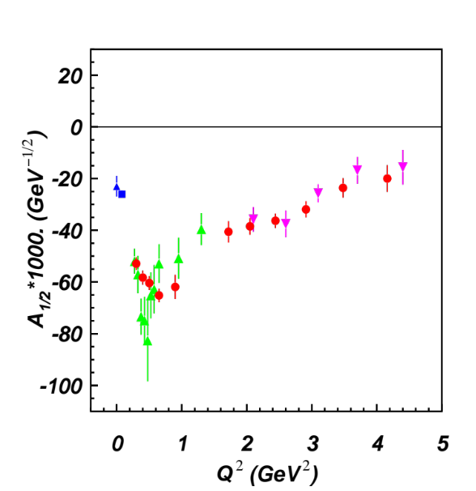
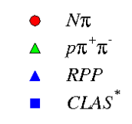
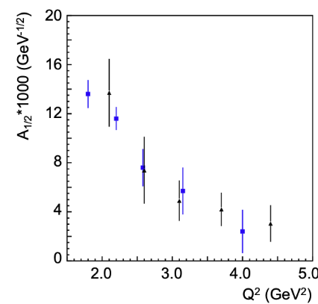
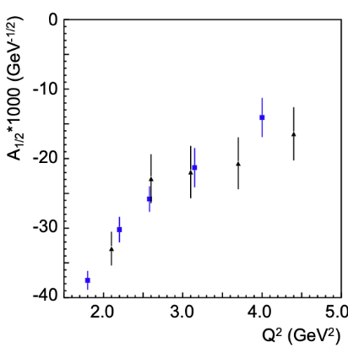
N* Electrocouplings of from πN and π⁺π⁻p CLAS Electroproduction Data
N(1440)1/2⁺
N(1520)3/2⁻
I.G. Aznauryan et al. (CLAS), PRC 80, 055203 (2009)
V.I. Mokeev et al., PRC 86, 035203 (2012)
V.I. Mokeev et al., PRC 93, 025206 (2016)
V.I. Mokeev et al., PRC 108, 025204 (2023)
A_{1/2}
A_{1/2}
pπ⁺π⁻ CLAS
2023
N(1675)5/2⁻
N(1680)5/2⁺
I.G. Aznauryan et al. (CLAS),
PRC 91, 045203 (2015)
black: CLAS π⁺π⁻p
V.I. Mokeev et al.,
arXiv:2608.04997[nucl-ex]
A_{1/2}
A_{1/2}
Consistent results on the γ_{v}pN* electrocouplings from independent studies of the two major πN and π⁺π⁻p electroproduction channels with different non-resonant contributions demonstrated the capabilities of the JANR/JM reaction models for their reliable extraction and allow us to evaluate their systematic uncertainties.
See the talk by R.W. Gothe, Monday, September 7, at 3:00 pm

Slide 9
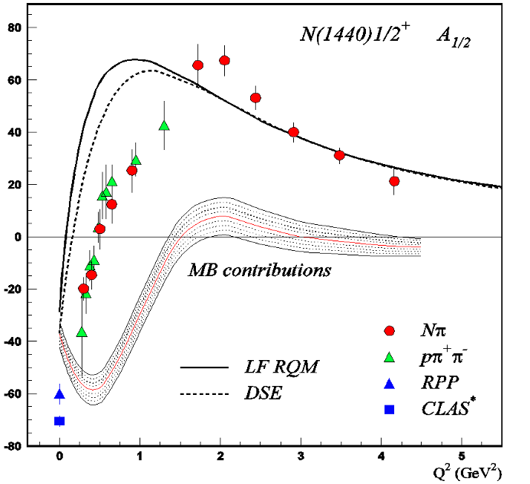
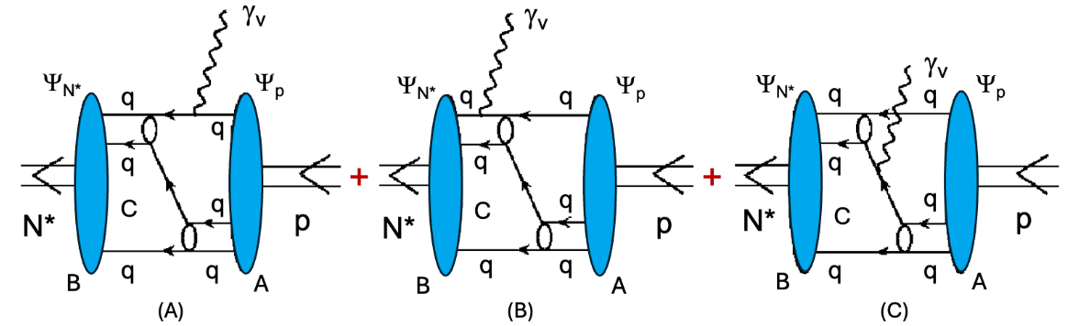
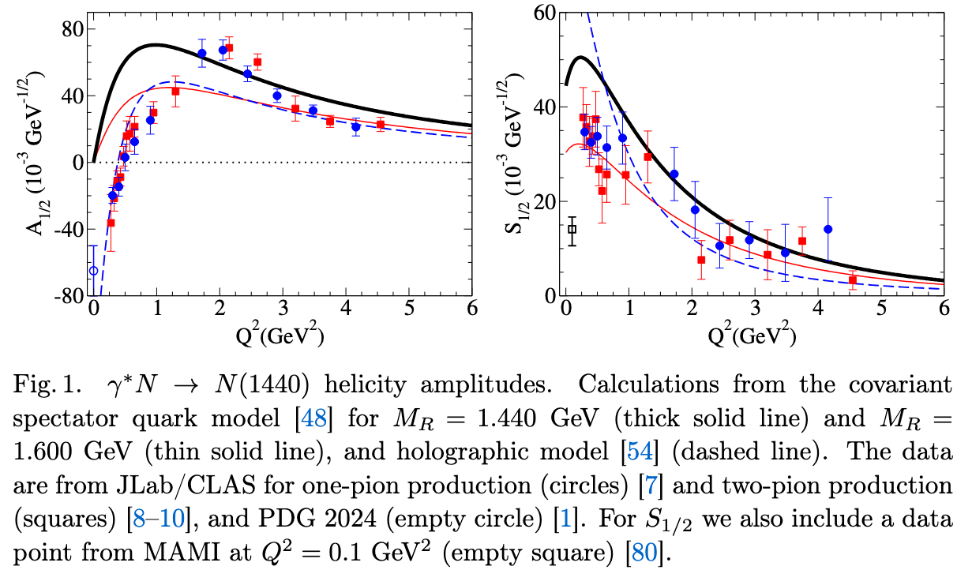
Interplay Between Meson-Baryon Cloud and Quark Core in N* Structure
Peng Cheng, et al, Acta Phys. Pol. B57, A13 (2026)
V.D. Burkert and C.D. Roberts, Rev. Mod. Phys.
91, 011003 (2019)
G. Ramalho, Acta Phys. Pol. B57, A11 (2026)
Good description of the CLAS data on N(1440)1/2⁺
electrocouplings have been achieved for Q²>2 GeV² within CSM, assuming quark core contribution only, offering evidence for a major contribution from quark core to the N(1440)1/2⁺ structure at Q²>2.0 GeV²
The same conclusion comes from the relativistic quark model (LF RQM) that employs phenomenological quark running mass (I.G. Aznauryan, V.D. Burkert, PRC 85, 055202 (2012) (top) and different quark models (bottom)
Comparison experimental results vs theory expectations suggests presence of the contributions from other component(s) beyond quark core to N(1440)1/2⁺ electroexcitations at Q²<1.0 GeV²
9

Slide 10
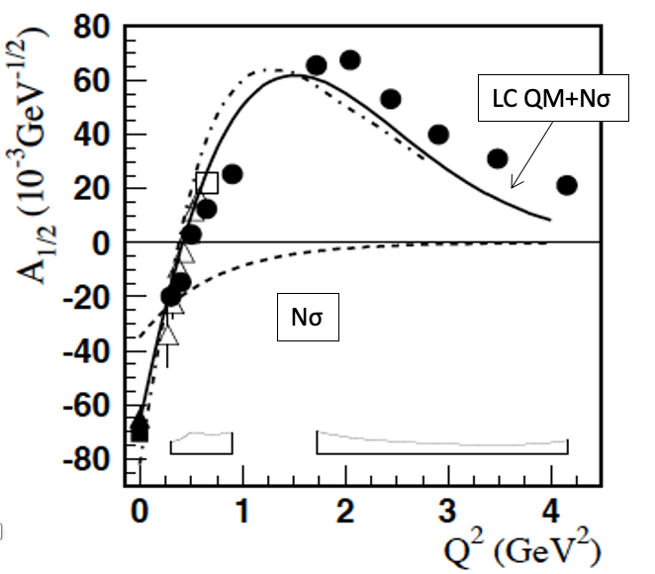
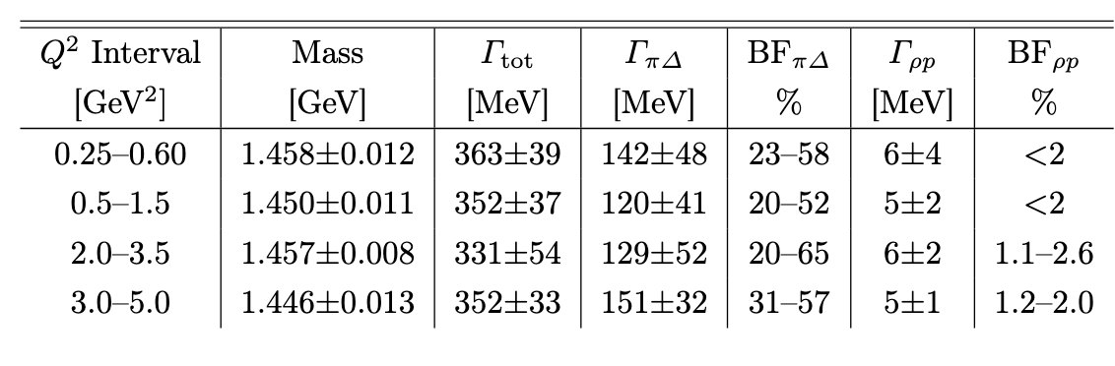
Further Evidence for Quark Core-Meson-Baryon Cloud Interplay in N(1440)1/2⁺ Structure
I.T. Obukhovsky et al., PRD 89, 014032 (2012)
Accounting for the contributions from both meson-baryon
cloud and quark core allowed us to improve the description of N(1440)1/2⁺ electrocouplings for Q²<1 GeV²
Q²-evolution of hadron decay parameters of N(1440)1/2⁺ from π⁺π⁻p electroproduction data
V.I. Mokeev and
D.S. Carman, Acta Phys. Pol. 57, A5 (2026)
A good description of the CLAS π⁺π⁻p electroproduction data has been achieved using Q²-independent mass, total and partial hadronic decay suggesting presence of quark core

Slide 11
γ_{v}pN* Electrocouplings in Resolving Theory Expectation Controversy on N* Structure
The CLAS results on the Q²-evolution of γ_{v}pN* electrocouplings, analyzed within the QCD-connected CSM and the broad array of quark models, revealed the structure of nucleon resonances across the mass range up to 1.8 GeV as a complex interplay between the inner core of three dressed quarks and the external meson-baryon cloud.
Contributions from meson-baryon cloud are pronounced mostly at Q²<1.0 GeV² while the transition to quark core dominance has been revealed with increasing Q².
LQCD & HEFT describe the N(1440)1/2⁺ and Δ(1600)3/2⁺ as predominantly dynamically generated, with little or no contribution from a 3-quark core. This conclusion follows from the successful description of πN elastic scattering phase shifts and inelasticities within HEFT, projected onto the finite-volume box used in LQCD calculations (A.W. Thomas, Acta Phys. Pol. B 57, A6 (2026)).
Predictions on Q²-evolution of N(1440)1/2⁺ and for Δ(1600)3/2 electrocouplings for Q² range up to 3 GeV², at least, within LQCD & HEFT confronted with the experimental results from CLAS are critical for insight into the origin of the differences mentioned above, with all approaches capable of predicting the Q²-evolution of both resonance electrocouplings and potentially converge in understanding of their structure.
11

Slide 12
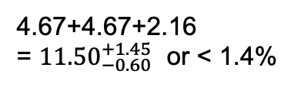
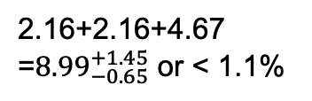
How do the Ground/Excited Nucleon Masses Emerge?
Composition of the Nucleon Mass:
proton
neutron
M_{p}, MeV (PDG23)
M_{n}, MeV (PDG23)
938.2720813
±0.0000058
939.5654133
±0.0000058
Sum of bare quark
masses, MeV
Sum of bare quark
masses, MeV
2.16+2.16+4.67
=${8.99}_{−0.65}^{+1.45}$ or < 1.1%
4.67+4.67+2.16
= ${11.50}_{−0.60}^{+1.45}$ or < 1.4%
$\overline{\text{MS}}\text{ scheme}$ at a renormalization scale of 2.0 GeV
The Higgs mechanism only generates the renormalization-group-invariant masses of bare quarks relevant to the pQCD regime.
The dominant part of N/N* masses is generated in processes other than the Higgs mechanism.
Studies of the structure of the nucleon ground state and N* electroexcitation within a broad range of Q² shed light on the emergence of N/N* masses at distances where the transition from pQCD to sQCD regimes is expected.
12

Slide 13
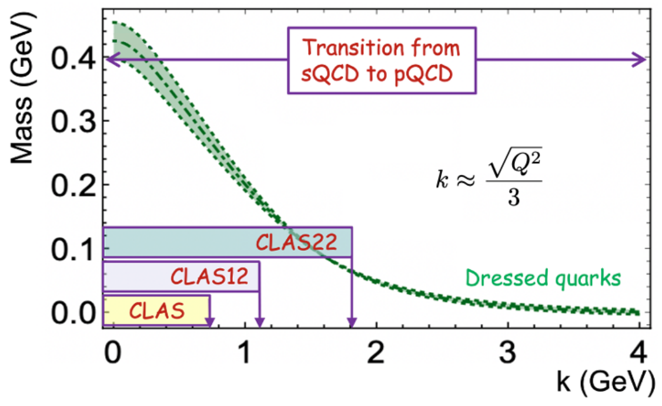
CSM Concept on EHM and Insight from γ_{v}pN* Electrocoupling Data
P. Achenbach, D.S. Carman, R.W. Gothe, K. Joo, V.I. Mokeev, and C.D. Roberts, Symmetry, 17, 1106 (2025)
M. Ding, C.D. Roberts, and S.M. Schmidt, Particles 6, 57 (2023)
The dominant part of hadron mass (>98%) is generated by strong interactions between dressed gluons and quarks at distances where the transition from pQCD to sQCD takes place. Studies of the structure of ground and excited nucleon states within CSM across a broad range of Q² allow us to map out the momentum dependence of dressed quark mass. EHM is encoded in the evolution of dressed quark mass with momenta/distances
The CLAS experiments, limited to Q² < 5 GeV², allowed exploration of a range of distances where ~30% of hadron mass is generated. Extending the Q² coverage up to 10 GeV² with the CLAS12 will offer insight into the distance scales where ~50% of hadron mass emerges.
Future potential experiments at facilities capable of measuring exclusive meson electroproduction for Q² < 30 GeV² across a large acceptance with luminosities at least 2-5 x 10³⁵ cm⁻²s⁻¹ provide a unique opportunity to explore the full range of distances over which the dominant portion of hadron mass and the structure of N/N* states are generated.
13

Slide 14
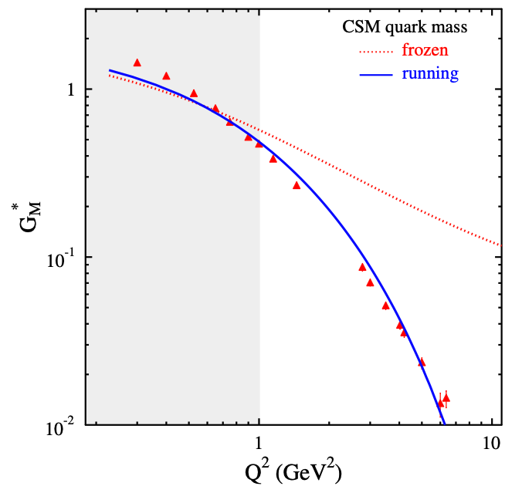
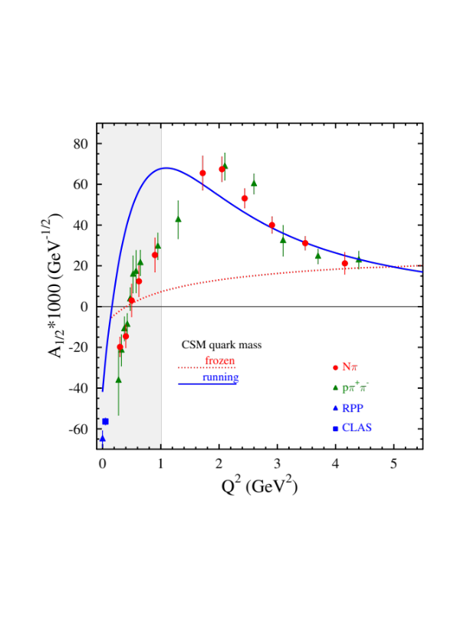
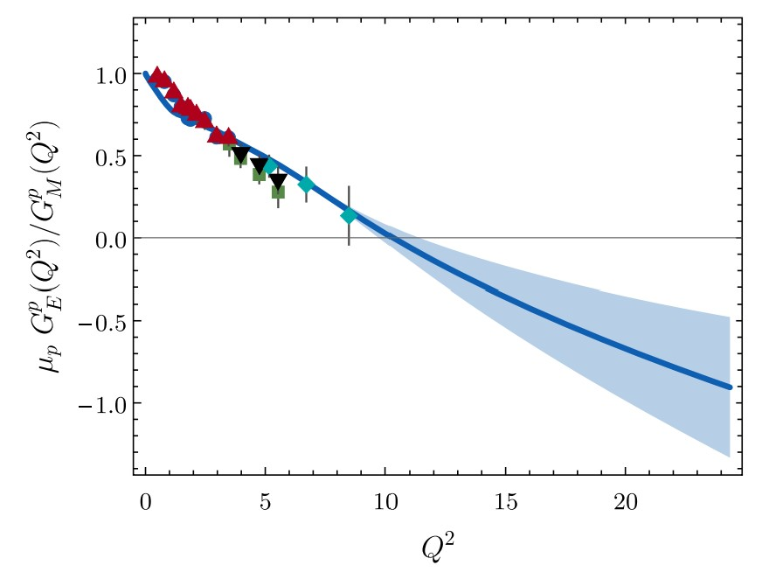
Insight to Dressed Quark Mass Function from Experimental Results on Meson and Baryon Structure
CLAS/Hall A/C results vs. CSM expectations
A successful description of the pion and nucleon elastic FFs and the electrocouplings of the Δ(1232)3/2⁺ and N(1440)1/2⁺ has been achieved in CSM with the same dressed quark/gluon mass functions.
N→Δ(1232)3/2⁺ magnetic FF
N(1440)1/2⁺
Substantial contributions from M-B cloud
J. Segovia et al., FBS 55, 1185 (2014)
J. Segovia et al., PRL 115, 171801 (2015)
Dressed quarks with dynamically generated masses represent active degrees of freedom in the structure of the pion, nucleon, and the Δ(1232)3/2⁺, N(1440)1/2⁺.
Strong evidence for insight into momentum dependence of dressed quark mass
Pion Elastic FF
C.D. Roberts et al., Prog. Part. Nucl Phys. 120, 103883 (2021)
Nucleon Elastic FF
M. Barabanov et al., Prog. Part. Nucl. Phys. 103835 (2021)
Q² F_{π} / GeV²
μ_{p}G_{E}^{p}(Q²)/G_{M}^{p}(Q²)
Data points: JLab F_{π} Collaboration
Hall A/C data
Q² (GeV²)
Q² (GeV²)
One of the most important achievements in hadron physics of the last decade
in synergistic efforts between experimentalists, phenomenologists, and theorists.
14
Notes:
- The picture of a quark inside of a hadron is a dynamical picture - what we effectively see depends on the quark momentum - review the picture and the importance of scale
- Model calculations of form factors and electrocouplings are sensitive to the evolution of the dressed quark mass function.
- Review the model calculations
- The data from CLAS12 will cover for the first time the range of Q2 where the dominant part of the hadron mass is generated addressing the key open problems of what is the nature of confinement and how is more than 98% of the visible mass in the Universe generated?

Slide 15
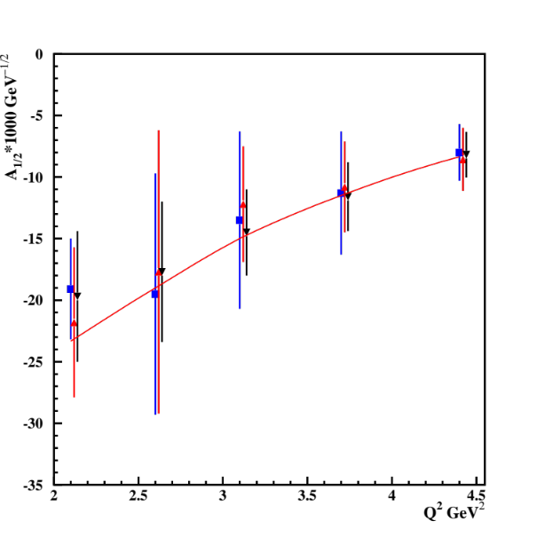
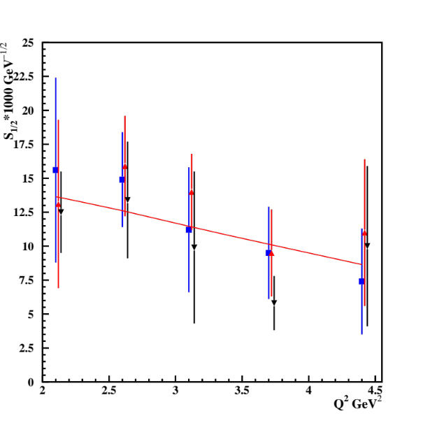
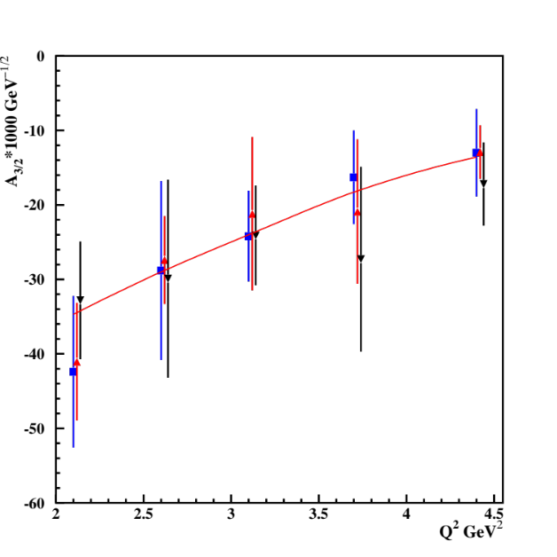
Δ(1600)3/2⁺ Electrocouplings : CSM Prediction vs. Data Determination
CSM predictions, Ya Lu et al., Phys. Rev. D 100, 034001 (2019)
Electrocouplings from independent analyses of π⁺π⁻p differential cross sections within three W-intervals, 1.46<W<1.56 GeV, 1.51<W<1.61 GeV, and 1.56<W<1.66 GeV for 2.0<Q²<5.0 GeV² [V.I. Mokeev et al., PRC 108, 025204 (2023)].
CLAS results on Δ(1600)3/2⁺ electrocouplings confirmed the CSM prediction, solidifying evidence for insight into dressed quark mass function and, consequently, into EHM from studies of γ_{v}pN* electrocouplings.
See the review talk by C.D. Roberts, Monday, September 9 at 10:30 am
15

Slide 16
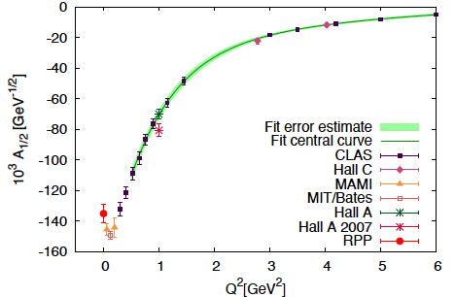
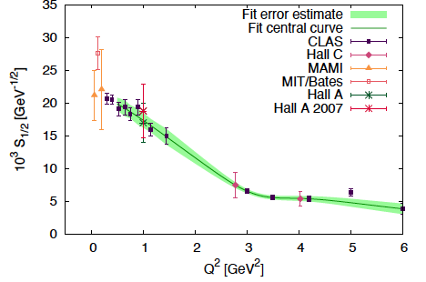
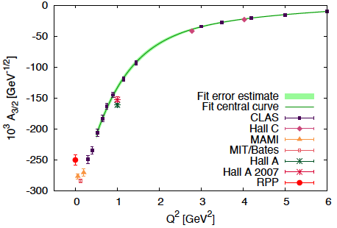
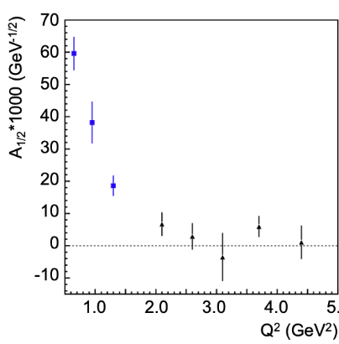
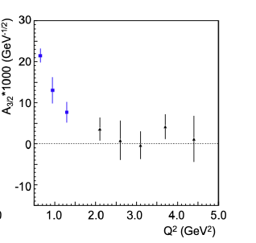
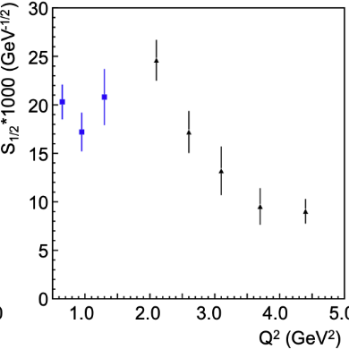
Connecting EHM and DCSB from Δ(1232)3/2⁺ and Δ(1700)3/2⁻ Electrocouplings
Δ(1232)3/2⁺
A_{1/2}
S_{1/2}
A_{3/2}
Δ(1700)3/2⁻
A_{1/2}
S_{1/2}
A_{3/2}
The results show substantial differences in Q²-evolution of Δ(1232)3/2⁺/Δ(1700)3/2⁻ chiral partner electrocouplings.
This is a promising opportunity to explore DCSB in connection to EHM by comparing the experimental results and the CSM predictions for Δ(1232)3/2⁺ and Δ(1700)3/2⁻ electrocouplings
16

Slide 17
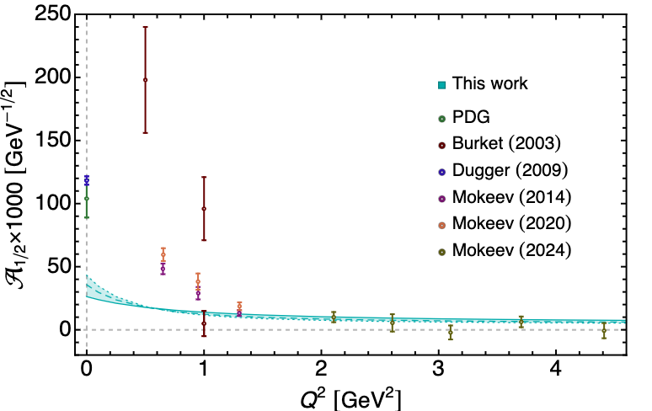
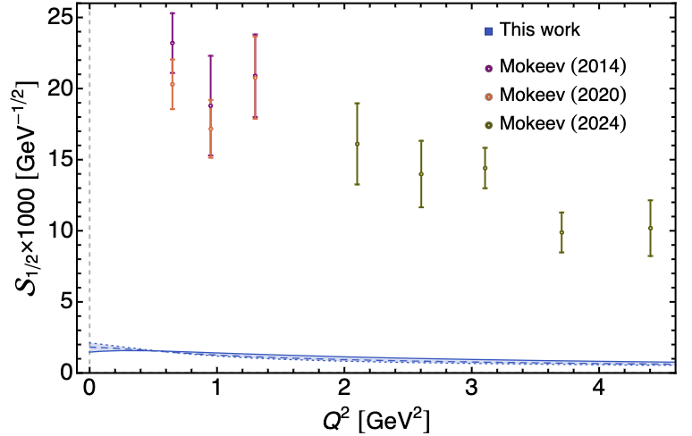
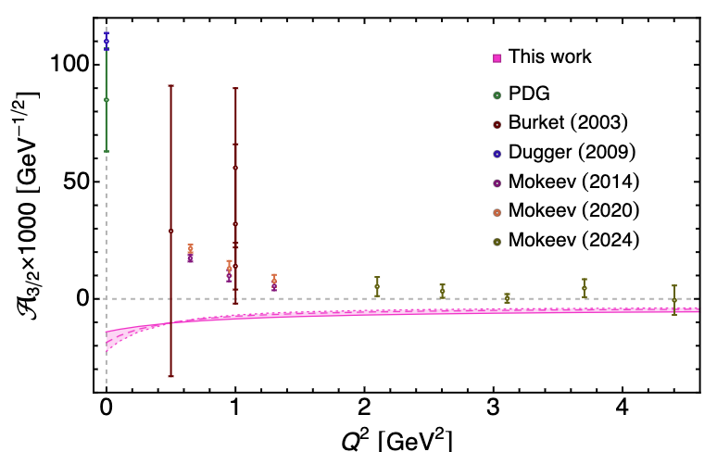
CSM Evaluations of Δ(1700)3/2⁻ Electrocouplings with Contact qq-Interaction
L.Albino , G.Paredes-Torres, K. Raya, A. Bashir, and J. Segovia, PRD 112, 054025 (2025)
Employing realistic qq-interaction that generates momentum dependent dressed quark mass is essential in exploration of the EHM and DCSB connection.

Slide 18
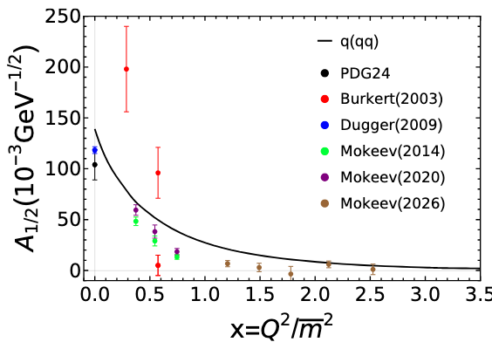
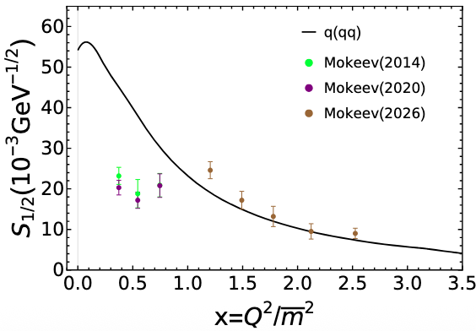
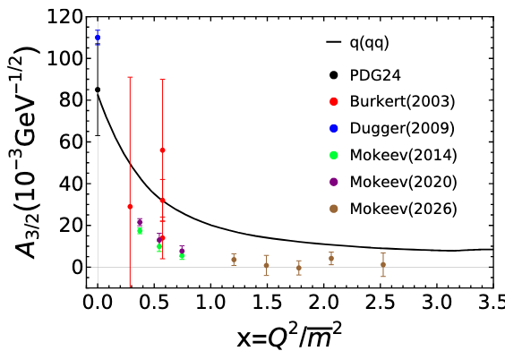
Studies of EHM and DCSB Connection by Employing QCD-Driven qq-Interaction
P. Cheng, L. Liu, Ya Lu, and
C.D. Roberts. Acta Phys. Pol., B57, A13 (2026)
CSM accounts for the connection between EHM and DCSB
in the evaluation of the dressed quark propagator and for
qq-interaction amplitudes
Successful description of the leading S_{1/2} electrocoupling has been achieved for Q²> 2.0 GeV², while for A_{1/2} and A_{3/2} electrocouplings for Q²>2.65 GeV²
Chiral partner Δ(1232)3/2⁺ electrocouplings have been successfully described earlier within the same theory framework (J. Segovia et al., FBS 55, 1185 (2014))
Comparative studies of the CLAS results on Δ(1232)3/2⁺/Δ(1700)3/2⁻ electrocouplings within CSM revealed a connection between DCSB and EHM in the baryon sector for the first time.

Slide 19
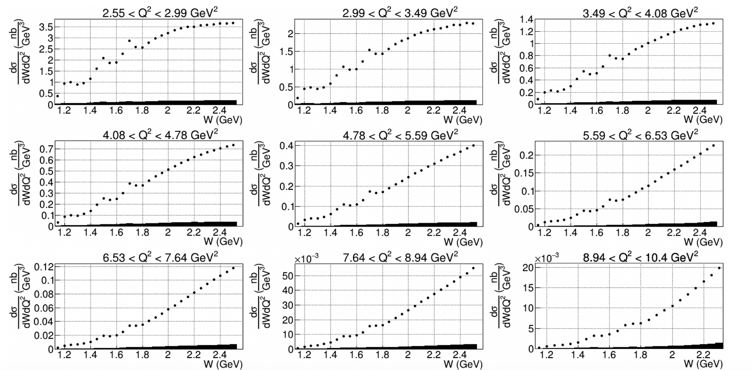
Extension in N* Structure Studies with CLAS12
CLAS12: Extension of the results on γ_{v}pN* electrocouplings of most N* states in the range W < 2.5 GeV and Q² up to 10 GeV² from exclusive channels: πN, ππN, KY, K*Y, KY*.
Measurements of inclusive (e,e’X) cross section with the CLAS12. V. Klimenko et al. (CLAS collaboration), PRC 112, 025201 (2025)
Resonance-like structures are clearly seen in the first, second, and third resonance regions for Q²<10 GeV²
19

Slide 20
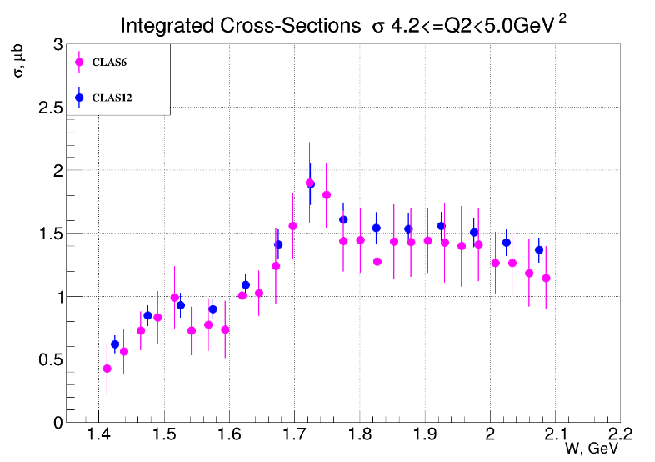
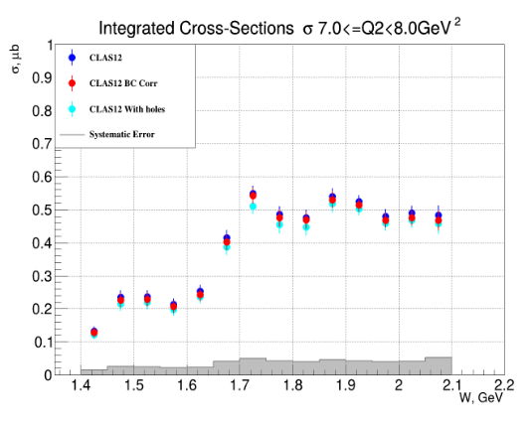
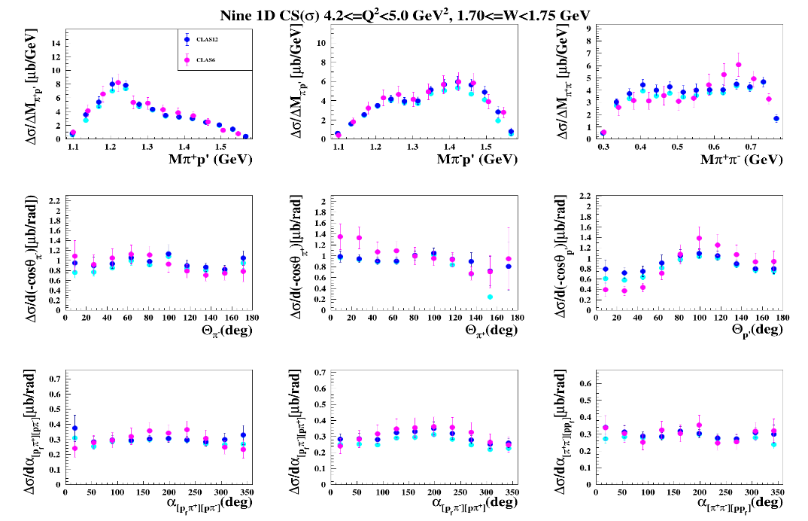
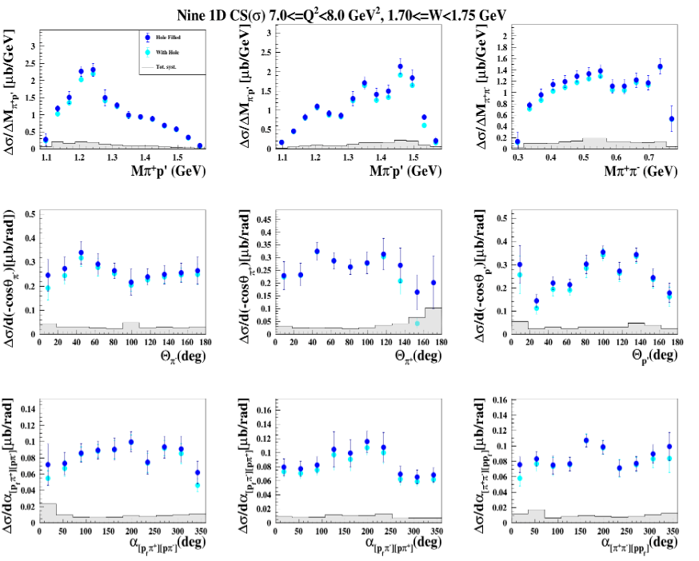
Preliminary Results on π⁺π⁻p Electroproduction Cross Sections from CLAS12
K. Neupane, R.W. Gothe, V.I. Mokeev (USC),
D.S. Carman (JLab)
Preliminary
Integrated and nine one-fold differential π⁺π⁻p cross sections have become available across the range of
W=[1.4-2.1] GeV for Q²=[2.4-8.0] GeV²
Consistency with the CLAS data in the overlapping range of Q²<5.0 GeV²
Allow us to extend the JM model over the range of Q²<8.0 GeV², paving the way to obtain γ_{v}pN* electrocouplings of prominent resonances across the mass range up to 2.0 GeV for Q²<8.0 GeV²
20

Slide 21
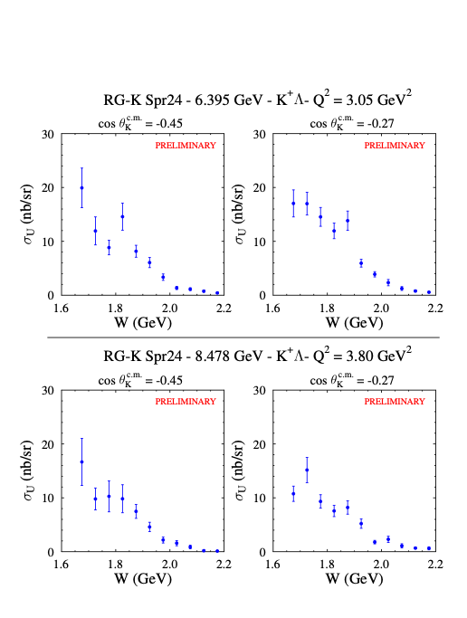
Extension of the Results on γ_{v}pN* Electrocouplings in Experiments of 12 GeV Era : KΛ and KΣ Electroproduction
Resonance-like structures appear in the W-dependence of σ_{u}(W) structure function.
Opportunities for the extraction of γ_{v}pN* electrocouplings from the CLAS12 KΛ and KΣ electroproduction data.
π⁺π⁻p, KΛ, and KΣ electroproduction channels are promising to discover new state of baryon matter known as “missing” resonances and hybrid-baryons with glue as the active structural component.
See the talk by D.S. Carman on Monday, September 7, at 9:30 am

Slide 22
Conclusions and Outlook
High-quality data of the 6-GeV era from CLAS have allowed for the determination of the electrocouplings of most N*s in the mass range up to 1.8 GeV for Q²<5 GeV². Consistent results on γ_{v}pN* electrocouplings from πN and π⁺π⁻p channels demonstrated the capabilities of the JANR/JM reaction models for credible extraction of these quantities from the data.
Analyses of CLAS data on γ_{v}pN* electrocouplings within the QCD-rooted CSM framework, together with studies using various quark models, revealed the N* structure as a complex interplay between an inner core of three dressed quarks and an external meson–baryon cloud with the transition to the quark core dominance as Q² increases
A good description of the Δ(1232)3/2⁺, N(1440)1/2⁺, and Δ(1600)3/2⁺ electrocouplings for Q²<5 GeV² achieved within CSM with the same dressed quark mass function inferred from the QCD Lagrangian and used in the successful description of the elastic nucleon and pion EM form factors, offers sound evidence for insight into the momentum dependence of the dressed quark mass.
CLAS12 is the only facility capable of obtaining the electrocouplings of all prominent N* states in the unexplored Q² range from 5 - 10 GeV², allowing for mapping of the dressed quark mass function at quark momenta where ~50% of hadron mass is generated.
Studies of exclusive meson electroproduction at W<2.5 GeV in facilities with luminosities at least 2-5*10³⁵cm⁻²s⁻¹ across large acceptance will allow us to determine γ_{v}pN* electrocouplings for Q²<30 GeV², offering the only foreseen opportunity to explore the full range of distances where hadron mass and N* structure emerge from QCD. Synergy between experiment, phenomenology, and theory are needed.
22

Slide 23
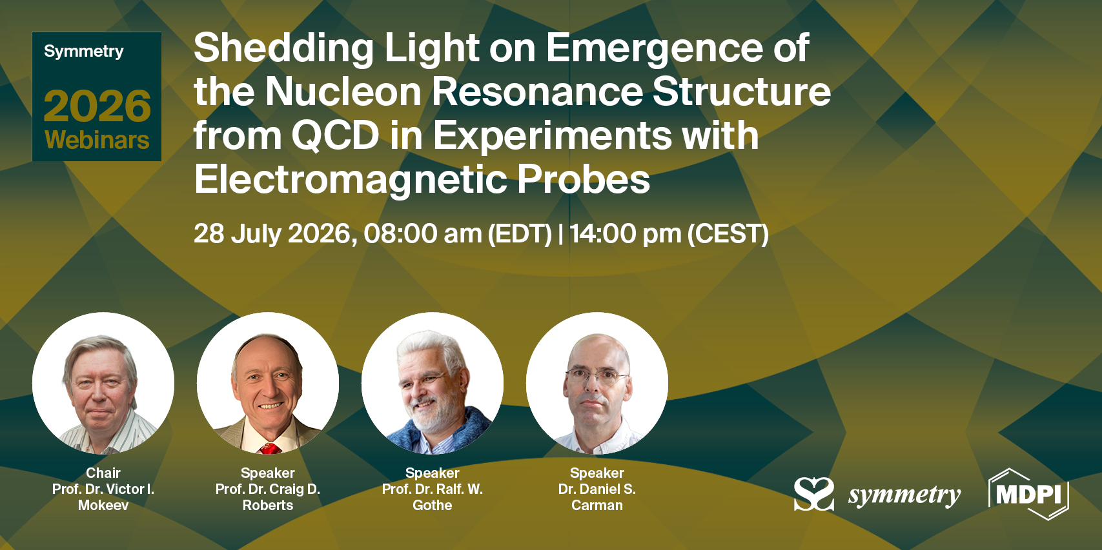
Special Issue: Emergence of Hadron Mass from Experiments at High Luminosity Facilities
Topics:
Studies of nucleon resonance electroexcitation amplitudes from exclusive meson electroproduction data obtained in 6-GeV era CLAS experiments
Extension of N* structure studies anticipated from CLAS12 experiments in the 12-GeV era and beyond
Theory framework(s) for understanding the emergence of hadron mass (EHM) and structure from results on the N* electroexcitation amplitudes
Webinar website:
https://sciforum.net/event/Symmetry-20
Related topical collection;
https://www.mdpi.com/journal/symmetry/topical_collections/67E84K92L5?webinar_id=218&_utm_from=3591e00bb3
23

Slide 24
Back up

Slide 25
Impact of the Extension of γ_{v}pN* Electrocouplings Results for Q²>5.0 GeV² on Insight into EHM
P. Achenbach, D.S. Carman, R.W. Gothe, K. Joo, V.I. Mokeev, and C.D. Roberts, Symmetry, 17, 1106 (2025)
To resolve the challenging problem on EHM, the dressed quark mass function M_{q}(k) should be mapped out in experiments over the entire range of quark momenta to ~2 GeV, where the transition from strongly coupled to perturbative QCD takes place, and the dominant part of hadron mass and N* structure emerge.
The CLAS experiments, limited to Q² < 5.0 GeV², allow exploration of a restricted range of distances where ~30% of hadron mass is generated. Extending the Q² coverage up to 10 GeV² with measurements from CLAS12 will offer insight into the distance scales where ~50% of hadron mass emerges.
A potential increase of CEBAF energy to 22 GeV would provide a unique opportunity to explore the full range of distance scales over which the dominant portion of hadron mass and the structure of excited nucleon states are generated.
25

Slide 26
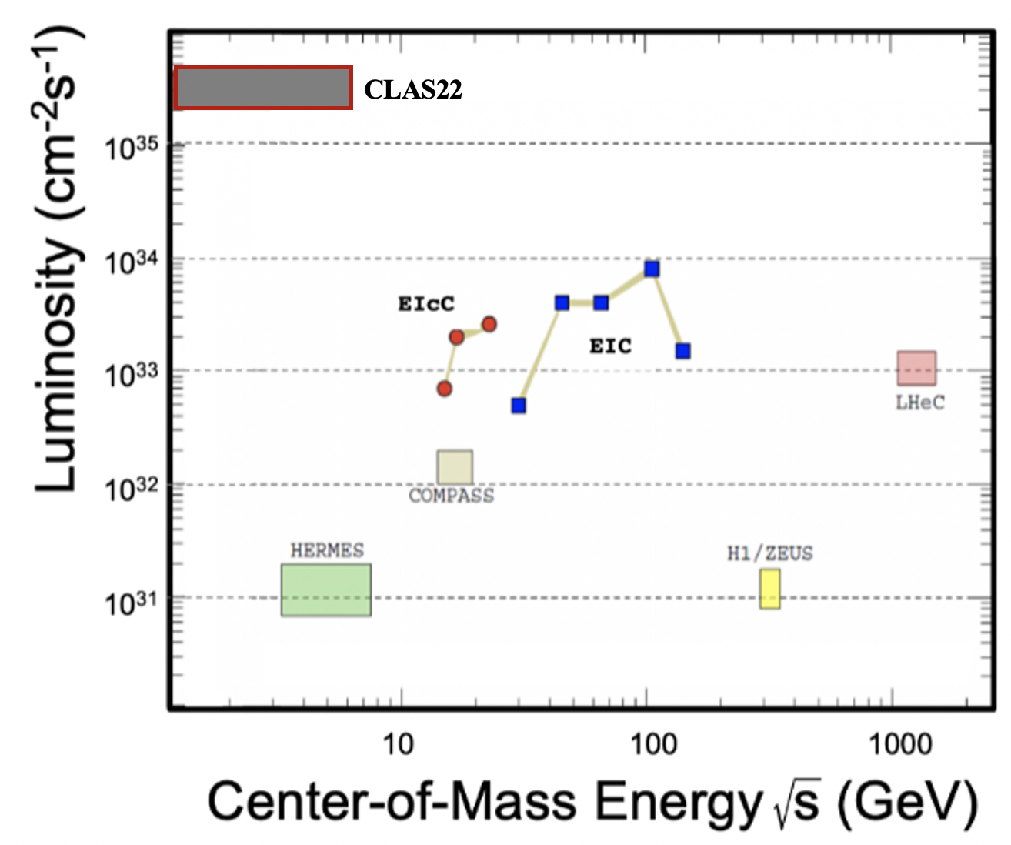
Unique Opportunities for Gaining Insight into EHM through Studies of N* Structure within a Potential CEBAF 22 GeV Energy Upgrade Including CLAS22
Simulations of πN, KY, and π⁺π⁻p electroproduction with CEBAF@22 GeV show:
γ_{v}pN* electrocouplings can be determined up to Q² ~ 30 GeV² for 𝓛 ~ 2 - 5 ⨉ 10³⁵ cm⁻²s⁻¹
Both EIC and EIcC would need much higher luminosity to carry out such a program
The luminosity “frontier” is a unique advantage of JLab
Beam energy 22 GeV
Large acceptance
High luminosity
Studies of exclusive reactions
Extending the γ_{v}pN* electrocoupling results into the Q² range from 10 - 30 GeV² after the CEBAF energy increase and pushing the capabilities of CLAS12 to measure exclusive electroproduction to the highest possible luminosity within a large acceptance, will offer the only foreseen opportunity to explore how the emergent part of the hadron mass and N* structures are coming from QCD and will make CEBAF@22 GeV unique and the ultimate QCD-facility at the luminosity frontier.
29

Slide 27
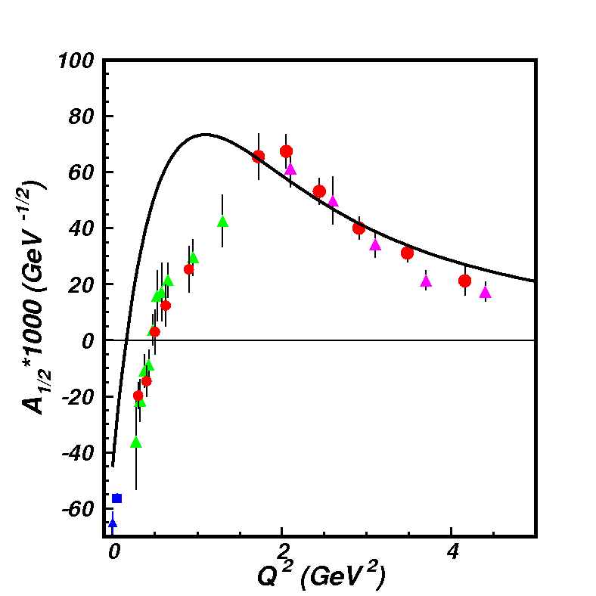
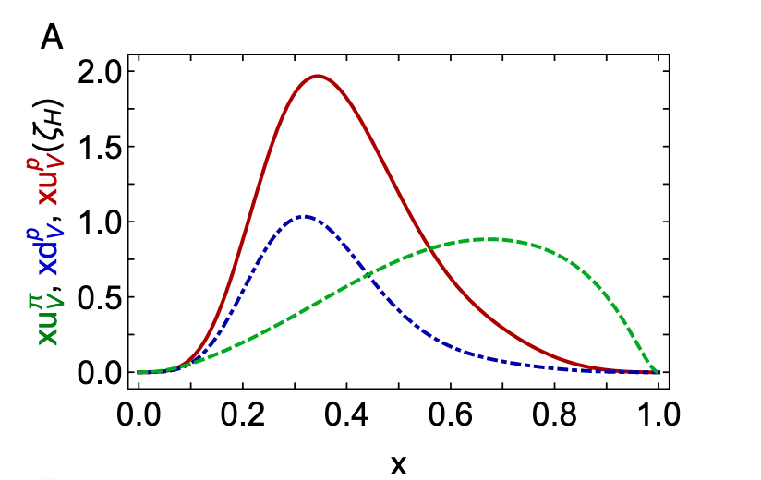
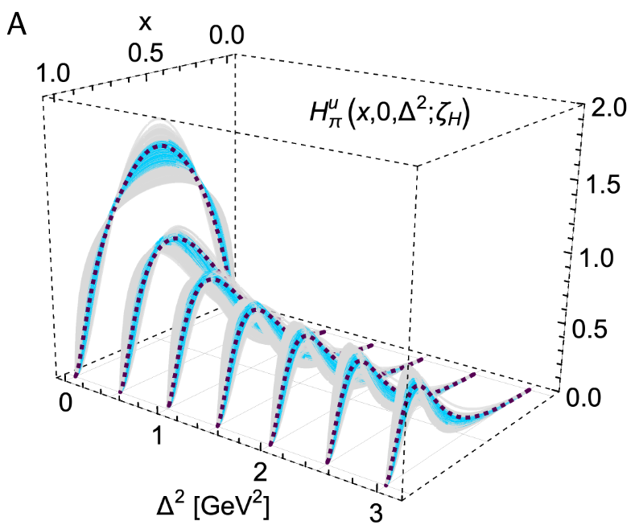
EHM from Global Hadron Structure Analysis within CSM
This will be extended by the future data on γ_{v}pN* electrocouplings from CLAS12 in the 12 GeV era
Nucleon Elastic FF
γ_{v}pN* Electrocouplings
Proton and pion PDF for valence quarks
N(1440)1/2⁺
μ_{p}G_{E}/G_{M} (Q²)
in DSEQCD
Pion GPDs
New data from studies of D-Y at AMBER and Sullivan processes at JLab
Pion Elastic FF
Pion PDF
CSM is currently the only approach that offers insight into EHM from combined studies of meson/baryon structure with connection to QCD. Ref. C.D. Roberts, FBS 64, 51 (2023).
17

Slide 28
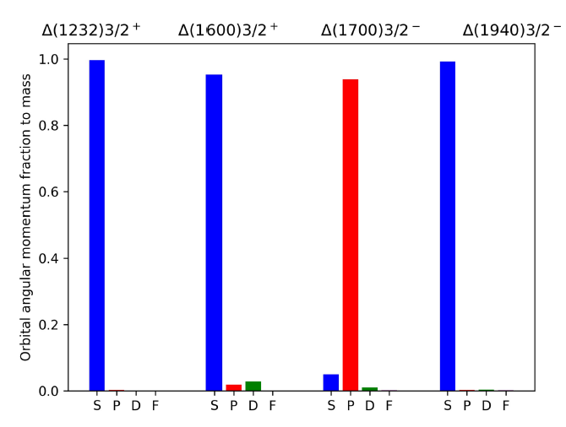




EHM and DCSB from Electroexcitation of Nucleon Resonances
L-L’ color map
L. Liu et al., PRD 105, 114047 (2022)
Δ(1600)3/2⁺
Resonance masses/spectrum are determined mostly by a single quark-diquark configuration expected from SU(6) assignment
Resonance wave functions reveal more complex quark-diquark composition accessible from the results on Q²-evolution of γ_{v}pN* electrocouplings
DCSB manifestation in the structure of chiral partners
Δ(1232)3/2⁺
Δ(1700)3/2⁻
Electrocouplings of most N* in the mass range < 2 GeV will become available from the CLAS exclusive meson electroproduction data for 2.0<Q²<5.0 GeV², allowing us to establish either universality or environmental sensitivity of dressed quark mass function and to explore connection between EHM and DCSB

Slide 29








Facets of Strong QCD from Combined Studies of the Ground/Excited Nucleon State Structure
N(1535)1/2⁻
V.D.Burkert and I.G. Aznauryan, Prog. Part
Nucl. Phys. 67, 1 (2012)
The results on electroexcitation of different resonances
allow us to rigorously test the quark model ingredients
for the description of the ground/excited hadron structure
N(1440)1/2⁺
V.M. Braun et al., Phys. Rev. D 89, 094511 (2014)
C. Mezrag et al., Phys. Rev. Lett. B 783, 263 (2018)
Parton distribution amplitudes (PDA) in:
N(938)1/2⁺
N(1535)1/2⁻
N(1440)1/2⁺
Pronounced differences
predicted for N/N* PDAs
can be explored in N* electroexcitation, offering insight into the sQCD mechanisms that underlie these differences
Rest frame quark-correlated-di-quark angular momentum content in:
L. Liu et al., e-print: 2203-12083 [hep-ph]
Studies of N* electroexcitation
will contribute to understanding
of the nature of spin of the
ground and excited states of the
nucleon
Δ(1232)3/2⁺
Δ(1600)3/2⁺
Δ(1700)3/2⁻
Exploration of N* electroexcitations is an important part of efforts aimed to considerably extend knowledge on sQCD

