Slide 1
Classical Solutions of Chern-Simons theory on 3-manifolds
Ramadevi Pichai,
Dept of Physics, IIT Bombay
11th Dec 2025
ISM 2025 (Dec 9-14, 2025 )
Based on work with Aditya Dwivedi, Archana Maji, Dmitry Noshchenko (arXiv: 2509.05270)
See Poster presentation by Aditya Dwivedi on 14th

Slide 2
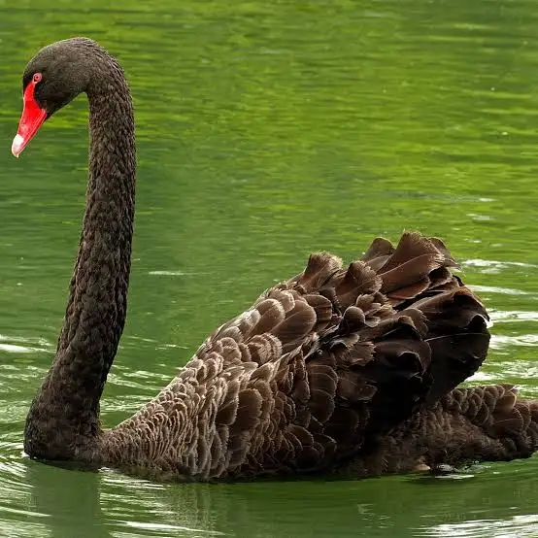
Motivation
Wanted to take you all on an excursion to see flamingoes and swans last ISM 2023
By swans – everyone thinks it is white-swans
(conventional saddles in the theory)
Surprises- some black swans present
(not saddles but classical solution)

Slide 3
Plan
Resurgence –brief overview in q-mech
Does classical solutions refer to only conventional saddles of a theory? – a toy example
Chern-Simons theory – tractable playground to address
Our results for some 3-manifolds

Slide 4
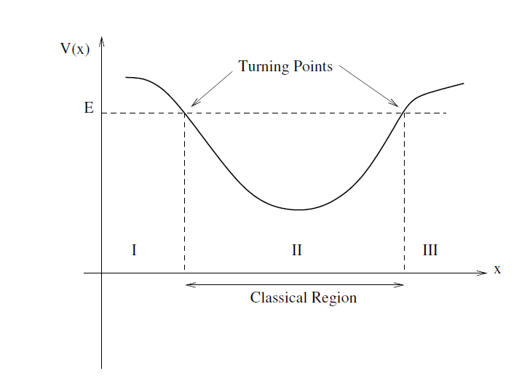

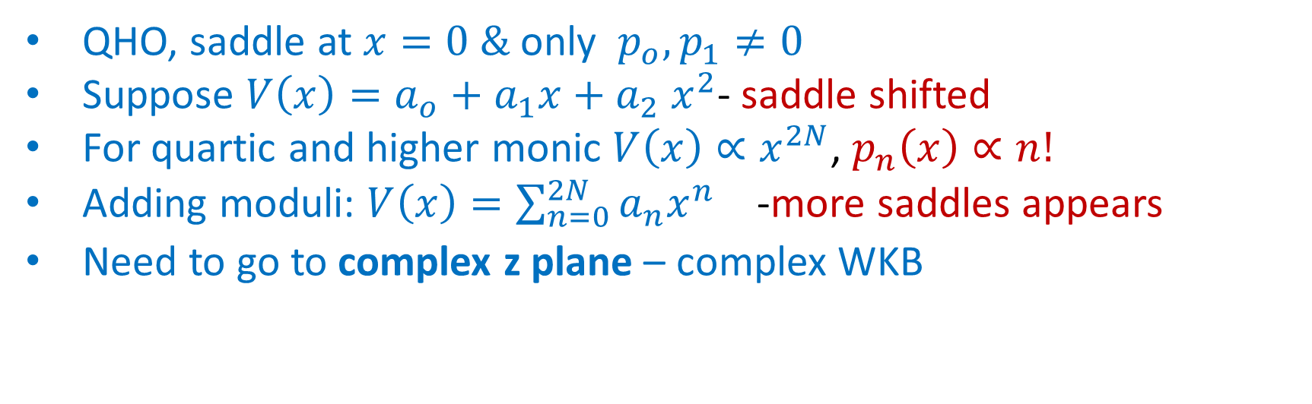
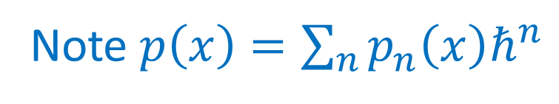
Recall WKB quantization
x₁
x₂
Note $p\left(x\right)=\sum_{n}{p_{n}\left(x\right)ℏ^{n}}$
QHO, saddle at $x=0 \&$ only $p_{o}, p_{1}≠0$
Suppose $V\left(x\right)=a_{o}+a_{1}x+a_{2} x^{2}$- saddle shifted
For quartic and higher monic $V\left(x\right)∝x^{2N}$, $p_{n}\left(x\right)∝n!$
Adding moduli: $V\left(x\right)={\sum_{n=0}^{2N}{a_{n}x^{n}}}_{}$ -more saddles appears
Need to go to complex z plane – complex WKB

Slide 5

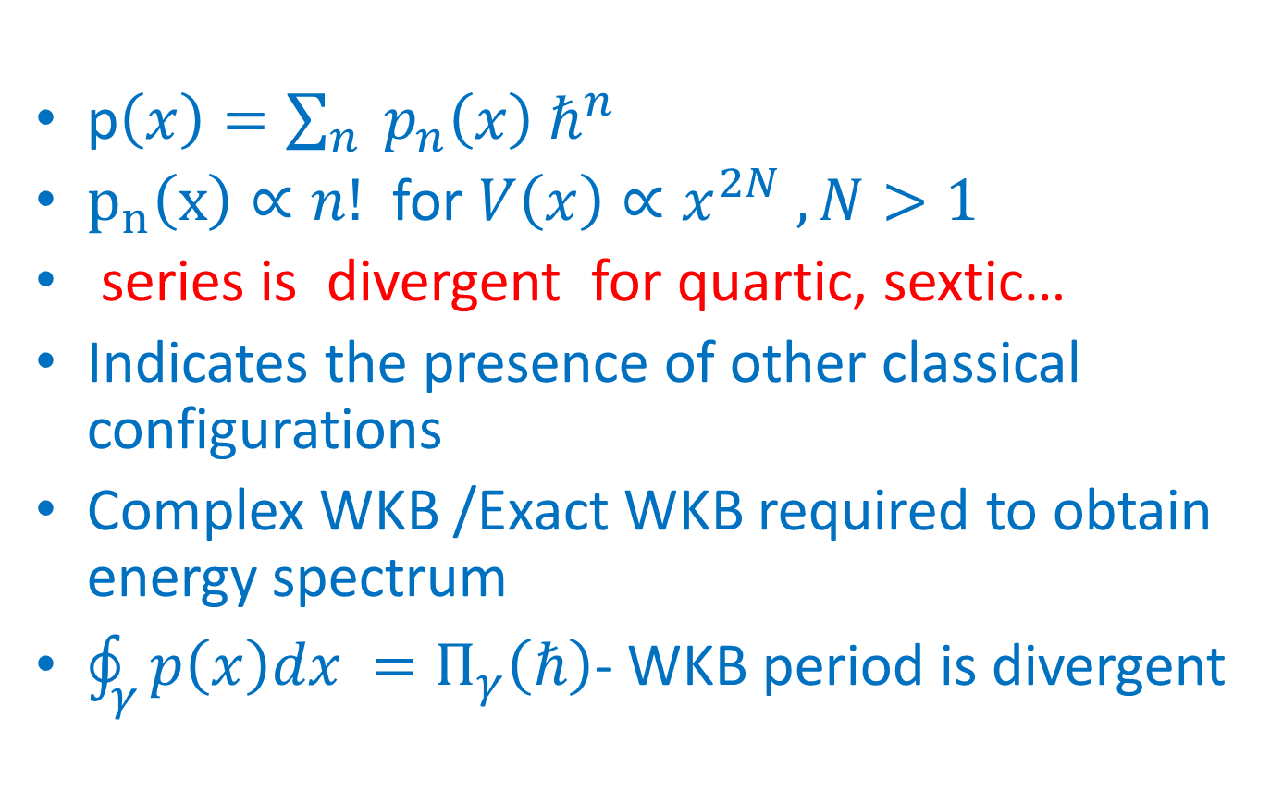
Polynomial Potentials
p$\left(x\right)=\sum_{n}{ p_{n}\left(x\right) ℏ^{n} }$
$p_{n}\left(x\right)∝n!$ for $V\left(x\right)∝x^{2N} , N>1$
series is divergent for quartic, sextic…
Indicates the presence of other classical configurations
Complex WKB /Exact WKB required to obtain energy spectrum
$\oint_{γ}{p\left(x\right)dx }=Π_{γ}\left(ℏ\right)$- WKB period is divergent

Slide 6
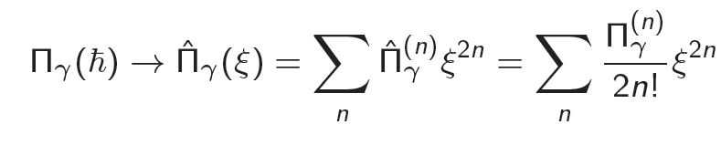
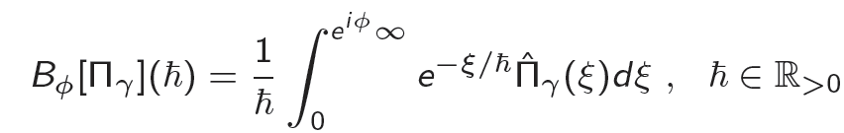
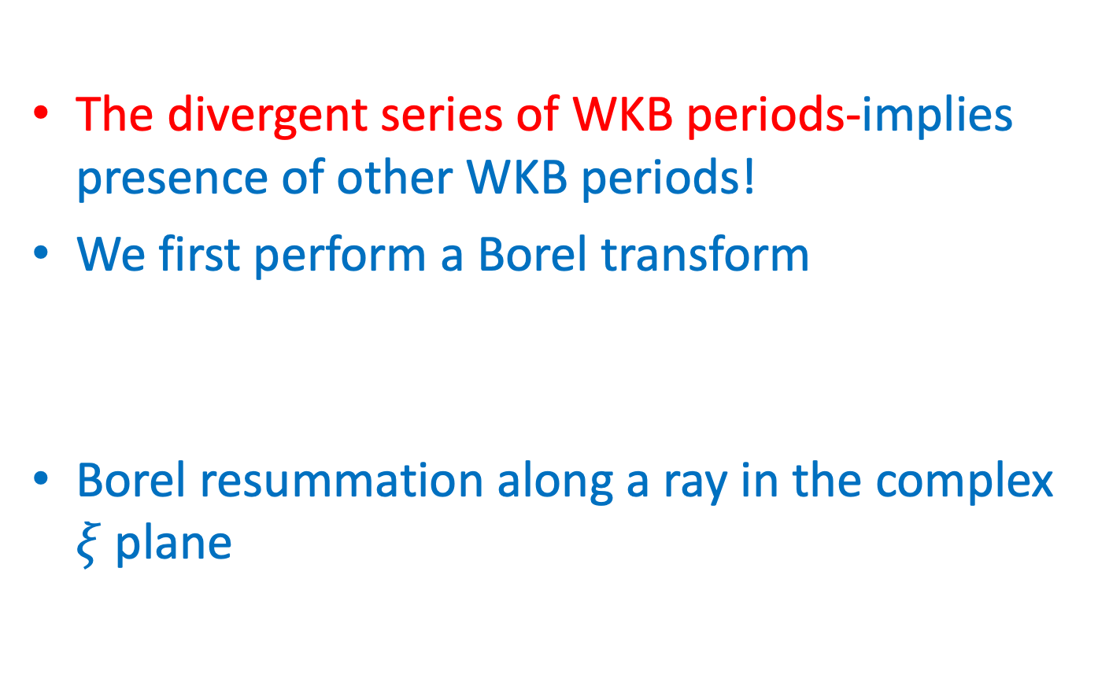
Borel transform, Borel resummation
The divergent series of WKB periods-implies presence of other WKB periods!
We first perform a Borel transform
Borel resummation along a ray in the complex $ξ$ plane

Slide 7

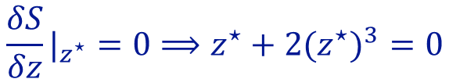
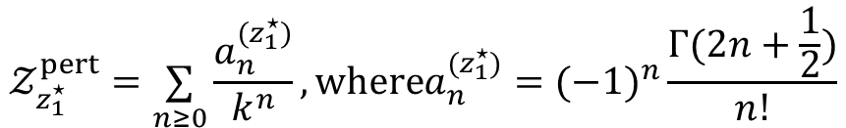
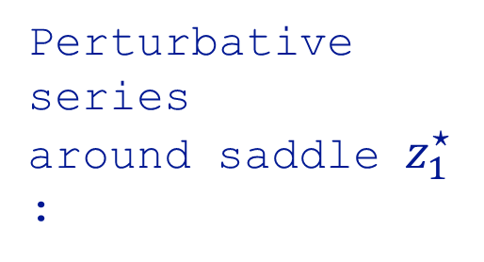
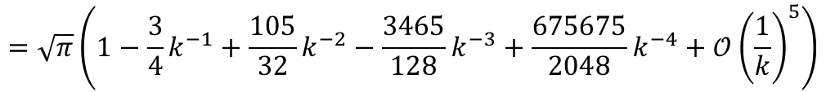




Quartic Integral
$$∫_{−∞}^{∞}dz e^{−kS(z)},where S(z)=z^{2}+z^{4}$$
$$\frac{δS}{δz}|_{z^{⋆}}=0⟹z^{⋆}+2(z^{⋆})^{3}=0$$
$z_{1}^{⋆}=0$, Trivial saddle
Extermising
$z_{2,3}^{⋆}=±\frac{i}{\sqrt{2}}$, Non-Trivial saddles
$$S_{z_{1}^{⋆}}=0,S_{z_{2}^{⋆}}=S_{z_{3}^{⋆}}=−\frac{1}{4}$$
Perturbative series
around saddle $z_{1}^{⋆}$ :
$$𝒵_{z_{1}^{⋆}}^{pert}=\underset{n≥0}{∑}\frac{a_{n}^{(z_{1}^{⋆})}}{k^{n}},wherea_{n}^{(z_{1}^{⋆})}=(−1)^{n}\frac{Γ(2n+\frac{1}{2})}{n!}$$
$$=\sqrt{π}\left(1−\frac{3}{4}k^{−1}+\frac{105}{32}k^{−2}−\frac{3465}{128}k^{−3}+\frac{675675}{2048}k^{−4}+𝒪{\left(\frac{1}{k}\right)}^{5}\right)$$
$$R=1/\lim_{n→∞}|\frac{a_{n+1}^{(z_{1}^{⋆})}}{a_{n}^{(z_{1}^{⋆})}}|=0$$
Radius of convergence:
$𝒵_{z_{1}^{⋆}}^{pert}$ is an asymptotic series

Slide 8
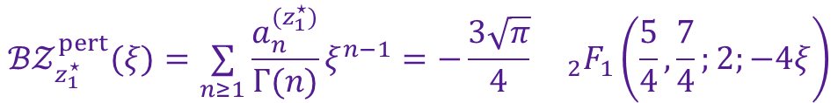
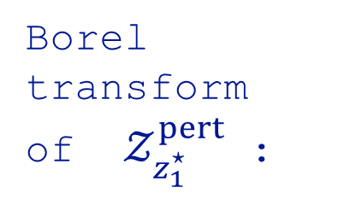

Quartic Integral contd.
Hypergeometric function
Borel transform
of $𝒵_{z_{1}^{⋆}}^{pert}$ :
$$ℬ𝒵_{z_{1}^{⋆}}^{pert}(ξ)=\underset{n≥1}{∑}\frac{a_{n}^{(z_{1}^{⋆})}}{Γ(n)}ξ^{n−1}=−\frac{3\sqrt{π}}{4}{}_{2}F_{1}\left(\frac{5}{4},\frac{7}{4};2;−4ξ\right)$$
$$=−\sqrt{π}\left(\frac{3}{4}−\frac{105}{32}ξ+\frac{3465}{256}ξ^{2}−\frac{225225}{4096}ξ^{3}+\frac{14549535}{65536}ξ^{4}+𝒪(ξ)^{5}\right)$$
Singularity is at $ξ_{⋆}=−\frac{1}{4}≡S_{z_{2}^{⋆}}−S_{z_{1}^{⋆}}=S_{z_{3}^{⋆}}−S_{z_{1}^{⋆}}$
$ℬ𝒵_{z_{1}^{⋆}}^{pert}(ξ)$ contains information about the non-trivial saddles $z_{2}^{⋆}$ and/or, $z_{3}^{⋆}$
$$\left(ζ=ξ+\frac{1}{4}\right)$$
Expanding $ℬ𝒵_{z_{1}^{⋆}}^{pert}(ξ)$ around $ξ_{⋆}=−\frac{1}{4}$:
$$ℬ𝒵_{z_{1}^{⋆}}^{pert}(ζ)=−\frac{log(ζ)}{\sqrt{2π}}(\frac{3}{4}+\frac{105}{32}ζ+\frac{3465}{256}ζ^{2}+\frac{225225}{4096}ζ^{3}+\frac{14549535}{65536}ζ^{4}+𝒪(ζ)^{5})+regular$$

Slide 10
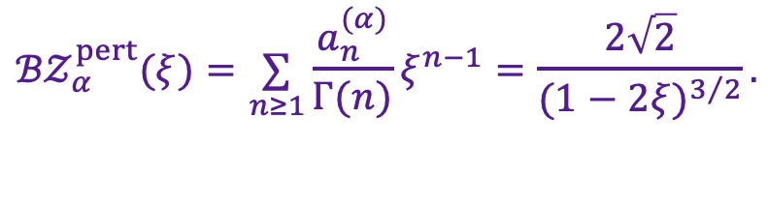
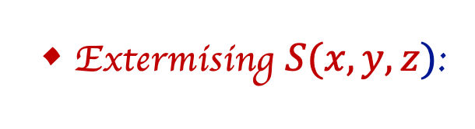
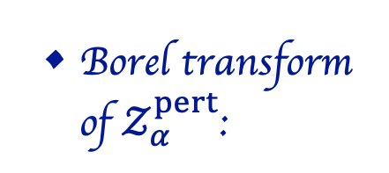
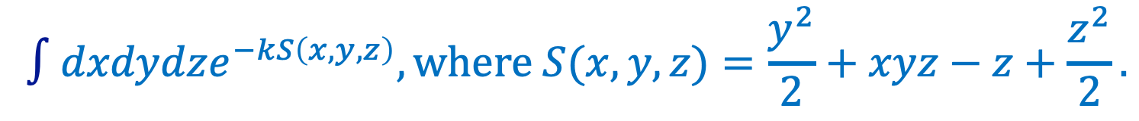
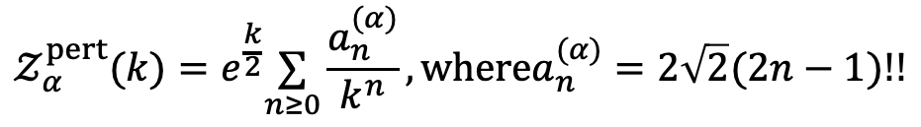
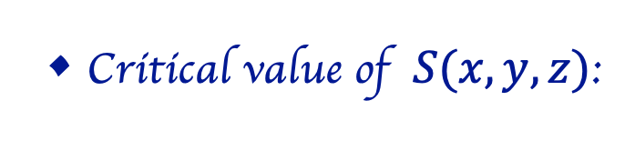
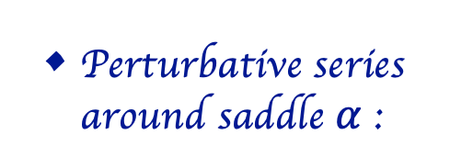
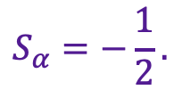

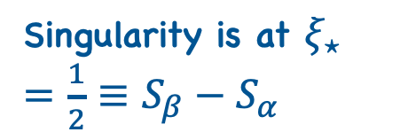
Another toy example
$$∫dxdydze^{−kS\left(x,y,z\right)},where S(x,y,z)=\frac{y^{2}}{2}+xyz−z+\frac{z^{2}}{2}.$$
Extermising $S(x,y,z)$:
:Unique saddle $α=(x^{⋆},y^{⋆},z^{⋆})=(0,0,1).$
Critical value of $S(x,y,z)$:
$$S_{α}=−\frac{1}{2}.$$
Perturbative series around saddle $α$ :
$$𝒵_{α}^{pert}(k)=e^{\frac{k}{2}}\underset{n≥0}{∑}\frac{a_{n}^{(α)}}{k^{n}},wherea_{n}^{(α)}=2\sqrt{2}(2n−1)!!$$
Asymptotic series
Borel transform of $𝒵_{α}^{pert}$:
$${ℬ𝒵}_{α}^{pert}(ξ)=\underset{n≥1}{∑}\frac{a_{n}^{(α)}}{Γ(n)}ξ^{n−1}=\frac{2\sqrt{2}}{(1−2ξ)^{3/2}}.$$
Singularity is at $ξ_{⋆}=\frac{1}{2}≡S_{β}−S_{α}$
${ℬ𝒵}_{α}^{pert}(ξ)$ encodes the information of another saddle $β$, with $S_{β}=0$

Slide 11
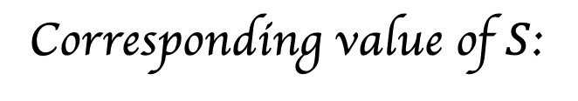

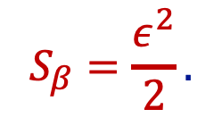
Toy example contd.
Consider a point parametrised by $ε$: $β=\left(\frac{1}{ε},ε,0\right)$
$$S_{β}=\frac{ε^{2}}{2}.$$
Corresponding value of $S$:
In the $ε→0$ limit $β$ becomes a saddle at infinity with $S_{β}$ being equal to zero.
Note: Borel plane not only captures the information of the usual saddles but also extra saddles lying at infinite distance regions.

Slide 12
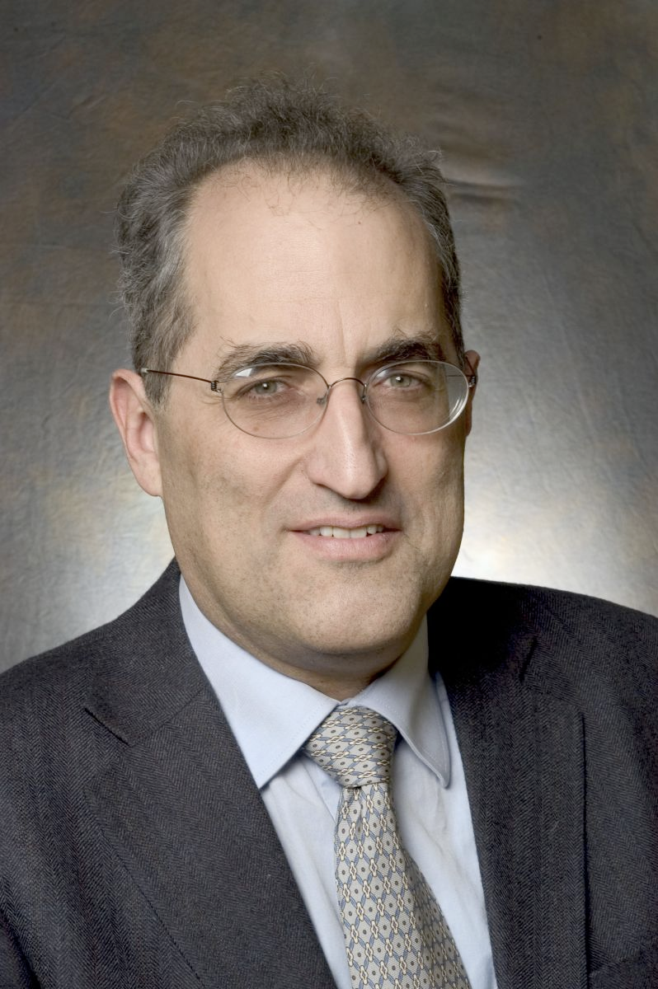
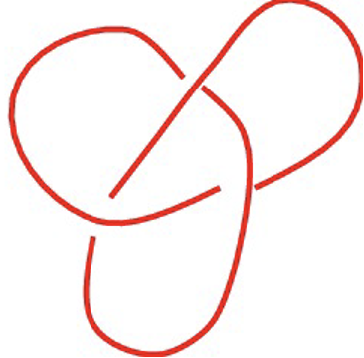
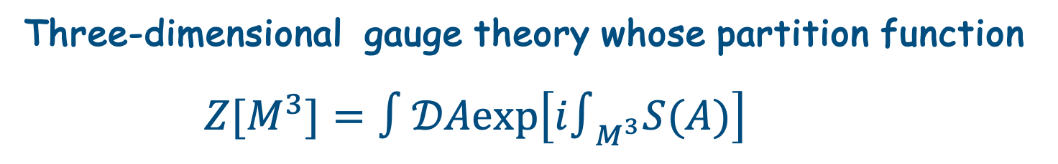
Chern-Simons Theory- Schwarz type theory
Three-dimensional gauge theory whose partition function
$Z[M^{3}]=∫𝒟Aexp\left[i∫_{M^{3}}S(A)\right]$
Edward Witten
$Z[M^{3}]$: Topological invariant of the three-manifold $M^{3}$
Trefoil
The expectation value of Wilson loop operators
$∝$ Witten-Reshitikhin-Turaev (WRT) invariant
Knot
invariants

Slide 13
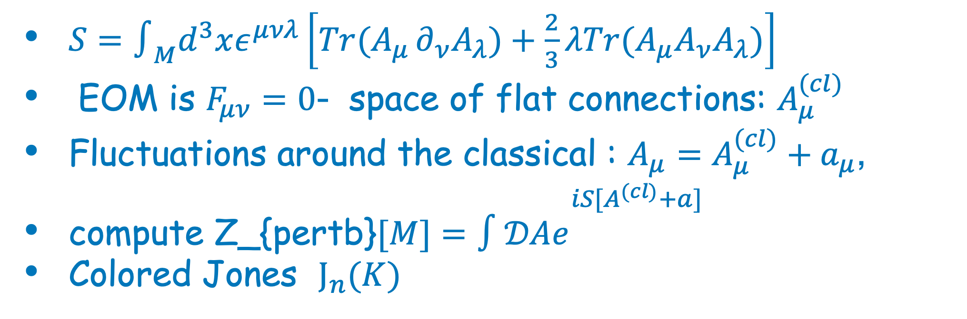
SU(2) Chern-Simons Theory
$S=∫_{M}d^{3}xε^{μνλ}\left[Tr(A_{μ}∂_{ν}A_{λ})+\frac{2}{3}λTr(A_{μ}A_{ν}A_{λ})\right]$
EOM is $F_{μν}=0$- space of flat connections: $A_{μ}^{(cl)}$
Fluctuations around the classical : $A_{μ}=A_{μ}^{(cl)}+a_{μ}$,
compute Z_{pertb}$[M]=∫𝒟Ae^{\begin{aligned}iS[A^{(cl)}+a] \\ \end{aligned}}$
Colored Jones $J_{n}(K)$

Slide 14
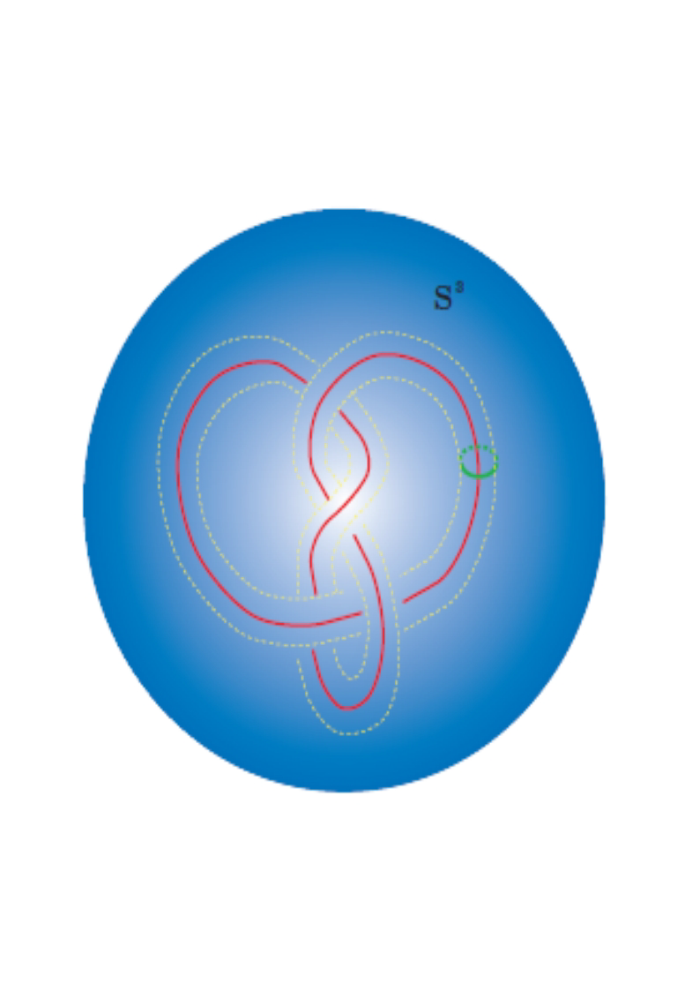
SU(2) Vs SL(2,C) Chern-Simons Theory
Analytic continutation of CS coupling
Topology Vs Geometry (Volume conjecture, space of flat connections)

Slide 15
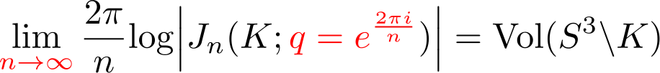
Volume conjecture
Large colour behaviour of colored Jones polynomial has interesting properties
[Kashaev ‘95]
[H. Murakami, J. Murakami ‘01]

Slide 16
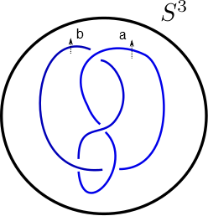

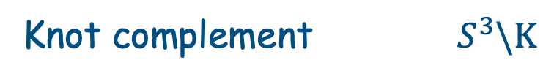

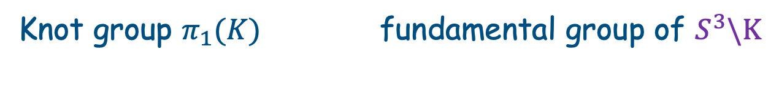
Classical A-polynomial
Character variety of the fundamental group of the knot complement
[Cooper,Culler,Gillet,Long,Shalen]
$SL(2,ℂ)$
Knot complement${ S}^{3}\backslash K$
Knot group $π_{1}(K)$ fundamental group of $S^{3}\backslash K$
Knot group $π_{1}(K)$
Example: Figure-eight knot
$π_{1}\left(K\right)=<a,b;bab^{−1}a^{−1}ba^{−1}b^{−1}aba^{−1}=1>$

Slide 17
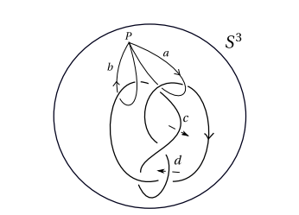
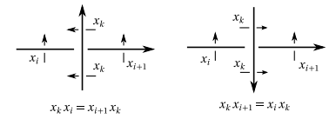


Wirtinger presentation
$π_{1}\left(K\right)=<a,b;bab^{−1}a^{−1}ba^{−1}b^{−1}aba^{−1}=1>$
Longitude:
Simplies to

Slide 18


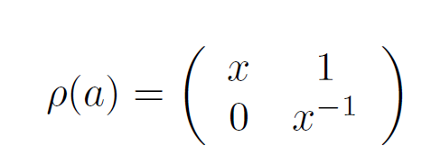

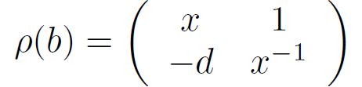

$$bab^{−1}a^{−1}ba^{−1}b^{−1}aba^{−1}=1$$

Slide 19
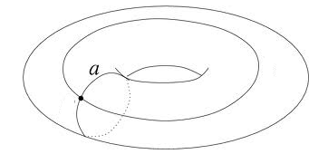



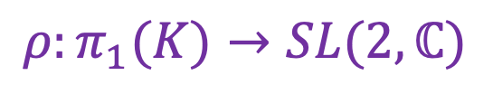

Space of flat connections
Representation of the
Fundamental group in
$$ρ:π_{1}(K)→SL(2,ℂ)$$
$$SL(2,ℂ)$$
$$ι$$
Zeros of the
Classical A-polynomial
gives space of flat connections
$$A\left(x,y\right)=0$$

Slide 20

Classical A-polynomial
Longitude l
$$l=ab^{−1}aba^{−2}bab^{−1}a^{−1}$$
Classical A-polynomial

Slide 21



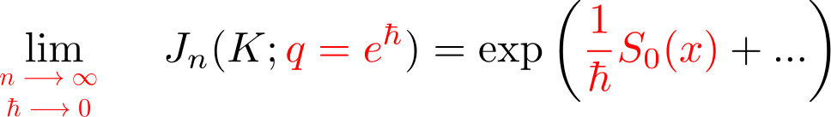
Generalized volume conjecture
[Gukov ‘05]
[Murakami]
A one parameter deformation of volume conjecture.
Relates asymptotic limit to classical A-polynomial
Integration done along the zero locus of the A-polynomial: A(K;x,y)=0

Slide 22
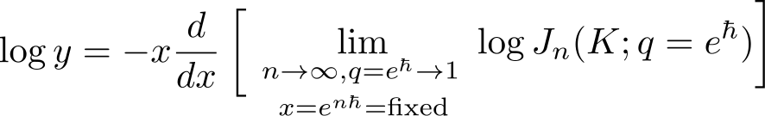
Generalized volume conjecture
[Gukov ‘05]
[Murakami]
A(K;x,y)=0

Slide 23
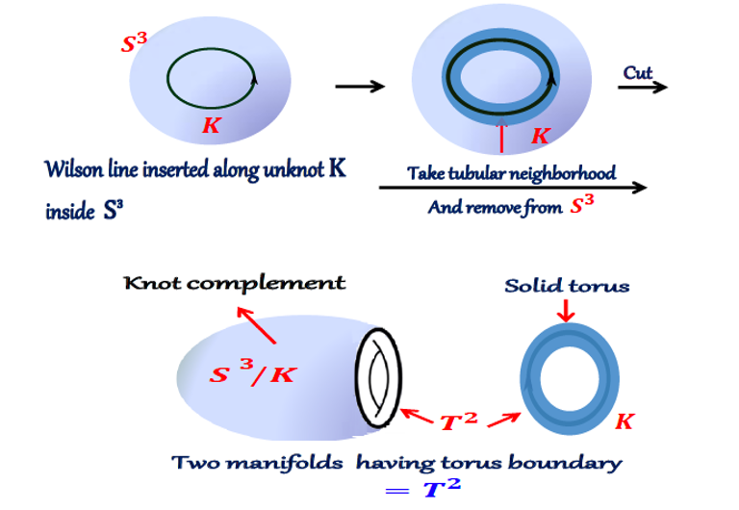

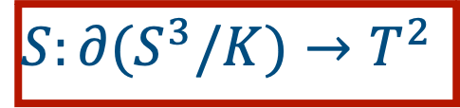
Three-Manifolds –Dehn Surgery
$S:∂(S^{3}/K)→T^{2}$
p/r surgery :$S_{\frac{p}{r}}^{3}(K)$

Slide 24
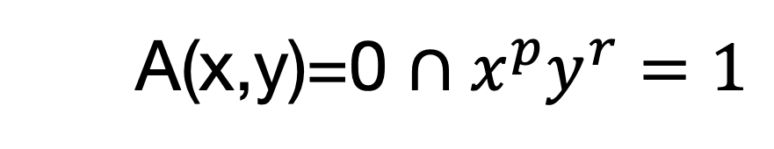
SL(2,C) flat connections for 3 manifolds
        A(x,y)=0 $∩x^{p}y^{r}=1$
Finite number of solutions.
What about asymptotic ends

Slide 26
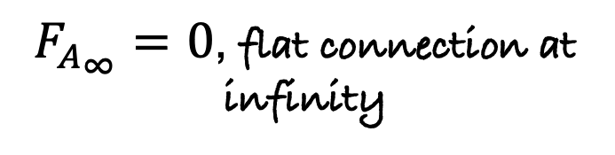


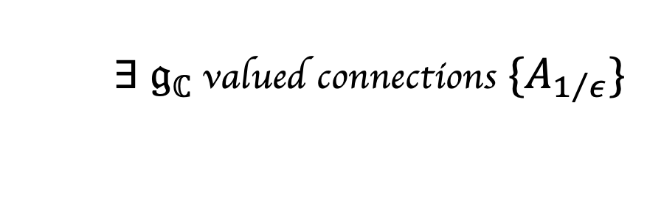
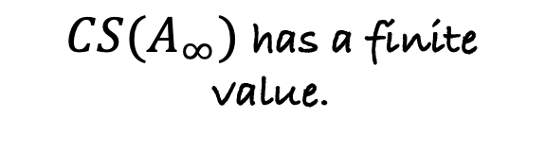

Flat connections at infinity
For $G_{ℂ}=SL(2,ℂ),$ $𝔤_{ℂ}=𝔰𝔩(2,ℂ)$
$$ε→0$$
$F_{A_{∞}}=0$, flat connection at infinity
        $∃$ $𝔤_{ℂ}$ valued connections $\{A_{1/ε}\}$
$A_{∞}$ may become singular.
$CS(A_{∞})$ has a finite value.
- These lead to extra contributions to the path integral.
-Show up in the study of non-perturbative effects….requiring the tools of resurgence

Slide 27





Resurgence
Perturbative series
around saddle $α$:
$$𝒵_{α}^{pert}[M;k]=e^{ikCS_{α}}\underset{n≥0}{∑}\frac{a_{n}^{(α)}}{k^{n+c_{α}}}$$
(Asymptotic in general)
$$a_{n}^{(α)}∼Γ(n+c_{α})$$
Borel Transform
Asymptotic series
Covergent series
Borel transform
of $𝒵_{α}^{pert}$:
$$ℬ𝒵_{α}^{pert}(ξ)=\underset{n≥0}{∑}(−i)^{n+c_{α}}\frac{a_{n}^{(α)}}{Γ(n+c_{α})}(ξ−CS_{α})^{n+c_{α} −1}.$$
Singularities are at $ξ_{⋆}=CS_{β}−CS_{α},(β≠α)$

Slide 28











Flat connections at infinity for twist Knots
P=1
P=-1
$$K_{1}$$
$$K_{−1}$$
$$3_{1}$$
$$4_{1}$$
$$K_{p}$$
Twist knot with p full
twist
See poster by
Aditya

Slide 29
Thank You

