Slide 1
ICEPP Winter School, 15-18 Feb (2026)
Quantum Energy Teleportation and its Application to Black Hole Physics
Masahiro Hotta
Tohoku University

Slide 2
Introduction
The interplay between quantum field theory and quantum information theory has attracted much attention in addressing many problems in physics.
○ AdS/CFT Correspondence
○ Information Loss Problem of Quantum Black Hole
○ Quantum-Classical Transition of Field Fluctuation in Inflationary Universe
….

Slide 3
Quantum Energy Teleportation
(QET)
〇 Interplay between energy and quantum information
〇 Extraction of zero-point energy under cyclic procedures
〇 QET can extract energy from black holes.

Slide 4
TAKEHOME MESSAGE
Even when the energy distribution of a quantum field is localized within a small, compact region, the quantum energy is not always freely expressed in that region. Instead, it can be partially extracted from a distant region. This process operationally generates a negative energy density in the field at the same time.

Slide 5
In light of quantum information theory, let us first address a fundamental question about quantum energy.
If a local excitation of a quantum field with positive average energy density is present right in front of you, can you always extract the entire average energy from the field using only your local operations?
your local operations
Average
energy
density
Complete Extraction of This Energy ?

Slide 6
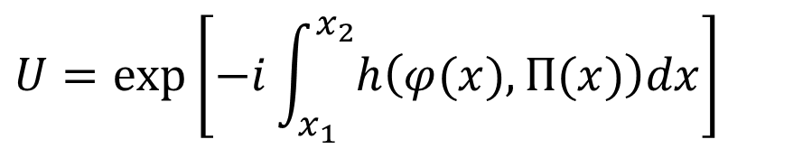
Example: Energy extraction in a state generated by local unitary operation
vacuum state
$$U=\exp\left[−i\int_{x_{1}}^{x_{2}}{h\left(φ(x),Π(x)\right)dx}\right]$$
field operator
canonical momentum operator
locality
Average
energy
density
However,….

Slide 7
The answer to the question is generally negative. For quantum states excited through local measurements of the zero-point oscillations of the vacuum state, it is impossible to extract the entire energy from the field, even by employing arbitrary local operations.
Average
energy
density
Preparation for Measurement-Excited State
Extraction of
Information about Field
Measurement of
Local Fluctuation of Field

Slide 8
The answer to the question is generally negative. For quantum states excited through local measurements of the zero-point oscillations of the vacuum state, it is impossible to extract the entire energy from the field, even by employing arbitrary local operations.
Average
energy
density
Extraction of Energy by Local Operations
(Arbitrary Local Operation)
Residual Energy

Slide 9
Interestingly, a person in a distant region with zero energy density of the field can effectively extract a part of this residual energy via quantum energy teleportation protocols, as long as they know the measurement result. In this lecture, I briefly review this process.
Average
energy
density
Announcement of Measurement Result
Residual Energy
Extraction of Energy

Slide 10
OUTLINE
Introduction
II. Recent Development of
Quantum Energy Teleportation
III. Brief Review of Entanglement
IV. Formulation of
Quantum Energy Teleportation
V. QET Application to Black Hole Physics
VI. Summary

Slide 11
II. Recent Development of
Quantum Energy Teleportation

Slide 12
Recently, two independent experiments on quantum energy teleportation (QET) have been reported.

Slide 13
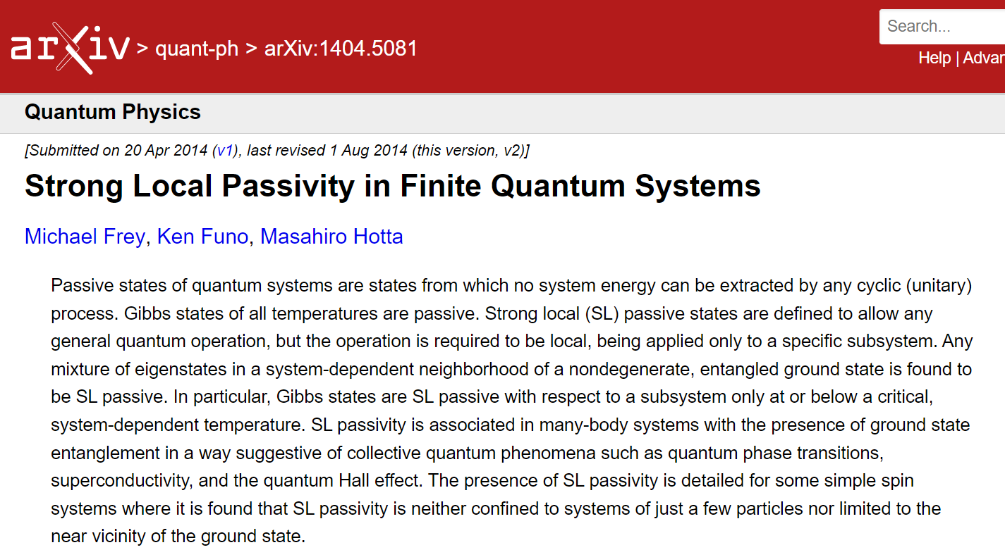
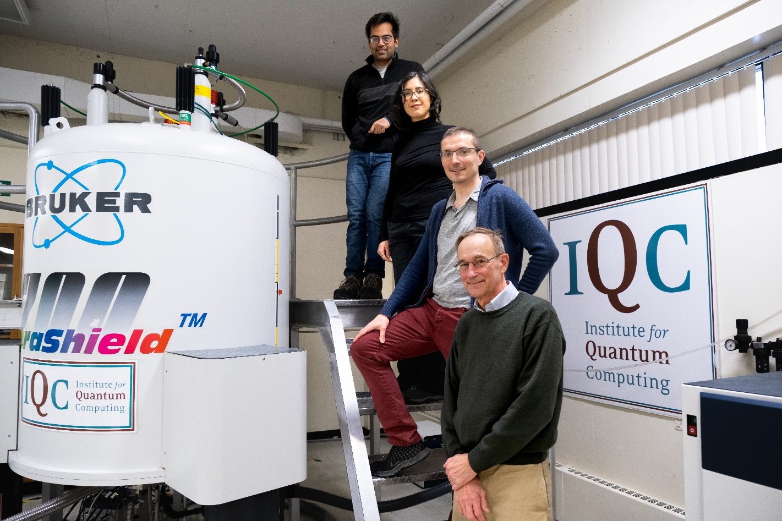
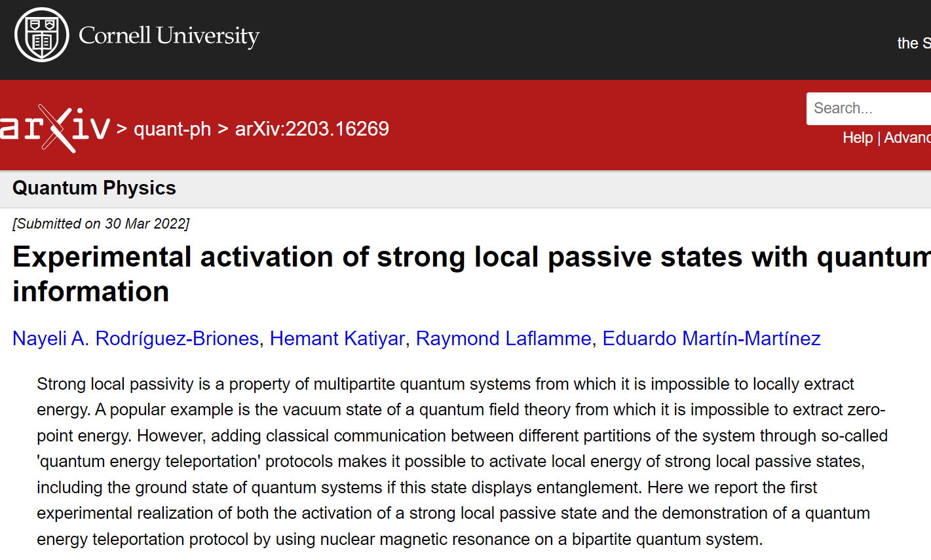
In 2022, the QET has been first performed using nuclear magnetic resonance. (IQC, Waterloo University)
Nayeli A. Rodríguez-Briones, Hemant Katiyar, Eduardo Martín-Martínez, and Raymond Laflamme,
Phys. Rev. Lett. 130, 110801 – Published 13 March 2023

Slide 14
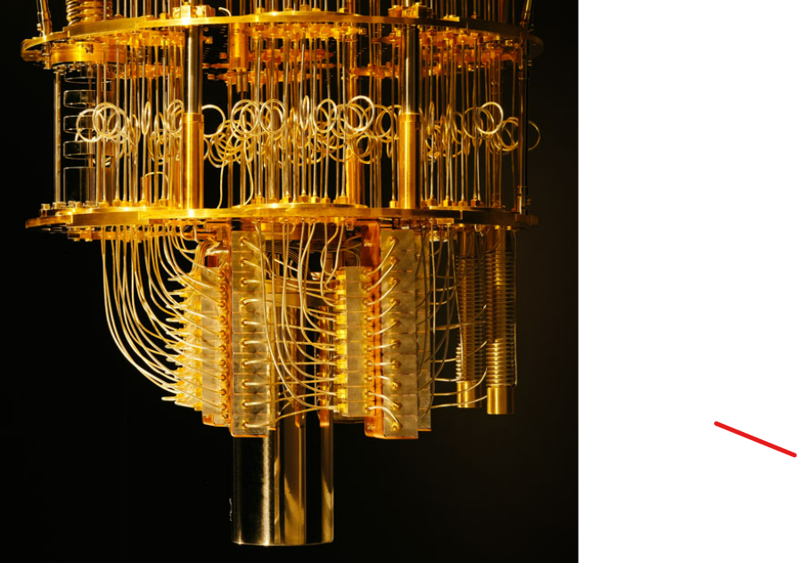
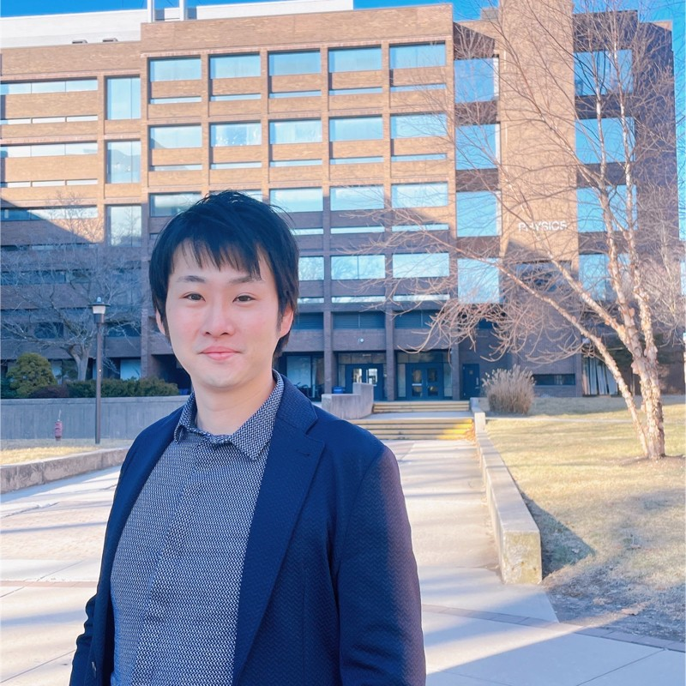
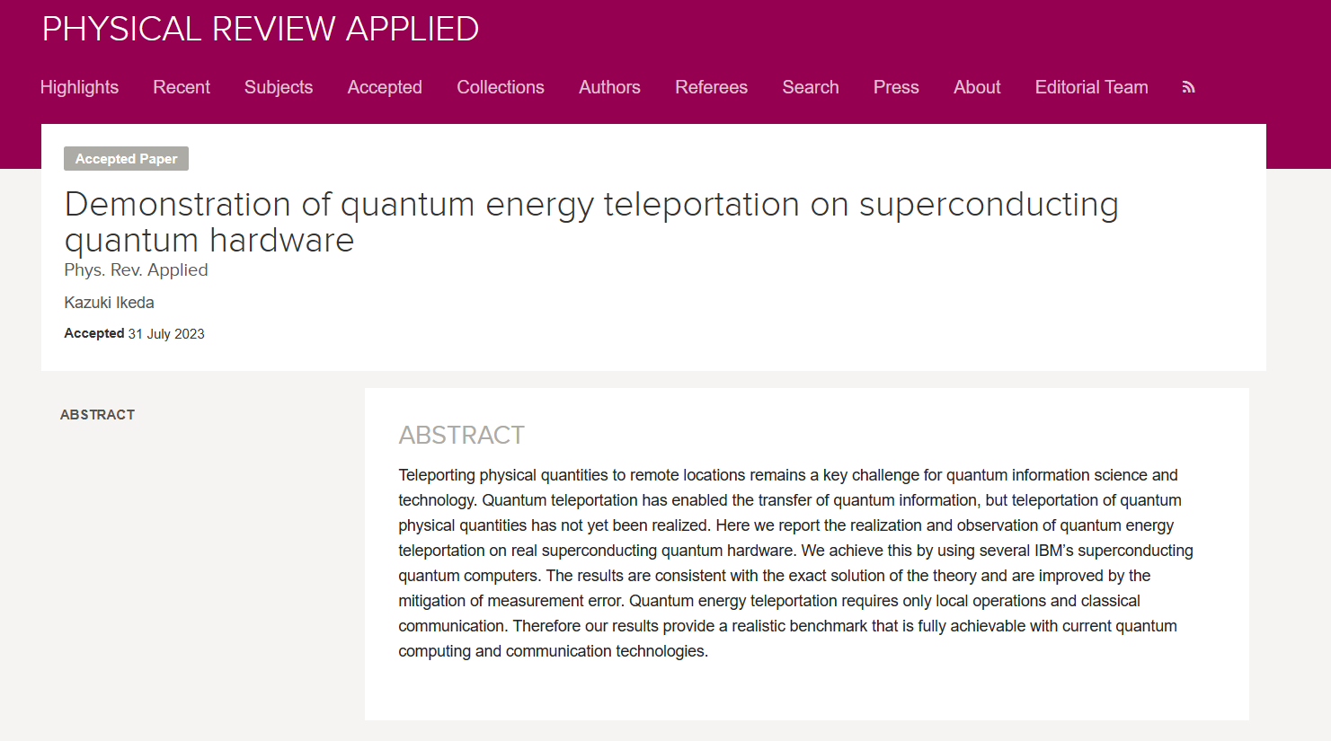
The second QET demonstration was performed using IBM quantum computer. (K. Ikeda, 2023)
Stony Brook University →University of Massachusetts

Slide 15
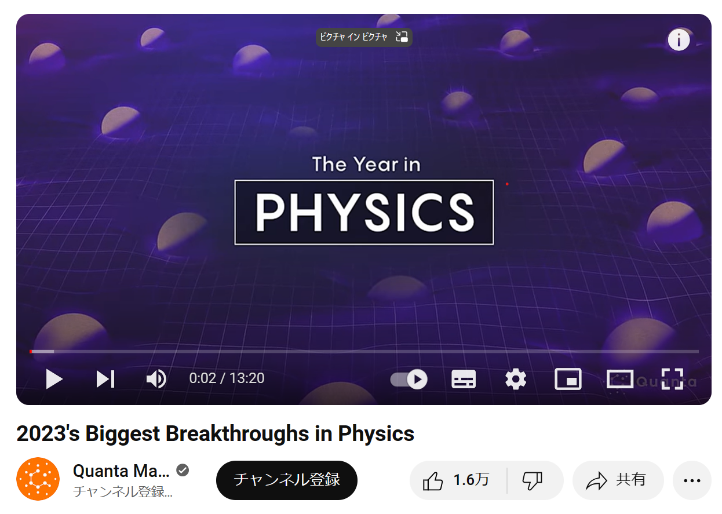
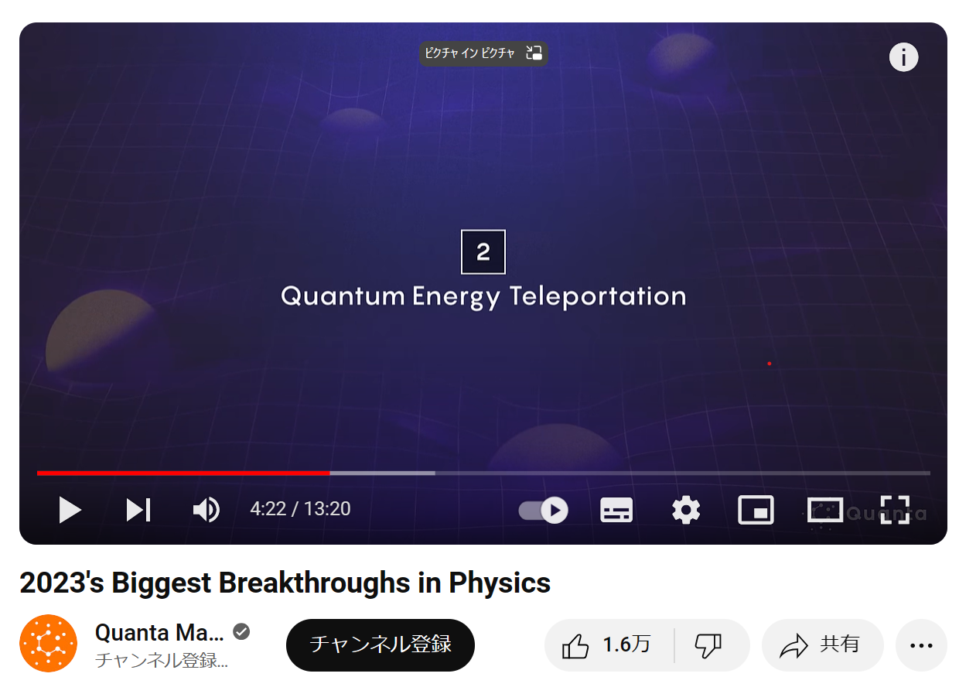
The QET experiments have been chosen as one of the top three biggest breakthroughs in physics for 2023 by Quanta Magazine, a publication of the Simons Foundation.

Slide 16

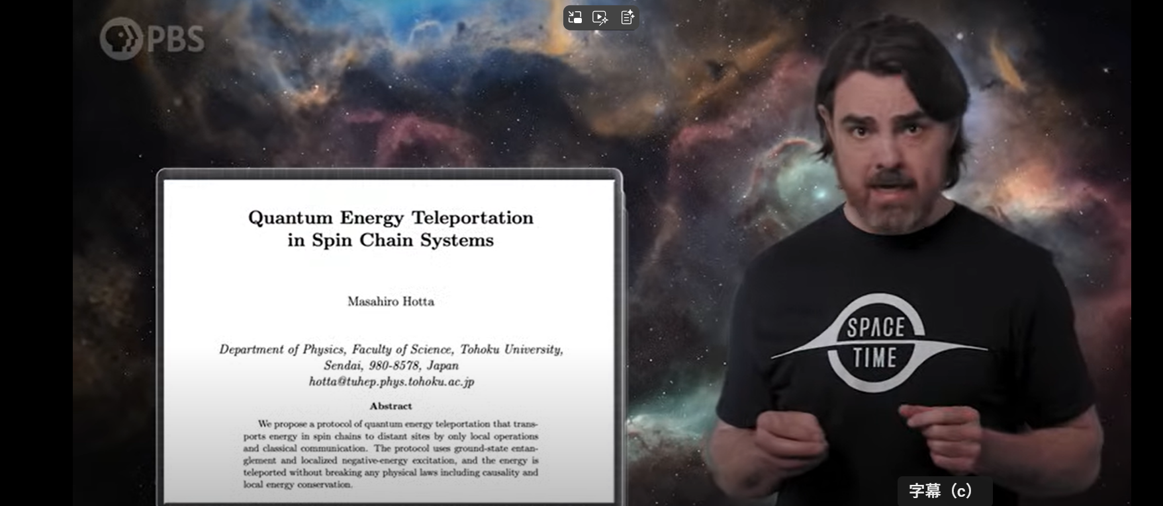
“Quantum Energy Teleportation is REAL! ”PBS Space Time · 2025/05/02

Slide 17
III. Brief Review of Entanglement

Slide 18
As a simple example, let us first consider a two-level spin system in the up state of the z component of the spin.

Slide 19
Let us assume that any quantum operation for the system is available.
Then, from this initial state, any quantum state of the system can be generated:
Let us prove it.

Slide 20
For the up state , we first measure an observable given by
The eigenvalue of emerges with probability .
Thus, the average state is given by

Slide 21
Next, let us perform a unitary operation which satisfies
This yields the final state which we want.

Slide 22
The inverse process can be also achieved. Let us measure the z component of the spin. Then, the state collapses to one of the eigenstates.
with probability
If the spin is found in the down state, a flip operation is applied to obtain the up state.
The state is transformed into the up state with probability one.

Slide 23
Therefore, any quantum state can be transformed into any other state through quantum operations.
Although this result may appear trivial at first glance, extending the same reasoning to many-body systems reveals profound and nontrivial phenomena, with entanglement being a prime example.

Slide 24
Entanglement quantifies the quantum correlations between quantum systems. To illustrate this concept, let us consider two spin systems, A and B.
Each is prepared in the pure up state at the initial time.

Slide 25
From the result established earlier, it follows that applying local operations to each system transforms the initial pure state only into a product of mixed states without any correlations.
Arbitrary state of A
Arbitrary state of B

Slide 26
If classical communication is also allowed, we can show that the composite system reaches a classical correlation. The term "classical" is used in the context of communication theory.
Local Operations
Local Operations
Classical Communication
Local Operations and Classical Communication (LOCC)
Available
State Change:
(referred to as seperable state)
Arbitrary state of B
Arbitrary state of A

Slide 27
Simple Example of Generating a Separable State with Correlation
Alice
Bob
At first, Alice measures for the system A in the initial state and obtains the eigenvalue with probability .

Slide 28
Alice
Bob
Next Alice announces the obtained result to Bob
via a classical channel.

Slide 29
Alice
Bob
Finally, Alice and Bob perform arbitrary local operations dependent on the result for their systems.

Slide 30
Alice
Bob
Then, the average state of the composite system becomes
a separable state with correlation.

Slide 31
LOCC is just a classical process in communication. Entanglement between A and B is defined as a quantum effect such that the amount of entanglement never increases by LOCC. A product state of pure states has minimum entanglement and the value is zero.
This definition leads to a fact that
any separable state has zero entanglement.
Entangled states are defined as non-seperable states.

Slide 32
Increasing entanglement requires non-local operations directly connecting A to B, or quantum channels which can transport not only classical but also quantum information (quantum states).
Non-Local Operation
Interaction
Quantum Channel
Entanglement is a purely quantum effect that generates interesting phenomena, including the breakdown of Bell's inequality and quantum teleportation.

Slide 33
Entanglement Entropy
as one of entanglement measures for pure states
Reduced States:

Slide 34
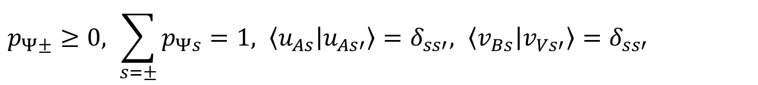
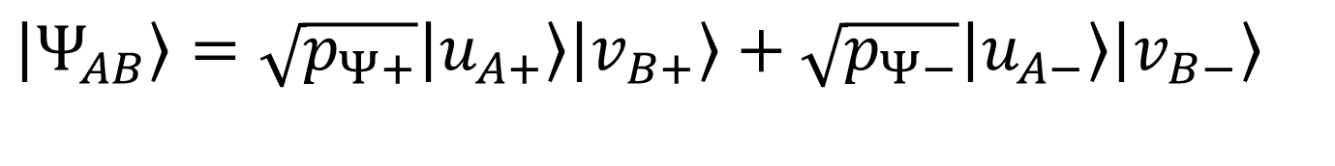
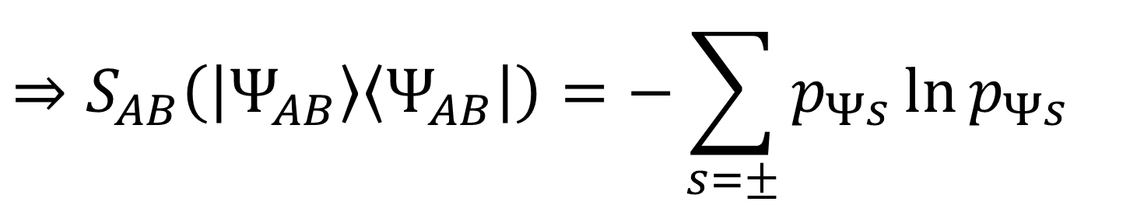
Schmidt Decomposition of Pure State
$$\left|Ψ_{AB}\right\rangle =\sqrt{p_{Ψ+}}\left|u_{A+}\right\rangle \left|v_{B+}\right\rangle +\sqrt{p_{Ψ−}}\left|u_{A−}\right\rangle \left|v_{B−}\right\rangle$$
$$p_{Ψ±}≥0, \sum_{s=±}{p_{Ψs}}=1, \left\langle u_{As} | u_{As′}\right\rangle =δ_{ss′}, \left\langle v_{Bs} | v_{Vs′}\right\rangle =δ_{ss′}$$
$$⇒S_{AB}\left(\left|Ψ_{AB}\right\rangle \left\langle Ψ_{AB}\right|\right)=−\sum_{s=±}{p_{Ψs}}\ln{p_{Ψs}}$$

Slide 35
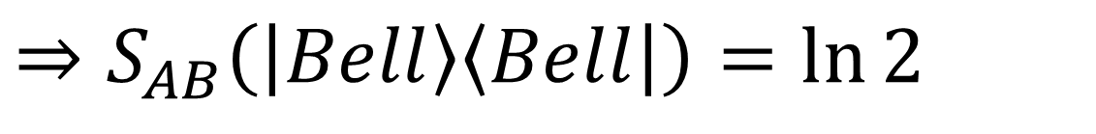
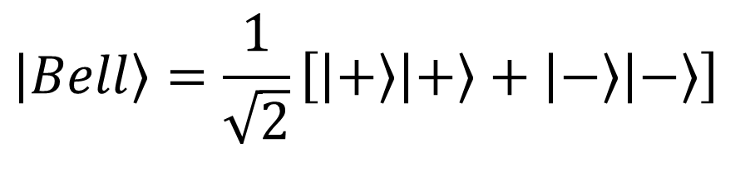
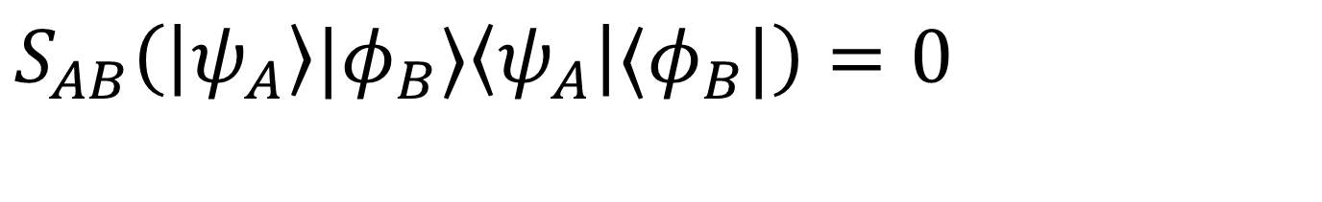
Entanglement entropy takes zero for product pure states
$$S_{AB}\left(\left|ψ_{A}\right\rangle |φ_{B}⟩\left\langle ψ_{A}\right|⟨φ_{B}|\right)=0$$
The Bell states attain the maximum value of entanglement entropy.
$$\left|Bell\right\rangle =\frac{1}{\sqrt{2}}\left[\left|+\right\rangle \left|+\right\rangle +\left|−\right\rangle \left|−\right\rangle \right]$$
$$⇒S_{AB}\left(\left|Bell\right\rangle \left\langle Bell\right|\right)=\ln{2}$$

Slide 36
IV. Formulation of
Quantum Energy Teleportation

Slide 37
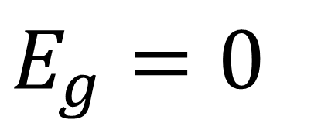
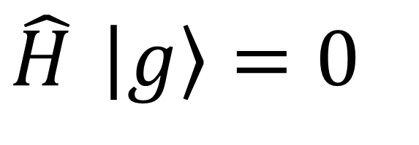

QET： Physics of Energy and Quantum Information in Zero-Point Fluctuation of Many-Body Systems and Quantum Fields
Non-negative operator as Hamiltonian
$$\hat{H}≥0$$
Ground state (vacuum state for quantum fields)
$$\hat{H} \left|g\right\rangle =0$$
$$E_{g}=0$$
with

Slide 38
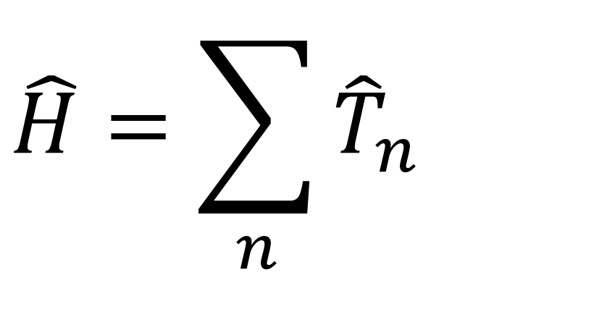
Energy density operator
at site n
Total Hamiltonian
$$\hat{H}=\sum_{n}{{\hat{T}}_{n}}$$
Site summation

Slide 39
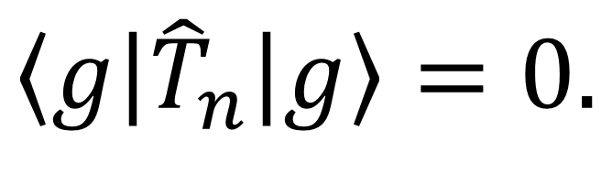

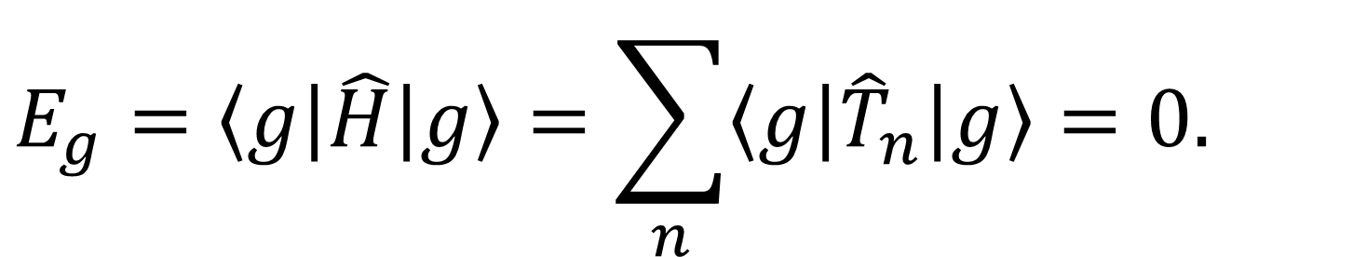
By shifting constant in the definition of ,
$${\hat{T}}_{n}$$
$$\left\langle g\right|{\hat{T}}_{n}\left|g\right\rangle =0.$$
$$E_{g}=\left\langle g\right|\hat{H}\left|g\right\rangle =\sum_{n}{\left\langle g\right|{\hat{T}}_{n}\left|g\right\rangle }=0.$$

Slide 40
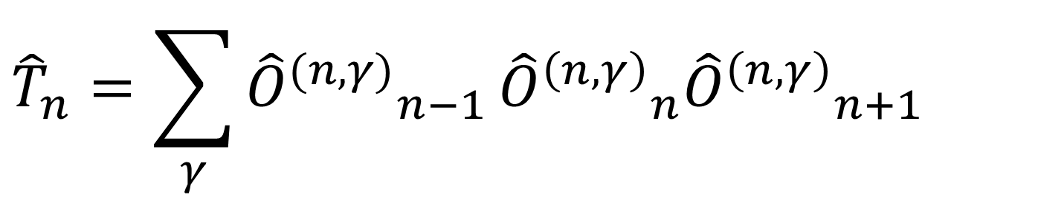
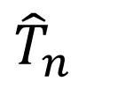
Example: Spin Chain with Nearest Neighbor Interaction
$${\hat{T}}_{n}$$
Energy Density Operator
$${\hat{T}}_{n}=\sum_{γ}{{{\hat{O}}^{(n,γ)}}_{n−1}}{{\hat{O}}^{\left(n,γ\right)}}_{n}{{\hat{O}}^{\left(n,γ\right)}}_{n+1}$$

Slide 41
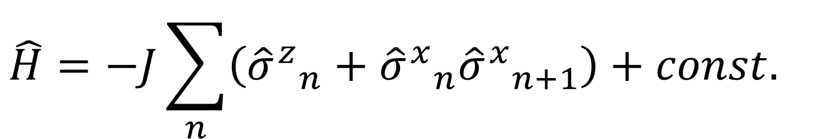
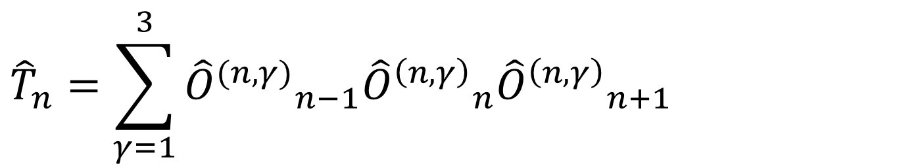
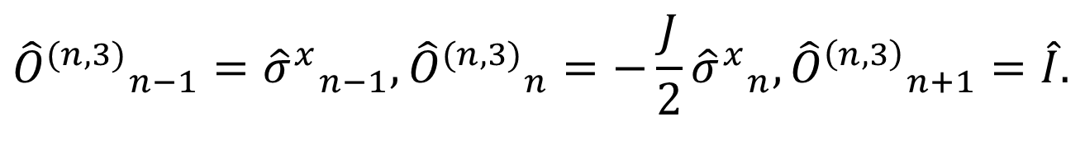
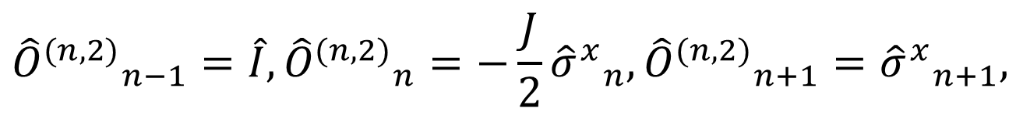
Critical Ising Spin Chain
$$\hat{H}=−J\sum_{n}{\left({{\hat{σ}}^{z}}_{n}+{{\hat{σ}}^{x}}_{n}{{\hat{σ}}^{x}}_{n+1}\right)}+const.$$
$${\hat{T}}_{n}=\sum_{γ=1}^{3}{{{\hat{O}}^{(n,γ)}}_{n−1}{{\hat{O}}^{\left(n,γ\right)}}_{n}{{\hat{O}}^{\left(n,γ\right)}}_{n+1}}$$
$${{\hat{O}}^{(n,1)}}_{n−1}=\hat{I},{{\hat{O}}^{(n,1)}}_{n}=−J{{\hat{σ}}^{z}}_{n}−ε,{{\hat{O}}^{\left(n,1\right)}}_{n+1}=\hat{I},$$
$${{\hat{O}}^{(n,2)}}_{n−1}=\hat{I},{{\hat{O}}^{(n,2)}}_{n}=−\frac{J}{2}{{\hat{σ}}^{x}}_{n},{{\hat{O}}^{(n,2)}}_{n+1}={{\hat{σ}}^{x}}_{n+1},$$
$${{\hat{O}}^{(n,3)}}_{n−1}={{\hat{σ}}^{x}}_{n−1},{{\hat{O}}^{(n,3)}}_{n}=−\frac{J}{2}{{\hat{σ}}^{x}}_{n},{{\hat{O}}^{\left(n,3\right)}}_{n+1}=\hat{I}.$$

Slide 42
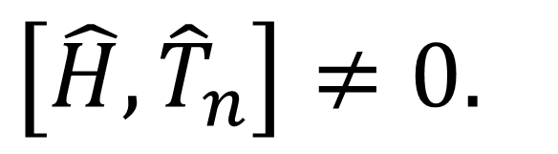
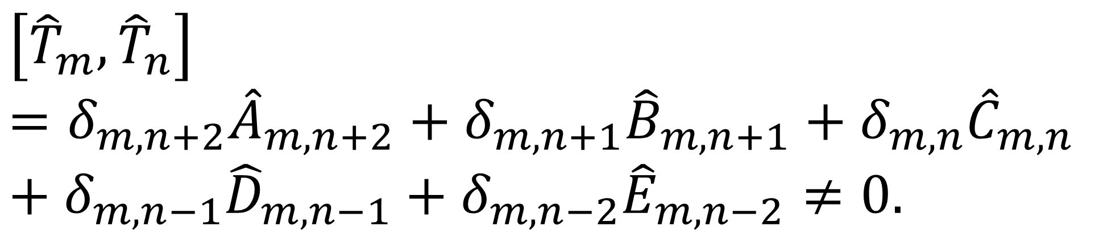
In ordinary systems, Hamiltonian and energy density do not commute with each other.
$$\left[{\hat{T}}_{m},{\hat{T}}_{n}\right]=δ_{m,n+2}{\hat{A}}_{m,n+2}+δ_{m,n+1}{\hat{B}}_{m,n+1}+δ_{m,n}{\hat{C}}_{m,n}+δ_{m,n−1}{\hat{D}}_{m,n−1}+δ_{m,n−2}{\hat{E}}_{m,n−2}≠0.$$
Non-commutative contributions
$$\left[\hat{H},{\hat{T}}_{n}\right]≠0.$$

Slide 43
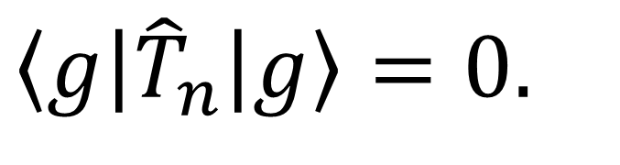
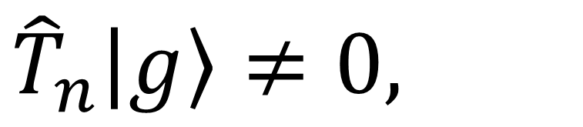
In the entangled ground states, energy density is not constrained to remain at zero.
$${\hat{T}}_{n}\left|g\right\rangle ≠0,$$
$$\left\langle g\right|{\hat{T}}_{n}\left|g\right\rangle =0.$$
though
Quantum fluctuation of energy density around zero.

Slide 44
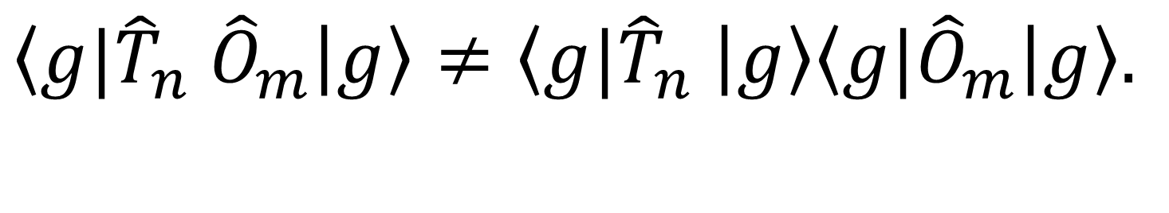
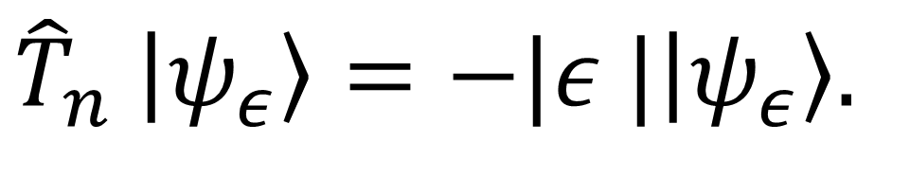
For quantum systems with entangled ground states, the energy density operators have negative eigenvalues.
$${\left\langle g\right.|\hat{T}}_{n} {\hat{O}}_{m}\left|g\right\rangle ≠{\left\langle g\right.|\hat{T}}_{n} \left|g\right\rangle {\left\langle g\right.|\hat{O}}_{m}\left|g\right\rangle .$$
$${\hat{T}}_{n} \left|ψ_{ε}\right\rangle =−|ε |\left|ψ_{ε}\right\rangle .$$
Masahiro Hotta , arXiv:0803.0348

Slide 45

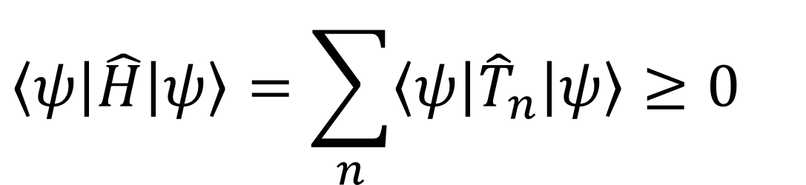
The existence of a negative energy density region should be accompanied by positive energy density regions, as dictated by the non-negativeness of the total Hamiltonian.
Energy density
$$\left\langle ψ\right|{\hat{T}}_{n}\left|ψ\right\rangle$$
$$\left\langle ψ\right|\hat{H}\left|ψ\right\rangle =\sum_{n}{\left\langle ψ\right|{\hat{T}}_{n}\left|ψ\right\rangle }≥0$$
Positive energy region
Negative energy region

Slide 46


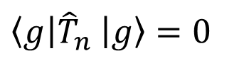
Entangled zero-point energy in ground states
(in vacuum states for quantum fields)
$$T_{n}$$
$$\left\langle g\right|{\hat{T}}_{n} \left|g\right\rangle =0$$
$$n$$
appears in various areas of physics including Unruh effect, Hawking radiation out of black holes, …

Slide 47
Of course, zero-point energy cannot be extracted through any local operation, thus resembling energy being conserved within a secured safe beneath the ground....
Inaccessible energy…
…Huh…
GROUND
STATE
Zero-point energy
at region B

Slide 48




It is noteworthy that local zero-point fluctuations become entangled as a result of nearest neighbor interactions among subsystems situated at distinct points.
$$T_{n}$$
Entangled
$$n$$
$$A$$
$$B$$

Slide 49
Performing measurement of zero-point fluctuation at a point, zero-point energy at a distant point becomes activated via ground-state entanglement and can be extracted by local operation dependent on the measurement result. This protocol is QET.
M. Hotta, Phys. Lett. A372, 5671, (2008);
M. Hotta, J. Phys. Soc. Jap.78, 034001, (2009);
M. Hotta, Phys. Rev. D78, 045006, (2008).

Slide 50
Local operations and classical communication allow extraction of zero-point energy!
Announcement of measurement result
Measurement energy cost:
Measurement Point
Local operation
dependent on
measurement result
Negative energy
allowed in QM
Quantum Energy Teleportation

Slide 51
Quantum field QET is also possible in the vacuum state.

Slide 52
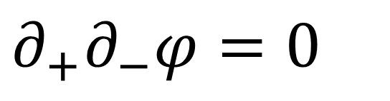
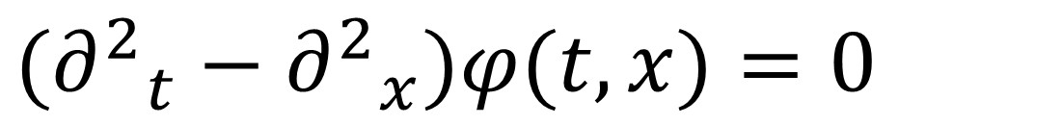
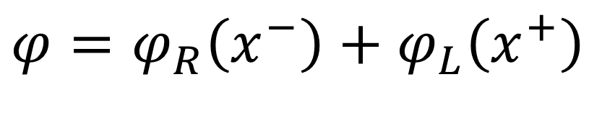
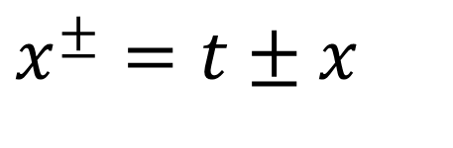
For simplicity, let us discuss a massless scalar field in 1+1 dimensional Minkowski spacetime.
$$({∂^{2}}_{t}−{∂^{2}}_{x})φ(t,x)=0$$
$$x^{±}=t±x$$
$$∂_{+}∂_{−}φ=0$$
$$φ=φ_{R}\left(x^{−}\right)+φ_{L}\left(x^{+}\right)$$
Right-mover component
Left-mover component

Slide 53
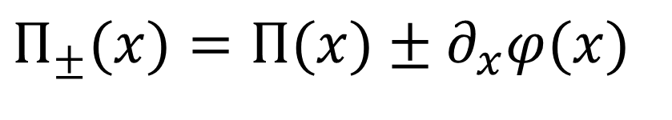
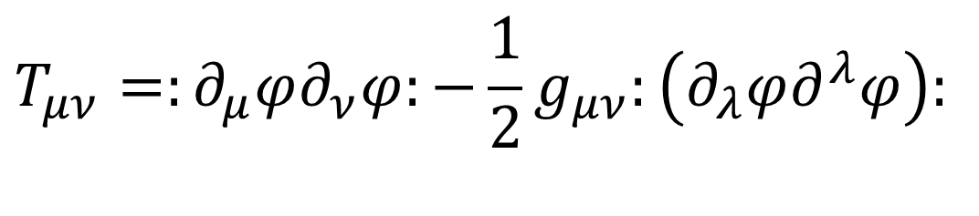
Chiral Momentum Operators
$$Π_{±}(x)=Π(x)±∂_{x}φ(x)$$
Primary degrees of freedom for left- and right- mover modes of field
$$\exp{(}itH)Π_{±}(x)\exp{(}−itH)=Π_{±}(x±t)=Π_{±}(±x^{±})$$
Energy-Momentum Tensor
$$T_{μν}=:∂_{μ}φ∂_{ν}φ:−\frac{1}{2}g_{μν}:\left(∂_{λ}φ∂^{λ}φ\right):$$

Slide 54
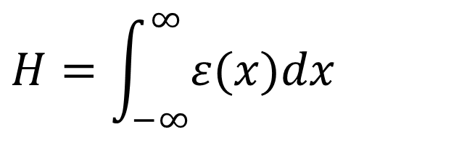
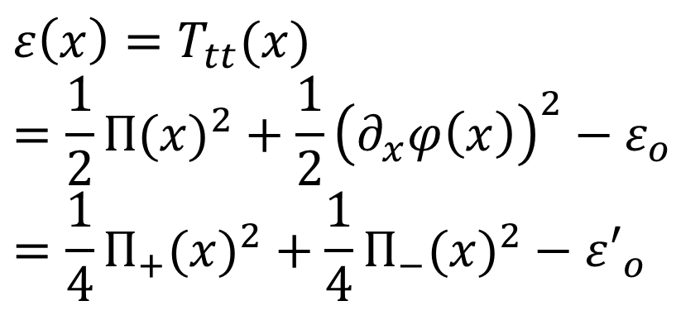
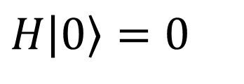
Energy Density Operator
$$ε\left(x\right)=T_{tt}(x) \\ =\frac{1}{2}Π(x)^{2}+\frac{1}{2}{\left(∂_{x}φ\left(x\right)\right)}^{2}−ε_{o} \\ =\frac{1}{4}Π_{+}(x)^{2}+\frac{1}{4}Π_{−}(x)^{2}−ε′_{o}$$
Zero-point energy
subtraction
Hamiltonian
$$H=\int_{−∞}^{∞}{ε(x)dx}$$
Vacuum State
$$H\left|0\right\rangle =0$$

Slide 55
General Measurement
switch on
switch off
time
system
Input State
Output State
Projective
measurement
for probe system
Measurement Interaction between System and Probe
probe
Amplification
of signal
detector
The probe measurement result α includes information about the system S.

Slide 56
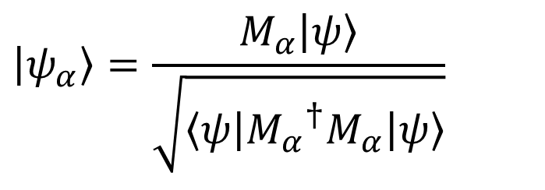
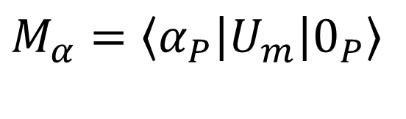
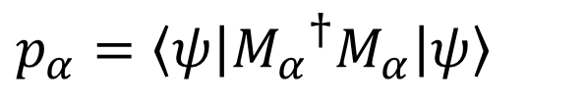
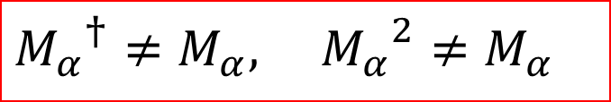

Measurement Operators for S:
$$M_{α}=\left\langle α_{P}\right|U_{m}\left|0_{P}\right\rangle$$
$${M_{α}}^{†}≠M_{α}, {M_{α}}^{2}≠M_{α}$$
$${Tr}_{P}\left[\left(I_{S}⊗\left|α\right\rangle {\left\langle α\right|}_{P}\right)U_{m}\left(ρ_{S}⊗\left|0\right\rangle {\left\langle 0\right|}_{P}\right){U_{m}}^{†}\right]=M_{α}ρ_{S}{M^{†}}_{α}$$
$$ρ_{S}=|ψ⟩⟨ψ|$$
$$α$$
$$p_{α}=\left\langle ψ\right|{M_{α}}^{†}M_{α}\left|ψ\right\rangle$$
Emergence probability of :
$$\left|ψ_{α}\right\rangle =\frac{M_{α}\left|ψ\right\rangle }{\sqrt{\left\langle ψ\right|{M_{α}}^{†}M_{α}\left|ψ\right\rangle }}$$
Post-measurement state of the field:

Slide 57



Example : Two-level spin as the probe
$$Φ_{S}=\frac{π}{4}−\int_{x_{1}}^{x_{2}}{λ_{A}(x)Π_{+}(x)dx}$$
$$U_{m}=\exp\left[−i\left(Φ_{S}⊗{σ^{y}}_{P}\right)\right]$$
$$M_{A}(+)=\cos{Φ_{S}}, M_{A}(−)=\sin{Φ_{S}}$$

Slide 58





$$M_{A}(+)=\cos{Φ_{S}}, M_{A}(−)=\sin{Φ_{S}}$$
$$p_{α}=\frac{1}{2}$$
$$α$$
We obtain the same probability for each :
$$α=+ or−$$
$$φ\left(t,x\right)$$
Information flow via the interaction
1-bit information about the quantum fluctuation of the field.

Slide 59



Post-Measurement States of Quantum Field:
$$α=+⇒\left|ψ_{+}\right\rangle =\frac{1}{\sqrt{2}}\left(e^{\frac{iπ}{4}}\left|λ_{A}\right\rangle +e^{−\frac{iπ}{4}}\left|−λ_{A}\right\rangle \right) \\ α=−⇒\left|ψ_{−}\right\rangle =\frac{1}{\sqrt{2}}\left(e^{−\frac{iπ}{4}}\left|λ_{A}\right\rangle +e^{\frac{iπ}{4}}\left|−λ_{A}\right\rangle \right)$$
Left-mover coherent states of the field
$$\left|±λ_{A}\right\rangle ∝\exp\left[±i\int_{x_{1}}^{x_{2}}{λ_{A}(x)Π_{+}(x)dx}\right]\left|0\right\rangle$$
$$\left\langle ψ_{+} | ψ_{−}\right\rangle ≠0$$
←general measurement

Slide 60



Average post-measurement state:
$$ρ′=\sum_{α=±}{M_{A}\left(α\right)}\left|0\right\rangle \left\langle 0\right|{M^{†}}_{A}\left(α\right)=\sum_{α=±}{p_{α}}\left|ψ_{α}\right\rangle \left\langle ψ_{α}\right|$$
Average excitation energy injected by measurement device:
$$E_{A}=\operatorname{Tr}\left[ρ′H\right]=\sum_{α=±}{\left\langle 0\right|{M_{A}}^{†}\left(α\right)}HM_{A}\left(α\right)\left|0\right\rangle$$
$$E_{A}=\int_{−∞}^{∞}{{\left(∂_{x}λ_{A}(x)\right)}^{2}dx}>0$$

Slide 61
Average
energy
density
Local Measurement
This excitation energy is locally distributed around soon after the measurement. However, it is proven that this energy cannot be completely withdrawn from the field by arbitrary local operations around .

Slide 62

The local measurement does not increase entanglement of the field fluctuations.
$$\left|0\right\rangle \left\langle 0\right|$$
Vacuum-state entanglement

Slide 63


The local measurement does not increase entanglement of the field fluctuations.
$$ENT_{AB}\left(ρ_{m}\right)<ENT_{AB}\left(\left|0\right\rangle \left\langle 0\right|\right)$$
Extraction of
Information about Field
Measurement of
Local Fluctuation of Field
$$ρ_{m}$$
Weaker entanglement

Slide 64

Because no local operations around increase the entanglement, the zero-energy state (the vacuum state) cannot be recovered. Thus, we have the residual energy of the field in any local operation process.
$$x=x_{A}$$
Entanglement gap
Residual Energy
Local Operation
Weaker entanglement

Slide 65
QET

Slide 66





Firstly, at time t=0, Alice performs the same measurement previously discussed. Then, the measurement device excites the left-mover mode with energy .
$$+E_{A}$$
$$t=0$$
$$α=±$$
Left-Mover Excitation
Local Measurement
$$x_{A}$$
$$E_{A}$$
QET STEP 1

Slide 67



$$x=x_{B}$$
At time t=T, the measurement result is announced to Bob at
and a local operation dependent on the measurement result is performed.
$$t=T$$
Local Operation dependent on
Measurement Result
$$x_{B}$$
QET STEP 2

Slide 68

Bob’s Local Operation dependent on Measurement Result:
$$U_{B}\left(α\right)=\exp\left[iαg\int_{−∞}^{∞}{p_{B}(x)Π_{+}(x)dx}\right]$$
Localized function around Bob
The coupling is fixed so as to extract maximum energy from the field.

Slide 69
Finally, positive energy is extracted by the operation with generation of negative-energy left-mover excitation of the field.
Negative
Energy Excitation
QET STEP 3

Slide 70


Teleported Energy from Alice to Bob:
$$E_{B}=\frac{4{\left|\left\langle 2λ_{A} | 0\right\rangle \right|}^{2}}{π\int_{−∞}^{∞}{p_{B}(x)^{2}dx}}{\left[\int_{−∞}^{∞}{dx}\int_{−∞}^{∞}{dy}p_{B}(x)\frac{1}{{\left(x−y+T\right)}^{2}}λ_{A}(y)\right]}^{2}$$
The amount of extracted energy by Bob is upper-bounded by the residual energy of Alice.
$$\min_{Γ_{A}}{E_{A}}≥E_{B}$$

Slide 71
Similar to Generation of Hawking Radiation
Outside Black Hole Horizon
Spacetime Diagram of QET
STEP 3
negative
energy flux
t=T
STEP 2
positive
energy flux
t=0
STEP 1

Slide 72
V. QET Application to Black Hole Physics

Slide 73
QET is the second proposed mechanism to extract energy from black holes and reduce their event horizon area. The first mechanism,
of course, is Hawking radiation emission.
M. Hotta, Phys.Rev.D81:044025,2010.

Slide 75
A

Slide 76
B
1bit
A
Measurement information

Slide 77


Black hole formation by gravitational collapse of the wave packets generated by Alice’s measurement.
QET can shrink the horizon using the measurement result information.
M. Hotta (2010)

Slide 78


A QET application to AdS/CFT (J. Wang and S. Yao, 2024).

Slide 79
Summary
○ Quantum energy can be transferred by local operations and
classical communication: quantum energy teleportation (QET).
○ QET experiments have already been successfully conducted.
○ QET can extract energy from black holes like Hawking radiation
emission.
○ QET can be applied to black hole physics in AdS/CFT.

