Slide 1
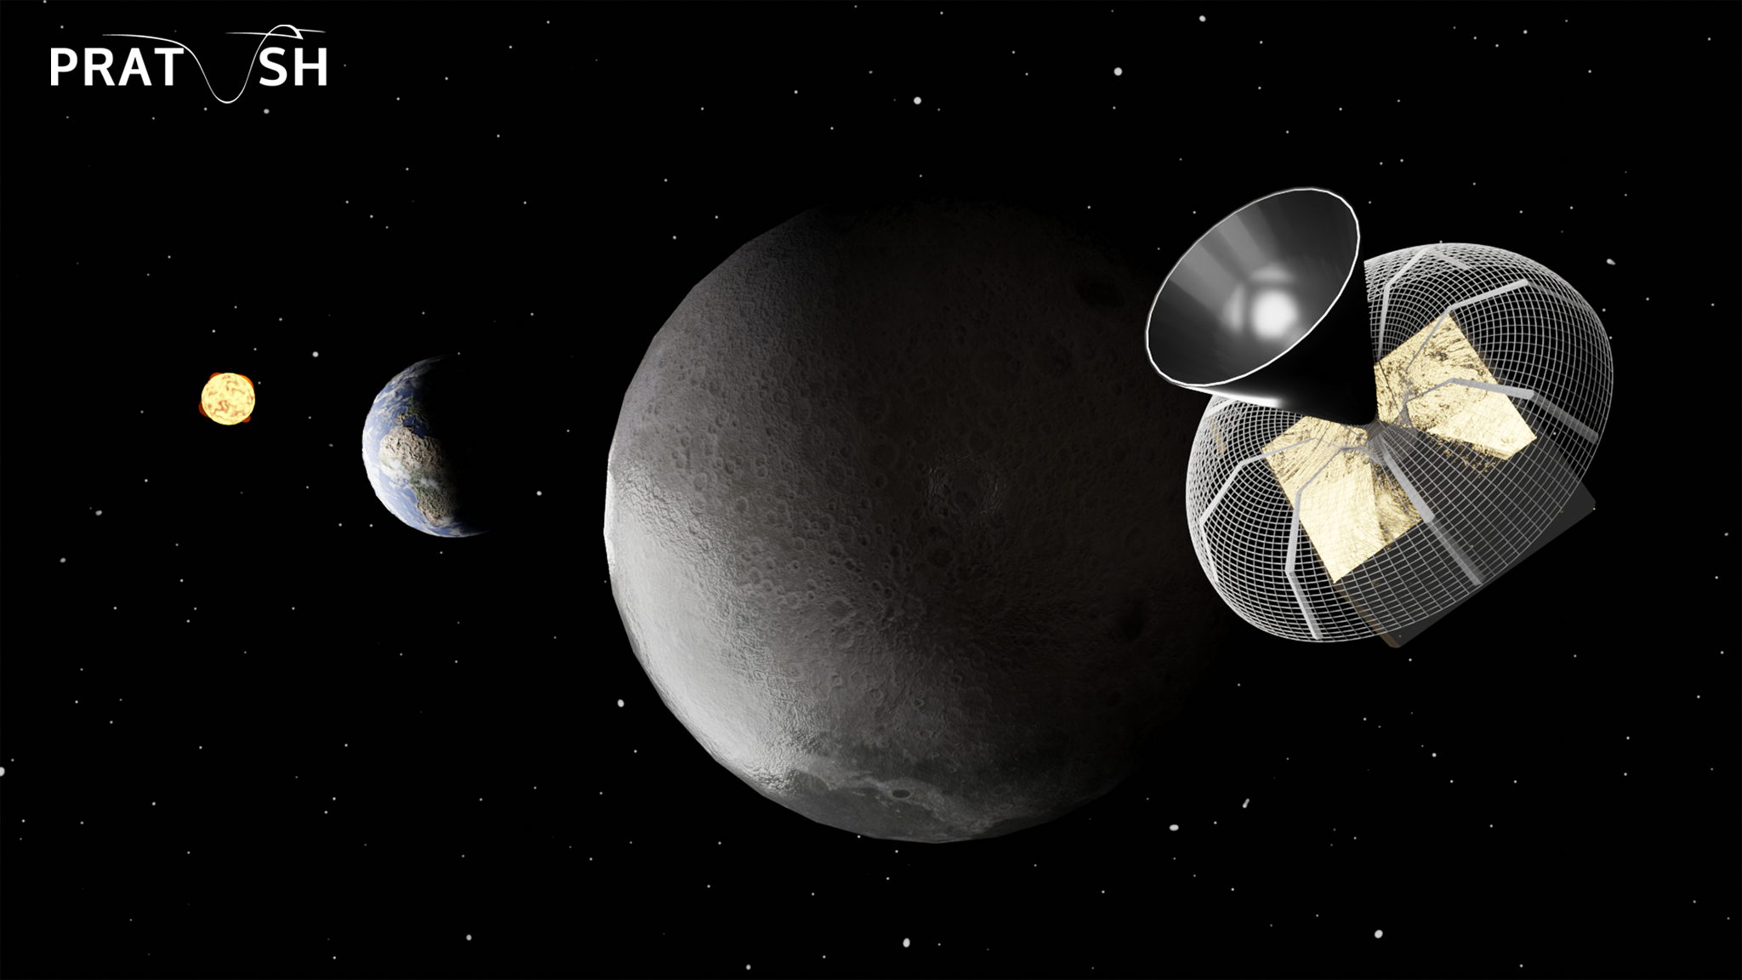

21-cm cosmology
The global signal perspective
Mayuri S Rao
COSNP 2026
IITM RP, 19 Jan 2026

Slide 2
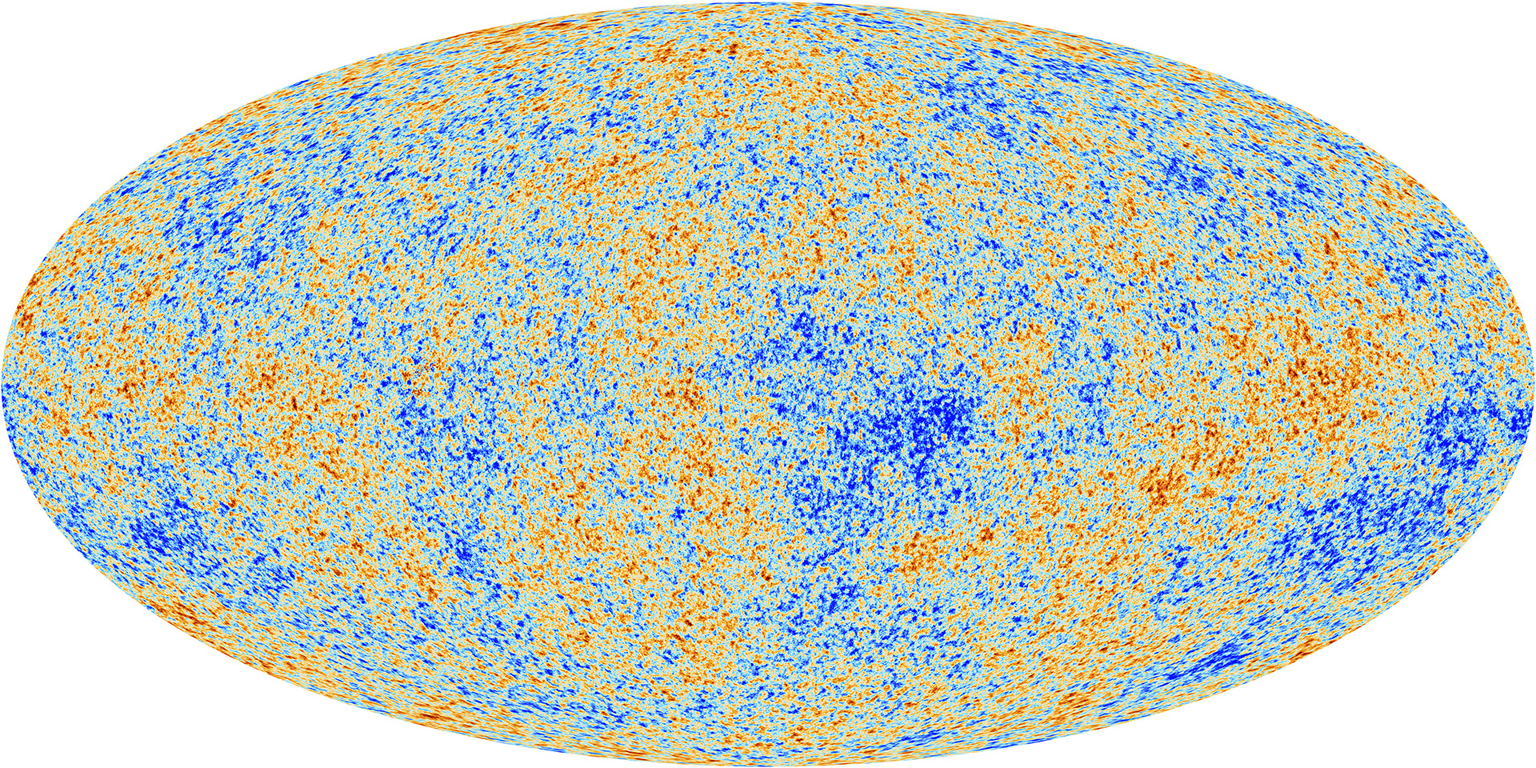
The progress we have made
z = 1100

Slide 3
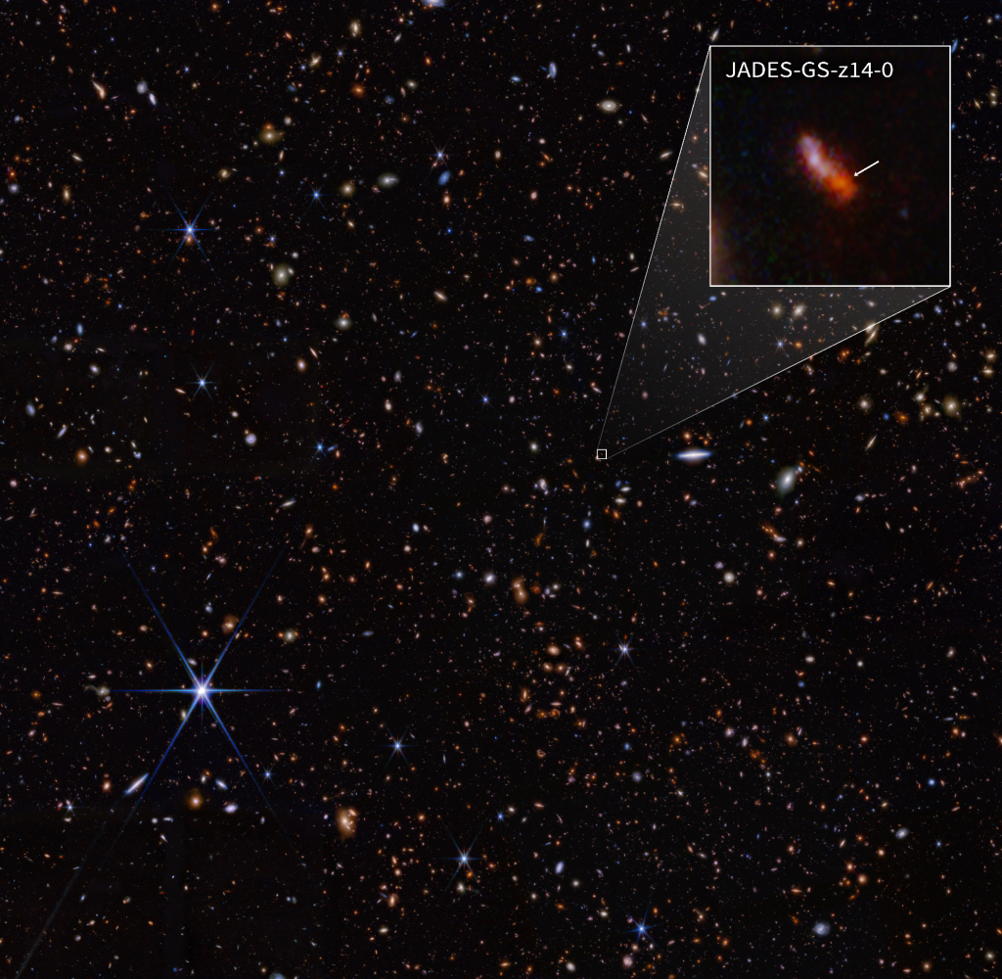
The progress we have made
MoM-z14 : z=14.44
280 Myr
NASA/ESA/CSA James Webb Space Telescope

Slide 4
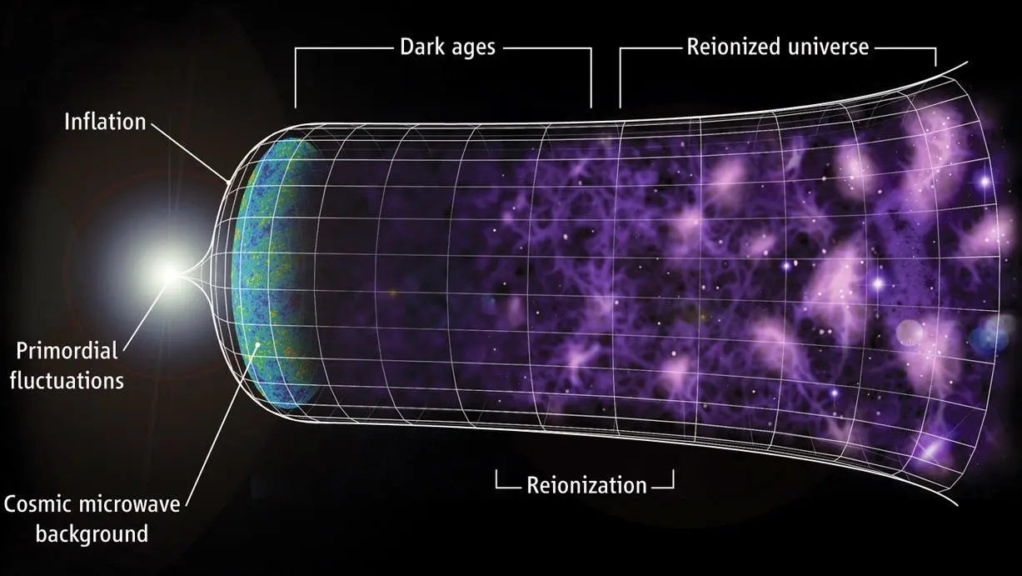

The middle

Slide 5
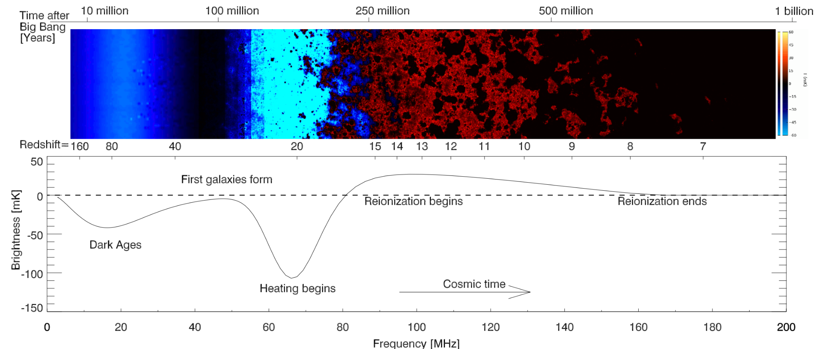
Using Hydrogen as a probe to complete the puzzle

Slide 6
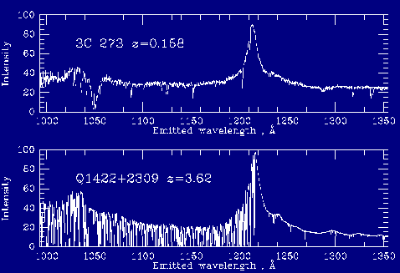
Hydrogen as a probe is not new to cosmologists
Courtesy : https://pages.astronomy.ua.edu/keel/agn/forest.html
From HST / Keck data

Slide 7
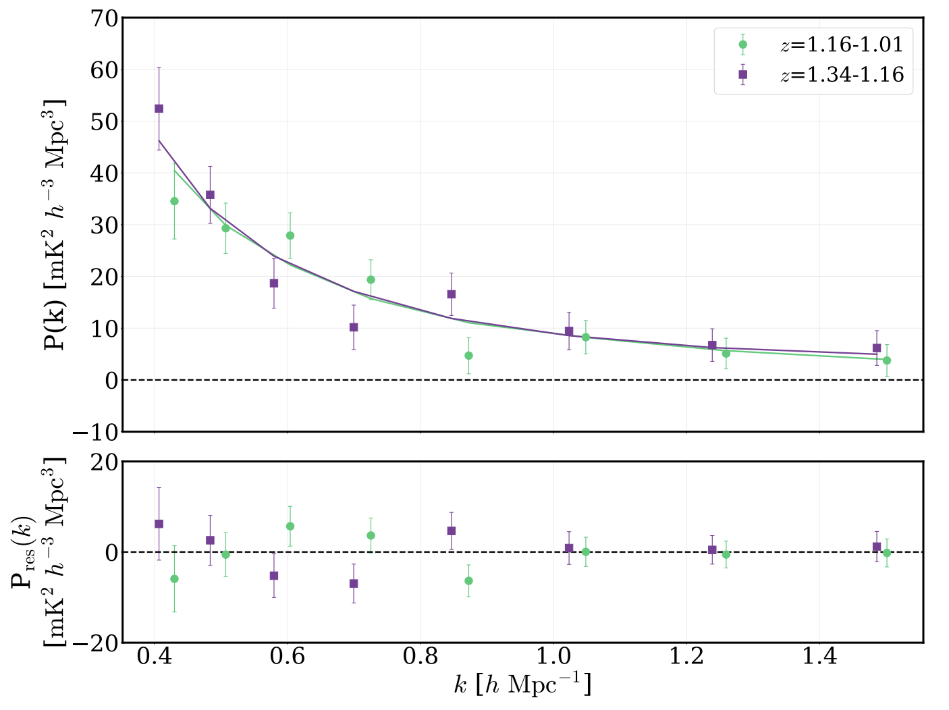
HI spectrum detection at z~1!
21-cm probes galaxy distribution and is a measure of large scale structure complementary to optical surveys.
Traces galaxy evolution through z
Power spectrum (real part) in both the sub-bands, best fit model and residuals consistent with expected noise
CHIME collaboration 2025

Slide 8
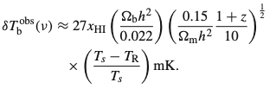
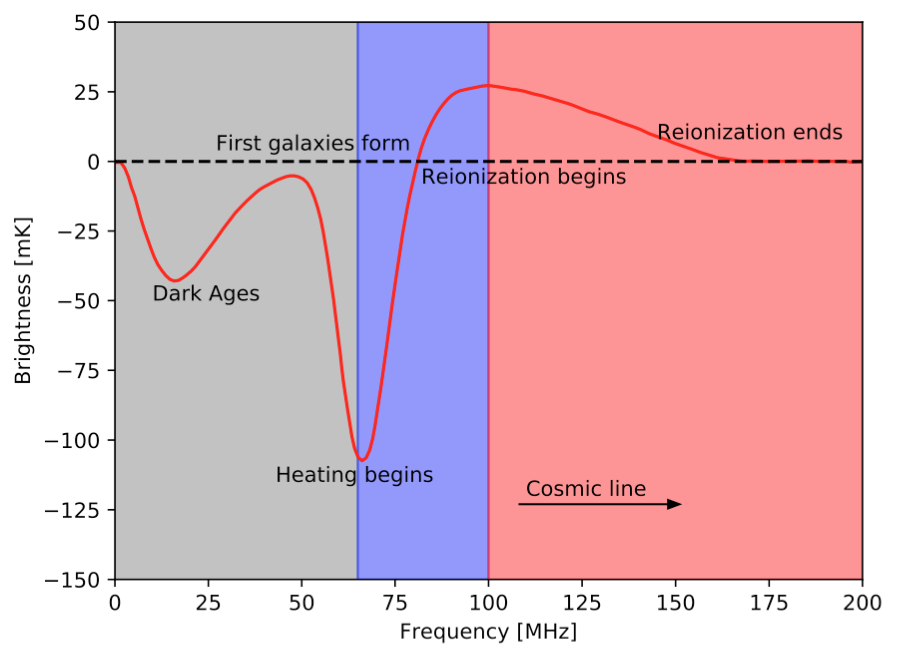

Collisions ineffective Ts ~ Tr
(Ts-Tr)Starts becoming positive
X-ray heating. If heating causes Ts>Ts, (Ts-Tr ) > 0
x_{HI}= 0
n1/ n0 = 3e^(−T∗/Ts) , where T∗ ≡ (hc)/(kλ₂₁) = 0.068K
Ts = Tk
Tk < Tr
(Ts - Tr)<0
Lyman Alpha coupling (WF effect)

Slide 9
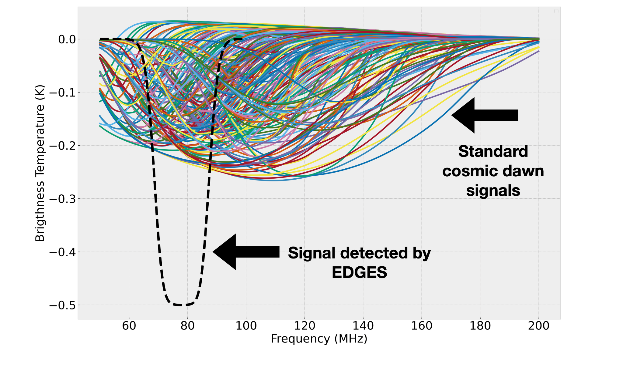

Slide 10
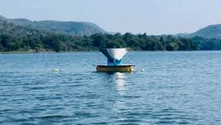
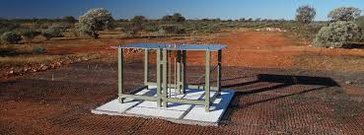
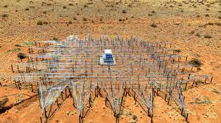
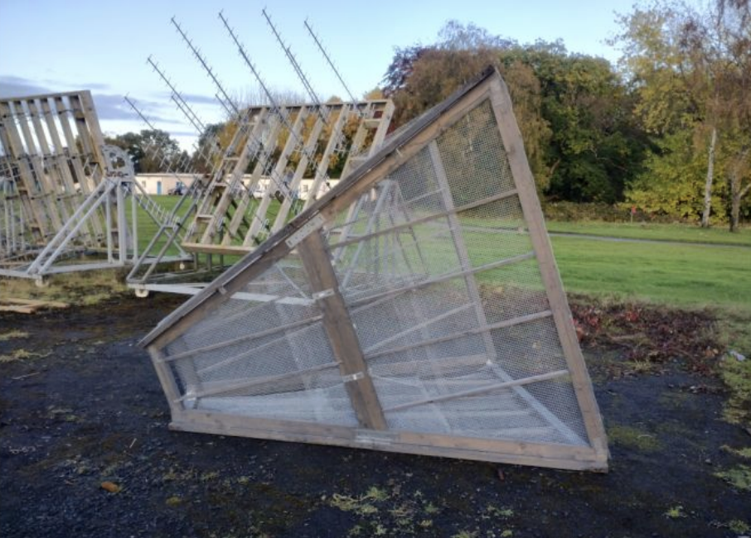
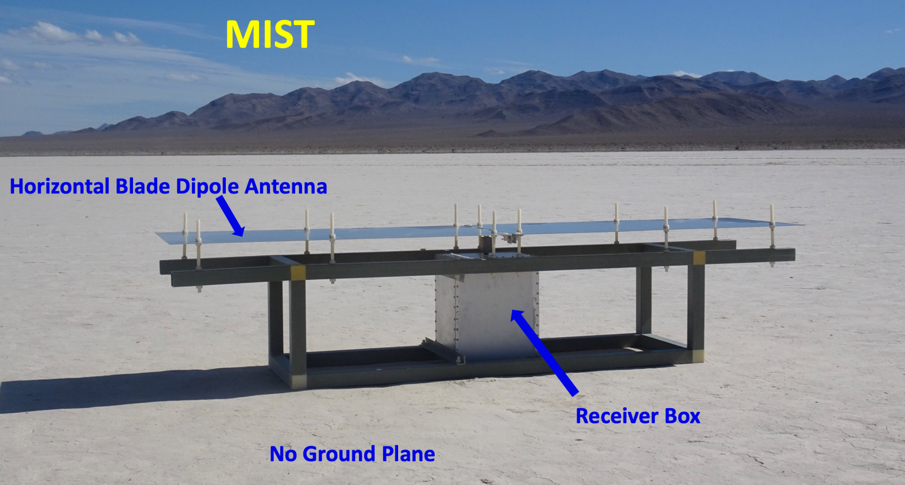
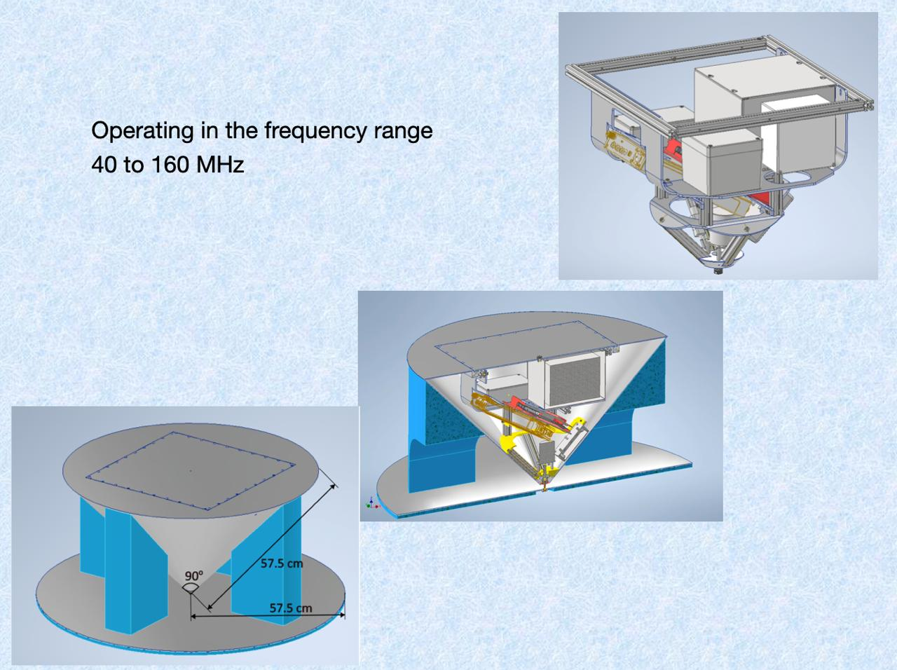
Some experimental Efforts to detect the signal
SARAS 3 EDGES REACH
RHINO MIST GINAN

Slide 11
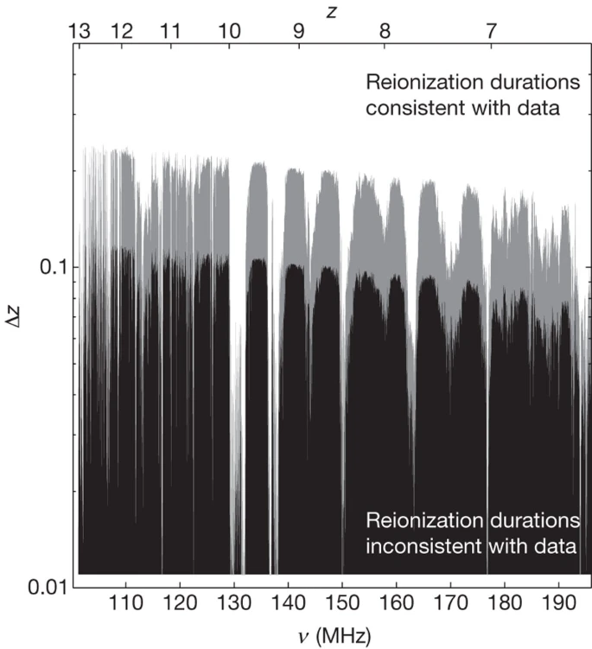
Constraints from global Signals
– EDGES (Bowman & Rogers, Nature, 2010)
– Observations over 100 - 200 MHz (6 < z < 13)
– Ruled out Rapid Reionization exclude a rapid reionization timescale of Δz, 0.06 at the 95% confidence level.

Slide 12
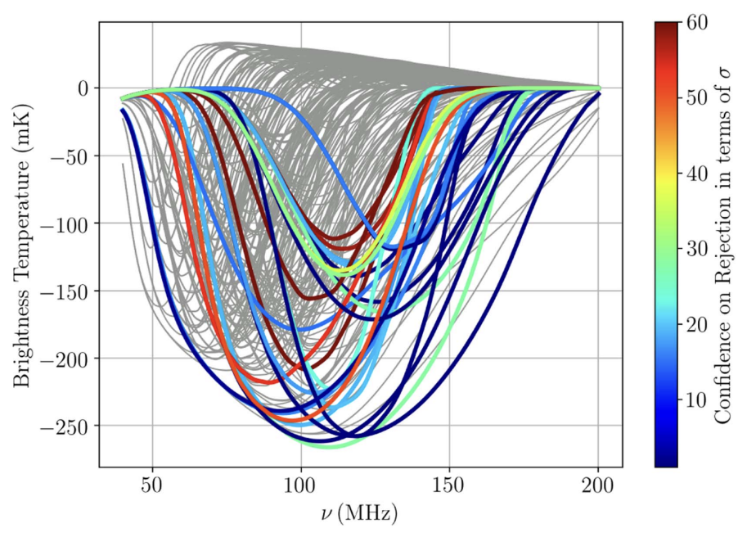
SARAS 2
SARAS-2 110–200 MHz
63 hours of science quality data Sensitivity achieved: root-mean-square (rms) noise of 11 mK at 122 kHz spectral resolution
Ruled out inefficient heating of the primordial gas by the first population of X-ray sources, along with rapid reionization (~ 10% of 264 standard models)
Saurabh Singh et al 2018 ApJ 858 54

Slide 13
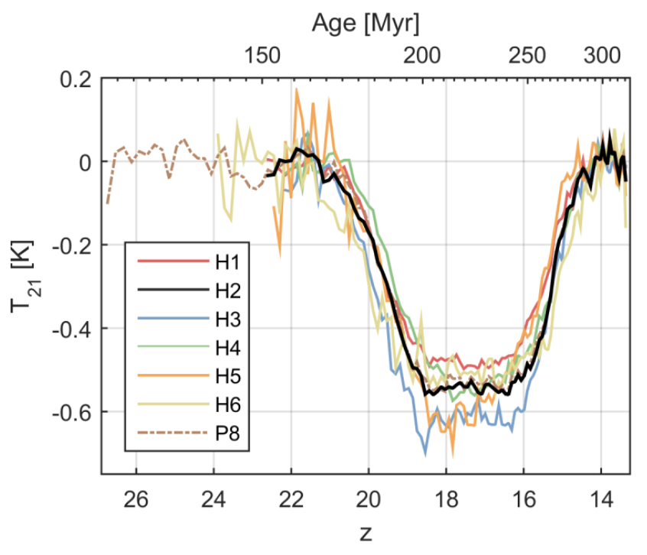
EDGES
– Reported a detection of a very deep and wide absorption trough centered at 78 MHz; 500⁺⁵⁰⁰₋₂₀₀ mK deep, 19⁺⁴₋₂ MHz FWHM, τ = 7⁺⁵₋₃ flattening parameter
– Created a lot interest as none of the standard cosmological models could predict/ explain this
– If truly cosmological origin then possibilities include excess radio background; dark-matter baryon radiative coupling
– Other explanations – instrumental artefacts, post-processing/ analysis induced
Bowman, Judd D., et al., Nature 555.7694 (2018): 67-70.

Slide 14
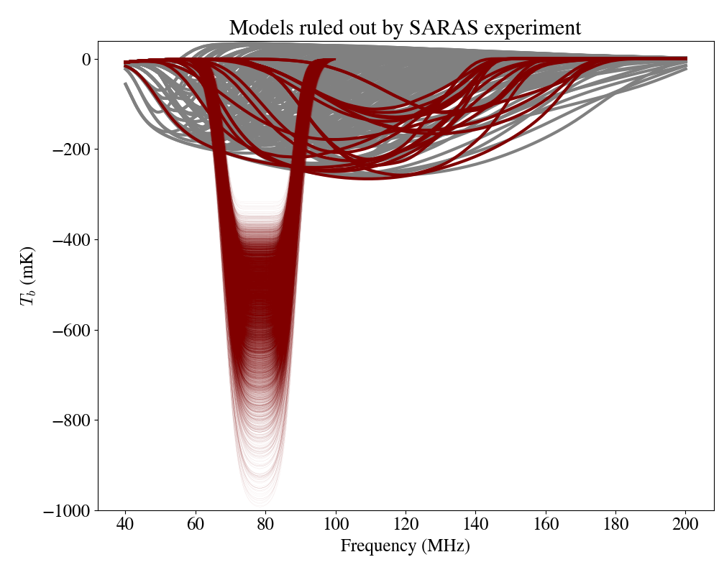
SARAS-3
– Ruled out the cosmological origins of the EDGES absorption trough (and similar class of signals detection to 95% confidence
– SARAS3 result reaffirms confidence in standard physics and cosmological models
Singh, Saurabh, et al.Nature Astronomy 6.5 (2022): 607-617.

Slide 15
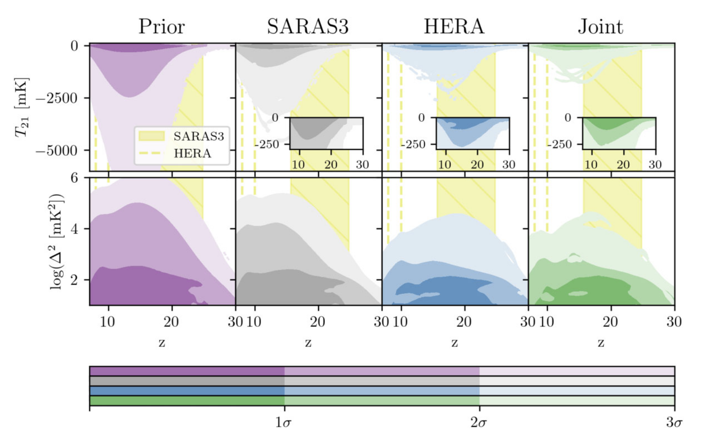
Joint constraints from HERA + SARAS 3
Joint analysis finds ~65% of the explored broad theoretical parameter space to be consistent with the joint data set, in comparison to ~92% for SARAS3 and ~79% for HERA alone
star formation efficiency, minimum halo mass for star formation, X-ray luminosity of early emitters, and the radio luminosity of early galaxies
Rejects at 68 % confidence a combination of galaxies with X-ray emission that is 33 and radio emission that is 32 times as efficient as present day galaxies
Rejects at 95 %confidence scenarios in which power spectra are ≥126 mK2 at z = 25 and the sky-averaged signals are ≤−277 mK
Bevins et al. MNRAS 527, 813–827 (2024)

Slide 16
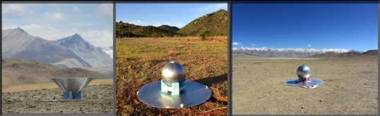
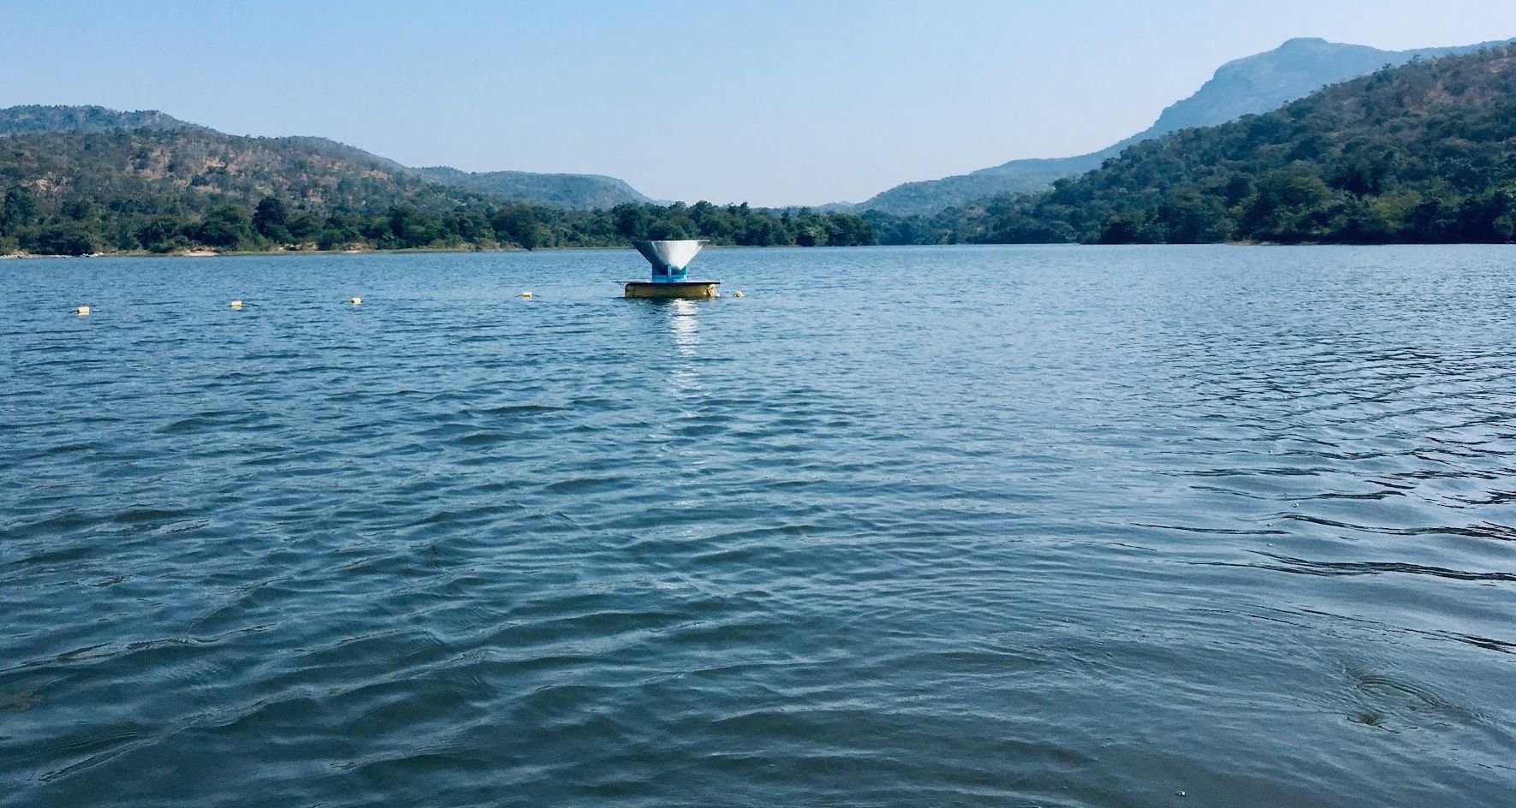
SARAS antennas
Typically monopole
To avoid balun that typically introduce chromaticity
To minimize reflections between dipole arms and ground plane

Slide 17


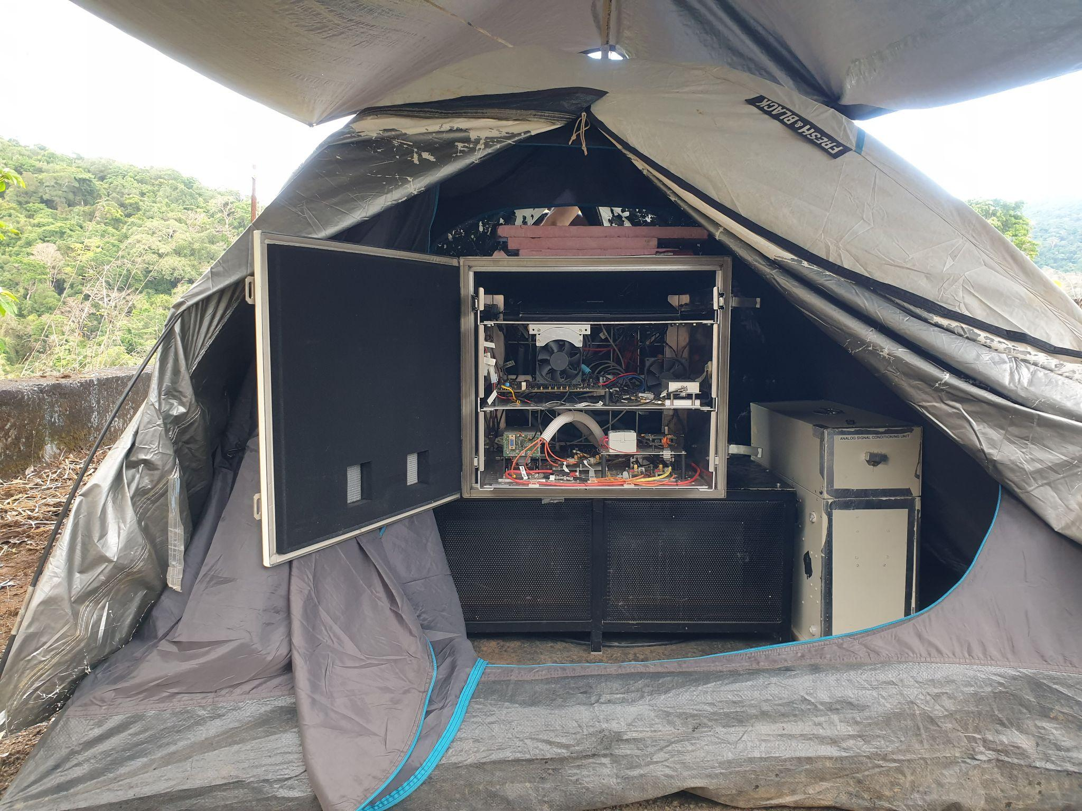
Some behind the scenes

Slide 18
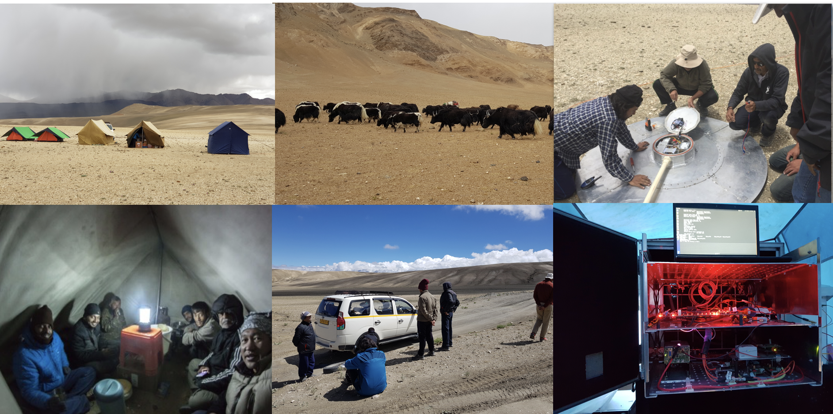
Observations – with hiccups

Slide 19
Basic telescope
Cosmological + astrophysical signal
Antenna
Analog Rx
+ calibration
Digital Rx
Notes:
All experiments aiming to detect the global signal from CD /EoR invariably face some instrument related challenges. Some of these as highlighted in pink can and must be addressed as part of the experiment design. These include standing waves in the cables connecting different parts of the receiver or those from a non-smooth shape in the coupling response of the antenna. However, ground based experiments face some unique challenges that can be alleviated by conducting the experiment in a cleaner environment. These challenges are those of terrestrial radio frequency interference even in the most radio quite sites on Earth. Features introduced in the data from interaction of the antenna with the Earth beneath it, including rocks and pebbles and soil moisture content. And third is the effect of ionosphere that may introduce frequency dependent effects by way of refraction and attenuation.

Slide 20
IN PRACTISE
Cosmological + astrophysical signal
Ionospheric effects (refraction)
Radio Frequency Interference (RFI)
Reflections
(standing waves)
Antenna
Frequency Dependent Beam
Analog Rx
+ calibration
Coupling to Earth,
Edge effects, losses, inhomogeneous medium
Data-analysis methods
Self generated RFI
Minimized in free space over lunar farside
Needs to be a part of experiment design
Digital Rx
Dynamic Range limitations
Notes:
All experiments aiming to detect the global signal from CD /EoR invariably face some instrument related challenges. Some of these as highlighted in pink can and must be addressed as part of the experiment design. These include standing waves in the cables connecting different parts of the receiver or those from a non-smooth shape in the coupling response of the antenna. However, ground based experiments face some unique challenges that can be alleviated by conducting the experiment in a cleaner environment. These challenges are those of terrestrial radio frequency interference even in the most radio quite sites on Earth. Features introduced in the data from interaction of the antenna with the Earth beneath it, including rocks and pebbles and soil moisture content. And third is the effect of ionosphere that may introduce frequency dependent effects by way of refraction and attenuation.

Slide 21
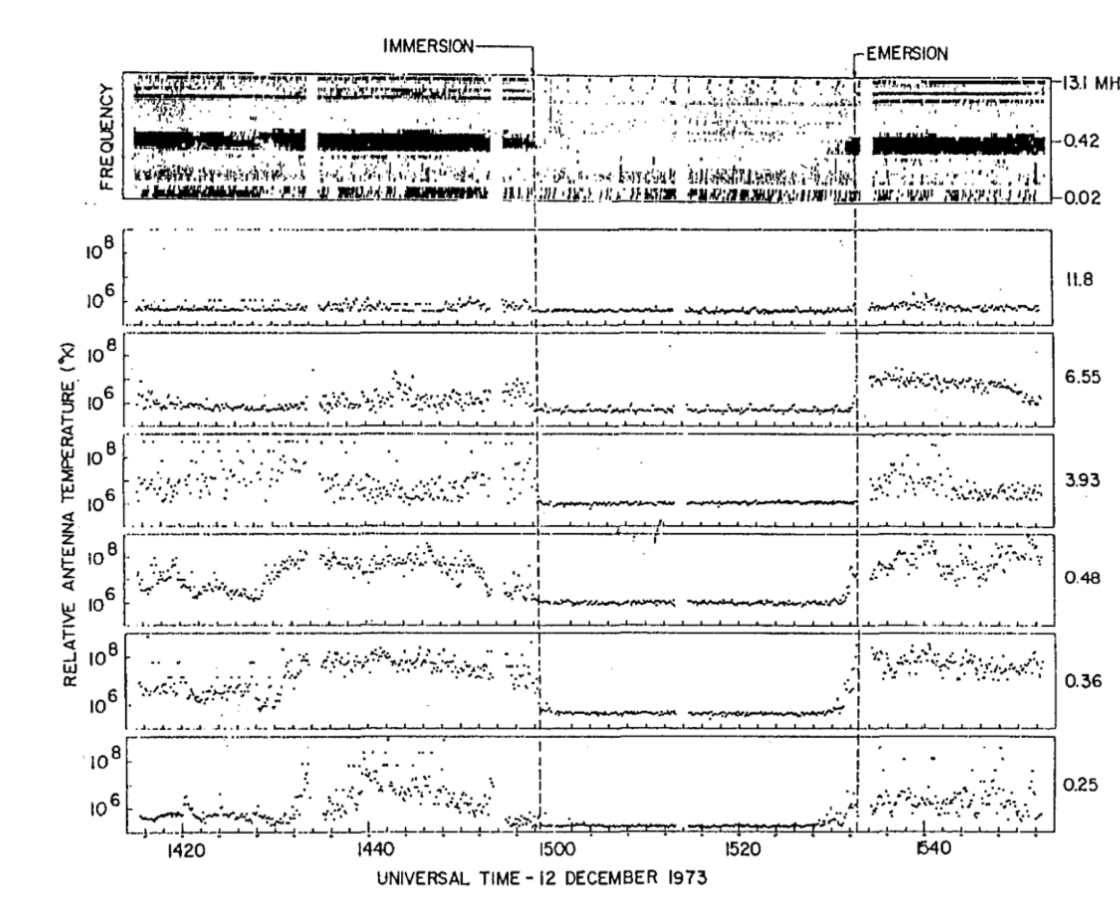
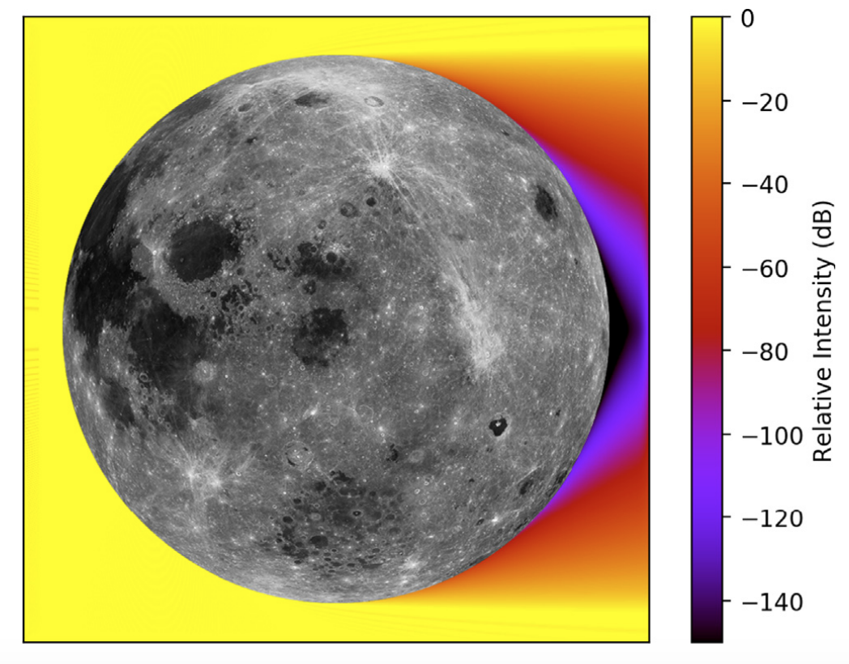
Why Lunar Farside?
RAE-2 measurement : 25 kHz - 13.1 MHz
Alexander et al 1975
Bassett et al (2020)
The moon is an attenuator.
Farside of the moon attenuates terrestrial RFI.
It provides a ‘clean’ environment.
Notes:
The far side of the moon is expected to have a pristine radio environment from previous orbiters as well as simulations. The moon itself acts as an absorber of terrestrial radiation and by operating in orbit around the moon and observing when in the farside the antenna is in free space devoid of any near field coupling effects.

Slide 22
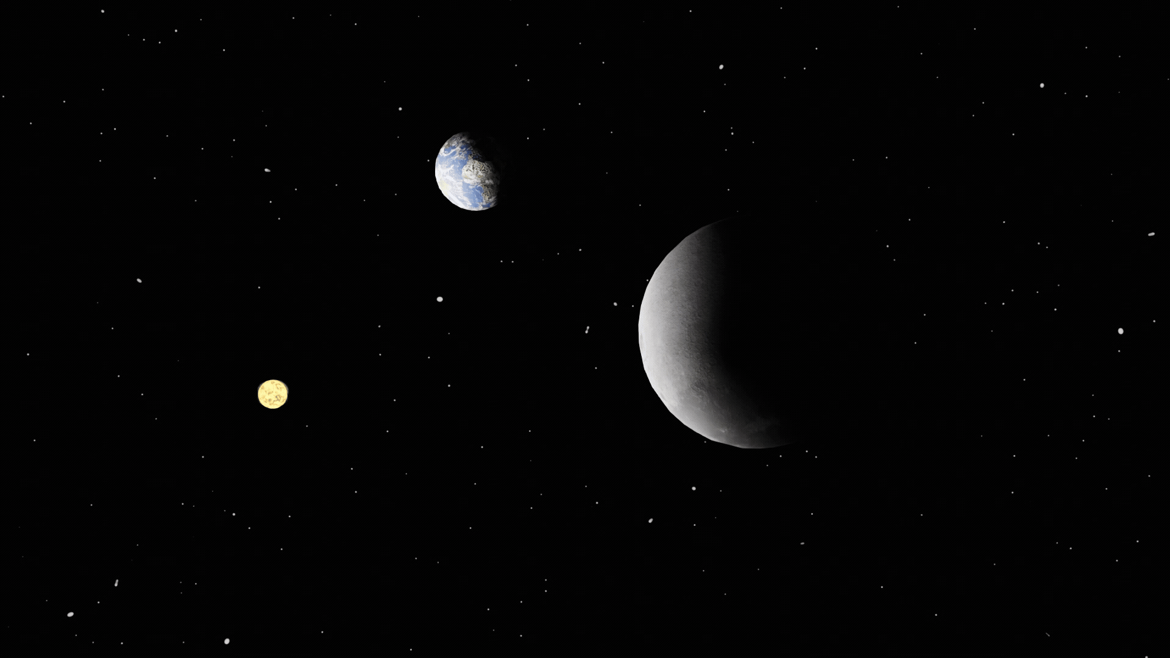

Slide 24
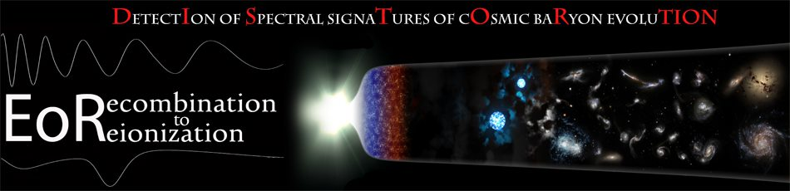

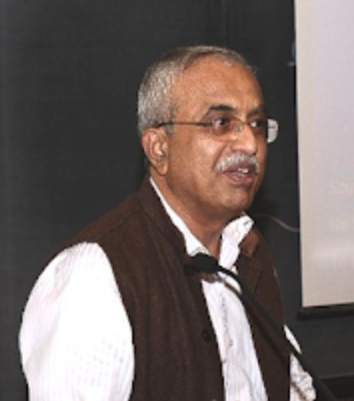
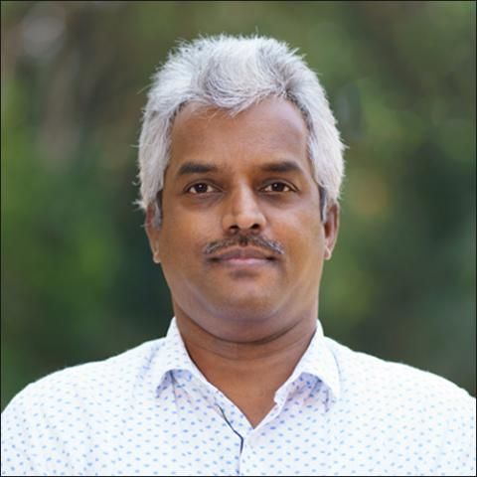
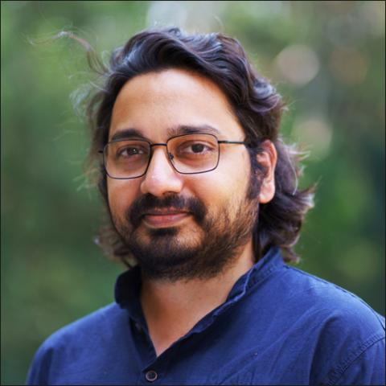
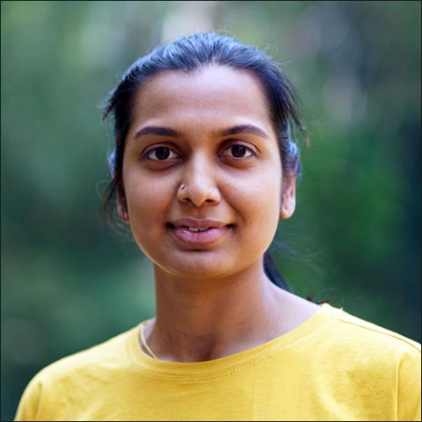






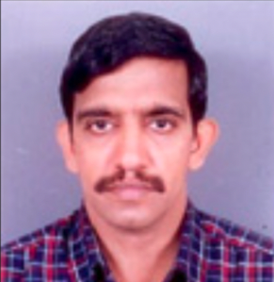




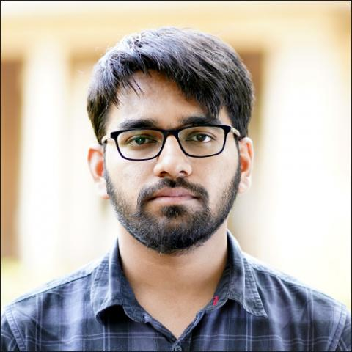



THE TEAM
+ Collaborators, Staff at Electronics and Mechanical Engineering Services, Gauribidanur field station, Visiting project students

Slide 25
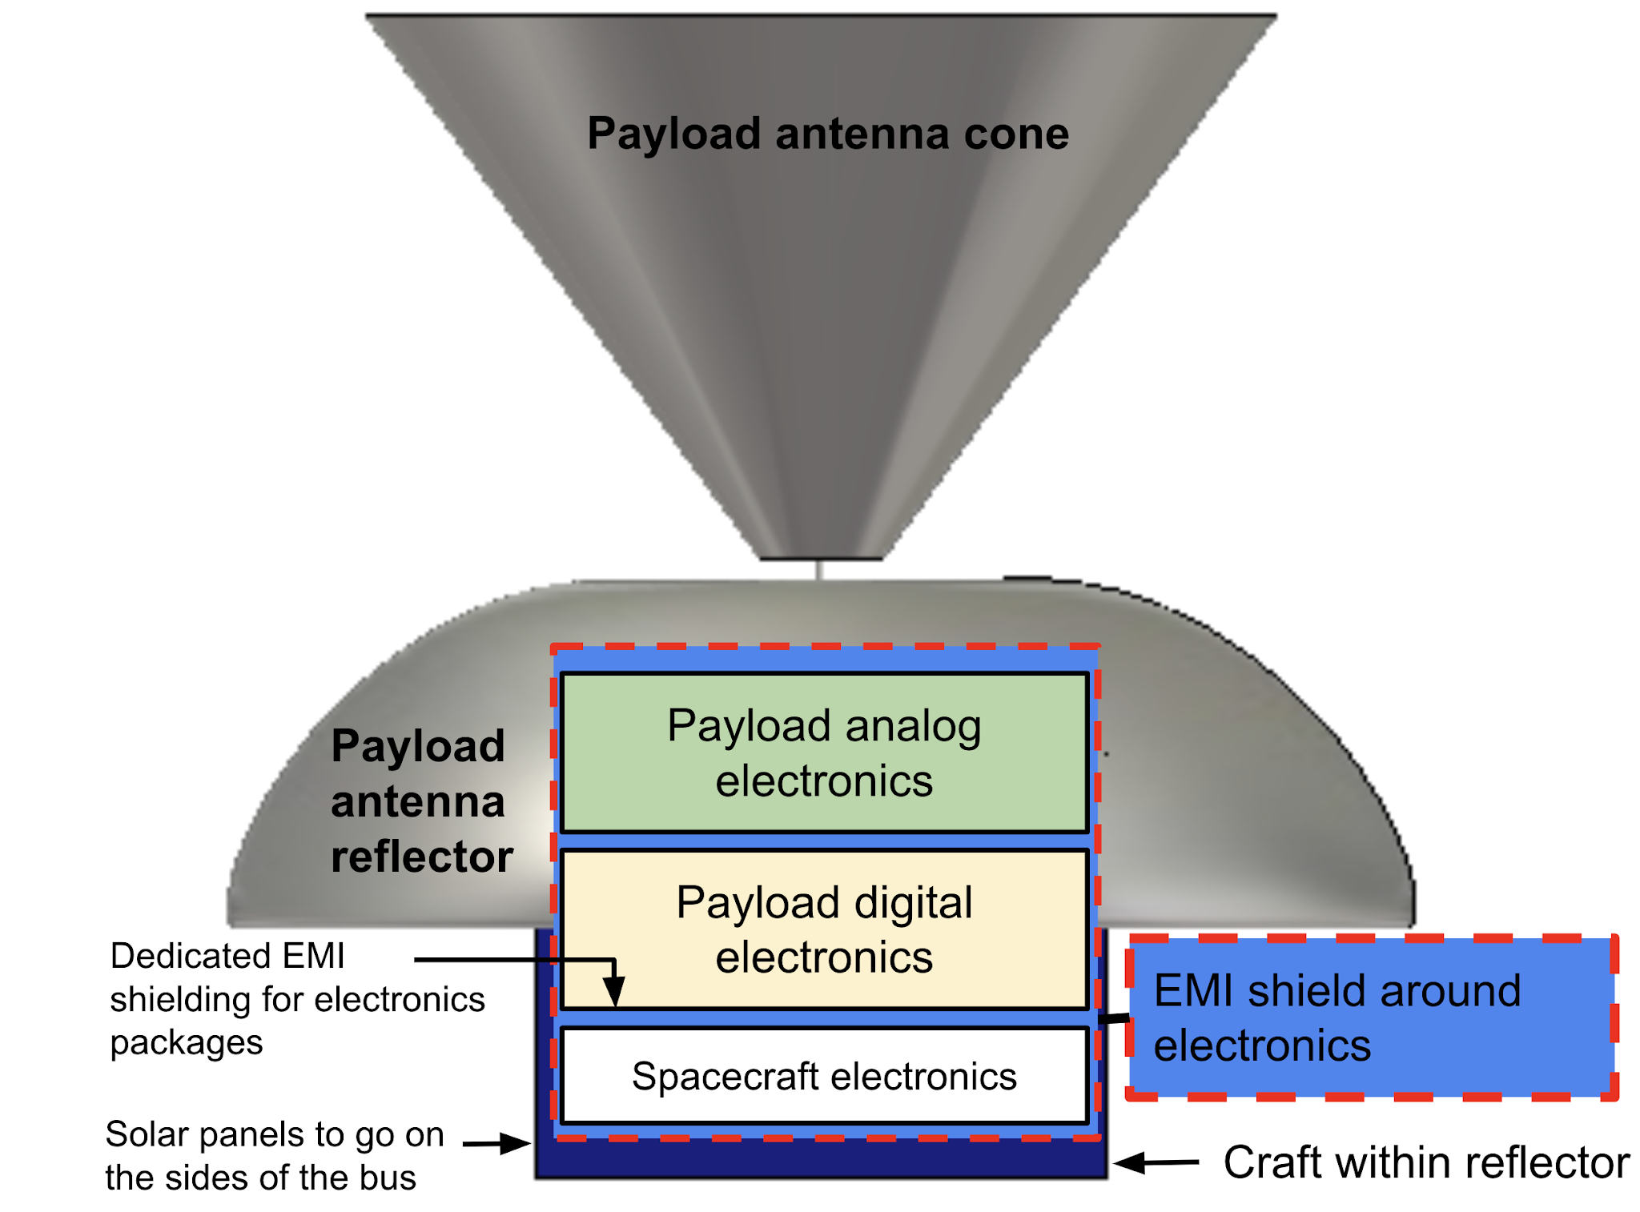
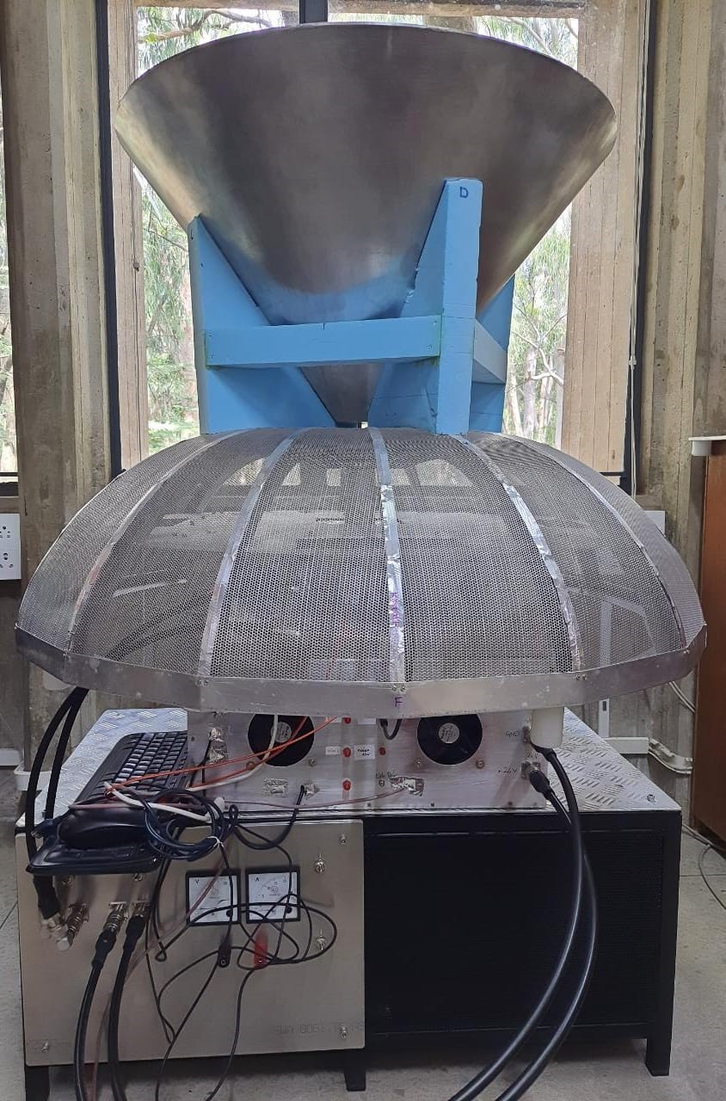
PRATUSH (प्रत्युष, ಪ್ರತ್ಯುಶ್ – Dawn / First light)
– Funded by Indian Space Research Organization for pre-project studies
– Favorably reviewed by technical committee
– Laboratory model built, tested
– Awaiting next review steps to selection

Slide 26
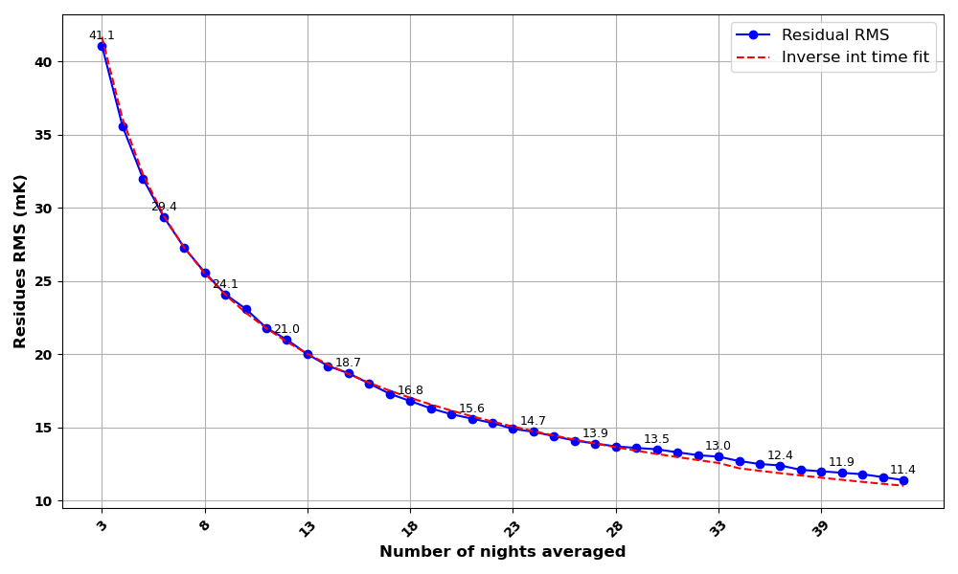

Slide 27
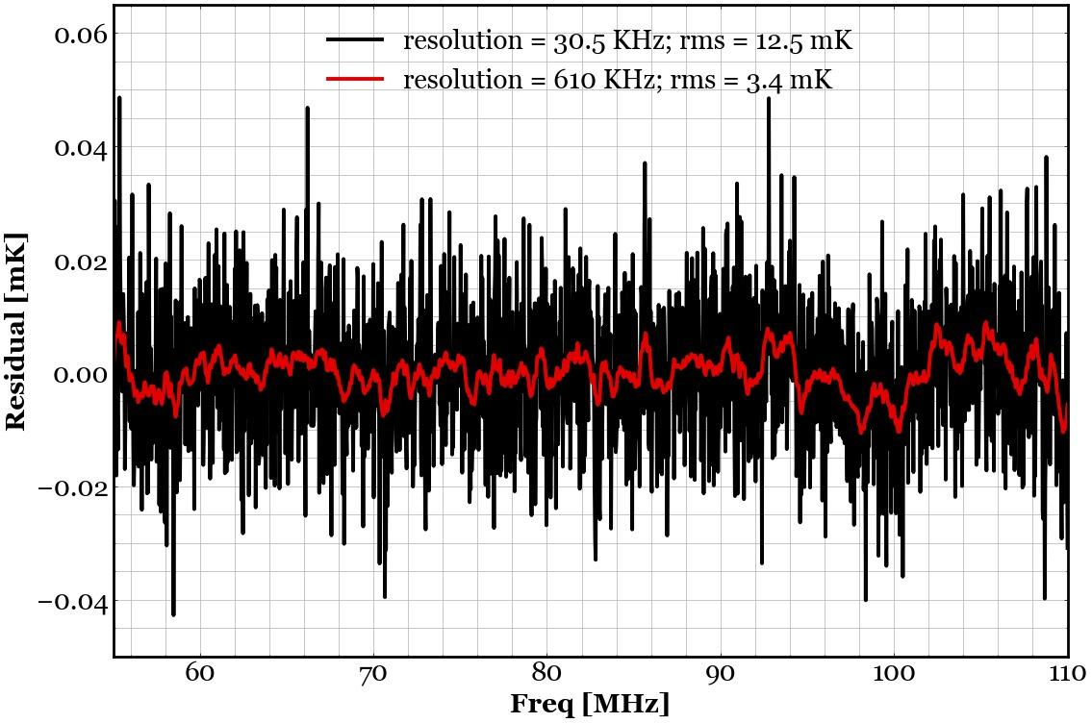
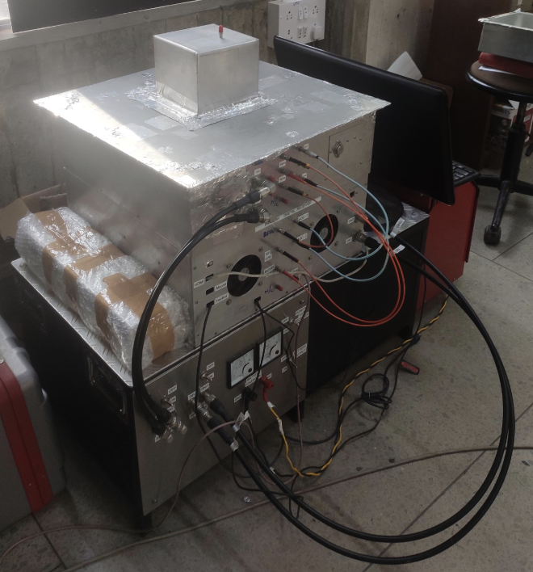
Analog section
Wheeler cap
Power cables
Digital section
[K]
Optical and SMA cables
Batteries
Laboratory model of PRATUSH
KS, Srivani, et al, Experimental Astronomy 60.1 (2025): 1.

Slide 28
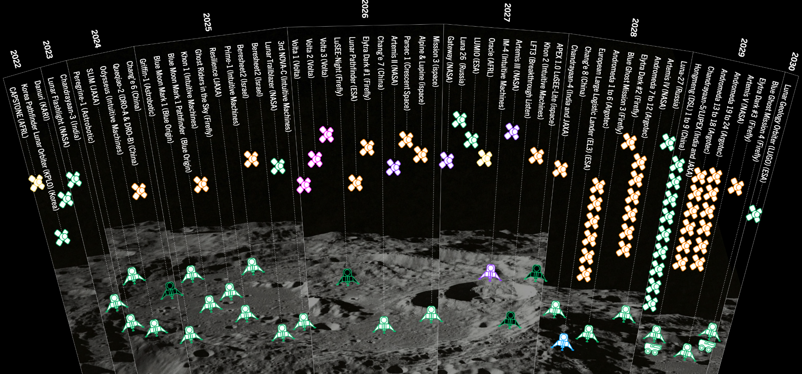
The farside ‘population’
Fig courtesy - Steve Prabu, LFT3

Slide 29
IN CLOSING
The (redshifted) 21-cm signal from HI is key to filling in the missing piece of the structure formation cosmology puzzle
Why 21-cm cosmology, current status (bias on Global signal), experimental challenges, what’s next – space!
Exciting results have been coming in from ground-based global and power spectrum experiments
We’ve had a close brush with ‘non-standard’ cosmology / physics and that’s what keeps things interesting
Lunar-farside based experiments will start giving competitive results - these will open new parameter space by probing very low frequencies (< 10 MHz) at high sensitivity.
THANK YOU!

Slide 30
BACK UP

Slide 31
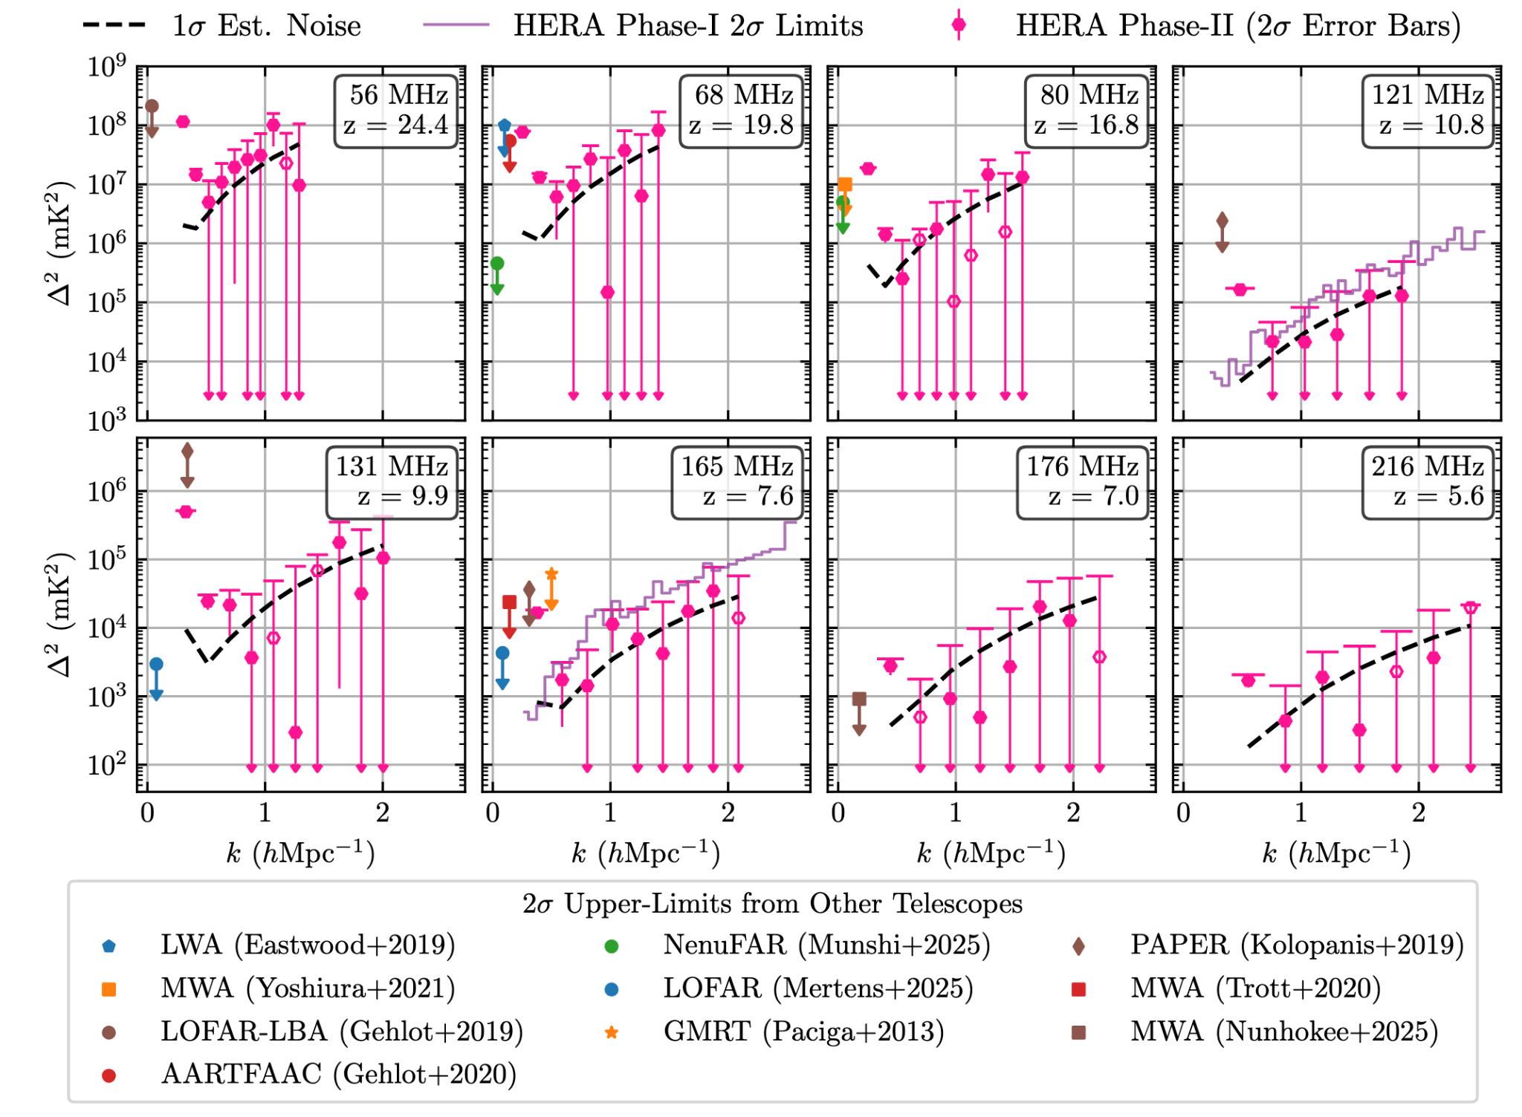
HERA Phase II constraints on CD and EoR
Tightest limit during Cosmic Dawn (z > 12) is 1.13 × 10⁶ mK2 at (k = 0.55 hMpc⁻¹ ,
z = 16.78), and during the EoR (5.5 < z < 12) it is 1.78 × 10³ mK² at (k = 0.70 hMpc⁻¹ , z = 7.05)
HERA Collaboration
2025

Slide 32
