Slide 1
Vibrations of Ultralight Tracking Detector Structures
Mattia Moretti | August 2025

Slide 2
Content
Mu3e experiment: Physical goals and how to achieve them
Theoretical interlude
Seismic motion induced vibrations
Cooling flow induced vibrations
Conclusion

Slide 3
Mu3e experiment:
Physical goals and how to achieve them

Slide 4
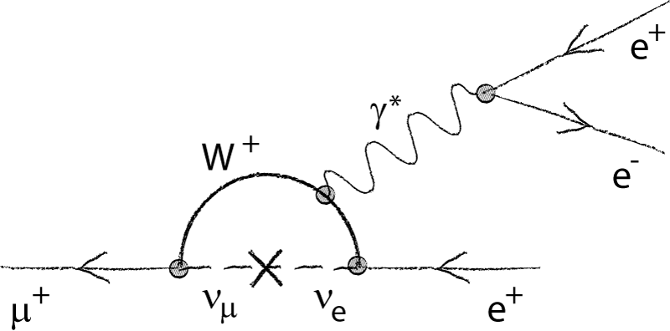
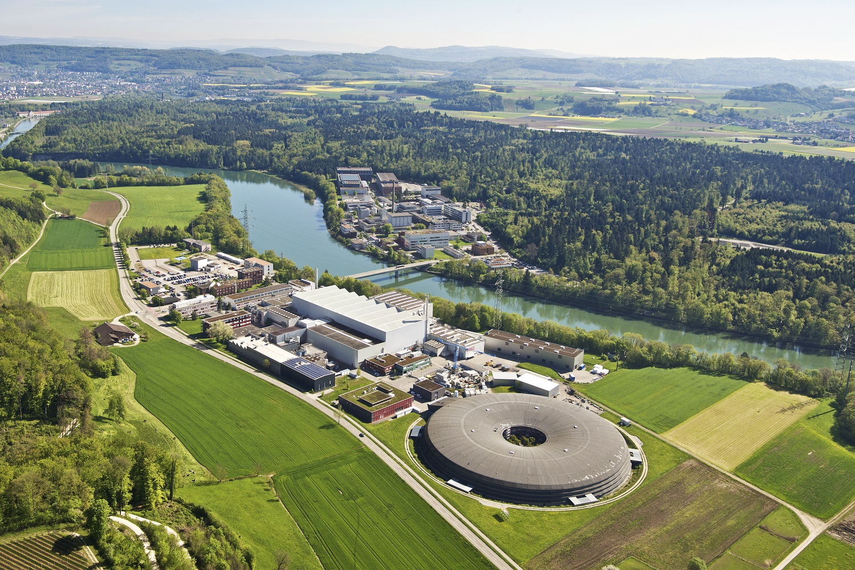
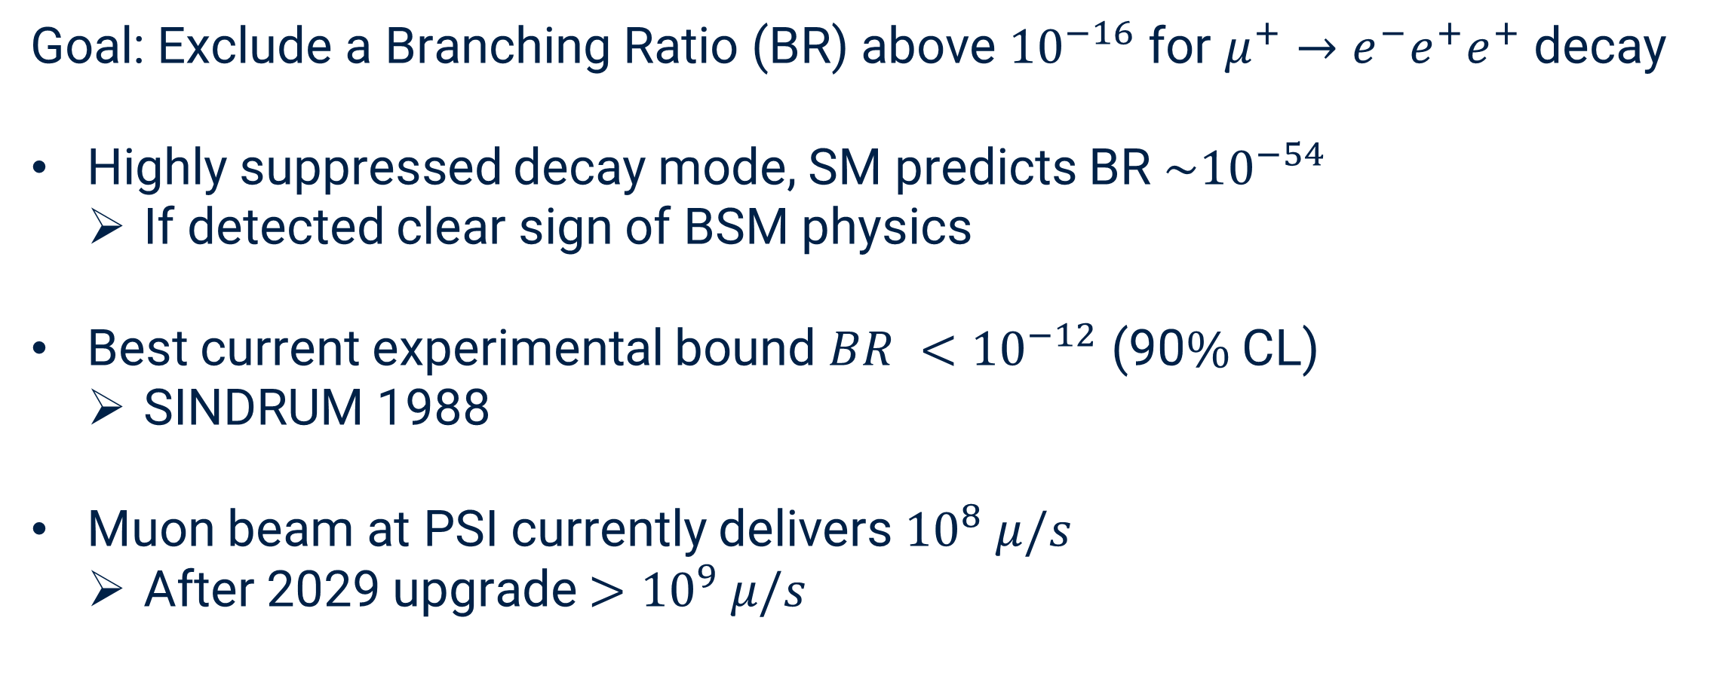
The Mu3e experiment
Goal: Exclude a Branching Ratio (BR) above ${10}^{−16}$ for $μ^{+}→e^{−}e^{+}e^{+}$ decay
Highly suppressed decay mode, SM predicts BR $\sim {10}^{−54}$
  If detected clear sign of BSM physics
Best current experimental bound $BR <{10}^{−12}$ (90$\%$ CL)
  SINDRUM 1988
Muon beam at PSI currently delivers ${10}^{8} μ/s$
  After 2029 upgrade $>{10}^{9} μ/s$

Slide 5
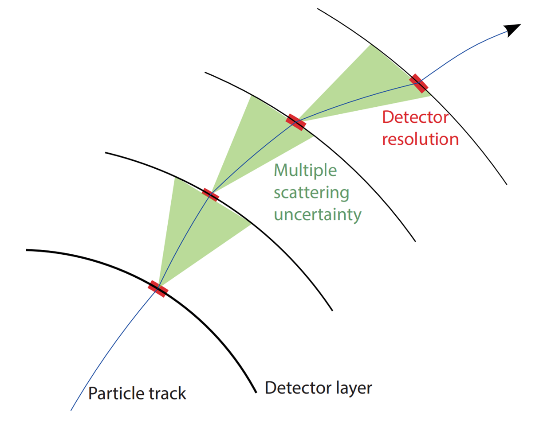
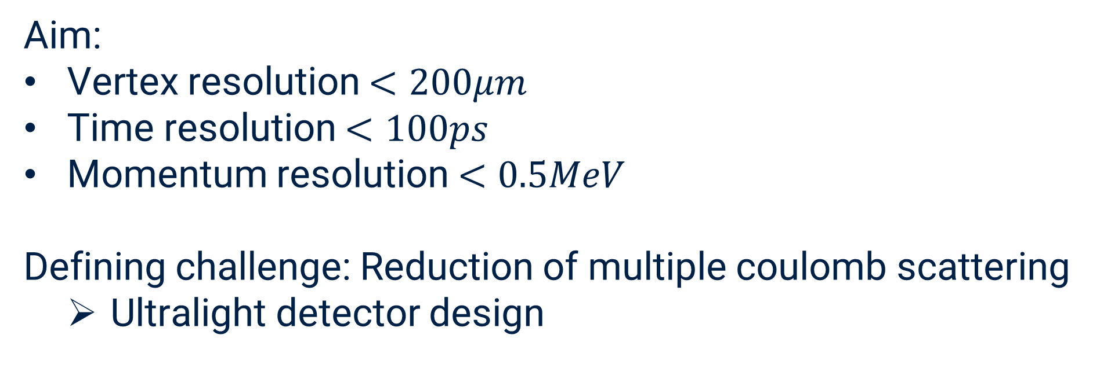
Resolution goals
Aim:
Vertex resolution $<200μm$
Time resolution $<100ps$
Momentum resolution $<0.5MeV$
Defining challenge: Reduction of multiple coulomb scattering
  Ultralight detector design

Slide 6
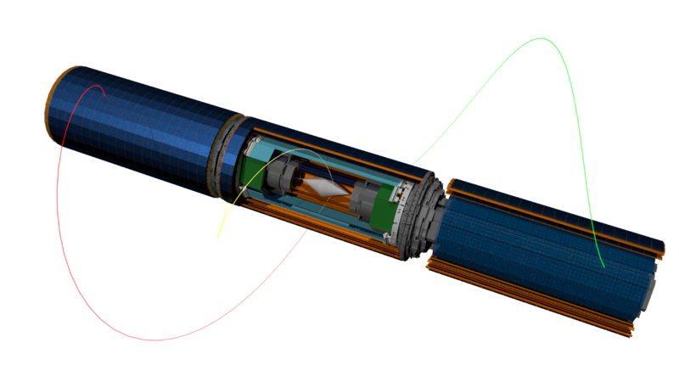
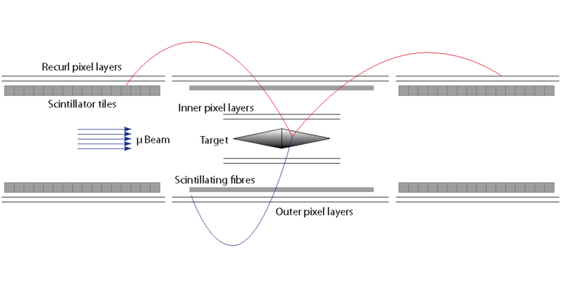
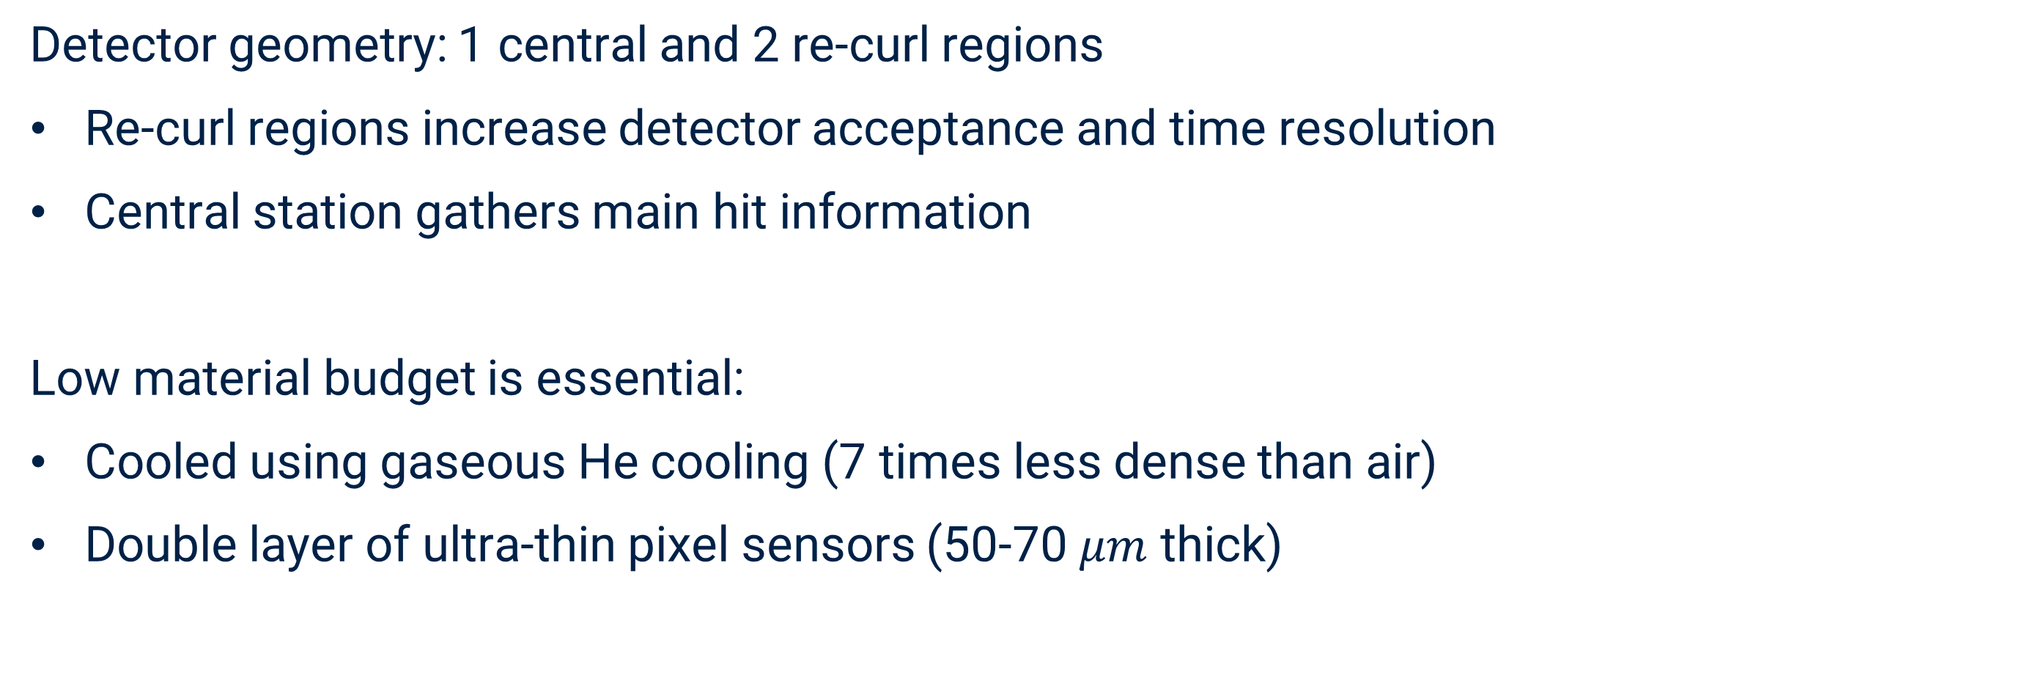
Mu3e pixel detector and cooling
Detector geometry: 1 central and 2 re-curl regions
Re-curl regions increase detector acceptance and time resolution
Central station gathers main hit information
Low material budget is essential:
Cooled using gaseous He cooling (7 times less dense than air)
Double layer of ultra-thin pixel sensors (50-70 $μm$ thick)

Slide 7
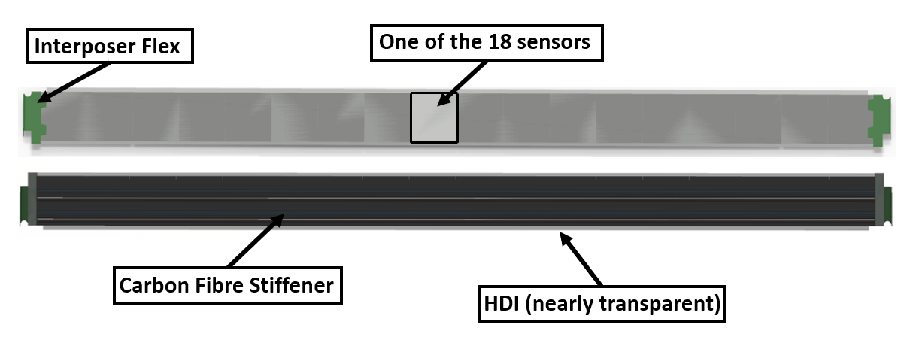
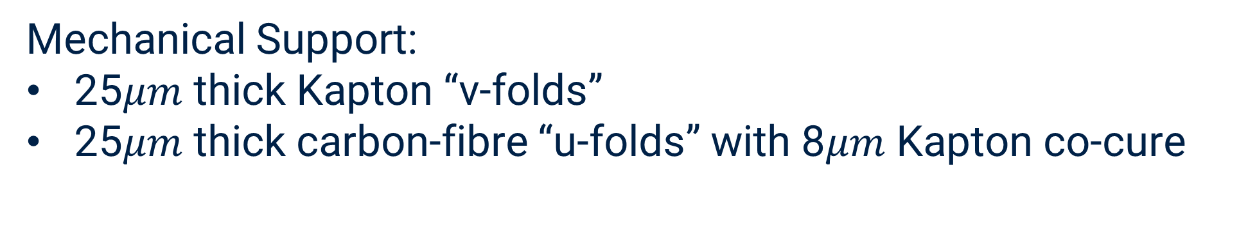
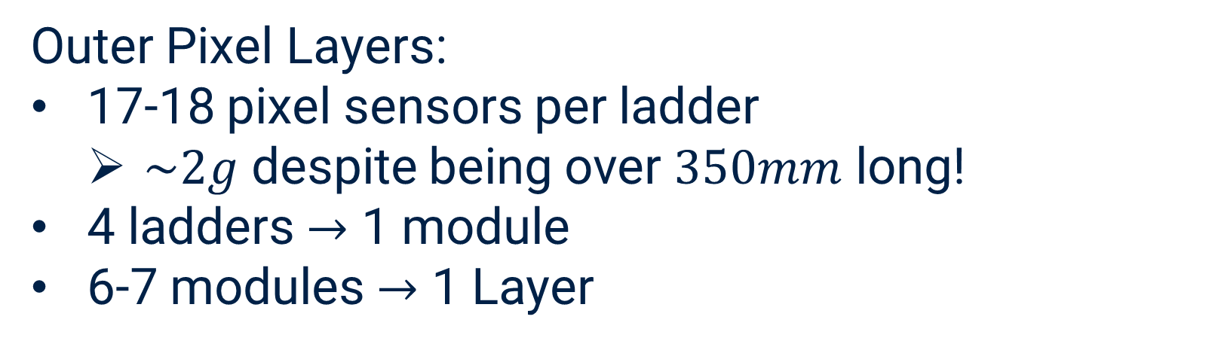
Ultralight silicon detectors
Outer Pixel Layers:
17-18 pixel sensors per ladder
  $\sim 2g$ despite being over $350mm$ long!
4 ladders $→$ 1 module
6-7 modules $→$ 1 Layer
Mechanical Support:
25$μm$ thick Kapton “v-folds”
25$μm$ thick carbon-fibre “u-folds” with 8$μm$ Kapton co-cure

Slide 8
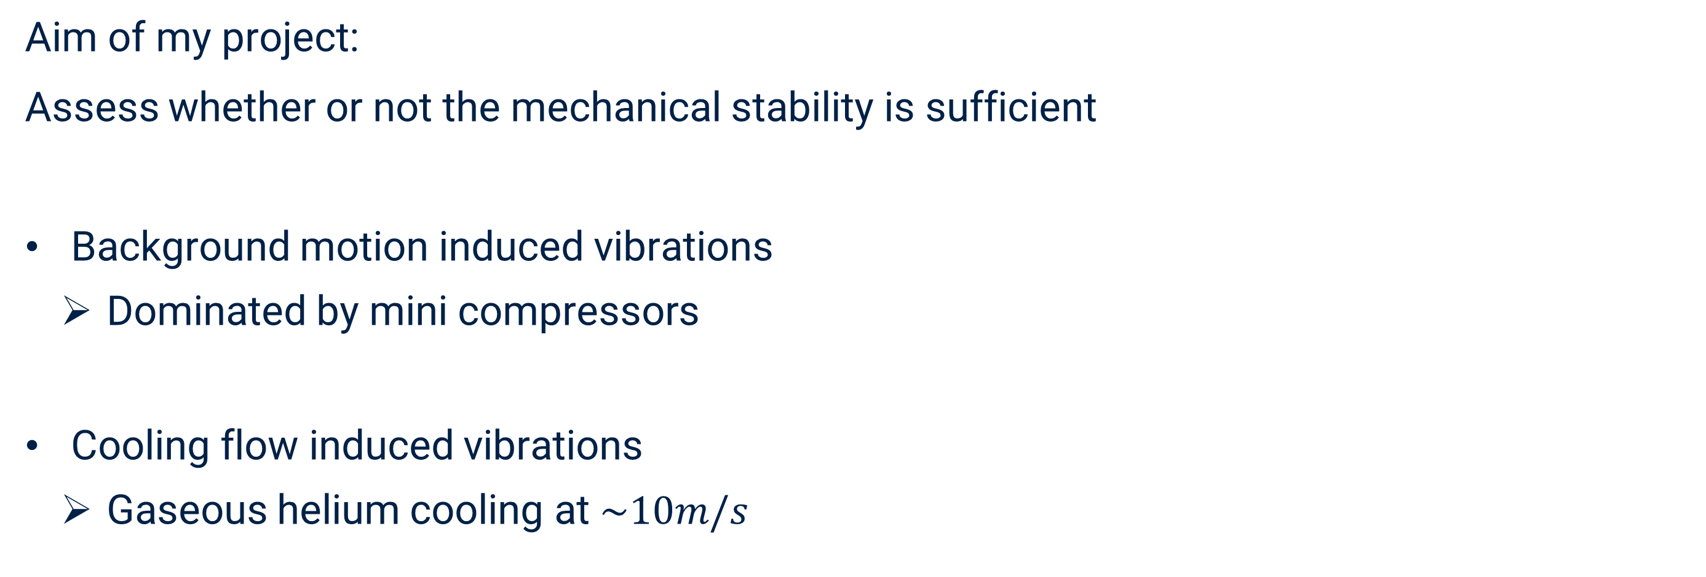
Vibrations of outer pixel ladders
Aim of my project:
Assess whether or not the mechanical stability is sufficient
Background motion induced vibrations
  Dominated by mini compressors
Cooling flow induced vibrations
  Gaseous helium cooling at $\sim 10m/s$

Slide 9
Theoretical interlude

Slide 10

Linear response functions
Linear response function:
$$X\left(ω\right)=H(ω)∙F(ω)$$
Harmonic oscillator:
$$H(ω)= \frac{1}{k}\frac{1}{1−{\left(\frac{ω}{ω_{0}}\right)}^{2}+i\frac{ω}{Qω_{0}}}$$
More complex model at a position $x_{0}$:
$$H\left(ω\right)= \sum_{n}{H_{n}(ω)}$$
$$m\ddot{x}\left(t\right)+2γ\dot{x}\left(t\right)+kx\left(t\right)=F(t)$$
$$\left(−mω^{2}+iω+k\right)X\left(ω\right)=F(ω)$$

Slide 11



Wiener-Khinchin theorem
Theorem (essentially):
$$x_{RMS}^{2}= \frac{1}{\sqrt{2π}}\int_{0}^{∞}{S_{x}(ω)}dω$$
$$"S_{F}\left(ω\right)={\left|F\left(ω\right)\right|}^{2}"$$
$$S_{x}\left(ω\right)={\left|H\left(ω\right)\right|}^{2}∙S_{F}(ω)$$
$$X\left(ω\right)=H(ω)∙F(ω)$$
$$⇒ x_{RMS}^{2}= \frac{1}{\sqrt{2π}}\int_{0}^{∞}{S_{F}(ω)∙{\left|H\left(ω\right)\right|}^{2}}dω$$

Slide 12
Seismic motion induced vibrations

Slide 13
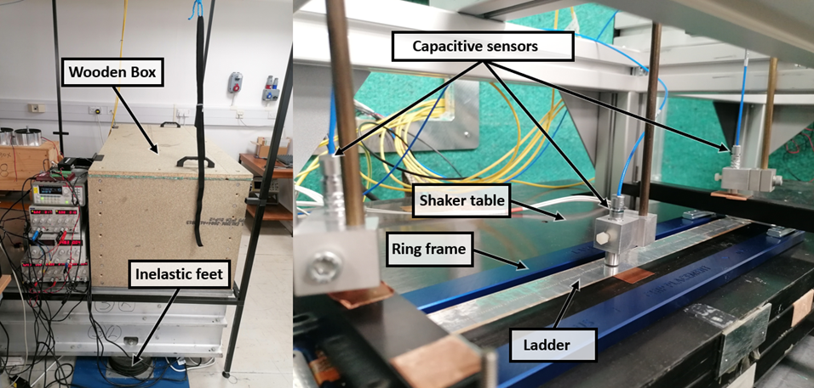
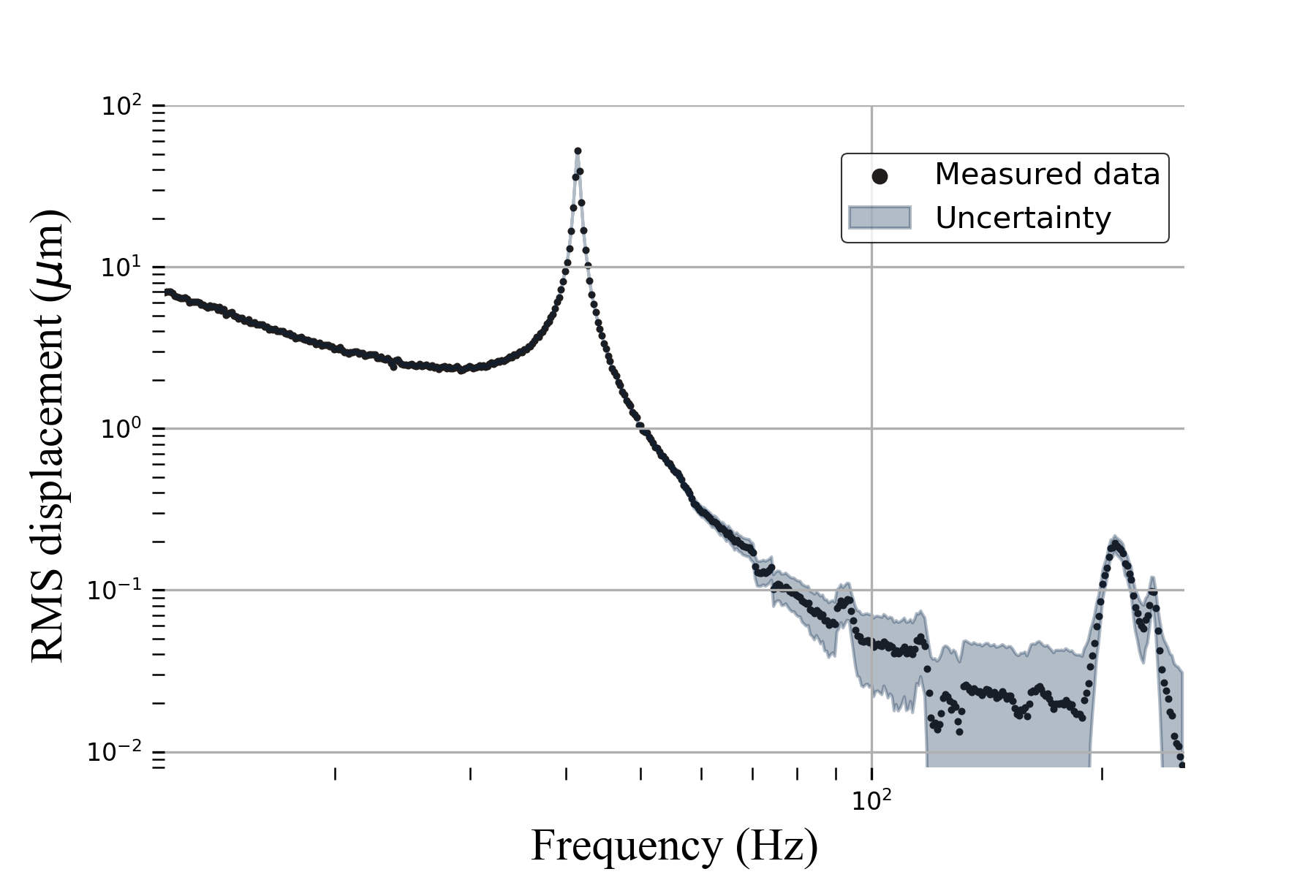
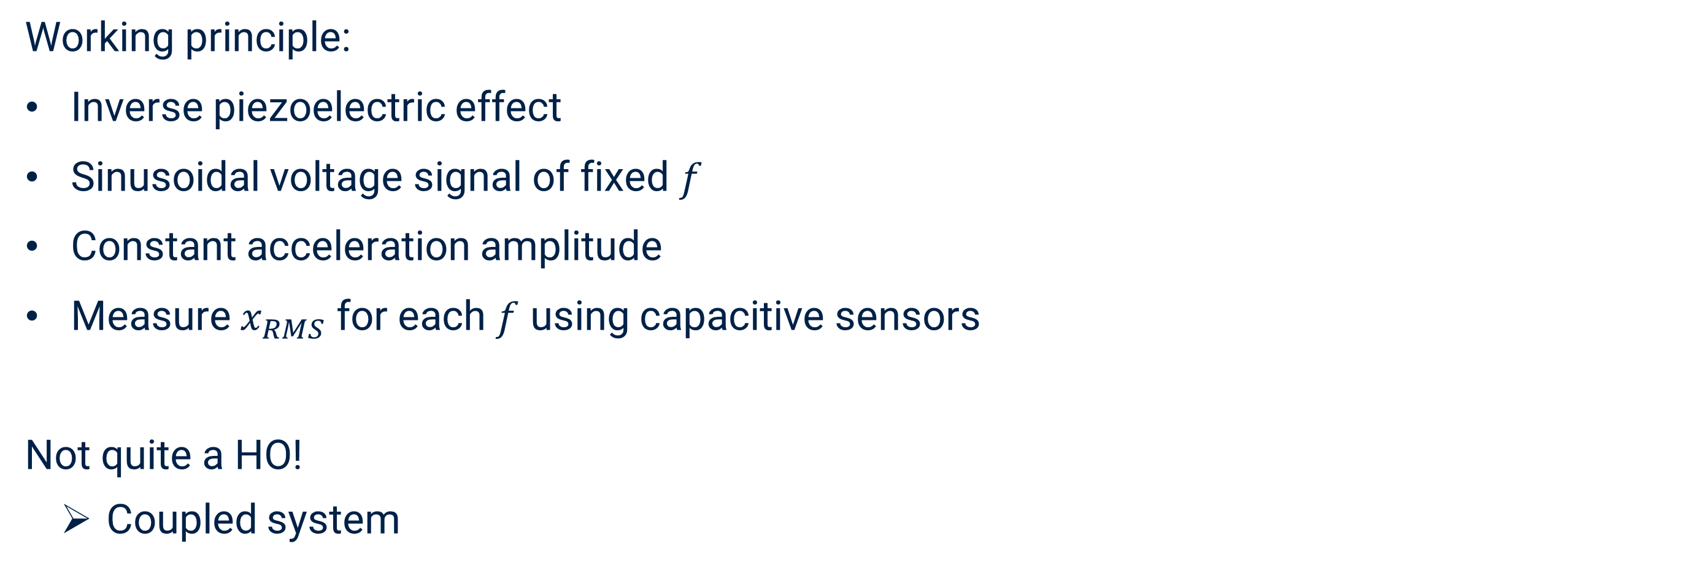
Shaker table
Working principle:
Inverse piezoelectric effect
Sinusoidal voltage signal of fixed $f$
Constant acceleration amplitude
Measure $x_{RMS}$ for each $f$ using capacitive sensors
Not quite a HO!
  Coupled system

Slide 14
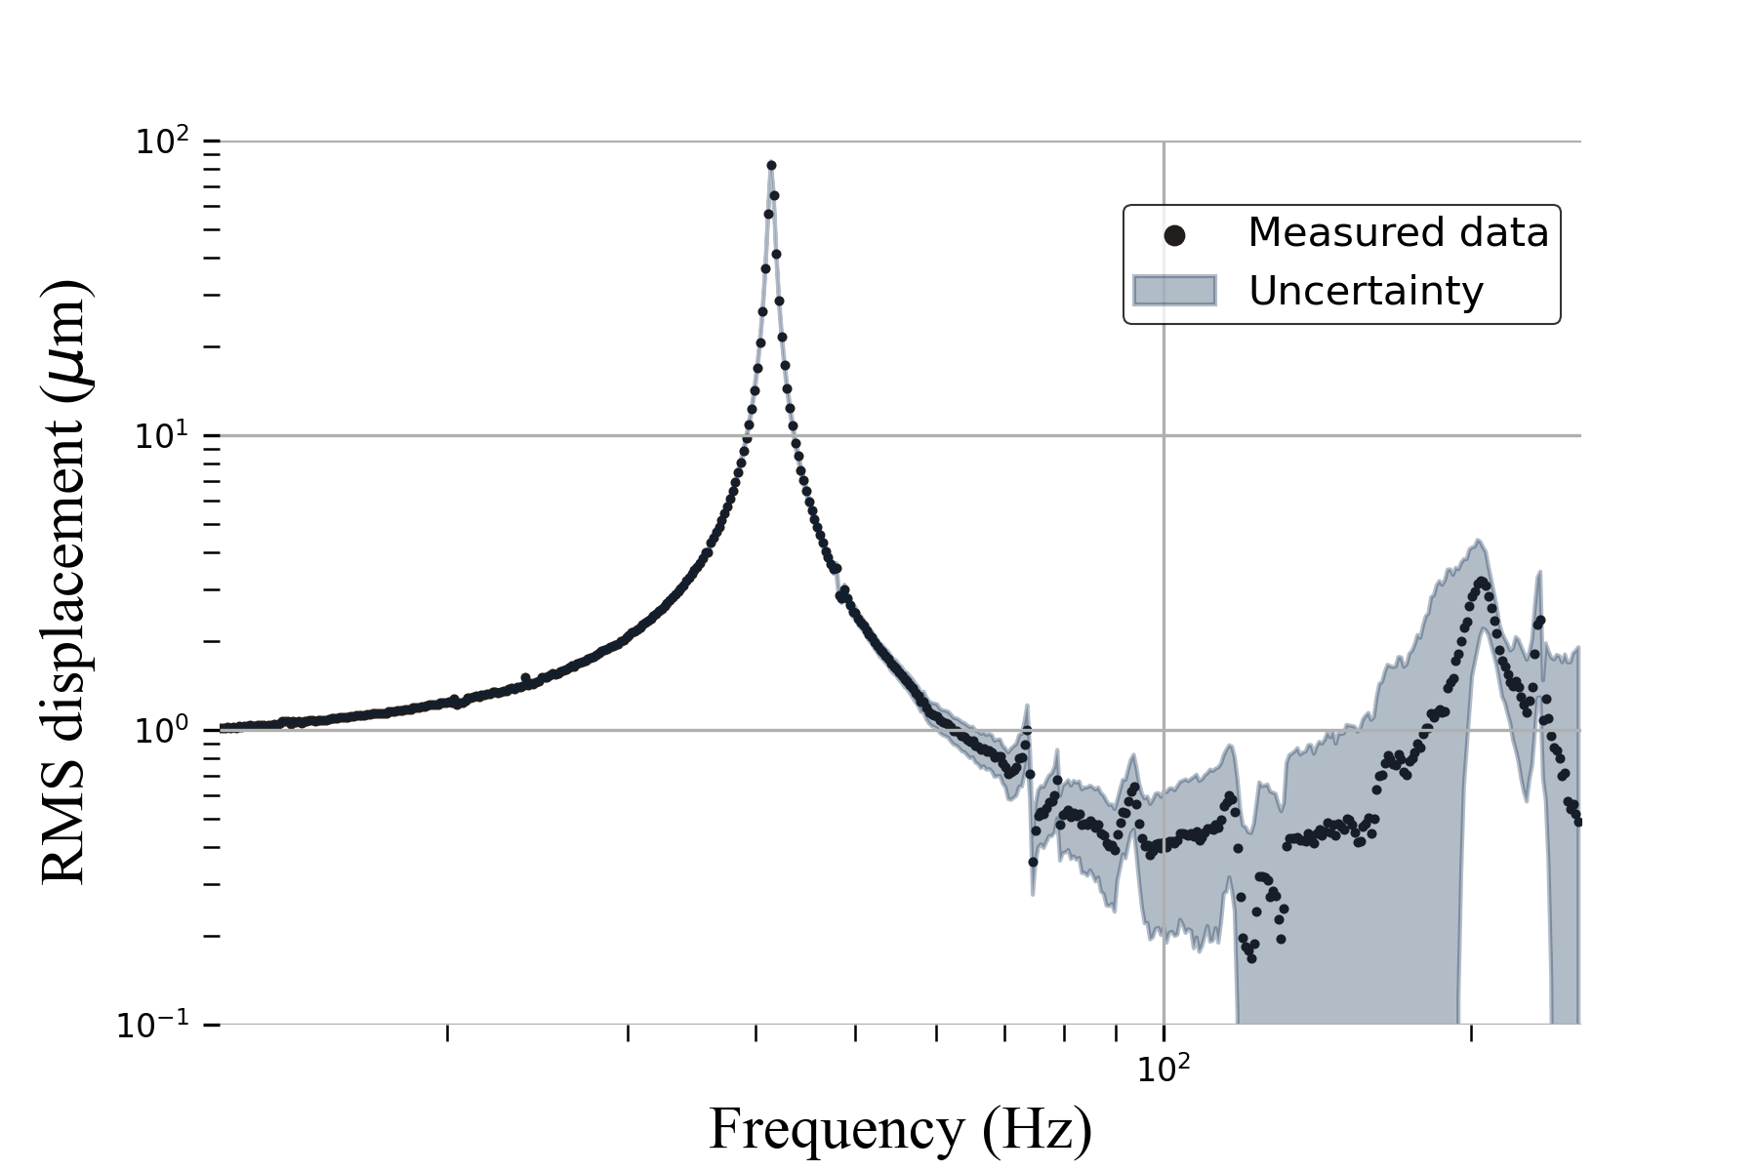
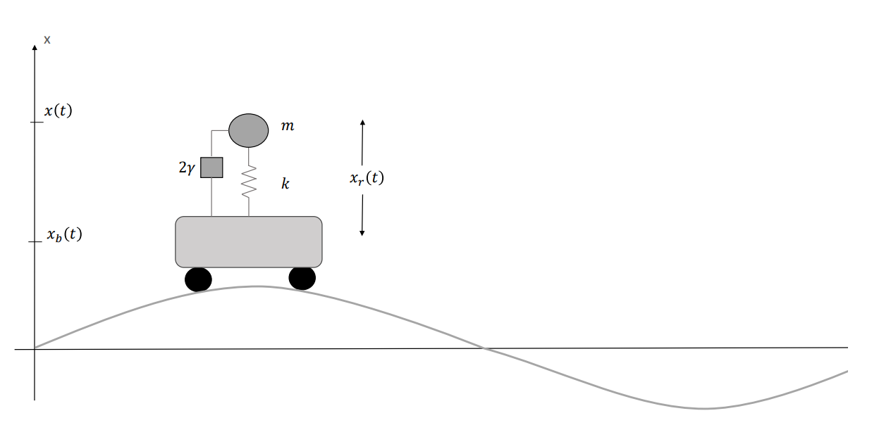
Shaker table
Working principle:
Inverse piezoelectric effect
Sinusoidal voltage signal of fixed $f$
Constant acceleration amplitude
Measure $x_{RMS}$ for each $f$ using capacitive sensors
Not quite a HO!
  Coupled system

Slide 15
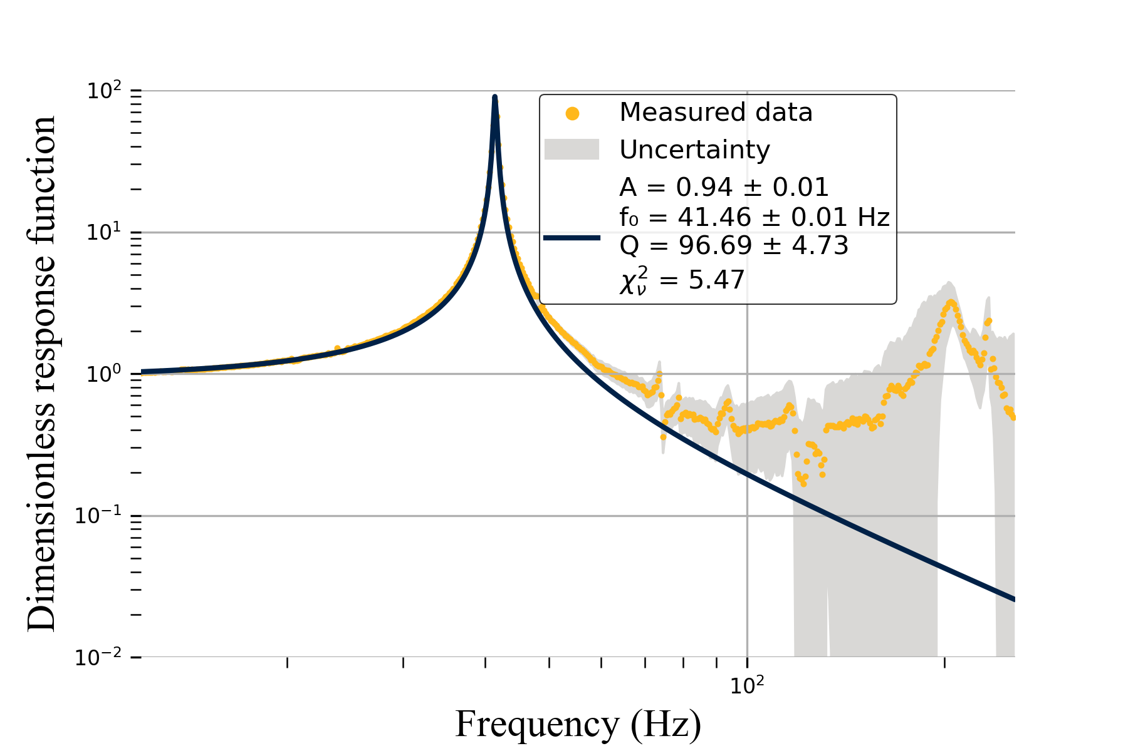
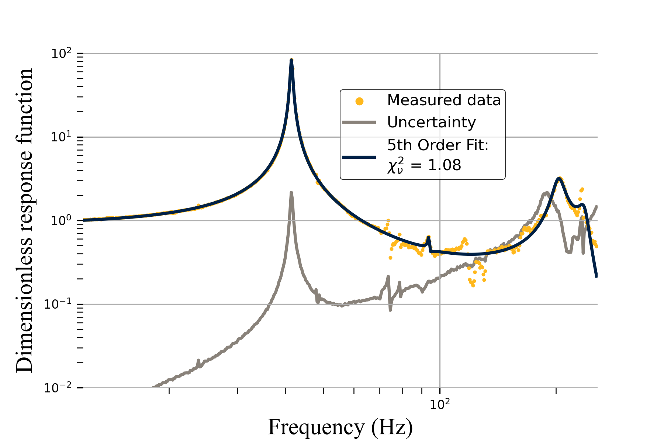
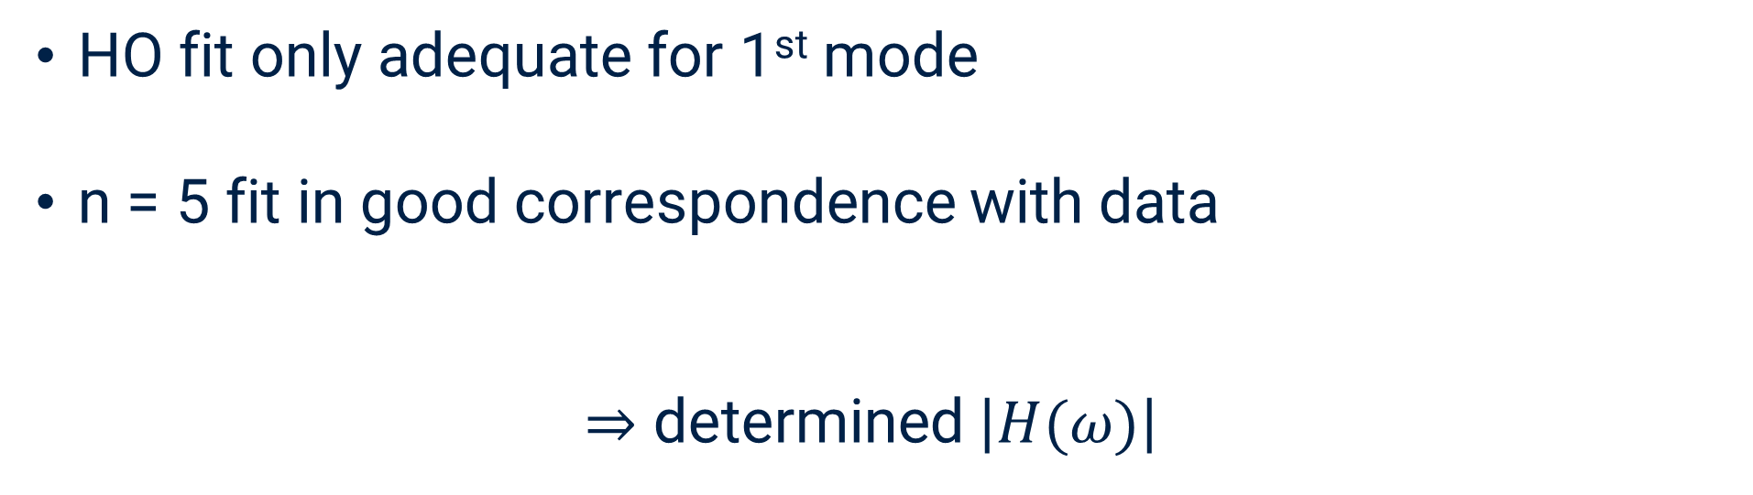
Linear response function
HO fit only adequate for 1st mode
n = 5 fit in good correspondence with data
$⇒$ determined $\left|H(ω)\right|$

Slide 16
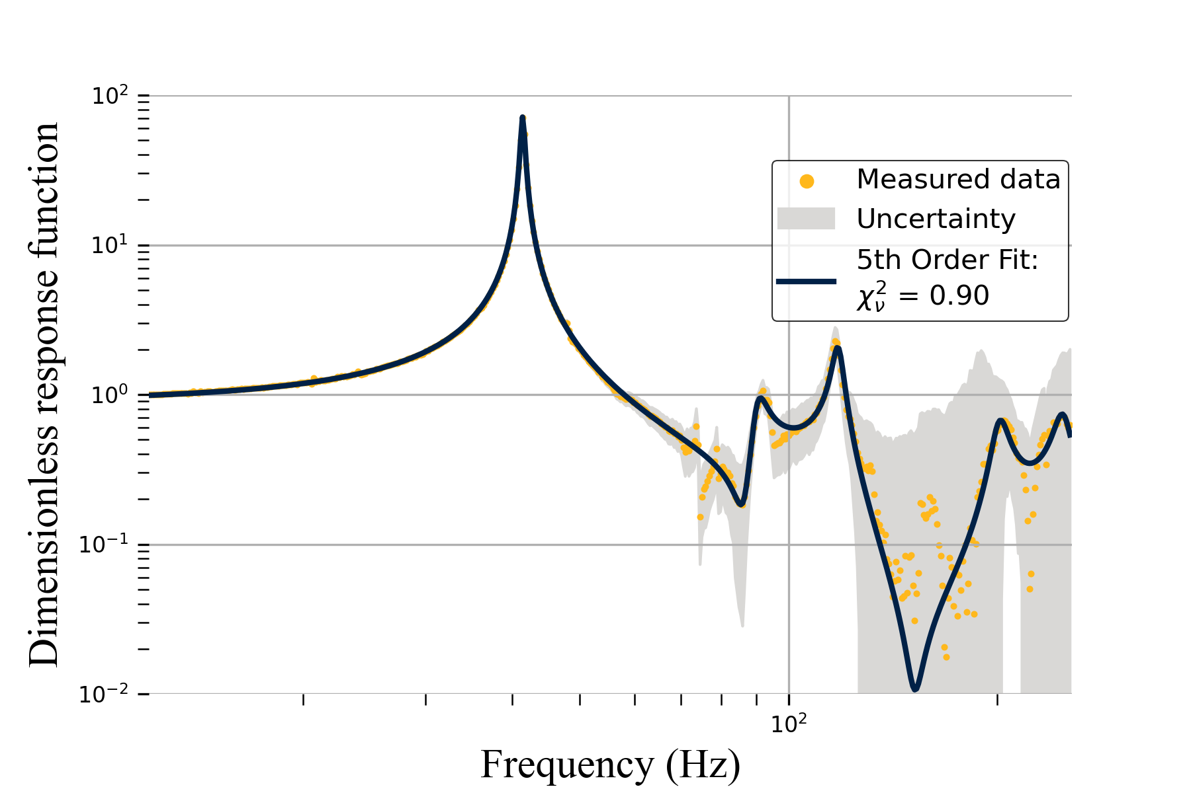
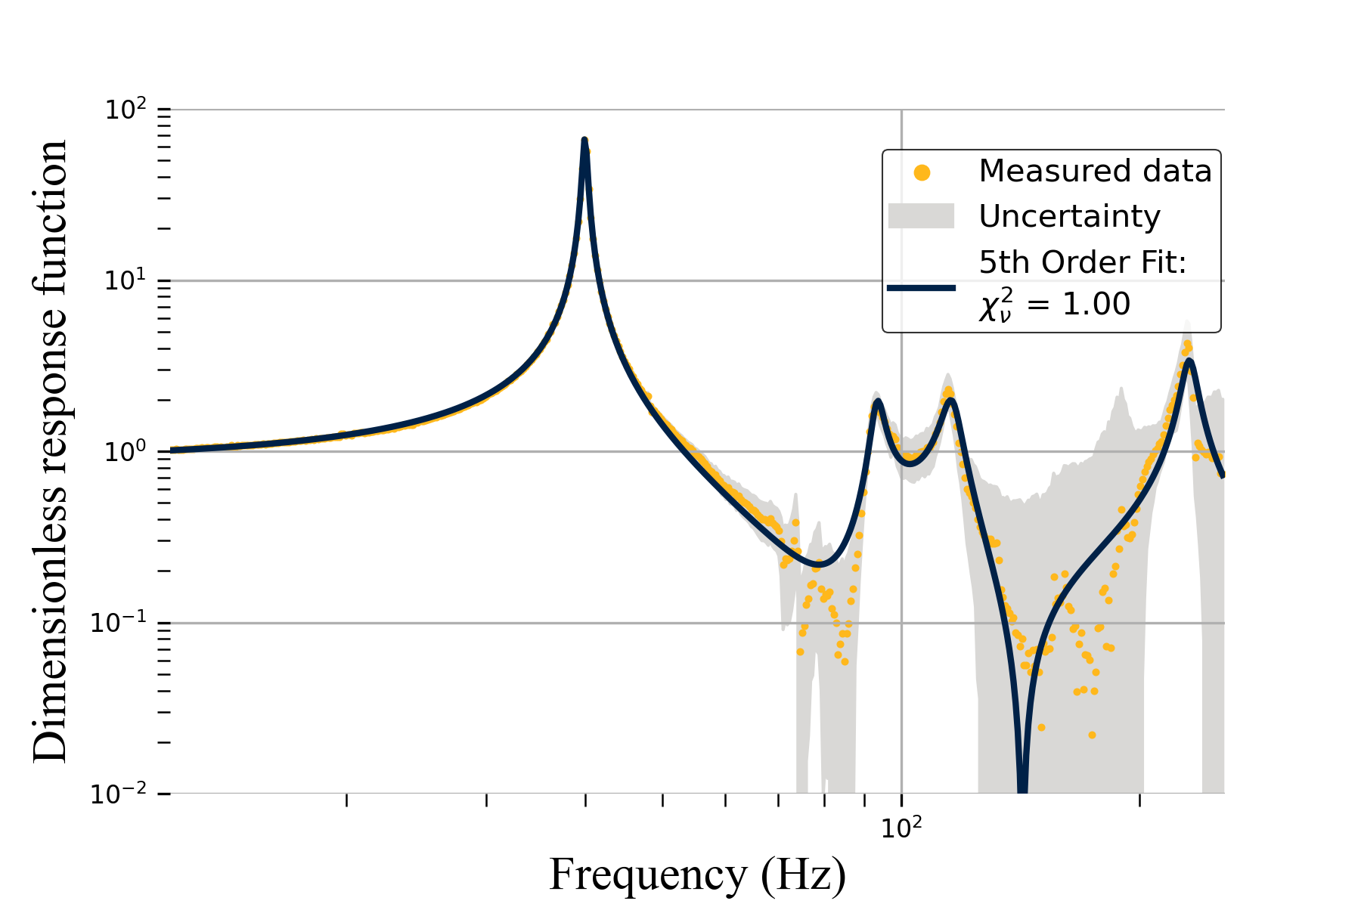
Linear response function
HO fit only adequate for 1st mode
n = 5 fit in good correspondence with data
$⇒$ determined $\left|H(ω)\right|$

Slide 17
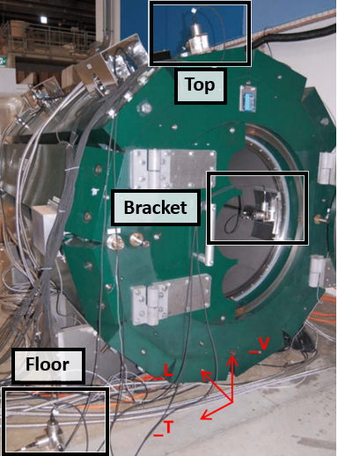

Expected RMS displacement
Background motion has been measured at PSI
  $S_{x}\left(f\right)={\left(2πf\right)}^{−4}S_{a}(f)$
$$⇒ x_{RMS}^{2}= \frac{1}{\sqrt{2π}}\int_{0}^{∞}{S_{x}(ω)∙{\left|H\left(ω\right)\right|}^{2}}dω$$

Slide 18
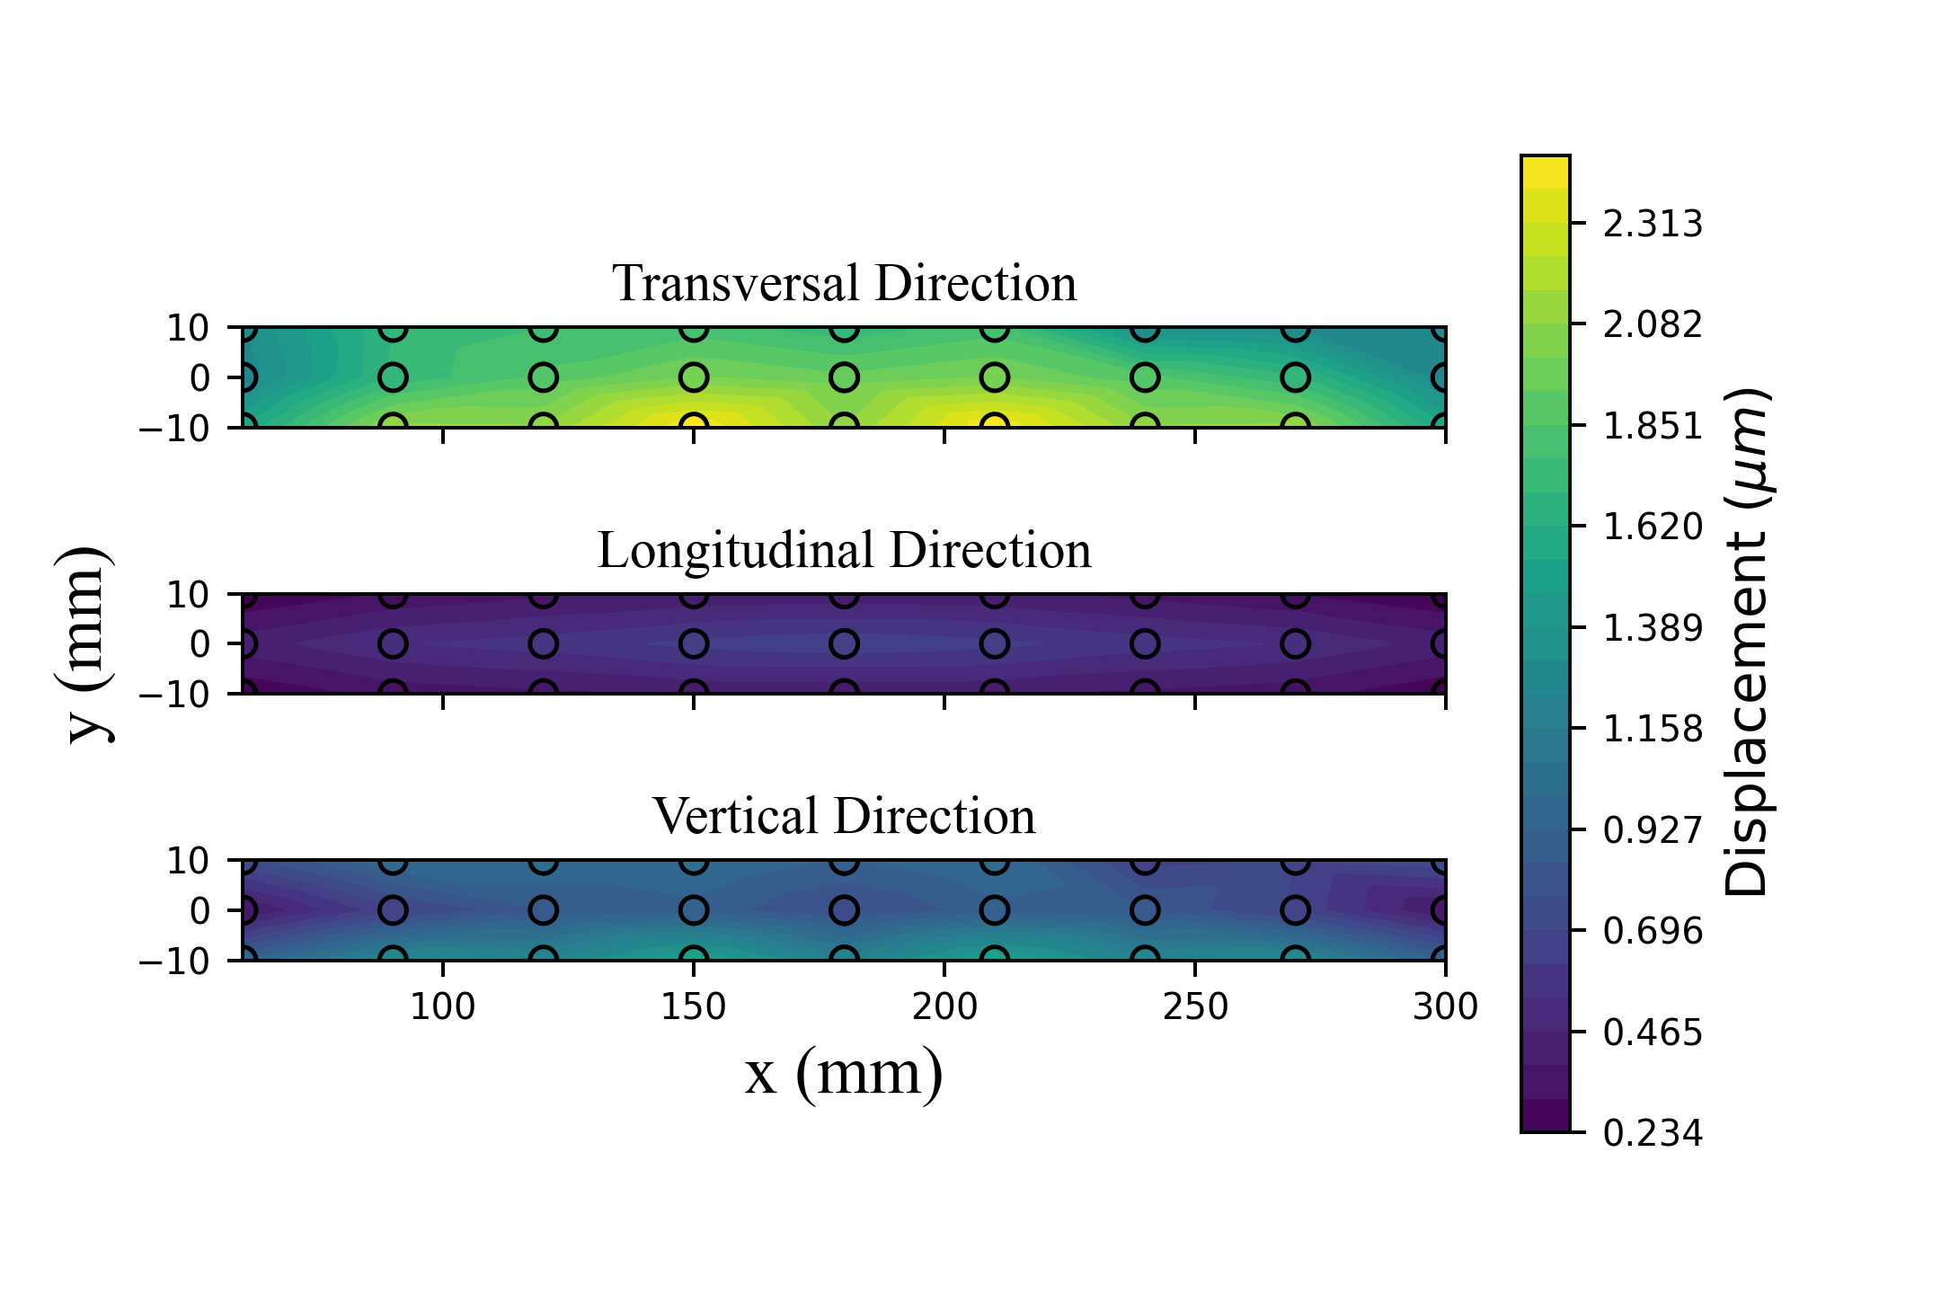
Expected RMS displacement
Hello

Slide 19
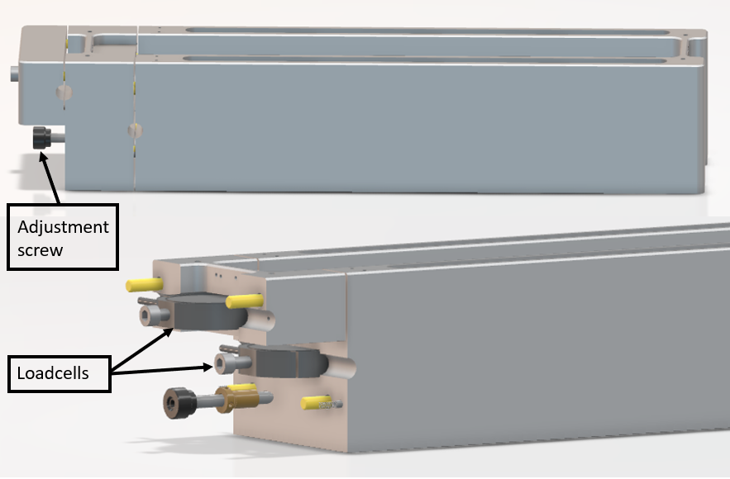
Extendable ring frame
First mode frequency depends on tension
Idea:
Length can be increased
Loadcells measure tension
! Wrong loadcells !

Slide 20
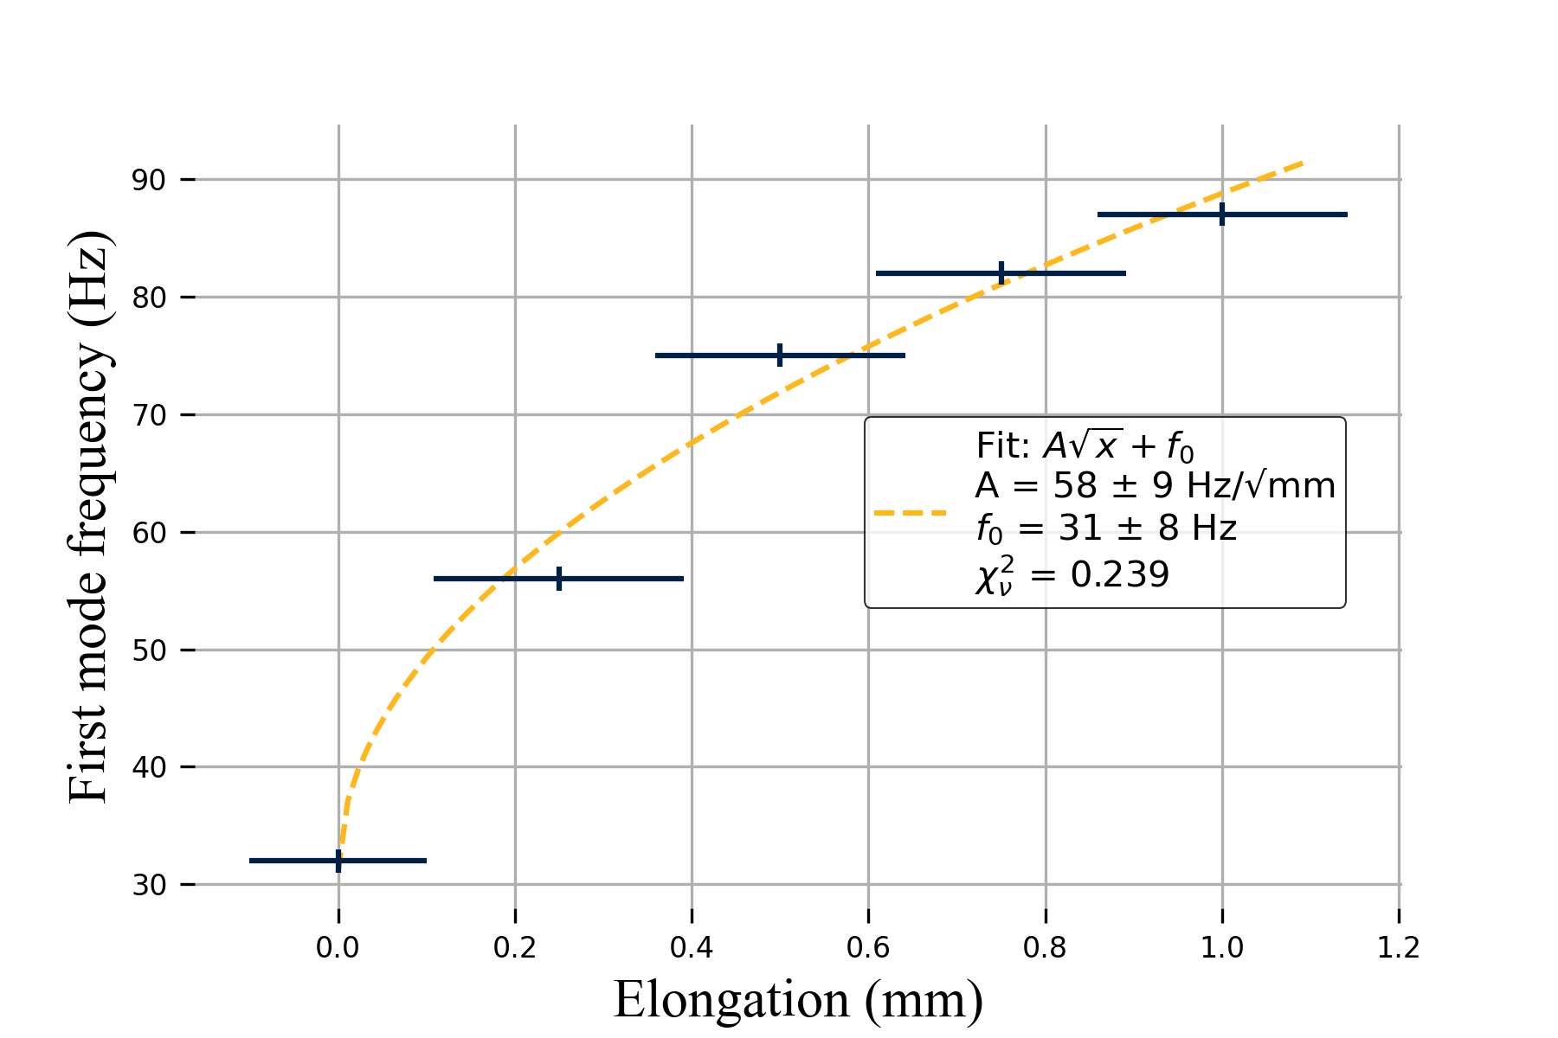
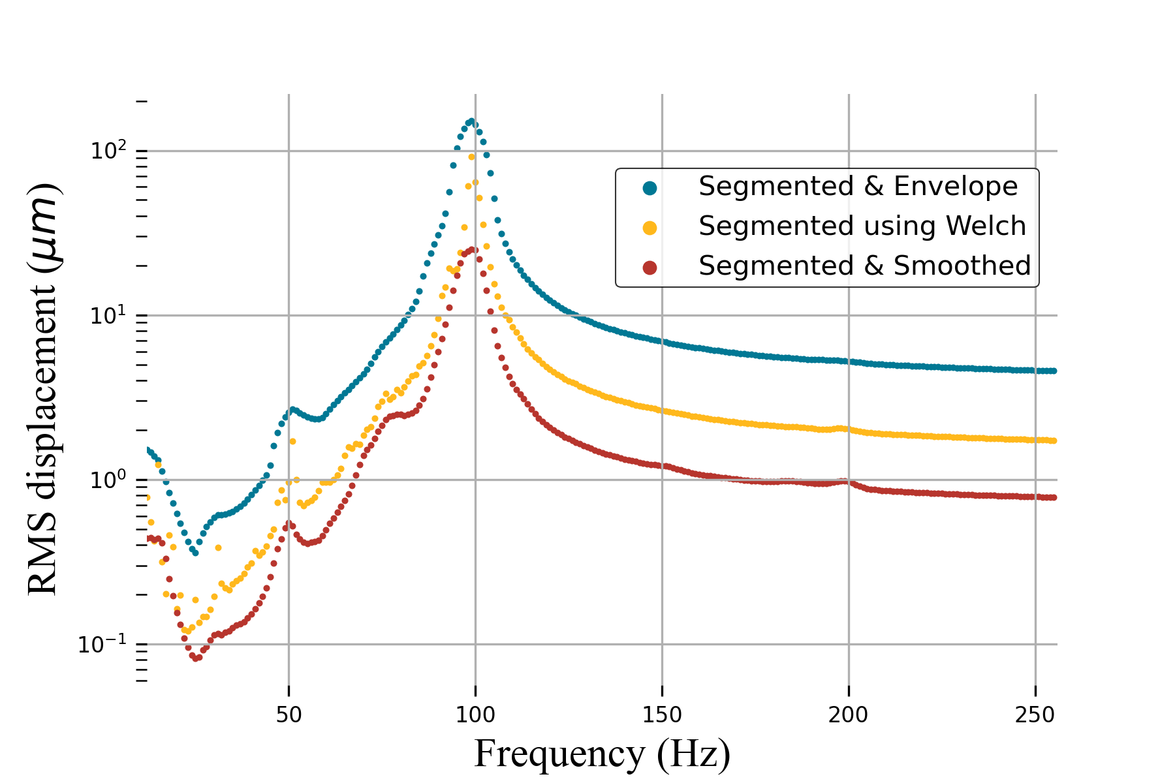
Extendable ring frame
First mode frequency depends on tension
Idea:
Length can be increased
Loadcells measure tension
! Wrong loadcells !

Slide 21
Cooling flow induced vibrations

Slide 22
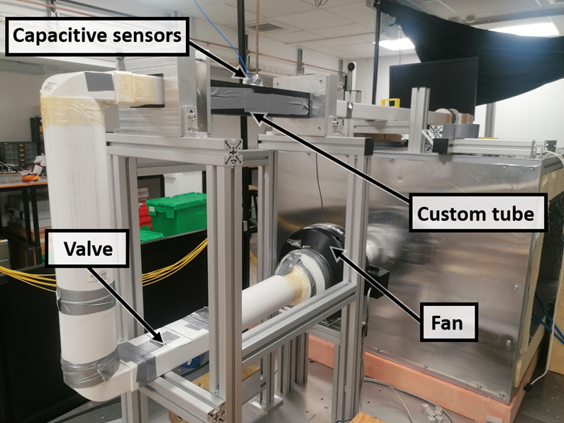
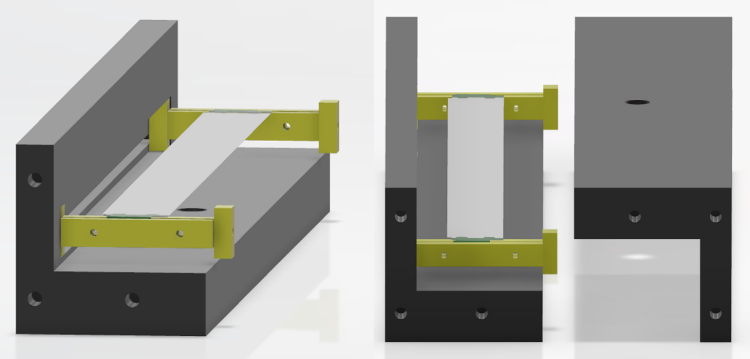
Wind tunnel
Working principle:
Fan pulls air out of the tubing
Custom tube holds ladder
Hot-wire anemometer for flow measurement
Displacement measured using capacitive sensor
Valve used to change flow velocity
Upstream and downstream flow differed!

Slide 23

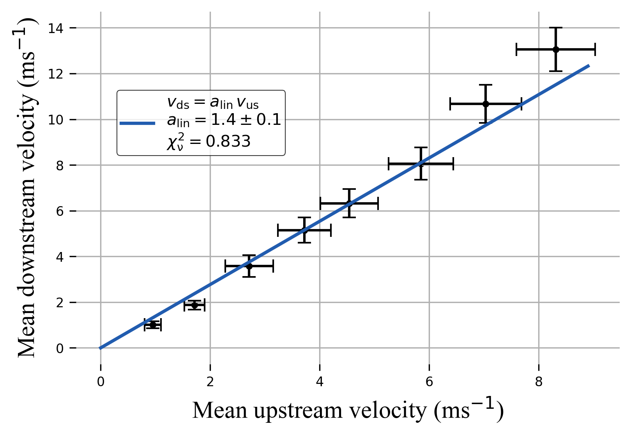
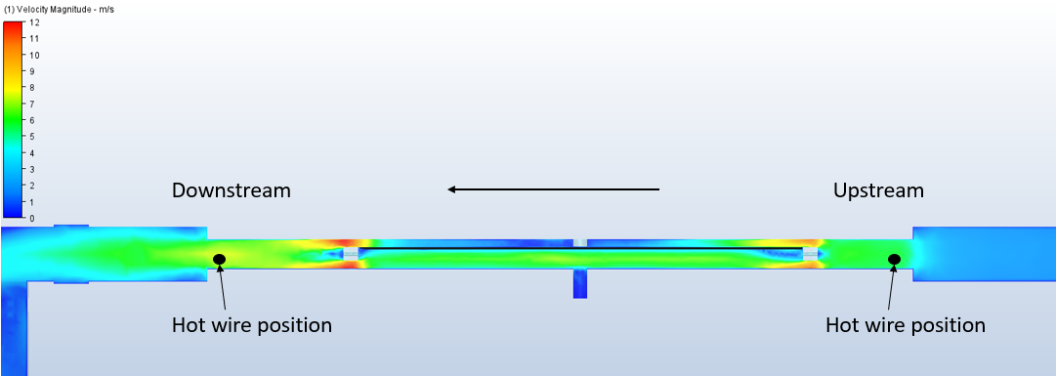
Wind tunnel
Working principle:
Fan pulls air out of the tubing
Custom tube holds ladder
Hot-wire anemometer for flow measurement
Displacement measured using capacitive sensor
Valve used to change flow velocity
Upstream and downstream flow differed!

Slide 24
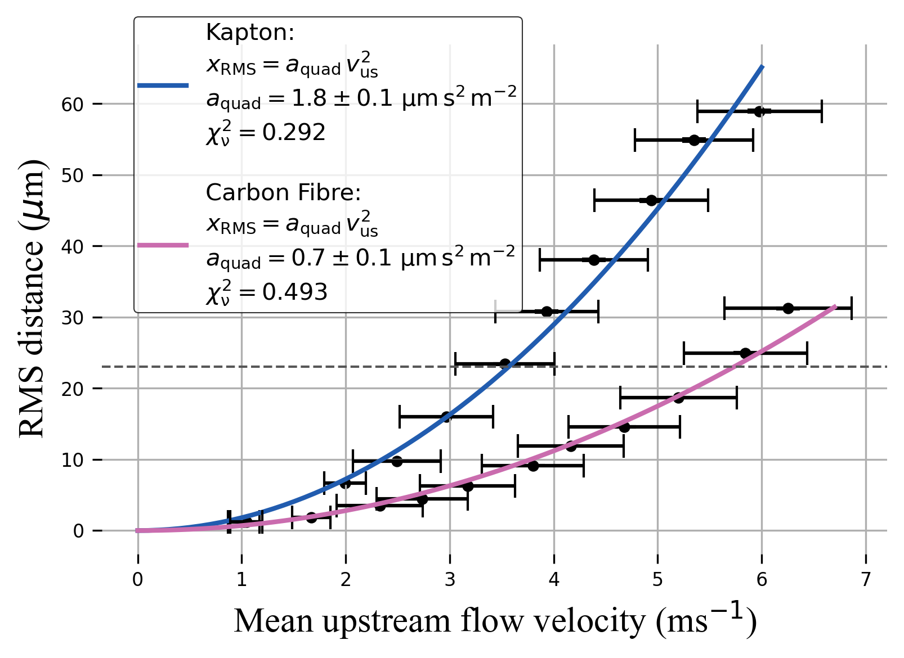
RMS displacement
Kapton ladder performs worse
How does this translate to Helium?
Other ways to compare setups?

Slide 25
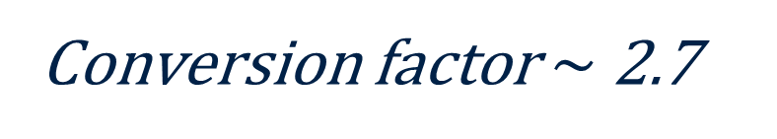
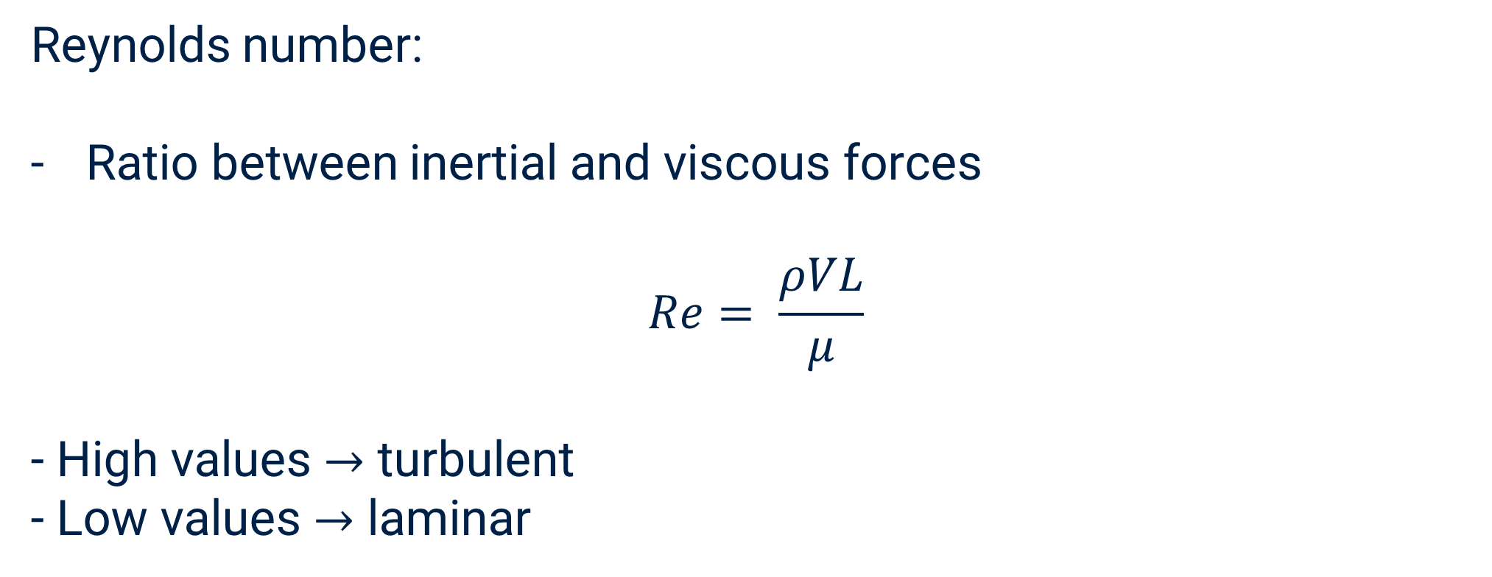

RMS displacement
Wiener-Khinchin again:
$$F_{aero}= \frac{1}{2}ρAv^{2}$$
$$⇒S_{F}={\left(\frac{1}{2}ρA\right)}^{2}S_{v^{2}}$$
$$x_{RMS}^{2}=\int_{0}^{∞}{S_{F}(f)∙{\left|H\left(f\right)\right|}^{2}}df$$
$$⇒x_{RMS}∝ρ$$
Reynolds number:
Ratio between inertial and viscous forces
$$Re= \frac{ρVL}{μ}$$
- High values $→$ turbulent
- Low values $→$ laminar
Kapton ladder performs worse
How does this translate to Helium?
Other ways to compare setups?
Conversion factor $\sim$ 2.7

Slide 26
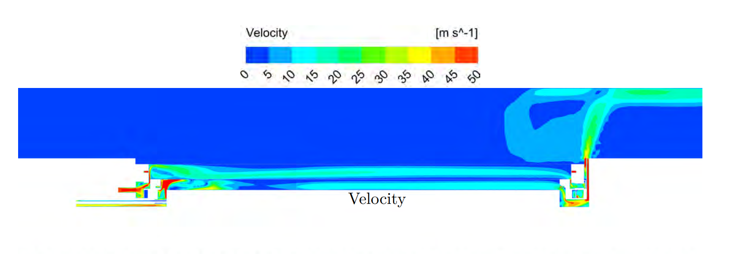
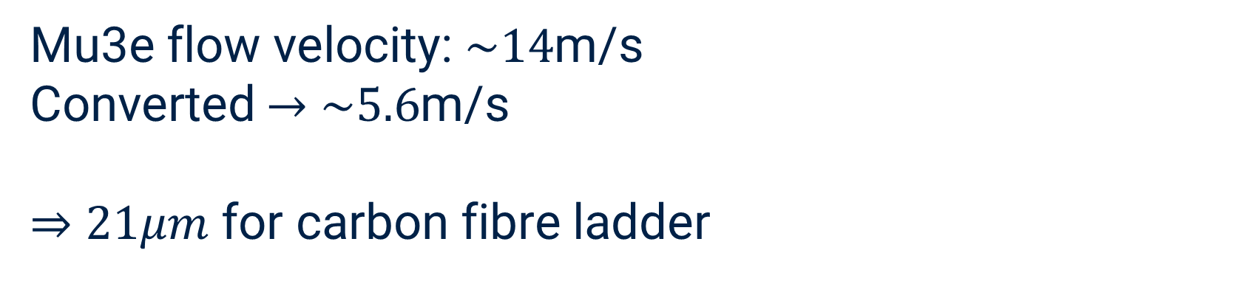
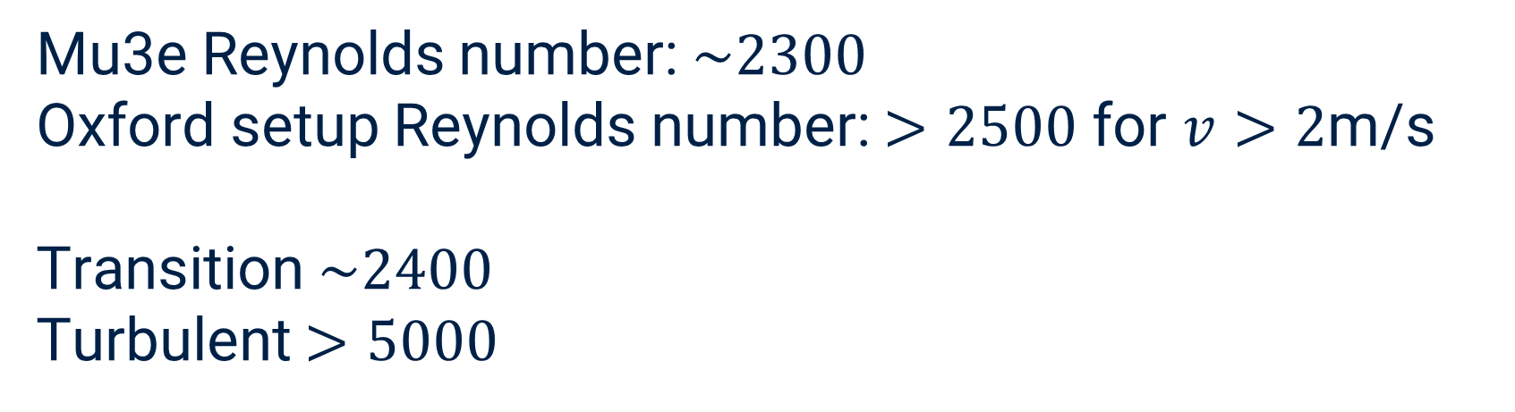
CFD comparison
Mu3e flow velocity: $\sim 14$m/s
Converted $→$ $\sim 5.6$m/s
$⇒$ $21μm$ for carbon fibre ladder
Mu3e Reynolds number: $\sim 2300$
Oxford setup Reynolds number: $>2500$ for $v>2$m/s
Transition $\sim 2400$
Turbulent $>5000$
Different regimes!

Slide 27

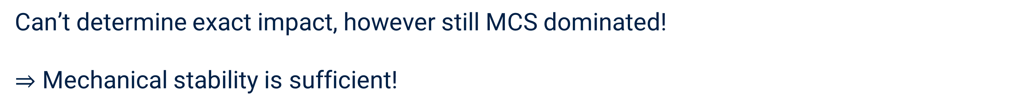
Conclusion
Intrinsic pixel resolution: $23μm$
Cooling flow induced vib: $21μm$
Background motion induced vib: $3μm$
$σ$ increases to $31μm$ (worst case)
Can’t determine exact impact, however still MCS dominated!
$⇒$ Mechanical stability is sufficient!

Slide 28
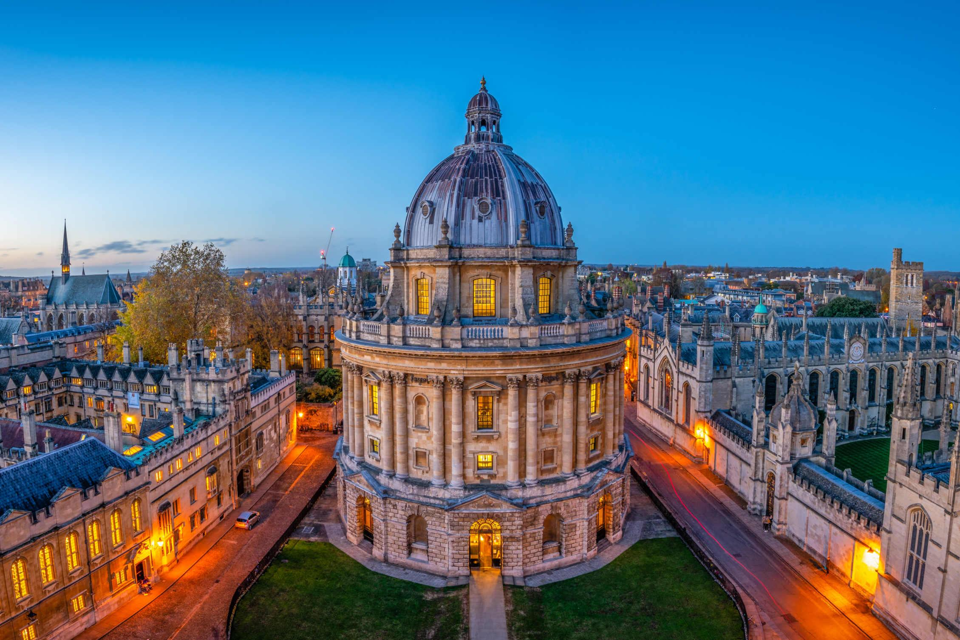
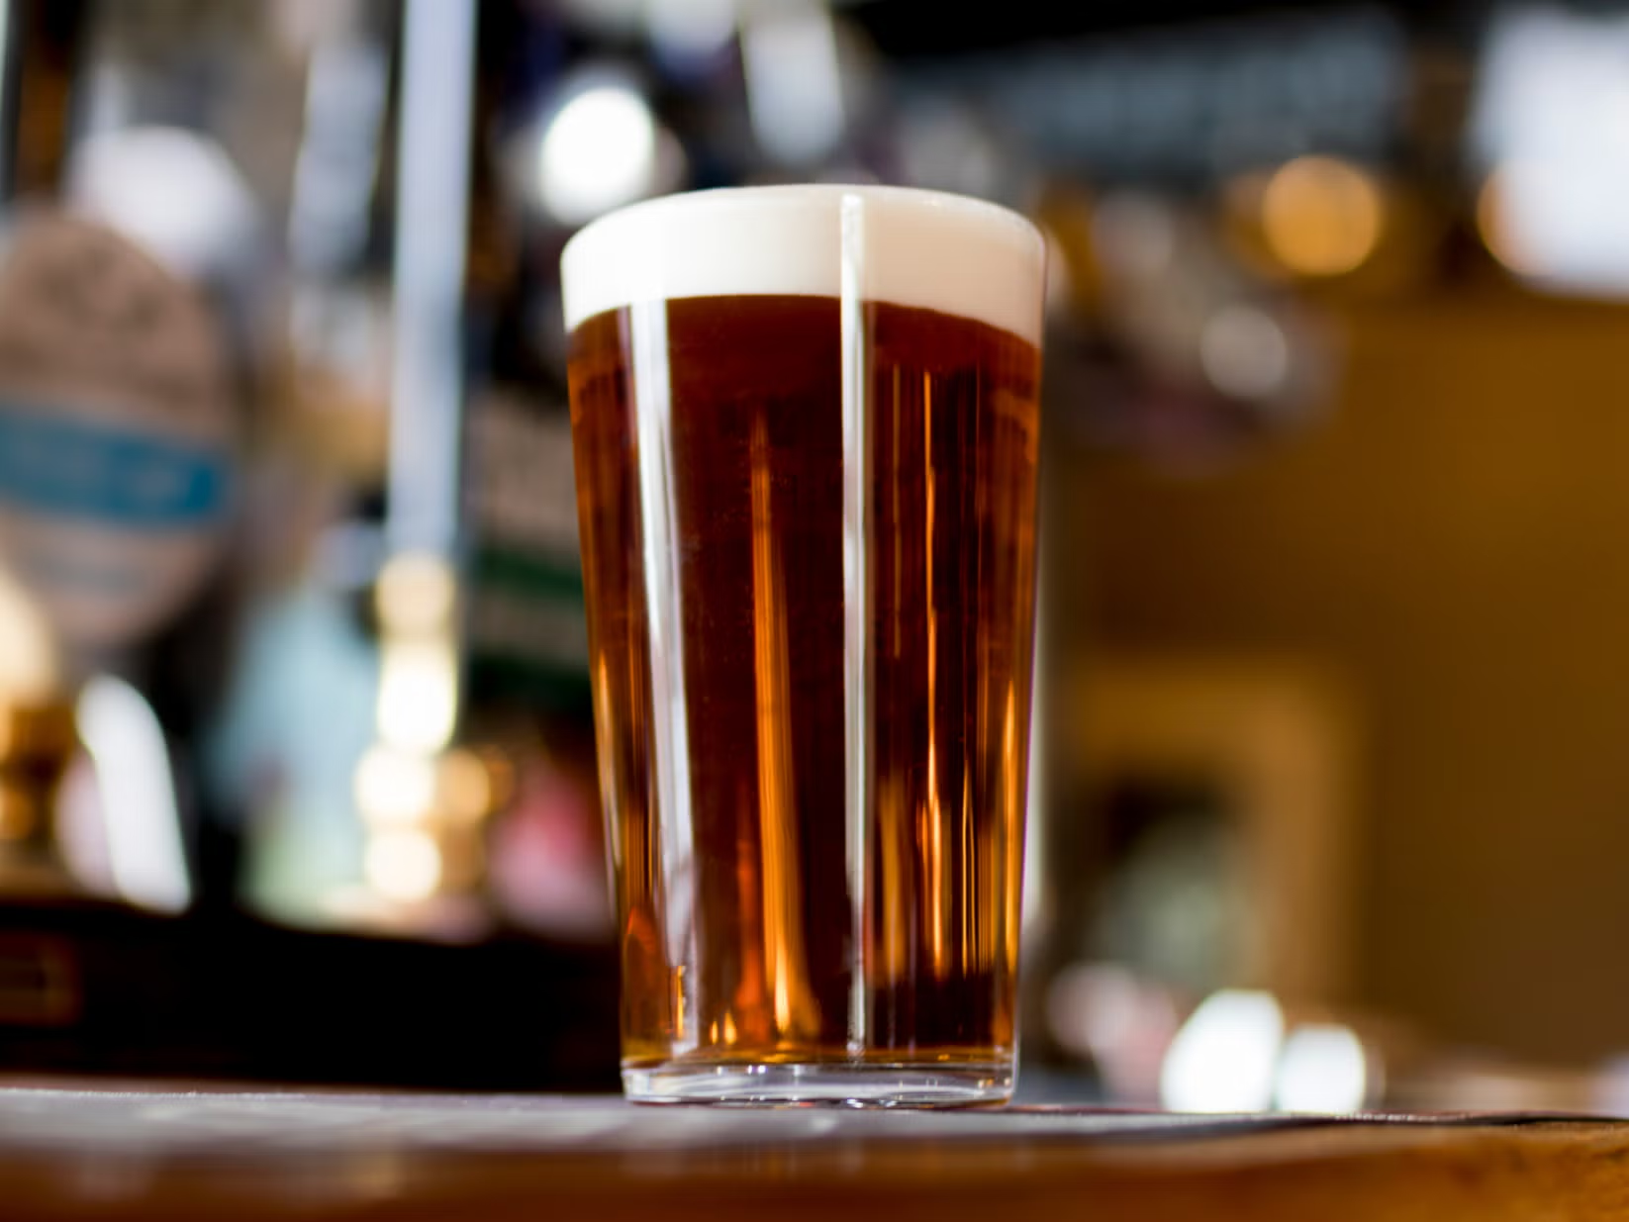
Thank you very much!
Fancy a pint?

