Slide 1



ECFA & Opportunities to Work at CERN
Haroon Rafique
ISIS Accelerator Physics Group, Plenary ECFA (UK), Visiting Scientist CERN BE-ABP
UK – CERN Accelerator Celebration Day
27 November 2025

Slide 2
Contents
UK CERN Accelerator Collaboration
More than the LHC: Impact on society
ECFA
ESPPU & UK Input
CERN Opportunities

Slide 3
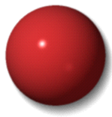













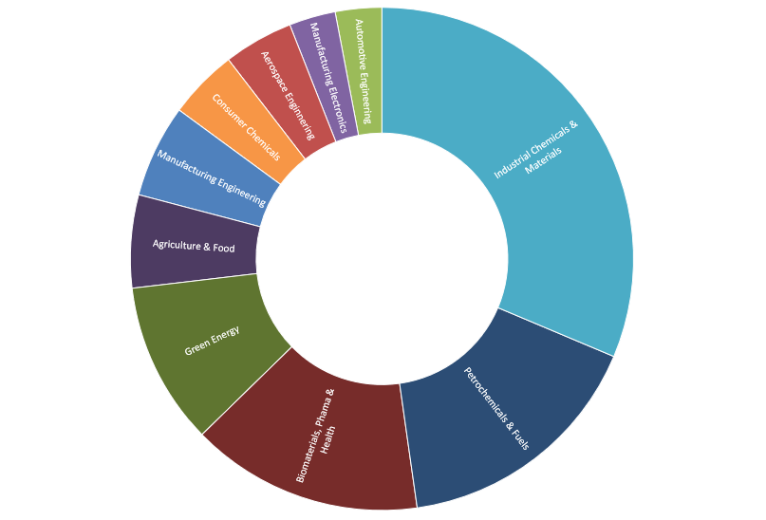
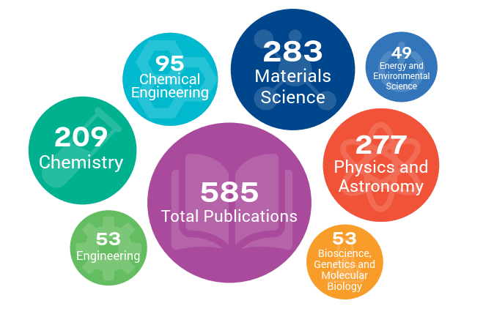
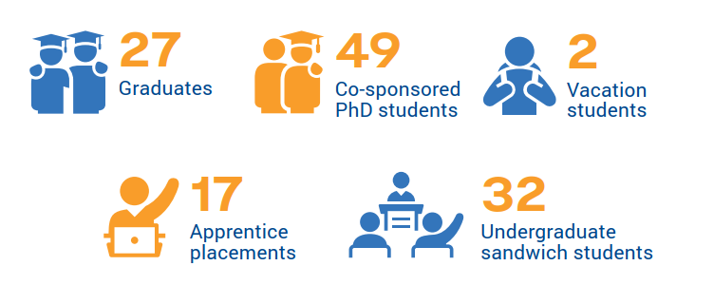
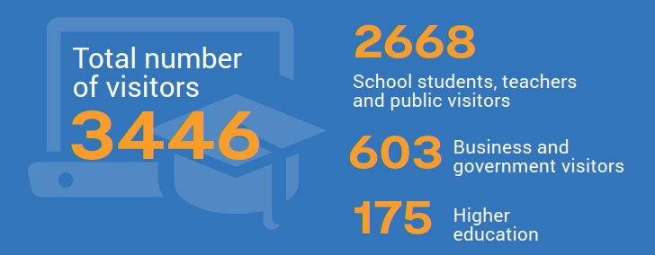
ISIS Neutron and Muon Source
diffraction
Neutron diffraction experiments determine the atomic and/or magnetic structure of a material
H
Li
Li
C
O
O
S
S
Mn
Mn
Zr
Zr
Cs
Cs
spectroscopy
Neutron spectroscopy measures the atomic and magnetic motions of atoms
NEUTRON
X
imaging
Radiography and tomography to a unique view of materials
X
-
-
rays
rays
reflectometry
Neutron reflectometry is a technique for measuring the structure of thin films and interfaces
neutrons
neutrons
small angle
Small angle neutron scattering is able to probe structures at length scales from around 1 nm to more than 100 nm
3
Notes:
The UK’s neutron and muon source is a successful user facility similar to CERN, operating for 40 years and continuing to deliver benefit to society.

Slide 4
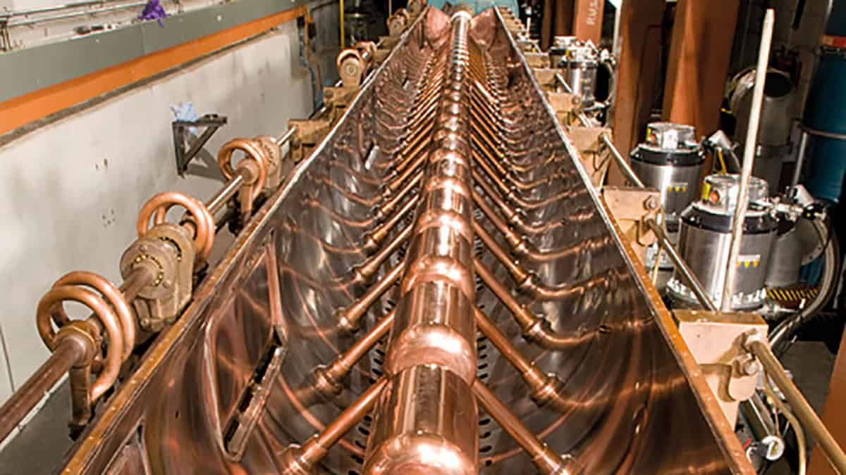
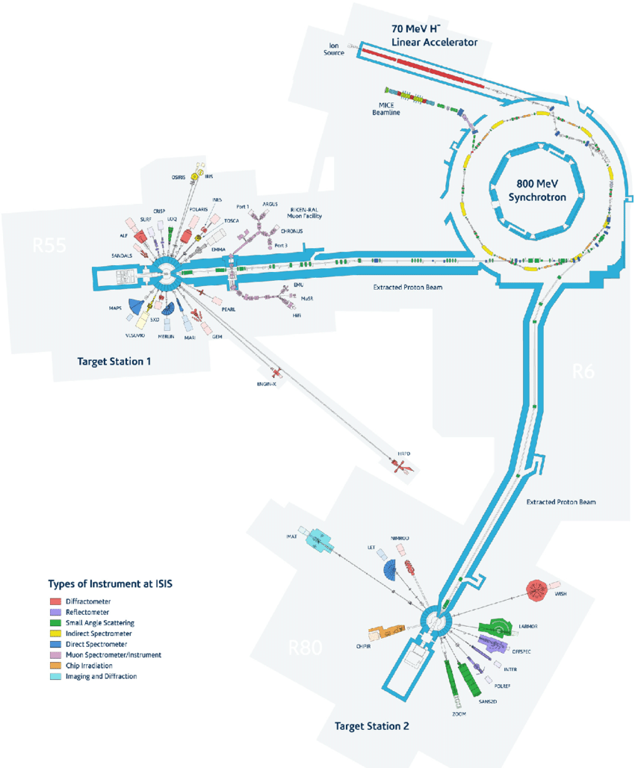
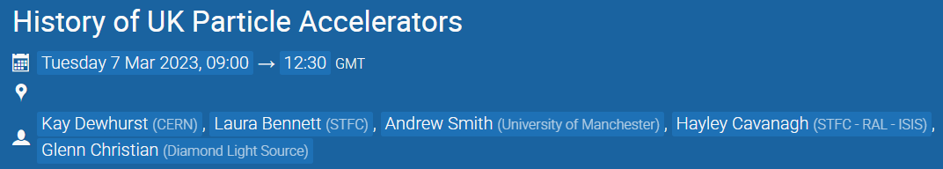

UK CERN Accelerator Collaboration
“The CERN Linac 1 was originally designed in the early 1950's, based on a similar accelerator built for AERE, Harwell in England” [reference]
At AERE Harwell in the 1950s, the UK designed one of the earliest Alvarez-type proton linacs, the Proton Linear Accelerator (PLA) with external engineering studies by the Metropolitan-Vickers Electrical Company (Manchester).
CERN historical material notes that in 1954, engineer Peter Standley was appointed “linkman between CERN and the company (Metropolitan Vickers)” when he joined the Linac Group – essentially a formal interface between CERN and Metro-Vick at the time Linac 1 was being realised.
PLA tanks 2 and 3 (30 MeV and 50 MeV) were later reused at the Rutherford/NIMROD injector, and then again in the ISIS 70 MeV linac – they are still in use.
ISIS Accelerators and Instruments
Notes:
ISIS is situated at the Rutherford Appleton Laboratory, or RAL, which is at Harwell. RAL evolved out of the scientific and technical ecosystem established at AERE Harwell.
CERN Linac 1 (fed 50 MeV protons into the PS) was designed based on a similar accelerator – the PLA.
PLA was developed with Manchester based firm Metropolitan-Vickers, which later worked closely with CERN to develop Linac 1.
PLA tanks 2 and 3 are still in use at ISIS – named for the Egyptian goddess of resurrection because of the repurposing of such technology.

Slide 5
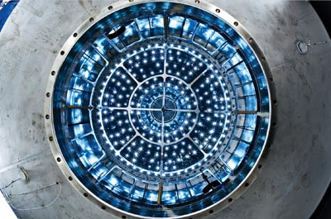
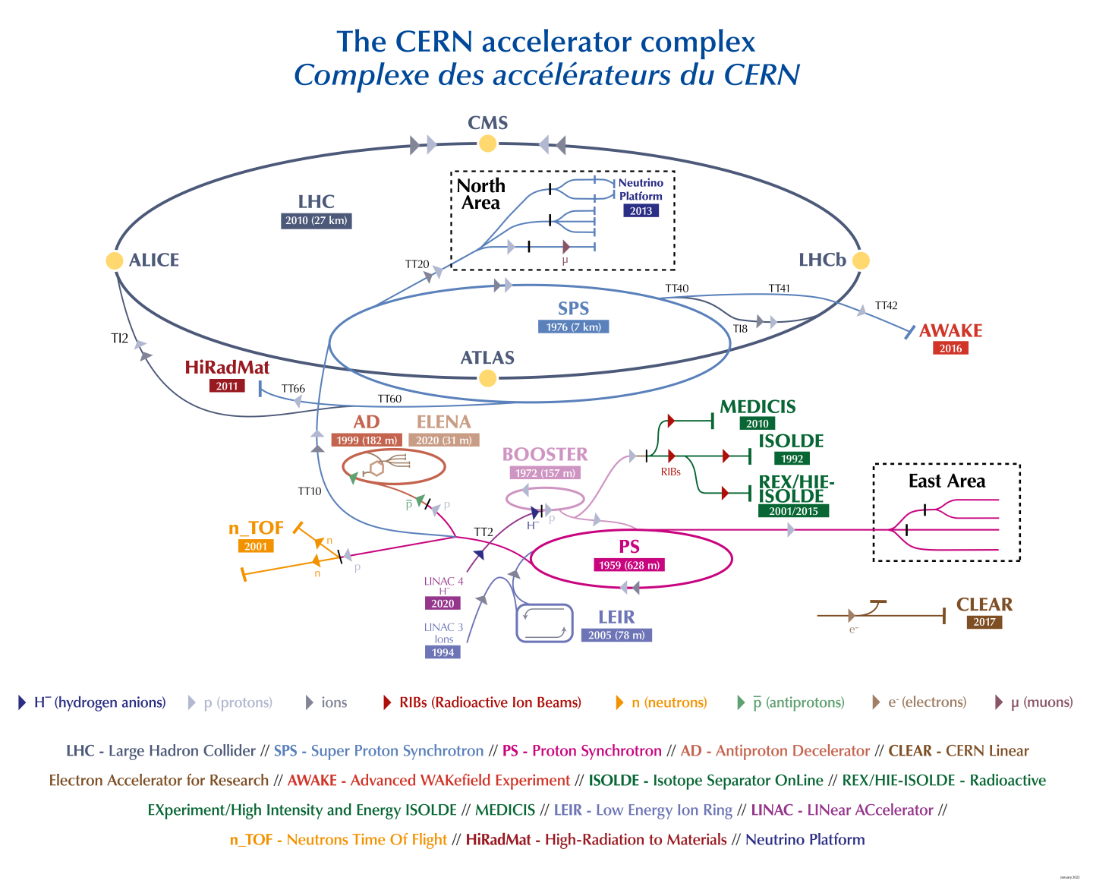
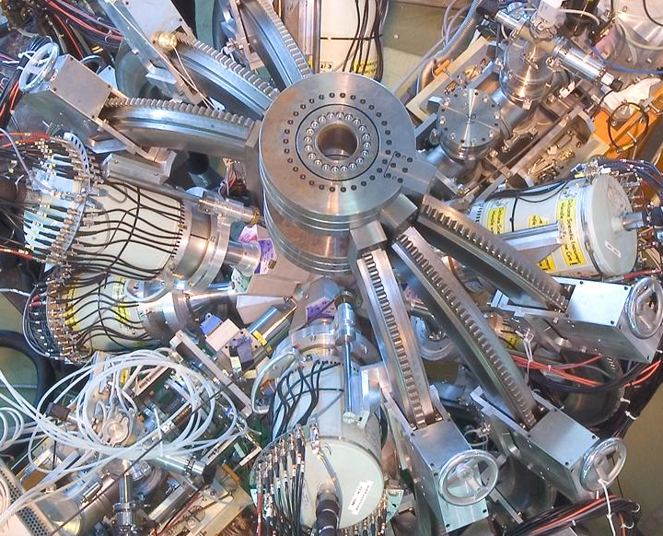

More than the LHC
MEDICIS
AWAKE
Antiproton Decelerator
Fixed Target Experiments
CLOUD
ISOLDE
Alpha Magnetic Spectrometer onboard the ISS
Notes:
Going back to the CERN accelerator complex we see that the proton injection chain now begins at Linac 4, you may find remnants of Linac 1 (or perhaps 2) in the Science Gateway.
CERN is more than the LHC…

Slide 6
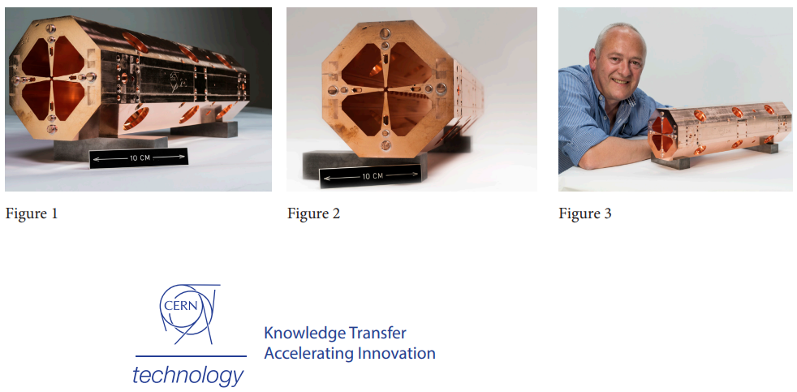
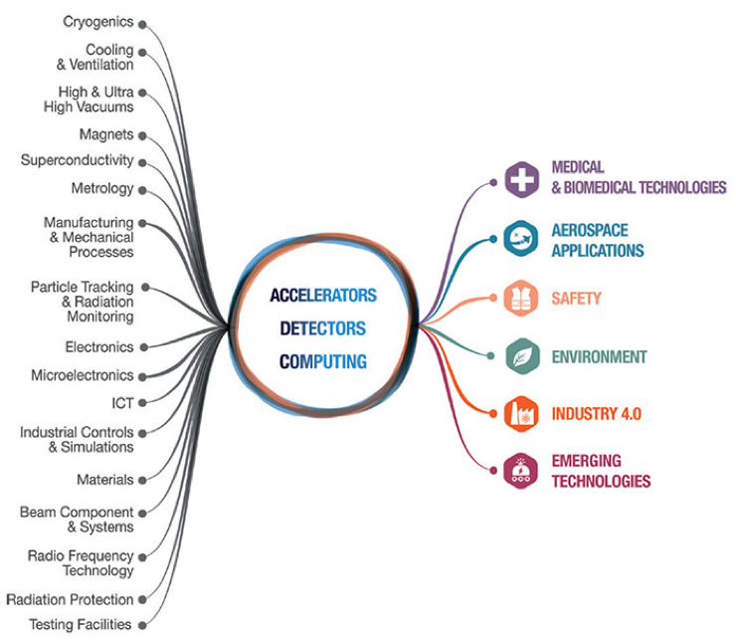
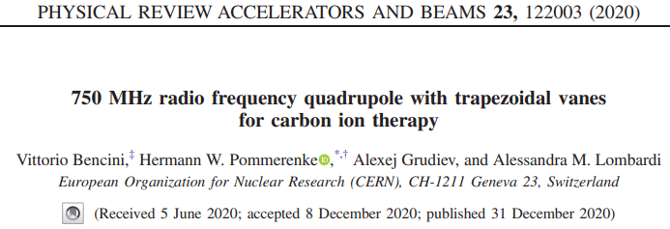
Impact on Society
“… in 1997, CERN set up a reinforced policy and team to support its knowledge- and technology-transfer activities. As a publicly funded Laboratory, CERN has a remit to ensure that its technology and expertise deliver prompt and tangible benefits to society wherever possible.”
Notes:
CERN has a remit to ensure that its technology and expertise deliver prompt and tangible benefits to society, which means that the Linac 4 pre-injector, the 750 MHz RFQ, was immediately developed for medical applications by my former office mate Vittorio, now a data scientist at Natural Cycles which is an interesting company which has a collection of ex-CERN staff.

Slide 7
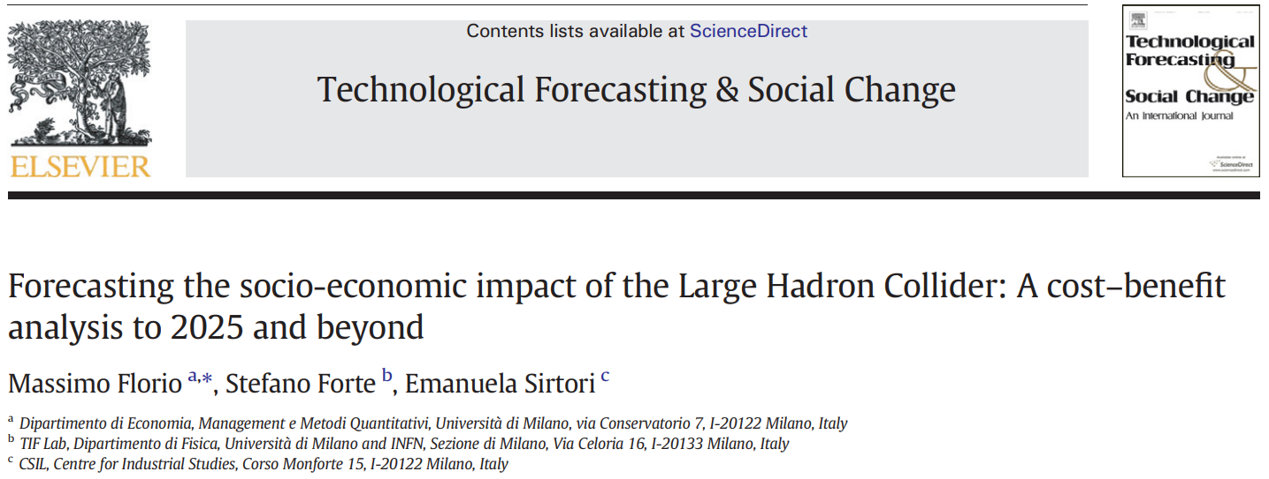
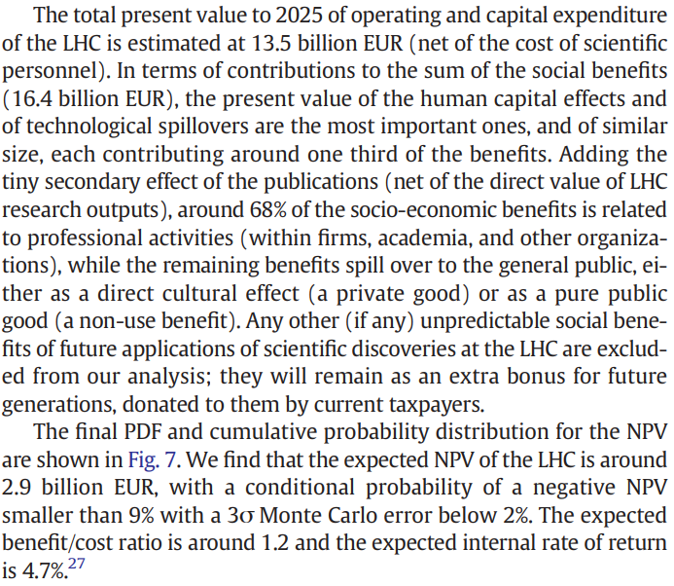
Return on Investment (ROI)
Independent cost–benefit analyses of CERN’s LHC and its High-Luminosity upgrade find benefit–cost ratios of around 1.2 for the LHC and about 1.7–1.8 for the HL-LHC, corresponding to quantified social benefits that are roughly 20% higher than costs for the LHC and 70–80% higher for the HL-LHC.
LHC 120% ROI: https://www.sciencedirect.com/science/article/abs/pii/S0040162516000731
HL-LHC 180% ROI: https://home.cern/news/news/cern/society-benefits-investing-particle-physics
HL-LHC 170% ROI: https://www.tandfonline.com/doi/abs/10.1080/00036846.2022.2140763
An independent lifetime impact study for the ISIS Neutron and Muon Source found a net economic impact of £1.4 billion, corresponding to a ROI of 214%.
Notes:
One way to gauge CERNs impact is the return on investment, so CERN commissions such studies.
LHC + 20%, HL-LHV +70-80%
ISIS 214%

Slide 8
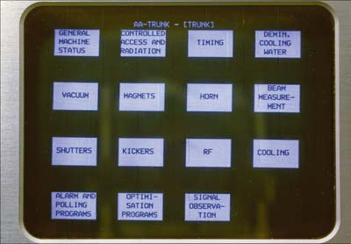
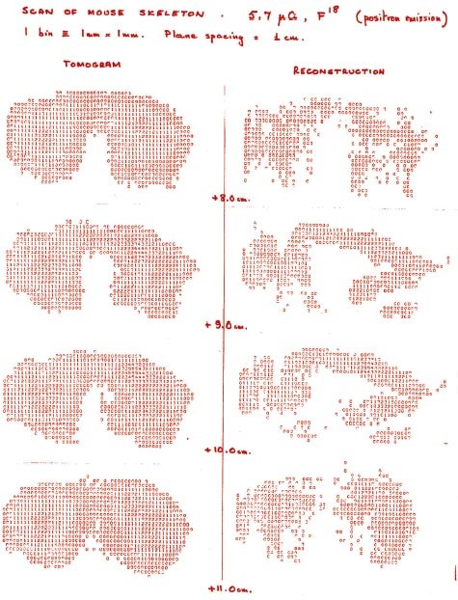
Impact (beyond fundamental science)
The technological development required for fundamental discovery science yields the unexpected.
1968: Multi wire proportional detector chambers (G. Charpak Nobel Prize) applied to medical field to reduce patient dose in imaging modalities
1973: First physical touch screen development by Frank Beck and Bent Stumpe
1977: Jeavons (hardware) and Townsend (software) begin the path to modern PET scanning using coincidence detection with avalanche chambers
1989: Administrative fix for communication based on scientific necessity, Tim Berners Lee develops the World Wide Web
1990: Crystal Clear Collaboration led to specialised PET scanners and improved time resolution
30 April 1993: CERN released the original World Wide Web software into the public domain and made the source code available free of charge
GEANT4 and FLUKA used as industry standard for radiation – matter interaction, used in medical fields.
Medipix, Timepix
Optimised photovoltaic cells
Neural networks deployed in particle physics before “Machine Learning”
White Rabbit timing technology
CERN Open Hardware Licence: legal framework to let people freely use, modify, and share hardware designs
First capacitive touchscreens used at CERN (Image: CERN)
The first PET image taken at CERN, in 1977, showing the skeleton of a mouse. Unlike a modern-day image, this one is truly digital – it is composed of numbers. Each number indicates how much of the isotope has been emitted at each point. (Image: CERN)
Notes:
What does that impact look like? The technological development required for fundamental discovery yields the unexpected.
Applications in the medical field, detectors reducing dose to patients and detecting issues with greater precision, codes used as medical industry standard affecting cancer treatment.
Not only was the world wide web created out of scientific necessity, CERN released it for free.
Particle detectors used machine learning before it was cool, and provide technological benefits such as the white rabbit timing technology.
We have heard about AWAKE from Edda and Morgan, and Xavi spoke on Medipix which originated from detector technology needs.

Slide 9
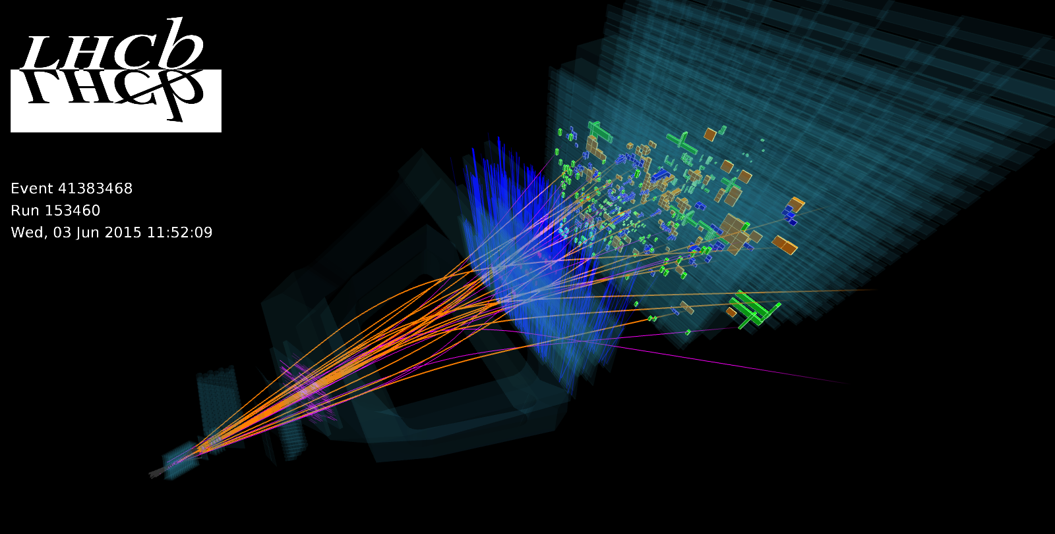
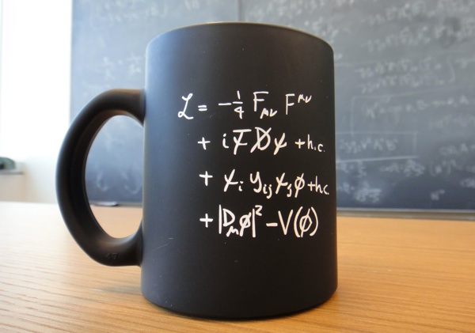
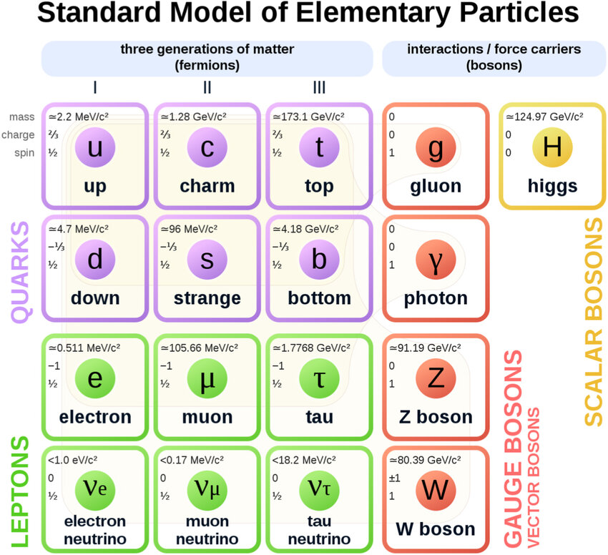
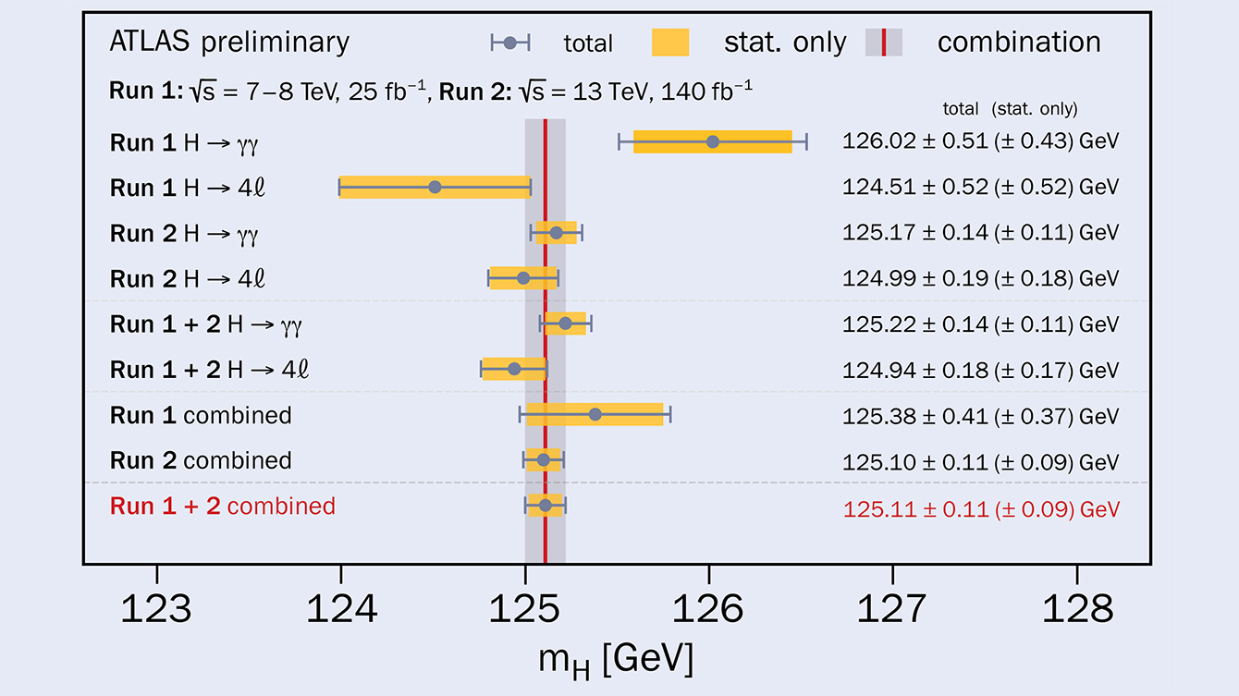
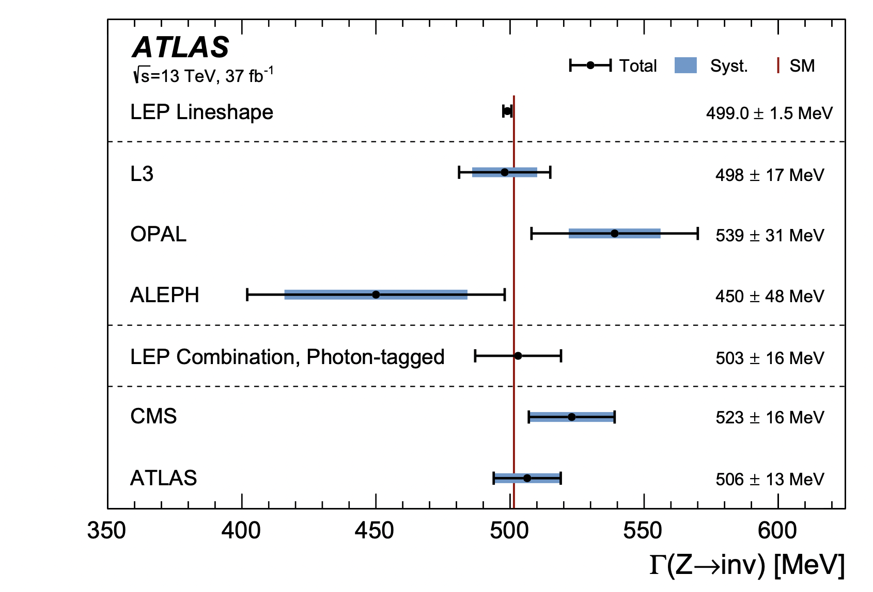
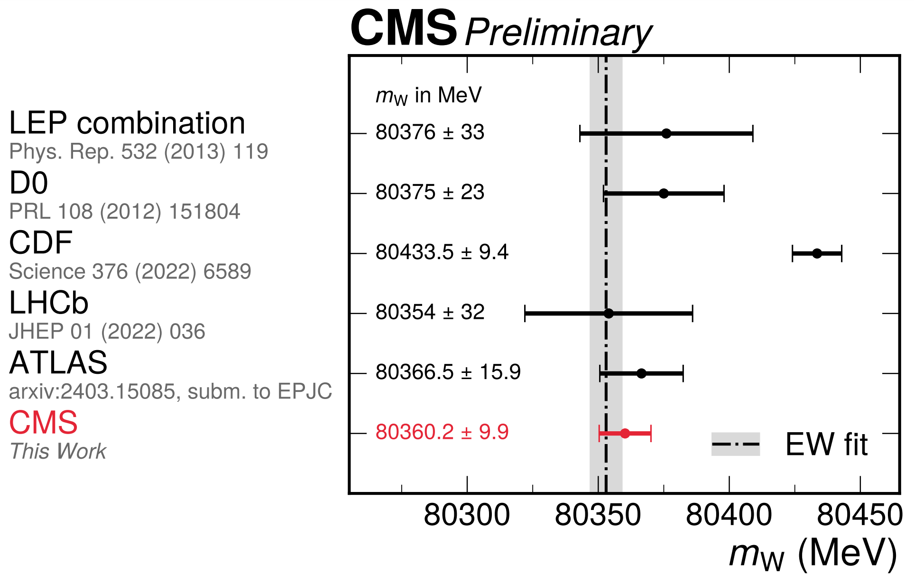
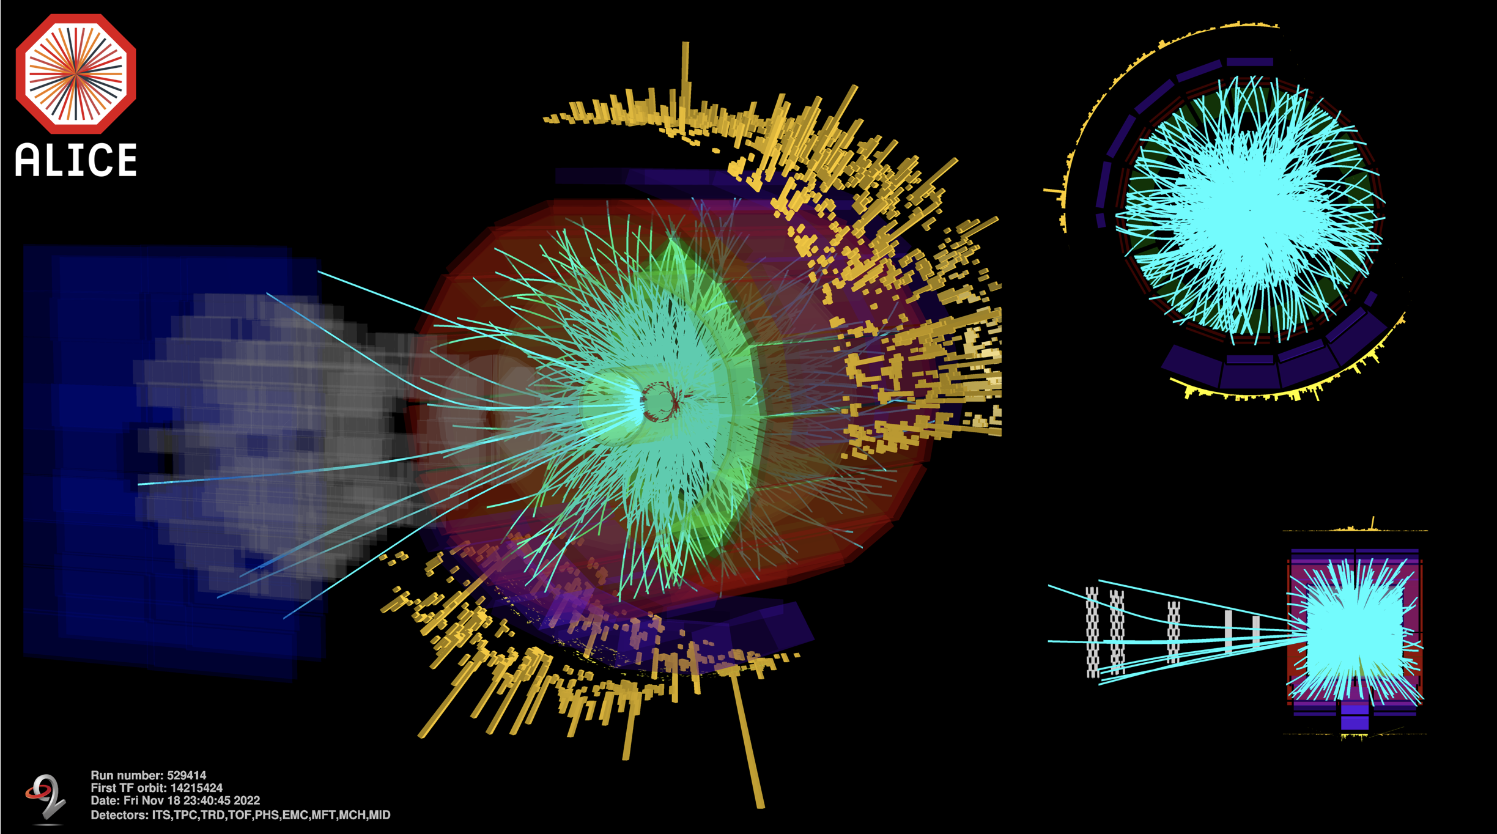
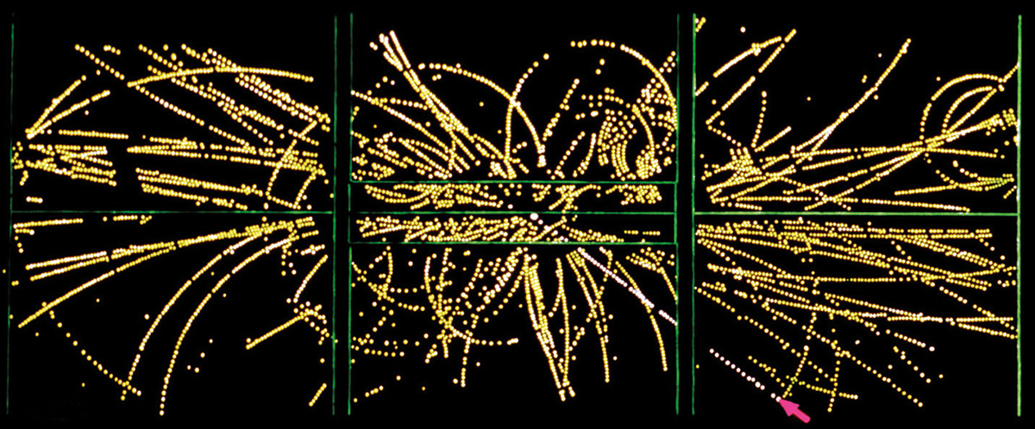
Matter – antimatter asymmetry
CP Violation
Theoretical Backbone
Mapped Standard Model
Precision Measurements
Recreated early universe conditions
Quark Gluon Plasma
Discovered key force carriers W, Z, Higgs
Notes:
Not to mention the obvious impact in fundamental physics, and by extension to society.

Slide 10
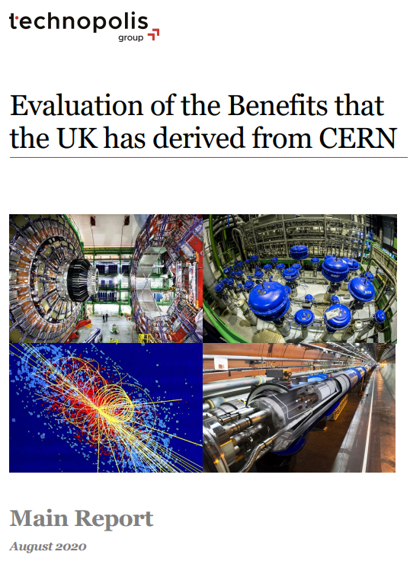
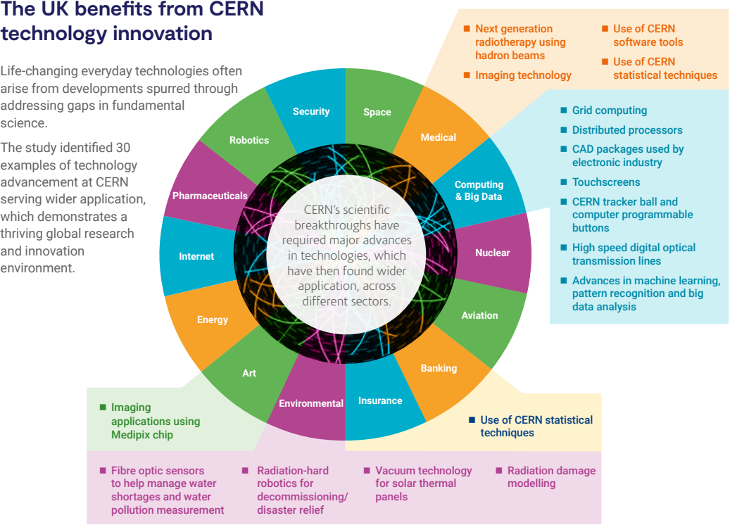
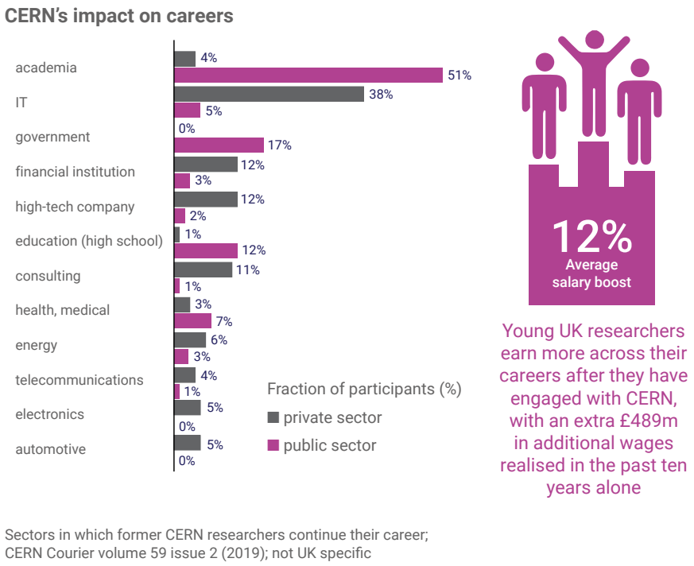
Notes:
There is a nice report concerning specific benefits to the UK – for example after engaging with CERN young researchers earn more…
In summary I want to cover a few topics that perhaps haven’t been mentioned yet today. The UK and CERN have worked together in accelerators for a long time. CERN is a vast and complex scientific machine, not just the LHC and the apparatus required to operate it, offering users world leading science in many domains. The scientific needs of the diversity of fundamental discovery science yields measurable benefit to society, at many levels. We can even measure CERNs benefit to this nation.

Slide 11
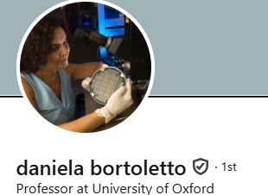

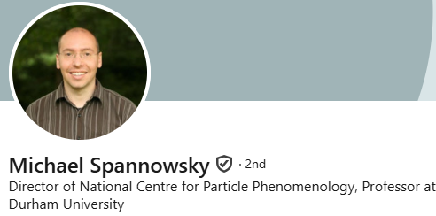
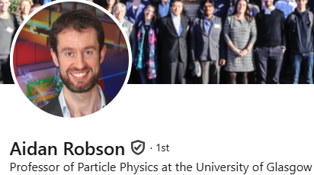
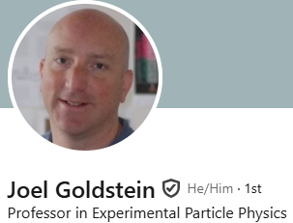
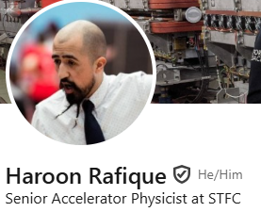
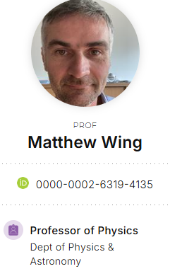

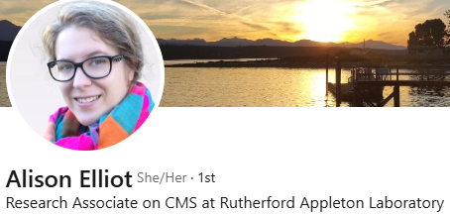
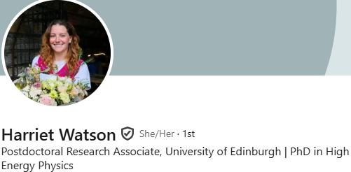
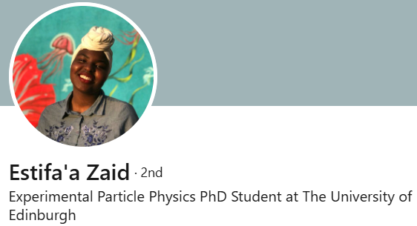
What is ECFA?
Founded 1963 by CERN DG & CERN Scientific Policy Committee to co-ordinate planning of next-generation high-energy accelerators in Europe.
Regular meetings (Plenary & Restricted) to formulate and recommend strategic actions.
Organising symposia and conferences.
Forming ad hoc study groups for specific challenges.
Country visits – issuing recommendations to governments and physics community.
Monitoring strategic plans (European Particle Physics Strategy and its Updates)
A few ‘plenary’ delegates per members state, one RECFA delegate
UK RECFA Delegate
UK Plenary ECFA Delegates
UK ECR ECFA Delegates
Notes:
ECFA functions as the strategic steering committee for Europe’s high-energy accelerator projects—guiding long-range planning, fostering equitable international collaboration, balancing research infrastructure, and ensuring alignment with broader European strategy through continual review and engagement.

Slide 12
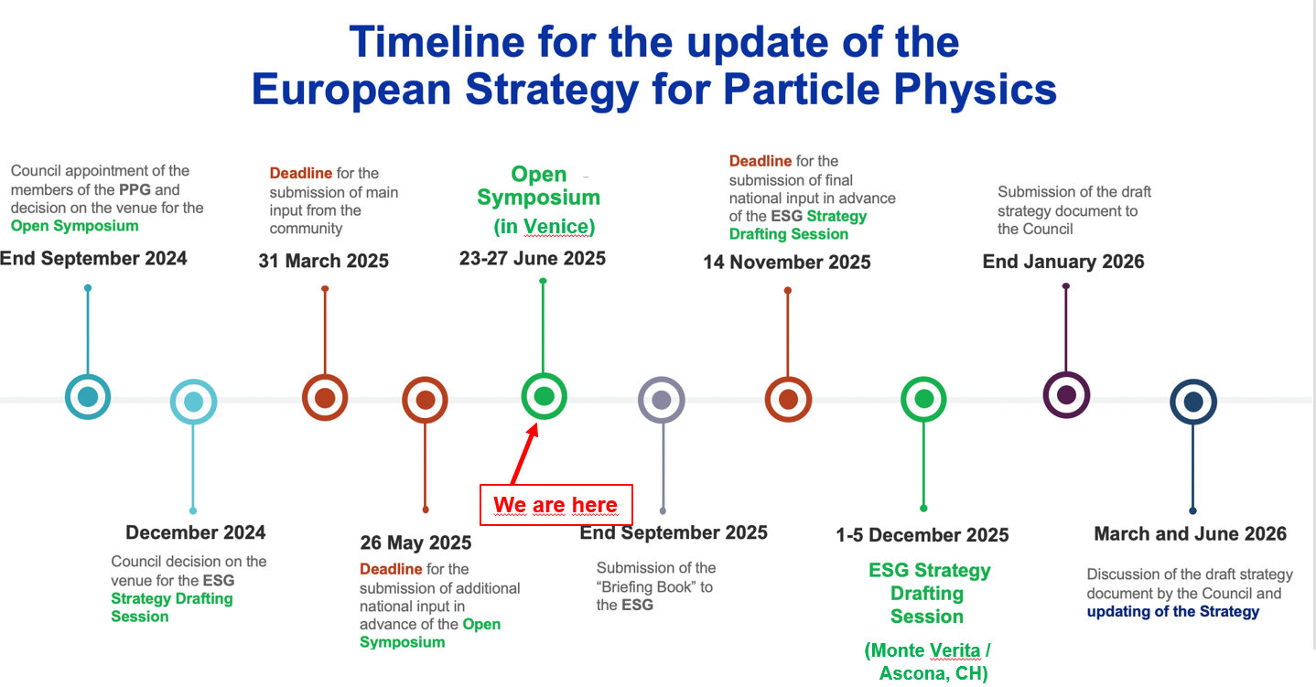
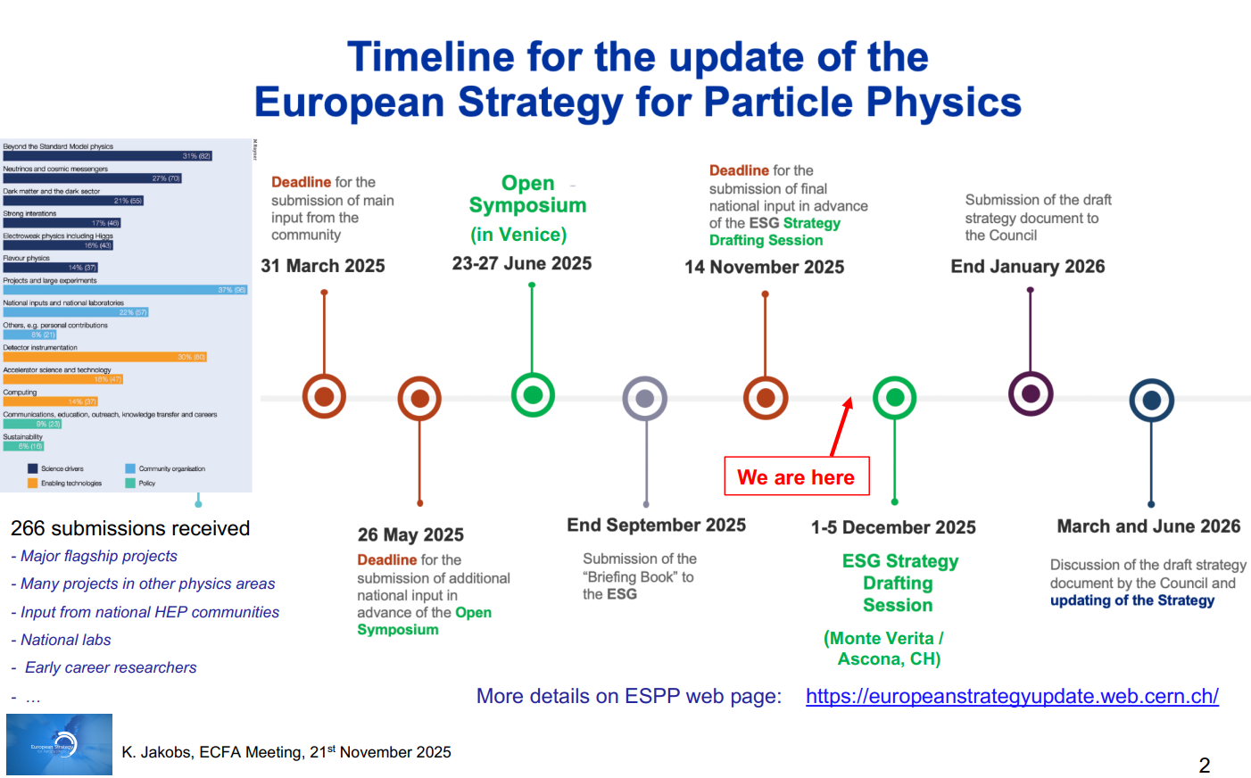

2026 Update to the European Strategy for Particle Physics (ESPPU)
Briefing Book:
Comprehensive factual summary of the current state of particle physics, compiled by the Physics Preparatory Group (PPG) including:
Scientific landscape
Technological capabilities and roadmaps
Community input summary
Options and considerations
It provides the evidence base for informed discussion and decision making.
UK Drafting Meeting 1 (Daresbury)
UK Drafting Meeting 3 (RAL)
Online Plan B Meeting
UK Kick-Off (Durham)
UK Drafting Meeting 2 (UCL)
We are here
ESPPU Open Symposium: https://agenda.infn.it/event/44943/overview
Notes:
What will CERN build next? What experiments are needed to answer the big questions in physics?
The ESPP is Europe's long-term plan for particle physics. It sets scientific priorities, guides investments in accelerators, experiments, and R&D, and aligns national efforts with global projects.
The ESPPU is the periodic update of the ESPP—typically every 7–8 years. It collects community input, evaluates progress, and recommends future directions.
Update to be complete June 2026, decision on FCC may be made by 2028

Slide 13
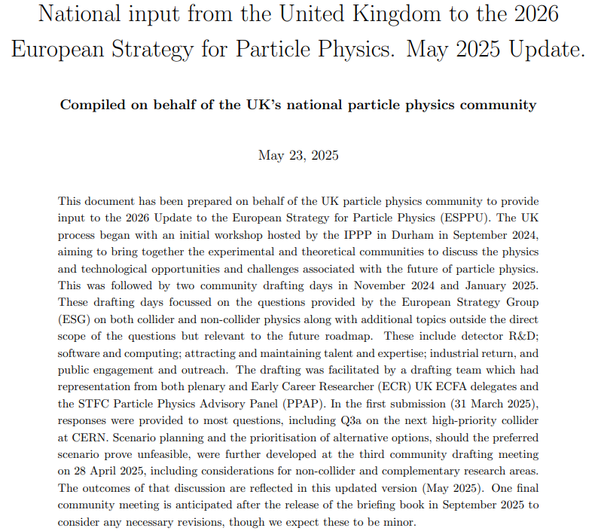
ESPPU UK Input
Kick-off → 4 drafting days → 550 participants → 90+ pages produced → 18 internal meetings → countless drafting hours.
All Contributions to the ESPPU: https://indico.cern.ch/event/1439855/contributions/
Drafting Team:
Jim Clarke (Director of ASTeC), Sinead Farrington (Director of STFC PPD), Mark Lancaster (UK representative on the European Strategy Group), Ruben Saakyan (Chair of PPAP)
UK ECFA delegates: Daniela Bortoletto (Oxford), Joel Goldstein (Bristol), Haroon Rafique (STFC ISIS), Aidan Robson (Glasgow), Michael Spannowsky (Durham), Sarah Williams (Cambridge), Matthew Wing (UCL)
UK ECR ECFA delegates (who did most of the minute taking): Patrick Dougan (Manchester), Allison Elliot (STFC PPD), Holly Pacey (Oxford), Harriet Watson (Edinburgh), Aidan Wiederhold (Manchester)
Plus numerous colleagues providing specific input / representation
Notes:
Process so far involved …
Available here with the update
Thanks to drafting team
#Teamwork #Community #Passion

Slide 14
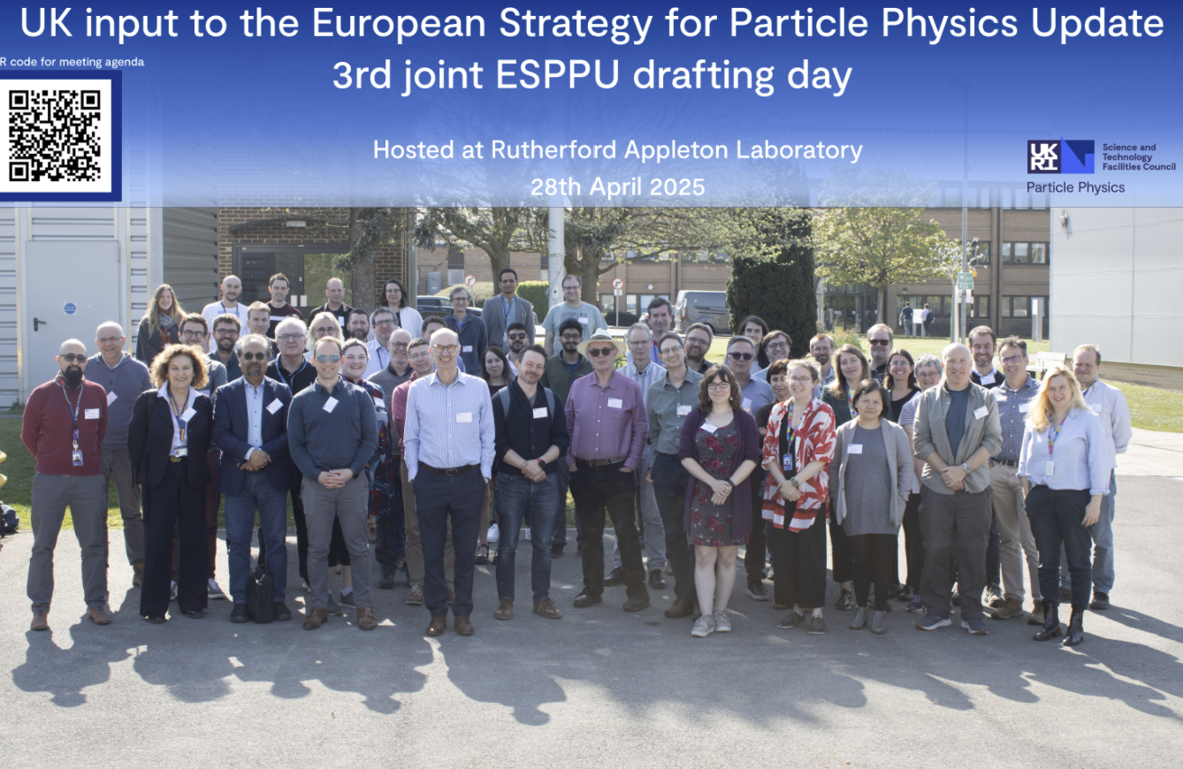
ESPPU UK Input
5 Events
Kick Off
23rd – 26th September 2024 @ Durham https://conference.ippp.dur.ac.uk/event/1357/overview
4 Drafting Days
4th Nov 2024 @ DL https://conference.ippp.dur.ac.uk/event/1391/
Minutes
9th January @ UCL https://indico.stfc.ac.uk/event/1183/
Minutes
28th April 2025 @ RAL https://indico.stfc.ac.uk/event/1430/
Minutes
29th October 2025 Online
https://indico.stfc.ac.uk/event/1688/
Thank you for all contributions!
Photo credit: STFC, Kai Gregory

Slide 15

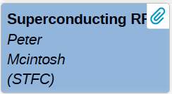
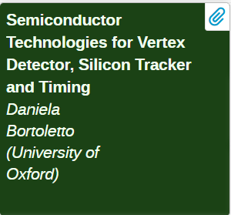
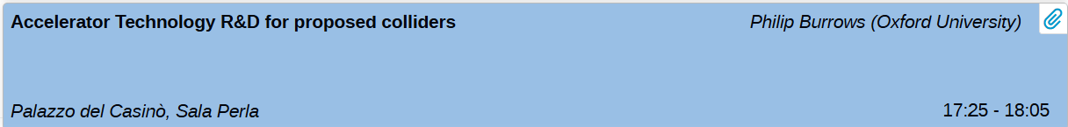
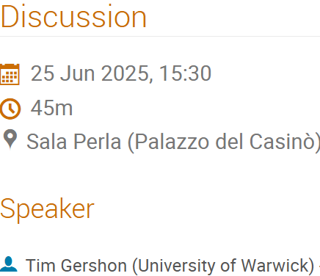

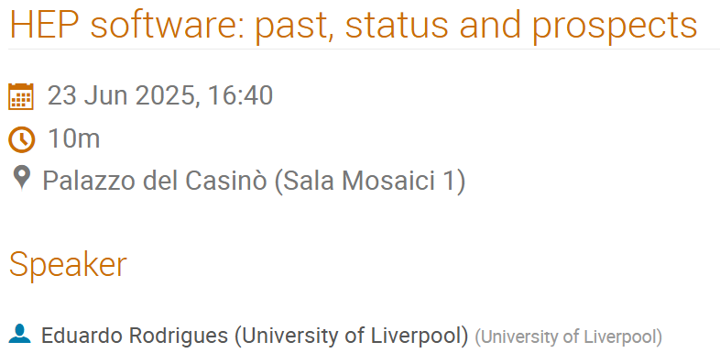
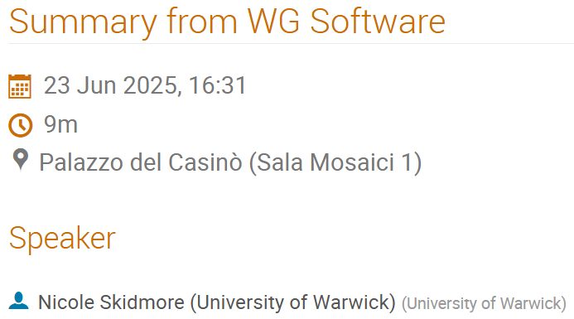
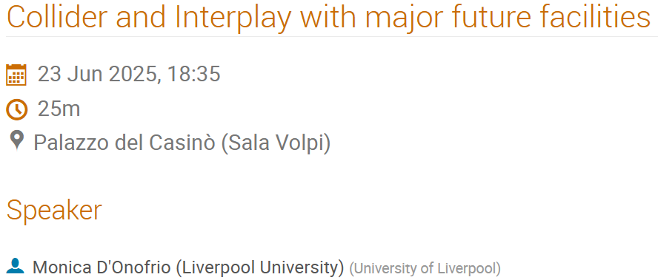
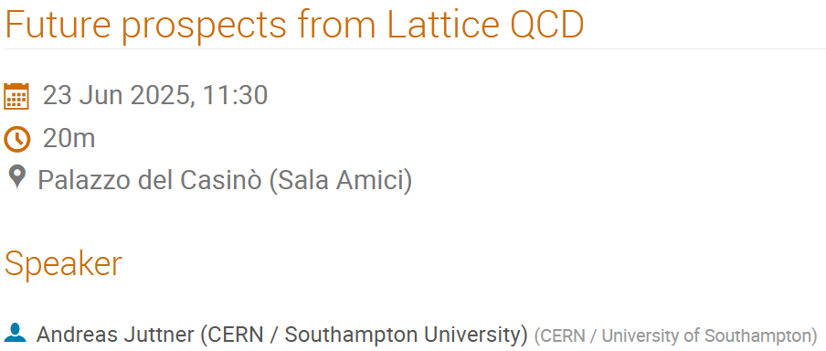






UK Contributions to Open Symposium
Notes:
Significant expertise in the UK – Accelerators, Computational, Detectors, various aspects of PP

Slide 16





UK Involvement in ESPP / ESG / PPG
ESPP Working Groups and Conveners
Physics Preparatory Group
Previously
Prof. Dave Newbold
European Strategy Group
Notes:
Strong UK representation in ESPP, PPG who prepare the Briefing Book, and ESG who will compile the update next week in Ascona

Slide 17

Physics Briefing Book
https://arxiv.org/abs/2511.03883
https://cds.cern.ch/record/2944678
Comprehensive factual summary of the current state of particle physics, compiled by the Physics Preparatory Group (PPG) including:
Scientific landscape
Technological capabilities and roadmaps
Community input summary
Options and considerations
It provides the evidence base for informed discussion and decision making.
Notes:
Recently released briefing book including more UK involvement (by institution)
In summary: a lot of work is being done across Europe (and beyond) to shape the future of particle physics (and detector, accelerator, computing related fields). The UK has significant representation in the ESG, PPG, ESPP, etc. indicating the significant expertise and leadership that we should celebrate. We should also ensure that this remains, which takes me to my final topic: training and careers.

Slide 18




Opportunities
Reach out to Barbara on LinkedIn to discuss opportunities at CERN
Notes:
Not just physics
Reach out to Barbara she’s happy to connect on LinkedIn – especially if applying
~2700 staff and currently < 1000 grads and fellows
Many entry points

Slide 19
Student Positions
Programme | Area | Stipend (CHF Monthly) | Study Requirement | Duration | Eligibility | Estimated Intake per year | Selection Rounds
Short Term Internship | Applied physics, engineering, computing, admin | 1,587 | Enrolled full-time in Bachelor or Master in technical or administrative field; must remain a registered student; ≥18 years old. | 1–6 months | Member or Associate Member States only | < 100 | Continuous
Summer Student Programme | Physics, engineering, computing, maths | 2,800 based on 93 CHF/day | Bachelor or Master student (not PhD), normally with ≥3 years (6 semesters) completed; must remain enrolled for the stay; no previous Summer Student or >3 months at CERN; good English. | 8–13 weeks | Current calls often restricted to CERN Member (and some Associate Member) States, with separate channels for Canada/US/Japan; historically some calls open more broadly. | ≈250–300 | 1 closing Jan
Openlab Summer Student | Computing / IT, software, data, HPC | 2,800 based on 93 CHF/day | Bachelor or Master student (not PhD) with a strong computing / IT profile, ≥3 years of study completed; must remain enrolled; no >3 months prior CERN work; good English. | ~9 weeks | Open to all nationalities (no citizenship restrictions) | ≈30–40 | 1 closing Jan
Administrative Student | Administration: HR, finance, law, logistics, translation, comms, librarianship, PR, etc. | 3,452 | BSc or MSc level, ≥18 months of undergraduate studies completed; must remain registered full-time; good English or French | 2 – 12 months | Member or Associate Member States | ≈30–50 | 3
Technical Student | Engineering (mechanical, electrical, electronics, civil), IT, computing, applied physics, etc. | 3,452 | Bachelor or Master student, ≥18 months of study completed; full-time enrolled; good English or French | 4 – 12 months | Primarily Member or Associate Member States (a few non-MS places via specific schemes) | ≈200–250 | 3
Doctoral Student | Applied physics & accelerators, engineering, computing, safety, materials, comms etc. | 3,891 | Already enrolled in a PhD at a university; thesis in an appropriate (non-HEP) technical/STEM field; dual home university + CERN supervision | Initial 6–12 months, renewable; max 36 months, with flexibility to spread over up to 4 years | Mainly Member / Associate Member States; a defined Non-Member State Doctoral track exists with separate calls. | ≈100 | Multiple
Notes:
Apologies for the tables – best way to summarise a large amount of info
Strongly recommend summer student programme
Next technical/admin student
Then doctoral
If you can get all 3 that’s the best way to staff. I had none but still had much CERN engagement – there are many ways in.
OpenLab worth noting is open to all nationalities – I co-supervised Meghana Madhyastha from India, she completed her PhD at John Hopkins and now works for Meta as an AI researcher. CERN can give one’s career a significant boost.

Slide 20
Staff Positions
Programme | Area | Stipend (CHF Monthly) | Study Requirement | Duration | Eligibility | Estimated Intake per year | Selection Rounds
Research Fellowship Programme | Experimental & theoretical physics, applied physics, engineering, computing, maths, etc. | ≈ 6,911–7,326 | PhD completed (or about to) with limited post-PhD experience: up to 3 years (applied) or 6 years (physics); never had a CERN fellow/graduate contract | Usually 24–36 months (often 2 years + 1-year extension | Member / Associate Member States; a small number of Non-Member State fellowships each year | ≈ 100 active fellows | 2
(Graduate) Origin (previously Junior Fellow) | Technical, scientific, engineering, computing, and administrative roles – “real work opportunity” jobs. | ≈ 5,000–5,500 | Very recent graduates, from technician to Master’s level. At application: max 2 years’ experience after Bachelor or Master; no PhD | 6–36 months | Member or Associate Member States | ≈ 450 active grads + fellows | Continuous for specific roles
(Postgraduate) Quest (previously Senior Fellow) | More senior project-based roles in engineering, computing, technical & admin domains; “results-focussed, project-based work.” | ≈ 6,050–6,650 | Master’s + 2–6 years’ experience, or PhD + ≤3 years’ experience; not open to Bachelor-only | 6–36 months | Member or Associate Member States | ≈ 450 active grads + fellows | Continuous for specific roles
Post-Career Break Fellowship | Applied sciences & engineering, computing, experimental & theoretical physics (projects across CERN, not just HEP). | 3,452 | BSc or MSc level, ≥18 months of undergraduate studies completed; must remain registered full-time; good English or French | 6–36 months | Member or Associate Member States | ≈ 450 active grads + fellows | 1
Limited Duration (LD) Staff | All core staff roles across physics, engineering, IT, technical, admin, finance, HR, etc. LD is the standard entry staff contract type. | 3,858 –12,156 depending on grade | Relevant professional qualification and experience per vacancy (from secondary education to PhD depending on job). Must meet Member/Associate State nationality requirement; previous staff contract at CERN makes you ineligible for another staff role | 5 – 8 years Only route to indefinite contract | Member or Associate Member States | ~ 180 hired in 2024 | Continuous for specific roles
Notes:
For graduates the Origin programme takes technician to masters within 2 years of completion of study – numerous strands such as engineering, computing, administrative. Similarly the Quest programme takes more experienced graduates for senior project-based roles. These are the main routes for graduates and those within a few years of study completion.
The most senior position is the LD – limited duration 5-8 year contract (most positions defined by the LHC operating cycle of 5 years, 3 operation + 2 shut-down) which has an additional requirement of member state nationality. Currently this is the only route to a permanent (called indefinite or IC) contract at CERN.
Also research fellowship and post career break fellowships

Slide 21


Application Tips
Work Experience (mostly for locals) advice
Applications are keyword driven
Apply search engine optimisation of your application
Mention experience, projects, (everything you’ve done)
Avoid CV templates such as EuroPass – make a custom CV
Specificity – mention names (e.g. machine learning in python using TensorFlow)
Demonstrate willingness and ability to learn on the job quickly
Students: Don’t predict the job – keep options open
Say how do you want to contribute!
FCC timeline 2040 - 2070

Slide 22
CERN Jobs
Reach out to Barbara on LinkedIn to discuss opportunities at CERN
Notes:
CERN Fellowships revamped
A selection of relevant positions
Talk to Barbara

Slide 23



Summary
CERN
Technological development required for fundamental discovery science yields the unexpected.
Benefit to society, return on investment, and impact demonstrated.
ECFA:
ECFA have been busy with the 2026 ESPPU
UK Input process shows strong physics case for next flagship collider
Briefing Book released
Await ESG strategy draft and CERN Council response
Opportunities at CERN
Student and staff opportunities, not just for physics
How will you contribute?
May be hiring in London for
Proton Linac R&D:
- RF Engineers
- Accelerator Physicists
Reach out to Barbara for CERN enquiries
Notes:
CERN is a place like no other
ECFA has been busy – community seeks direction in uncertain times
Many ways to contribute to CERN

Slide 24

Thank You – Questions?
Connect with me on LinkedIn
Notes:
Accelerator ECRs building a network at CERN – hope to work with ECFA to support accelerator ECRs in the UK – please discuss with me via email, linkedin, in person etc

Slide 25
UK Engagement with CERN: Get Involved
🌟 Share Your CERN Success Stories
Have a great CERN-related achievement or impact story? Help us showcase the value of UK investment in CERN by sharing it with us!
👥 Become a UK CERN Champion
Support CERN HR by promoting studentships, fellowships, ORIGIN, and QUEST opportunities in UK universities.
📧 Contact: career.events@cern.ch
🔭 Future Focus & Industry Links
What technologies or capabilities will you focus on next?
Which UK companies or sectors should we connect with? See www.uk-ilo.org for more information
🚧 Barriers to Collaboration
Faced challenges working with UK companies or recruiting UK students/grads?
Let us know what’s holding things back so we can help improve collaboration.
Tell your network about the work you do and the wide range of work going on at CERN e.g. online (LinkedIn, Instagram etc. using #UKatCERN) and/or tell us!
Send us a quick email with a lab/workshop/experiment photo!
Contact:
UKatCERN@stfc.ukri.org
Science and Technology Facilities Council
@STFC_matters
Science and Technology Facilities Council
Slide courtesy of the STFC CERN Strategy Delivery Team
Notes:
Share CERN stories with the strategy delivery team – encourage more ROI
Share CERN opportunities with students, technicians, etc – benefit from skills pipeline
Foster industry links (get in early for CERNs next project)

