Slide 1
UK-CERN accelerator celebration day
26 November 2025

Slide 2
The Institution of Engineering and Technology
Provides expert advice to UK Parliament, Government and other agencies.
Awards professional registration qualifications such as Chartership.
Recognises and promotes excellence through awards, scholarships and prizes.
Inspires the next generation: many undergraduate programmes in the UK are accredited by the IET.
Delivers world-class knowledge products and services.

Slide 3
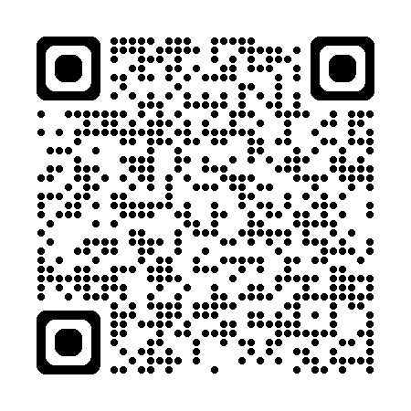
IET Technical Networks
Our technical networks can connect you to like-minded peers.
Technical Networks are great for:
Building CPD
Accessing low or no-cost events, online and in-person
Finding specialist content
New opportunities
Meet or connecting with other experts in your field
Multidisciplinary learning
Find out more at: engx.theiet.org/technical-networks
Notes:
This event is being run by the IET’s Particle Accelerator Engineering Network, a volunteer led network which aims to share the latest industry news and information with the wider community. They run a variety of events each year which are usually free to attend.

Slide 4
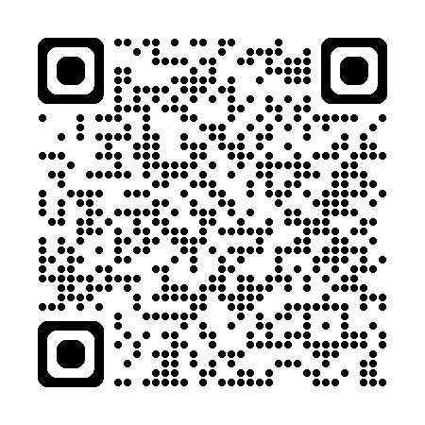


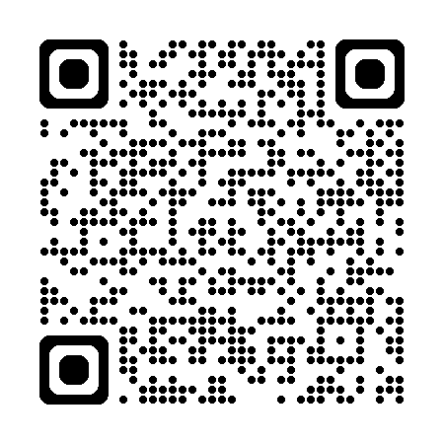
Follow us:
EngX
IET Particle Accelerator
Technical Network
Notes:
To keep up to date with their upcoming events and news, make sure to follow their social accounts.

