Slide 1



UK Strategy for CERN
and Industrial Liaison
Richard Farrow
Head of UK Industrial Liaison Office
27th November 2025
uk-ilo.org

Slide 2


Outline
The UK Strategy for CERN.
UK Government Industrial Strategy
STFC Industrial Liaison. Goal 3.
The role of accelerator people. What can you do to help?
Innovation Hubs.

Slide 3
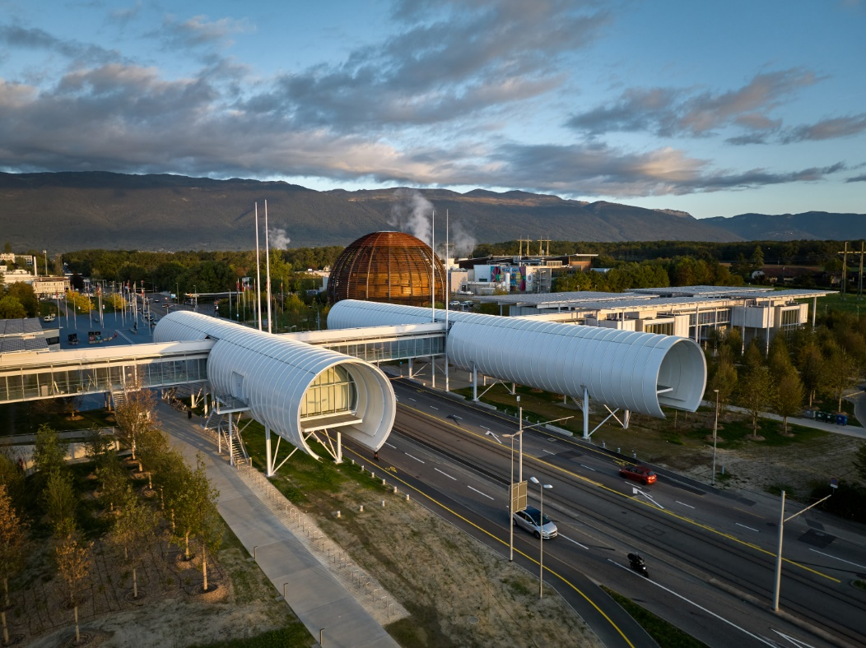
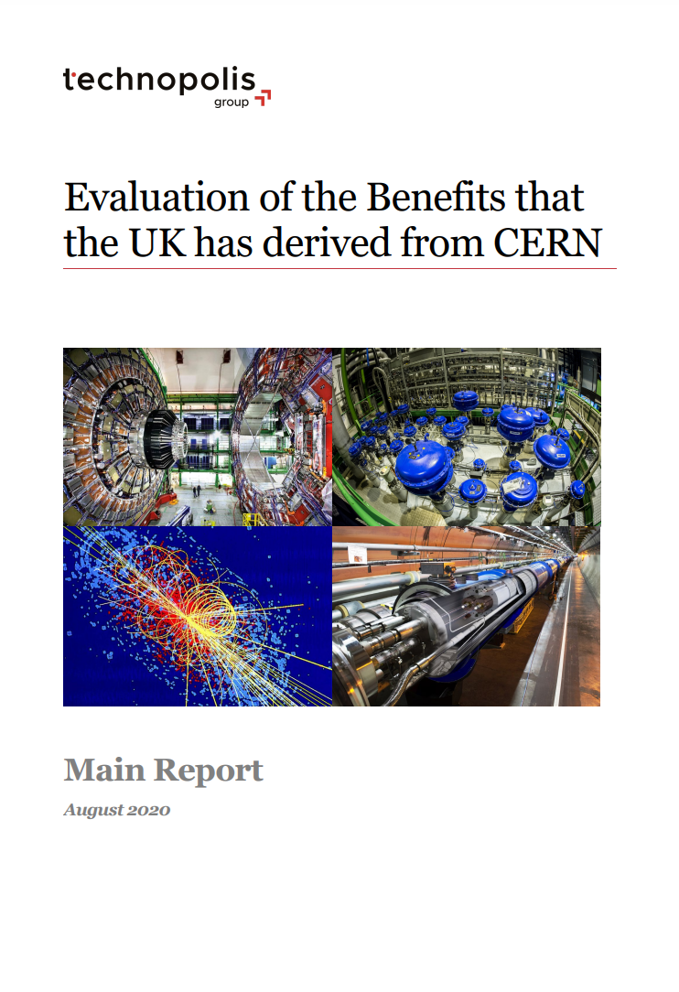


UK Strategy for Engagement with CERN
  Background and context
  UK founding member of CERN in 1954.
  UK second largest subscription. ~£170m p.a.
  Further ~£30m p.a. on experiments.
  Major commitment. 50% of international.
  UK return from CERN membership have been too low for many years (industrial and personnel)
  Matched by increasing government interest in UK investments.
  STFC + DSIT Strategy launched Oct 2023.
www.uk-ilo.org
Slide 3
Photos from CERN
Notes:
The UK is one of 12 founding members of CERN.
The UK subscription (entrance fee) to CERN is around £160 million per year (~15% of Member State contributions), Second highest contribution.
UK research grants (experiments) to CERN a further £20 to £30 million per year.
CERN contributions are around 50% of all international facility contributions (8).
UK maintains a world class team of accelerator scientists and engineers who work alongside CERN.
CERN employs 204 UK staff as part of its activities (~8%)
Around 30 UK universities work with CERN and it’s experiments annually.
UK companies win ~£20m of supply/service contracts to CERN each year (~5%)
UK companies gain many additional benefits from engagement.

Slide 4

UK Government Industrial Strategy (June 2025)
Four pillars.
  Making it easier for industry to do business.
  Invest in areas where IS-8 are strong. Cities and clusters.
  Focus on high potential sectors : IS-8.
  Enrich partnership between industry and state.
IS-8…..Advanced Manufacturing.
  Harness the latest technologies in the Advanced Manufacturing sector through £4.3 billion in funding, including up to £2.8 billion in R&D programmes over the next 5 years to spur innovation, automation, digitisation and commercialisation.
UKRI : Driven by the Industrial Strategy.
  Delivery focused. Making our R&D work.
  Strengthening links and routes to exploitation and commercialisation.
www.uk-ilo.org

Slide 5
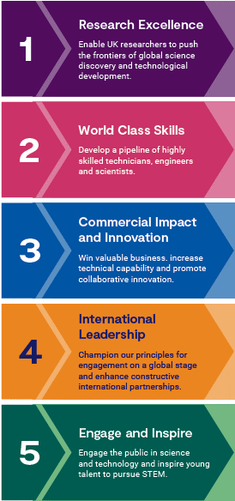
The Strategy in a Nutshell
Purpose of the strategy is to maximise and raise awareness of the mutual opportunities, benefits and impact of UK investment in CERN, and provide an action-oriented framework for delivery
Our vision is to unlock the full potential of our investment in CERN and remain central to its continued success, by working with our partners to lead scientific discovery and inspire the next generation
Underpinned by four
“principles”
Sustainability
Diversity and Inclusivity
Transparency
Continuous Improvement
Five pillars:
Research Excellence
World Class Skills
Commercial Impact and Innovation
International Leadership
Engage and Inspire
https://www.gov.uk/government/publications/uk-strategy-for-engagement-with-cern-unlocking-the-full-potential-of-uk-membership-of-cern
Slide 4
Notes:
Becky
Strategy spans all areas of engagement between the UK and CERN.
Becky – pillar 1; Abi pillar 2; Rich and team pillar 3; DSIT/Jess pillar 4; STFC pillar 5 – Steph H/Jess ; Jess oversight of all pillars – expansion of the team working to deliver this -→ next slide is workin towards implementation plan

Slide 6
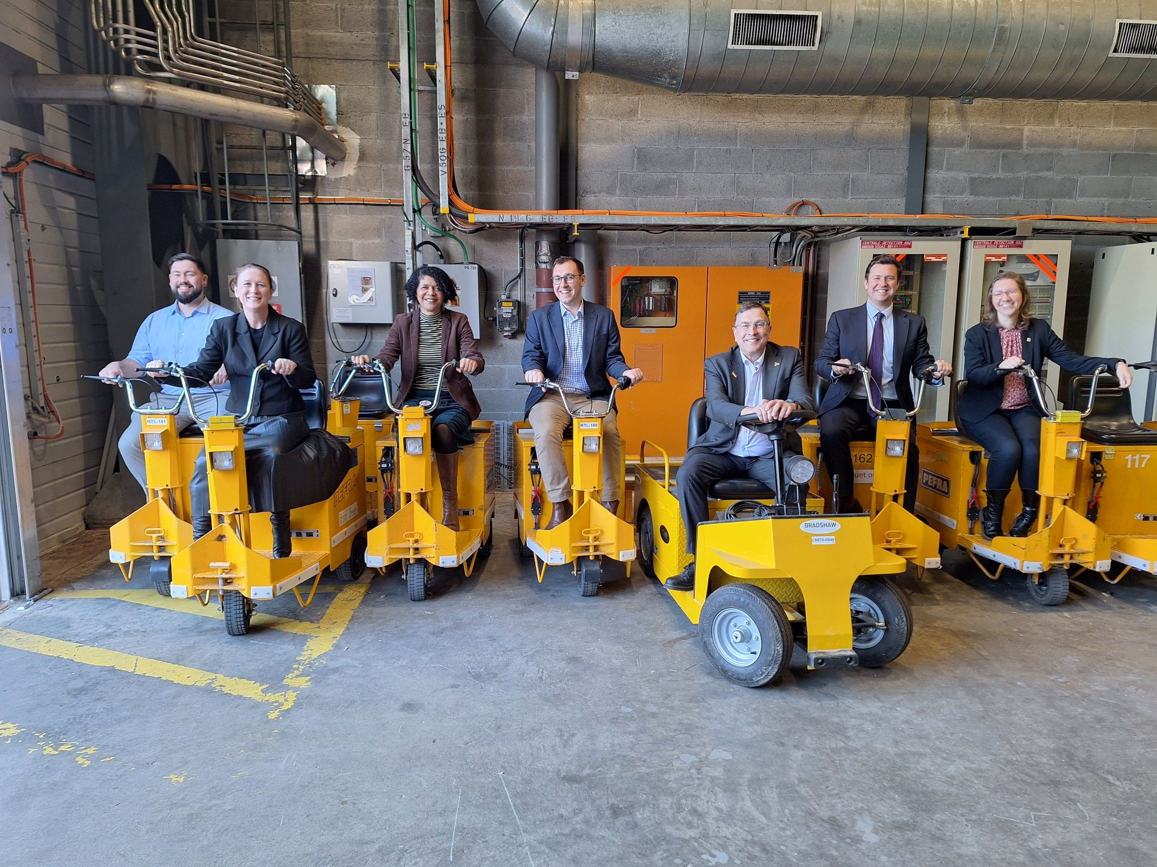
Update on implementation (late 2023- present)
Team Successes!
Delivered VIP visits to CERN including the Select Committee and DSIT Secretary of State
Redeveloped the CERN pages on the STFC-UKRI website to make content easier to find
Completed survey mapping CERN connections across STFC – 150 responses!
Events and comms to celebrate CERN’s 70th anniversary including a DSIT ‘show and tell’ day
Collaborating with other CERN Member States to enhance the balance of CERN’s industrial and personnel returns, including contributing to revisions of CERN’s procurement regulations.
Members of the Science, Innovation and Technology Select Committee on visit at CERN (Photo cred: Steph Hills)
Notes:
Becky
Over the past couple of years, the CERN Strategy Team we’ve hosted high-profile visits to CERN, including the DSIT Secretary of State and the Science Select Committee. We’ve revamped the STFC-UKRI CERN webpages to improve accessibility and completed a major survey mapping CERN connections across STFC—with over 150 responses. We also celebrated CERN’s 70th anniversary with events and communications, and we’re working with other Member States to improve industrial and personnel returns, including input into CERN’s procurement regulations. Procurement thresholds had not seen a substantive revision since around 1965. The 2024 update was therefore a major modernization effort.

Slide 7
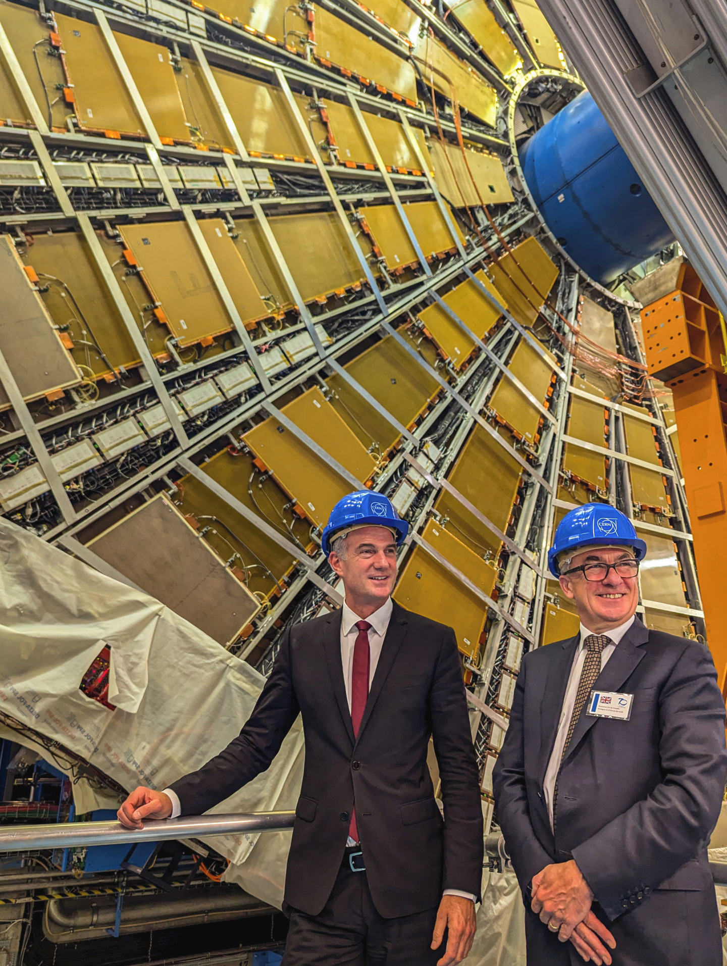
Update on implementation (late 2023- present)
Team Current Activities
Develop and deliver suite of activities to improve UK ‘skills return’ from CERN
Support UK delegates on CERN governance to represent the UK voice (e.g. upcoming FCC discussions and decision points)
Scoping ways to better connect the UK engineering community with CERN to help realise the full benefits from UK membership at CERN
Supported a UK-wide Technical Roadshow with CERN Talent Acquisition, aimed at showcasing career opportunities for students pursuing technical and vocational pathways.
New dedicated website for Industrial Liaison Office (www.uk-ilo.org) and monthly newsletter
Looking for academics working with industry to identify wider supply chain opportunities
Secretary of State for Science, Innovation and Technology, Peter Kyle with Director General-Designate, Mark Thomson (Photo cred: CERN)
Notes:
Becky
Our current focus is on strengthening the UK’s skills return from CERN. We’re supporting UK delegates in governance discussions, including the Future Circular Collider (a proposed 91km circular particle accelerator). We’re also working on an initiative to better connect UK engineers with CERN, and recently supported a UK-wide technical roadshow with CERN Talent Acquisition. A new website—uk-ilo.org—and monthly newsletter are helping us reach industry. We’re also identifying academics working with industry to unlock wider supply chain opportunities

Slide 8
Goal 3 : Commercial Impact and Innovation
Getting the best value for UK Industry
from our CERN subscription
www.uk-ilo.org

Slide 9
The wider industrial value of CERN.
Commercial contract value and….
  Profile and credibility.
  Improved skills.
  Innovation.
  Capital investment.
  Partnerships with academia
  Commercial partnerships
  Stronger export experience
www.uk-ilo.org
Slide 14

Slide 10
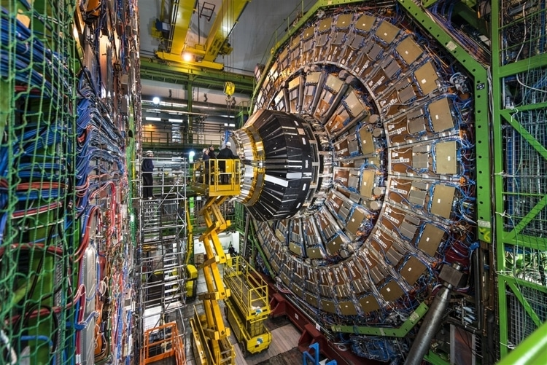
How Business Interacts with CERN
Contracts
Collaborations
IP and know-how
www.uk-ilo.org

Slide 11

CERN Procurement Contracts
35 member states. Access to CERN and contracts.
500M CHF per year (£450m)
Canteen services to cryogenic systems. Supplies and Services.
3 types of procurement. Uncontrolled / Price Enquiries / MS-IT.
Formal documented process. Use CERN paperwork.
Adjudication method is Lowest Cost (LCCB). Moving to BVM.
Great pressure to engage UK companies.
UK presently winning ~5% of contracts. Poorly Balanced.
www.uk-ilo.org

Slide 12
Collaborations
How CERN develops its next generation technologies.
Mostly with national institutes and universities….generally not with industry directly.
E.g. REBCO magnet technology (University of Southampton / INFN)
Lead ultimately to manufacturing contracts.
Procurement takes place after prototyping.
Early industrial engagement into collaboration is key. Allows industry to…
  Prepare.
  De-risk manufacturing.
  Contribute expertise to the collaborative development.
  Provide cost estimates / suggest value engineering.
Creates problems (for industry) with unbiased procurement.
www.uk-ilo.org

Slide 13
IP, Technologies and Know How.
What we develop is valuable.
CERN / STFC / Institutes / Universities have valuable ideas…but they need to generate revenue.
Contact with industry is key.
STFC : BID Team / CERN KT Team provide mechanisms to support.
  Examples : Medipix (CERN Sensor), Cobalt (SORS).
Not just products but processes and services are valuable.
Critical to promote and capture benefits to national economies.
www.uk-ilo.org

Slide 14
How we can all help?
Procurement.
  Supporting industry with our technical knowledge.
  Providing connection to CERN (and other opportunities)
Collaboration.
  Bring industry contacts in early to collaborations.
  Build national supply chains with multiple partners.
  Transfer techniques and know how to industry.
  Listen as well as speak!
  Engineer mechanisms where industry wins as well as science.
KT and Exploitation.
  Build trust with industry partners.
  Provide fair and balanced routes to exploit IP.
  Work with KT / BID / University commercial teams to support exploitation.
Shared industrial benefit is critical to the future of our endeavours.
www.uk-ilo.org

Slide 15
Innovation Hubs
Co
Co
IT R&D
Co
UK R&D
CERN R&D
Co
Co
DE R&D
Co
Co

Slide 16
Innovation Hubs
Co
IT R&D
Co
Co
UK R&D
CERN R&D
Co
Co
DE R&D
Co
Shared R&D
Shared Innovation
Greater industry
contact
Co

Slide 17

The future….
Industry has changed……
Technical, environmental and political challenges…..
CERN needs industry more than industry needs CERN
CERN must be seen as a driver for UK industrial growth
CERN, STFC, academia and industry must work strongly in long term partnerships for mutual benefit.
www.uk-ilo.org
Slide 16

Slide 18
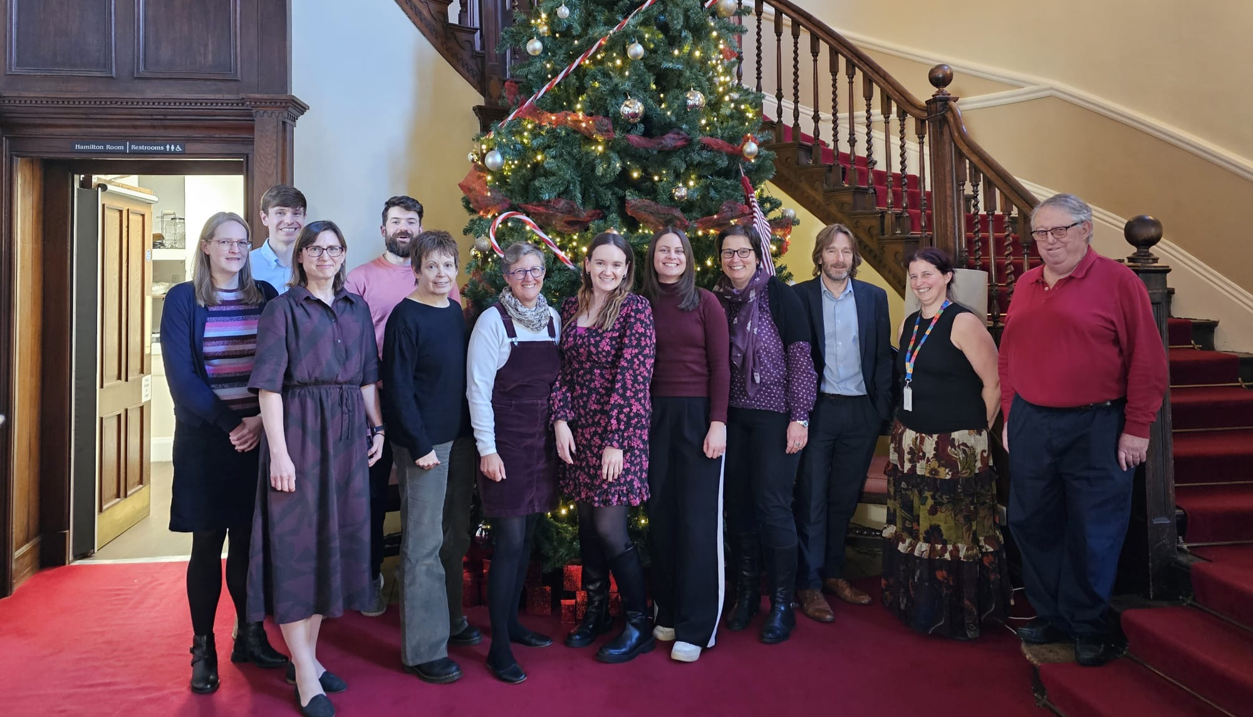
Thank you!
richard.farrow@stfc.ukri.org
www.uk-ilo.org

