Slide 1



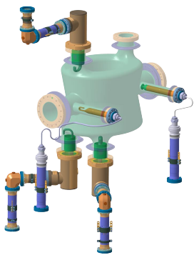

Crab Cavities for High Luminosity LHC
Amelia Edwards on behalf of HL-LHC WP4
UK-CERN accelerator celebration day
27th November 2025

Slide 2
Outline of the talk:
Introduction to crab cavities for HL-LHC
Design Choices & Challenges
Dressed Cavity Validation at CERN
Cryomodule Tests at CERN

Slide 3
Part 1: Introduction to the Crab Cavities for HL-LHC

Slide 4
What is High Luminosity LHC (HL-LHC)?
In short – Increase the luminosity of the LHC by a factor of x5-7
More Luminosity
More Collisions
More Data
More Physics!
Notes:
*than the LHC nominal value
HL-LHC improves luminosity by increasing beam brightness and squeezing the beams more tightly

Slide 5
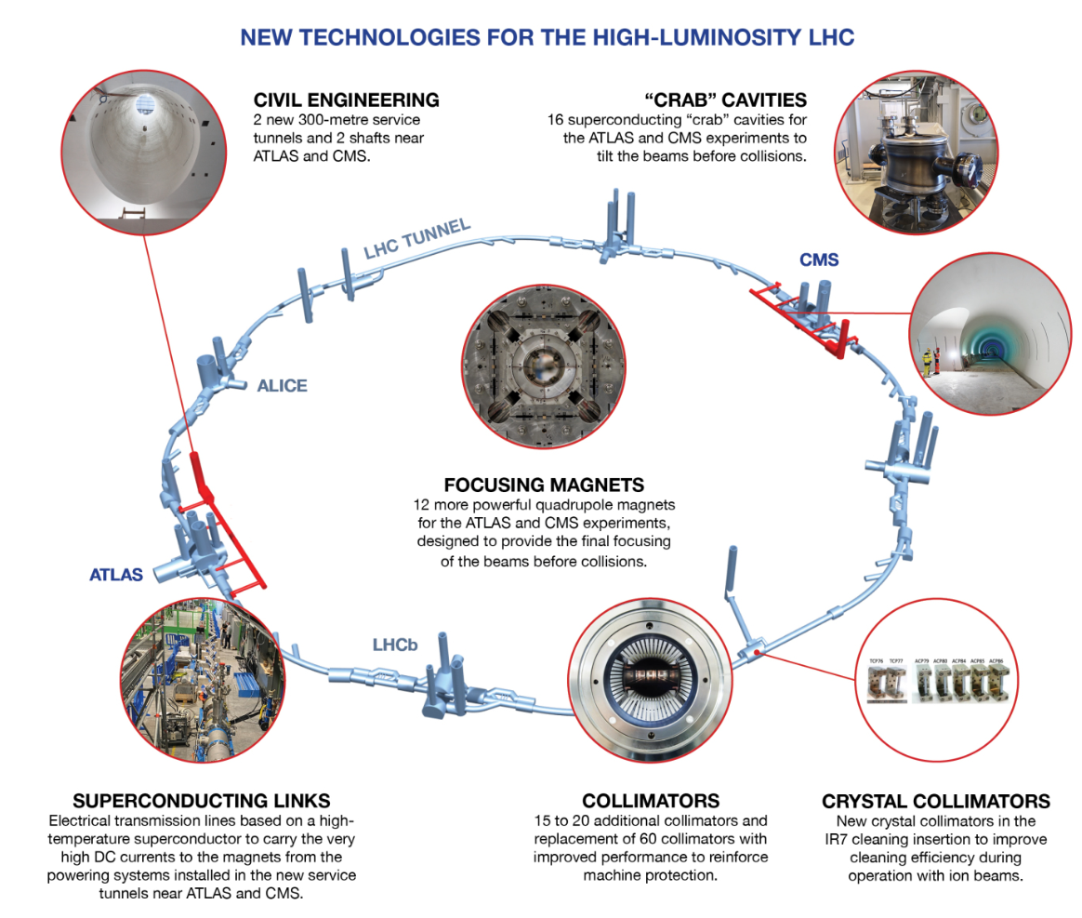
What is High Luminosity LHC (HL-LHC)?
In short – Increase the luminosity of the LHC by a factor of x5-7
Using a variety of technologies to increase beam brightness + more focused beams at the detectors of CMS & ATLAS
Notes:
*than the LHC nominal value
HL-LHC improves luminosity by increasing beam brightness and
To achieve this, the beam will need to be more intense and more focused than at present in the LHC. New equipment will need to be installed over about 1.2 of the LHC’s 27 kilometres.squeezing the beams more tightly

Slide 6
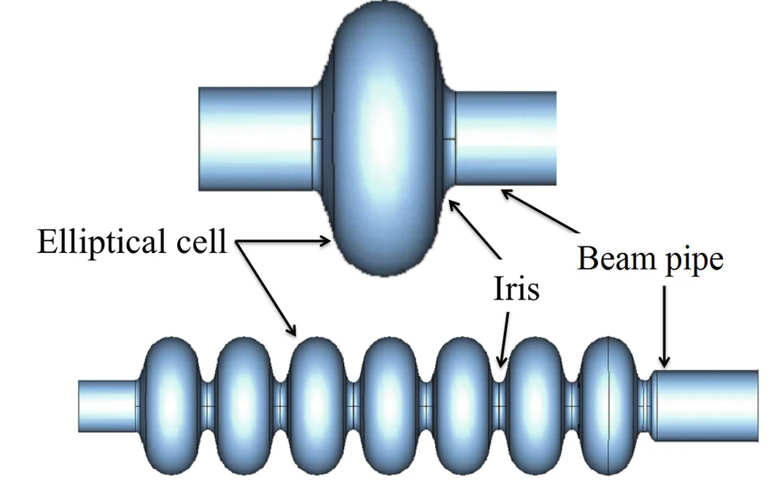
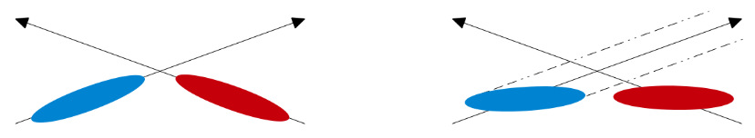
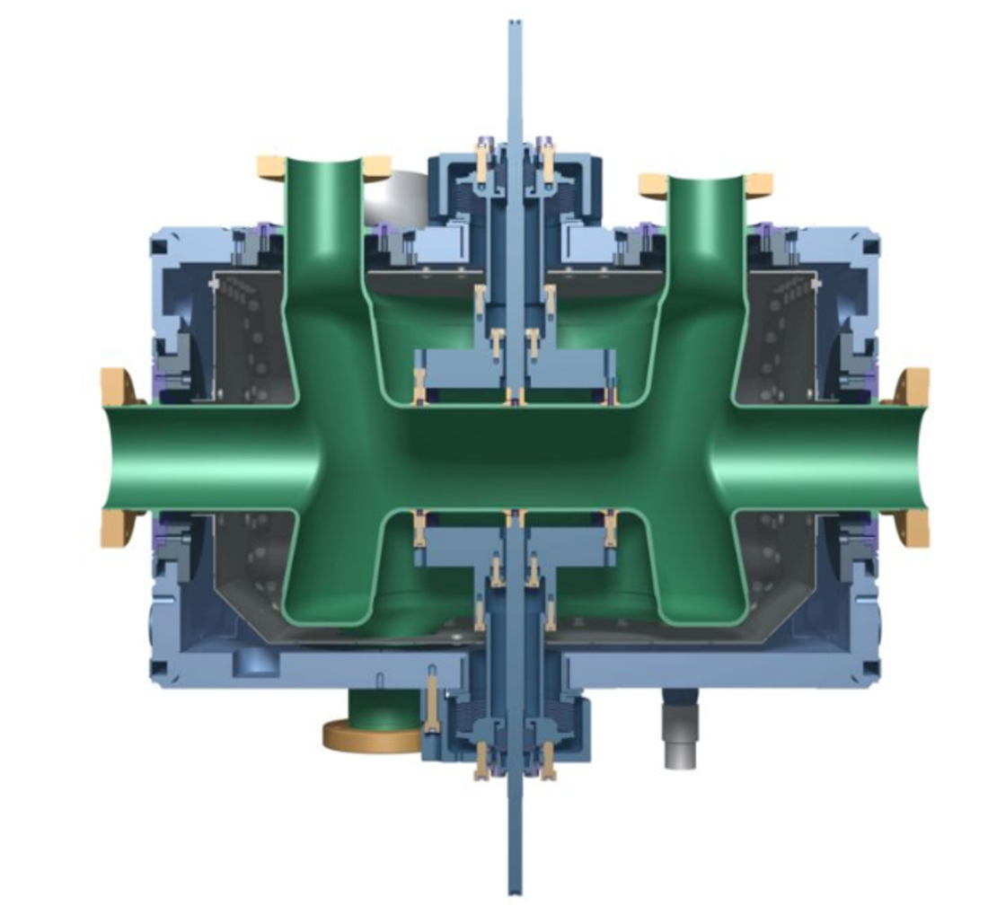
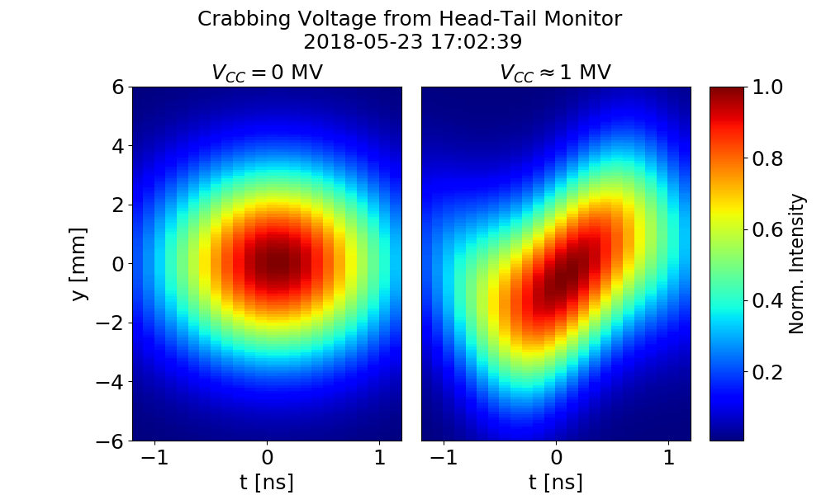
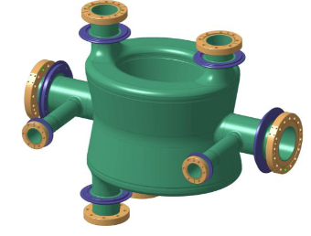
What is a crab cavity?
Crab cavities are a type of RF cavity which are designed to apply a time-dependent transverse kick to bunches to achieve the bunch rotation
They differ from typical RF cavities which are used to accelerate the bunch along the orbit
Notes:
A novel superconducting RF system consisting of eight cavities per beam for transverse deflection (akacrab cavities) of the buncheswill be used to compensate the geometric loss in luminosity due to the non-zero crossing angle and the extreme focusing of the bunches in the HL-LHC.
The non-zero crossing angle implies an inefficient overlap of the colliding bunches at the IP.
The time-dependent transverse kick from an RF deflecting cavity is used to perform a bunch rotation, in the crossing plane about the barycentre of the bunch (seeFigure4-1).
The other key technology, necessary to take advantage of the smaller beam-spot size at the interaction points, is a series of superconducting radio-frequency (RF) “crab” cavities that enlarge the overlap area of the incoming bunches and thus increase the probability of collisions.

Slide 7

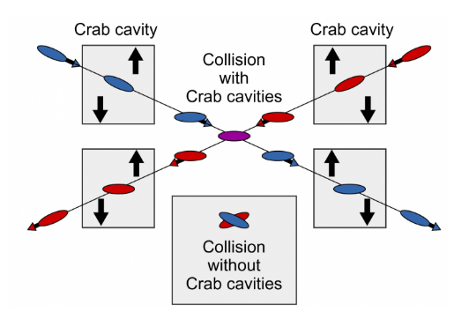
Why do we need crab cavities?
Beams have a crossing angle when colliding in the detectors
The crossing angle reduces the effective overlap during collisions
Crab cavities will rotate the bunches to collide head on

Slide 8
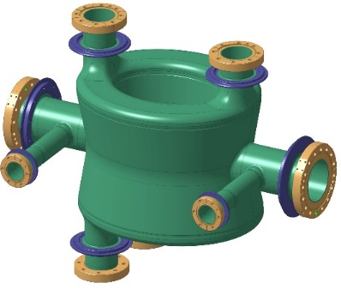
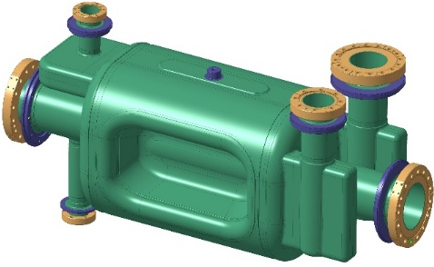
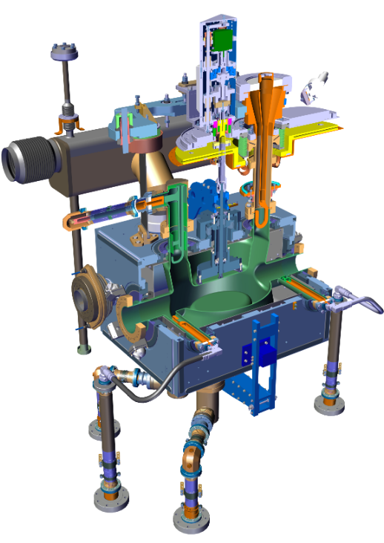
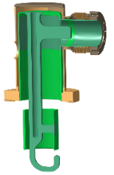
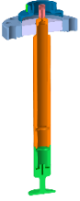
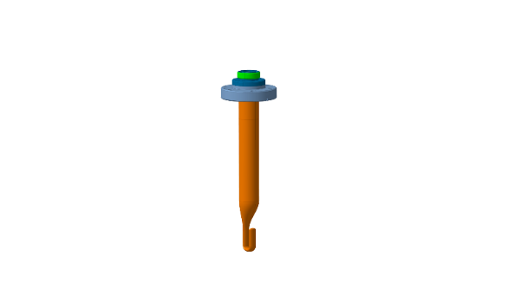
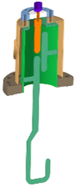
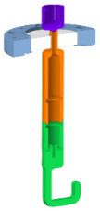
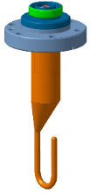
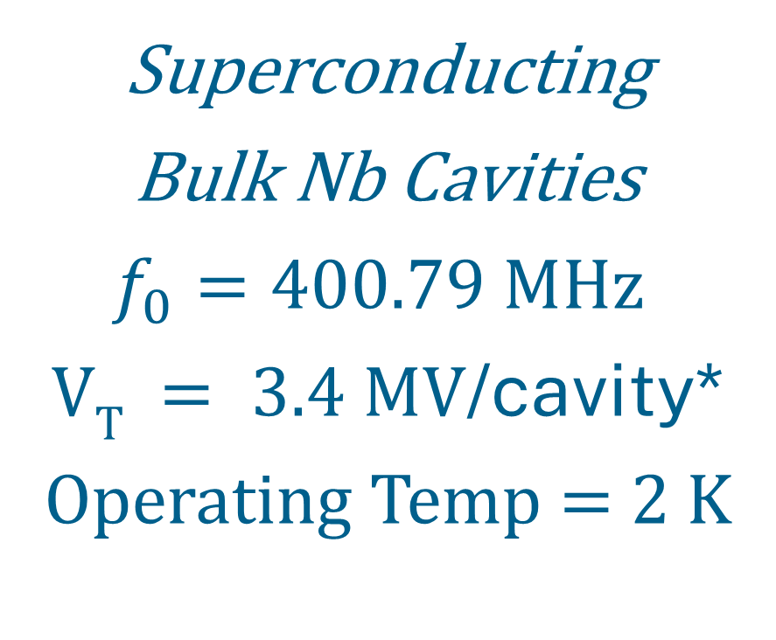
HL-LHC Crab Cavity Geometries
Double Quarter Wave (DQW) cavity
– to be used in Point 5 (CMS), vertical
Radio Frequency Dipole (RFD) cavity
– to be used in Point 1 (ATLAS), horizontal
Superconducting
Bulk Nb Cavities
$f_{0}=400.79 MHz$
$VT = 3.4 MV$/cavity*
Operating Temp = 2 K

Slide 9
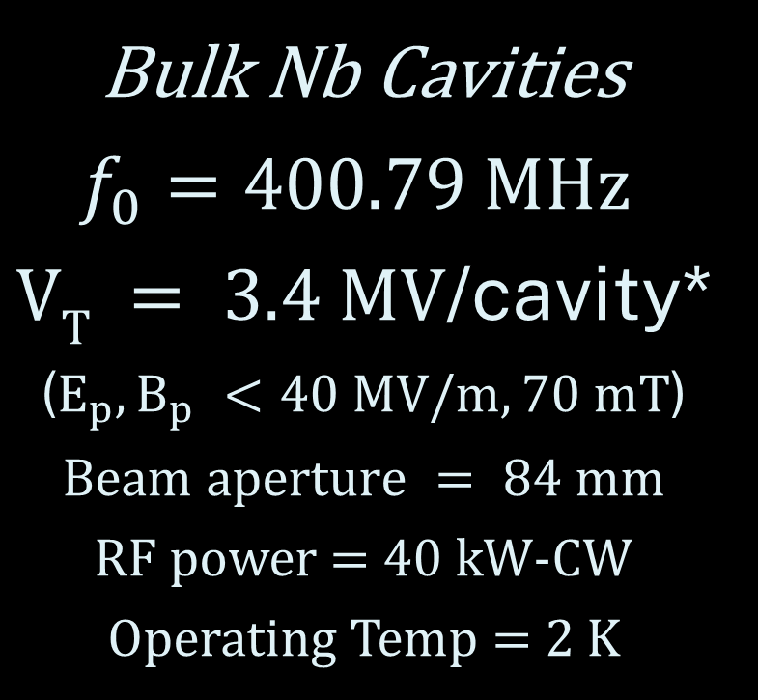
HL-LHC Cavity Geometries
Bulk Nb Cavities
$f_{0}=400.79 MHz$
$VT = 3.4 MV$/cavity*
($E_{p}, B_{p} <40 MV/m, 70 mT$)
$$Beam aperture = 84 mm$$
RF power = 40 kW-CW
Operating Temp = 2 K
Radio Frequency Dipole (RFD) cavity
– to be used in Point 1 (ATLAS), horizontal
Double Quarter Wave (DQW)

Slide 10
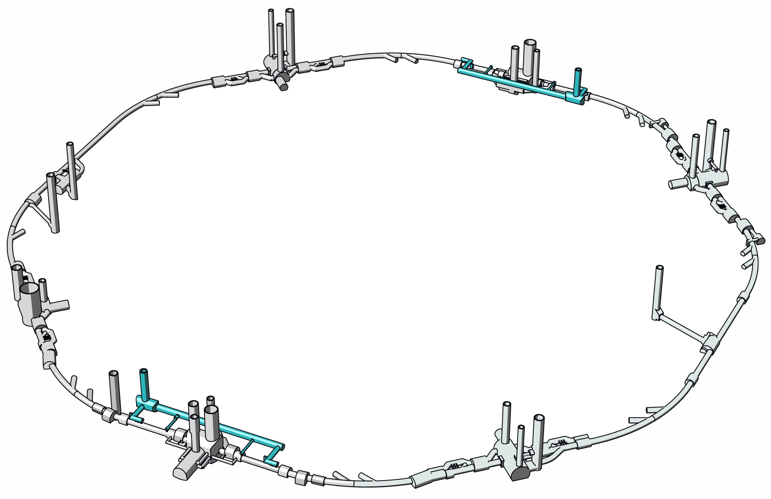
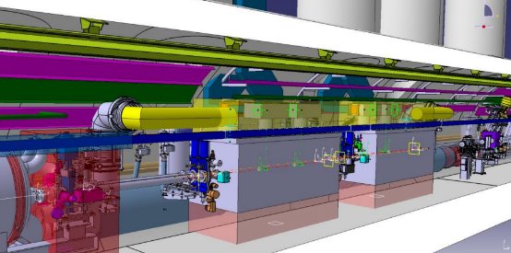
Integration of the Crab Cavities & Cryomodules
16 crab cavities in total, eight of each type (DQW & RFD)
One cavity type at each interaction point
Two cavities per cryomodule
One cryomodule per beam /per IP
P5 - DQW
P1 - RFD

Slide 11

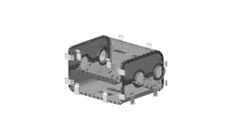
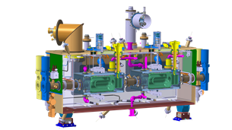
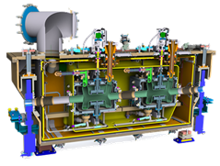
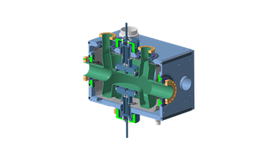
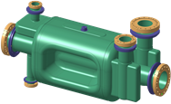
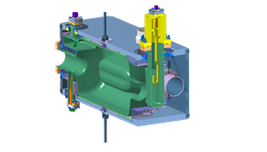
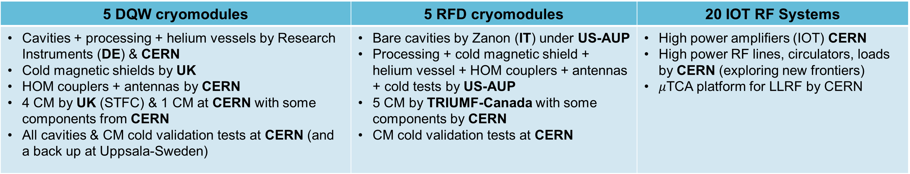
HL-LHC Crab Cavities – A Worldwide Collaboration!
5 DQW cryomodules | 5 RFD cryomodules | 20 IOT RF Systems
Cavities + processing + helium vessels by Research Instruments (DE) & CERN Cold magnetic shields by UK HOM couplers + antennas by CERN 4 CM by UK (STFC) & 1 CM at CERN with some components from CERN All cavities & CM cold validation tests at CERN (and a back up at Uppsala-Sweden) | Bare cavities by Zanon (IT) under US-AUP Processing + cold magnetic shield + helium vessel + HOM couplers + antennas + cold tests by US-AUP 5 CM by TRIUMF-Canada with some components by CERN CM cold validation tests at CERN | High power amplifiers (IOT) CERN High power RF lines, circulators, loads by CERN (exploring new frontiers) $μ$TCA platform for LLRF by CERN

Slide 12
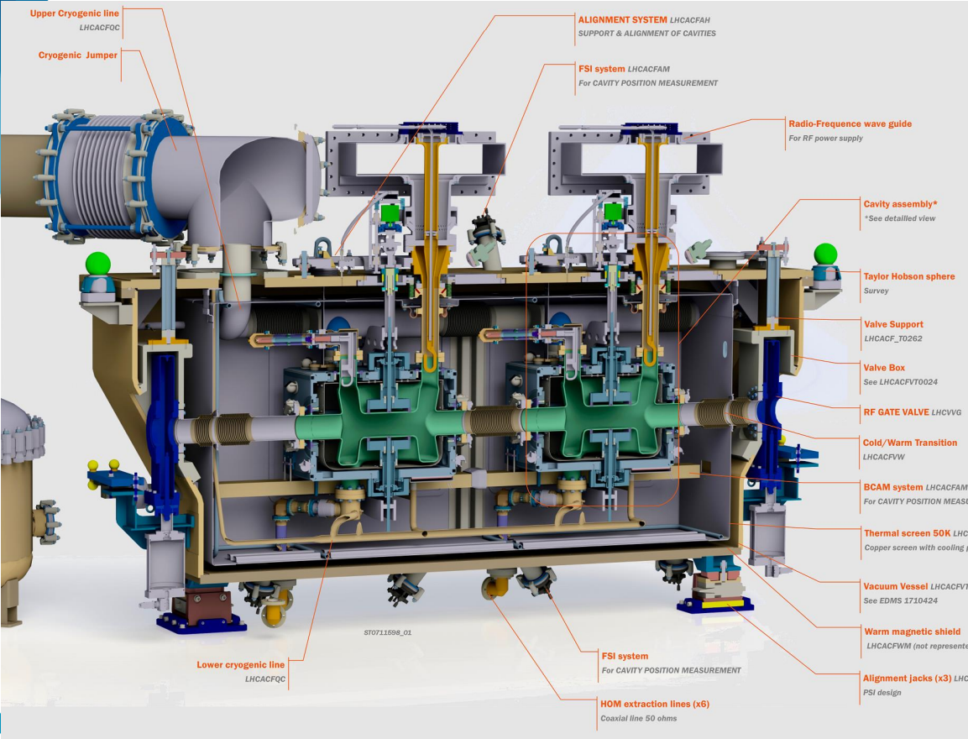
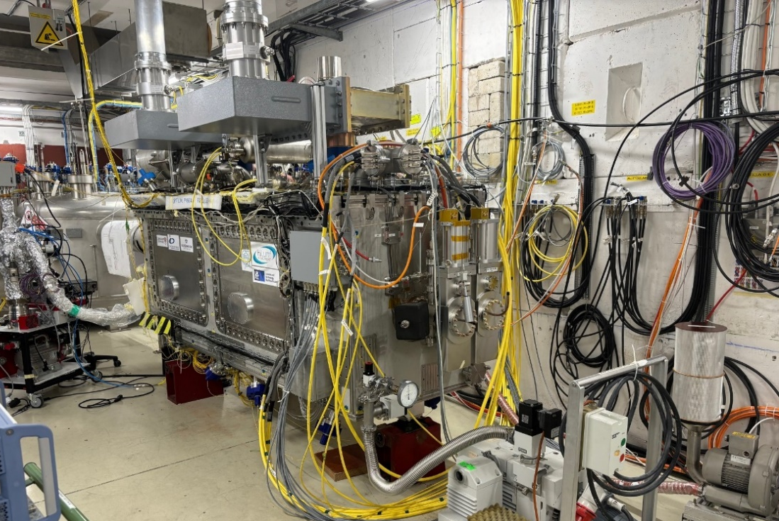
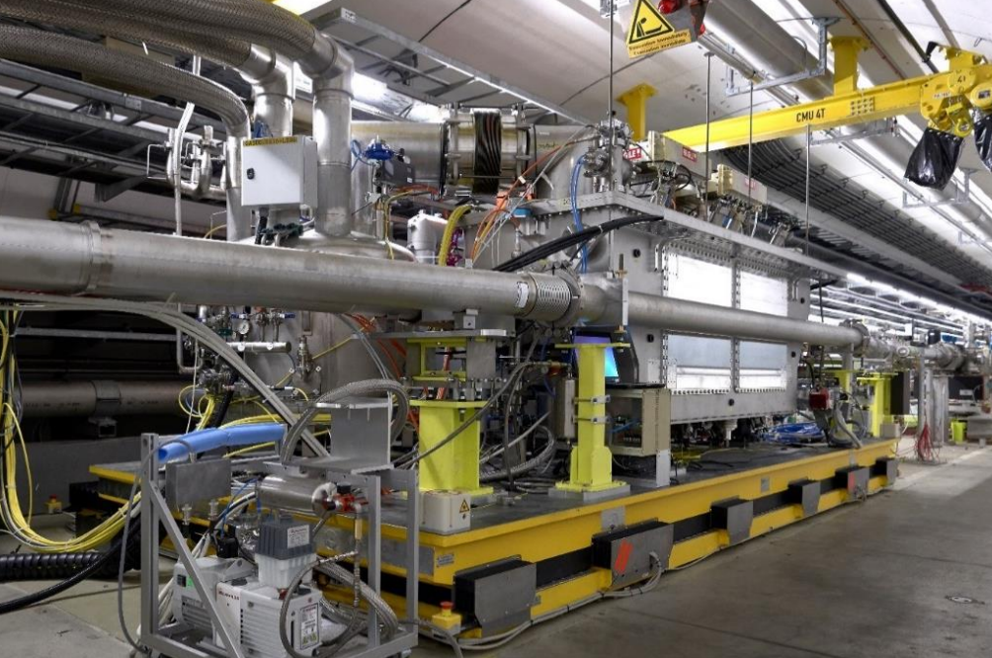
HL-LHC Crab Cavities – Collaboration with the UK
CERN
UK
SM18 – 2K Test
STFC Daresbury
Cryomodule Assembly
x2
SPOILER ALERT!
Details from the UK Collaboration coming up in the next talk!
SM18 Cryomodule Test
LHC Installation!

Slide 13
Part 2: Design Choices & Challenges

Slide 14
Why choose super-conducting cavities operating at 2K?
Superconducting niobium cavities operating in superfluid helium at 2K
Why 2 K? Why 2 K instead of 4.5 K?
Much lower RF losses
4.5K would not be sufficient to reach required kick voltage
Keeps cryogenic heat load within HL-LHC limits
Notes:
-271.15
At 4.5 K the RF losses would be too high to deliver the required transverse kick; only at 2 K does niobium have a low enough surface resistance to make the crab cavities efficient and cryogenically affordable.
“For the crab cavities, we need very high RF fields but with extremely low power dissipation. At 4.5 Kelvin, niobium’s surface resistance is still too high — the losses would be large, and the cryogenic power needed would exceed what the HL-LHC can provide. Operating at 2 Kelvin, in superfluid helium, reduces those losses by more than an order of magnitude. That’s what makes the required kick voltage achievable while keeping the heat load and quench margin within the limits of the cryogenic system.”

Slide 15
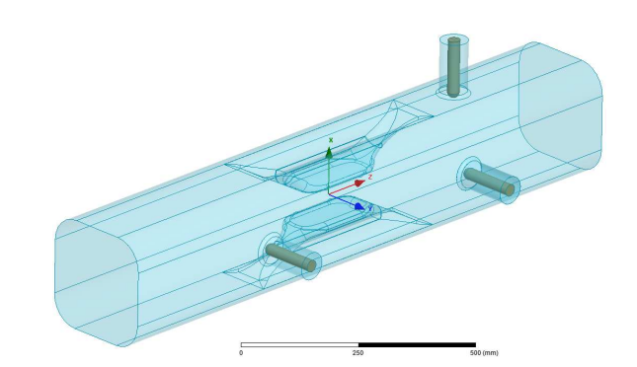
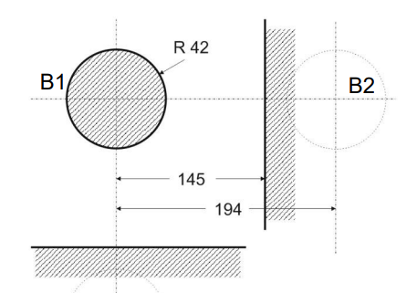
Why so compact? A Compact Cavity Design to fit the LHC Tunnel Constraints
Adopting compact, complex geometries
Why a Compact Geometry?
Must fit in tight LHC tunnel space
Second beam line in very close proximity
Suitable for 400MHz which:
Matches LHC bunch structure & RF systems
Compatible with existing RF power tech
Second beam pipe is very close! Only 194mm from the centre of the cavity
Notes:
“The LHC tunnel gives us almost no free space, and the crab cavities have to be installed between two beam lines that are extremely close together. A traditional elliptical cavity simply wouldn’t fit in that region. That’s why we use compact geometries — the DQW and RFD designs — which are short and wide enough to fit into the existing interconnect without modifying the beam separation. These shapes also let us integrate the HOM dampers and the power couplers in a very confined volume. The trade-off is tighter machining tolerances and more sensitive alignment, because small deviations can affect the electromagnetic performance.”

Slide 16
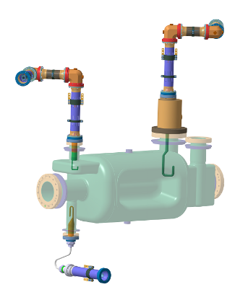
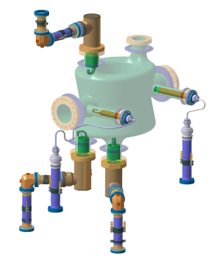
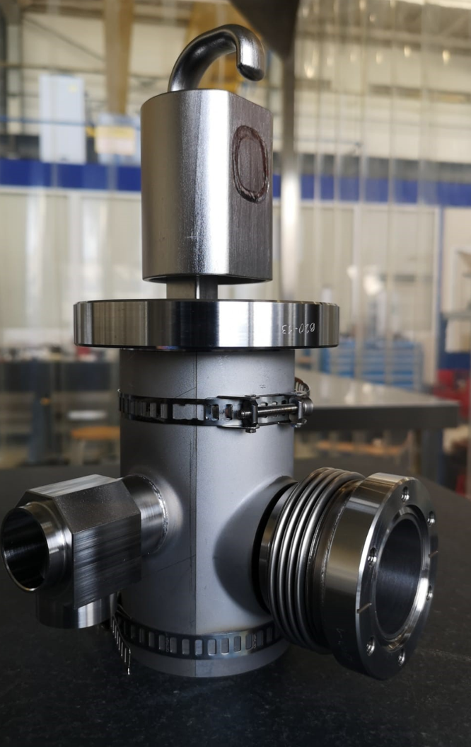
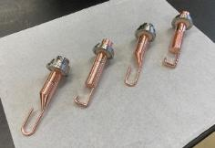
Controlling Unwanted Modes and Powering the Cavity
The HL-LHC beam and complex geometry excite higher-order modes (HOMs) and requires high-power, reliable input couplers.
HOMs & Couplers
Beam excites many higher-order modes
Need strong damping for stability & heat load
HOM couplers integrated in limited space
Requires careful conditioning & thermal design
Notes:
“The HL-LHC beam can excite a whole range of higher-order modes, and we need to make sure these modes are well damped so they don’t add heat load or drive instabilities. Because the cavity design is so compact, the HOM couplers have to fit into very limited space, while still extracting enough power from these unwanted modes.
At the same time, the input coupler has to deliver clean and stable RF power to the cavity. These couplers work in a demanding environment, so they need careful conditioning and a robust thermal design. Together, the HOM damping and the RF power coupling make the cavity stable, efficient, and reliable for operation in the HL-LHC.”

Slide 17
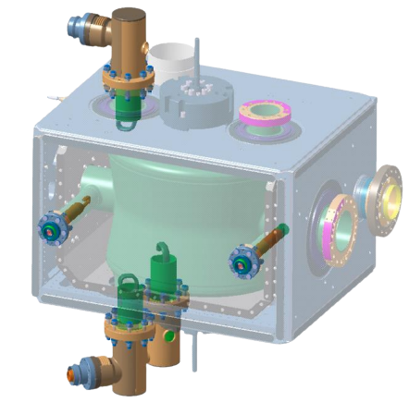
Part 3: Dressed Cavity Validation

Slide 18
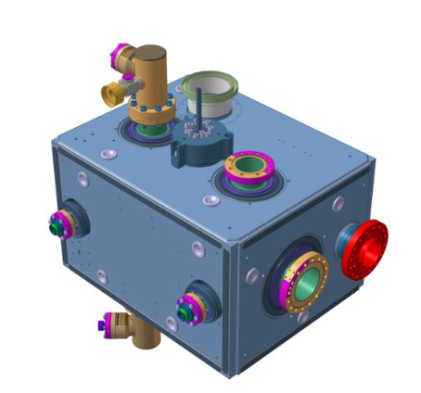
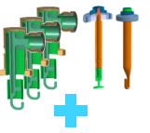
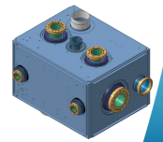

What do we mean by a Dressed Crab Cavity?
Notes:
The Double Quarter Wave (DQW) cavity uses three on-cell, coaxial, superconducting (internally cooled) HOM couplers to damp the HOMs. They have an L-C band-stop filter centred at 400 MHz to reject any power from the fundamental mode

Slide 19
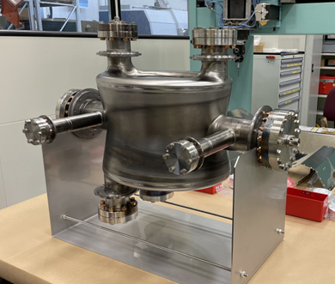
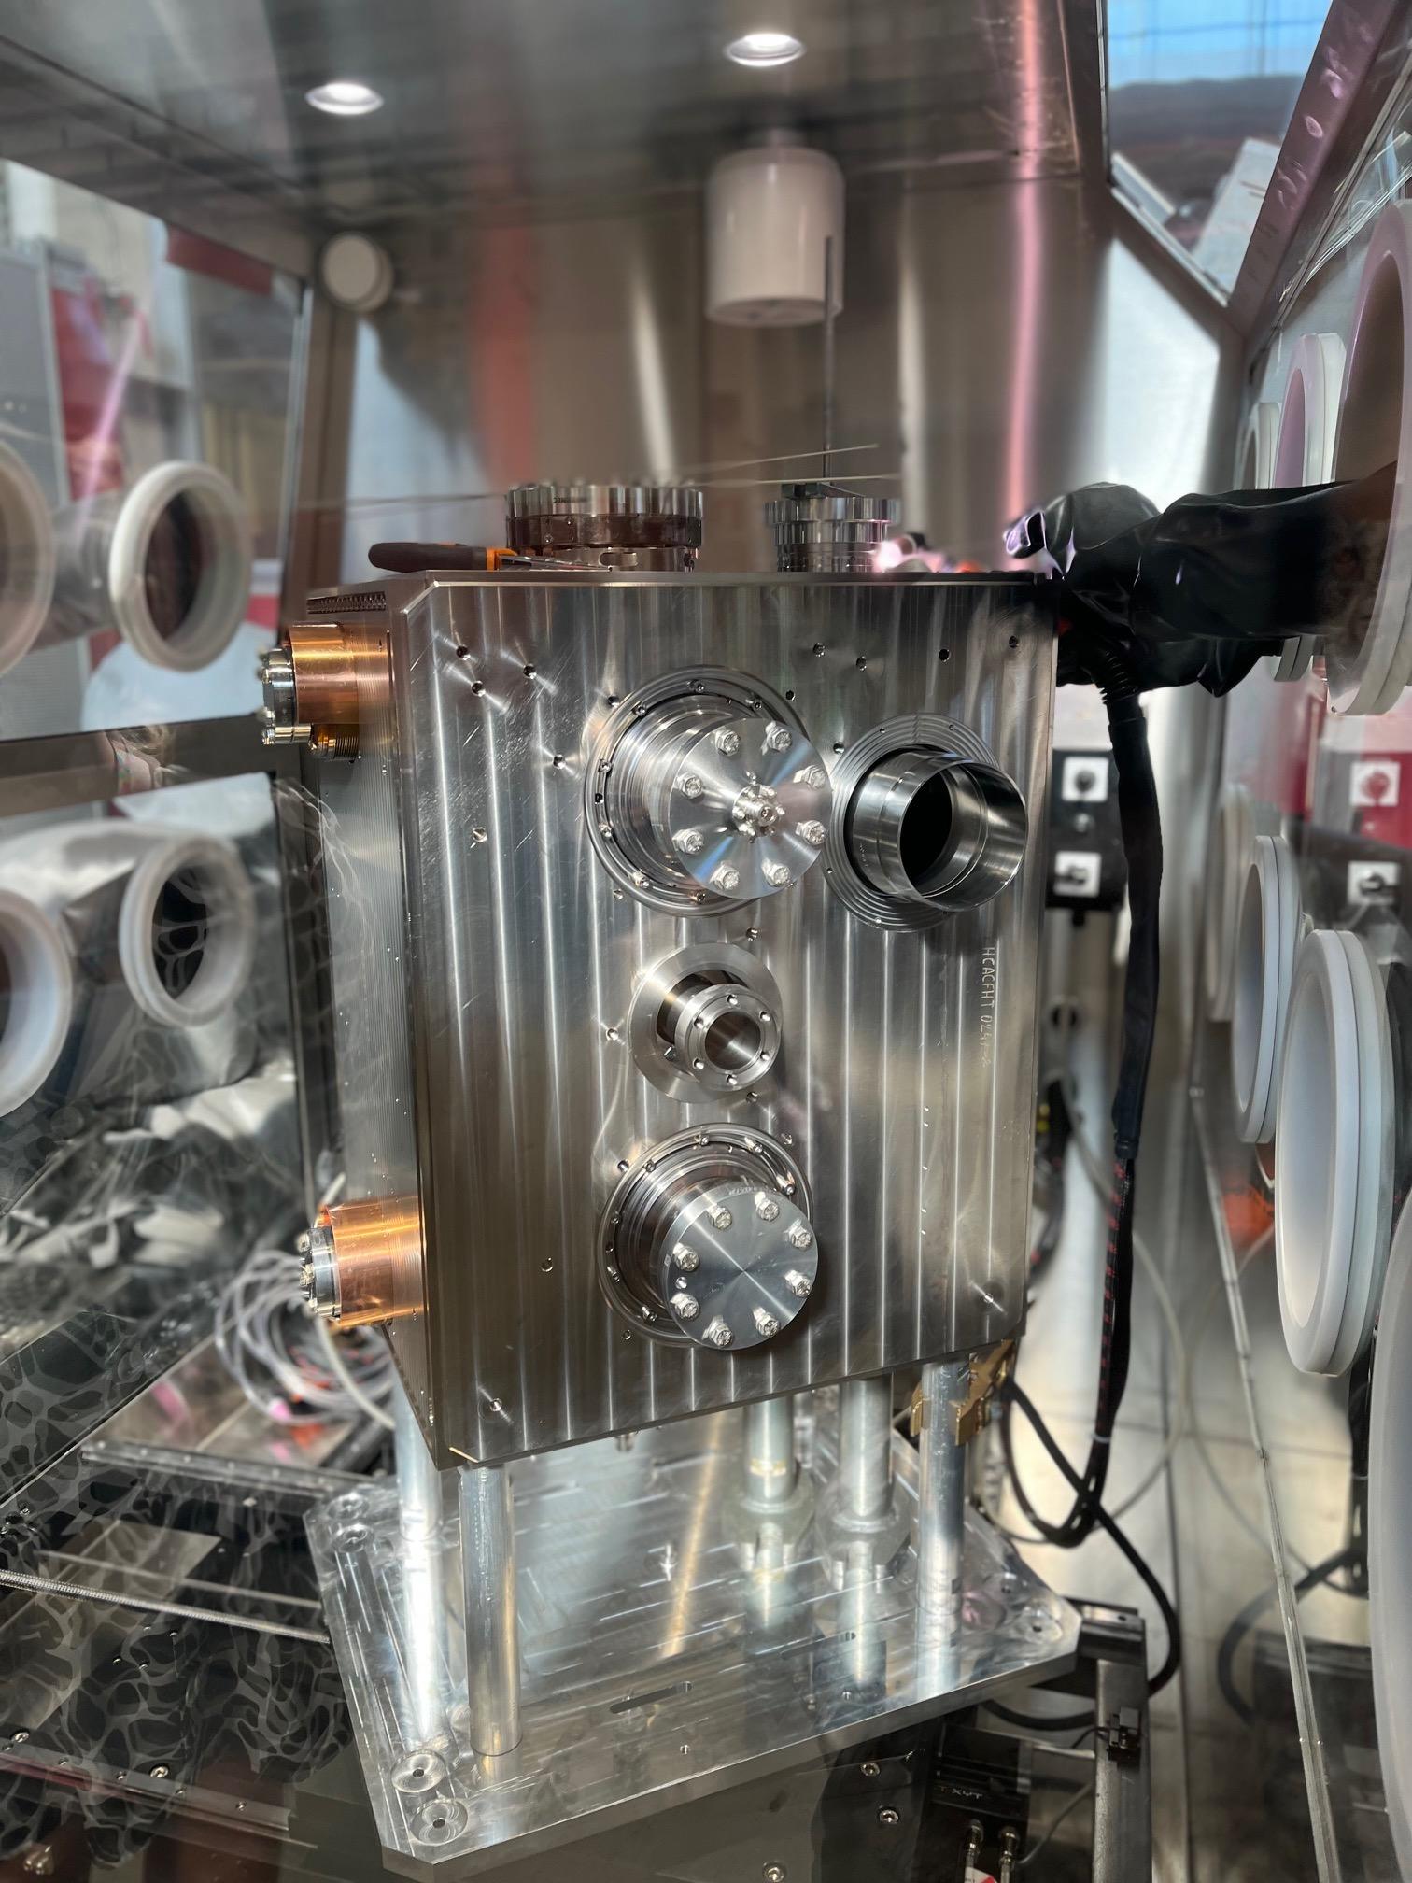
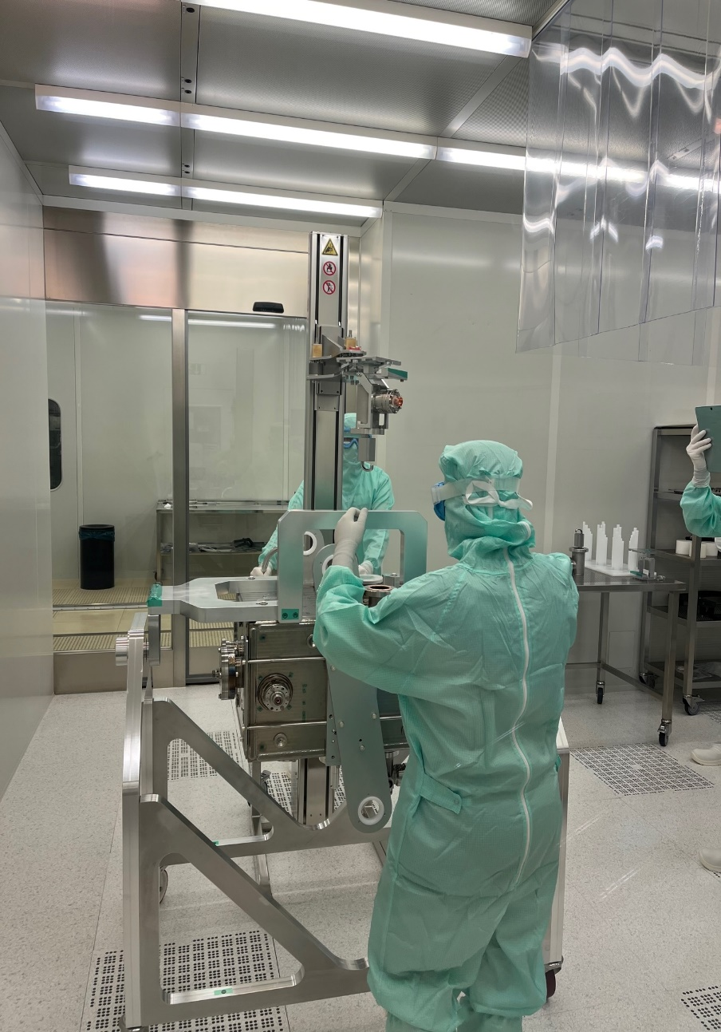
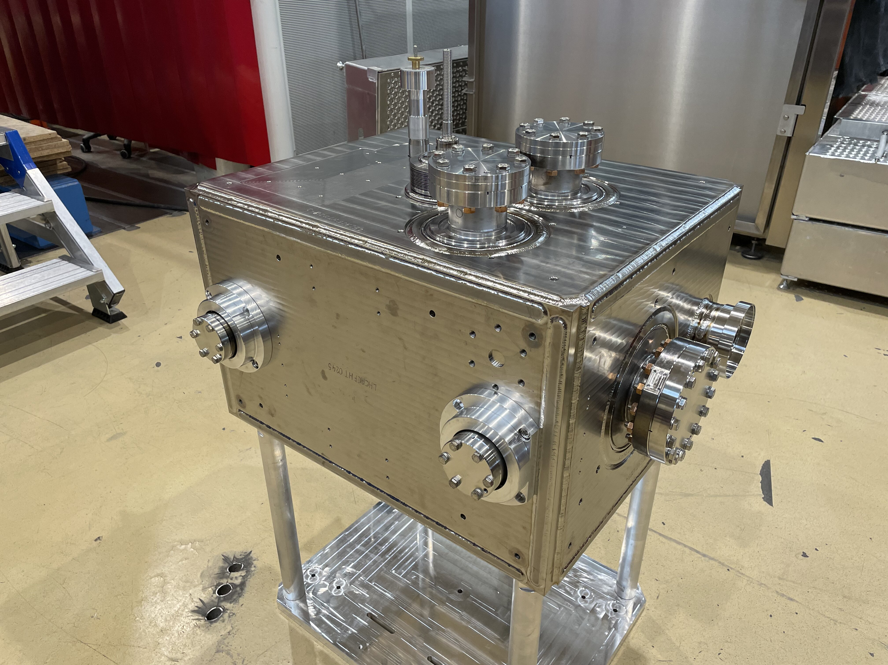
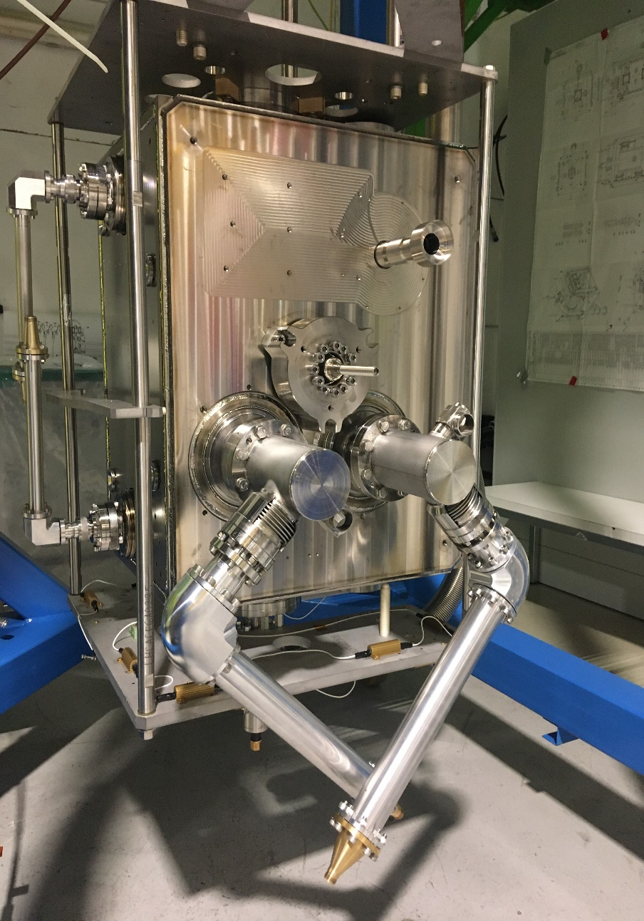
Crab Cavities: Cold Tests
Baseline: tested 3 times as bare, jacketed and dressed.
Bare (BC)
Jacketed (JC): Cold Magnetic Shield + Helium tank assembly (bolted) and TIG welding
Dressed (DC): JC with RF couplers: 3 HOMs, 1 HF HOM, 1 FA + VT input antenna & 25/50Ω adapters
Bare
Jacketed
Dressed
Slide courtesy of K. Turaj (SY-RF)

Slide 20
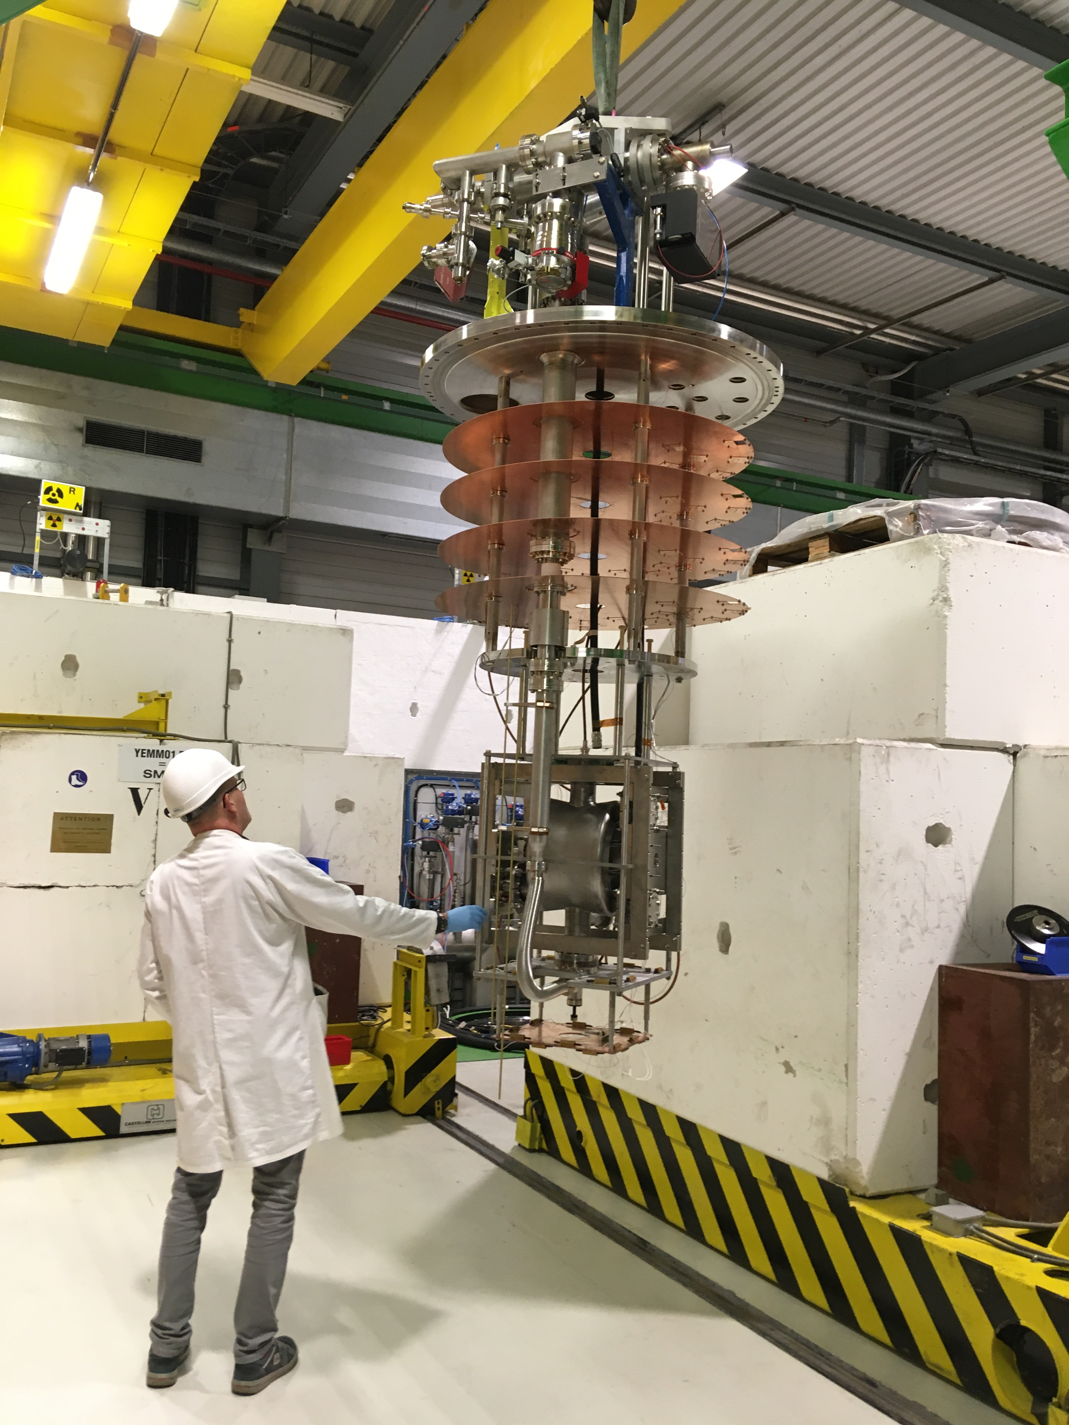
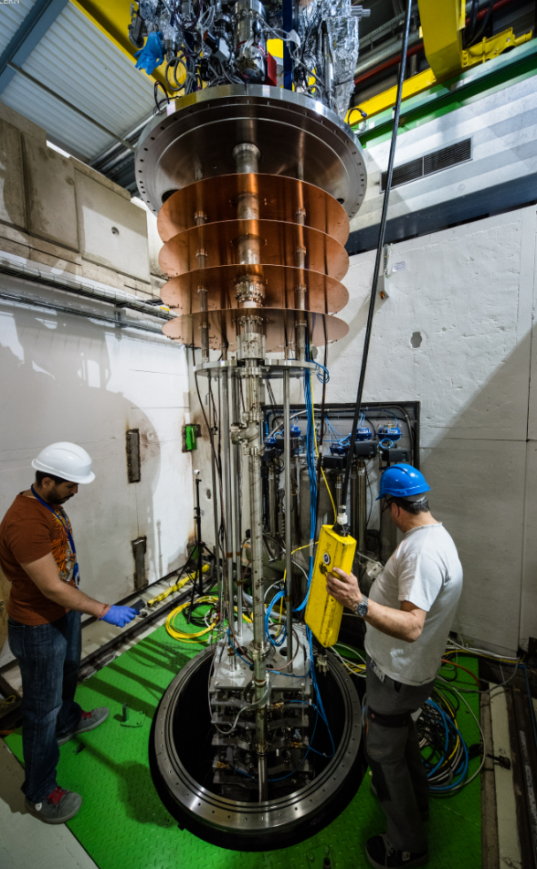
Vertical Testing at 2K
Two vertical cryostats
Test temperature: 2K, 2.5K for RF conditioning
Sensors used during the tests:
Temperature sensors: CERNOX.
3 single-axis magnetic flux probes.
Radiation monitors - different position depends on the cryostat.
Cryostats with magnetic field compensation coils → set at ~0.5µT (BC).
Stiffening frame for bare cavities.
Cavities tested fully immersed in the LHe bath.
Cavity vacuum actively pumped by turbo and ion pump until ~130K.
Controlled cool-down to keep the gradient across the cavity to <50K.
Between 4-6 weeks process in total!
x18 Tests scheduled for 2026.

Slide 21
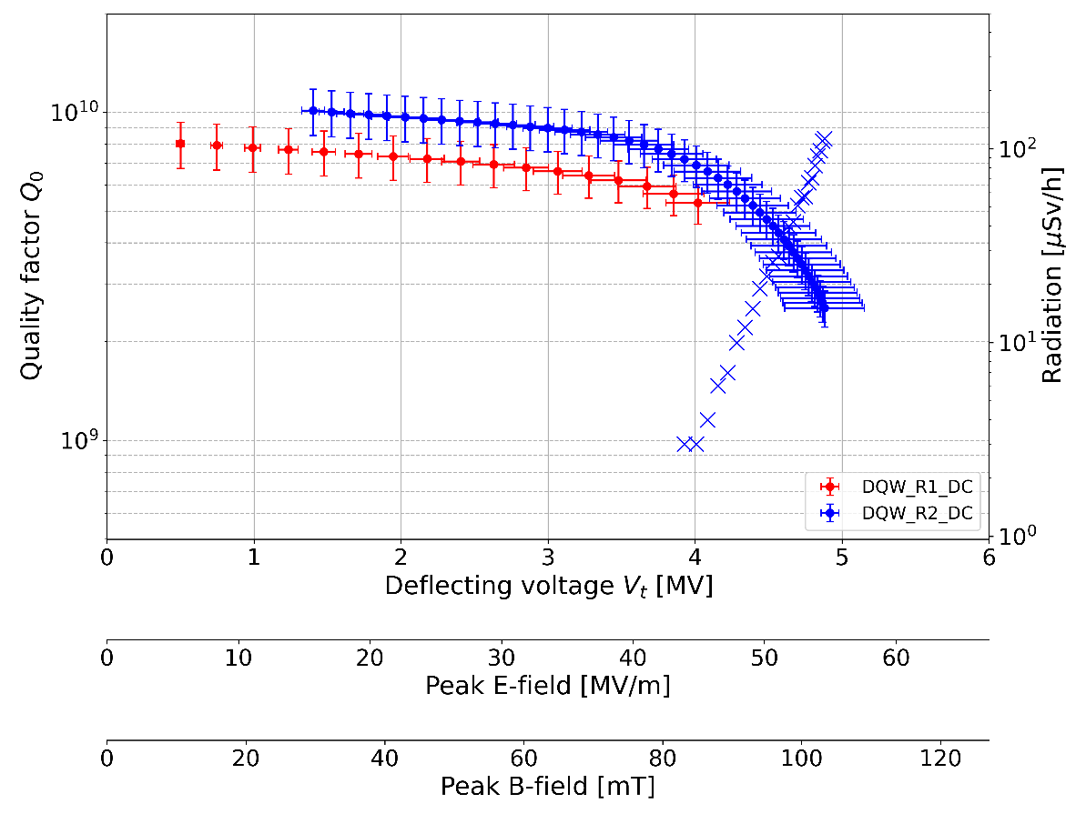
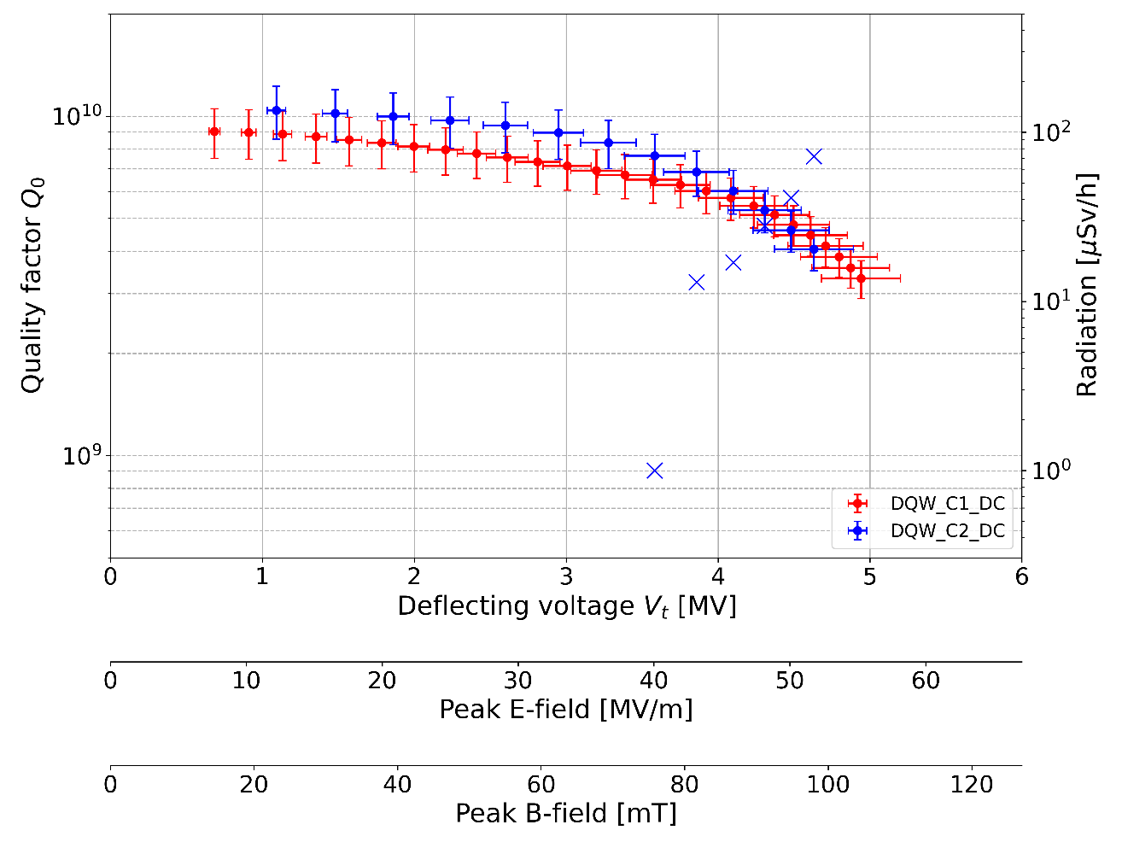
The First Four Dressed DQW Cavities
RI DQW1 & DQW2
Four DQW cavities qualified with all couplers installed
Two cavities produced by Research Instruments (DE)
Two produced at CERN
All four shipped to UK!
CERN DQW1 & DQW2

Slide 22

And the cavities were shipped to Daresbury…

Slide 23


Crab Cavity Cryomodules - A Very Complex System!
Maintain ultra-clean cavity surface
Cryogenics at 2 K
Ultra-clean vacuum & insulation vacuum
Precise alignment of cavities & beamline
Tuning systems
Magnetic & thermal shielding
Many RF connections in compact space
Integrated supports & diagnostics
Notes:
“One of the biggest challenges is the cryomodule, because this is where all of the systems that support the cavity have to come together in a very compact volume.
We need 2-Kelvin cryogenics, an ultra-clean RF vacuum, and a separate insulation vacuum, all carefully managed inside the same structure. The cavities have to be held in precise alignment with the beamline, while also being free to move for thermal contraction and controlled by both slow tuners and fast piezo tuners.
We also need extensive magnetic shielding and thermal shielding to protect the cavities, and a surprising number of RF connections, sensors, and diagnostics all routed through a very confined space. Designing and building this cryomodule so that everything fits, functions, and remains accessible is a major engineering effort — it’s where the full system really comes together.”

Slide 24



WP04 Collaborations for DQW cryomodule CERN/STFC
Slide courtesy of T. Capelli (EM-MME)
On going activity at STFC + planning
DQW - CM2 assembly on-going (step 6 / 13)
CERN specialists' visits at STFC
6 visits from CERN specialists done for CM2
5 visits to be done by end of 2025
(Less visits for the following cryomodules (6 instead of 11 per CM ? TBC))
Delivery of CM2 at CERN planned Feb 26
DQW - CM3 preparation started using CERN cavities
Planning of production of remaining CMs :
Production of component under CERN responsibility -> Components for CM2 & 3 done (few items for NCRs resolution under production and foreseen to be delivered on time)
Preparation for the assembly of DQW-CM1 at CERN + Planning – On-Going
See pres. S.Barrière & J.Dequaire
See presentations :
E.Jordan

Slide 25

Part 4: Cryomodule Testing

Slide 26

How do we Test the Cryomodules? SM18 Horizontal Test Bunker
Test preparation:
Transport ,Inspection, Cabling, Instrumentation
RF checks, Tuner, Alignment.
Welding cryolines and Jumper installation.
Vacuum activities: LT, RGA x3 volumes.
4-month test plan outlined for each cryomodule to qualify to nominal voltage of 3.4 MV
5 Weeks
Tests at 2K:
Cool down: 1 W
FPC processing: 4 W (2 FPCs in parallel).
RF meas.: 2W: HOMs, Tuner, voltage ramp-up, Field Emission, Alignment.
Warm up: 1 W .
8 Weeks
Removal CM:
Disconnect jumper and cutting cryo lines.
Vacuum LT and RGA.
Disconnect cabling, Transport.
3 W
After 2K validation, cryomodules will be installed in the LHC

Slide 27

Beam Tests of Cryomodules? SPS-prototypes
Built in the UK!
DQW: 2018-2023 operation, Removed in 2023/24 YETS
RFD: Installed in the SPS in YETS 2024-25
SPS-LSS6
(2018-23)
SPS-LSS6
(2025-26)

Slide 28




UK RFD Cryomodule installation into SPS
After leaving SM18 horizontal test bunker the cryomodule was installed into the SPS during the maintenance period of 24/25

Slide 29




First Demonstration of Horizontal Crabbing using RFD Prototype Cryomodule!
Reached operational target (3.4MV) in both cavities.
Horizontal crabbing & transparency demonstrated
5 MDs completed this year
x [mm]

Slide 30
Thankyou!
This is the work of many colleagues across many departments inside CERN and from our other collaborators in HL-UK and STFC-UK

