Slide 1

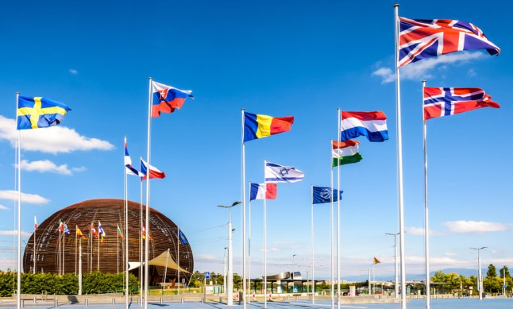
The AWAKE Experiment
Edda Gschwendtner, CERN
UK-CERN Accelerator Celebration Day
27 November 2025

Slide 2
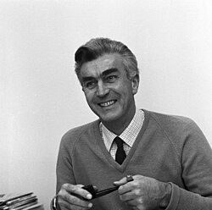
“The accelerator only really behaves when a few physicists are standing right next to it, worrying about it. “
John Adams

Slide 3
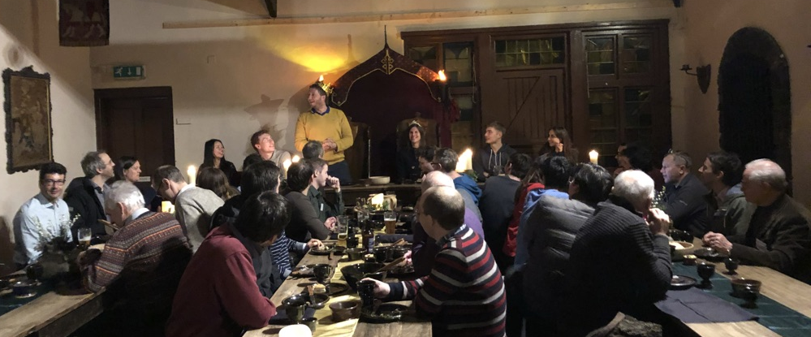
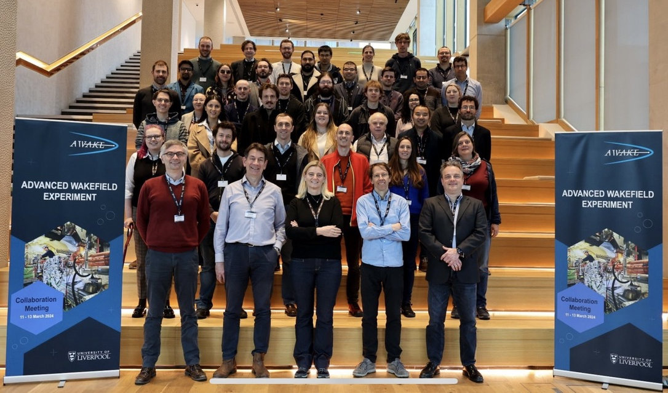
AWAKE and UK
UK
AWAKE Collaboration Meeting: 8 outside CERN
AWAKE:
> 28 PhD students, > 11 Master students, > 20 Post-docs
AWAKE Collaboration Meeting 2018, Manchester
UK PhD Thesis in AWAKE
Yangmei Li: Studies of Proton Driven Plasma Wakefield Acceleration, University of Manchester, 2018
Fearghus Keeble: Measurement of the electron energy distribution at AWAKE: UCL, 2019
Barney Williamson: Electron Beam Dynamics in a Proton-driven Plasma Wakefield, University of Manchester, 2021
James Chappell: Experimental study of long timescale plasma wakefield evolution, UCL, 2021
Aravinda Perera: Seeded self-modulation of elliptical beams in plasma wakefields, University of Liverpool, 2022
Linbo Liang: Beam-driven plasma wakefield acceleration in AWAKE, University of Manchester, 2023
Can Davut: Design and experimental verification study of non-invasive short electron bunch length monitor for AWAKE Run 2, University of Manchester, 2023
Adam Scaachi: High average power plasma wakefield acceleration and dark photon searches, UCL, 2025 (Master thesis)
Fern Pannell: Experimental study of accelerating gradients in a proton-driven plasma wakefield at AWAKE, UCL, 2026
Catherine Swain, Novel imaging diagnostics methods for AWAKE Run 2c, University of Liverpool, 2026
AWAKE Collaboration Meeting 2024, Liverpool
23 AWAKE Collaboration papers in high-level journals
Notes:
.

Slide 4
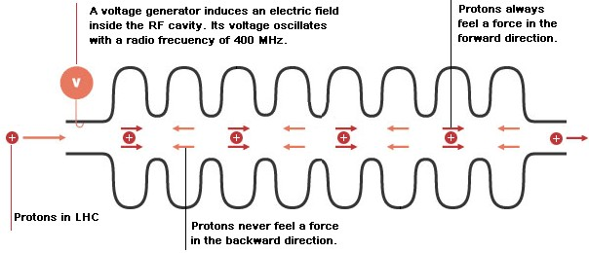
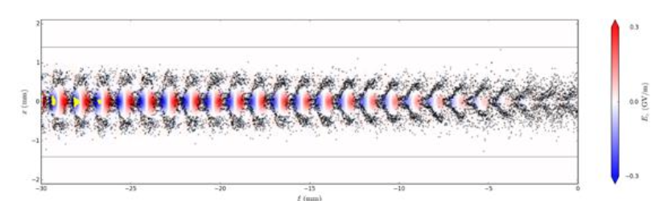
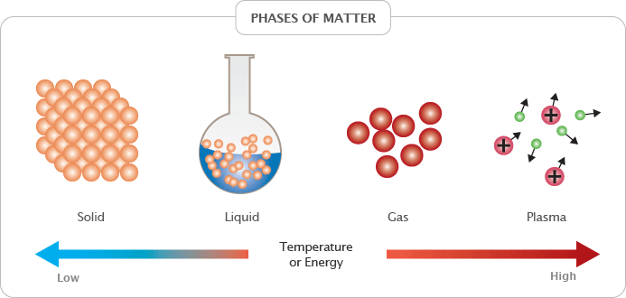
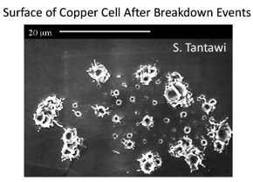
Introduction
Conventional RF Cavities
Plasma Acceleration
Very successfully used in all accelerators (hospitals, scientific labs,…) in the last 100 years.
Typical gradients:
  LHC: 5 MV/m
  ILC: 35 MV/m
  CLIC: 100 MV/m
Accelerating fields are limited to <100 MV/m
In metallic structures, a too high field level leads to break down of surfaces, creating electric discharge.
Fields cannot be sustained; structures might be damaged.
Plasma is already ionized or “broken-down” and can
sustain electric fields up to three orders of magnitude higher gradients
→ order of 100 GV/m.
→ ~1000 factor stronger acceleration!
E. Gschwendtner, CERN
4

Slide 5
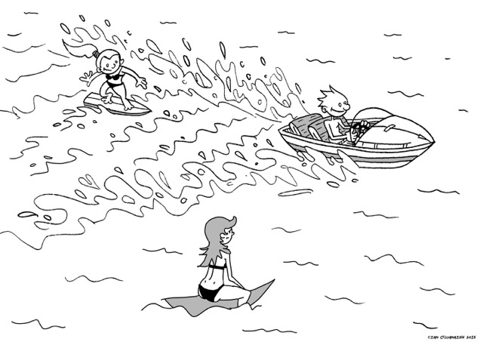
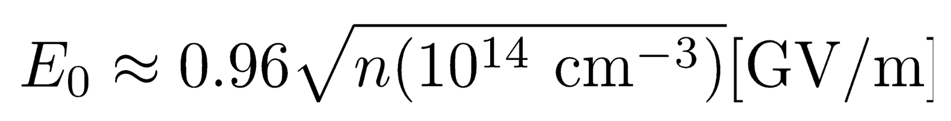
Plasma Wakefield Acceleration
Plasma:
quasi-neutral, electrostatic interactions dominate, charge particles are dense enough to support collective behaviour.
Drive-bunch or pulse:
relativistic charged particles bunches
or
laser pulse.
Witness-bunch: accelerated in the longitudinal electric field.
The maximum accelerating field (wave-breaking field) is:
Example: n_{pe} = 1x10¹⁸ cm⁻³ ➔ E_{WB} = ~100 GV/m ➔ λ_{pe} = ~30 µm
Example: n_{pe} = 7x10¹⁴ cm⁻³ (AWAKE) ➔ E_{WB} = 2.5 GV/m ➔ λ_{pe} = 1.2 mm

Slide 6
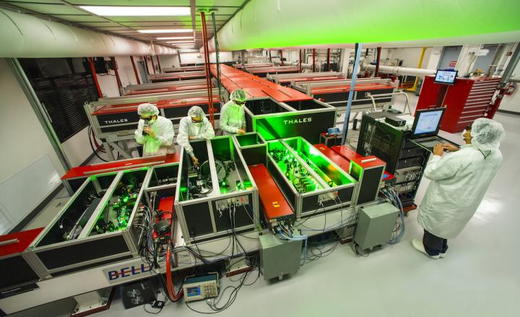
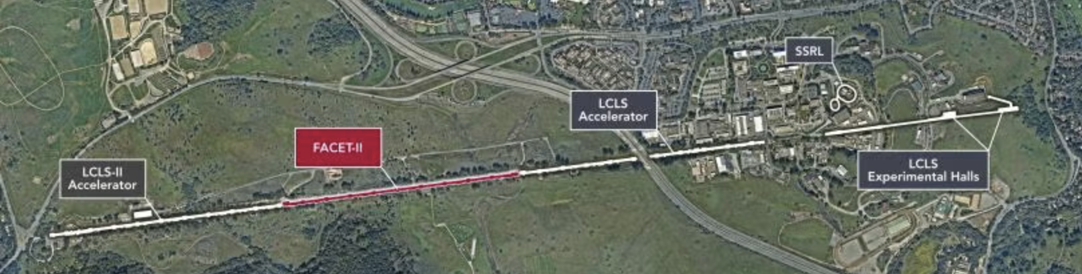
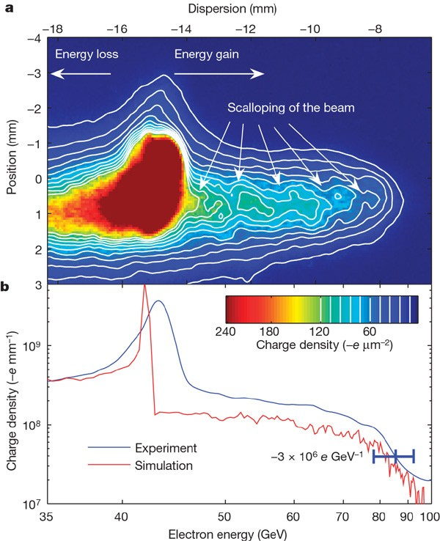
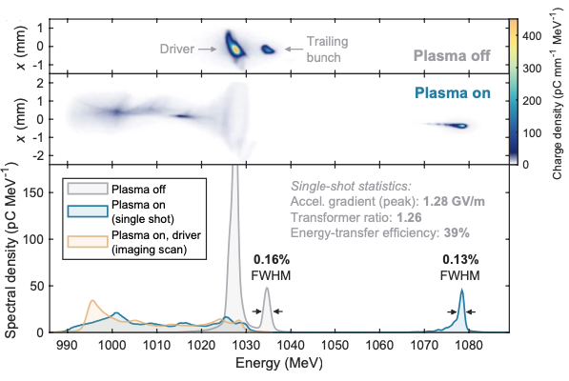
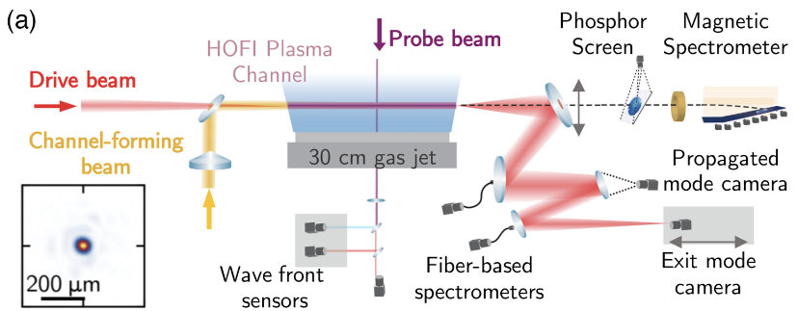
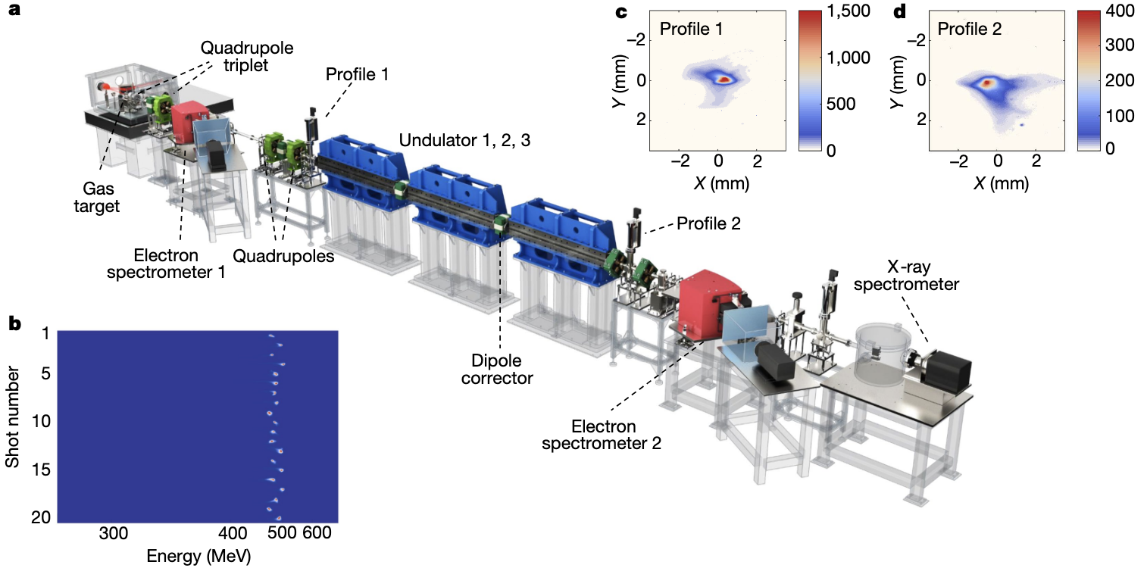
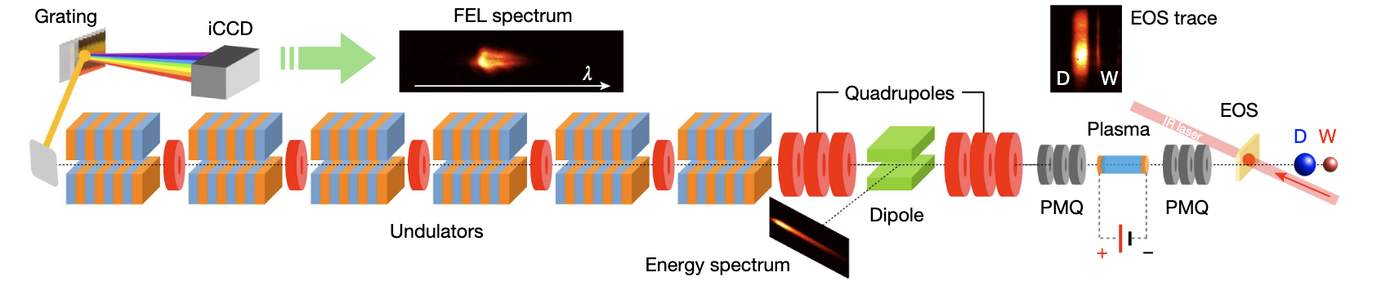
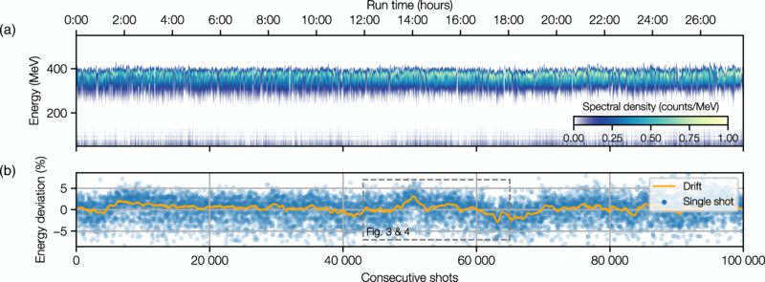
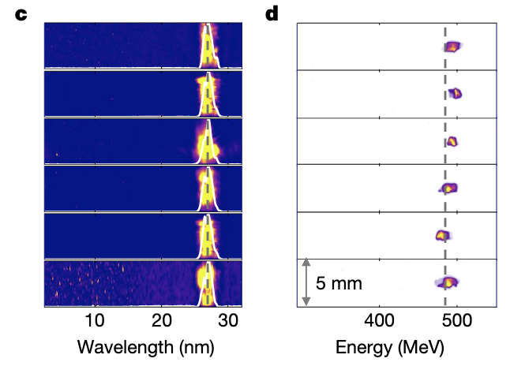
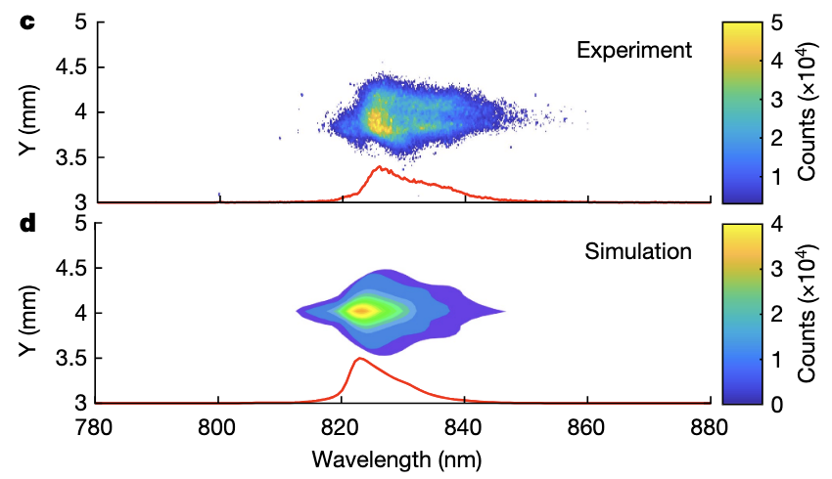
State-of-the-Art
Transfer efficiency 42+/-4% with 0.2% energy spread, up to 70% with energy spread increase
9.2 GeV in 30 cm → 30.7 GeV/m
42 GeV in 85 cm → 52 GeV/m
Laser Driven
FACET, SLAC, USA
FLASHForward, DESY
BELLA, Berkeley Lab, USA
Electron Driven
Electron Driven
I. Blumenfeld et al, Nature 455, p 741 (2007)
A. Picksley et al., PRL 133, 255001 (2024)
C.A. Lindstrøm et al., Phys.Rev.Lett. 126, 014801 (2021)
Stable 24hr operation
Laser Driven based FEL: First demonstration
Electron Driven based FEL: First demonstration
LUX laser plasma accelerator, DESY
500 MeV electrons from LWFA
Sparc-Lab
Laser Driven
China
94 MeV electrons from PWFA
FEL lasing at 830 nm
FEL lasing amplification of 100 reached at 27nm wavelength
R. Pompili et al., Nature 605, 659-662 (2022)
Since then two more groups: Soleil/HZDresden, Berkeley
A. Maier et al., Phys. Rev. X 10, 031039 (2020)
W.T. Wang, K. Feng, et al., Nature, 595, 561 (2021)

Slide 7
Plasma Wakefield Accelerator Landscape
10 TeV collider
Higgs factories
Particle physics applications
10 TeV
250 GeV
Colliders based on PWA
First applications
O (~10s GeV)
HALHF
ALiVE
O (~5 GeV)
Fixed-Target experiments
Injectors
Collider components
Test beams
FELs
Medical
National security
Radiation generation
➔ AWAKE Run 2
Near-Term
Mid-Term
Long-Term

Slide 8
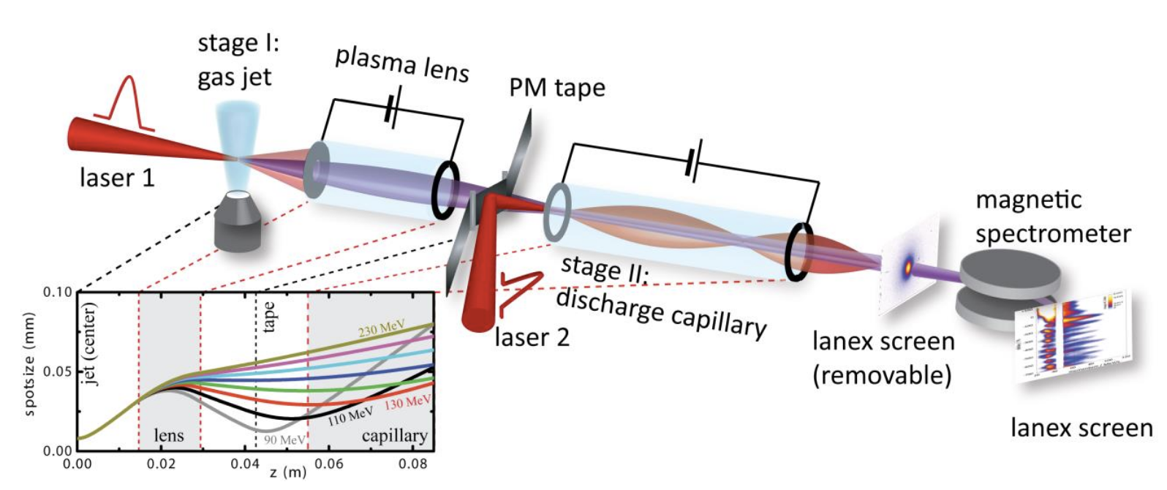
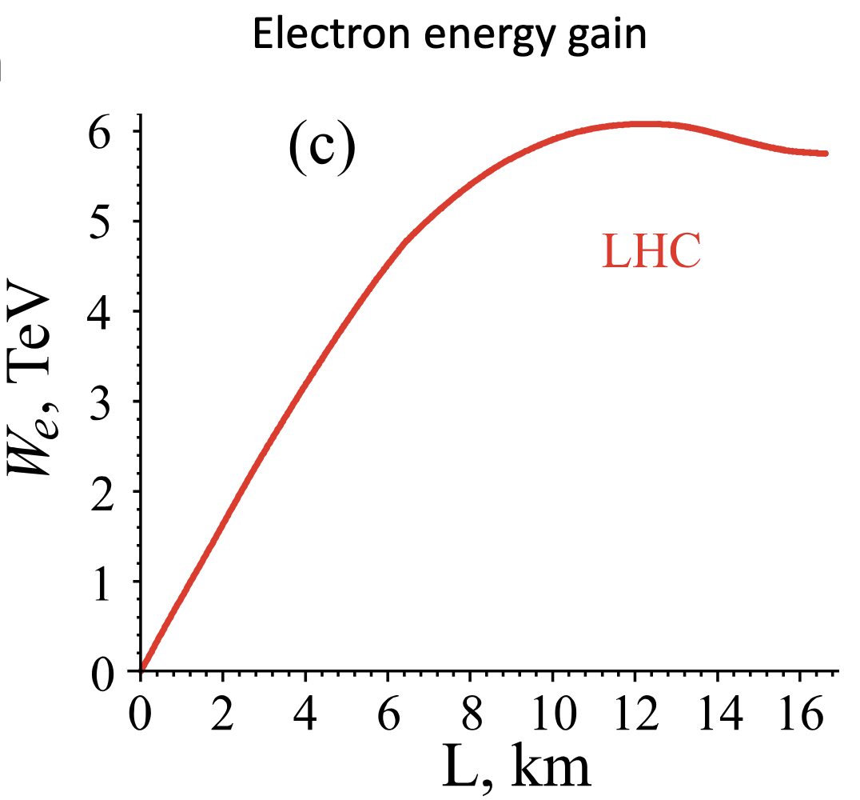
Towards Higher Energies
➔ Staging
➔ More energetic drivers
Lasers or electron drivers: ~10s of J/bunch
Proton driver: ~SPS 19 kJ/bunch, LHC 112 kJ/bunch
Single plasma cell
BELLA, Berkeley, LBNL
S. Steinke et al., Nature 530, 190 (2016)
Staging of 2 plasma cells demonstrated at 100MeVs level (laser driven).
Experiments ongoing at GeVs level.
No beam-driven staging yet demonstrated (no facility).
SPS p⁺ (450 GeV): accelerate to 200 GeV electrons.
LHC p⁺ can yield to 3 TeV electrons.
A. Caldwell, K. V. Lotov, Phys. Plasmas 18, 13101 (2011)

Slide 9
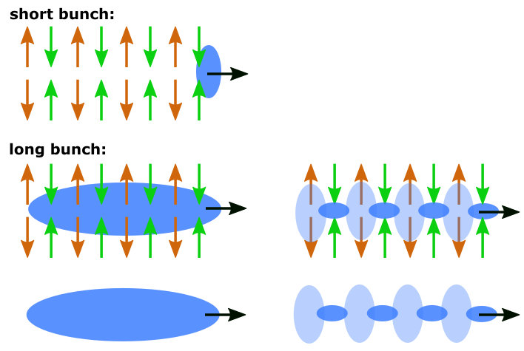
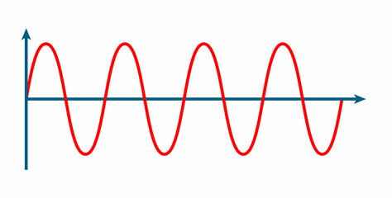
Proton Bunch as a Drive Beam
  In order to create high wakefield amplitudes, the drive bunch length must be in the order of the plasma wavelength.
  CERN SPS proton bunch: very long! (σ_{z} = 5 - 10 cm) → much longer than plasma wavelength (λ = 1mm)
  → Would create only small wakefield amplitudes

Slide 10
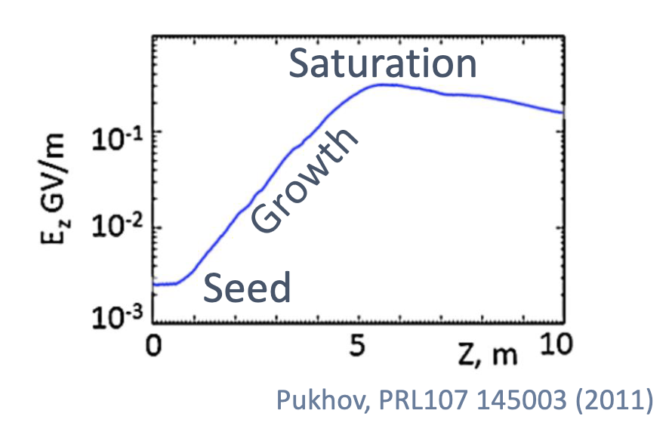
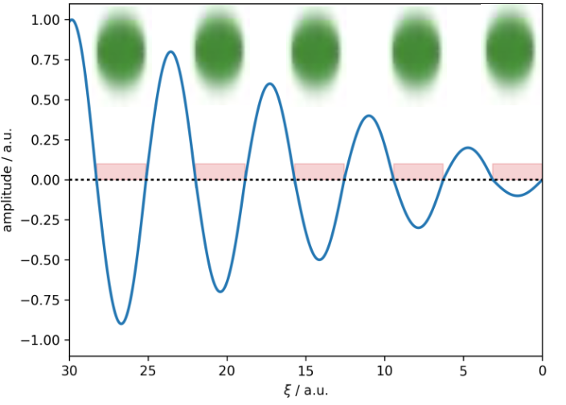
Self-Modulation of the Proton Bunch
Self-Modulation Instability:
p⁺ bunch
Density modulation on-axis → micro-bunches.
  Micro-bunches separated by λ_{pe}.
  Resonant wakefield excitation
  Large wakefield amplitudes
Initial transverse wakefields
Periodic focusing/defocusing fields
Radial bunch and plasma density modulation
Stronger wakefields
Full modulation
➔ Immediate use of SPS proton bunch for driving strong wakefields!

Slide 11
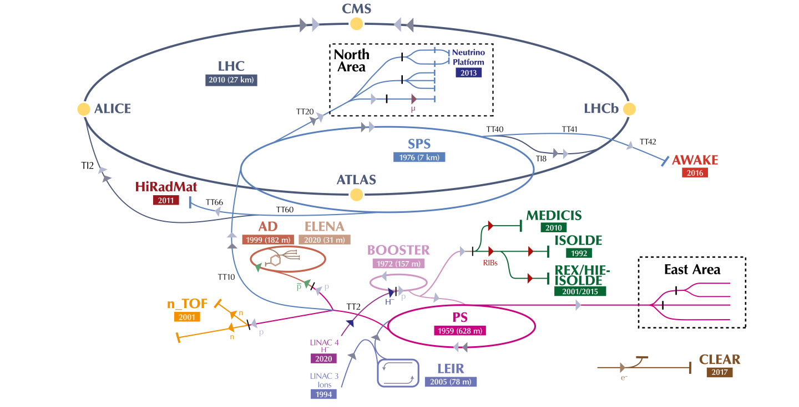
AWAKE at CERN
Advanced WAKEfield Experiment
Accelerator R&D experiment at CERN.
Unique facility driving wakefields in plasma with a 400 GeV proton bunch from the SPS (highly relativistic protons with high energy > kJ)
Accelerating externally injected electrons to GeV scale.
The only proton driven plasma wakefield acceleration experiment worldwide.
High energy gain possible because the high-energy driver is available today.
E. Gschwendtner, CERN

Slide 12
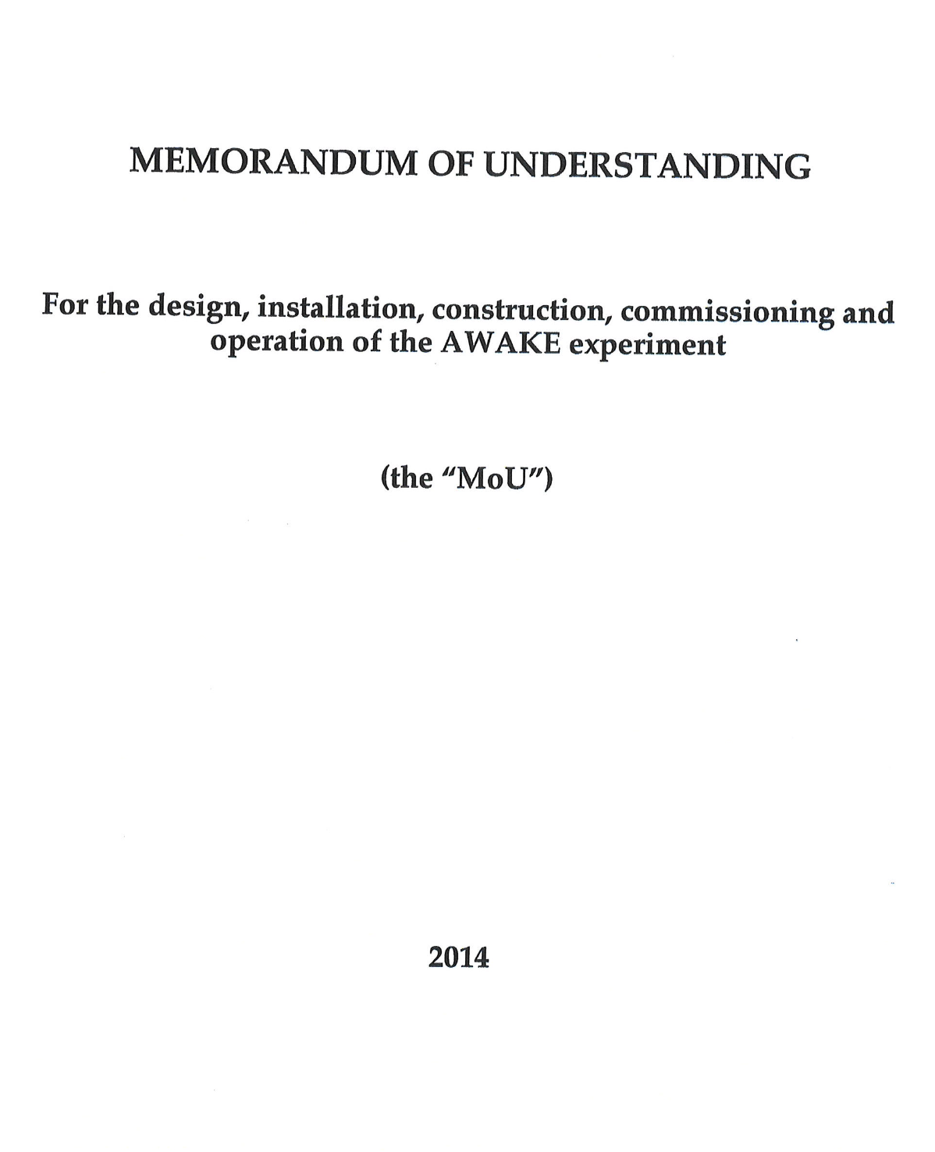
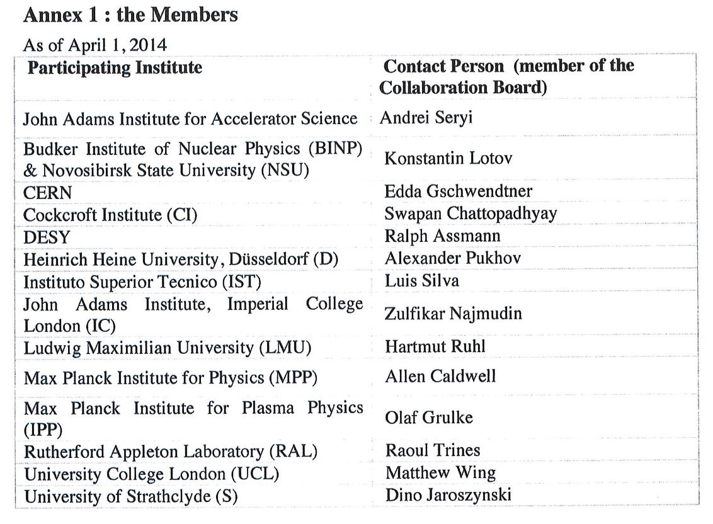
AWAKE Collaboration
2013: Approval of AWAKE
2014: Memorandum of Understanding
UK
14 founding institutes
➔ 6 from the UK!
Contributions
Beam instrumentation
Electron injector acceleration structure
Discharge plasma source
Beam instrumentation
Electron spectrometer
Radiation protection
E. Gschwendtner, CERN

Slide 13








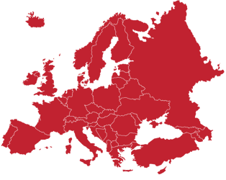














AWAKE Collaboration Today
➔ Strong UK commitment!
UK
Korea
Madison
Lancaster
Daresbury
Manchester
Uppsala
Liverpool
Greifswald
Oxford
London
Marburg
Lausanne
Dusseldorf
Munich
Budapest
CERN
Lisbon

Slide 14
AWAKE has a Clear Timeline towards Applications
AWAKE addresses key challenges relevant for the entire plasma-based accelerator community:
quality, emittance control, energy spread, external injection, plasma source developments, …
Strong-field QED
Injector for EIC
Transition from proof-of-concept towards applications.
E. Gschwendtner, CERN

Slide 15

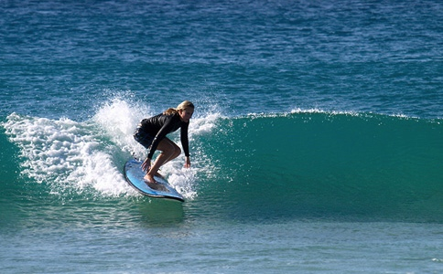
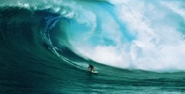
AWAKE Experiment until Today
RUN 1 (2016-2018)
p+ self-modulation
2 GeV e- acceleration
RUN 2 (2021-2033)
e- acceleration to several GeV,
beam quality control, scalability

Slide 16
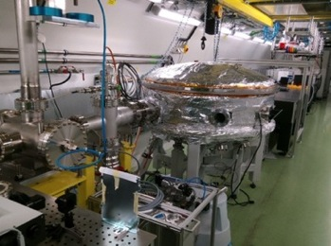
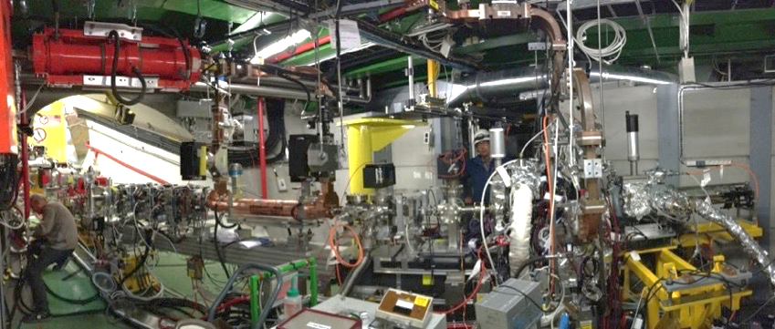
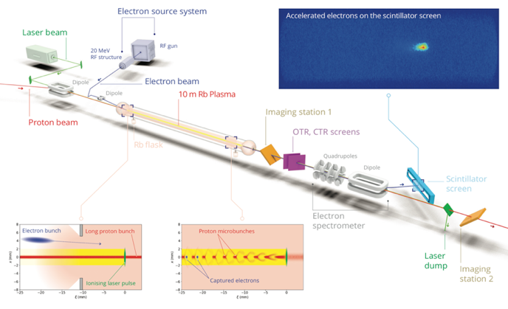
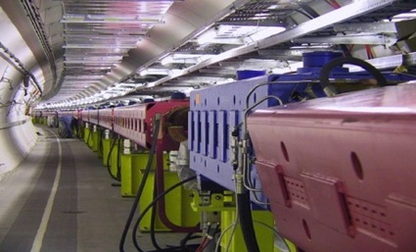
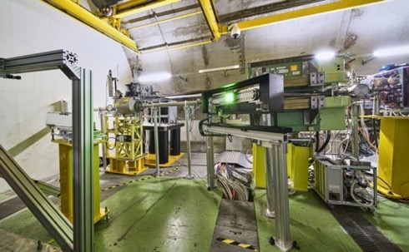
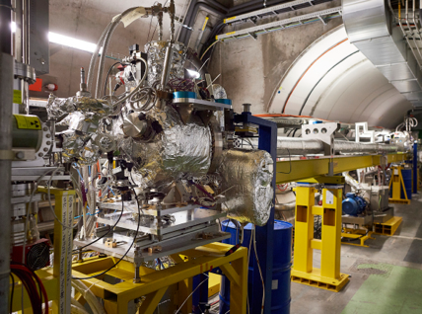
Key Ingredients of AWAKE
Laser line
Transfer line
Diagnostics and booster structure
Electron source
UK
500mJ
120fs
UK
20 MeV
4x10⁹ e
2ps
Laser, compressor in laser room
400 GeV
3x10¹¹ p
400ps
UK
Rubidium vapour
Density: 10¹⁴ – 10¹⁵ cm⁻³
Density uniformity < 0.2%
UK
750m proton beam line
Diagnostics
10m Plasma cell in AWAKE tunnel

Slide 17
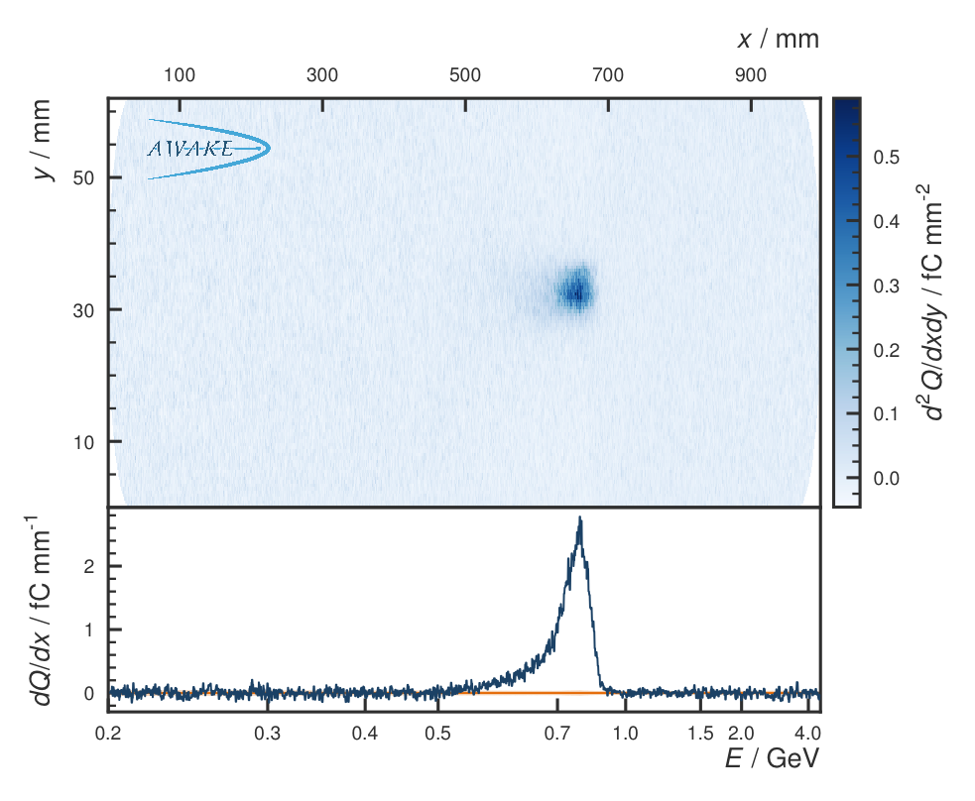
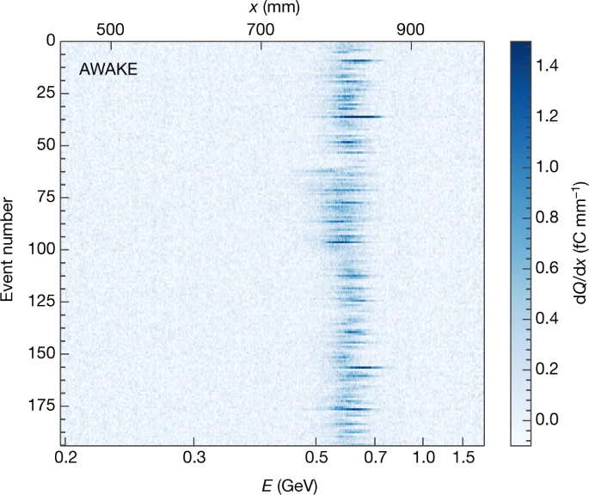
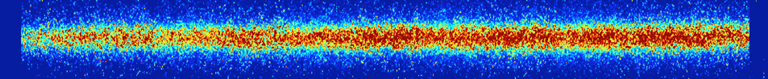
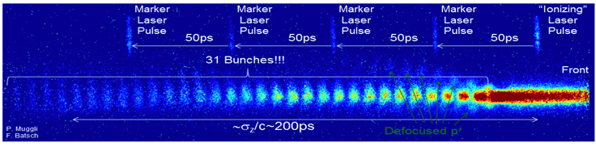
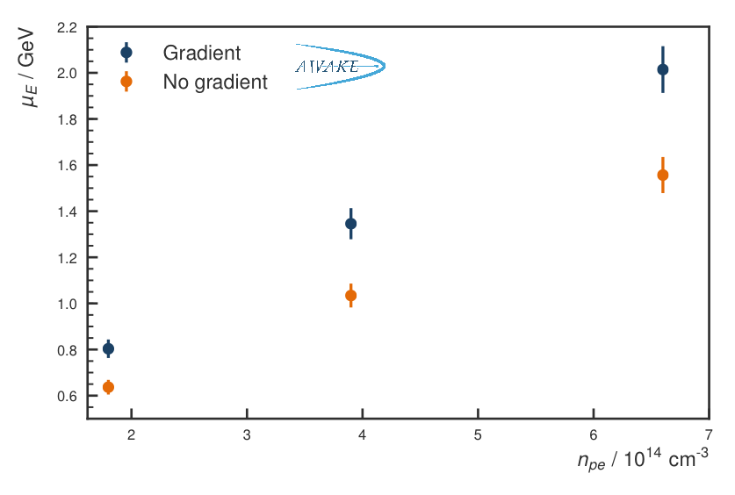
Proof-of-Principle Results
Seeded self-modulation of the proton bunch
Electron acceleration
Plasma off:
Plasma on:
Electron spectrometer signal
UK
Energy repeatability
Seeded with laser ionization front
Seeded with e- beam
Increased electron energy gain
with increasing plasma density
with plasma density gradient
Unseeded: phase not reproducible
→ Phase stability of the SM
→ Reproducible SM
→ Wakefield growth due to SM
AWAKE Collaboration, Phys. Rev. Lett. 122, 054802 (2019).
M. Turner et al. (AWAKE Collaboration), Phys. Rev. Lett. 122, 054801 (2019).
M. Turner, P. Muggli et al. (AWAKE Collaboration), Phys. Rev. Accel. Beams 23, 081302 (2020)
F. Braunmueller, T. Nechaeva et al. (AWAKE Collaboration), Phys. Rev. Lett. July 30 (2020).
A.A. Gorn, M. Turner et al. (AWAKE Collaboration), Plasma Phys. Control Fusion, Vol. 62, Nr 12 (2020).
F. Batsch, P. Muggli et al. (AWAKE Collaboration), accepted in Phys. Rev. Lett. (2021)
L. Verra et al. (AWAKE Collaboration), Phys. Rev. Lett, 129, 024802 (2022)
Electron energy
AWAKE Collaboration, Nature 561, 363–367 (2018)

Slide 18
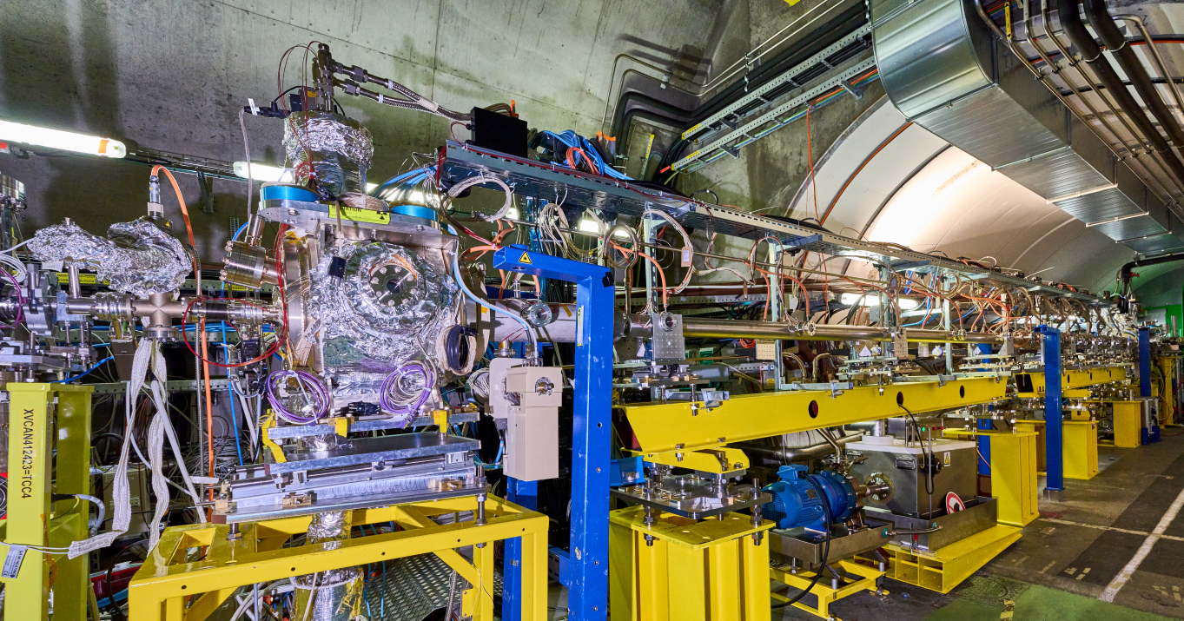
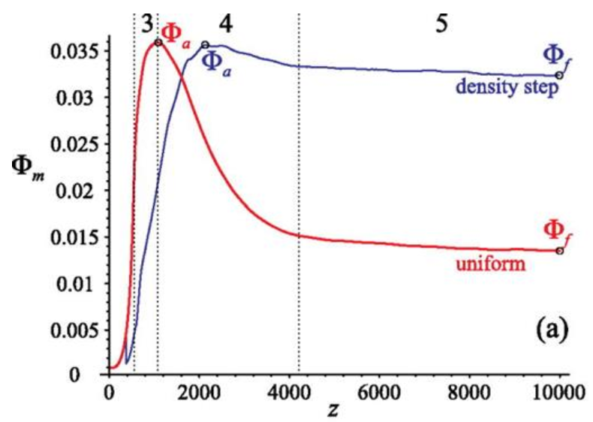
Upgrade of the Plasma Source
Introducing a density step in the plasma source:
stabilization of large wakefield amplitudes
Increased wakefield amplitudes after SSM saturation
New Rubidium vapour source with density step installed in 2023
Saturation
UK
Decay
Growth
Density step
K. V. Lotov, Physics of Plasmas 22, 103110 (2015)
K. V. Lotov and P. V. Tuev 2021 PPFC 63 125027
Length: ~ 10 m, independent electrical heater of 50 cm from 0.25 to 4.75 m, Step height up to ±10%.
10 diagnostic viewport ➔ measure light emitted by wakefields dissipating after the passage of the protons.

Slide 19
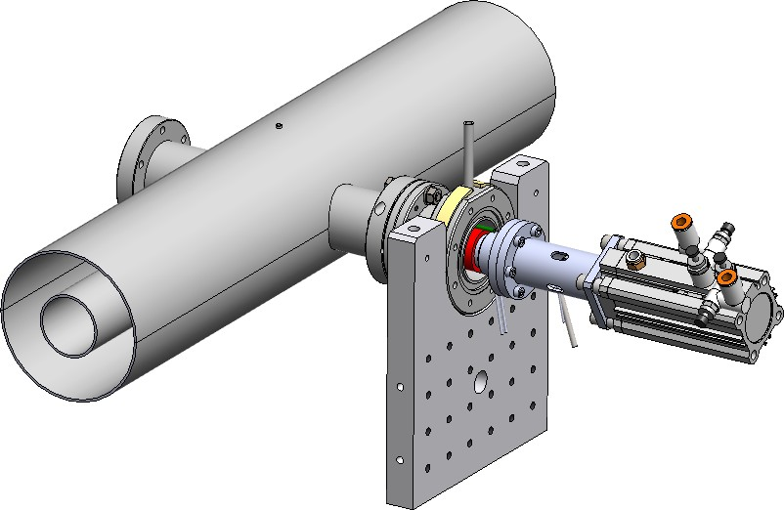
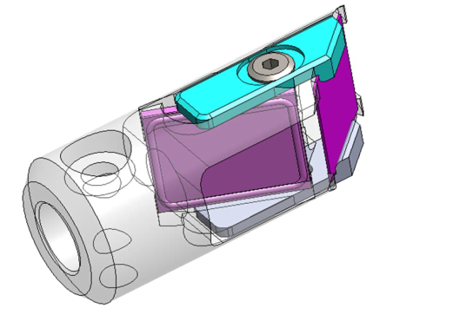
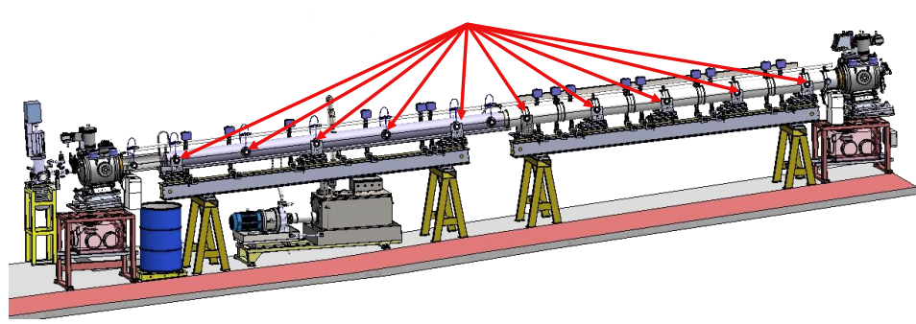



Upgrade of the Plasma Source: Density Step, Change of Plasma Length
8 electrical heaters
Temperature/density step
UK
0.2mm Al foil laser beam dump changing plasma length
YAG screen for e-, p+ alignment
10 plasma light ports
10 ’plungers’
Since 2014: MPP Munich, close collaboration with UK companies for all Rb vapour sources in different phases:
Feasibility study, design, engineering, prototyping, construction, upgrade, maintenance, decomissioning.
Budget: ~3 MCHF
MPP Munich, GWA
10 diagnostic viewport
  measure light emitted by wakefields dissipating after passage of the p+ bunch
10 plungers from 0.5m to 10.3m
  align the proton and electron bunches inside the plasma source
  Block the ionizing laser pulse ←→ vary the plasma length

Slide 20
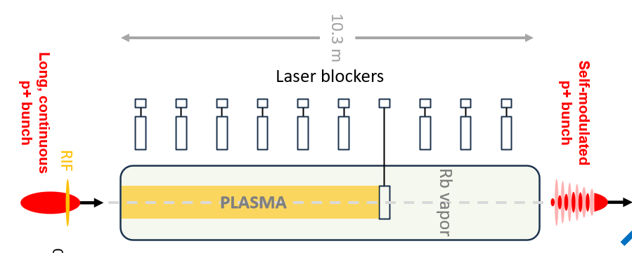
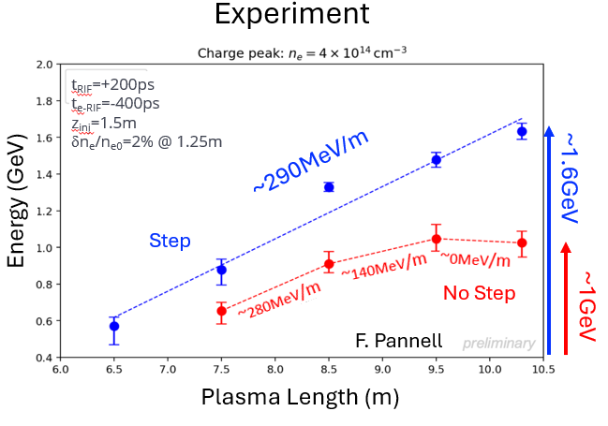
New Plasma Source with Density Step - Results
UK
With density step:
Increased energy gain.
Acceleration gradient is more ‘constant’.

Slide 21
AWAKE: What’s Next?
RUN 1 (2016-2018)
p+ self-modulation
2 GeV e- acceleration
RUN 2 (2021-2033)
e- acceleration to several GeV,
beam quality control, scalability

Slide 22

Next: Two Plasma Sources – Electron Beam Quality
Demonstrate electron acceleration and emittance control of externally injected electrons (Run 2c).
Separate self-modulation from acceleration to accelerate electrons with high quality
  Two plasmas
External injection of 150 MeV, 200fs long electron bunches
Bunch quality sufficient for applications
150 MeV
Self-modulator plasma
on-axis e-beam injection
Accelerator plasma
Expected parameters:
Normalized emittance: (2-30) mm mrad
Q_{e} = 100 pC
dE/E: 5-8 %
Run 2c: E ~ 4-10 GeV in 10 m
➔ Start with physics program in 2029 after LS3
E. Gschwendtner, CERN

Slide 23
Next, Next: Scalable Plasma Sources – Demonstrate Scalability
Development of scalable plasma sources to 100s m length with sub-% level plasma density uniformity (Run 2d)
Expected parameters:
Normalized emittance: (2-30) mm mrad
Q_{e} = 100 pC
dE/E: 5-8 %
Run 2c: E ~ 4-10 GeV in 10 m
Run 2d: E > 10 GeV in 10+ m
1m Helicon Plasma Source
Self-modulator plasma
Accelerator plasma
Scalable plasma source
10m Discharge Plasma Source → prototype successfully tested in 2023
UK
→ Scalability demonstration: 2032/2033
M. Turner et al. (AWAKE Collaboration), PRL 134, 155001, 2025
Then: ready to propose first particle physics applications: e.g. SFQED, injector for EIC,…

Slide 24







Towards Post-LS3 Run: CNGS Target Area Dismantling
E-source & Klystron
Exp. Area & Diagnostics
100m CNGS target area
e- and p+ beamlines
Plasma source
AWAKE dismantling and decabling is completed
600 m³ equipment (including 500 m³ shielding blocks) up to 20 mSv/hr
Before
e-beamline
After
Plasma source rubidium washing
UK
CNGS target area dismantling: Nov 2025 – Jan 2027
New surface building for the storage of CNGS concrete shielding blocks to reuse at CERN.

Slide 25

Towards Post-LS3 Run: Integration
18 MeV
electron line
150 MeV
electron line
Electron spectrometer triplet
1st plasma source
2nd plasma source
Electron spectrometer dipole

Slide 26





Towards Post-LS3 Run: New Electron Source System
New e-source
in CTF2 → commissioned
New electron beam: 150 MeV, 200 fs, 100 pC, σ = 5.75 µm
bunch length shorter than plasma wavelength, $ε_{norm (x,y)}$ = 2mm mrad
On-axis injection, Blow-out regime, Beam loading: reach small ∂E/E, Match transverse properties to the plasma
UK
S-band gun
UK
Position of beam line elements well defined.
Design and integration of services ongoing.
X-band accelerating structure prototype

Slide 27


Towards Post-LS3 Run 2: Injection Region
Crucial for the physics program of Run 2c!
UK
Very challenging area:
Limited space, layout optimization needed.
Several components require custom designs.
Close collaboration with CERN, institutes and GWA Ltd.
Provide specifications by end of the year.
20 cm gap

Slide 28

Towards Post-LS3 Run 2: Diagnostics and Laser System
New and improved diagnostics:
Challenge: 150 MeV e-beam, position, e-bunch emittance 2-30mm mrad, 200fs bunch length, 5.75mu beam size
Beam Position Monitors: separate electron from proton signals
Transition and synchrotron radiation monitors: emittance measurements and bunch-length
Cherenkov diffraction bunch length monitors
Electro-optical monitors: bunch length
Electron spectrometer: energy and emittance
Laser system
Complex laser system:
Forward ionization for self-modulator plasma
Backward ionization for accelerator plasma
Independent, synchronized laser for photocathode of RF guns
  Witness bunch injection stabiliy at < 50 – 100 fs level
UK
UK
150 MeV OSR
EOS
Wire scanner OTR
Mulit-GeV OSR

Slide 29



Towards Run 2d – AWAKE Scalable Plasma Source R&D
  Laser ionization does not scale to long plasma lengths (> 20 m) due to laser pulse energy depletion.
  Need scalable plasma sources to reach higher energies
  Plasma source R&D efforts
  Technical challenge: achieve 0.25% plasma uniformity, after being able to measure it
    So far, ~ 6% measured uniformity, at the limit of diagnostic capability!
    → focus on plasma diagnostics and source design optimization
  Work in parallel on scalability and tunability:
    For Helicon plasma source: stacking RF-antenna/generators/coils for → large investment
    For discharge plasma source stacking sources → optimize shared electrodes design and electrical circuit
UK
HPS
DPS

Slide 30




Synergies with Other Major Projects
UK
AWAKE is a novel accelerator in a real accelerator environment
  Commissioning and operation of complex experiment.
HALHF, ALIVE, Higgs factories
  Long, uniform, well-controlled plasma sources.
  External injection → staging.
  Proton-driven wakefields.
  Understanding of beam-plasma instabilitites.
  Development and validation of simulation tools.
FCC-ee, CLIC
  Experts on electron acceleration and operation are trained on AWAKE.
CLEAR, CTF2
  Development of new RF photo-injector.
  Development/test of electron beam diagnostics.
  Maintaining electron gun and beam line expertise.

Slide 31
Summary
Plasma wakefield acceleration have demonstrated significant achievements and an enormous potential. Reaching higher energies (>10 GeV) with plasma wakefield acceleration require either plasma staging when using laser/electron drive beams, or using a proton driver in a single plasma source such as in AWAKE.
The AWAKE Run 2 experiment exploits the unique possibilities of the CERN injector complex, adds to the diversity of the CERN experiments and addresses key challenges relevant for plasma-based accelerator community.
The UK contributions from institutes and industry have been fundamental to AWAKE from the very beginning, spanning from design, implementation, operation, analysis and remain indispensable as we prepare for Run 2.

Slide 32
Many thanks!

Slide 33

First Applications of AWAKE Technology
Once AWAKE Run 2 is demonstrated –
High energy, ~50 GeV
UK
    First applications to high energy physics for 50 GeV beam:
      Use for collider, e.g. ep collider, which would be like a low-luminosity LHeC.
      Beam-dump experiments to e.g. search for dark photons.
      Interaction with high-power laser to investigate strong-field QED.
        Investigate new regions with high energy
        Currently no competitors
        With increasing laser power probe more phase space.
      Injector for EIC
Nonlinear Breit–Wheeler
Beam energy →
Requirements on emittance are moderate for first applications.
Credit: B. King
Laser intensity →

