Slide 1
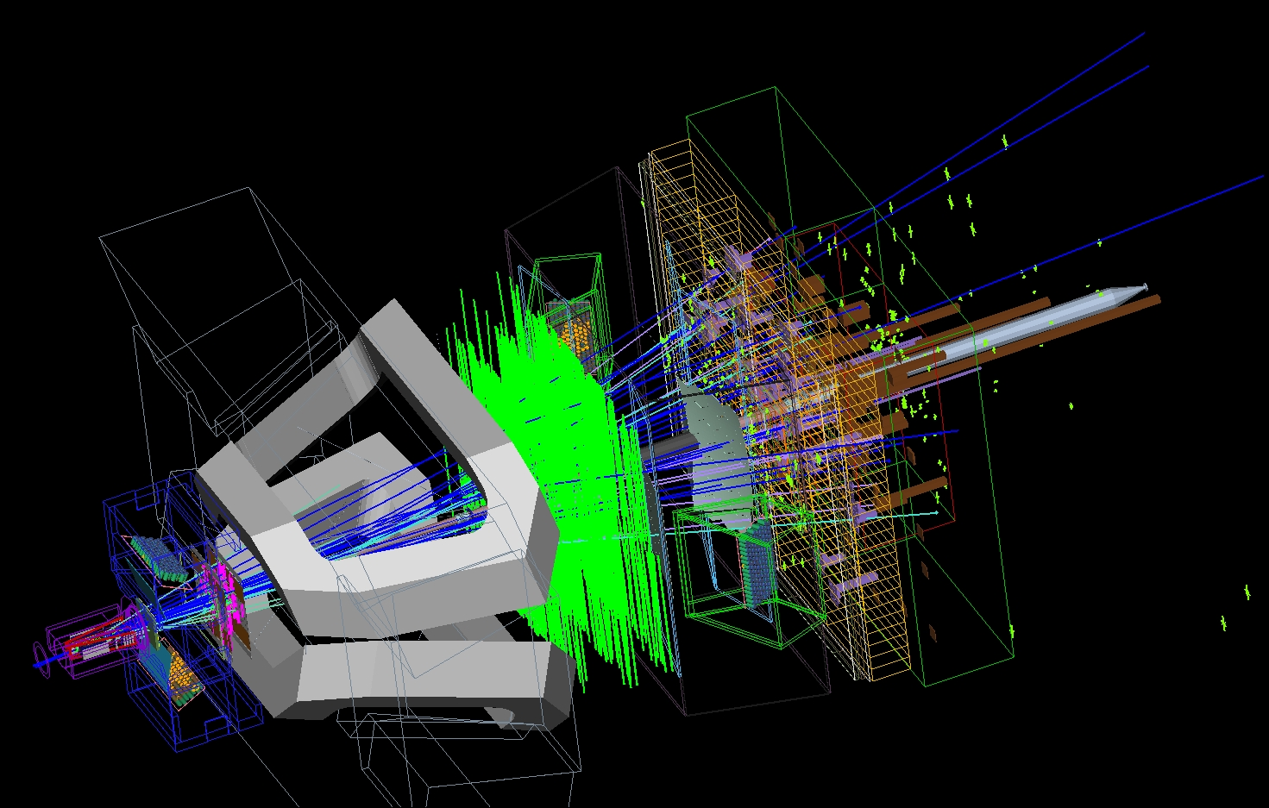
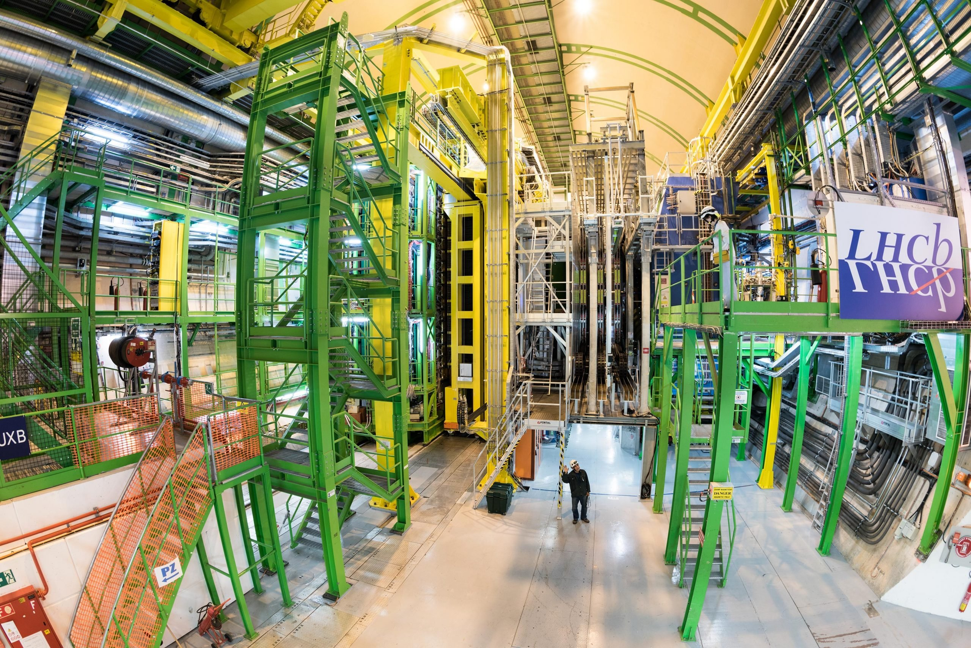
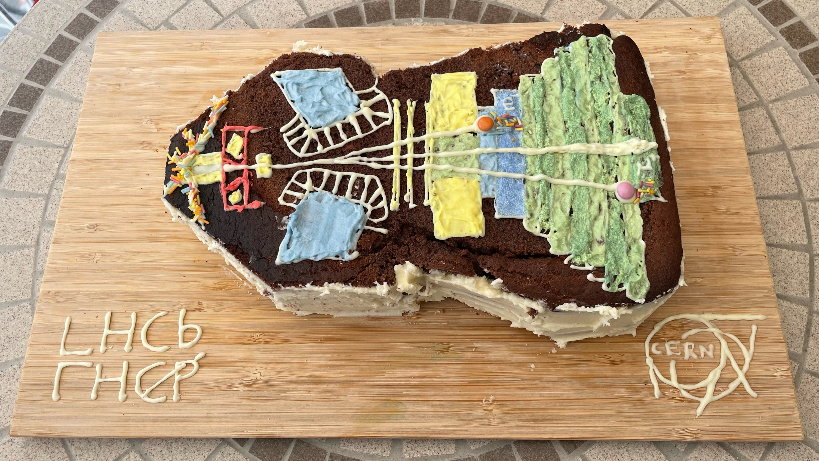




Particle Physics Masterclass
14/08/25 – Marcus Madurai
Slides pieced together from Miriam Watson, Eleni Skorda and many other people!

Slide 2

The Particle Zoo
How small are particles, really?
m
10⁻¹⁵
10⁻¹⁰
10⁻⁸
10⁻⁷
10⁻⁶
10⁻⁵
10⁻⁴
10⁻³
10⁻²
10⁻¹
10⁰
10¹
10²
10³
10⁴
10⁵
10⁶
10⁷
10⁸
10¹⁰
10¹⁵

Slide 3
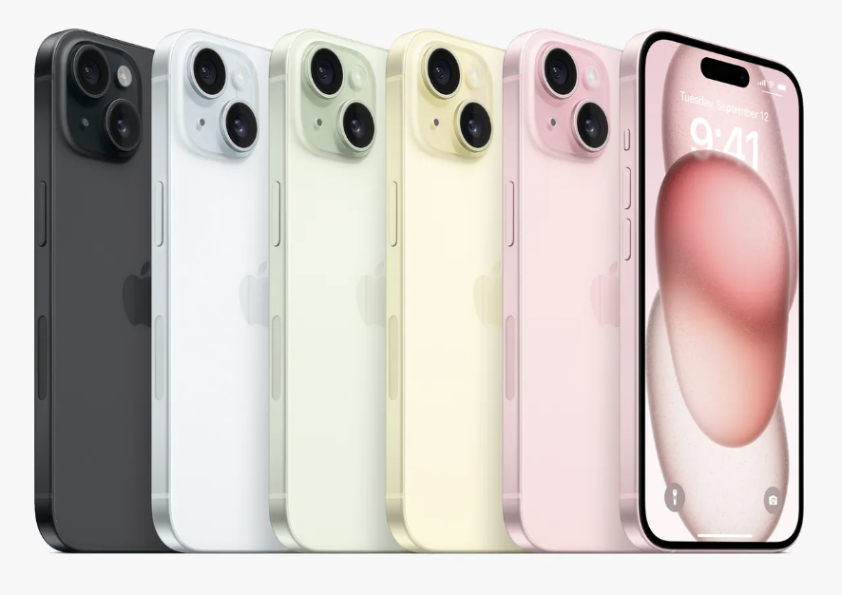
The Particle Zoo
How small are particles, really?
*The width of this room*
m
10⁻¹⁵
10⁻¹⁰
10⁻⁸
10⁻⁷
10⁻⁶
10⁻⁵
10⁻⁴
10⁻³
10⁻²
10⁻¹
10⁰
10¹
10²
10³
10⁴
10⁵
10⁶
10⁷
10⁸
10¹⁰
10¹⁵

Slide 4
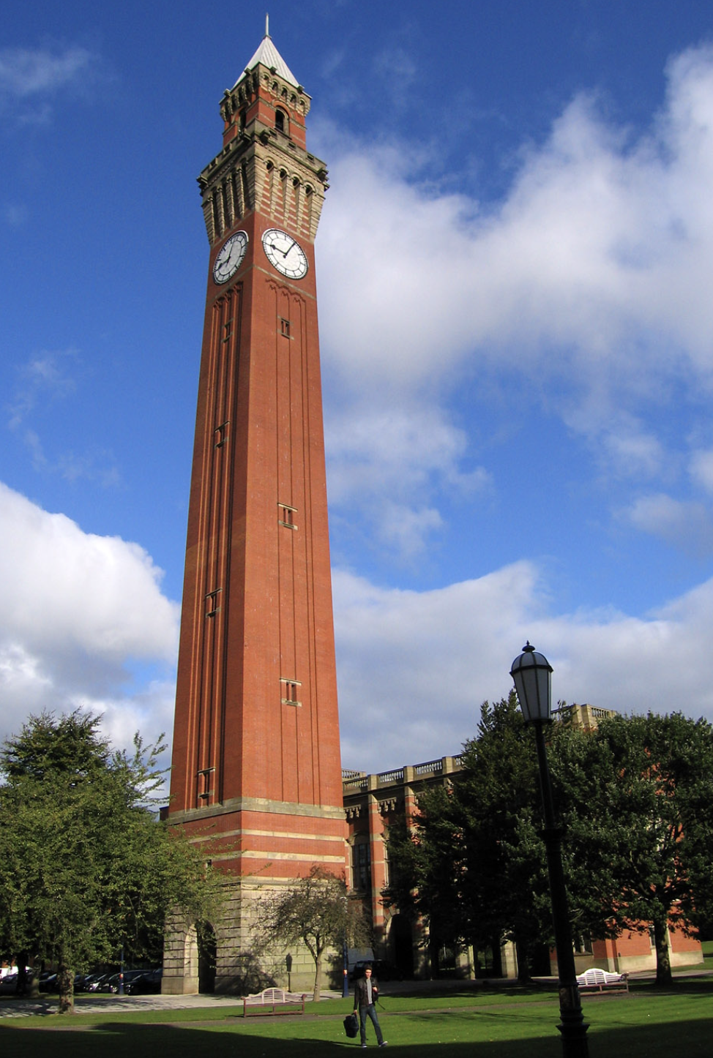
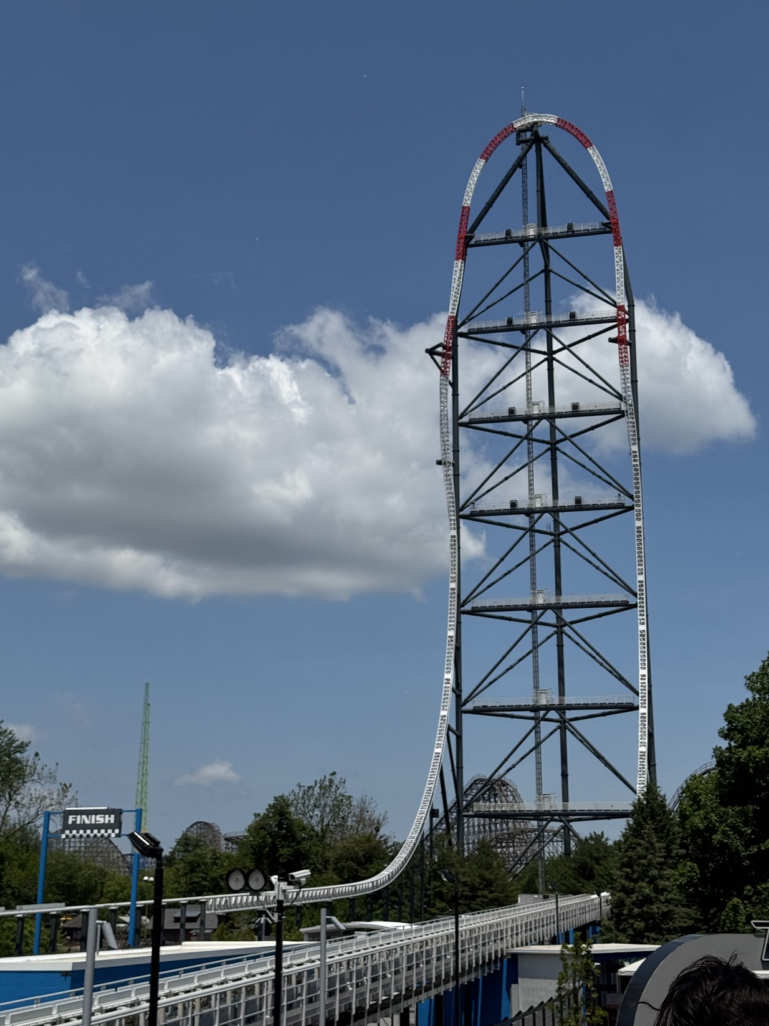

The Particle Zoo
How small are particles, really?
m
10⁻¹⁵
10⁻¹⁰
10⁻⁸
10⁻⁷
10⁻⁶
10⁻⁵
10⁻⁴
10⁻³
10⁻²
10⁻¹
10⁰
10¹
10²
10³
10⁴
10⁵
10⁶
10⁷
10⁸
10¹⁰
10¹⁵

Slide 5
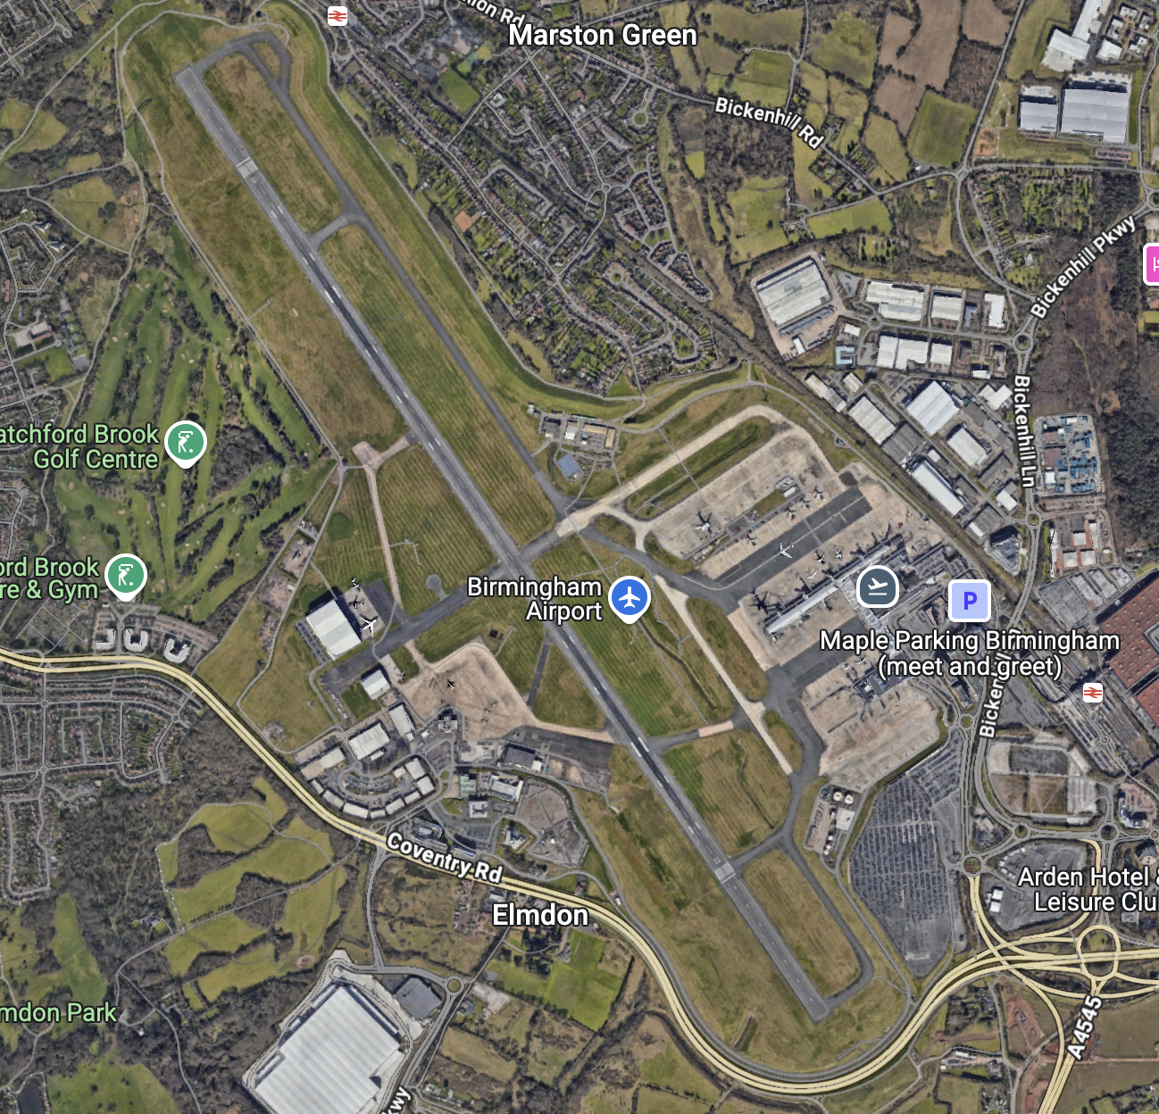
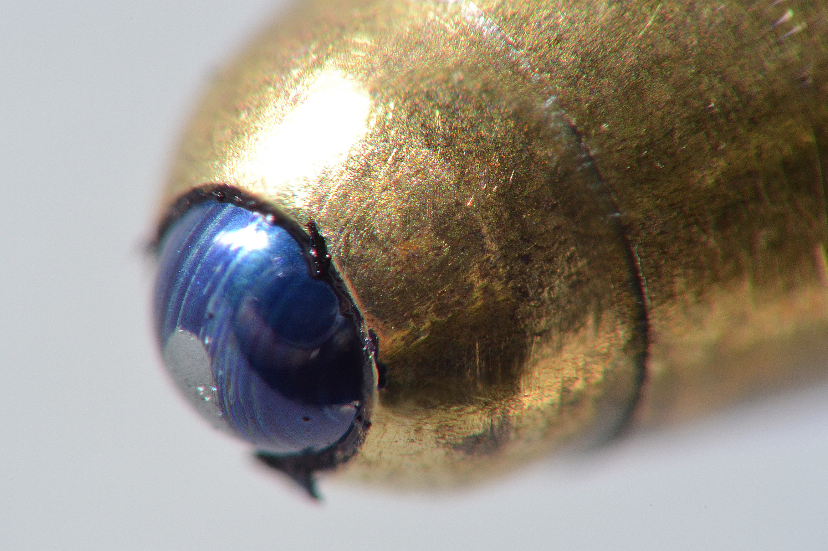
The Particle Zoo
How small are particles, really?
m
10⁻¹⁵
10⁻¹⁰
10⁻⁸
10⁻⁷
10⁻⁶
10⁻⁵
10⁻⁴
10⁻³
10⁻²
10⁻¹
10⁰
10¹
10²
10³
10⁴
10⁵
10⁶
10⁷
10⁸
10¹⁰
10¹⁵

Slide 6
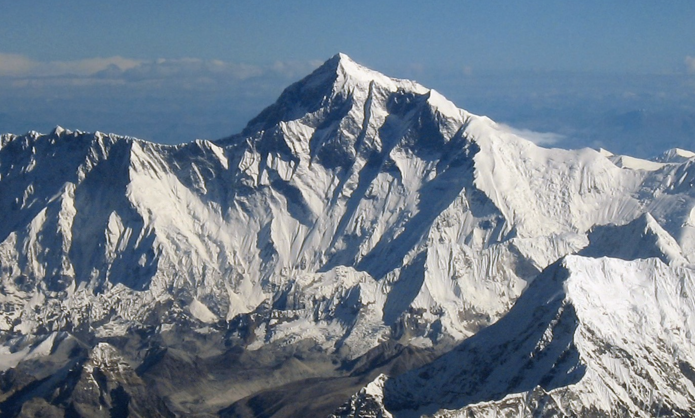
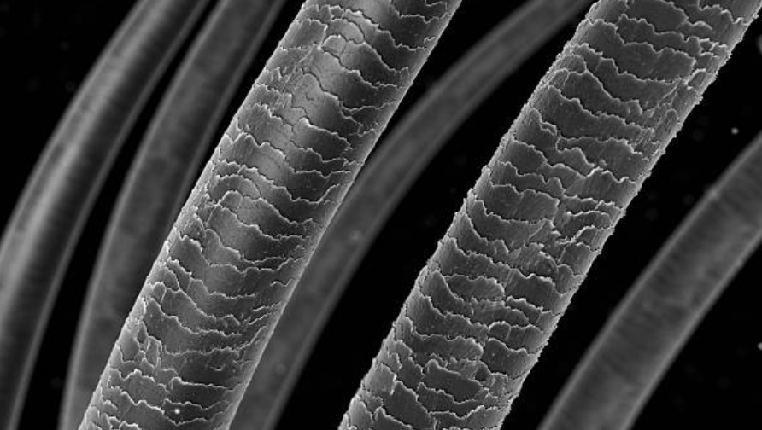
The Particle Zoo
How small are particles, really?
m
10⁻¹⁵
10⁻¹⁰
10⁻⁸
10⁻⁷
10⁻⁶
10⁻⁵
10⁻⁴
10⁻³
10⁻²
10⁻¹
10⁰
10¹
10²
10³
10⁴
10⁵
10⁶
10⁷
10⁸
10¹⁰
10¹⁵

Slide 7
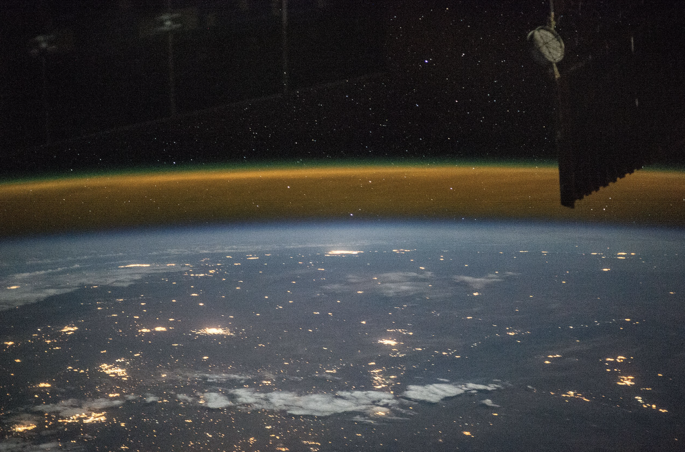
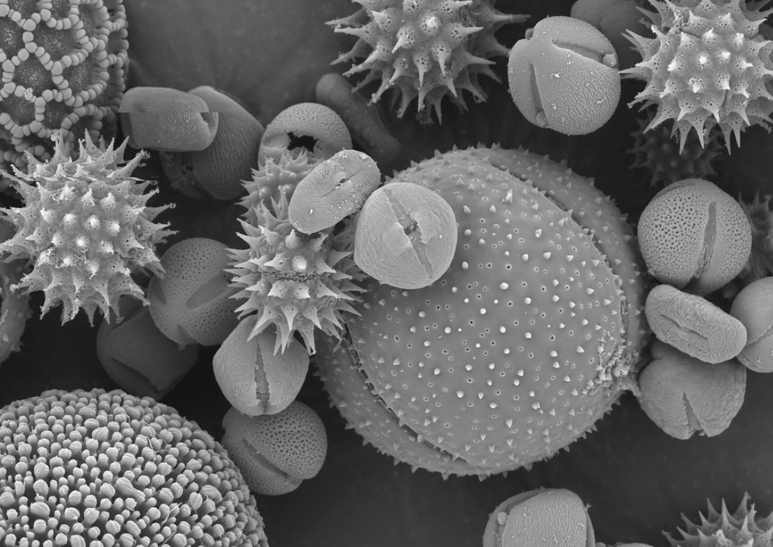
The Particle Zoo
How small are particles, really?
m
10⁻¹⁵
10⁻¹⁰
10⁻⁸
10⁻⁷
10⁻⁶
10⁻⁵
10⁻⁴
10⁻³
10⁻²
10⁻¹
10⁰
10¹
10²
10³
10⁴
10⁵
10⁶
10⁷
10⁸
10¹⁰
10¹⁵

Slide 8
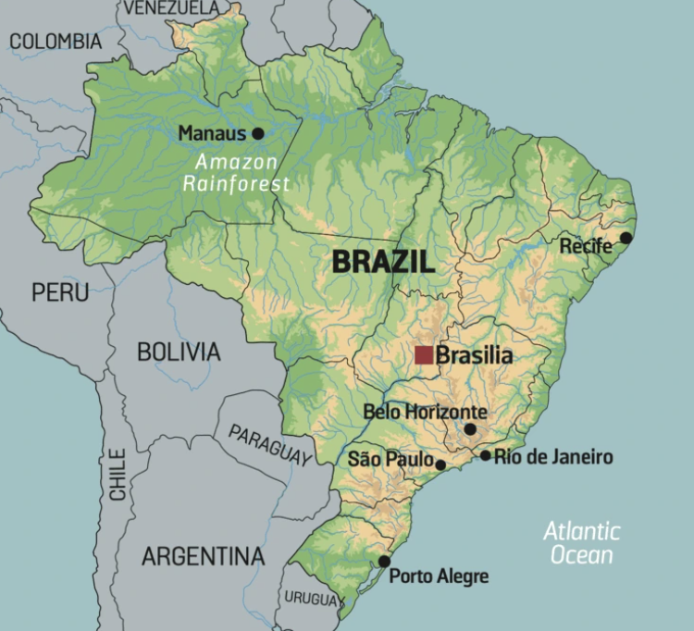
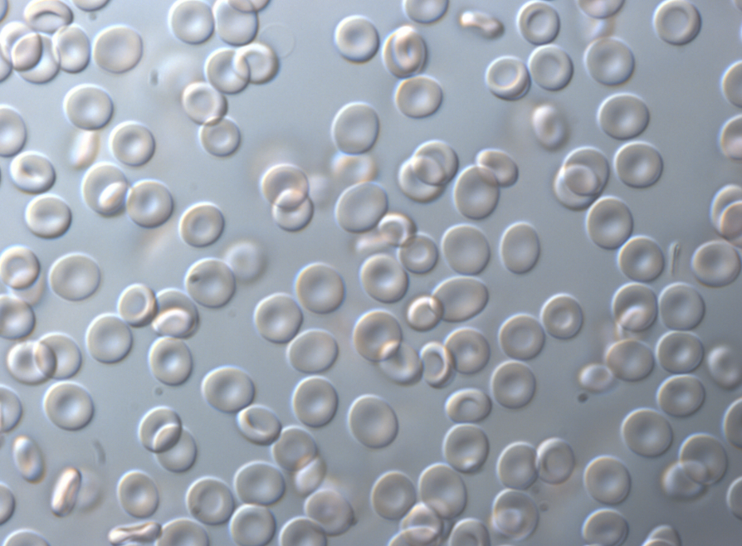
The Particle Zoo
How small are particles, really?
m
10⁻¹⁵
10⁻¹⁰
10⁻⁸
10⁻⁷
10⁻⁶
10⁻⁵
10⁻⁴
10⁻³
10⁻²
10⁻¹
10⁰
10¹
10²
10³
10⁴
10⁵
10⁶
10⁷
10⁸
10¹⁰
10¹⁵

Slide 9
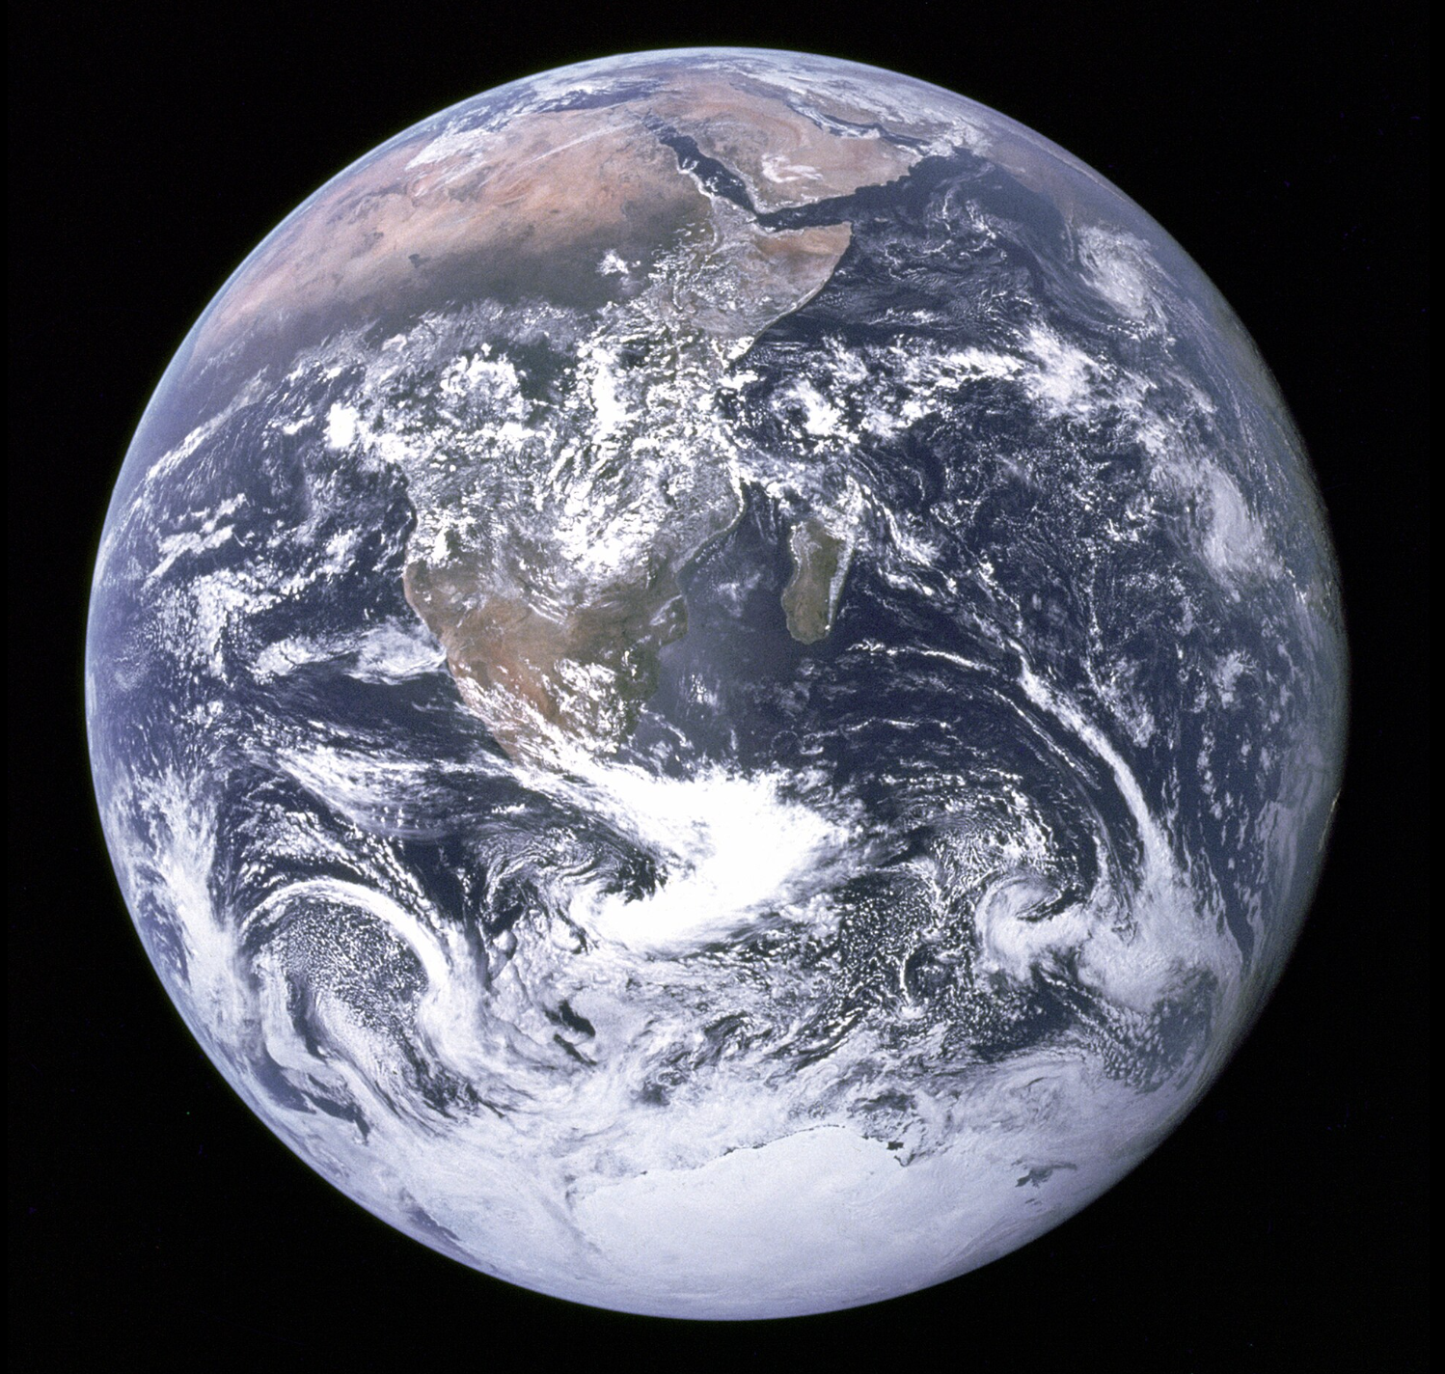
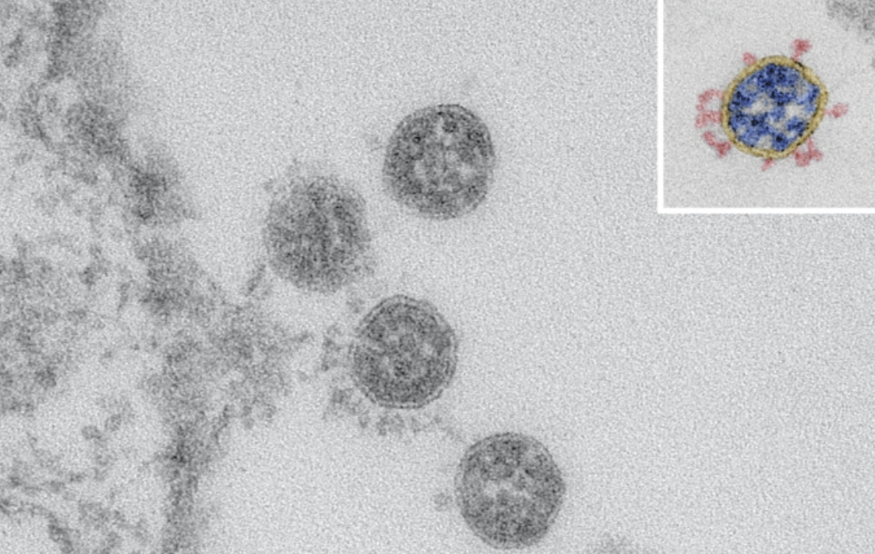
The Particle Zoo
How small are particles, really?
m
10⁻¹⁵
10⁻¹⁰
10⁻⁸
10⁻⁷
10⁻⁶
10⁻⁵
10⁻⁴
10⁻³
10⁻²
10⁻¹
10⁰
10¹
10²
10³
10⁴
10⁵
10⁶
10⁷
10⁸
10¹⁰
10¹⁵

Slide 10
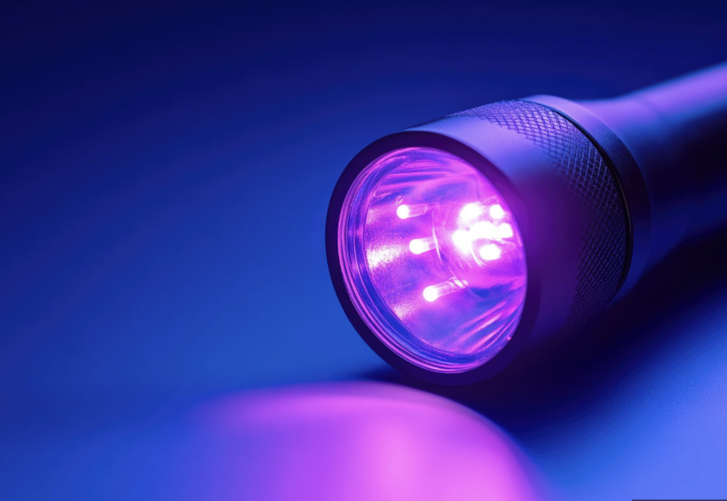
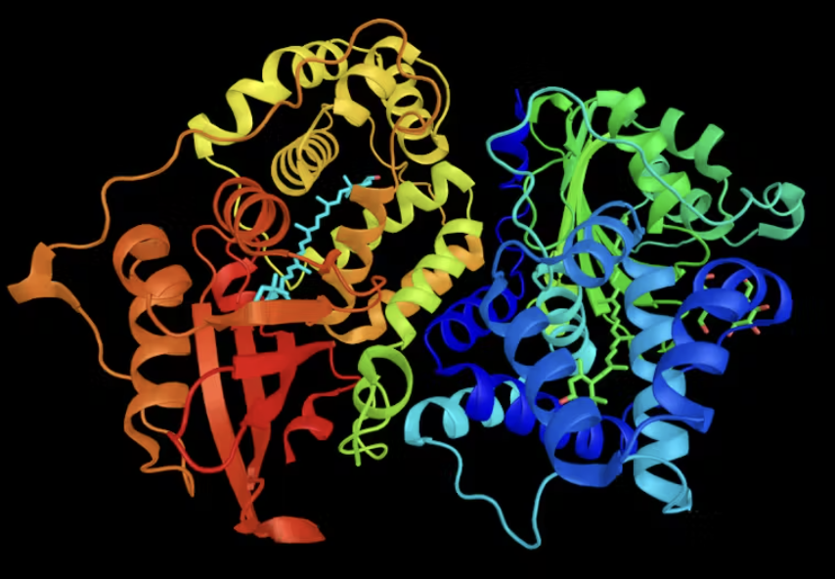
The Particle Zoo
How small are particles, really?
x10
m
10⁻¹⁵
10⁻¹⁰
10⁻⁸
10⁻⁷
10⁻⁶
10⁻⁵
10⁻⁴
10⁻³
10⁻²
10⁻¹
10⁰
10¹
10²
10³
10⁴
10⁵
10⁶
10⁷
10⁸
10¹⁰
10¹⁵

Slide 11
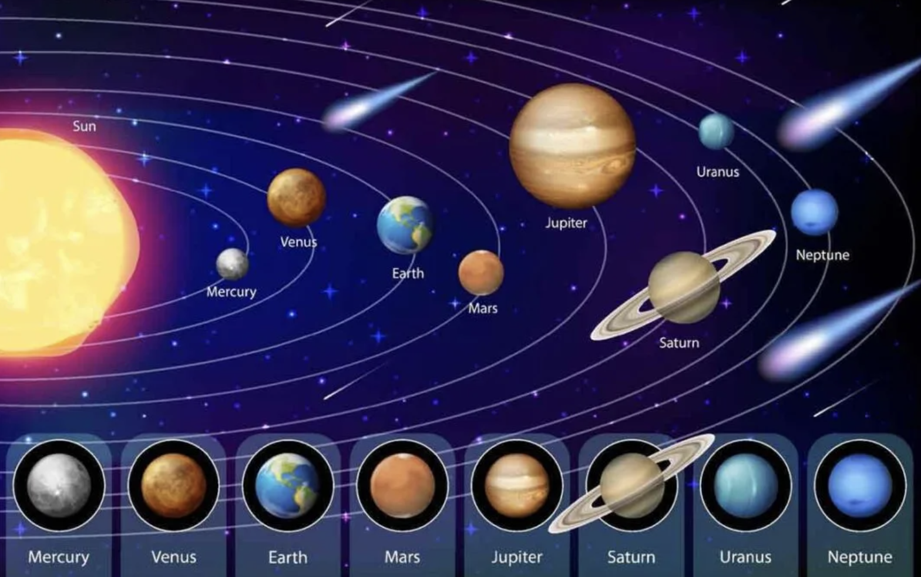
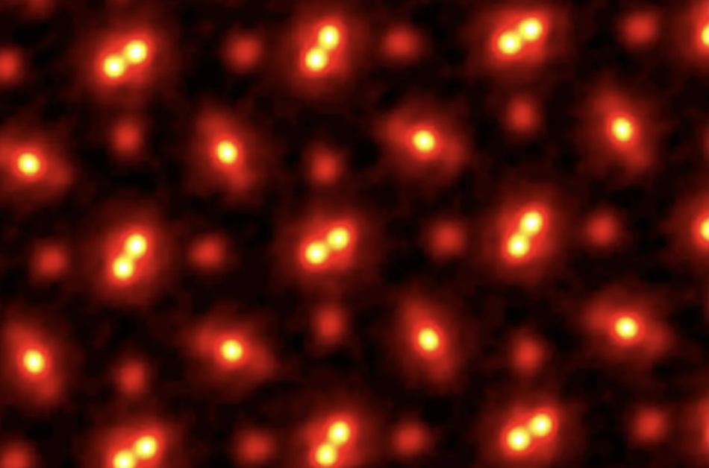
The Particle Zoo
How small are particles, really?
m
10⁻¹⁵
10⁻¹⁰
10⁻⁸
10⁻⁷
10⁻⁶
10⁻⁵
10⁻⁴
10⁻³
10⁻²
10⁻¹
10⁰
10¹
10²
10³
10⁴
10⁵
10⁶
10⁷
10⁸
10¹⁰
10¹⁵

Slide 12
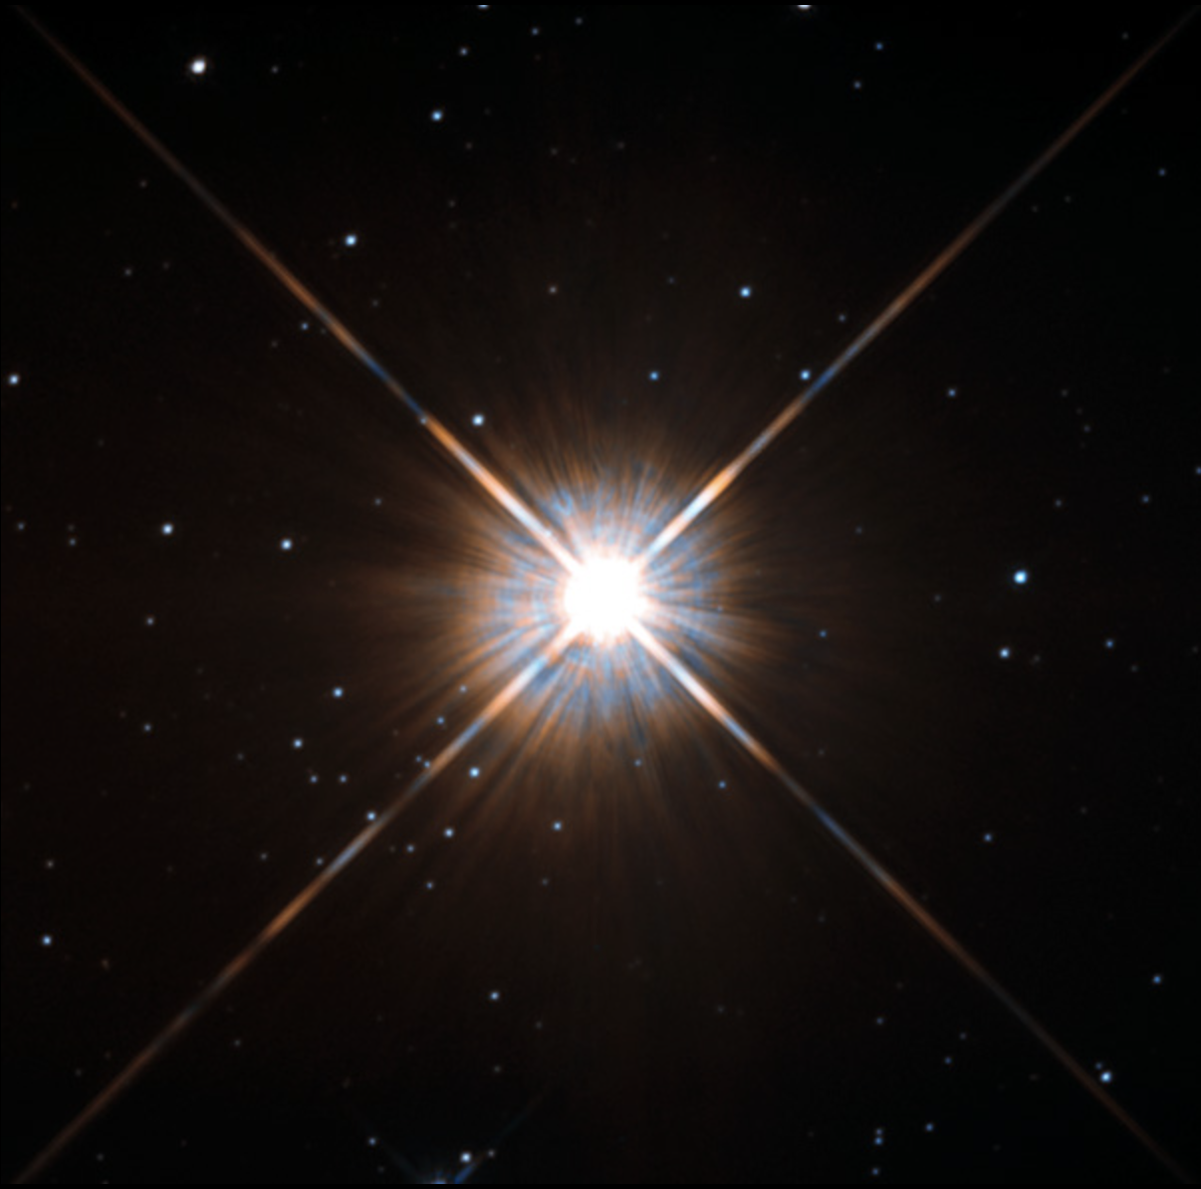
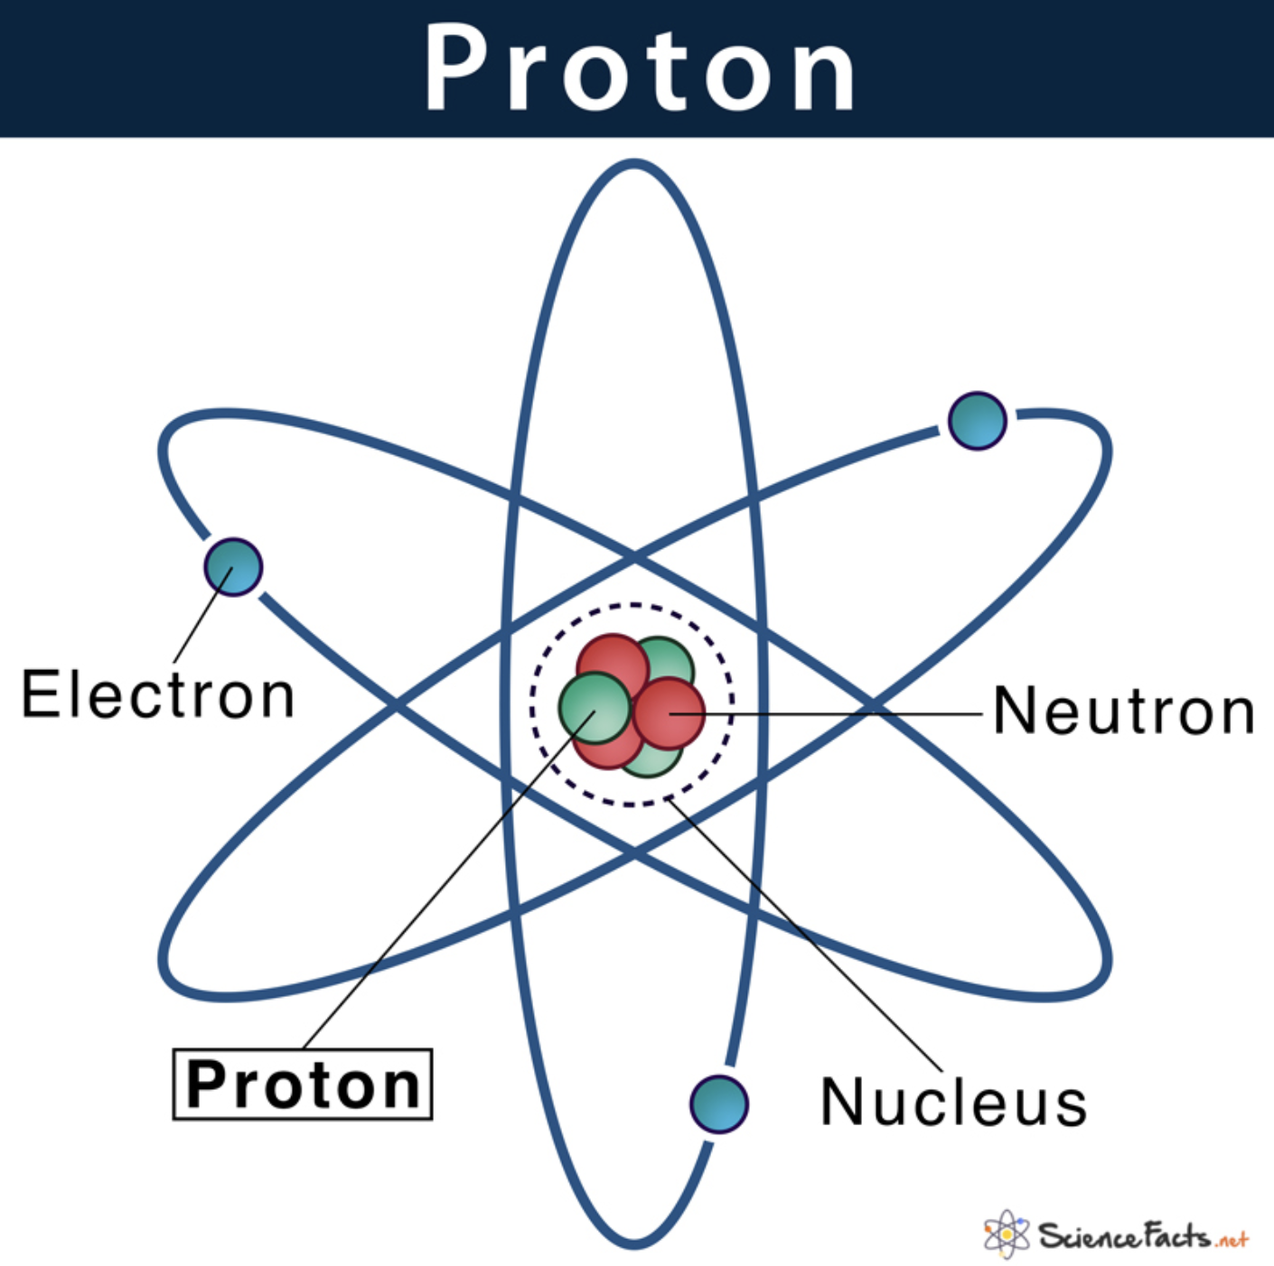
The Particle Zoo
How small are particles, really?
m
10⁻¹⁵
10⁻¹⁰
10⁻⁸
10⁻⁷
10⁻⁶
10⁻⁵
10⁻⁴
10⁻³
10⁻²
10⁻¹
10⁰
10¹
10²
10³
10⁴
10⁵
10⁶
10⁷
10⁸
10¹⁰
10¹⁵

Slide 13
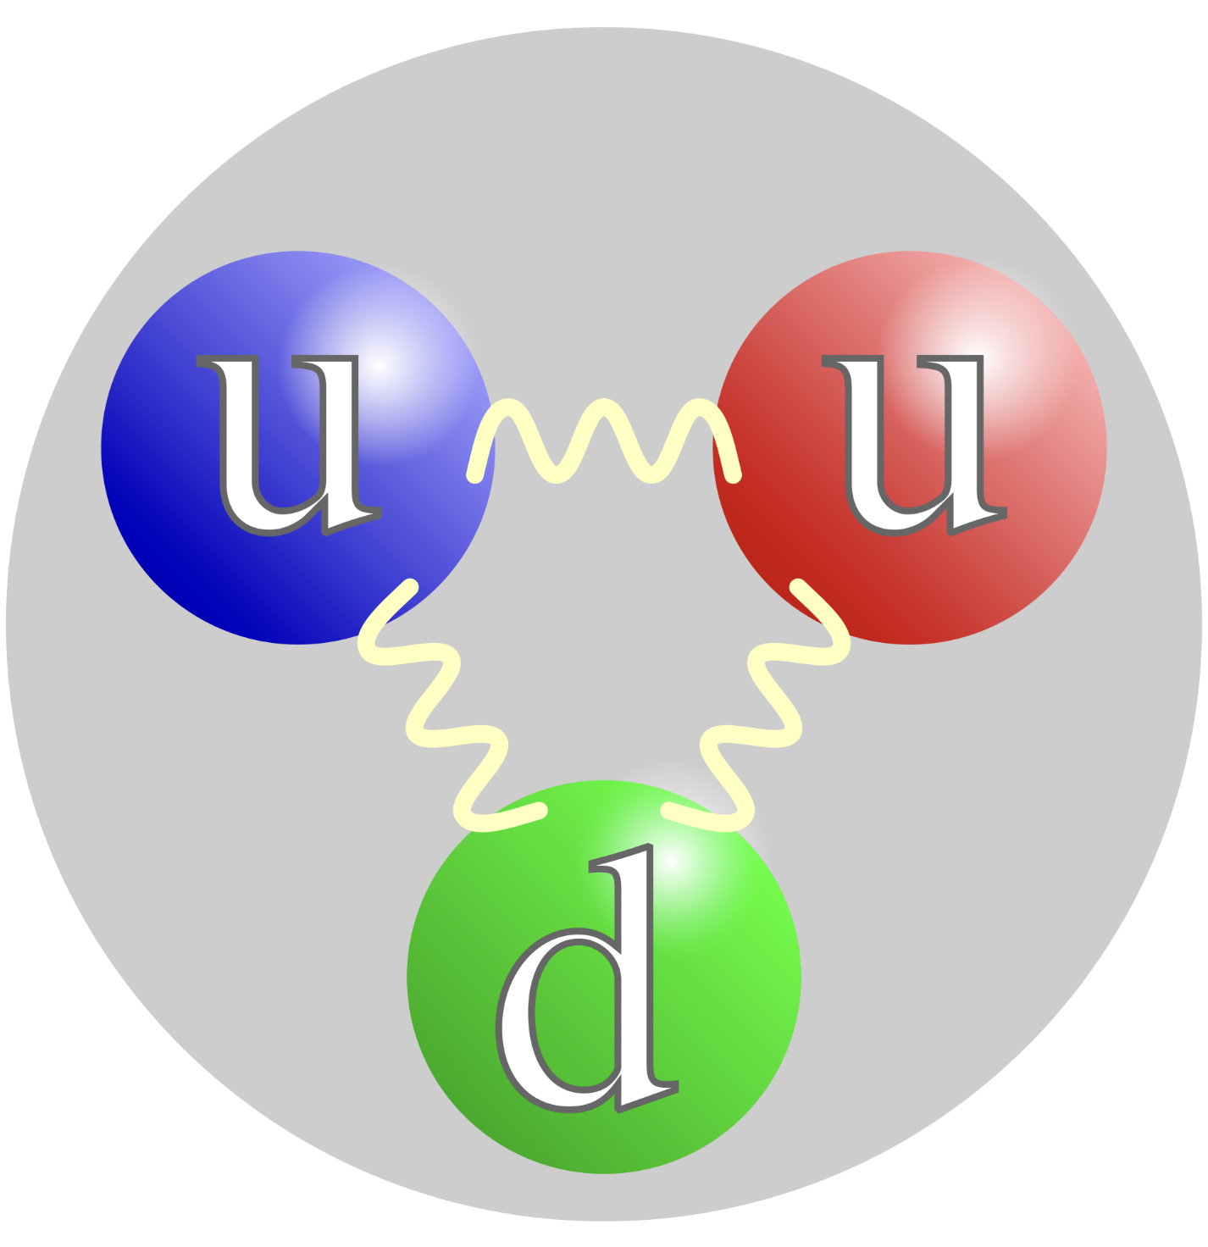

The Particle Zoo
Quarks
How small are particles, really?
Gluons
We think quarks are fundamental

Slide 14
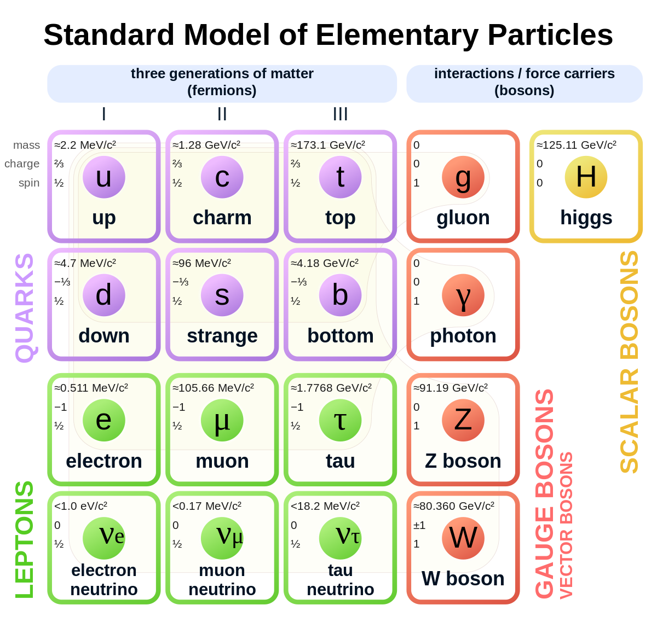
The Particle Zoo
17 fundamental particles
Some are more common than others
Each particle has different properties:
  Mass, lifetime, charge
  Each particle has a different role
All particles have a corresponding anti-particle
Some particles can decay into lighter particles

Slide 15
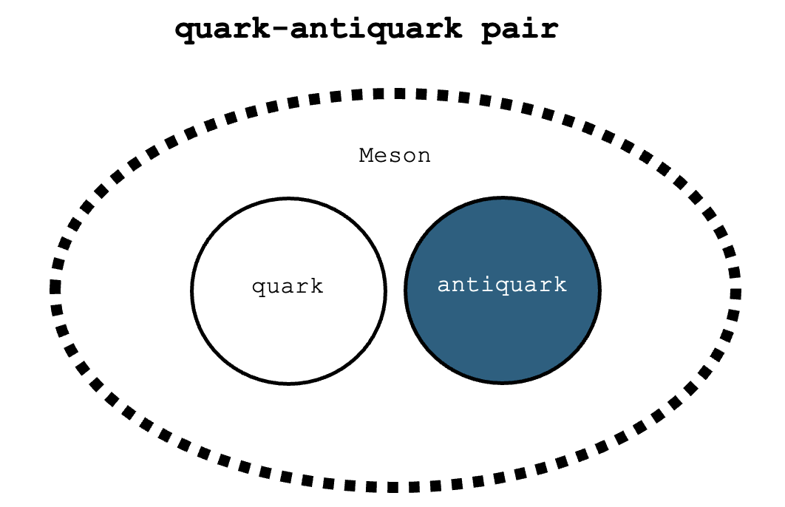
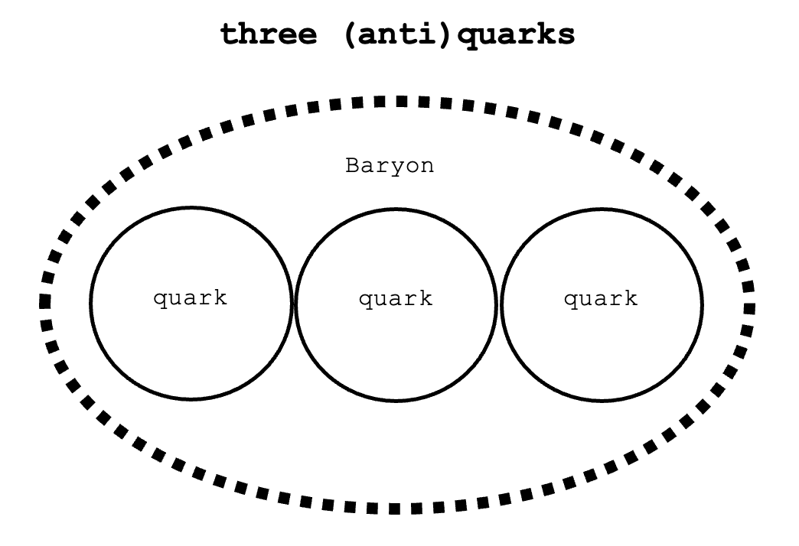

The Particle Zoo
Quarks make up either mesons or baryons
For example:
  Proton contains $uud$
  Neutron contains $udd$
  Kaon contains $u\overline{s}$
Lone quarks cannot exist!
Meson
Baryon

Slide 16
The Particle Zoo
Leptons can exist by themselves
Neutrinos:
  Almost massless
  Do not interact with other particles very easily 👻
Electron is most common

Slide 17
The Particle Zoo
Forces allow particles to interact
Gauge bosons are force carriers
Messengers between particles
Notes:
Speech force
Handshake force
Hug force

Slide 18



Force Carriers
Similar to how we interact…
Speech force
Handshake force
Hug force

Slide 19
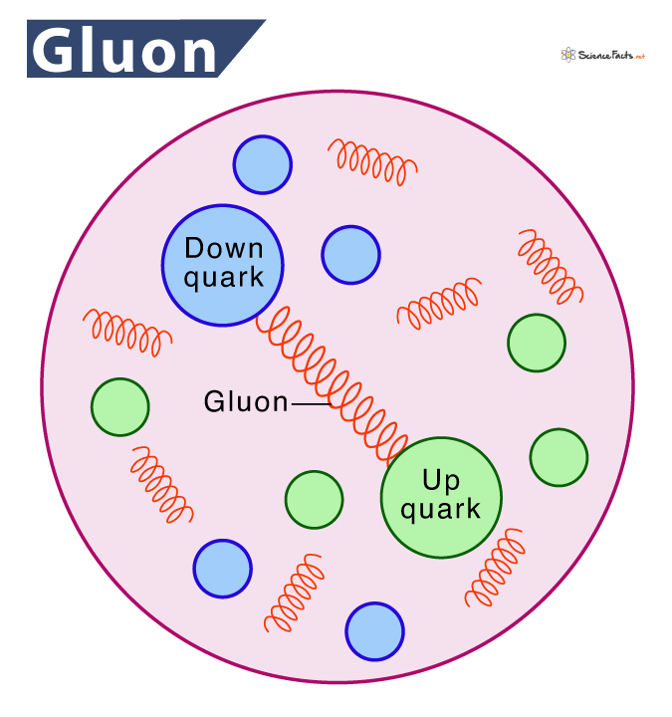
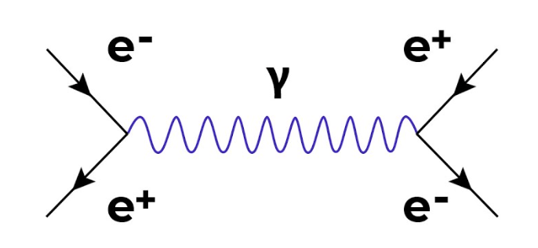
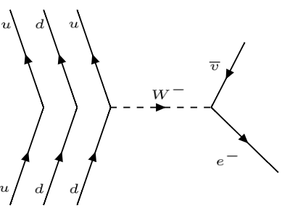
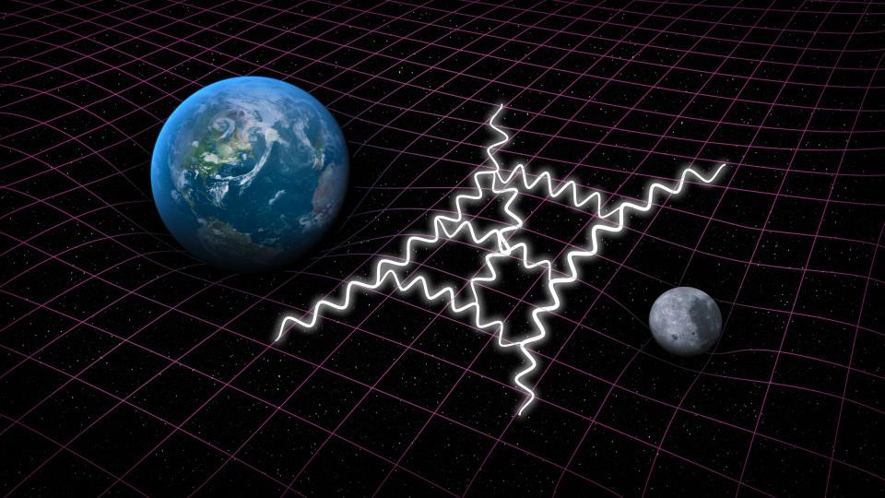

Force Carriers
Strong force (gluon)
Electromagnetic force
Binds quarks together
Magnetic + electrostatic force
Weak force (W/Z)
Gravity
Radioactive decay
Attraction of mass
Notes:
Speech force
Handshake force
Hug force

Slide 20
The Particle Zoo
Scalar bosons (Higgs boson)
<~1970 the Standard Model contained massless particles only
Peter Higgs (& Brout, Englert) proposed a Higgs Field that gave particles mass
Predicts new particle → Higgs boson
Discovered in 2012 by physicists at CERN

Slide 21
Many questions!
The standard model is annoying …
So correct! Yet, so wrong …
How on earth does gravity actually work?
Where did all the anti-matter go?
Why are some particles so heavy and others so light?
Where and what is dark matter?
Why are the length scales of the
fundamental forces so different?

Slide 22
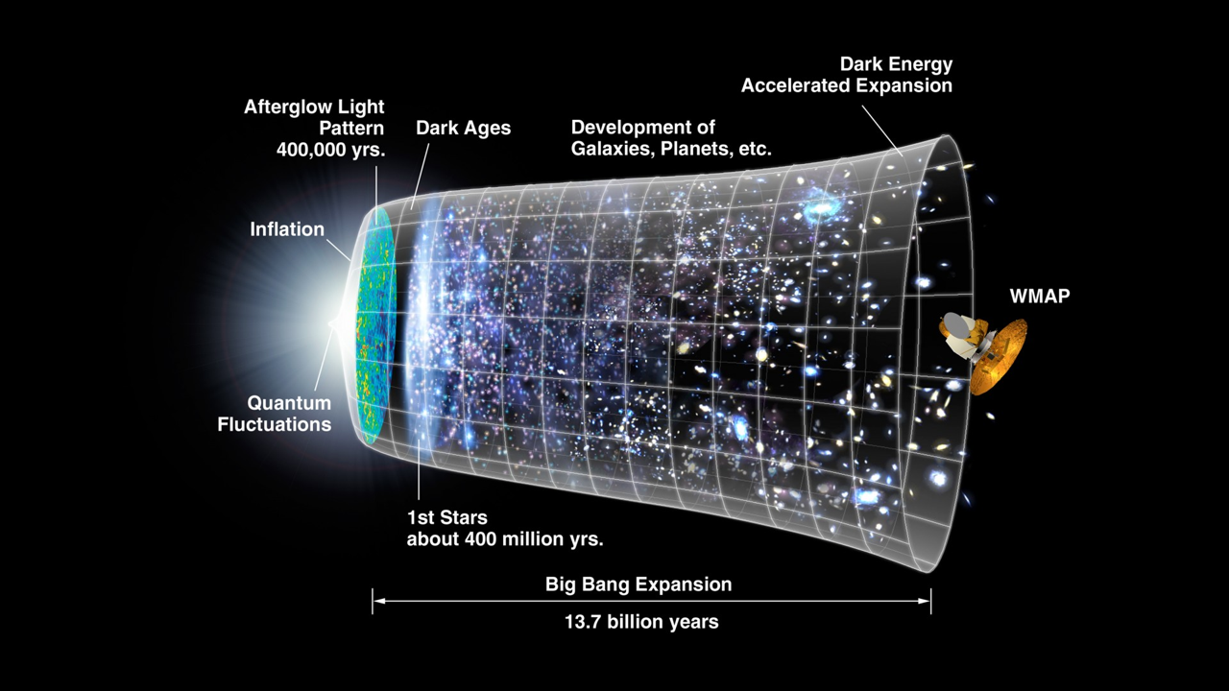
The Particle Zoo
Most of the universe today is comprised of up, down and electrons …
Heavier particles must be artificially created!
Beginning:
🤩
Today: 🥱

Slide 23
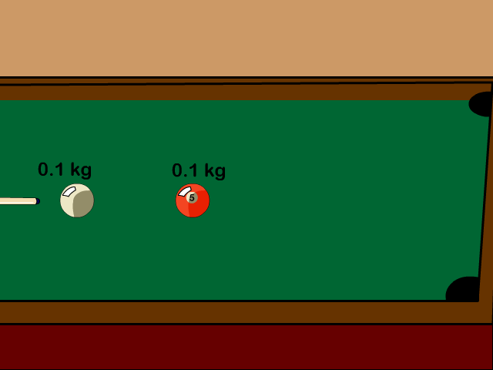
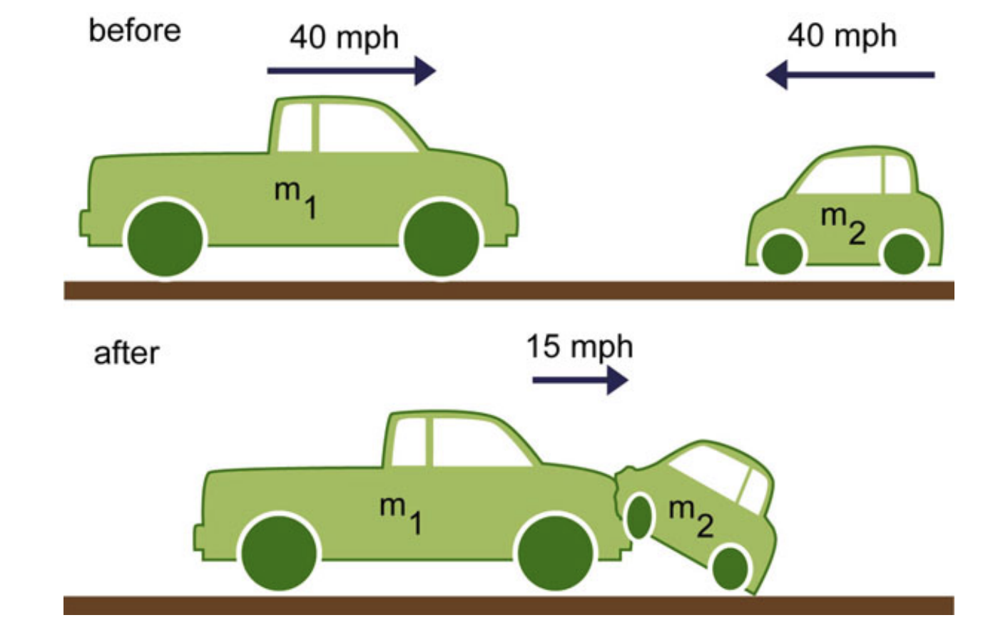
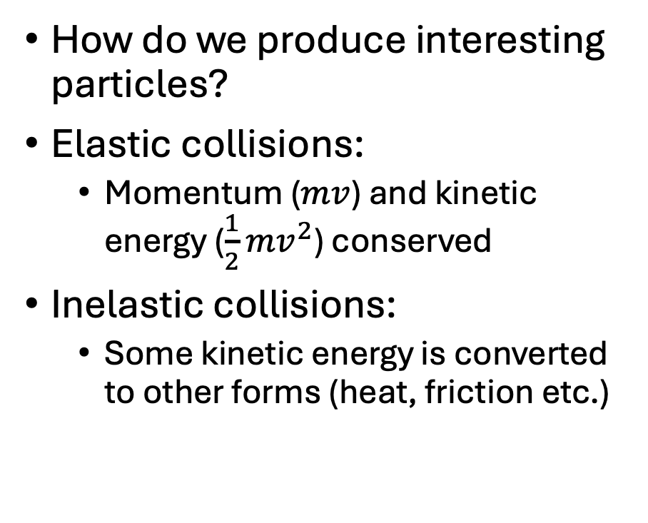
The LHC
How do we produce interesting particles?
Elastic collisions:
  Momentum ($mv$) and kinetic energy ($\frac{1}{2}mv^{2}$) conserved
Inelastic collisions:
  Some kinetic energy is converted to other forms (heat, friction etc.)

Slide 24

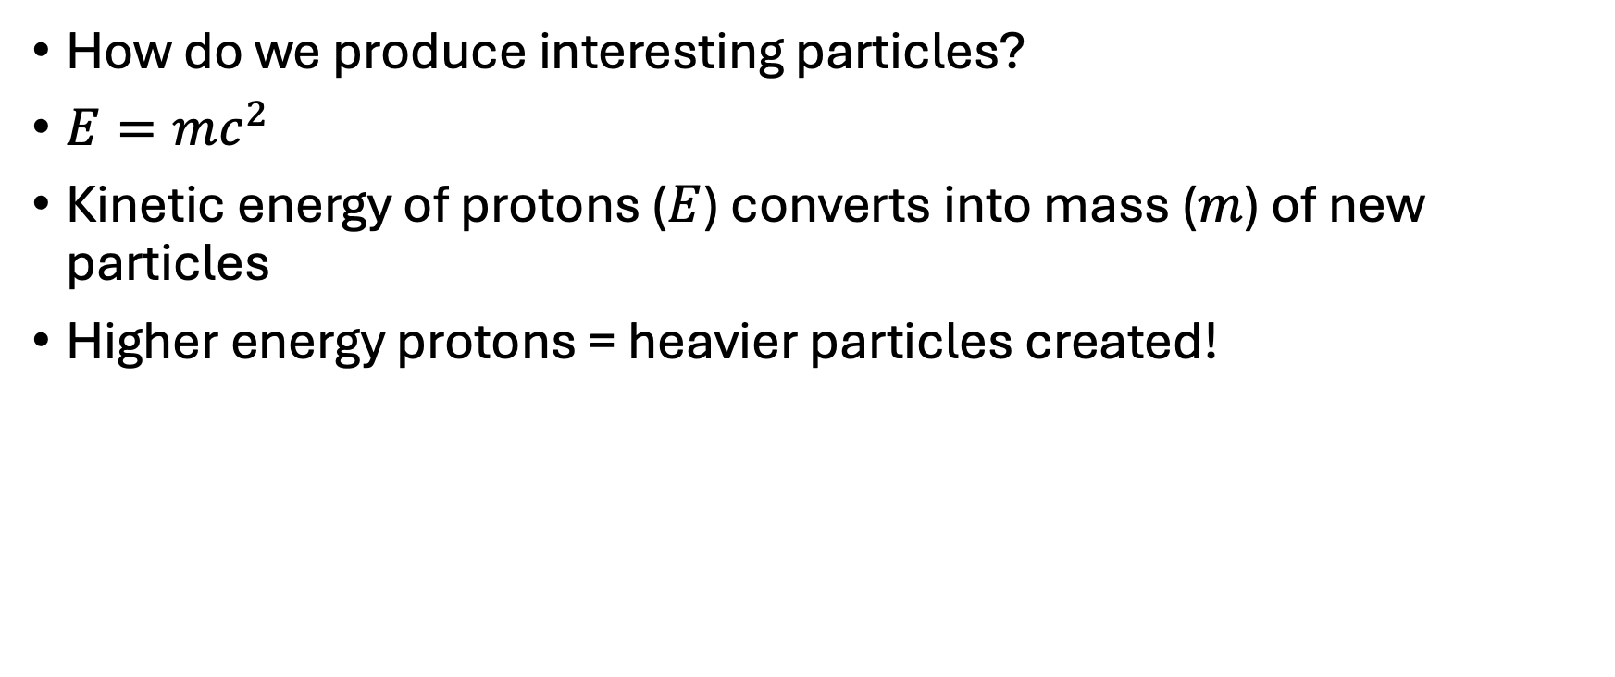
The LHC
Quantum mechanically!
How do we produce interesting particles?
$E=mc^{2}$
Kinetic energy of protons ($E$) converts into mass ($m$) of new particles
Higher energy protons = heavier particles created!
Proton
Proton

Slide 25
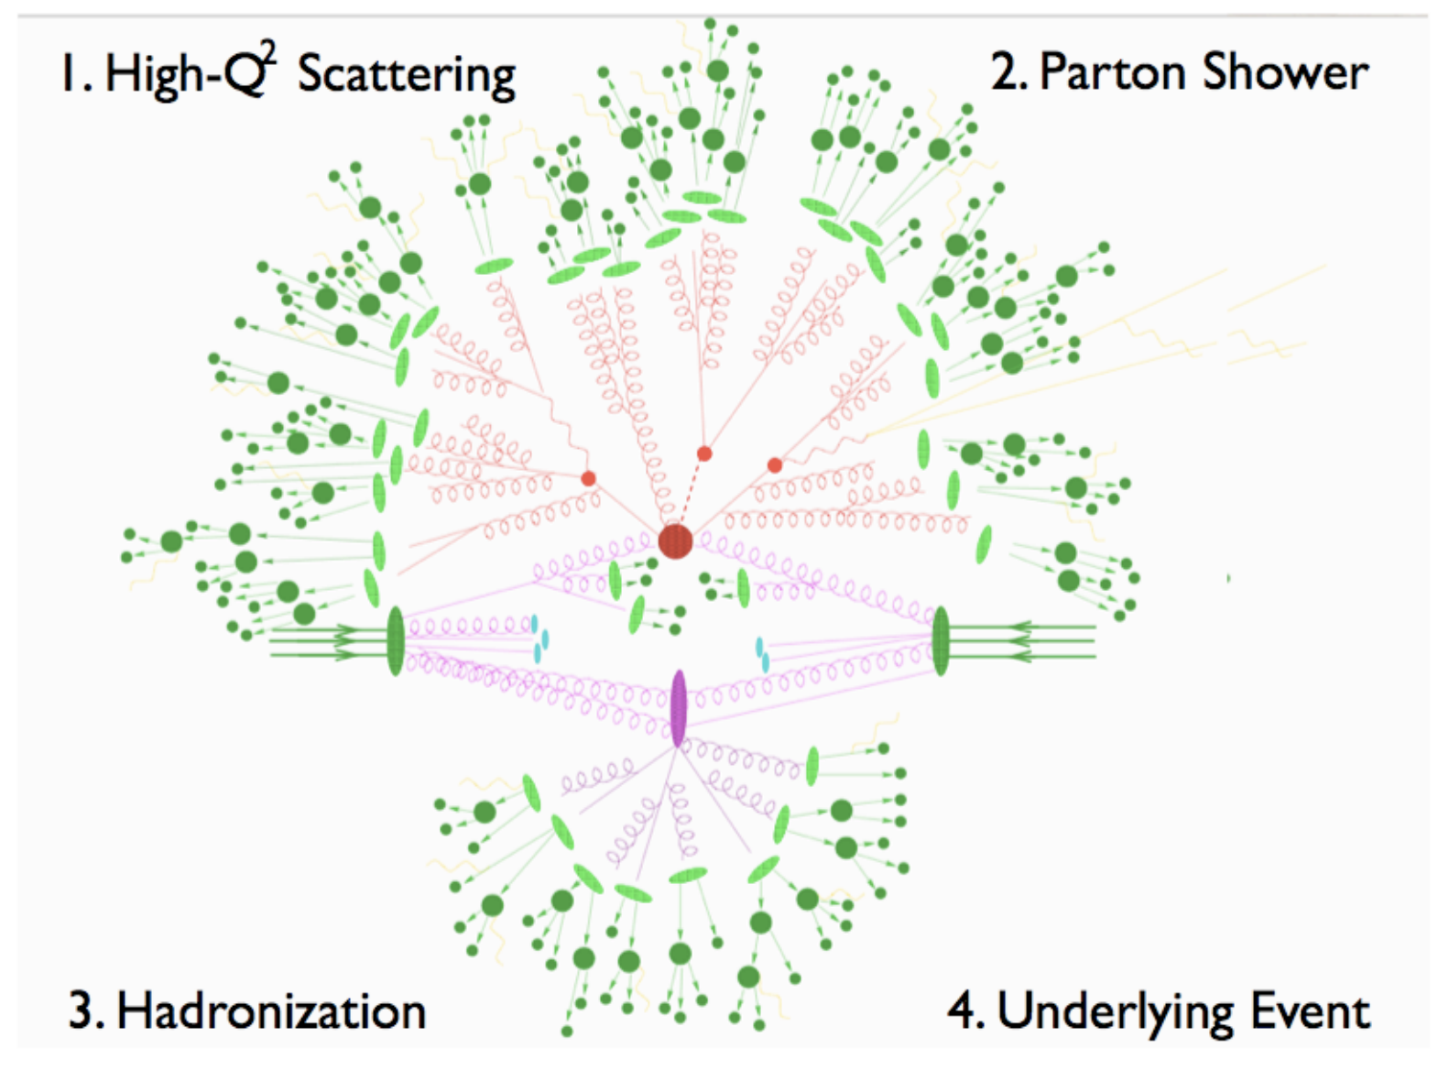
The LHC
Quantum mechanically!
How do we produce interesting particles?
$E=mc^{2}$
Kinetic energy of protons ($E$) converts into mass ($m$) of new particles
Higher energy protons = heavier particles created!
Proton
Proton

Slide 26
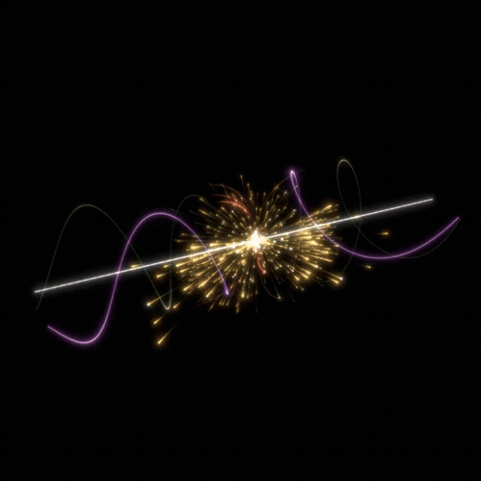
The LHC
Quantum mechanically!
How do we produce interesting particles?
$E=mc^{2}$
Kinetic energy of protons ($E$) converts into mass ($m$) of new particles
Higher energy protons = heavier particles created!
Proton
Proton

Slide 27
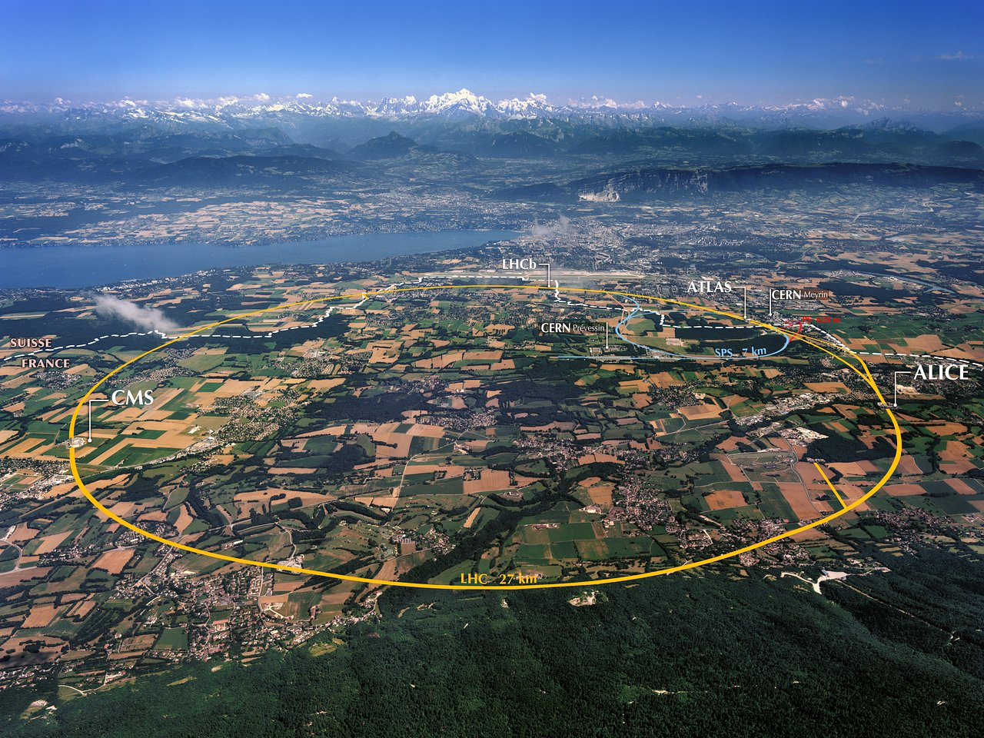
The LHC @ CERN
How do we produce interesting particles and collide high energy protons?
Large Hadron Collider @ European Organisation of Nuclear Research
Situated on the Swiss-French border, near Geneva
Largest machine in the world

Slide 28
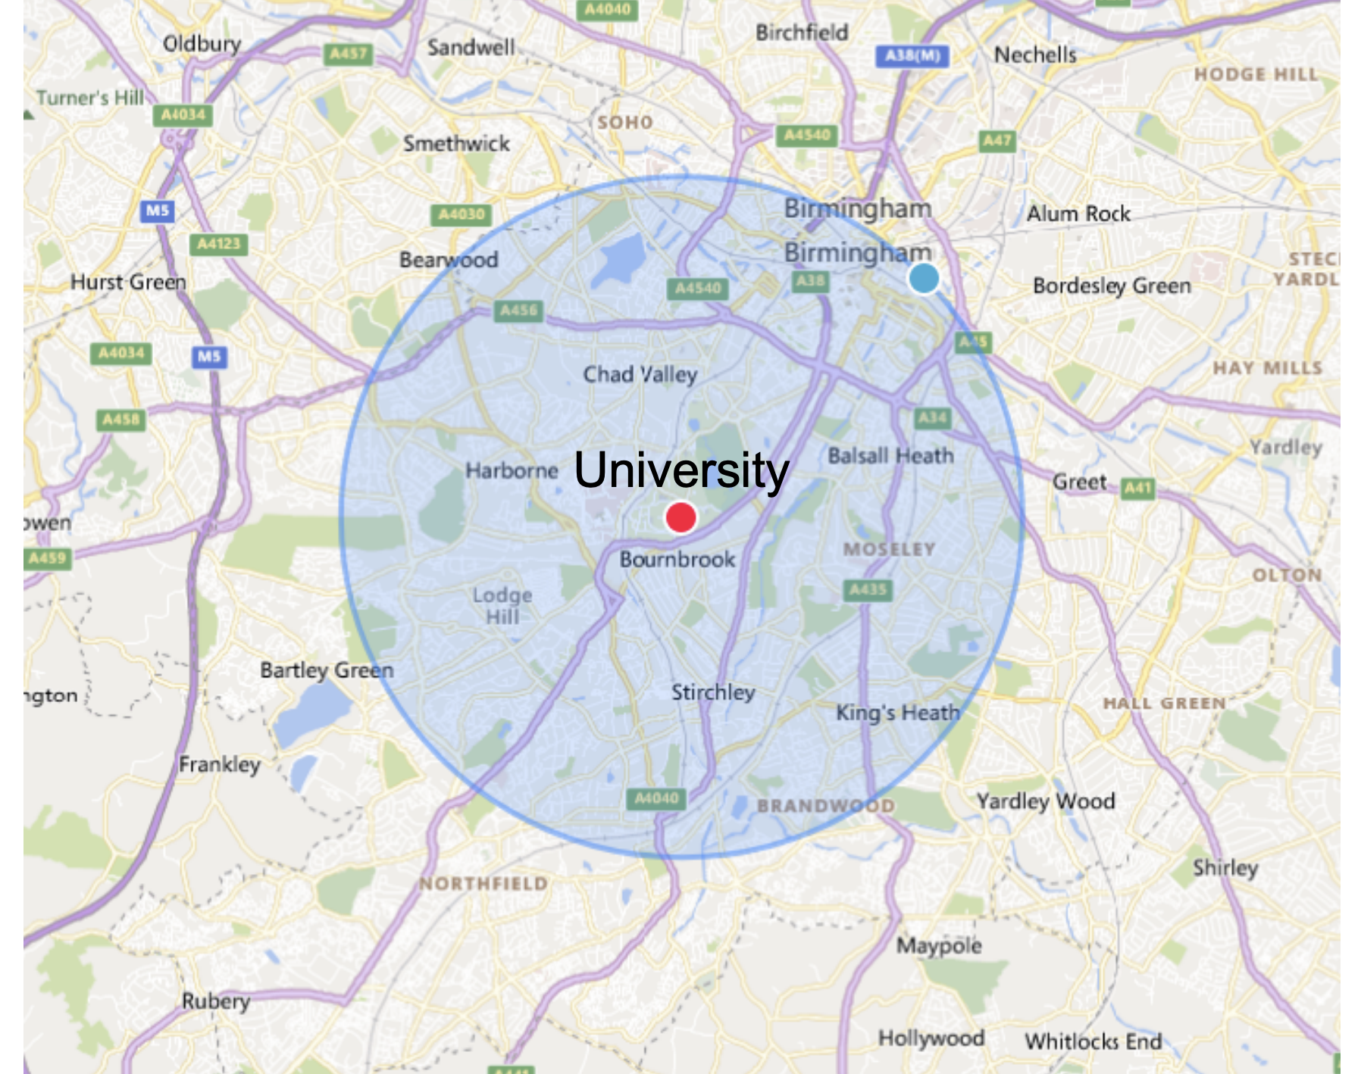
The LHC @ CERN
The LHC in Birmingham!

Slide 29
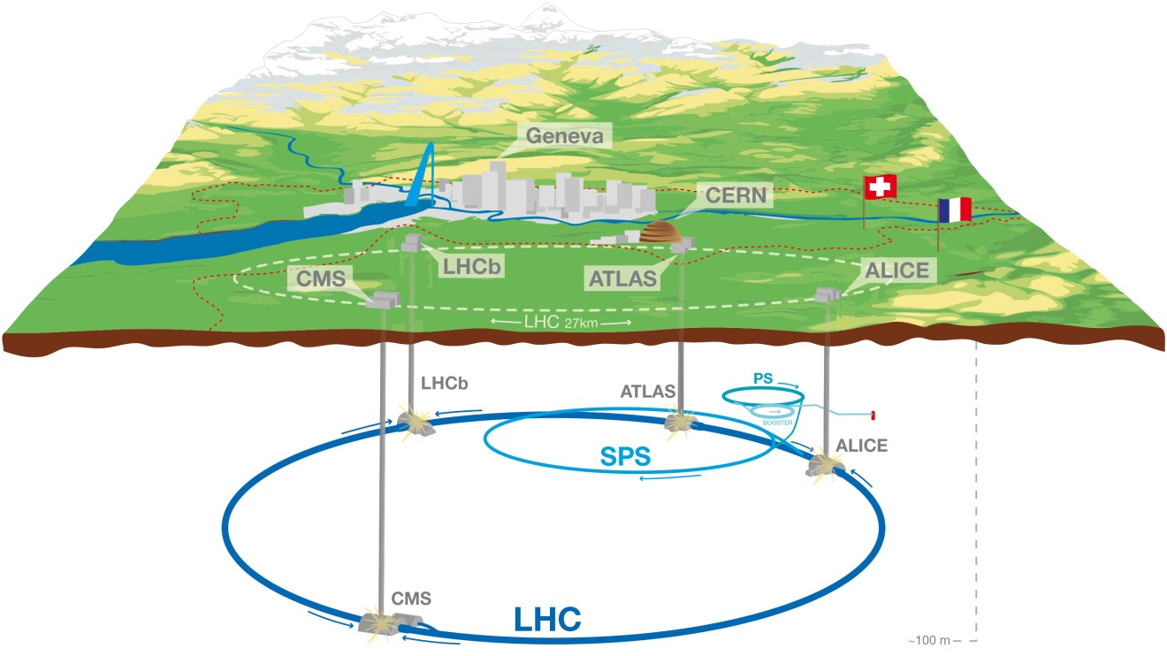
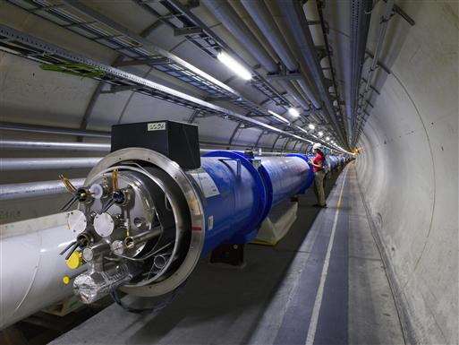
The LHC @ CERN
27km circumference ring 100m underground
Two beams of protons circulate in opposite directions
Electric fields and magnets accelerate and bend protons
Each beam contains ~2000 bunches
~10¹⁰ protons per bunch
Beam circulated 11,000 times per second
Protons travel ~99.9999991% the speed of light

Slide 30




The LHC Detectors
Beams cross at 4 Interaction points
Large detectors act like cameras

Slide 31

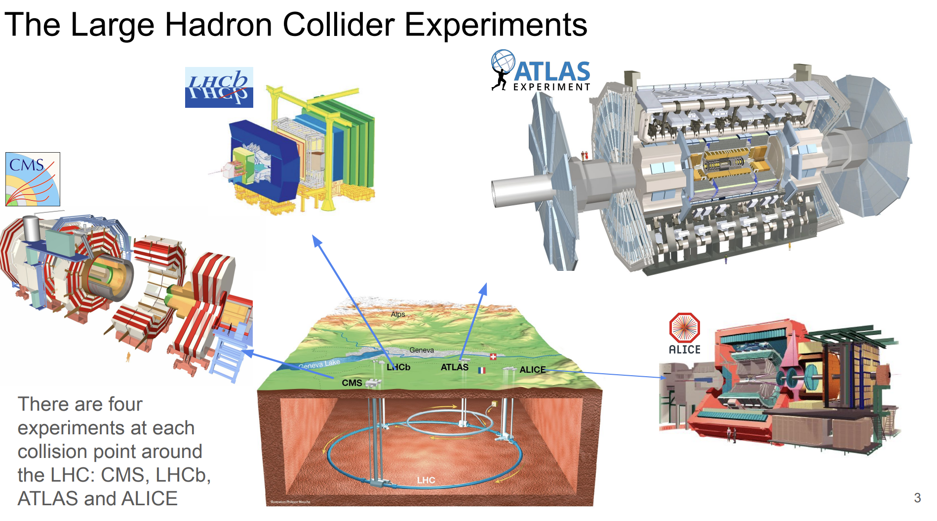
The LHC Detectors

Slide 32
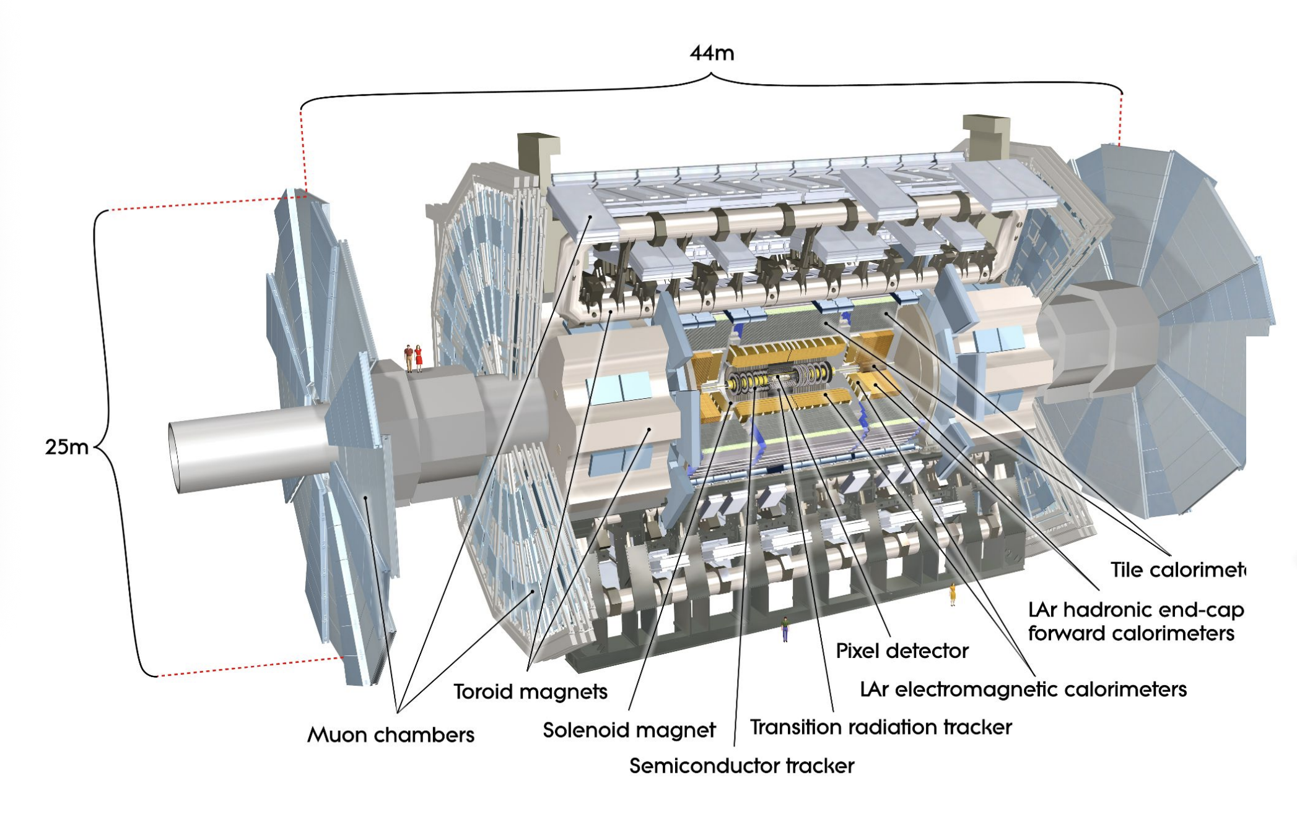
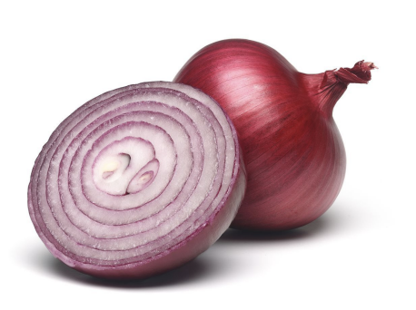
The ATLAS Detector

Slide 33
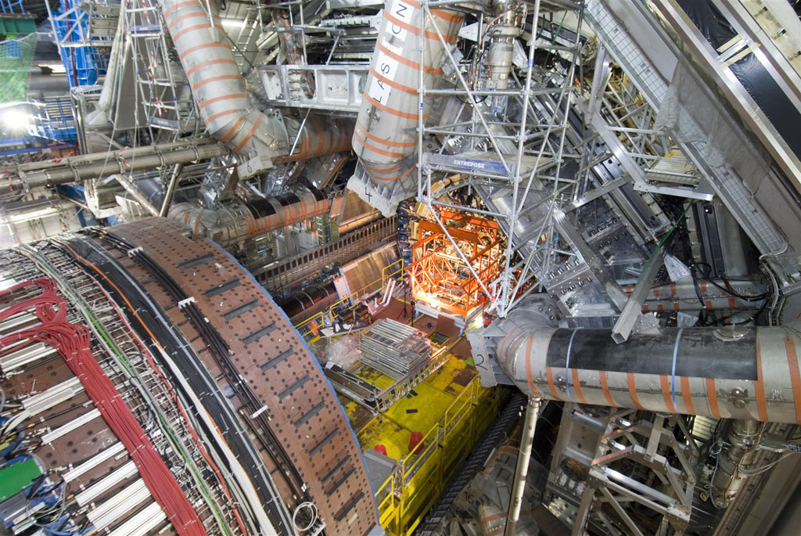
The ATLAS Detector

Slide 34
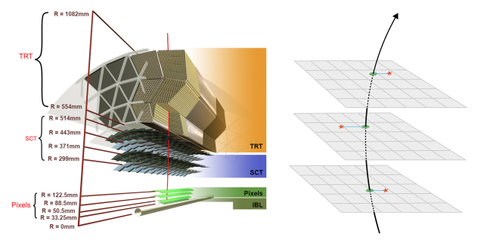
The ATLAS Detector
Tracking detector tracks charged particles
Where they’re going/where they came from
Strong magnetic field bends particles

Slide 35
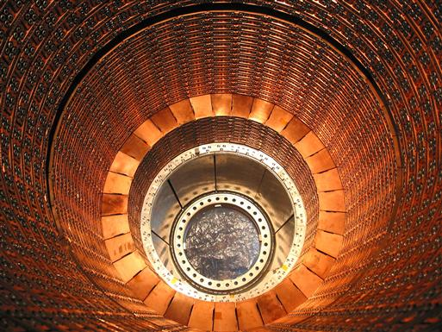
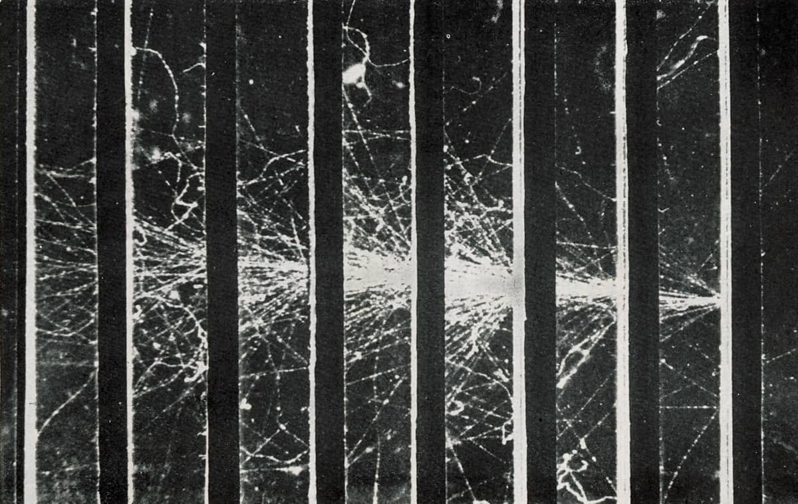

The ATLAS Detector
Calorimeters measure photon and electron energy
Particles shower and are destroyed
$$e^{−}$$

Slide 36
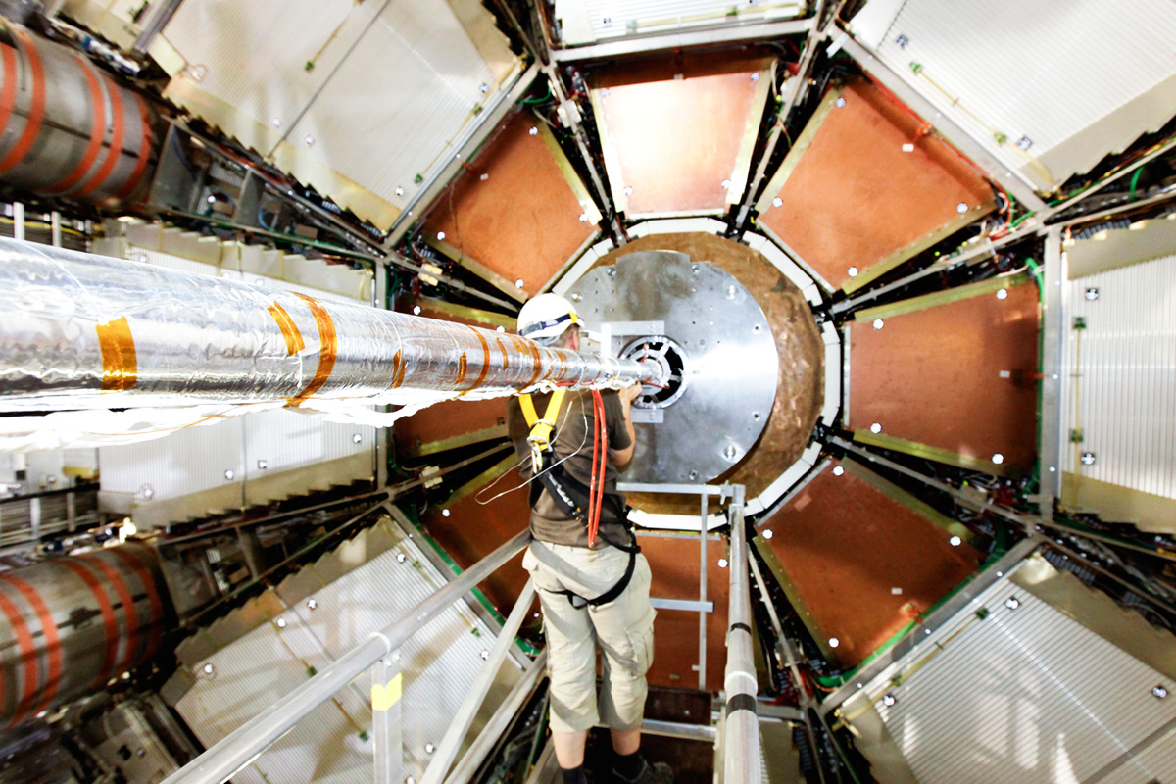
The ATLAS Detector
Muon chambers measure the most penetrating particle - muons

Slide 37

The ATLAS Detector
Where and how a particle interacts in the detector gives you information about it

Slide 38



A Global CERN
~16,000 researchers from 90 countries from over 600 institutions
~2,500 based full time at CERN
All sights total ~1000 football pitches

Slide 39






The Science @ CERN
Why is it useful?
Consequences

Slide 40


Thanks for your attention!
Notes:
At the beginning I said our universe is mostly made up of regular matter -> why???

Slide 41
Backups
Notes:
At the beginning I said our universe is mostly made up of regular matter -> why???

