Slide 1
FY26 R&D Proposals from USHFCC Muon Group
“A Muon System Made of Drift Tubes and Scintillator Strips for FCC-ee”
“Precision Muon Timing and ToF-based PID with µRWELL-PICOSEC Technology”

Slide 2
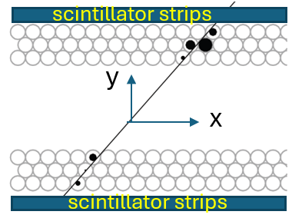
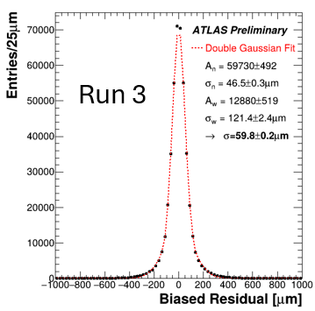
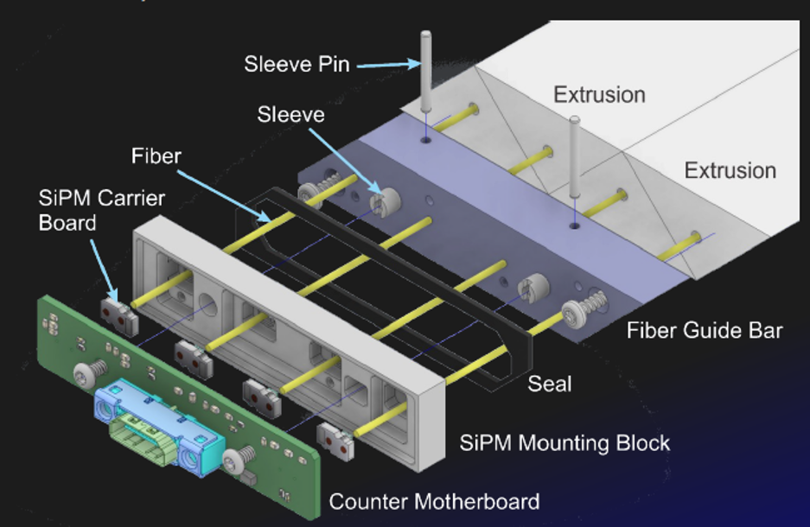
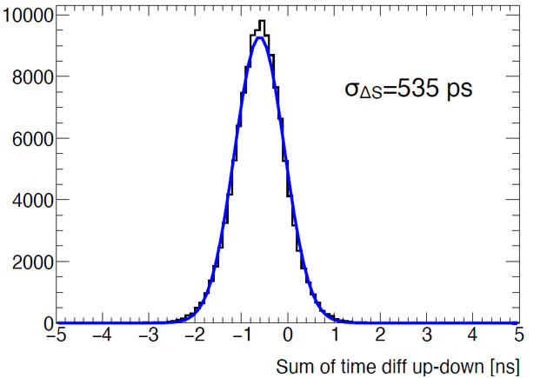

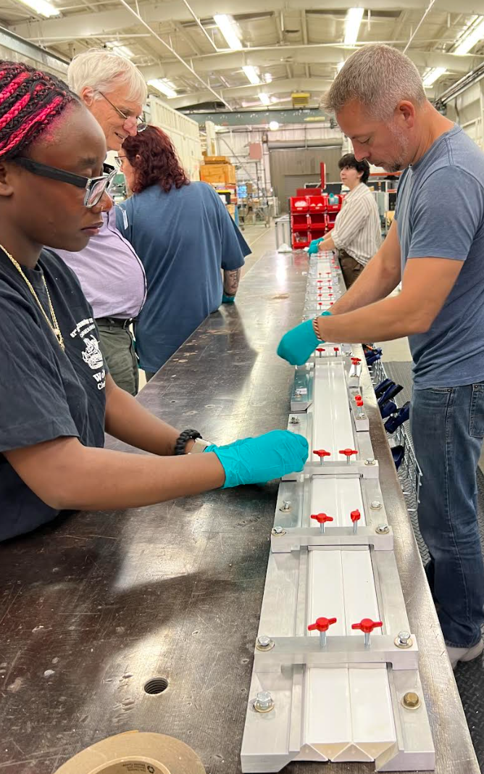
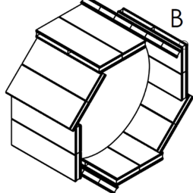
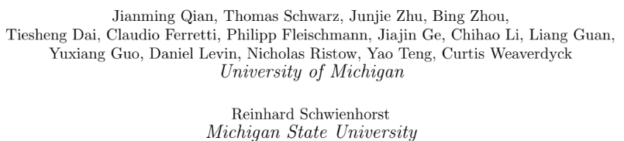
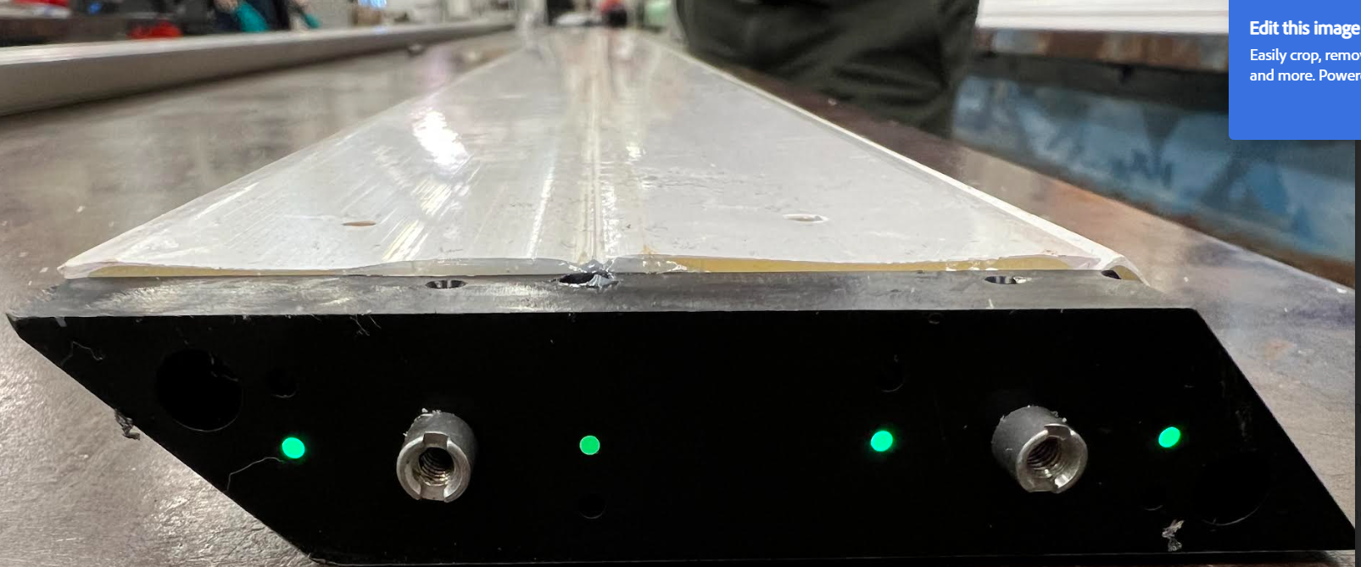
A. R&D Proposal for A muon System Made of Drift Tubes and Scintillator Strips For HFCC
A combination of drift tubes and scintillators for a muon system is a high precision, fast timing, Robust, and cost-effective option to meet the muon detection requirements at HFCC. A modest support holds high strategic value of the R&D program.
Scintillator strips module with SiPM RO
Scintillator Strip Test (Rome)
MDT
σ ~80μm
A drift tube + scintillator strip module (2m x 6m)
Visiting S. strip construction at Fermilab
Proposed R&D in FY2026
Joined by Fermilab and UMASS
Build a 2-ML module (tube+strip) and the associated front-end readout electronics, with the goal of demonstrating both spatial and timing resolution performance with test beam experiments.
Layout for Geant4 simulation
Funding request: total 50k ($30k for engineers, $20k for strip Elx)

Slide 3
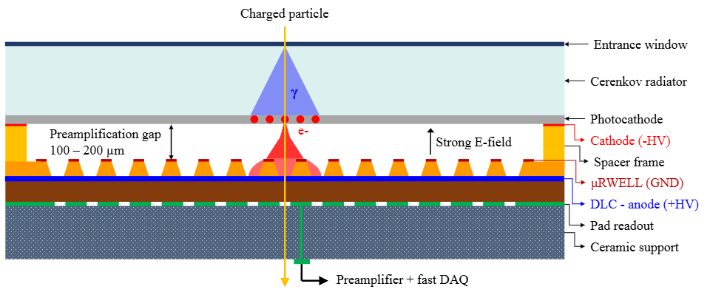
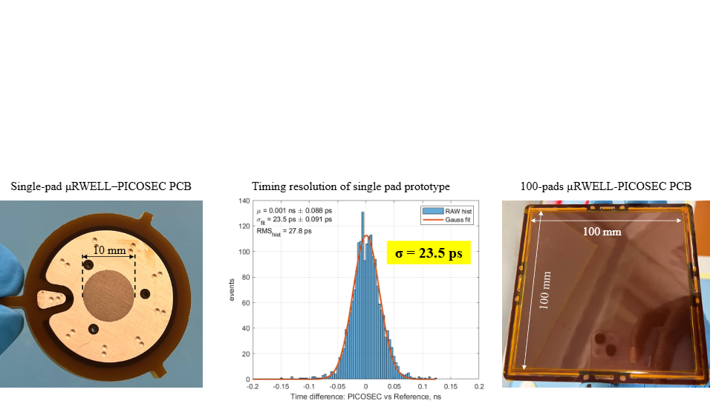
B. Precision Muon Timing and ToF-based PID with µRWELL-PICOSEC Technology
K. Gnanvo, X. Bai, S. Lee (JLAB) & P. Iapozzuto, M. Hohlmann (FIT)
Motivation (dual use):
Detection of delayed charged particles from long-lived particle decays in muon system, e.g. $\text{H} →X_{LLP}^{0}$ $X_{LLP}^{0}→ℓ^{+}ℓ^{−}ℓ^{+}ℓ^{−}$
Particle identification using time-of-flight (ToF) detector outside central tracker (“barrel timing wrapper”)
Concept: µRWELL-PICOSEC detector (MPGD with Cherenkov radiator)
First beam test results with
small single-channel prototype:
gas
JLAB
Approach:
Design, construction, and test of 10cm x 10cm prototype with 100 channels
Photocathode made from non-hygroscopic Diamond-like Carbon (DLC) instead of CsI
Beam test at CERN in summer 2026
Funding request: total $43k ($23.5k personnel, $12k detector, $7.5k travel)

