Slide 1
EIC International Accelerator Collaboration
Commissioning Tool Workgroup
EIC Virtual Accelerator Updates
Yue Hao

Slide 2
Plans for EIC VA
Control Room
Software, GUI
Infer
Train
USER Interface
(JupyterHub)
AI/ML applications
Machine Model
MADX
Elegant
BMAD
Beam-Beam Sim.
...
Deploy
EIC Virtual Accelerator
Machine Portal / Database
IOC
IOC
IOC
IOC
IOC
EIC Accelerator Complex

Slide 3
Aug 2025 Updates, Overview
Current effort : Machine Portal
  Separate machine description
Adopt the concept of PALS
  Only small subset is implemented
  Parameter is grouped by parameter groups
  Define ControlP group
  Option fields: PV_names, str_limit, ramp_rates, …
Export and Load from Human readable file
  YAML is chosen
Package name: EICVIBE
  EIC Virtual Beam Environment
Control Interface, PVAccess
EIC Machine Portal
Import
Design
Lattice
Machine readable Machine Description file (YAML)

Slide 4
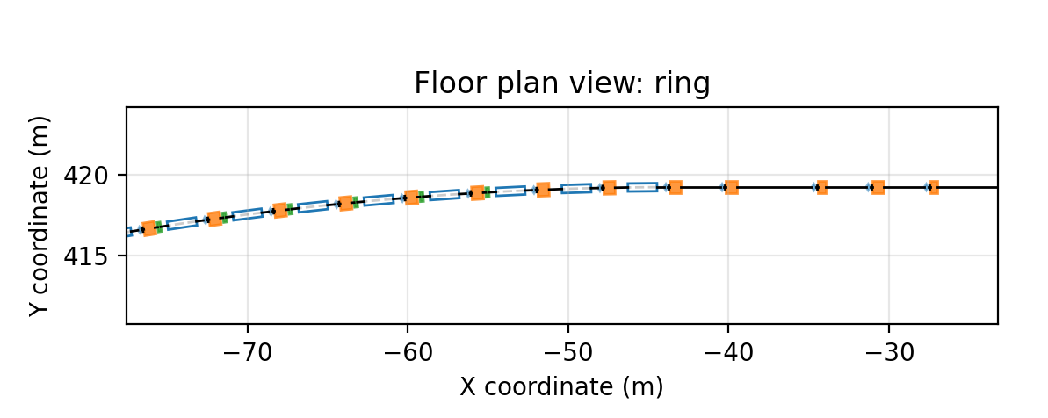
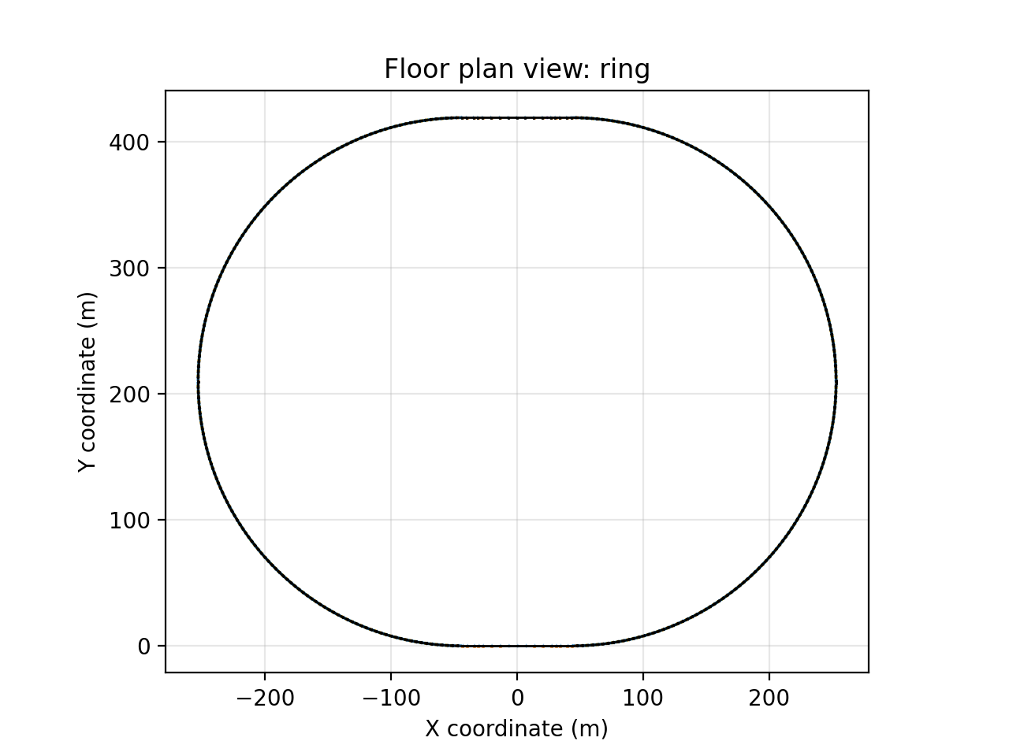
Aug 2025 Updates, Design import
Use cpymad to read the madx file
Each separate element has unique name, with initial parameter inherited from the prototype element.
Combine continuous drifts in design
Tested using one version of RCS design

Slide 5
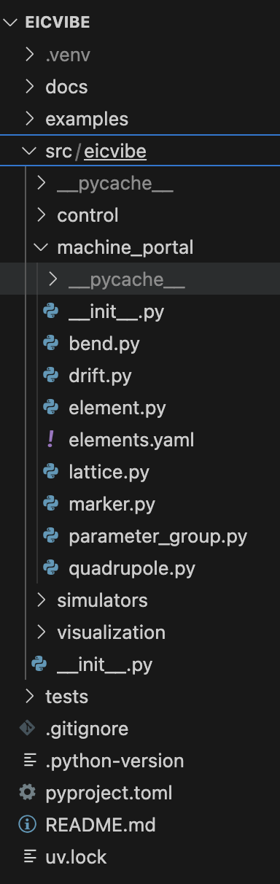
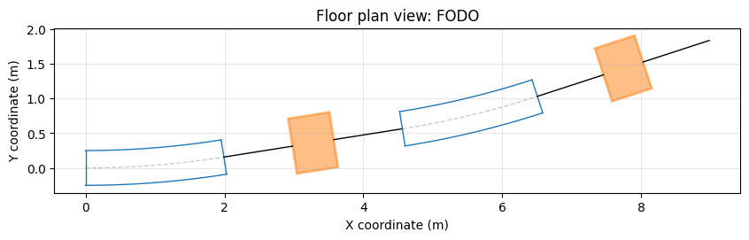
Aug 2025 Updates, Human Readable Lattice
the lattice/element properties can be written in YAML format (no extensions)
A short Example of FODO Description file
name: FODO
root_branch: FODO
elements:
- Bend:
name: Bend1
length: 2.0
BendP:
ANGLE: 0.15707963267948966
- Drift:
name: Drift1
length: 1.0
- Quadrupole:
name: Quad1
length: 0.6
MagneticMultipoleP:
K1: 1.2
ApertureP:
X:
- -0.05
- 0.05
…
FODO:
- Bend:
name: Bend1_1
length: 2.0
inherit: Bend1
BendP:
ANGLE: 0.15707963267948966
- Drift:
name: Drift1_1
length: 1.0
inherit: Drift1
- Quadrupole:
name: Quad1_1
length: 0.6
inherit: Quad1
…
Need Modifications when PALS standard is finished.

Slide 6
Aug 2025 Updates, Simulation Engines
We have several simulation code used modeling EIC for different sub-systems or dynamical effects
  Large efforts to connect each of them
  First priority:
    Xsuite (For lattice design and tracking)
    BMAD (Spin tracking)
    Elegant (Collective effects)
Ongoing effect to connecting to Xsuite
Virtual Accelerator (online model) Modes
  Linac / Transport line mode: simulation loops from start-to-end, computation time ~ms-s, access diagnostic results and lattice
  Ring mode: continuous simulation, with buffer reading diagnostic data, simulation parameter change change on-the-fly
  Ramping mode: Simulation loops from after ramping finish, computation time in <second for orbit, >>second for dynamics. Simulation follows ramping plan as external input.

