Slide 1
Detect Axions with Mössbauer Effect
Shengyi Liu
HKUST
2026.1.15
IAS Program on Fundamental Physics @HKUST
Based on e-Print:
Shengyi Liu, Kun-Feng Lyu, Jie Meng, Jing Shu, Yakun Wang, Yue Zhao
2511.14851 [hep-ph]

Slide 2
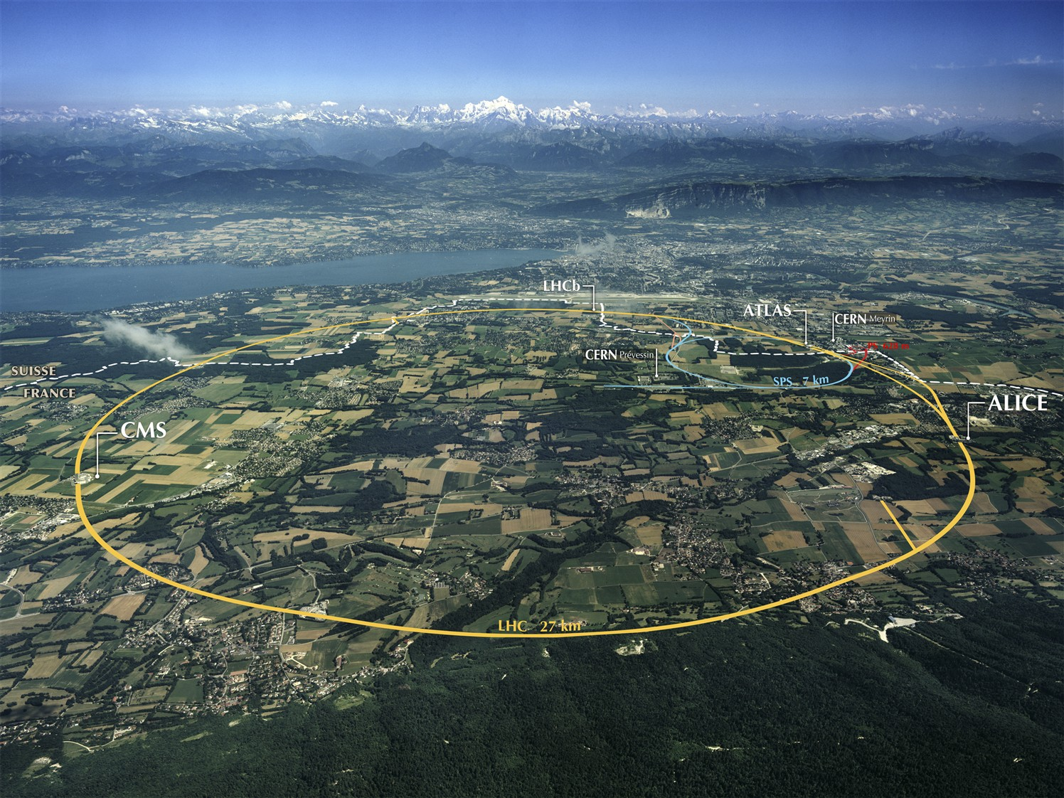
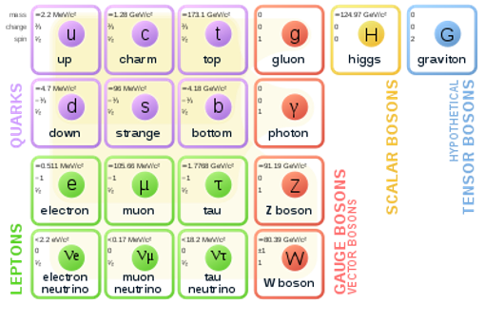
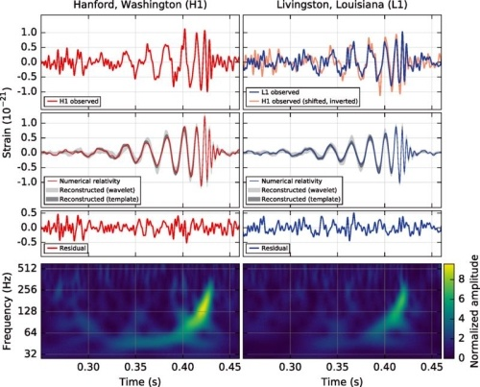
Current Status of Particle Physics:
+
anything else?

Slide 3
Left-over problems:
• The identity of dark matter
• Gauge hierarchy problem
• Strong CP problem
• The identity of inflaton field
• Baryogenesis
• Cosmological constant
•
•
•

Slide 4
Left-over problems:
• The identity of dark matter
misalignment mechanism
• Gauge hierarchy problem
relaxion
• Strong CP problem
QCD axion
• The identity of inflaton field
• Baryogenesis
can be related to axion
• Cosmological constant
•
•
•

Slide 5

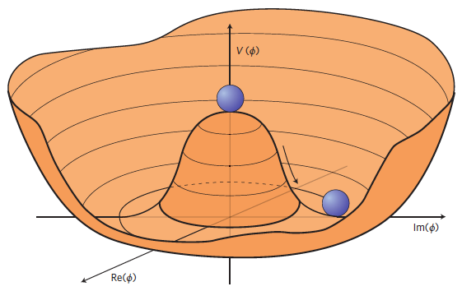
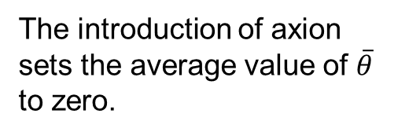

QCD axion direct detection
0

Slide 6
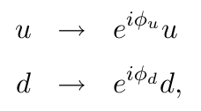
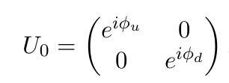




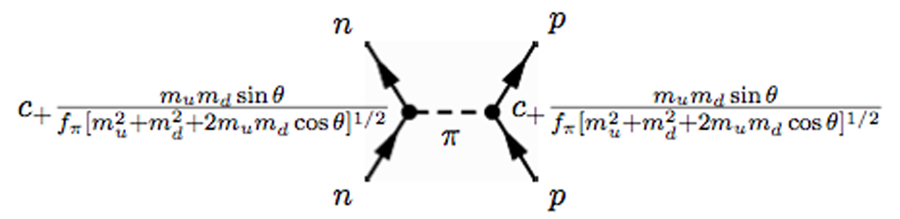
Chiral Lagrangian
Axion affects the nucleon and mesons through Chiral Lagrangian.
lead to pion-axion mixing
change nucleon mass
change nucleon-pion interactions

Slide 7
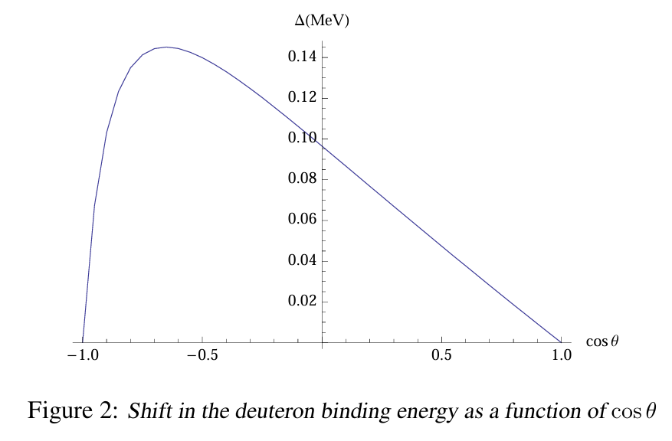
Simple example

Slide 8
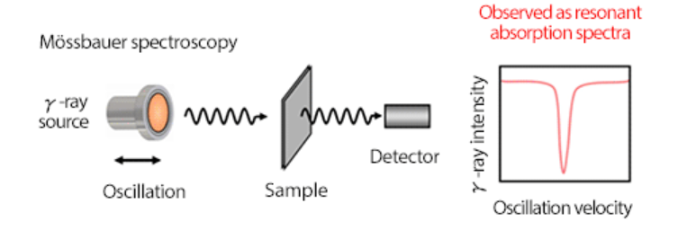



Mossbauer Effect
Extremely narrow
It is very challenging to measure the natural linewidth experimentally.
So far, the best measurement has achieved 7 times of the nature width.
If axion leads to the change of nucleon-pion coupling, it will change the energy splits.

Slide 9
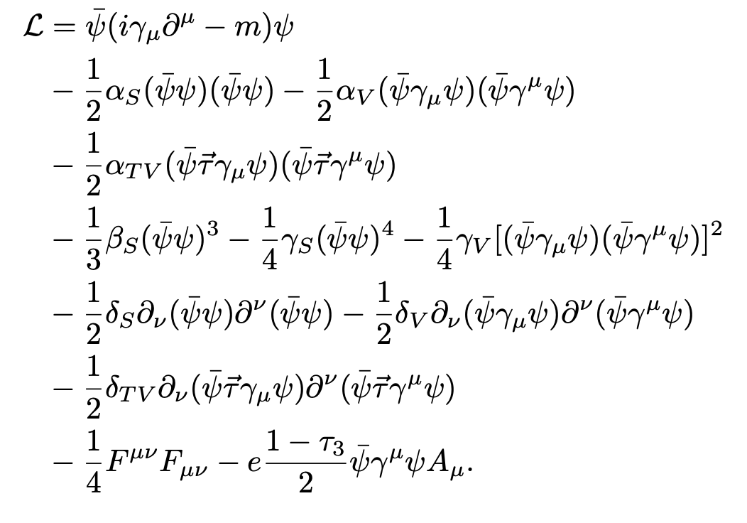
RDFT calculations
modified by axion

Slide 10
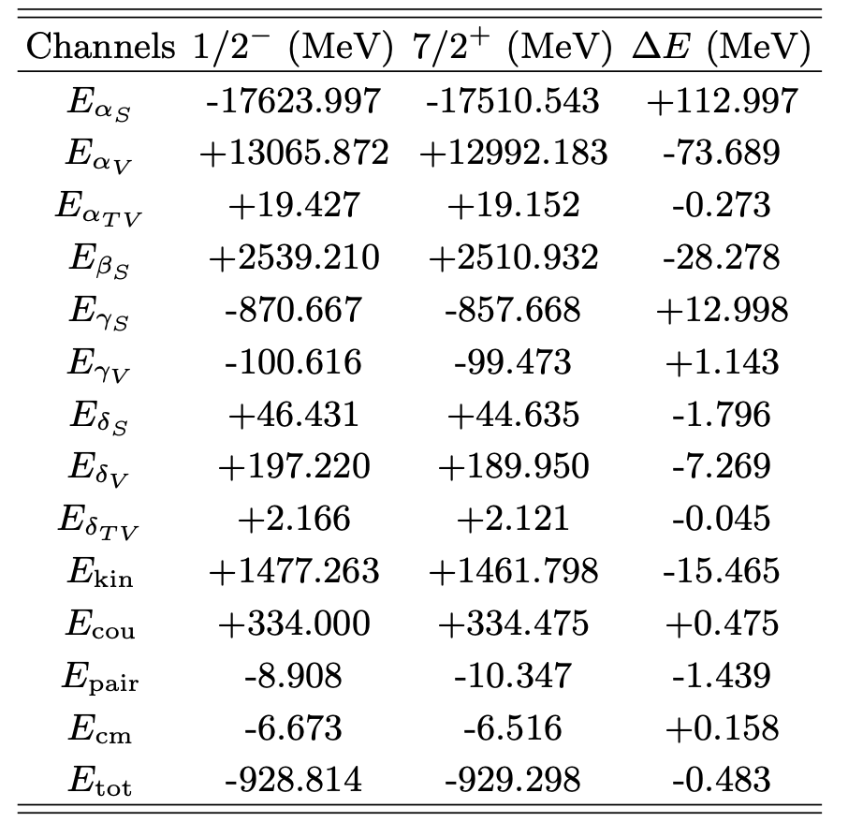
RDFT Results
Dominant terms

Slide 11
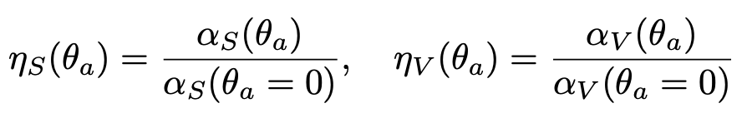
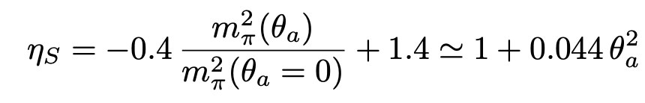
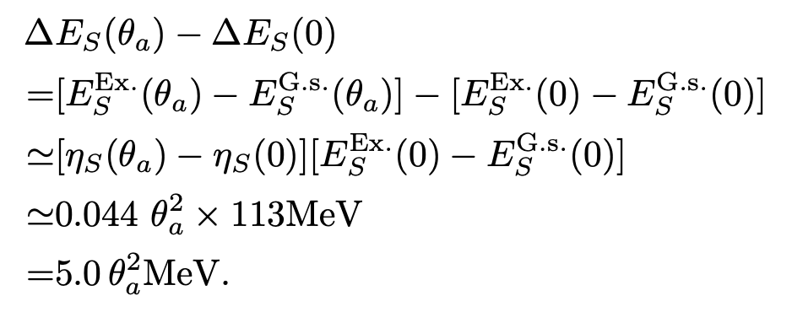
Axion Correction
The scalar interaction part as example
Total correction

Slide 12
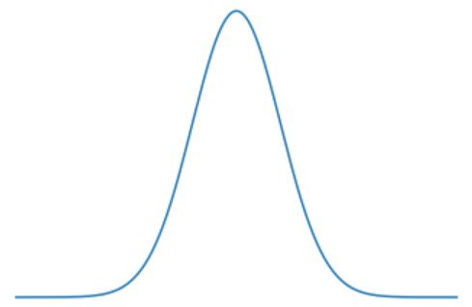

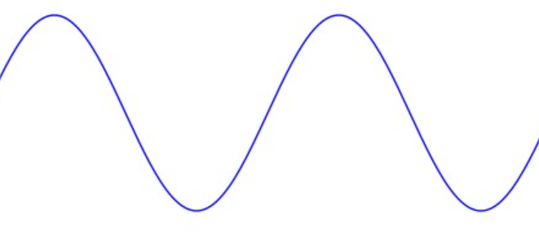
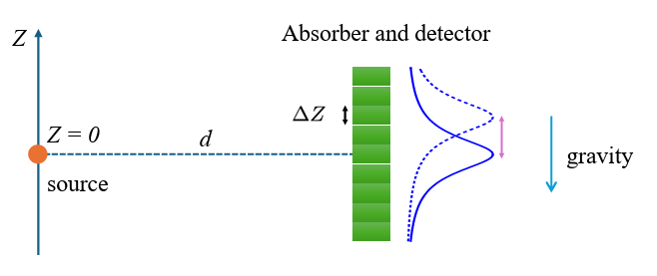
Experiment Setup
axion field value
Similar setup has been proposed to search for gravitational wave.
Sci. Bull. 69, 2795 (2024)

Slide 13

Systematic and Statistical Uncertainties
A too narrow detector leads to a very large statistical error.
source radiation intensity
branching ratio of the 88 keV photon
A competition:
the systematic uncertainty
worse with a larger detector width
the statistical uncertainty
better with a larger detector width
A smart data analysis strategy is introduced to balance these two competing aspects.

Slide 14
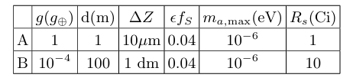
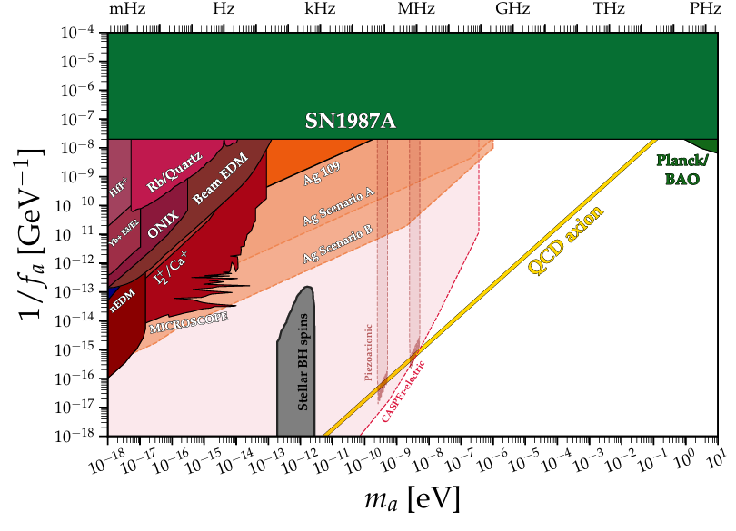
Sensitivity

Slide 15
Sensitivity
Ruled out by current width measurement.
Jetp Lett. 90, 499–503 (2009)
Detector time resolution determines the frequency upper limit.

Slide 16
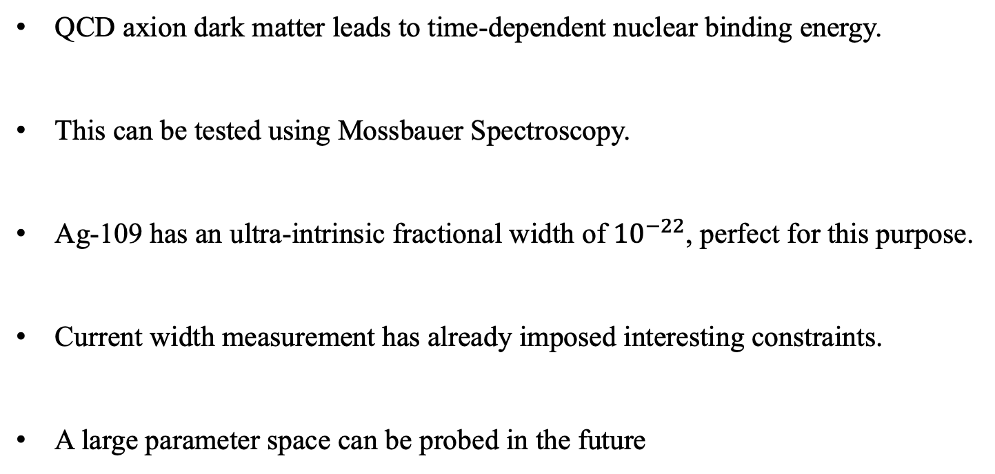
Conclusion
QCD axion dark matter leads to time-dependent nuclear binding energy.
This can be tested using Mossbauer Spectroscopy.
Ag-109 has an ultra-intrinsic fractional width of ${10}^{−22}$, perfect for this purpose.
Current width measurement has already imposed interesting constraints.
A large parameter space can be probed in the future

