Slide 1
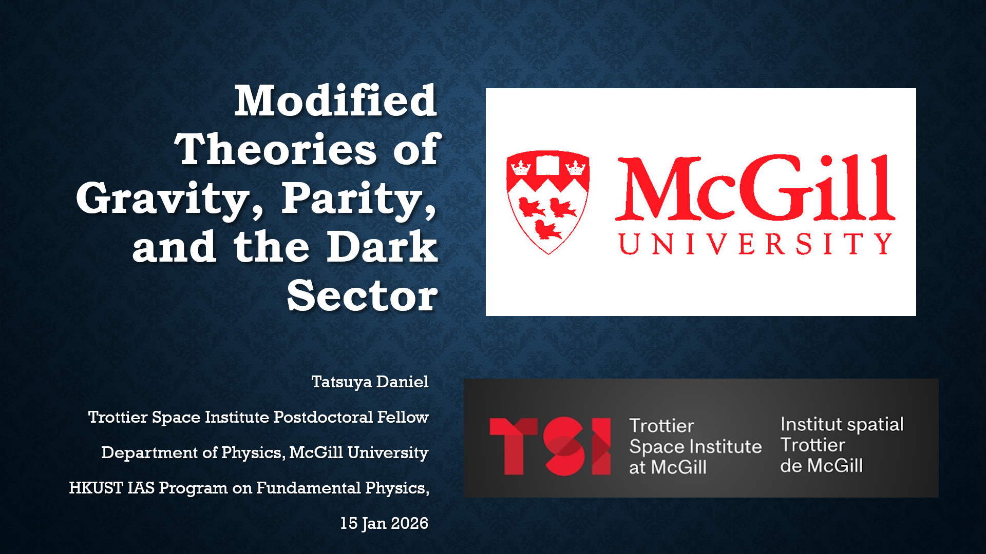

Slide 2
Tests of general relativity

Slide 3
Tests of general relativity
GR agrees remarkably well with observations

Slide 4
Tests of general relativity
GR agrees remarkably well with observations
Solar system tests

Slide 5
Tests of general relativity
GR agrees remarkably well with observations
Solar system tests
  Gravitational lensing, Shapiro delay

Slide 6
Tests of general relativity
GR agrees remarkably well with observations
Solar system tests
  Gravitational lensing, Shapiro delay
Binary pulsars

Slide 7
Tests of general relativity
GR agrees remarkably well with observations
Solar system tests
  Gravitational lensing, Shapiro delay
Binary pulsars
Gravitational waves

Slide 8
Tests of general relativity
GR agrees remarkably well with observations
Solar system tests
  Gravitational lensing, Shapiro delay
Binary pulsars
Gravitational waves
Black hole observations

Slide 9
Tests of general relativity
GR agrees remarkably well with observations
Solar system tests
  Gravitational lensing, Shapiro delay
Binary pulsars
Gravitational waves
Black hole observations
  EHT, X-rays from accretion disks

Slide 10
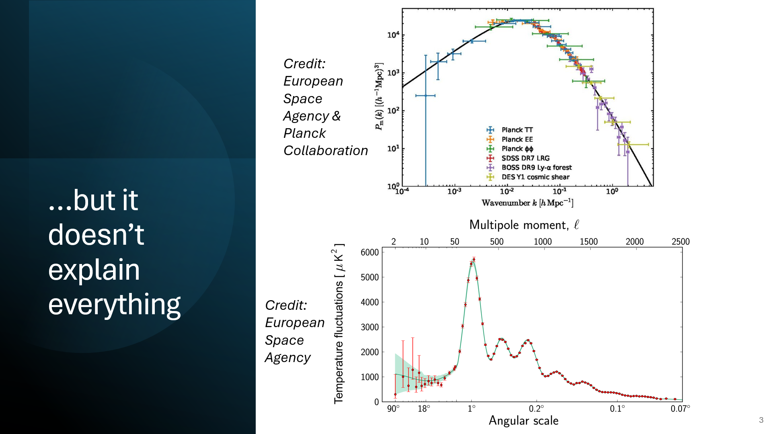

Slide 11
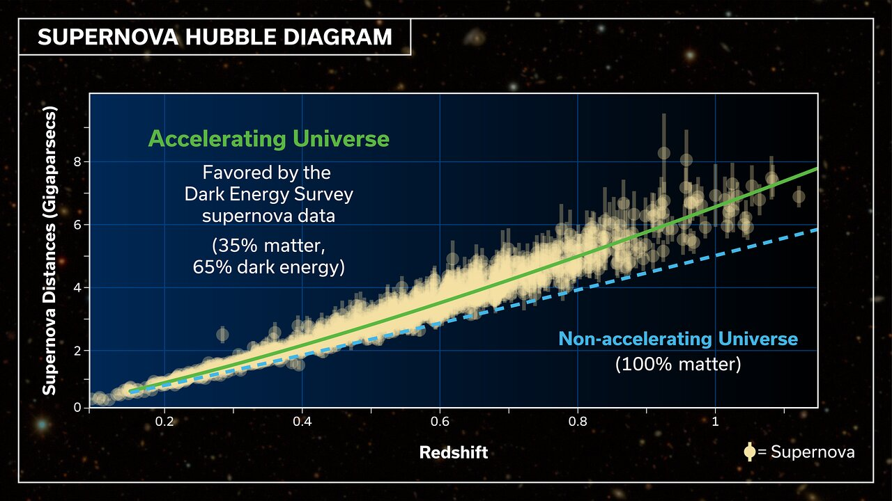
Credit: DES Collaboration

Slide 12
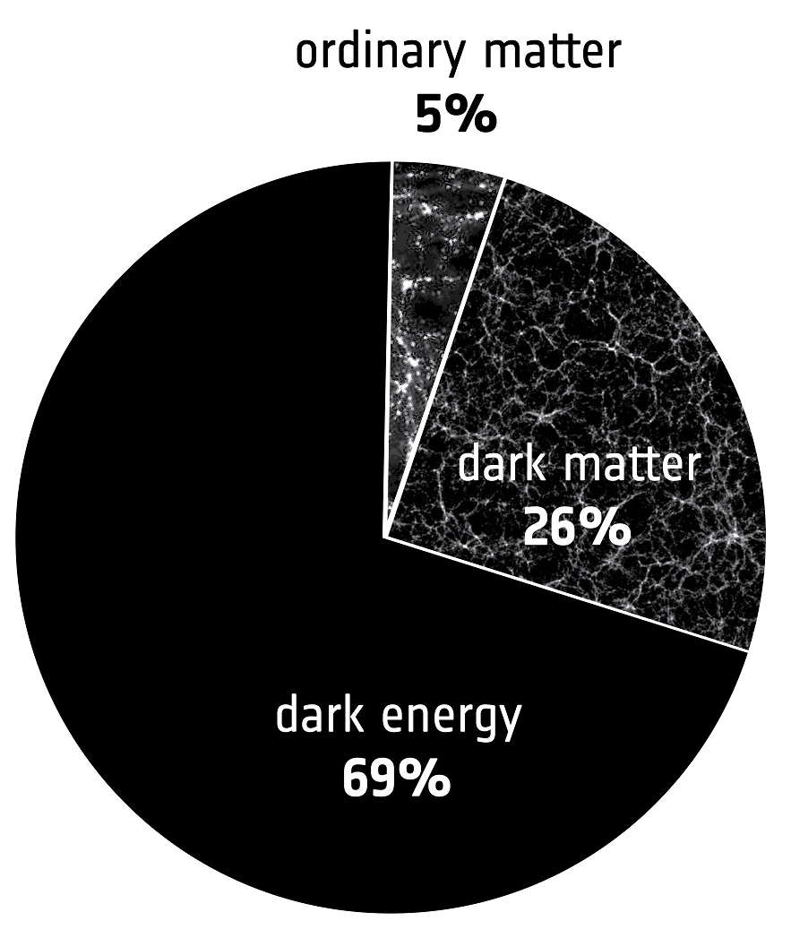
Credit: DES Collaboration
Credit: European Space Agency

Slide 13
What is dark matter and dark energy?

Slide 14
What is dark matter and dark energy?
Short answer: we don’t know

Slide 15
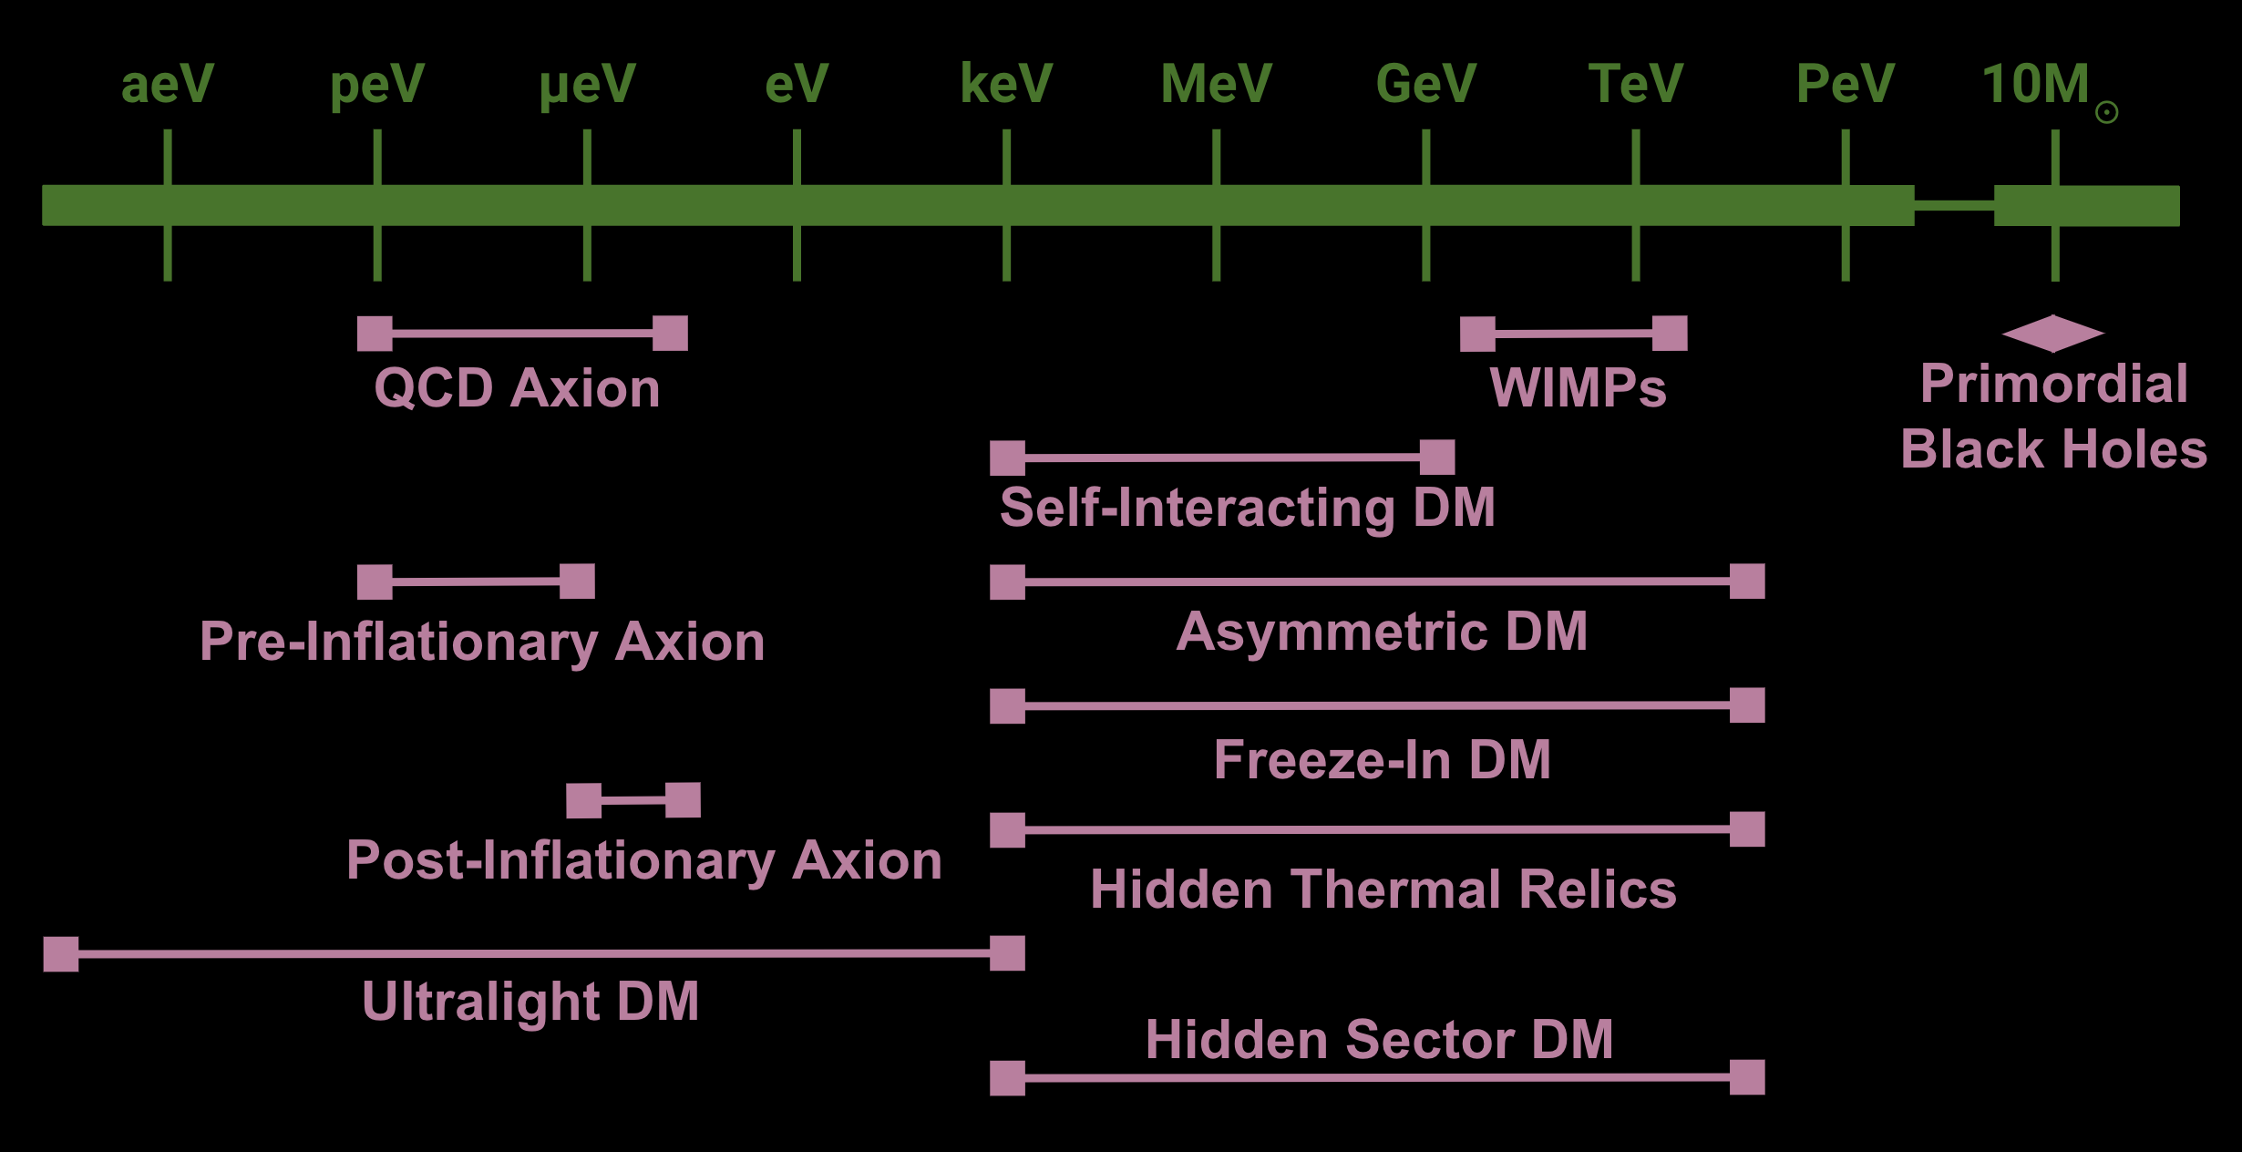
What is dark matter and dark energy?
Short answer: we don’t know
Credit: University College London, HEP Group

Slide 16
What is dark matter and dark energy?
Short answer: we don’t know
DM: Axion
Peccei & Quinn, 1977 PRD
Credit: University College London, HEP Group

Slide 17
What is dark matter and dark energy?
Short answer: we don’t know
DM: Axion
Peccei & Quinn, 1977 PRD
DE: Quintessence
Peebles & Ratra, 1988 PRD
Wetterich, 1988 Nuclear Physics B
Caldwell, Dave & Steinhardt, 1998 PRL
Credit: University College London, HEP Group

Slide 18
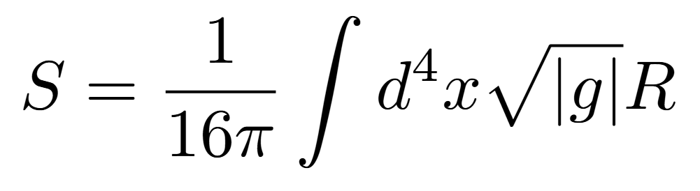

Slide 19
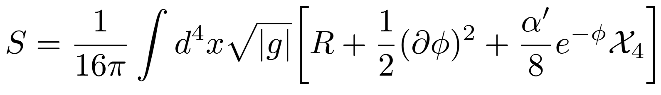

Slide 20
Dilaton
GB

Slide 21
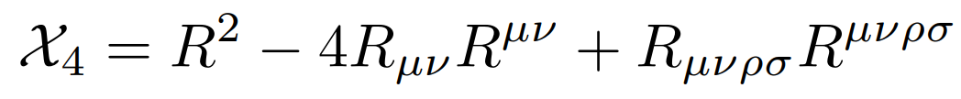
Dilaton
GB

Slide 22
Dilaton
GB

Slide 23
Dilaton
GB

Slide 24
Dilaton
Axion
GB
CS

Slide 25
A model with both DM and DE
Chern-Simons-Gauss-Bonnet gravity
Dilaton
Axion
GB
CS

Slide 26
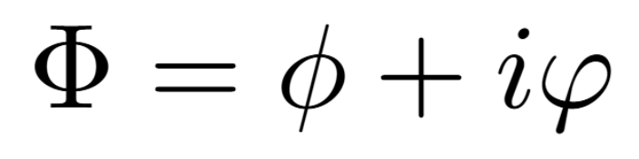
A model with both DM and DE
Chern-Simons-Gauss-Bonnet gravity
Dilaton
Axion
GB
CS

Slide 27
A model with both DM and DE
Chern-Simons-Gauss-Bonnet gravity
Well motivated from fundamental theory
  Weinberg 1989
Dilaton
Axion
GB
CS

Slide 28
A model with both DM and DE
Chern-Simons-Gauss-Bonnet gravity
Well motivated from fundamental theory
  Weinberg 1989
Both DM and DE in one shot
  Smith et al. 2024 [2410.11099]
  Ortega, TD, Koushiappas 2024 [2411.08911]
Dilaton
Axion
GB
CS

Slide 29
A model with both DM and DE
Chern-Simons-Gauss-Bonnet gravity
Well motivated from fundamental theory
  Weinberg 1989
Both DM and DE in one shot
  Smith et al. 2024 [2410.11099]
  Ortega, TD, Koushiappas 2024 [2411.08911]
Dilaton
Axion
GB
CS
Possible resolution to Hubble tension
  Bernardo, Brandenberger & Fröhlich, 2022 JCAP
  Alexander, Bernardo & Toomey, 2023 JCAP

Slide 30
A model with both DM and DE
Chern-Simons-Gauss-Bonnet gravity
Well motivated from fundamental theory
  Weinberg 1989
Both DM and DE in one shot
  Smith et al. 2024 [2410.11099]
  Ortega, TD, Koushiappas 2024 [2411.08911]
Dilaton
Axion
GB
CS
Possible resolution to Hubble tension
  Bernardo, Brandenberger & Fröhlich, 2022 JCAP
  Alexander, Bernardo & Toomey, 2023 JCAP
Axions: tidal disruption of solitons
  Wechsler et al., 2022 PRD

Slide 31
A model with both DM and DE
Chern-Simons-Gauss-Bonnet gravity
Well motivated from fundamental theory
  Weinberg 1989
Both DM and DE in one shot
  Smith et al. 2024 [2410.11099]
  Ortega, TD, Koushiappas 2024 [2411.08911]
Dilaton
Axion
GB
CS
Possible resolution to Hubble tension
  Bernardo, Brandenberger & Fröhlich, 2022 JCAP
  Alexander, Bernardo & Toomey, 2023 JCAP
Axions: tidal disruption of solitons
  Wechsler et al., 2022 PRD
Chern-Simons: parity violation, baryogenesis
  Alexander, Peskin & Sheikh-Jabbari, 2006 PRL

Slide 32
Observational Windows

Slide 33
Observational Windows
Gravitational waves

Slide 34
Observational Windows
Gravitational waves
  GW generation: inspiral of compact objects, Bayesian parameter estimation

Slide 35
Observational Windows
Gravitational waves
  GW generation: inspiral of compact objects, Bayesian parameter estimation
  Parametrize beyond-GR effects in GW propagation (Jenks et al., 2023 PRD; TD, Jenks & Alexander, 2024 PRD)

Slide 36
Observational Windows
Gravitational waves
  GW generation: inspiral of compact objects, Bayesian parameter estimation
  Parametrize beyond-GR effects in GW propagation (Jenks et al., 2023 PRD; TD, Jenks & Alexander, 2024 PRD)
  Modifications to GR amplitude and phase: parametrized-post-Einsteinian formalism (e.g. Yunes & Pretorius, 2009 PRD)

Slide 37
Observational Windows
Gravitational waves
  GW generation: inspiral of compact objects, Bayesian parameter estimation
  Parametrize beyond-GR effects in GW propagation (Jenks et al., 2023 PRD; TD, Jenks & Alexander, 2024 PRD)
  Modifications to GR amplitude and phase: parametrized-post-Einsteinian formalism (e.g. Yunes & Pretorius, 2009 PRD)
Neutron stars

Slide 38
Observational Windows
Gravitational waves
  GW generation: inspiral of compact objects, Bayesian parameter estimation
  Parametrize beyond-GR effects in GW propagation (Jenks et al., 2023 PRD; TD, Jenks & Alexander, 2024 PRD)
  Modifications to GR amplitude and phase: parametrized-post-Einsteinian formalism (e.g. Yunes & Pretorius, 2009 PRD)
Neutron stars
  TOV equations

Slide 39
Observational Windows
Gravitational waves
  GW generation: inspiral of compact objects, Bayesian parameter estimation
  Parametrize beyond-GR effects in GW propagation (Jenks et al., 2023 PRD; TD, Jenks & Alexander, 2024 PRD)
  Modifications to GR amplitude and phase: parametrized-post-Einsteinian formalism (e.g. Yunes & Pretorius, 2009 PRD)
Neutron stars
  TOV equations
  Mass-radius relation

Slide 40
Observational Windows
Gravitational waves
  GW generation: inspiral of compact objects, Bayesian parameter estimation
  Parametrize beyond-GR effects in GW propagation (Jenks et al., 2023 PRD; TD, Jenks & Alexander, 2024 PRD)
  Modifications to GR amplitude and phase: parametrized-post-Einsteinian formalism (e.g. Yunes & Pretorius, 2009 PRD)
Neutron stars
  TOV equations
  Mass-radius relation
  I-Love-Q relations (Yagi & Yunes, 2013 PRD)

Slide 41
Model Agnostic Framework

Slide 42
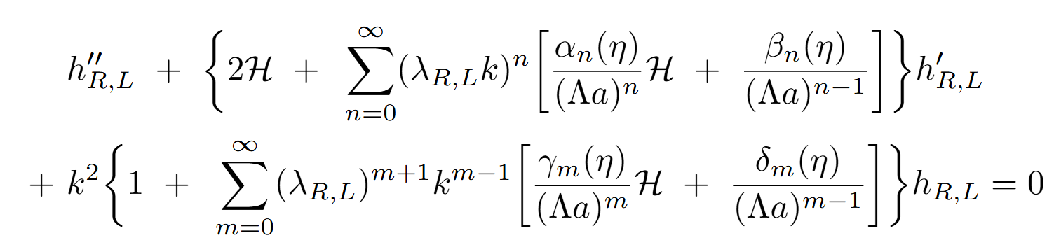
Model Agnostic Framework
Jenks et al., 2023 PRD; TD, Jenks & Alexander, 2024 PRD

Slide 43


Model Agnostic Framework
Jenks et al., 2023 PRD; TD, Jenks & Alexander, 2024 PRD

Slide 44
CS-GB Waveforms

Slide 45
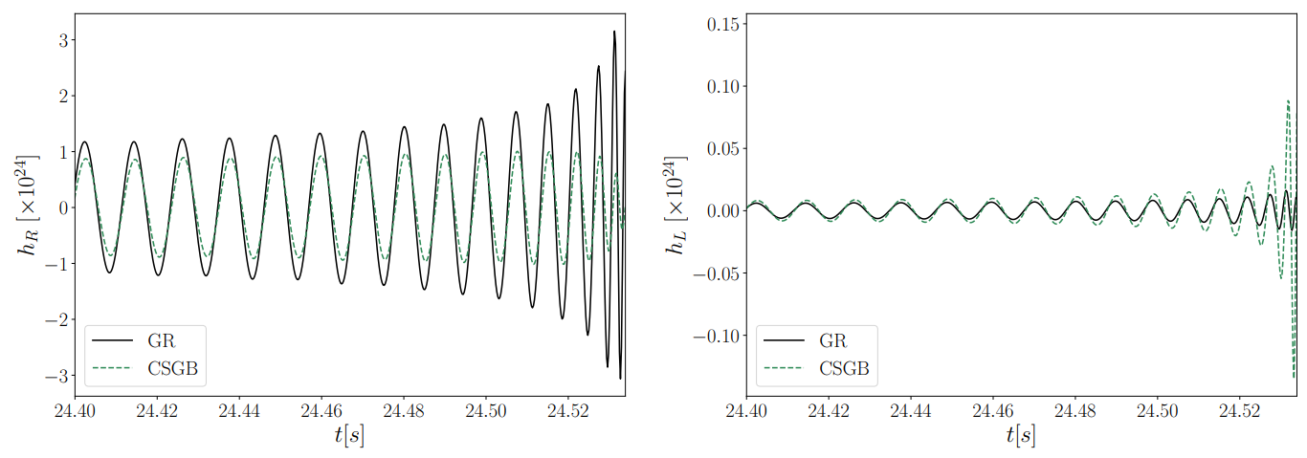
CS-GB Waveforms

Slide 46
CS-GB Waveforms

Slide 47
Constraints on Theory Parameters

Slide 48
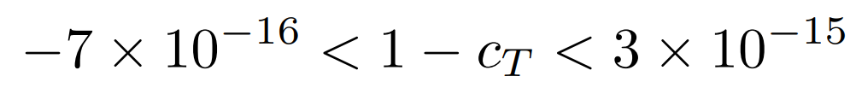
Constraints on Theory Parameters
Velocity (GW170817)

Slide 49
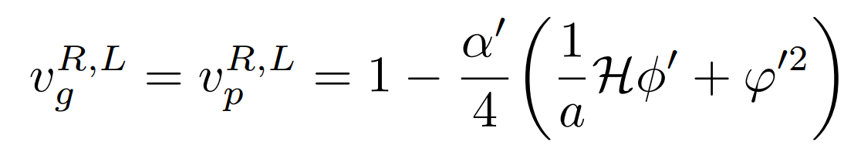
Constraints on Theory Parameters
Velocity (GW170817)

Slide 50
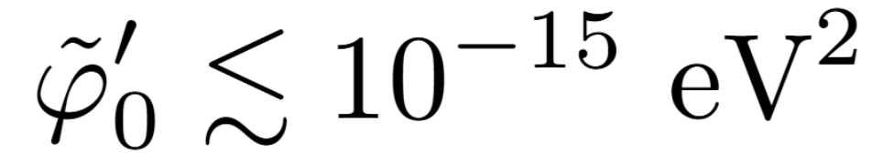
Constraints on Theory Parameters
Velocity (GW170817)
TD, Jenks & Alexander, 2024 PRD

Slide 51
Constraints on Theory Parameters
Velocity (GW170817)
Amplitude birefringence (GWTC-3)
TD, Jenks & Alexander, 2024 PRD

Slide 52
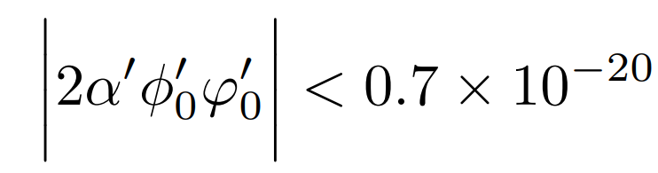
Constraints on Theory Parameters
Velocity (GW170817)
Amplitude birefringence (GWTC-3)
TD, Jenks & Alexander, 2024 PRD
Ng et al., 2023 PRD

Slide 53

Constraints on Theory Parameters
Velocity (GW170817)
Amplitude birefringence (GWTC-3)
TD, Jenks & Alexander, 2024 PRD
Ng et al., 2023 PRD
TD, Jenks & Alexander, 2024 PRD

Slide 54
Extended Parameterization (Alexander, TD & Manton, 2025 [2510.25895])

Slide 55
Extended Parameterization (Alexander, TD & Manton, 2025 [2510.25895])

Slide 56
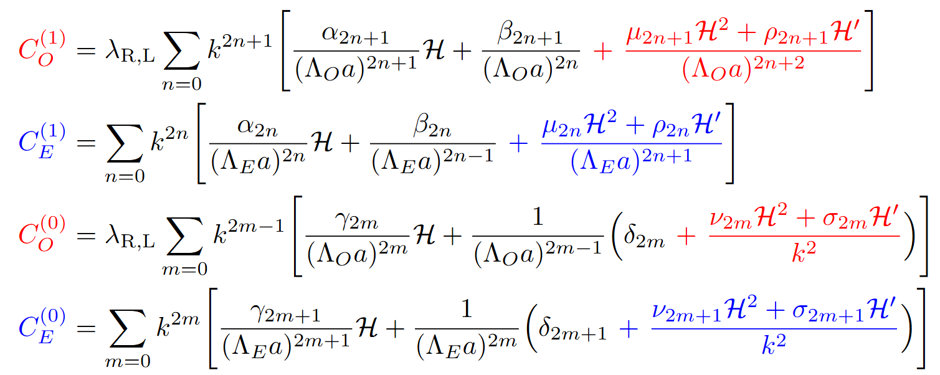
Extended Parameterization (Alexander, TD & Manton, 2025 [2510.25895])

Slide 57
Extended Parameterization (Alexander, TD & Manton, 2025 [2510.25895])

Slide 58
Extended Parameterization (Alexander, TD & Manton, 2025 [2510.25895])

Slide 59
Extended Parameterization (Alexander, TD & Manton, 2025 [2510.25895])

Slide 60
Kalb-Ramond Dark Matter

Slide 61
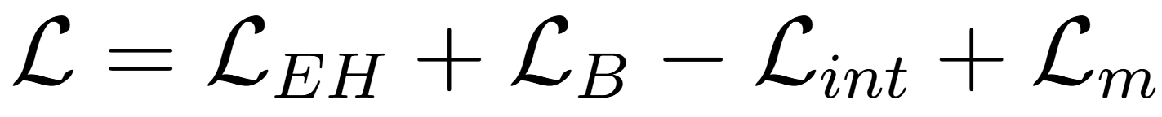
Kalb-Ramond Dark Matter

Slide 62
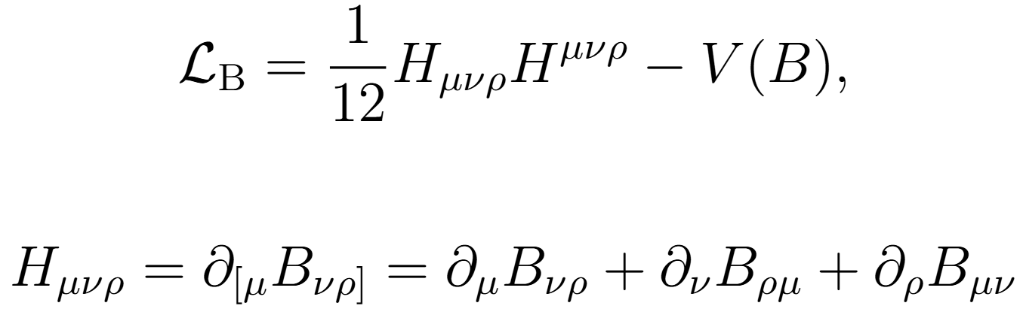
Kalb-Ramond Dark Matter

Slide 63
Kalb-Ramond Dark Matter

Slide 64
Kalb-Ramond Dark Matter

Slide 65
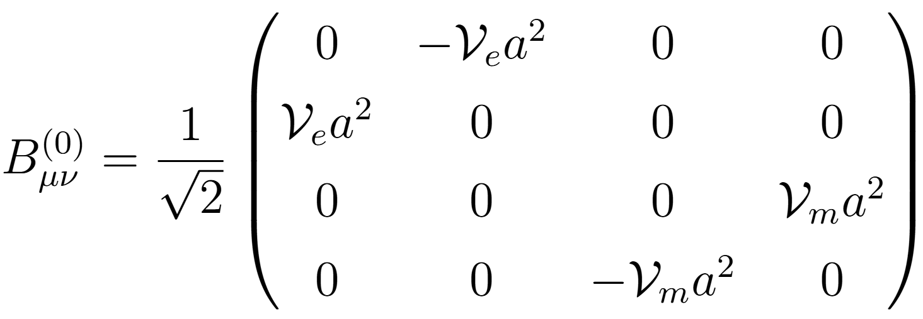
Kalb-Ramond Dark Matter

Slide 66
Kalb-Ramond Dark Matter (continued)

Slide 67
Kalb-Ramond Dark Matter (continued)

Slide 68
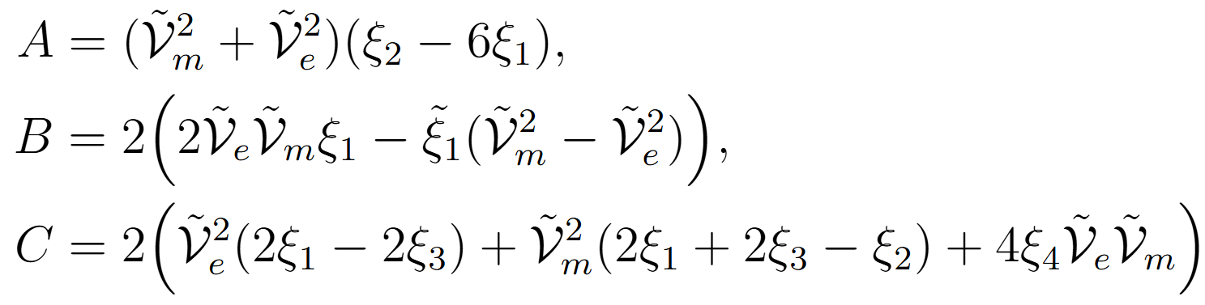
Kalb-Ramond Dark Matter (continued)
Alexander,
TD & Manton, 2025 [2510.25895]

Slide 69
Kalb-Ramond Dark Matter Waveforms

Slide 70
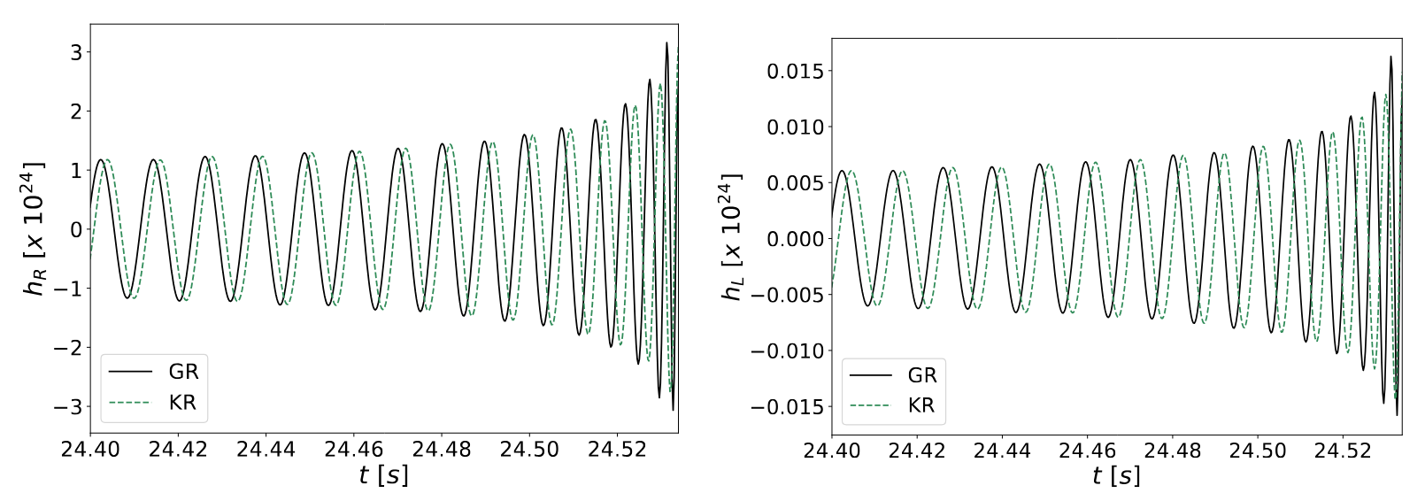
Kalb-Ramond Dark Matter Waveforms

Slide 71
Kalb-Ramond Dark Matter Waveforms

Slide 72
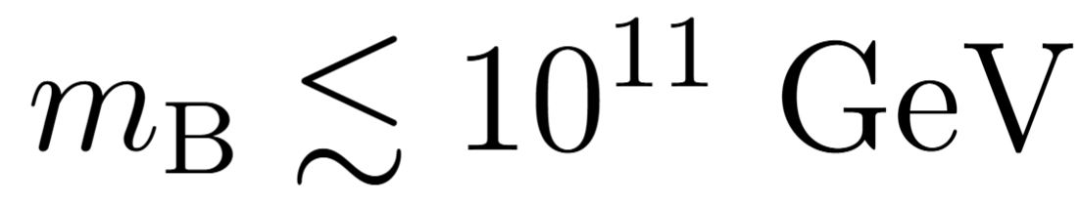
Kalb-Ramond Dark Matter Waveforms

Slide 73
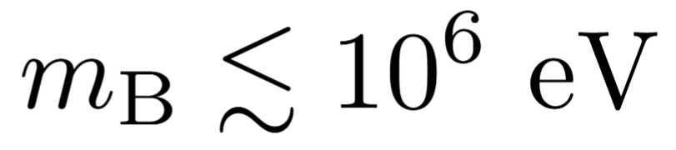
Kalb-Ramond Dark Matter Waveforms
compare
Capanelli et al., 2024 JHEP

Slide 74
U(1) fields

Slide 75
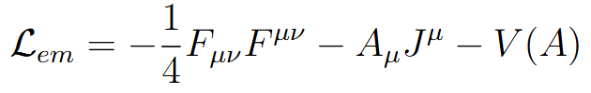
U(1) fields

Slide 76
U(1) fields

Slide 77
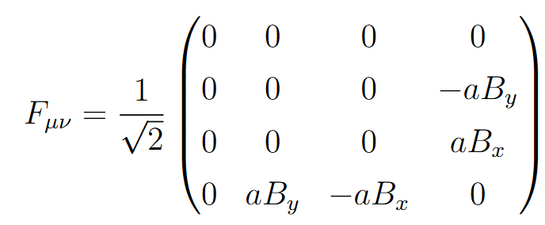
U(1) fields

Slide 78
U(1) fields (continued)

Slide 79
U(1) fields (continued)

Slide 80
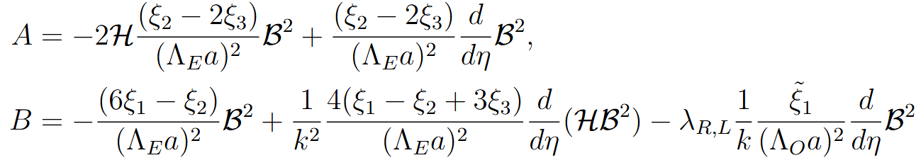
U(1) fields (continued)
Alexander,
TD & Manton, 2025 [2510.25895]

Slide 81
U(1) fields (continued)
Alexander,
TD & Manton, 2025 [2510.25895]

Slide 82
Waveforms for U(1) fields

Slide 83
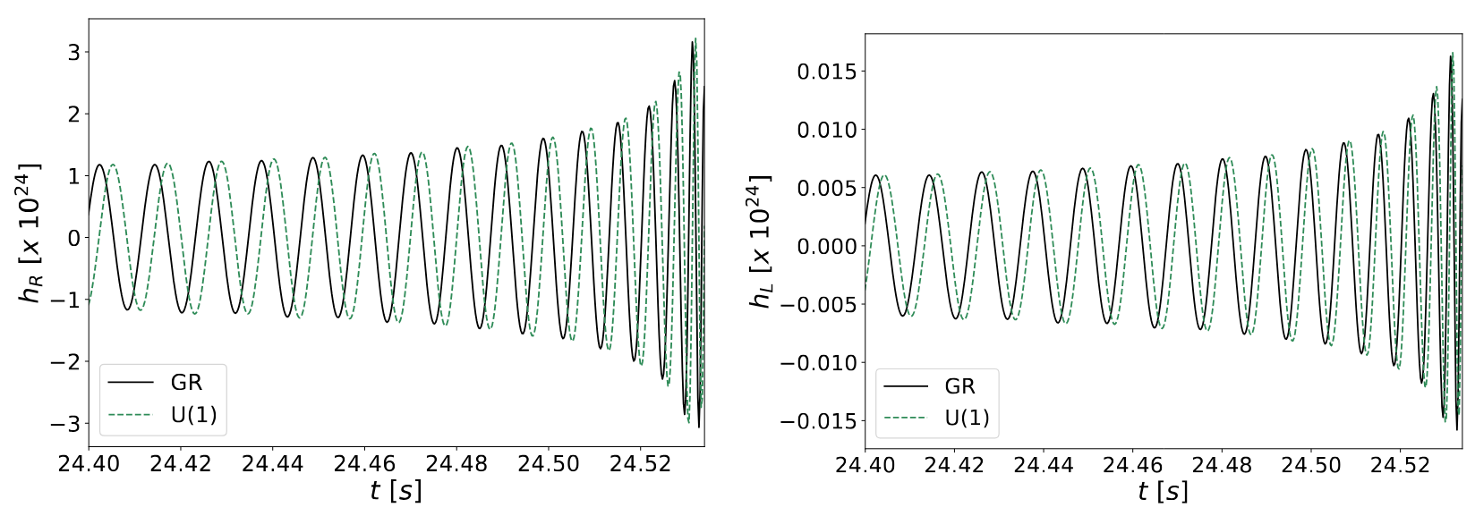
Waveforms for U(1) fields

Slide 84
Waveforms for U(1) fields

Slide 85
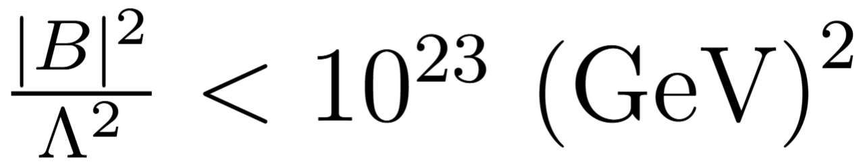
Waveforms for U(1) fields

Slide 86
Summary

Slide 87
Summary
GR agrees well with observations, but challenges

Slide 88
Summary
GR agrees well with observations, but challenges
  Dark matter and dark energy

Slide 89
Summary
GR agrees well with observations, but challenges
  Dark matter and dark energy
Discussed model that gives both (CS-GB gravity)

Slide 90
Summary
GR agrees well with observations, but challenges
  Dark matter and dark energy
Discussed model that gives both (CS-GB gravity)
  Also has parity violation

Slide 91
Summary
GR agrees well with observations, but challenges
  Dark matter and dark energy
Discussed model that gives both (CS-GB gravity)
  Also has parity violation
Probe parity violation using GWs and other methods

Slide 92
Summary
GR agrees well with observations, but challenges
  Dark matter and dark energy
Discussed model that gives both (CS-GB gravity)
  Also has parity violation
Probe parity violation using GWs and other methods
Extended framework to DM theories

