Slide 1
Quantum Nature Based Detection of Signals Free of Classical Noise
Xuliang Du
Prof. Sen Yang’s Group
Notes:
Hello everyone. Thank you for attending this talk. My name is Xuliang DU from Professor Sen YANG’s group. Today I’m gonna talk about a technique we developed to detect Quantum Nature Based Signals that is Free of Classical Noise

Slide 2
Outline
Exotic interaction beyond standard model
The Nitrogen-Vacancy (NV) Center in Diamond
Quantum Nature Based Detection-Quantum Correlation
Notes:
I will first talk about the potential application of our table top quantum sensing device for the field of physics beyond standard model. That is the exotic interaction mediated by the new bosons.
Then I will briefly introduce our quantum sensing system based on NV centers in diamond.
After that, I will talk about our new sensing scheme, the quantum correlation.

Slide 3
Outline
Exotic interaction beyond standard model
The Nitrogen-Vacancy (NV) Center in Diamond
Quantum Nature Based Detection-Quantum Correlation
Notes:
The first part of this presentation is about the motivation of my research. Then, I will introduce the physical system, the Nitrogen-Vacancy (NV) Center in Diamond, about how we use it as a single qubit for quantum research. After that, I will present my work on the experimental implementation of the Variational Quantum Eigensolver or VQE algorithm on the NV center in diamond. At last, I will talk about future work on qutrits of VQE and single-shot readout.

Slide 4
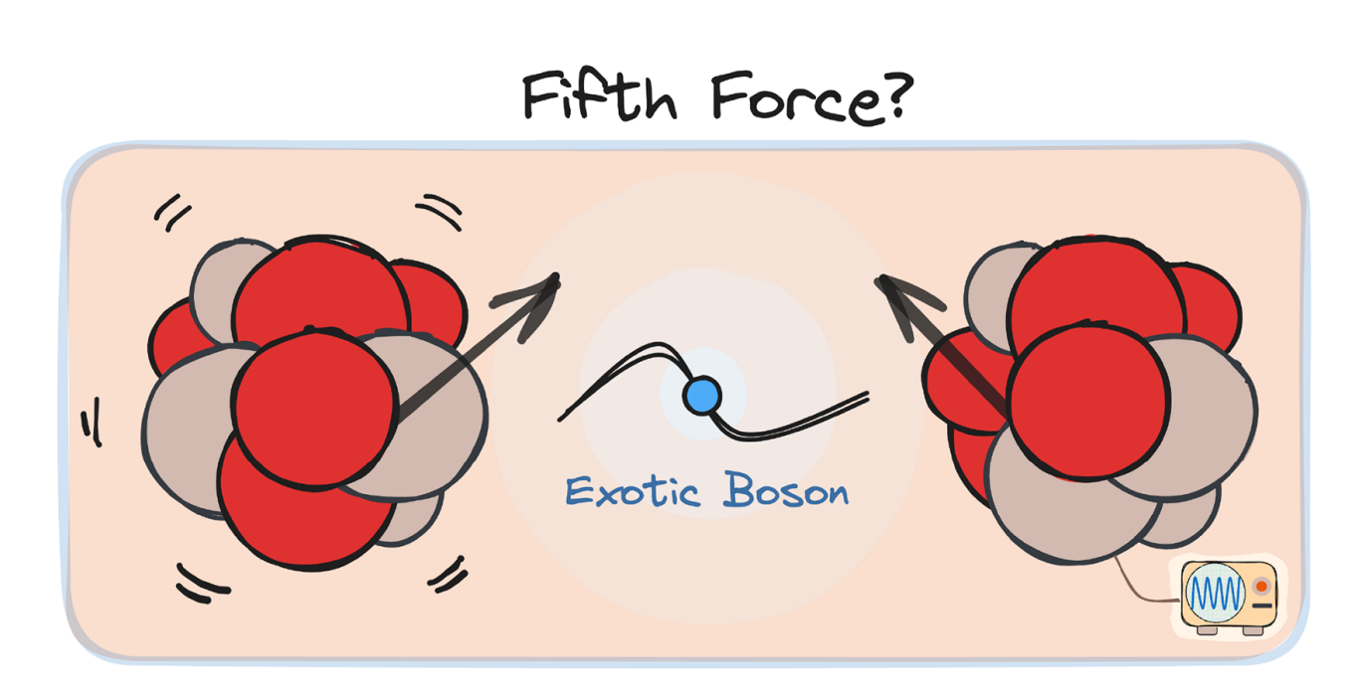
Exotic Interactions
Motivation: Beyond the Standard Model
  The Standard Model is highly successful but incomplete (e.g., Dark Matter, Dark Energy, Strong CP problem).
  The "Dark Things": New physics may be hidden in light, weakly coupled particles (e.g., Axions, ALPs, Dark Photons, Exotic Bosons).
The "Fifth Force" Hypothesis
  Exchange of these new bosons induces exotic spin-dependent interactions between fermions.
  Manifests as a short-range correction to gravity or electromagnetism.
Cong et al., (2025). Spin-dependent exotic interactions. Rev. Mod. Phys., 97, 025005.
Notes:
We know that the Standard Model is one of the most successful theories in physics. However, it is not perfect. It fails to explain some major mysteries, like Dark Matter and Dark Energy. And new physics may be hidden in these unexplained things.
This leads to the 'Fifth Force' Hypothesis. If these new bosons exist, their exchange will induce a new force between fermions. Then It will manifest as a short-range correction to gravity or electromagnetism at the micro-scale.

Slide 5
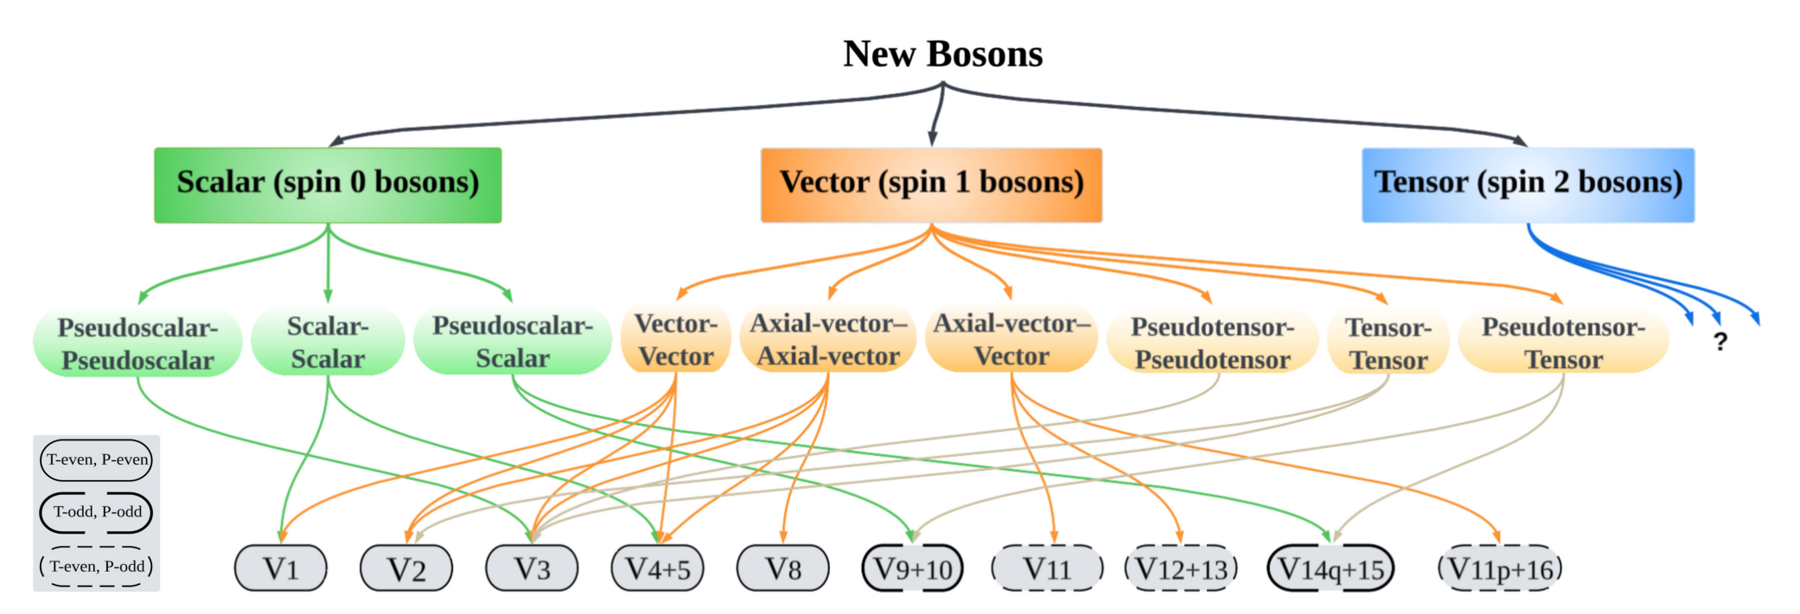
Exotic interactions
16 independent potentials (V1…V16) derived from symmetry principles (Dobrescu & Mocioiu)
Many potentials (e.g., V4+5, monopole-dipole) are strictly constrained at macro-scales but poorly explored at the micro-scale.
Cong et al., (2025). Spin-dependent exotic interactions. Rev. Mod. Phys., 97, 025005.

Slide 6
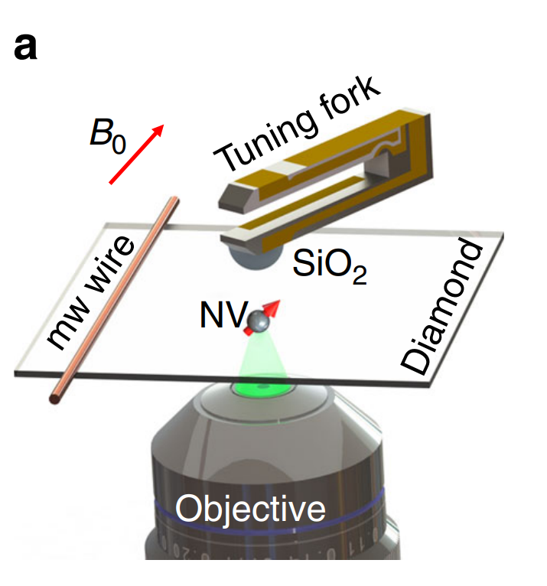
Exotic interactions
The Challenge: Short-Range & Complex Couplings
  Short-Range: Existing constraints are weak at the submillimeter scale.
  Complex Couplings: Target interactions involve spin and relative velocity terms.
The Solution: Table-top System
  Single NV Center: Acts as a localized quantum spin sensor
Rong et al., Searching for an exotic spin-dependent interaction with a single electron-spin quantum sensor. Nat Commun 9, 739 (2018)

Slide 7
Outline
Exotic interaction beyond standard model
The Nitrogen-Vacancy (NV) Center in Diamond
Quantum Nature Based Detection-Quantum Correlation
Notes:
With our experimental system, we can realize the VQE algorithm.

Slide 8
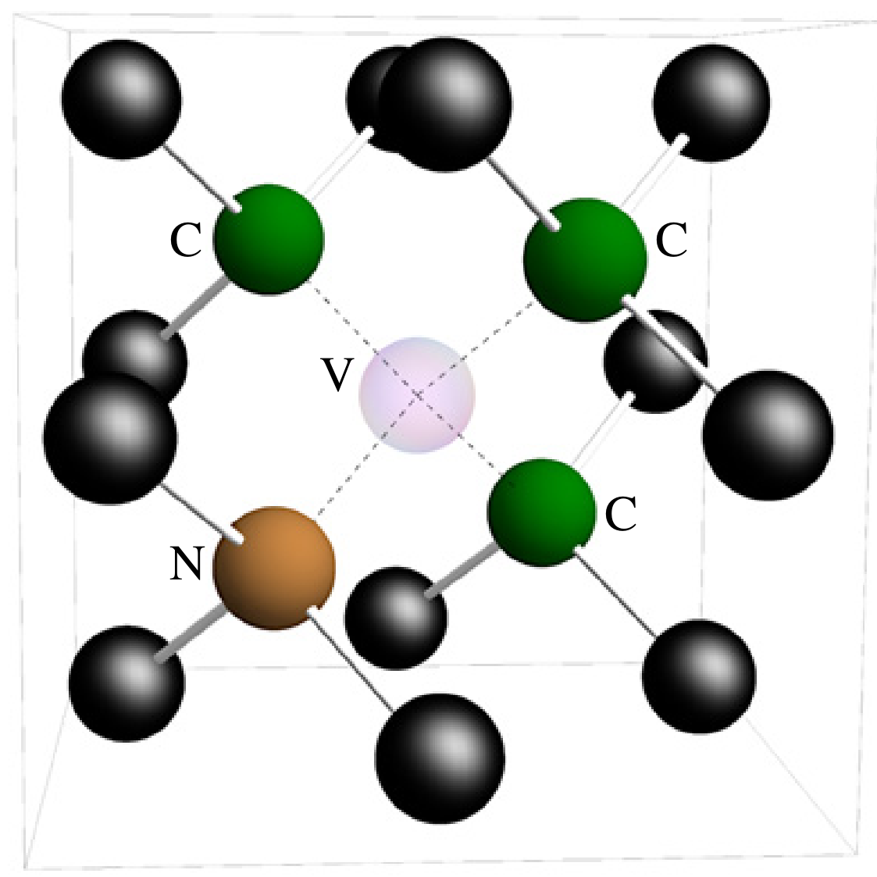
The NV Center in Diamond
NV:
point defect in diamond
Composition:
1 vacancy + 1 substitutional nitrogen
Spin-1 system:
extra electron -> NV⁻ -> S = 1
Figure from Doherty M W, Manson N B, Delaney P, et al. The nitrogen-vacancy colour centre in diamond[J]. Physics Reports, 2013, 528(1): 1-45.
NV center
NV-Env Interaction
Nuclear spins &
Classical background
Notes:
The Nitrogen-Vacancy Center is a form of point defect in diamond that occurs when a vacant lattice site lies nearest neighbor to a substitutional nitrogen atom. This schematic diagram on the top right shows the structure of the NV.
Typically, we can find single NV centers in natural diamond samples. But it is also possible to create NV centers homogeneously through exposure to high-energy electron irradiation or create NV centers locally via ion implantation.
There are 3 types of NV, NV+, NV0 and NV minus. In our experiment, we mainly focus on the NV minus which has 6 electrons. 3 electrons come from the three adjacent carbons, and 2 electrons come from the nearest-neighbor nitrogen atom. And the last extra electron is believed to be derived from other sources, potentially from substitutional nitrogens within the same diamond.
The electronic levels in the bandgap of the NV center are shown on the right side. With 6 electrons in 8 levels, the NV center becomes a Spin-1 system.

Slide 9
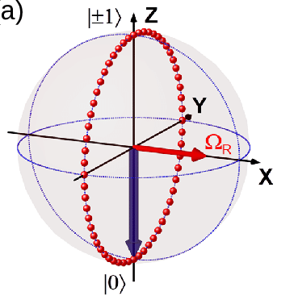
The NV Center in Diamond
Laser
Intersystem crossing
Initialization
Read-out
microwave
manipulation
Notes:
Since the NV center is a spin-1 system, it has triplet and singlet states. The specific energy levels are illustrated in the right figure. The single states are considered metastable. It means that the population of the singlet state will go back to the triplet state finally. The population transfer between the triplet and singlet states corresponds to the intersystem crossing. When we use NV as a qubit, we usually refer the ms = plus or minus 1 state as the spin-up state and the ms = 0 state as the spin-down state. The spin-spin interaction contributes to the splitting between the 0 state and ±1 states.
To initialize the NV, we need to shine the green laser. The wavelength is typically 520nm. This transition is represented by the yellow arrow here. The black dashed arrow represents the effect of the phonon.
The intersystem crossing is key to the initialization of the NV center. NV centers in ms = ±1 spin sublevels of excited triplet state have a higher probability of going through triplet-singlet intersystem crossing to the singlet. However, when the population goes back to the ground state, ms = ±1 and ms = 0 states have equal probabilities. Therefore, if we the shine the green laser for enough time, the system will go through this loop many times and eventually have a higher population in the ms = 0 state.
The read-out of the NV center is also based on this difference. The NV in ms = ±1 state has a higher probability of going through intersystem crossing. But this process will not emit photons. This means that the NV in these states has a lower fluorescence count. As a result, Measurement based on this fluorescence contrast is possible to read out the spin state of the NV center
In our experiment, we use ms = -1 state as the spin-up state and ms = 0 state as the spin-down state.

Slide 10
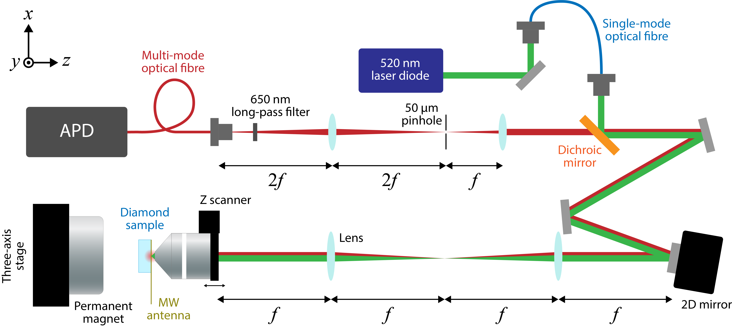
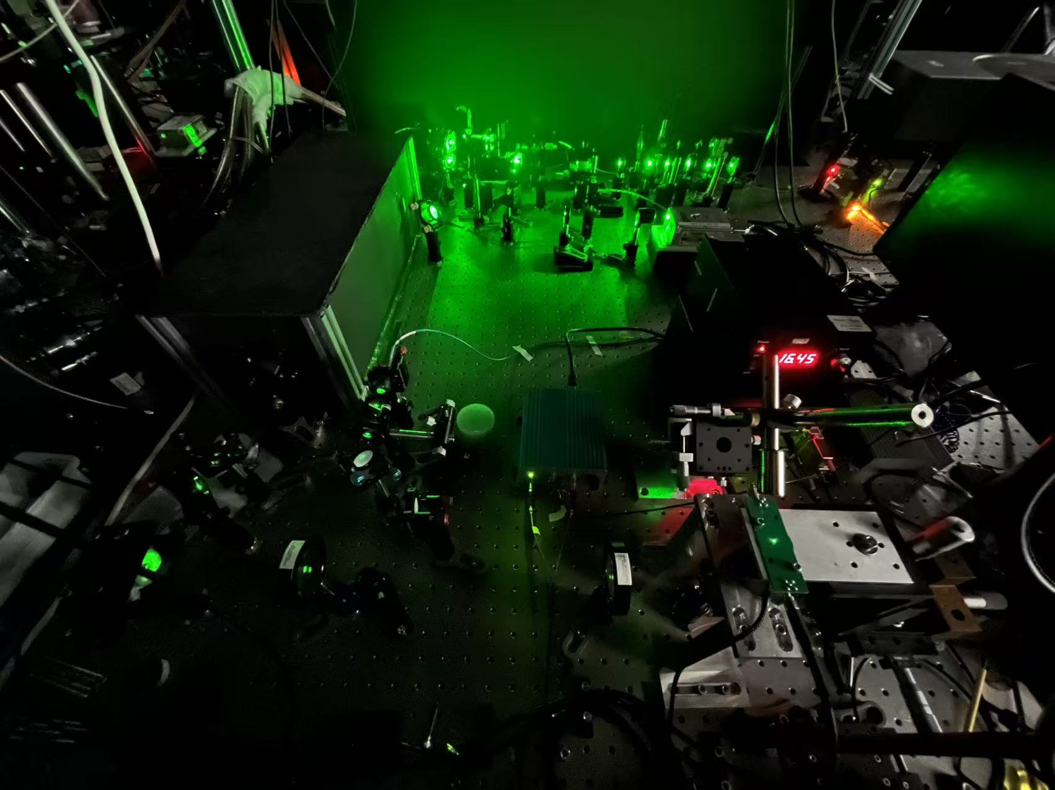
The NV Center in Diamond
Experiment Setup
Room temperature
Ambient pressure
Notes:
Here is the experimental setup of our system, which is under room temperature and ambient pressure. Our whole system can be placed on one optical table.

Slide 11
Outline
Exotic interaction beyond standard model
The Nitrogen-Vacancy (NV) Center in Diamond
Quantum Nature Based Detection-Quantum Correlation
Notes:
With our experimental system, we can further develop a sensing scheme that use the quantum nature signal, the quantum correlation.

Slide 12
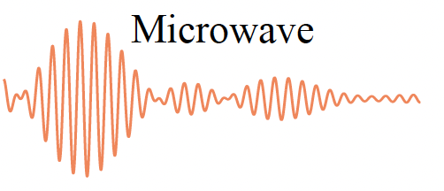
Quantum Signal Distillation
Why we need Quantum Signal Distillation?
Environment
Frequency domain
How to single out quantum targets from the classical noise background?
Quantum target
e.g.: a nuclear spin
Quantum target
Fourier
Transform
…
…
Sensor
Classical noise
Classical noise
The quantum target is concealed!

Slide 13
Quantum Signal Distillation, how?
Add a quantum dimension to the sensing technology
  Single out quantum signals from a classical background
Based on Correlation
  Extend resolution from T2 to T1 limitation
  Read out nuclear spins simultaneously
Nuclear spins &
Classical background
NV center
Notes:
In real world, quantum system is open, meaning that the system always interacts with its environment. The coupling with the environment introduces noises to the system leading to decoherence, which is a headache to quantum information science and technology. For instance, decoherence of qubits erases the encoded information and degrades quantum gates. However, the investigation into the environmental noises inspires new sensing and detection techniques, as an example, the NV-based correlation spectroscopy with the state-of-art resolution of 3.8 Hz allows single-molecule chemical structure analysis. Furthermore, with the knowledge about the surrounding environment, one can employ them as useful resources such as Qubits and quantum memory.

Slide 14

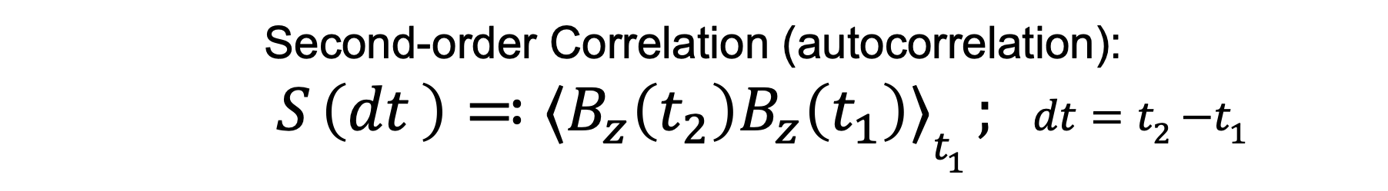

2nd-order classical Correlation
. . . .
time
$$t_{1}$$
$$t_{2}$$
Second-order Correlation (autocorrelation):
$${{ S}_{ }\left({dt}_{ }\right)≕⟨B}_{z}\left(t_{2}\right)B_{z}\left(t_{1}\right)⟩t_{1} ; { dt=t}_{2}−t_{1}$$
Shen et al. Phys. Rev. Lett., 130, 070802.
Notes:
In real world, quantum system is open, meaning that the system always interacts with its environment. The coupling with the environment introduces noises to the system leading to decoherence, which is a headache to quantum information science and technology. For instance, decoherence of qubits erases the encoded information and degrades quantum gates. However, the investigation into the environmental noises inspires new sensing and detection techniques, as an example, the NV-based correlation spectroscopy with the state-of-art resolution of 3.8 Hz allows single-molecule chemical structure analysis. Furthermore, with the knowledge about the surrounding environment, one can employ them as useful resources such as Qubits and quantum memory.

Slide 15
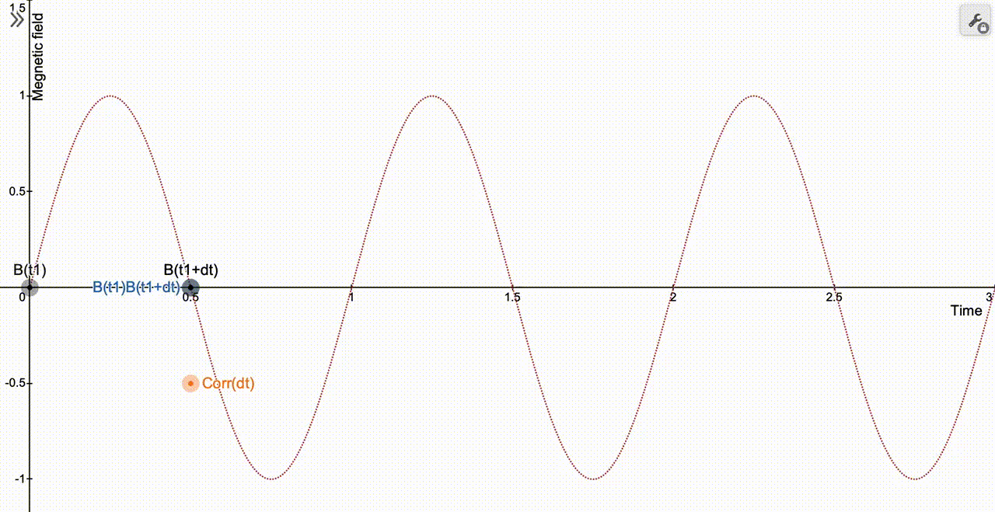
The Correlation Signal : dt = 0.5T

Slide 16
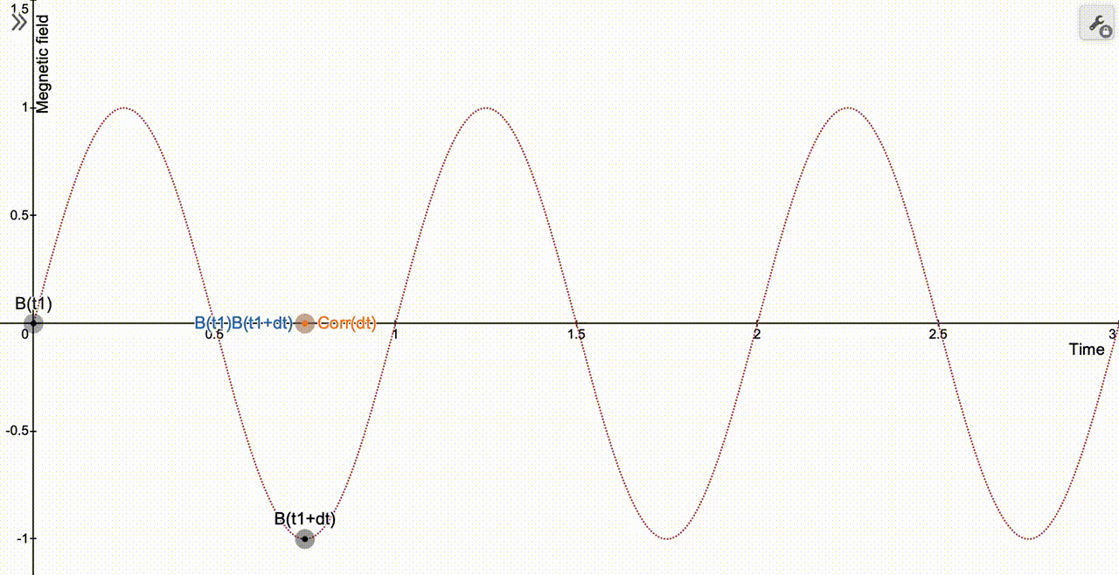
The Correlation Signal : dt = 0.75T

Slide 17
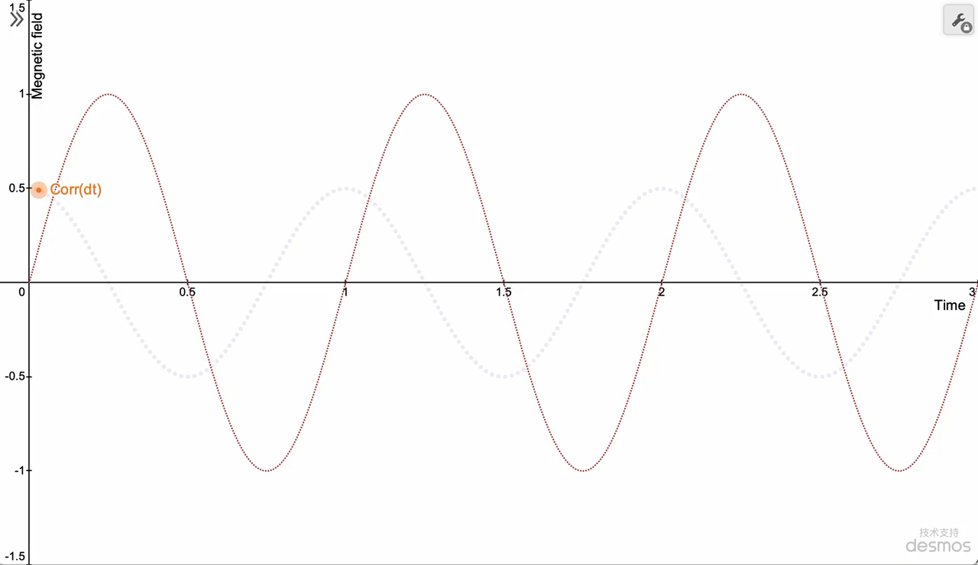
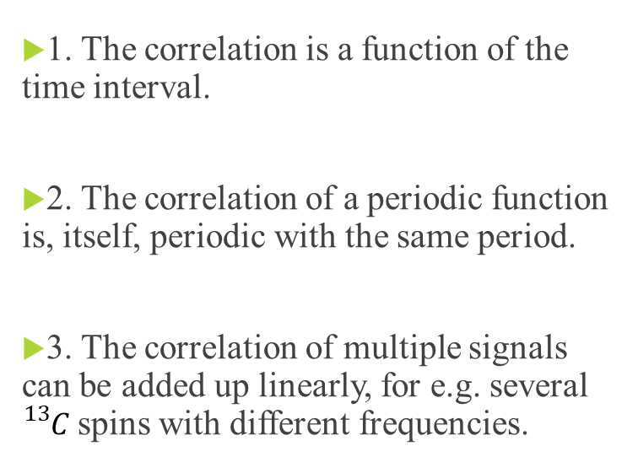
Properties of the classical Correlation
1. The correlation is a function of the time interval.
2. The correlation of a periodic function is, itself, periodic with the same period.
3. The correlation of multiple signals can be added up linearly, for e.g. several ${}_{}^{13}{C }$spins with different frequencies.

Slide 18

Noise operator instead of classical signals
. . . .
time
$$t_{1}$$
$$t_{2}$$
Second-order Correlation:
$${S\left({dt}_{ }\right)≕⟨\hat{B}}_{z}\left(t_{2}\right){\hat{B}}_{z}\left(t_{1}\right)⟩t_{1} ; { dt=t}_{2}−t_{1}$$
Scalar -> Operator

Slide 19
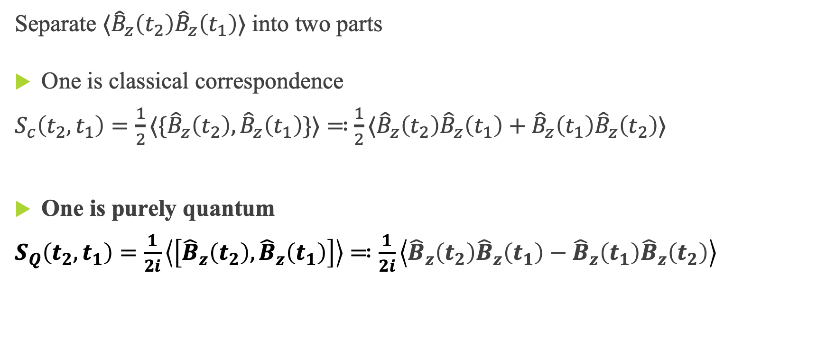
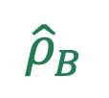
Adding a quantum dimension
Separate $⟨{\hat{B}}_{z}\left(t_{2}\right){\hat{B}}_{z}\left(t_{1}\right)⟩$ into two parts
One is classical correspondence
$S_{c}\left(t_{2},t_{1}\right)=\frac{1}{2}⟨\{{\hat{B}}_{z}\left(t_{2}\right), {\hat{B}}_{z}\left(t_{1}\right)\}⟩$ ≕$\frac{1}{2}⟨{\hat{B}}_{z}\left(t_{2}\right){\hat{B}}_{z}\left(t_{1}\right)+{\hat{B}}_{z}\left(t_{1}\right){\hat{B}}_{z}\left(t_{2}\right)⟩$
One is purely quantum
$S_{Q}\left(t_{2},t_{1}\right)=\frac{1}{2i}\left\langle \left[{\hat{B}}_{z}\left(t_{2}\right), {\hat{B}}_{z}\left(t_{1}\right)\right]\right\rangle$ $≕\frac{1}{2i}\left\langle {\hat{B}}_{z}\left(t_{2}\right){\hat{B}}_{z}\left(t_{1}\right)−{\hat{B}}_{z}\left(t_{1}\right){\hat{B}}_{z}\left(t_{2}\right)\right\rangle$
$${\hat{ρ}}_{B}$$
Notes:
The anticommutator of Bz contributes to the real part, while the commutator contributes to the imaginary part. These two quantities behave so differently, lead us to call them classical correlation and quantum correlation respectively.

Slide 20



Quantum Signal Distillation
${ S}_{Q}\left(t_{2},t_{1}\right)=\frac{1}{2i}\left\langle \left[{\hat{B}}_{z}\left(t_{2}\right), {\hat{B}}_{z}\left(t_{1}\right)\right]\right\rangle$ vanishes when,
${\hat{B}}_{z}\left(t\right)$ commutes with itself at any time
Pattern based filters
Quantum nature -based filter
Notes:
While the quantum correlation, which cannot be emulated by any classical noise, is currently unassessed/unexamined by experiment. This correlation function is purely quantum, since it vanishes only if Bz is commutable at any time or the environment is in a maximally-mixed state. The commutative Bz means that the coupling between the system and environment behaves like a classical noise. The quantum correlation only exists when the system-environment coupling is “quantum”. At room temperature, a nuclear spin cluster is essentially in a maximally-mixed state in thermal equilibrium. Thus, the quantum correlation usually cannot be observed at room temperature if the system is coupled with a bath (which is in thermal equilibrium by definition). Overall, the quantum correlation relates to both the quantumness of the coupling and the purity of the environmental state

Slide 21
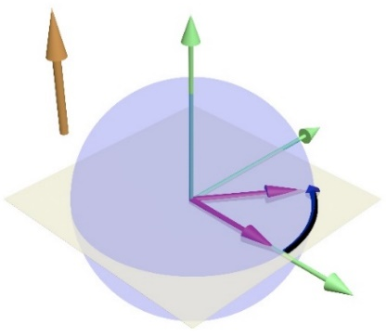
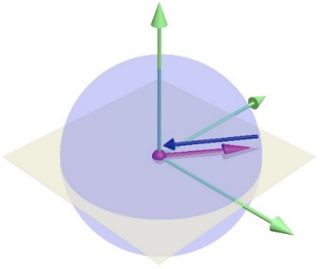
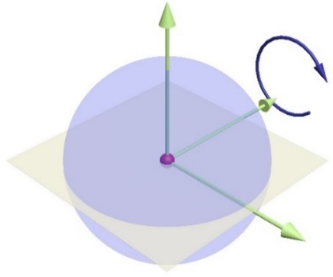
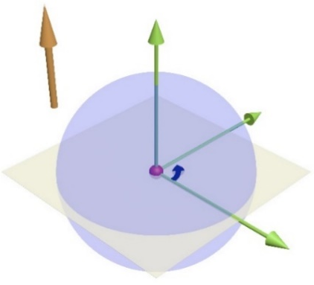
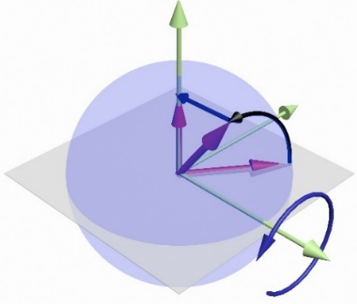
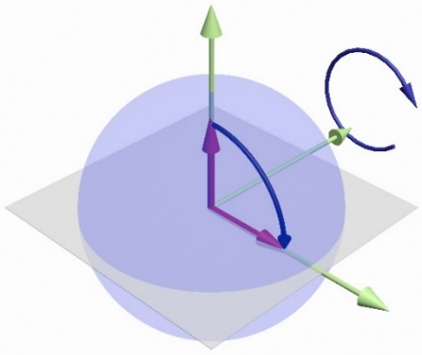
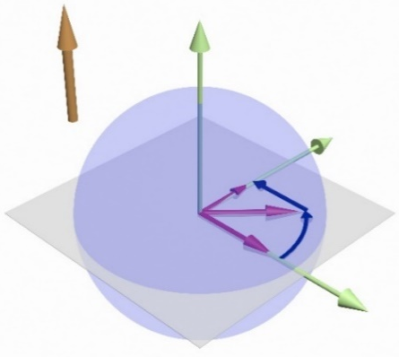












Semi-classical picture of correlation signals
Quantum Correlation
$$b(t)$$
z
Meas
$${\hat{σ}}_{y}$$
y
$$φ_{1}$$
$$φ_{2}$$
$$t_{1}$$
x
$$t_{2}$$
1. Interrogation
2. Phase Randomization
3. Waiting time
4. Rotation
5. Interrogation
Classical Correlation
Meas
$${\hat{σ}}_{y}$$
$$φ_{1}$$
$${\sin{φ}}_{1}$$
$$φ_{2}$$
$$t_{1}$$
2. Rotation
+ Phase Randomization
$$t_{2}$$

Slide 22



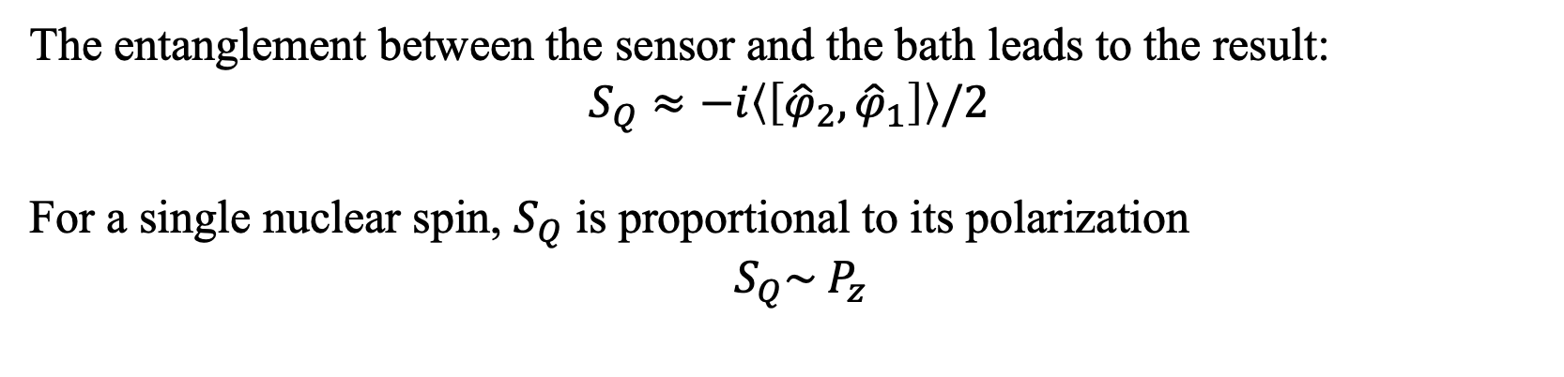
The quantum correlation signal from quantum theory
Quantum Correlation
$$b(t)$$
z
Meas
$${\hat{σ}}_{y}$$
y
$$φ_{1}$$
$$φ_{2}$$
$$t_{1}$$
x
$$t_{2}$$
1. Interrogation
2. Phase Randomization
3. Waiting time
4. Rotation
5. Interrogation
The entanglement between the sensor and the bath leads to the result:
$$S_{Q}≈−i\left\langle \left[{\hat{φ}}_{2},{\hat{φ}}_{1}\right]\right\rangle /2$$
For a single nuclear spin, $S_{Q}$ is proportional to its polarization
$S_{Q}\sim P_{z}$

Slide 23
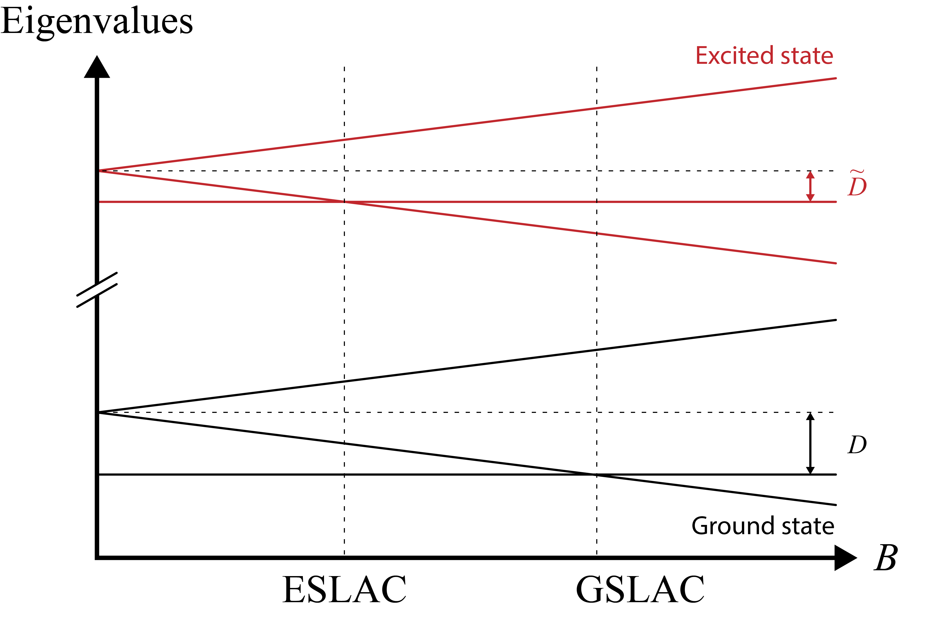




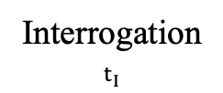

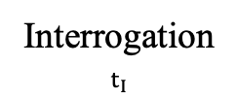

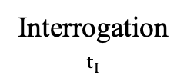




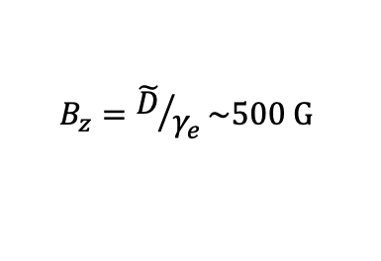

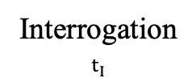
Measurement of the Correlation signals
QCorr$≡$
In.
Phase Randomization
R.O.
$$S_{Q}$$
$$\left(\frac{π}{2}\right)y$$
Interrogation
$t_{I}$
$$\left(\frac{π}{2}\right)y$$
Interrogation
$t_{I}$
$$\left(\frac{π}{2}\right)x$$
CCorr$≡$
In.
Phase Randomization
R.O.
$$S_{C}$$
$$\left(\frac{π}{2}\right)y$$
Interrogation
$t_{I}$
$\left(\frac{π}{2}\right)$_{x}
$$\left(\frac{π}{2}\right)y$$
Interrogation
$t_{I}$
$\left(\frac{π}{2}\right)$_{x}
$$B_{z}={\tilde{D}}/{γ_{e}}\sim 500 G$$

Slide 24
Correlation signals of a single nuclear spin
Correlation signals in time domain
Correlation spectrums after Fourier Transform

Slide 25
Correlation Spectrums of a single nuclear spin
together with a 0.5 MHz microwave
Classical correlation:
Both the target ¹³C nuclear spin signal and the classical background occur
Quantum correlation:
Only the ¹³C nuclear spin signal exists

Slide 26
Quantum Signal Distillation
Classical correlation:
The classical noise conceals the target ¹³C nuclear spin signal.
Quantum correlation:
The ¹³C nuclear spin signal can still be detected if it is polarized.

Slide 27
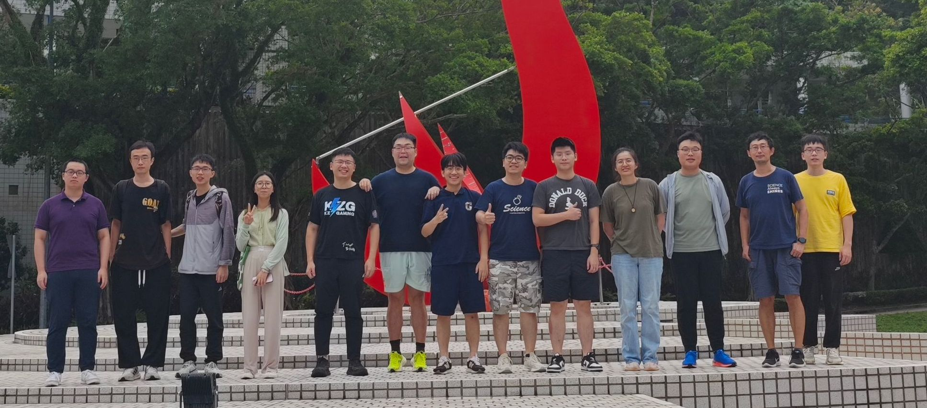

Acknowledgements
Thank you all!
王评教授（北师大珠海校区）
杨森教授课题组（港科大）
Notes:
Thank you!

Slide 28
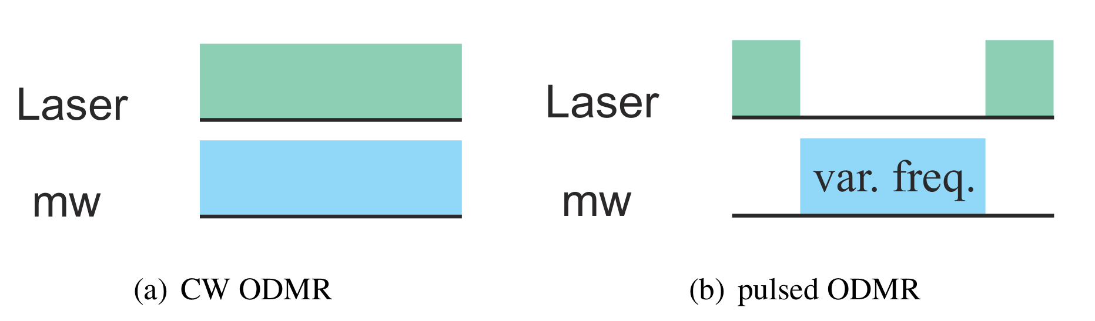
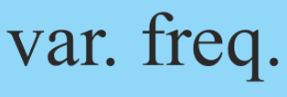
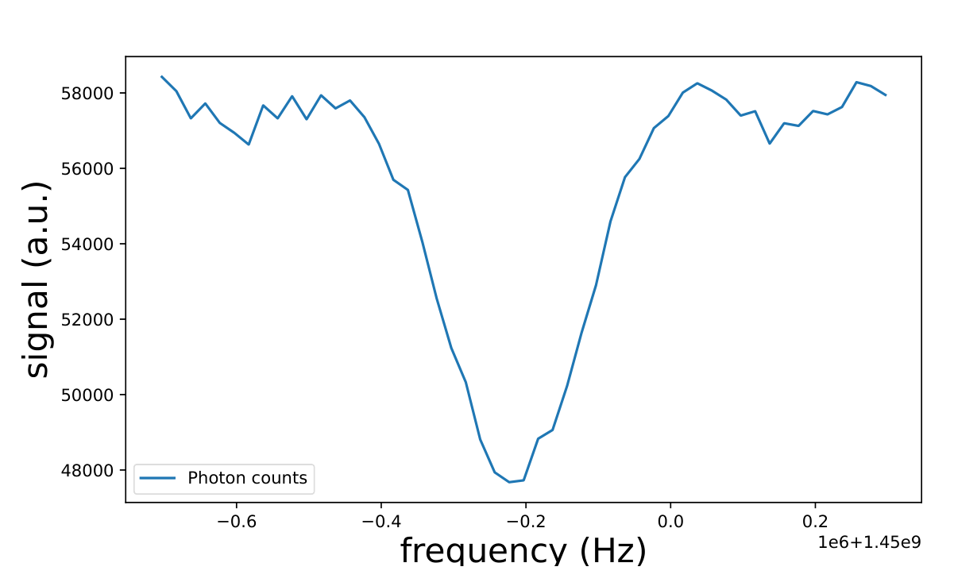
The NV Center in Diamond
Manipulations of NV as a qubit
  Optically Detected Magnetic Resonance(ODMR)
    To determine the transition frequency between its spin-up and down states
Notes:
After we define the up and down states, we can use the resonant microwave to control the spin.
The experiment to determine the transition frequency between the up and down states is the Optically Detected Magnetic Resonance or ODMR. There are 2 kinds of ODMR, continuous wave ODMR and pulsed ODMR. They have different pulse sequences as shown in the right figures. In these figures, the horizontal axis is the time.
Their mechanism is that, as we scan the frequency of the microwave, only the resonant microwave will flip the NV spin to the spin-up state. The spin-up state is ms = 0 state and has a 30% lower contrast. Thus, the collected fluorescence count will have a dip at the resonant scanning point.
CW ODMR is for a rough measurement and has larger linewidth and smaller contrast because the laser is always on, and the microwave power must be very large. Pulsed ODMR is for a finer measurement with a smaller linewidth and higher contrast. The linewidth was limited by power broadening and the magnetic field inhomogeneity.
A typical data of a pulsed ODMR experiment is shown in the bottom right figure. The horizontal axis is the frequency of the microwave, and the vertical axis is the fluorescence count. We can see from this dip that the resonant frequency is near 1.45 giga Hertz.

Slide 29
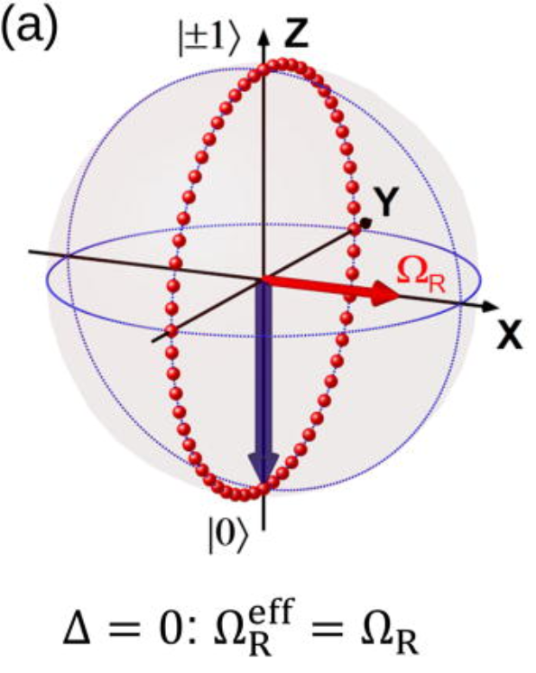
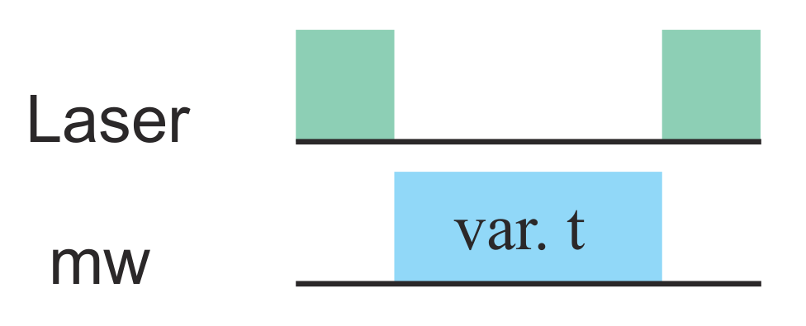
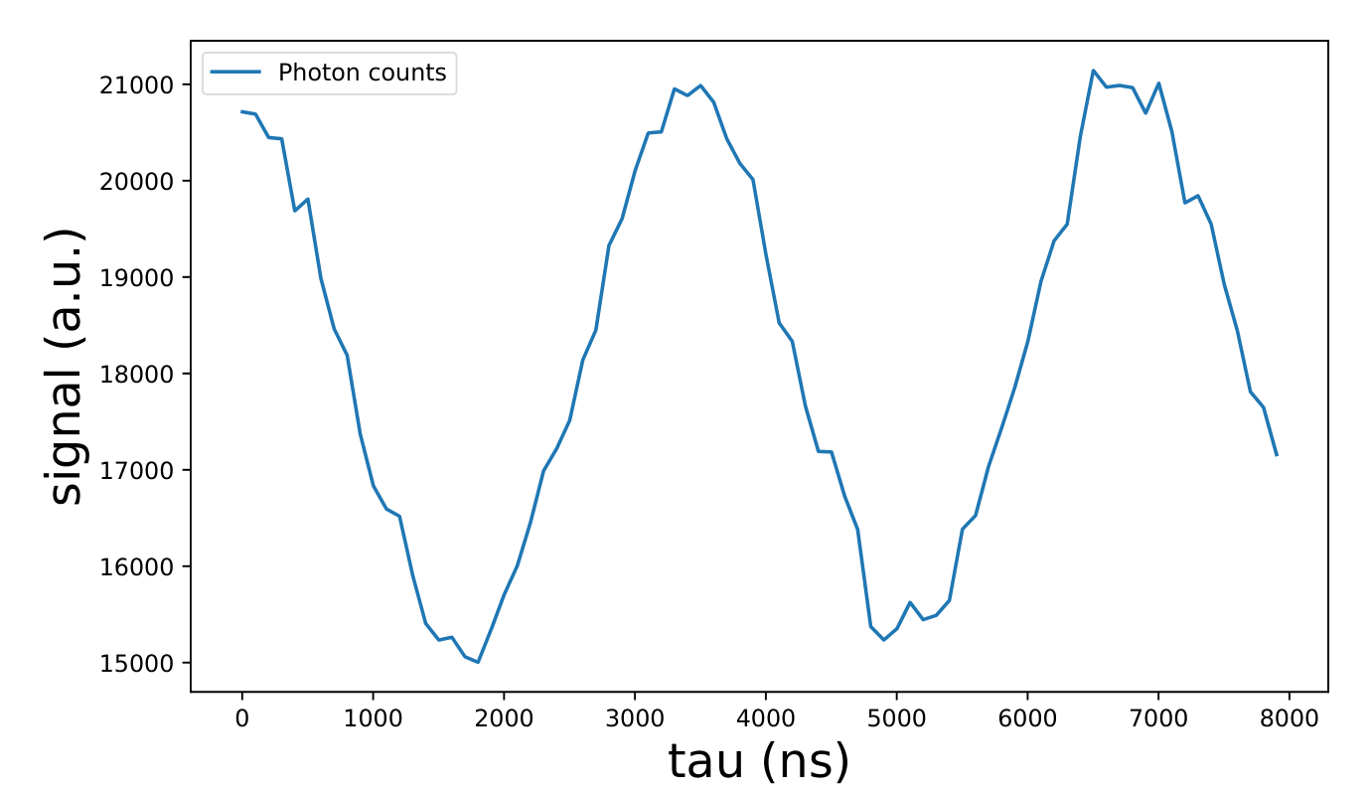
The NV Center in Diamond
Manipulations of NV as a qubit
  Rabi Oscillation
    To implement rotation gates on the NV qubit
Figure from Yang Y, Vallabhapurapu H H, Sewani V K, et al. Observing hyperfine interactions of NV− centers in diamond in an advanced quantum teaching lab[J]. American Journal of Physics, 2022, 90(7): 550-560.
Notes:
After we know the precise transition frequency from the spin-up state to the spin-down state, it becomes possible to implement rotation gates on qubits by applying microwave at the resonant frequency.
An AC microwave generates an oscillating magnetic field at the NV spin, which is perpendicular to the NV axis. As the NV naturally precesses at the frequency of the energy splitting, the oscillating magnetic field behaves like a static horizontal magnetic field in the rotating frame at this frequency. The figure on the top right illustrates the magnetic field and the NV. In the Bloch sphere in this rotating frame, this equivalent static horizontal magnetic field will resul in the Rabi oscillation between the spin-up and down states.
Besides, whether this static magnetic field in this rotating frame is in the x or y direction depends on the phase of the oscillating microwave. By applying the microwave for various times, various rotations can be realized. It also means that various kinds of rotating gates are realized in a quantum circuit.
A typical data of a Rabi Oscillation experiment is shown in the bottom right figure. The horizontal axis is the duration time of the microwave, and the vertical axis is the fluorescence count. We can see from the different fluorescence counts that the NV spin is oscillating between the spin-up and down states.

Slide 30
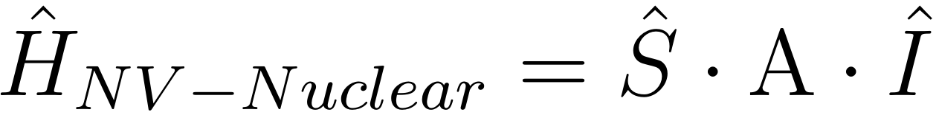
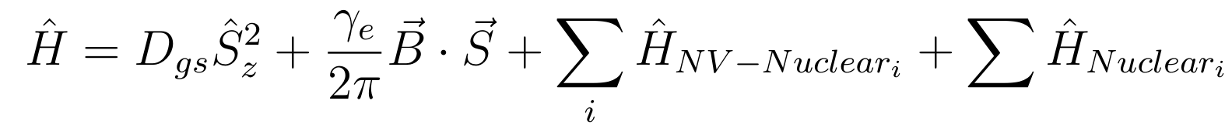
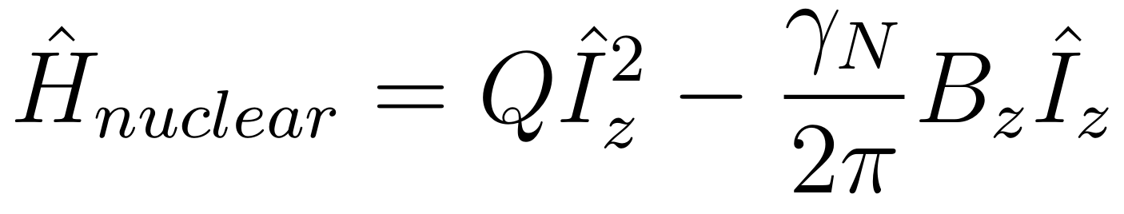
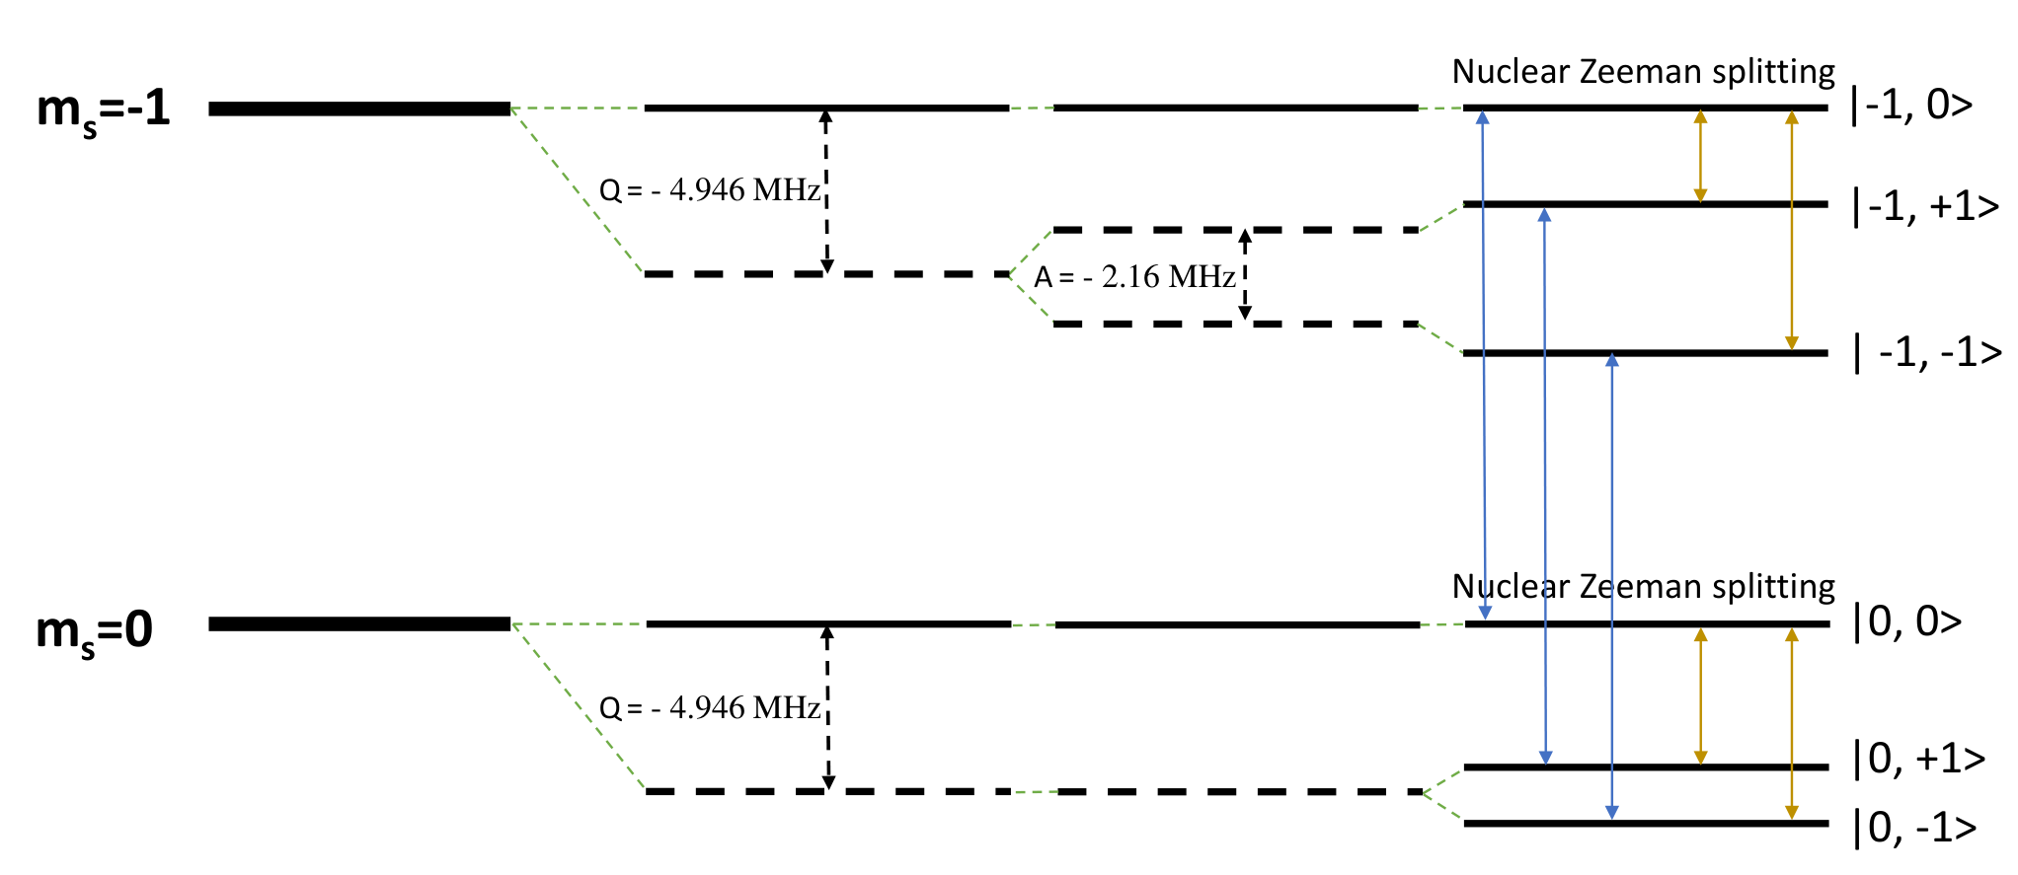
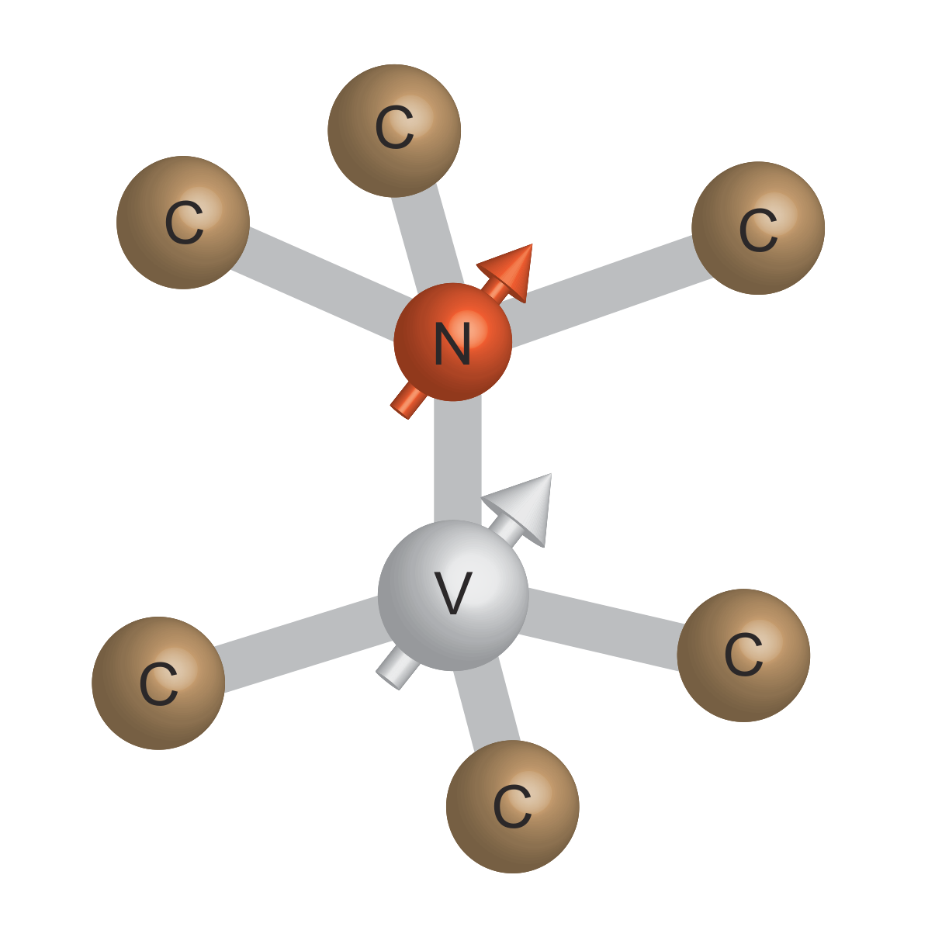
The NV Center in Diamond
Multi-qubits with Nitrogen spin
Notes:
The nuclear spins situated around the NV center can also function as qubits. Especially, we can use the nearest nitrogen nuclear spin and the NV spin to form a 2-qubit system. The nitrogen nuclear also has a spin of 1 and the spin up and down states of the nitrogen nuclear spin are often defined as the m_i = +1 state and m_i = 0 state.
The Hamiltonian describing this 2-qubit system has this form. The first part is the zero-field splitting caused by the spin-spin interaction at the ground state.
The second part is the zeeman splitting.
The third part is the coupling between the nuclear and the NV.
The last part is the energy of the nuclear.
Since we are focusing on the nitrogen nuclear, the nuclear Hamiltonian has this form. The first part is quadrupole splitting and the second part is the nuclear zeeman shift.
Considering all these interactions, the energy levels in the NV spin subspace of ms = 0 ms = -1 is shown in this bottom left figure.
The purple arrows here characterize flipping the NV spin. This is realized by applying the resonant microwave.
The orange arrows here represent flipping the nuclear spin and this is realized by applying resonant rf signal.

Slide 31
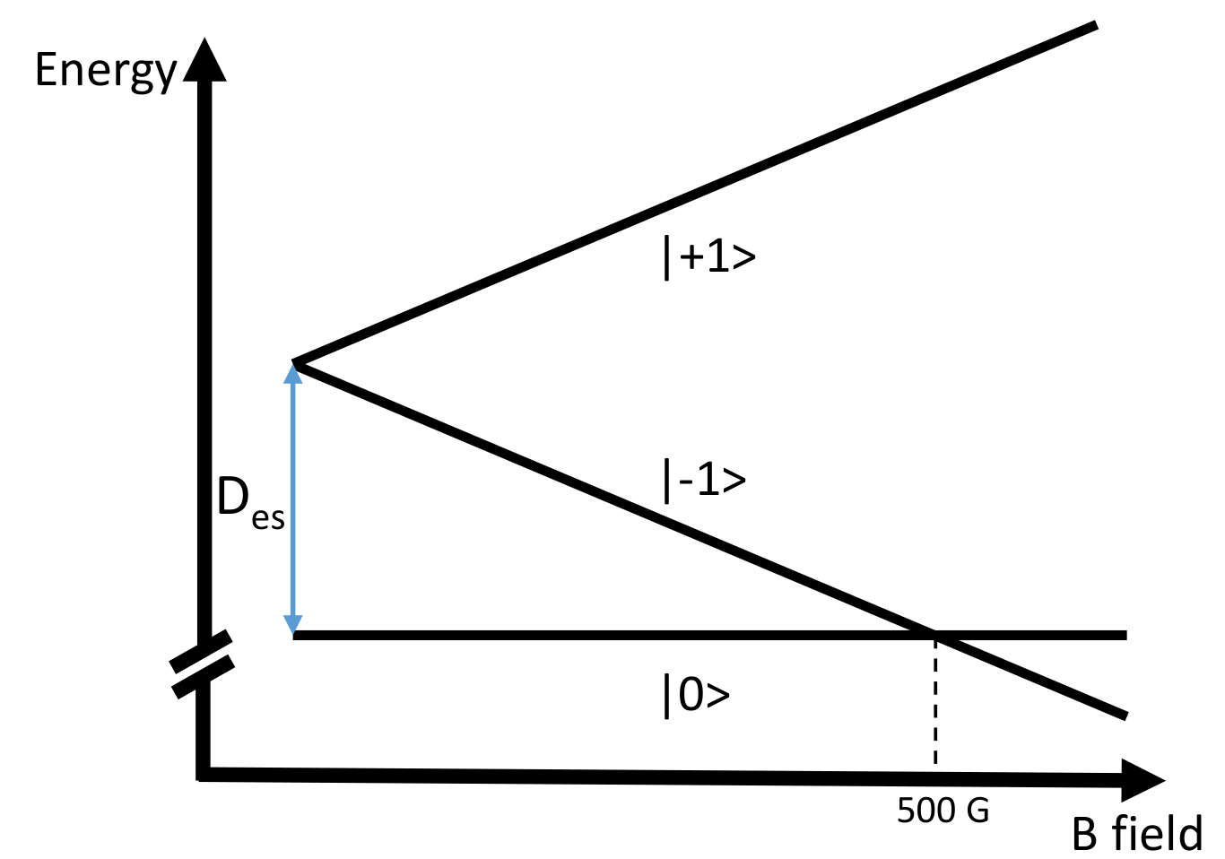
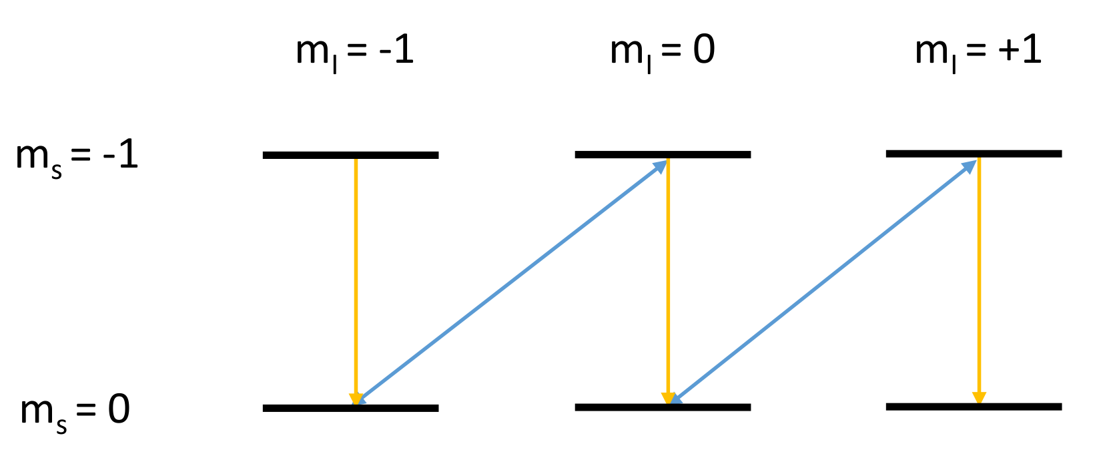
The NV Center in Diamond
Multi-qubits with Nitrogen spin
Excited state level anticrossing (esLAC)
Initialization
Read-out
Notes:
To work as a qubit, the nuclear spin also needs to be initialized to a specific state. One convenient method for achieving this is using the excited state level anti-crossing or esLAC effect. This requires a magnetic field of around 500 Gauss.
The figure on the top right illustrates the energy level depending on the magnetic field. The horizontal axis is the statica magnetic field, and the vertical axis is the energy. In the excited state, a magnetic field of about 500 Gauss can bring the energy of the ms = −1 state close to the energy of the ms = 0 state, thereby inducing the esLAC effect.
The figure on the bottom right shows the specific energy level of the 2-qubit system. During the esLAC effect, the hyperfine interaction between the NV spin and nitrogen nuclear spin can cause a flip-flop process between these 2 states and these 2 states. The purple arrows here just mean these processes. The yellow arrows mean the dynamic under green laser illumination.
As a result, the flip-flop process of esLAC together with the laser illumination can initialize the NV and the nuclear to the ms = 0 and m_i = +1 state.
The read-out of the 2-qubit system also relies on this mechanism. When the laser shines on the system, different states will go through different distance back to initial state. This can cause a difference in the fluorescence counts.

Slide 32
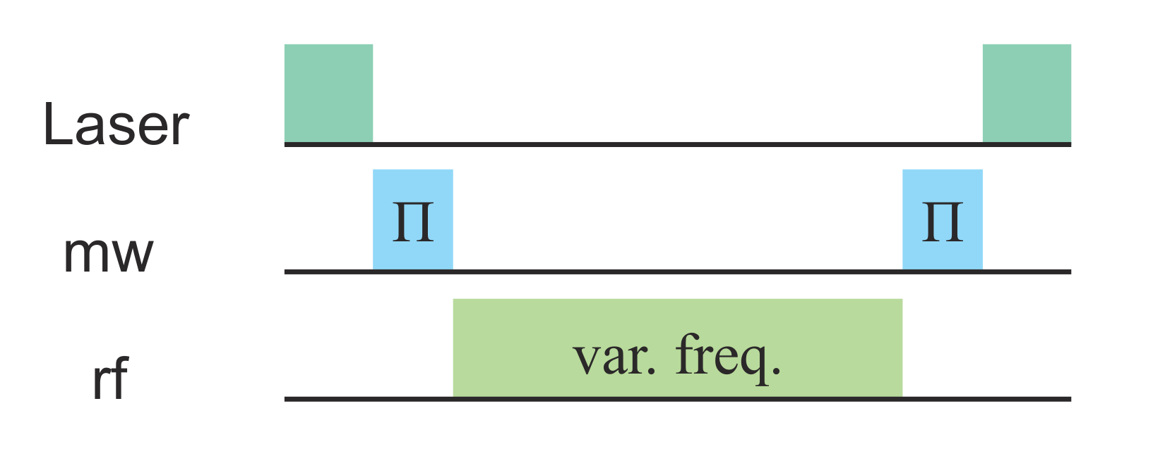
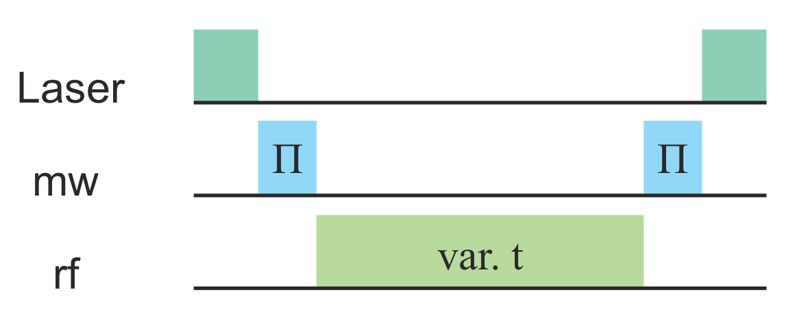
The NV Center in Diamond
Manipulations of the 2-qubit system
  Nuclear Magnetic Resonance (NMR)
    To determine the transition frequency between the nitrogen nuclear’s spin-up and down states
  Nuclear Rabi Oscillation
    To implement rotation gates on the Nitrogen spin qubit
Notes:
Here are 2 typical experiments to manipulate the 2-qubit system. The NMR experiment is to determine the transition frequency between the nitrogen nuclear’s spin-up and down states, like the ODMR, but the ODMR is for the NV spin, NMR is for the nuclear spin. The Nuclear Rabi Oscillation is to implement rotation gates on the Nitrogen spin qubit, lile the regular Rabi oscillation for the NV spin. The pulse sequences of these 2 experiments are shown on the right.

