Slide 1


Progress of the High Field HTS Magnet R&D
for Next-generation High Energy Accelerators
Qingjin XU
Institute of High Energy Physics,
Chinese Academy of Sciences
15 Jan 2026
IAS Program on Fundamental Physics (FP 2026), HKUST, 12-16 Jan 2026

Slide 2


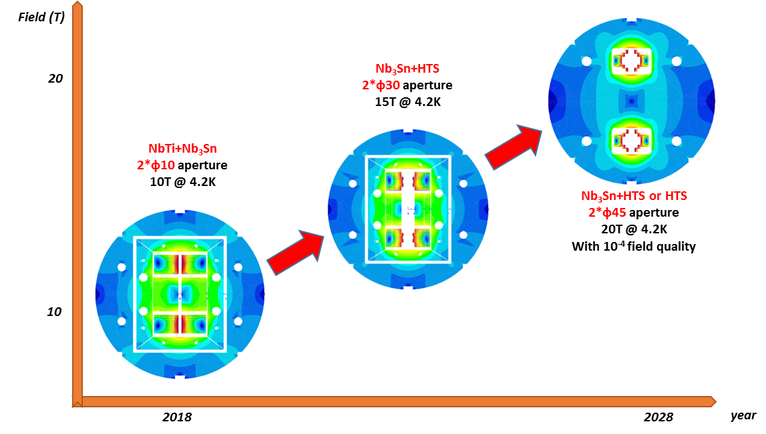
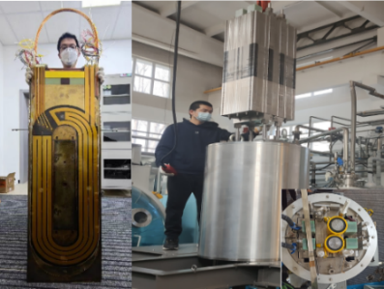
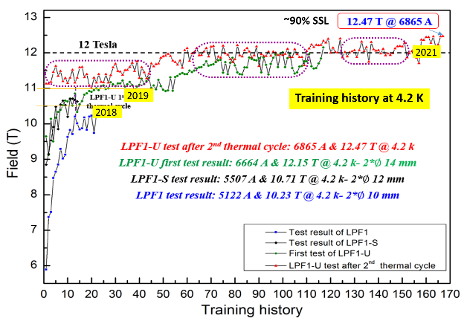
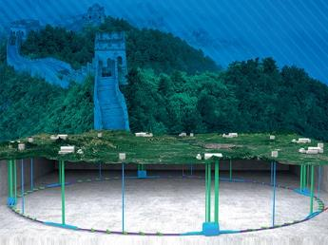
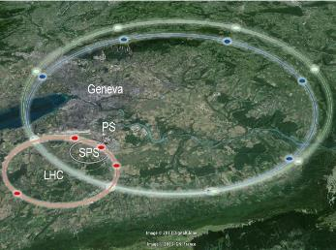
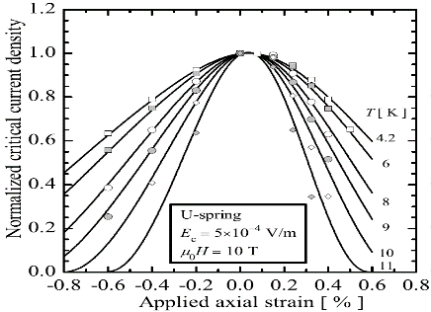
Roadmap of the High Field Magnet R&D at IHEP
2021-2026 15~16T @ 4.2K
NEXT-GENERATION PARTICLE ACCELERATORS
2018-2021, 12.47T @4.2K
NbTi + Nb₃Sn
CEPC-SPPC
FCC
Challenges: Stress control, quench protection, field quality control,……
2018
2030
2

Slide 3
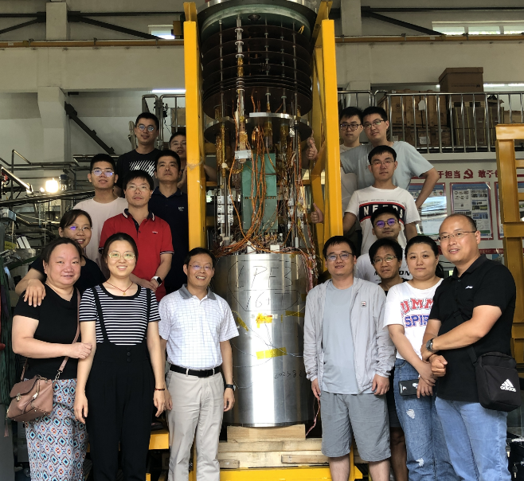
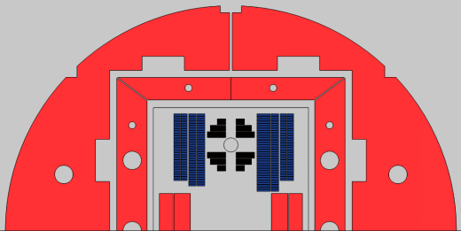
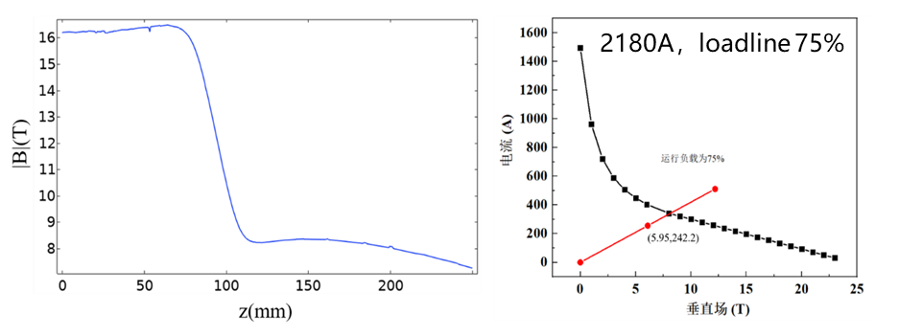
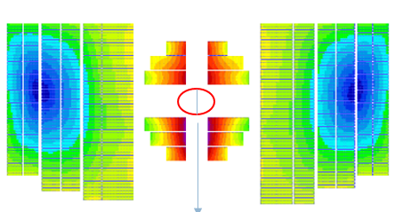
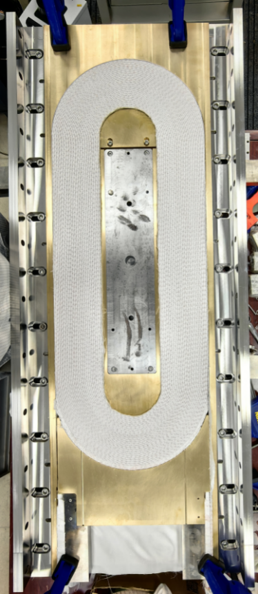
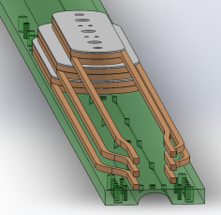
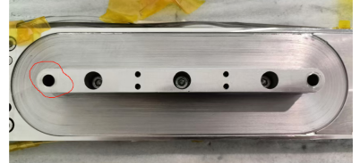
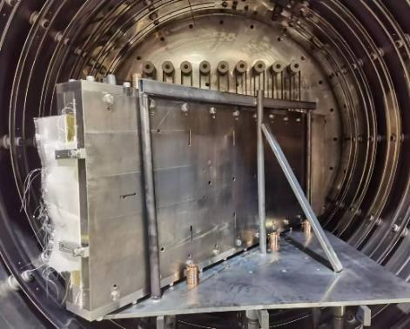
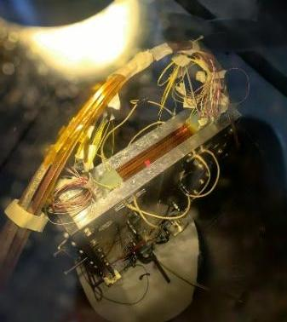
Development of the High Field Model Dipoles
Latest design: Target field：10 T (LTS) + 6 T (HTS) at 4.2 K
LTS: Nb₃Sn common coils with shell-based structure, aperture: 2* ∅78 mm
HTS: ReBCO racetracks, stacked tapes with MI insulation, aperture: 16*24 mm²
AP: 75 mm
75 mm
3
HFM team @ IHEP-CAS
3

Slide 4
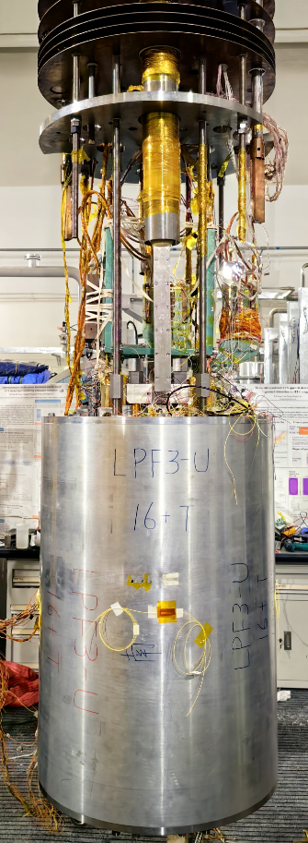
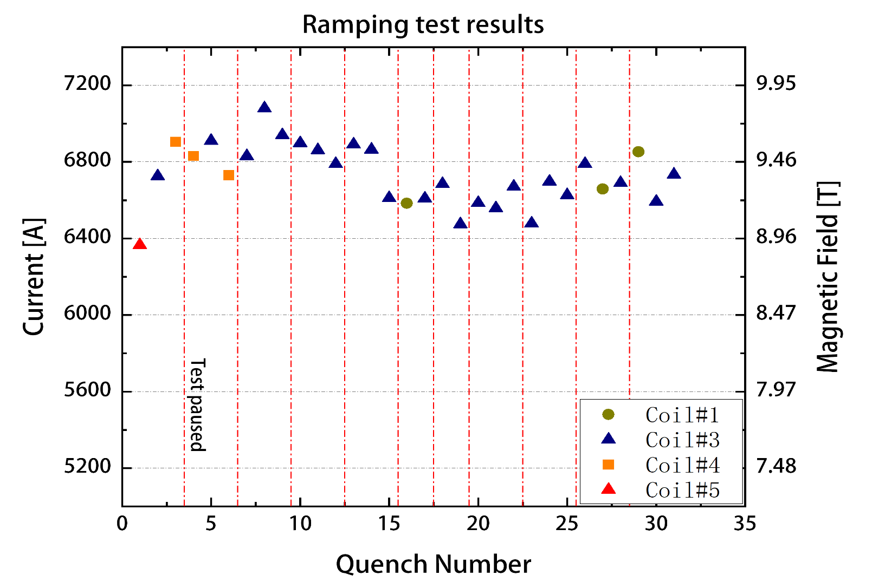
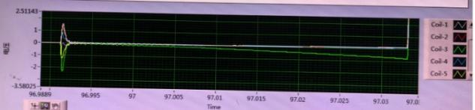
Development of the High Field Model Dipoles
Test of the LPF3-U magnet at 4.2 K Nov. 2024 to Jan. 2025
Main challenges: The LTS coils are strongly coupled with the HTS coils in magnetic field and stress during LTS training. the HTS induced current enhance the field strength and stress of the adjacent LTS coils, and the frequent training quench of LTS cause irreversible degradation of the HTS coils.
Nb₃Sn coils reached 9.8 T, 98 % of the design value.
Coupling between HTS & LTS caused difficulties to the training of LTS
Most of quenches occured in the inner Nb₃Sn coils.
LTS still have potential for performance improvement. More R&D needed on training tests……
Common-coil dipole with 78-mm gap
2024.11.22
LPF3-U 磁体组装完成
4

Slide 5
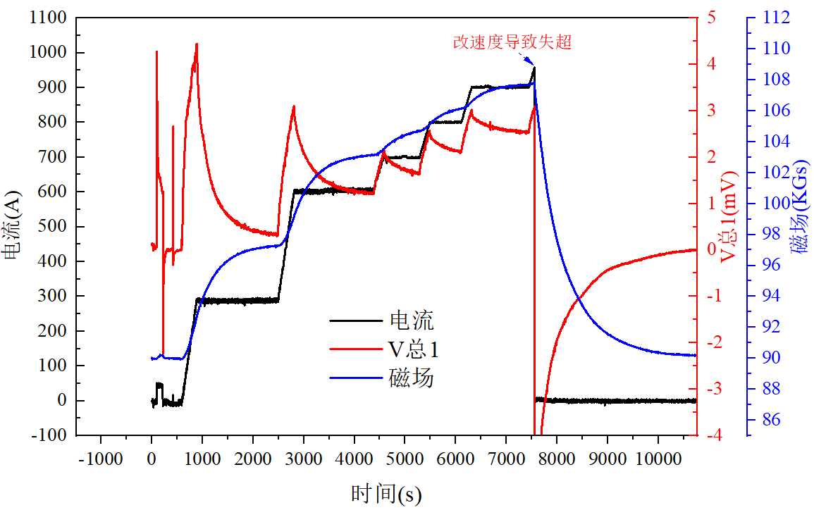
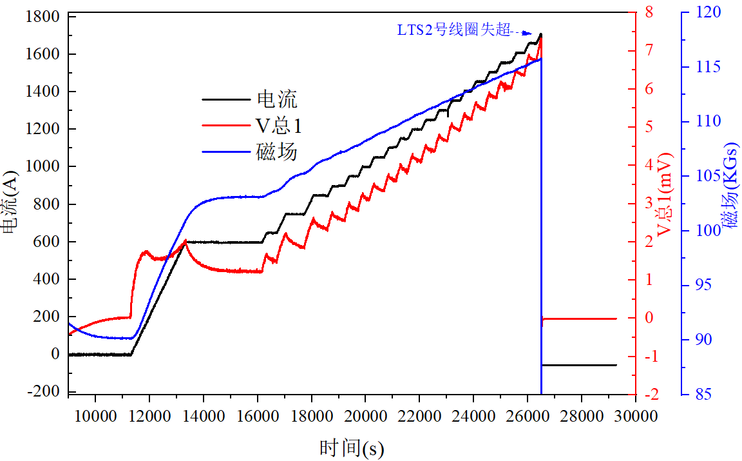
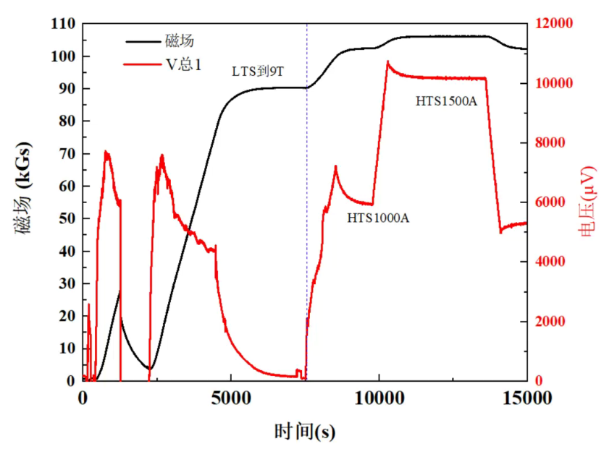
Development of the High Field Model Dipoles
Test of the LPF3-U magnet at 4.2 K Nov. 2024 to Jan. 2025
The HTS coils reached a maximum excitation current of 2.5 kA (115 % of the design current) in 9 T background field, but generally degraded along with the training of LTS coils, and provided a magnetic field significantly below the design value with long delay.
HTS Stand-alone test @77 K
HTS Test after assembly @77 K
Training of LTS coils
1st HTS test with 9 T BG field
2nd HTS test with 9 T field
LTS training
3rd HTS test with 9 T field
1st HTS test with 9 T BG field
2nd HTS test with 9 T BG field
3rd HTS test with 9 T BG field
5

Slide 6
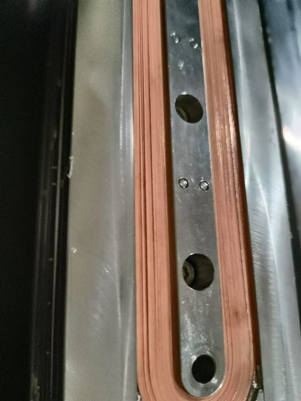
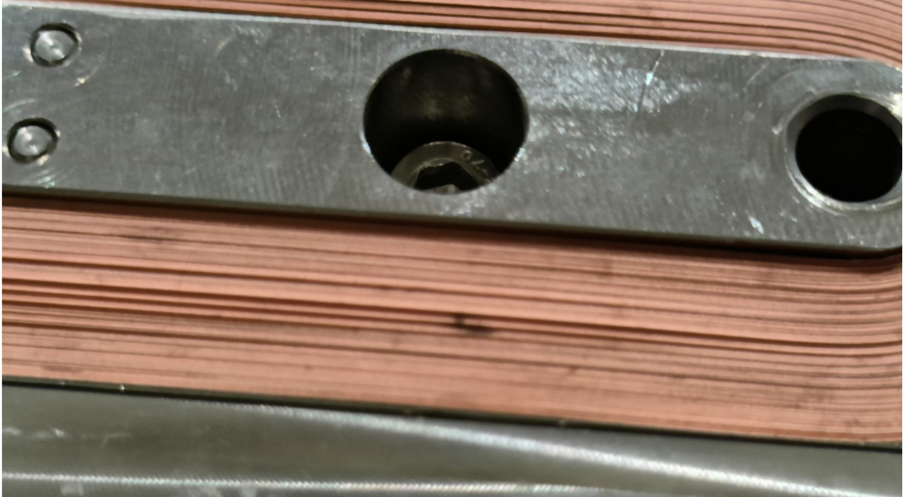
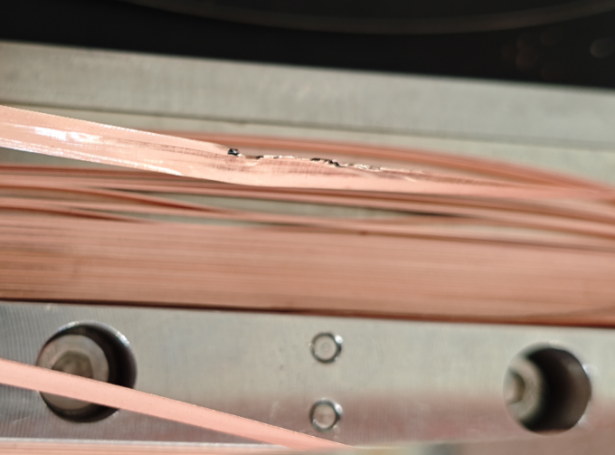
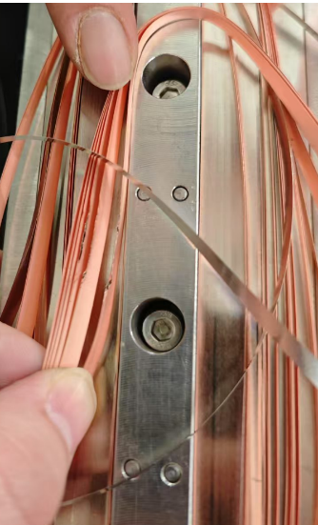
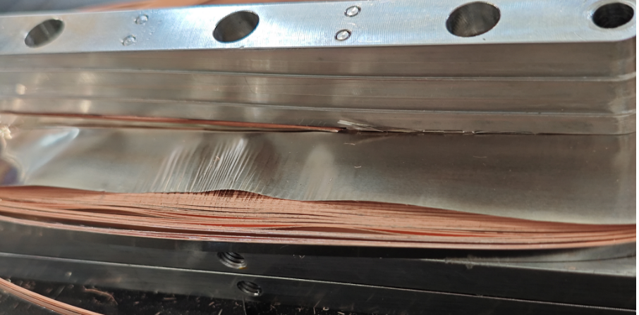
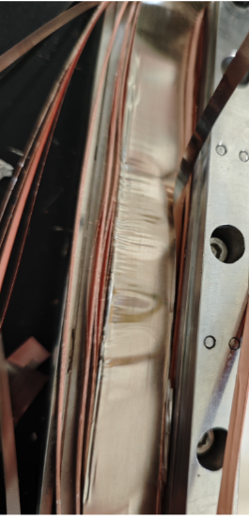
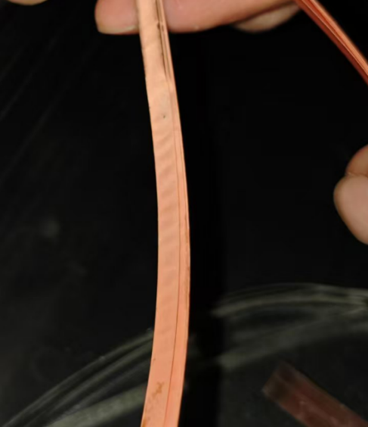
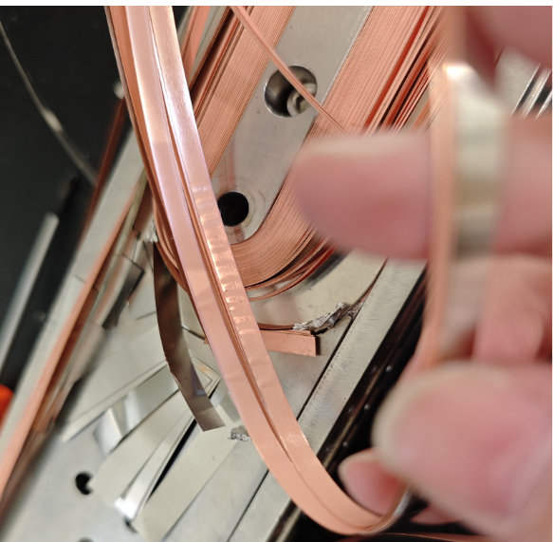
Development of the High Field Model Dipoles
Disassembly of the magnet and HTS coils in Jan 2025
After disassembly, Serious damage of the outer HTS coils observed: conductor delamination, damage of layer insulation..., caused by strong coupling (between LTS and HTS) induced electromagnetic forces during the training of LTS
Damage in interturn between layers
After testing, the coil surface is not flat
Damage of layer insulation
Delamination
6

Slide 7
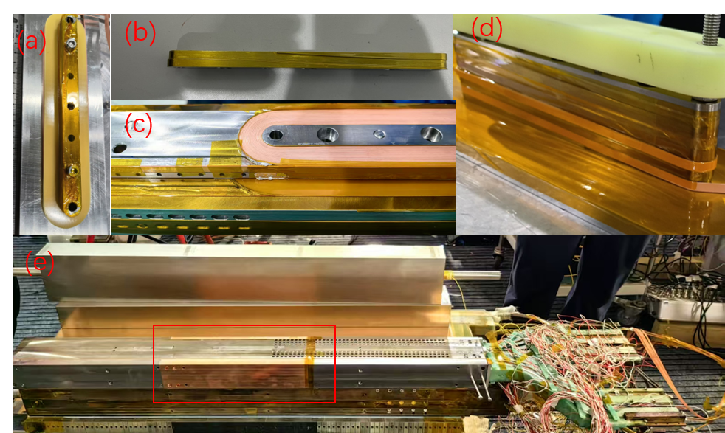
Development of the High Field Model Dipoles
Refabrication of the new HTS coils in Spring 2025
To reduce time delay of field, the layer insulation in the coil was replaced from stainless steel to G10
To reduce the impact of LTS quench to HTS, high-purity copper and HTS tapes were deployed around the HTS coil
7

Slide 8
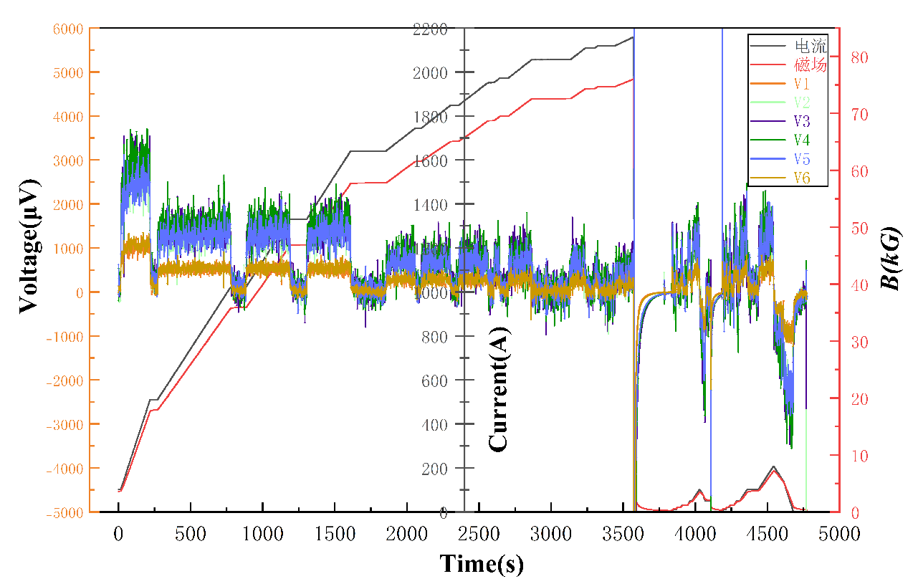
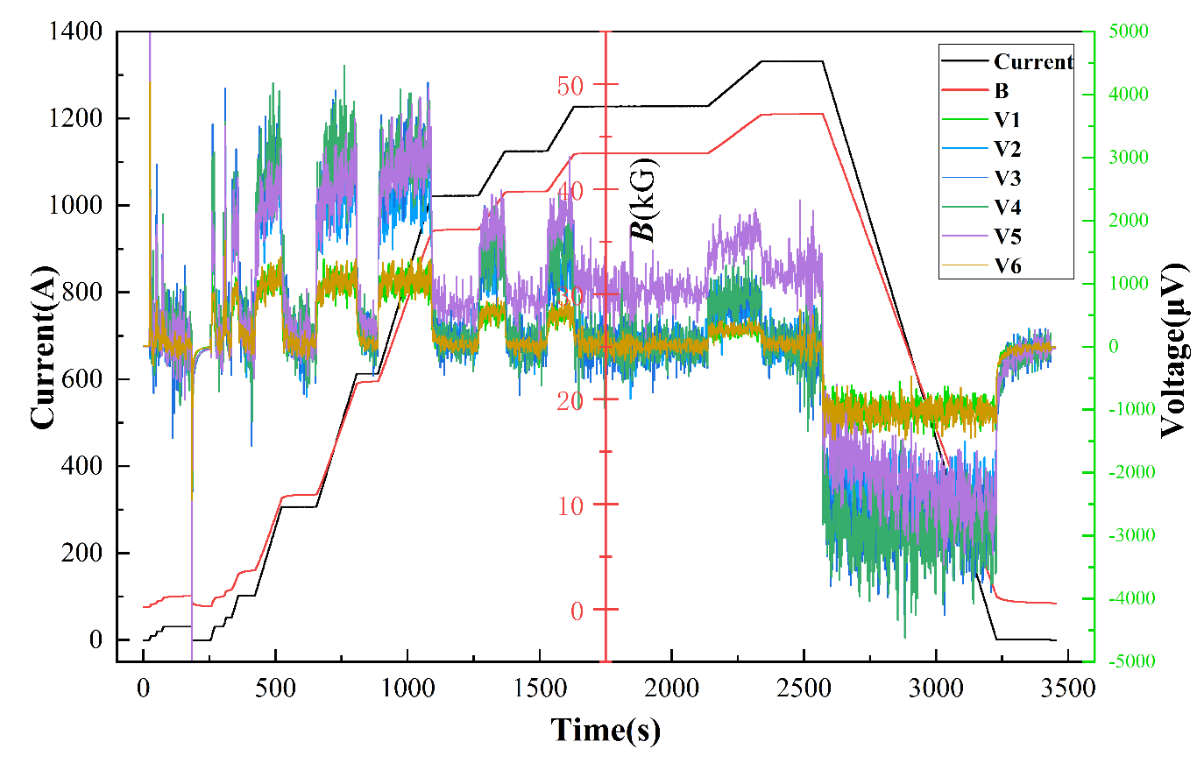
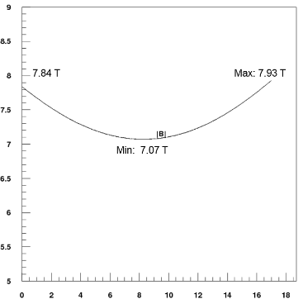
Development of the High Field Model Dipoles
Refabrication and test of the new HTS coils in Summer 2025
HTS stand alone: 2159 A, 7.6 T in the aperture@ 4.2 K
Maximum field on the coil (calculated): ~10 T
Performance limited by a power failure: current discharged in 1 s
Power failure at 2159 A damaged 1 of 6 HTS coils
Resistive voltage appeared in #5 coil from ~800 A;
bypassing #5 coil for the following tests
8

Slide 9
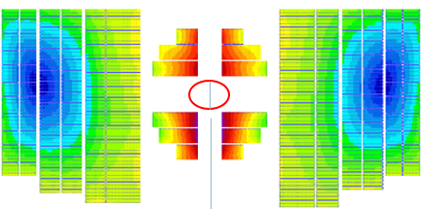
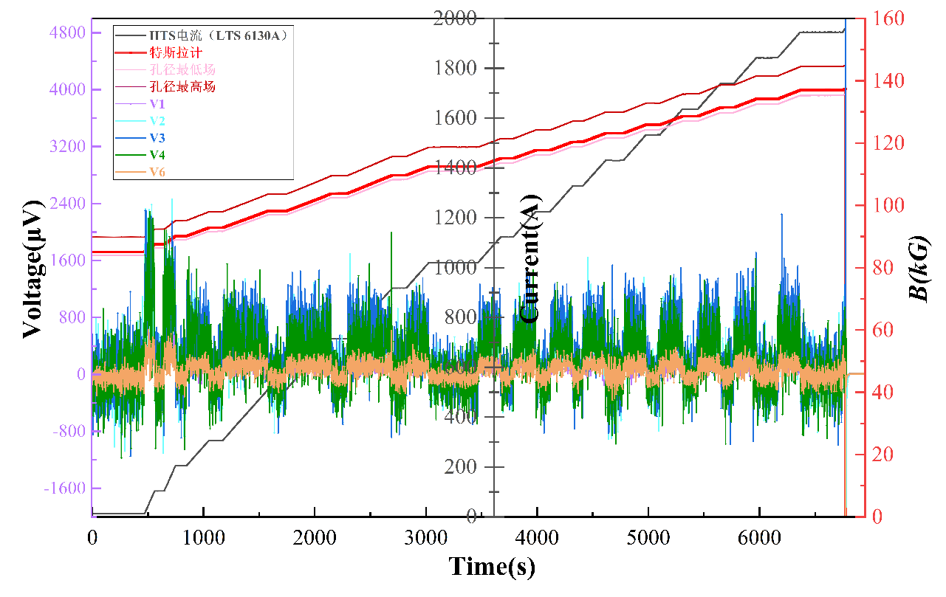
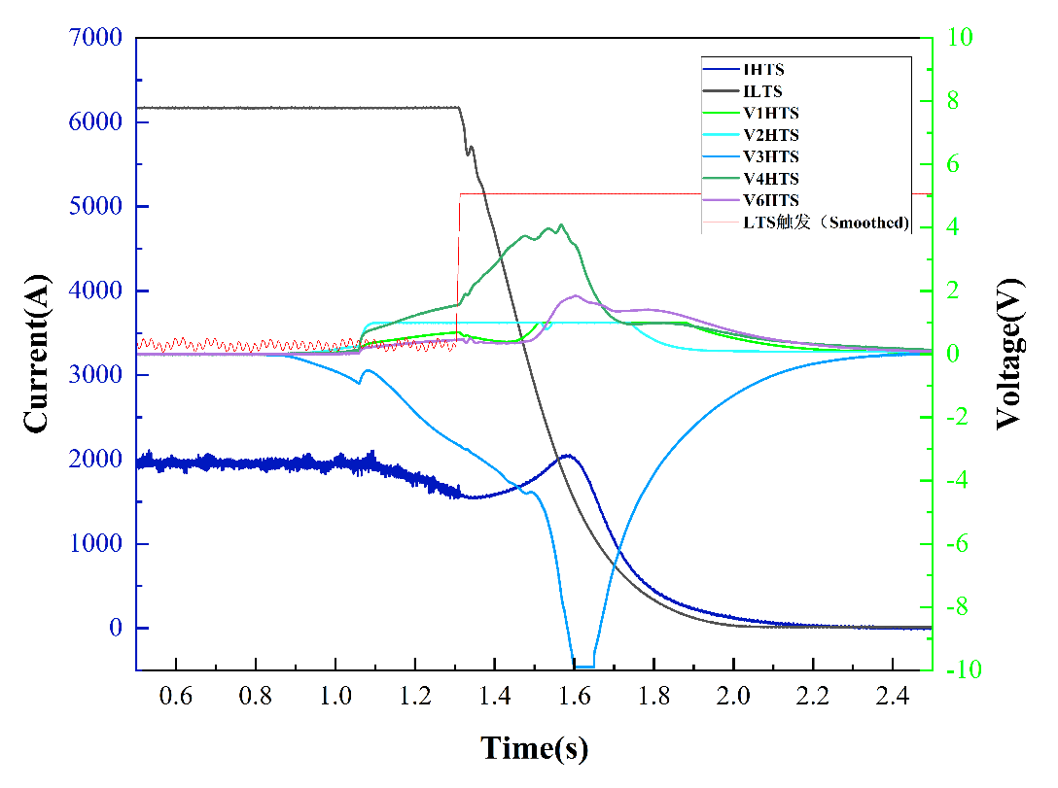
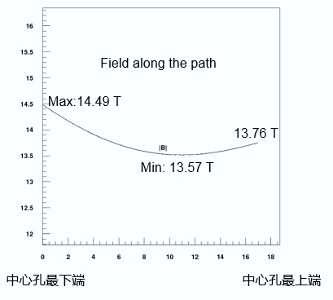
Development of the High Field Model Dipoles
Refabrication and test of the new HTS coils in Summer 2025
2nd powering with LTS: #3 HTS coil quench at 1959A, and after 0.4156s, the LTS quench detection system triggered. The current decay time of HTS is 1.3 s, and LTS is 0.7718 s;
2nd HTS powering with Nb₃Sn at 4.2K
Quench at HTS 1959 A & LTS 6130 A (bypassing #5 HTS coil)
Voltage and current variations during the quench
Dipole field along the major axis
Field map within the aperture. The highest field in the HTS coil ~16.2T (calculated)
9

Slide 10
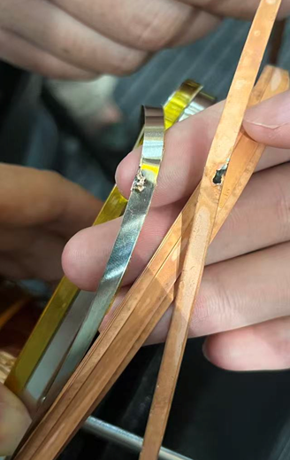
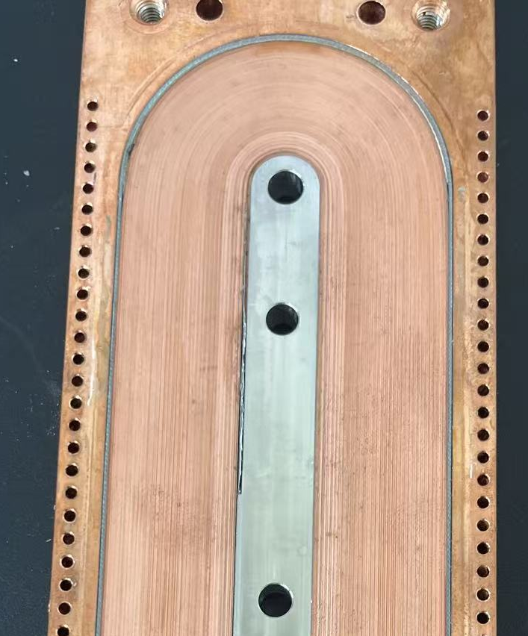
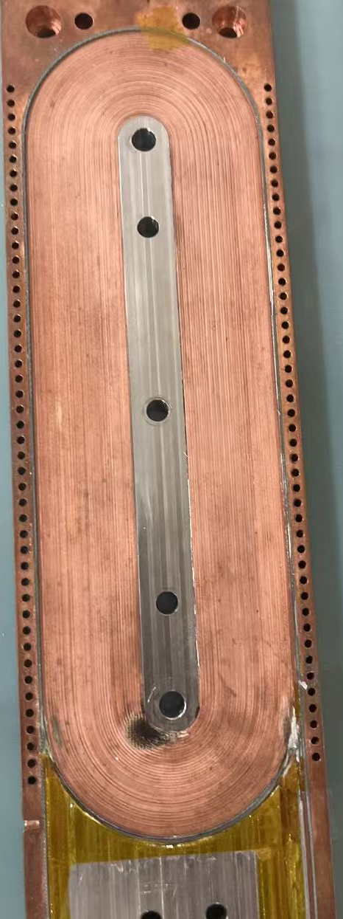
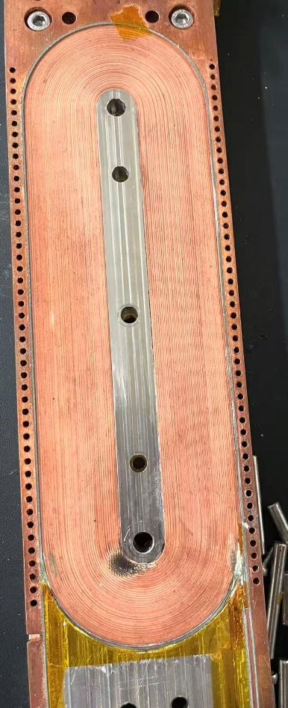
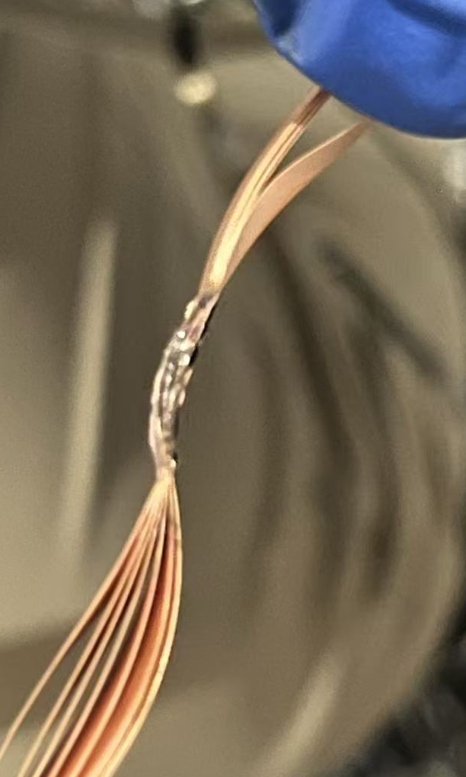
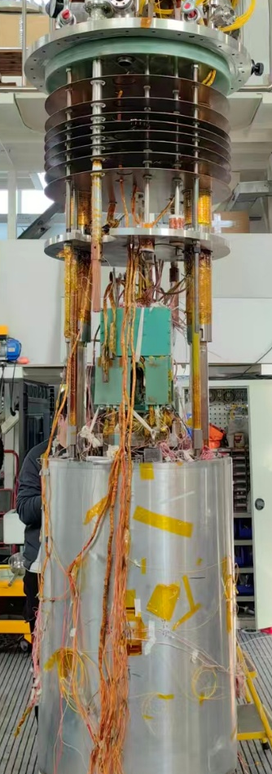
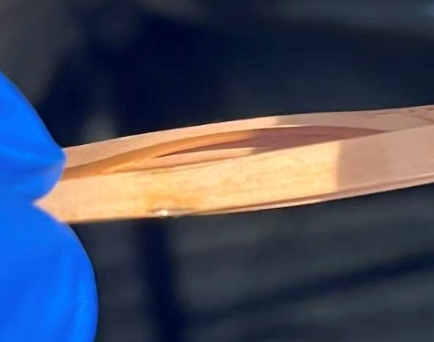
Development of the High Field Model Dipoles
Refabrication and test of the new HTS coils in Summer 2025
Power failure damaged coil (#5 coil) during the stand-alone test: conductor partially burned at the coil end
Quench at 14 T damaged coil (#3 coil) during powering with Nb₃Sn coils: conductor burned at the bending section
New ReBCO coils have been fabricated and assembled in the magnet, test with be done in Jan 2026
#5 coil
#3 coil inner
#3 coil outer
10

Slide 11
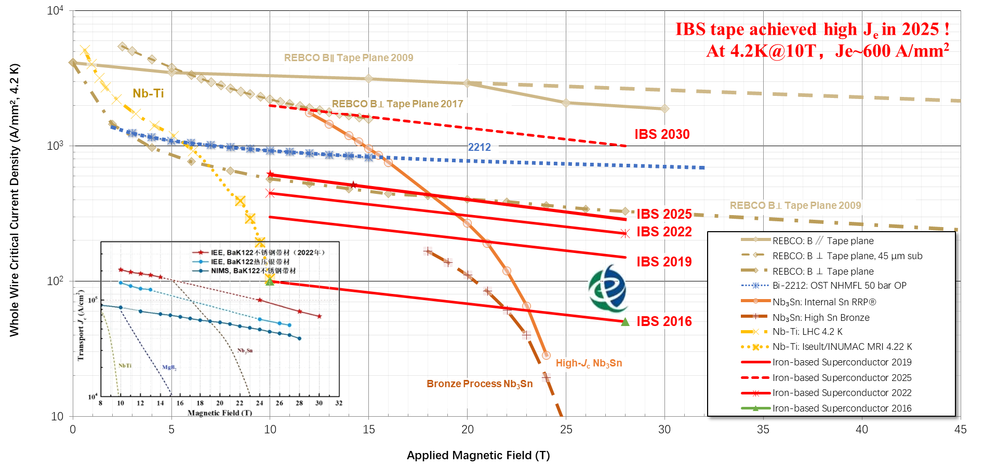
IBS Technology: Status and Outlook
11

Slide 12

IBS Technology: Status and Outlook
Powder-In-Tube 122 tapes: Long length
100m long, 7-core Ba122 tapes are fabricated by rolling process, and the J_{c} is continuously improving.
8倍
I_{c} >300A, J_{c} >10⁵ A/cm²
In 2024, the J_{c} of long wires has been increased to 10⁵ A/cm² @ 4.2 K, 10 T by optimizing fabrication process
12

Slide 13
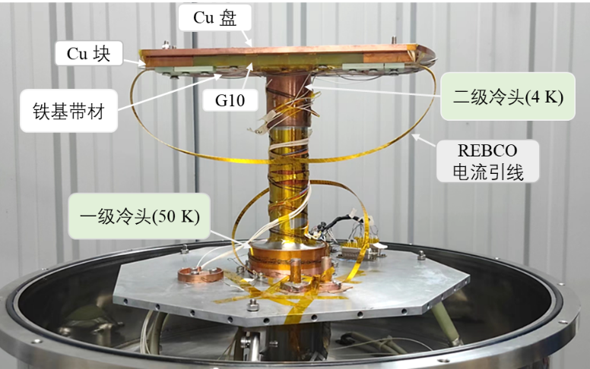
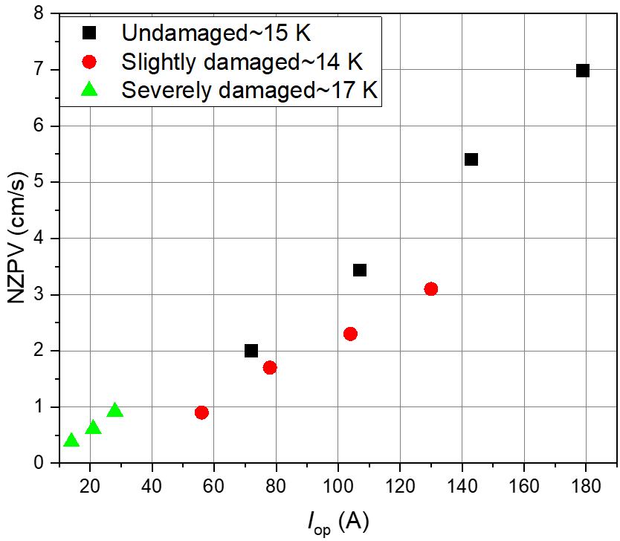
IBS Technology: Status and Outlook
Quench propagation study of the IBS tapes and coils
In 15~17K, when the transmission current of iron-based superconductor is 14-179A, the corresponding NZPV value is 0.4– 7cm/s
13
Chunyan Li et al. Supercond. Sci. Technol. 37 (2024) 085021

Slide 14
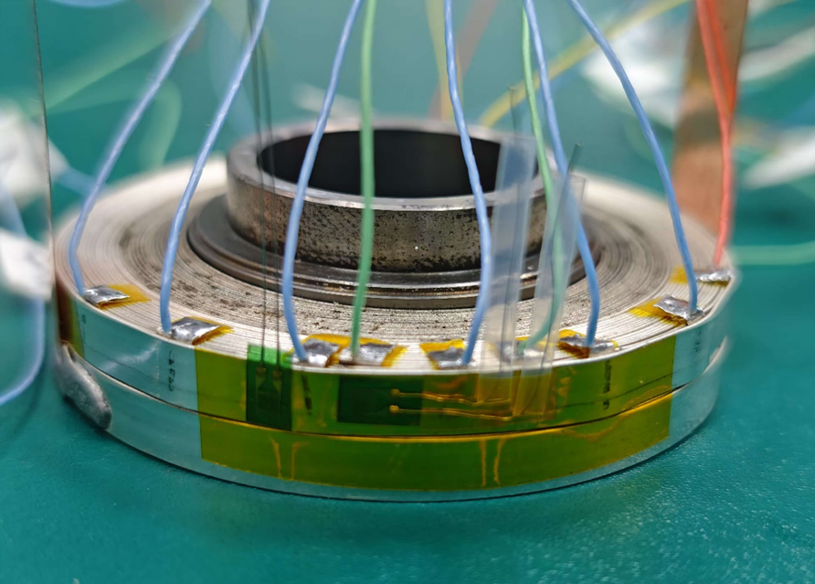
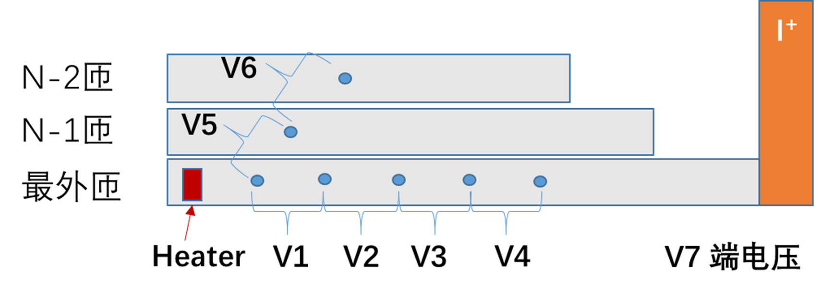
IBS Technology: Status and Outlook
Quench propagation study of the IBS tapes and coils
IBS-MI coil
IBS-NI coil
14

Slide 15
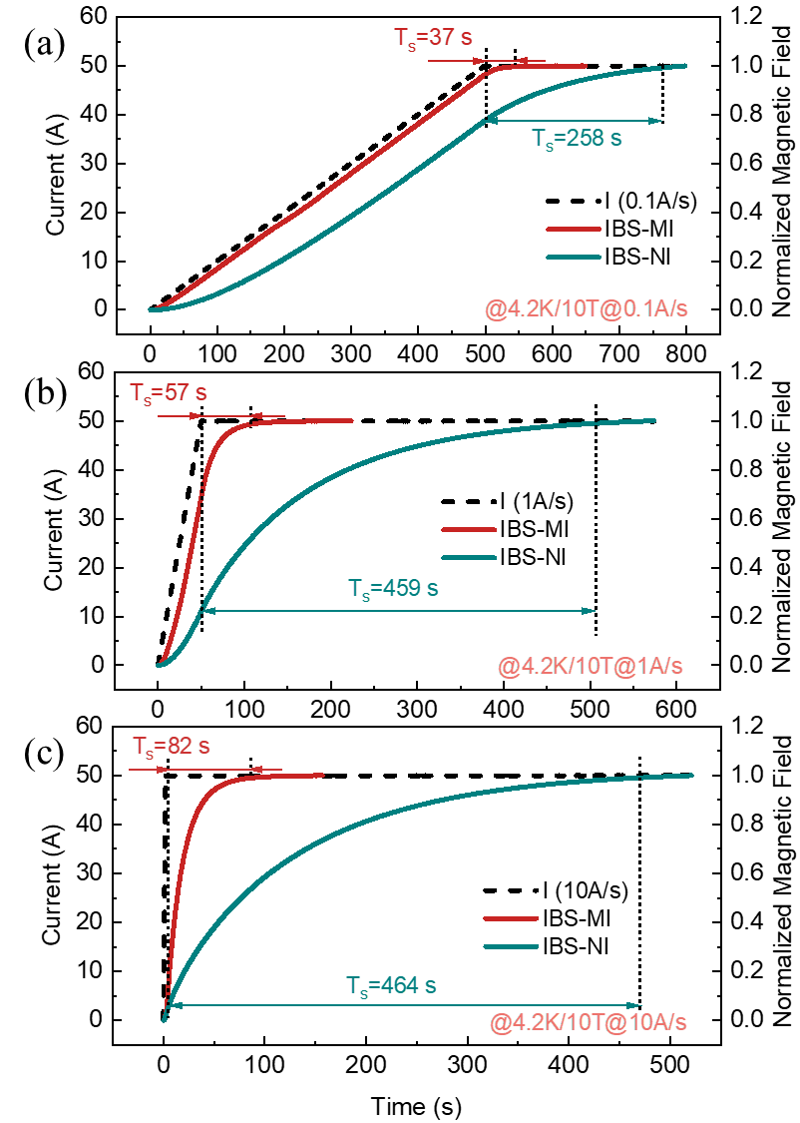






IBS Technology: Status and Outlook
Performance comparison with different fabrication methods
VS
IBS coil
REBCO coil
15
Fan Ren, Chunyan Li et al. Supercond. Sci. Technol. 38 (2025) 125007

Slide 16



IBS Technology: Status and Outlook
IBS Solenoid Coil tested at 32-35 T background field
2024 Supercond. Sci. Technol. 37 015001
DP-6串联线圈电压引线图
Fabricated a series-connected IBS coil consisting of six DP coils and tested at 32T background field
16

Slide 17



IBS Technology: Status and Outlook
IBS Solenoid Coil tested at 32-35 T background field
I_{c} of Φ34mm-17 turns-DPC reached 49 A at 4.2 K and 35 T
2024 Supercond. Sci. Technol. 37 015001
Fabricated a series-connected IBS coil consisting of six DP coils and tested at 35T background field
17

Slide 18





IBS Technology: Status and Outlook
Development of the first 7-kA class IBS transposed cable
18

Slide 19













Development of the CCT magnets for HL-LHC
Connection to LHC (UL)
Service gallery (UR)
UA Gallery
Service cavern
SC Links
Q4
Collimators
D2
Crab cavities
D1
CP
Q3
TAXN
DFM
DFX
Q2b
Q2a
Q1
TAXS
Lucio Rossi - HiLumi LHC to the CERN guides - Globe 26 February 2019
O. Brüning @ HL-LHC Annual meeting in Geneva, 29th September 2025
19

Slide 20

Development of the CCT magnets for HL-LHC
20

Slide 21






Development of the CCT magnets for HL-LHC
All the delivered magnets have been successfully tested at CERN.
All the tested magnets reached the design target: field strength, field quality, operating stability…
Performance Test at CERN
21

Slide 22
Summary
Long-term high field HTS magnet R&D is ongoing for future high-energy accelerators at IHEP-CAS
Hybrid model dipoles with LTS and HTS are being developed from 2021. ReBCO coils reached record-breaking dipole field at 4.2 K：beyond 7 T in the aperture and beyond 14 T with Nb₃Sn coils, but quench protection issue still to be solved
Continuously pioneer IBS related conductor and magnet R&D: Significant improvement in J_{e} of IBS tape in 2025, IBS coil I_{c} reached 49 A at 35 T. 7 kA class IBS transposed cable successfully developed
Delivery of all HL-LHC CCT magnets expected to be completed by early 2026. Continuous collaboration with CERN on High Field HTS technology is expected for the next years
Thanks for your attention!
22

