Slide 1
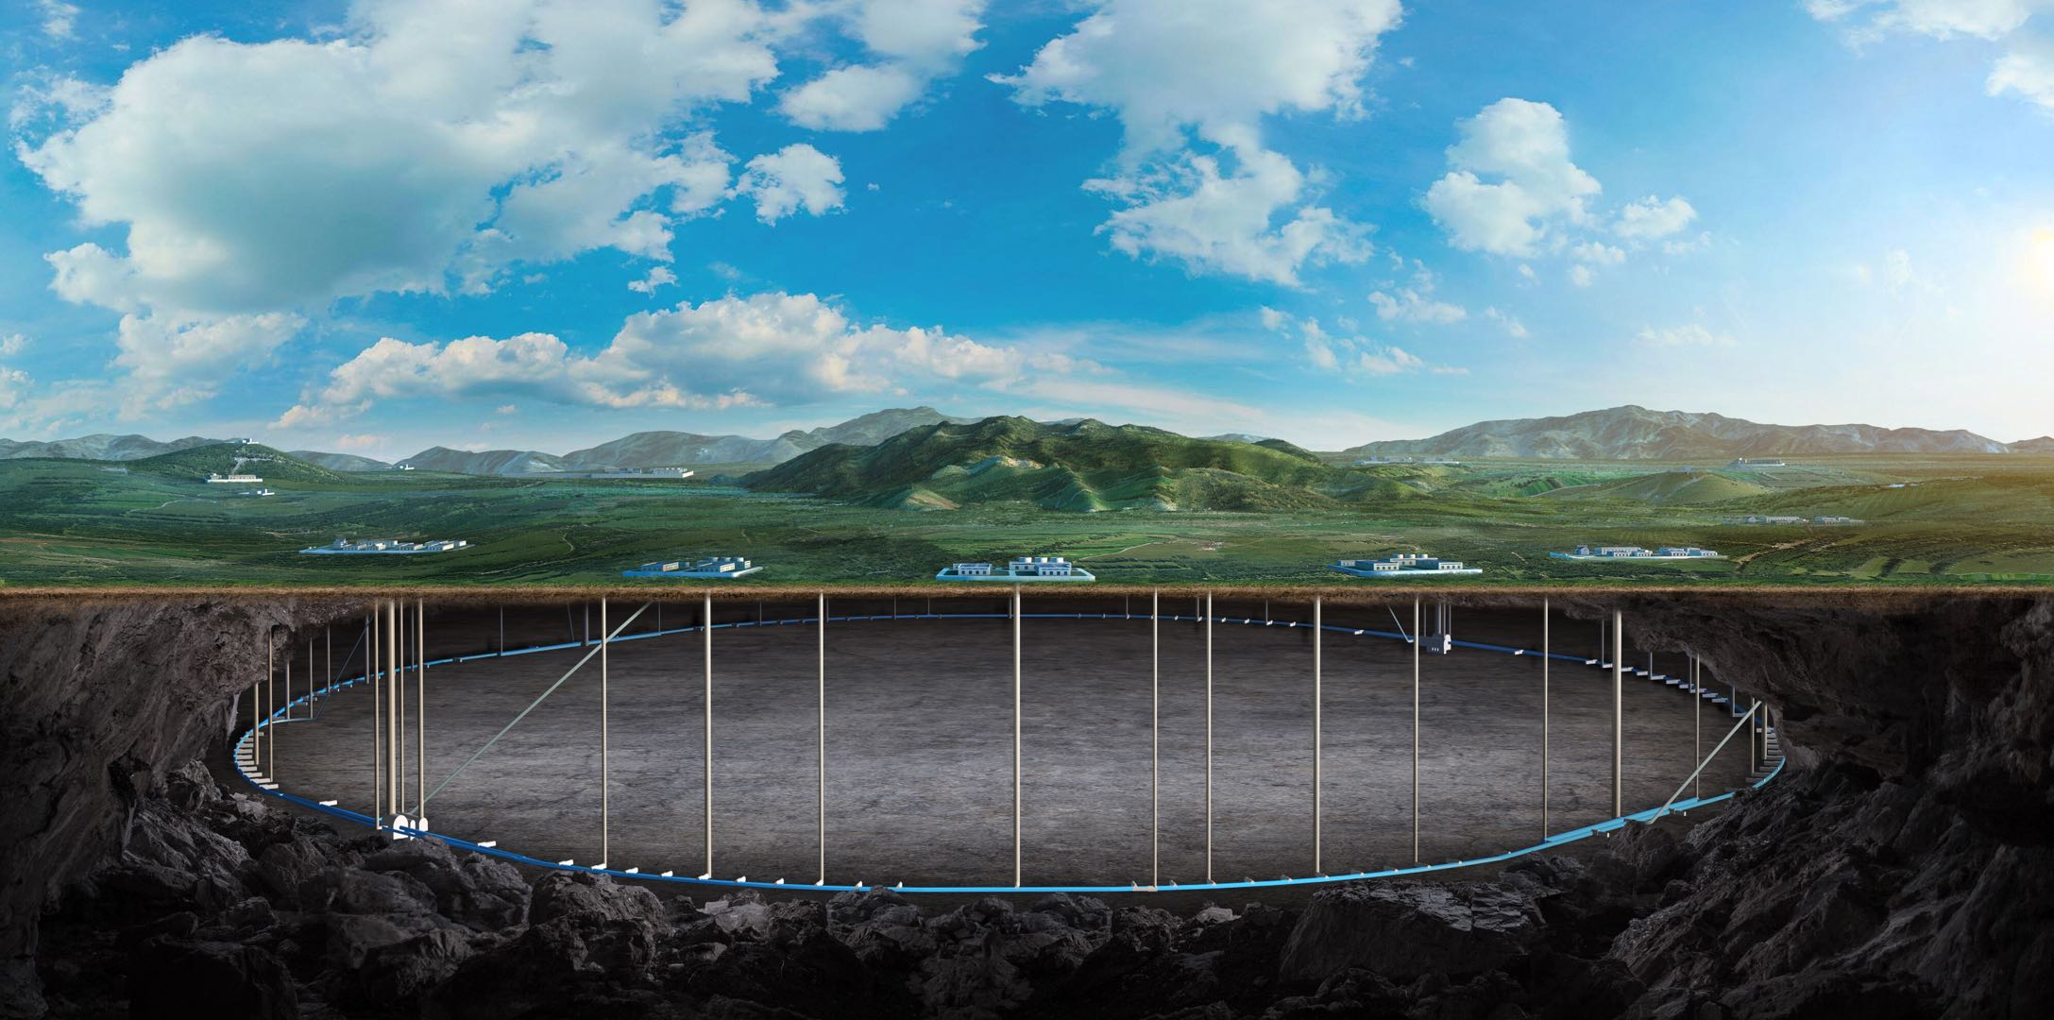


BEPCIIU commissioning and HEPS operation
Daheng Ji
BEPCII-U & HEPS commissioning team
2026.01.15

Slide 2
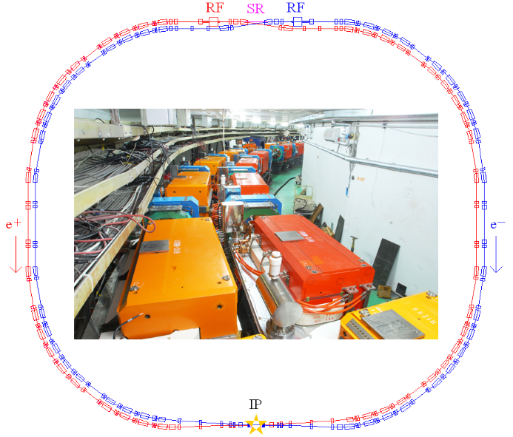
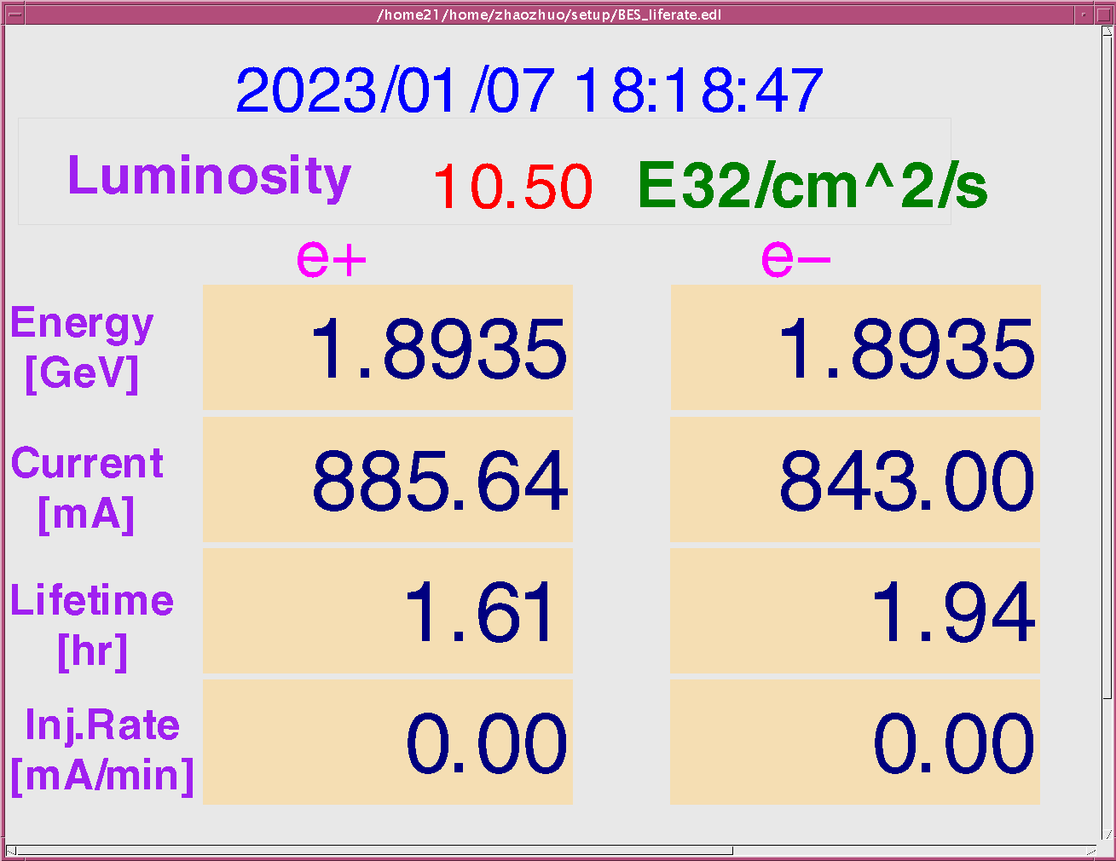
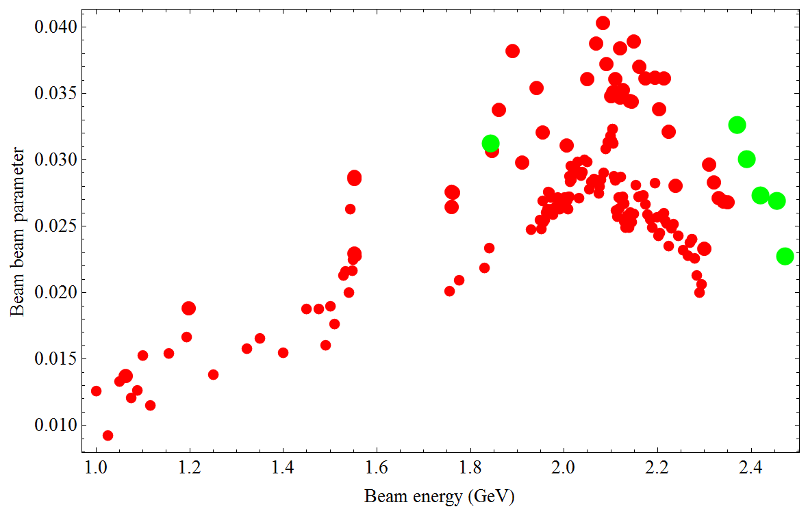
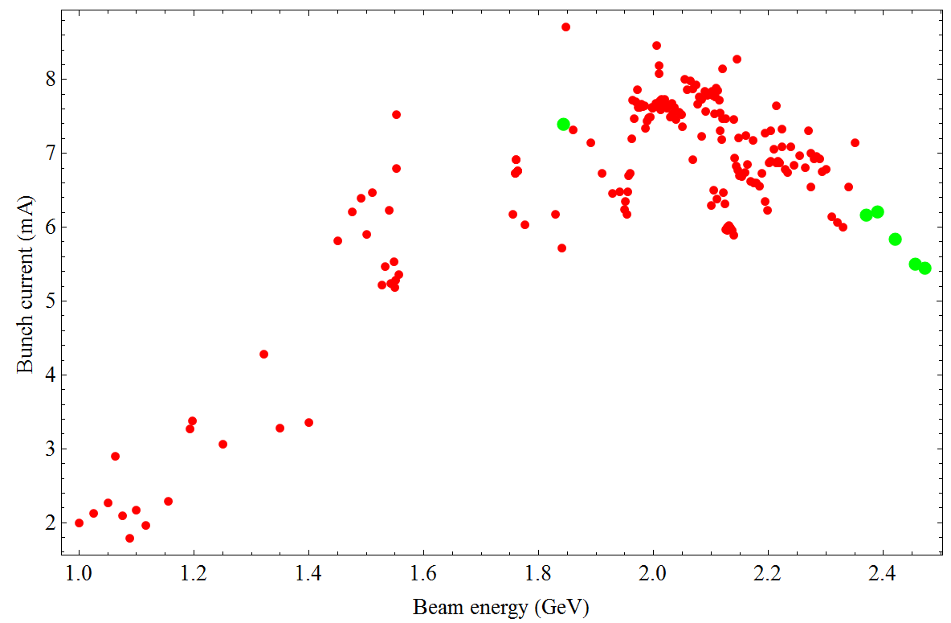
BEPCII-U：upgrade program of BEPCII
BEPCII：
HEP
Beam energy range 1-2.1 GeV
Optimized beam energy 1.89 GeV
Beam current 910 mA
Luminosity 1×10³³cm⁻²s⁻¹ @1.89 GeV
Synchrotron radiation
Beam energy 2.5 GeV
Beam current 250 mA
BEPCII-U: Increase luminosity at higher Energy
Squeeze bunch length and 𝛽_{𝑦}∗ by increasing RF voltage + Increase beam current

Slide 3
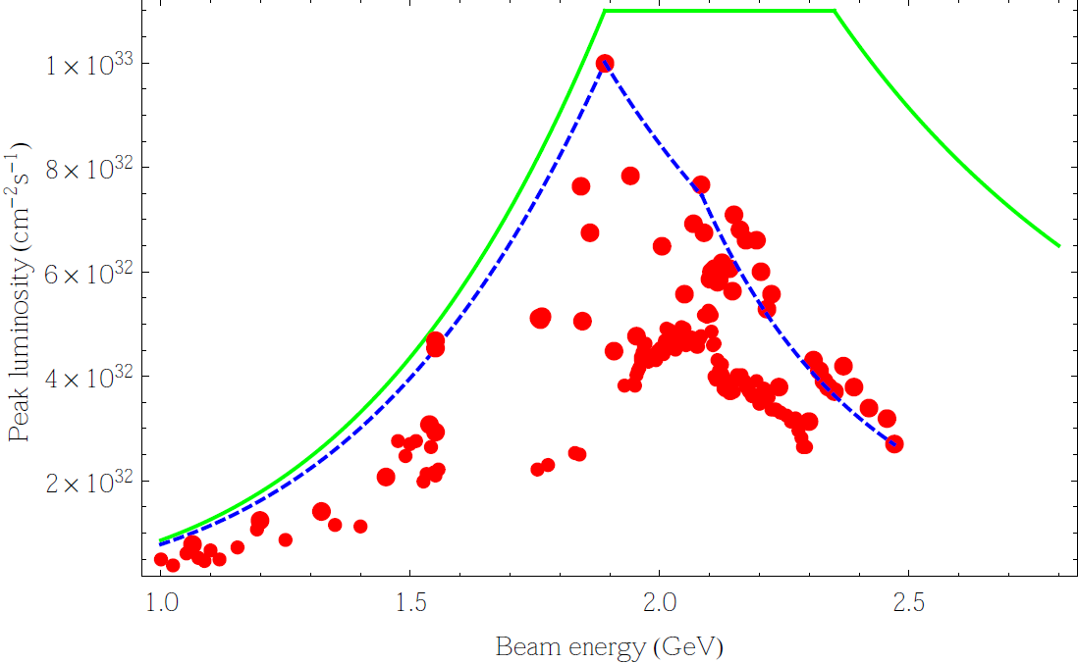
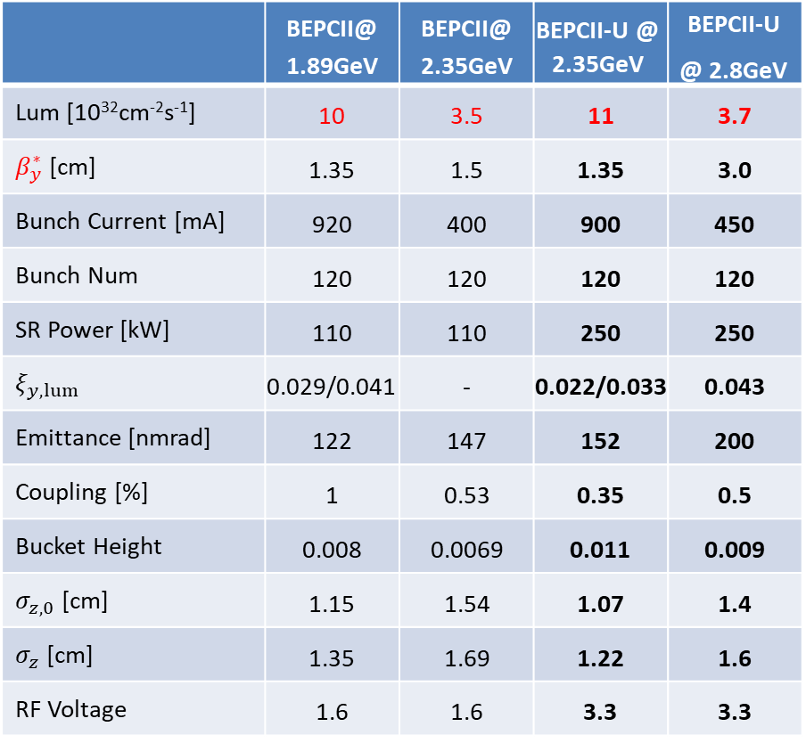
Design parameters before / after upgrade
Beam Energy：2.35GeV
BEPCII-U vs BEPCII
 | BEPCII@ 1.89GeV | BEPCII@ 2.35GeV | BEPCII-U @ 2.35GeV | BEPCII-U @ 2.8GeV
Lum [10³²cm⁻²s⁻¹] | 10 | 3.5 | 11 | 3.7
$β_{y}^{∗}$ [cm] | 1.35 | 1.5 | 1.35 | 3.0
Bunch Current [mA] | 920 | 400 | 900 | 450
Bunch Num | 120 | 120 | 120 | 120
SR Power [kW] | 110 | 110 | 250 | 250
$$ξ_{y,lum}$$ | 0.029/0.041 | - | 0.022/0.033 | 0.043
Emittance [nmrad] | 122 | 147 | 152 | 200
Coupling [%] | 1 | 0.53 | 0.35 | 0.5
Bucket Height | 0.008 | 0.0069 | 0.011 | 0.009
$σ_{z,0}$ [cm] | 1.15 | 1.54 | 1.07 | 1.4
$σ_{z}$ [cm] | 1.35 | 1.69 | 1.22 | 1.6
RF Voltage | 1.6 | 1.6 | 3.3 | 3.3
3 times
Luminosity is increased by a factor of 3 @2.35GeV
Maximum beam energy is increased from 2.1GeV to 2.8GeV.

Slide 4
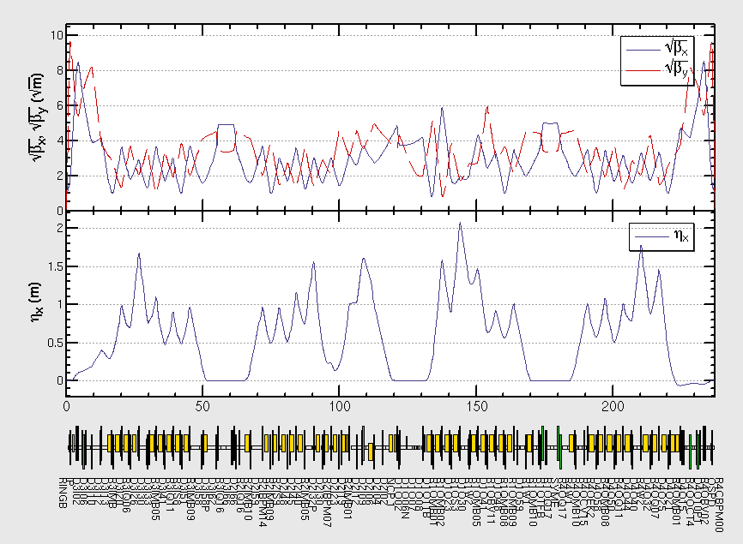
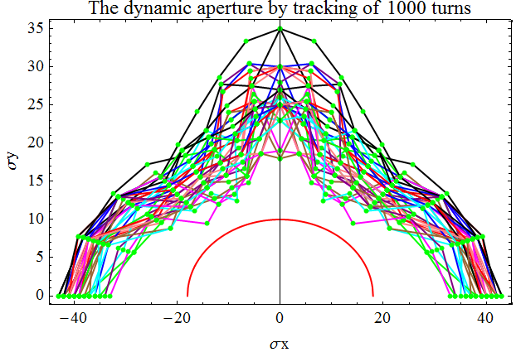
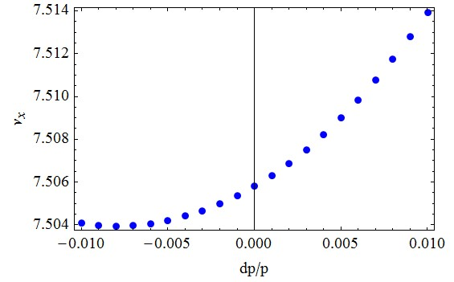
Lattice modified @ 2.35gev
Local optics redesigned at the RF region
Global tuning has been done to minimize the emittance
Dynamic aperture is optimized to ensure enough beam lifetime
Intensive multiparticle tracking has been done to make sure the luminosity performance

Slide 5
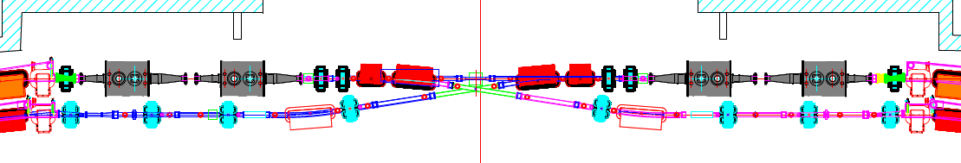
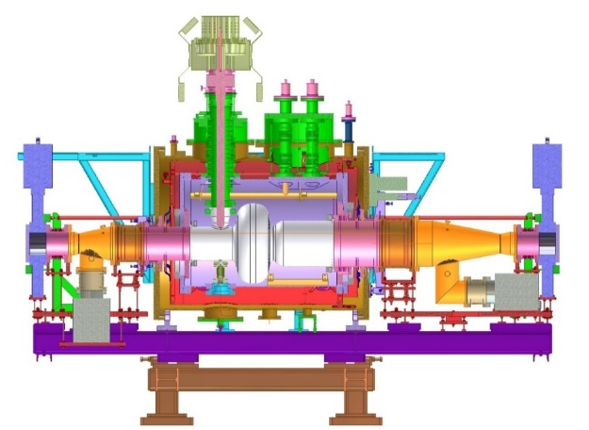
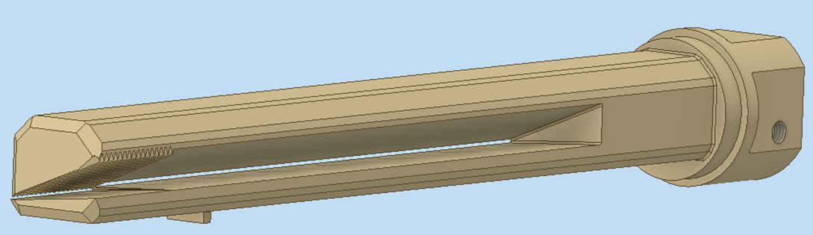
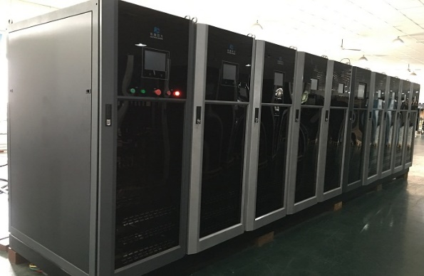
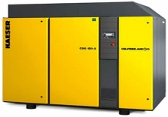
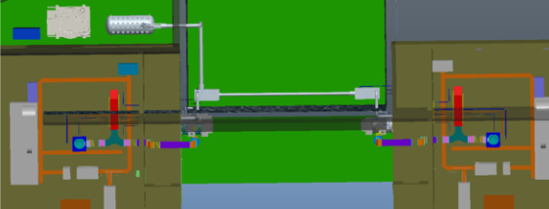
Hardware upgrade: RF
new cavity
BEPCII-U RF region
new cavity
1 existing + 1 new RF Cavity/ per ring
2 old cavities; 1 backup cavity; 1 new cavity
Survey will be kept exactly the same as BEPCII
Two sets of 500MHz, 200kW solid state power source are installed
Cryogenic system: upgraded with a new refrigerator
Photon absorber capacity upgraded from 110 kW to 250 kW

Slide 6
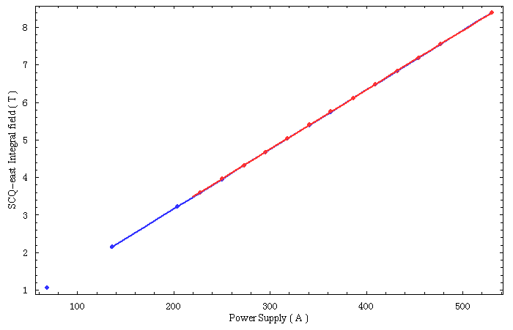
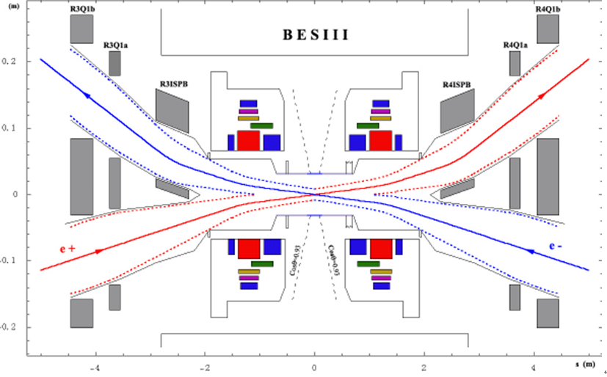
Hardware upgrade ----SCQ
530A
530A
The strength of SCQ(Superconducting Quadrupole) is critical for high luminosity at 2.8 GeV (current SCQs exceed quench current limit).
New SCQs replace existing ones for 2.8 GeV operation.

Slide 7
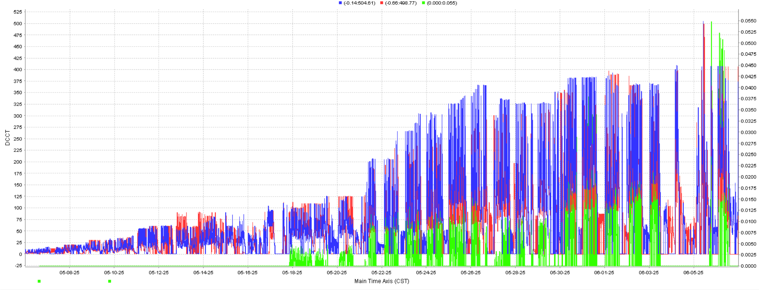
Schedule
2024 .7-12, Shut down for hardware dismantling and installation
2025-2028, Operation at 1.89~2.5GeV, and prepare for energy upgrade
Current status: Commissioning at 1.89 GeV
2028.6-9, Energy upgrade to 2.8GeV
2028.9~2030, Operation at 2.5~2.8GeV
e+, e-, Lum.

Slide 8
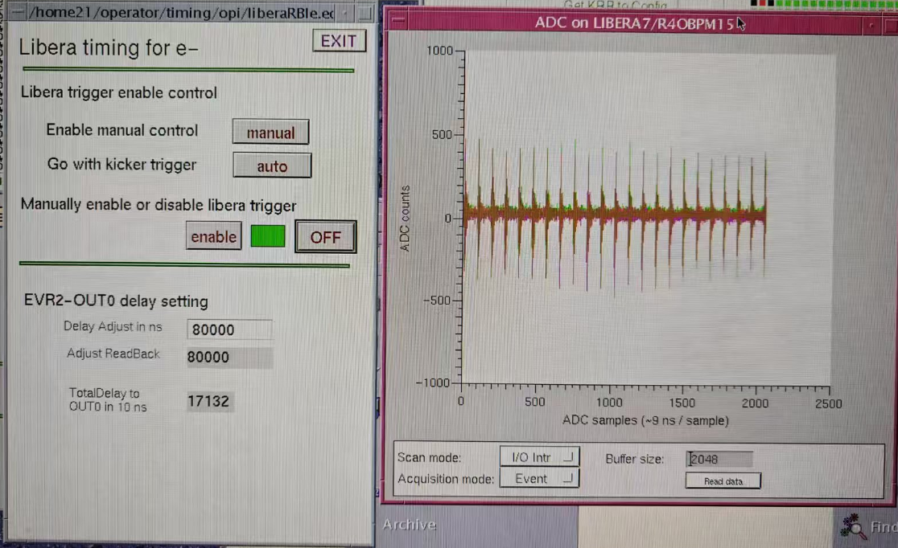
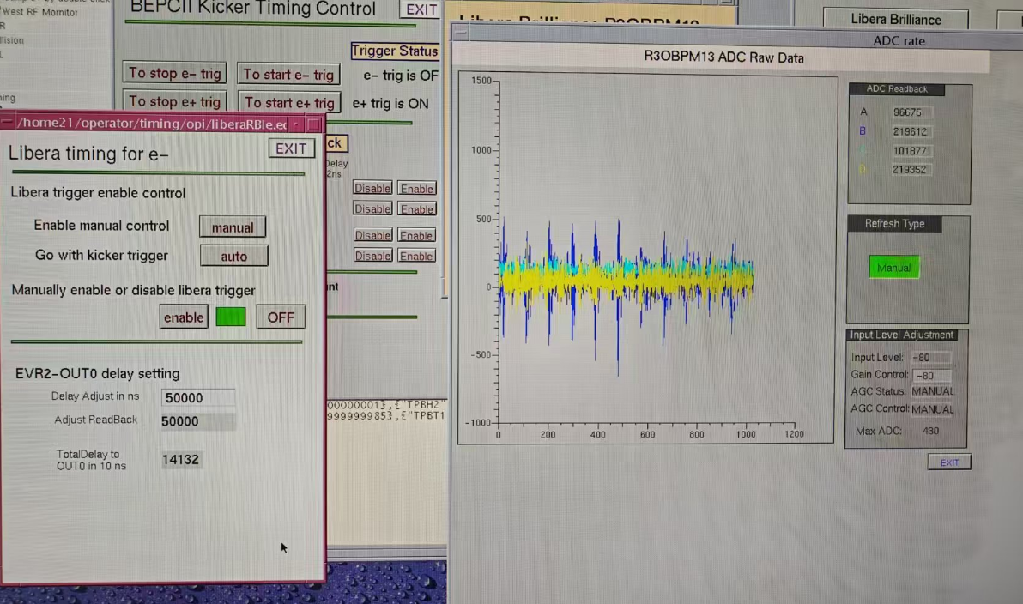
Beam commissioning w/o RF
The cryogenic system was ready at May 2nd.
In March and April, commissioning of injection beams at 1.89GeV was conducted without the RF system, with the BPR and BER obtaining beam signals of 80 turns and 100 turns respectively.
BER 120 turns
BPR 80 turns

Slide 9
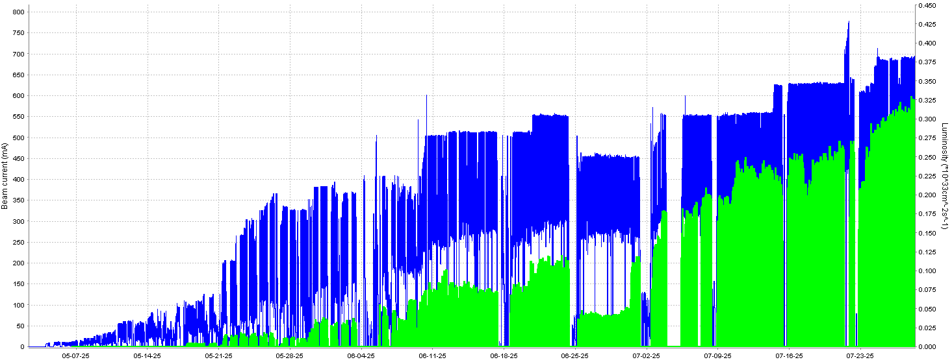
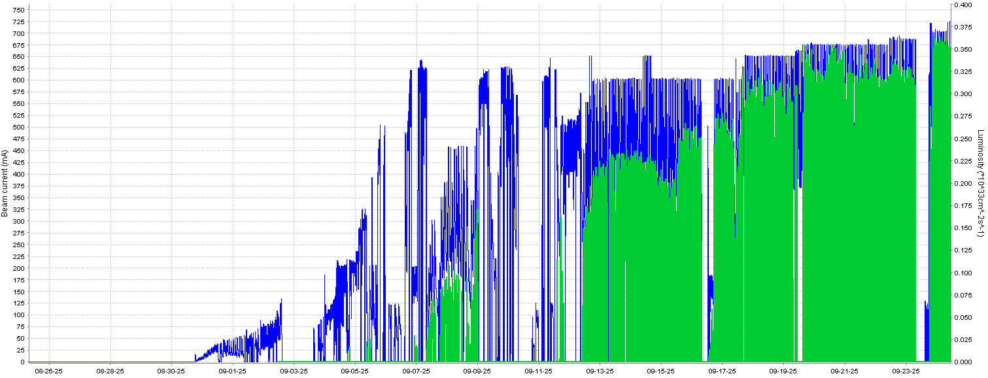
Status of BEPCII-U operation
May.2 – Sep.30
BEPCII upgrade operates stably & beam current and luminosity increasing steadily
◆ Beam current ◆ Luminosity
◆ Beam current ◆ Luminosity
May.2– July.29
Aug.25– Sep.30
Beam current 720mA/720mA & Peak luminosity 3.8×10³²cm⁻²s⁻¹
Data taking with 8 beam lines for BSRF parasitic experiments

Slide 10
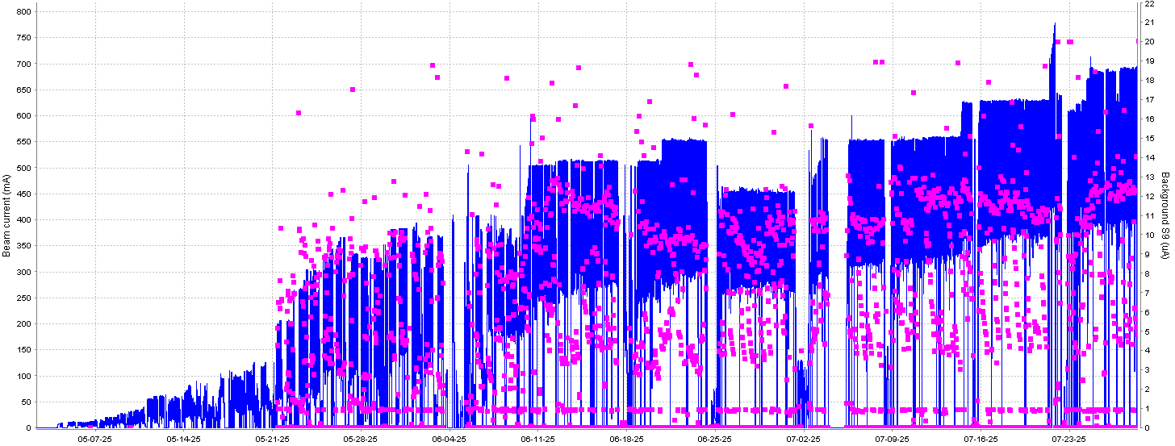
Status of BEPCII-U operation
◆ Beam current ◆ Dark current
Vacuum recovery of a new machine by monitoring the background limitation of BES (<12uA)
Current vacuum of BER(5×10⁻⁹ torr@720mA) is better than BPR(1×10⁻⁸ torr@720mA)

Slide 11
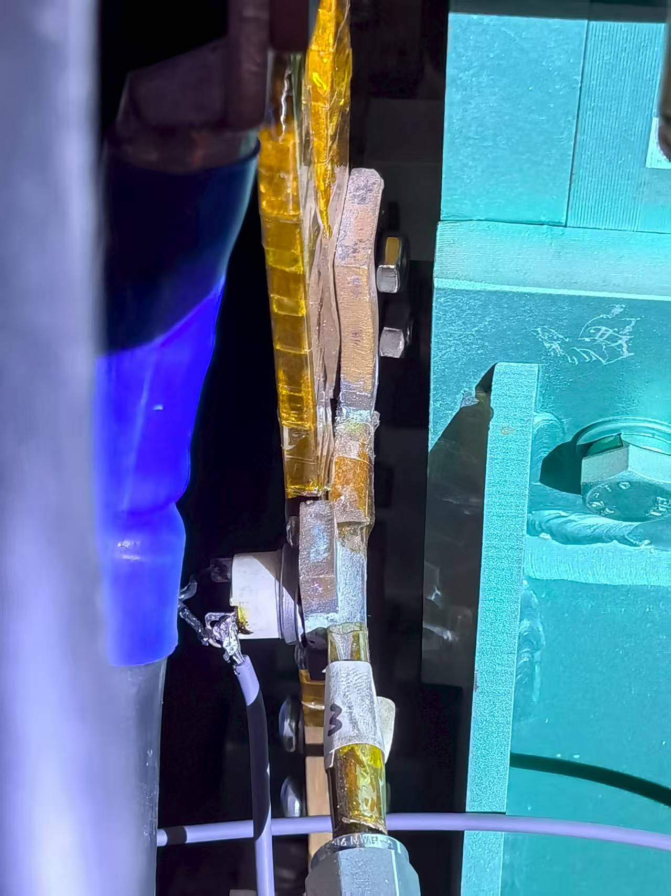
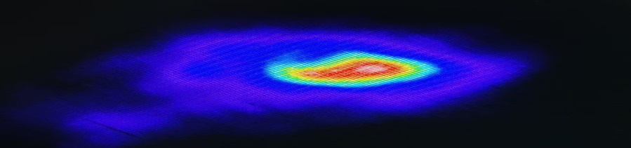
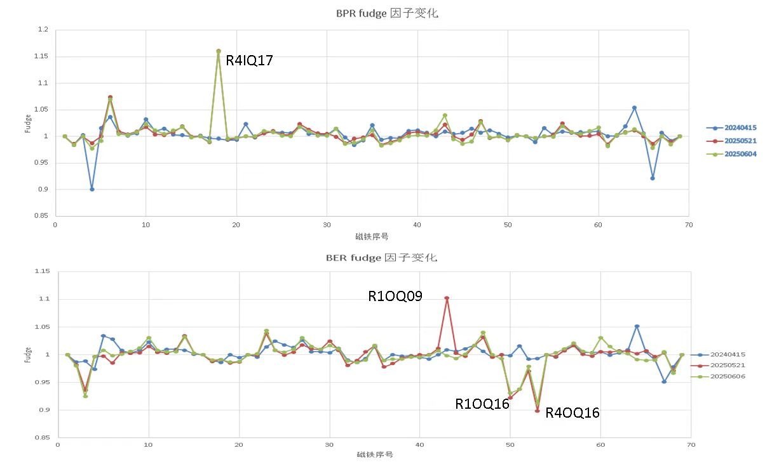
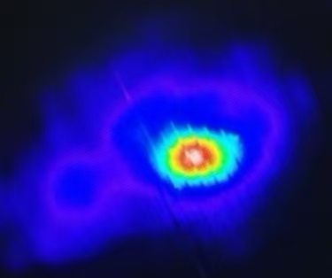
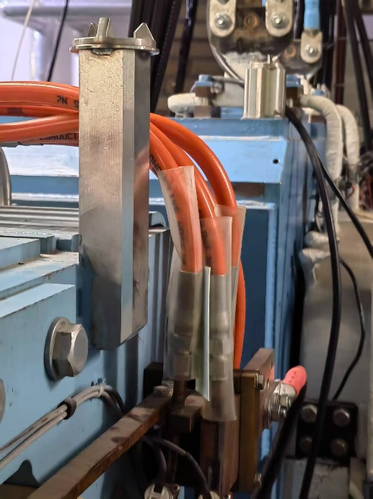
Status of BEPCII-U operation
Hardware issues identified during operation
Imperfect compensation between the solenoid and the anti-solenoid. Imperfect compensation for the vertical focusing effect of the solenoid.
Magnet short circut
Sextupole R3OS4, Jul.22
Magnet short circut
Quadrupole R4IQ17, Jun.17

Slide 12
Current status of BEPCII-U
As of September 30th, during the past 73 HEP operation days, the maximum beam current and peak luminosity reached 720mA and 3.8×10³²cm⁻²s⁻¹ respectively. The dark current is controlled under 12μA. The integral luminosity reached 420.4 pb⁻¹ and 183 user experiments were finished by BSRF 8 parasitic beam lines.
BEPCII is an operational facility with a scheduled BESIII data-taking task and urgent BSRF beam usage demands, resulting in a severe shortage of dedicated beam commissioning time for the accelerator after the upgrade project and its restart.

Slide 13
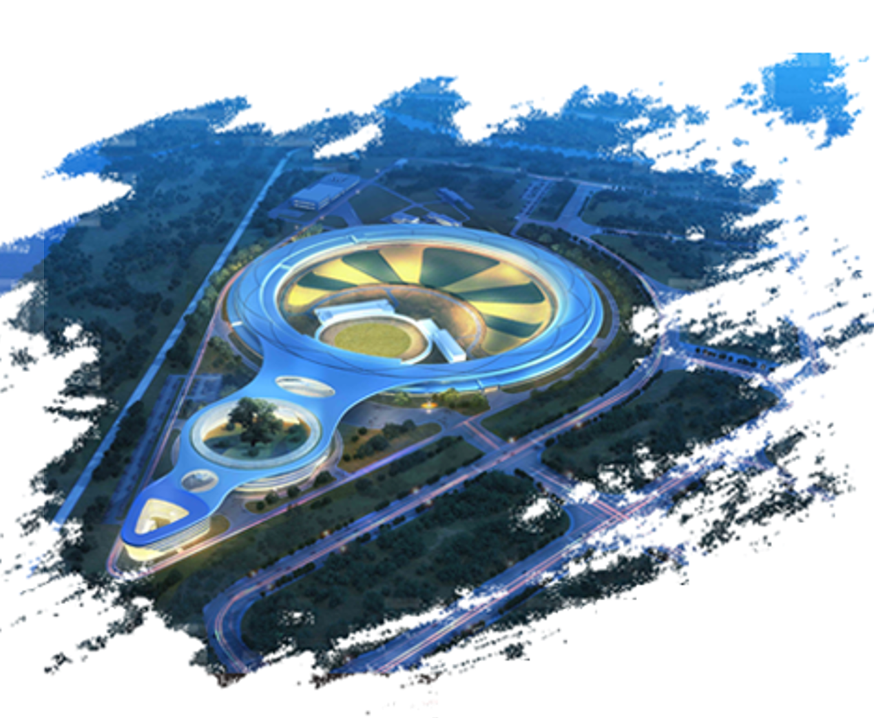
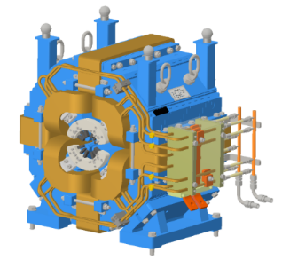
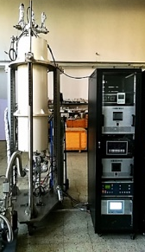
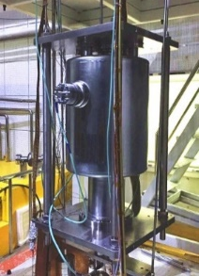
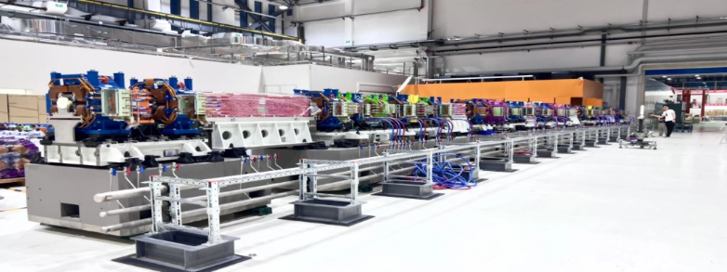
High Energy Photon Source
(HEPS)
4th-generation synchrotron radiation light source
Circumference | 1360.4 | m
Energy | 6 | GeV
Emittance | ≤0.06 | nm·rad
Brightness | >1×10²² | phs/s/mm²/mrad²/0.1%BW
Beam Line | ≥90 | Initially: 14
Photon Energy | 0.1-300 | keV

Slide 14
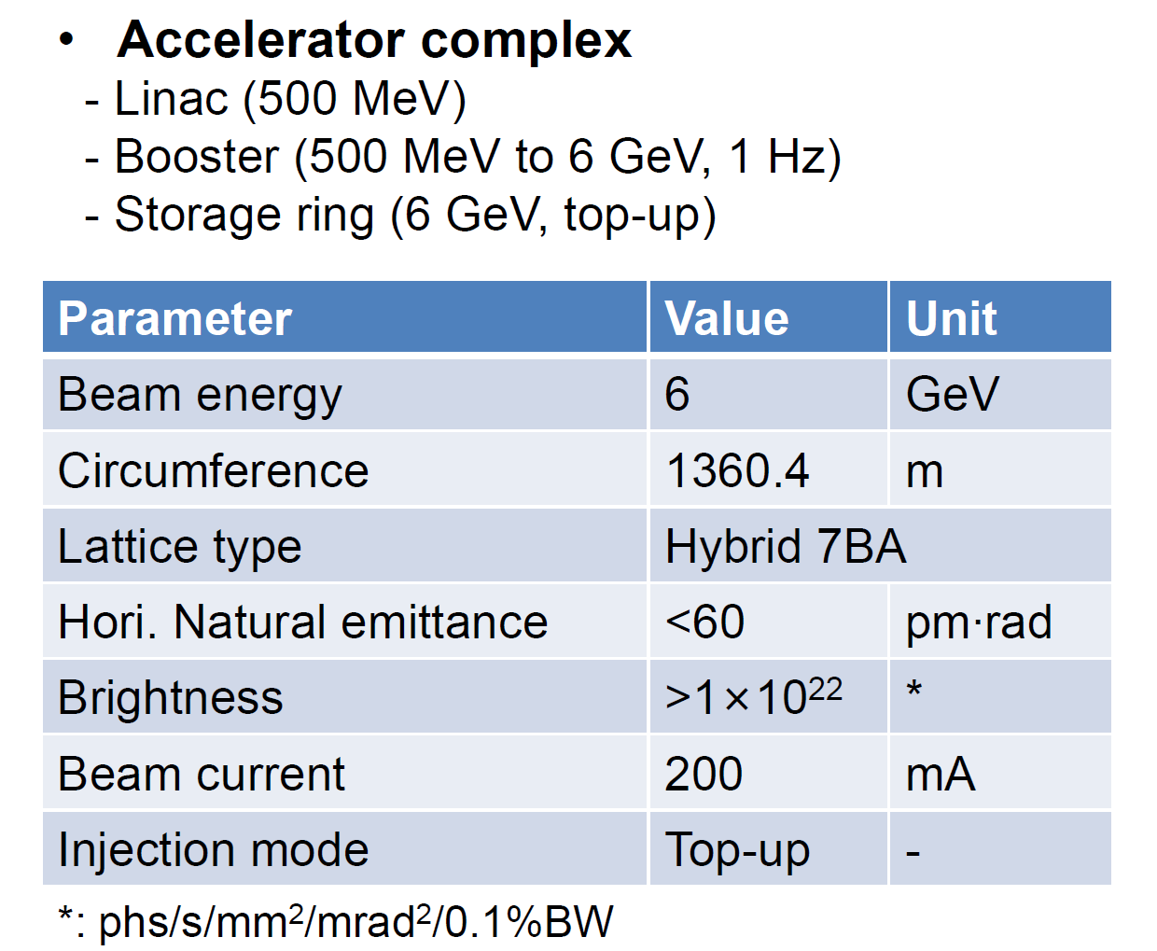
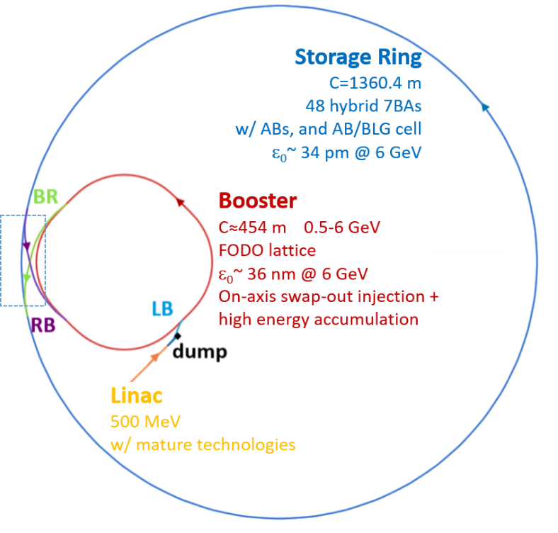
High Energy Photon Source (HEPS)
[1] Y. Jiao et al., J. Synchrotron Rad. 25, 1611–1618 (2018).
[2] Y. Jiao, RDTM 4, 399 (2020).
[3] H. Xu et al., RDTM 7, 279–287 (2023).

Slide 15
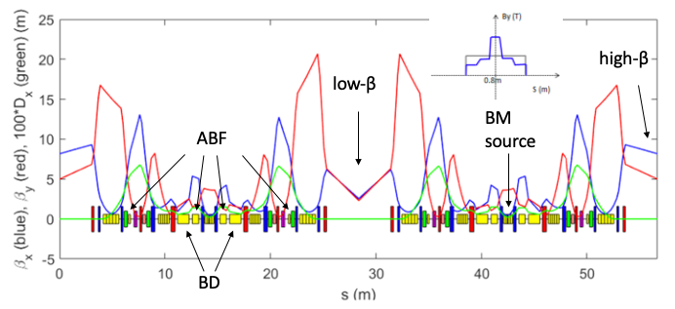
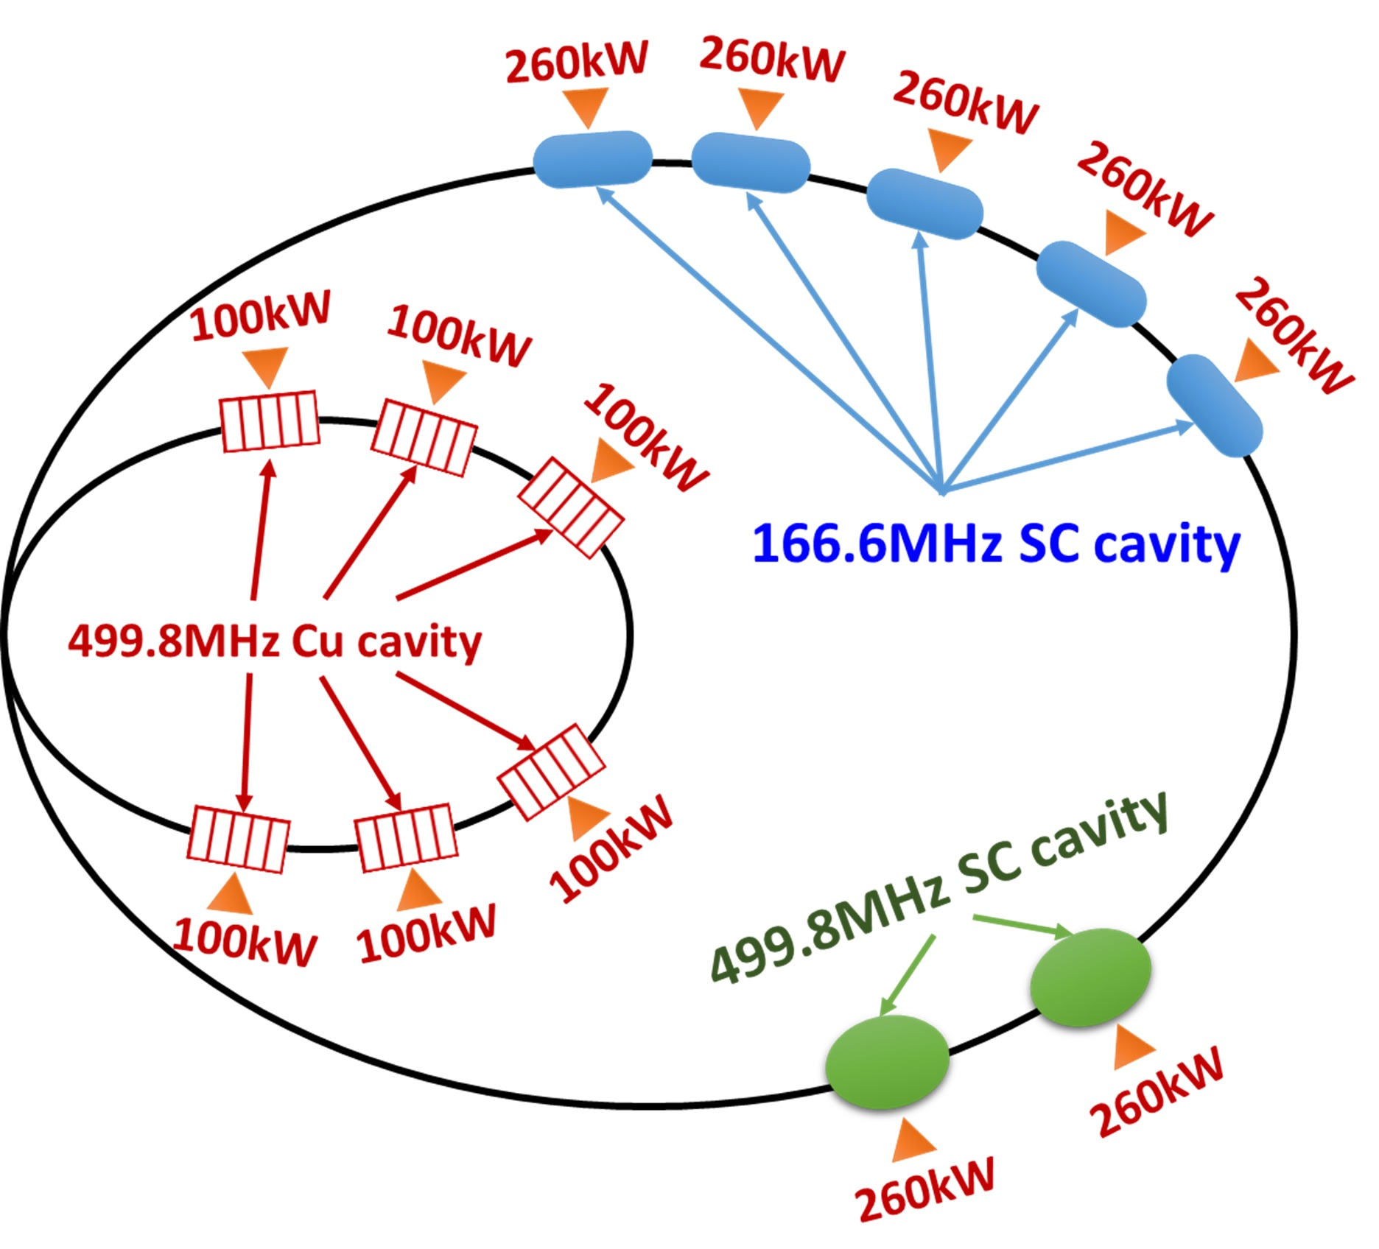
High Energy Photon Source (HEPS)
HEPS Storage Ring
1700⁺ Magnets
19 IDs
~1300 vacuum chambers
500⁺ BPMs
288 Girders
[1] Y. Jiao et al., J. Synchrotron Rad. 25, 1611–1618 (2018).
[2] Y. Jiao, RDTM 4, 399 (2020).
[3] H. Xu et al., RDTM 7, 279–287 (2023).
5 166MHz SRF
2 500MHz SRF

Slide 16
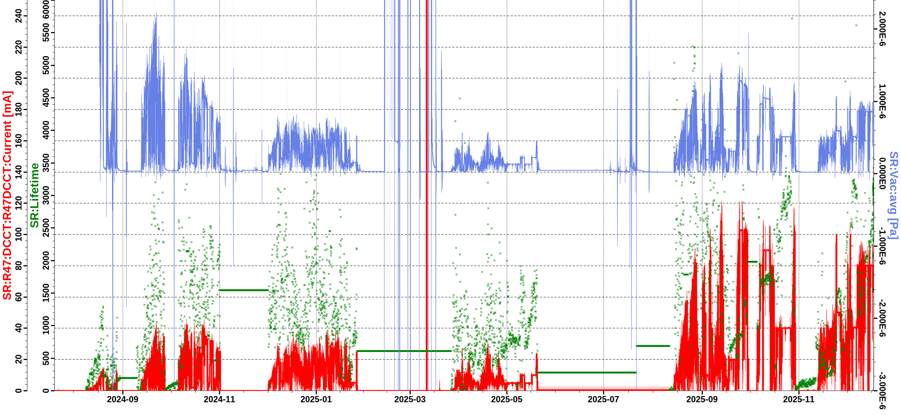
HEPS storage ring commissioning
Phase 1
Phase 3
Phase 5
Phase 7
Phase 2
Phase 4
Phase 6
Shut down#1
Shut down#2
Shut down#3
Shut down#4
Shut down#6
Shut down#5

Slide 17
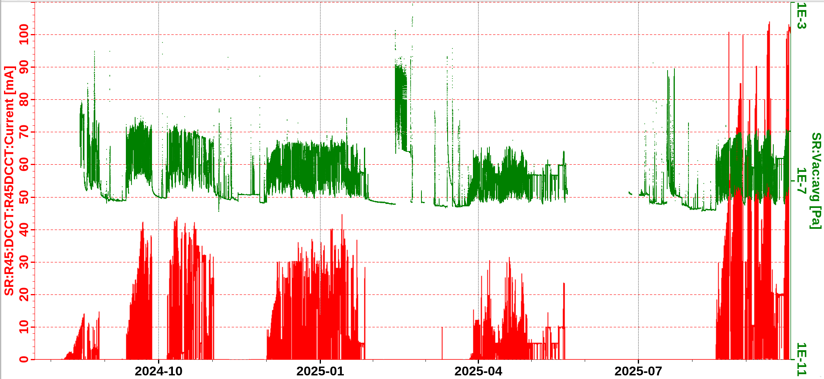
Not all hardware systems were ready at Day One
The commissioning was paused a few times mainly for installation
Staged commissioning
injection: slotted-pipe kicker -> stripline kicker
RF: 500MHz RF -> 166 MHz RF + 500 MHz (3rd harmonic)
ID: backup vacuum chamber -> In-air IDs -> In-vacuum IDs
SD#1:
1，replace injection kickers & pulsers
2，replace R20VC14 vacuum chamber
SD#2：
1，replace vacuum chambers of ID21/42/46；
SD#3：
1，install ID09；
2，replace vacuum chambers of ID08 & ID30；
3，install 3 collimators；
4，replace 500MHz SCC；
SD#4：
1，install most IDs；
2，fine global alignment；
3，install beam dump kicker；
SD#5：
1，install 166MHz & 500MHz SCCs；
2，install 4th collimator；
3，fine alignment of booster；
4，install remaining IDs
1st &2nd round
3rd round
4th round
5th round
6th round
SD#1
SD#2
SD#3
SD#4
SD#5

Slide 18
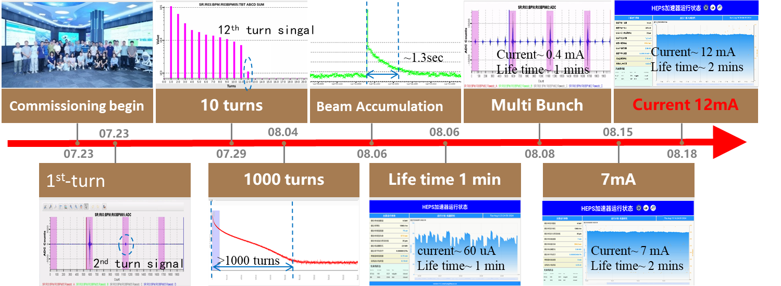
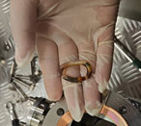
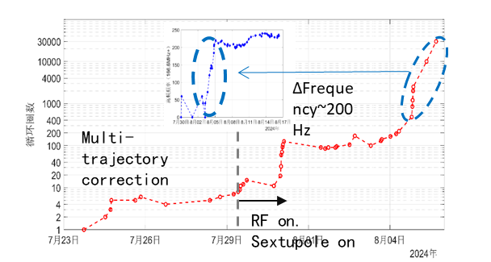
Phase 1: Achieved beam storage with current >10 mA.(7.23-8.27)
Shut down #1:
Replace injection kicker and power supply;
Replace R20VC14 vacuum chamber.

Slide 19
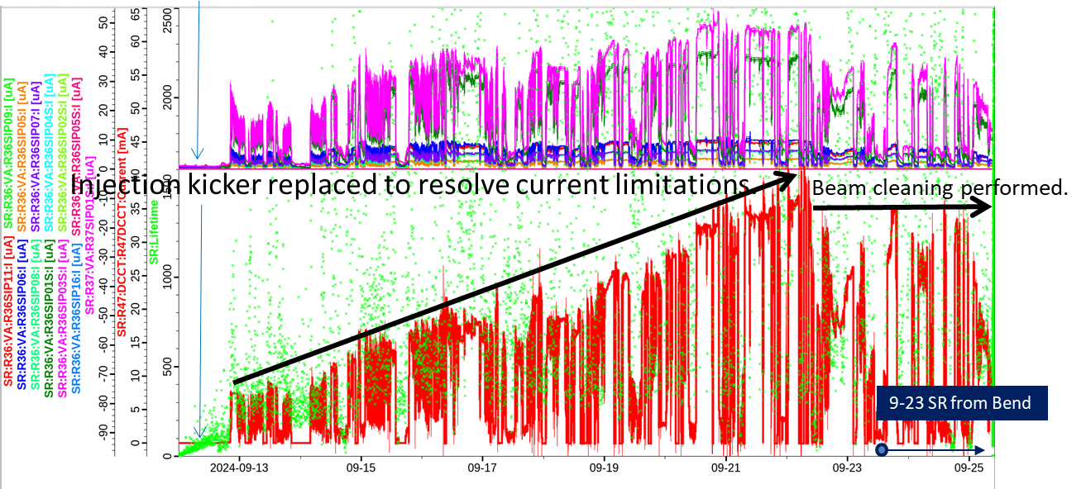
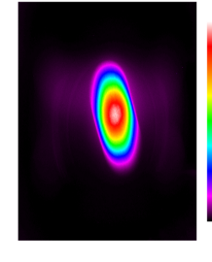
Phase 2: Current increased to ~40 mA.(9.12-9.26)
Shutdown #2: Replace ID21/42/46 vacuum chambers.

Slide 20
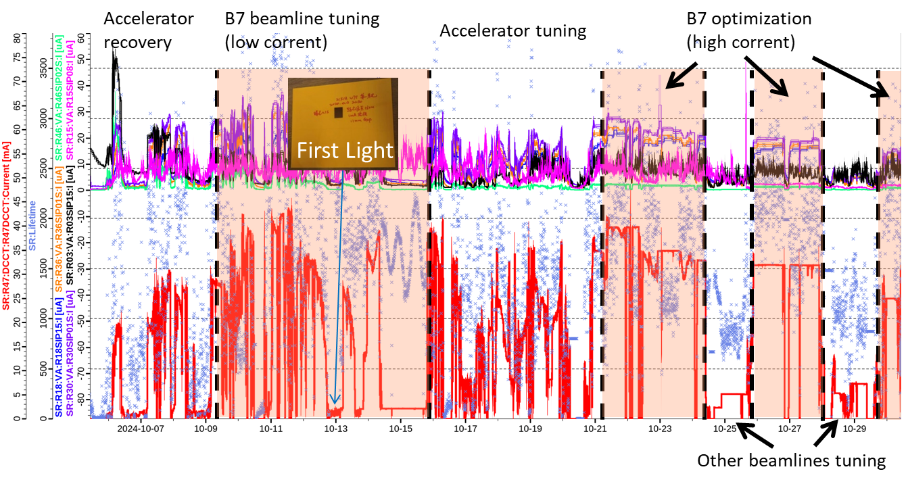
Phase 3: First light, beamline experiments. (10.5-11.1)
Shutdown #3:
Install ID09 ID;
Replace ID08 and ID30 vacuum chambers;
Install three collimators;
Replace superconducting cavity.

Slide 21
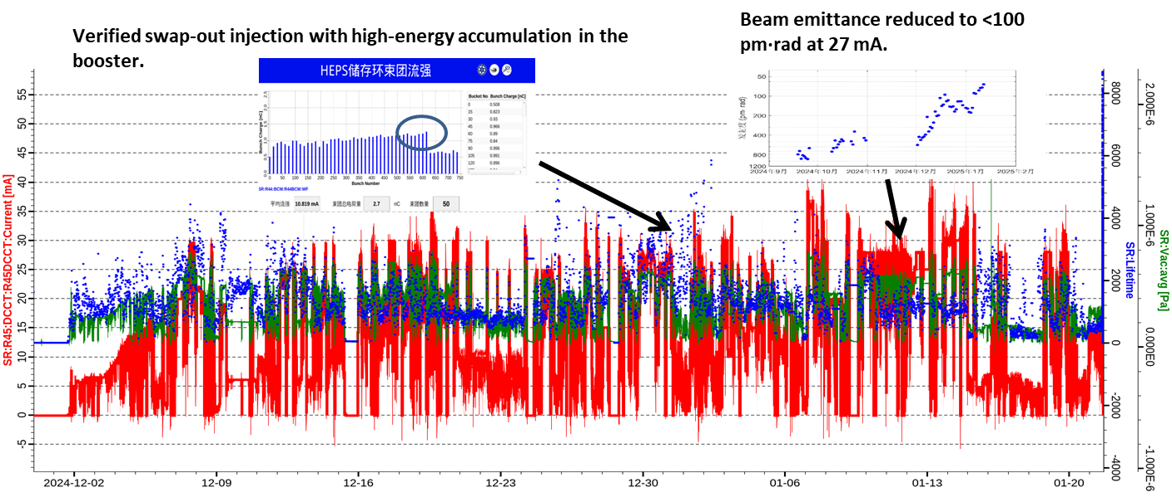
Phase 4: Preliminary beam dynamics optimization completed.(11.30-1.26)
Shutdown #4:
Install most ID;
Perform full-ring precise alignment;
Install pre-kicker.
COD(rms): ~100/100 um.
Beta beating (rms): ~3%/3%.
Dispersion deviation (std): ~4/3 mm.

Slide 22
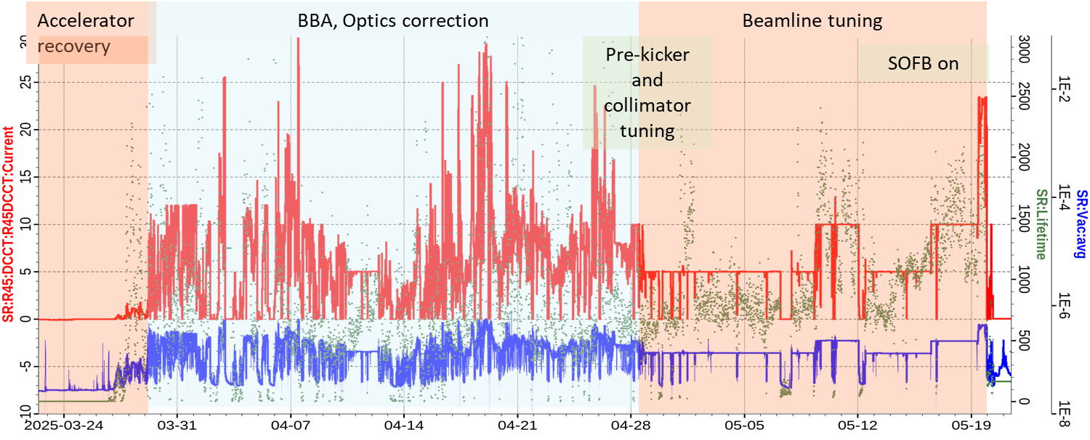
Phase 5:Optimization of storage ring current, lifetime, and vacuum. (3.23-5.20)
Shutdown #5 (5.20-8.10):
Install all 166 MHz cavity;
Replace collimator.

Slide 23
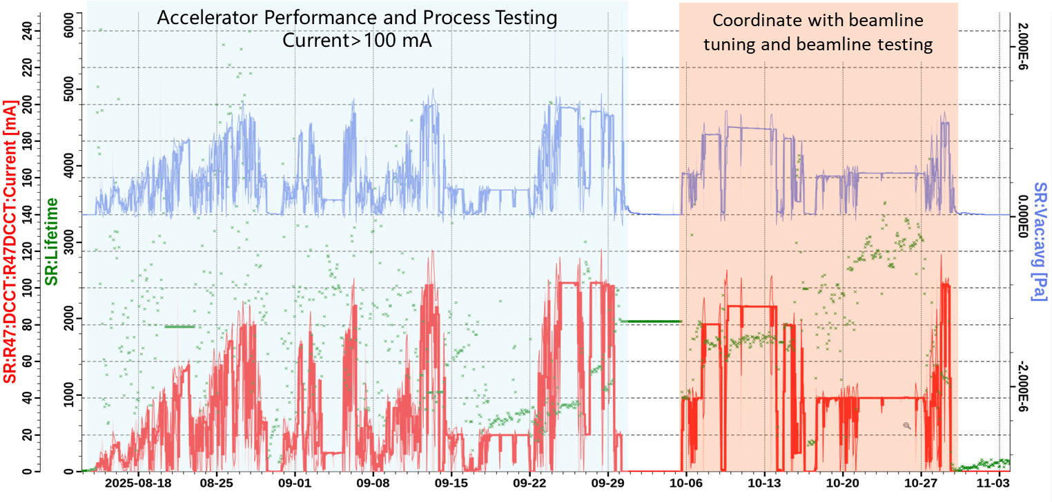
Phase 6: Complete performance process test and process acceptance (8.12 – 10.29)
Emittance is reduced to 56 pm.rad.

Slide 24
HEPS Storage Ring Commissioning
Phase 1
Phase 3
Phase 5
Phase 7
Phase 2
Phase 4
Phase 6
Shut down#1
Shut down#2
Shut down#3
Shut down#4
Shut down#6
Shut down#5

Slide 25
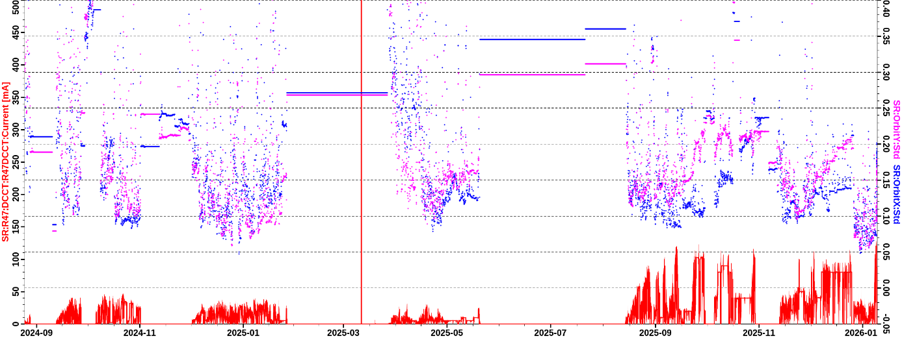


Orbit, optics, dispersion optimization
COD(rms): ~60/60 um.
Beta beating (rms): ~2%/2%.
Dispersion deviation (std): ~1.5 mm.
Coupling<10%
Optics corrected by sextupole mover

Slide 26


Top-up injection based on high-energy accumulation in the booster (2025.01)
2025.01.02, achieved the world’s first successful commissioning and was officially put into operation.
2025.09.12, the single-bunch charge of the storage ring exceeded 5nC, meeting the requirements for relevant beamline testing and acceptance.

Slide 27


The beam emittance self-test passed the review (2025.03)
The expert panel confirmed that the HEPS storage ring achieved a beam emittance of less than 100 pm·rad at 27 mA and 6 GeV.

Slide 28

The beam orbit stability of the storage ring improved
A series of hardware and software optimizations were implemented to improve the beam orbit stability.
2025.09: Achieved at 100 mA
Horizontal orbit stability of less than 10% of the bunch size
Vertical orbit stability of less than 20% of the bunch size

Slide 29


FOFB Commissioning and Operation

Slide 30

The vacuum cleaning has exceeded 100 A∙h
Normalized total beam lifetime Iτ(mA*h)

Slide 31

Commissioning of the third harmonic cavity for beam length stretching
08.18, Approximately 3.4-fold beam length stretching was achieved

Slide 32
Next Beam Tuning – Target: Design Specifications
Continue optimizing BBA and optics correction;
Optimize harmonic cavity settings and control strategies to enhance longitudinal stability;
Increase beam current;
Improve orbit stability (e.g., SOFB and FOFB operation);
Perform vacuum cleaning.

Slide 33
Thanks to BEPCII-U & HEPS Commissioning Team
Thank you !

