Slide 1





On Electron Cloud Effects and Possible Mitigation Strategies
Luca Sabato¹, Lotta Mether², Tatiana Pieloni¹, Adam Furman^{1,2},
Cantún Karla³, Maury Humberto⁴, Yaman Fatih⁵
¹ ² ³ ⁴ ⁵
Acknowledgments: Oide Katsunobu, Zimmermann Frank, Zobov Mikhail , Iadarola Giovanni
This work was performed under the auspices of, and with support from, the Swiss Accelerator Research and Technology (CHART) program (www.chart.ch).
IAS Program 12-15th January 2026, HONG KONG

Slide 2
Outline
Introduction
Multipacting and Stability
Photoelectrons
Mitigation Techniques
Conclusions and Outlooks

Slide 3
Outline
Introduction
Multipacting and Stability
Photoelectrons
Mitigation Techniques
Conclusions and Outlooks

Slide 4
Motivation
Electron cloud (e-cloud) effects have been observed in several accelerators all over the world (LHC, KEKB, DAɸNE, …)
more commonly in those operated with positively charged particles
Presently among the major performance limitations for high energy collider
transverse beam instabilities
incoherent beam effects
vacuum degradation
heat load
E-cloud effects have to be studied for FCC-ee
to give input to chamber design and material properties to avoid e-cloud formation
define beam parameters and identify performance limitations

Slide 5
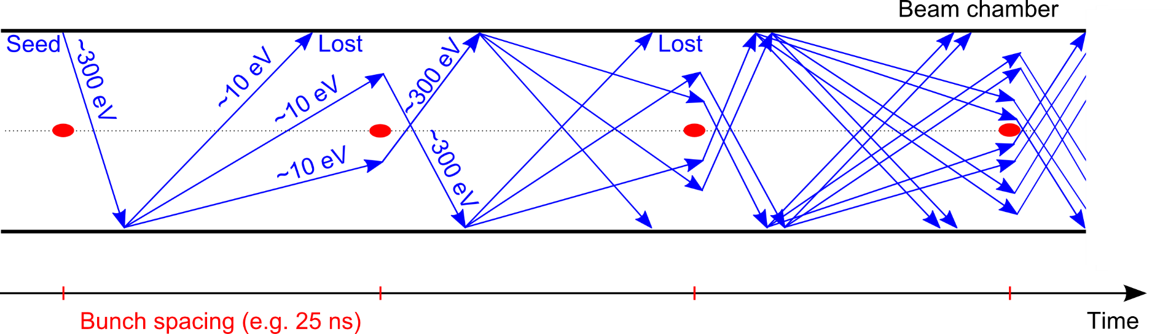
E-Cloud Formation
e⁻ is emitted
electron cloud
A circulating beam can produce primary electrons (seed)
ionisation of the residual gas in the beam chamber
photoemission from the chamber’s wall due to the synchrotron radiation emitted by the beam
Bunch passage
Secondary Electron Emission
Courtesy of
G. Iadarola
With the particle bunch passage
primary electrons can be accelerated to energies up to hundreds of eV
after impacting the wall, secondary electrons can be emitted
Secondary electrons have energies of tens of eV
after impacting the wall, they can be either absorbed or elastically reflected
if they survive until the passage of the following bunch, they can be accelerated, projected onto the wall and produce secondaries
Secondary electron emission can drive an avalanche multiplication effect

Slide 6
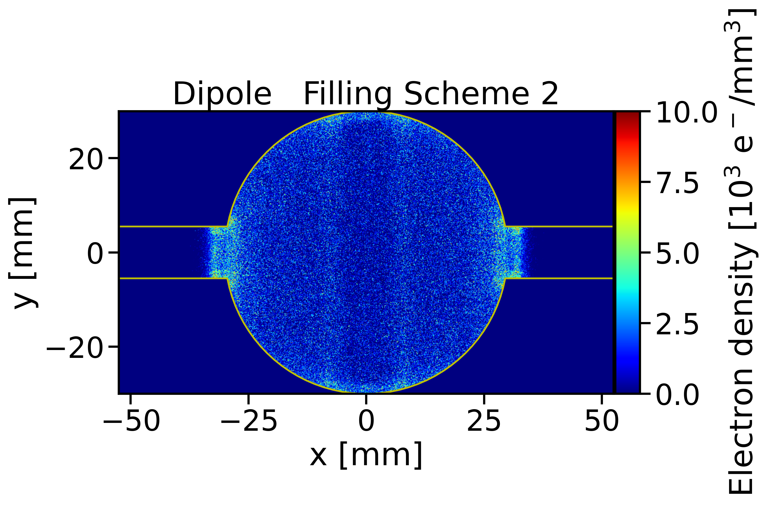
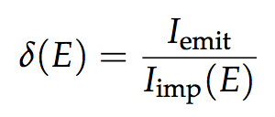
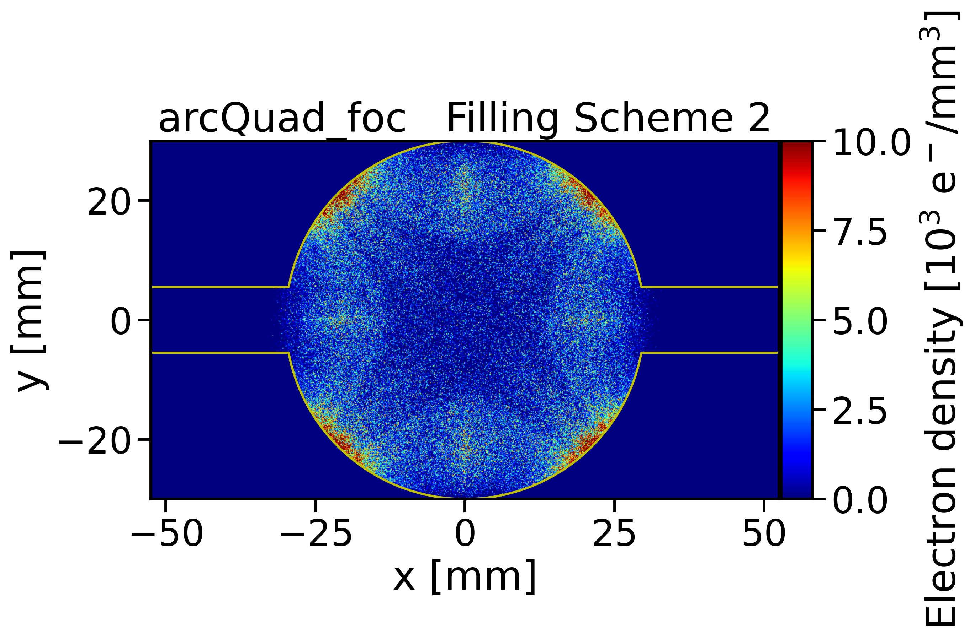
E-Cloud Parameters
Chamber geometry influences e⁻ acceleration and time of flight
Surface properties have a primary role in the e⁻ multiplication process
The main quantity involved is the Secondary Electron Yield (SEY):
depends on
surface chemical properties
history of the surface, in particular on accumulated electron dose
Bunch spacing → It determines how many electrons survive between consecutive bunch passages and has direct impact on multipacting threshold
For FCC-ee: the strongest e-cloud effects are foreseen for the Z running mode due to the largest number of bunches (smallest bunch spacing)
Bunch intensity and bunch length → affect the acceleration received by the electrons
Magnetic fields → Electron trajectories are strongly influenced
Dipole
Quadrupole
Electron density 10³ e⁻/mm³

Slide 7
Outline
Introduction
Multipacting and Stability
Photoelectrons
Mitigation Techniques
Conclusions and Outlooks

Slide 8
E-Cloud Build-up Studies for FCC-ee baseline
From Feasible Study Report
Studies done for GHC Lattice by Ohmi-san
Main collider
Effects visible for positrons- electron beam effect negligible
Bunch Intensity [x10¹¹ ppb] | Bunch Spacing [ns] | Number bunches / Train | Number Trains | Gap Length [ns] (gap/bunch spacing)
2.15 | 25 | 280 | 40 | 575 (23)
Extensive simulation campaign scanning all relevant parameters using Zimmerman-Rumolo model (PyEcloud)
Simulations have been benchmarked versus Furman-Pivi model → F. Yaman, “Electron cloud simulations using the Furman-Pivi model”, FCC-ee electron cloud meeting 18/03/2025
Important to understand the impact of lower bunch intensity (we will need to fill the ring and then top-up), chamber radius, magnetic fields of different elements
“Electron cloud studies”, FCC week 2023
“Electron Cloud Studies”, FCC week 2025
“Update on the Electron Cloud Studies for FCC-ee”, FCC e-cloud meeting 12/09/2023

Slide 9
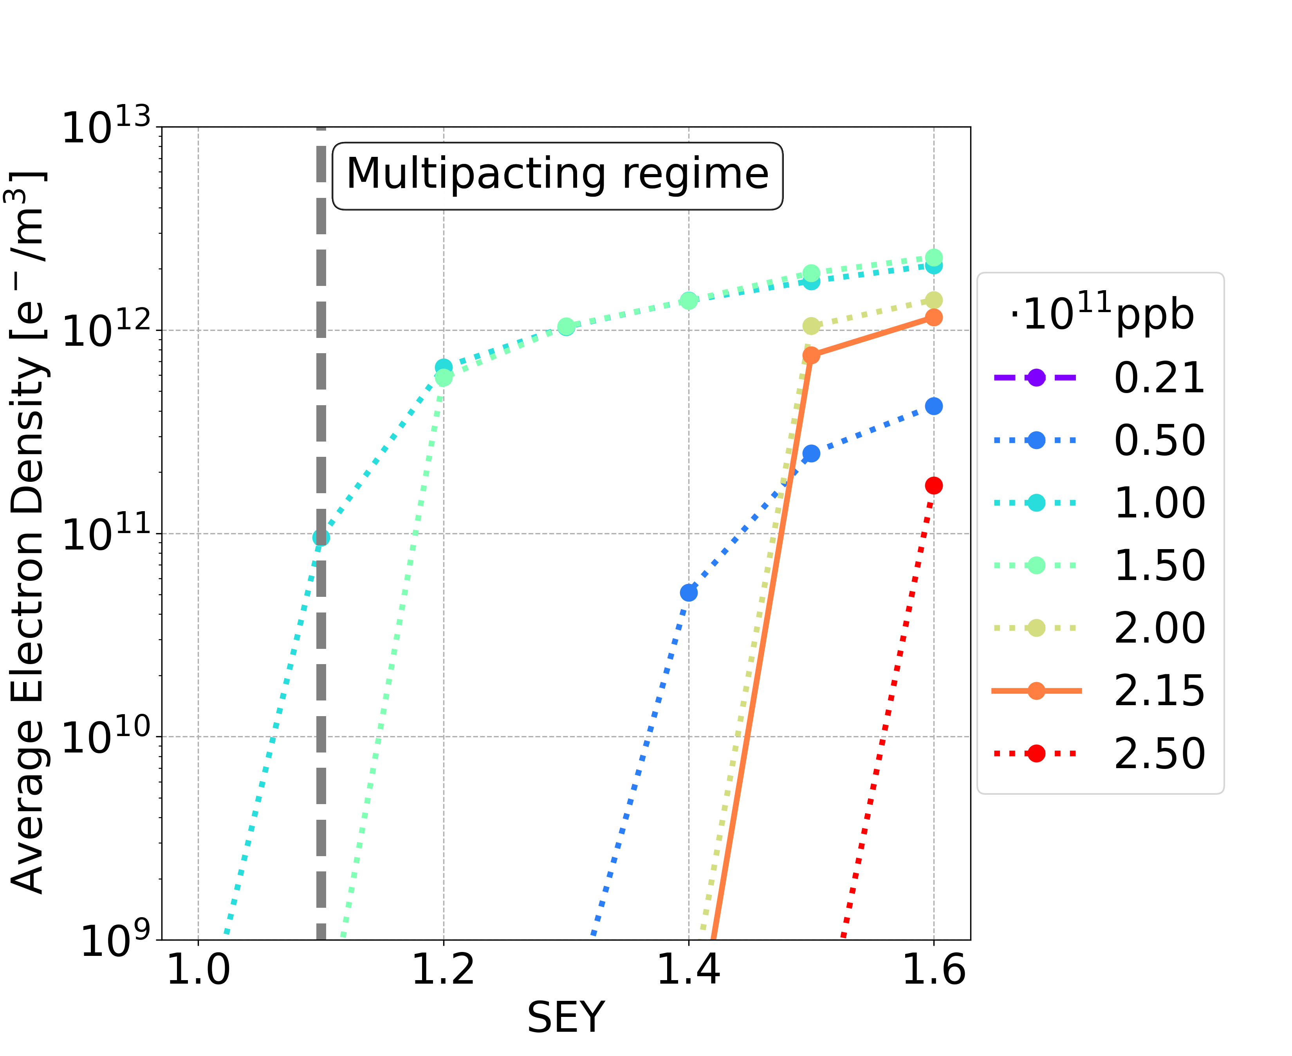
E-Cloud Build-Up Studies: multipacting
Dipole case
Secondary Emission Yield (SEY)
Lower bunch intensity:
charge accumulation phase
Bunch population | SEY multipacting thresholds
nominal | 1.4
below nominal | 1.0
Nominal bunch intensity
Starting from an initial random seed of uniformly distributed electrons of 10⁷ e/m
Avoid Multipacting:
→ Compute the Average electron density for different SEY values and different magnetic elements (drift, dipole, quads, sextupoles)
→ Repeat for intensities in the range from 0.2-2.5 10¹¹ ppb to establish the intensity dependency and identify worse case during the accumulation phase

Slide 10
E-Cloud Build-Up Studies Baseline
Element | Field | Bunch population | Thresholds
Drift Space | - | nominal | 1.4
 |  | below nominal | 1.2
Dipole | 15.2 mT | nominal | 1.4
 |  | below nominal | 1.0
Quadrupole | 1.45 T/m | nominal | 1.1
 |  | below nominal | 1.0
Sextupole | 72.5 T/m² | nominal | 1.1
 |  | below nominal | 1.0
Non monotonic behaviour versus intensity of the cloud formation (intensities [1.0-1.5] ∙ 10¹¹ ppb most critical)→ problematic during top-up and accumulation!
The SEY multipacting thresholds are extremely tight for baseline parameters
difficult to satisfy using the baseline copper chamber with thin NEG coating (SEY 1.0-1.2)→ might require more complex surface treatments
Dipole, Quadrupoles and sextupoles have the lowest SEY multipacting thresholds

Slide 11
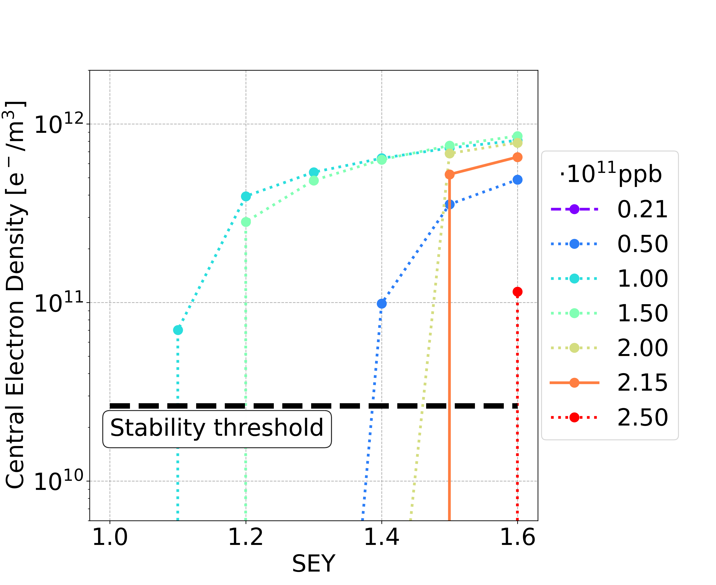



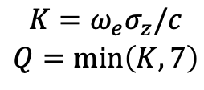
E-Cloud Stability Threshold
E-cloud could trigger instabilities, because the beams pass through the e-clouds and they receive transverse kicks
Is the central density above the stability threshold? Which is the e-cloud density stability threshold?
Theoretical equation:
Simulations by means of PyECLOUD-PyHEADTAIL in order to track the beams through the e-clouds and observe instability rise and parameter evaluations (emittances)
From K. Ohmi et al., “Study of Electron Cloud Instabilities in FCC-hh”, Proc. of IPAC2015
$$ρ_{e,th}=\frac{2γν_{s}ω_{e}σ_{z}/c}{\sqrt{3}KQr_{e}β_{y}L}$$
$$ω_{e}=\sqrt{\frac{λ_{p}r_{e}c^{2}}{σ_{y}\left(σ_{x}+σ_{y}\right)}}$$
$$\begin{matrix}K=ω_{e}σ_{z}/c \\ Q=min⁡\left(K,7\right)\end{matrix}$$
$$λ_{p}=\frac{i_{b}}{{\sqrt{2π}σ}_{z}}$$
Theoretical and numerical e-cloud density stability threshold have the same order of magnitude with strong vertical instability observed and with relevant emittance blow-up

Slide 12
E-Cloud Stability: Summary
Dipoles and Quadrupoles
Above the SEY multipacting threshold, the central e-cloud density before the bunch passage is larger than the e-cloud stability threshold → leads to beam instabilities
Sextupoles
The central e-cloud density before the bunch passage is smaller than the e-cloud stability threshold (element length dependence)
Above the SEY multipacting threshold, the e-cloud leads to beam instabilities, because the central density is above the stability threshold

Slide 13
Outline
Introduction
Multipacting and Stability
Photoelectrons
Mitigation Techniques
Conclusions and Outlooks

Slide 14
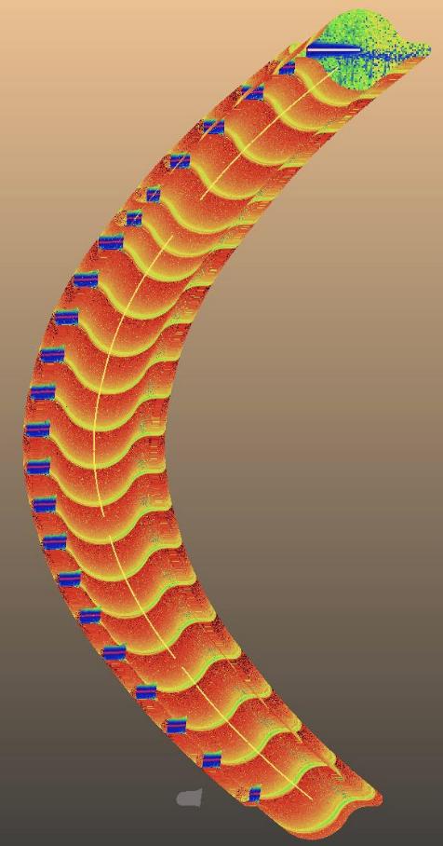
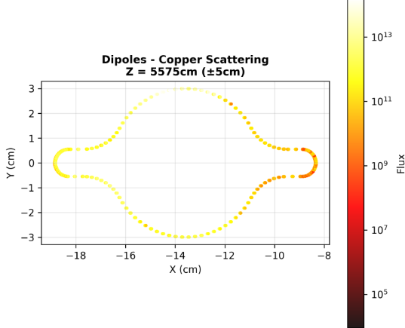
Photoelectron Emission
Photon Flux
The circulating beam particles can produce primary electrons via photoemission from the chamber’s wall due to the synchrotron radiation emitted by the beam
The results presented in the previous slides do not take into account the photoemission
What is the impact of the photoelectrons on the e-cloud formation process?
Material properties determine the conversion from radiation to electrons Absorber structures control where most of the radiation impacts the walls
The number of photoelectrons is determined by:
the amount of photons scattered into the main beam chamber
the Photoelectron Yield (PY)
property of the beam chamber
defined as the ratio between the emitted photoelectrons and the number of impinging photons
Simulations of photon flux with Synrad curtesy Marton Ady, Gabriel Saretti

Slide 15
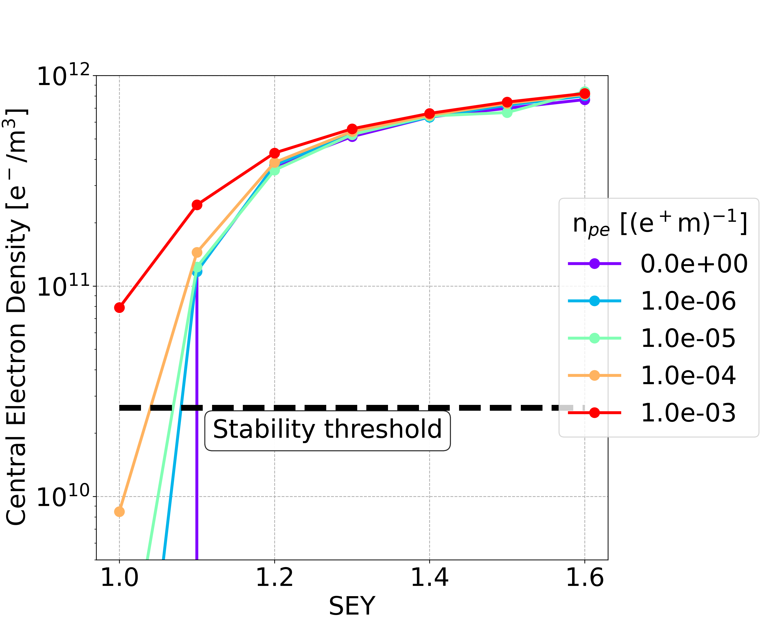
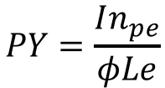
Photoelectron Yield Limit
Dipole
Number of photoelectrons generated per positron and per unit length
The central density could be larger than the stability threshold even below the SEY multipacting threshold
High values of n_{pe} should be avoided ( < 1.0 ∙ 10⁻⁴ (e⁺ m)⁻¹ )
The PY and the number of photoelectrons are related through the following equation
$$PY=\frac{In_{pe}}{φLe}$$
I: beam current (1.27 A)
L: chamber's perimeter (278 mm)
e: elementary charge
φ: realistic photon flux -> from ray tracing codes (e.g., SYNRAD+ Marton-Saretti) in the order of 10¹³ - 10¹⁴ photons/cm² s (not in the absorber areas)
The constraint on the material is very tight with PY~ 2x10⁻³ → incompatible with the expected PY of the foreseen chamber surface (0.1-0.25 for NEG coated!) (in the absorber areas the photon flux is expected to be even higher!)
A new design of the photon absorbers is under development and will reduce the photon flux inside the main beam chamber by a factor 100 !
A detailed photoelectron emission model based on synchrotron radiation simulations will be developed and studies extended to understand the impact of photoelectrons in realistic configurations → new PhD student Adam Furman

Slide 16
Outline
Introduction
Multipacting and Stability
Photoelectron Impacts
Mitigation Techniques
Conclusions and Outlooks

Slide 17
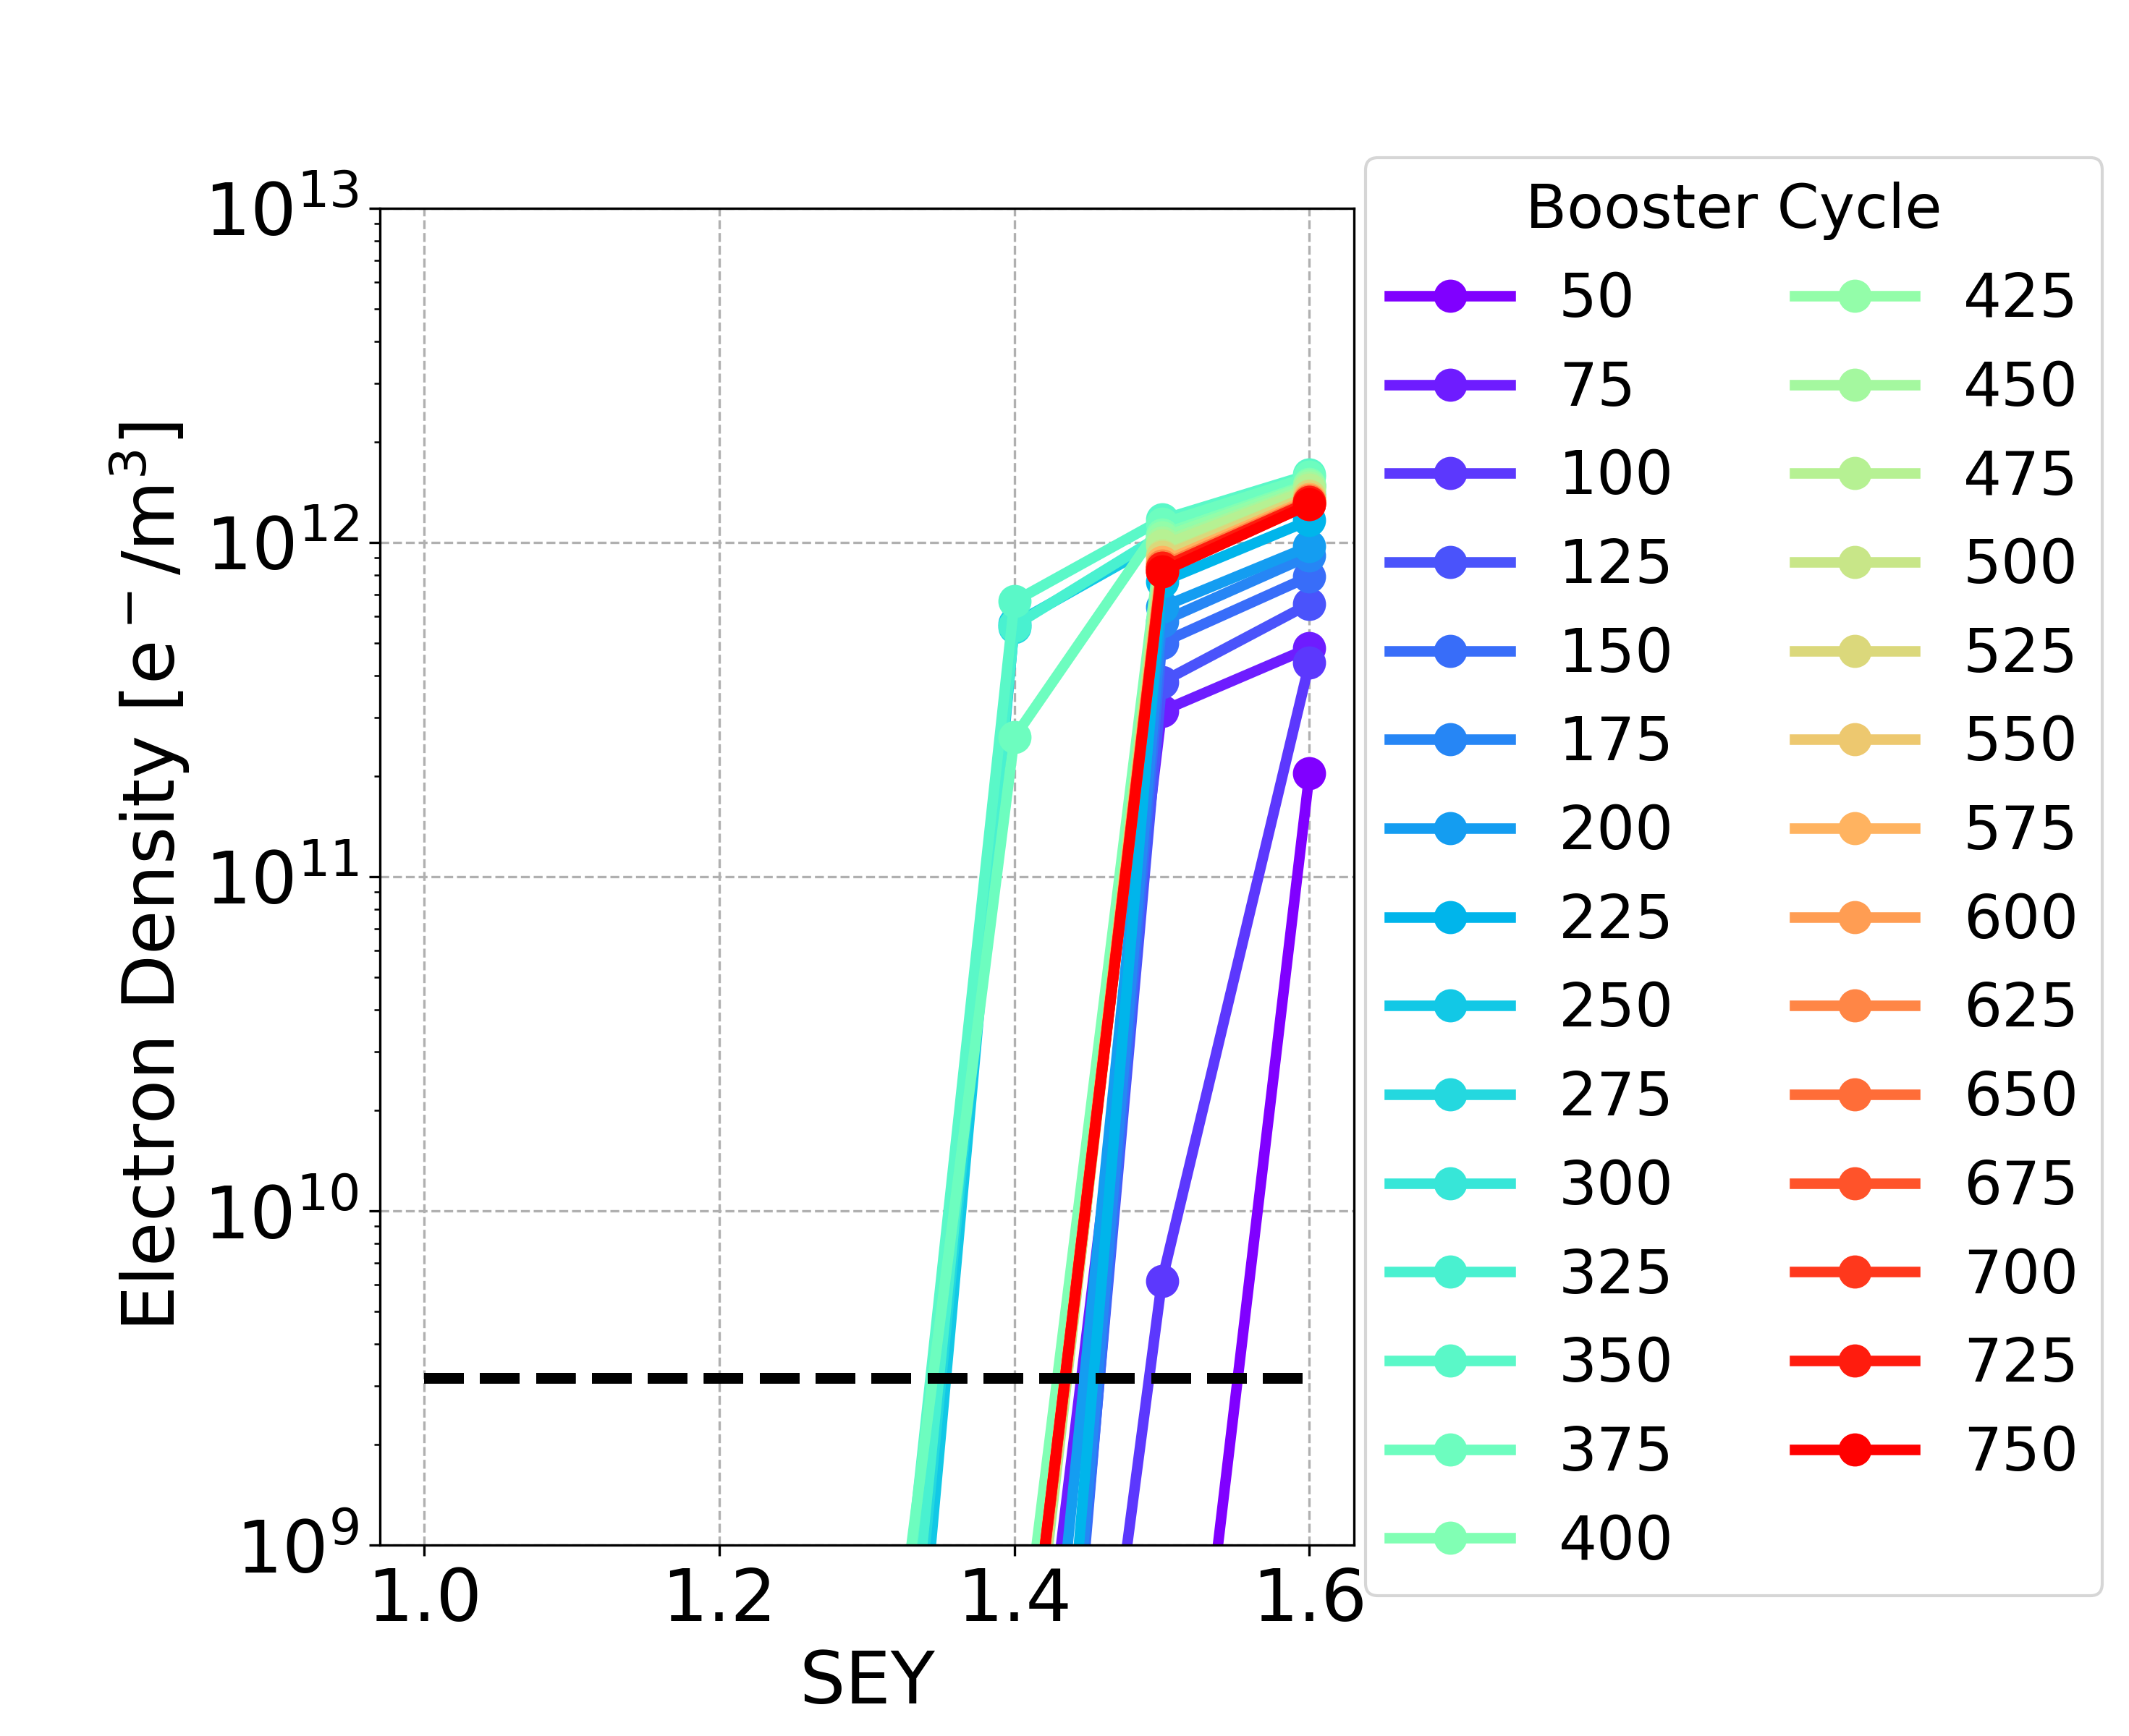
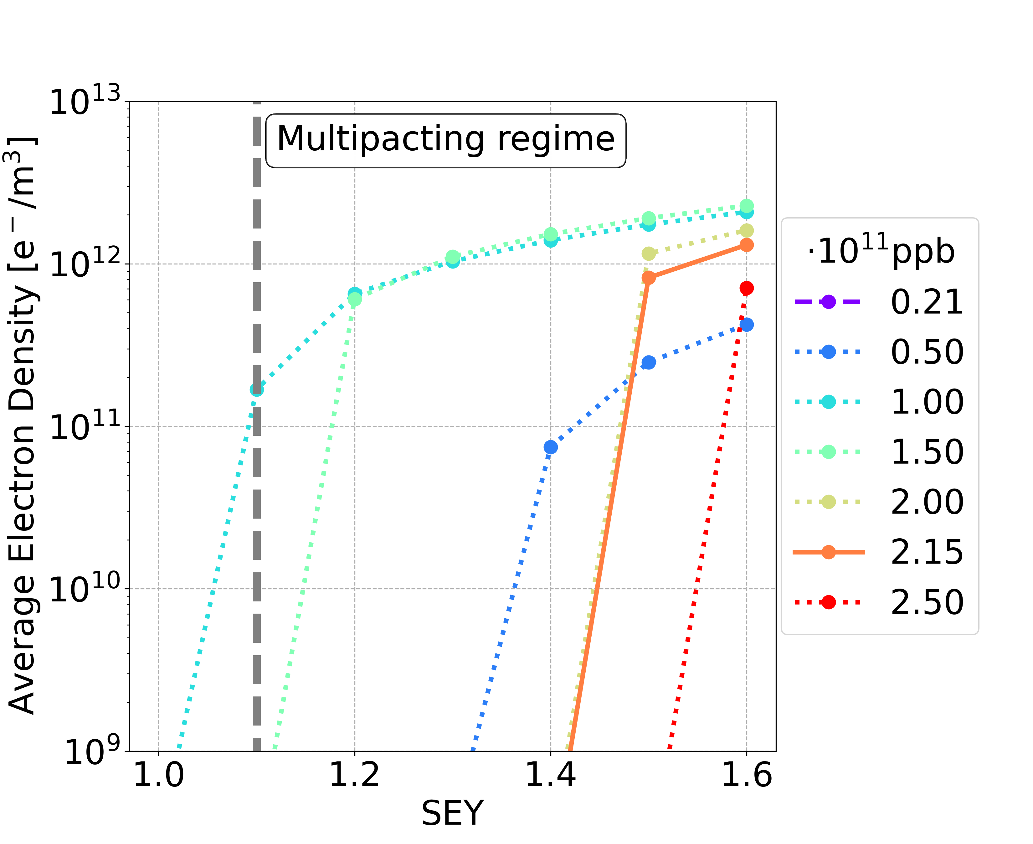
Mitigation I: Non-Uniform Bootstrap Injection
Hannes Bartosik, FCC week 2024
During the charge accumulation phase: do not fill the bunches of the train uniformly, in this way the critical bunch intensities will be reached with a larger bunch spacing
With special filling schemes during the charge accumulation phase, the SEY multipacting thresholds are higher and they tend to the SEY multipacting thresholds for the nominal bunch intensity

Slide 18
Charge Accumulation Phase: Summary
Element | Field | Special filling schemes during charge accumulation phase | Uniform 25 ns
Drift Space | - | 1.4 | nominal | 1.4
 |  |  | below nominal | 1.2
Dipole | 15.2 mT | 1.3 | nominal | 1.4
 |  |  | below nominal | 1.0
Quadrupole | 1.45 T/m | 1.1 | nominal | 1.1
 |  |  | below nominal | 1.0
Sextupole | 72.5 T/m² | 1.1 | nominal | 1.1
 |  |  | below nominal | 1.0
A major concern with this approach is having bunches of significantly different intensities in the collider at the same time, which makes difficult to find a working point that ensures stability for all bunches
Studies on the interplay between beam-beam effects and impedance show that the horizontal plane is dominated by the coherent x-z instability →not enough tune space to accommodate the expected bunch-by-bunch intensity and voltage spread
Roxana Soos et al., FCC week 2025

Slide 19
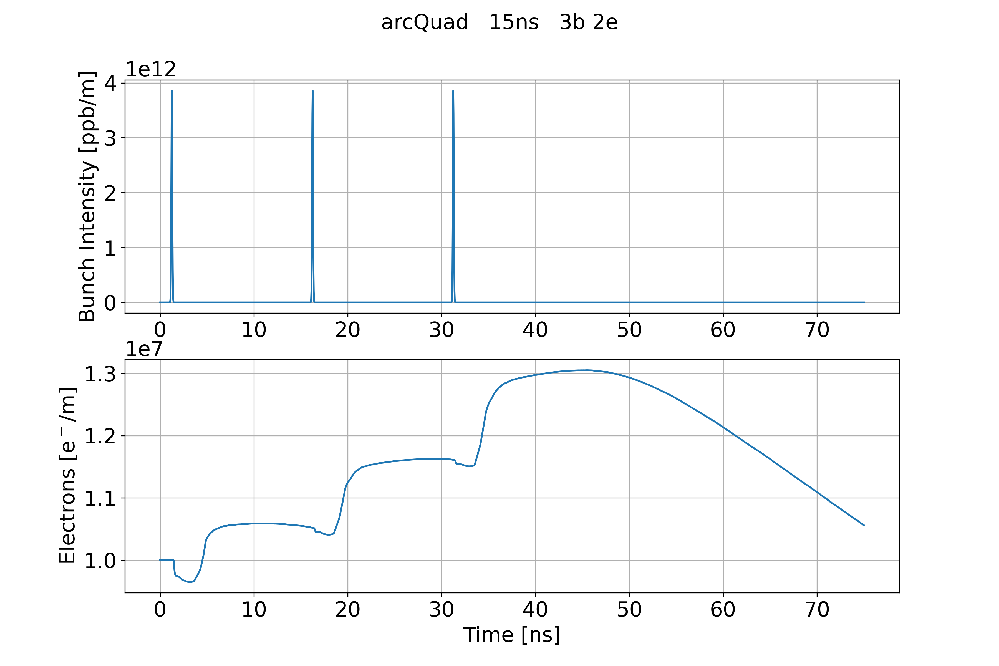
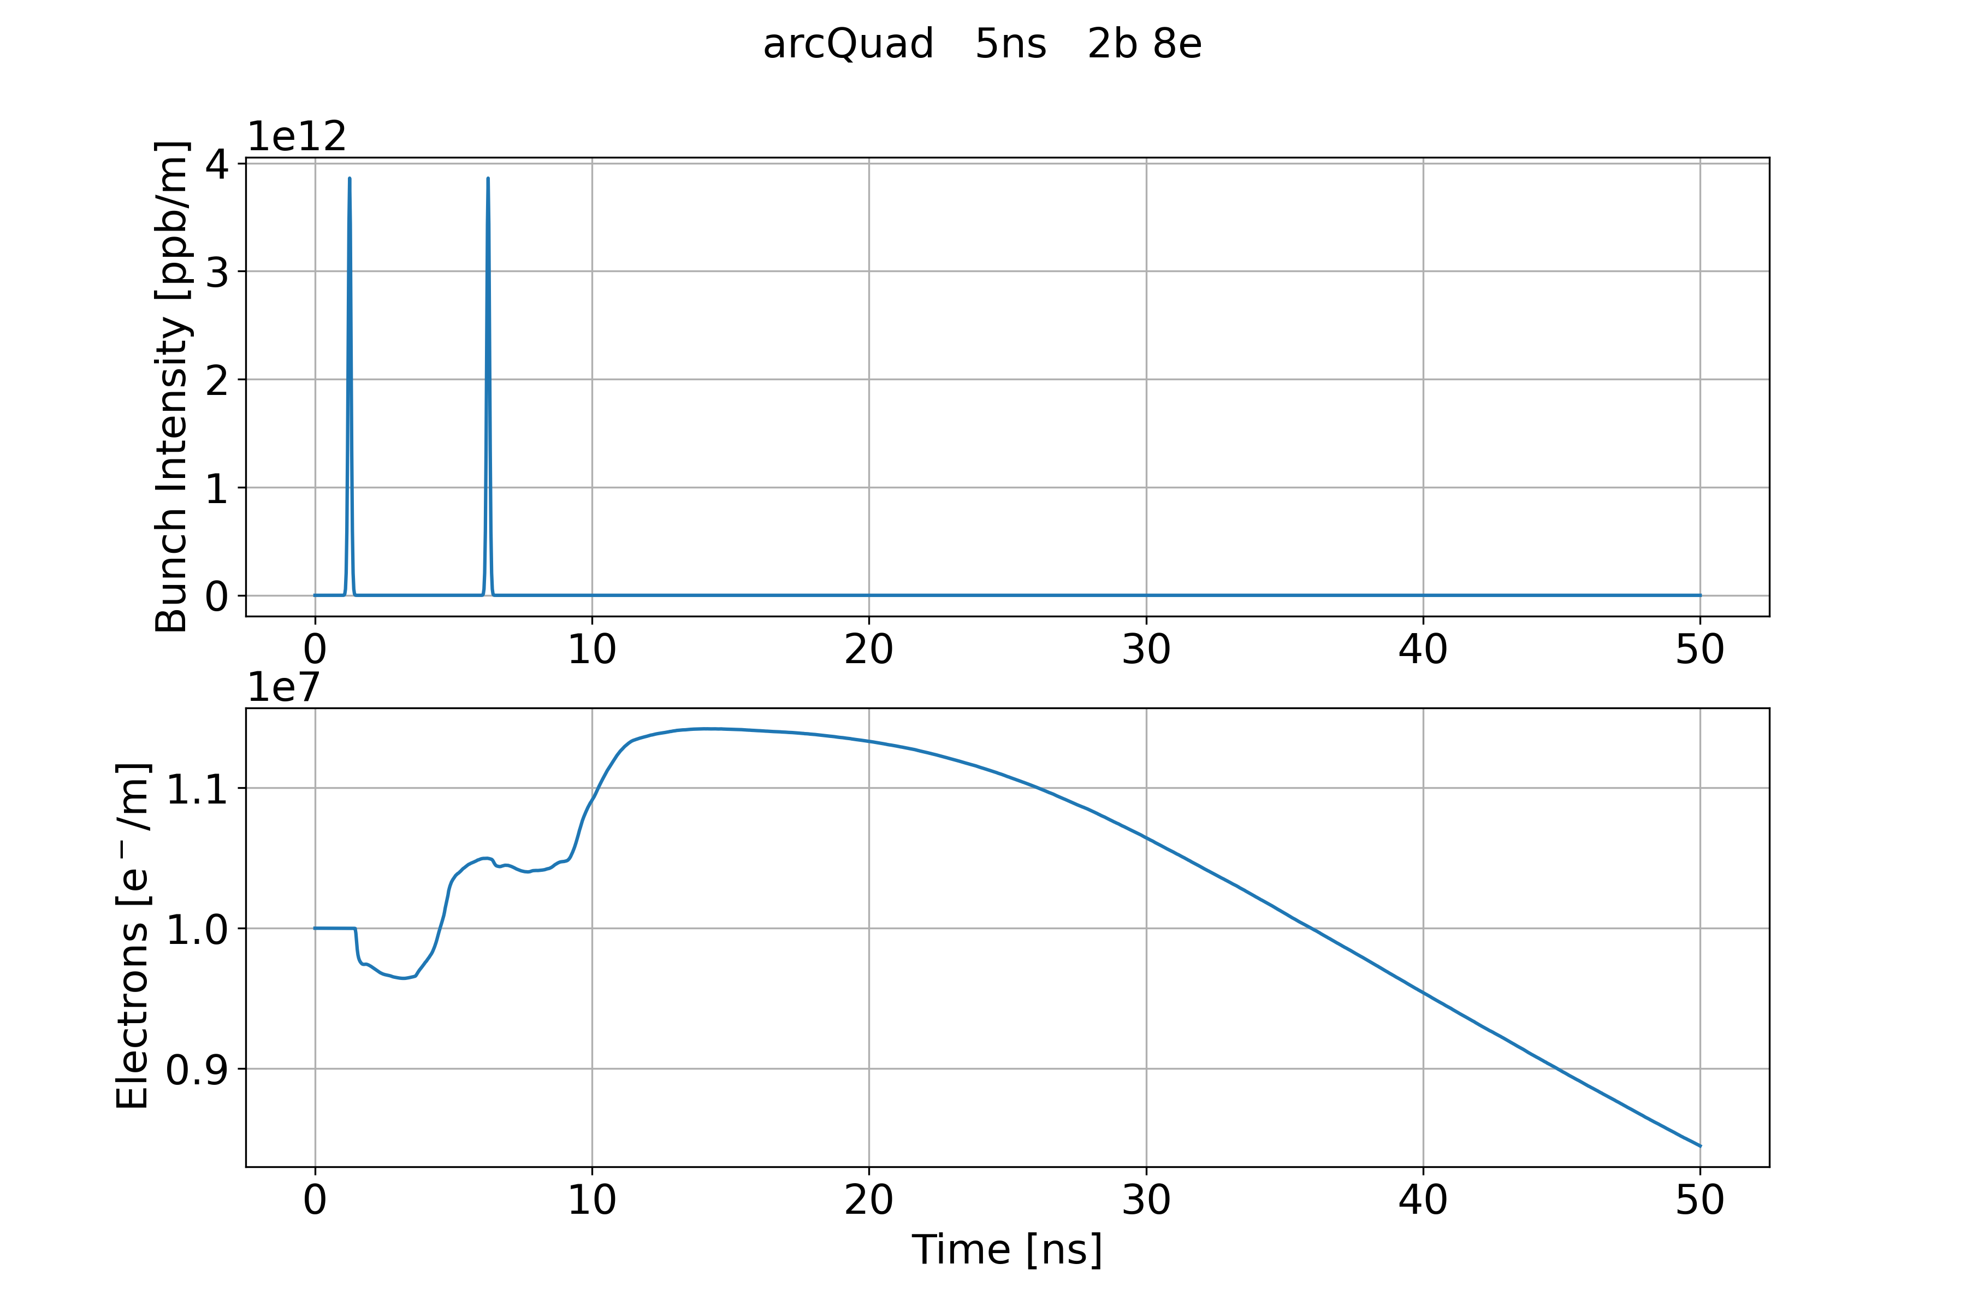
Mitigation II: 5ns non-uniform Bunch Spacing
Investigated possible filling schemes: reduced bunch spacing and small gaps after
Considering larger bunch spacing (20 ns and 15 ns), the gap lenght is not long enough to mitigate the e-cloud
e-cloud after the bunch passages and the gap is larger than the initial e-cloud density
Considering very small bunch spacing (10 ns and 5 ns), the gap is long enough to mitigate the e-cloud
e-cloud after the bunch passages and the gap is smaller than the initial e-cloud density
Bunch spacing 15 ns with 3 bunches and 2 empty
Bunch spacing 5 ns with 2 bunches and 8 empty

Slide 20
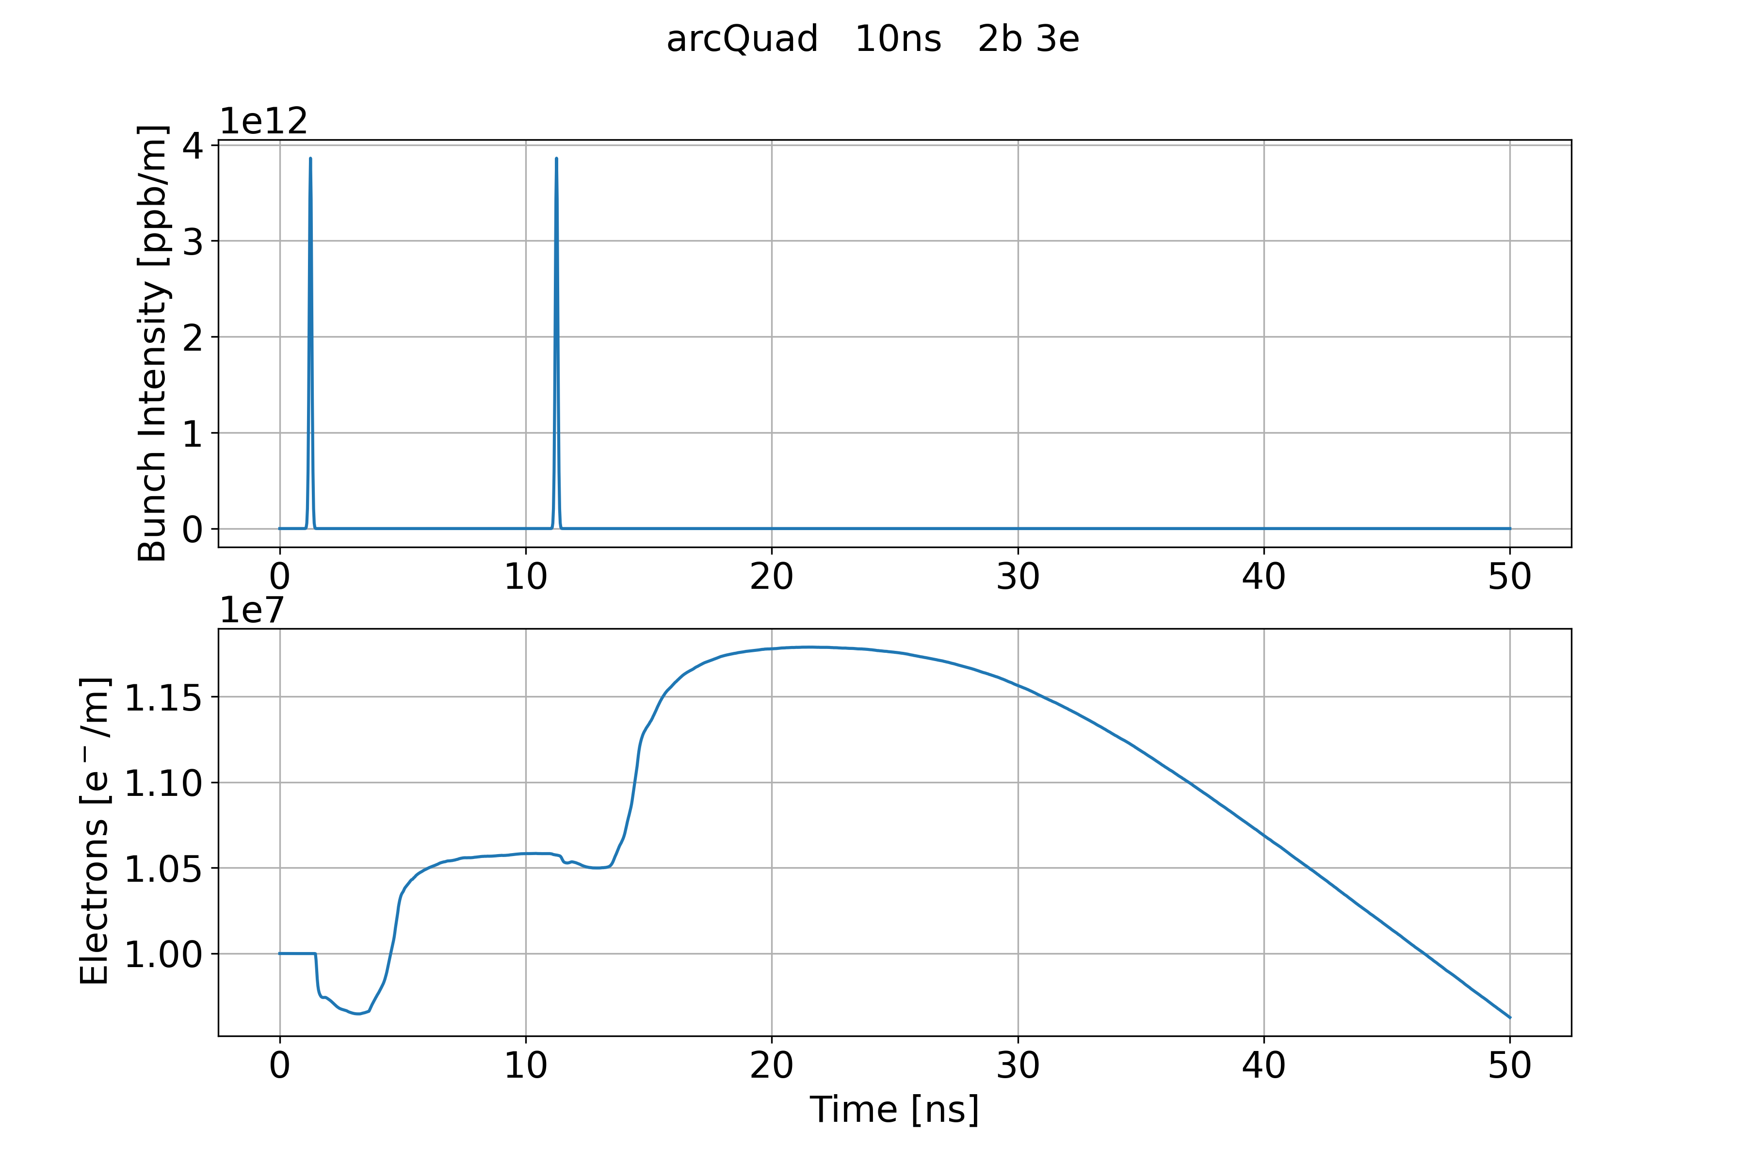
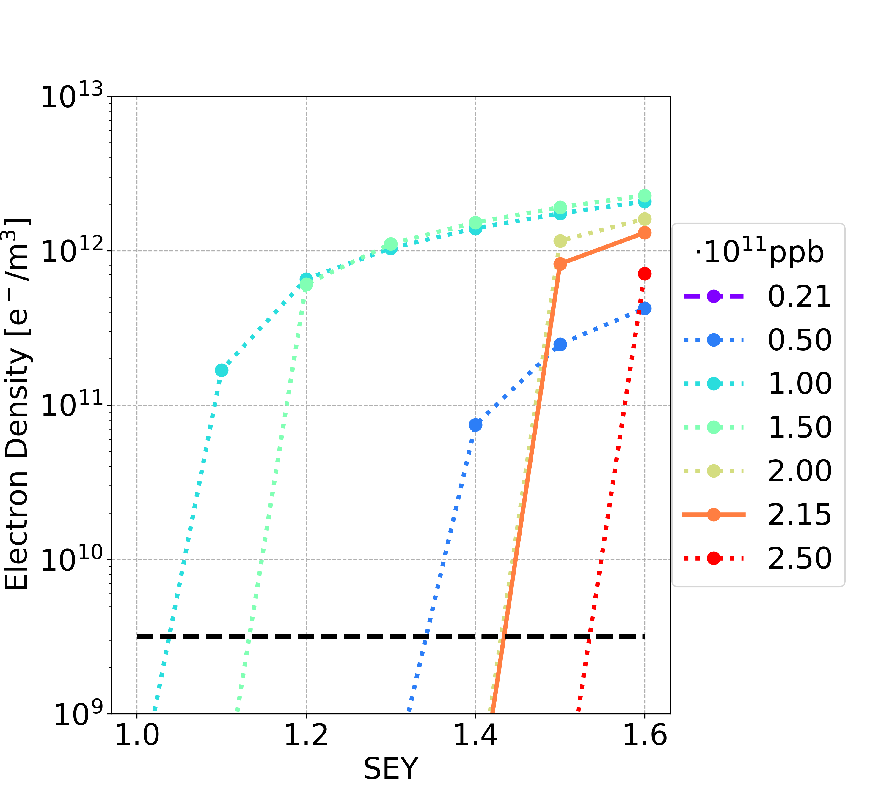
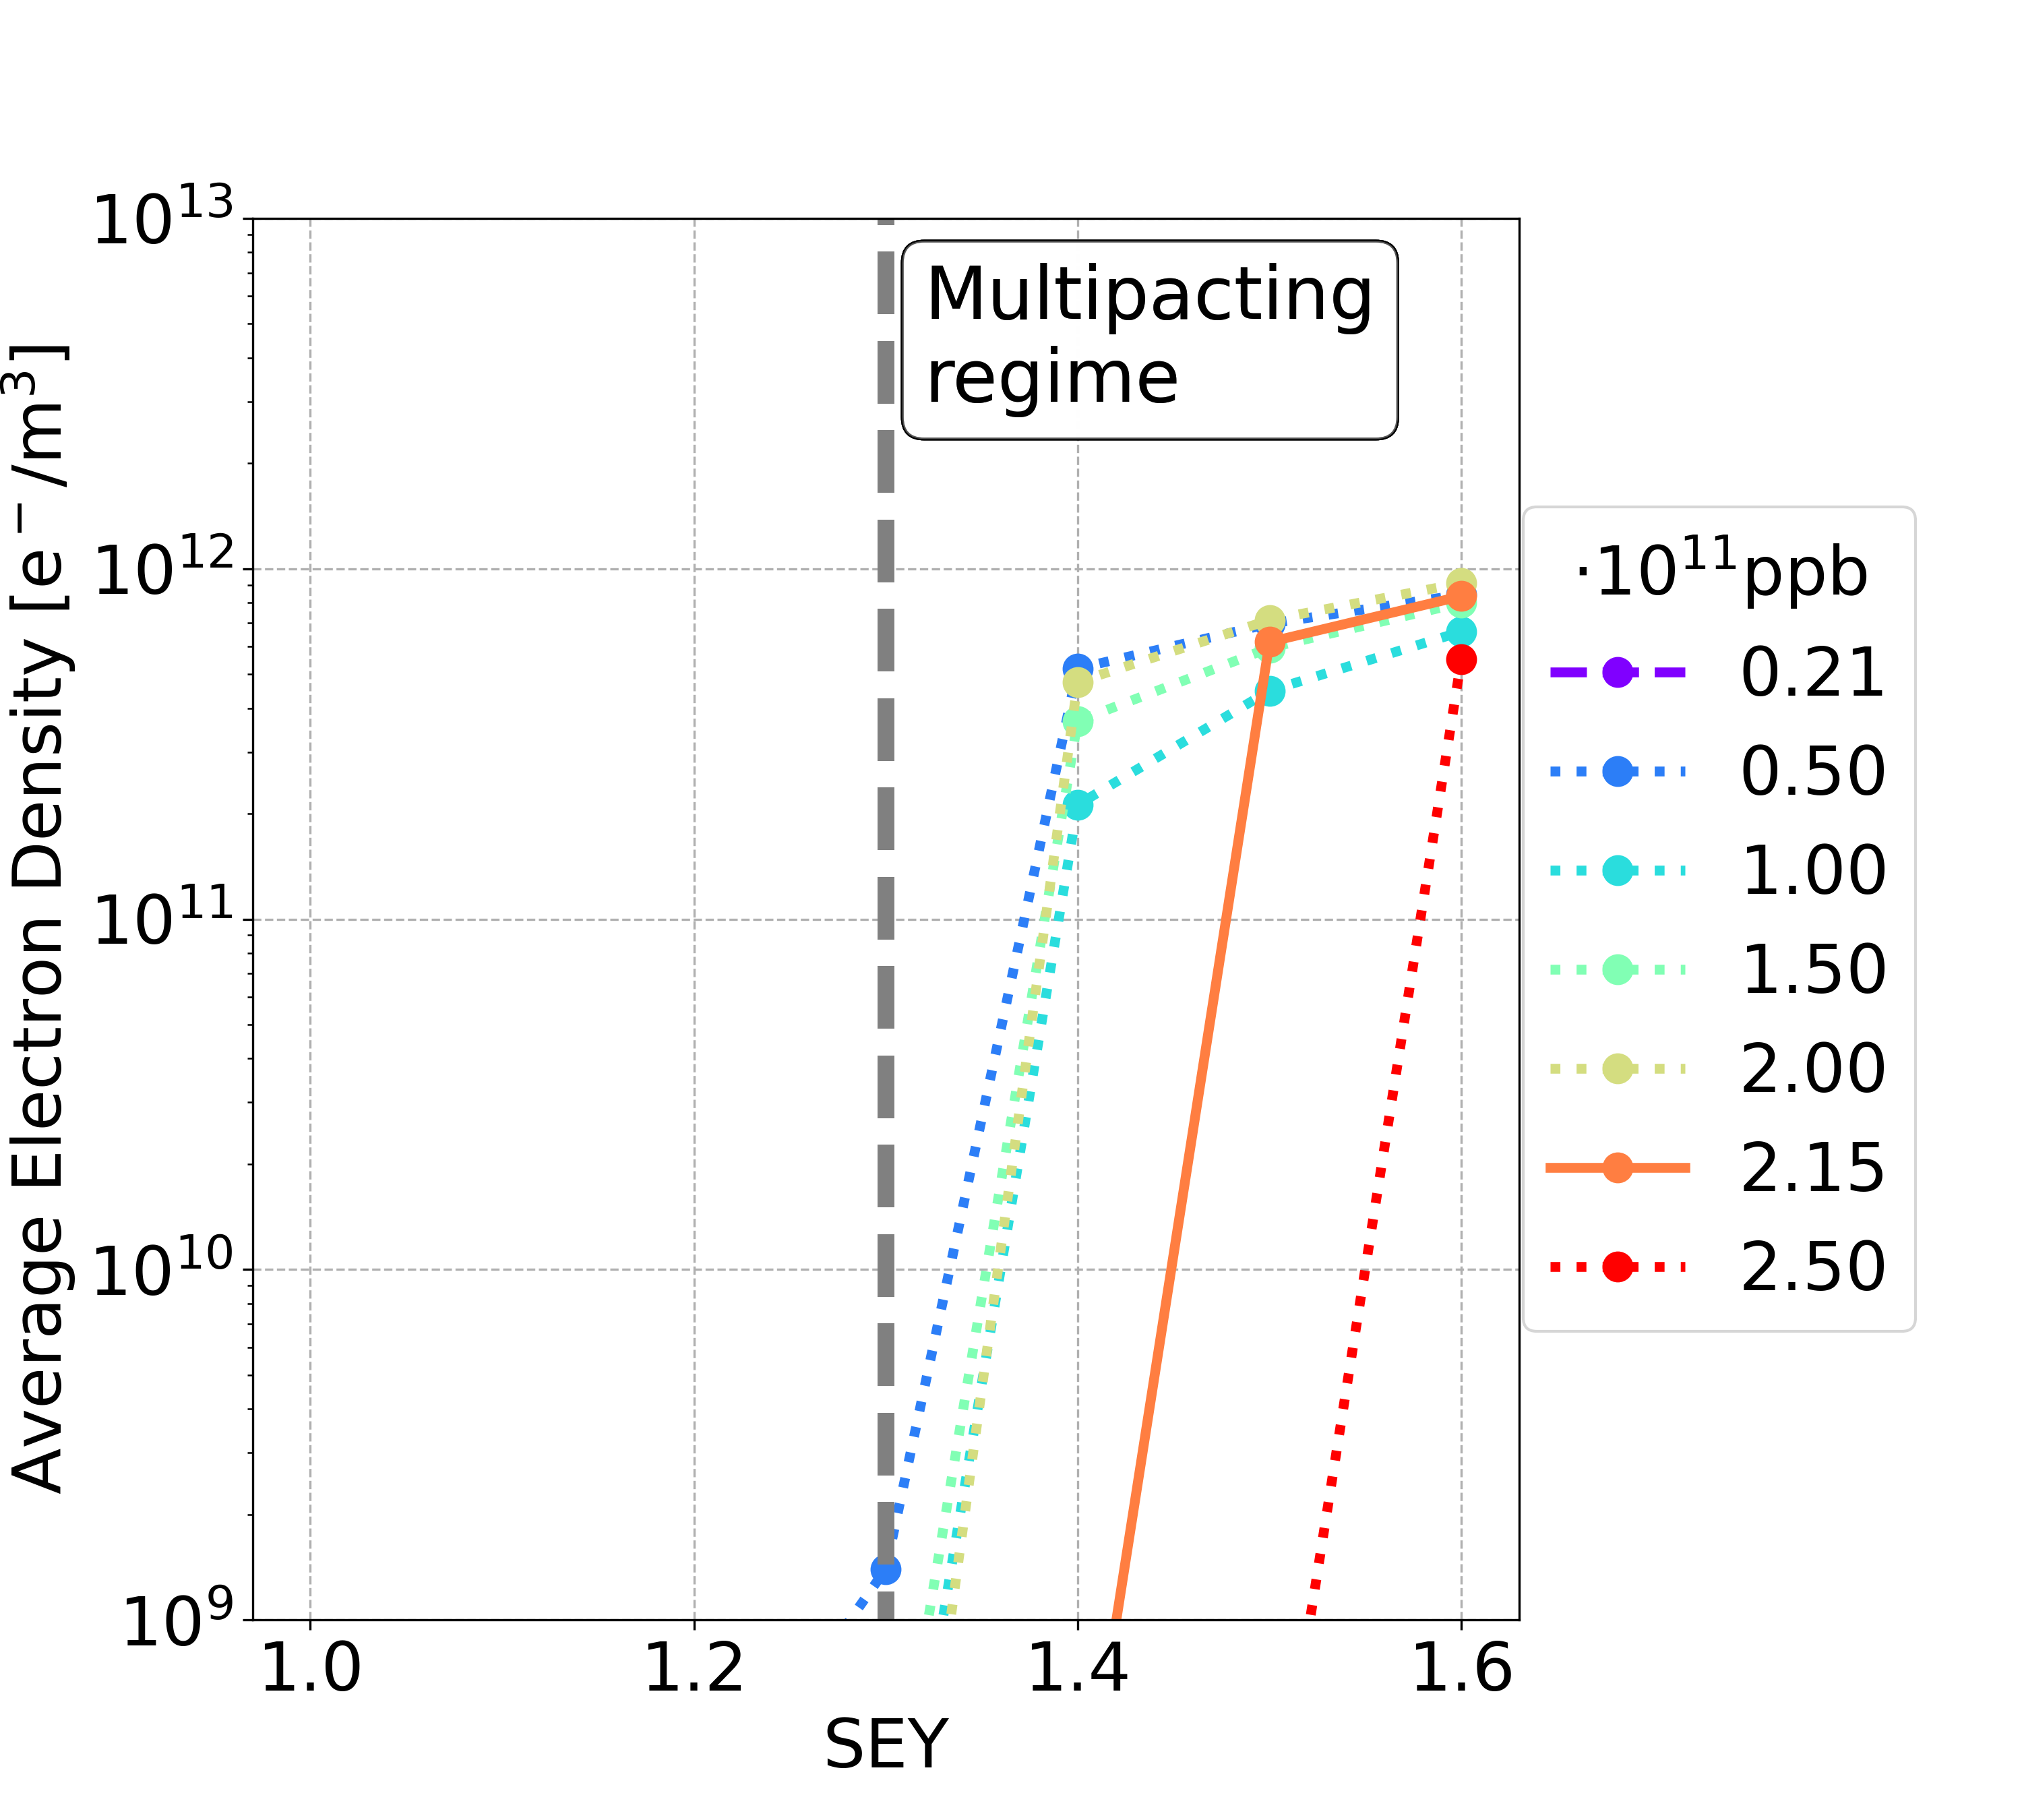
Short Bunch Spacing: 10 ns vs 5 ns
Considering the passage a full train of 280 bunches and the following train gap
Higher SEY threshold for lower intensities is obtained using NON-uniform filling schemes with 5 ns bunch spacing
Bunch spacing 25 ns uniform
Bunch spacing 5 ns with 2 bunches and 8 empty
Multipacting
regime
Dipole case

Slide 21
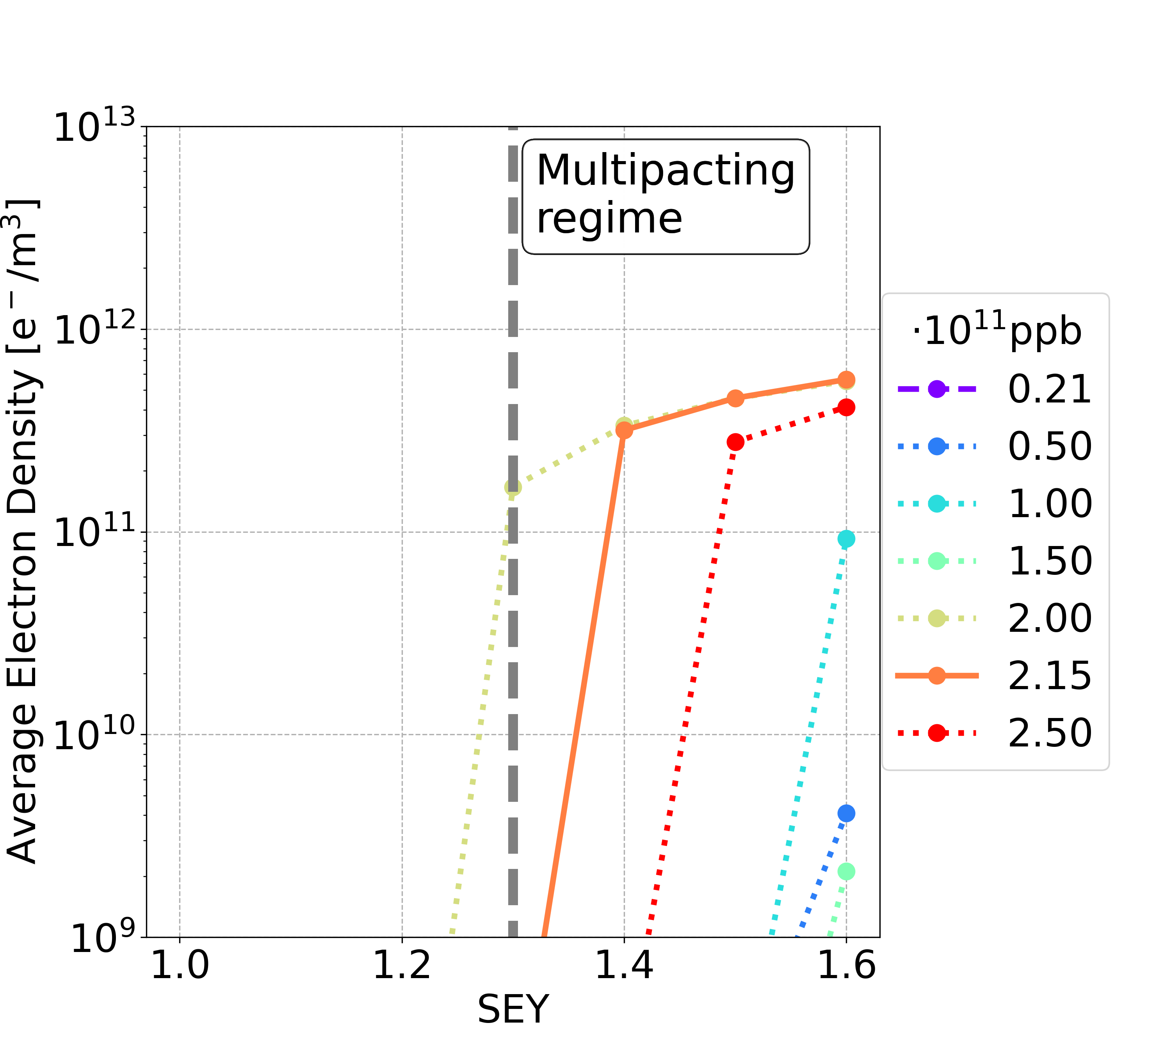
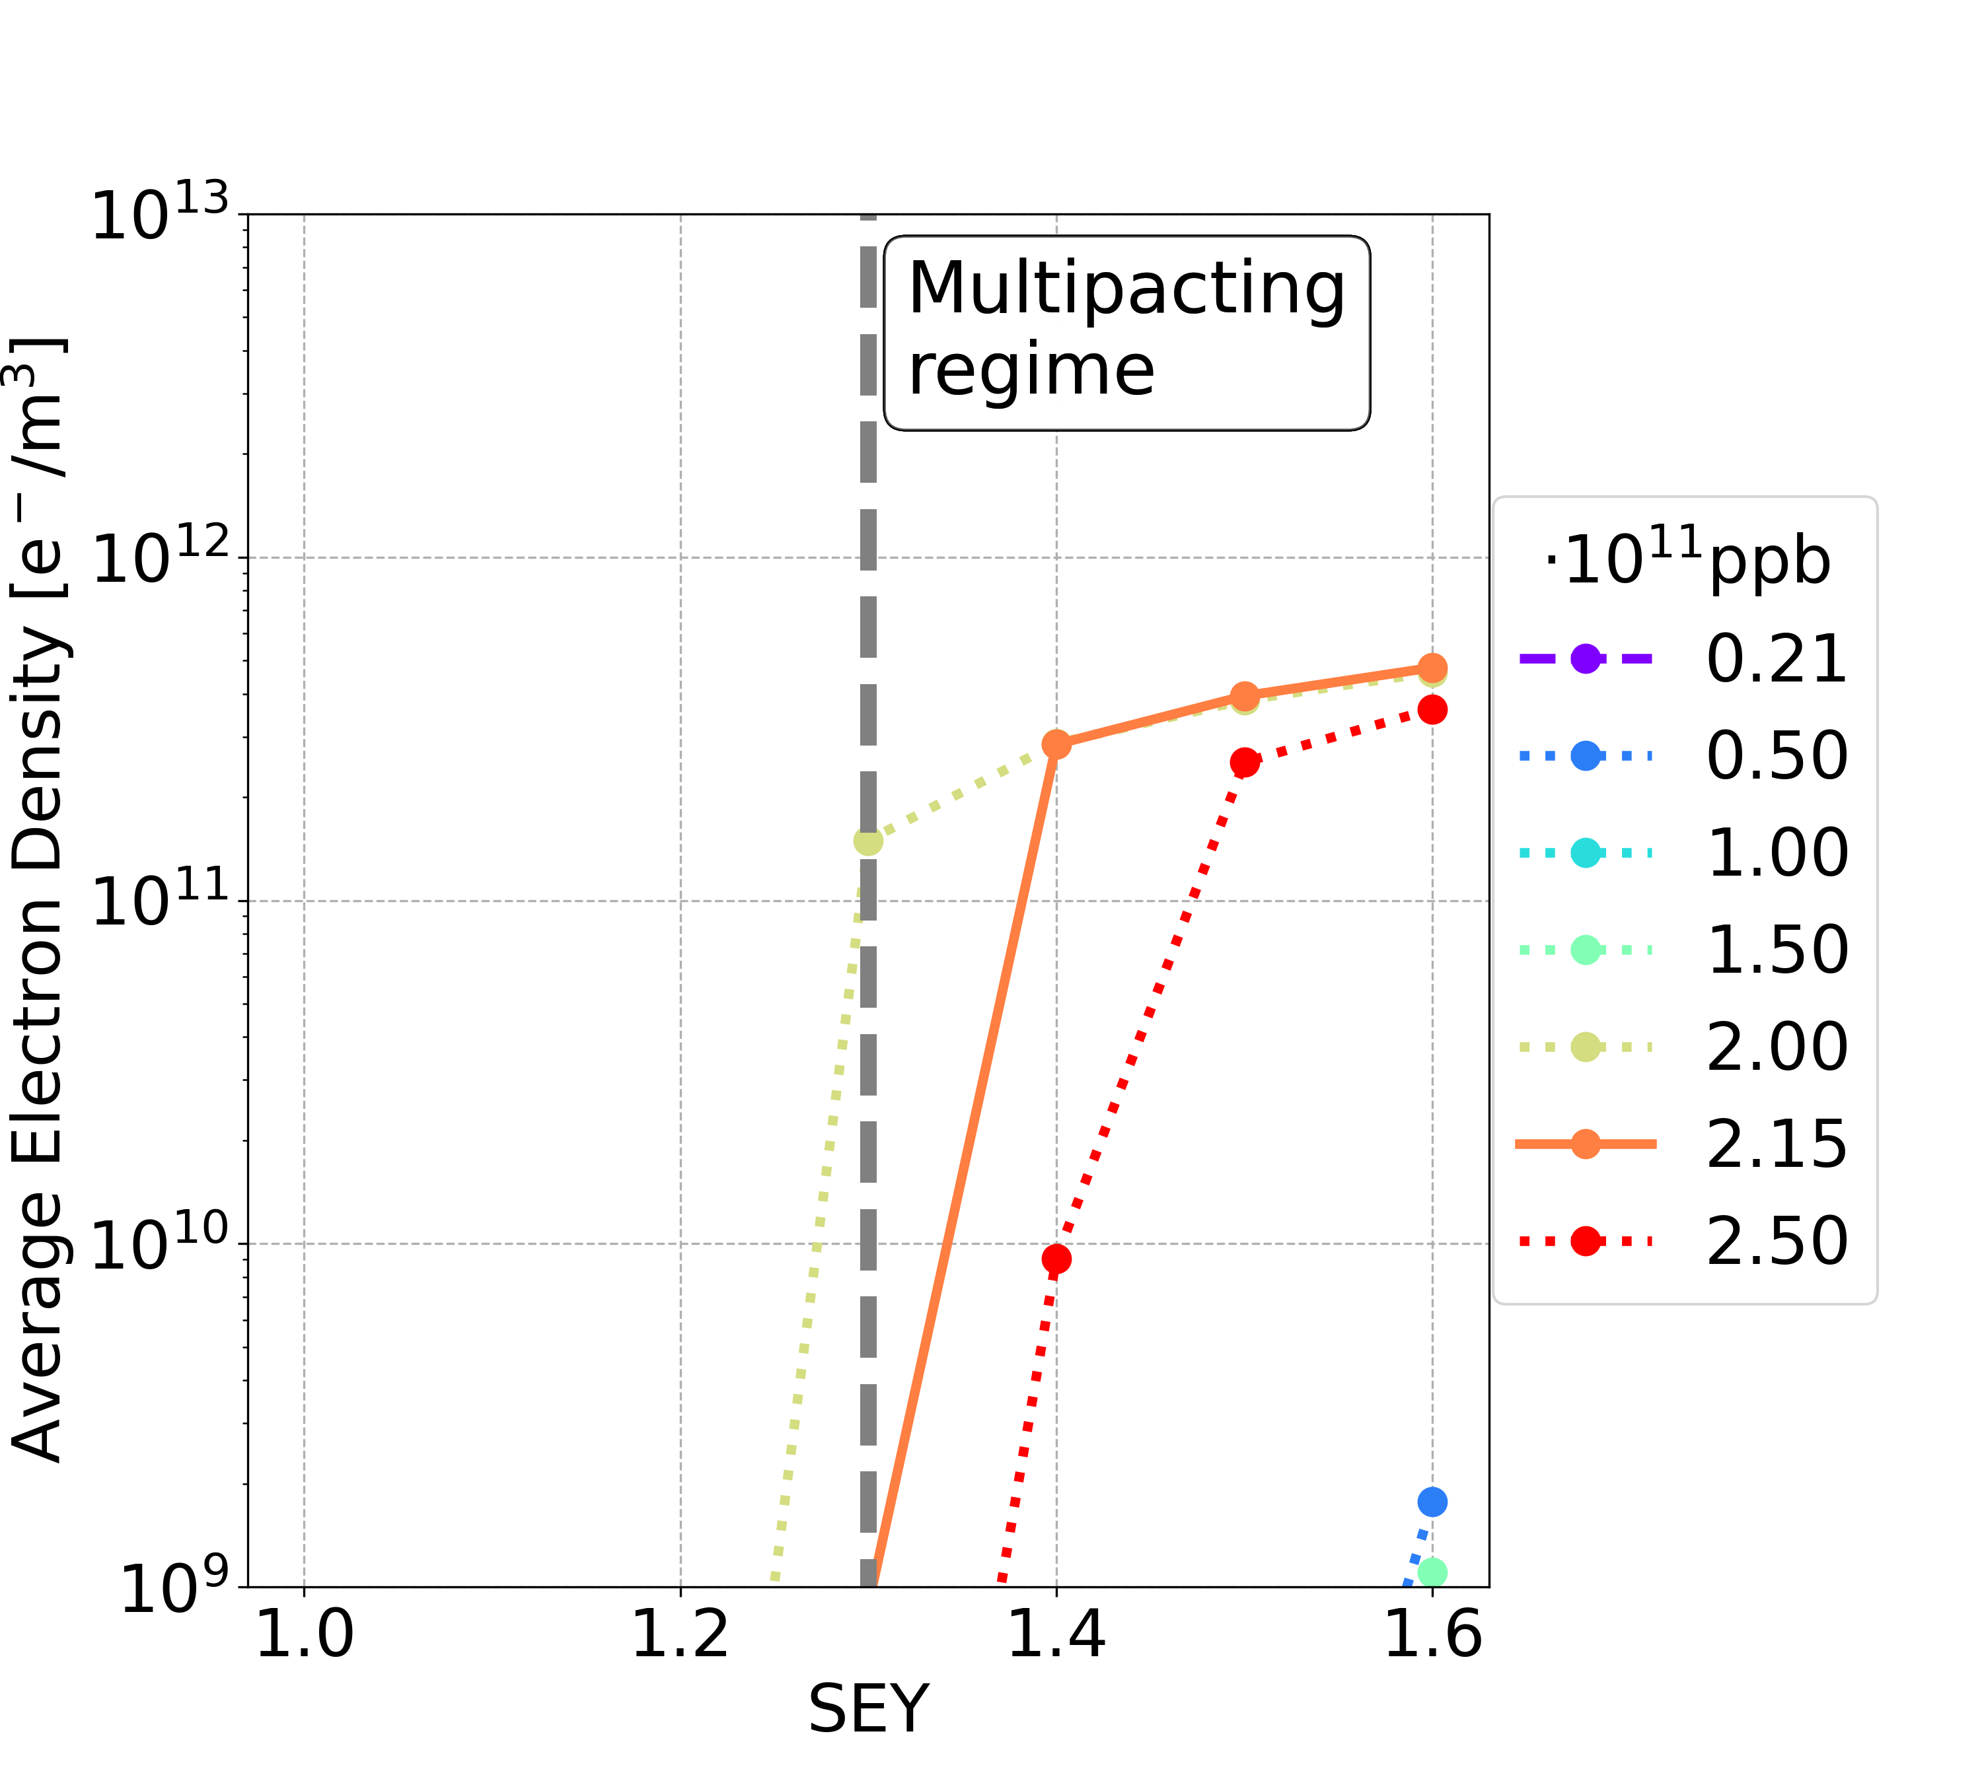
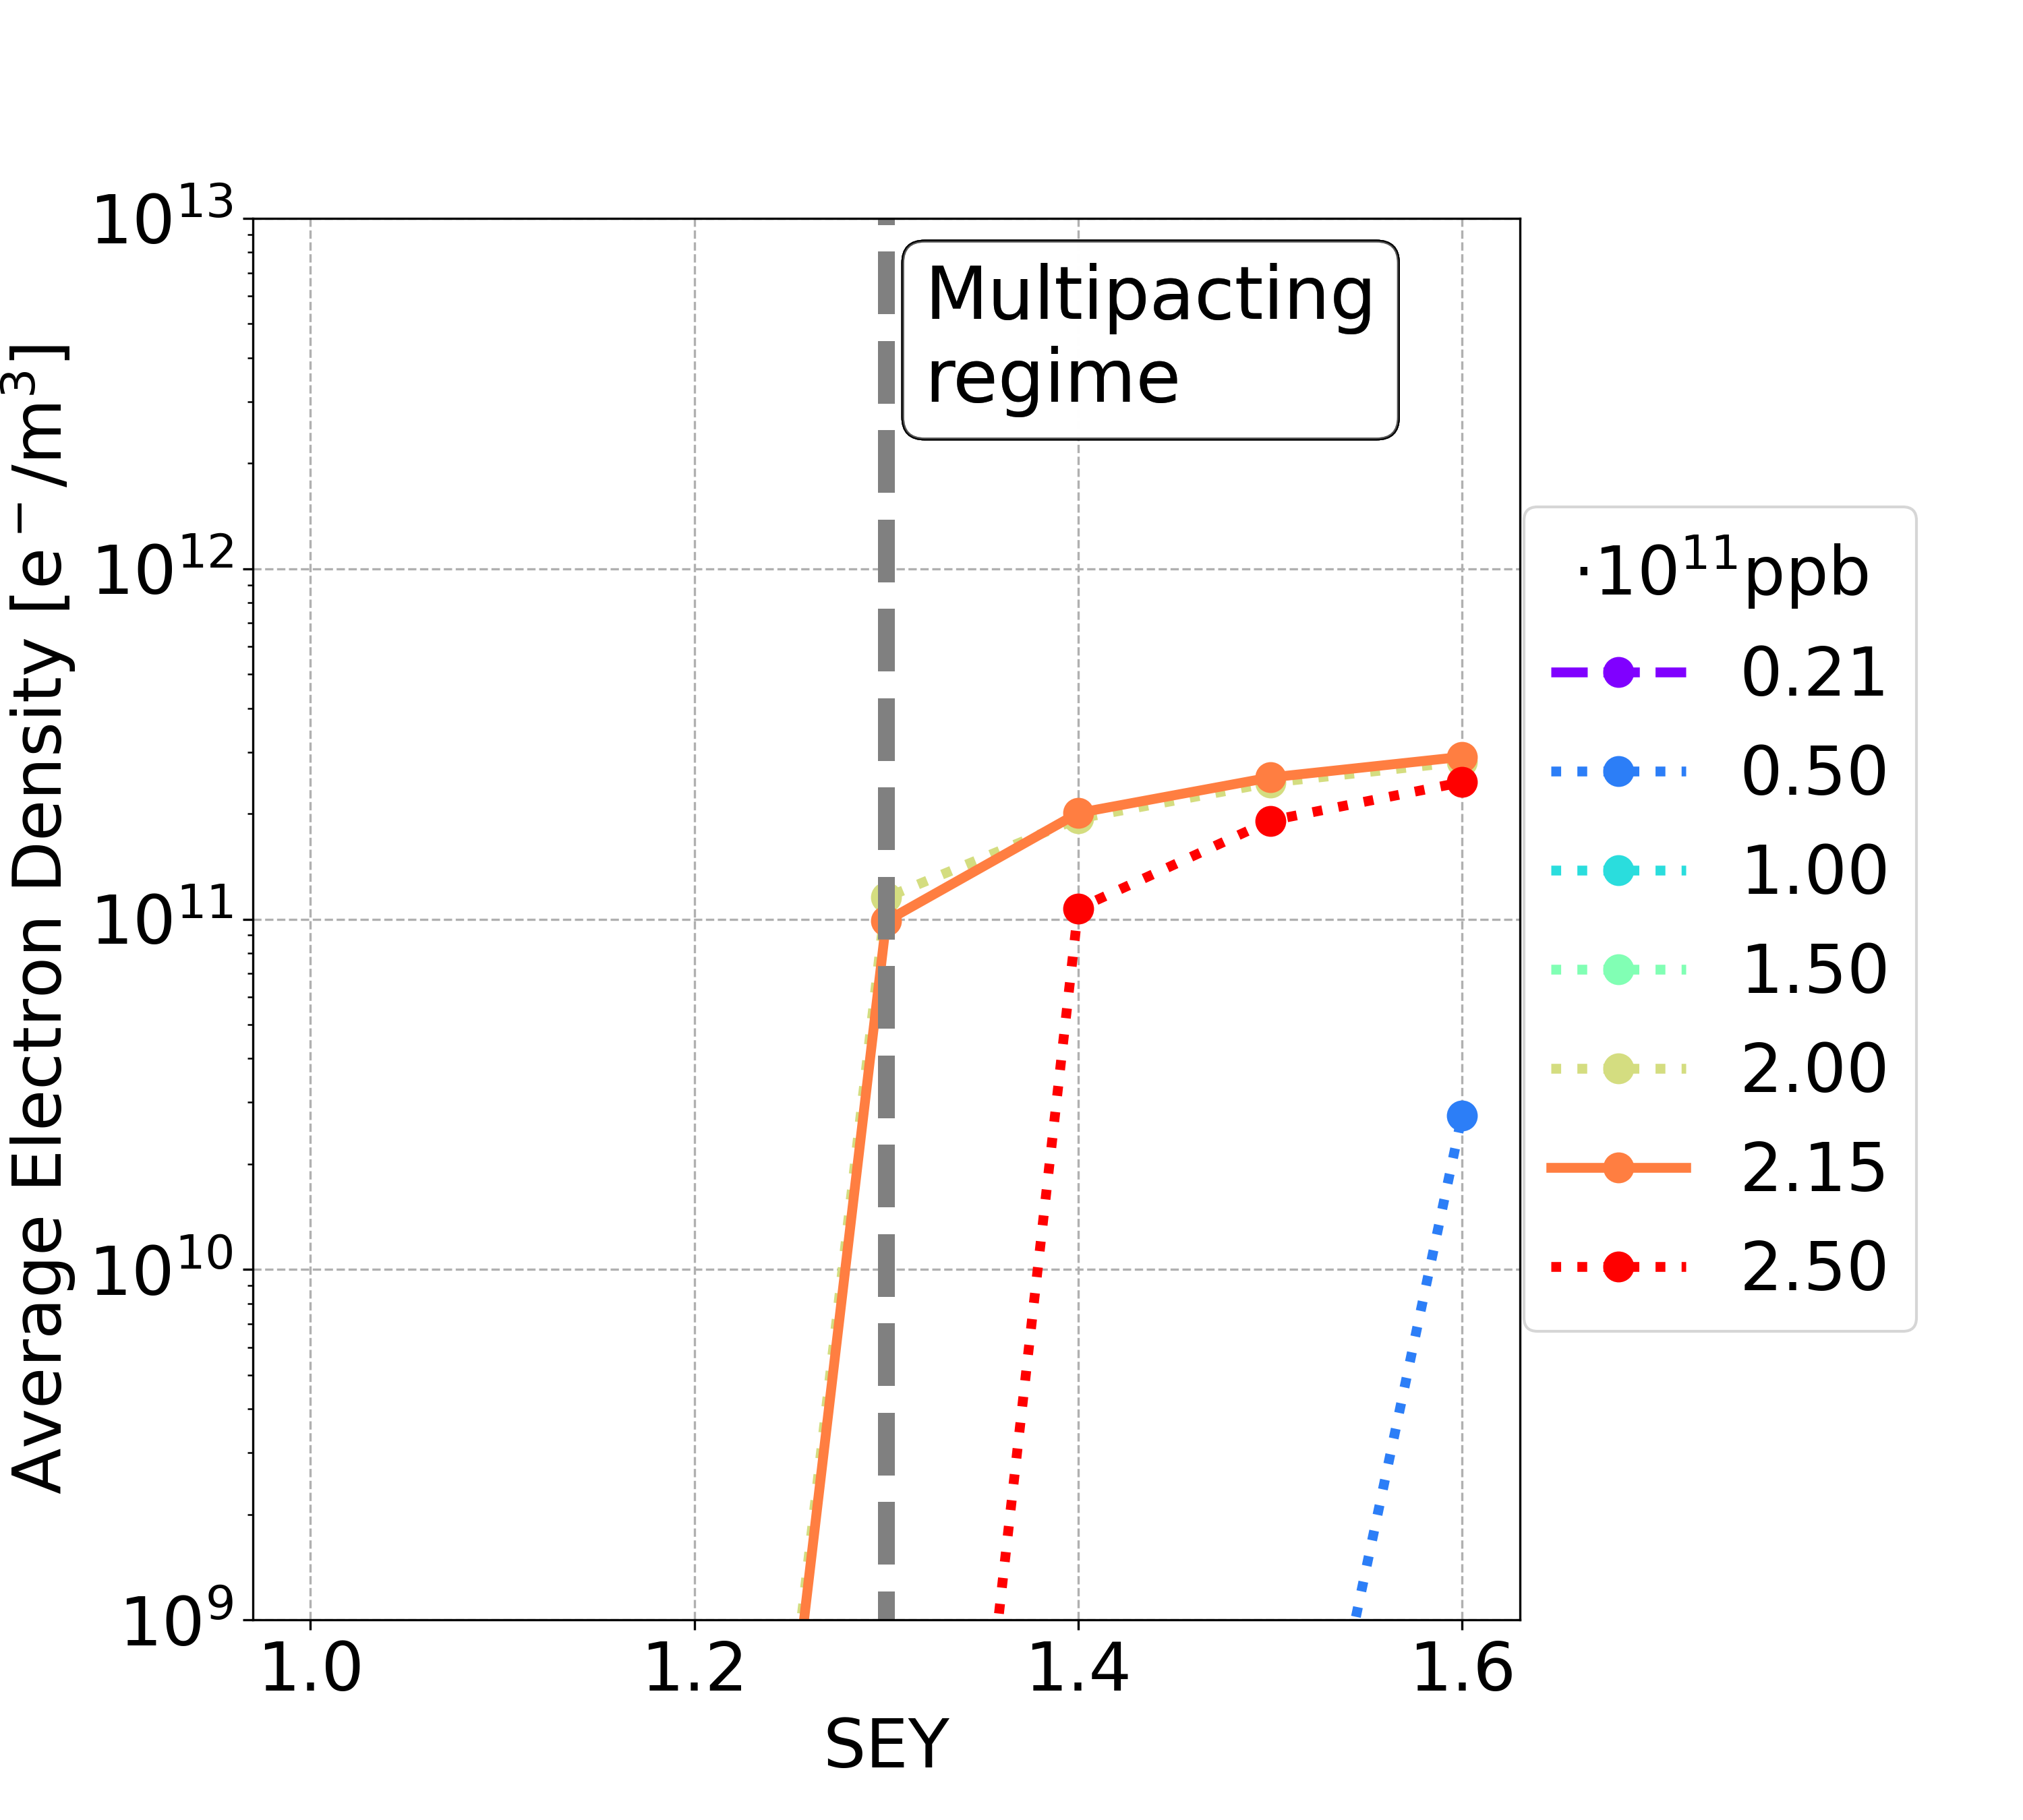
Non-uniform Bunch Spacing 5 ns
Considering the passage of a full train of 280 bunches and the following train gap, a better e-cloud mitigation is obtained using filling schemes with 5 ns bunch spacing
2b+8e
4b+16e
5b+20e
8b+32e
Dipole case
Electron average densitieas are reduced
SEY multipacting thresholds for critical bunch intensities are increased: could mitigate!

Slide 22
Non-uniform Bunch Spacing 5 ns: Summary
Element | Field | Bunch population | Uniform 25 ns | 2b+8e | 4b+16e | 5b+20e | 8b+32e
Drift Space | - | nominal | 1.4 | 1.4 | 1.4 | 1.4 | 1.3
 |  | below nominal | 1.2 | 1.4 | 1.4 | 1.4 | 1.3
Dipole | 15.2 mT | nominal | 1.4 | 1.4 | 1.3 | 1.3 | 1.2
 |  | below nominal | 1.0 | 1.2 | 1.2 | 1.2 | 1.2
Quadrupole | 1.45 T/m | nominal | 1.1 | 1.3 | 1.3 | 1.3 | 1.3
 |  | below nominal | 1.0 | 1.2 | 1.3 | 1.3 | 1.3
Sextupole | 72.5 T/m² | nominal | 1.1 | 1.4 | 1.5 | 1.5 | 1.4
 |  | below nominal | 1.0 | 1.3 | 1.5 | 1.5 | 1.4
Using filling schemes with non-uniform bunch spacing, the strict constraint on the SEY multipacting thresholds could be mitigated, for all the analysed magnetic elements
No tighter constrains during accumulation
Need to be further explored with photoelectrons
Investigating possible implementation (impedance, injectors…)

Slide 23
Outline
Introduction
Secondary Electron and Photoelectron Emission
Electron Cloud Effects
Mitigation Techniques
Conclusions and Outlooks

Slide 24
Conclusions and Outlooks
The material constraints in order to avoid e-cloud avalanche multiplication and to control photoelectrons are extremely tight for baseline parameters and planned 150nm NEG coating (SEY 1.0-1.2, PY~0.1-0.2)
Above the SEY multipacting threshold (as low as below 1.0), the e-cloud leads to beam instabilities→ for central densities above 2x10¹⁰ m⁻³
Considering the additional contribution of the photoemission on the e-cloud formation process, the beam could be unstable even below the SEY multipacting threshold: PY ~ 10⁻³ required for existing photon flux → New photo absorbers are underdevelopment to improve by factor 100 the photon absorption→ very challenging
Further systematic studies and the development of a more detailed model describing the impact of photoelectrons on electron cloud effects have started
Incoherent ecloud effects have to be addressed→ Electron and positron beams will experience different electron-cloud effects → slightly different parameters for the two beams with consequences for other collective effects
Non-uniform 5ns bunch spacing filling schemes mitigates the e-cloud formation process
Discussions and studies on-going to evaluate possible implementation
Investigation of the effectiveness of various active mitigation strategies of the e-cloud instabilities, such as the use of a transverse feedback system in combination with chromaticity and octupole settings are also under going

Slide 25
Thanks for your attention

Slide 26
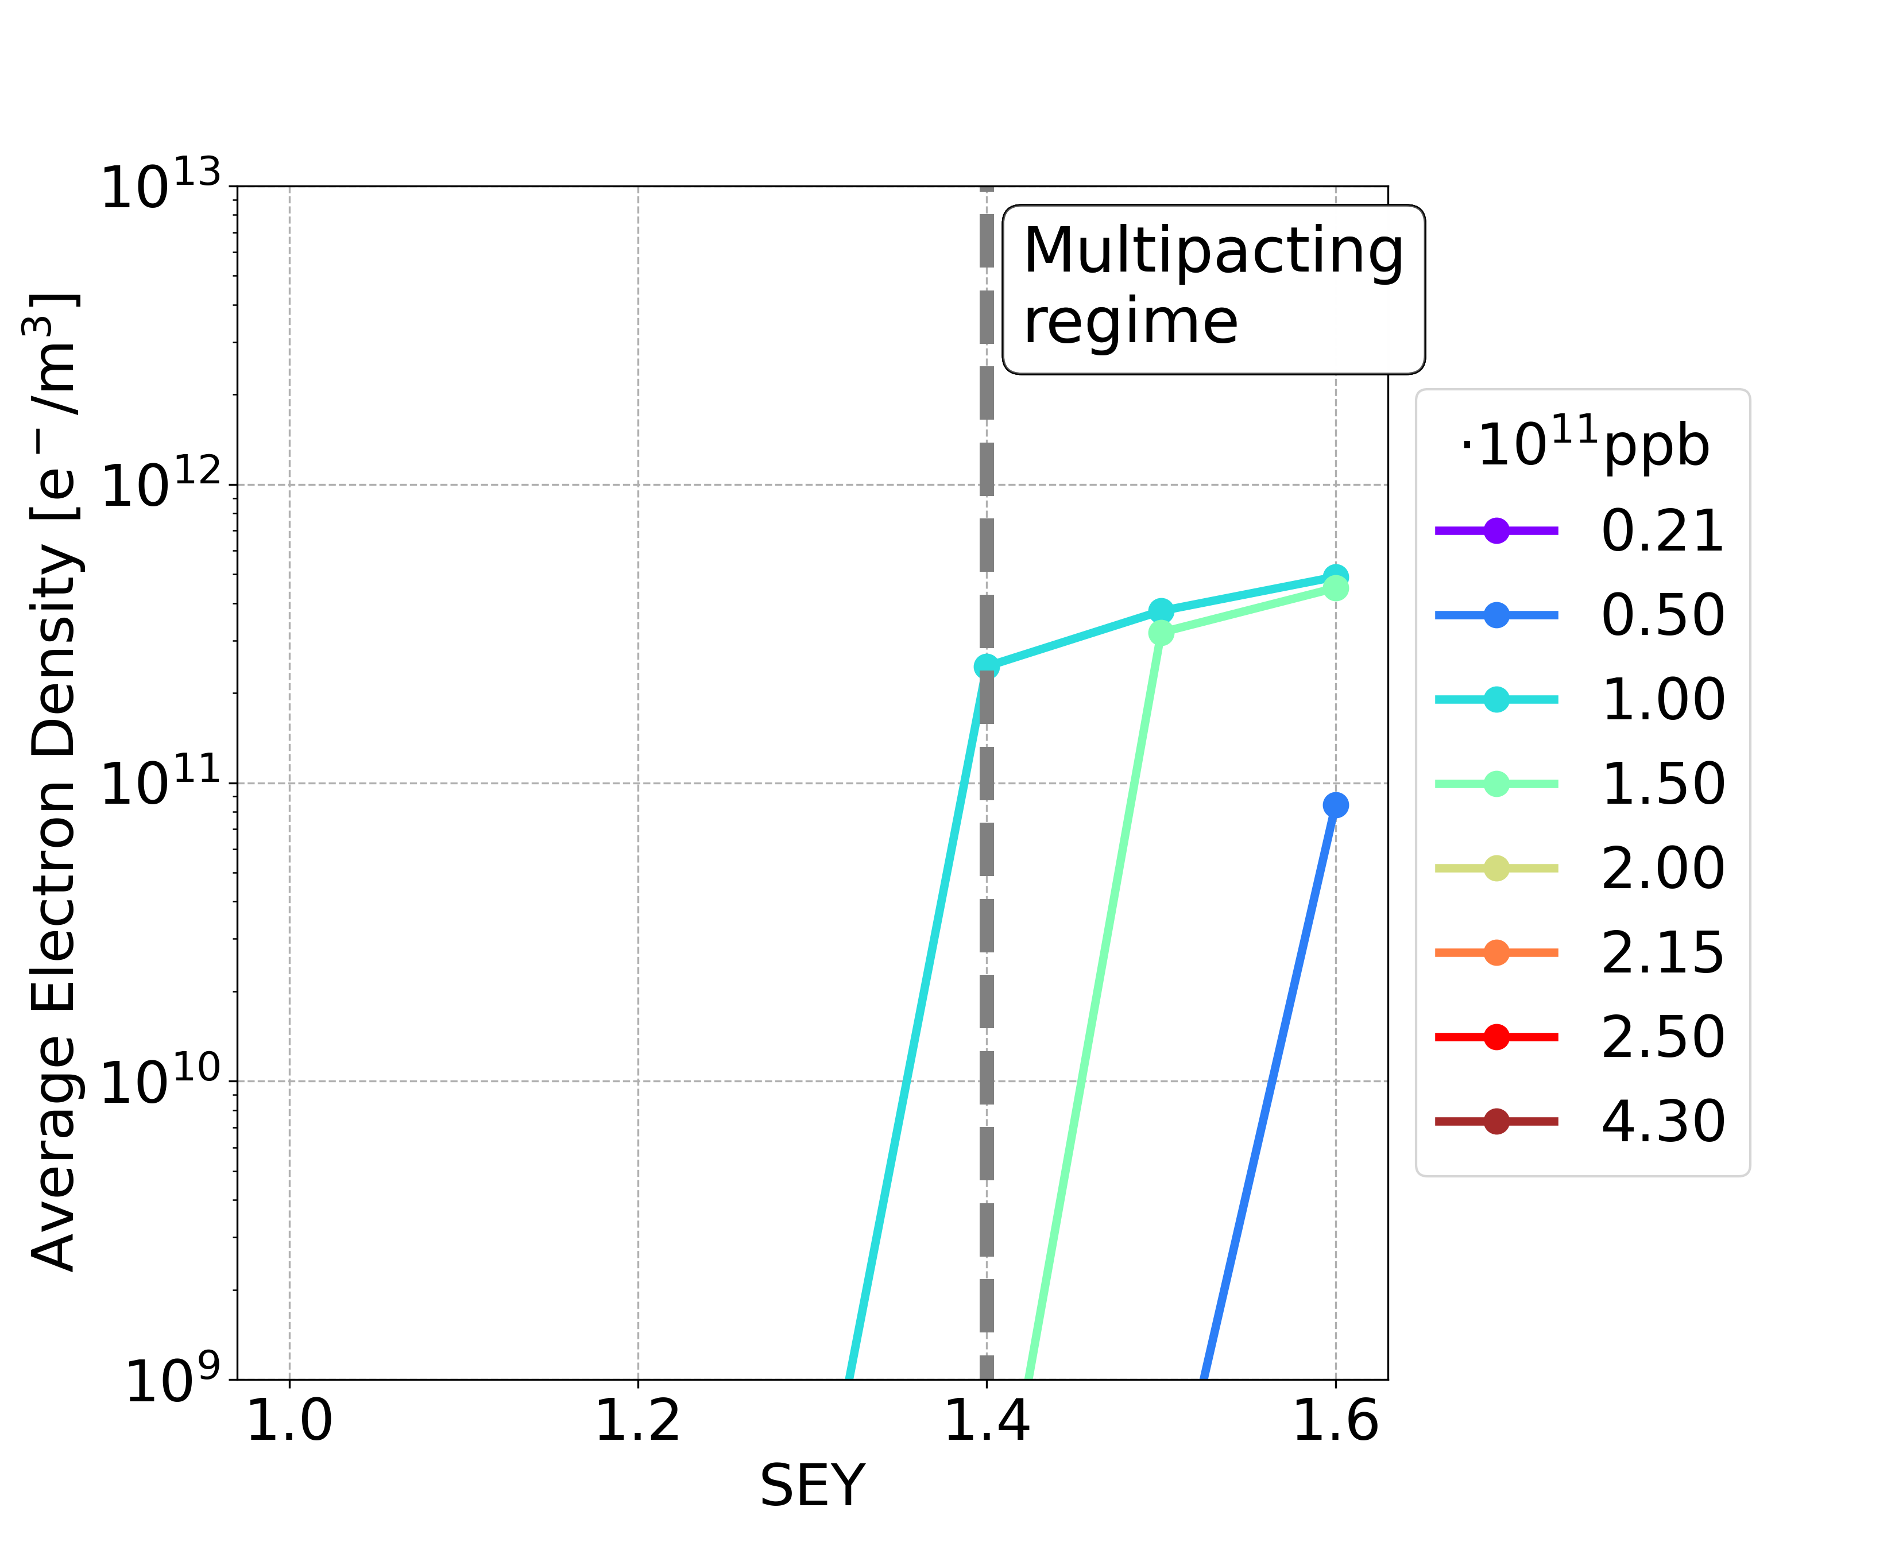
Mitigation techniques : Larger Bunch Spacing
From FCC Feasibility Study Report (March 2025)
E-cloud could be mitigated using larger bunch spacing
Larger bunch spacing
Dipole 50 ns
Element | 25 ns | 30 ns | 40 ns | 50 ns
Drift Space | 1.2 | 1.3 | 1.5 | > 1.6
Dipole (15.2 mT) | 1.0 | 1.1 | 1.2 | 1.3
Quadrupole (1.45 T/m) | 1.0 | 1.0 | 1.1 | 1.3
Sextupole (72.5 T/m²) | 1.0 | 1.1 | 1.3 | 1.4
Increasing the bunch spacing requires increasing the bunch intensity to maintain a constant beam current
→ Larger bunch intensities could lead to problems due to other collective effects, such as beam-beam and beam-coupling impedance (Mauro Migliorati FCC week 2024)

Slide 27
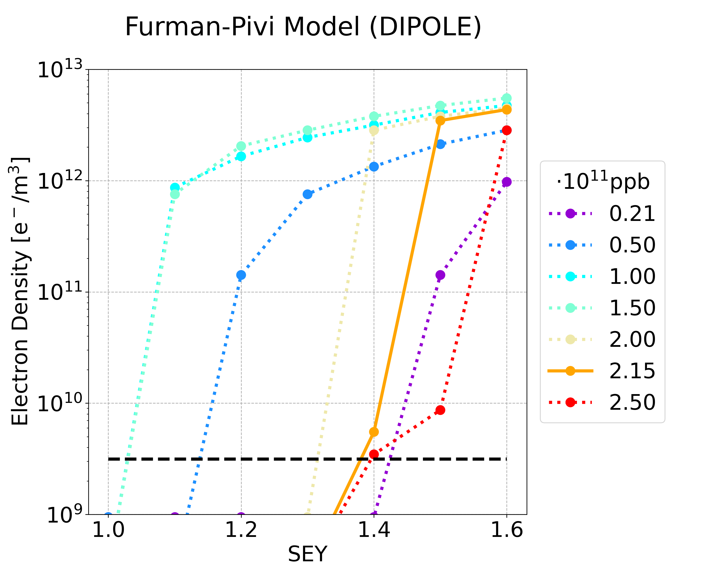
SEY Models
Simulations based on different parametrisations of the surface SEY
ECLOUD Model
Furman-Pivi Model
Courtesy of Fatih Yaman
Furman-Pivi model is more pessimistic:
Multipacting occurs for lower SEY
Larger e-cloud density
More details in: F. Yaman, “Electron cloud simulations using the Furman-Pivi model”, FCC-ee electron cloud meeting 18/03/2025

Slide 28
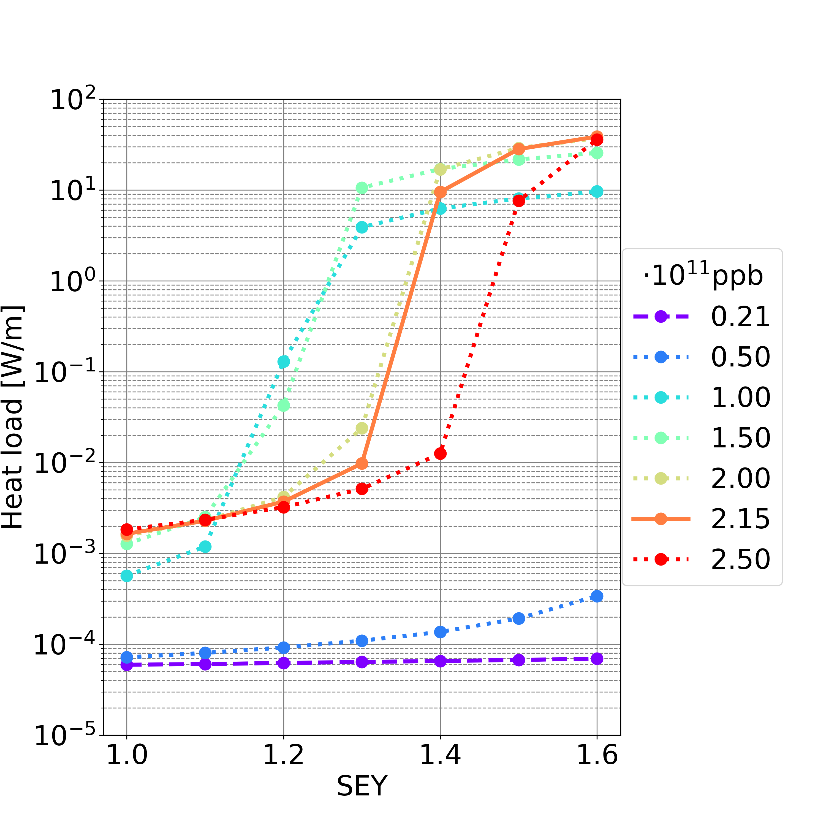
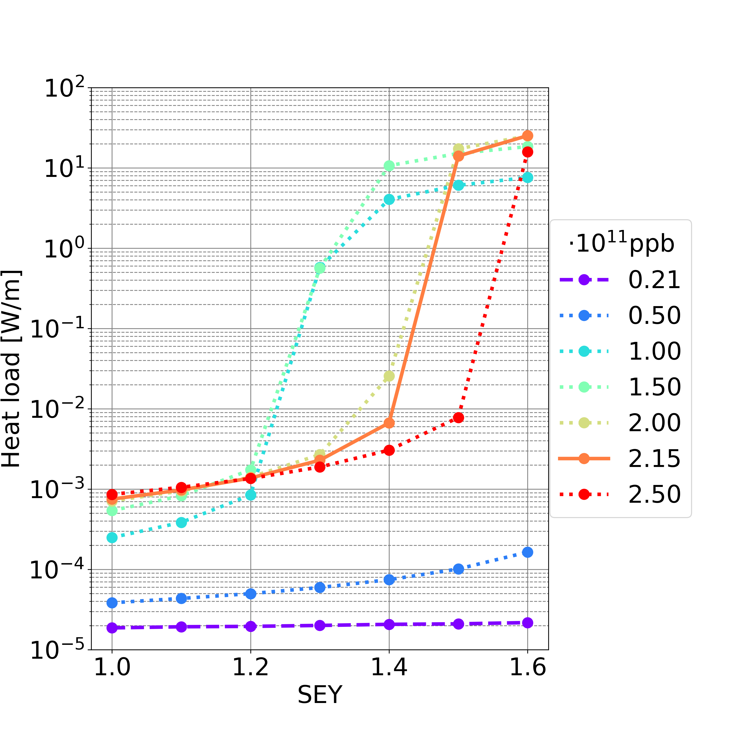
Heat Loads: Drift Space
Filling scheme 1
Filling scheme 2
L_{drift} = 17.4 km (L_{drift} /L = 19.18%)
Synchrotron radiation power: ∼50 MW per beam
If multipacting (considering nominal bunch intensity and maximum simulated SEY=1.6):
Filling scheme 1: ∼38.7 W/m -> full circumference ∼673 kW ∼1.35% of synchrotron radiation power
Filling scheme 2: ∼25.3 W/m -> full circumference ∼439 kW ∼0.88% of synchrotron radiation power
If no multipacting (considering SEY smaller the SEY multipacting threshold, all simulated bunch intensities):
Filling scheme 1 (SEY<=1.1) & 2 (SEY<=1.2): smaller than 0.01 W/m -> full circumference smaller than 200 W ∼0.0004% of synchrotron radiation power

Slide 29
Heat Loads: Summary
In case there is multipacting, the total heat loads are in the order of:
5-7% of synchrotron radiation power for the filling scheme 1
Dipoles are the main contributors to the total heat loads
If there is no multipacting, the total heat loads are negligible compared to the synchrotron radiation power

Slide 30
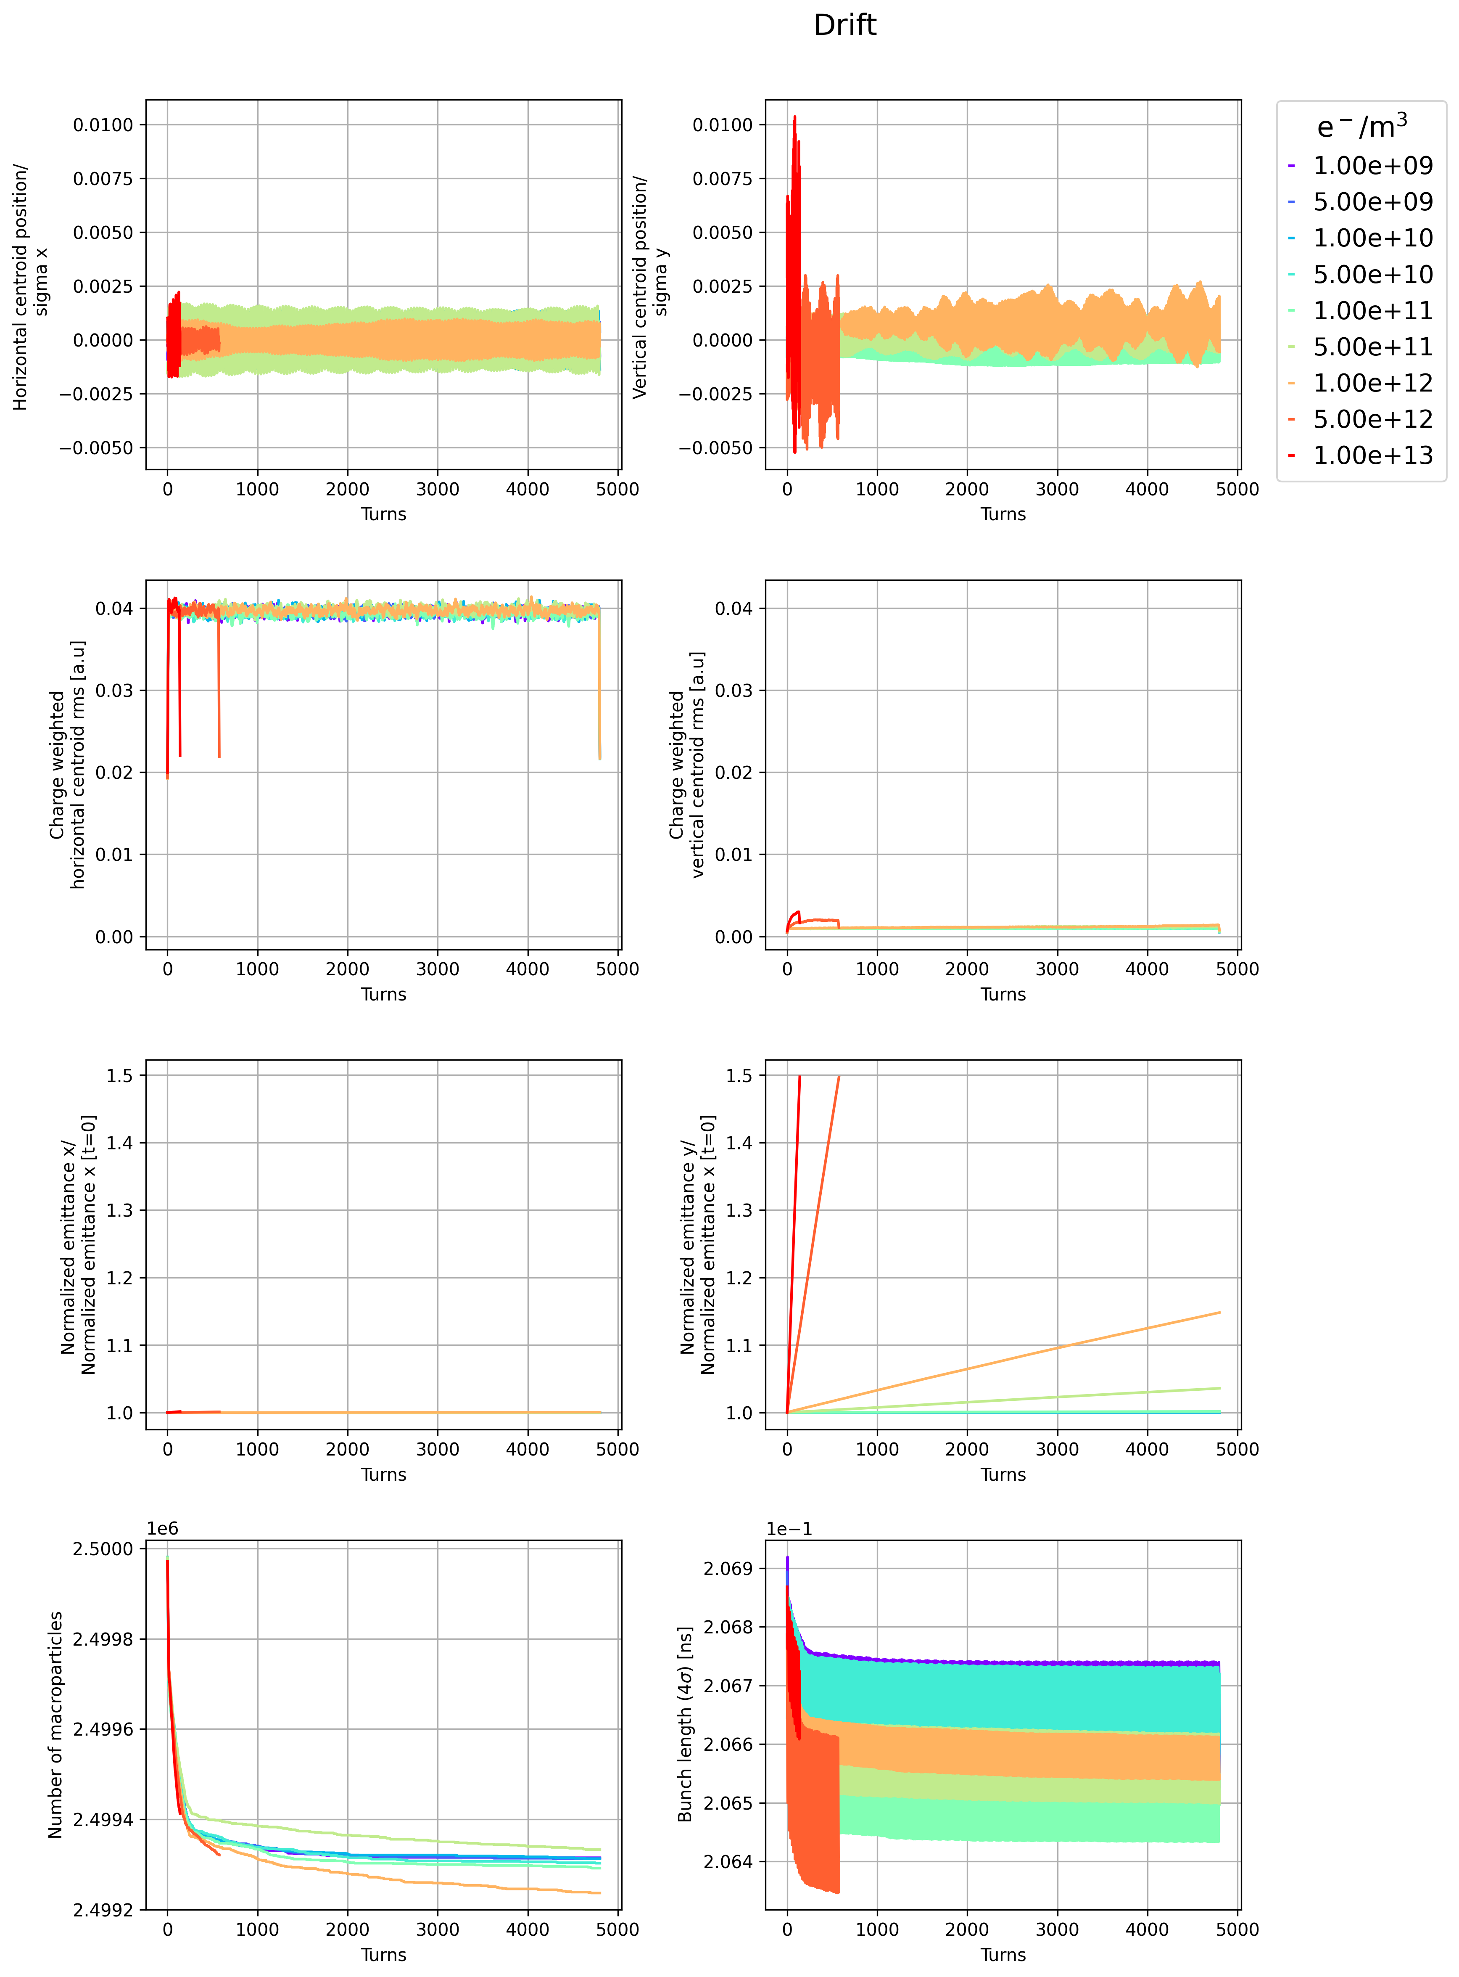
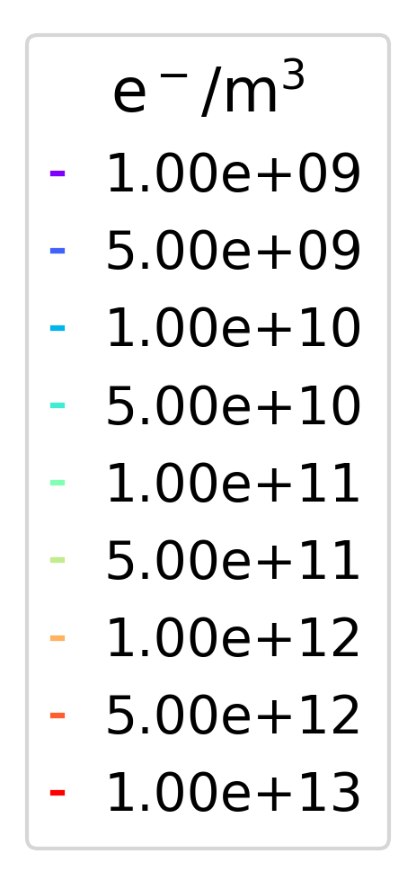
E-Cloud Stability Simulation Threshold
Drift Space case:
considering only the drift length L_{drift} = 17.4 km (L_{drift} /L = 19.18%)
Horizontal
Vertical
Centroid/
Sigma
Stable
Unstable
Very unstable
Normalised emittance/
Normalised emittance [t=0]
Theoretical and numerical e-cloud density stability threshold have the same order of magnitude: ⍴_{e,th} = 9.53 ⋅10¹⁰ e⁻/m³
Vertical plane is unstable

Slide 31
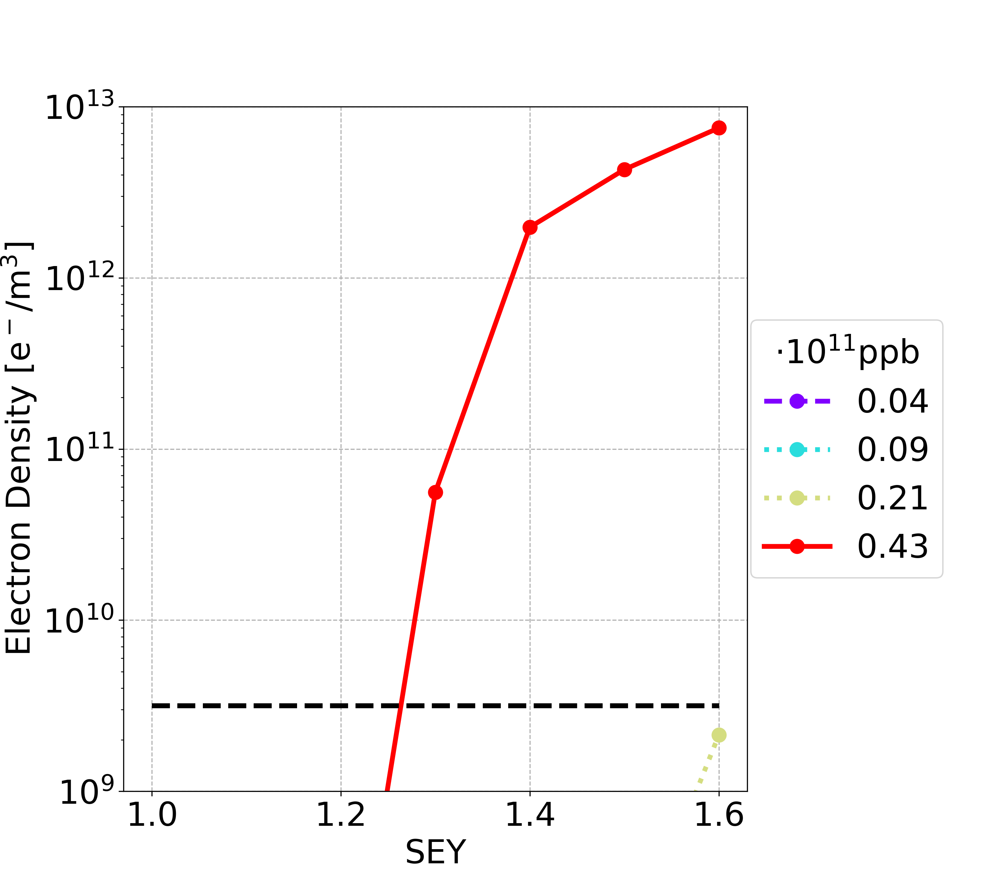
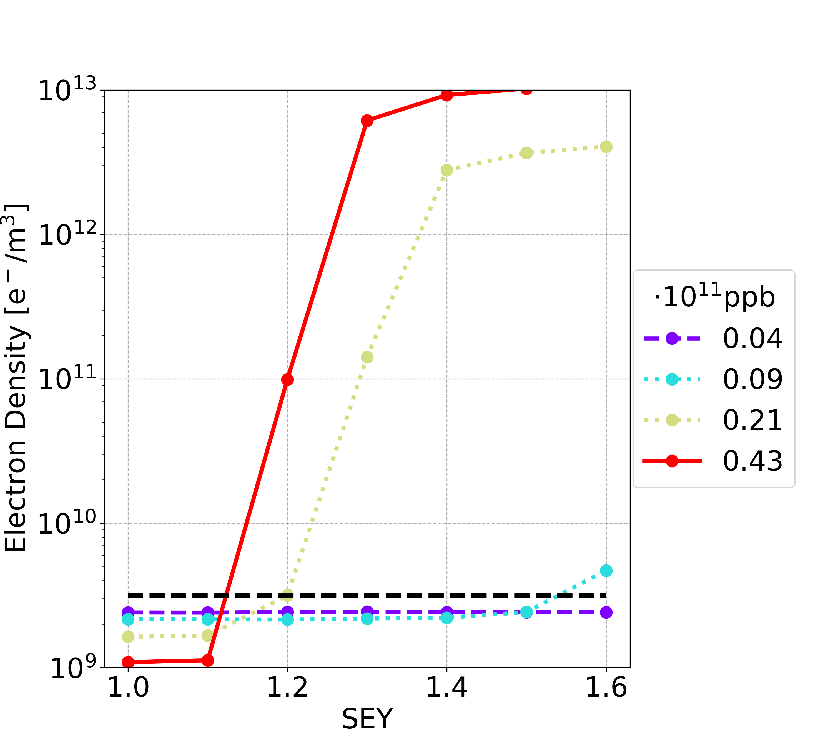
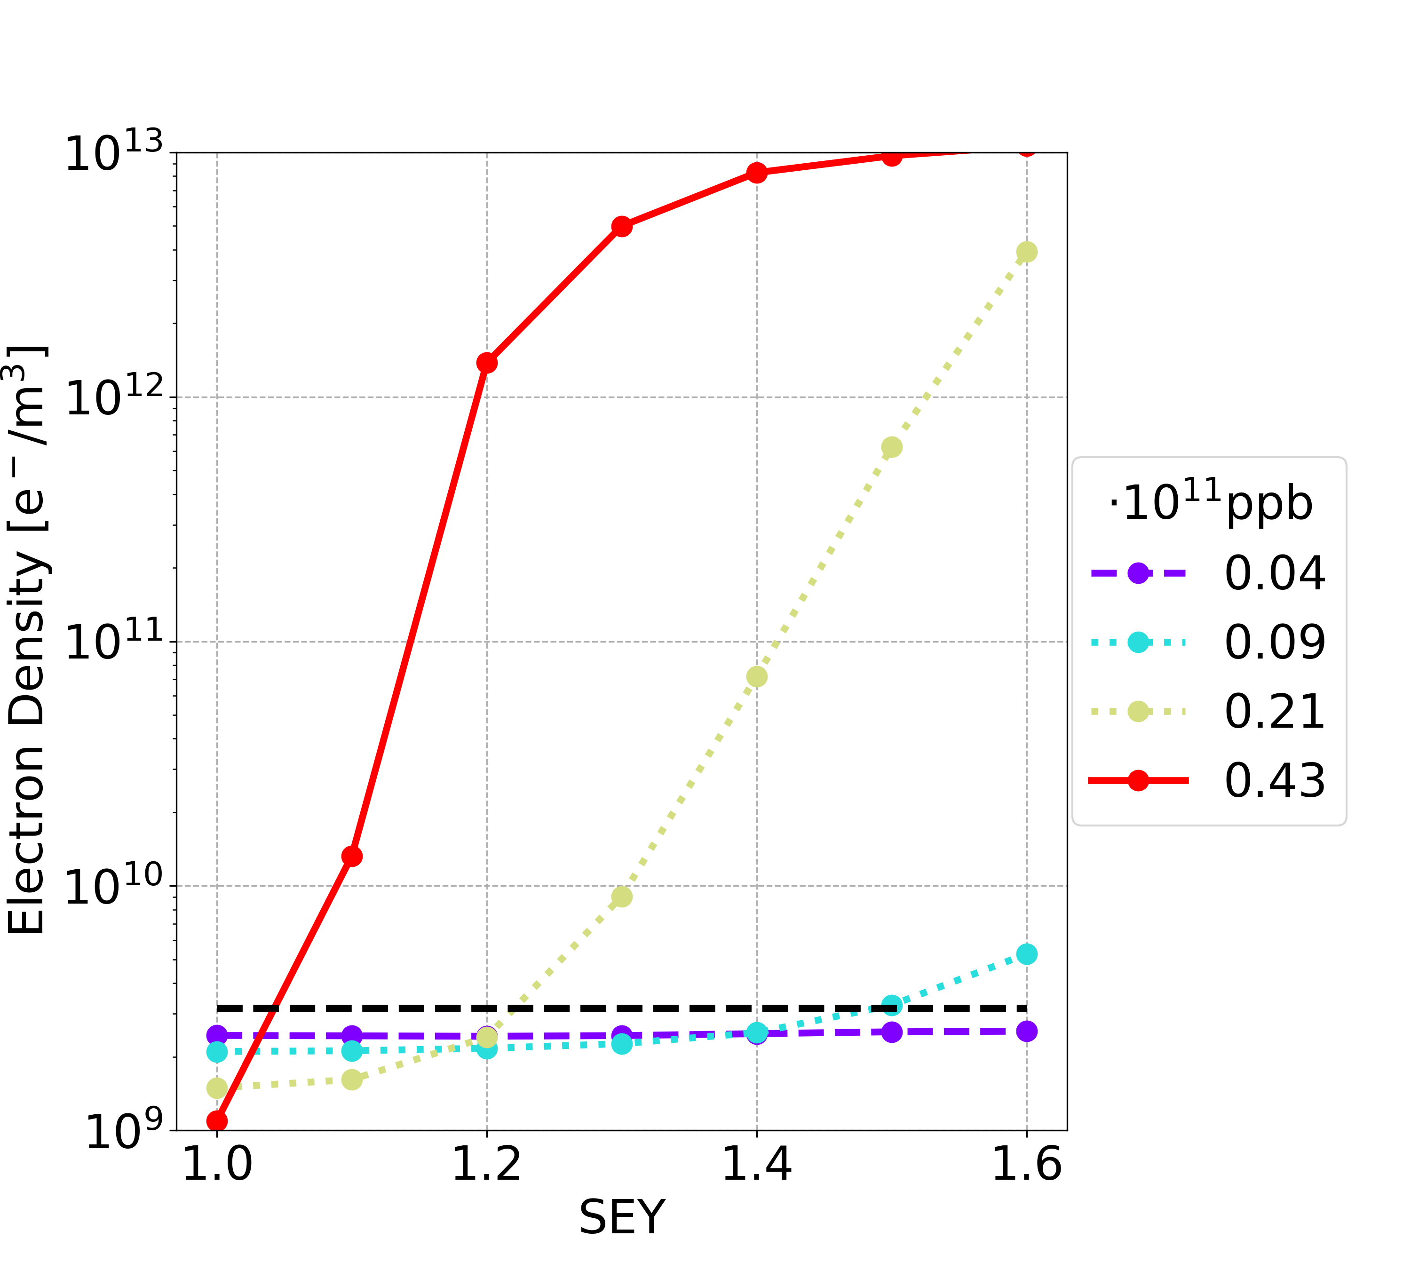
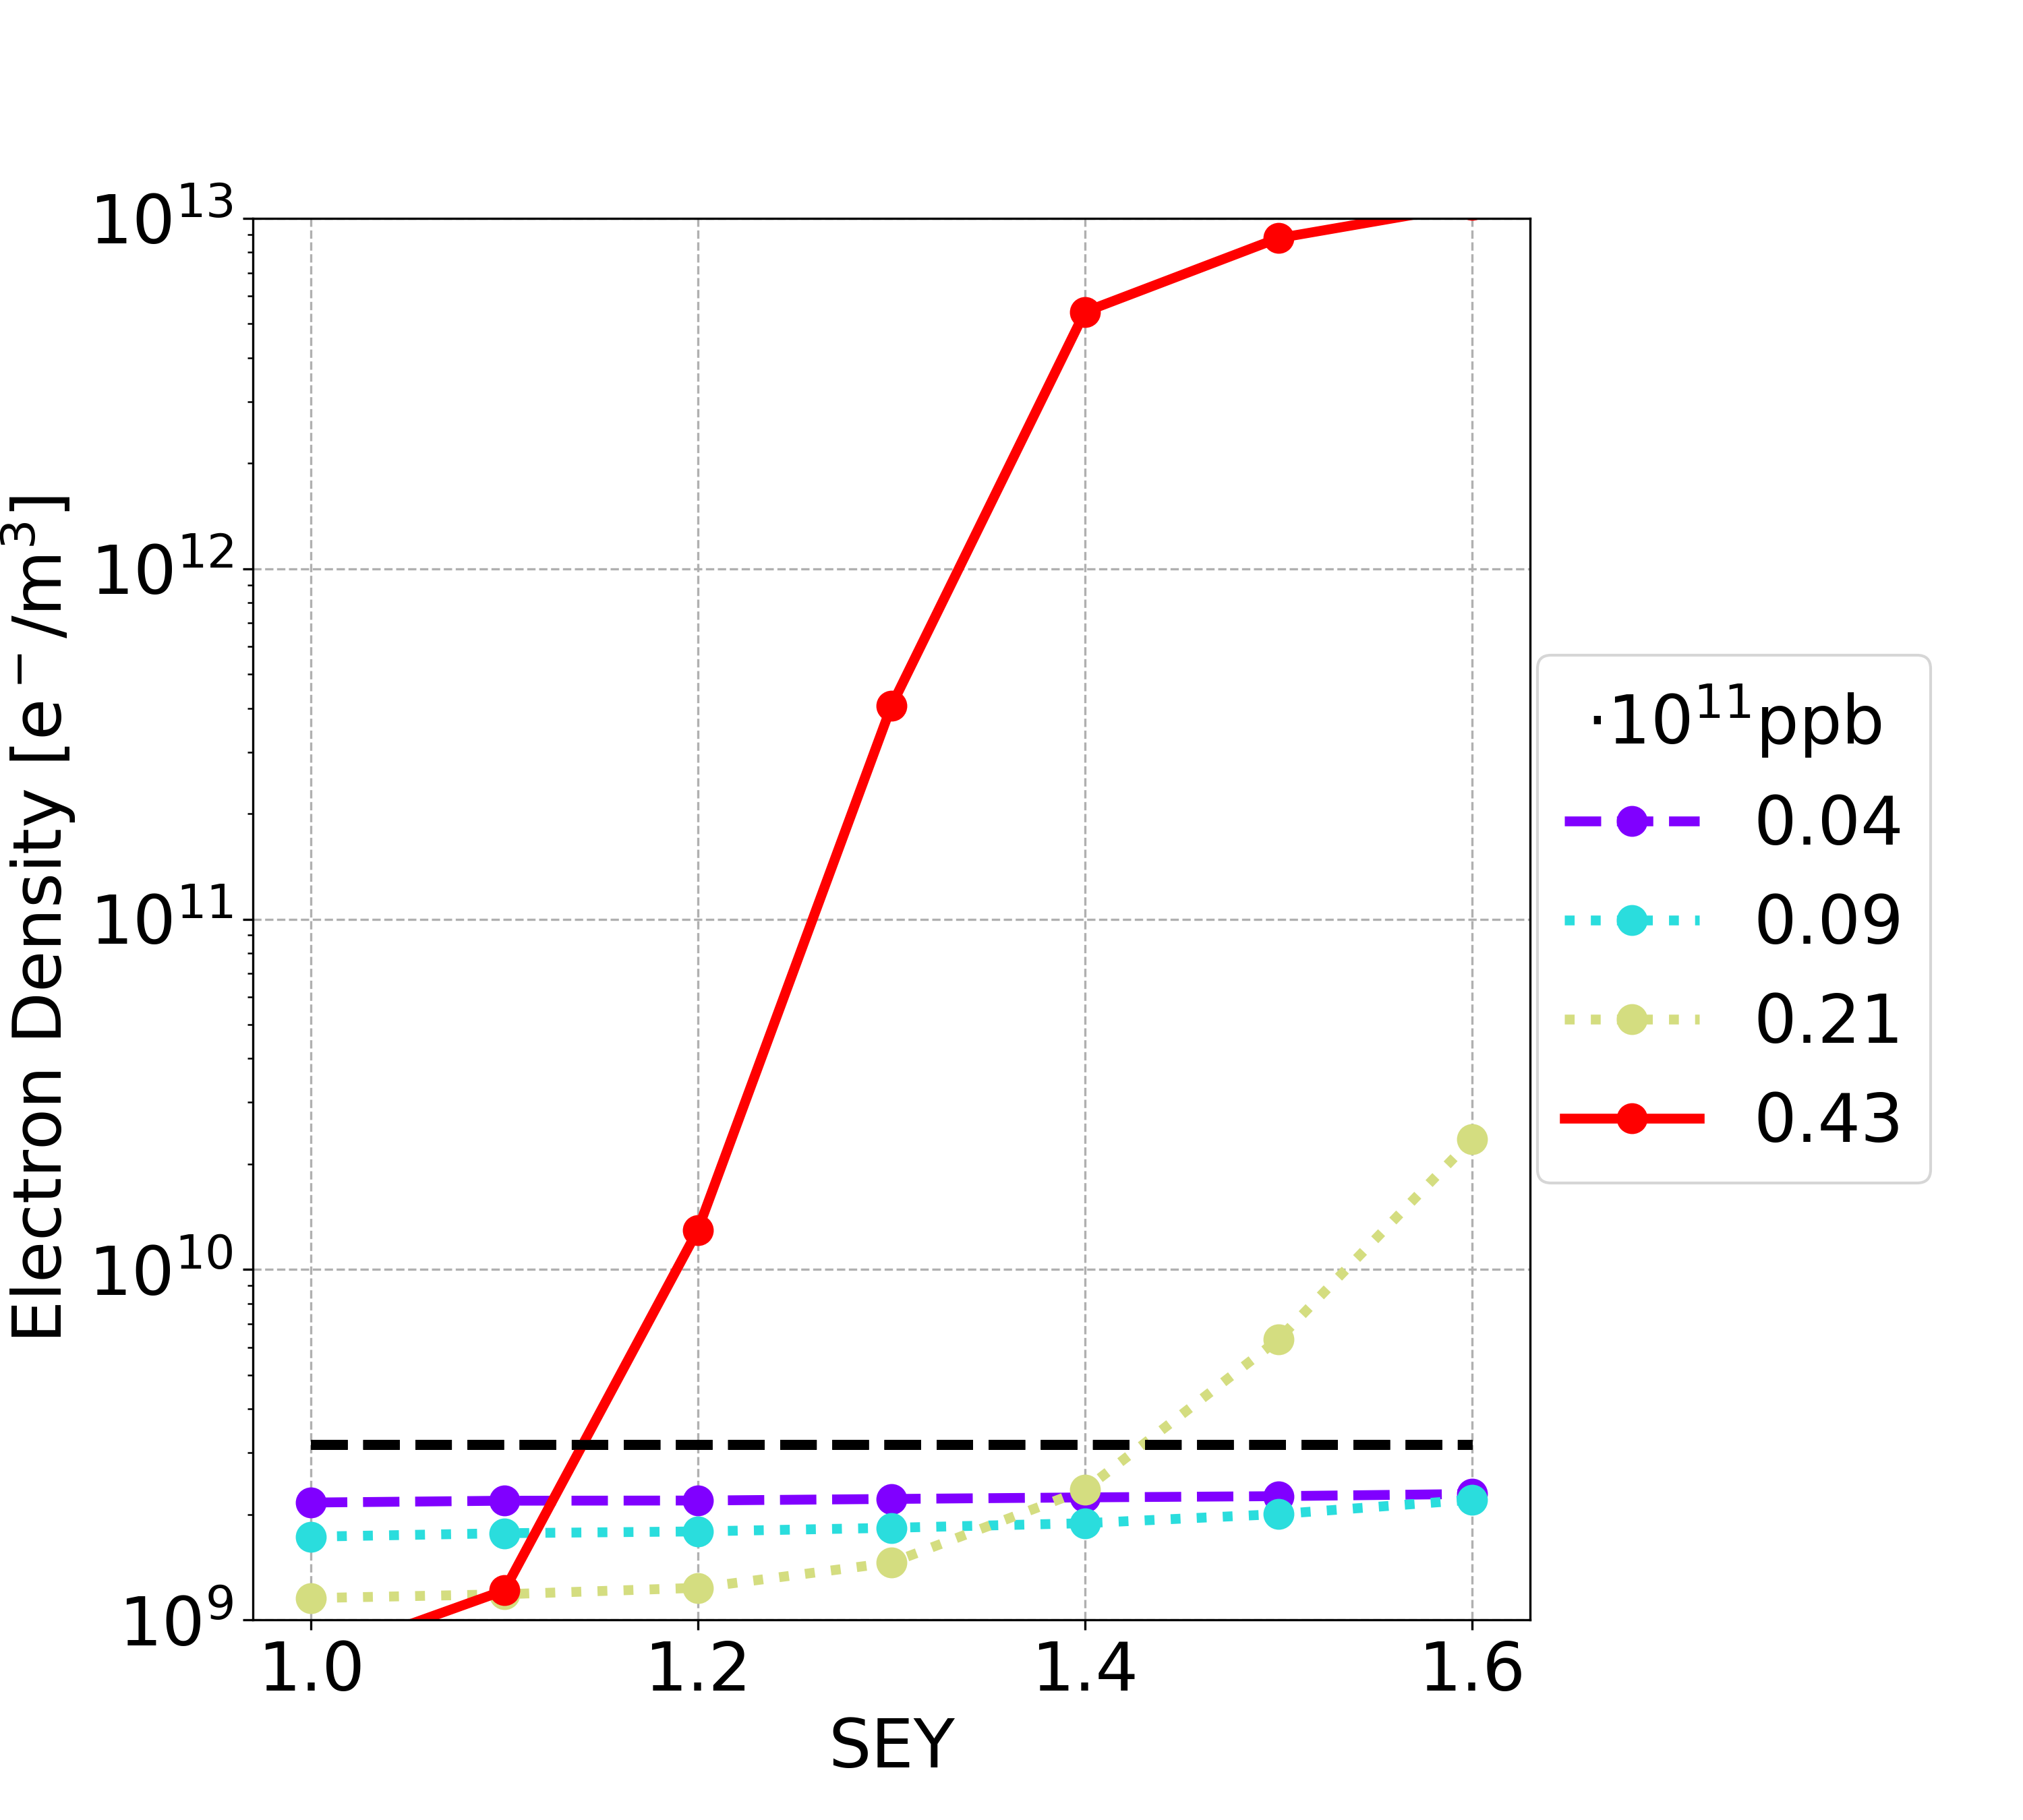
5 ns Uniform Bunch Spacing (56,000 bunches)
Drift
Dipole
Quadrupole
Sextupole
Analysed ranges
Bunch spacing: from 25 ns down to 5 ns
Total number of bunches per train: from 280 up to 1,400 (Number of trains 40)
Nominal bunch intensity: from 0.43e11 ppb down to 4.3e10

Slide 32
Comparison 25 and 5ns Uniform Bunch Spacing
Element | Field | Bunch population | 25 ns | 5 ns
Dipole | 15.2 mT | nominal | 1.4 | 1.2
 |  | below nominal | 1.0
Drift Space | - | nominal | 1.4 | 1.1
 |  | below nominal | 1.2
Quadrupole | 1.45 T/m | nominal | 1.1 | 1.0
 |  | below nominal | 1.0
Sextupole | 72.5 T/m² | nominal | 1.1 | 1.1
 |  | below nominal | 1.0
5 ns uniform bunch spacing
e-cloud density are higher when there is multipacting
Considering the nominal case the SEY multipacting thresholds are lower

Slide 33
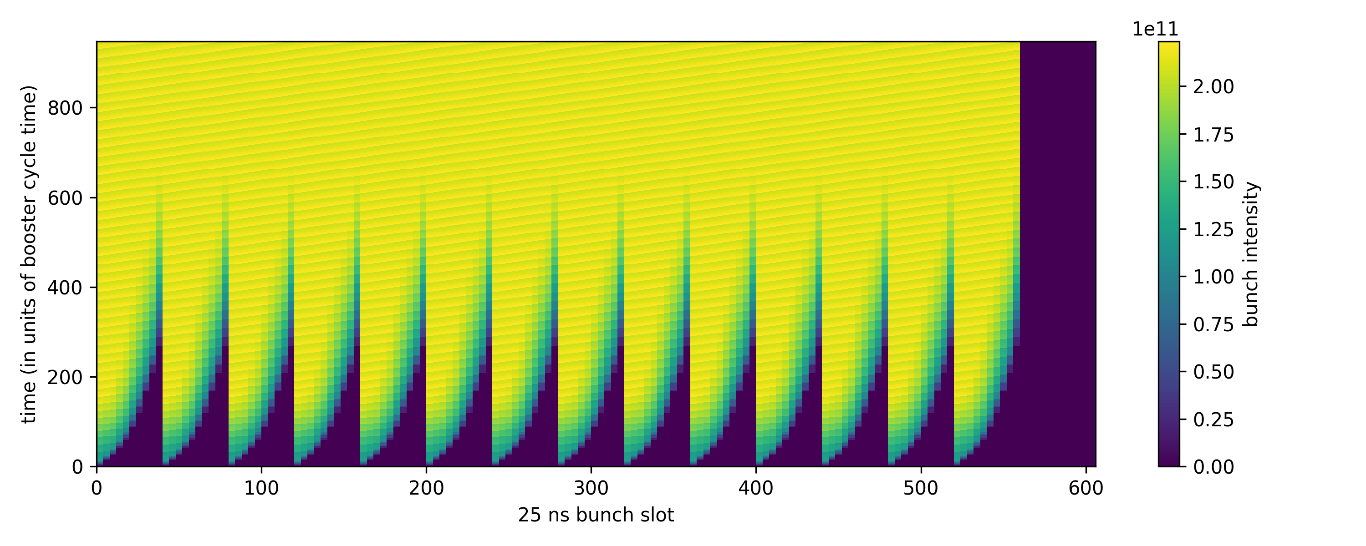
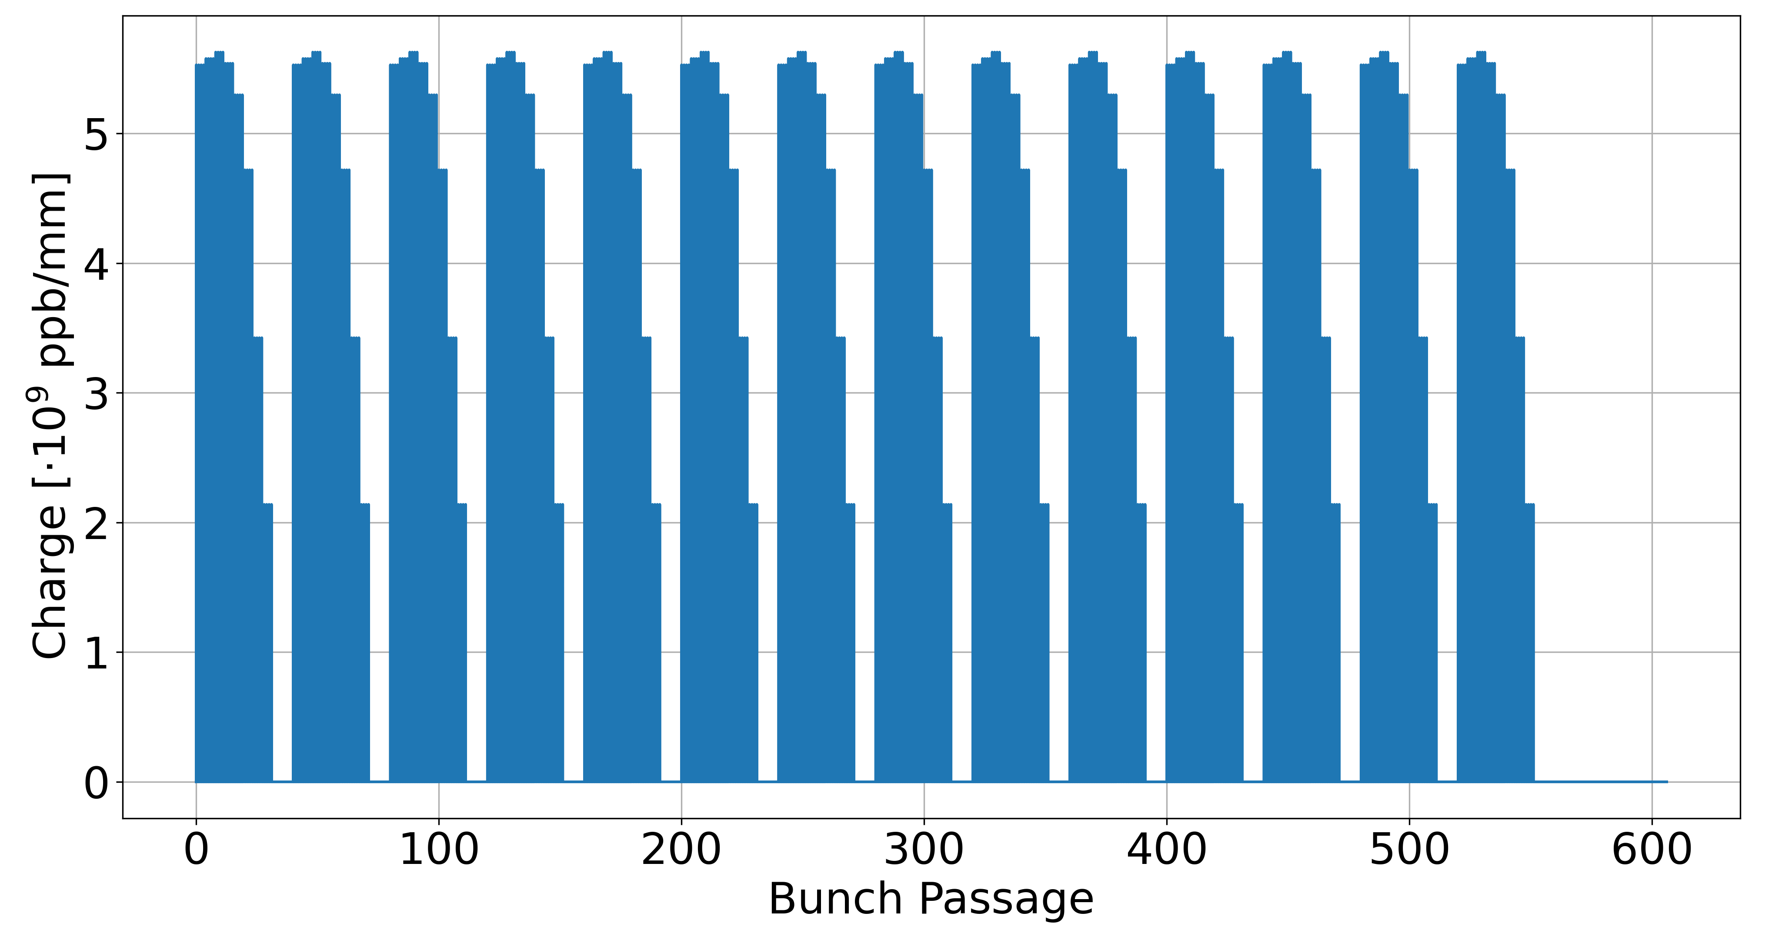

Charge Accumulation Phase
Option 1
Option 2
Option: 1 Booster Cycle: 200
Courtesy of Hannes Bartosik (FCC week 2024)

Slide 34
Mitigation: Non-Uniform reduced bunch spacing
Analysed trains with uniform bunch spacing
Trains with 25 ns bunch spacing
Trains with smaller bunch spacing and with small gaps in order to mitigate the e-cloud (keeping the same train duration):
Trains with 10 ns bunch spacing (2 bunches + 3 empty bunches)
1 2 3 280
...
Time [ns]
0 25 50
1 2 3 280
...
e e e
Time [ns]
0 10 20 30 40 50

Slide 35
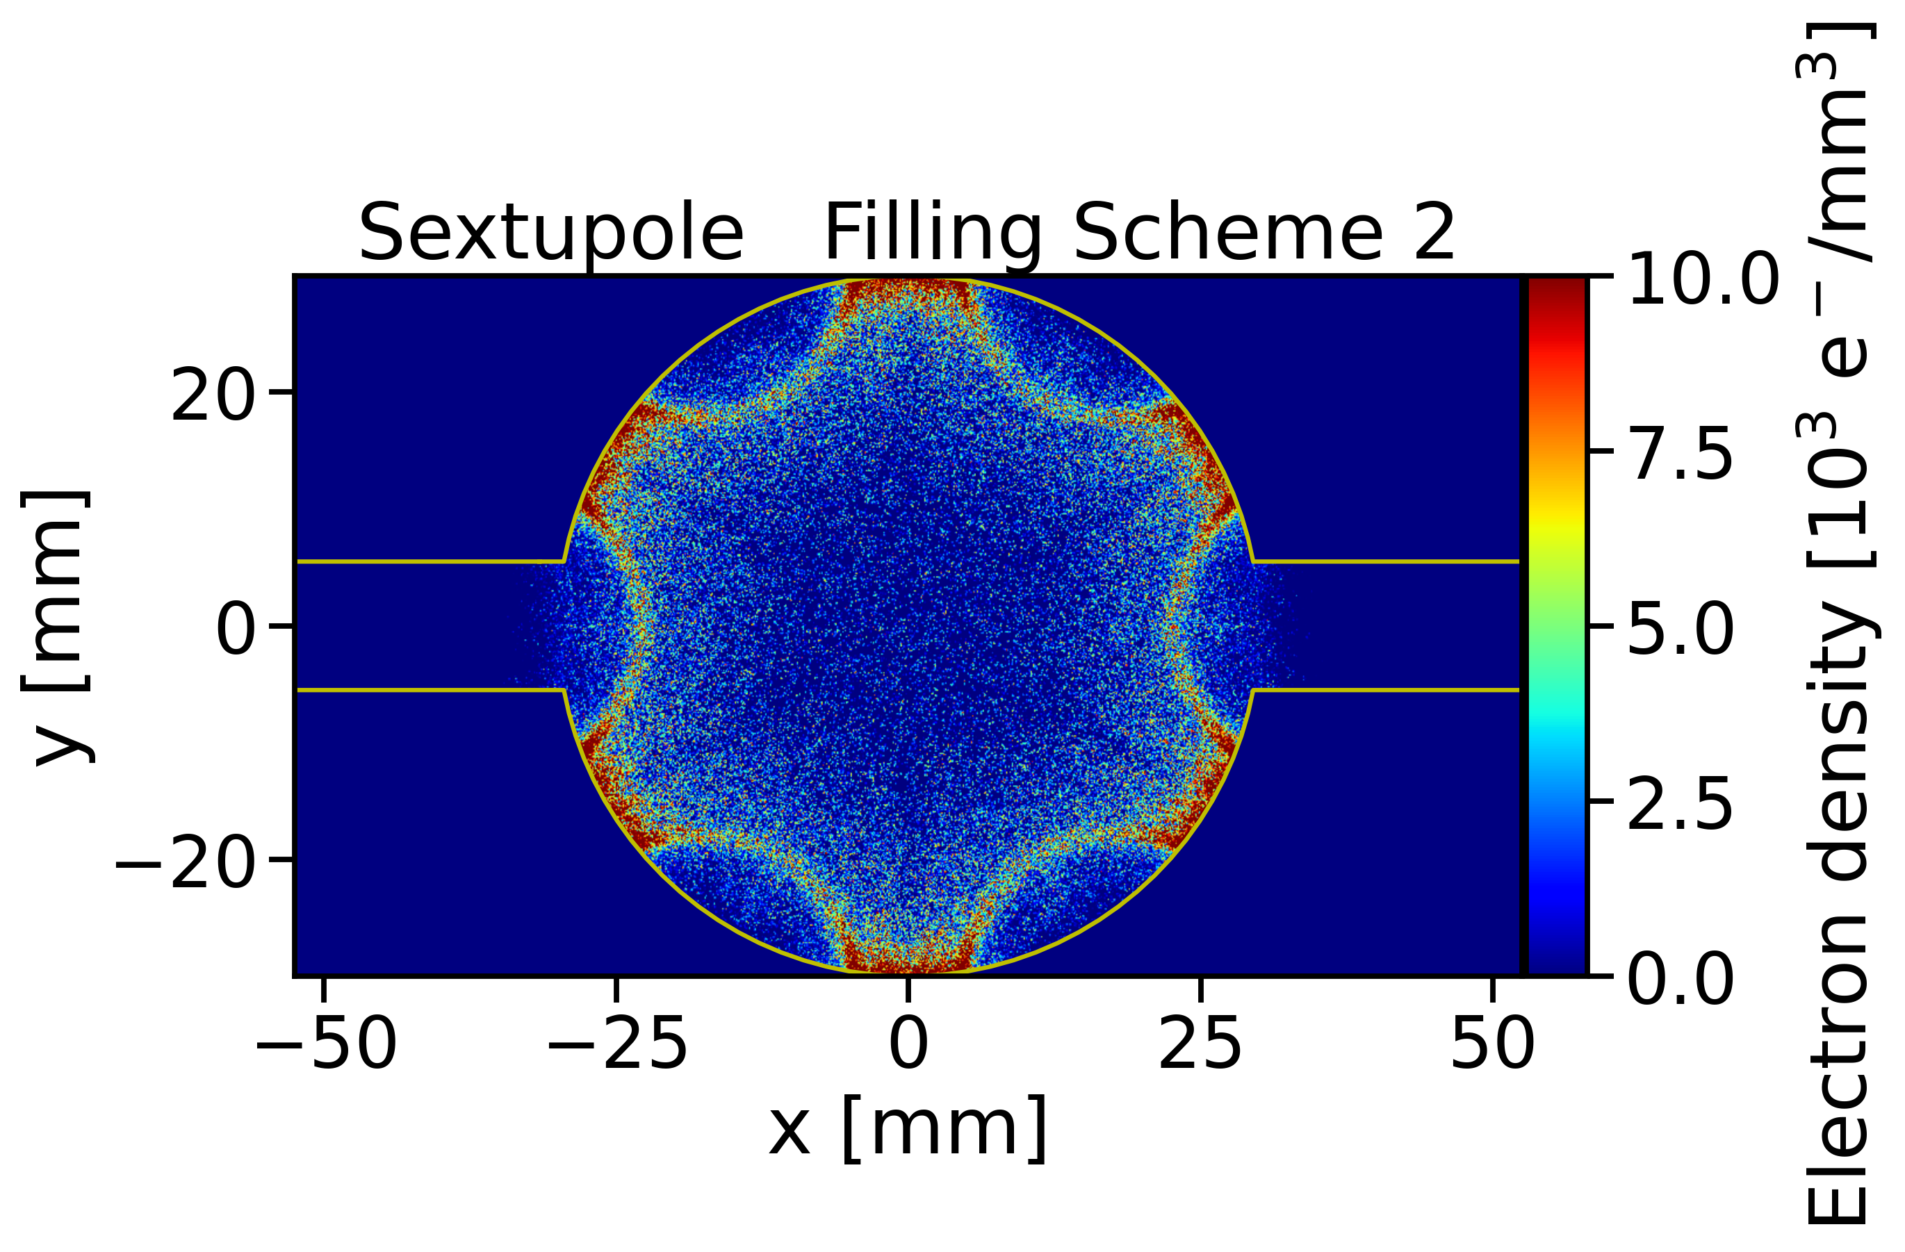
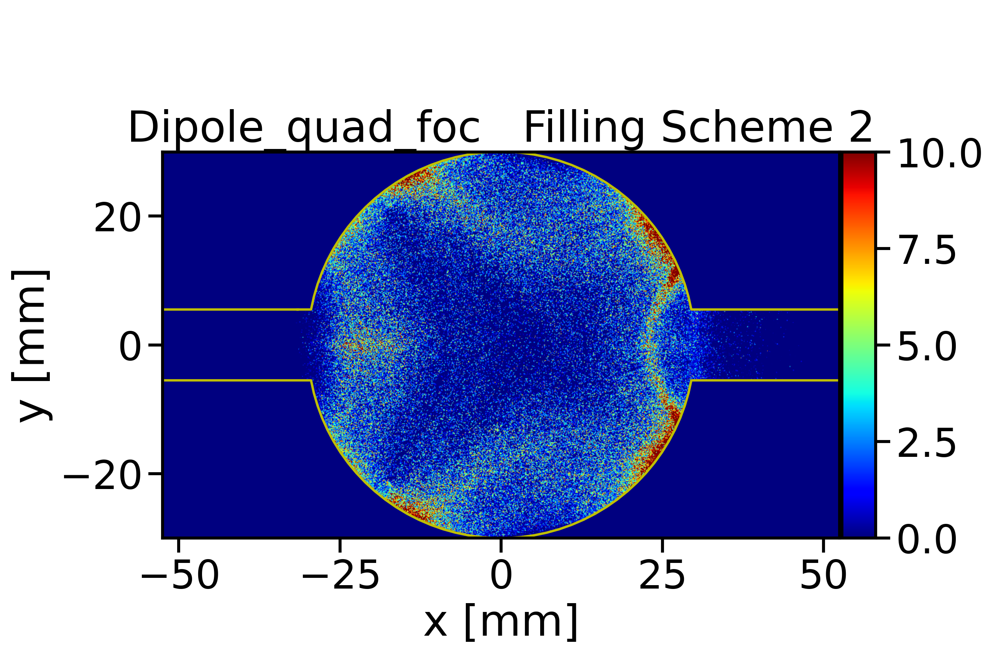
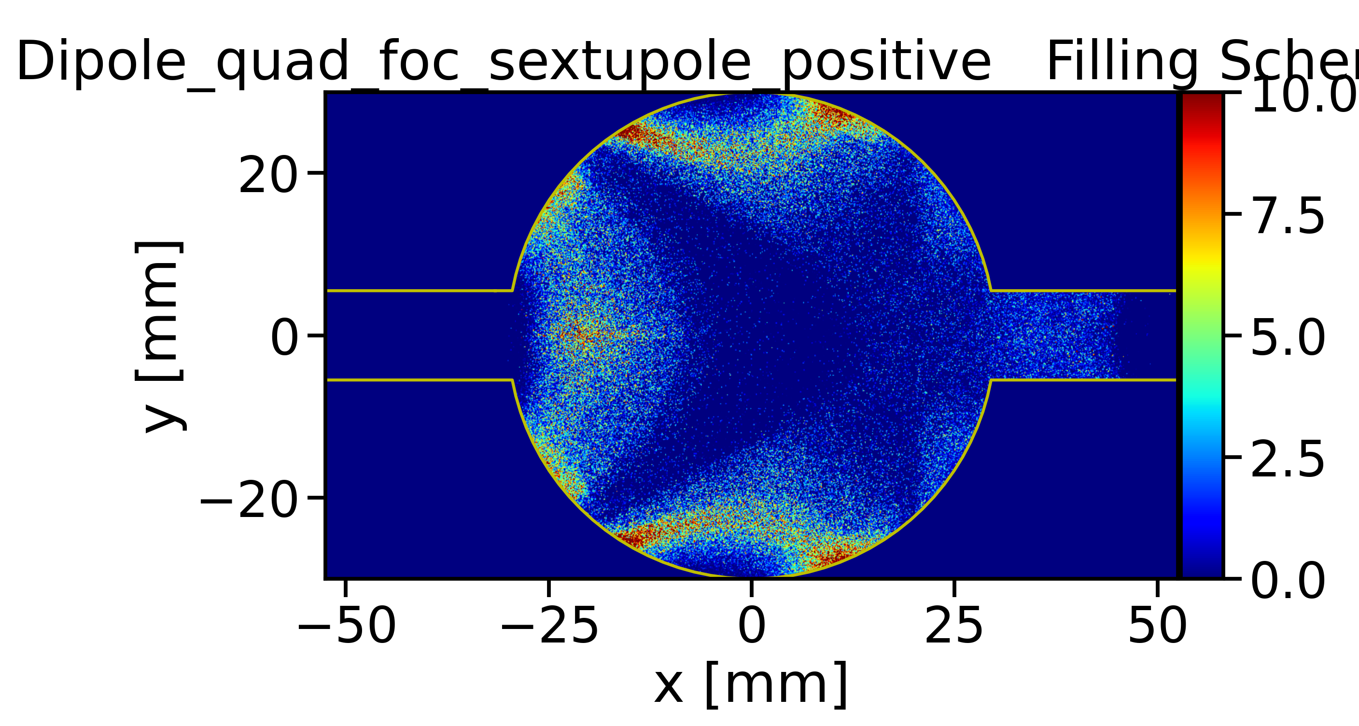
Outlooks: Nested Magnets
Nested Magnets under exploration by overlapping dipole fields with arc quadrupoles and sextupoles
Thereby increasing the dipole filling factor and reducing the synchrotron radiation
On going development on HTS SSS magnets development (Koratzinos et al.)
On going studies on nested magnet alternative optics (more details in L. Van Riesen-Haupt presentation)
The configurations with nested magnets have to be studied from the e-cloud point of view
Dipole
Quadrupole
Sextupole
Dipole + Quadrupole
Dipole + Quadrupole + Sextupole
10.0

