Slide 1
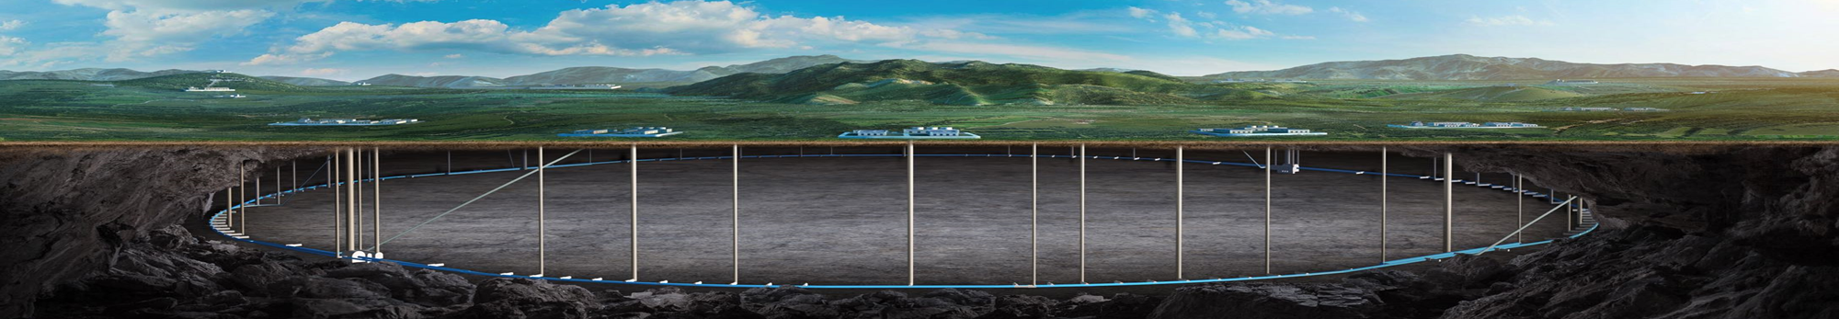

CEPC Alignment and Installation
Wang xiaolong
On behalf of CEPC Alignment and Installation Group
HKUST IAS Program on Fundamental Physics
Jan. 12-16, 2026, Hongkong

Slide 2
Contents
  Introduction
  CEPC alignment work progress
  summary

Slide 3
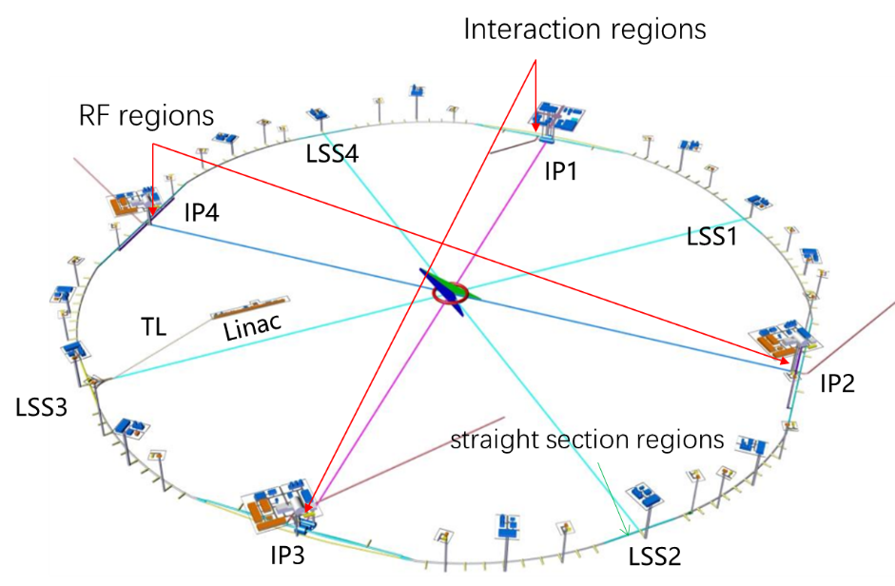
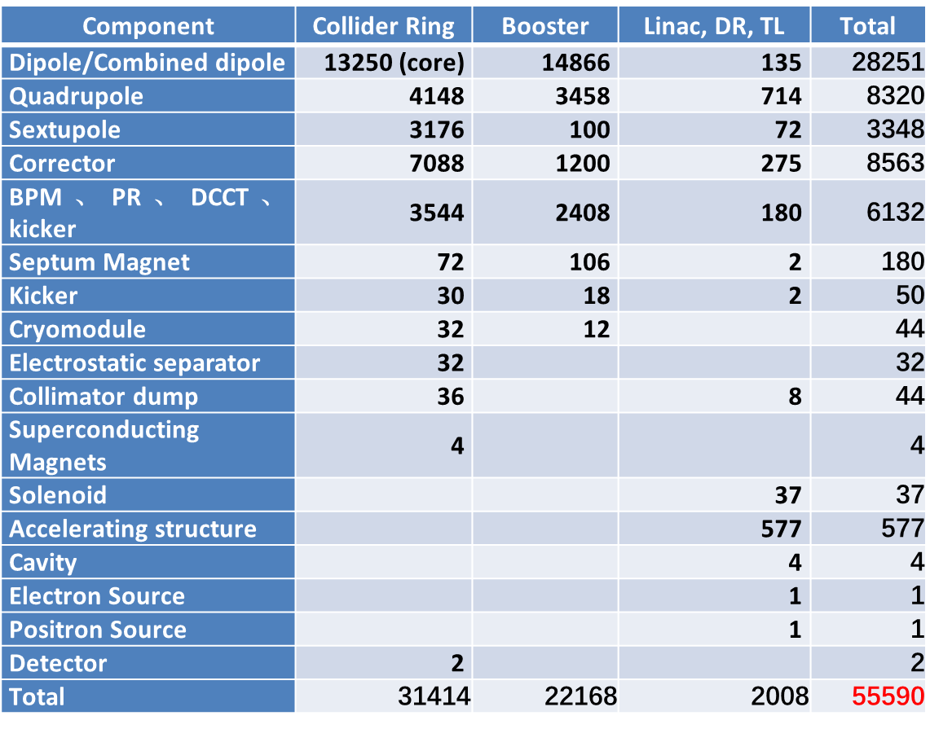
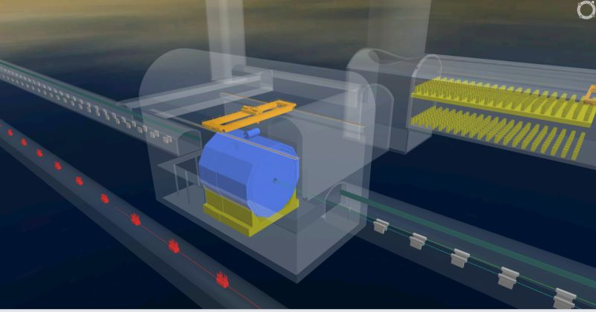
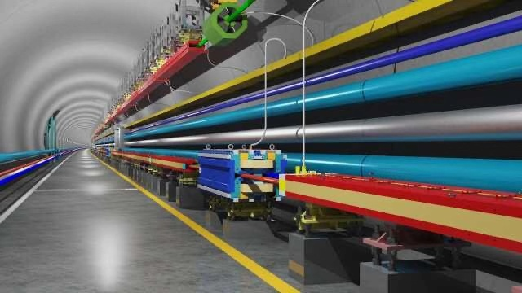
Introduction
1.6km
1.5km
Detector
Ring tunnel
Tunnel cross section：6×5m

Slide 4
Introduction
Accelerator component alignment accuracy requirement
Relative position accuracy requirement of adjacent components（1 σ）
Component | Transversal/mm | Vertical /mm | Longitudinal/mm | Roll /mrad | Pitch /mrad | Yaw /mrad
Dipole | 0.1 | 0.1 | 0.3 | 0.1 | 0.2 | 0.2
Quadrupole | 0.1 | 0.1 | 0.2 | 0.1 | 0.2 | 0.2
Sextupole | 0.1 | 0.1 | 0.2 | 0.1 | 0.2 | 0.2
Booster combined magnet | 0.2 | 0.2 | 0.3 | 0.3 | 0.2 | 0.2
Corrector | 0.2 | 0.2 | 0.3 | 0.2 | 0.2 | 0.2
BPM | 0.2 | 0.2 | 0.3 | 0.2 | 0.2 | 0.2
Cryomodule | 0.5 | 0.5 | 1 | 0.3 | 0.3 | 0.3
Septum Magnet | 0.2 | 0.2 | 0.3 | 0.2 | 0.2 | 0.2
Kicker | 0.2 | 0.2 | 0.3 | 0.2 | 0.2 | 0.2
Electrostatic separator | 0.2 | 0.2 | 0.3 | 0.2 | 0.2 | 0.2
IR Quadrupole | 0.1 | 0.1 | 0.1 | 0.1 | 0.1 | 0.1
4

Slide 5
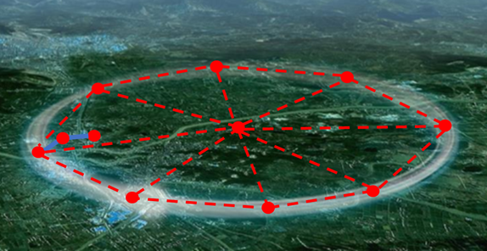
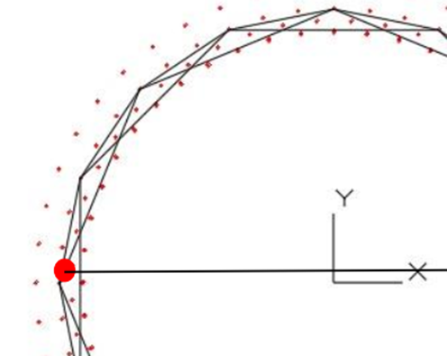
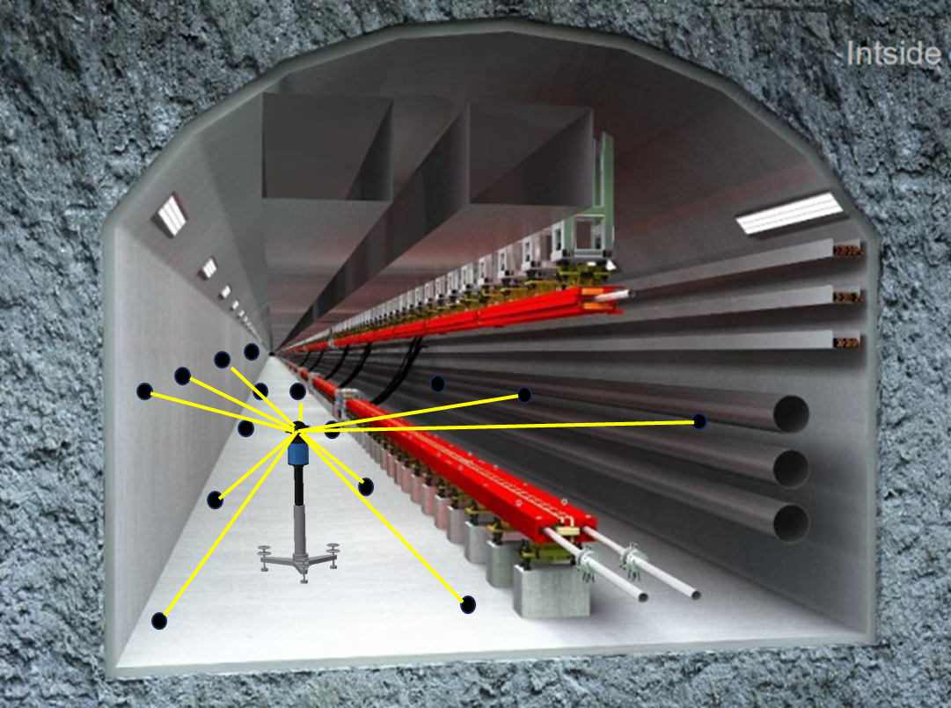
Introduction
  CEPC alignment technical route
    Build a high-precision quasi-geoid model as a global datum for the observations reduction;
    Establish a three-levels control network to provide a positional reference framework for component installation and control error accumulation;
Surface control network
Backbone control network
Tunnel control network
5

Slide 6
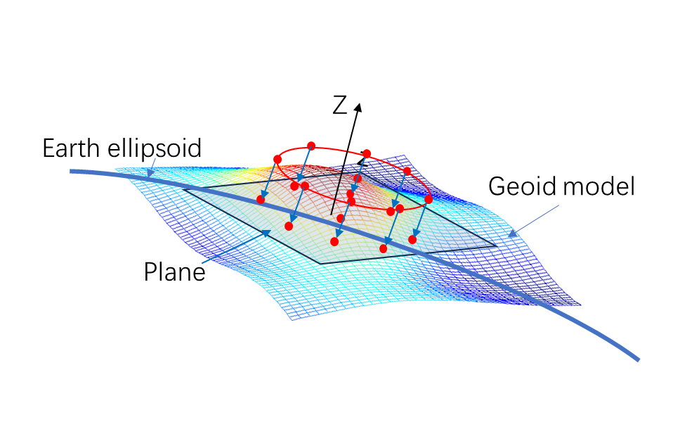
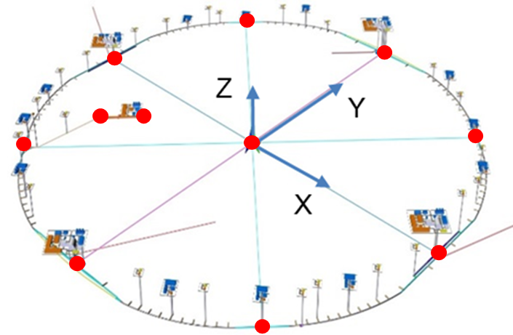
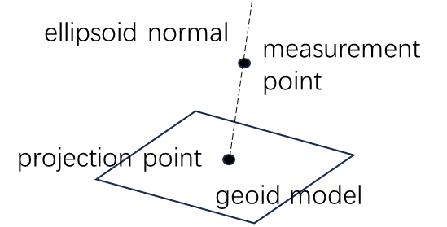
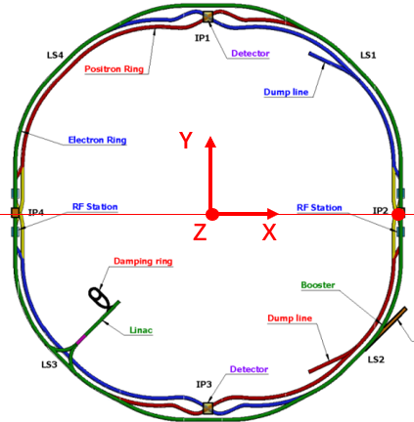
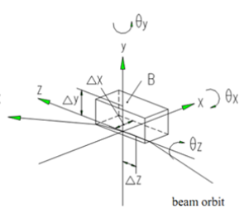
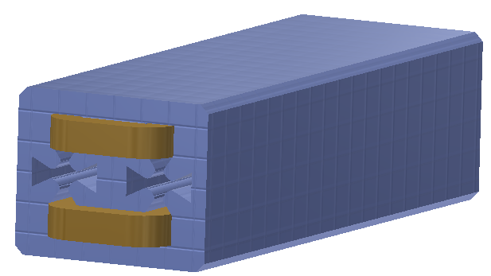
Introduction
    Based on CGCS2000, quasi-geoid model, surface network to establish CEPC coordinate system;
surface network
China Geodetic Coordinate System 2000 (CGCS2000)
    Through fiducialization and coordinate transformation to calculate the nominal coordinates of the component fiducials in CEPC coordinate system;
fiducialization
nominal coordinate calculation
fiducials
Z
Y
X
6

Slide 7
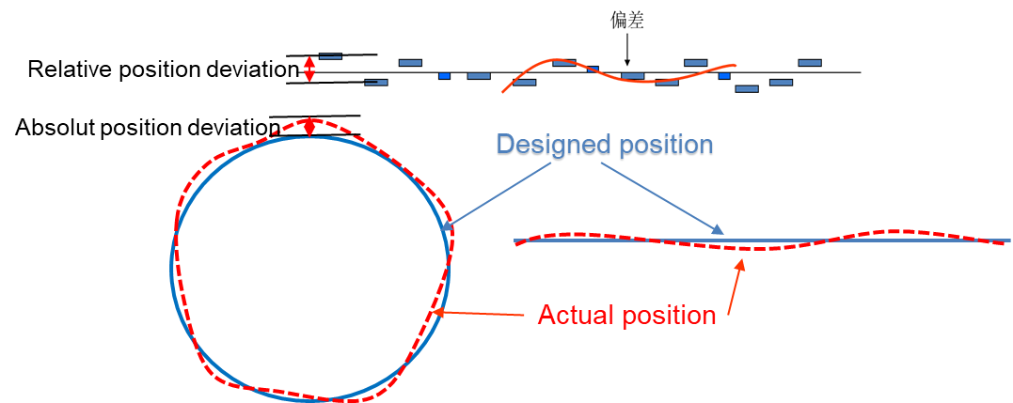
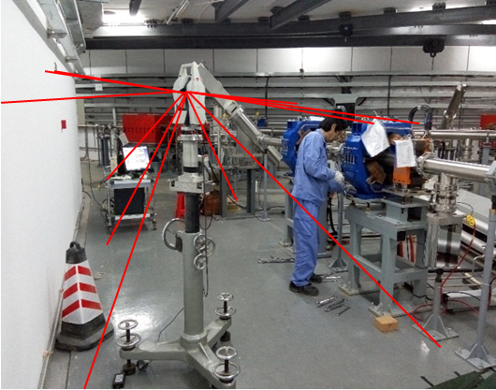
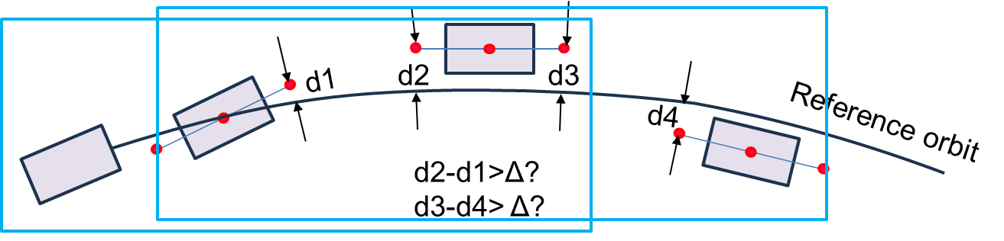
Introduction
    Use the control network as a positional reference, by measurement and adjustment to complete the component initial alignment.
    Through smooth alignment achieve the positional accuracy requirement.
Initial alignment
Smooth alignment
window
  Perform periodic survey and alignment to deal with the deformation problem.
7

Slide 8
CEPC Alignment work progress

Slide 9
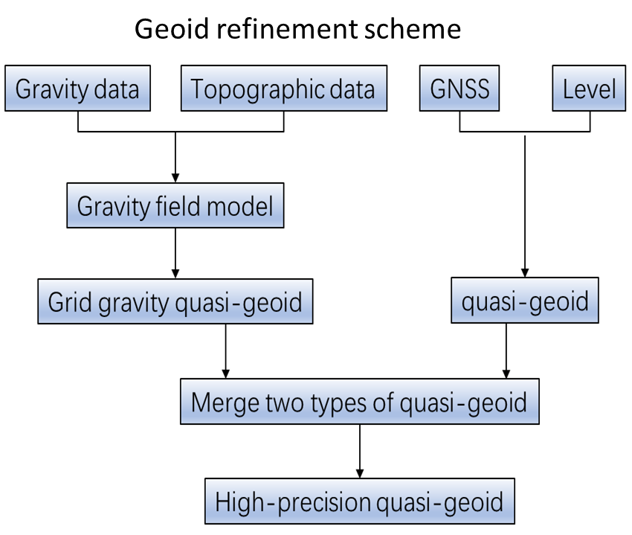
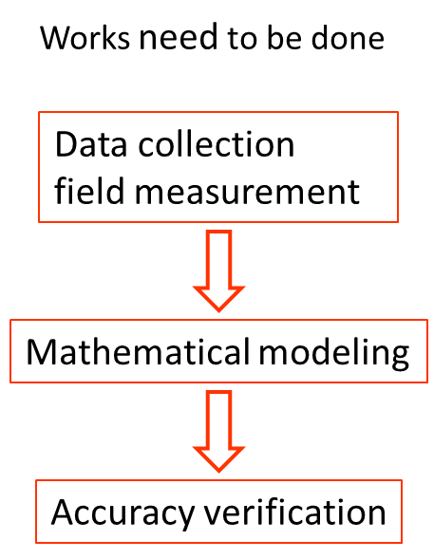
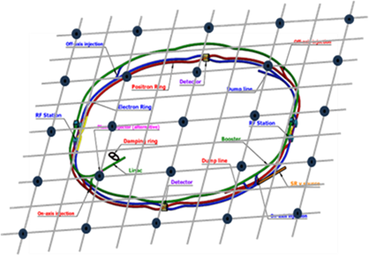
1、Geoid refinement
  Geoid refinement goal：To build a quasi-geoid model with 10mm elevation anomaly accuracy and 1″ vertical deflection accuracy.
  Collaborating with Wuhan University，a geoid refinement scheme based on gravity, GNSS, leveling and vertical measurement data has been developed.
Global coverage grid distribution measurement plan

Slide 10
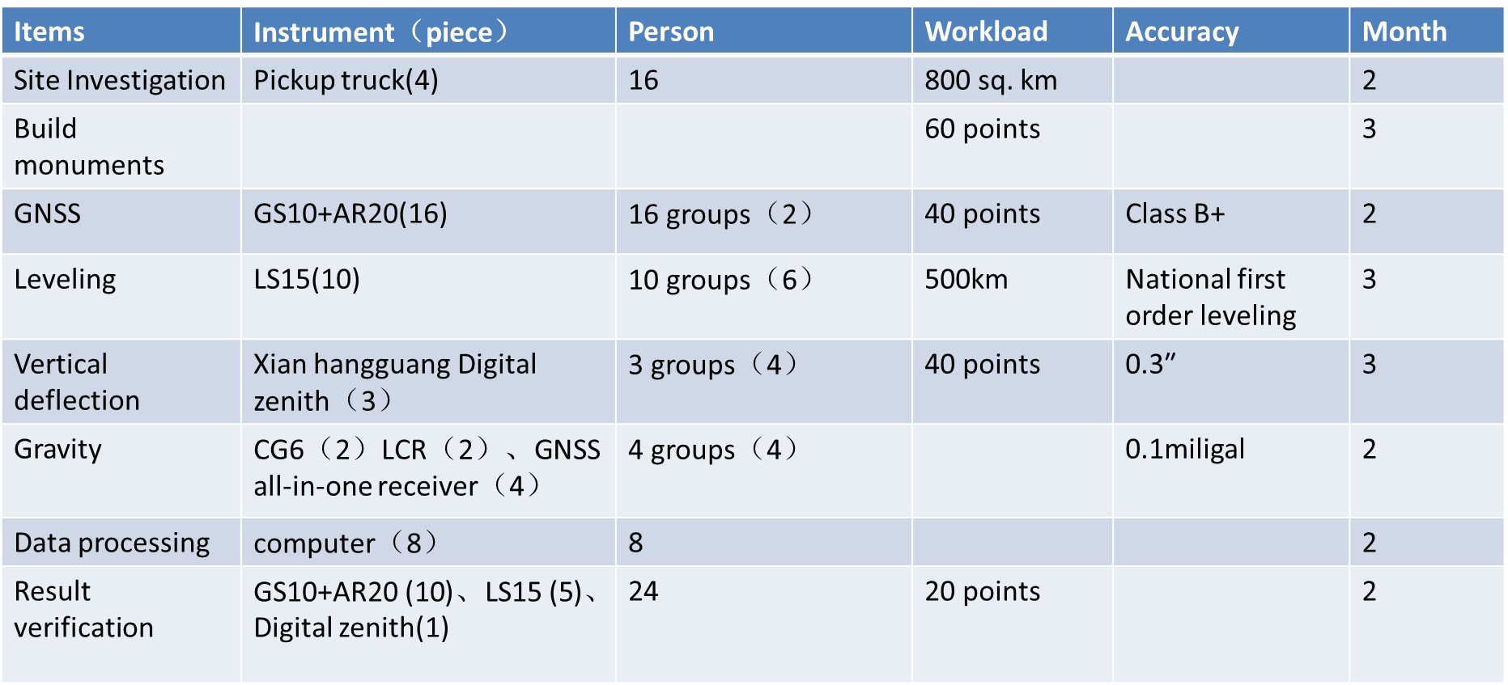
1、Geoid refinement
Geoid refinement work plan
  Take approximately one year.

Slide 11
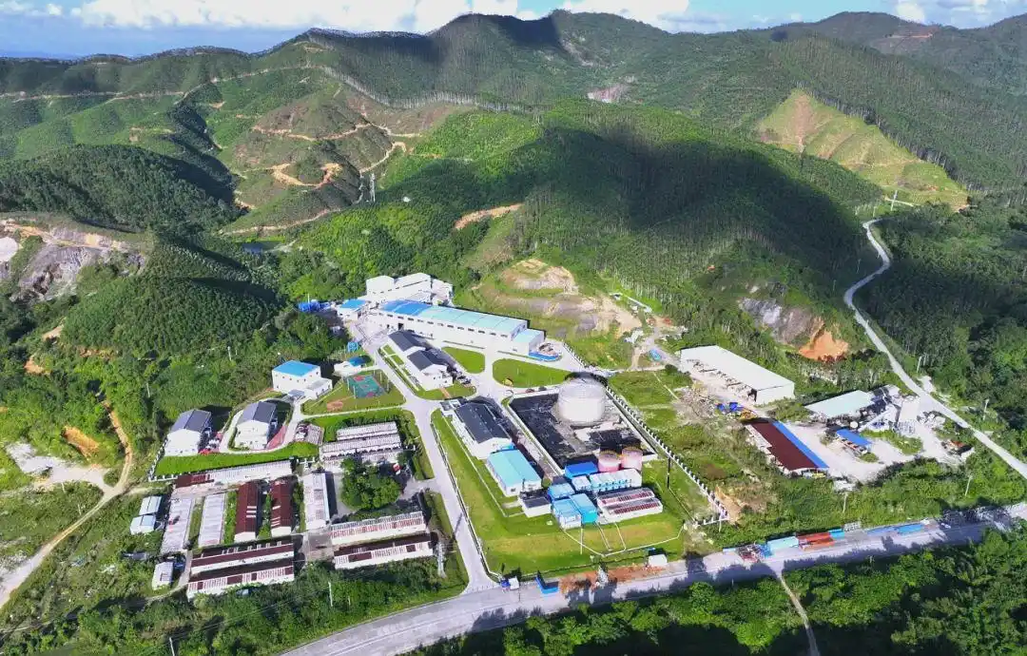
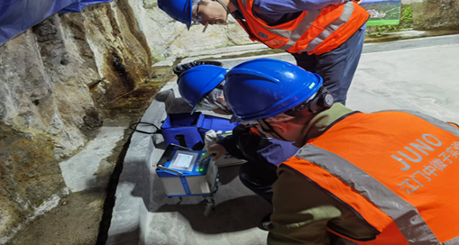
1、Geoid refinement
  Quasi-geoid model extension.
    Base on the ground quasi-geoid model, take into account the mass overlying the tunnel, the remove-restore method will be employed to extend the ground geoid model downward to the tunnel.
  Select JUNO as the experiment site.
  A field investigation and preliminary gravity measurement have been conducted.
  The measurement result shows the terrain mass above the tunnel has a significant impact on the measurement and must be considered for model extension.
  Next, carry out underground geoid refinement experiment when conditions permit.
Jiangmen Underground Neutrino Experiment
(JUNO)

Slide 12
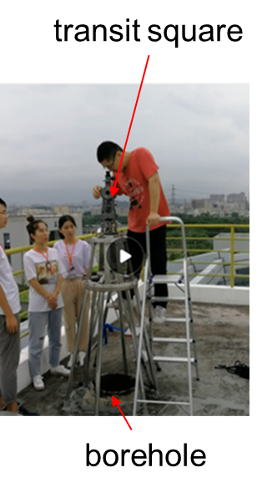
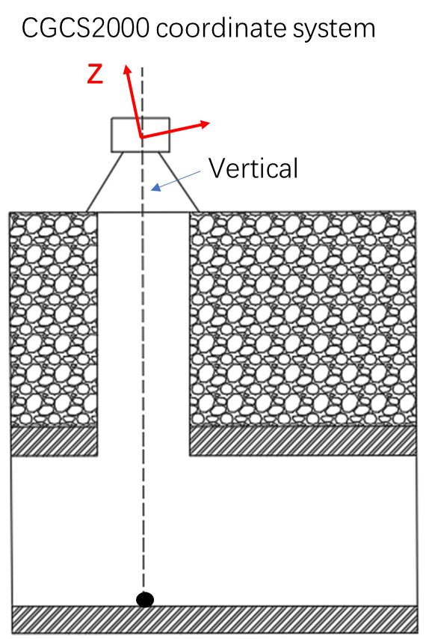
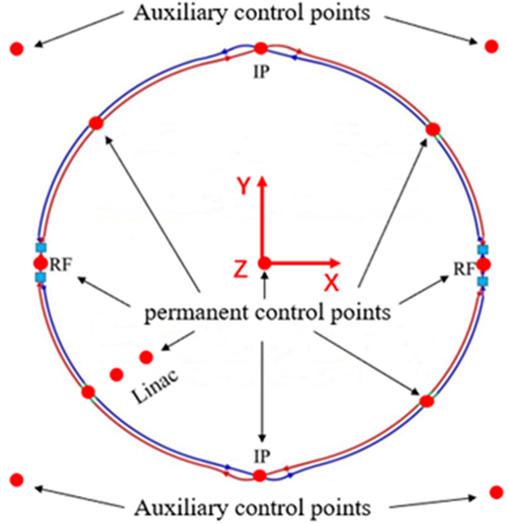
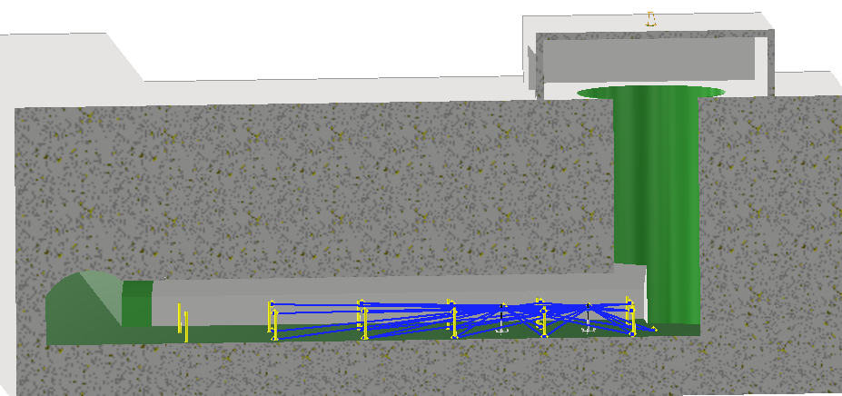
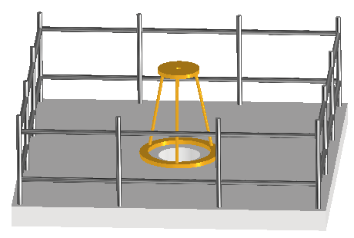
2、Surface network
  Surface network structure.
① Centering observation method
  Ring 8 points + 1 center point +2 linac points + Several auxiliary points.
  The height from ground to ring tunnel :50~300m.
Ground point
Tunnel permanent point
Sight hole
GNSS receiver
Ground
Ground point
shaft
Auxiliary tunnel
Ring tunnel
pillars
Laser tracker
Control point
Observation platform

Slide 13
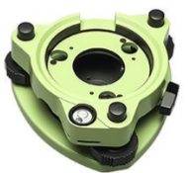
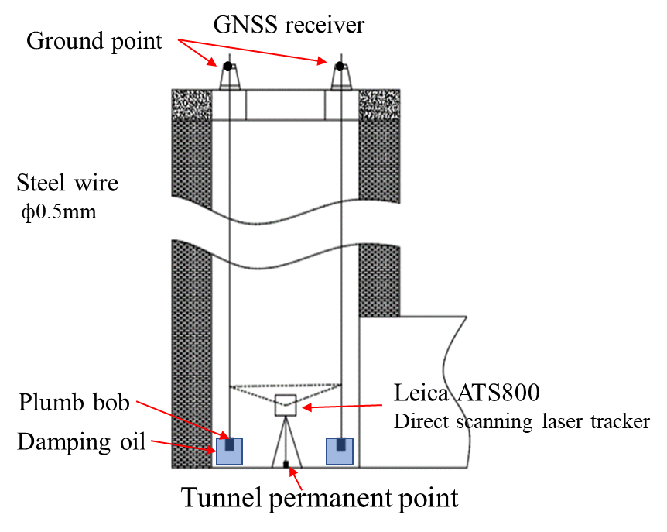
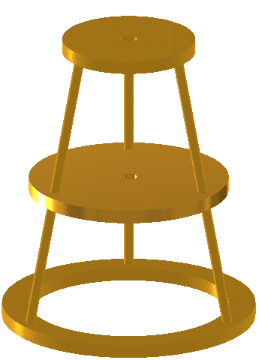
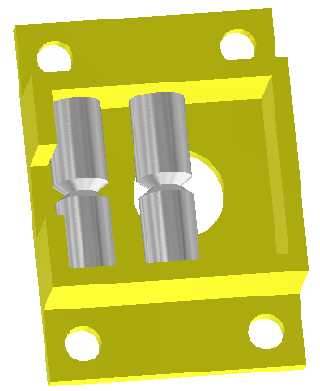
2、Surface network
Long distance vertical connection measurement.
Vertical
Instrument base
Groove
Wire positioning device
Tow-layer support

Slide 14
2、Surface network
Surface network measurement:
GNSS measurement
Measuring instrument | GNSS receivers (Leica GS10+AR20)
Group | 16×(2 persons)
Software | GAMIT
Time | 3 weeks
Accuracy | Horizontal ±5mm，Elevation ±10mm
Surface network observations processing:
  Using CGCS2000 coordinates of CORS stations around CEPC region as the known data, conducting GNSS observations adjustment to obtain the coordinates of each point in CGCS2000 .
  Based on CGCS2000, quasi-geoid model and surface network to establish CEPC coordinate system, then, obtain surface network coordinates in CEPC coordinate system.

Slide 15
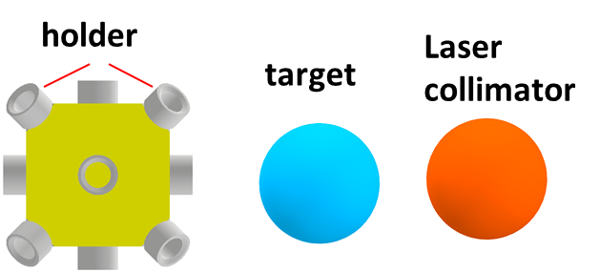
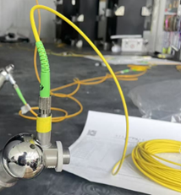
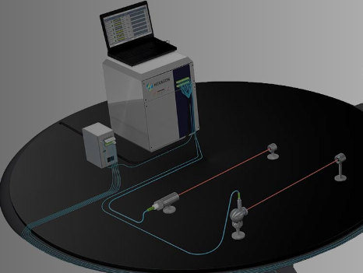
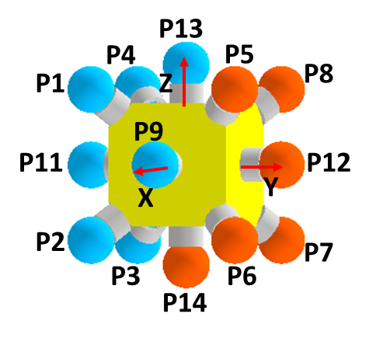
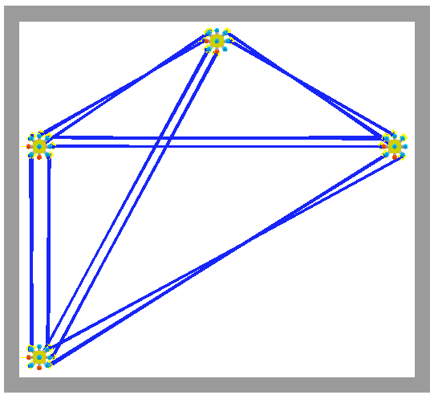
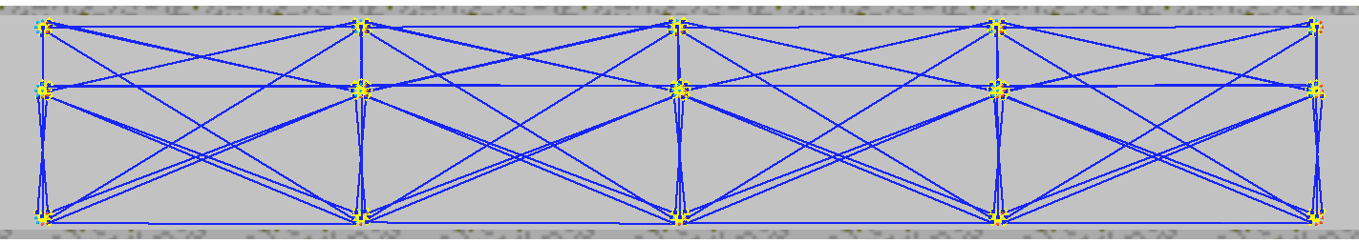
3、Laser monitoring network
In order to achieve automatic measurement of the tunnel control network and monitor tunnel deformation, a laser monitoring network was designed.
The coordinates of targets can be calculated by the laser ranging values.
Multiline laser ranging system
Node
C
B
Node
D
50m
laser
accelerator
Z
X
Z
A
Y

Slide 16
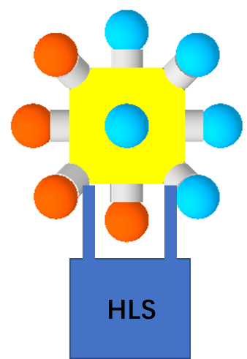
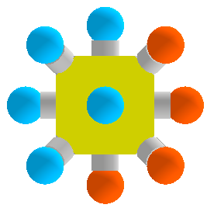
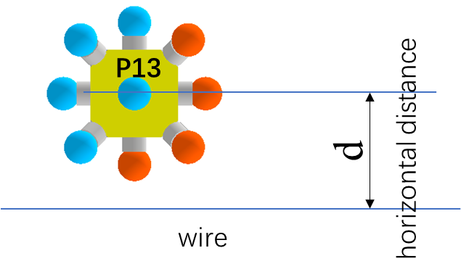
Laser monitoring network
Error accumulation control
  To control the vertical error accumulation, HLS are added on the A and D nodes.
  To control the transversal error accumulation, wires are added beside the B nodes.
C
B
Node
D
accelerator
Z
X
A
Top view
B
Y
W1
W3
W4
100m
W2
X

Slide 17
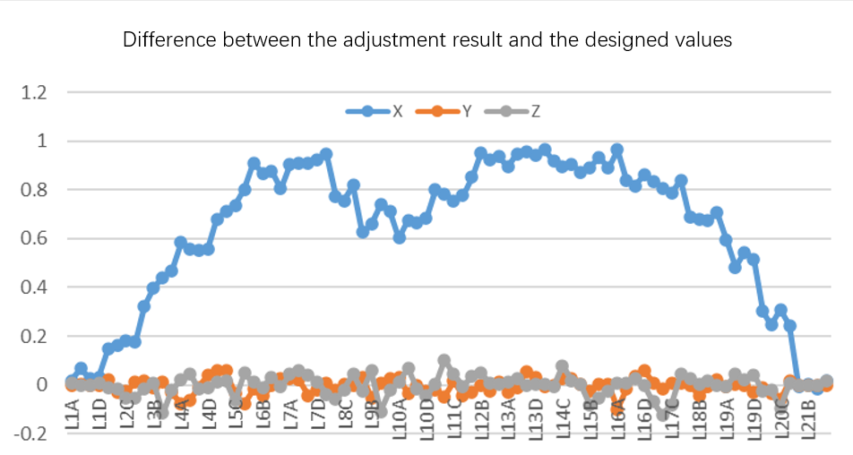
Laser monitoring network
Simulation of the laser monitoring network with HLS and wires constraint
  A 1km length laser monitoring network is designed, in total 84 nodes, 42 HLS sensors and 19 wires.
  The simulated distance observations between points, elevation observations of HLS and horizontal distances between the point and wire are generated.
  Quite good results have been achieved, the biggest error is smaller than 1mm.
Error /mm
Nodes along Y

Slide 18
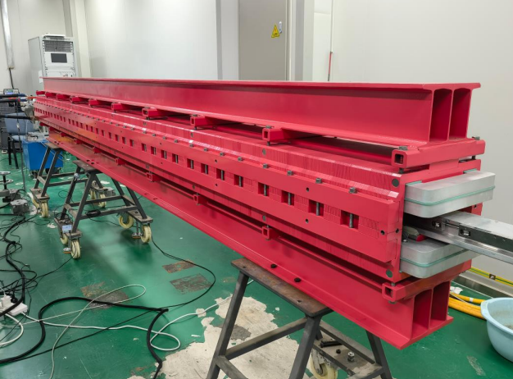
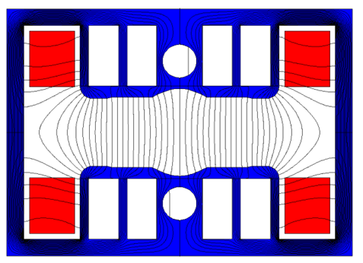
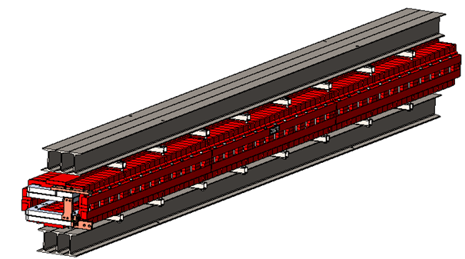
4、CEPC booster dipole-sextuple combined magnet
CEPC booster dipole-sextuple combined magnet has complex magnetic field form and slender mechanical structure, which bring challenges to the alignment.
A prototype of booster dipole-sextuple combined magnet has been fabricated. A series experiments is planned to be carried out to verify its alignment accuracy, consistency between the mechanical center and the magnetic center, and installation deformation.
Cross section of combined magnet
Reinforced steel beam
4.6m
0.4m
0.26m

Slide 19
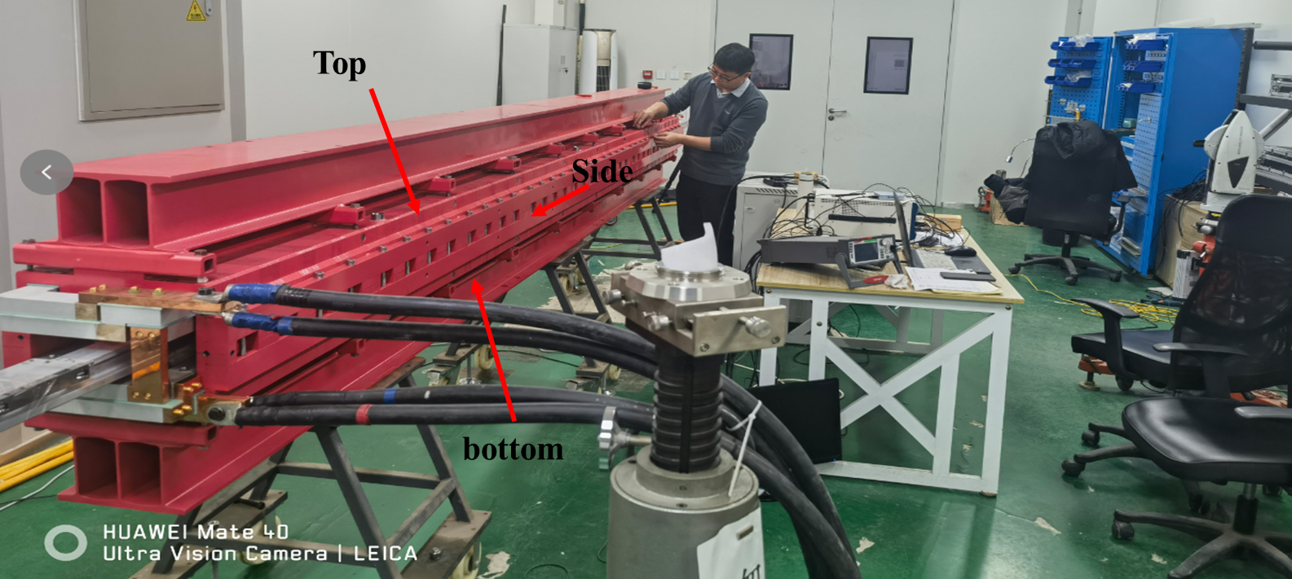
4、CEPC booster dipole-sextuple combined magnet
The magnet was supported by 3 supports, its top surfaces directly above the supports were leveled to the same height, better than 0.03mm.
South
North

Slide 20
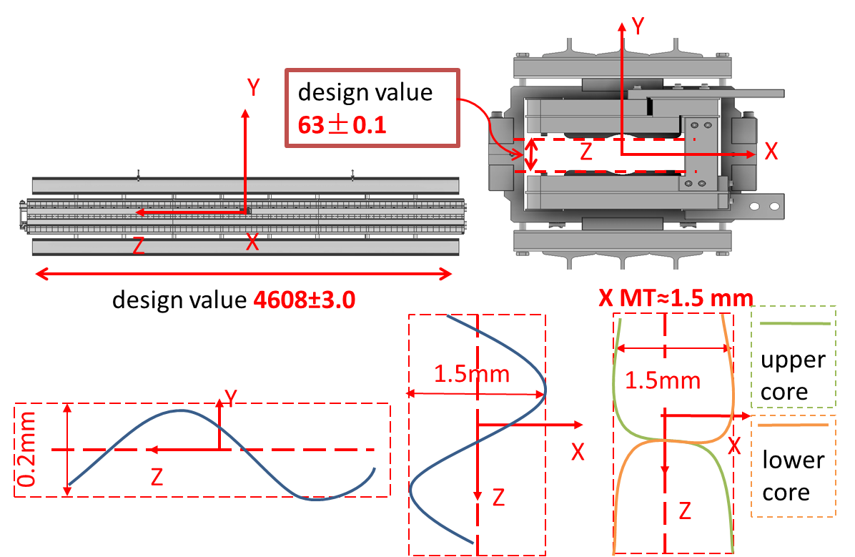
4、CEPC booster dipole-sextuple combined magnet
Magnet shape inspection.
Combined magnet design indicators
transversal
vertical

Slide 21
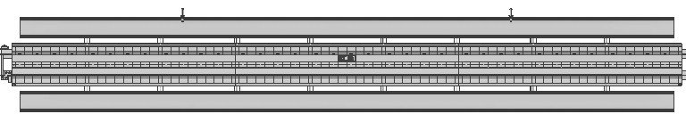
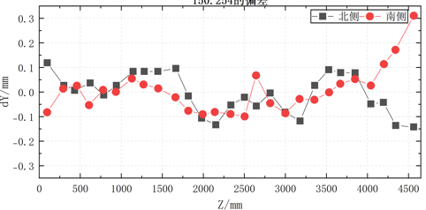
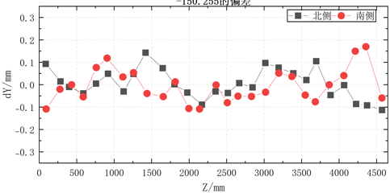


4、CEPC booster dipole-sextuple combined magnet
Y
  The top, both sides and bottom surfaces are measured by a laser tracker.
Z
X
The magnet straightness is better than the design indicator (1.5mm in x),
Deviation of the measurement points from their mean (flatness)
Top surface
bottom surface
max | 0.30mm
min | -0.15mm
max | 0.17mm
min | -0.11mm
North side
South side
max | 0.38mm
min | -0.41mm
max | 0.38mm
min | -0.71mm

Slide 22



4、CEPC booster dipole-sextuple combined magnet
Mechanical center measurement experiment.
Middle plane
12 inserting plates
505mm
Y
Middle plane
Z
X
Inserting plate
Intersection line (mechanical center)
  Two mechanical center measurement methods were compared: based on inserting plates vs based on full-length measurement.
  The purpose is to compared the difference of the mechanical centers by these two methods. (combined magnet fiducialization scheme is based on measure the inserting plates)

Slide 23

4、CEPC booster dipole-sextuple combined magnet
  Three repeated measurements were conducted
  Based on the full-length measurement mechanical center, a coordinate system is built, in this coordinate system, the inserting plates mechanical centers are calculated.
Y
  Which one is better needs to be further compared with the magnetic center.
Z
X
Mechanical center offset of the inserting plates relative to the full-length measurement
Full-length measurement mechanical center
C2
 |  | x/mm | y/mm | z/mm
1 | C1 | -0.122 | -0.011 | 0.000
 | C2 | 0.031 | 0.004 | 4600.000
2 | C1 | -0.119 | -0.012 | 0.000
 | C2 | 0.012 | 0.009 | 4600.000
3 | C1 | -0.107 | -0.011 | 0.000
 | C2 | 0.018 | -0.006 | 4600.000
Inserting plates mechanical center
C1

Slide 24

4、CEPC booster dipole-sextuple combined magnet
A gantry has been designed (by Guo runbing), it will be used for simulating suspension installation for the subsequent experiments: magnetic field measurement, deformation measurement, temperature change experiment.
Gantry

Slide 25



5、Simulation of temperature impact on the magnet alignment
Simulation of temperature impact on the magnet alignment. (Minxian Li)
  CEPC collider quadrupole and sextupole were calculated.
  Using Ansys software, based on the design model and material properties, the magnet poles position changes from 25 °C to 35 °C was calculated.
Collider quadrupole
one path
Y
X

Slide 26


5、Simulation of temperature impact on the magnet alignment
  The average movement of magnet poles in X is 0.022mm, in Y is 0.108mm.
Movement /mm
Movement /mm

Slide 27




5、Simulation of temperature impact on the magnet alignment
Collider sextupole
  Currently, only the sextupole in the red circle are calculated.
one path
Y
X

Slide 28


5、Simulation of temperature impact on the magnet alignment
  The average movement of magnet poles in X is 0.028mm, in Y is 0.137mm.
Movement /mm
Movement /mm
The average movement in the X-direction
The average movement in the Y-direction

Slide 29


5、Simulation of temperature impact on the magnet alignment
  Each end of the quadrupole elongated by 0.2 mm along the Z-direction.
  Along the Z-direction, one end of the sextupole moved 0.036mm, the other end moved 0.267mm.
Quadrupole
Sextupole
  Next, the simulation calculations for other magnets will be carried out..

Slide 30
Summary
  A geoid refinement scheme have been developed, how to extend it to the underground tunnel need further research.
  A laser monitoring network was designed to achieve automatic measurement of the tunnel control network .
  A CEPC booster dipole-sextuple combined magnet prototype has been fabricated, based on it, a series measurement experiments will be conducted.
  Simulation of temperature impact on collider quadrupole and sextupole alignment has be conducted, it will be continued for other magnets.

Slide 31
Thank You !

