Slide 1
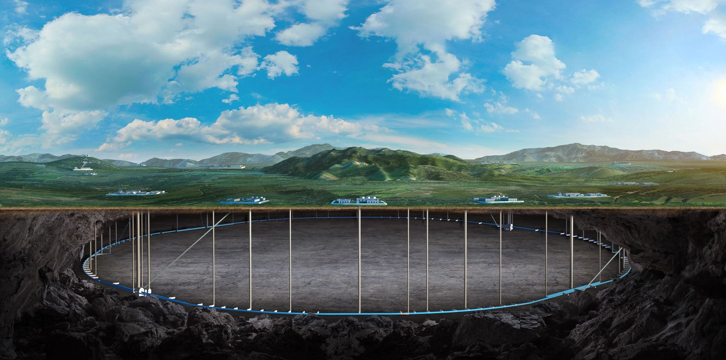


CEPC linac and C3 technology development
Jingru Zhang
On behalf of the linac group

Slide 2
Content
Introduction
EDR progress status
C-band cryogenic copper technology development
Summary

Slide 3
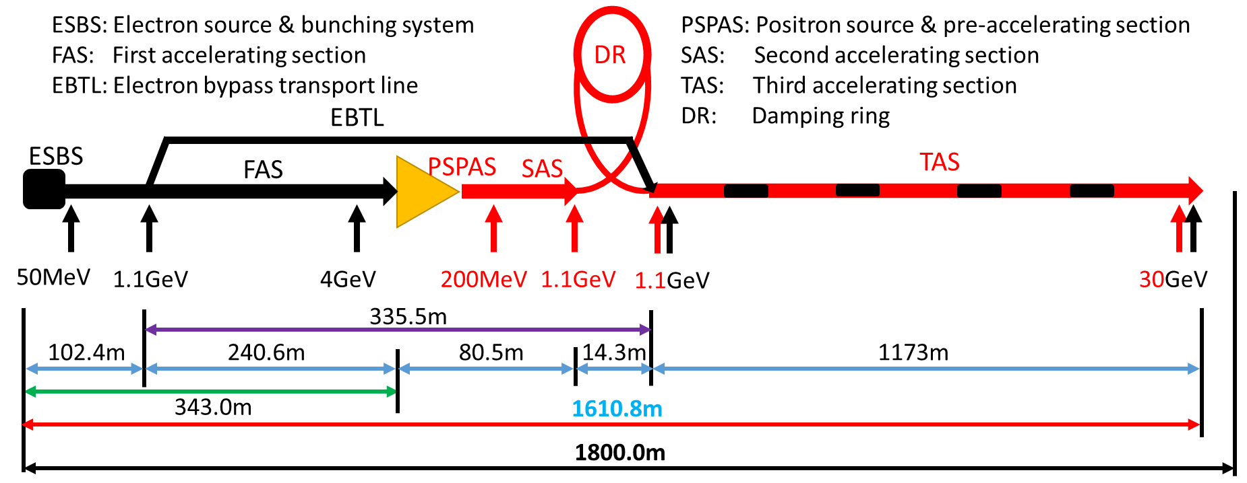
Introduction: CEPC Linac
The CEPC Linac is a normal-conducting linear accelerator that produces 30-GeV electron and positron beams, based on S-band and C-band RF technology
It is designed to function as a high-energy XFEL facility capable of producing photons with energies greater than 50 keV
An alternative linac scheme based on PWFA technology is currently under development
Parameter | Symbol | Unit | Baseline
Energy | E_{e-}/E_{e+} | GeV | 30
Repetition rate | f_{rep} | Hz | 100
Bunch number per pulse |  |  | 1 or 2
Bunch charge |  | nC | 1.5 (3)
Energy spread | σ_{E} |  | 1.5×10⁻³
Emittance | ε_{r} | nm | 6.5
Switch time for electron and positron |  | s | 3.0

Slide 4
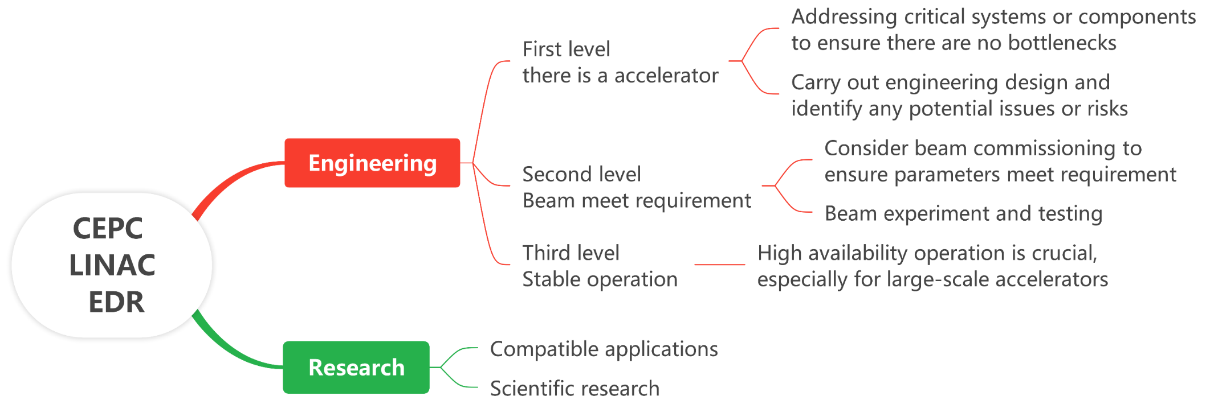
Introduction: CEPC LINAC
CEPC Linac, as the first-stage accelerator, needs to be constructed and commissioning first
The EDR target for the CEPC Linac is structured at two levels, as outlined below
[Engineering] The top priority is to ensure readiness for construction and commissioning
[Research] The secondary focus on having potential for upgradability and scalability

Slide 5
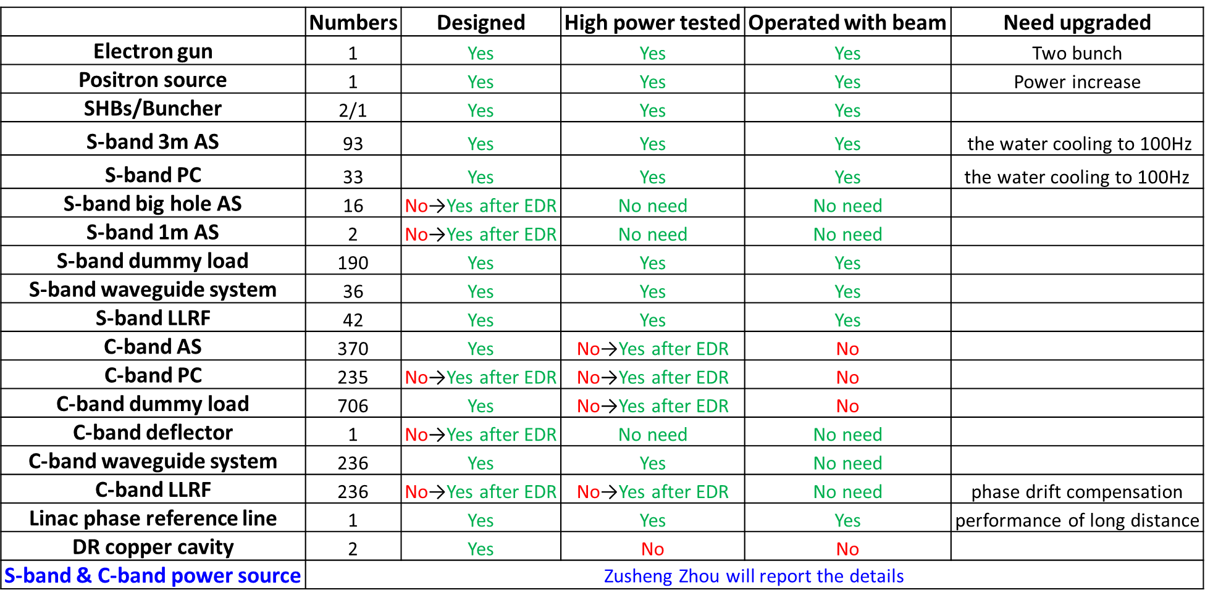
Introduction: CEPC LINAC
It comprises two key aspects
software aspect, which focuses on physics design
hardware aspect, which involves technical design and verification
Physics design
Survey and plan
High energy XFEL design
Key physics issues in PWFA
Technical design and verification
Equipment design
High power test
Double-bunch acceleration experiment

Slide 6
EDR progress status

Slide 7
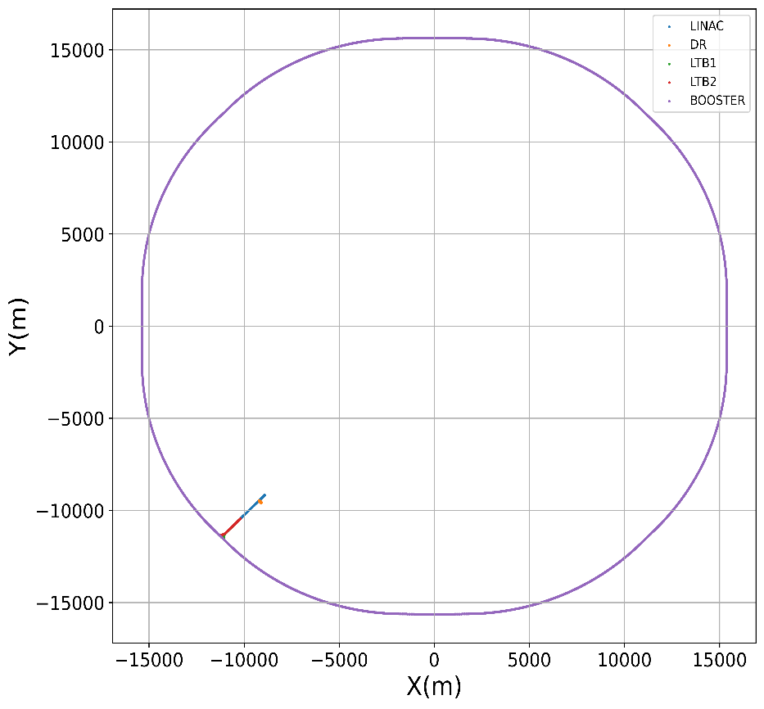
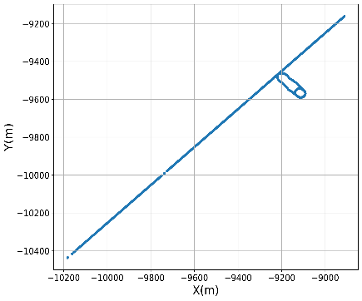
Physics design: Survey and plan
In accordance with the CEPC naming convention, we have provided the survey file, which has taken into consideration all accelerating sections, damping rings (DR), transfer lines, and beam dump lines
A preliminary construction plan has been developed
Major Task | Sub-task | Duration
Infrastructure | Infrastructure (including water, electricity, gas) | 4 years
Installation | Alignment Surveying & Control Network Establishment | 1 month | 2 years
 | Equipment Installation & Vacuum Sealing | 21 months
 | Linac Alignment Adjustment | 1 month
 | System Integration and debugging | 1 month
Commissioning | High-Power Conditioning, Troubleshooting & Maintenance | 5 months | 2 years
 | Beam Commissioning | 15 months
 | Fine Alignment | 1 month
 | Re-commissioning & Trial Operation | 3 months
Operation | Linac Beam Delivery to Booster | 2 years

Slide 8
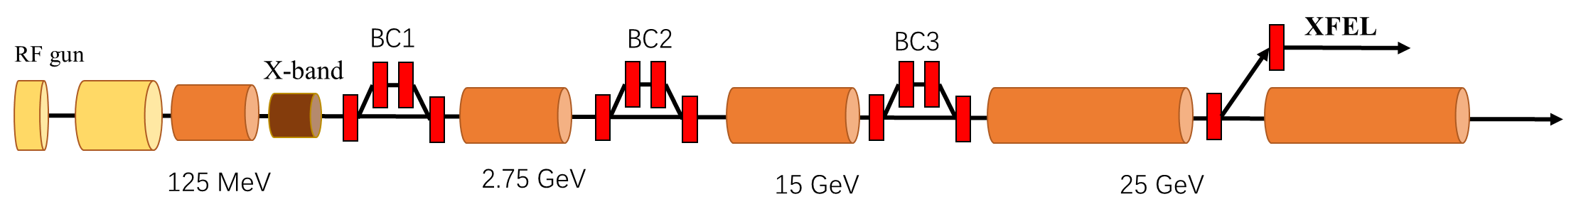
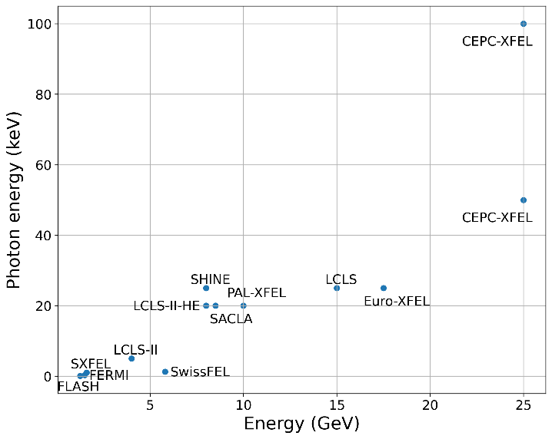
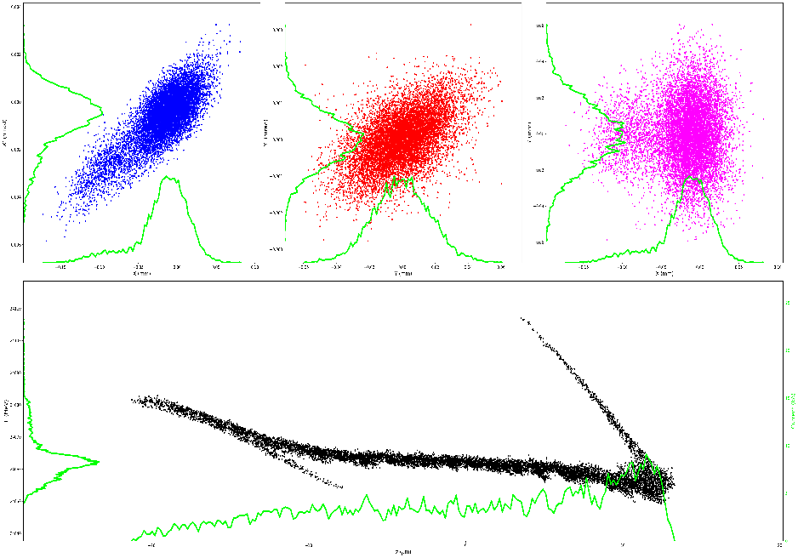
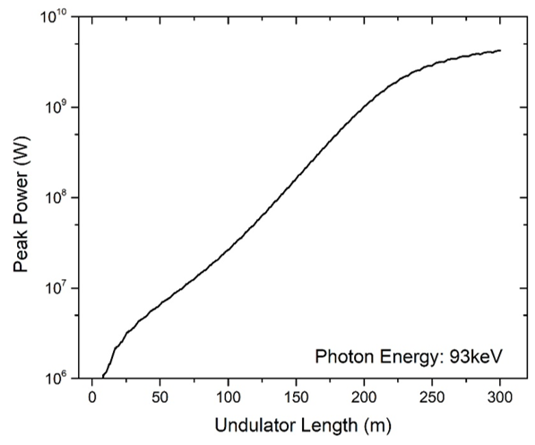
Physics design: High energy XFEL
The CEPC Linac can provide a high-energy beam, making it an excellent solution for XFELs with photon energies ranging from 50 keV to 100 keV
Except for the Z mode, it can generally be ensured that 50% of the time is available for XFEL operation in other modes
Time (s) | Higgs | W | Z | tt
T0 | 20 | 36 | 71 | 32
T1 | 3
T2 | 2.7 | 13 | 20 | 0.35
T3 | 3
T4 | 13.3 | 6.1 | 63.8 | 14.24
T5 | 11.3 | 17 | 1.2 | 25.6
XFEL duty | 57% | 47% | 2% | 80%

Slide 9
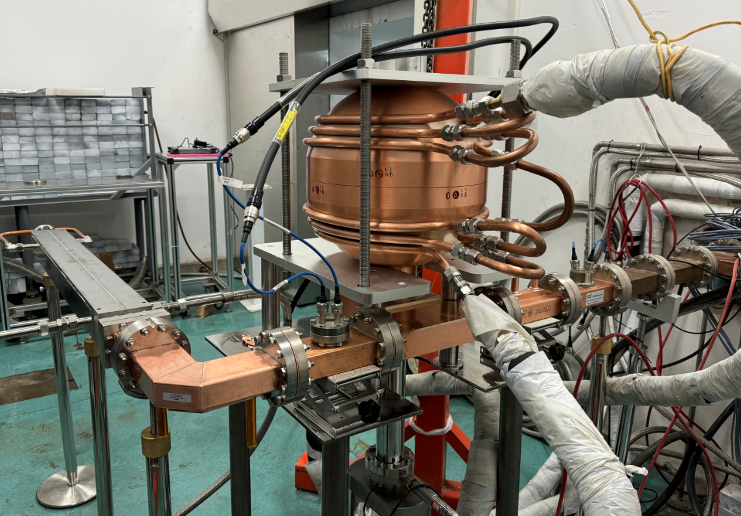
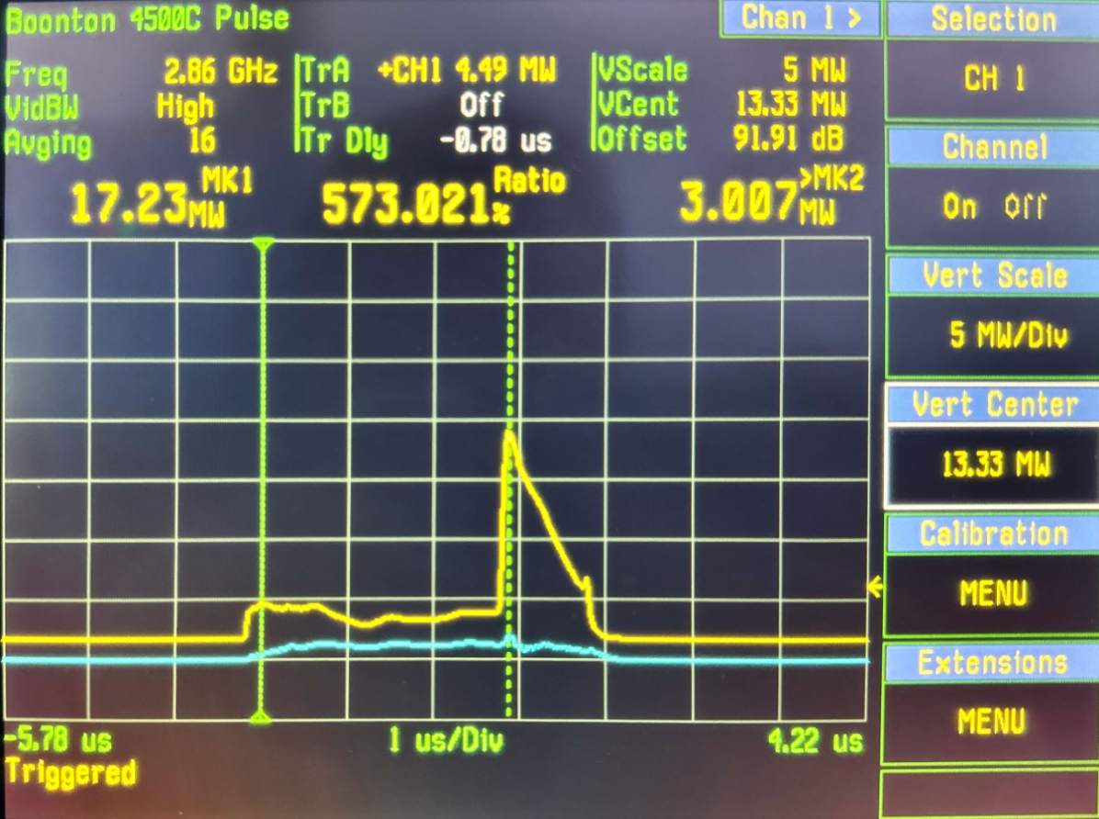
Technical design and verification: S-band spherical cavity pusle compressor and metal load test
The high-power testing of the S-band spherical pulse compressor and metal load was completed
The input power to the pulse compressor is 66 MW (coresponding to 80MW power source), and the energy multiplication factor is 1.8
The maximum pulse power input the metal load is 205 MW (after pulse compressor), and the average power is 4.2 kW
The pulse compressor will be used in RF system (80MW power source) of project PWFA linac at IHEP
High power test system
High power test waveform

Slide 10
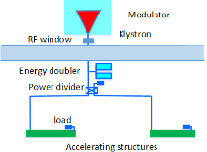
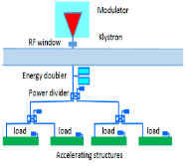
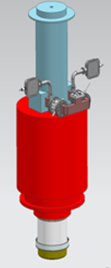
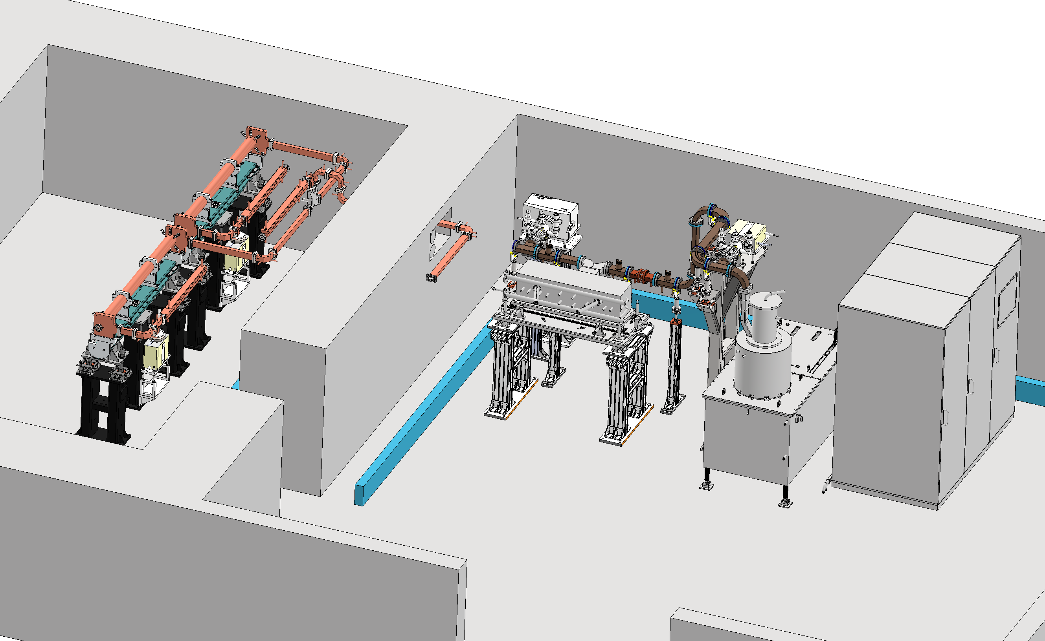
Technical design and verification: C-band high power test platform plan
A C-band high-power test platform planed to be established in Huairou Park at IHEP
2 accelerating structures (AS)
Pulsed compressor, waveguides, directional couplers, loads, bend and straight waveguides, etc.
The 80 MW C-band klystron will be completed in 2026 (Zusheng Zhou’s presentation)
3us, 100Hz
50MW
80MW
M≥1.7
M≥1.9
65MW
65MW
22MW (6.6kW)
40MV/m
40MV/m
10% attenuation in waveguide
10% attenuation in waveguide
Increase the energy multiplication factor of the pulse compressor or increase the efficiency of the AS

Slide 11
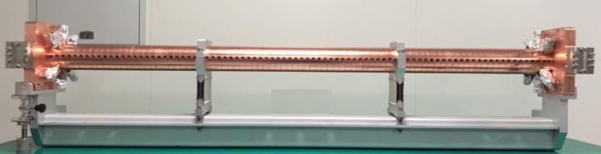
Technical design and verification: C-band accelerating structure
The design parameters between different lab
Mode :3π/4, 2π/3, 4π/5
Length
Disc thickness
Though the phase advance is deferent, the other key parameters is very similar
Our future research will focus on parameter optimization, with the goal of enhancing the efficiency of the AS
 | IHEP | Spring8 | SINAP
Frequency: f（MHz） | 5712 | 5712 | 5712
No. of Cells | 87+2 | 100 regular cells +2 coupler | 77+2
Phase advance | 3π/4 | 2π/3 | 4π/5
Total length(m) | 1.8 | 1.8 | 1.784
Length of cell : d (mm) | 19.675 | 17.495 | 20.994
Disk thickness: t (mm) | 4.5 | 4 | 5
Average aperture: 2a (mm) | 14.04 | 15.938~12.107 | 15
Average diameter : 2b (mm) | 45.6 | 43.196~41.869 | -
Shunt impedance(average) : Rs (MΩ/m) | 66.05 | 66 | 62
Quality factor : Q | 11358~11186 | 9300/8900(measured) | 10470
Group velocity: Vg/c (%) | 2.8% ~ 0.96% | 2.3%(average) | 1.7%(average)
Filling time : t_{f} (ns) | 350 | 290 | 330
Attenuation factor : τ | 0.56 | 0.59 | 0.585
Espeak/E0 | 2.57 | 2.6 | 2.6

Slide 12
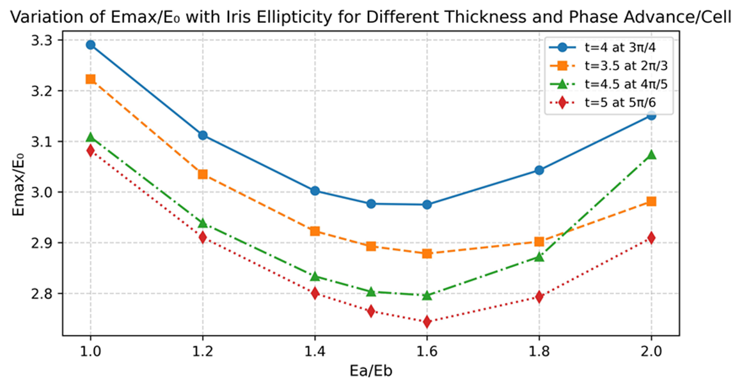
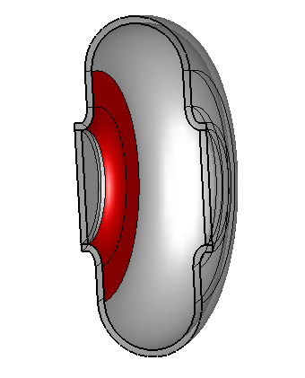
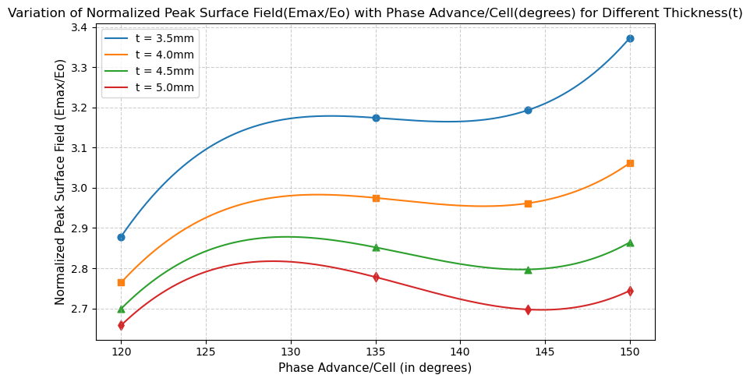
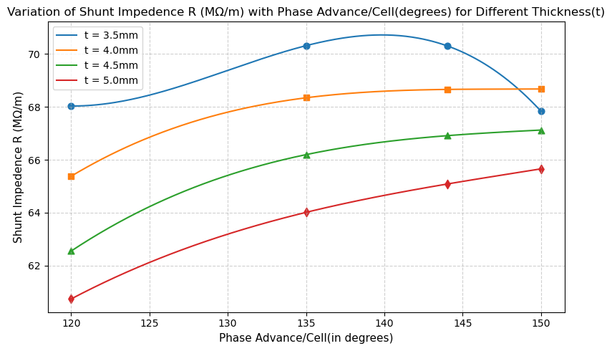
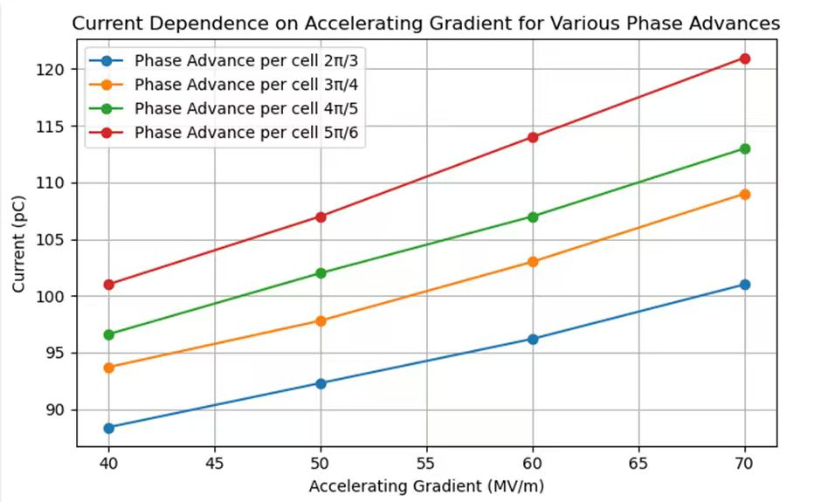
Technical design and verification: C-band accelerating structure
The first cell of the structure is optimized
The different modes and deferent thickness iris were compared. If the iris is thicker, the shunt impedance is increase. The surface electrical field is higher
We try to find a group of values with clear advantages

Slide 13
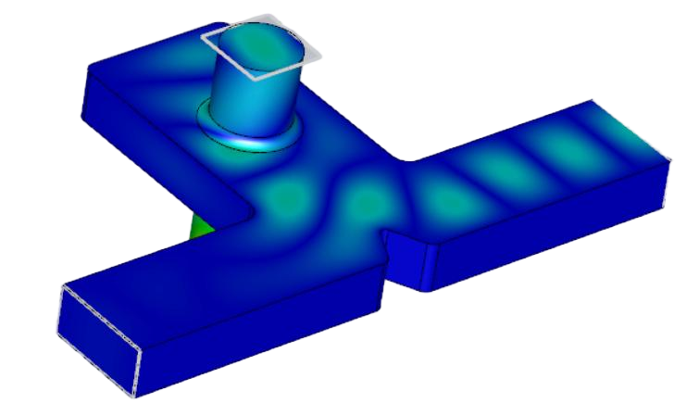
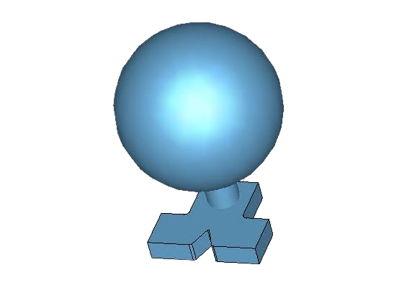
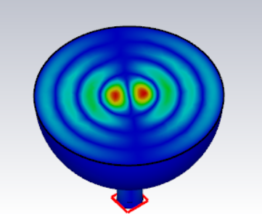
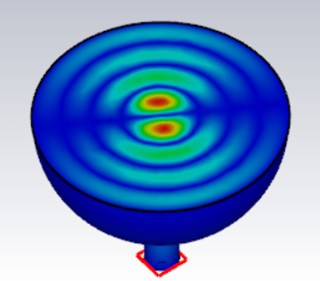
Technical design and verification: C-band pulse compressor: Spherical cavity type TE_{1,1,4}
The TE₁₀ mode and TE₂₀ mode excite two polarization-degenerate TE₁₁ modes at the interface between the cylinder and the waveguide
When we select TE₁₁₄ mode in the cavity, the energy multiplication factor is 2
The diameter of the cavity is 117 mm
Parameters | Design values
Frequency（MHz） | 5712
Input power(MW) | 80
Working mode | TE₁₁₄
Input pulse length (μs) | 3
Compressed pulse length (μs) | 0.5
Coupling coefficient (β) | 5.43
Cavity Radius (mm) | 116.88
Unloaded Q | 126000
Energy multiplication factor | 2
Electric field diagram of the mode converter
Spherical resonant cavity (TE₁₁₄)

Slide 14
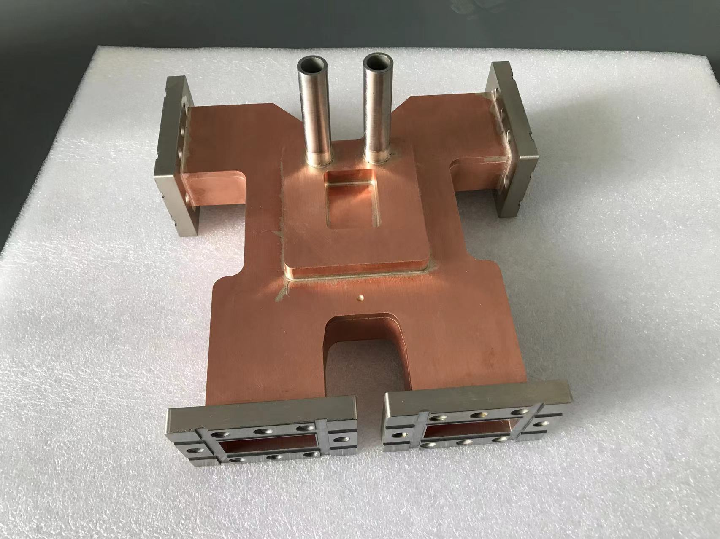
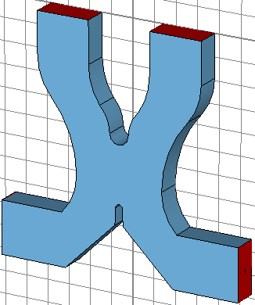
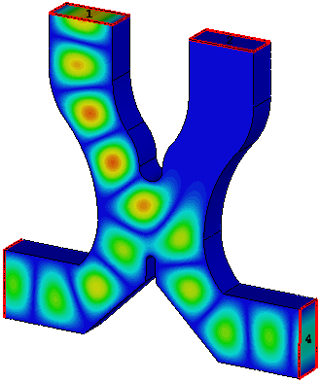
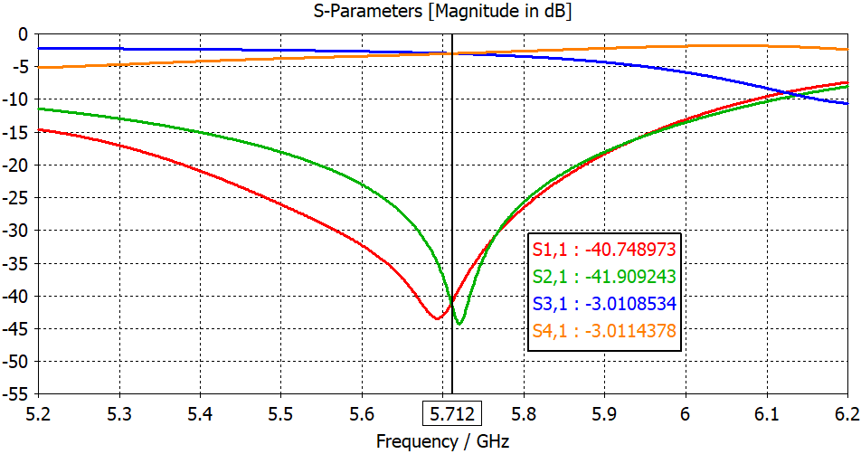
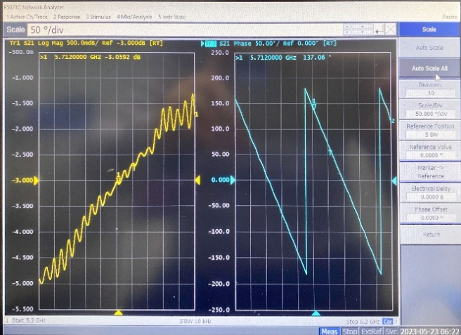
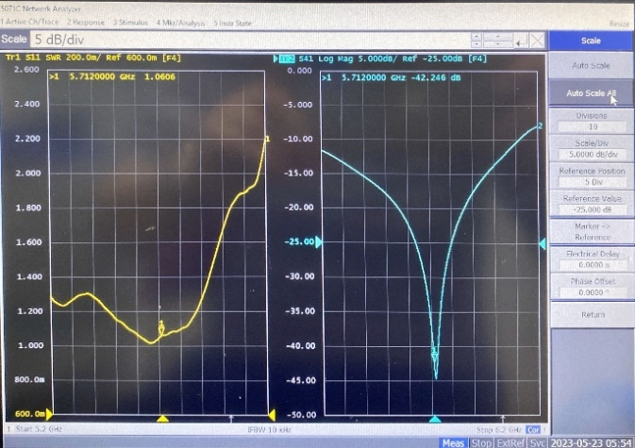
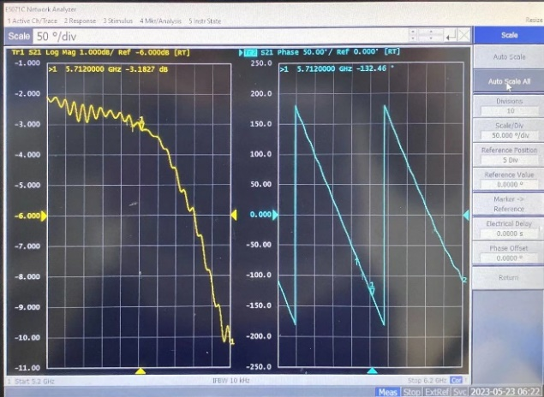
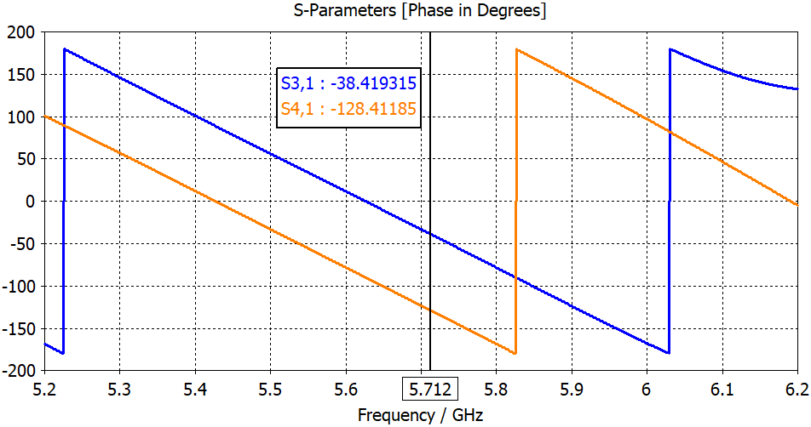
Technical design and verification: C-band hybrid power divider design and test
Hybrid divider
VSWR：1.06
Amplitude imbalance: 0.13dB
Phase imbalance degree: 0.48°
 | Amplitude |  |  |  | Phase
 | S11 | S21 | S31 | S41 | S31 | S41 | Phase difference
Designed | -40.7 | -41.9 | -3.01 | -3.01 | -30.4 | -120.4 | 90
Measured | -20.9 | -42.2 | -3.05 | -3.18 | 137 | -132.5 | 90.48

Slide 15
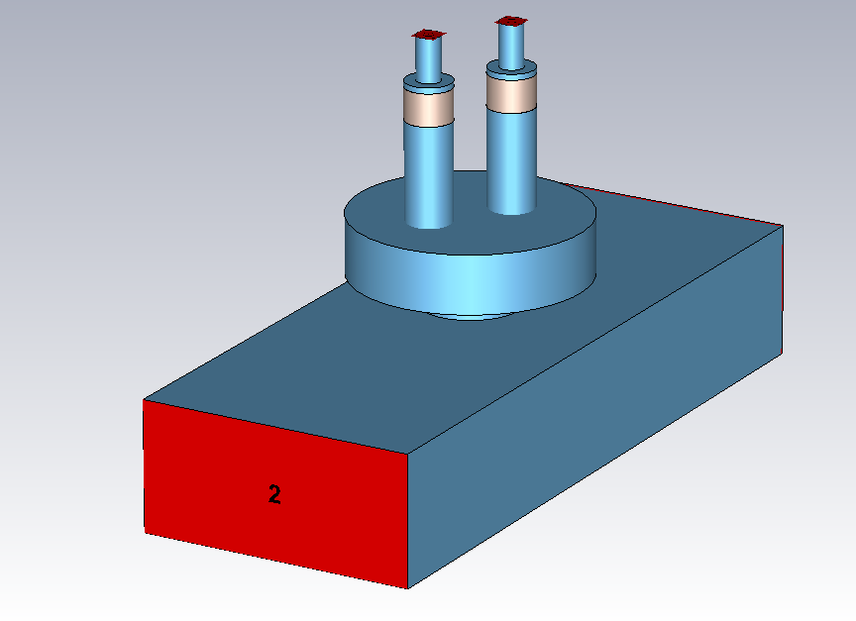
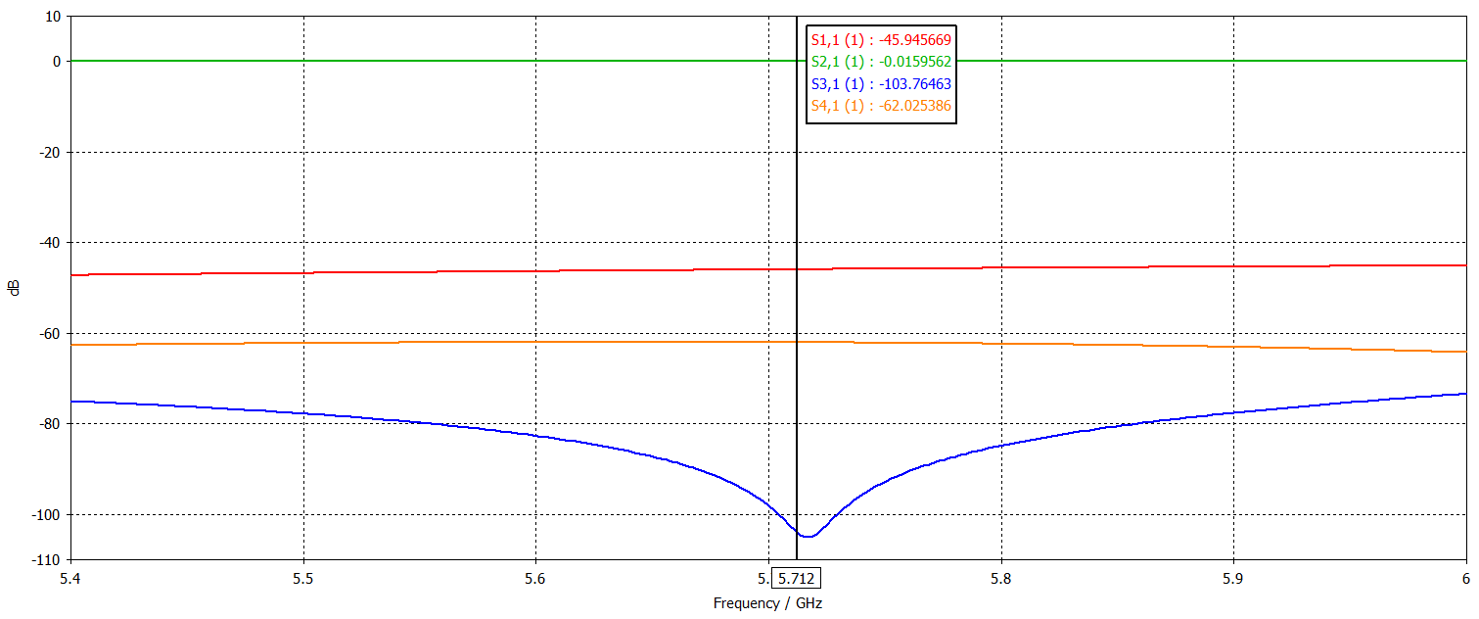
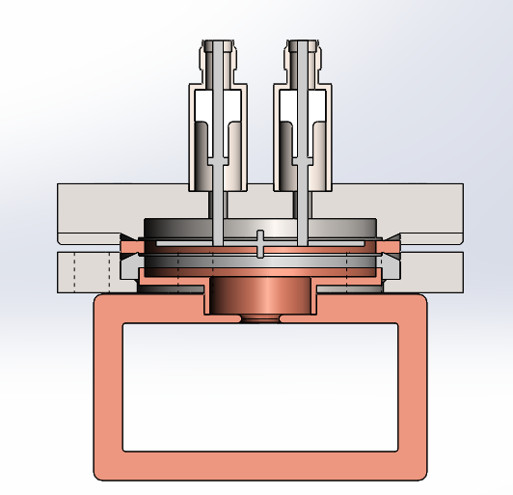
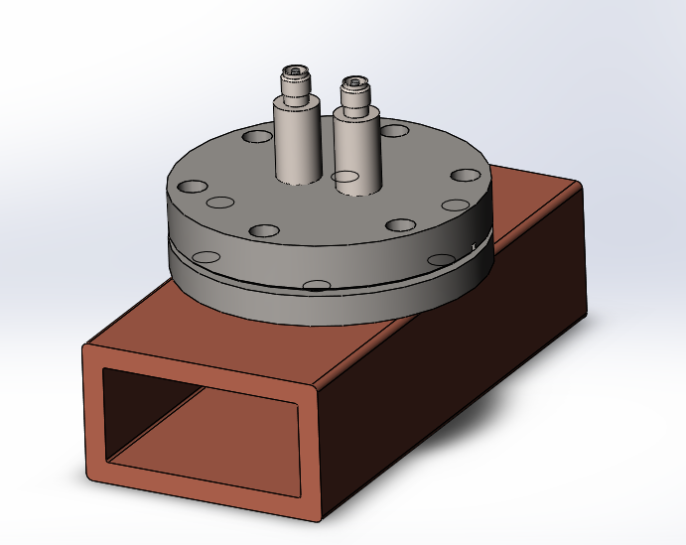
Technical design and verification: C-band high directional coupler
The Bethy hole-type directional coupler has been selected
In the design, we utilize the CF35 flange and SMA feed-through
The coupling coefficient is 62 dB, while the directivity is 41.8 dB, it can effectively to differentiate between forward and backward waves
Now it is under production
SMA feedthrough
CF35 flage
S11 (dB) | S12 (dB) | S13 (dB) | S14 (dB)
-45.9 | 0.016 | -103.8 | -62

Slide 16
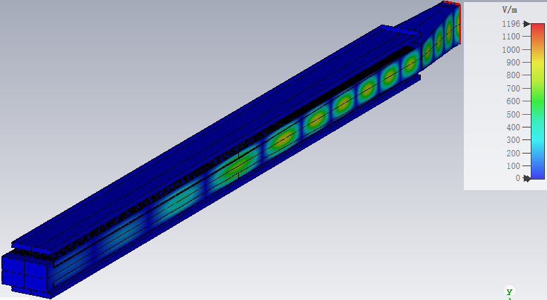
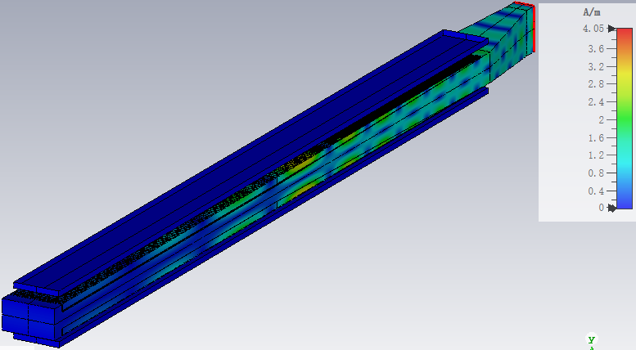
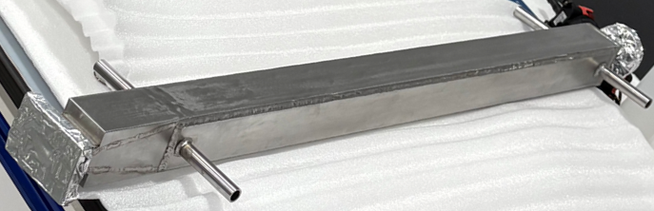
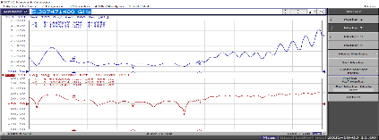
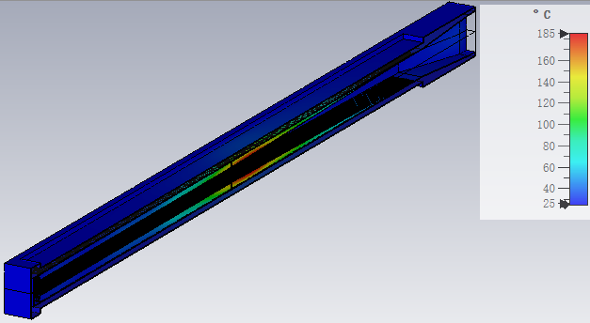
Technical design and verification: C-band stainless steel metal load
Pure SS430 load with BJ48 input port, composed of waveguide taper, match section, regular section and end cavity. 1.02 VSWR in 5712 MHz working frequency, and >400 MHz bandwidth (S₁₁<-20 dB)
It has been processed and completed, the measured VSWR is 1.08
Distribution of the electric and magnetic field, Esmax ~ 30 MV/m with 300 MW peak power input
Electric field
Magnetic field
The maximum temperature reaches approximately 185 °C, accompanied by an average input power of 10 kW and a cooling water flow rate of 30 L/min
Distribution of temperature
Cold test result

Slide 17
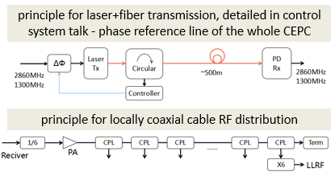
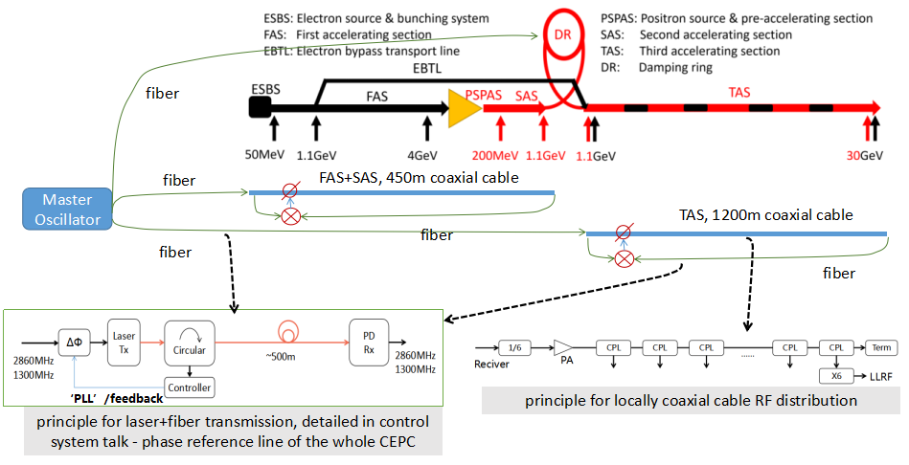
Technical design and verification: Linac phase reference line & LLRF
The phase stability should be <0.2deg (rms) from beam physics
The phase reference line shall provide signals to LLRF as follows:
Three laser+fiber based PRL for DR, transmitting 650MHz, FAS+SAS and TAS, transmitting 2860MHz, phase <0.02deg
Two coaxial-cable based PRL for locally FAS+SAS and TAS:2860MHz divided to 476.67MHz, distributed along the cable to reduce signal attenuation, at the local LLRF receiver, multiplied back to 2860MHz and 5720MHz
Phase reference coaxial cables will be placed in the temperature-controlled duct with stability <0.1K
Standard 7/8 inch coaxial cables are used with temperature coefficient ~5ps/km/K, 1km phase will <0.5deg (peak-peak, 0.1deg rms)
Linac LLRF singals | Value
Phase stability | 0.2deg (rms)
Amplitude stability | 0.2% (rms)
2860MHz number | 33
5720MHz number | 236
650MHz @DR number | 2
Reference signal power | >0dBm
Reference signal jitter | <80fs(rms)

Slide 18
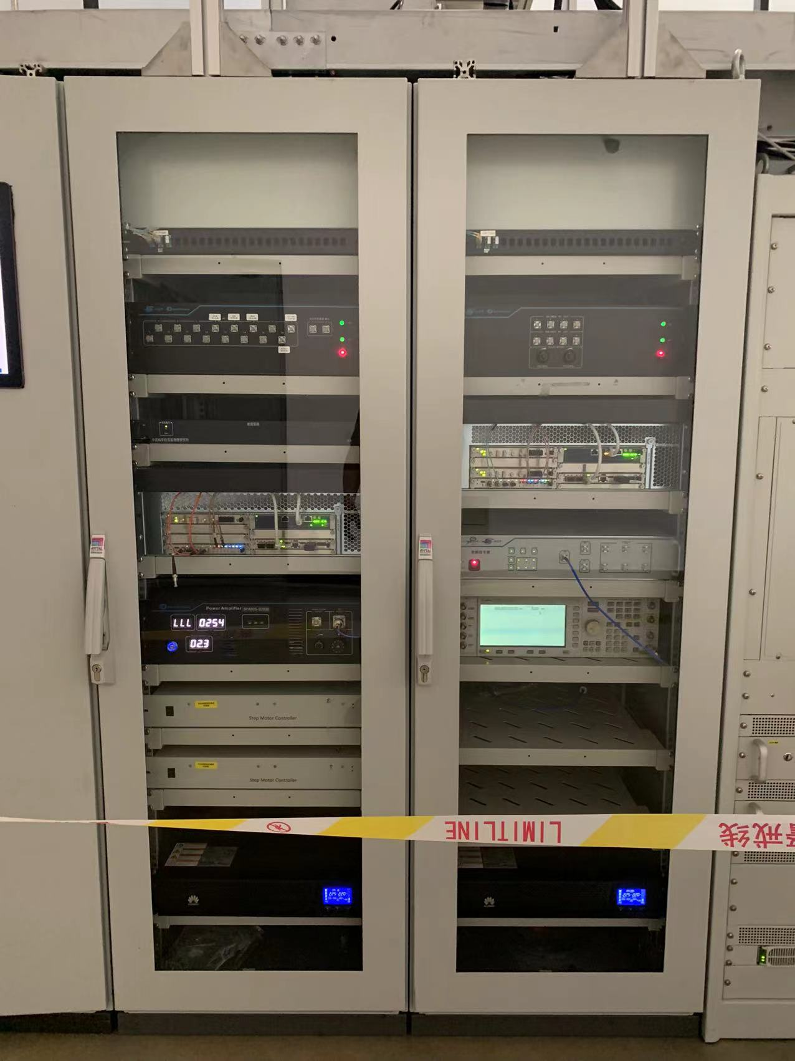
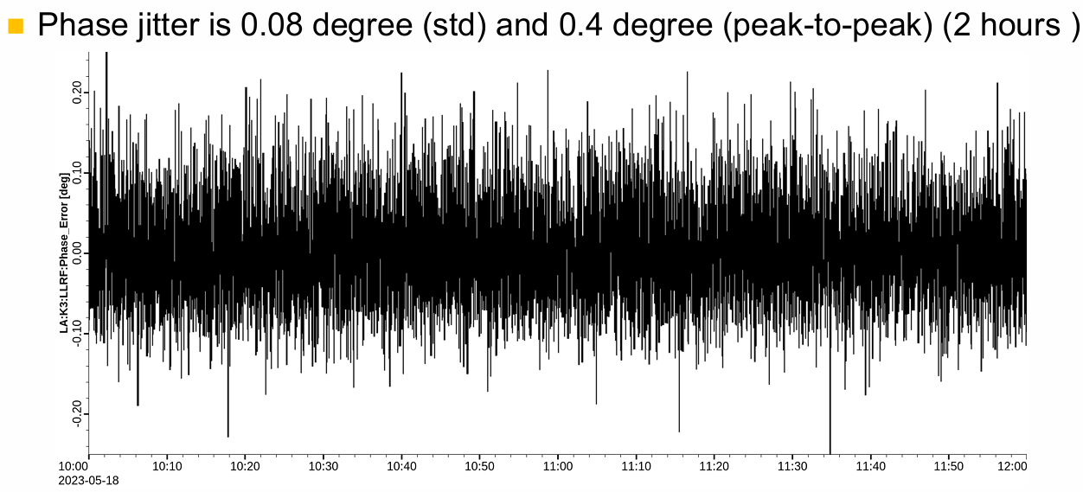
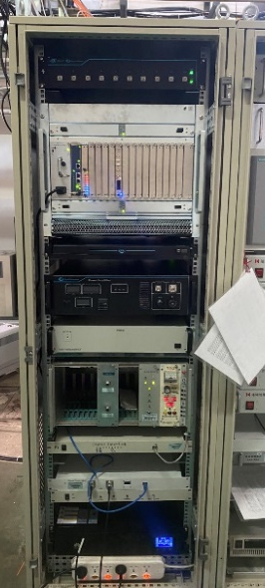
Technical design and verification: Linac phase reference line & LLRF
Proven down-conversion LLRF architecture with high phase stability for CEPC Linac
The LLRF system based on down-conversion architecture has already been widely applied at IHEP. There are 5 sets of 2998.8 MHz LLRF systems in the HEPS linac and 22 sets of 2856 MHz LLRF systems in the BEPCII linac
The long-term online phase stability of is 0.08° RMS and 0.4° peak-to-peak, meets CEPC linac phase stability requirements
BEPCII LINAC LLRF System
HEPS LINAC LLRF System

Slide 19
C-band cryogenic copper technology development

Slide 20
R&D of C-band cryogenic copper accelerating structures
The aforementioned details pertain to the preparation of a C-band normal temperature test bench, specifically tailored for the baseline design requirements of the linac RF system
To achieve higher gradients of fixed power source, we have additionally developed cryogenic copper accelerating structures that operate within liquid nitrogen (77K)
We have designed two types of parallel coupling structures
Type I: 20 cells，a=0.05*λ₀, 2a=5.25mm
Type II: 40 cells，a=0.1*λ₀, 2a=10.5mm

Slide 21


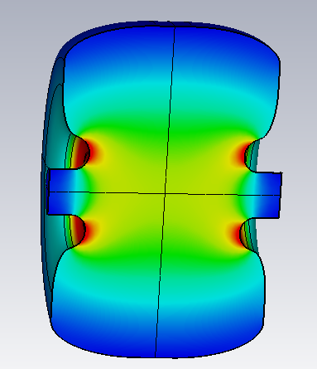
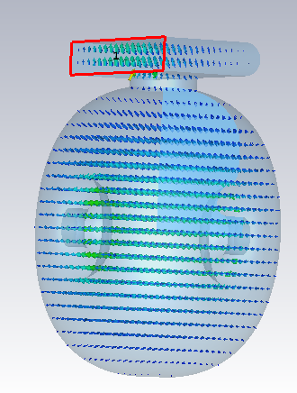



C-band 20 cells parallel coupling structure design
It is a standing wave structure. This is the first model we examined. We completed cavity optimization, coupling design, and power distribution design
The shunt impedance has been determined to be 303 MΩ/m at 77K
Based on the experimental data, the Q₀ value increase by a factor of 2.8 attains 34079
The whole structure parameters
RF Parameter | value | Unit
Temp T | 77 | K
Frequency f₀ | 5712 | MHz
Working mode | π | ----
Cavity numbers n | 20 | ----
Total length L | 525 | mm
The gradient of the total cavity | 24.8
a=0.05*λ₀
Cavity optimization
Field distribution
Thermal analysis

Slide 22






Cold test results after tuning
We have finished the manufacturing and tunning processes, and the brazing technique was employed for all welding procedures
The frequency error for each cell is within ±15 kHz, and the field distribution exhibits a flatness of over 90%
Room temperature measured s-parameters
20 cells structure
Electric field distribution after tuning
The structure installed in the cryostat

Slide 23




Cold test results after tuning
We performed the cavity's performance test under the 77 K liquid nitrogen environment
The frequency shifted by 16.6 MHz when the temperature changed from room temperature to 77 k
The final measured Q₀ was 31387, which reached 92.1% of the theoretical one
数据采集
网络分析仪
陶瓷窗
真空泵
抽气波导
被测腔体

Slide 24



High power test
There is a C-band test platform in the Dongguan branch of the IHEP
We carried out two rounds of high-power tests. The gradient reached 90.3 MV/m in the first round in March 2025
The second round high power test in Nov. 2025, the gradient reached 128.5 MV/m @2.5 μs, 32.45 MW

Slide 25


Dark current
At 10Hz, after approximately 5 × 10⁶ pulses, The dark current was measured using a Faraday cup. The dark current was measured to be approximately 1.1 nC per pulse at an accelerating gradient of 128.5 MV/m
It was observed that the dark current exhibits a decreasing trend as the conditioning duration increases. However, we terminated the high-power test due to the requirement to repurpose the test bench for other applications

Slide 26






Wakefield simulation
Structural modeling was completed and the short-range wakefield was calculated
For application in a CEPC injector, with a bunch charge ranging from 1.5 to 3 nC, a diameter of at least 10.5 mm is necessitated (Bunch length: 0.3 mm)
C3: r=2.62mm
C3: r=5.25mm
C-band: r=7.24mm
Transverse Wake Max. = 3503 V/pC/m
Loss factor = -14.8 V/pC
Transverse Wake Max. = 873 V/pC/m
Loss factor = -7.2 V/pC
Transverse Wake Max. = 378 V/pC/m
Loss factor = -5.1 V/pC

Slide 27



40 cells cryogenic accelerating structure design
Type II: a=0.1*λ₀ (2a=10.5mm)
The shunt impedance and E_{Smax}/E₀ both decrease when compared to the Type I
The fabrication has been completed, and we are preparing for tuning in our lab

Slide 28


High power test bench at Huairou testing platform
Based on the 80MW C-band klystron, another C-band test bench is currently under development, with high-power testing scheduled in 2026
It will reach 144MV/m with 80MW input theoretically, taking into account the actual operating power of the klystron (typically 80% of the design value), waveguide attenuation and other factors, our phase one target gradient is 80 MV/m
Beam test bench

Slide 29
Summary
According to the booster and collider time line, the construction time for the linac is provided
A C-band nornmal temperature test bench is currently being designed
Type I cold copper structure high-power test gradient reached 128.5 MV/m
Type II cold copper structure is being prepared for tuning. Subsequently, high-power tests will be conducted

Slide 30
Thank you for your attention

