Slide 1


CEPC polarized electron source R&D
环形正负电子对撞机
Circular Electron Positron Collider
Xiaoping Li, Zhe Duan, Valery Tyukin, Cai Meng, Wei Liu, Zhongtian Liu

Slide 2
Content
CEPC Electron Source
Generation of polarized electron beams
Polarized electron source related R&D
Polarized electron source R&D plan for CEPC at IHEP
Domestic R&D on the superlattice GaAs photocathode
Preliminary test on the superlattice GaAs photocathode
A Polarized electron gun design for CEPC
Summary

Slide 3
Content
CEPC Electron Source
Generation of polarized electron beams
Polarized electron source related R&D
Polarized electron source R&D plan for CEPC at IHEP
Domestic R&D on the superlattice GaAs photocathode
Preliminary test on the superlattice GaAs photocathode
A Polarized electron gun design for CEPC
Summary

Slide 4
CEPC Linac
Baseline design of the CEPC Linac
A 30GeV room temperature Linac
A combination of S-Band (2860MHz) and C-Band (5720MHz)
The Linac tunnel length is 1.8km
Parameter | Symbol | Unit | Baseline
Energy | E_{e-}/E_{e+} | GeV | 30
Repetition rate | f_{rep} | Hz | 100
Bunch number per pulse |  |  | 1 or 2
Bunch charge |  | nC | 1.5
Energy spread | σ_{E} |  | 1.5×10⁻³
Emittance | ε_{r} | nm | 6.5

Slide 5
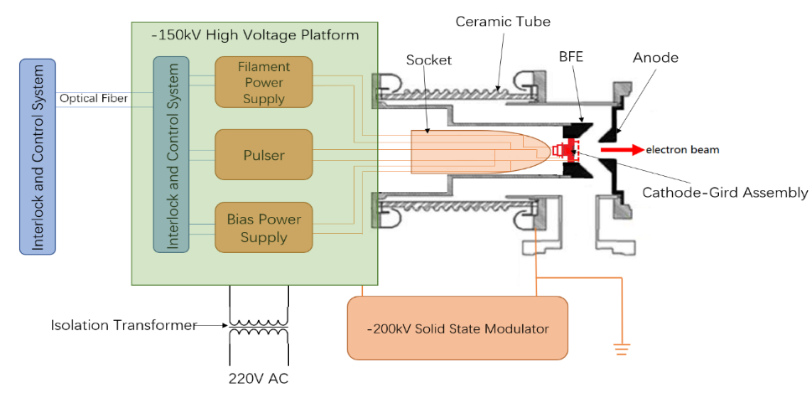
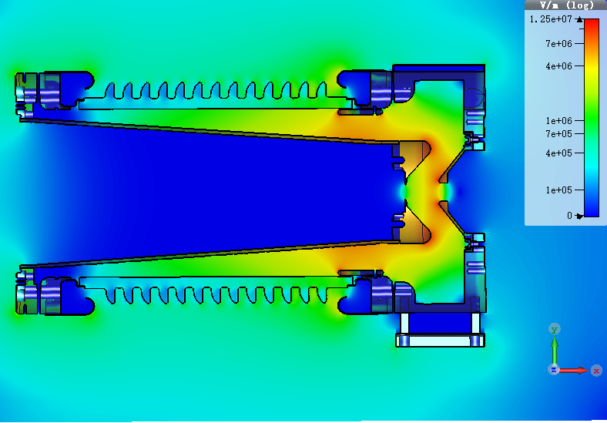
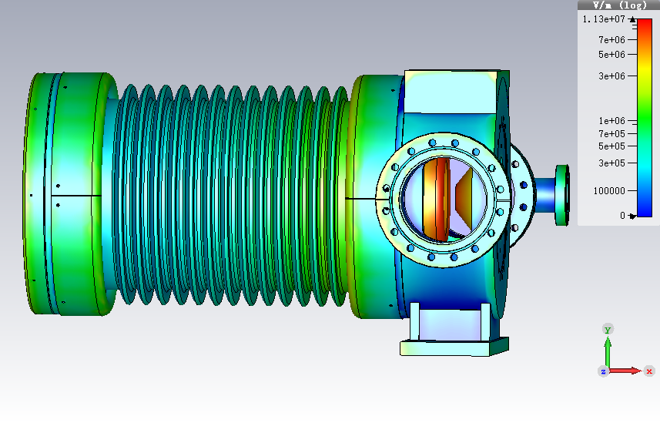
CEPC Electron Source
Introduction to CEPC Electron Source
The electron source is used for generating an electron beam with a specific longitudinal distribution that can be accelerated for injection and positron production.
Electron Gun (Baseline design)
A traditional thermionic triode gun with two operation modes
1.5nC for electron injection
10nC for positron generation
Has been verified at BEPCII and HEPS Linac
Parameter | Unit | Value
Type | - | Thermionic Triode Gun
Cathode | - | Dispenser cathode
Beam current | A | > 10
High voltage of anode | kV | 150
Bunch charge 1 | nC | 1.5 (e– injection)
Bunch charge 2 | nC | 10 (e⁺ production)
Repetition | Hz | 100
CEPC electron source parameters and its design

Slide 6
Content
CEPC Electron Source
Generation of polarized electron beams
Polarized electron source related R&D
Polarized electron source R&D plan for CEPC at IHEP
Domestic R&D on the superlattice GaAs photocathode
Preliminary test on the superlattice GaAs photocathode
A Polarized electron gun design for CEPC
Summary

Slide 7
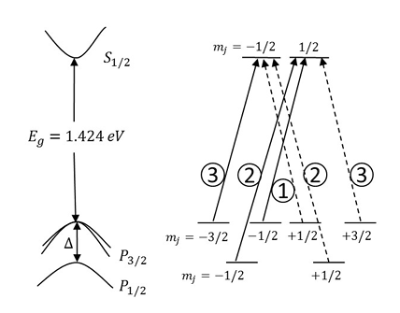
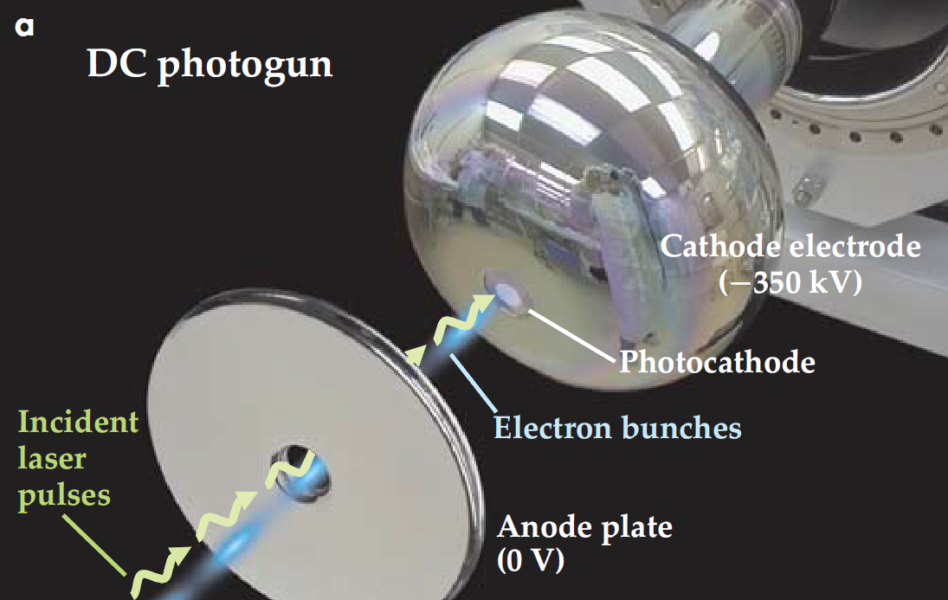
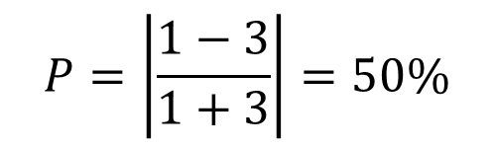
Generation of polarized electron beams
Polarized electron generation
One effective method for generating polarized electrons is using GaAs photocathode in a photocathode HV electron gun (Extremely high vacuum)
The unique band structure of GaAs determines that electron beams with a certain polarization can be generated under the driving of circularly polarized laser at a specific wavelength
For a common bulk GaAs, a maximum polarization in theory is 50%, considering depolarization effect it usually is about 30-35% at 780nm laser wavelength
$$P=\left|\frac{1−3}{1+3}\right|=50\%$$
Polarized electron generation from a common bulk GaAs

Slide 8
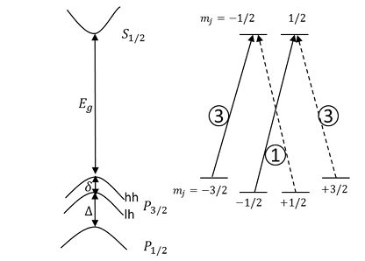
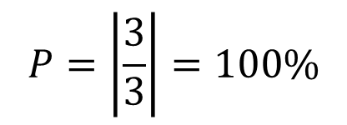
Generation of polarized electron beams
Polarized electron generation
Strained GaAs and its energy band structure
For a strained GaAs, a maximum polarization in theory is 100%, considering depolarization effect it usually is about 85% at 780nm
Constructing superlattice structure is an effective way to obtain strained GaAs
This type of photocathode is not easy to obtain and needs to be grown on a substrate using MBE equipment
$$P=\left|\frac{3}{3}\right|=100\%$$
Polarized electron generation from superlattice GaAs

Slide 9
Content
CEPC Electron Source
Generation of polarized electron beams
Polarized electron source related R&D
Polarized electron source R&D plan for CEPC at IHEP
Domestic R&D on the superlattice GaAs photocathode
Preliminary test on the superlattice GaAs photocathode
A Polarized electron gun design for CEPC
Summary

Slide 10
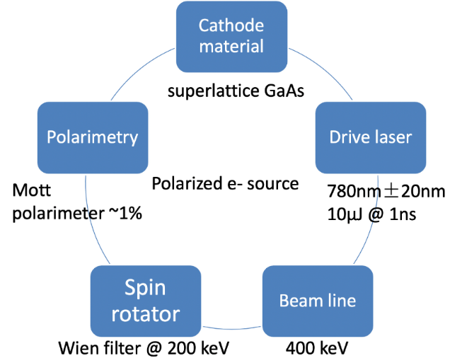
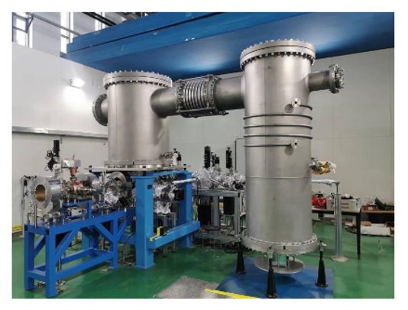
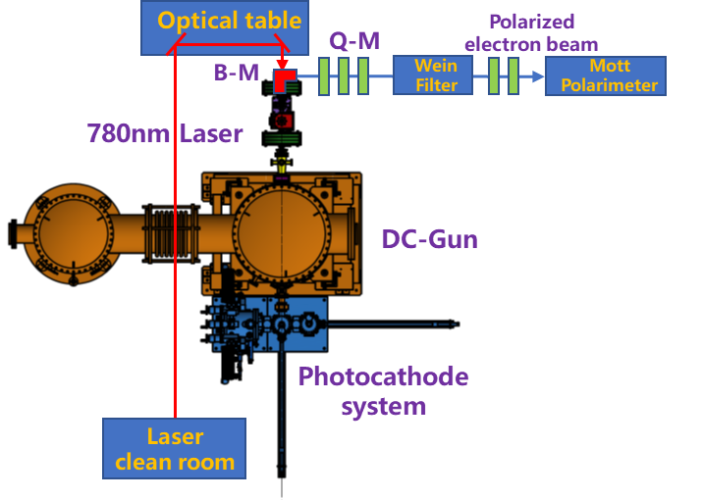
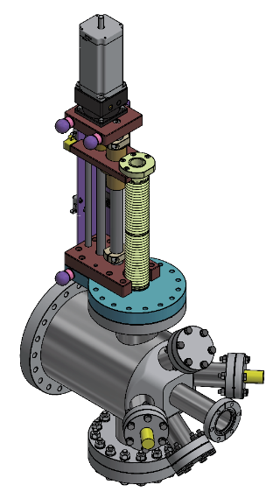
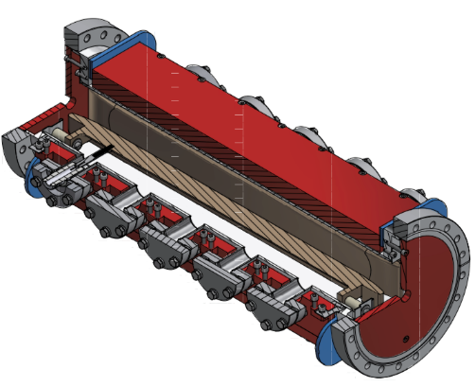
Polarized electron source related R&D
Polarized electron source R&D plan for CEPC at IHEP
Goals: Generation of electron beams with a bunch charge (≥2nC) and high polarization (≥85%)
Based on a photocathode DC gun developed by IHEP with an extremely high vacuum (10⁻¹⁰Pa)
Beam line setup and beam dynamics study has been carried out
Key components such as Wien filter and Mott polarimeter has been designed
We expect a beam commissioning scheduled in 2027
Wien filter
Mott polarimeter
A photocathode DC gun @IHEP
Scheme of PES R&D based on DC gun

Slide 11
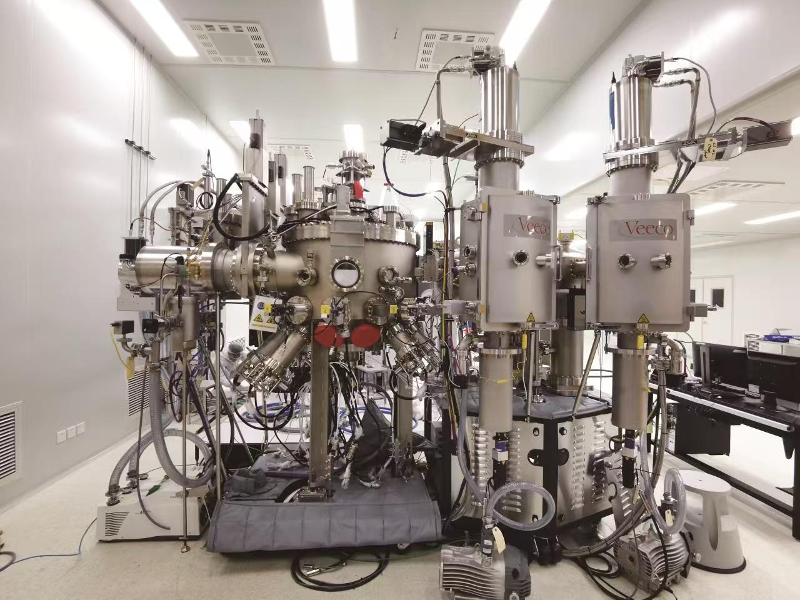
Polarized electron source related R&D
Domestic R&D on the Superlattice GaAs photocathode
One of the most important part for Polarized electron source is Superlattice GaAs Photocathode
Since the beginning of 2025, we have been starting the R&D of Superlattice GaAs
In collaboration with a domestic company Acken Optoelectronics Ltd. @ Suzhou
Superlattice GaAs photocathode produced by MBE system, main requirements are Polarization ≥85% and QE ≥0.5%
The first the batch of photocathodes have been produced
GaAs | 5 nm | p=5×10¹⁹ cm⁻³
GaAs/GaAsP SL | (4/3 nm) ×14 | p=5×10¹⁷ cm⁻³
GaAsP_{0.35} | 2750 nm | p=5×10¹⁸ cm⁻³
Graded GaAsP_{x} (x = 0~0.35) | 5000 nm | p=5×10¹⁸ cm⁻³
GaAs buffer | 200 nm | p=2×10¹⁸ cm⁻³
p-GaAs substrate (p>10¹⁸ cm⁻³)
Structure of Superlattice layers
MBE system in Acken
Samples of superlattice GaAs/GaAsP

Slide 12
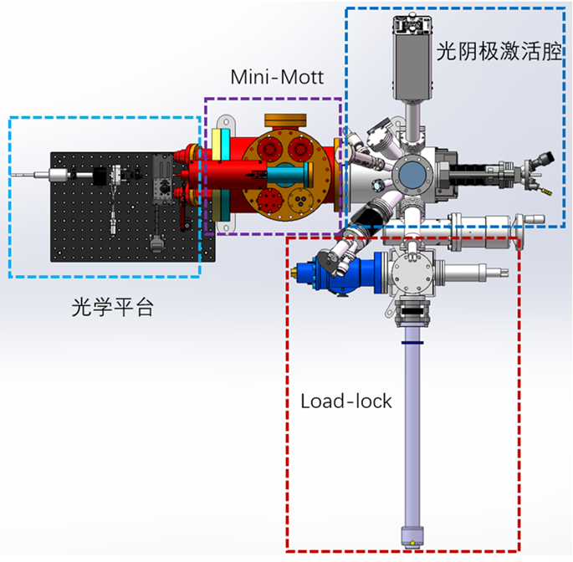
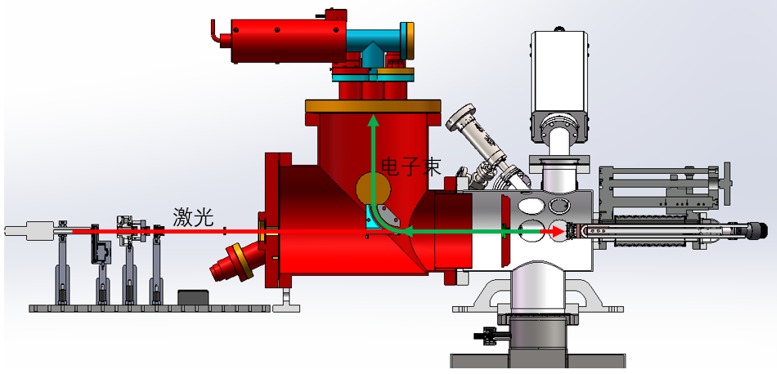
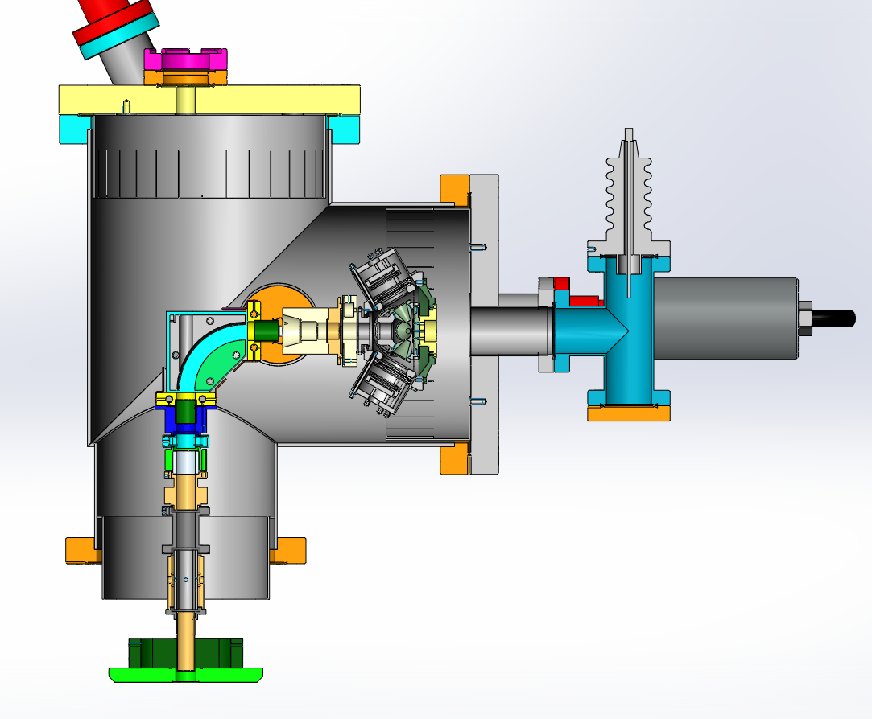
Polarized electron source related R&D
Domestic R&D on the Superlattice GaAs photocathode
Build a platform for photocathode performance test (both pol & QE), this platform has been designed and is currently under development, expected to start experimental study on superlattice GaAs this year
Including a photocathode load-lock chamber, an activation chamber and a testing laser system
A Mini-Mott polarimeter for a low energy electron beam has been designed, we will start to develop it ASAP
Platform for photocathode performance test

Slide 13

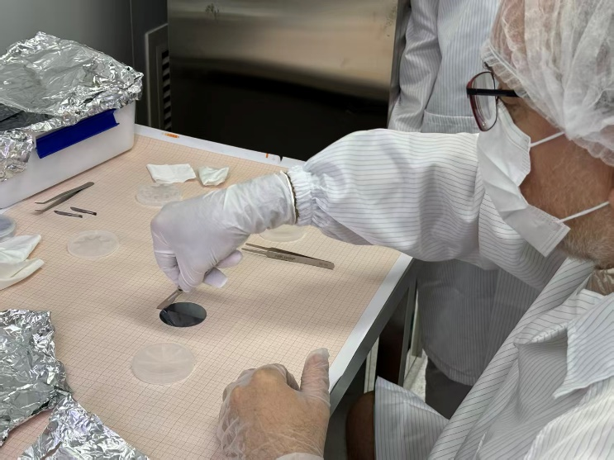
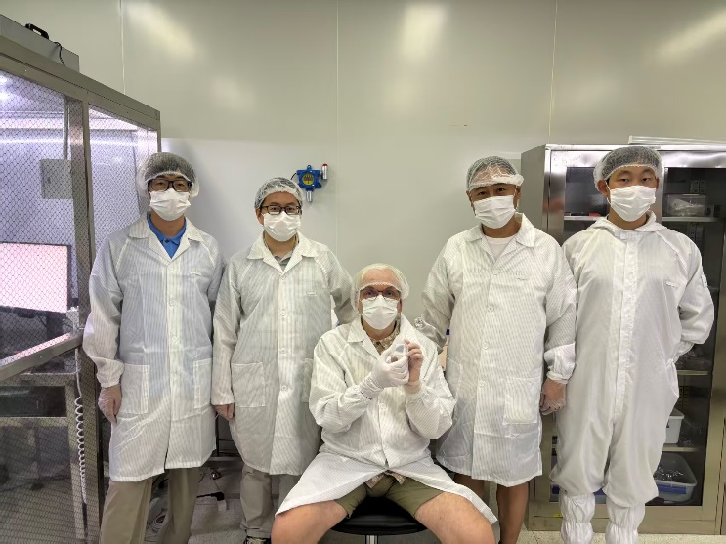
Polarized electron source related R&D
Preliminary test on the Superlattice GaAs photocathode
From 2024, Valery Tyukin from Inst. of Nuclear Physics, JGU Mainz participated in research on PES (PIFI 2024/2025)
A superlattice GaAs wafer has been cut, and a quarter had been delivered to the Inst. of Nuclear Physics, JGU Mainz
Activation experiment of the Superlattice GaAs has been carried out in JGU Mainz
To test the performance of Superlattice GaAs (both QE and polarization)
As a very important experimental data for our Mott polarimeter calibration in future
Valery Tyukin
Superlattice GaAs wafer cut in Acken

Slide 14
Polarized electron source related R&D
Preliminary test on the Superlattice GaAs photocathode
The QE is two to three times lower than that of bulk GaAs (Need more activation experiment to increase QE)
The lifetime of the Superlattice GaAs in preparation chamber is a few hundred hours, which is a good indicator
The central part of Superlattice will be used for future beam experiments on the main accelerator at Mainz
The SL structure is cut along blue lines
Piece on the left bottom is tested
SL in loadlock chamber
Preheating in loadlock chamber
Yo-Yo method, Cs + NF3
Maximal QE=3.4% @650nm

Slide 15
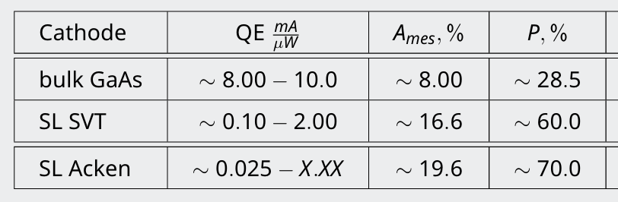
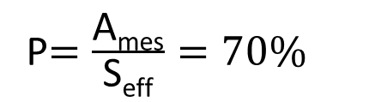
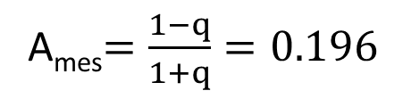
Polarized electron source related R&D
Preliminary test on the Superlattice GaAs photocathode
Polarization measurement at an electron beam energy of 100.0 keV with a laser λ ∼ 776nm has been carried out
The effective Sherman function Seff is directly affecting the results of polarization measurement, and in this time experiment polarization is estimated at 70% when using Seff=0.28 that was determined years ago
The preliminary polarization measurement results show that Superlattice structure is working, the next step is to further confirm the polarization with an energy of several MeV on the main accelerator at Mainz with a higher accuracy
Left detector
Right detector
A_{mes}$=\frac{1−q}{1+q}=0.196$
P$=\frac{\text{A}\text{mes}}{\text{S}\text{eff}}=70\%$
Asymmetry measurements: left and right detectors

Slide 16
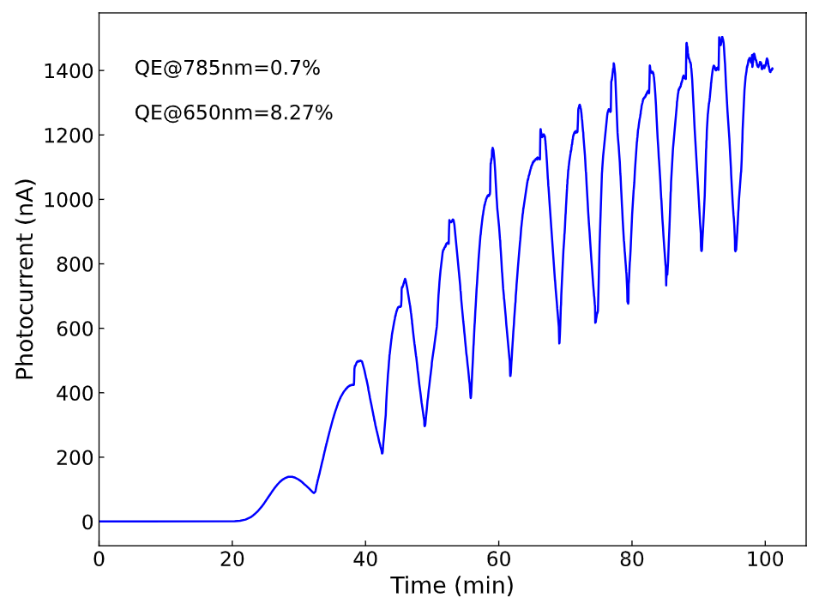
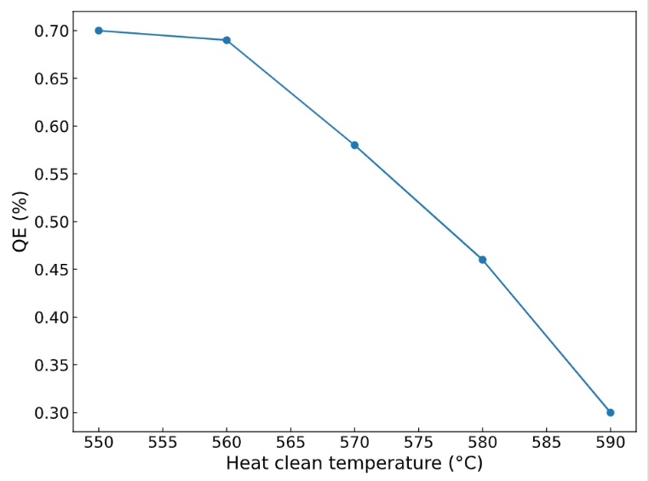
Polarized electron source related R&D
Preliminary test on the Superlattice GaAs photocathode
Considering the low QE results of Superlattice at Mainz, cross check of activation experiment was carried out on the platform of Chongqing University in China (only activation experiment and QE measurement) based on another quarter.
Yo-Yo method by using Cs+O₂ activation
QE is 0.7% @785nm and 8.27%@650nm, and QE of Superlattice decreasing with the increase of heat clean temperature
For CEPC polarized electron source, Superlattice with a QE≥0.5% will be enough to meet the requirements
Activation experiment study on Superlattice GaAs at Chongqing University

Slide 17
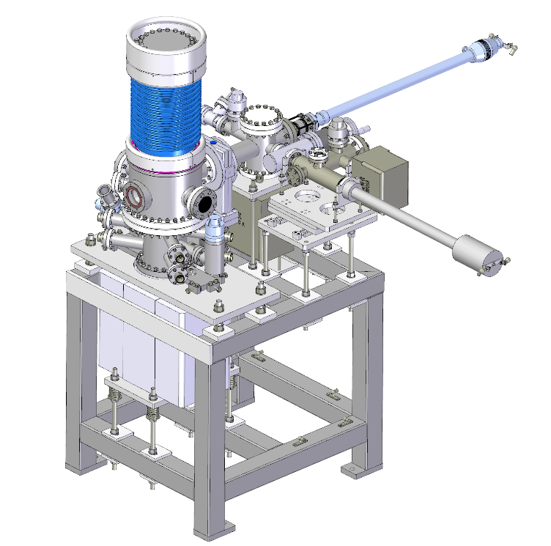
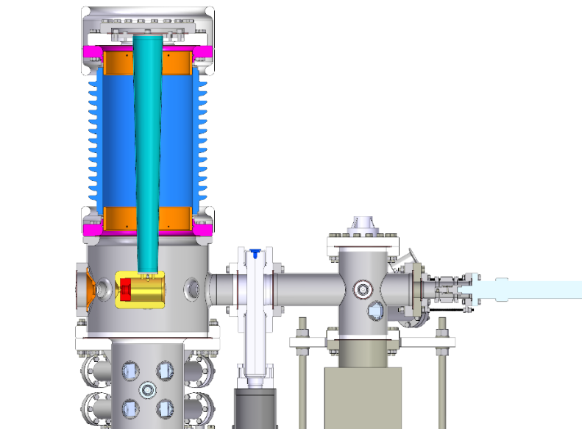
Polarized electron source related R&D
A Polarized electron gun design for CEPC
A 150kV HV photocathode electron gun has been designed (Beam parameters are consistent with the thermionic gun)
We proposed a two electron guns scheme and do not change the layout of the injector, share the bunching system
As an alternative solution for CEPC electron source
It can also be adopted in BEPCII as a polarized electron source
Two electron guns scheme for CEPC
A 150kV HV photocathode electron gun

Slide 18
Content
CEPC Electron Source
Generation of polarized electron beams
Polarized electron source related R&D
Polarized electron source R&D plan for CEPC at IHEP
Domestic R&D on the superlattice GaAs photocathode
Preliminary test on the superlattice GaAs photocathode
A Polarized electron gun design for CEPC
Summary

Slide 19
Summary
Introduction of electron source for CEPC.
The method of generating polarized electrons.
Introduced progress of polarized electron source related R&D plan.
Domestic R&D on the superlattice GaAs photocathode and preliminary test results.
A polarized electron gun design for CEPC.

Slide 20
Thank you for your attention!

