Slide 1
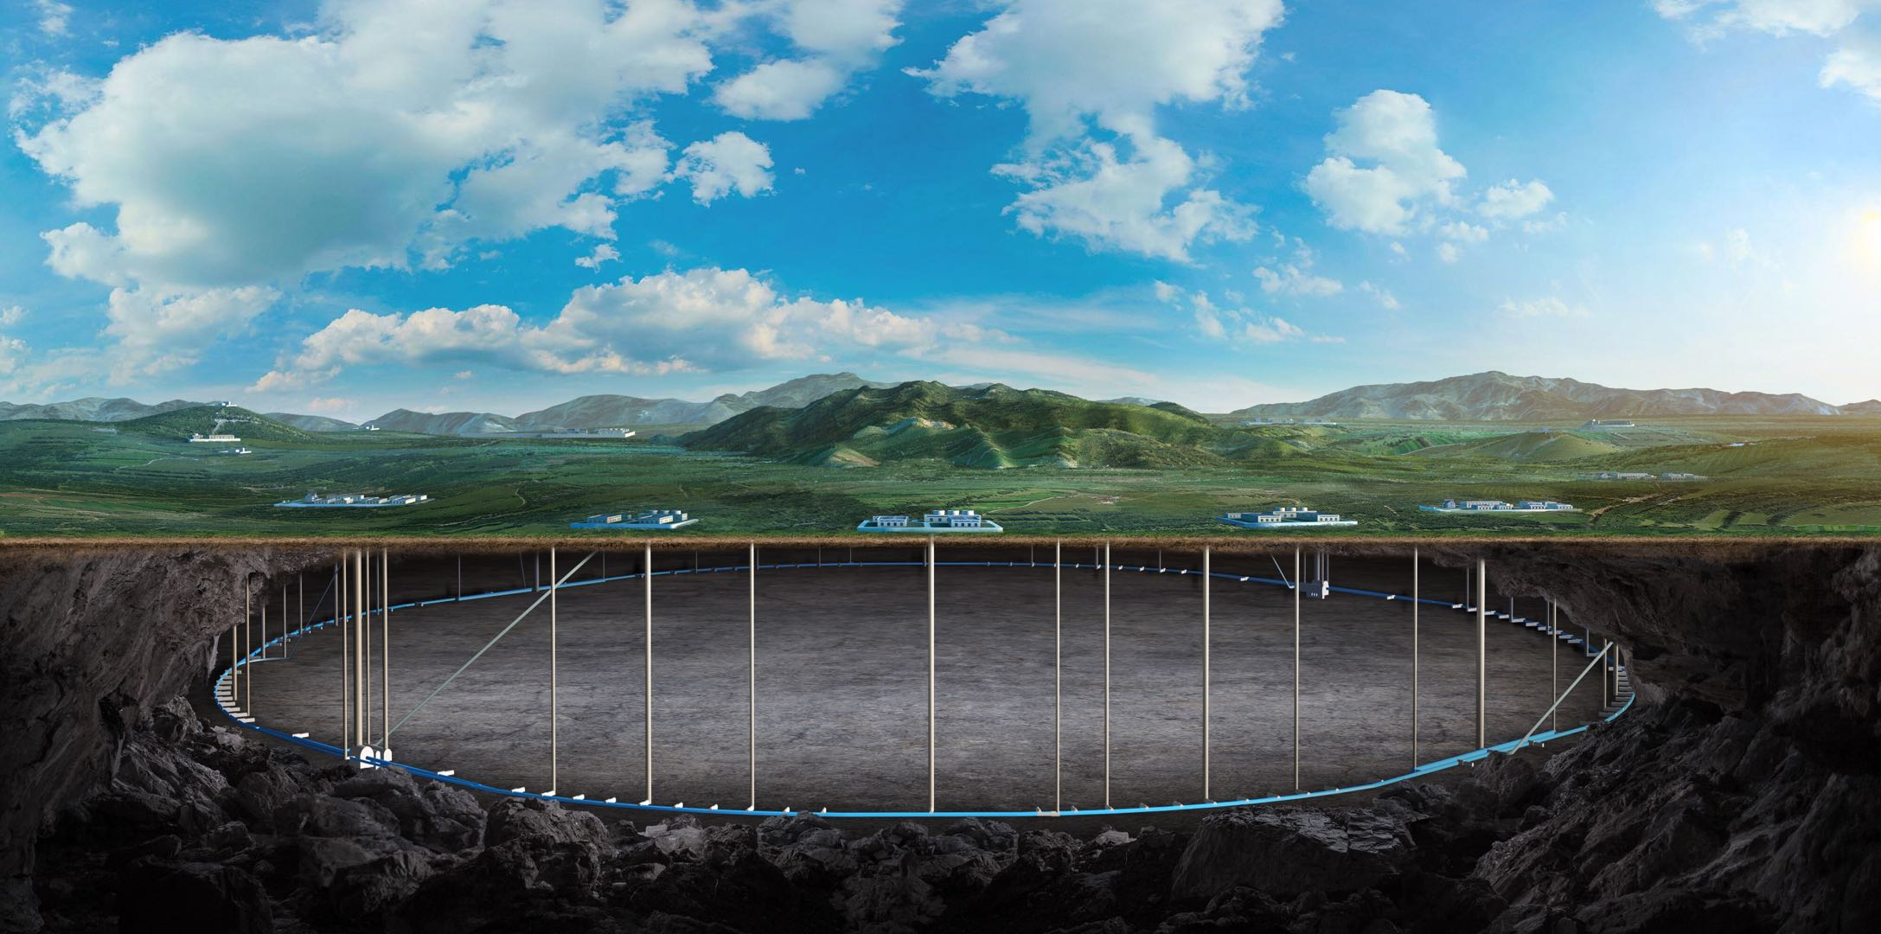


CEPC Superconducting Quadruople Magnet
Yingshun Zhu
On behalf of CEPC IR SC magnet system
Jan. 12-16, HKUST, 2026 IAS Program on Fundamental Physics

Slide 2
Content
Introduction
EDR plan of superconducting quadrupole magnets
EDR status
  Magnetic field design
  Quench protection and simulation
  Direct winding CCT quadrupole short model status
Conclusion

Slide 3
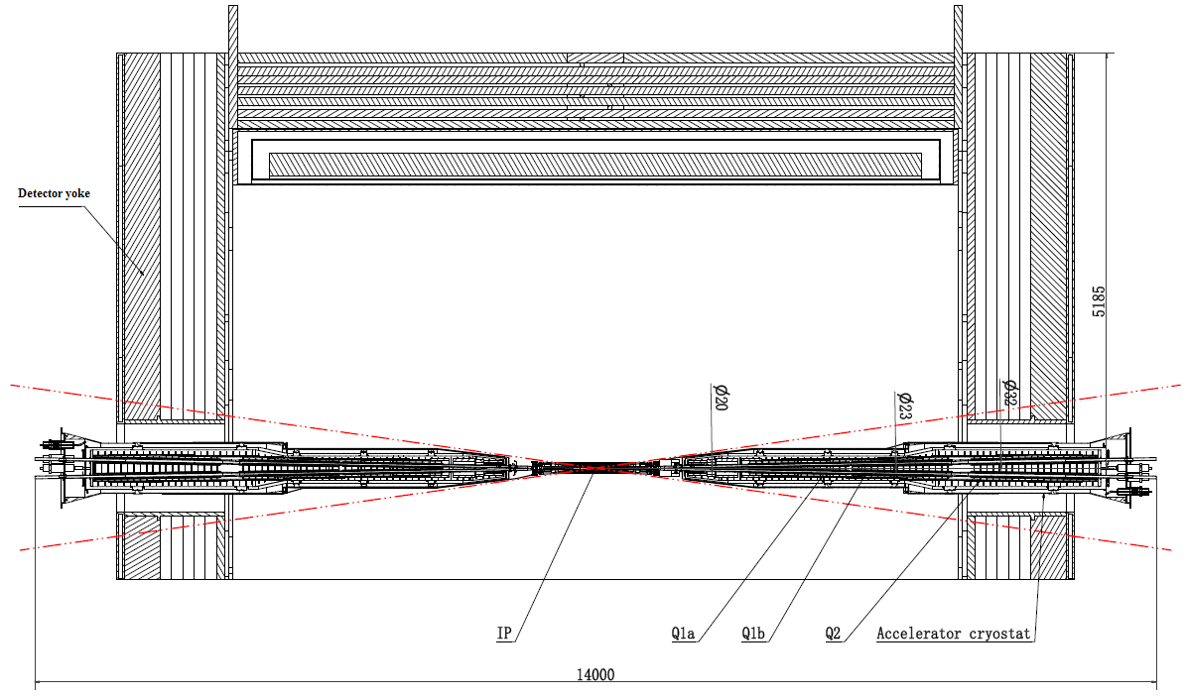
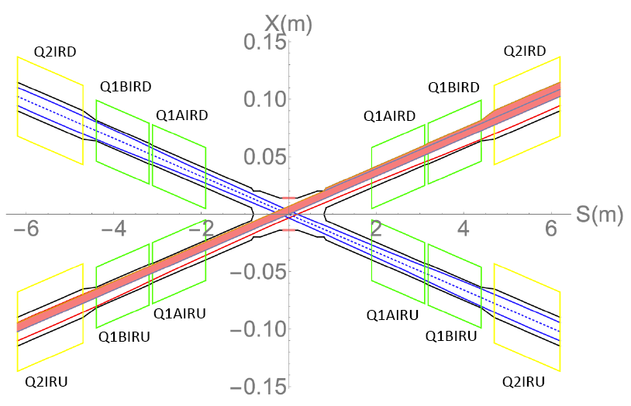
Introduction
There are 2 interaction points in CEPC collider ring
To final focus the beams for high luminosity, compact high gradient double aperture quadrupole magnets (Q1a, Q1b, Q2) are required on both sides of IP point
To cancel the effect of the detector solenoid field (3T) on the beam, anti-solenoids before Quadrupoles and outside Quadrupoles are needed
EDR requirements of CEPC Final Focus quadrupoles are based on L* of 1.9 m, beam crossing angle of 33 mrad

Slide 4
Introduction
Design requirement of CEPC Interaction Region quadrupole magnets:
1) Basic requirement of CEPC Interaction Region quadrupole magnets
Magnet | Field gradient (T/m) |  |  |  | Magnetic length (m) | Width of GFR (mm) | Minimal distance between two aperture beam lines (mm)
 | tt | Higgs | W | Z
Q1a | 140.7 | 142.3 | 94.9 | 109.7 | 1.21 | 14.92 | 62.71
Q1b | 58.9 | 85.4 | 57.0 | 64.8 | 1.21 | 18.17 | 105.28
Q2 | 51.3 | 96.7 | 64.5 | 0.0087 | 1.5 | 24.48 | 155.11
Field crosstalk will introduce Dipole field, sextupole, etc
2) Ratio of multipole field to quadrupole field ≤ 3×10⁻⁴
3) Integral dipole field at the center of quadrupole aperture is zero
Local dipole field at each longitudinal position ≤300 Gs

Slide 5
EDR plan of superconducting quadrupole magnets
EDR goal of SC quadrupoles
Optimize and finish good magnet design, innovative, technically achievable
Complete the Engineering Design Report
EDR plan of SC quadrupoles
Year | Work plan | Status
2024 | Iteration and finalize design requirements for SC quadrupole magnets Choose a good magnet design option | Finished
2025 | Optimization of SC quadrupole, detailed magnetic field analysis, quench analysis Finish magnet design, summarize magnet parameters Complete 2025 CEPC proposal of SC quadrupoles Start direct winding experiments of CCT quadrupole coil | Finished
2026 | Key technologies study, magnet engineering design Manufacture a direct winding CCT Q1a short model | To be done
2027 | Cryogenic test of CCT Q1a short model Complete Engineering design report | To be done

Slide 6
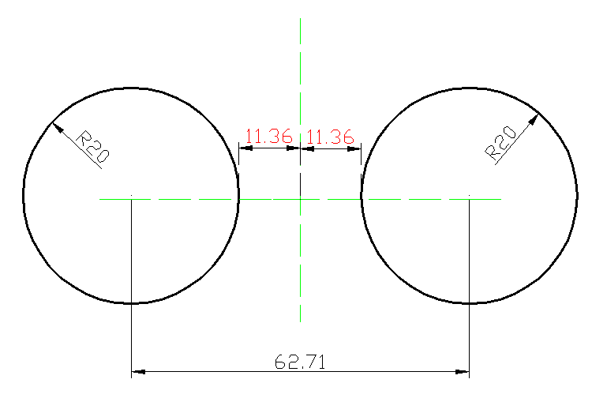
Magnetic field design of superconducting CCT quadruoples
The design requirement of Q1a is the most challenging
Minimal distance between two aperture beam lines: 62.71 mm
Radius of single aperture <31.36mm
Leaving space for beam pipe, inner helium vessel, coil support
Quadrupole coil inner radius: 20 mm
Challenging to meet stringent design requirements for Q1a
1) High field gradient: 142.3 T/m
2) Limited magnet radial space
R: [20mm, 31.36mm], 11.36mm
3) Magnetic field crosstalk between two apertures
High order field harmonics ≤ 3×10⁻⁴
Local dipole field: ≤ 300 Gs
FCC-ee FFQ: 100 T/m

Slide 7
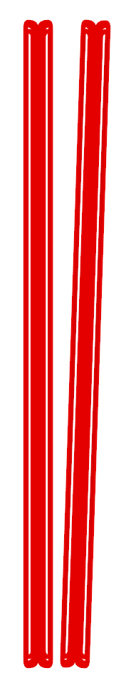

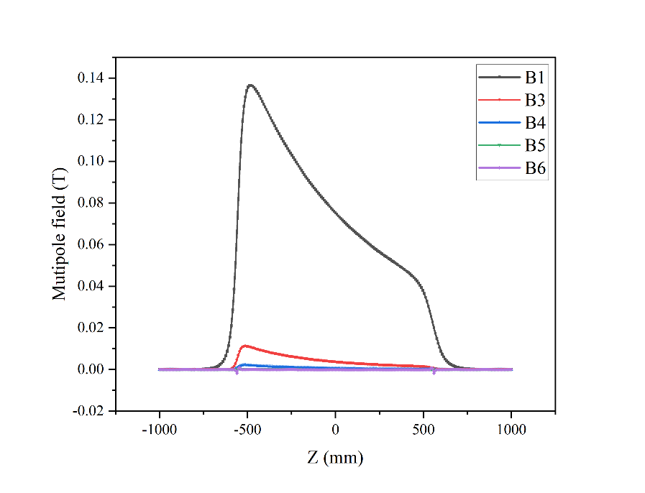
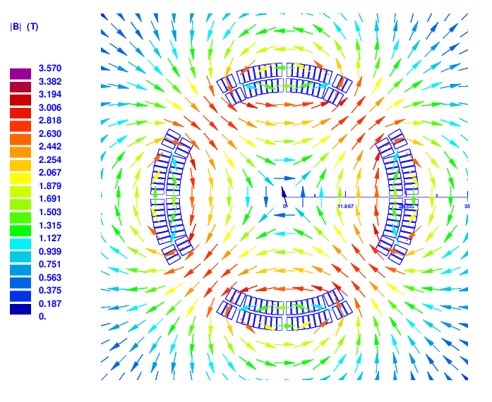
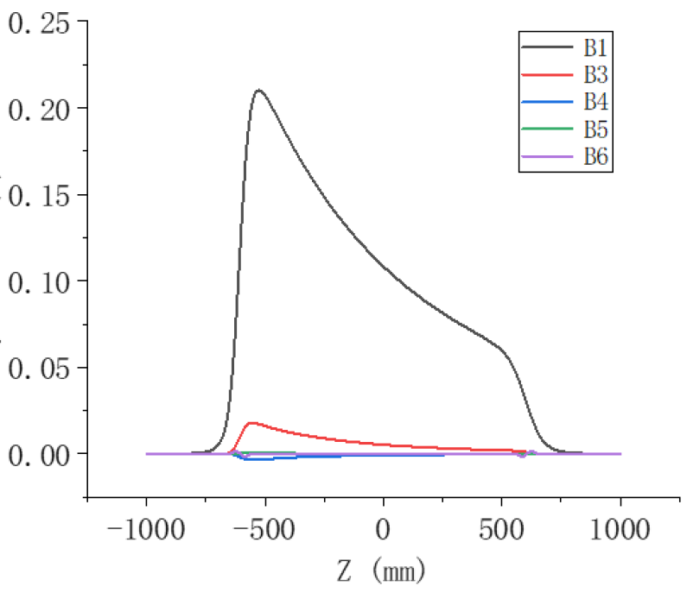
Field crosstalk in double aperture iron-free quadrupole
In EDR, requirement on local dipole field in each aperture is relaxed to ≤ 300 Gs
To reduce magnet weight, iron-free structure is selected for CEPC SC quadrupoles
The two apertures of Q1a is in close proximity, distance between two beams changes
Field crosstalk generates multipolle fields that vary longitudinally and should be solved
Using anti-symmetric coil, dipole field can not meet the design requirement
Cos2θ coil
CCT coil

Slide 8

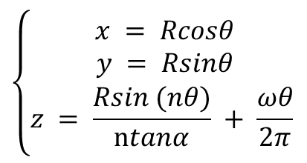
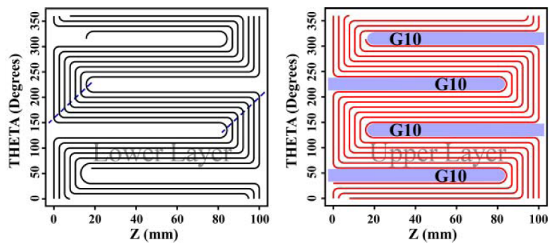
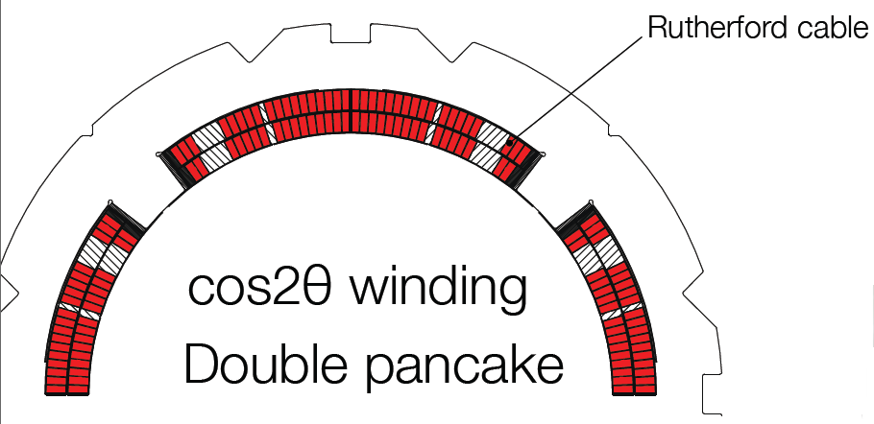
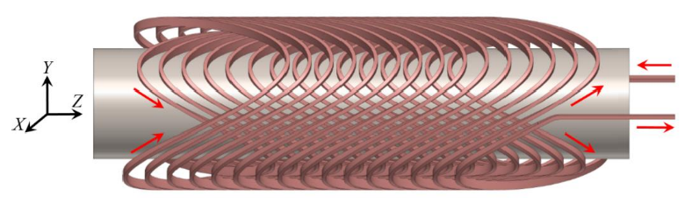
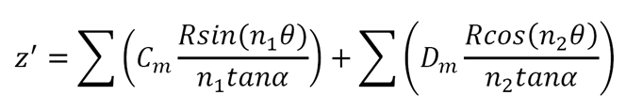
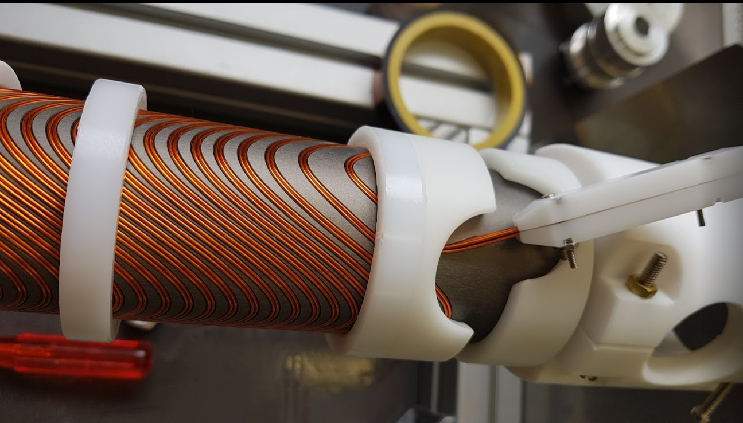
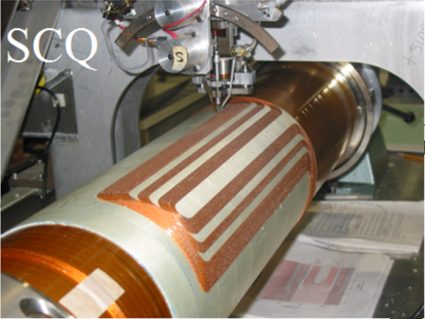
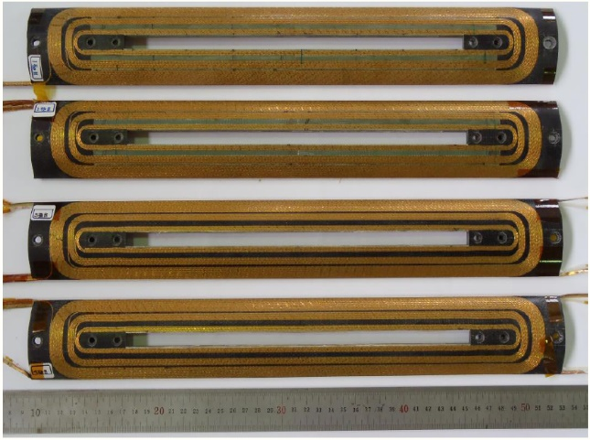
CCT option to solve field crosstalk in iron-free quadrupole
Field crosstalk varies with longitudinal position
Three kinds of quadrupole coil structures are studied
Cos2θ and Serpentine coil: hard to locally adjust field distribution
CCT (Canted cosine theta) coil can locally adjust field distribution
CCT quadrupole coil is the selected option (Iron-free, coil self correction)
CCT Coil with self correction
CCT coil
Direct winding Serpentine coil
Cos2θ coil

Slide 9
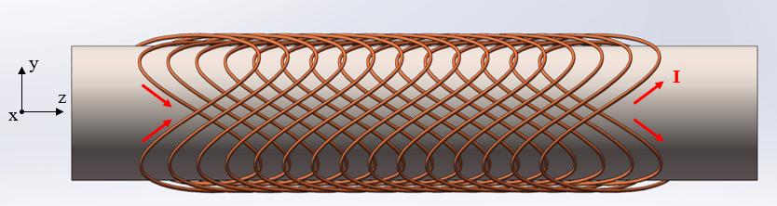
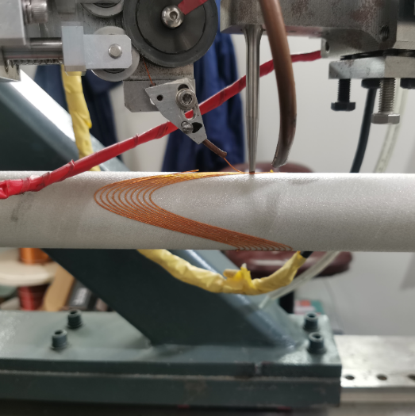
CCT option to solve field crosstalk in iron-free quadrupole
Besides quadrupole coil, several corrector coils are needed in CEPC IR
Dipole corrector coil, Skew quadrupole coil
Direct winding CCT coil is preferred. Baseline design
Wind CCT coil layer by layer on tube surface using Direct winding technology
Traditional CCT coil is alternative option
Conductors in groove, each layer requires a skeleton
Advantages of Direct winding CCT coil:
Accurate wire position and high magnetic field precision
No gap between adjacent layers or coils
Compact structure for SC magnets with multiple coils
Coil self correction is used to solve magnetic field crosstalk
Pre-stress can be applied by wrapping fiberglass on coil layers
Magnetic field harmonics can be corrected during multi-layer winding process
Direct winding CCT

Slide 10
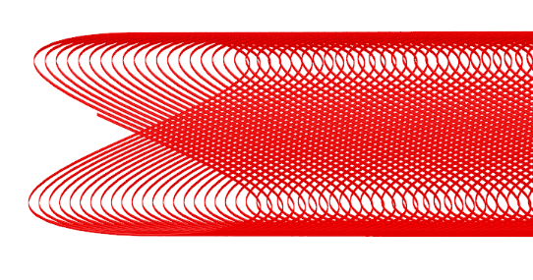

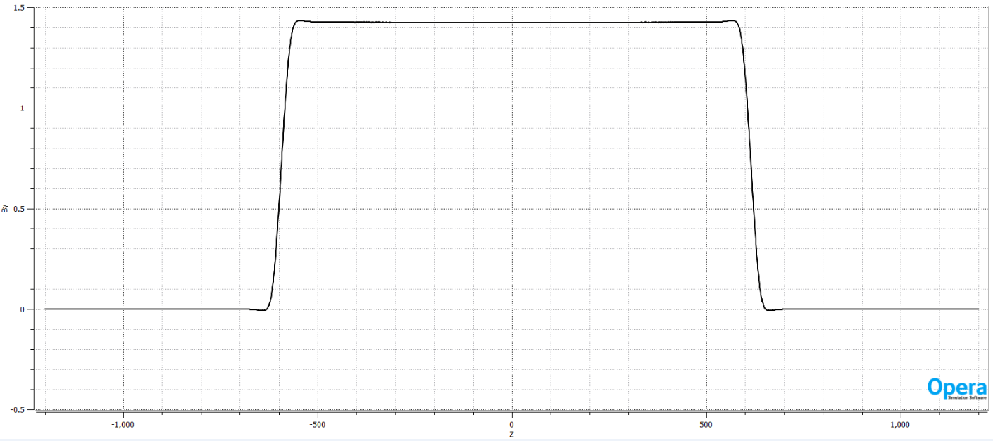
Magnetic field design of superconducting CCT quadruoples
Q1a Direct winding CCT coil
142.3T/m, Coil thickness 11mm
Baseline: Round 0.75mm NbTi conductor, Cu:SC=1, Temperature 2K
Canted angle: 24 deg, pitch: 2.3 mm
8 layers CCT quadrupole coil: inner radius 20mm
Excitation current: 720A
3D field calculation in OPERA-3D
Radius of single aperture <31mm

Slide 11
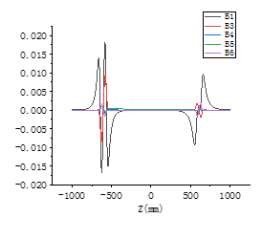
Magnetic field design of superconducting CCT quadruoples
Q1a Direct winding CCT coil
In 3D calculation, large number of conductor segments
Coil self correction technology is used to solve magnetic field crosstalk
After correction, local dipole field decreases to less than 300Gs (Higgs)
Before correction
Requirement: Local dipole field ≤300 Gs
Dipole field after correction

Slide 12
Magnetic field design of superconducting CCT quadruoples
Q1a: integrated multipole field before coil self correction (Higgs)
Q1a: After coil self correction, integrated multipole field<2×10⁻⁴ (Higgs)
Rref=7.46mm
n | bn (Bn/B2) | an (An/B2) | Required integrated field harmonics
2 | 10000 |  | Bn/B2 ≤3×10-4
3 | -65.0 | -0.1
4 | 10.3 | 0.1
5 | -1.7 | -0.06
6 | 0.2 | 0.01
7 | -0.03 | <0.01
n | bn (Bn/B2) | an (An/B2) | Required integrated field harmonics
2 | 10000 |  | Bn/B2 ≤3×10-4
3 | -0.78 | -0.1
4 | 0.27 | 0.1
5 | -1.5 | -0.06
6 | 0.16 | 0.01
7 | -0.03 | <0.01

Slide 13


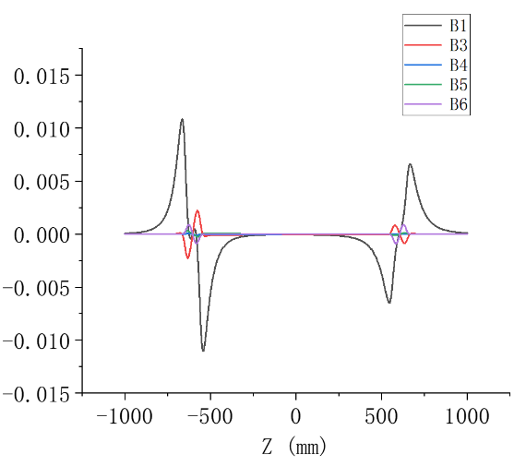
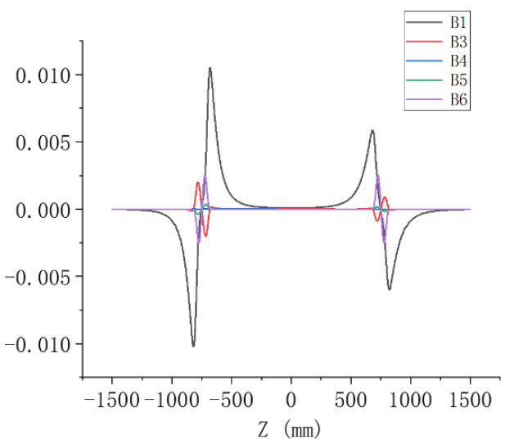
Magnetic field design of superconducting CCT quadruoples
Q1b Q2 Direct winding CCT coil
Baseline: ∅ 0.85mm NbTi conductor, canted angle: 24 deg (Q1b), 22 deg (Q2)
8 layers CCT quadrupole coil
Coil thickness 12mm
After correction, local dipole field decreases to less than 150Gs (Higgs)
Calculated integrated field harmonics are smaller than 2×10⁻⁴
Q1b
Q2
Multipole field after correction

Slide 14
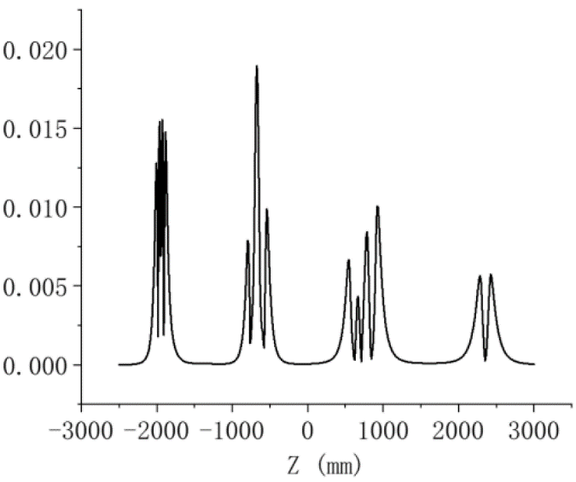
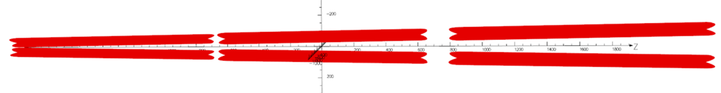
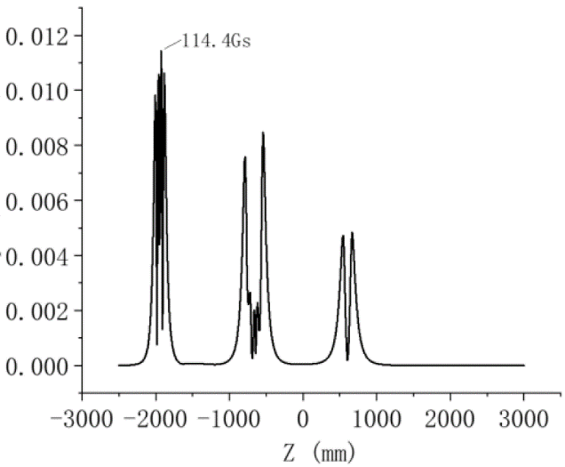
Magnetic field design of superconducting CCT quadruoples
Combined 3D magnetic field simulation of Q1a, Q1b, Q2 (Direct winding CCT )
Local dipole field at each position <300Gs, meet the requirement
Higgs mode
Dipole field distribution
Requirement: Local dipole field ≤300 Gs
Z mode
Dipole field distribution

Slide 15
Design parameters of SC quadrupoles with CCT coil
Design parameters of Q1a, Q1b, Q2 with iron-free CCT coil @ Higgs
Baseline: Direct winding CCT coil
 | Q1a | Q1b | Q2
Field gradient (T/m) | 142.3 | 85.4 | 96.7
Magnetic length (m) | 1.21 | 1.21 | 1.5
Excitation current (A） | 720 | 640 | 760
Conductor diameter (NbTi, mm) | 0.75 | 0.85 | 0.85
Current density (A/mm²) | 1630 | 1128 | 1340
Maximum dipole field in aperture (Gs) | 193 | 134 | 107
Stored energy (KJ) | 16.7 | 15.2 | 36.1
Peak field in coil (T) | 4.0 | 3.7 | 4.1
Integrated field harmonics | <2×10⁻⁴
Load line @2K | 75% | 63% | 71%
Single aperture inner radius (mm) | 19 | 26 | 31
Single aperture outer radius (mm) | 30.8 | 39 | 44
Magnet mechanical length (m) | 1.23 | 1.23 | 1.53
Net weight (kg) | 25 | 32 | 43
Total weight of Q1a, Q1b, Q2 (kg) | 100

Slide 16
Quench protection and simulation
Protection Strategy:
  First, Detect a quench as quickly as possible → the Quench Detector(QD)
  Then switch off the power supplies and trigger QPA (Quench Protection Assembly)
  Extract the stored energy by external dump resistors circuit
How do we detect a quench?
  Measurement through voltage taps from coil and lead
  Resistive voltage reaches threshold U_{th} + validation delay
Structure of the Quench Protection System

Slide 17
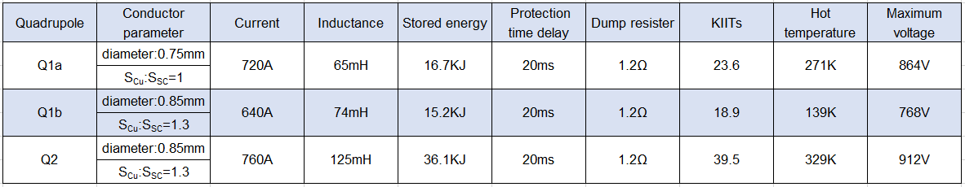
Quench protection and simulation
The growth of the resistive region in a magnet is a complex process
1-D model: thermal links between turns and layers are not accounted for
  20ms total protection time delay between a quench and the dump resister activation
  Dump resister 1.2Ω
First quench analysis for CEPC IR SC magnets has been performed
Results support that an active protection system with an external energy dissipation resistor is feasible
  Assuming a 20ms protection time delay , the dump resister 1.2Ω
Simulated hot temperature ＜330K， maximum voltage ＜ 1000V

Slide 18
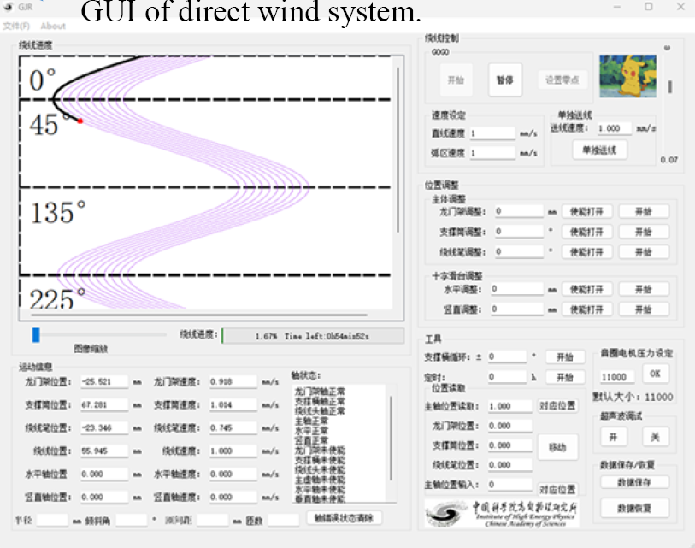
Direct winding CCT quadrupole short model status
SC quadrupole design was reviewed in Mini-Review of CEPC MDI in June 2025
“The committee fully endorses the plan to build a prototype of a direct wind Q1a CCT quadrupole”
Direct winding experiments of CCT coil has started
According to the quadrupole coil design, data file of CCT coil winding path suitable for the winding machine has been generated
Control system software of winding machine has been developed

Slide 19

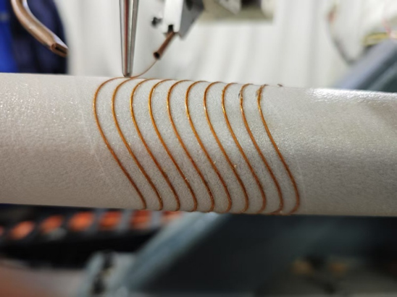
Direct winding CCT quadrupole short model status
Direct winding experiment of CCT coil has been performed
Use NbTi wire with 0.33mm diameter
Direct winding test:
Pure CCT quadrupole
CCT quadrupole coil with self correction
The shape of the test CCT winding looks good
Pure CCT quadrupole
CCT quadrupole coil with self correction

Slide 20
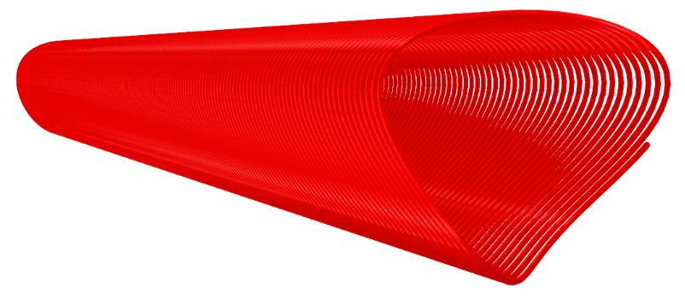
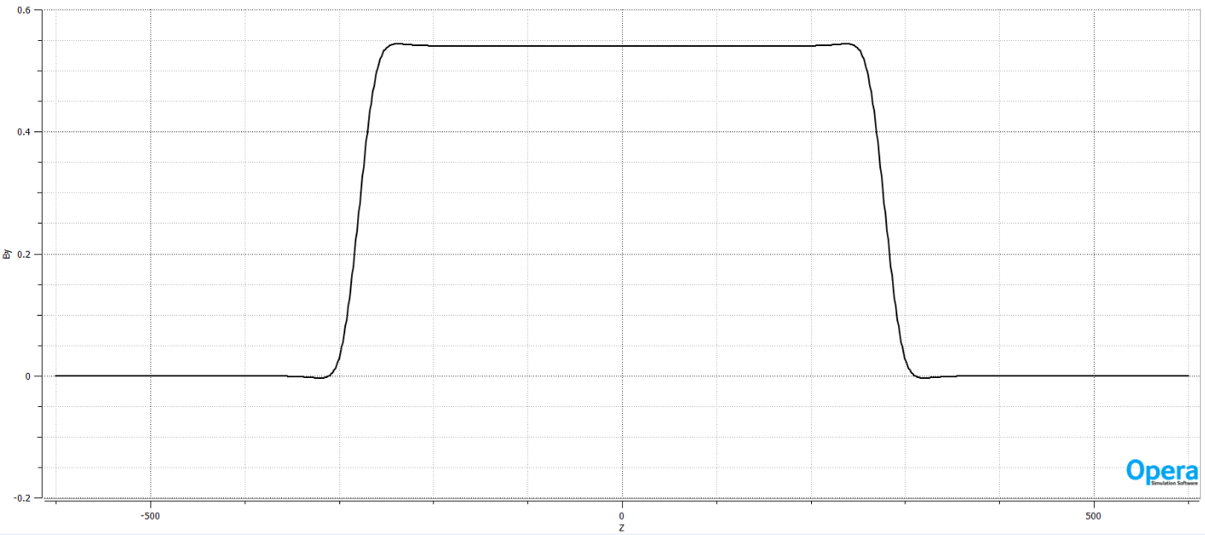
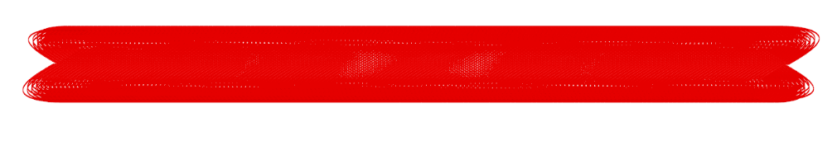
Direct winding CCT quadrupole short model status
In EDR, the 1st step: develop a single aperture Direct winding CCT quadrupole model
the 2nd step: double aperture CCT quadrupole model with self correction
Main purpose: research and master key technologies of Direct winding CCT quadrupole
Coil aperture: ∅ 40mm, Field gradient: >40 T/m @4.2K, mechanical length: 0.6m
Not enough fund; use existing NbTi wire in the laboratory
Diameter 1mm or 0.6mm (not CEPC specification)
A total of 6 layers Direct winding CCT coil
Canted angle: 30 deg, pitch: 3.3 mm
Single aperture quadrupole

Slide 21
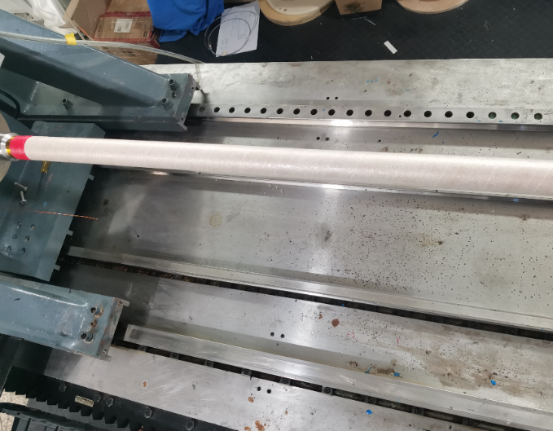
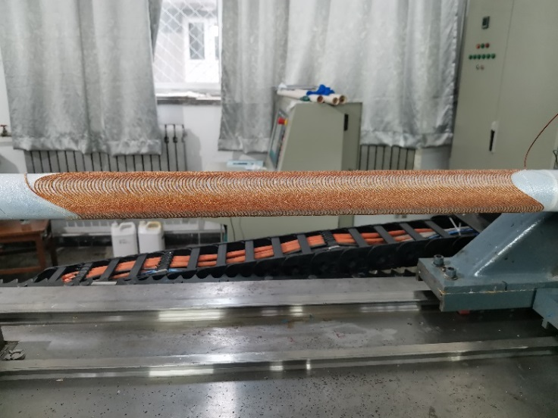
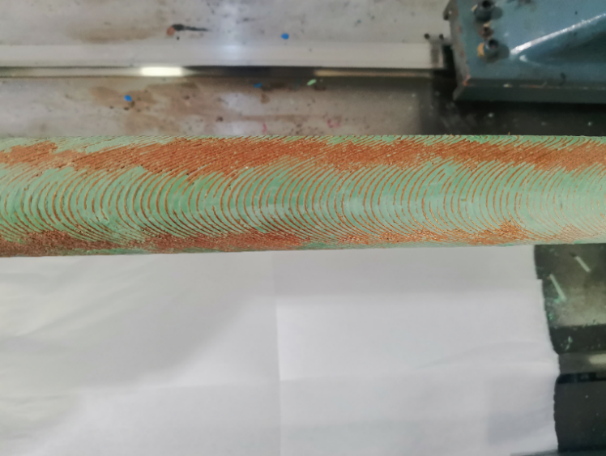
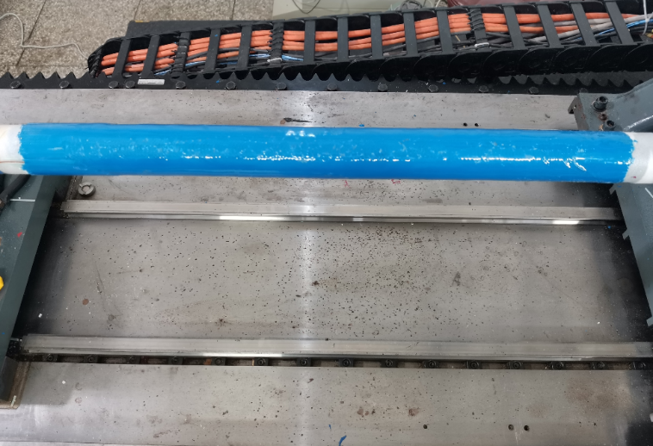
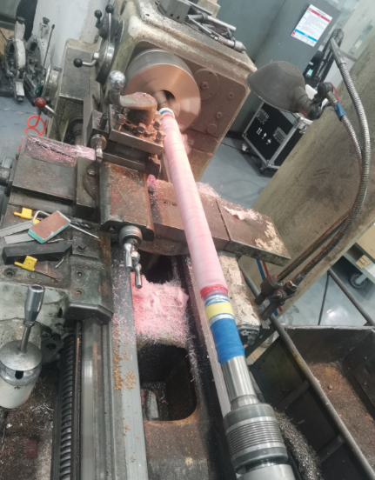
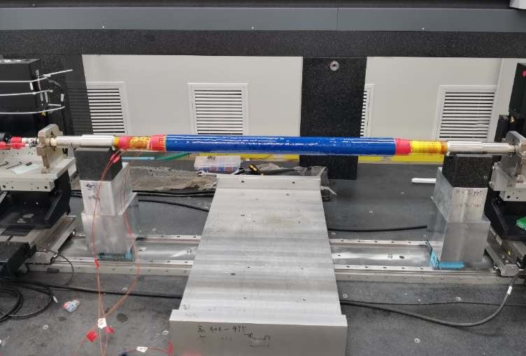
Direct winding CCT quadrupole short model status
Main fabrication process of one double-layer CCT using direct winding technology:
Wrap substrate coil winding apply epoxy apply pre-stress surface machining
room temperature magnetic field measurement
4 layers CCT coils have been wound

Slide 22
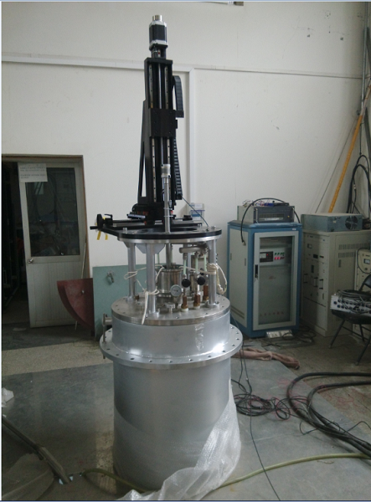
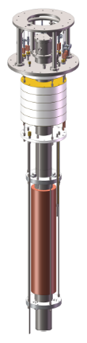
Direct winding CCT quadrupole short model status
The single aperture direct winding CCT quadrupole model will be tested at 4.2K, using cryogenic vertical test facility at IHEP
The update of rotation coil and Hall probe measurement system located in the middle of the Dewar is in progress
To measure the variation of field harmonics along longitudinal direction, short PCB rotating coil will be fabricated
Vertical test will be performed in the first half of 2026

Slide 23
Conclusion
For CEPC superconducting quadrupole magnets, it is challenging to meet stringent design requirements
1) High field gradient 142.3T/m 2) Limited radial space ~11mm 3) Field crosstalk of two apertures
With updated design requirement, Iron free coil is selected
Direct winding CCT quadrupole coil option is the baseline design
Basic magnet design of CCT quadrupoles is finished and reviewed
Direct winding experiment of CCT coil has been performed
Study on key technologies of Direct winding CCT 0.6m quadrupole model in progress
The first single aperture quadrupole short model will be cold tested at 4.2K

Slide 24
Thanks for your attention!
Jan. 12-16, HKUST, 2026 IAS Program on Fundamental Physics

