Slide 1
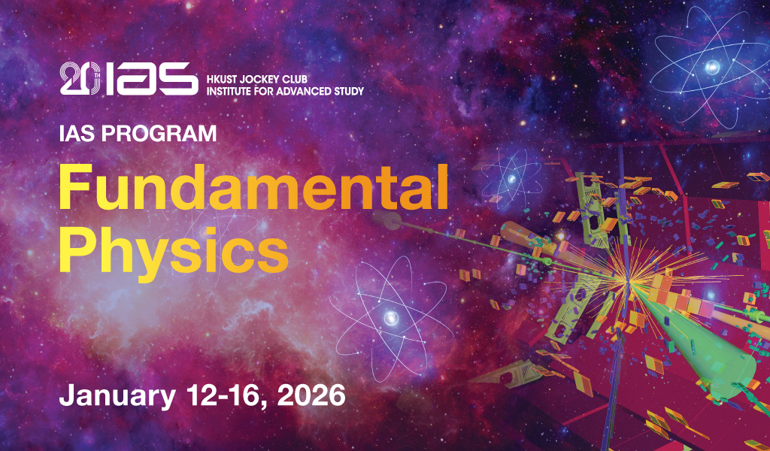
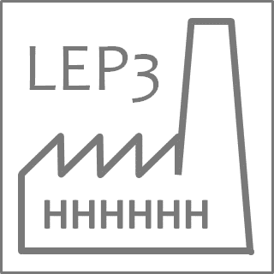
LEP3: Accelerator design choices
M. Koratzinos
IAS Conference on Fundamental Physics 2026
13/1/2026

Slide 2
LEP3
LEP3 is a low-cost Higgs factory in a re-purposed LHC tunnel
It offers ~ one third of the performance of FCC but only at ~one third of the cost.
Talk by T. Camporesi in this conference (Wednesday)
Here I will concentrate on technical choices for the accelerator and especially on progress since the ESPP Venice Meeting (in June 25 2025)

Slide 3
Strategic choices of LEP3
Reuse the LHC tunnel
Utilize most of the FCC-ee work done so far
Have two experiments, could use repurposed ATLAS and CMS
Reduce the ZH energy to 115GeV per beam
Give up running at the ttbar threshold
Use a single RF frequency (800MHz) for a simpler system
Reduce the beampipe diameter from 60 to 30mm

Slide 4
Higgs rate

Slide 5
ZH energy
FCC runs at 120GeV (slightly above the maximum Higgs rate)
Energy lost per turn is proportional to E^4
Luminosity is proportional to E^-3 (to first order)
by running at 115 GeV we gain 1GV or 18.5% of RF voltage (and cost), which is a lot!
We also gain 13.6% of luminosity
Unfortunately, we also lose 14.4% of total Higgs xsection. The effect of background needs to be evaluated

Slide 6
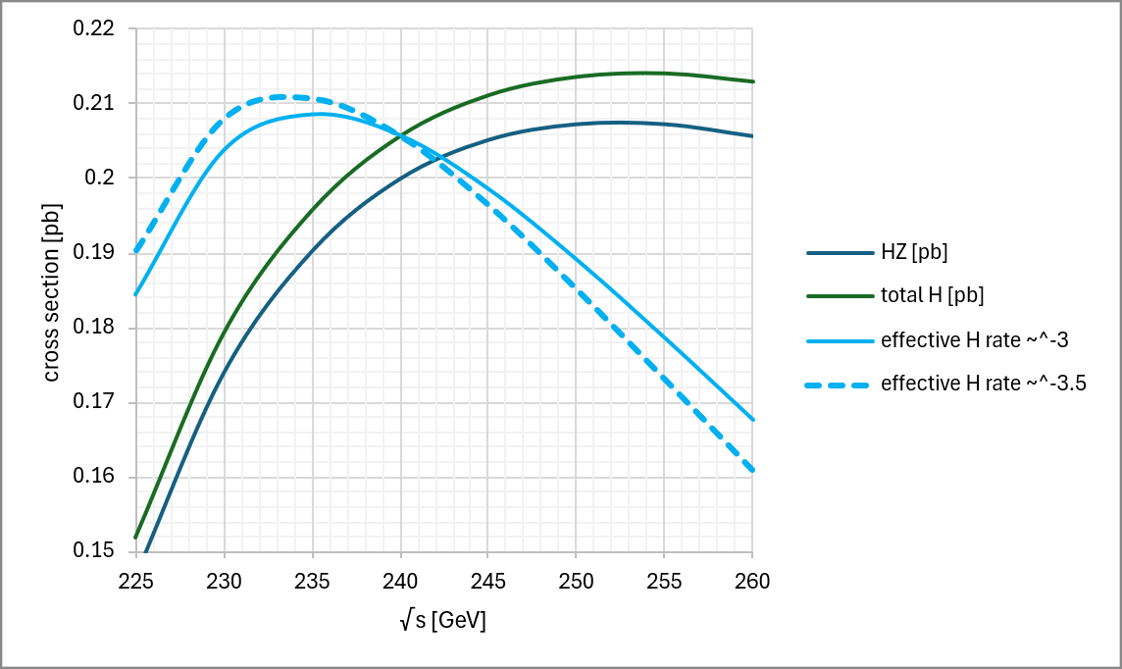
Higgs effective rate
In a circular collider, the maximum Higgs rate is not at maximum cross section!
To first order, we expect a power law of E_{beam}⁻³.
If we do the best fit to FCC luminosities over the range 45-182.5GeV, we get a power law of E_{beam}^{-3.6} to E_{beam}^{-3.2}
Power law of -3: maximum at 236GeV. At 230GeV we are 2.2% lower than max
Power law -3.5: maximum rate at 233GeV. At 230GeV we are 1.4% lower than max
Above is without taking into account ISR – after taking ISR into account, the 230GeV rate is 2.3% lower compared to 240GeV
Choose beam energy of 115GeV

Slide 7
luminosity

Slide 8

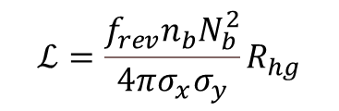
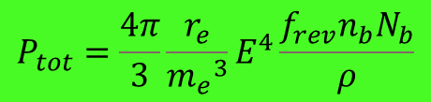
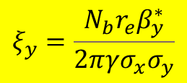
Luminosity of circular colliders
The usual luminosity formula is this:
$$ℒ=\frac{f_{rev}n_{b}N_{b}^{2}}{4πσ_{x}σ_{y}}R_{hg}$$
$$ξ_{y}=\frac{{N_{b}r}_{e}β_{y}^{∗}}{2πγσ_{x}σ_{y}}$$
$$P_{tot}=\frac{4π}{3}\frac{r_{e}}{{m_{e}}^{3}}E^{4}\frac{f_{rev}n_{b}N_{b}}{ρ}$$
This is not very informative as to what luminosities might be achievable. But if we express the above formula in terms of 1/ total synchrotron radiation power and 2/vertical beam-beam parameter we get:
$$ℒ=const×P_{tot} \frac{ρ}{{E_{0}}^{3}}ξ_{y}\frac{R_{hg}}{β_{y}^{∗}}$$
The vertical beam-beam parameter (or tune shift) is a measure of disruption of the colliding beams. At LEP (4 IPs) it reached a value of 0.1. FCC-ee ZH (also 4 IPs) runs at 0.134. Colliders with two IPs (line LEP3) can run with higher tune shifts than colliders with 4 IPs
https://cds.cern.ch/record/1757596/files/CERN-ACC-NOTE-2014-0066.pdf

Slide 9
Luminosity of circular colliders (2)
In natural units, the achievable luminosity (for FCC) is:
$$ℒ={6.0×10}^{34}\left(\frac{P_{tot}}{50MW}\right)\left(\frac{ρ}{10km}\right){\left(\frac{120GeV}{E_{0}}\right)}^{3}\left(\frac{ξ_{y}}{0.1}\right)\left(\frac{R_{hg}}{0.84}\right){\left(\frac{1mm}{β_{y}^{∗}}\right)cm}^{−2}s^{−1}$$
And for LEP3 is:
$$ℒ={2.0×10}^{34}\left(\frac{P_{tot}}{50MW}\right)\left(\frac{ρ}{3km}\right){\left(\frac{115GeV}{E_{0}}\right)}^{3}\left(\frac{ξ_{y}}{0.1}\right)\left(\frac{R_{hg}}{0.84}\right){\left(\frac{1mm}{β_{y}^{∗}}\right)cm}^{−2}s^{−1}$$
Note that the above formula does not tell you how to design your collider; simply gives you the maximum performance. You need to design the optics so that your beam lifetimes are sufficient.
To increase luminosity at a fixed power, bending radius and beam energy one needs to
Use the smallest possible beta*_y
Run at the highest possible vertical beam-beam parameter

Slide 10
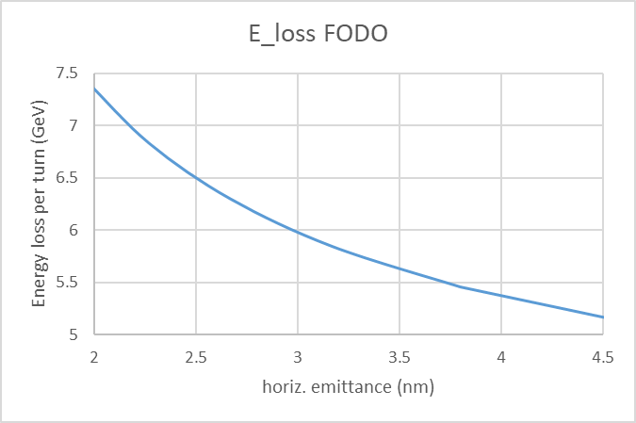
The FODO lattice
The first LEP3 lattice was derived from the FCC FODO one. It delivered a horizontal emittance of 3.8nm for an energy loss of 5.5GeV.
Emittance grows as the third power of the FODO length
Strength of Quads grows inversly with FODO length; Quads become longer and therefore the dipoles need to grow stronger; this results in smaller bending radius and therefore larger Energy loss per turn
ESPP paper working point
This lattice was used for the parameter set already published for LEP3

Slide 11
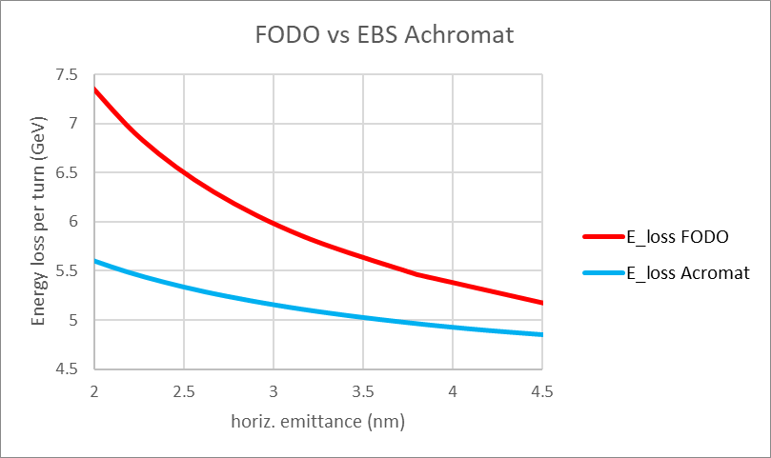
Low-emittance lattice – EBS achromat
…Is able to deliver lower emittance for the same energy loss compared to FODO
Lower horizontal emittance means:
Lower vertical emittance
Smaller beam sizes
For the same magnet aperture, smaller beta*_y is possible
This translates into higher luminosity
New working point
Pioneered by Pantaleo Raimondi

Slide 12
LEP3 Optics

Slide 13
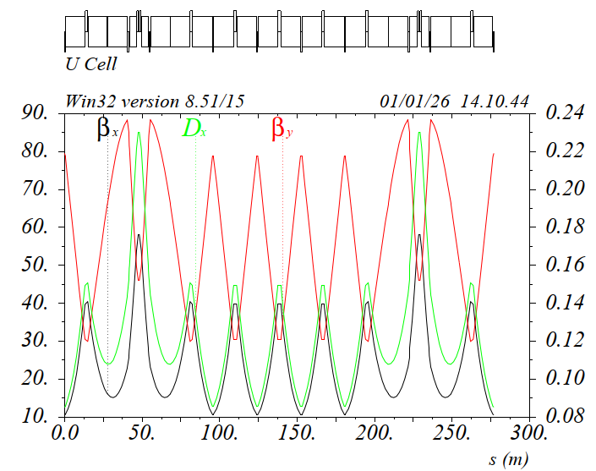
EBS Achromat cell adapted for LEP3 Z/W/ZH modes
SD1 SD2
SF1
Sextupoles are grouped in
a high beta/dispersion region
Phase advance between the sextupoles:
dmux ~ 3pi
dmuy ~ pi
Given the phase relations, all the detunings are intrinsically small, effective dmux and dmuy are slightly adjusted (few %) to compensate for the interleaved sextupole scheme.
Betas and dispersion at sextupoles and dispersion are optimized for best performance
Pantaleo Raimondi

Slide 14
ARC lattice layout
Cell length: 276.88m
Each cell consists of:
- 18 dipoles ~ 12.618m long with defocusing gradient
~0.51T/m @115GeV
- 4 dipoles ~ 4.5m long
- 20 quadrupoles with gradients ~ 21T/m @115GeV and more precisely:
7 QFs ~ 1.85m, 4 QFs ~ 1.10m, 9 QDs ~ 0.85m
- 6 sextupoles with gradients ~ 740T/m2 @115GeV, more precisely:
2 SFs ~ 0.54m long, 4 SDs ~ 0.34m long
80 Cells make a 22151m circumference
To this we need to add:
- 6 Straight sections (for RF, injection, collimation…)
- 2 Interaction Regions (for the two experiments)
the 8 octants will be divided in:
- 4 octants consisting of 10 cells
- 4 octants facing the 2 interaction regions consisting of 9 cells
(to be explained in the Final Focus section)
Pantaleo Raimondi

Slide 15
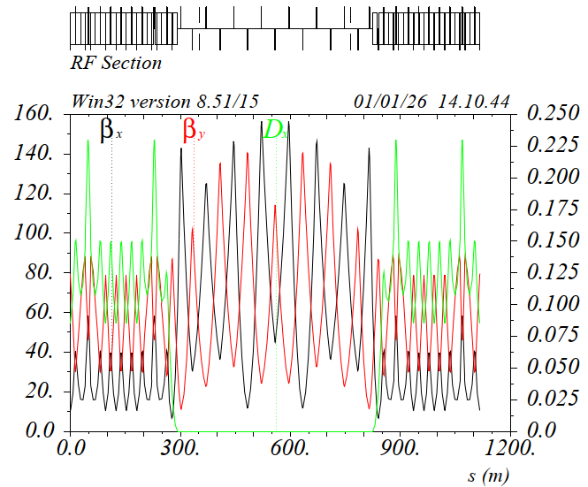
Straight Section insertion
Straight Sections (SSs) are included with the Transparency Conditions criteria (TCs)
SSs are 563.5 m long, however two extra dipoles are needed in the Dispersion Suppressor and they sit in the SSs, reducing the available SSs length to about 535m
In fact the 4*2 last dipoles facing the SSs are 25% weaker wrt the ARC dipoles.
The TCs make so that the breaking of the ring periodicity is minimal, and no ARC sextupole families are needed when the SSs are included in the lattice.
Presently all the SSs are the same and they are very close to what will be the “Standard” RF section.
Pantaleo Raimondi

Slide 16
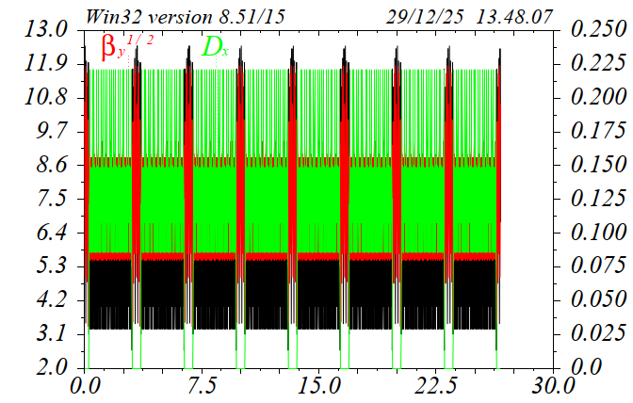
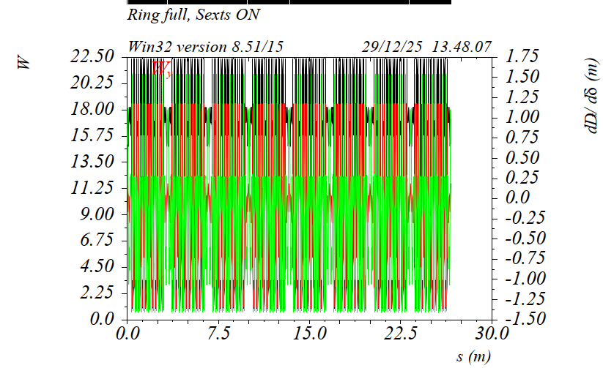
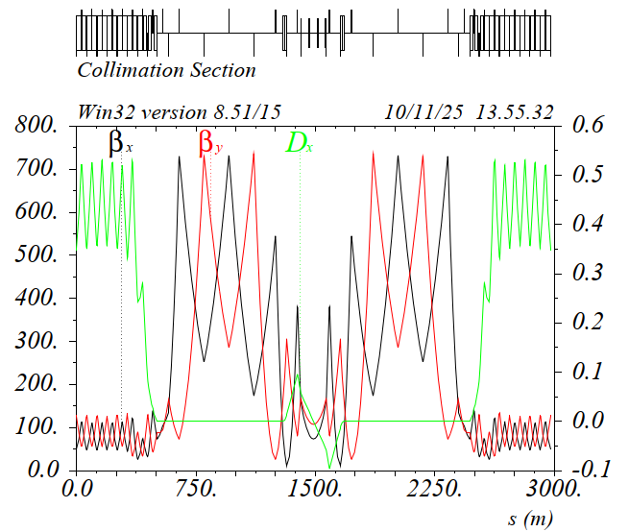
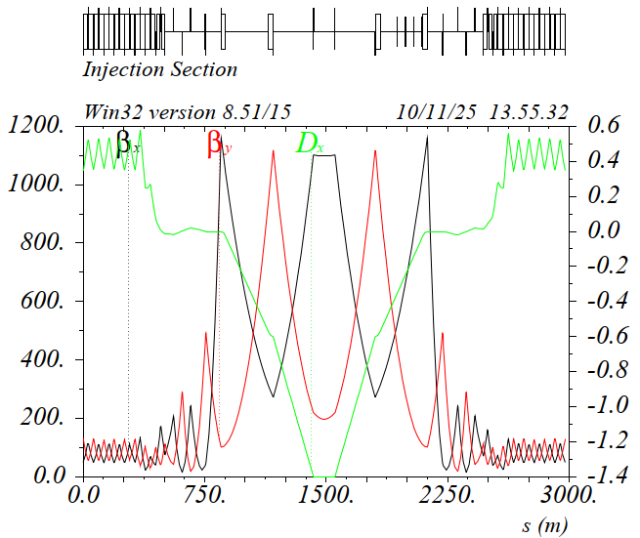
Straight Section insertion
Full ring, consisting of 8 octants and 8 identical Straight Sections. Because of the TCs, the chromatic functions in the octants remains periodic.
The ring is 26659mt long.
Specialized SSs (injection and collimation) can be included as well, they can be a shorter version of the FCCee ones
Pantaleo Raimondi

Slide 17
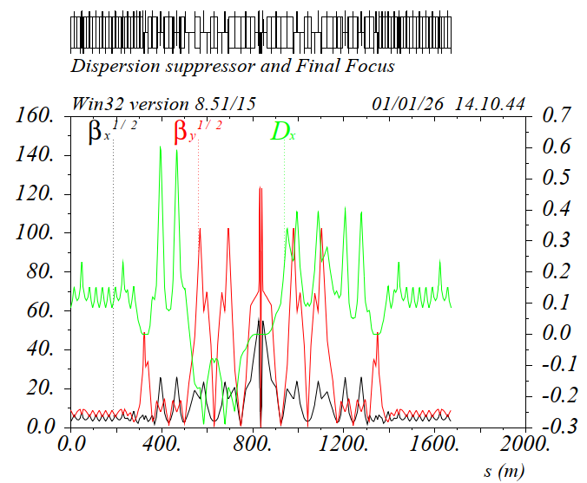
Final Focus system
LEP3 FF has been developed starting from a rescaling of the FCCee LCC-FF design.
All the layout constraints are met, in particular:
- Ring length
- IP positions
- IP crossing angle (30mrad)
The FF is 1025.9m long and has a net bend angle of 0.1347rad.
The last ARC octant cell (per side) has been replaced by the FF-Dispersion Suppressor and the FF itself.
The FF is a 5th order achromat in both planes.
The dipoles have been optimized for best dispersion and optical functions across the Chromatic Correction Sections (CCSx/y)
The dipoles in the incoming CCSy have opposite sign wrt to other dipoles, thus generating a dogleg that matches the layout constraints.
The FF Left and Right magnets and drift lengths are identical and optics nearly identical as well, thus ensuring a high degree of symmetry
FF has been inserted in the lattice with the TCs
CCSy
Crab
Sextupole
CCSx
Pantaleo Raimondi

Slide 18
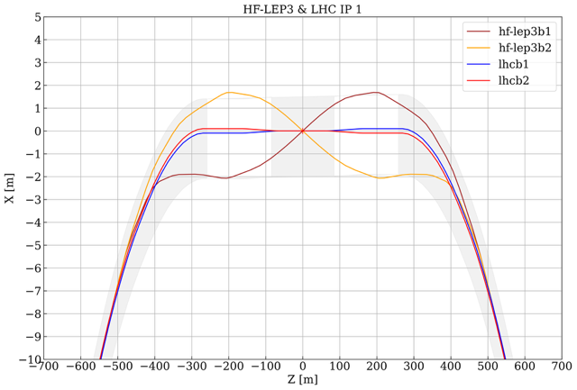
How it fits in the LHC tunnel
Tunnel outline
LSS half length is 282.75m
IP1: tunnel diameter 4.4m
IP5: tunnel diameter 3.8m
Beam separation begins at ~500m from the IP
Maximum distance of the two beams 3.8m (at 200m from the IP) tunnel diameter at 200m is 4.4m
At 282m, where the tunnel diameter changes to 3.8m, beam separation is ~2.9m
We should be able to fit the two beams in the existing tunnel with minimum civil engineering intervention.
The booster ring would need an experiment bypass
Ilias Efthymiopoulos

Slide 19
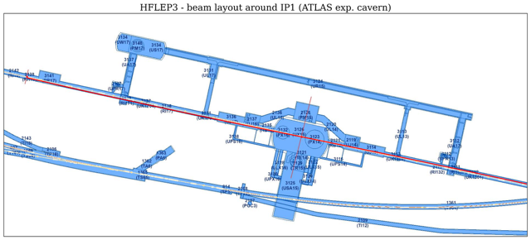
Fit around Point 1
Scraping the sides of the tunnel
Beams collide at ATLAS center
Ilias Efthymiopoulos

Slide 20
LEP3 Updated parameter set
Parameter | LEP3 (ZH) | LEP3 (WW) | LEP3 (Z)
beam energy [GeV] | 115 | 80 | 45.6
number of experiments/crossing angle at the IP [mrad] | 2/30 | 2/30 | 2/30
Circumference [m] | 26659 | 26659 | 26659
Bending radius [m] | 3080 | 3080 | 3080
SR power per beam [MW] | 50 | 50 | 50
beam current [mA] | 10 | 41 | 387
number bunches/beam | 12 | 80 | 1600
bunch intensity [10¹¹] | 4.4 | 2.8 | 1.3
SR energy loss / turn [GeV] | 5.2 | 1.2 | 0.13
total RF voltage [GV] | 6.0 | 1.5 | 0.30
RF frequency [MHz] | 800 | 800 | 800
longitudinal damping time [turns] | 22 | 65 | 353
horizontal beta* [m] | 0.2 | 0.15 | 0.1
vertical beta* [mm] | 1.0 | 0.7 | 0.5
horizontal emittance [nm] | 2.7 | 1.3 | 0.4
vertical emittance [pm] | 5.5 | 2.6 | 0.9
horizontal rms IP spot size [um] | 23 | 14 | 7
vertical rms IP spot size [nm] | 74 | 43 | 21
horiz. beam-beam parameter | 0.03 | 0.01 | 0.00
vert. beam-beam parameter | 0.16 | 0.14 | 0.14
rms bunch length SR only [mm] | 3.1 | 3.4 | 2.6
rms bunch length with SR + BS [mm] | 4.6 | 6.2 | 8.0
beam lifetime rad Bhabha + BS [min] | 6 | 11 | 13
luminosity per IP [10³⁴ cm⁻²s⁻¹] | 3.0 | 11.4 | 92
integrated luminosity/year [ab-1] | 0.7 | 2.7 | 22.1
years of operation | 6 | 3 | 5
total integrated luminosity[ab-1] | 4.3 | 8.2 | 110.3

Slide 21
Improvements since the ESPP meeting
Compared to LEP3 of May 2025, we have reduced emittances, increased bending radius, increased vertical beam-beam parameter. Result is 85% higher luminosity at the ZH and 120% at the Z
Compared to LEP3 of May 2025, sextupole power requirements have decreased dramatically.
Compared to FCC:
For ZH: higher vertical beam-beam parameter, but with half the number of IPs – luminosity is a factor 2.5 lower
For Z: LEP3 has smaller emittances (LEP3 does not change the lattice at the Z, but FCC does), so comes to within 25% of the FCC luminosity. This leaves the option open to decrease the SR power at the Z while keeping reasonable performance
Compared to LCF:
LCF for the full power program has 0.5 ab⁻¹ per year (>99% sqrt(s)) and LEP3 has 0.7 ab⁻¹ (+40%)

Slide 22
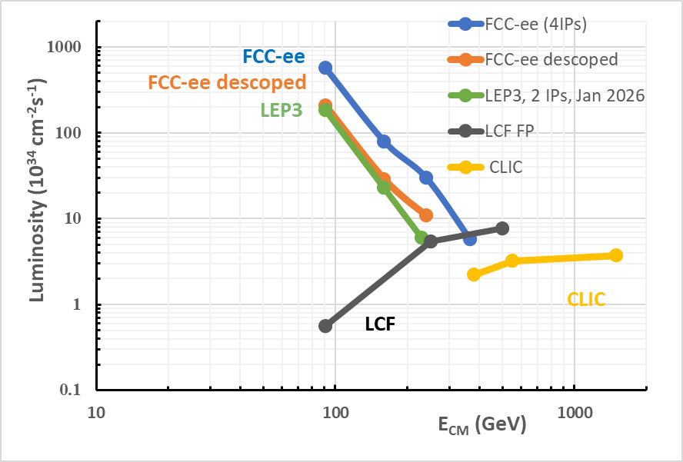
Luminosity of projects considered in the ESPP

Slide 23
Beam pipe diameter

Slide 24
Beam pipe diameter
Another area of improvement, which can decrease the cost of the project considerably, is reducing the size of the beam pipe.
The beam pipe diameter is chosen so that beam instabilities are avoided. These instabilities are proportional to the resistive wall impedance of the beam pipe, which grows:
linearly with the total arc length of the collider (~factor 4 wrt FCC)
Linearly with the beta functions (~factor 2 wrt FCC)
Linearly with the beam current (~factor 3 wrt FCC)
inversely with the third power of the beampipe diameter;
Therefore, if we decrease the inner diameter of LEP3 by 2 (from 60 to 30mm) the impedance would still be reduced by a factor: ~4*2*3/8= 3.
The cost of the magnets goes with the square of the beam pipe inner diameter of the diameter, so cost savings will be substantial.

Slide 25
Synchrotron radiation absorber

Slide 26
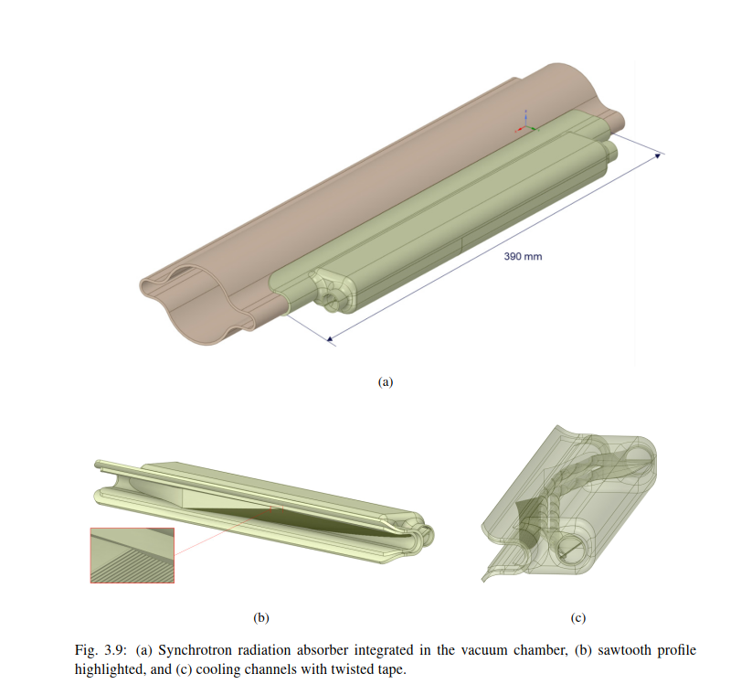
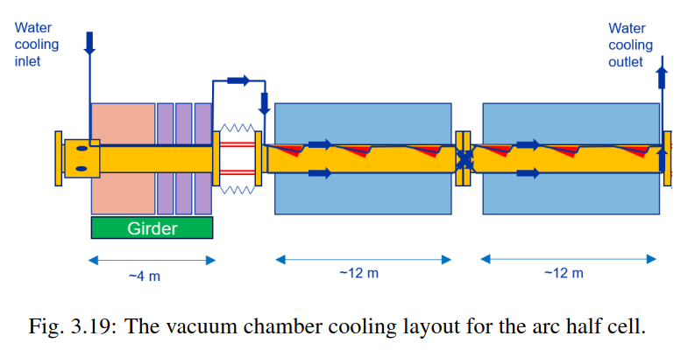
FCC-ee: discreet absorber option
A discrete SR absorber of 0.4m length every ~4m

Slide 27
Synchrotron radiation absorber
If we keep the discrete absorber solution of FCC-ee, our discrete absorbers (for the same power) would be ~1.5m from each other
We should investigate if a continuous system works better for LEP3
SR power per meter at LEP3: 2.5kW

Slide 28
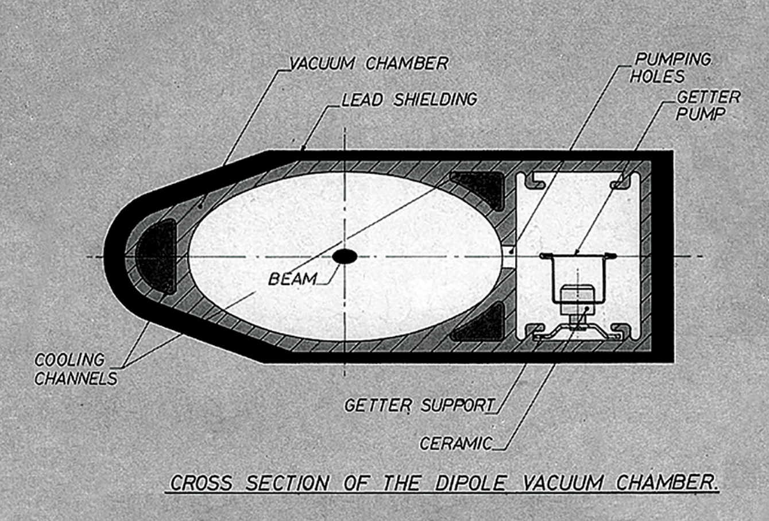
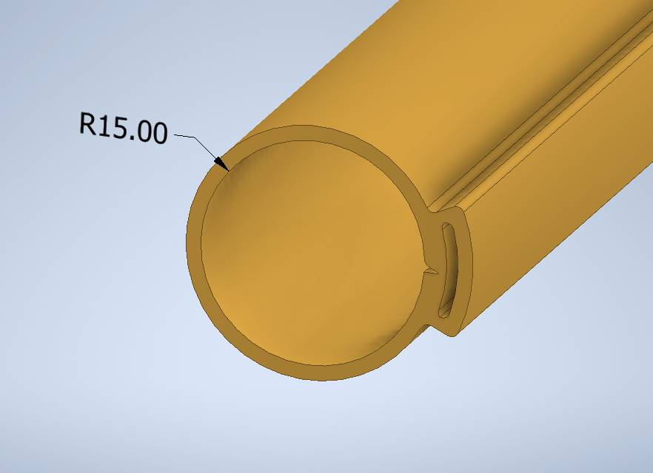
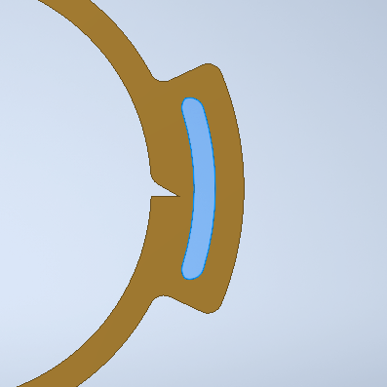
From LEP2 to LEP3
LEP2 vacuum chamber – extruded Aluminium
Oval shape is bad for impedance
Beam sizes were larger at LEP2
Artist’s impression of LEP3 beam pipe:

Slide 29
Injector complex

Slide 30
LEP3 injector
The energy of the injector is determined by the minimum field of the booster magnets and the energy swing
For FCC, injector energy is 20GeV.
LEP3 has magnets that are a factor 3.4 stronger
We can safely reduce the energy to 10GeV – maybe more?
This makes the injector shorter and cheaper
This in turn possibly allows a different placement, fully on CERN land, resulting in a much shorter transfer line

Slide 31
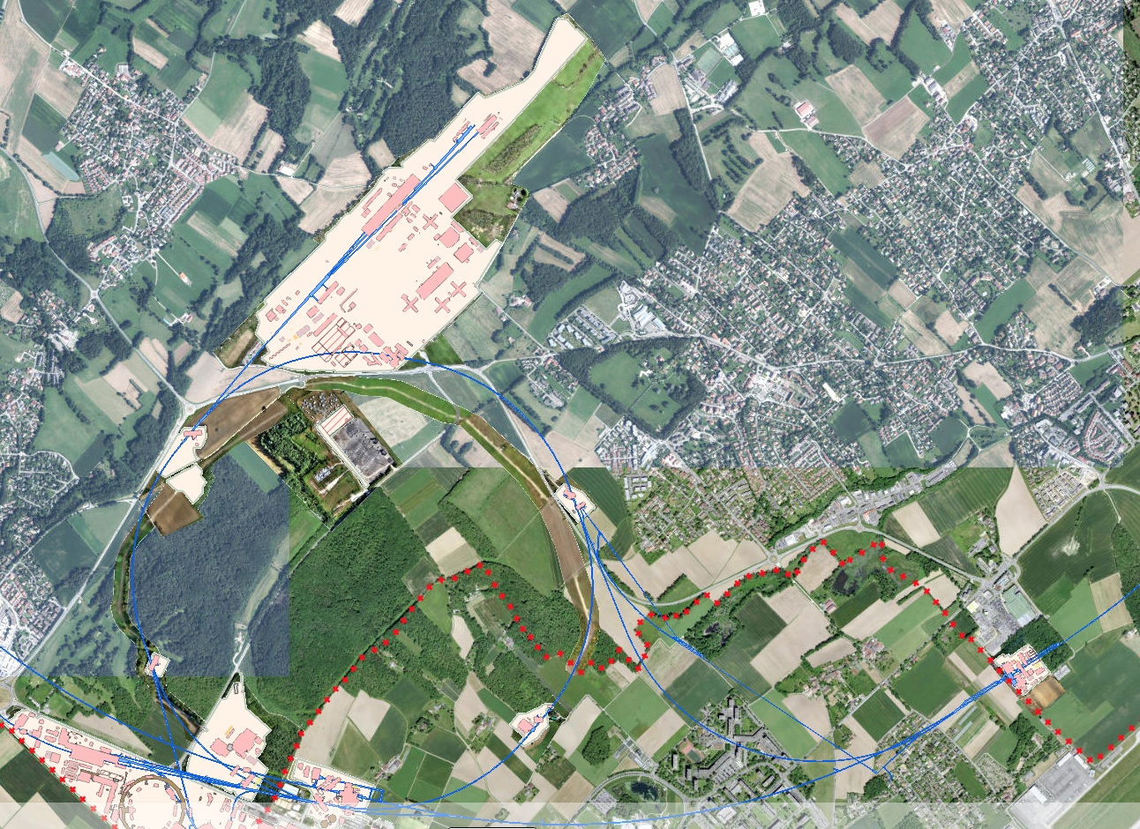
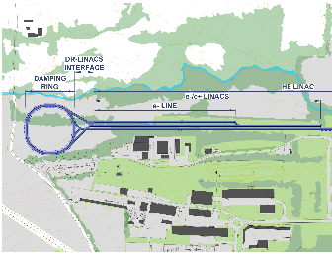
Injector placement
Transfer line ca 1 km
1 km

Slide 32
RF

Slide 33
RF strategy
Together with the RF group, we have come up with an RF design that respects all our requirements (Ivan Karpov)
We have opted for a pure 800MHz system (cheaper to build and operate than a hybrid 400-800MHz system)
For the Z running: single cell; for the WW and ZH collider: 4-cell for the booster: 6-cell
We use a single RF system at the ZH and a double at the Z (and currently a double system at the WW)
We have four LSS to fit the RF for the collider and the booster, each 563.5m long

Slide 34
RF parameters
800 MHz system only
Running | Z | WW* | ZH | Booster ZH
Common RF for two beams | No | No | Yes | No
Total Required RF Voltage (MV) | 500 | 1500 | 6000 | 6000
No. of Cryomodules | 104 | 104 | 104 | 66
Frequency (MHz) | 800 | 800 | 800 | 800
Cells/Cavity | 1 | 4 | 4 | 6
Voltage/Cavity (MV) | 2.4 | 14.4 | 14.4 | 22.7
Accelerating gradient (MV/m) | 12.9 | 19.3 | 19.3 | 20.3
Power/cavity (kW) | 240.4 | 240.4 | 240.4 | 20.1
Beam current (mA) | 371 | 39 | 9 | 0.9
Total Power (MW) | 100 | 100 | 100 | 5.3
Total Voltage (MV) | 1000 | 3000 | 6000 | 6000
*Reverse Phase Operation allows to avoid fundamental power coupler modification between WW and ZH modes
Total cost of 1.4 BCHF
$→$ 800 MHz option seems to be more feasible in terms of integration, performance margins, and cost
$→$ Additional R&D can help in reducing the RF system cost (e.g., more powerful FPCs)
Ivan Karpov, LEP3 Meeting, 28.05.2025

Slide 35
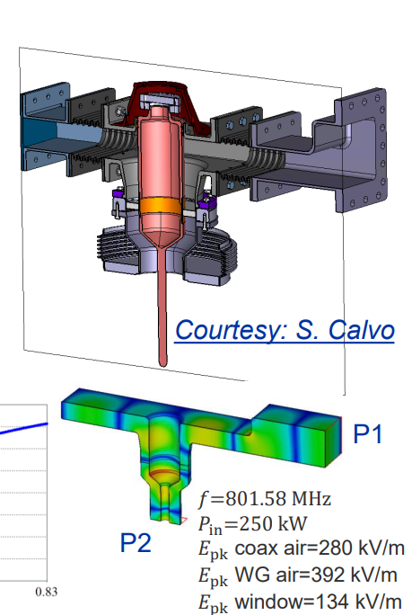
Fundamental power couplers
At LEP3 we are not limited by the achievable gradient, but by the amount of power we can put in the cavities (the Fundamental Power Couplers)
Current state of the art of these couplers is 250kW for 800MHz
If we were able to get 22% more power from these couplers, then 6-cell cavities (which are more space efficient) would fit, and the collider would not need 4-cell cavities
This would make the system cheaper (less cryomodules) and shorter
Some R&D on this topic would be very beneficial for LEP3

Slide 36
Does the RF fit in the LEP3 tunnel?
LEP3 has 8 LSS, each 563.5m long (4360m total)
Two will be used by the experiments (plus polarimeters, plus depolarizers?)
Two are difficult to access
We are planning to fit the collider RF in two LSSs and the booster RF in two other LSSs
LEP3 at ZH: SR loss: 5.2GeV; installed RF: 6.0GV
(the LEP3 RF system is 52% of the FCC one)
We have fitted the RF system in the 563.5m available using 4 LSSs

Slide 37
LEP3 RF configuration -Z
Point 1
Point 2
Point 3
Point 4
Z (45GeV)
Beam 1
DET1
Beam 1
Beam 1
Beam 1
Beam 2
Beam 2
Beam 2
Beam 2
800 MHz
800 bunches
Booster
Booster
800 MHz
Booster
Booster
Point 5
Point 6
Point 7
Point 8
Beam 1
DET2
Beam 1
Beam 1
Beam 1
800 MHz
Beam 2
Beam 2
Beam 2
Beam 2
Booster
Booster
800 MHz
Booster
Booster

Slide 38
LEP3 RF configuration -ZH
Point 1
Point 2
Point 3
Point 4
H (115GeV)
Beam 1
DET1
Beam 1
Beam 1
Beam 1
Beam 2
Beam 2
Beam 2
Beam 2
800 MHz
20 bunches
Booster
Booster
800 MHz
Booster
Booster
Point 5
Point 6
Point 7
Point 8
Beam 1
DET2
Beam 1
Beam 1
Beam 1
Beam 2
Beam 2
Beam 2
Beam 2
800 MHz
Booster
Booster
800 MHz
Booster
Booster
This arrangement needs electrostatic separators which will have to be designed and should fit in the tunnel

Slide 39
RF integration
Space is more tight in LEP3 than FCC with the exception of height:
LEP3: diameter: 4.4m height: 3.6m
FCC: diameter: 5.5m height: 3.2m
Integration will be difficult because we have (in the Z running mode) three beampipes. Two need to bypass the cryomodules
LEP3 plans to use 800MHz modules that are more compact than 400MHz
R&D on compact cryomodules would be appreciated!

Slide 40
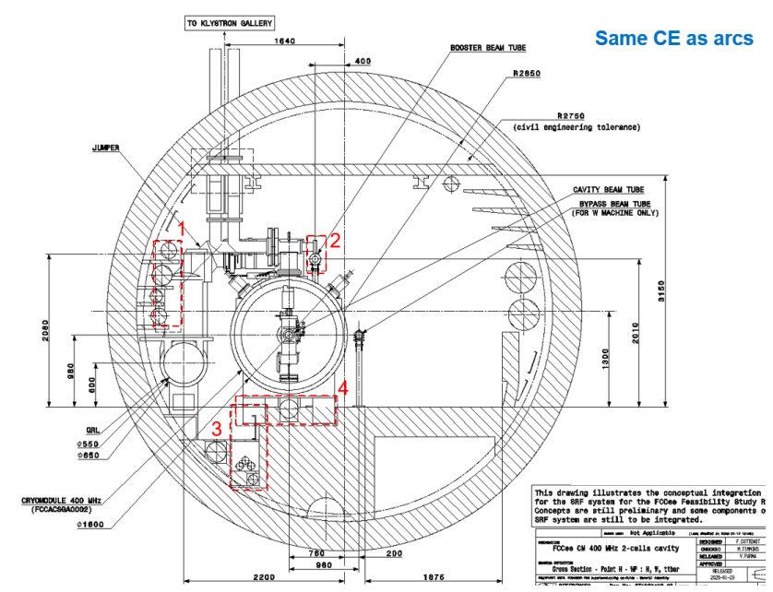
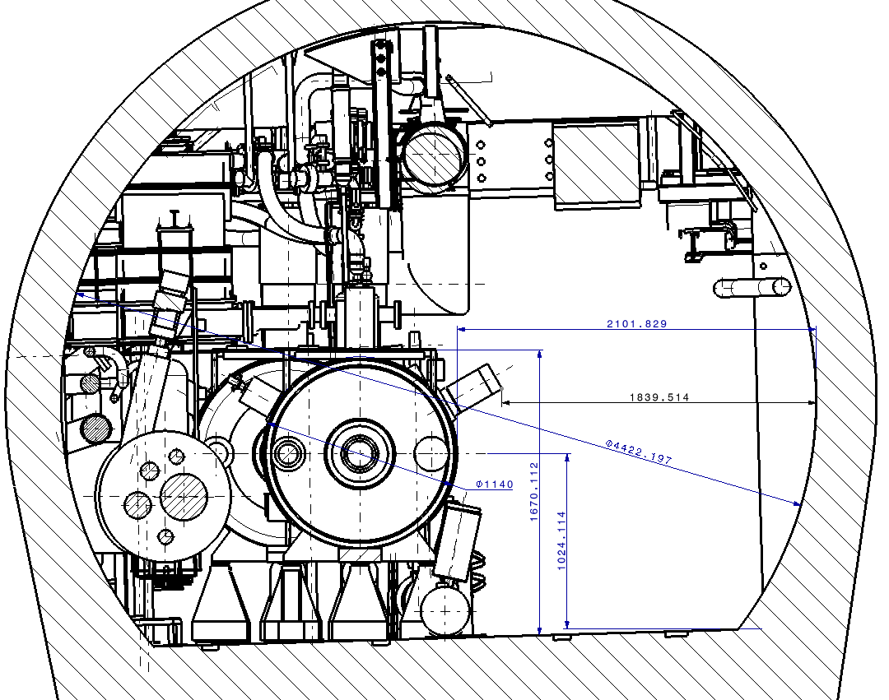
Compare tunnel sizes @RF areas
LHC 400MHz
FCC-ee 400MHz
LEP3 has more headroom!
LEP3 3.6m
FCC 3.2m

Slide 41
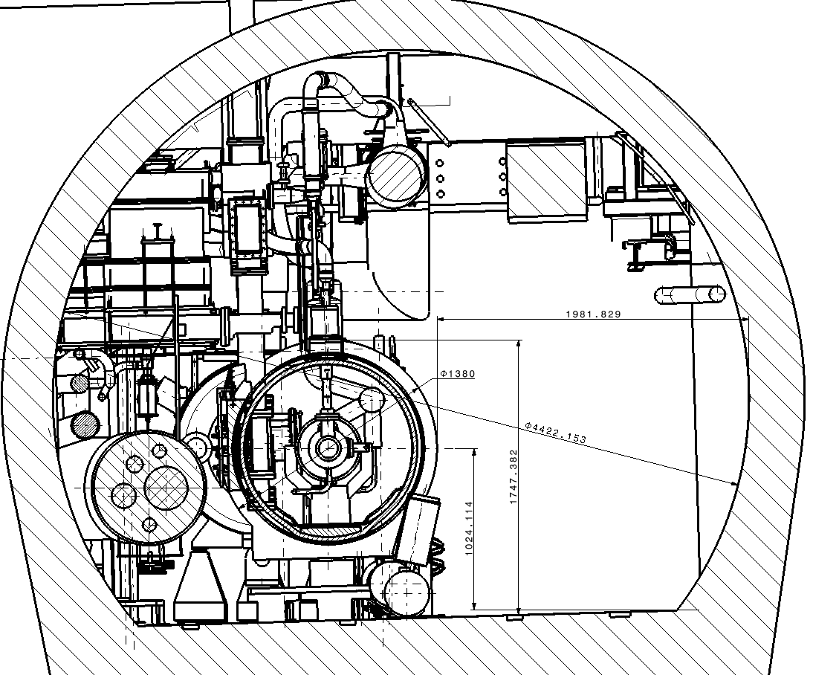
First LEP3 integration studies
LHC 400 MHz CM integration Pt 4
LHC 400 MHz Cryomodule
FCCee 800 MHz Cryomodule
FCCee 800 MHz CM integration Pt 4
QRL
QRL
The two beam pipes bypassing the system are not shown!
M. Timmins EN/MME - 28/03/2025

Slide 42
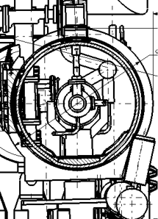
New integration drawings
What is not shown are the other two beam lines, the second collider line and the booster line.
More integration work needed
Overtaking unit

Slide 43
Power consumption

Slide 44
Collider magnet power consumption
Compared to FCC, LEP3 is:
Factor 3 smaller
Factor 3 higher dipole field
Factor 2 smaller aperture (leading to a factor 4 less power)
Dipoles: aperture 74 strength 61mT (at 182.5GeV)
Quads: FCCee (feasibility study) total length: 8410m max strength: 12T/m, aperture 74mm; LEP3 1900m; 21T/m; 44mm
Sextupoles: aperture 66mm, strength 880T/m2; length 6074m; LEP3 only 185m 740T/m2; 44mm
The new lattice design has a much lower number of sextupoles, so a normal-conducting solution is feasible
We will keep the superconducting option as an option for increased performance/lower consumption

Slide 45
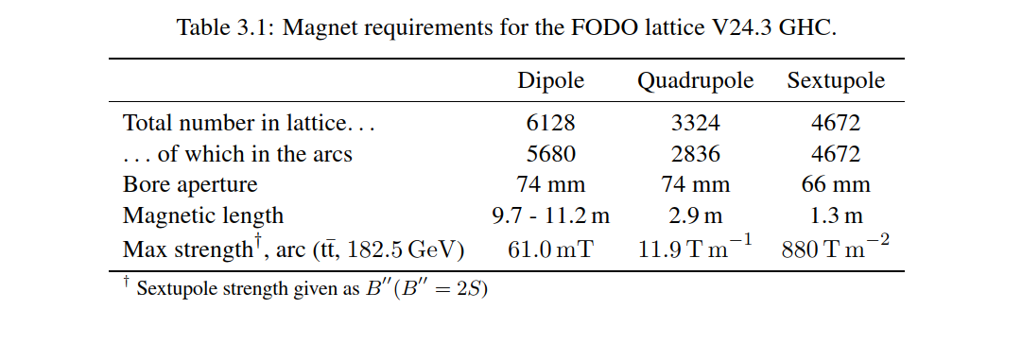
Collider magnet power consumption
Use FCC lattice V24.3 GHC as basis
Power demand (next page) includes conversion (10%) and distribution (5%) losses, so total power consumption(this page) needs to be multiplied by 1.17 to get the power demand
Apertures of LEP3 quads and sextupoles are under discussion and might change by small amounts – overall pictures remains.
 | length | strength mT | aperture mm | length factor | strength factor | aperture factor | Power factor | power Z (MW) | power W (MW) | power H (MW)
FCC dipoles | 62964 | 38.40 | 74 | 1.00 | 1.00 | 1.00 | 1.00 | 0.80 | 2.60 | 5.80
LEP3 dipoles | 19352 | 125.00 | 38 | 0.31 | 10.60 | 0.26 | 0.86 | 0.69 | 2.23 | 4.98
FCC quads | 8410 | 12.00 | 74 | 1.00 | 1.00 | 1.00 | 1.00 | 1.40 | 4.30 | 9.80
LEP3 quads | 1900 | 21.00 | 44 | 0.23 | 3.06 | 0.35 | 0.24 | 0.34 | 1.05 | 2.40
FCC sexts | 6074 | 880.00 | 66 | 1.00 | 1.00 | 1.00 | 1.00 | 1.30 | 3.90 | 8.90
LEP3 sexts | 185 | 740.00 | 44 | 0.03 | 0.71 | 0.44 | 0.01 | 0.01 | 0.04 | 0.09
FCC cables | 62964 |  |  | 1.00 |  |  | 1.00 | 1.2 | 3.80 | 8.60
LEP3 cables | 19352 |  |  | 0.31 |  |  | 0.31 | 0.37 | 1.17 | 2.64
FCC total |  |  |  |  |  |  |  | 4.70 | 14.60 | 33.10
LEP3 total |  |  |  |  |  |  |  | 1.41 | 4.49 | 10.11

Slide 46
LEP3 power consumption – FCC as basis
FCC |  | Z | LEP3-Z | W | LEP3-W | H | LEP3-H | TT
Beam energy (GeV) |  | 45.6 | 45.6 | 80 | 80 | 120 | 115 | 182.5
PRF EL (MW) | Collider | 146 | 146 | 146 | 146 | 146 | 146 | 146
PRFb EL (MW) | Booster | 2 | 2 | 2 | 2 | 2 | 2 | 2
Pcryo (MW) | Collider | 1.2 | 10 | 11.5 | 21 | 11.5 | 21 | 27.6
Pcryo (MW) | Booster | 0.35 | 1.3 | 0.80 | 2.5 | 1.50 | 4.9 | 7.40
Pcv (MW) | all | 25 | 9 | 26 | 9 | 28 | 10 | 33
PEL magnets (MW) | Collider | 6 | 2 | 17 | 5 | 39 | 12 | 89
PEL magnets (MW) | Booster | 1 | .3 | 3 | 1 | 5 | 1.5 | 11
Experiments (MW) | Pt A & G | 10 | 5 | 10 | 5 | 10 | 5 | 10
Data centers (MW) | Pt A & G | 4 | 2 | 4 | 2 | 4 | 2 | 4
General services (MW) |  | 26 | 7 | 26 | 7 | 26 | 7 | 26
Power during beam operation (MW) |  | 222 | 185 | 247 | 201 | 273 | 211 | 357
Average power / year (MW) |  | 122 |  | 138 |  | 152 |  | 202
Highlighted: new numbers
Cooling and ventilation: about 1/3 of FCC, due to tunnel lengths
Cryo: LEP3 calculation is slightly higher than FCC – to be checked.

Slide 47
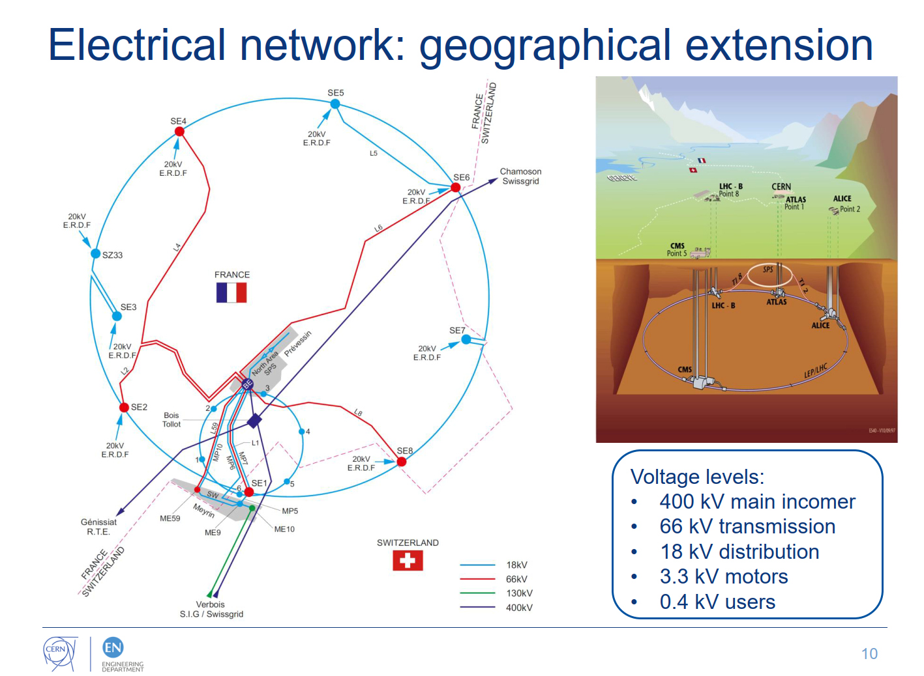
Installed capacity
More than 700MVA installed in the 400kV line, so no modification needed
400MVA installed on the 66kV lines
Point 2: two 38MVA transformers; would need to install a third or replace the 38MVA with a 70MVA
Point 6: only one 38MVA transformer; would need to install a second 70MVA transformer
Power lines to points 2 and 6 would need upgrading
Davide Bozzini, CERN electrical group, 6 June 2019

Slide 48
polarization

Slide 49
Polarization
When we talk about polarization for LEP3 (and FCC) we refer to transverse polarization which can be used as an accurate means of measuring the beam energy using the resonant depolarization method (RDP):
Built up 5% or more transverse polarization (or inject polarized bunches)
Measure and monitor the polarization levels
Use a resonator to find the ‘spin tune’ by destroying polarization for a specific bunch
Spin tune is proportional to energy
A second method is also considered: free spin presession (FSP), relying on injecting polarized bunches. If it could be made to work, it has many advantages over the RDP method

Slide 50
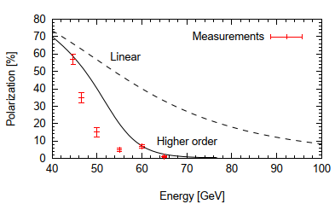
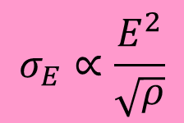
Polarization at the Z and WW
LEP only saw polarization up to 60GeV
Problem is that energy spread increases with energy squared and decreases with the square root of the bending radius
If the energy spread is larger than ~52MeV in the case of LEP, the distribution hits half integer spin tune resonance bands and the bunch quickly depolarizes
In the case of FCC, due to the large bending radius, polarization is expected at the Z and WW energies
LEP3 can get polarization at the Z, but will be difficult for the WW running
$$σ_{E}∝\frac{E^{2}}{\sqrt{ρ}}$$

Slide 51
Energy determination
LEP achieved an energy uncertainty for the Z mass of ~2MeV
FCC is expected to achieve a systematic error of 100keV or lower. This is achieved by performing ~10,000 depolarization measurements instead of ~30 (and a lot of hard work on the systematics)
LEP3 can achieve similar systematic error on the Z
On the W, FCC is hoping to achieve ~160keV using RDP.
Work is needed to determine if LEP3 can make the RDP or FSP methods work (maybe not routinely, but with special optics)

Slide 52
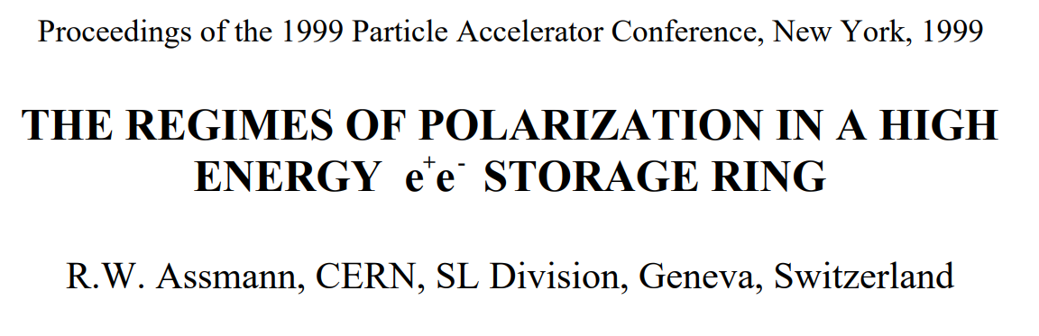
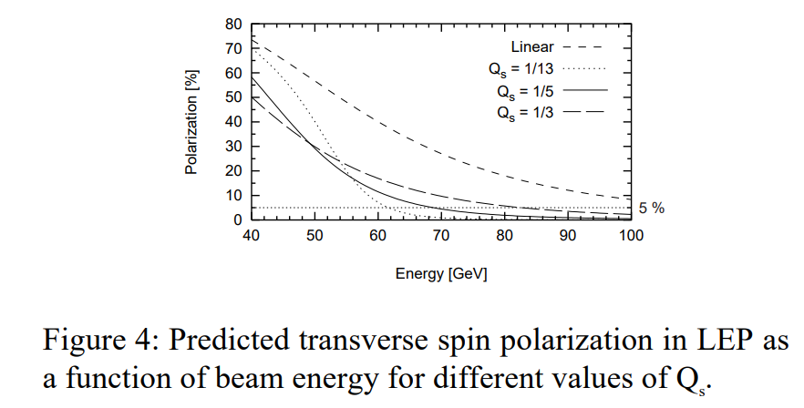
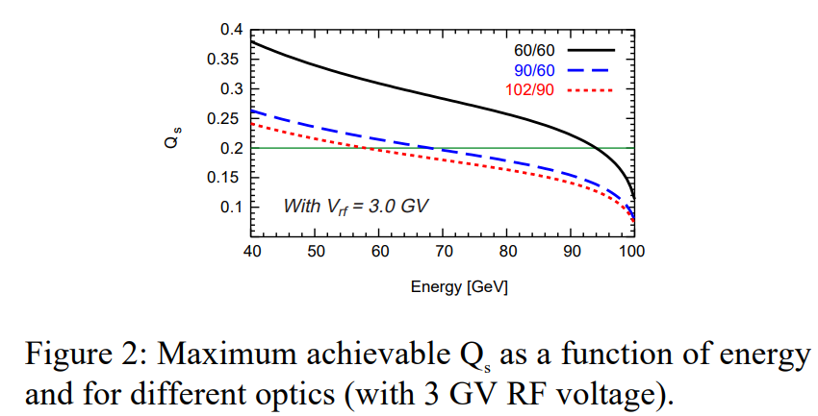
https://accelconf.web.cern.ch/p99/papers/thp24.pdf
WW running: can LEP3 measure the energy?
The prediction is that for very high synchrotron tune values, detectable levels of polarization might be possible

Slide 53
Upgrades

Slide 54
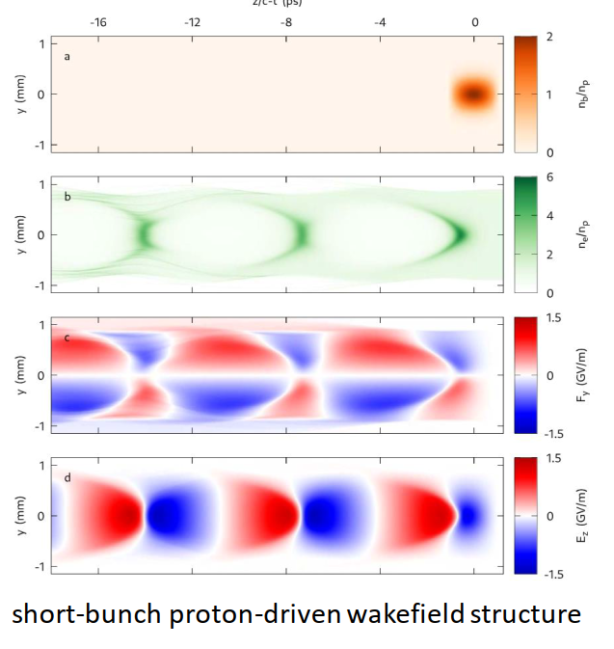
LEP3 cannot reach the ttbar threshold
…not so fast!
Please follow Allen Caldwell’s presentation on Thursday on LEP3 ALiVE (WORK BY (Tom Wilson and John Farmer Max)
➔Reach the ttbar threshold by colliding 115GeV positrons with 290GeV electrons from a proton-driven plasma accelerator of size 300-500m
Possible luminosity: 0.2E34
Protons can be had by a super SPS with 14-16T magnets
A long shot, but it is nice that people are thinking about these things and coming to innovative solutions

Slide 55
Conclusions
We have started addressing the points where we were given poor marks by the ESPP
Recent work on optics of LEP3 gives excellent results
Luminosity is greatly improved over the ESPP version
Vacuum chamber diameter can be reduced from the ESPP version
Power demand is reduced
If this is to be a viable option, more work on verifying all aspects of the design is needed.

Slide 56
Thank you

Slide 57
Extra slides

Slide 58
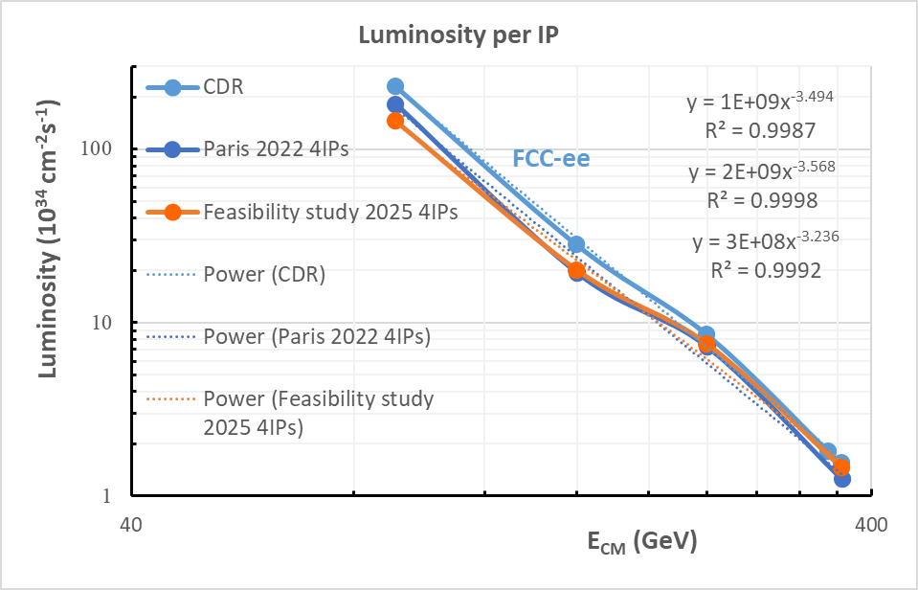
What is the power law of FCC luminosities?
Power law varies between -3.6 and -3.2. Latest is -3.2
Empirical formula from FCC suggests that luminosity drops a bit more steeply than the expected E_{beam}⁻³

Slide 59
LEP3 lattice development
January 7th, 2026
Pantaleo Raimondi
Fermilab/CERN

Slide 60
Outline
Strategy recap
ARC lattice
Straight sections
Final Focus system
Hardware requirements
Performances
Conclusions

Slide 61
LEP3 vs FCC Superfactory
LEP3/FFC length ratio ARC about 0.30 =>
- 3 times lower current (constant SR/RF power)
- @Z <3% of the RF buckets are used
- 2 vs 4 IPs
LEP3 potential should assume:
- ARC lattice that delivers same FCC emittance
- FF that delivers same betas*
- sqrt(2) larger vertical tune shift (because 2 IPs)
Luminosity could be around 50% wrt FCC (per IP)
If the y-tuneshift is only limited by the half-integer (FCC assumption @Z), the luminosity could be around 70% wrt FCC @Z.
Since at ZH the half-integer is crossed for FCC, L@LEP3 can’t easily exceed 50% of the L@FCC

Slide 62
LEP3 challenges
Not a green field:
Cons: Limits to performances and options
Pros: Reuse existing infrastructure
Conceive an ARC lattice that delivers an FCC-like horizontal emittance
Conceive a Final-Focus system with FCC characteristics that can be implemented with minimum impact on the existing layout
Optimize parameters for optimal performances specific to LEP3
Optimize hardware for cost and power consumption
Scaling from other machines and scaling laws might mislead us
Specificity of the requirements should drive the choice of technical solutions

Slide 63
LEP3 ARC vacuum chamber diameter
Chamber diameter is crucial
Daphne has about 90mm: 0.5GeV 2.0amps colliding
EBS has about 20mm 6.0GeV 0.2amps circulating (10mAmps single bunch)
MAX4 has about 20mm 3.0GeV 0.5Amps circulating
LEP3 will operate in the 45/120GeV range with ~0.01-0.3Amps colliding beams,
most likely up to 30% of the FCC current
Impedance is a strong parameter that limits the minimum chamber dia,
for the transverse part we should consider that (ARC only part):
- impedance effect decreases linearly with total ARC length => factor 4 wrt FCCee
- impedance effect decreases linearly with betas => factor 2 wrt FCCee
- impedance effect decreases linearly(?) with current => factor 3 wrt FCCee
- impedance is affected by bunchlength
- impedance increases with 1/dia^3
- same overall impedance effect is achieved by decreasing the dia by 24^1/3 => factor 2.9
FCCee has dia= 60mm => LEP3 can adopt dia=30mm and still have more stable beams
LEP3 inner chamber diameter can be very confortably set to 30mm
Magnets gaps (opposite poles) should be around 38mm

Slide 64
EBS Achromat cell adapted for LEP3 Z/W/ZH modes
SD1 SD2
SF1
Sextupoles are grouped in
an high beta/dispersion region
Phase advance between the sextupoles:
dmux ~ 3pi
dmuy ~ pi
Given the phase relations all the detunings are intrinsically small, effective dmux and dmuy are slightly adjiusted (few %) to compensate for the interleaved sextupoles sheme.
Betas and dispersion at sextupoles and dispersion are optimized for best performance

Slide 65
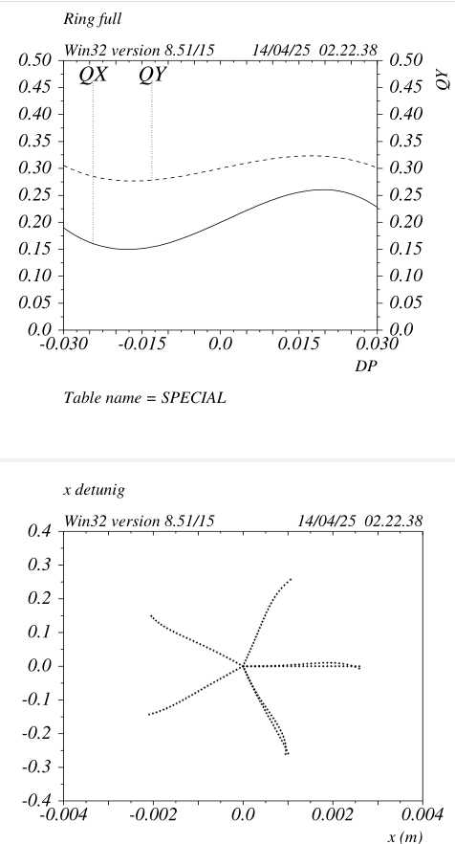
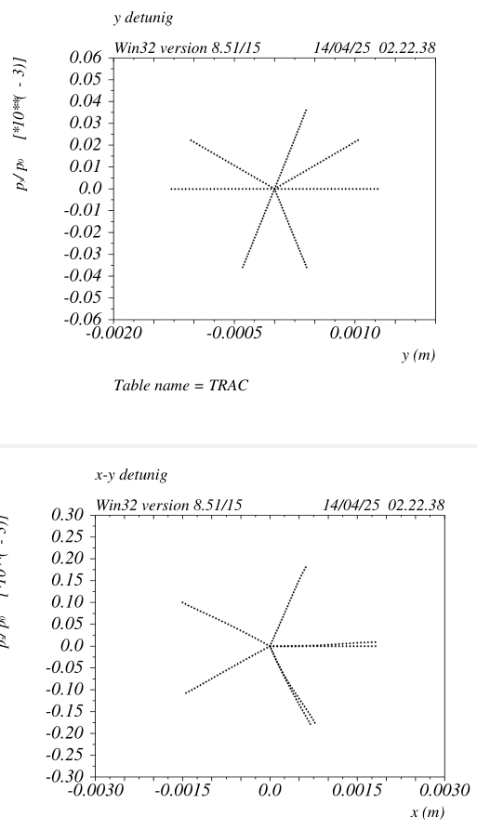
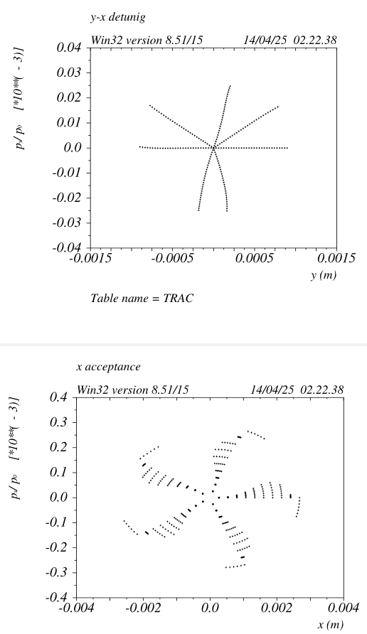
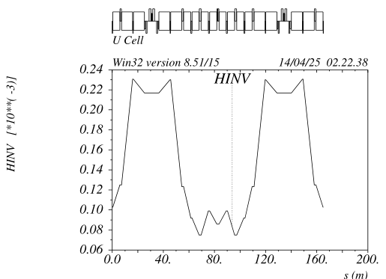
Chromatic and DA properties HFD
High order chromaticities
are small, MA>+/-3%
No visible high order x detuning
Energy dependent detuning is very small as well (not shown)
(Repeat) All the studies are based on
cell designs with vanishing RDTs up to the second order

Slide 66
ARC lattice layout
Cell length: 2768.88mt
Each cell consists of:
- 18 dipoles ~ 12.618mt long with defocusing gradient
~0.51T/m @115GeV
- 4 dipoles ~ 4.5mt
- 20 quadrupoles with gradients ~ 21T/m @115GeV
7 QFs ~ 1.85mt, 4 QFs ~ 1.10mt, 9 QDs ~ 0.85mt
- 6 sextupoles with gradients ~ 740T/m2 @115GeV
2 SFs ~ 0.54mt long, 4 SDs ~ 0.34mt long
80 Cells make a 22151mt circumference
In facts including:
- 6 Straight sections
- 2 Interaction Regions (IR)
the 8 octants will be divided in:
- 4 octants consisting of 10 cells
- 4 octants facing the 2 interaction regions consisting of 9 cells
(to be explained in the Final Focus section)

Slide 67
LEP3 quadrupoles and sextupoles requirements wrt FCC @115GeV
FCC-LCC Ring-ARC needs:
2240 quads/beam
QFs about 2.9mt long
QDs about 2.1mt long
Gradients about 7.5 T/m
Total magnet length for the 2 rings (QFs + QDs) = 1120*(2.9+2.1)=5600mt @7.5T/m
LEP3 Ring-ARC needs:
1520 quads/beam
QFs about 1.0-1.8mt long
QDs about 0.85mt long
Gradients about 21T/m
Total quadrupole length for the LEP3 ARC (QFs+QDs) = 76*25.0 = 1900mt @21T/m
Quadrupole length ratio: for LEP3 about 34% of the FCCee quads are needed
Power consumption scaling (LEP3/FCC) @115GeV:
Power goes with Lmag*G^2*gap^2
Power ratio LEP3/FCCee @115GeV = 1900/5600*(21/7.5)^2*(1/2)^2 = 0.67 (the 1/2^2 is due to the ratio of Lep3 vs FCC magnet gaps)
Total sextupoole length is about 185mt, whereas FCC-LCC needs about 730mt

Slide 68
Straight Section insertion
Straight Sections (SSs) are included with the Transparency Conditions criteria (TCs)
SSs are 563.5 mt long, however two extra dipoles are needed in the Dispersion Suppressor and they sit in the SSs, reducing the available SSs length to about 535mt
In fact the 4*2 last dipoles facing the SSs are 25% weaker wrt the ARC dipoles.
The TCs make so that the breaking of the ring periodicity is minimal, and no ARC sextupole families are needed when the SSs are included in the lattice.
Presently all the SSs are the same and they are very close to what will be the “Standard” RF section.

Slide 69
Straight Section insertion
Full ring, consisting of 8 octants and 8 identical Straight Sections. Because of the TCs, the chromatic functions in the octants remains periodic.
The ring is 26659mt long.
Specialized SSs (injection and collimation) can be included as well, they can be a shorter version of the FCCee ones

Slide 70
Final Focus system
LEP3 FF has been developed starting from a rescaling of the FCCee LCC-FF design.
All the layout constraints are met, in particular:
- Ring length
- IP positions
- IP crossing angle (30mrad)
The FF is 1025.9mt long and has a net bend angle of 0.1347rad.
In fact the last ARC octant cell (per side) has been replaced by the FF-Dispersion Suppressor and the FF itself.
FF is a 5th order achromat in both planes.
The dipoles have been optimized for best dispersion and optical functions across the Crhomatic Correction Sections (CCSx/y)
The dipoles in the incoming CCSy have opposite sign wrt to other dipoles, thus generating a dogleg that matches the layout constraints.
The FF Left and Right magnets and drifts lengths are identical and optics nearly identical as well, thus ensuring a high degree of symmetry
FF has been inserted in the lattice with the TCs
CCSy
Crab
Sextupole
CCSx

Slide 71
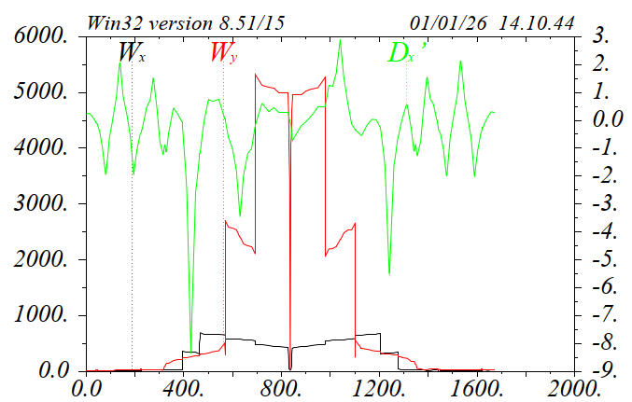
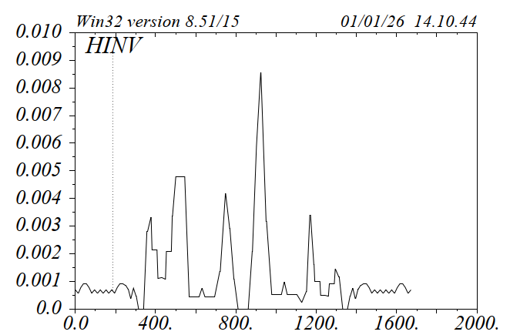
Final Focus system
Chromaticities due to the low-betas IP are compensated in the FF, ARC sextupoles remain unchanged.
FF dipoles presently generate about 20% emittance growth.
The larger contribution comes from the Left_CCSx that has the stronger dipoles and a correspond larger Curl-H.
These dipoles also increase the total E_Loss/turn by about 4%.
Furter optimizations should mitigate these drawbacks
The Curl-H spikes just on the side of the IP do not correspond to significant emittance growth, since the dipoles in these region are extremely weak to meet the SR requirements in the Interaction Region.
Left
CCSX

Slide 72
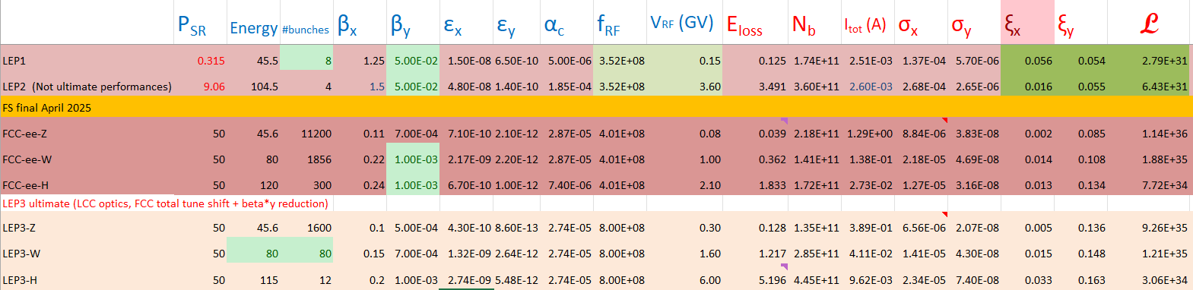
Draft parameters comparisons
M Koratzinos
LEP3 parameters dimensioned considering:
- 50MW SR per beam
- Best “reasonable” vertical tune_shift
- Beam parameters consistency and most consistent with FCC ones
Arc optic identical for all modes => Favors Z-mode, that approaches the FCC performances
LEP2 vs LEP3-H shows the effective gain from LPA&CW scheme (~35)

Slide 73
Conclusions
An optic optimized for LEP3 has been realized with the same strategy and techniques developed for FCCee
The resulting lattice can be used for easy performance comparison, considering that the IP parameters are similar to the FCC
Layout compatibility with LHC tunnel, while ensuring optimal performances and hardware constraints is confirmed
First look at hardware requirements/solutions/options (magnets, vacuum chamber etc) can be performed
Beam Dynamics and Beam-Beam studies have yet to be performed, keeping in mind that there is a high degree of similarities with the work done for FCCee
Lattice will evolve in order to improve performances and relax hardware requirements
ARC lattice presents intriguing aspects that might be studied for possible FCCee implementation
FF lattice presents intriguing aspects that might be studied for possible FCCee implementation as well

Slide 74
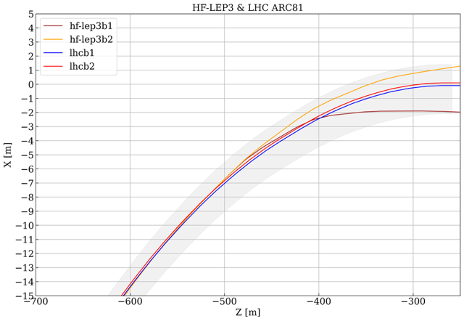
Fit at the beginning of the arcs
Beams start deviating already at the arcs (but of course deviation in the beginning is small)
Outline of LHC tunnel

Slide 75
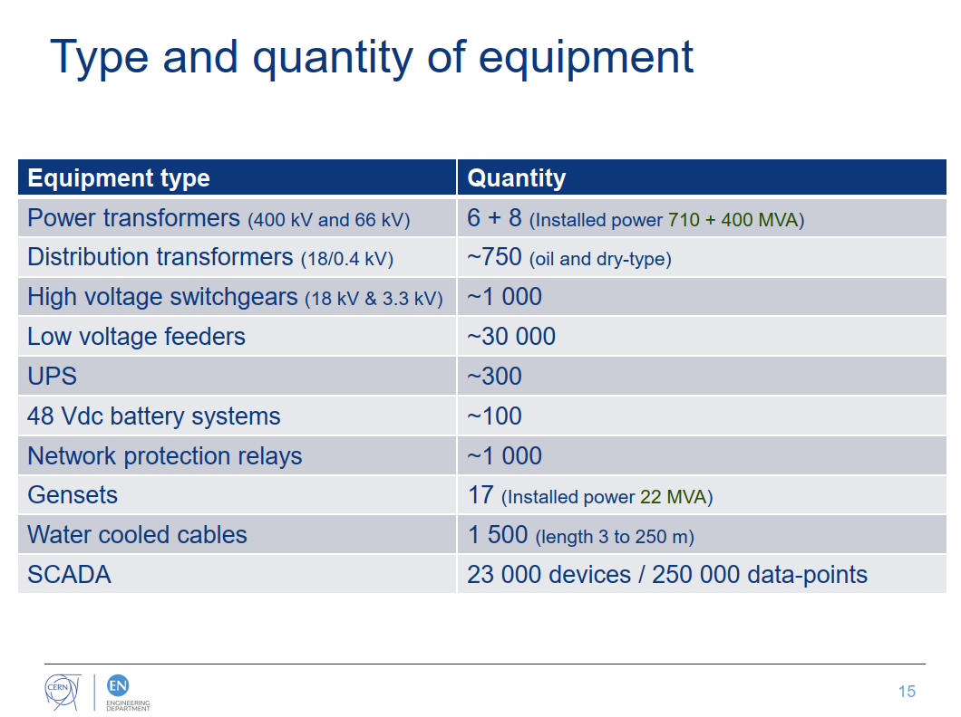
Installed power
More than 700MVA installed in the 400kV line, so no modification needed
400MVA installed on the 66kV lines
There are dedicated lines going to the even IP points
Point 2: two 38MVA transformers; would need to install a third or replace the 38MVA with a 70MVA
Point 6: only one 38MVA transformer; would need to install a second 70MVA transformer

Slide 76
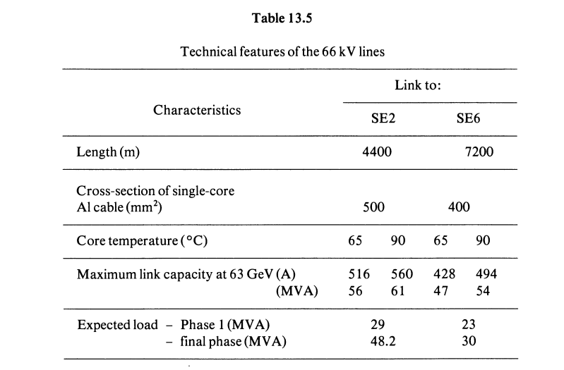
Power lines to P2 and P6
From the LEP technical design report vol. 2
The installed copper (aluminium) conductor is 4.4+7.2kms long and is able to carry 50-60MVA.
These conductors would need upgrading

Slide 77
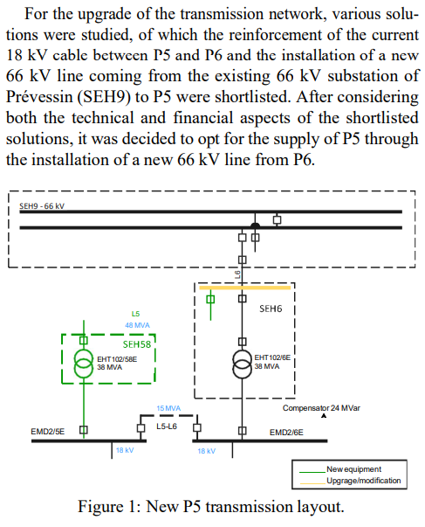

Upgrade of P5
Recently, an upgrade of the capacity of P5 has been performed, through the supply of a new 66kV line from P6.
We can use this upgrade tp get an idea of the cost of upgrading for LEP3

Slide 78

CERN electrical consumption
Long shutdown: 40MW
YETS: 60MW
Full LHC operation: 200MW
LHC+injector chain: 140MW

Slide 79

Consumption 2018
10-min average maximum: 215MW

Slide 80

From power consumption to energy per year
FCC-ee, ttbar operation, new numbers: 357MW, 1.8TWh
LEP3, ZH at 230GeV operation, 250MW, 1.3TWh
From the CERN web pages:

Slide 81

Higgs rate when including ISR
Oliver Buchmuller
difference of rates at 240GeV to 230GeV: 2.7%

Slide 82

Luminosity of world projects

Slide 83
Polarization times: FCC and LEP3
machine | Circumf (m) | Radius (m) | energy | tau_pol (hours) | pol to 5% (mins)
FCC - 45 | 90658 | 10021 | 45 | 215.9 | 650
FCC - 80 | 90658 | 10021 | 80 | 12.2 | 37
LEP3 - 45 | 26660 | 2958 | 45 | 5 | 15
LEP3 - 80 | 26660 | 2958 | 80 | 0.3 | 1
FCC-ee at the Z needs polarization wigglers.
LEP3 at the Z (or W) needs no polarization wigglers

