Slide 1

CEPC vacuum chamber production line
Yongsheng Ma
Vacuum group, IHEP,CAS
Jan 13th 2026

Slide 2
Content
Preview of CEPC vacuum system
Production line development of NEG coating/ Spray for heating film in EDR
Prototype of thermal-spray heating layer and testing
Summary

Slide 3

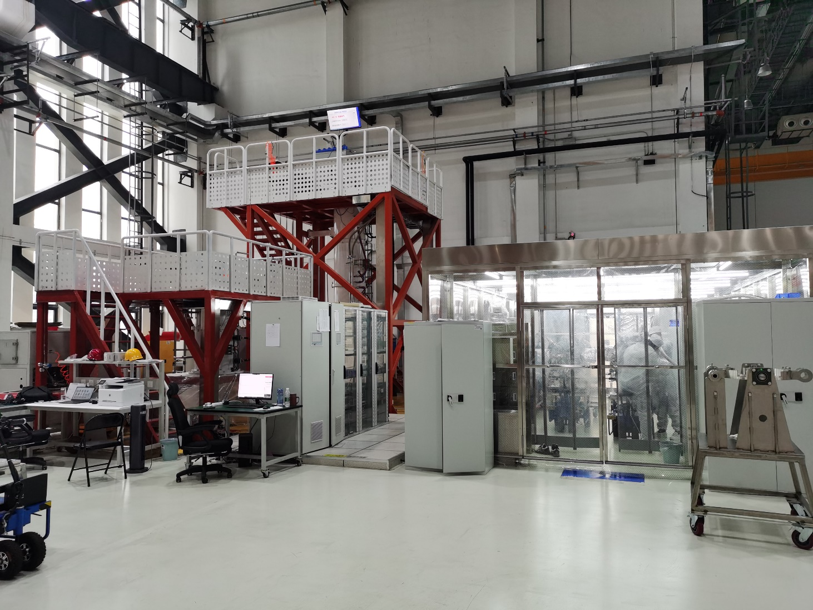
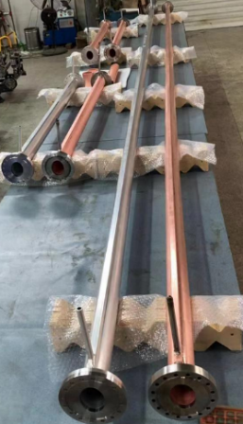
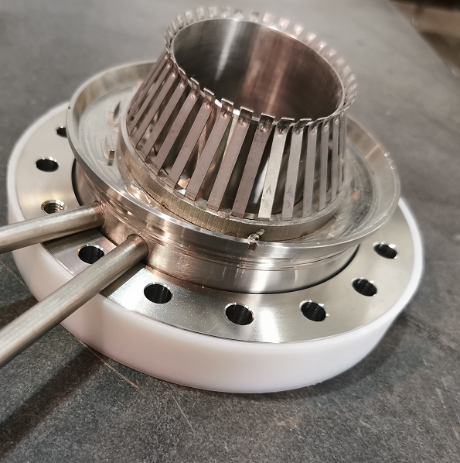
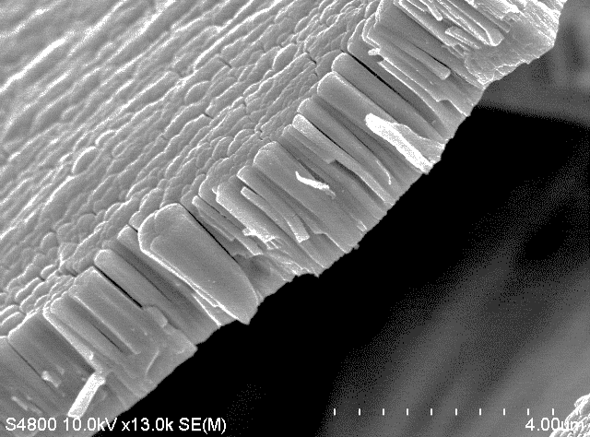
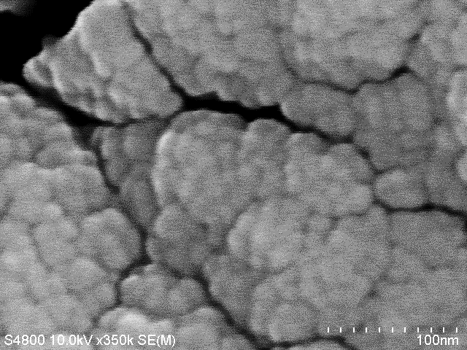
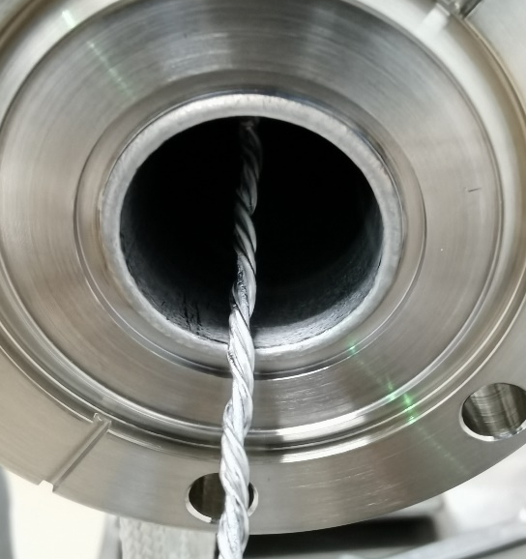
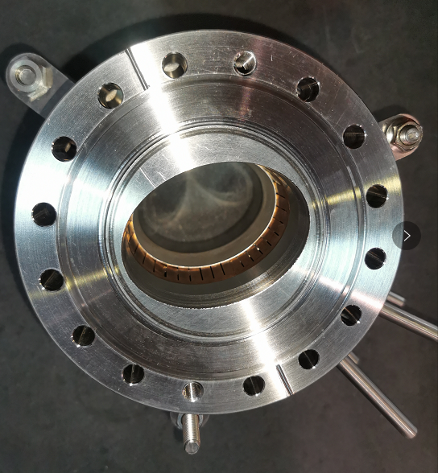
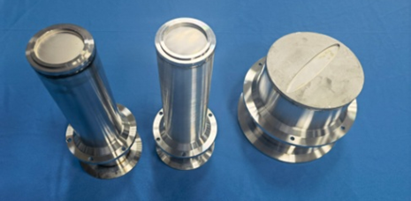
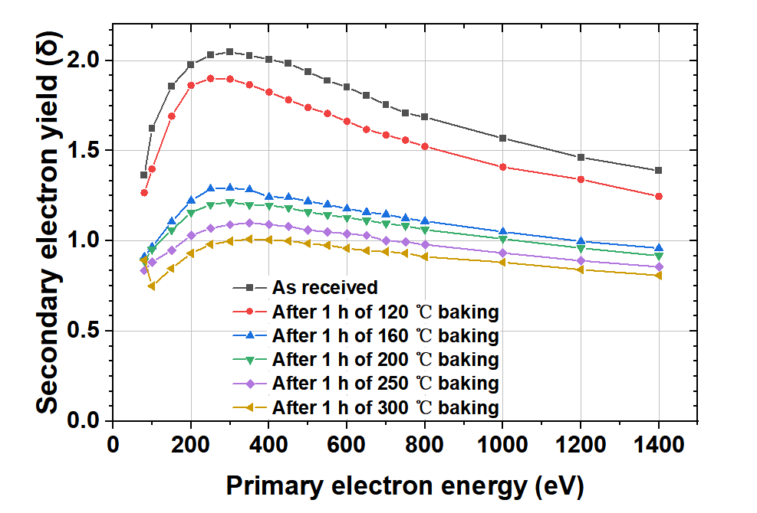
Preview of CEPC vacuum system
Technical developments in TDR
Machine and Vacuum Parameters
 | E | I | ρ
 | Gev | A | m
Higgs | 120 | 0.0167 | 10700
W | 80 | 0.084 | 10700
Z | 45.5 | 0.803 | 10700
tt | 180 | 0.0033 | 10700
Accelerator | length/m
LINAC | 1,601+335
Damping ring | 147
Booster | 100,000
Collider | 200,000
Transport line | 4,680
Total length/m | 306,763
Those prototypes have a good application in HEPS.

Slide 4
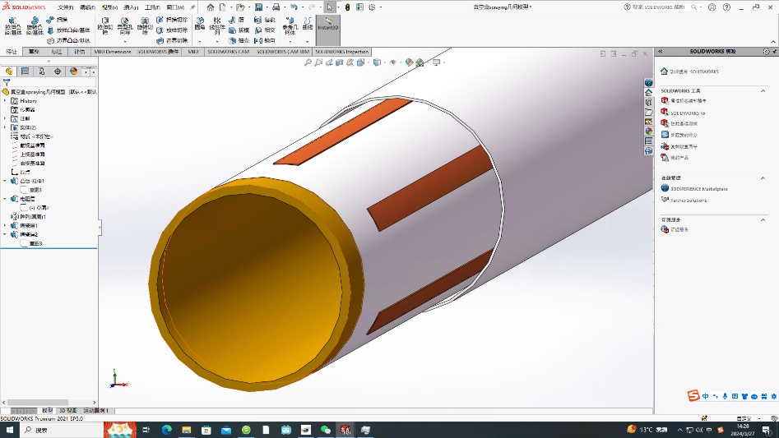
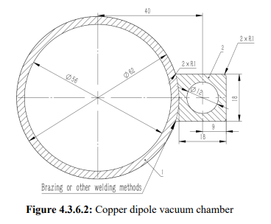
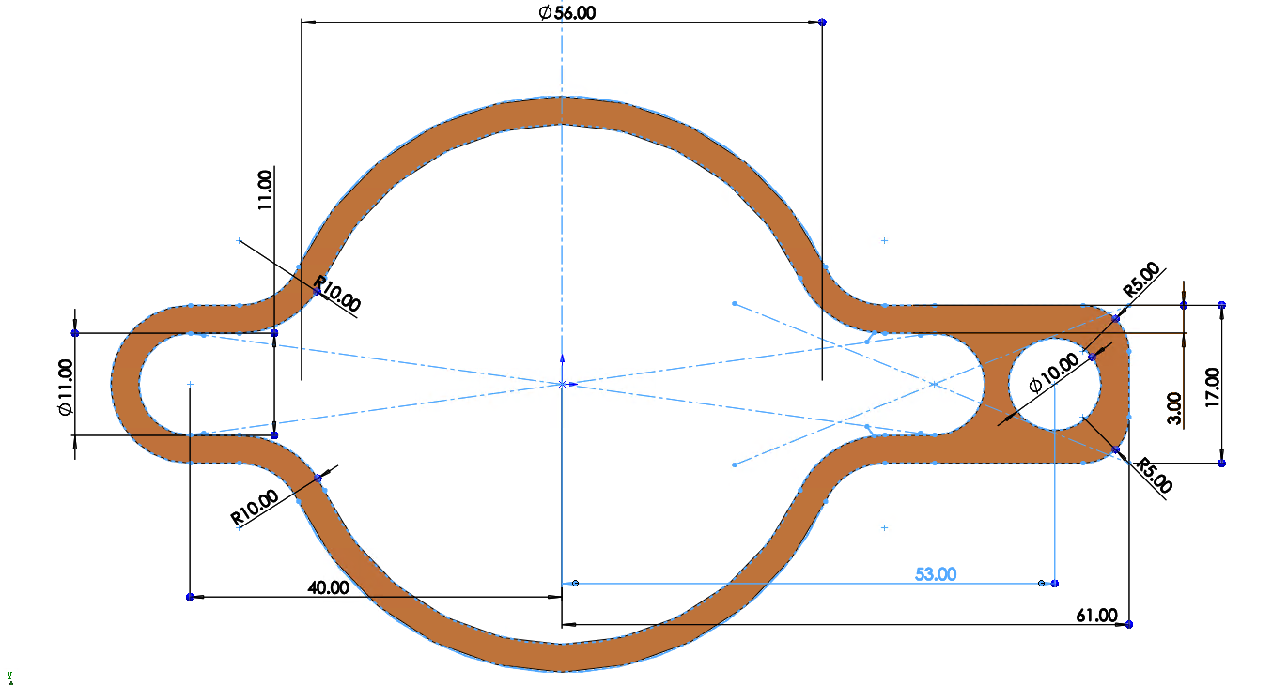
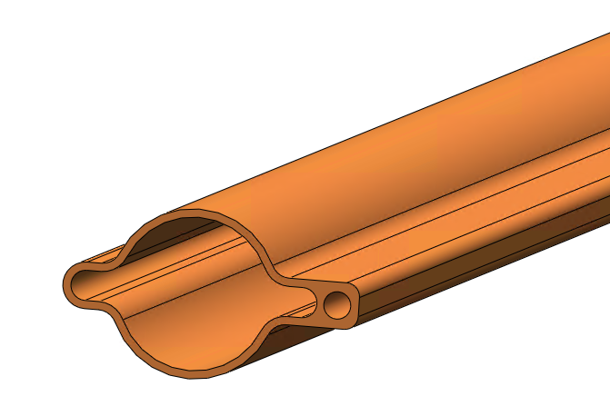
Structure of vacuum chamber for CEPC collider rings
Heating layer
Alloy copper
NEG coating
56
VC with photon absorber
Notes:
A thorough comparison of the advantages and disadvantages of the proposed distributed approach versus
the photon stopper approach is necessary for effective management of synchrotron radiation;

Slide 5
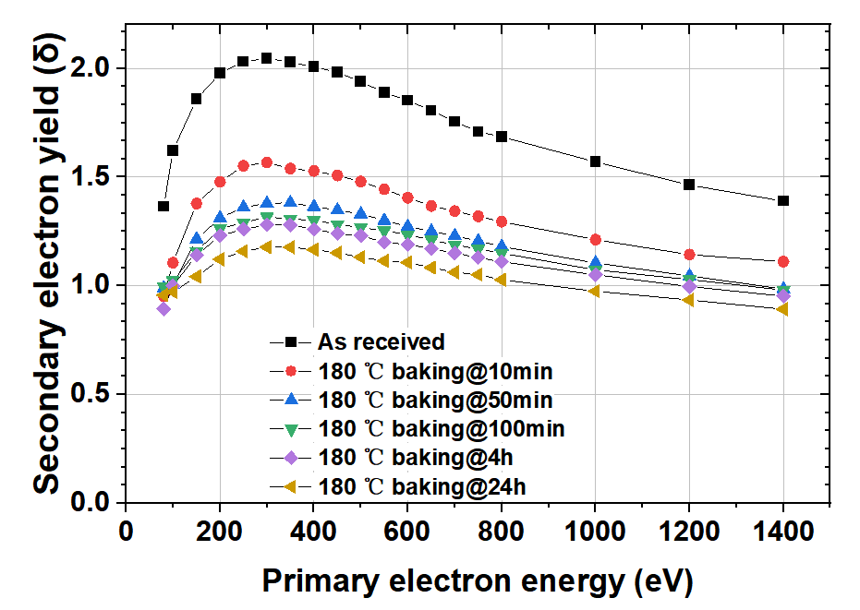
Benefits from NEG coating
NEG coating of 200nm is employed to suppress e-cloud of positron ring and absorb residual gases simultaneously. SEY will blow 1.2 after 24h activation of 180℃ and could even lower under higher activation temperature.
Similar to positron ring, NEG coating is proposed to vacuum chamber of electron storage ring to absorb extra gas load.

Slide 6
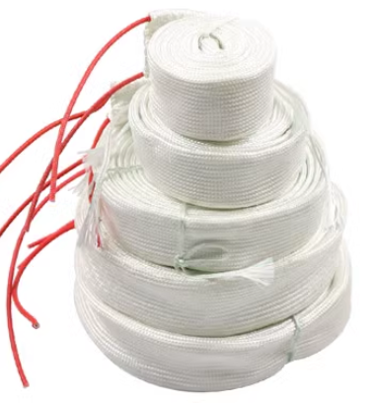
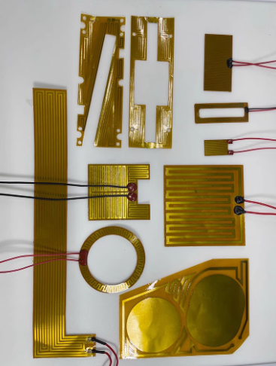
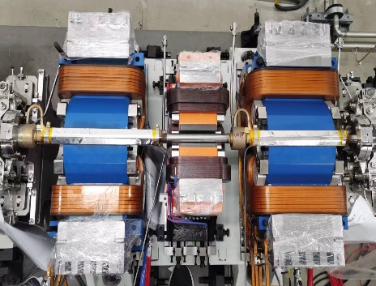
VC baking & Why spray heating film
The baking is the most crucial procedure in achieving ultra-high vacuum
Necessity:
In order to meet the ultra-high vacuum requirement of achieving a dynamic vacuum level of 3.0E-10 mbar.
NEG coating reactivation
Too thick
Lifetime is very short under SR of CEPC
N₂
N₂
H₂
H₂
O₂
MO
O₂
Heat
O
High
vacuum
or
inert gas
H₂O
C
MC
CO
H₂O
CO₂
CO₂

Slide 7
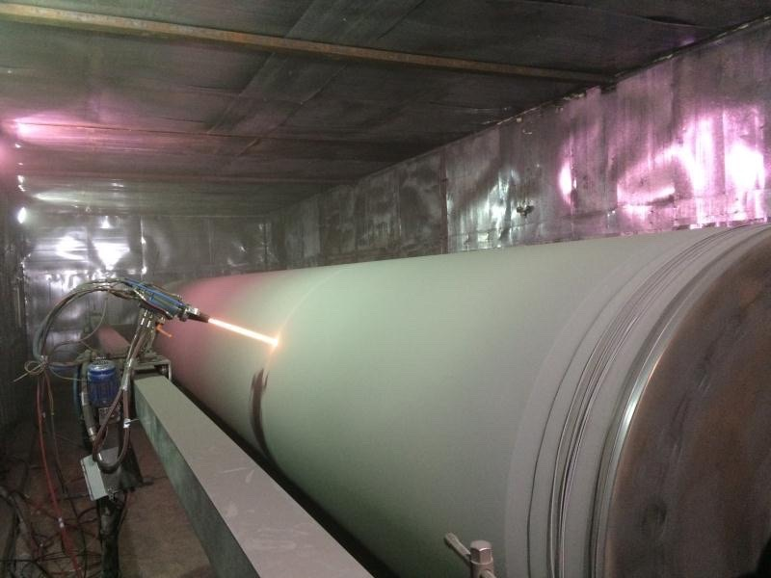
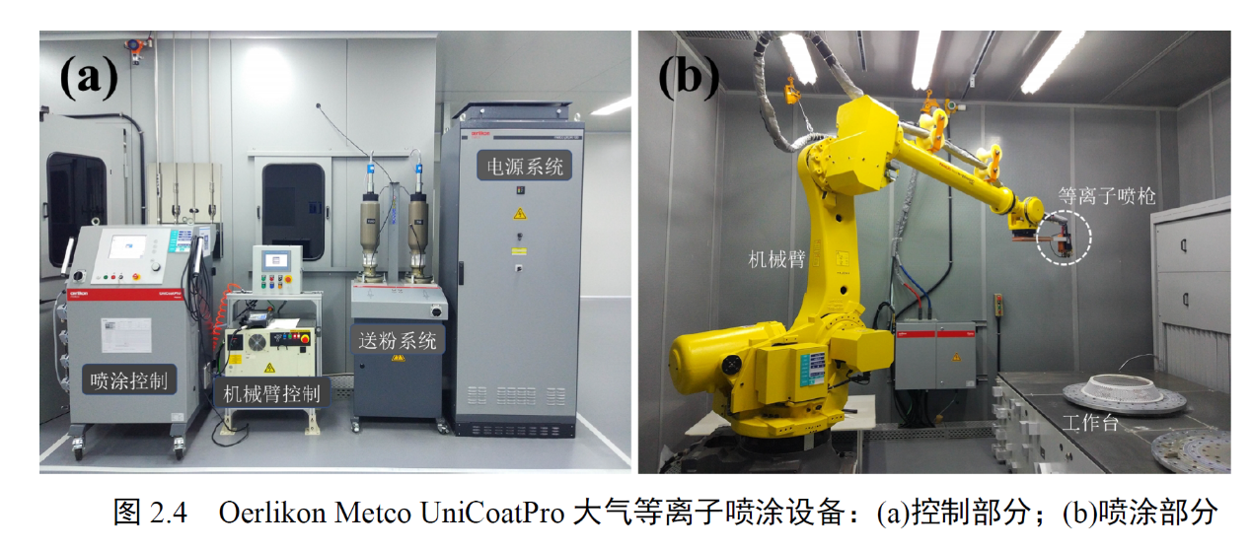
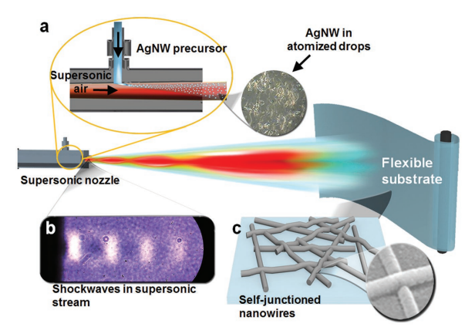
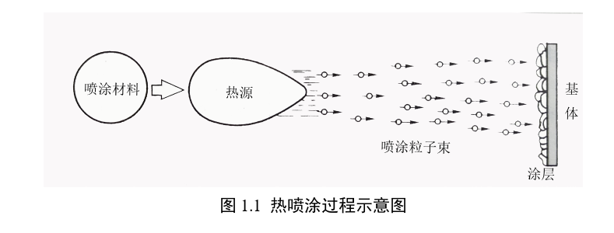
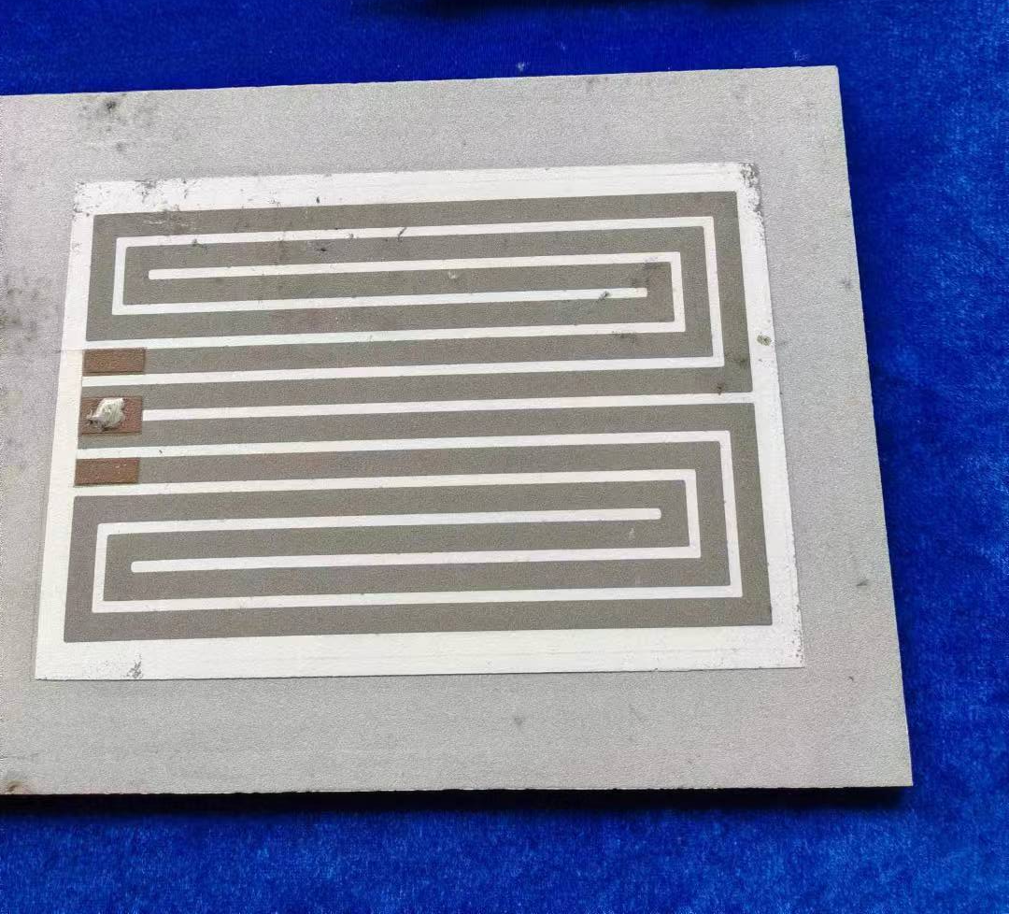
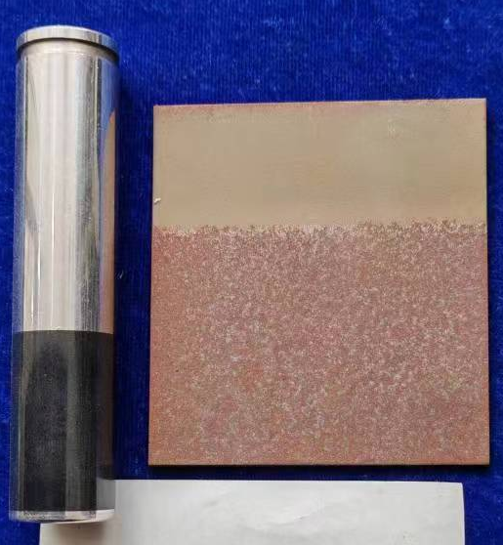
Spraying for heating film
Multilayer heating film will be coated outside of the vacuum chamber which composited by ceramic and conductivity layer
The heating temperature could reach 250℃
Heating layer
Thickness： 0.5mm
Ceramic layer
Convection
Radiation
Conductivity layer
I
solution
Conduction
Ceramic layer
Cu/ceramic transition layer
Vacuum chamber
Related commercial products
Cu/Ag NW
Processing of spray
Plasma spraying
Electric heating circuit
De-icing for airplane

Slide 8
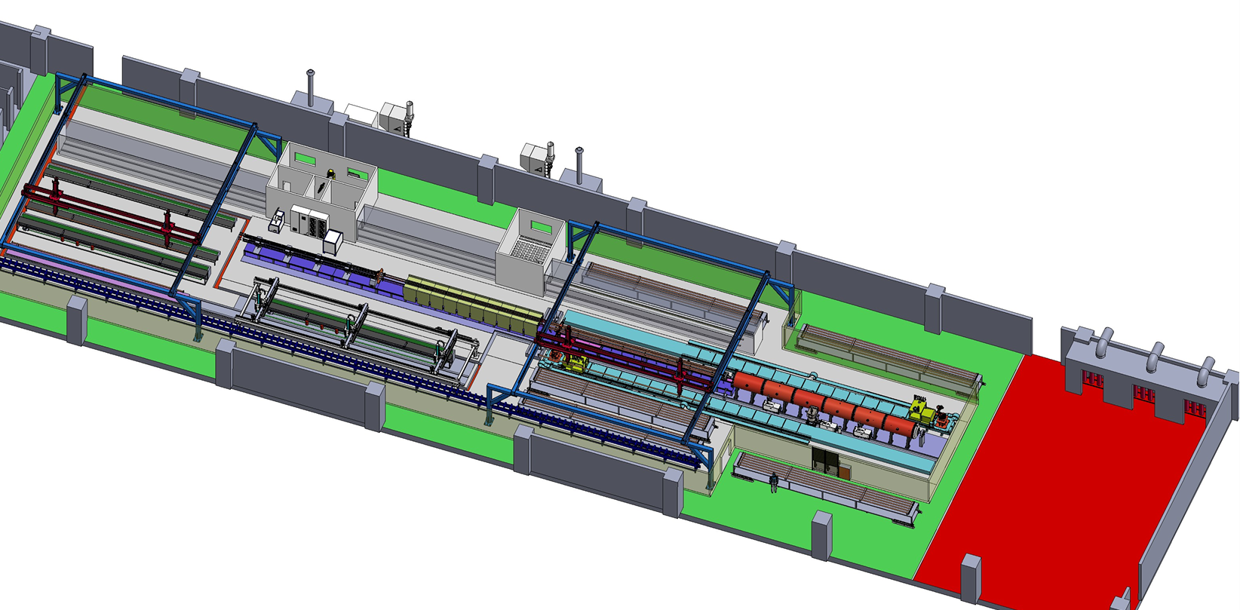
Preview of NEG coating/ Spray for heating film production line
Requirement
Due to the difference in length, two production lines will be used to complete the production of vacuum chambers for the CEPC collider. The quantity of NEG coating and spraying facilities for the two lines varies to match the production speed.
The full quantity of vacuum chambers for the collider will be manufactured within five years, utilizing two production lines operating at a combined capacity of 4,500 units per year.
Advantages
More stable process, less manpower, less NEG coating facility, more adaptive capacity in production, etc.
Heating layer spraying
Items | Specifications
Dimension | L 11400-d56-D62
Weight | 50~100kg
NEG coating | Thickness：200nm±30% SEY<1.1 S、Q、life-times
Spraying heating | Thickness<0.5mm Heating temperature <300℃
Cleaning
NEG coating

Slide 9
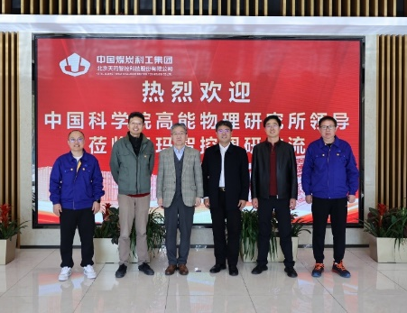
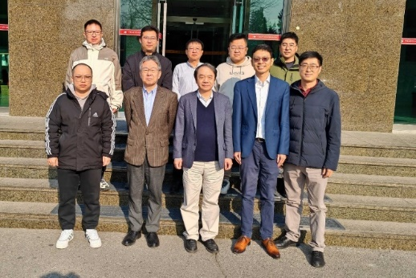
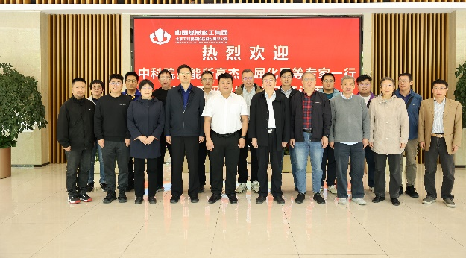
Critical Step in the Production Line
Important nodes and progresses
Technical scheme review
Procurement bidding
Process Review prior to Manufacturing
Most of components have been manufactured 2025.11
The production line will be conditioned 2026.3
2024.10
2024.12
2025.6
Manufacturer visit
Project kicker off
Process Review prior to Manufacturing

Slide 10
Production line composition
Classification | Sub-devices | Parameters | Note
Electron-beam welder | Electron-beam gun Power supply Vacuum chamber | Meets the Length of 11.4m vacuum chamber 6 working position | Design and manufacturing
Brazing | Mechanical holder Power supply | 350℃ 11.4m long | Low temperature brazing in air by conductivity heating, expecting stead by double hole copper tube
Heating film spraying facility | Electron-beam gun Power supply Controller Mechanical Structure | Meets the Length of 11.4m vacuum chamber Multilayer Spray Ceramic and conductivity layer | R&D
NEG coating tower | Pumping system Vacuum measurement Power supply Vacuum chambers Discharge Gas Cathode、controller | Meets the Length of 11.4m vacuum chamber 6 working position Background vacuum <5e-7Pa Baking temperature 200℃ | Developing to be more fitted the production line
Measurement and testing | Dimension measurement Leakage testing | Dimension measurement 11.5m/0.1mm Leakage testing 1e-10 mbar·L/s | Design and manufacturing
Cleaning | rinsing | deionized water rinsing | Design and manufacturing
Production line auxiliary equipment | Moving band robot arm system controller | Meets the Length of 11.4m vacuum chamber | Design and manufacturing

Slide 11
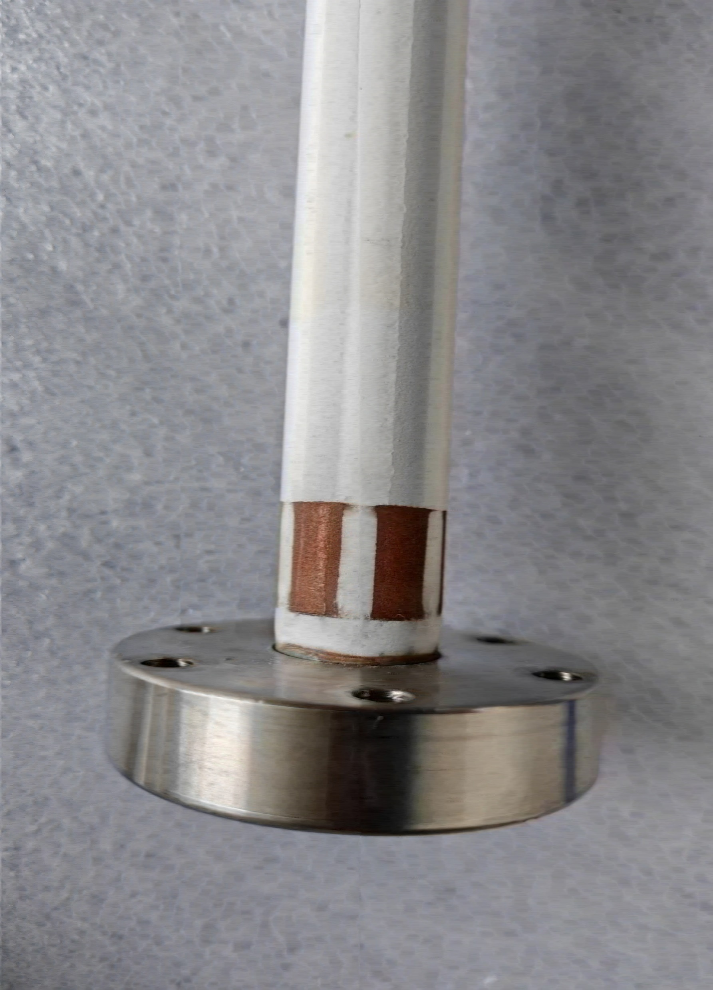
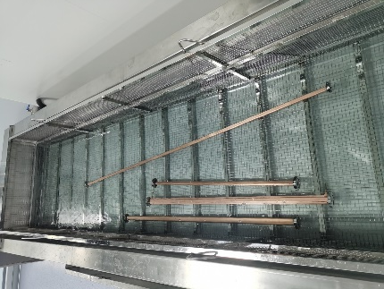
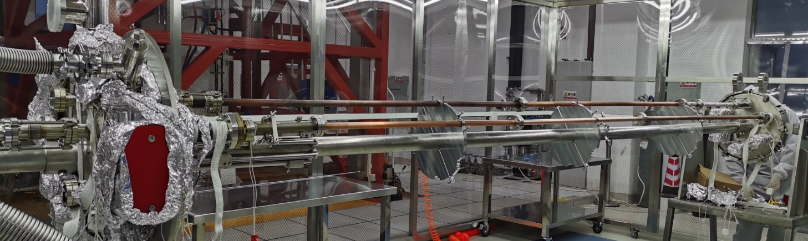
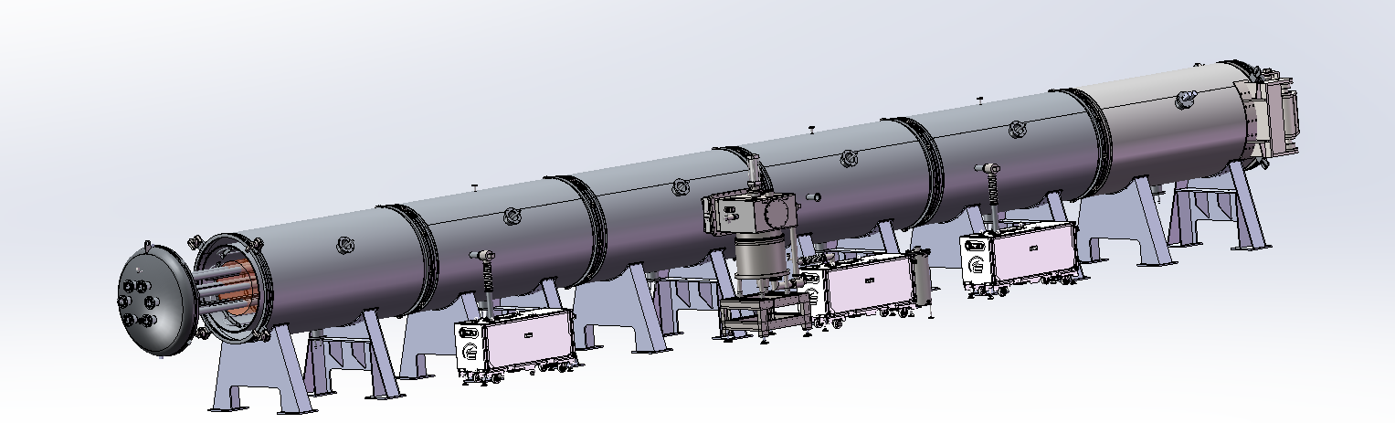
Procedure of NEG coating & spraying of production line
Spraying (Air plasma spraying)
Sandblasting
Spraying_Isolation_layer
Spraying_Conductivity-layer
Spraying_Isolation-layer
Spraying_Contactor-layer
Cleaning
Outside
Inside
NEG coating
vacuum chambers, cathodes assembling by mechanical arms (flanges sealing).
Leakage testing.
Deliver the assembles to vacuum oven/ baking/ NEG coating;
Disassembly the vacuum chambers
Function | Materials | Thichness/um
Transition-layer | MCrAlY alloy | 50~100
Isolation-layer | Al2O3 cermic | ~200
Conductivity-layer | NiCr alloy | 50~100
Isolation-layer | Al2O3 cermic | ~200
Contactor-layer | Copper | ~50
Notes:
Atmosphere plasma spray

Slide 12
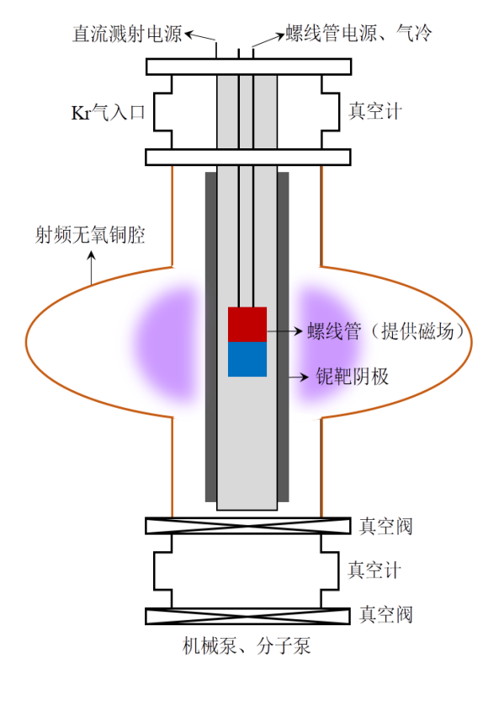
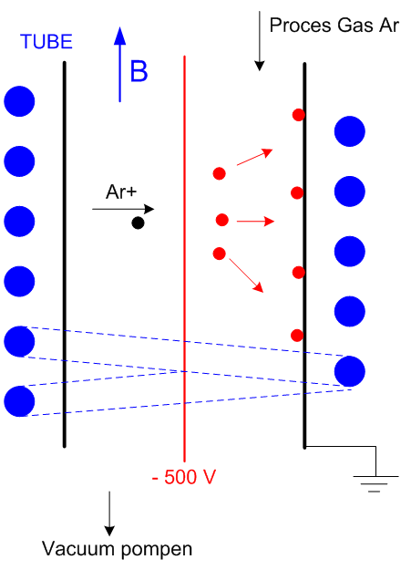
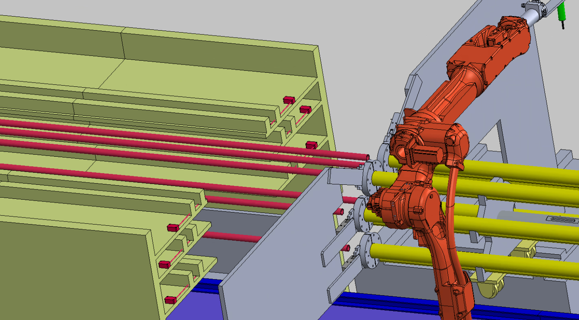
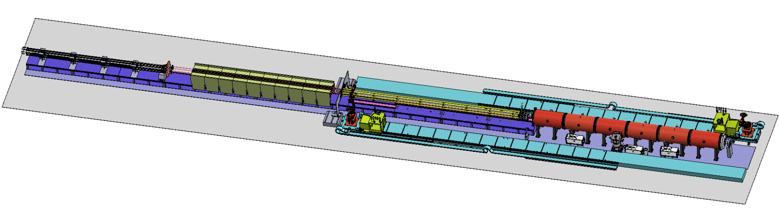
Layout & composition of NEG coating facility
NEG coating, VC assembly and disassembly with automatic robot arms.
DCMS for NEG coating
Kr+
磁环
Cathodes driven
Inside magnet
Cathodes
VC assembly
Vacuum oven

Slide 13
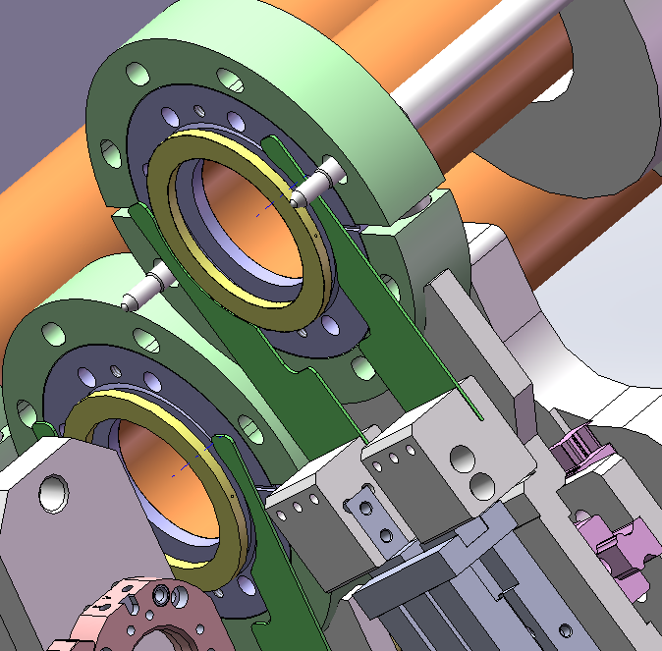
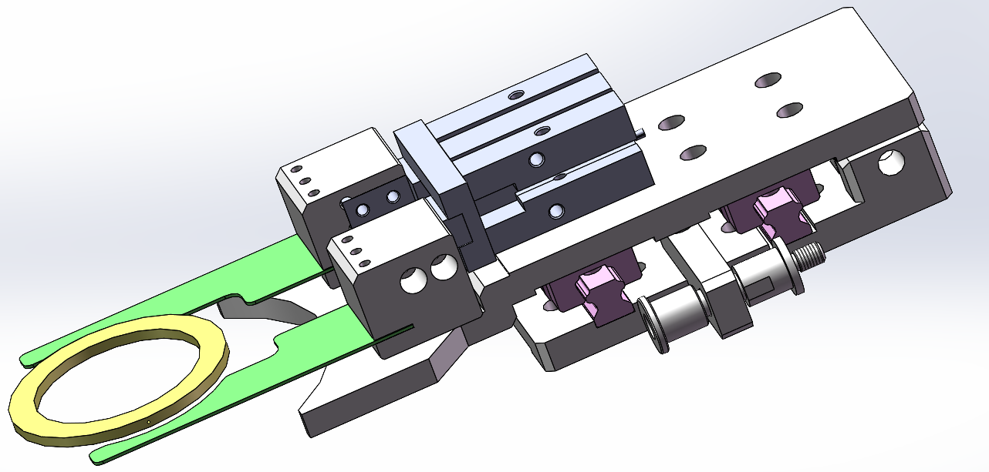
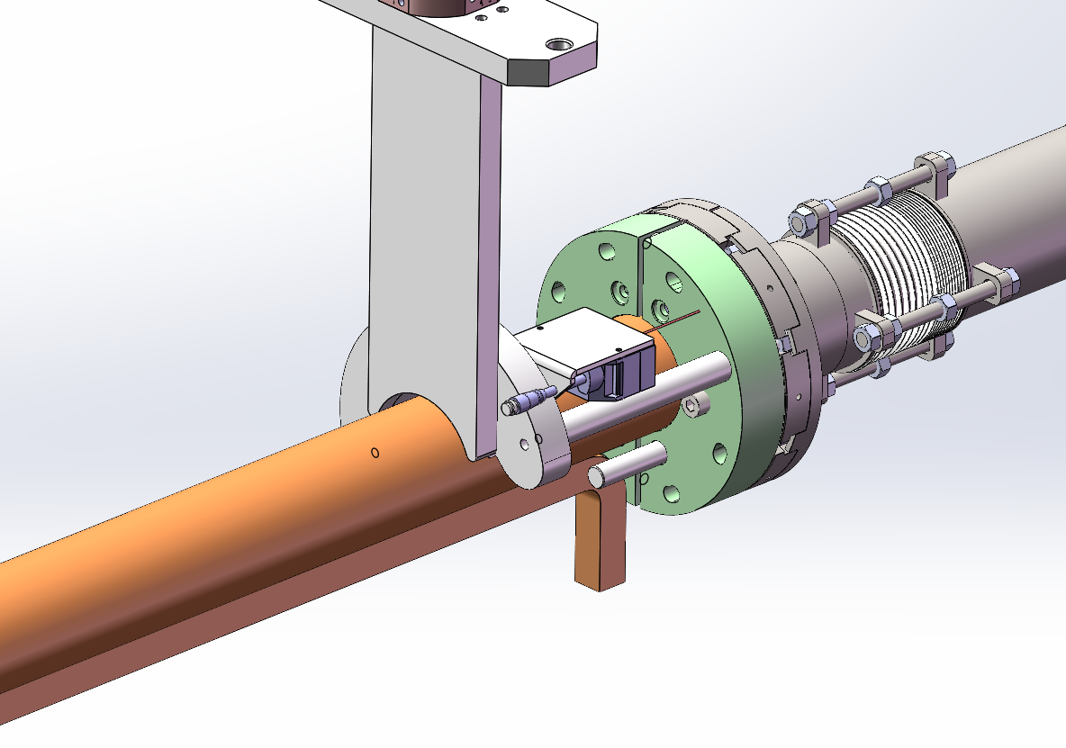
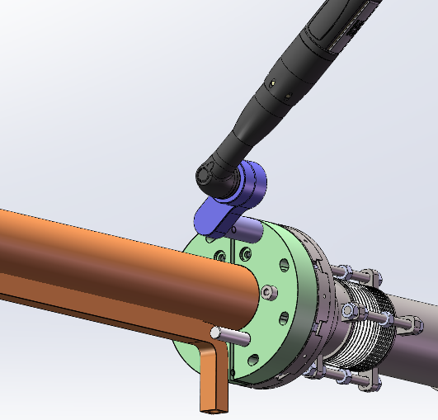
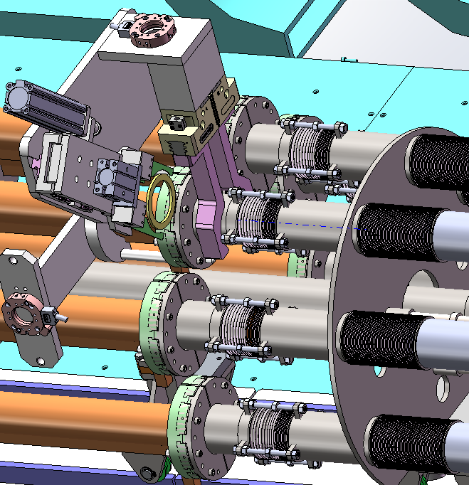
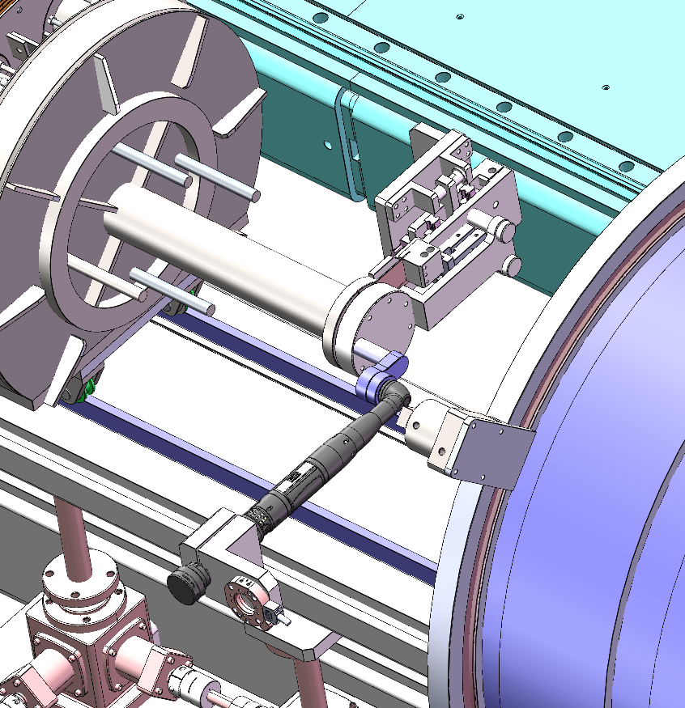
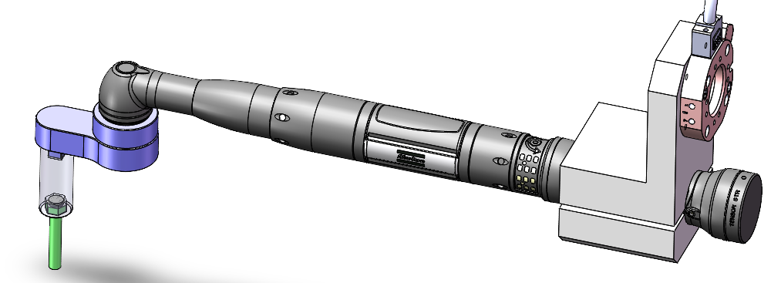
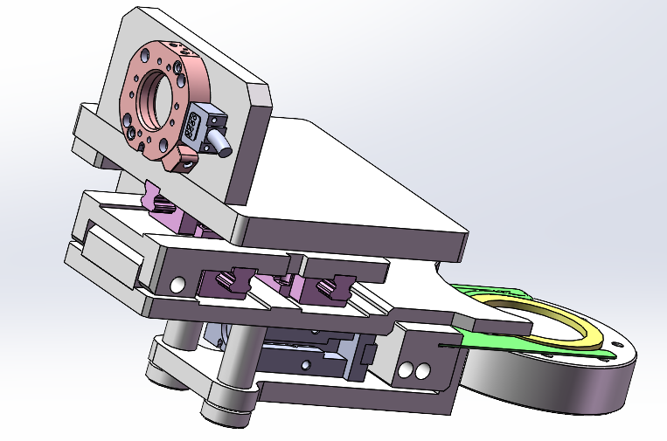
Vacuum chamber automatic assembly
z
X
Sealing gasket installation
Flanges fastening

Slide 14
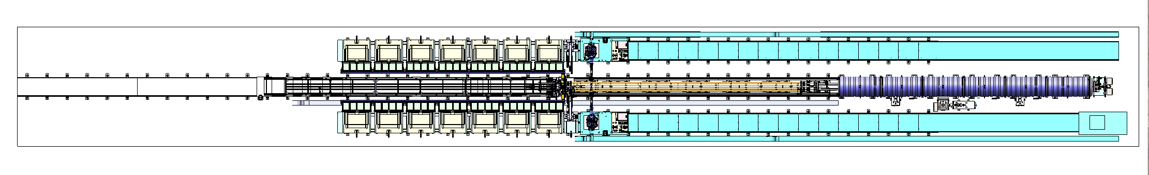
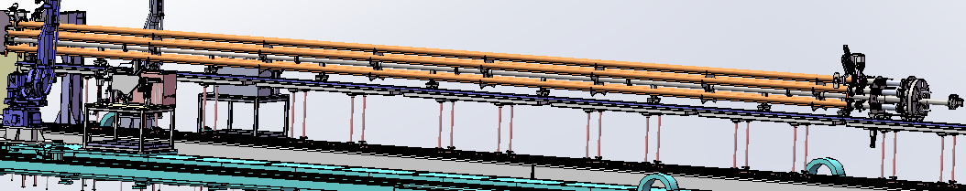
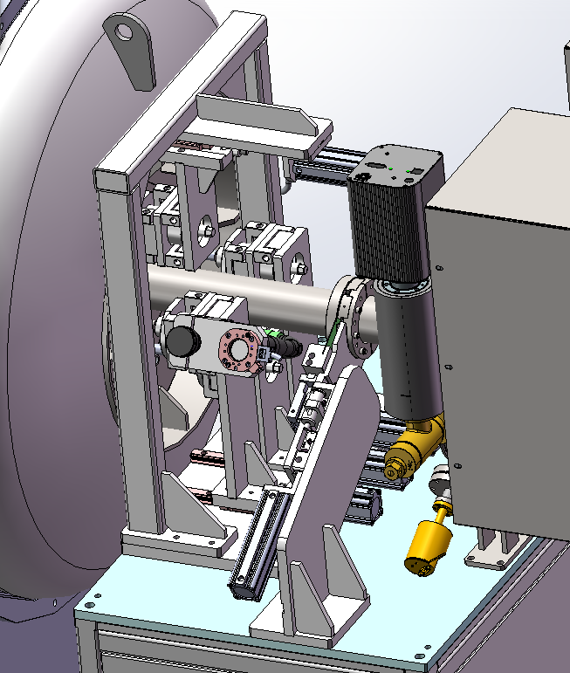
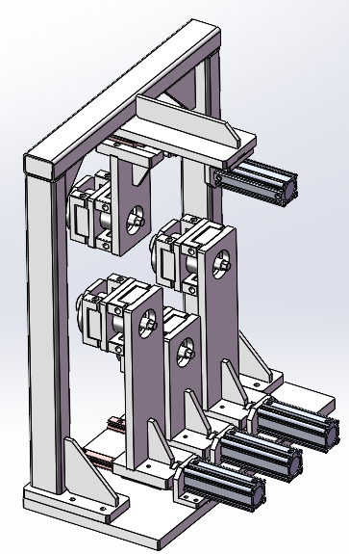
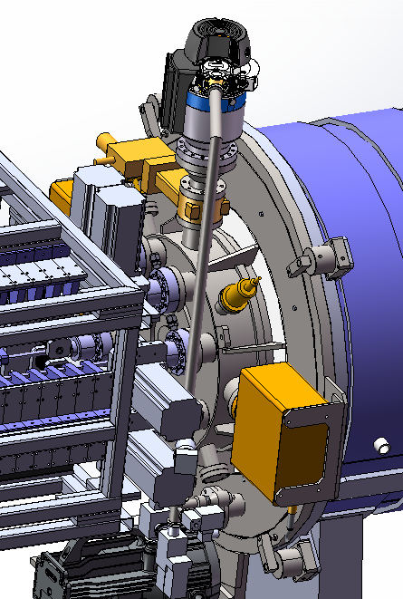
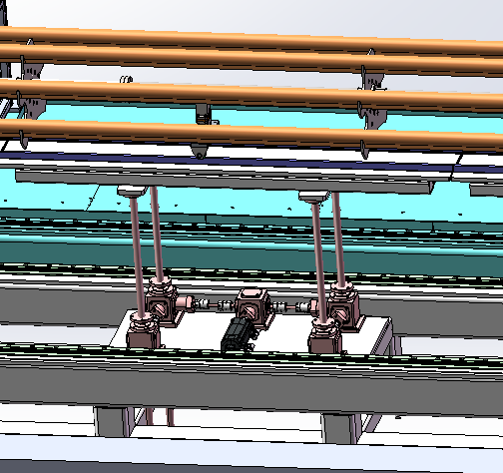
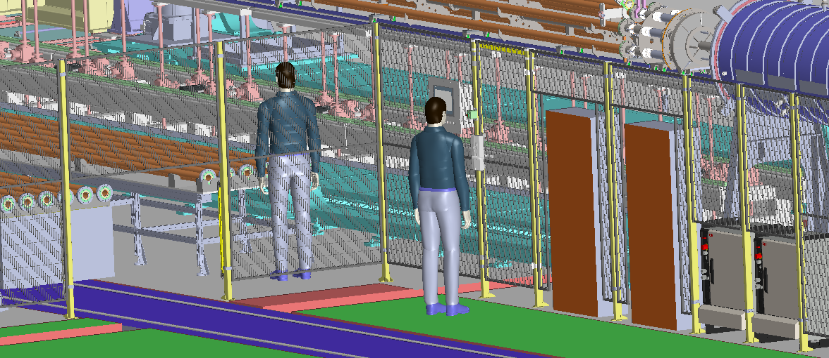
Vacuum chamber automatic assembly
Due to the diameter of CEPC is D56, we plan to replace the cathode wire with a magnetron sputtering cathode
Permanent magnet instead of the solenoid which supplies magnetic field for DCMS;
By combining the low vacuum chamber outside of the vacuum chambers to be coated with NEG, the high vacuum process is simplified;
VC inserted into the oven
Safety insurence
VC & cathode support
UHV system for NEG coating

Slide 15






Prototype of cathode for NEG coating
Motor for magnets driven
23000mm(23 meters)
~12000mm(12 meters)
Magnetron Cathode
After testing and conditioning, the cathode achieves a stable DCMS plasma discharge under 367 V and 1.1 A.
15

Slide 16
















Manufacturing progress of production line
The oven for NEG coating, which provides a low vacuum environment and baking capabilities, is under manufacturing.
The 12-meter cathode prototype for NEG coating is under manufacturing.

Slide 17









Manufacturing progress of production line
The main components of vacuum oven for NEG coating have been manufactured and under are now being assembled.

Slide 18




Plasma Spraying system
Plasma Spraying
& Laser etching room
Sandblasting room
The vacuum chamber will be transferred by motorized conveyance to the coating station, where a robotic arm will execute multi-layer deposition using an automated spray gun.
Notes:
Reciprocating motion

Slide 19









Heating coating spraying
The processing step for the heating coating spraying
Sandblasting
Plasma Spraying
Etching by laser
项目 | 参数
驱动方式 | 旋转气缸驱动
遮蔽材质 | 不锈钢
轴向可调节范围 | 100mm

Slide 20







Length of 1.5m prototype of Spraying
A 1.5-meter prototype has been developed to validate key process steps that will be implemented in the production line.
Installation
Sandblasting
Spraying
Spraying_Isolation-layer
Spraying_Conductivity-layer
Spraying_Isolation_layer

Slide 21











Elements and thickness of thermal-spray heating layer
NiCr Conductivity-layer
Al₂O₃ isolation layer
NiCr Transition-layer
Al₂O₃ isolation layer
Thickness
Ni
Cr
Al₂O₃：174um
NiCr：64.5um
Al₂O₃：173um
=471um
Al
O
NiCr：59.5um
＜0.5mm
Cu

Slide 22






Prototype of thermal-spray heating layer and testing
Dimension: L1500*D60 Substrate: copper
Constant V=110V
Several ten times reheating tests which shows a good lifetimes and performance
D60-1500 mm

Slide 23







Plasma spraying devices
The spraying system is similar to the system detailed in the following pictures.

Slide 24
Summary
The production line for vacuum chamber NEG coating and thermally sprayed heating layers is currently under installation and will be commissioned by March 2026.
It is capable of handling vacuum chambers with a minimum dimension of 56 mm and a maximum length of 11.5 meters for NEG coating applications. There are no dimensional restrictions for the thermal-sprayed heating layer process.
This production line will be up and running soon—we’re open for business and welcome collaboration on related manufacturing tasks.
Additionally, a 1.5-meter prototype of the thermally sprayed heating layer has been fabricated, with relevant performance tests successfully completed.

Slide 25
Thanks for your attention!

